Slide 1
A new analytical model of magnetofluids surrounding
rotating black holes
侯业辉 北京大学物理学院
Based on arXiv: 2309.13304
Collaborate with: 张震宇, 郭敏勇, 陈斌
2023.12.03

Slide 2
Contents
Introduction to the background
Analytical solutions in Kerr spacetime
Applications to accretion and jet flows

Slide 3
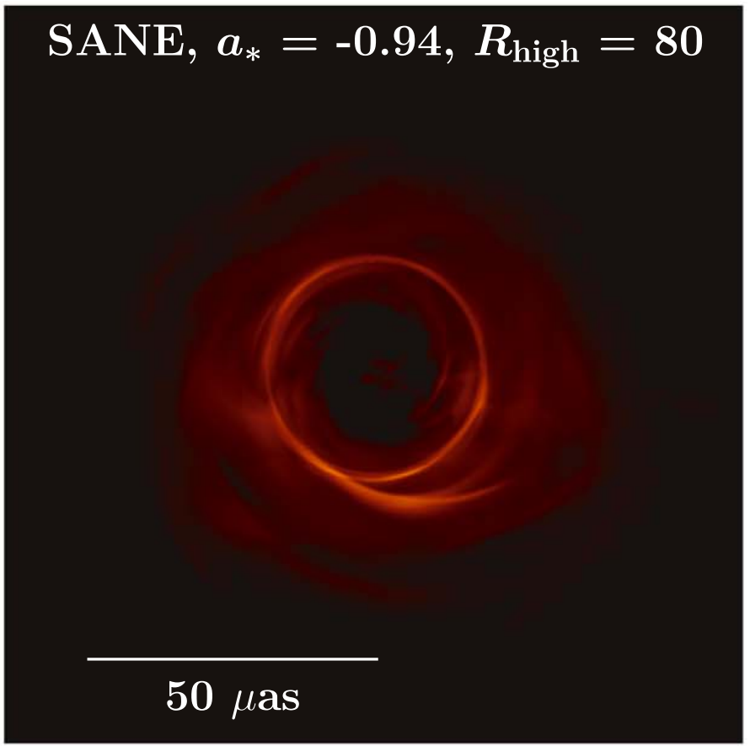
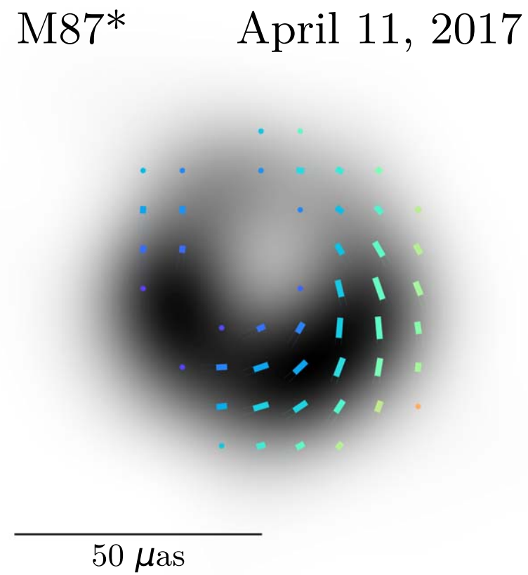
Why are we interested in magnetofluid models?
Polarization pattern
↓
Magnetic field
↓
Magnetofluid
Photon ring generated by GRMHD, EHT Collaboration, Astrophys.J.Lett. 875 (2019), L1.
Polarized image for M87*. EHT Collaboration, Astrophys.J.Lett. 910 (2021) 1, L13.

Slide 4
Connection with other studies
● Polarized Image of Equatorial Emission in Kerr spacetime:
Zachary Gelles, Elizabeth Himwich, Daniel C.M. Palumbo, Michael D. Johnson, Polarized image of equatorial emission in the Kerr geometry, Phys.Rev.D 104 (2021) 4, 044060.
● Signatures of Electromagnetic Energy Extraction：
Andrew Chael, Alexandru Lupsasca, George N. Wong, Eliot Quataert, Black Hole Polarimetry I. A Signature of Electromagnetic Energy Extraction, Astrophys.J. 958 (2023) 1, 65.
● Dependence of BH imaging on magnetofluid models:
Emission profile , Optical depth , Doppler shift , magnetization . . .

Slide 5
Difficulties in solving the fluid dynamics
Theoretically:
Magnetofluid dynamics in curved spacetime is under explored !
GRMHD equations:
Physical quantities: Fluid velocity $u^{μ}$, Number density $n$, Temperature $T$, Pressure $p$, Magnetic field $B^{μ}$. . .

Slide 6
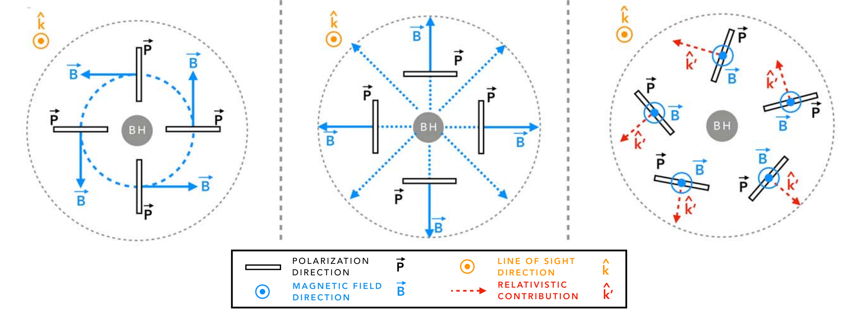
Accretion models and the polarization patterns
Geometrically thin disc :
$α$-disk , Novikov-Thorne disk , Thin disc formations , Inner-ISCO flow …
Geometrically thick models :
Abramowicz’s Tori model
Thick poloidal flow ( ? )
$$\vec{P}⋅\vec{B}≈0$$
$$Toroidal : u^{φ}$$
$$Poloidal: u^{r},u^{θ}$$
$$\vec{B}∝\vec{u}$$
Illustration of polarization patterns and magnetic fields. EHT Collaboration, Astrophys.J.Lett. 910 (2021) 1, L13.

Slide 7
Contents
Introduction to the background
Analytical solutions in Kerr spacetime
Applications to accretion and jet flows

Slide 8
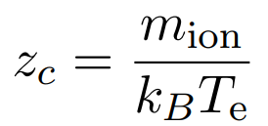
Hot plasma at the horizon-scale
Thermal quantities:
Number densities $n=n_{e}=n_{ion} ,$ Temperatures $T_{e} , T_{ion} ,$ Pressure $p=k_{B}n_{e}T_{e}+k_{B}n_{ion}T_{ion}$
● Hot electrons :
● Near-collisionless :
● Characteristic quantities:

Slide 9
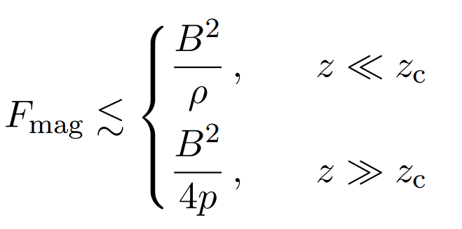
The ballistic approximation
● Euler equations:
● Gas pressure part: For M87∗ , $z≪z_{c}≈122,$ the parameter range typically for GRMHD simulations.
● Magnetic pressure part: We take $B = 10 Gauss ,$ $n = 5×{10}^{12} m^{−3} .$

Slide 10
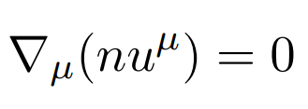
Streamlines in the Kerr exterior
$$(r,θ)$$
$$(r_{i},θ_{i})$$
$$X(θ_{i})$$
Conditions： ① $\frac{∂X}{∂θ_{i}}≈0, X=E,L,Q \text{.}$ ② $u^{θ}=0 .$ (Conical)
Streamlines
$${r=r}_{i}$$

Slide 11
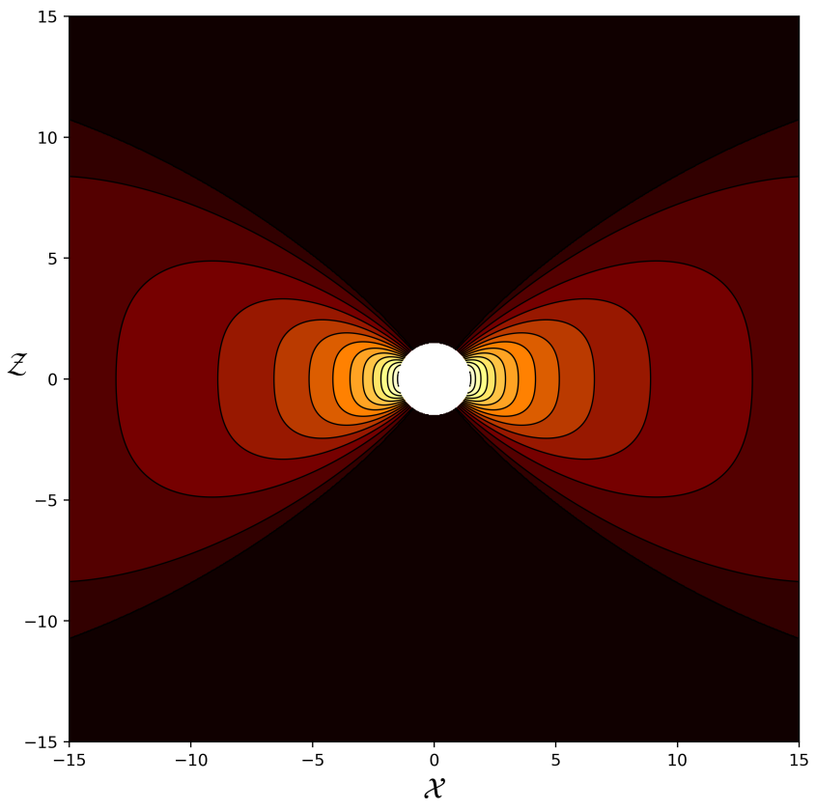
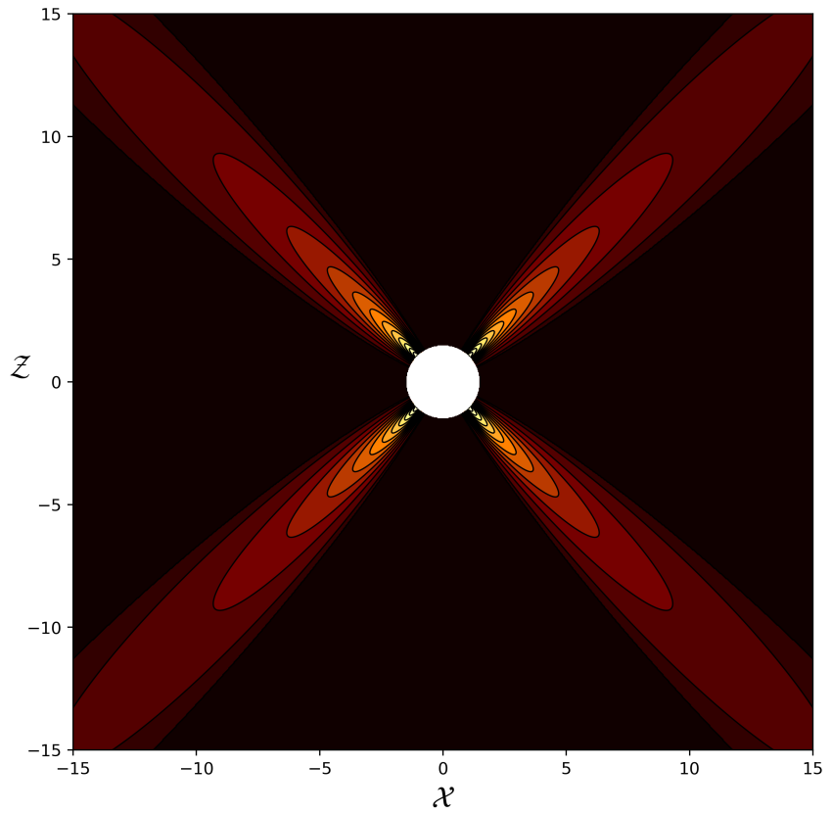
The conical solution
● Conserved quantities:
● Expressions for thermodynamics:
$$θ_{J}=π/2, σ=1/5$$
● Boundary condition:
$$θ_{J}=π/4, σ=1/10$$

Slide 12
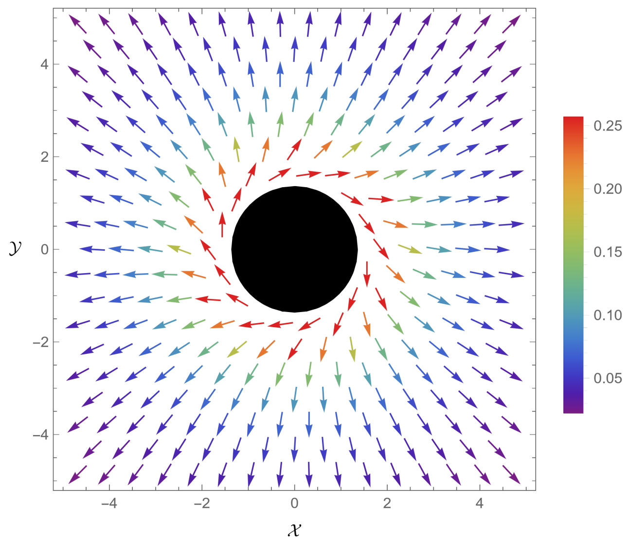
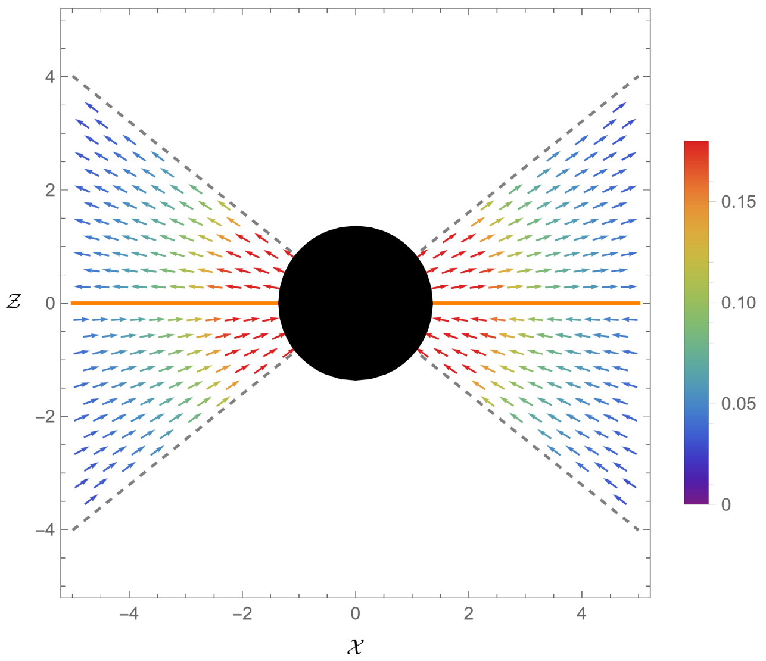
The associated magnetic field
● Ideal MHD condition:
● The stationary and axisymmetric field (Ruffini):

Slide 13
Contents
Introduction to the background
Analytical solutions in Kerr spacetime
Applications to accretion and jet flows

Slide 14
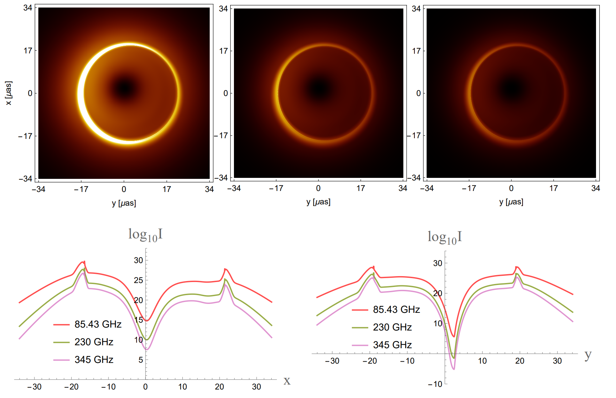
Images of the thick disk
With the explicit expressions for $n$, $T_{e}$, and $B^{μ}$ , the model offers a direct avenue to study black hole imaging.

Slide 15
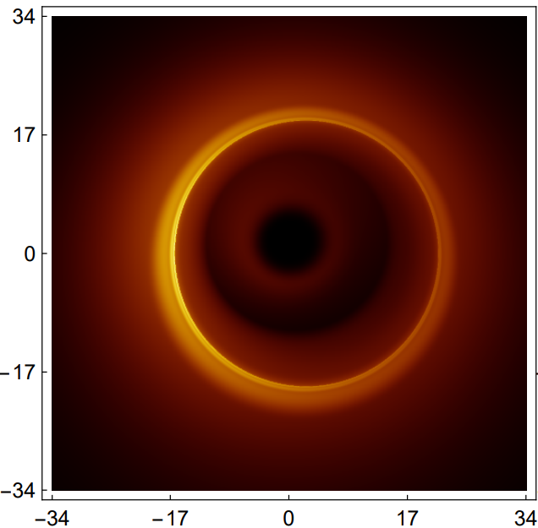
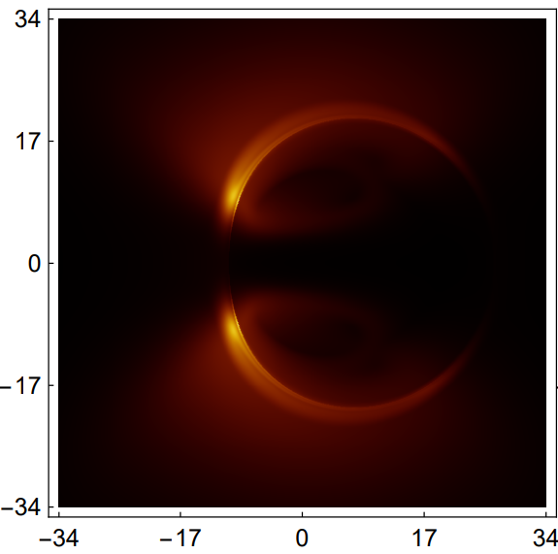
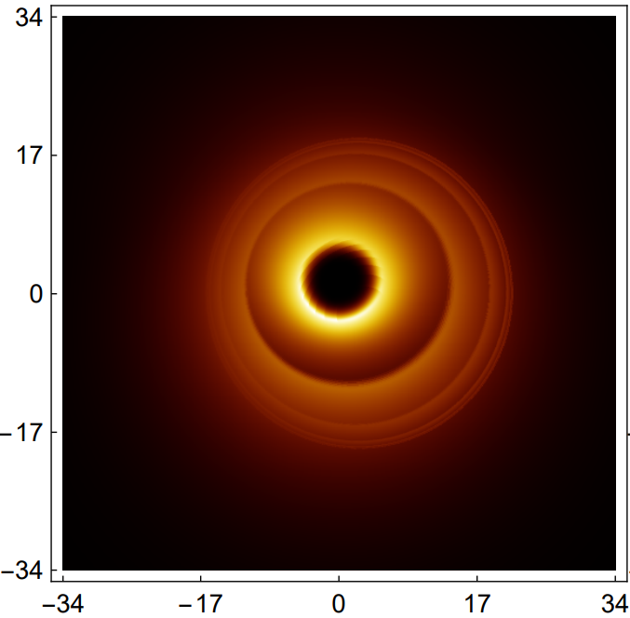
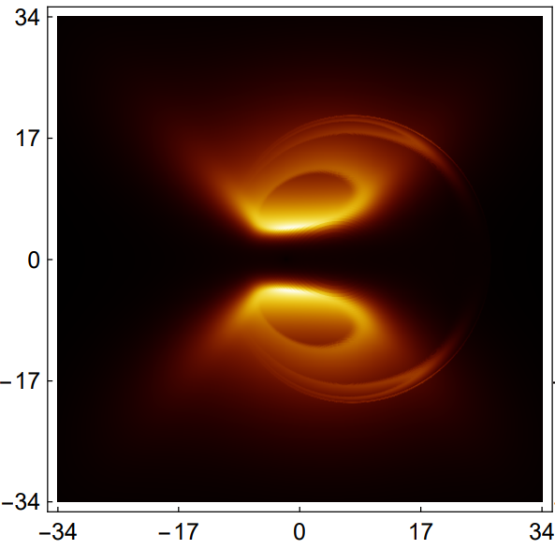
Images of the funnel wall jet
Funnel Wall
Evacuated Funnel
Magneto-
sphere
Accretion Disk
Magneto-
sphere

Slide 16
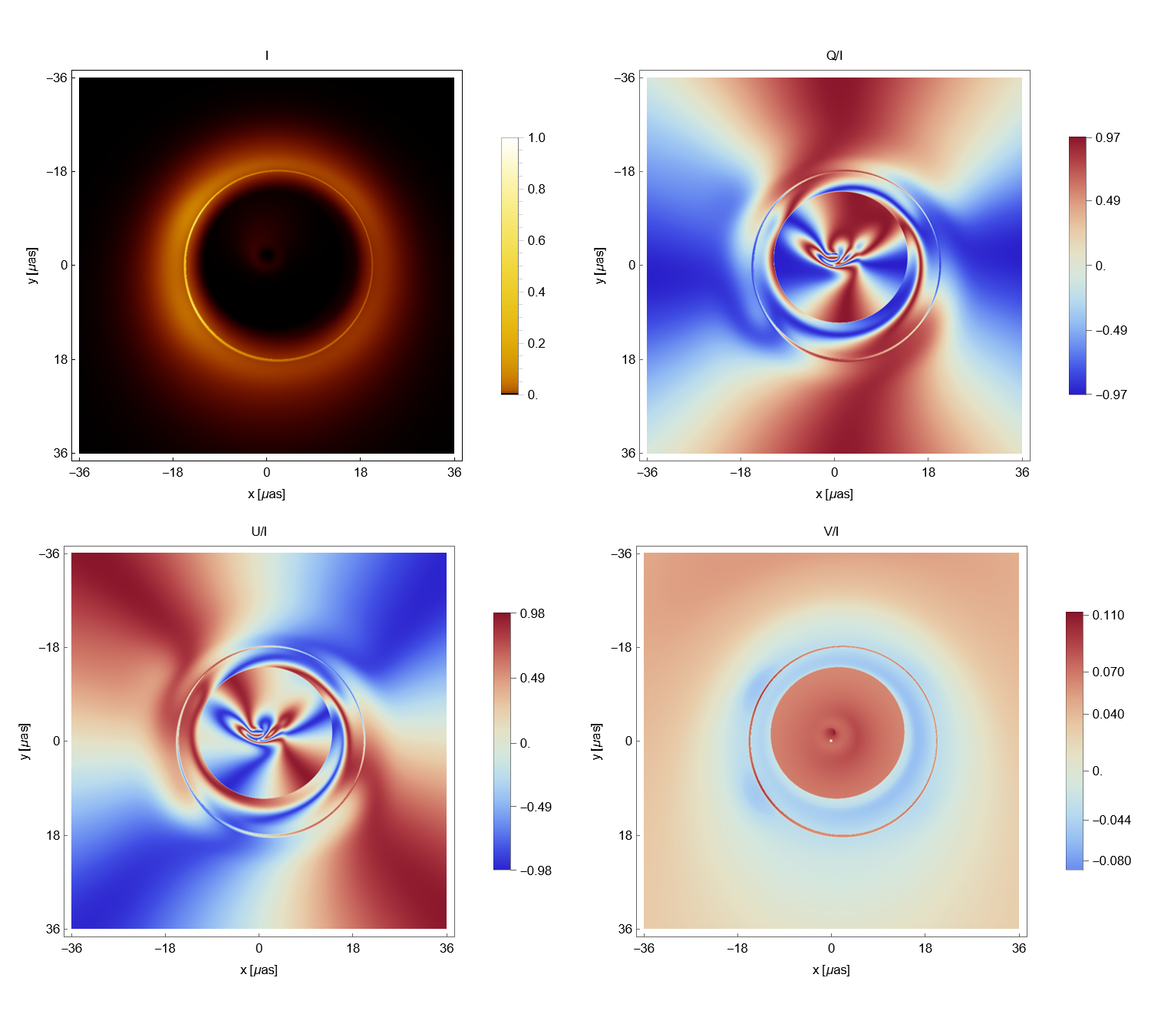
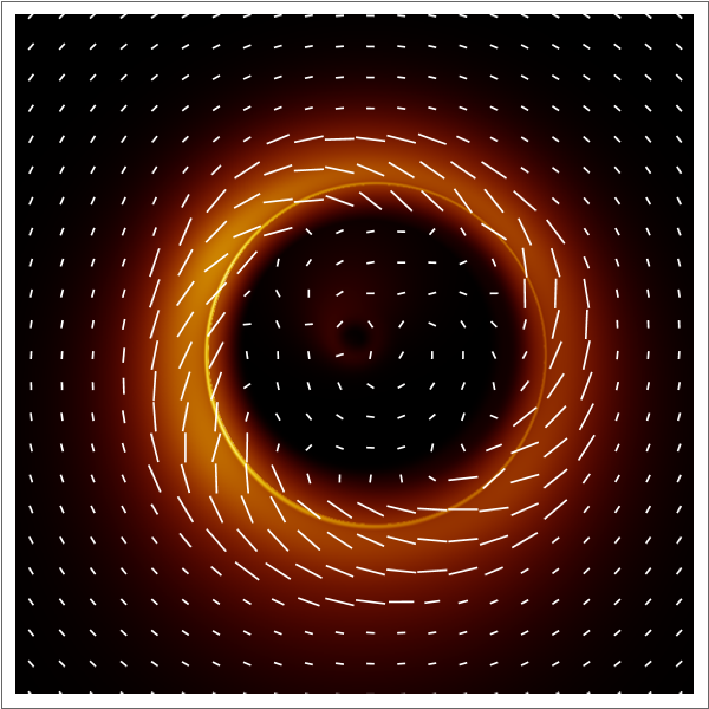
Polarization patterns

Slide 17
Thanks for your attention :)

