Slide 1



粒子加速器原理
~大作业讲解~
RCS计算及模拟
刘星光、苑尧硕
liuxg@ihep.ac.cn
中国科学院高能物理研究所 东莞研究部
2023

Slide 2
选题情况

Slide 3
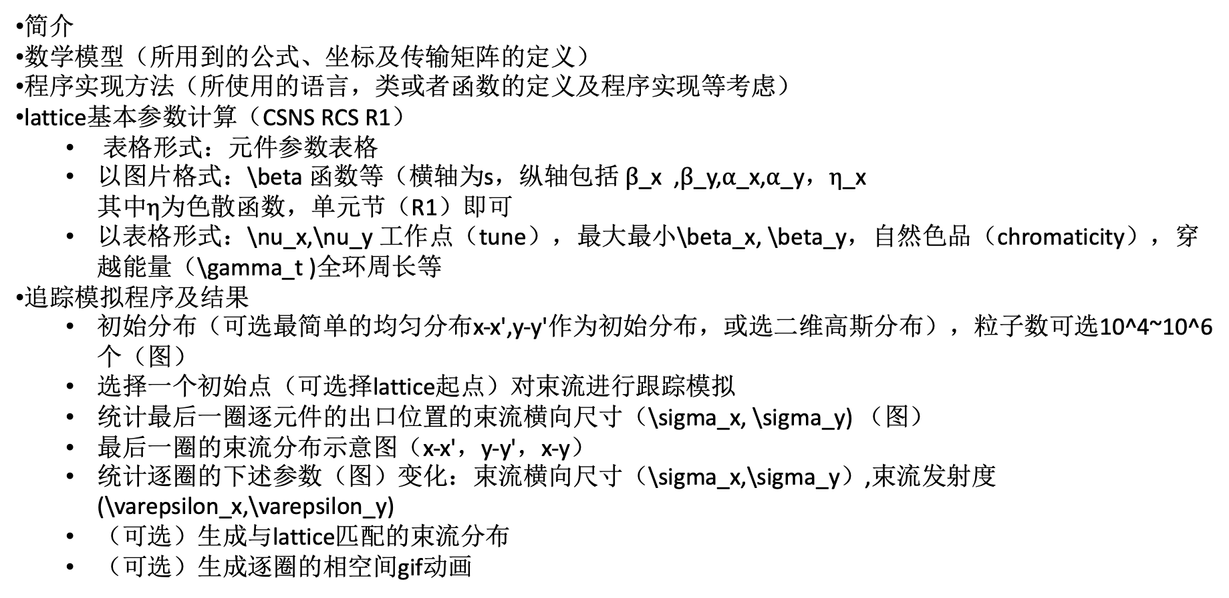
作业要求
简介
数学模型（所用到的公式、坐标及传输矩阵的定义）
程序实现方法（所使用的语言，类或者函数的定义及程序实现等考虑）
lattice基本参数计算（CSNS RCS R1）
  表格形式：元件参数表格
  以图片格式：\beta 函数等（$\text{横轴为}\text{s}\text{，}\text{纵轴包括} β\text{_}\text{x} \text{,}β\text{_}\text{y}\text{,}α\text{_}\text{x}\text{,}α\text{_}\text{y}\text{，}η\text{_}\text{x} \text{其中}η\text{为色散函数，单元节（}\text{R}\text{1）}\text{即可}$
  以表格形式：\nu_x,\nu_y 工作点（tune），最大最小\beta_x, \beta_y，自然色品（chromaticity），穿越能量（\gamma_t )全环周长等
追踪模拟程序及结果
  初始分布（可选最简单的均匀分布x-x',y-y'作为初始分布，或选二维高斯分布），粒子数可选10^4~10^6个（图）
  选择一个初始点（可选择lattice起点）对束流进行跟踪模拟
  统计最后一圈逐元件的出口位置的束流横向尺寸（\sigma_x, \sigma_y) （图）
  最后一圈的束流分布示意图（x-x'，y-y'，x-y）
  统计逐圈的下述参数（图）变化：束流横向尺寸（\sigma_x,\sigma_y）,束流发射度(\varepsilon_x,\varepsilon_y)
  （可选）生成与lattice匹配的束流分布
  （可选）生成逐圈的相空间gif动画

Slide 4
Lattice描述文件
// ！RCS Ring Lattice： R1
// ！Simplified version， 20231103
// Note that whole RCS ring should have four R1
L01: DRIFT, L = 5.5;
QF01: QUAD, L = 0.41, K1 = 0.74065659951575;
L02: DRIFT, L = 0.800;
QD02: QUAD, L= 0.90, K1 = -0.579364095806417;
L03: DRIFT, L =1.15;
QF03: QUAD, L = 0.41, K1 = 0.664196402392476;
L04: DRIFT, L =3.800;
MB: SBEND, L = 2.1, ANGLE = 0.261799387799149;
L05: DRIFT, L =1.200;
MB: SBEND, L = 2.1, ANGLE = 0.261799387799149;
L106: DRIFT, L = 1.3;
QF04: QUAD, L = 0.45, K1 = 0.570558026371608;
L07: DRIFT, L = 1.3;
QD05: QUAD, L =0.90 , K1 =-0.579364095806417;
L08 :DRIFT, L =0.800;
QF06: QUAD, L = 0.62, K1 = 0.608457760781354;
L09 :DRIFT, L =0.900;
MB: SBEND, L = 2.1, ANGLE = 0.261799387799149;
L10 :DRIFT, L =3.500;
MB: SBEND, L = 2.1, ANGLE = 0.261799387799149;
L11: DRIFT, L = 0.900;
QF07: QUAD, L = 0.62, K1 = 0.608457760781354;
L12 :DRIFT, L =0.800;
QD08: QUAD, L = 0.90, K1 = -0.579364095806417;
L13 :DRIFT, L =1.3;
QF09: QUAD, L = 0.45, K1 = 0.570558026371608;
L14 :DRIFT,L = 1.3;
MB: SBEND, L = 2.1, ANGLE = 0.261799387799149;
L15: DRIFT, L = 1.200;
MB: SBEND, L = 2.1, ANGLE = 0.261799387799149;
L15: DRIFT, L = 3.80;
QF10: QUAD, L = 0.41, K1 = 0.664196402392476;
L16 :DRIFT,L = 1.15;
QD11: QUAD, L= 0.90, K1 = -0.579364095806417;
L17 :DRIFT,L = 0.800;
QF12: QUAD, L = 0.41, K1 = 0.74065659951575;
L18 :DRIFT,L = 5.5;

Slide 5
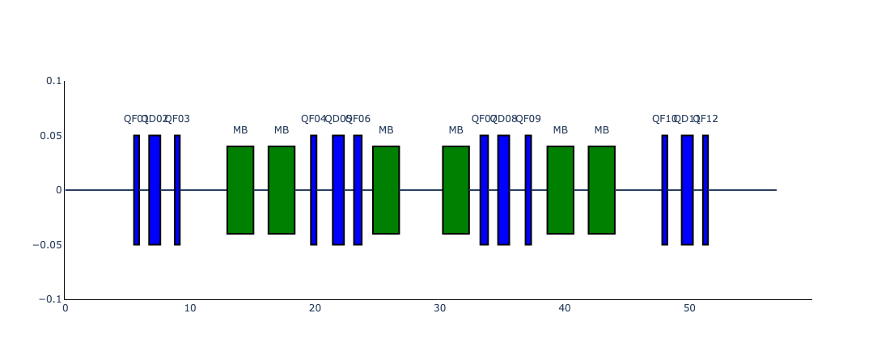
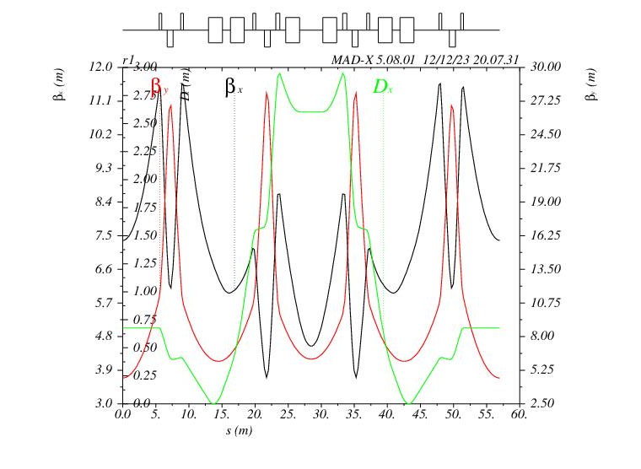
MADX
LENGTH | 56.98
ALFA | 0.02999595
GAMMATR | 5.77389227
Q1 | 1.32102622
Q2 | 1.09246772
DQ1 | -1.0565439
DQ2 | -2.2641779

Slide 6
合抱之木，生于毫末；九层之台，起于垒土；千里之行，始于足下。
--《老子》第六十四章
All big things start small.
that even the biggest and most ambitious goals can be achieved by taking small, incremental steps.
Gemini Pro (beta)

Slide 7
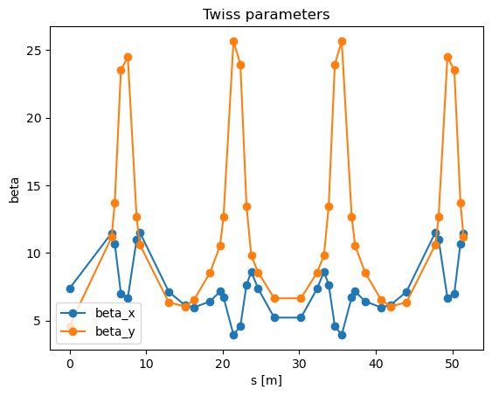
各元件进出口位置Twiss参数
构建基本传输矩阵，根据矩阵性质获得Twiss 参数
以各元件为起点构建新的传输矩阵
# 计算一系列矩阵的点积（dot product），
注意点积的顺序
def Mdot(ml):
# 储存结果的临时矩阵，先存上第一个
mt = ml[0]
# 如果只有一个元件则直接返回
if len(ml) == 1:
return mt
else:
# 依次对元件进行点积（注意顺序）
for i in range(1,len(ml)):
mt = np.dot(ml[i],mt)
return mt
# 通过比对传输矩阵获得twiss参数
# cos 𝜑 + 𝛼 sin 𝜑 𝛽 sin 𝜑
# −𝛾 sin 𝜑 cos 𝜑 − 𝛼 sin 𝜑
def twiss_from_m(m):
mtr=m[0,0]+m[1,1] # 注：虽然定义为三阶用于计算含色散的函数，计算twiss参数比对时仅用2x2的矩阵的迹
if (mtr>2):
raise ValueError("二阶矩阵的迹应小于2才是稳定解",mtr)
c=mtr*0.5 # cos项，等于迹的一半
# 计算其他项
s=np.sqrt(1-c**2)
beta=m[0,1]/s
alpha=(m[0,0]-c)/s
gamma=-(m[1,0])/s
return [beta,alpha,gamma]
# 漂移段，3*3
def D(l):
return np.array([[1,l,0],
[0,1,0],
[0,0,1]])
# 四极磁铁：聚焦平面
def QF(l,k):
sk=np.sqrt(k)
skl=sk*l
return np.array([[np.cos(skl),np.sin(skl)/sk,0],
[-sk*np.sin(skl),np.cos(skl),0],
[0,0,1]])
# 四极磁铁：散焦平面
def QD(l,k):
sk=np.sqrt(np.abs(k))
skl=sk*l
return np.array([[np.cosh(skl),np.sinh(skl)/sk,0],
[sk*np.sinh(skl),np.cosh(skl),0],
[0,0,1]])
# 偏转磁铁（sector magnet）：推荐以偏转半径rho 和 偏转角度 theta 定义
def SBend(r, a):
return np.array([[np.cos(a), r*np.sin(a), r*(1-np.cos(a))],
[-np.sin(a)/r, np.cos(a), np.sin(a)],
[0, 0, 1]])
# 注：无偏转的平面（比如y）按漂移段处理
tune x: 0.3210262231879895
tune y: 0.09246771879564876

Slide 8
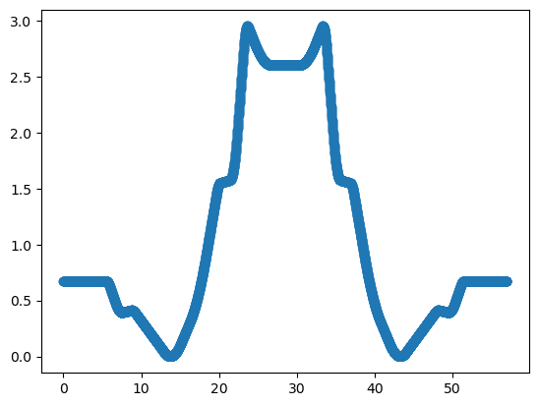
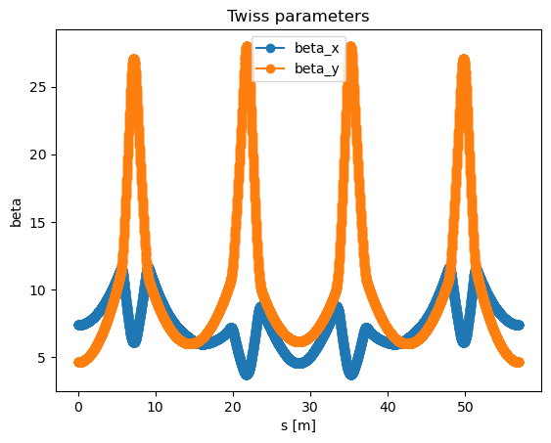
# loop over s and build the transfer matrix for each s
for i in s:
[mlx,mly,mls]=lat_matrices_s(rcs_r1,i)
[b,a,r]=twiss_from_m(Mdot(mlx))
d,dp=np.linalg.solve(Mdot(mlx)[:2, :2]-np.identity(2),-Mdot(mlx)[0:2, 2].reshape(2, 1))
twiss_x.append([i,b,a,r,d[0],dp[0]])
[b,a,r]=twiss_from_m(Mdot(mly))
twiss_y.append([i,b,a,r])
任意位置处的传输矩阵
# def a function to return matrix from a lattice list in format of
[type, a1,a2,a3] starting at any give s position
def lat_matrices_s(lat,s):
mls=[e[1] for e in lat]
sl=np.cumsum(mls)
sl_max=sl[-1]
for i,l in enumerate(mls):
sl[i]-=l # 修正sl为元件入口处位置
sl=np.append(sl,sl_max)
# print(sl)
id=0
lower=upper=0.0
lat_new=[]
splited=[]
for i in range(len(sl)-1):
if sl[i] <= s < sl[i + 1]:
id=i
lower=s-sl[i]
upper=sl[i+1]-s
if lower >0: # only split when s doesn't coincide with a starting point
splited=[[lat[id][0],lower,lat[id][2]],[lat[id][0],upper,lat[id][2]]]
# if it is sbend whose angle need to be split as well
# print("element",lat[id])
if lat[id][0]=='SBend’:
p=lower/lat[id][1]
a1=lat[id][2]*p
a2=lat[id][2]-a1
splited=[[lat[id][0],lower,a1],[lat[id][0],upper,a2]]
# print("split sbend:",splited)
if id==len(lat)-1: # split final element
# print("split final element:",i,lower,upper)
lat_new=lat[:id]+splited
else:
lat_new=lat[:id]+splited+lat[id+1:]
else:
lat_new=lat
# raise an error if s is larger than sl[-1]
elif s >= sl_max or s<0:
raise ValueError('s is larger than the last s in the lattice!')
D和D’的计算
# if splited is not empty
lat_temp=[]
if splited:
lat_temp=lat_new[id+1:]+lat_new[:id+1] # staring from s
else:
lat_temp=lat_new[id:]+lat_new[:id]
# print(lat_temp)
ml=[element_matrix(e[0],*e[1:]) for e in lat_temp]
mlx=list(map(lambda x: x[0],ml)) # select the x matrices
mly=list(map(lambda x: x[1],ml)) # select the y matrices
mls=list(map(lambda x: x[2],ml)) # select the s list
# print(id+1)
return [mlx,mly,mls]

Slide 9



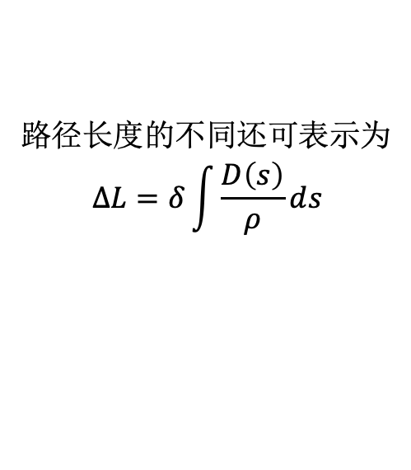
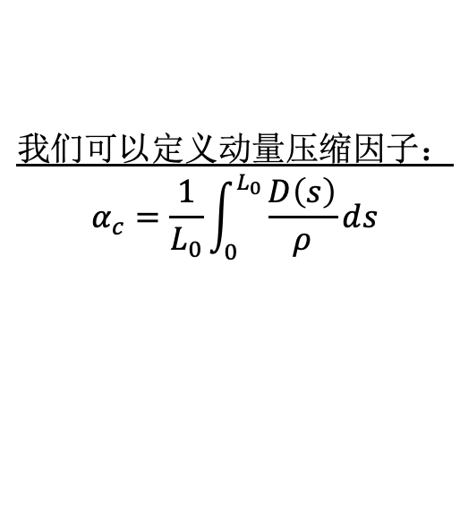
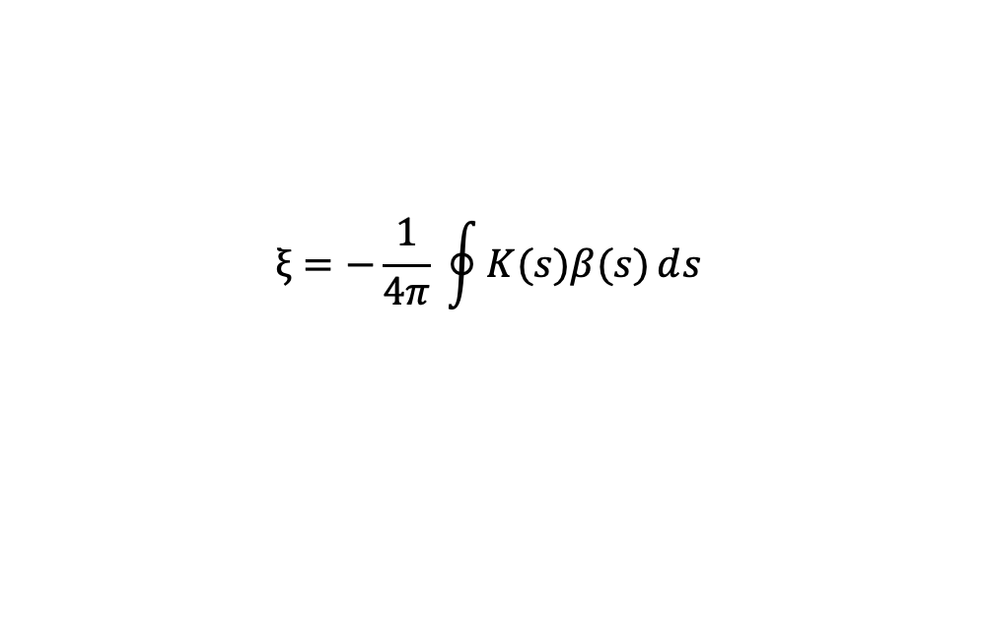
$α_{c},γ_{t}$ and chromaticity
# calculate the momentum compact factor and chromaticity of the ring:
[mlx,mly,mls]=lat_matrices(rcs_r1) # only mls would be use here
sl=np.cumsum(mls)
sl_max=sl[-1]
for i,l in enumerate(mls):
sl[i]-=l # modify position
print("sl_max:\n",sl_max)
ds=0.01
# set up a s list between 0 and sl[-1], ds as stepsize
sr=np.arange(0,sl_max,ds)
alpha_c=0.0
chromaticity=0.0
chromaticity_y=0.0
rho=2.1/0.261799388
for s in sr:
id=0
for i in range(len(sl)-1):
if sl[i] <= s < sl[i + 1]:
id=i
[mlx,mly,mls]=lat_matrices_s(rcs_r1,s)
[b,a,r]=twiss_from_m(Mdot(mlx))
[by,ay,ry]=twiss_from_m(Mdot(mly))
# if this is a SBend, then acumulate the D(s)/rho
if rcs_r1[id][0] == 'SBend':
d,dp=np.linalg.solve(Mdot(mlx)[:2, :2]-np.identity(2),-Mdot(mlx)[0:2, 2].reshape(2, 1))
alpha_c += d[0]/ rho * ds
chromaticity += 1/(rho*rho) * b * ds
if rcs_r1[id][0] == 'Q':
# print("k value:",s,id,rcs_r1[id][2])
chromaticity += rcs_r1[id][2]*b*ds
chromaticity_y += -rcs_r1[id][2]*by*ds
print("momentum compactor factor is:", alpha_c/sl_max)
print("trasitinoal energy is:", 1/np.sqrt(alpha_c))
print("chromaticity x is:",-chromaticity/(4*np.pi))
print("chromaticity y is:",-chromaticity_y/(4*np.pi))
路径$长度的不同$还可表示为
$$ΔL=δ\int{\frac{D\left(s\right)}{ρ}ⅆs}$$
$$我们可以定义动量压缩因子：$$
$$α_{c}=\frac{1}{L_{0}}\int_{0}^{L_{0}}{\frac{D\left(s\right)}{ρ}ⅆs}$$
与$γ_{t}$比较$有：γ_{t}^{2}=1/α_{c}$
$$色品：$$
$$ξ=−\frac{1}{4π} \oint{K(s)β(s)ⅆs}$$
$$Δν=ξ δ$$
sl_max: 56.97999999999998
momentum compactor factor is: 0.02999597661771785
trasitinoal energy is: 5.77388988
chromaticity x is: -1.0880762847134944
chromaticity y is: -2.1734012594276693

Slide 10
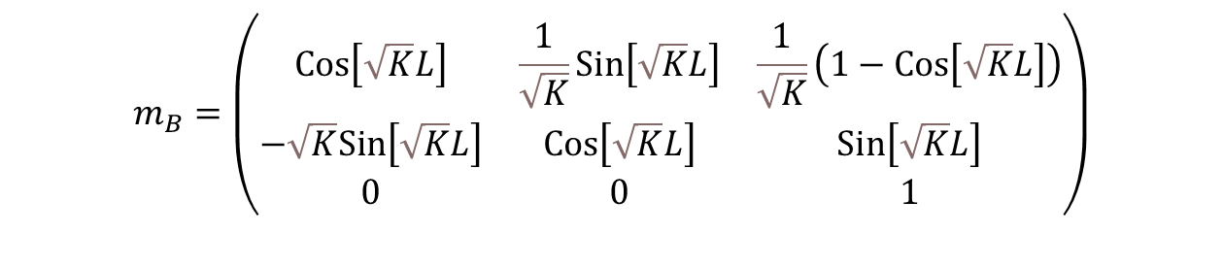
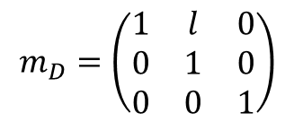
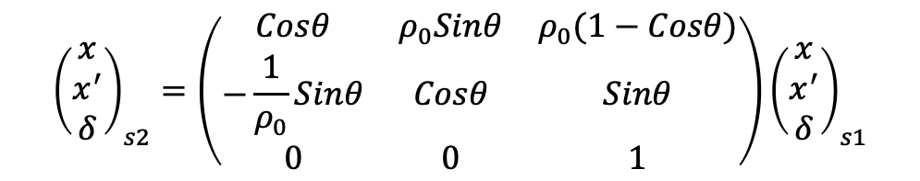
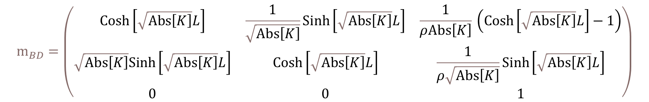
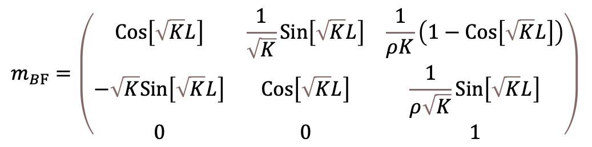
传输矩阵
直线节
纯二极磁铁
$$m_{B}=\left(\begin{matrix}Cos\left[\sqrt{K}⁢L\right] & \frac{1}{\sqrt{K}}⁢Sin\left[\sqrt{K}⁢L\right] & \frac{1}{\sqrt{K}}⁢\left(1−Cos\left[\sqrt{K}⁢L\right]\right) \\ −\sqrt{K}⁢Sin\left[\sqrt{K}⁢L\right] & Cos\left[\sqrt{K}⁢L\right] & Sin\left[\sqrt{K}⁢L\right] \\ 0 & 0 & 1\end{matrix}\right)$$
$$m_{D}=\left(\begin{matrix}1 & l & 0 \\ 0 & 1 & 0 \\ 0 & 0 & 1\end{matrix}\right)$$
$${\left(\begin{matrix}x \\ x^{′} \\ δ\end{matrix}\right)}_{s2}=\left(\begin{matrix}Cosθ & ρ_{0}Sinθ & ρ_{0}(1−Cosθ) \\ −\frac{1}{ρ_{0}}Sinθ & Cosθ & Sinθ \\ 0 & 0 & 1\end{matrix}\right){\left(\begin{matrix}x \\ x^{′} \\ δ\end{matrix}\right)}_{s1}$$
组合型二极磁铁（聚焦）
$$m_{BF}=\left(\begin{matrix}Cos\left[\sqrt{K}⁢L\right] & \frac{1}{\sqrt{K}}⁢Sin\left[\sqrt{K}⁢L\right] & \frac{1}{ρ⁢K}⁢\left(1−Cos\left[\sqrt{K}⁢L\right]\right) \\ −\sqrt{K}⁢Sin\left[\sqrt{K}⁢L\right] & Cos\left[\sqrt{K}⁢L\right] & \frac{1}{ρ⁢\sqrt{K}}⁢Sin\left[\sqrt{K}⁢L\right] \\ 0 & 0 & 1\end{matrix}\right)$$
组合型二极磁铁（散焦）
$$m_{BD}=\left(\begin{matrix}Cosh\left[\sqrt{Abs\left[K\right]}⁢L\right] & \frac{1}{\sqrt{Abs\left[K\right]}}⁢Sinh\left[\sqrt{Abs\left[K\right]}⁢L\right] & \frac{1}{ρ⁢Abs\left[K\right]}⁢\left(Cosh\left[\sqrt{Abs\left[K\right]}⁢L\right]−1\right) \\ \sqrt{Abs\left[K\right]}⁢Sinh\left[\sqrt{Abs\left[K\right]}⁢L\right] & Cosh\left[\sqrt{Abs\left[K\right]}⁢L\right] & \frac{1}{ρ⁢\sqrt{Abs\left[K\right]}}⁢Sinh\left[\sqrt{Abs\left[K\right]}⁢L\right] \\ 0 & 0 & 1\end{matrix}\right)$$

Slide 11
Tracking
定义4维矩阵
判断元件矩阵及构建元件列表的矩阵
# define the same transfer matrix as we calculate the twiss, ignore the dispersion term
import numpy as np
def D(l):
return np.array([[1,l,0,0],
[0,1,0,0],
[0,0,1,l],
[0,0,0,1]])
def QF(l,k):
sk=np.sqrt(k)
skl=sk*l
return np.array([[np.cos(skl),np.sin(skl)/sk,0,0],
[-sk*np.sin(skl),np.cos(skl),0,0],
[0,0,np.cosh(skl),np.sinh(skl)/sk],
[0,0,sk*np.sinh(skl),np.cosh(skl)]])
def QD(l,k):
sk=np.sqrt(np.abs(k))
skl=sk*l
return np.array([[np.cosh(skl),np.sinh(skl)/sk,0,0],
[sk*np.sinh(skl),np.cosh(skl),0,0],
[0,0,np.cos(skl),np.sin(skl)/sk],
[0,0,-sk*np.sin(skl),np.cos(skl)]])
# define a function return matrix for sector magnet(recommand rho and angle form):
def SBend(r, a):
return np.array([[np.cos(a), r*np.sin(a), 0,0],
[-np.sin(a)/r, np.cos(a), 0,0],
[0,0,1,r*a], # vertical as dirft space
[0,0,0,1]])
# return element matrix by its type and parameters
def element_matrix(*args):
if args[0] == 'D’:
l=args[1]
return D(l)
elif args[0] == 'Q’:
l=args[1]
k=args[2]
if k>0:
return QF(l,k)
elif k<0:
return QD(l,k)
else:
return [D(l),D(l),l] # if k=0, return as drift
elif args[0] == 'SBend’:
l=args[1]
angle=args[2]
rho=l/angle
return SBend(rho,angle)
else:
print('Unknown element type!’)
return None
# define a function doing the do production for a list of given matrix:
def Mdot(ml):
mt = ml[0] # temp matrix to store the results
if len(ml) == 1: # return if there is only one matrix
return mt
else:
# do the dot production one by one from the 2nd element
for i in range(1,len(ml)):
mt = np.dot(ml[i],mt)
return mt

Slide 12
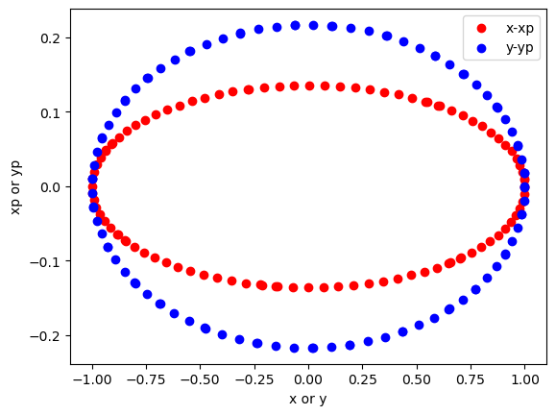
单粒子与多粒子追踪
# a simple track function for one particle, p is in the shape of np.array([[x],[xp],[y],[yp]])
def track_single(tm,p):
return np.dot(tm,p)
# track a bunch of particles
def track(tm,p):
return np.array([track_single(tm,p[i]) for i in range(len(p))])
单粒子在同一位置的轨迹
# test particle at position x=1 and y=1, both xp and yp are zero
x0=np.array([1,0,1,0]).reshape(4,1)
# track for 100 times
r=[]
TM=Mdot(ml*4)
r.append(x0) # store the initial distribution first
for i in range(100):
x0=track_single(TM,x0)
r.append(x0)
多粒子统计参数计算
# calculate the emittance for a given distribution: e=sqrt(mean(x^2)*mean(xp^2)-mean(x*xp))
def distribution_parameters(p):
ex=np.sqrt(np.mean((p[:,0]-np.mean(p[:,0]))**2)*np.mean((p[:,1]- np.mean(p[:,1]))**2)-np.mean(p[:,0]*p[:,1])**2)
ey=np.sqrt(np.mean((p[:,2]-np.mean(p[:,2]))**2)*np.mean((p[:,3]-np.mean(p[:,3]))**2)-np.mean(p[:,2]*p[:,3])**2)
# beam size given as standard deviation
sx=np.std(p[:,0])
sy=np.std(p[:,2])
return ex/np.pi,ey/np.pi,sx,sy

Slide 13
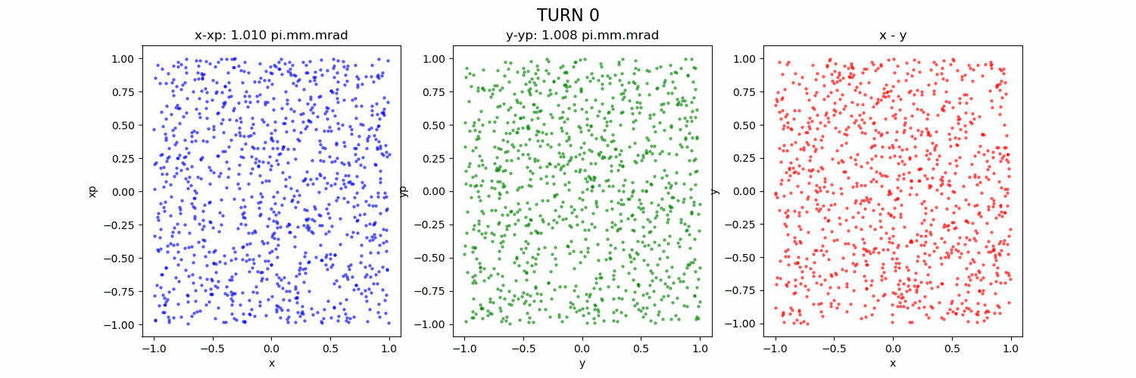
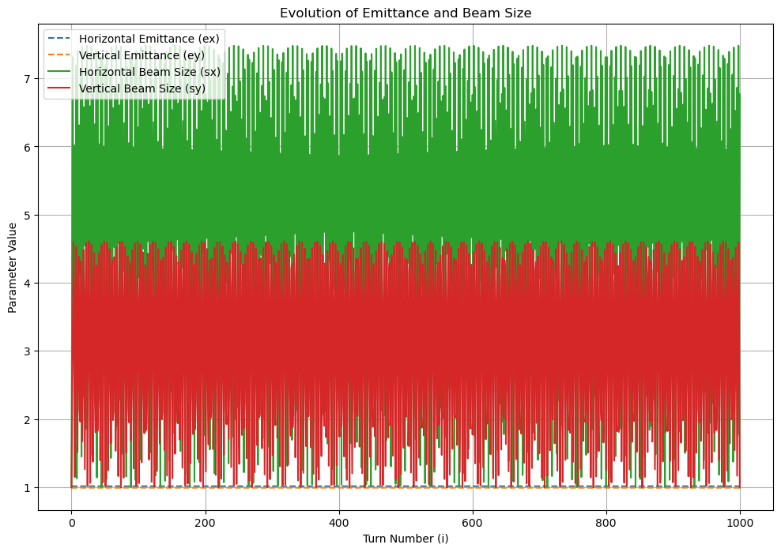
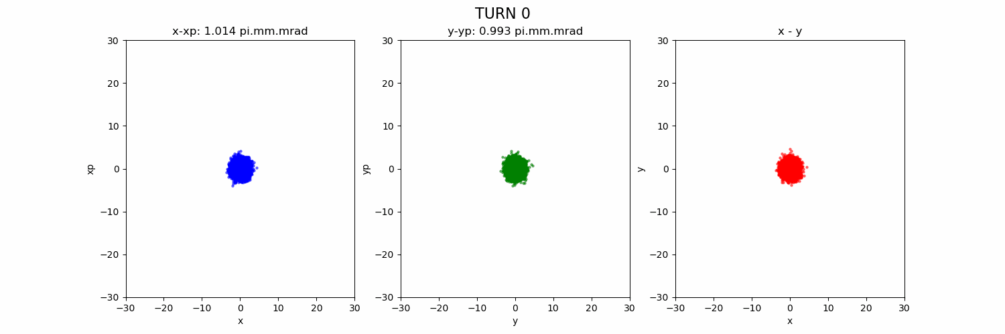
均匀分布 vs 正态分布
均匀分布
束流参数统计
正态分布

Slide 14
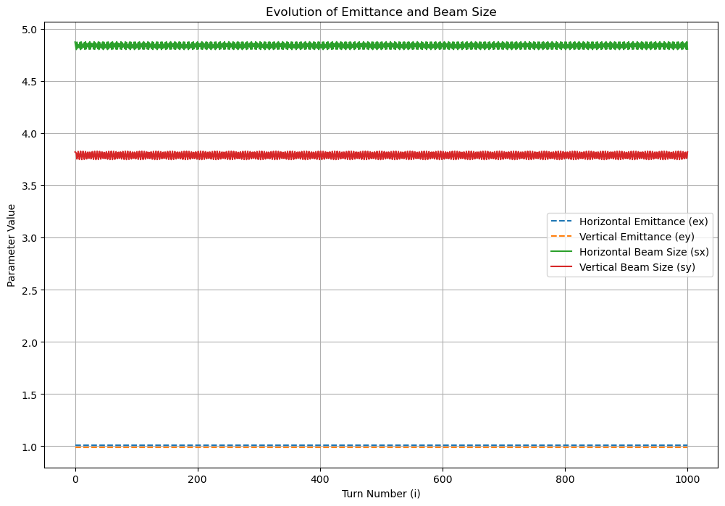
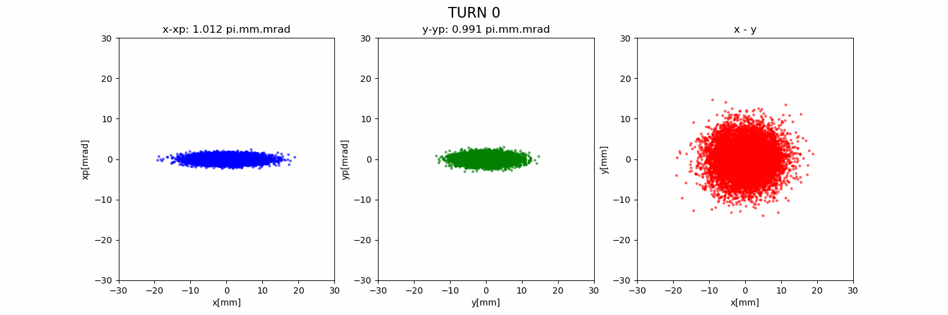
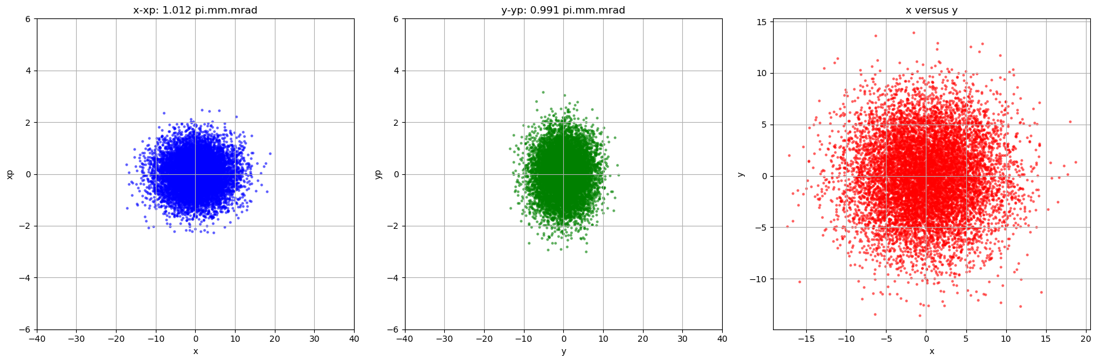
匹配分布
# matched beam generation
print("Notice that at the staring point, alpha_x,y is zero, \n which means that the distribution is a typical ellipse.ex=sqrt(sx^2*sxp^2-sxxp^2)")
ex0=ey0=1.0e-6 # pi.mm.mrad
bx0=7.372117913456016
by0=4.612052201102539
sx0=np.sqrt(bx0*ex0*np.pi)
sxp0=np.sqrt(ex0*np.pi/bx0)
# sxp0=ex0/sx0
sy0=np.sqrt(by0*ey0*np.pi)
syp0=np.sqrt(ey0*np.pi/by0)
# syp0=ey0/sy0
print("sx0,sxp0,sy0,syp0",[sx0*1000,sxp0*1000,sy0*1000,syp0*1000])
num_particles =10000
# Covariance matrix
cov_x = [[sx0**2, 0],
[0, sxp0**2]]
cov_y = [[sy0**2, 0],
[0, syp0**2]]
# Generate random samples from a multivariate normal distribution
mean = [0, 0]
x, xp = np.random.multivariate_normal(mean, cov_x, num_particles ).T
y, yp = np.random.multivariate_normal(mean, cov_y, num_particles ).T
束流参数统计
匹配分布初始(y-scale任意）

