Slide 1
Craig Roberts … http://inp.nju.edu.cn/
Grant no. 12135007
Flavour Physics,the Higgs boson,and Emergent Mass

Slide 2
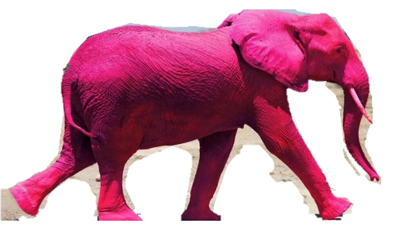
Or so the story has gone

Slide 3
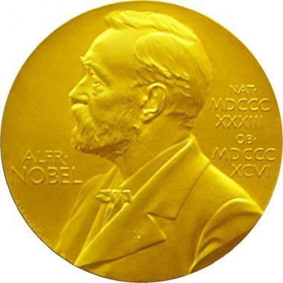
Mass in Nature
Phenomenological understanding of mass generation via Higgs-like mechanism
But … there are two sources of mass in Nature
To some people, this may be surprising
Because, when considering the origin of mass in the Standard Model (SM), thoughts typically turn to the Higgs boson
Notion behind Higgs mechanism for mass generation was introduced more than fifty years ago; and it became an essential piece of the SM.
2012 – Discovery of something seeming to possess all anticipated properties of the Higgs
SM became complete
Nobel Prize in physics awarded to Englert and Higgs
“. . . for the theoretical discovery of a mechanism that contributes to our understanding of the origin of mass of subatomic particles . . . ”
“… a mechanism that contributes …”
NOT the complete story. Far from it …

Slide 4
Mass in Nature
Phenomenological understanding of mass generation via Higgs-like mechanism
But the hierarchy problem is real
Quantum corrections to the mass of a scalar boson are quadratically divergent = not renormalisable
Large quantum contributions to the square $mass_{Higgs}^{2}$ would inevitably make the mass huge
Unless there is incredible fine-tuning cancellation between quadratic-divergent corrections and bare mass.
But … there are two sources of mass in Nature
To some people, this may be surprising
Because, when considering the origin of mass in the Standard Model (SM), thoughts typically turn to the Higgs boson
Notion behind Higgs mechanism for mass generation was introduced more than fifty years ago; and it became an essential piece of the SM.
2012 – Discovery of something seeming to possess all anticipated properties of the Higgs
SM became complete
Nobel Prize in physics awarded to Englert and Higgs
“. . . for the theoretical discovery of a mechanism that contributes to our understanding of the origin of mass of subatomic particles . . . ”
“… a mechanism that contributes …”
NOT the complete story. Far from it …

Slide 5
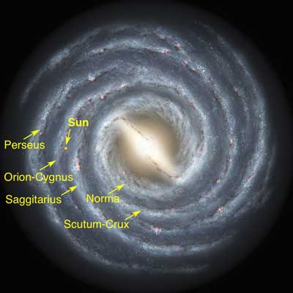
Emergent Phenomena … in the Standard Model(?)
Existence of our Universe depends critically on, inter alia, the following empirical facts:
Proton is massive
i.e., the mass-scale for strong interactions is vastly different to that of electromagnetism
Proton is absolutely stable
Despite being a composite object
constituted from three valence quarks
Pion is unnaturally light (not massless, but lepton-like mass)
Despite being a strongly interacting composite object built from a valence-quark and valence antiquark
Emergence: low-level rules producing high-level phenomena, with enormous apparent complexity

Slide 6
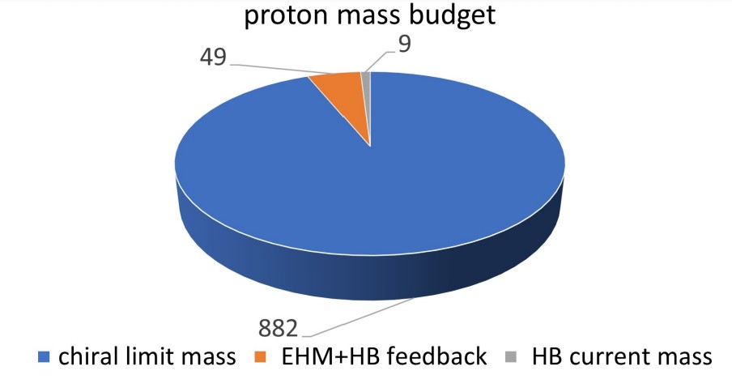
Emergence of Hadron Mass
Proton mass budget
Only 9 MeV/939 MeV is directly from Higgs
Evidently, there is another phenomenon in Nature that is extremely effective in producing mass:
Emergent Hadron Mass (EHM)
Alone, it produces 94% of the proton’s mass
Remaining 5% is generated by constructive interference between EHM and Higgs-boson
What is EHM?
Does it have a reductionist explanation,
i.e. can it be explained by mere “mechanisms”, like a Swiss watch?
If so, what are they and do they lie within the Standard Model?

Slide 7
Emergent Hadron Mass (EHM)
In quantum field theory, mass and length^{–1} are effectively the same thing
Thus, asking for the origin of 99% of visible mass in the Universe is possibly/probably the same as asking what is the source of the proton’s size
Confinement scale!
Confinement is far more than the statement that Nature contains only colour-singlet combinations of gluons and quarks
Those combinations have fm-scale sizes
This is crucial
It wouldn’t be confinement if the scales were Å size
Confinement …
If one can’t measure them, what are the gluons and quarks in the SM Lagrangian?
Are they anything more than a theoretical “trick”; useful things for calculations in perturbation theory, but practically irrelevant when resolving detectable hadrons?
What degrees-of-freedom should be used to compute and understand hadron properties?

Slide 8
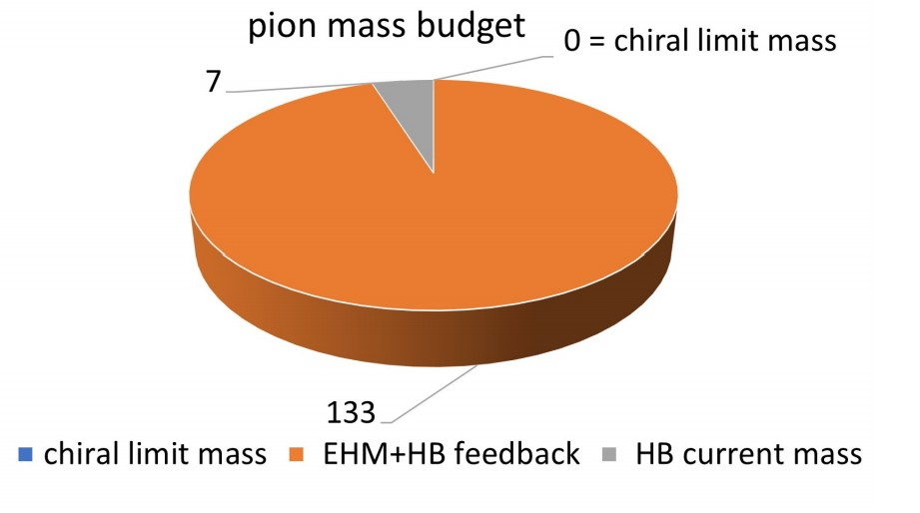
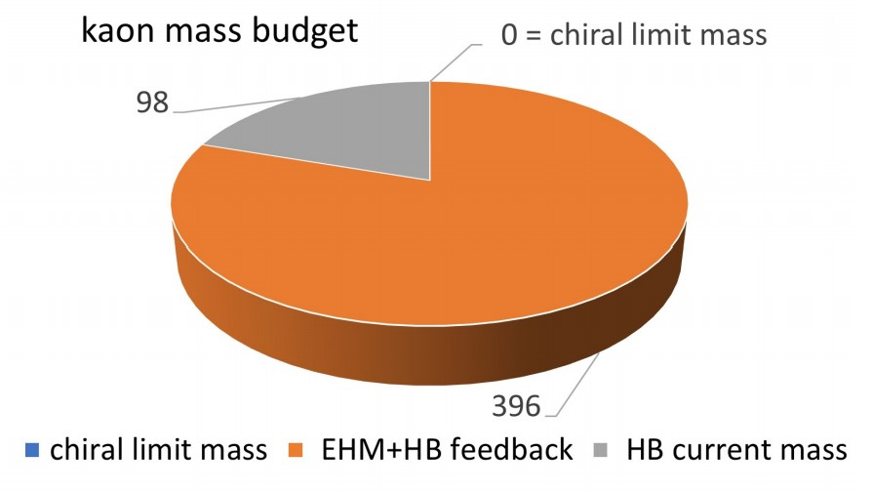
Mass Budgets of Pseudoscalar Mesons
Without Higgs(-like) Mechanism, all pseudoscalar mesons are identical and massless in the chiral limit
chiral limit mass, 0

Slide 9
Mass Budgets of Pseudoscalar Mesons
Without Higgs(-like) Mechanism, all pseudoscalar mesons are identical and massless in the chiral limit
chiral limit mass, 0

Slide 10
Mass Budgets of Pseudoscalar Mesons
Without Higgs(-like) Mechanism, all pseudoscalar mesons are identical and massless in the chiral limit
chiral limit mass, 0
Tracking the evolution of pseudoscalar meson properties with increasing current-quark mass provides insights into evolving character of constructive interference between EHM & HB

Slide 11
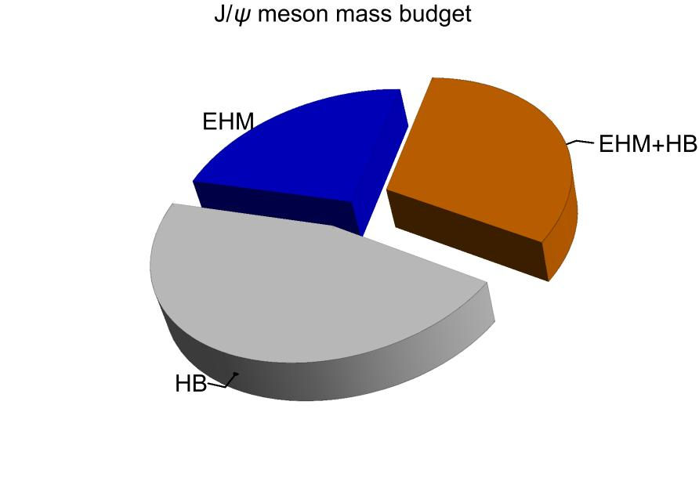
Vector meson mass budgets
With increasing HB couplings, EHM component is unchanged, but EHM fraction of total becomes smaller as HB & HB+EHM fractions increase

Slide 12
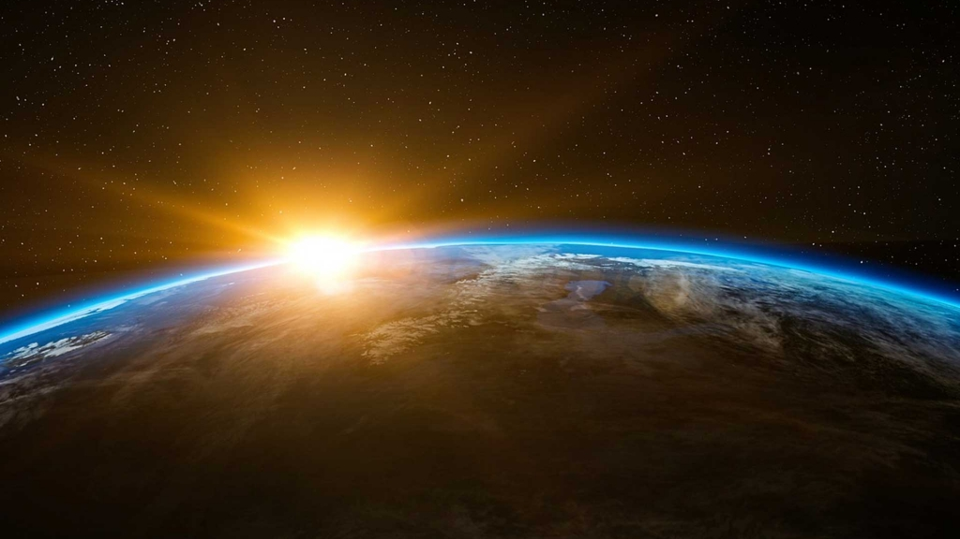
Origin of Mass:
The Frontier of Physics

Slide 13
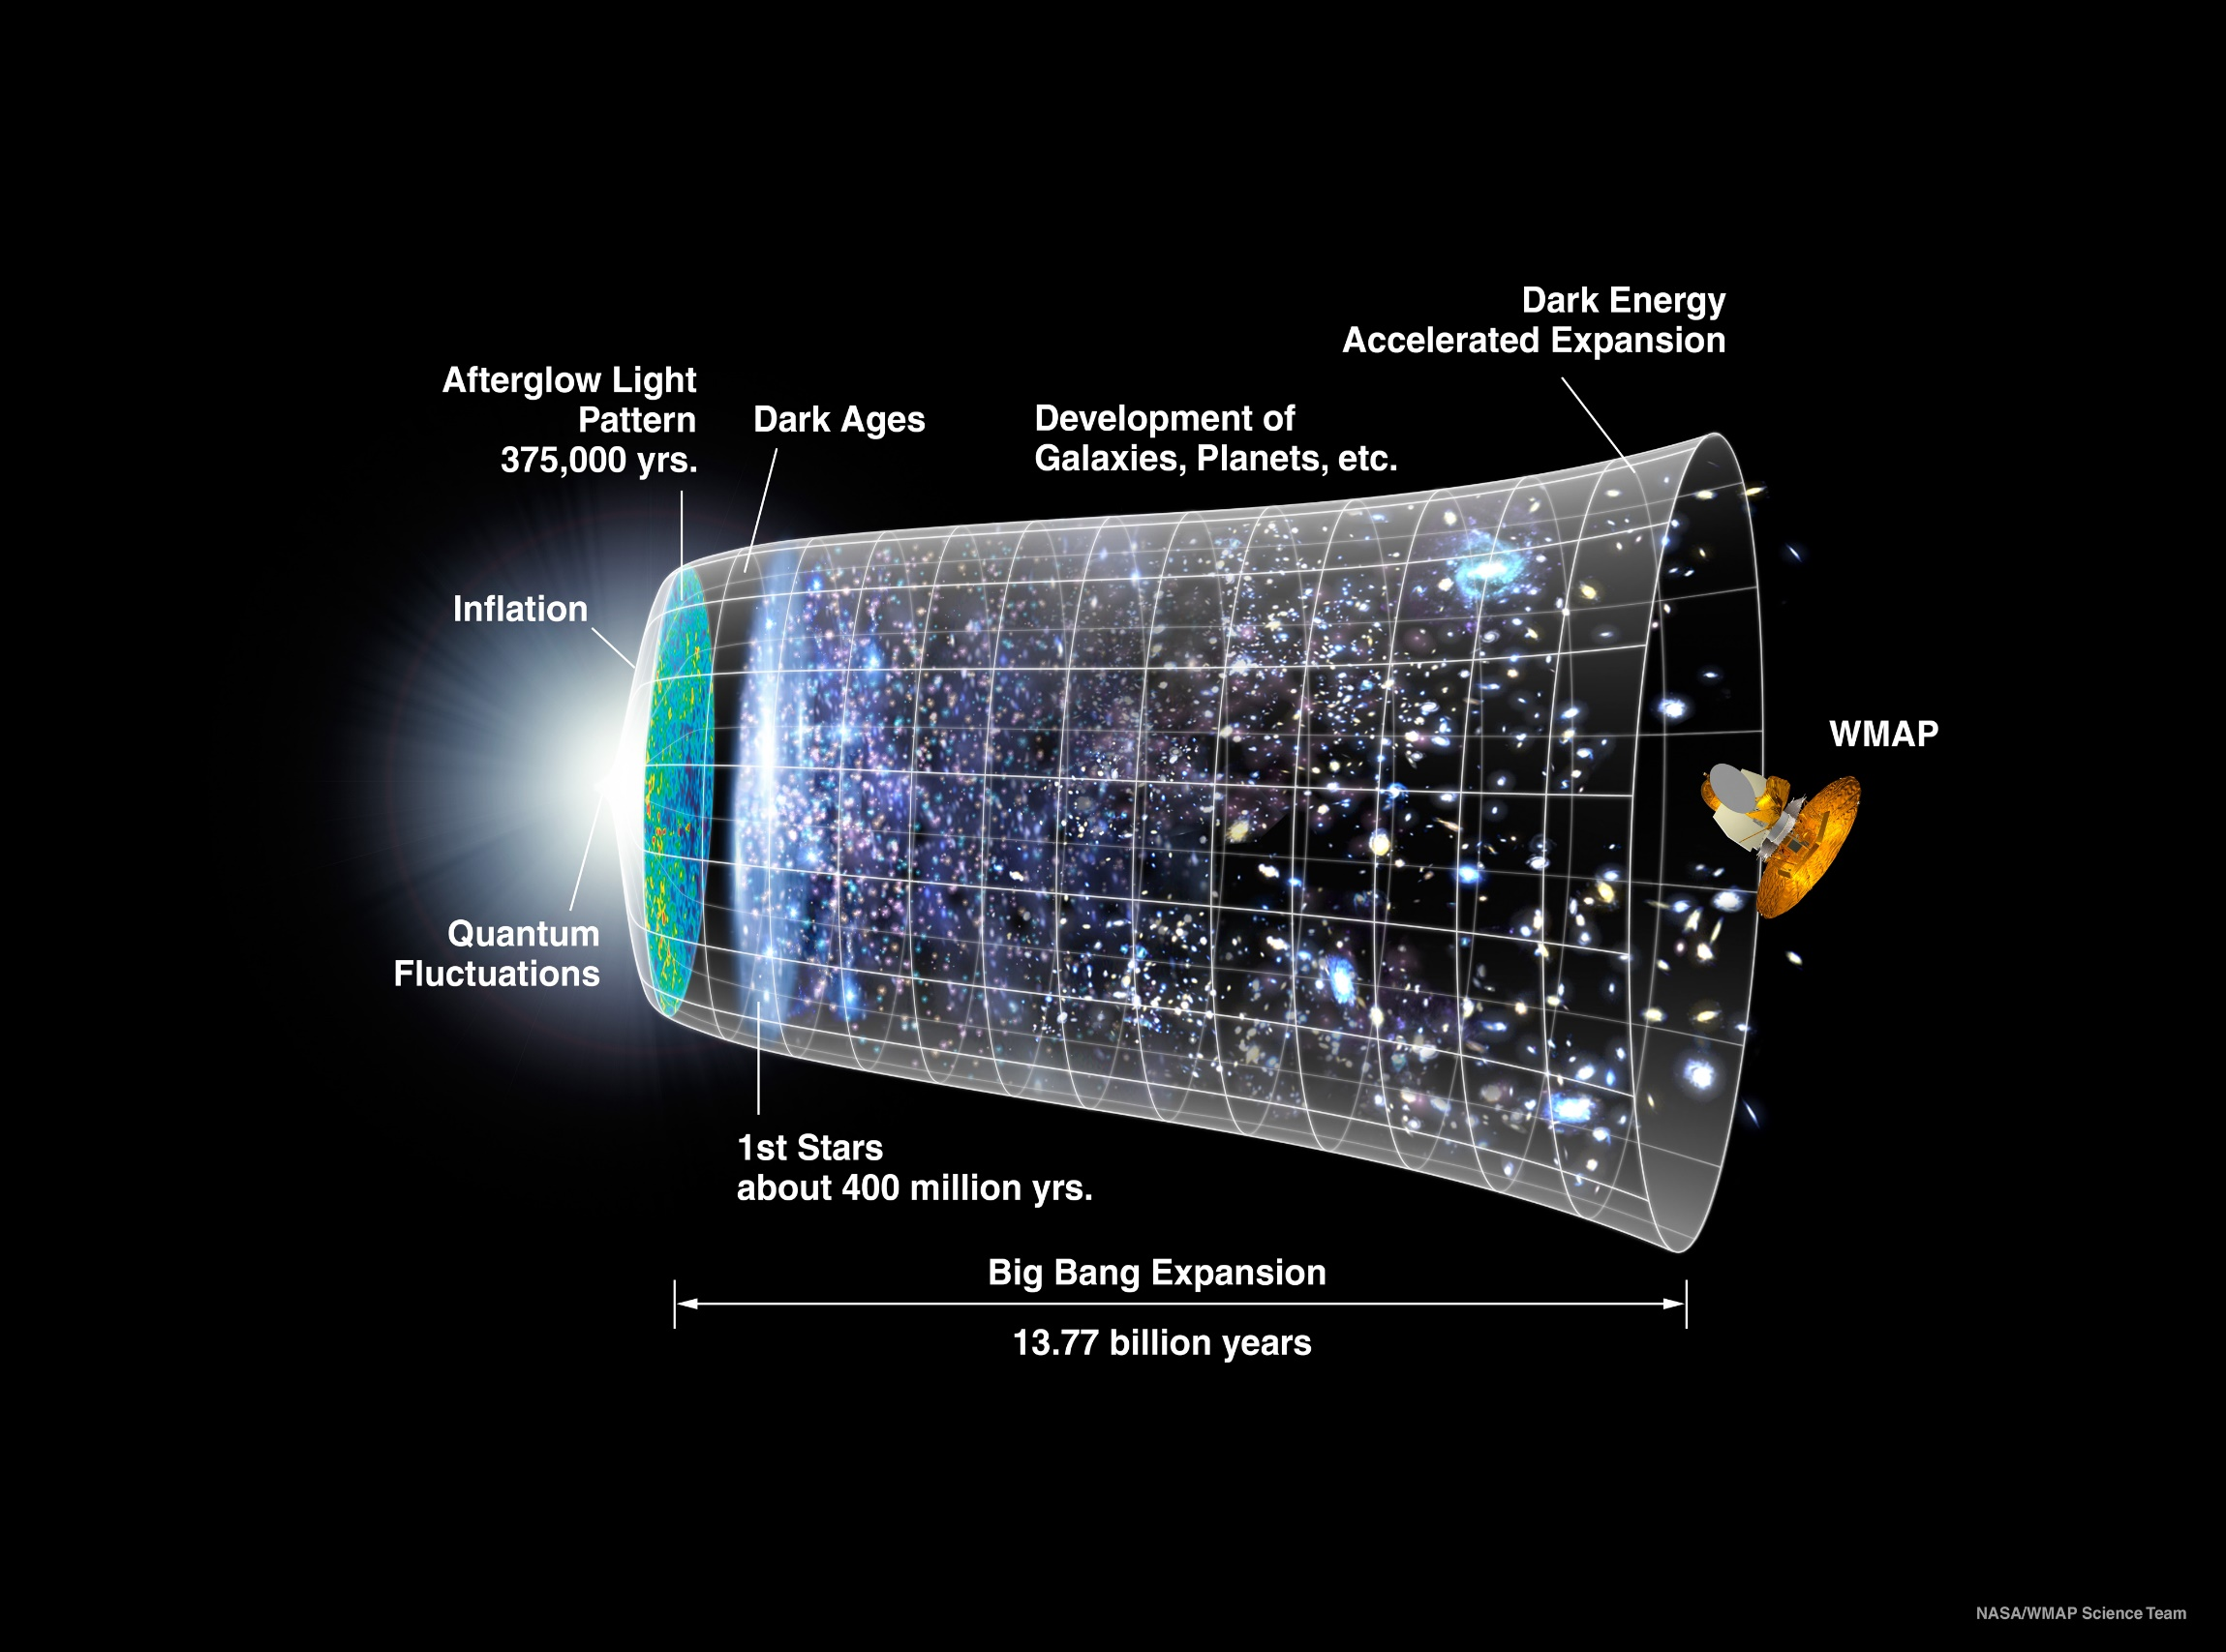
Our Universe
Mass emerged $1μ$second after the Big Bang
Its appearance was crucial to the formation of the Universe as we know it

Slide 14
Quantum Chromodynamics
$$L= \frac{1}{4}G_{μν}^{a}\left(x\right)G_{μν}^{a}\left(x\right)+\overline{ψ}\left[γ⋅∂_{x}+m+ig \frac{λ^{a}}{2}γ⋅A^{a}\left(x\right)\right]ψ\left(x\right)$$
$$G_{μν}^{a}\left(x\right)=∂_{μ}A_{ν}^{a}(x)−∂_{ν}A_{μ}^{a}(x)−f^{abc}A_{μ}^{b}{(x)A}_{ν}^{c}(x)$$
One-line Lagrangian – expressed in terms of gluon and quark partons
Which are NOT the degrees-of-freedom measured in detectors
Questions
What are the (asymptotic) detectable degrees-of-freedom?
How are they built from the Lagrangian degrees-of-freedom?
Is QCD really the theory of strong interactions?
Is QCD really a theory? $⇒$ Implications far beyond Standard Model

Slide 15
Strong Interactions in the Standard Model
Only apparent scale in chromodynamics is mass of the quark field
Quark mass is generated by Higgs boson couplings into QCD
In connection with everyday matter, that mass is less-then 0.5% of the empirical scale for strong interactions,
viz. more-than two orders-of-magnitude smaller
Plainly, the Higgs-generated mass is very far removed from the natural scale for strongly-interacting matter
Nuclear physics mass-scale – 1 GeV – is an emergent feature of the Standard Model
No amount of staring at L_{QCD} can reveal that scale
Contrast with quantum electrodynamics, e.g. spectrum of hydrogen levels measured in units of m_{e}, which appears in L_{QED}

Slide 16
Whence Mass?
Classical chromodynamics … non-Abelian local gauge theory
Remove the current mass … there’s no energy scale left
No dynamics in a scale-invariant theory; only kinematics … the theory looks the same at all length-scales … there can be no clumps of anything … hence bound-states are impossible.
Our Universe can’t exist
Higgs boson doesn’t solve this problem …
normal matter is constituted from light-quarks
the mass of protons and neutrons, the kernels of all visible matter, are 100-times larger than anything the Higgs can produce
Where did it all begin? … becomes … Where did it all come from?

Slide 17
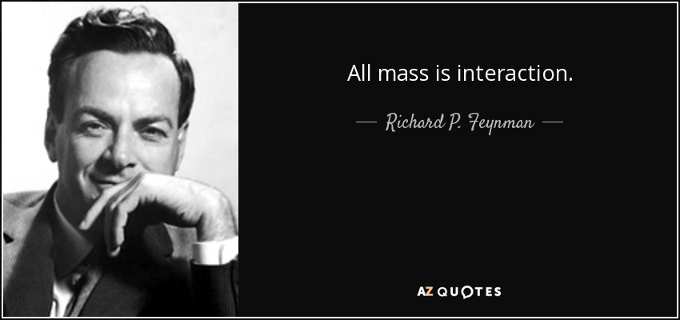

Slide 18
Trace Anomaly
In a scale invariant theory
the energy-momentum tensor must be traceless: T_{μμ} ≡ 0
Regularisation and renormalisation of (ultraviolet) divergences in Quantum Chromodynamics introduces a mass-scale
… dimensional transmutation:
Lagrangian’s constants (couplings and masses) become dependent on a mass-scale, ζ
α → α(ζ) in QCD’s (massless) Lagrangian density, L(m=0)
⇒ ∂_{μ}D_{μ} = δL/δσ = αβ(α) dL/dα = β(α) ¼G_{μν} G_{μν} = T_{ρρ} =: Θ₀
Quantisation of renormalisable four-dimensional theory forces nonzero value for trace of energy-momentum tensor
Trace anomaly
QCD β function … specifies how the coupling “runs”

Slide 19
Trace Anomaly
Knowing that a trace anomaly exists does not deliver a great deal
… Indicates only that a mass-scale must exist
Key Question: Can one compute and/or understand the magnitude of that scale?
One can certainly measure the magnitude … consider proton:
In the chiral limit the entirety of the proton’s mass is produced by the trace anomaly, Θ₀
… In QCD, Θ₀ measures the strength of gluon self-interactions
… so, from one perspective,
m_{p} is (somehow) completely generated by glue.
The mass of visible matter is almost entirely produced by massless non-matter fields

Slide 20
On the other hand …

Slide 21
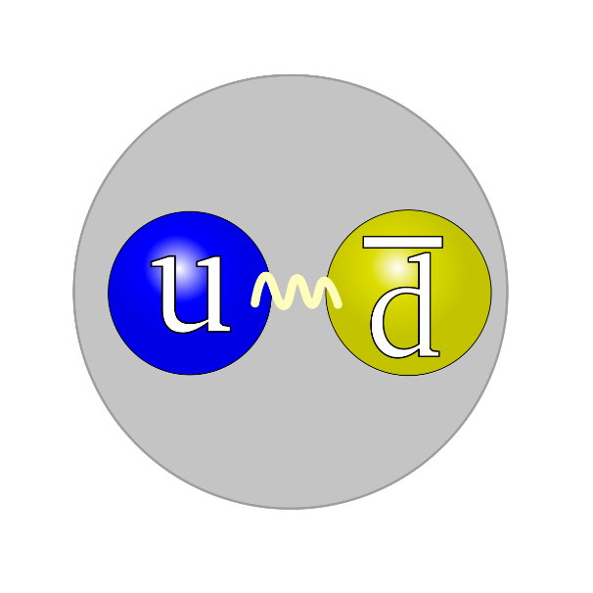
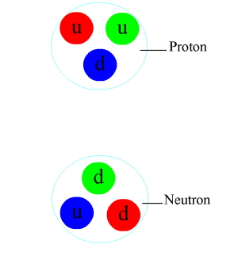
Pion
The pion is another one of the hadrons that was discovered as the standard model was being built
Predicted by Yukawa in 1935
It had to exist, otherwise there was nothing that could hold neutrons and protons together inside a nucleus
The pion, too, is crucial.
It MUST be unnaturally light, otherwise the force it produces would act over a range that is too short to be useful in binding nuclei

Slide 22
Trace Anomaly
In the chiral limit, pion is massless Nambu-Goldstone boson:
⇒
Does this mean that the scale anomaly vanishes trivially in the pion state, i.e. gluons contribute nothing to the pion mass?
Difficult way to obtain “zero”!
Easier to imagine that “zero” owes to cancellations between different operator contributions to the expectation value of Θ₀.
Of course, such precise cancellation should not be an accident.
It could only arise naturally because
of some symmetry and/or symmetry-breaking pattern.

Slide 23
Whence “1” and yet “0” ?
No statement of the question
“How does the mass of the proton arise?”
is complete without the additional clause
“How does the pion remain massless?”
Natural visible-matter mass-scale must emerge simultaneously with apparent preservation of scale invariance in related systems
Expectation value of Θ₀ in pion is always zero,
irrespective of the size of the natural mass-scale for strong interactions = m_{p}

Slide 24
Whence “1” and yet “0” ?
No statement of the question
“How does the mass of the proton arise?”
is complete without the additional clause
“How does the pion remain massless?”
Natural visible-matter mass-scale must emerge simultaneously with apparent preservation of scale invariance in related systems
Expectation value of Θ₀ in pion is always zero,
irrespective of the size of the natural mass-scale for strong interactions = m_{p}
Modern Physics must
Elucidate the entire array of Empirical Consequences
of the Mechanism responsible
so that the Standard Model can be Tested and Bounded

Slide 25
In QCD, so is the absence of mass

Slide 27
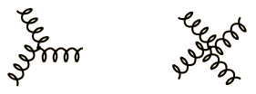
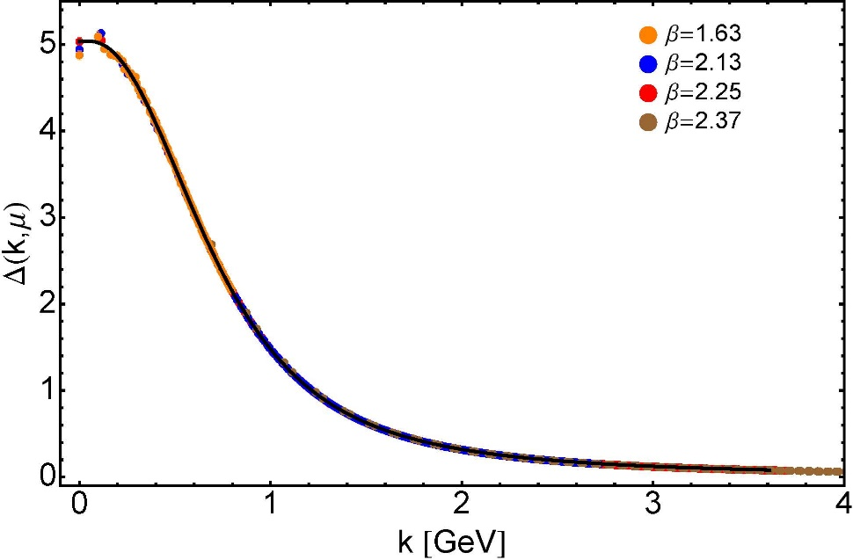
Modern Understanding Grew Slowly from Ancient Origins
More than 40 years ago
Dynamical mass generation in continuum quantum chromodynamics,
J.M. Cornwall, Phys. Rev. D 26 (1981) 1453 … $∼1100$ citations
Owing to strong self-interactions, gluon partons $⇒$ gluon quasiparticles,
described by a mass function that is large at infrared momenta
3-gluon vertex
4-gluon vertex
$$\frac{1}{m_{g}^{2}}$$
Truly mass from nothing
An interacting theory, written in terms of massless gluon fields, produces dressed gluon fields that are characterised by a mass function that is large at infrared momenta
Gluon propagator … continuum and lattice QCD agree
QCD fact
Continuum theory and lattice simulations agree
Empirical verification?

Slide 28
Modern Understanding Grew Slowly from Ancient Origins
EHM means
Gluons are massive
More than 40 years ago
Dynamical mass generation in continuum quantum chromodynamics,
J.M. Cornwall, Phys. Rev. D 26 (1981) 1453 … $∼1050$ citations
Owing to strong self-interactions, gluon partons $⇒$ gluon quasiparticles,
described by a mass function that is large at infrared momenta
3-gluon vertex
4-gluon vertex
$$\frac{1}{m_{g}^{2}}$$
Truly mass from nothing
An interacting theory, written in terms of massless gluon fields, produces dressed gluon fields that are characterised by a mass function that is large at infrared momenta
Gluon propagator … continuum and lattice QCD agree
QCD fact
Continuum theory and lattice simulations agree
Empirical verification?

Slide 29
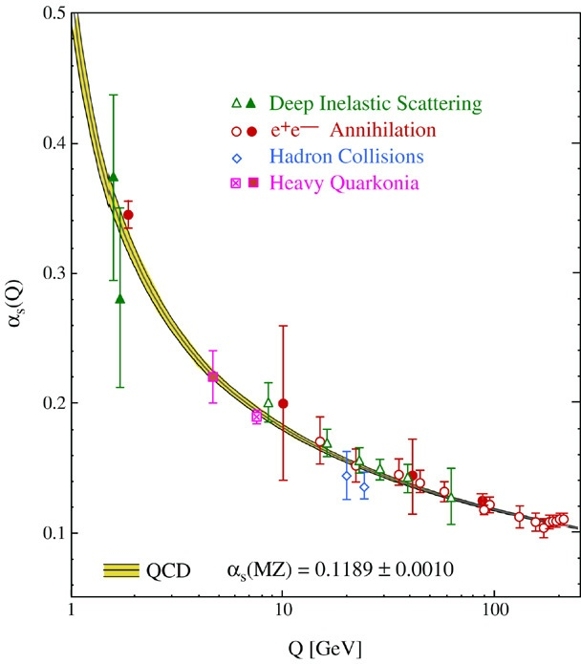
QCD’s Running Coupling
This is where we live
Asymptotic Freedom
Interaction becomes weaker as energy grows
(charges get closer together)
⇐
What’s happening
out here?!

Slide 30
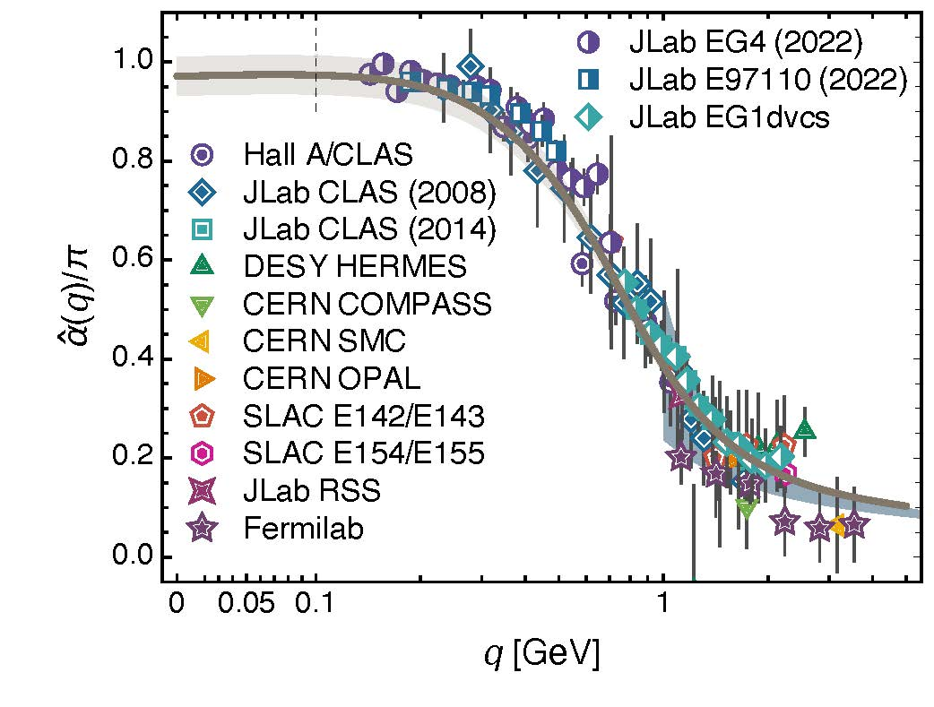
Process independent effective charge = running coupling
W orkshop on Dyson-Schwinger Equations in Modern Mathematics
and Physics (DSEMP2014) Trento, Italy, September 22-26, 2014
Effective charge from lattice QCD, Zhu-Fang Cui, Jin-Li Zhang et al.,
NJU-INP 014/19, arXiv:1912.08232 [hep-ph], Chin. Phys. C 44 (2020) 083102/1-10
2334 total downloads
Modern theory enables unique QCD analogue of
“Gell-Mann – Low”
running charge to be rigorously defined and calculated
Analysis of QCD’s gauge sector
yields a parameter-free prediction
N.B. Qualitative change in α̂_{PI}(k) at k ≈ ½ m_{p}
No Landau Pole
“Infrared Slavery” picture – linear potential – is not correct explanation of confinement
Below $k∼{{\hat{m}}_{0}}_{ },$interactions become scale independent, just as they were in the Lagrangian; so, QCD becomes practically conformal again
Process independent strong running coupling
Daniele Binosi et al., arXiv:1612.04835 [nucl-th], Phys. Rev. D 96 (2017) 054026/1-7
Experimental determination of the QCD effective charge α_{g1}(Q).
A. Deur; V. Burkert; J.-P. Chen; W. Korsch, Particles 5 (2022) 171
QCD Running Couplings and Effective Charges, Alexandre Deur, Stanley J. Brodsky and Craig D. Roberts, NJU-INP 071/23, e-Print: 2303.00723 [hep-ph], Prog. Part. Nucl. Phys. in press

Slide 31
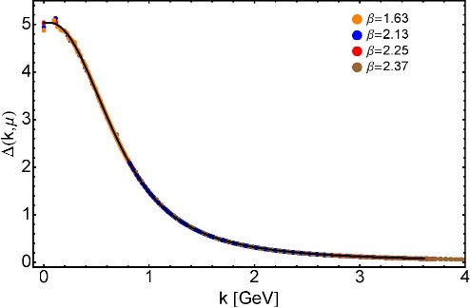
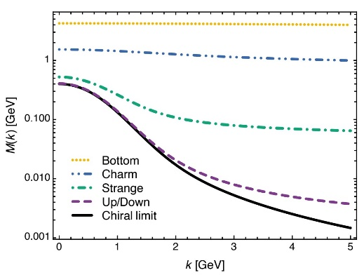
EHM Basics
Absent Higgs boson couplings, the Lagrangian of QCD is scale invariant
Yet …
Massless gluons become massive
A momentum-dependent charge is produced
Massless quarks become massive
EHM is expressed in
EVERY strong interaction observable
Challenge to Theory =
Elucidate all observable consequences of these phenomena
and highlight the paths to measuring them
Challenge to Experiment =
Test the theory predictions so that
the boundaries of the Standard Model
can finally be drawn
Three pillars of EHM
JLab Beam Energy (GeV) | Fraction EHM mapped (%)
6 | $$≈35$$
12 | $$≈50$$
22 | $$≈90$$

Slide 32
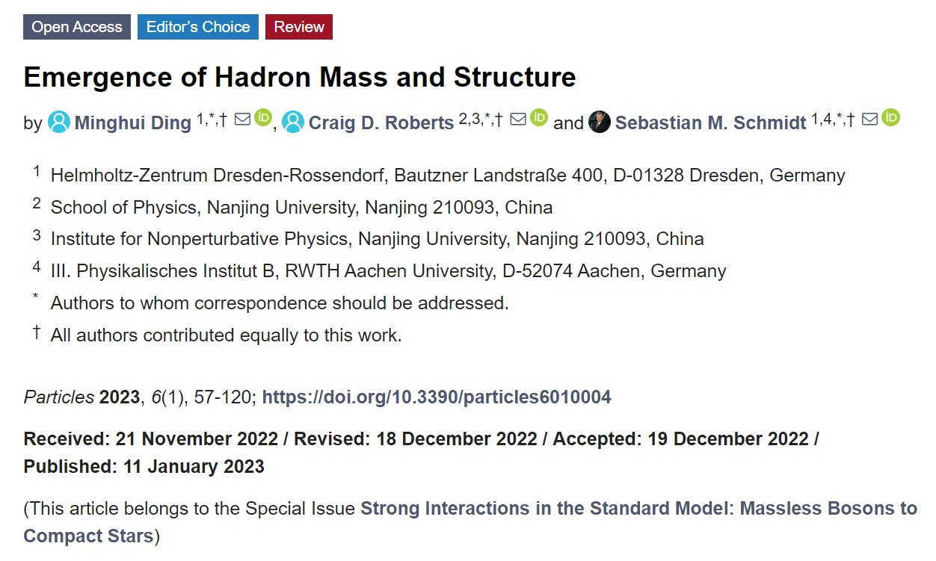
Section 10 …
Transition Form Factors of Heavy + Light Mesons

Slide 33
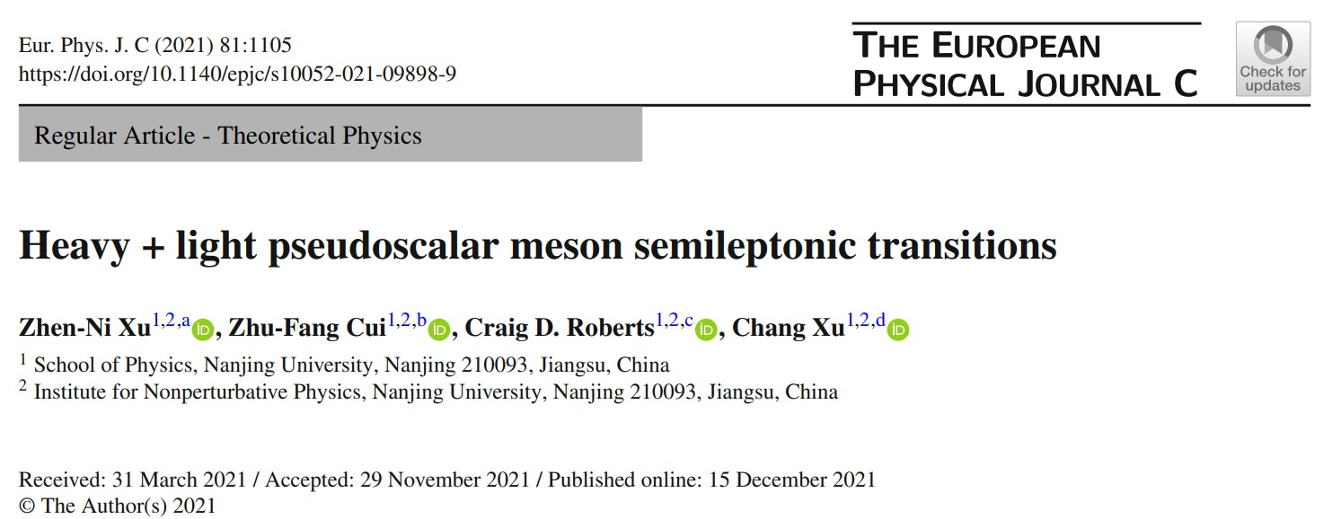
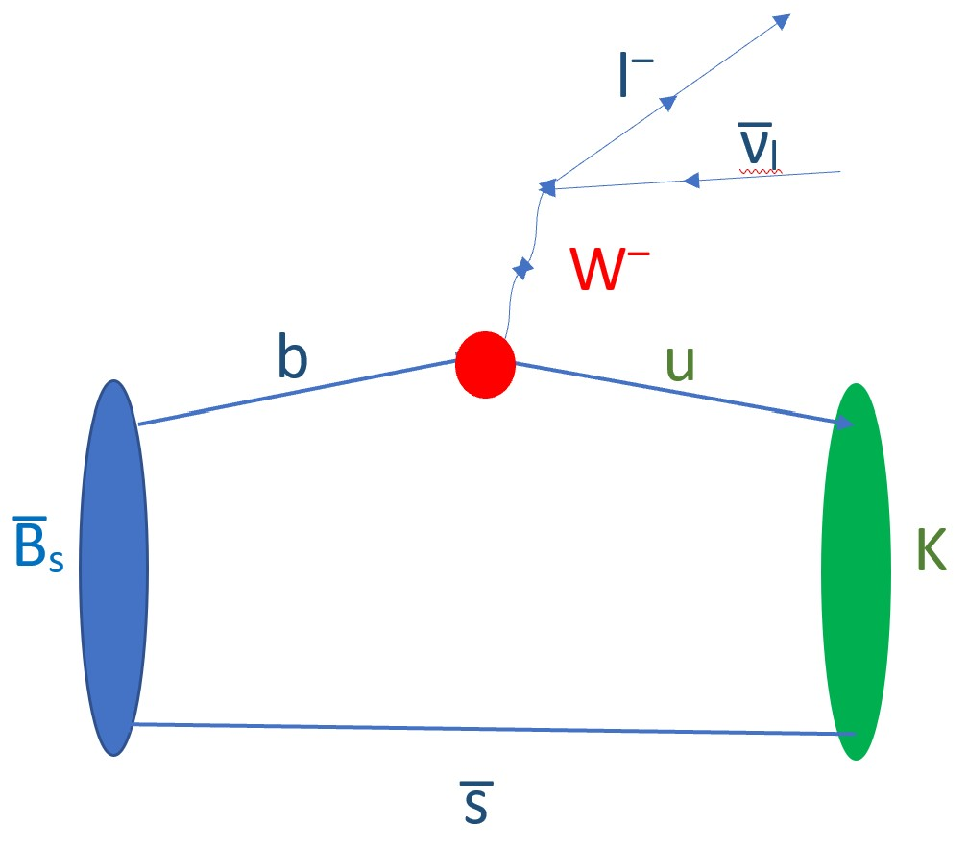

Slide 34
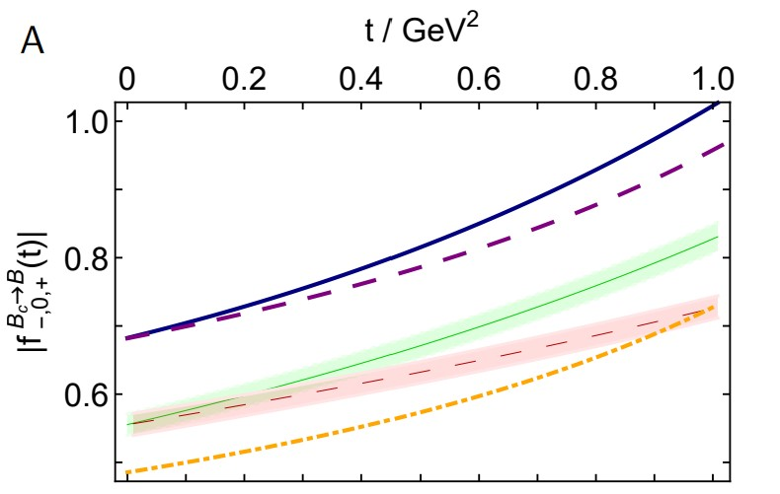
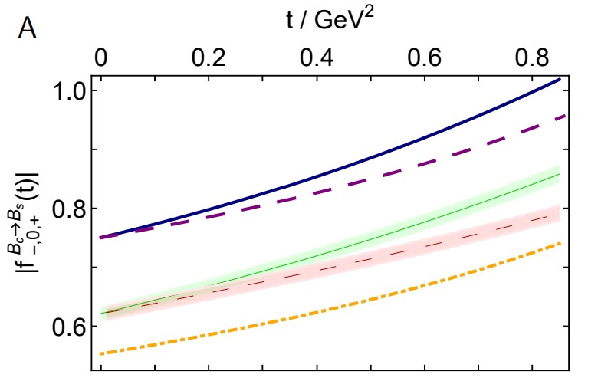
Semileptonic transition form factors
Heavy+light pseudoscalar meson semileptonic transitions, Zhen-Ni Xu et al., NJU-INP 040/21, arXiv:2103.15964 [hep-ph]
SCI – lQCD:
20% relative difference
Symmetry-preserving regularisation of a vector × vector contact interaction (SCI)
Unified treatment of semileptonic transitions from π, K, D_{(s)}​, B_{(s,c)}​ initial states to $0^{+}$ final states.
Framework:
algebraic simplicity
few parameters
ability to simultaneously treat systems from Nambu-Goldstone modes to heavy+heavy mesons.
Results:
SCI $0^{+}→0^{+}$ form factors are typically somewhat stiff
Yet, predictions comparable with experiment & rigorous SM theory.
Hence, predictions for five unmeasured B_{s,c}​ branching fractions should be reasonable guide.
SCI
lQCD
SCI
lQCD

Slide 35
Semileptonic transition form factors
Heavy+light pseudoscalar meson semileptonic transitions, Zhen-Ni Xu et al., NJU-INP 040/21, arXiv:2103.15964 [hep-ph]
SCI $0^{+}→0^{+}$form factors are typically somewhat stiff.
Yet, predictions comparable with experiment and rigorous theory.
Hence, predictions for the five unmeasured B_{s,c}​ branching fractions should be reasonable guide.
SCI
lQCD
SCI
lQCD

Slide 36
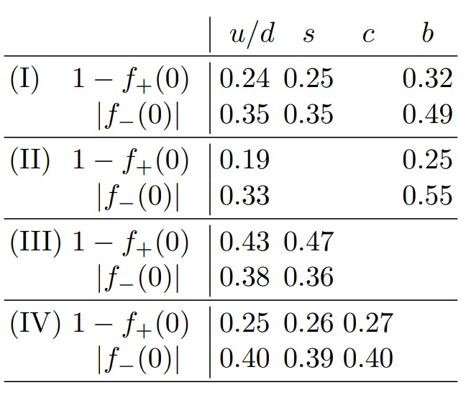
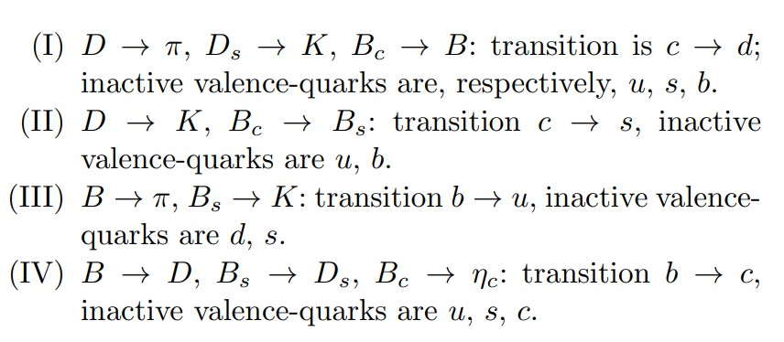
Semileptonic transition form factors
Heavy+light pseudoscalar meson semileptonic transitions, Zhen-Ni Xu et al., NJU-INP 040/21, arXiv:2103.15964 [hep-ph]
Analysis provides insights into effects of Higgs boson couplings via current-quark masses on transition form factors
Consider evolution of form factors with increasing mass of transition's inactive valence-quark,
i.e., as quark mass produced by Higgs becomes more important part of final-state meson's mass cf. EHM component.
Four classes in semileptonic P→P′ decays:
Characterise evolution by values of
[1-f₊(0)] and |f–(0)| because
[1-f₊(0)] = 0 =|f–(0)| in systems made from mass-degenerate valence degrees-of-freedom.
As current-mass of the inactive valence degree-of-freedom increases, so do deviations from flavour-symmetry limits.

Slide 37
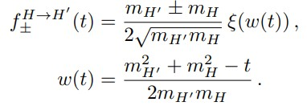
Isgur-Wise Function
Semileptonic transitions connecting systems distinguished by a large disparity between current masses of their valence degrees-of-freedom,
e.g., heavy + light mesons,
valuable simplifications can be exploited
For instance, when $m_{Q_{2}}\tilde{>}{m_{Q}}_{1}≫m_{q}$, then $H_{Q_{2}q}→H_{Q_{1}q}$ semileptonic transitions are described by a single scalar function = Isgur-Wise function:
Same simplification for $0^{+}→1^{+}$ semileptonic transitions
Questions:
Can theory predict the function?
Is $ξ\left(w\right)$ accessible via achievable experiments?
Do measurements confirm theory?

Slide 38
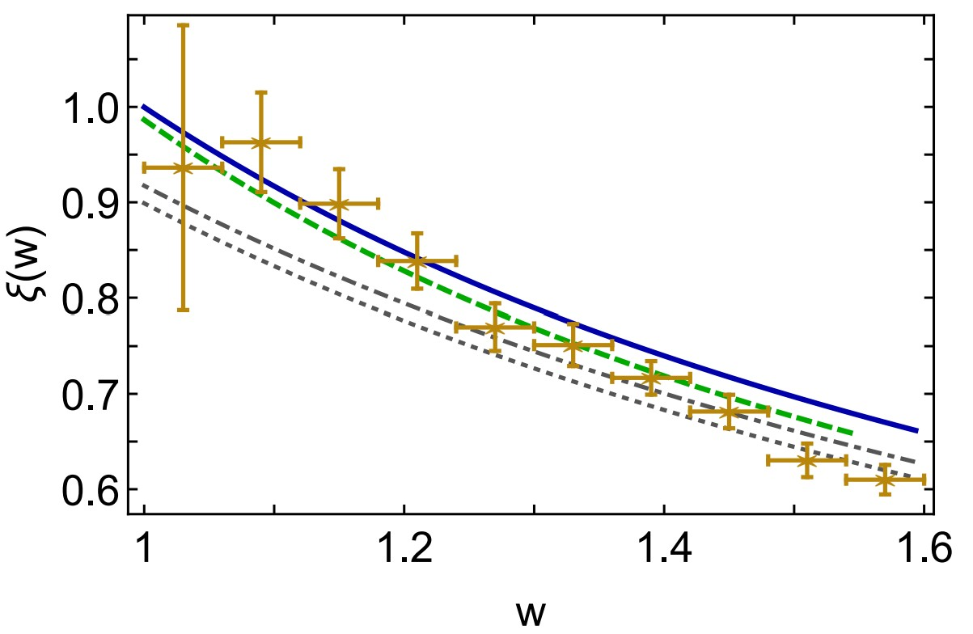
Semileptonic transition form factors
Heavy+light pseudoscalar meson semileptonic transitions, Zhen-Ni Xu et al., NJU-INP 040/21, arXiv:2103.15964 [hep-ph]
SCI is not a precision instrument. Yet, it can be “priceless” when it comes to laying the foundations for more sophisticated studies and checking whether their results are realistic
Results on B_{(s)}​→D_{(s)}​ transitions yield prediction for Isgur-Wise function
fair agreement with modern data.
SCI analysis provides benchmarks for studies using realistic interactions
Essentially algebraic, so results are readily obtained
Expresses impact of EHM as expressed in gluon mass-scale and EHM+HB feedback
Typically, accurate to 20% or better
Data Belle 2016
(Analysis uncovered error in one “Editor’s Selection” lQCD study, requiring Erratum to be published)
SCI
Blue = B​→D
Green = B_{s}​→D_{s}

Slide 39
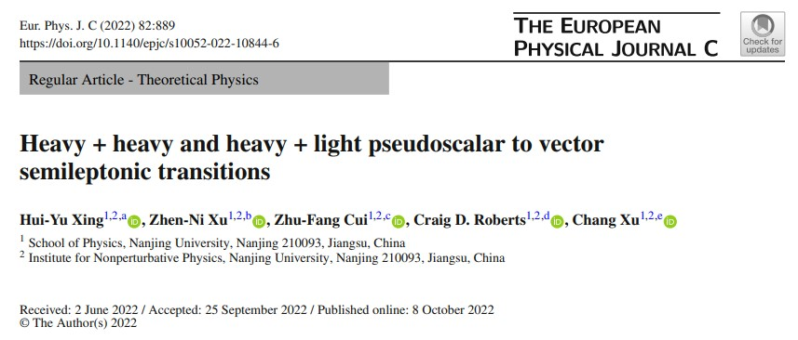
*

Slide 40
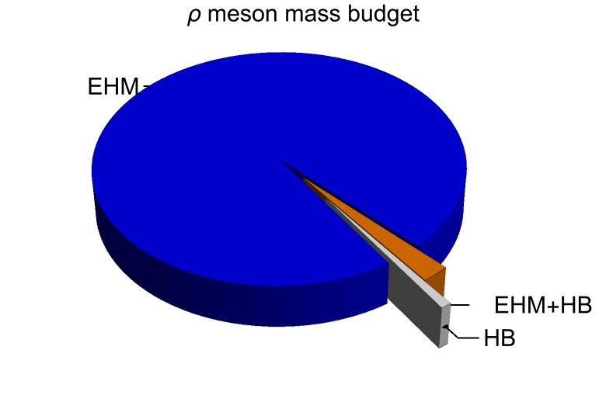
Heavy + heavy and heavy + light $0^{+}→1^{−}$ semileptonic transitions
SCI treatment of 12 transitions:
$D→ρ;D_{(s)}→K^{∗}; D_{s}→φ;B→ρ;B_{s}→K^{∗};B_{(s)}→D_{\left(s\right)}^{∗};B_{c}→B_{\left(s\right)}^{∗}, J/ψ$, $D^{∗}$
Unified with the SCI analysis of $0^{+}→0^{+}$ transitions
Vector-meson final states involve both $V$ & $A$ components of the weak current, whereas $0^{+}→0^{+}$ are only sensitive to $V$
Recall … initial state mass budgets – HB:EHM+HB
$$B_{c}\left(87:13\right) …B_{\left(s\right)}\left(80:20\right)…D_{\left(s\right)}(70:30)$$
Compare with light meson mass budgets
$$K\left(20:80\right)…π(5:95)$$
Overlap to vector meson final states, e.g.,
Comprehensive study of EHM+HB interference

Slide 41
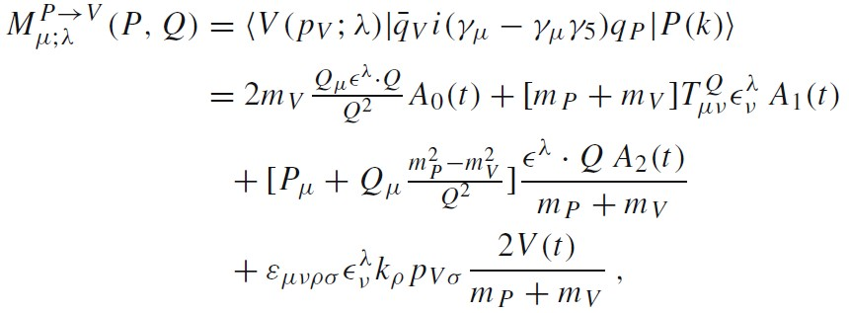
$0^{+}→1^{−}$ semileptonic transitions
Transitions described by 4 independent form factors
Contain all hadron structure information and a great deal about EHM+HB effects
Symmetries connect $A_{0}(0)$ with $A_{1}\left(0\right), A_{2}(0)$
With all form factors in hand, then branching fractions are straightforward to calculate
So, form factors deliver access to CKM matrix elements and SM tests
Sound results for form factors require reliable tools for handling strong QCD
Fits to lattice QCD results are available
Continuum Schwinger function methods are competitive alternative

Slide 42
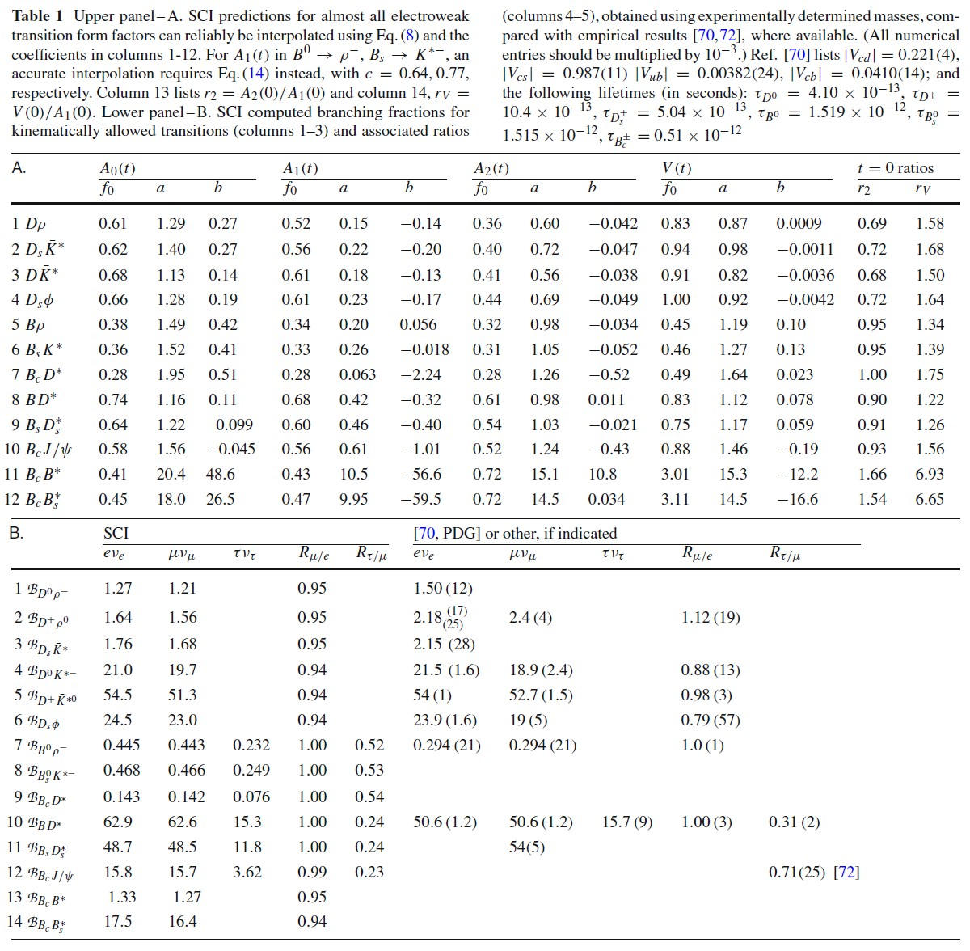
$0^{+}→1^{−}$ semileptonic transitions
Vast amount of information provided within a single unifying framework, e.g.,
Form factor parametrisations
Branching fractions to various leptonic final states
SCI results compare well wherever sound experimental or independent theory analyses are available
Hence, SCI branching fraction predictions should be reasonable guide
Valid statement of SM predictions, based on sound treatment of strong-interaction physics

Slide 43
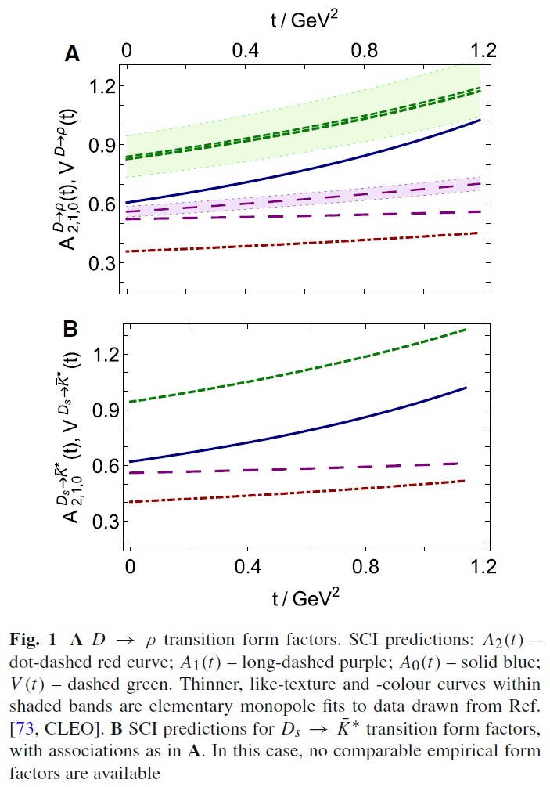
$0^{+}→1^{−}$ semileptonic transitions … $D_{(s)}$
Predictions for $D→ρ$ agree with CLEO and BESIII
Associated analysis suggests that PDG estimate of ${Br}_{D^{+}→ρ^{0}μ^{+}ν_{μ}}$ is too large
Predictions for $D_{s}→{\overline{K}}_{s}^{∗}$, form factors
But no pointwise data available
Nevertheless, BESIII reports results for
$r_{2}=\frac{A_{2}\left(0\right)}{A_{1}\left(0\right)}, r_{V}=\frac{V\left(0\right)}{A_{1}\left(0\right)}$
which agree with SCI predictions:
{0.77(29) , 1.67(38)} cf. {0.72 , 1.68}

Slide 44
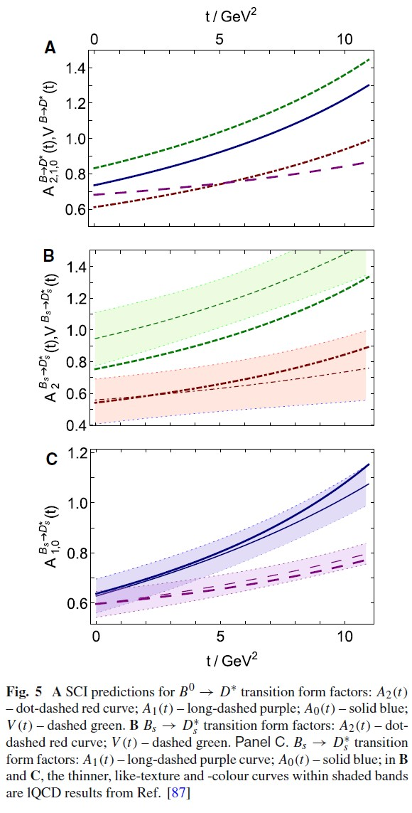
$0^{+}→1^{−}$ semileptonic transitions … lepton flavour
Branching fraction ratios and lepton flavour universality
SCI prediction
$$R_{D^{∗}}=\frac{Br_{B→D^{∗}τν_{τ}}}{{Br}_{B→D^{∗}μν_{μ}}}=0.24$$
Confirms $2.9σ$disagreement between SM theory and experiment $=0.31(2)$
SCI predictions: $R_{D}=0.27$ and $R_{D_{s}}=0.26$
Empirically $R_{D}=0.34\left(3\right)$
... 17% reduction from 2016 estimate $R_{D}^{2016}=0.40(5)$,
... suggests that experiment is moving toward SM prediction
Tensions also with $R_{B_{c}→J/ψ}$ ... discuss later

Slide 45
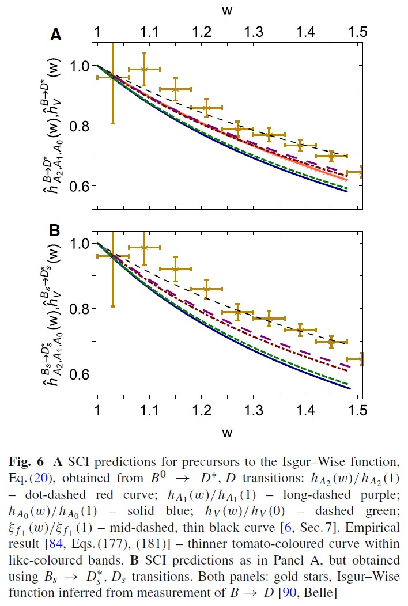
$0^{+}→1^{−}$ semileptonic transitions … $ξ(w)$
Isgur-Wise function from $B_{(s)}^{0}→D_{(s)}^{∗−}$ transitions
Data from Belle (2016)
“empirical” curve from
Y. S. Amhis et al., Averages of b-hadron, c-hadron, and τ –lepton properties as of 2018. Eur. Phys. J. C 81(3), 226 (2021)
Article reports world averages of measurements obtained by the Heavy Flavor Averaging Group
SCI prediction matches the HFLAV inference
Slope parameter
SCI prediction: $ρ^{2}=1.16$
HFLAV: $ρ^{2}=1.122(24)$

Slide 46
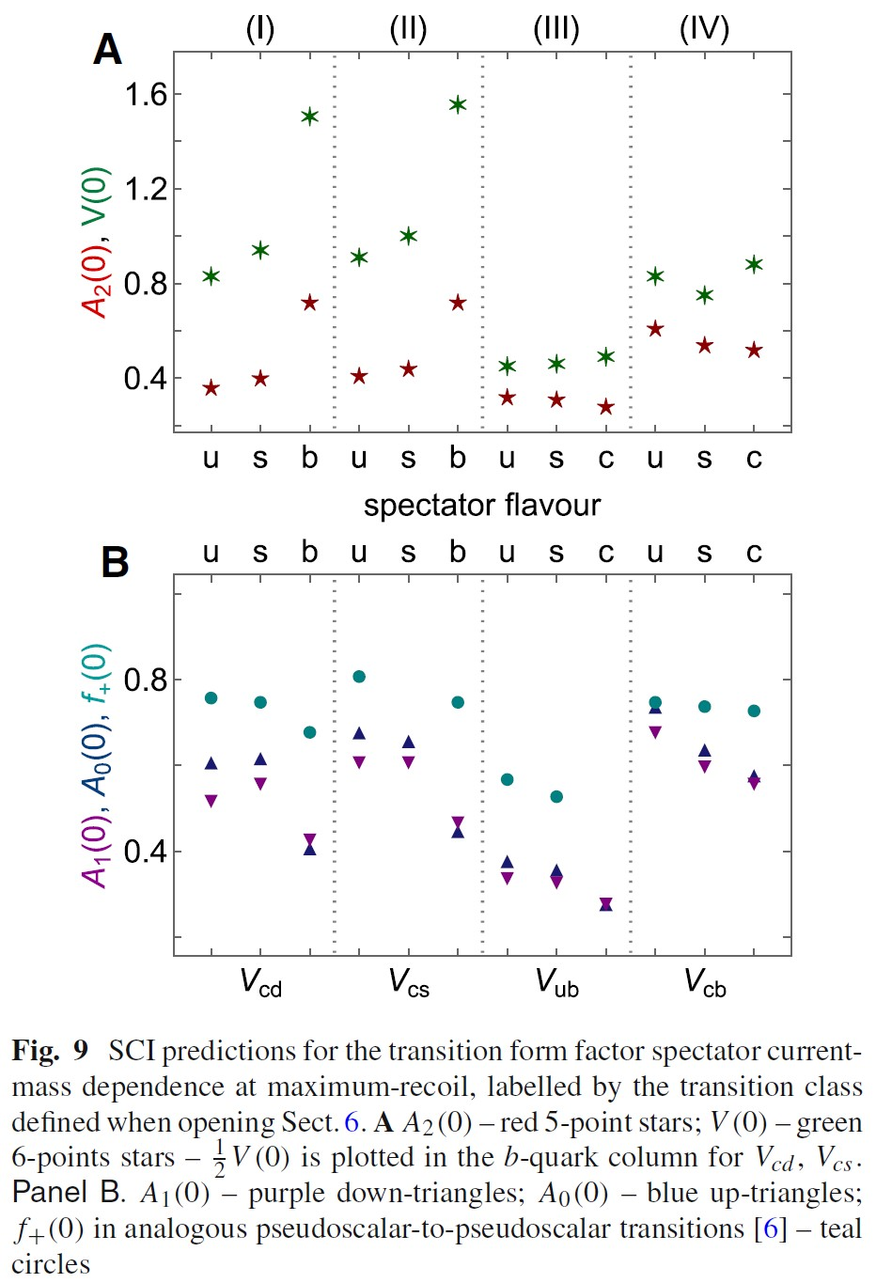
$0^{+}→1^{−}$ semileptonic transitions … EHM+HB
As mass of spectator quark, $m_{spec}$, is varied, some patterns emerge
For instance:
$V(0)$ tends to increase as $m_{spec}$ increases, whereas $A_{1,0}(0)$, $f_{+}(0)$ decrease
$A_{2}\left(0\right)$ increases for $c →d, s$ transitions, but decreases for $b→u,c$
Responses are expressions of dynamical information encoded in symmetry-determined Ward–Green–Takahashi identities satisfied by the two pieces $\left(V−A\right)$ of each weak transition vertex

Slide 47
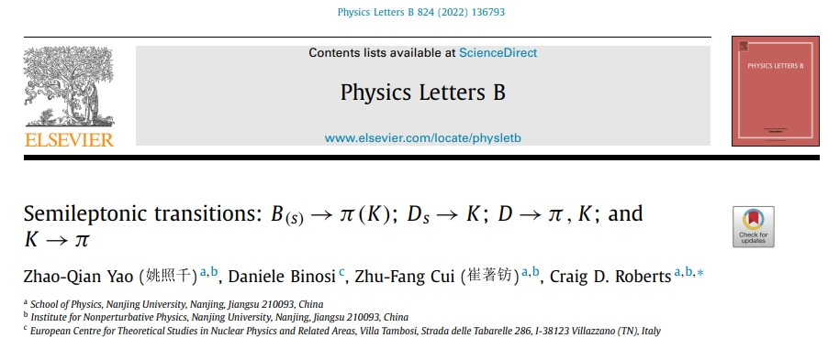

Slide 48
${\overline{B}}^{0}→π^{+}$& ${\overline{B}}_{s}^{0}→K^{+}$ Semileptonic Transitions
Semileptonic transitions: B_{(s)} → π(K); D_{s} → K; D → π, K; and K → π, Zhao-Qian Yao (姚照千) et al., e-Print: 2111.06473 [hep-ph], Phys. Lett. B 824 (2022) 136793
$b→u$ CKM matrix element is poorly known
an average of a selection of disparate results yields $\left|V_{ub}\right|=0.00382(24)$
Best means of determining $\left|V_{ub}\right|$… use theoretically clean processes that involve ground-state hadrons in initial and final state,
e.g., optimally ${\overline{B}}^{0}→π^{+}$& ${\overline{B}}_{s}^{0}→K^{+}$ semileptonic transitions
Measurements of ${\overline{B}}^{0}→π^{+}$ available & ${\overline{B}}_{s}^{0}→K^{+}$recently observed [LHCb 2020].
“clean” means, e.g.,
processes involve only vector component of the weak interaction vertex
initial and final states are systems constituted from just two valence degrees-of-freedom.
Sound theoretical treatment of these transitions is challenging because
$π$ & $K$ are Nambu Goldstone Bosons
Huge disparity between masses of initial and final states.
CSMs algorithms now enable systematic treatment of these transitions

Slide 49
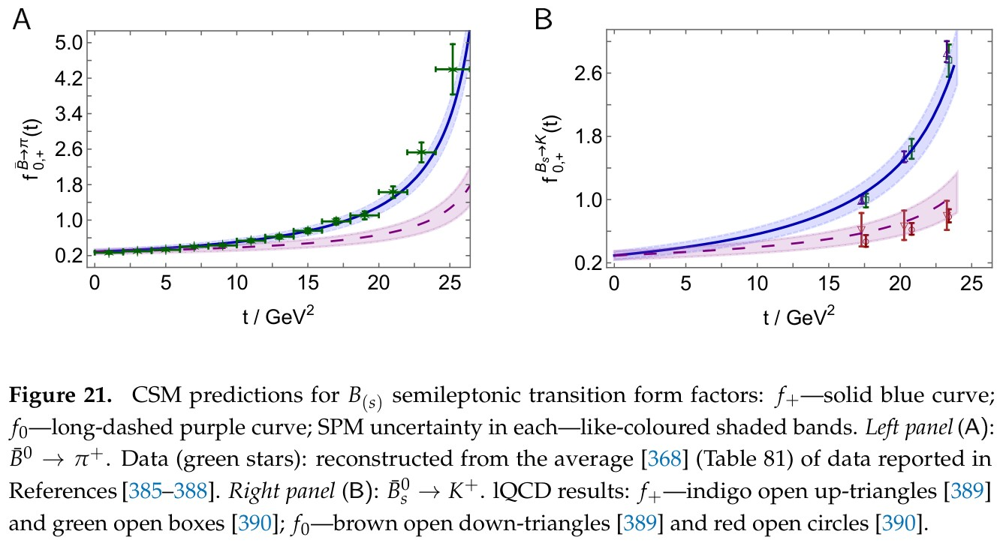
${\overline{B}}^{0}→π^{+}$& ${\overline{B}}_{s}^{0}→K^{+}$ Semileptonic Transitions
Semileptonic transitions: B_{(s)} → π(K); D_{s} → K; D → π, K; and K → π, Zhao-Qian Yao (姚照千) et al., e-Print: 2111.06473 [hep-ph], Phys. Lett. B 824 (2022) 136793
CSM predictions ${\overline{B}}^{0}→π^{+}$form factors are depicted in Figure 21A.
Data have been collected by two collaborations [BaBar & Belle 2010, 2013]
… CSM predictions agree with these data.
$f_{+}^{\overline{B}}\left(t=0\right)=0.27\left(2\right)$ cf. $f_{+}^{\overline{B}}\left(t=0\right)=0.287\left(54\right)$
Using CSM transition form factors, precise agreement with $μ^{−}{\overline{ν}}_{μ}$ branching fraction obtained with
$$\left|V_{ub}\right|=0.00374(44)$$
Value matches other analyses of $\overline{B}→π^{+}μ^{−}{\overline{ν}}_{μ}$, thus increases tension with higher value inferred from inclusive decays
No data are available $τ^{−}{\overline{ν}}_{τ}$ final state $⇒$ can’t now test lepton flavour universality
CSMs deliver pointwise behaviour of transition form factors on entire kinematic domain … not just at a few points located at upper end of kinematic range, which must then be fitted and extrapolated

Slide 50
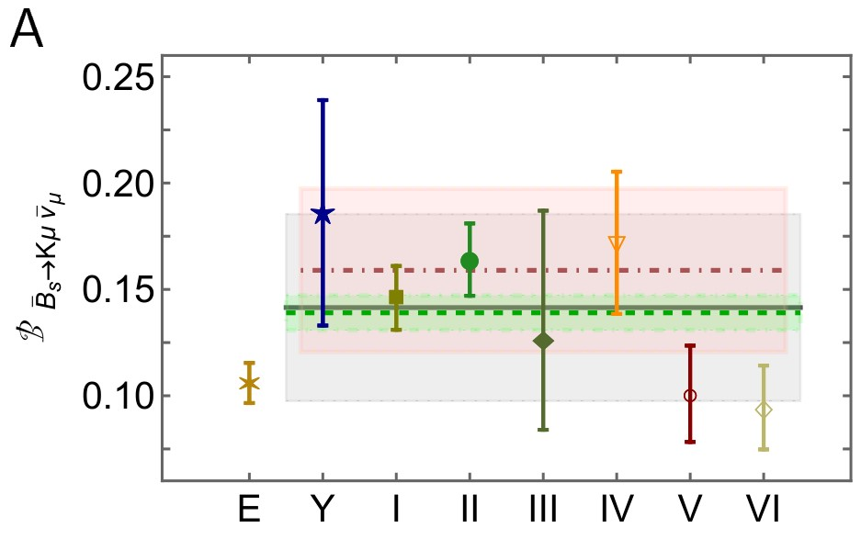
${\overline{B}}^{0}→π^{+}$& ${\overline{B}}_{s}^{0}→K^{+}$ Semileptonic Transitions
Semileptonic transitions: B_{(s)} → π(K); D_{s} → K; D → π, K; and K → π, Zhao-Qian Yao (姚照千) et al., e-Print: 2111.06473 [hep-ph], Phys. Lett. B 824 (2022) 136793
Fig. 21B CSM predictions ${\overline{B}}^{0}→K^{+}$form factors
Branching fraction recently measured
$$B_{B^{0}→K^{−}μ^{+}ν_{μ}}=\left[0.106±{0.005}_{stat}+{0.008}_{syst}\right]×{10}^{−3}$$
No form factor data available
CSM prediction: $f_{+}^{\overline{B_{s}}→K}\left(t=0\right)=0.293\left(55\right)$
So, $\frac{f_{+}^{{\overline{B}}_{s}→K}\left(0\right)}{f_{+}^{\overline{B}→π}\left(0\right)}>1$ at 85% confidence level
Ratio is marker of EHM+HB interference
Theory scatter $⇒$ room for improvement in ${\overline{B}}_{s}→K$ theory
Measurements of ${\overline{B}}_{s}→K$form factors useful, for refining
comparisons with theory & between theories
progress toward more accurate value of $\left|V_{ub}\right|$.
CSM
models (3)
lQCD (3)
V&VI (lQCD) … probably severe underestimate of $f_{+}^{{\overline{B}}_{s}→K}\left(0\right)$

Slide 51
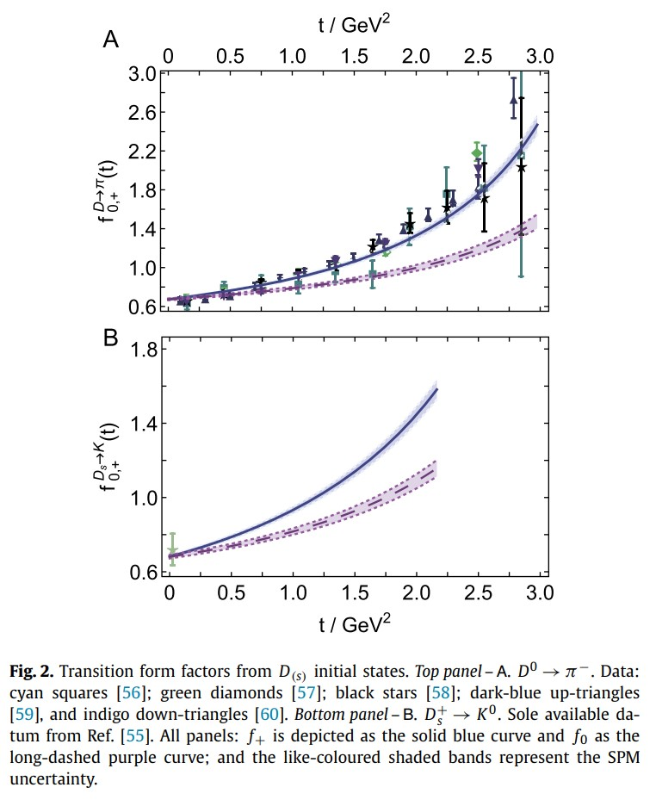
$D^{0}→π^{−}e^{+}ν_{e}$
CSM prediction is consistent with available data, although may be hint of tension with [BESIII, 2015 & 2017] at larger values of $t$.
Owing to kinematics, the contribution to the branching fraction from the large $t$ is suppressed
Using these form factors
CSM $\frac{Br_{D^{0}→π^{−}μ^{+}ν_{μ}}}{Br_{D^{0}→π^{−}e^{+}ν_{e}}}=0.987(2)$
PDG $\frac{Br_{D^{0}→π^{−}μ^{+}ν_{μ}}}{Br_{D^{0}→π^{−}e^{+}ν_{e}}}=0.918(40)$
$2σ$ too small.
CSM and PDG agree on $μ^{+}ν_{μ}$ final state branching fraction; hence, PDG overestimates $e^{+}ν_{e}$ fraction
CSM $Br_{D^{0}→π^{−}e^{+}ν_{e}}=2.70\left(12\right)$
PDG $Br_{D^{0}→π^{−}e^{+}ν_{e}}=2.91(04)$
$5.1σ$ too large

Slide 52
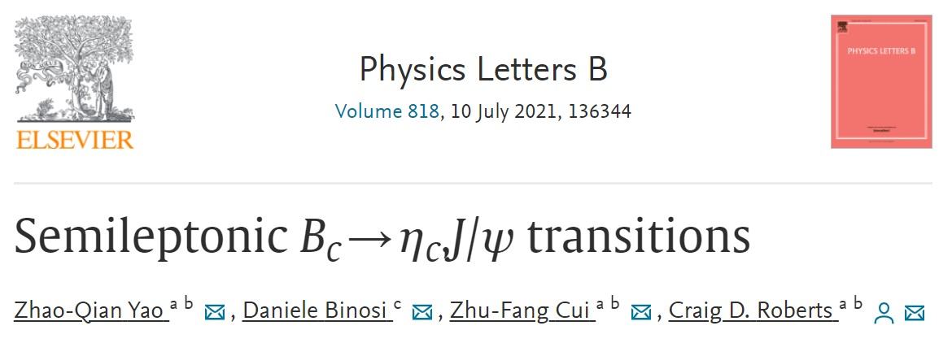
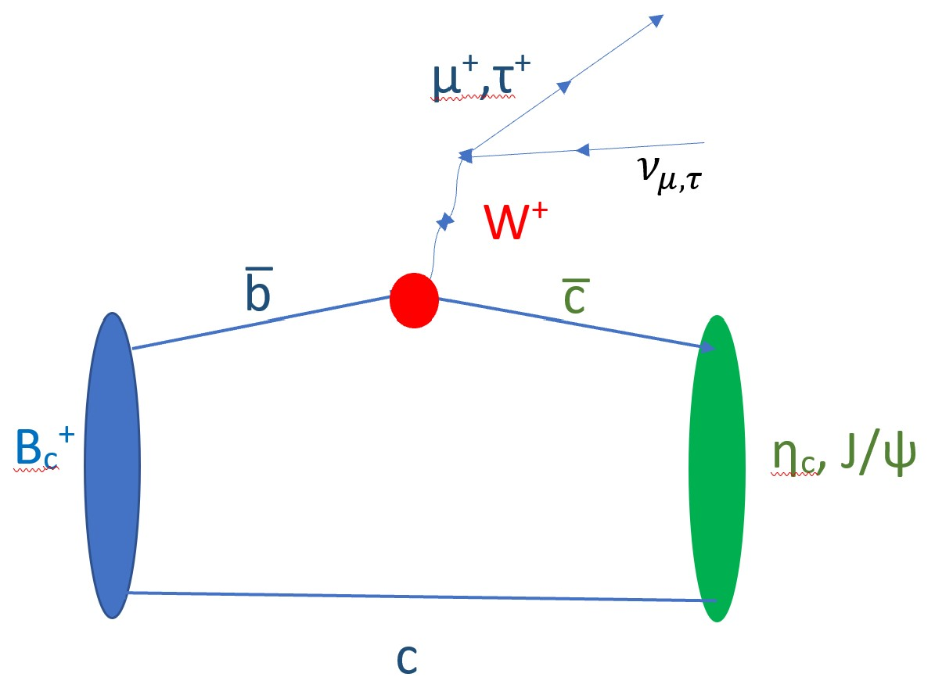

Slide 53
$B_{c}→η_{c}, J/ψ$ Transitions
Semileptonic B_{c} → η_{c} , J/ψ transitions, Zhao-Qian Yao, Daniele Binosi, Zhu-Fang Cui and Craig D. Roberts, Phys. Lett. B 818 (2021) 136344/1-7
B_{c} discovered twenty years ago
m_{Bc}= 6.2749(8) GeV ⇒ lies below threshold for B+D decay
open flavour state ⇒ electromagnetic decays are forbidden
Standard Model ⇒ only flavour-changing weak decays are possible
Consequently, B_{c} has a relatively long lifetime: 0.510(0) ps
These things make B_{c} especially interesting system
lightest open-flavour composite of Nature’s 2 heaviest quarks that are experimentally pliable
lives long enough to make measurements possible
Possible flavour-changing B_{c} weak decays involve one of following transitions
$\overline{b}→\overline{u}, \overline{b}→\overline{c}, c→s, c→d$
Specific entries in CKM matrix modulate strengths of these transitions
|V_{cs}| is largest of four here ⇒ $B_{c}→B_{s}$ dominates … confirmed by modern calculations

Slide 54
$B_{c}→η_{c}, J/ψ$ Transitions
Semileptonic B_{c} → η_{c} , J/ψ transitions, Zhao-Qian Yao, Daniele Binosi, Zhu-Fang Cui and Craig D. Roberts, Phys. Lett. B 818 (2021) 136344/1-7
Phase space also plays a role:
$η_{c}, J/ψ$final states phase space is more than 10-times larger than for $B$
such magnification can overwhelm the factor-6 suppression from |V_{cb}|/|V_{cd}|
Calculations of branching fractions ratio confirm this
Thus, not surprising that $B_{c}$ was discovered in $J/ψ$final states, especially given narrow, prominent decay width for $J/ψ→ℓ^{+}ℓ^{−}$
Data acquired in last decade, potentially indicating violations of lepton universality in b-quark decays, make studies of $B_{c}$ decays even more interesting
LHCb collaboration
Can be checked using modern CSM methods

Slide 55
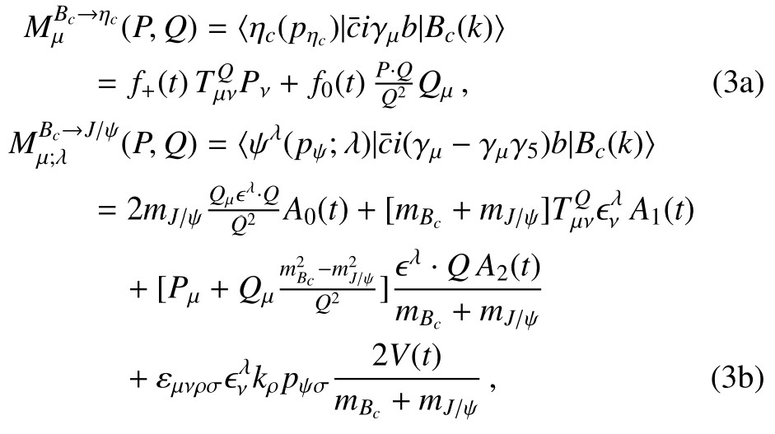
$B_{c}→η_{c}, J/ψ$ Transitions
6 form factors
to compute
2 for $η_{c}$ and 4 for $J/ψ$
5 distinct maximum recoil (t=0) values
Comparisons …
Recent continuum and lattice estimates
Evidently, different approaches produce a range of values
Nevertheless, all values within ∼ 20% of their respective mean.
Semileptonic B_{c} → η_{c} , J/ψ transitions, Zhao-Qian Yao, Daniele Binosi, Zhu-Fang Cui and Craig D. Roberts, Phys. Lett. B 818 (2021) 136344/1-7

Slide 56
$B_{c}→η_{c}$ Transitions
CSM compared with a preliminary lattice result from [Colquhoun:2016osw]
Few lattice points
Difference between these points & CSM curves = 10(3)%
lQCD values lie uniformly below CSM curves
No further information on $B_{c}→η_{c}$ is currently available from lQCD.
Therefore, ab initio CSM can be valuable in analysing future experimental data on the related transitions
Semileptonic B_{c} → η_{c} , J/ψ transitions, Zhao-Qian Yao, Daniele Binosi, Zhu-Fang Cui and Craig D. Roberts, Phys. Lett. B 818 (2021) 136344/1-7

Slide 57
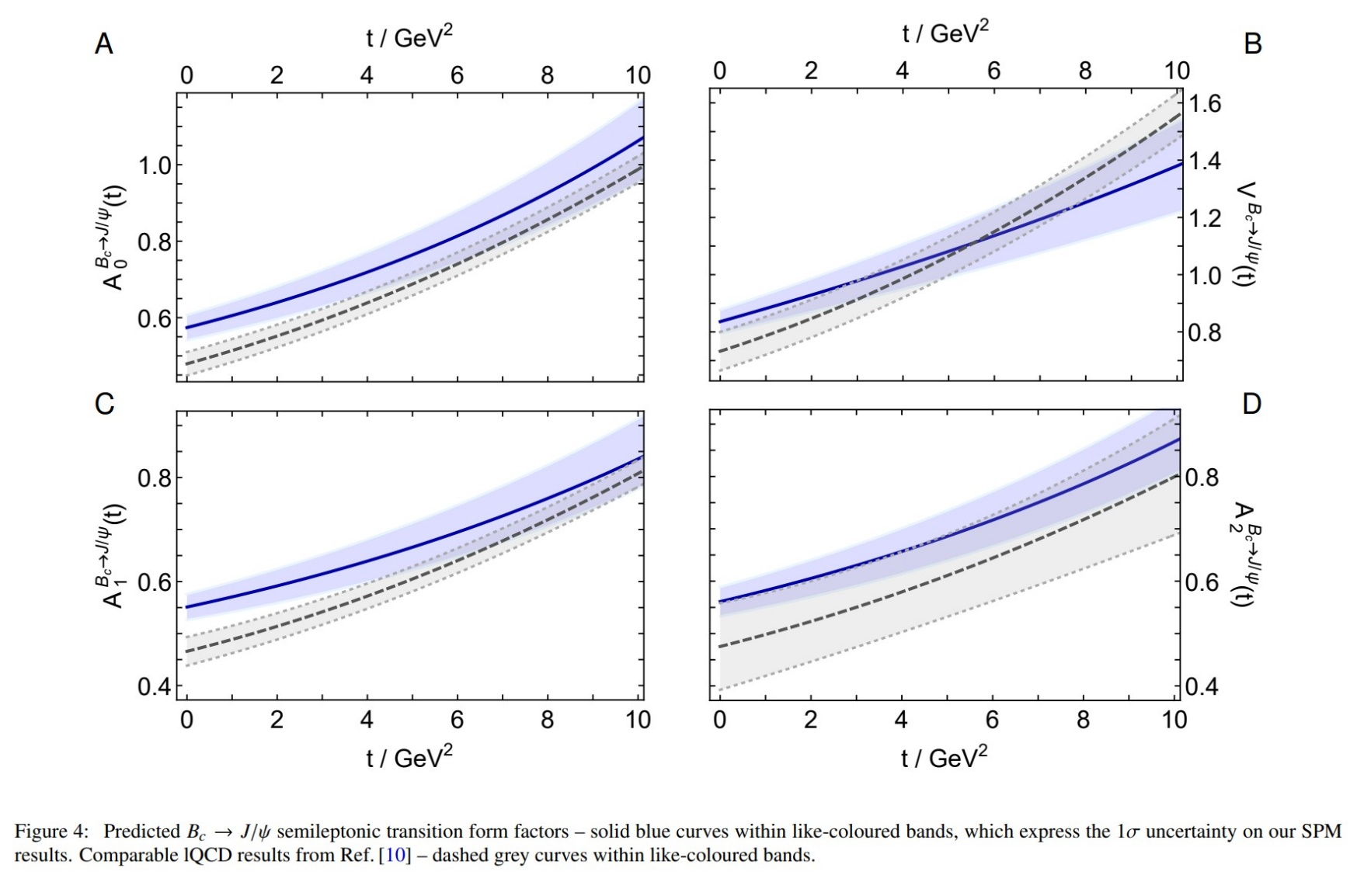
$B_{c}→J/ψ$ Transitions
CSM $B_{c}→J/ψ$transition form factors are depicted at right
Comparison with lQCD results [Harrison:2020gvo]
Minor qualitative differences, most notably concerning $V^{B_{c}→J/ψ}(t)$
Otherwise, semi-quantitative agreement.
CSM transition form factors can be used to reduce a dominant systematic error in extraction of $R_{J/ψ}$ from experiment
Improved precision and more stringent test of SM
Semileptonic B_{c} → η_{c} , J/ψ transitions, Zhao-Qian Yao, Daniele Binosi, Zhu-Fang Cui and Craig D. Roberts, Phys. Lett. B 818 (2021) 136344/1-7

Slide 58
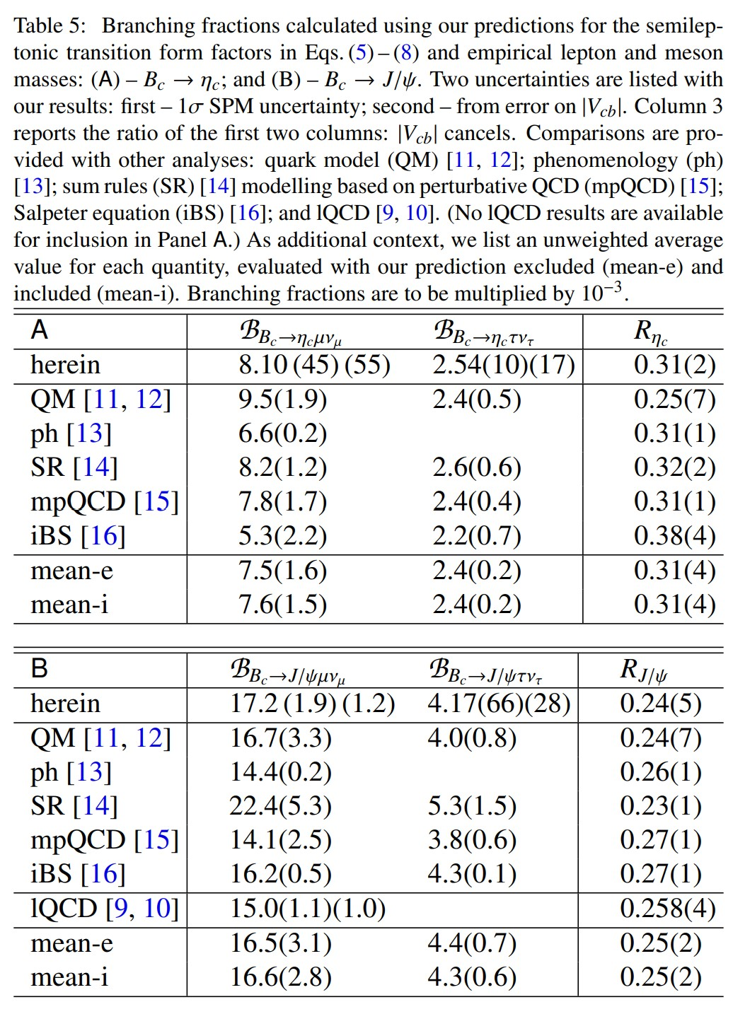
$B_{c}→η_{c}, J/ψ$ Transitions
CSM $R_{η_{c} }=0.31\left(2\right)$
“World Mean” $R_{η_{c} }=0.31\left(4\right)$
CSM $R_{J/ψ }=0.24\left(5\right)$
“World Mean” $R_{J/ψ }=0.25\left(2\right)$
LHCb
Predictions using CSMs confirm $2σ$ discrepancy between LHCb (too high) and SM

Slide 59
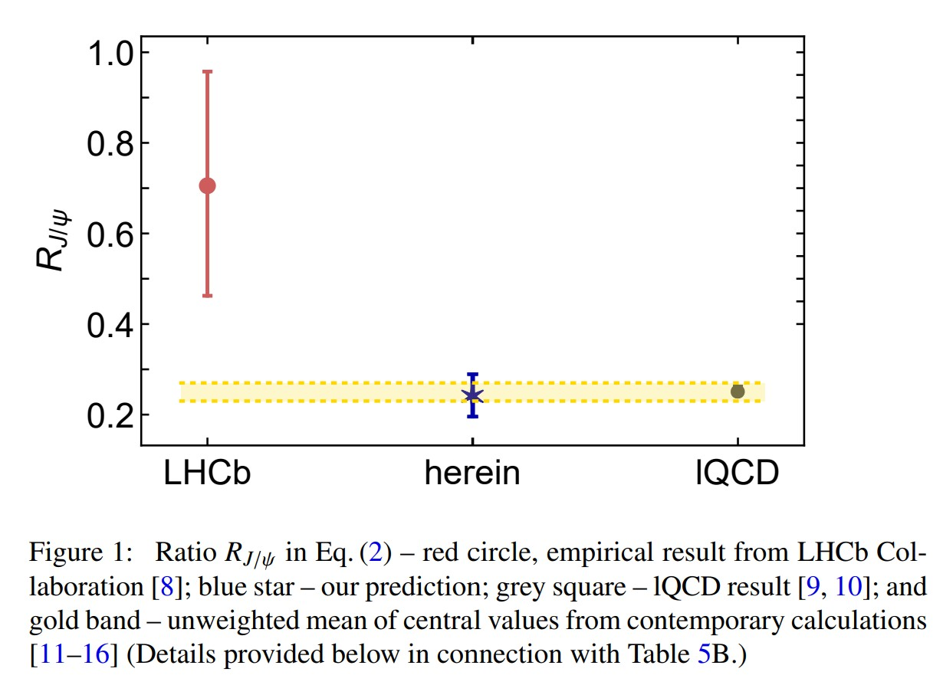
$B_{c}→η_{c}, J/ψ$ Transitions
Contemporary Standard Model calculations of $R_{J/ψ }$are in agreement.
Combined (mean of central values)
$R_{J/ψ }$= 0.253(16)
approximately 2σ below the sole empirical
result [LHCb 2017].
If subsequent, precision experiments don’t lead to a substantially lower central value then may conclude that lepton flavour universality is violated in semileptonic $B_{c}→J/ψ$decays.
However, precision of existing empirical information is insufficient to support such a claim.
Moreover, compelling case only after including information on semileptonic $B_{c}→η_{c}$ transitions
Similar statements hold in connection with $R_{D_{(s)}^{(∗)} }$ratios,
which follow patterns very similar to those in $B_{c}→η_{c}, J/ψ$

Slide 60
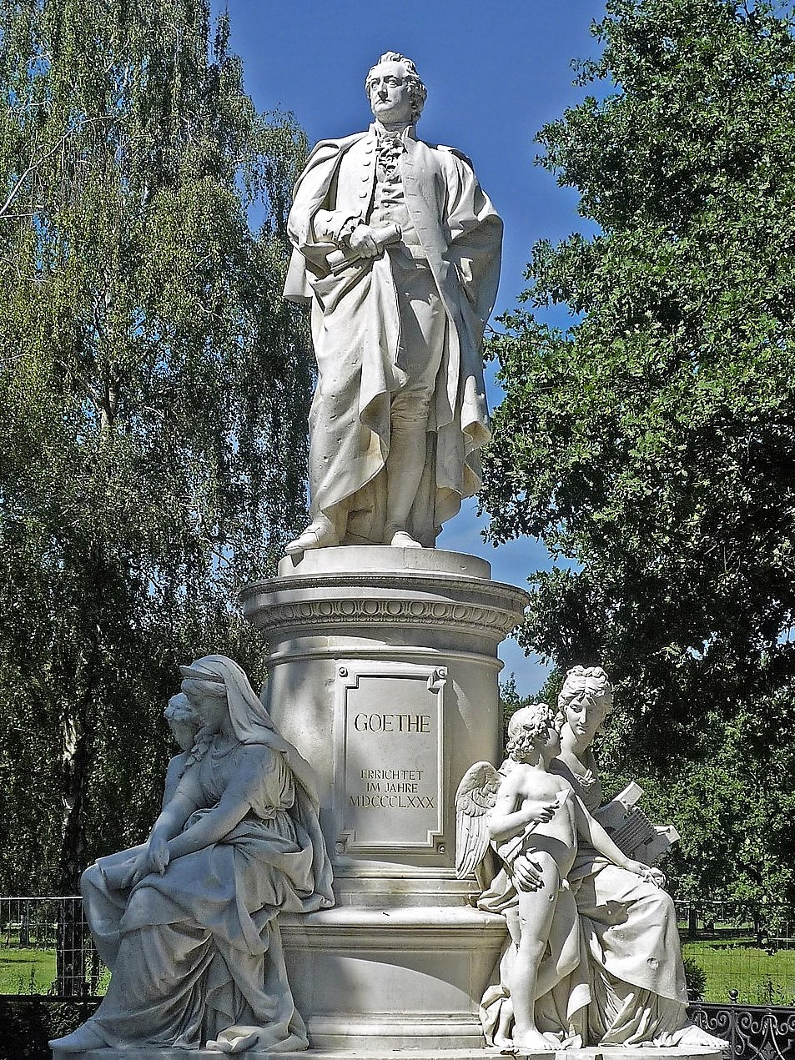
Epilogue

Slide 61
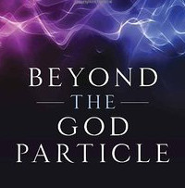
Epilogue
Nature has two sources of mass
Higgs mass-generating mechanism
= understood as a phenomenology
Physics and Dynamics of Emergent Hadron Mass
= much to learn
EHM (probably?) lies within the SM, i.e., in strong QCD
Basic predictions:
Gluons acquire mass ⇒ running coupling saturates on infrared domain, restoring approximate conformal behaviour
Studying evolution of hadron properties with current-quark mass is clear window onto constructive interference between Nature’s two sources of mass
This is a new feature of flavour physics, which adds enormously to its role in searching for physics beyond the Standard Model

Slide 62
$${\text{L}}_{Nature}= ?$$
There are theories of many things,
But is there a theory of everything?
Thankyou

