Slide 1
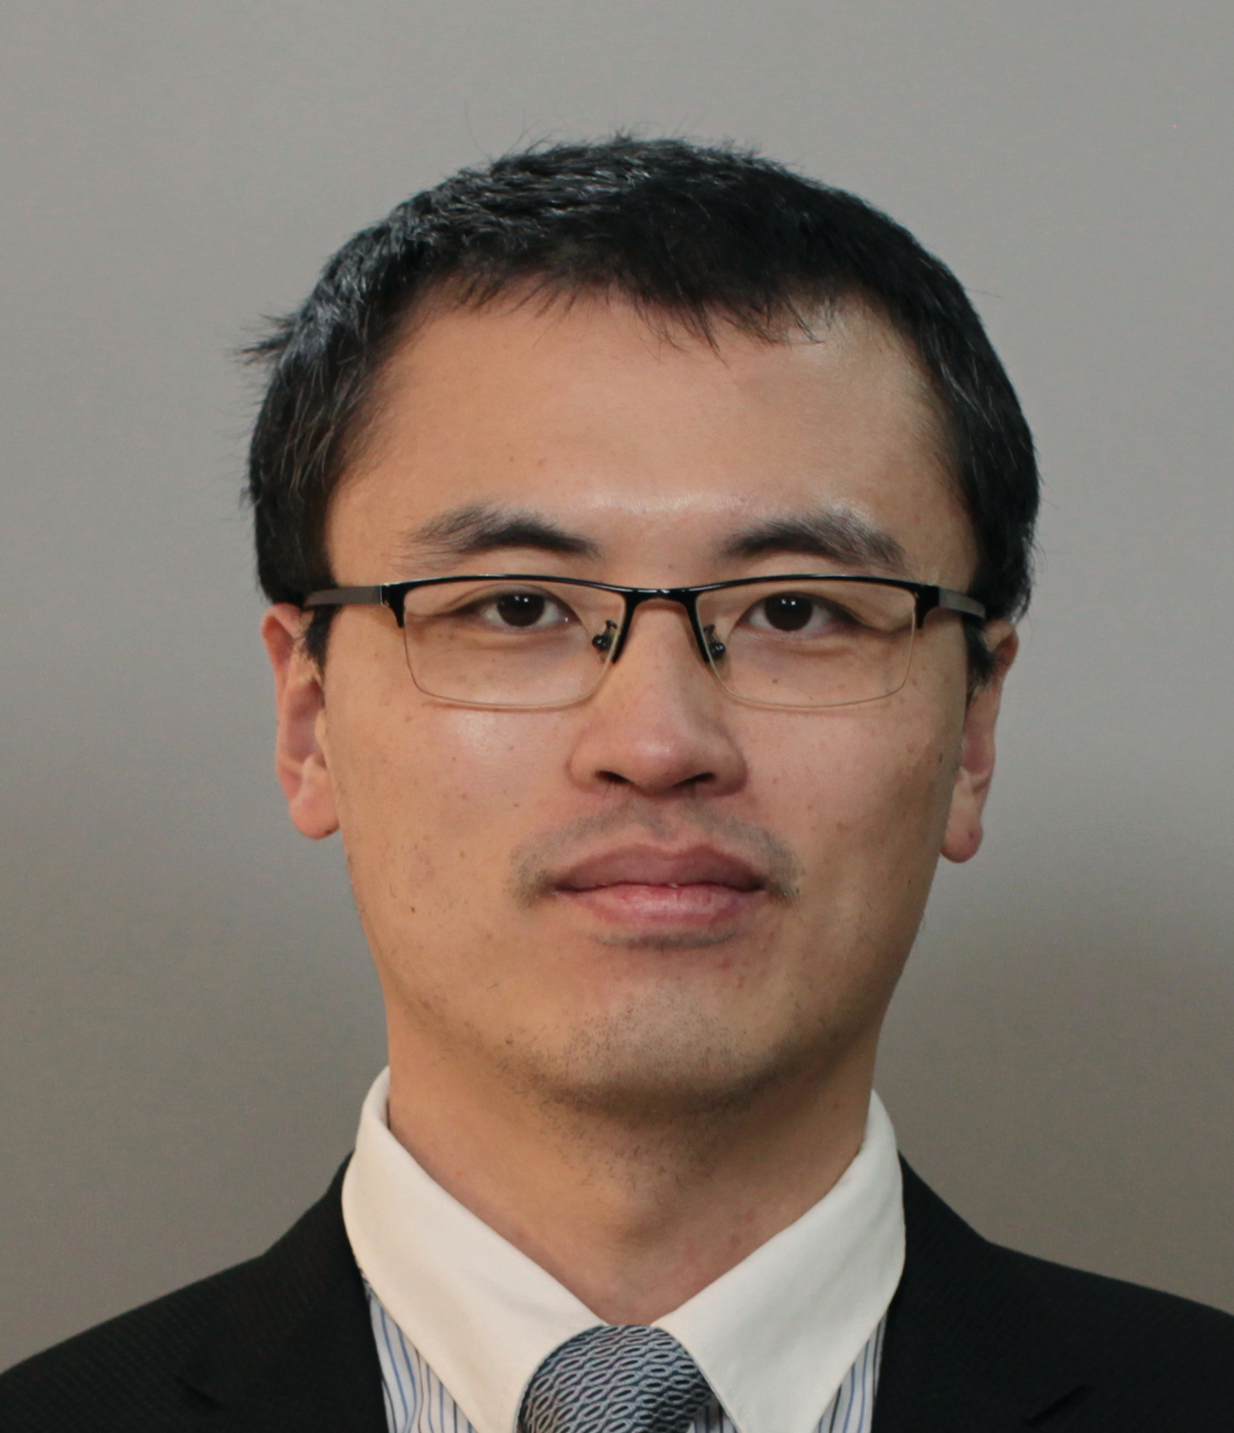
Quantum Hall Effect: Composite Fermions and Phase Transitions
报告人：吴英海副教授，华中科技大学
时间：2023年10月17日下午13:30
地点：海纳苑8幢319教室
报告摘要
报告人简介
Quantum Hall states are prototypical examples of topological phases. They were initially discovered in two-dimensional electron gases and have generated widespread interest in many other areas. The advances in cold atoms create novel settings for studying topological states. The constituents of quantum gases can be different types of bosons, fermions, and their mixtures. We propose a class of symmetry-protected topological states in two-dimensional Bose-Fermi mixtures using the composite fermion theory. These states have no fractionalized excitations but possess gapless edge states. In certain continuum and lattice models, we can induce continuous quantum phase transitions between these states and some fractional quantum Hall states by tuning the inter-species interaction. The critical theory of these transitions are Chern-Simons-Higgs field theory in which the condensation of a scalar boson field leads to “locking” of a pair of emergent gauge fields.
Ying-Hai Wu obtained his bachelor degree from Department of Modern Physics of University of Science and Technology of Chain in 2009, he then studied at the Pennsylvania State University under the supervision of Prof. Jainendra Jain and obtained his Ph.D. degree in 2014. He was a postdoc research in the theory group of Max Planck Institute of Quantum Optics during 2014 and 2017. He has been an associate professor in School of Physics of Huazhong University of Science and Technology. His main research areas are strongly correlated topological states and quantum impurity systems. He has published about 30 papers in peer-reviewed journals.

