Slide 1
Detecting Quadratically Coupled Ultra-light Dark Matter with Stimulated Annihilation
第十七届 $TeV$ 工作组学术研讨会
2023. 12.15- 12.19 南京
汇报人：龚远林
合作者：刘鑫, 武雷, 杨峤立, 祝斌
Base on: arXiv:2308.08477
New physics Group In Nanjing Normal Univ.

Slide 2
01
Introduction
02
Stimulated Annihilation
目录
Bose enhancement
Signal power
CONTENTS
03
Local Halo
Iso-thermal halo
Caustic ring model
Earth/Sun halo
04
Result and Summary

Slide 3
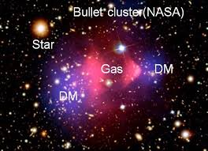
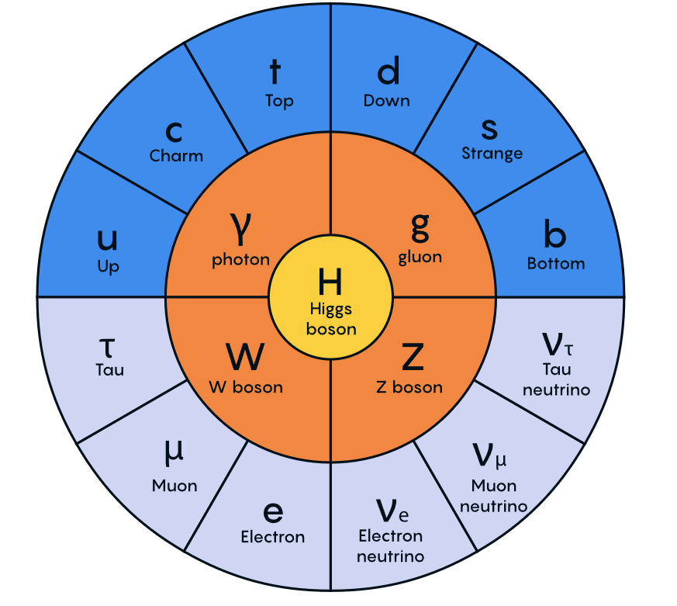
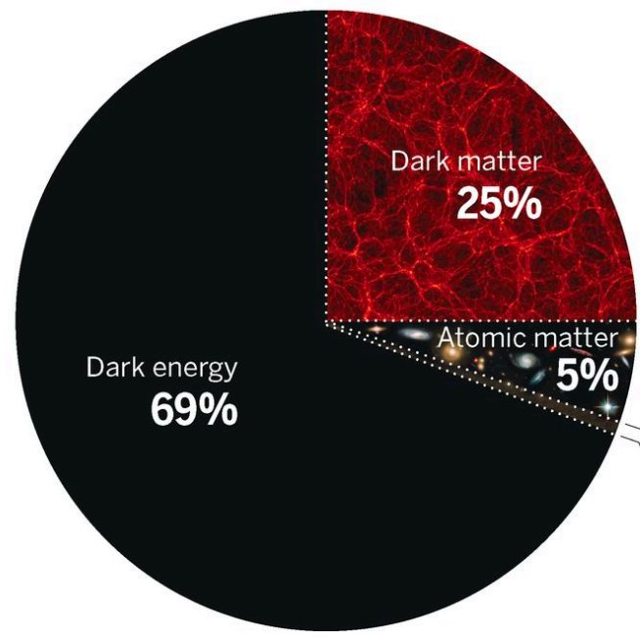
Introduction
Dark Matter
Standard Model
New physics ?
?

Slide 4
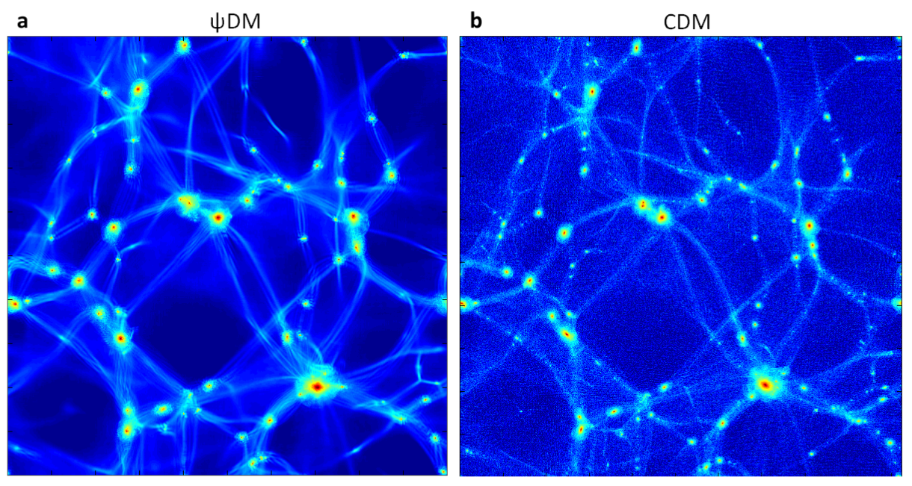
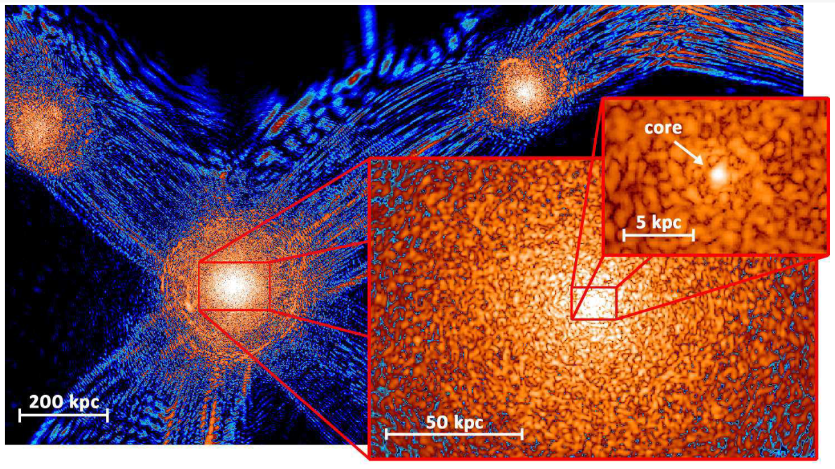
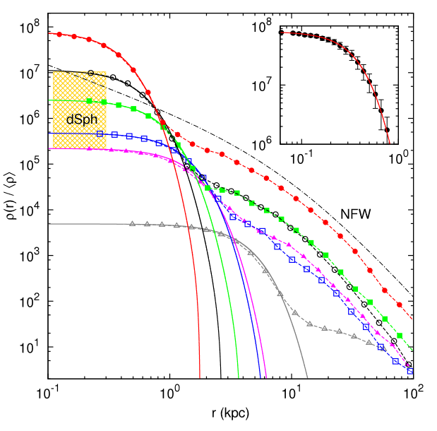
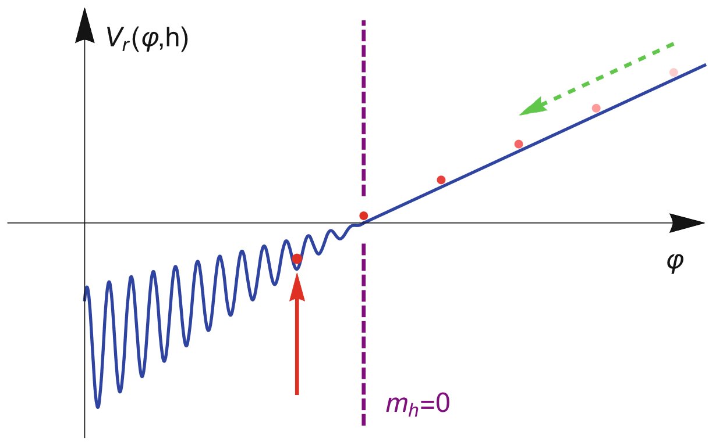
Introduction
Ultra-light Dark Matter
Schive, Chiueh, Broadhurst, 1406.6586
Small Scale Problem
Core-cusp problem
Comparison of cosmological large-scale structures formed by standard CDM and by wavelike DM
A slice of density field of wave DM simulation
Radial density profiles of haloes formed in the wave DM model
Higgs Naturalness Problem
During inflation, the Hubble friction of relaxion $φ$ makes it “slowly rolls down”, where spontaneous symmetry breaking of Higgs h occurs and eventually $φ$halts by the periodic potential and $m_{h}$ settles at
$$m_{h}\sim 125 GeV≪M_{Pl}$$
dynamical solution to the hierarchy problem
Strong CP Problem, String theory…
Peter W. Graham et al, Phys. Rev. Lett. 115 (2015) 22, 221801
Jackson Kimball et al, The Search for Ultralight Bosonic Dark Matter
Notes:
Panel (a) shows the structure created by evolving a single coherent wave function for ΛψDM calculated on AMR grids. Panel (b) is the structure simulated with a standard ΛCDM N-body code GADGET-212 for the same cosmological parameters, with the high-k modes of the linear power spectrum intentionally suppressed in a way similar to the ψDM model to highlight the comparison of large-scale features. This comparison clearly demonstrates that the large scale distribution of filaments and voids is indistinguishable between these two completely different calculations, as desired given the success of ΛCDM in describing the observed large scale structure. ψDM arises from the low momentum state of the condensate so that it is equivalent to collisionless CDM well above the Jeans scale.
This scaled sequence (each of thickness 60 pc) shows how quantum interference patterns can be clearly seen everywhere from the large-scale filaments, tangential fringes near the virial boundaries, to the granular structure inside the haloes. Distinct solitonic cores with radius ∼ 0.3 − 1.6 kpc are found within each collapsed halo. The density shown here spans over nine orders of magnitude, from 10−1 to 108 (normalized to the cosmic mean density). The color map scales logarithmically, with cyan corresponding to density . 10.
Dashed lines with various symbols show six examples of the halo profiles normalized to the cosmic mean density. All haloes are found to possess a distinct inner core fitted extremely well by the soliton solution (solid lines).

Slide 5
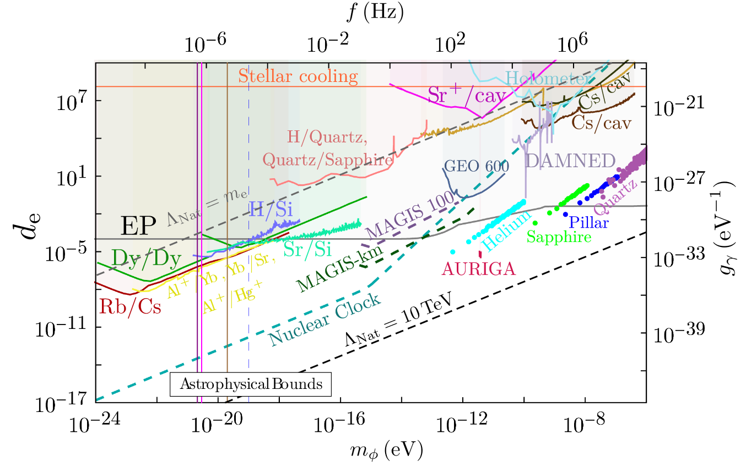
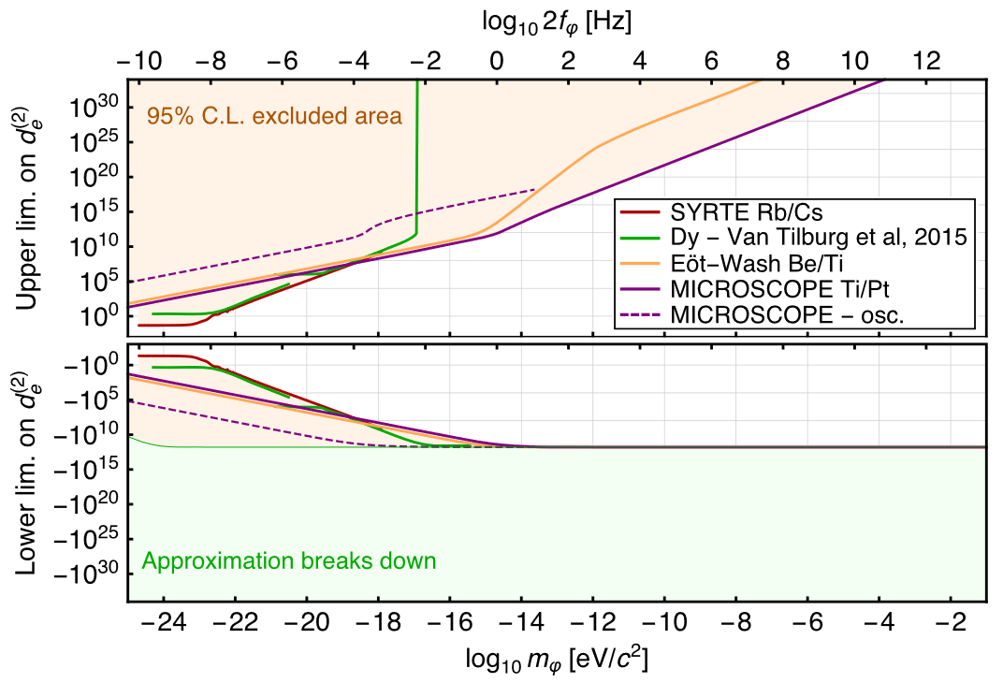
Introduction
Scalar ULDM
Interaction portal
Linear
Quadratic
Variation of the constant
Experiment search
$$φ≈φ_{0}cos⁡(m_{φ}t)$$
Atomic clock, Atomic interferometer, EP tests$……$
$$φ_{0}=\frac{\sqrt{2ρ_{0}}}{m_{φ}}$$
$Local density ρ_{0}$
Snowmass2021. 2203.14915
A. Hees et al. 1905.08524
Beyond $ρ_{0}=0.\text{3 }\text{GeV}\text{/}{cm}^{3}$?
More exploration on Quadratic interaction ?
T. Damour et al, CQG 27, 202001 (2010),
PRD 82, 084033 (2010).
Y. V. Stadnik et al, PRL. 115, 201301 (2015).
Notes:
The sensitivity of EP violation tests is characterized in terms of
the differential acceleration a between two test bodies A and B
in the presence of a source C, and takes the following form

Slide 6
Introduction
Why quadratic ?
Problem with quadratic
$$−\frac{φ}{Λ_{ }}$$
$$ℒ_{lin}=\frac{φ}{Λ_{ }}𝒪_{SM}$$
$$ℒ_{quad}=\frac{φ^{2}}{Λ_{ }^{2}}𝒪_{SM}$$
Cutoff-suppression
Screen—— might be screened at the surface of a central body
A. Hees et al. 1807.04512
Necessity for quadratic
1, Domination under $Z_{2}$ symmetry
$$ℒ_{lin}=\frac{φ}{Λ_{ }}𝒪_{SM}$$
$$ℒ_{quad}=\frac{φ^{2}}{Λ_{ }^{2}}𝒪_{SM}$$
$$φ→−φ$$
2, Domination under technically-Natural Models
Abhishek Banerjee et al. 2211.05174
3, Even parity
$φ^{2}$ is of even parity in $φ$
$$⇒$$
$φ$ can represent either a scalar or pseudoscalar particle
4, $d_{e}^{\left(2\right)}∝ρ$ but not $d_{e}^{\left(1\right)}∝ρ^{1/2}$
Notes:
We require that these theories are natural in the sense that there is no fine-tuning in order to achieve, such hierarchies between the small values of the linear coupling compared to the relatively large values of the quadratic coupling

Slide 7
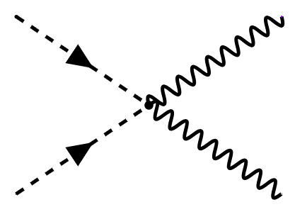
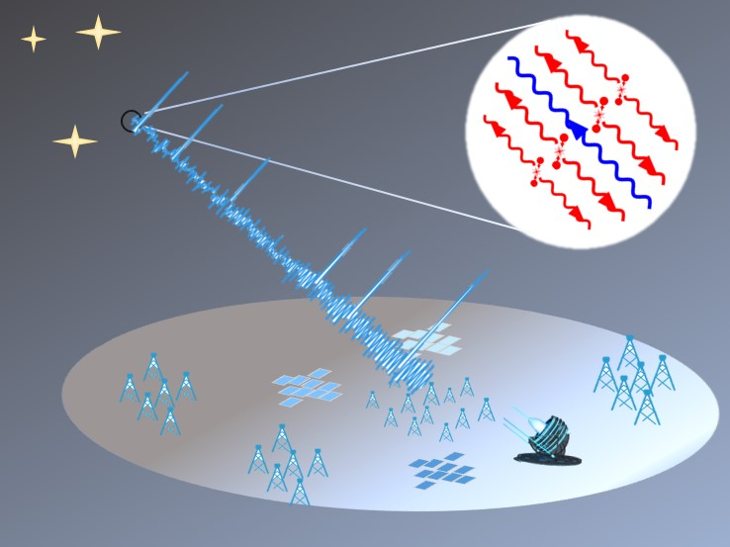
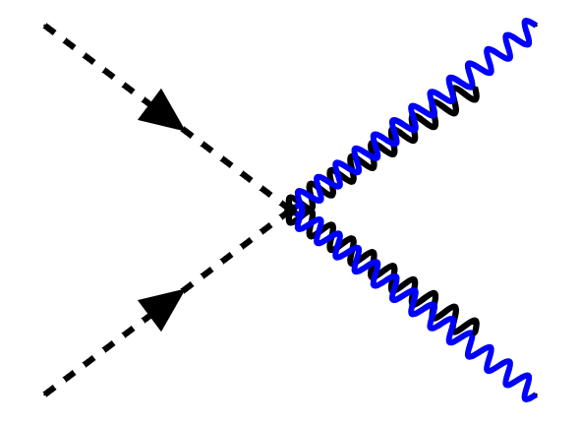
Stimulated Annihilation
Quadratic interaction
$$φ$$
$$γ$$
$$σ_{0}=\frac{1}{32π}\frac{1}{β}g^{′2}m_{φ}^{2}$$
$$φ$$
$$γ$$
Spontaneous Annihilation
Bose Enhancement
$$Outgoing radiation$$
Reflected photon
$σ_{eff}∝2 f_{γ}^{ } σ_{0}$
Stimulated Annihilation
Y. G, Xin Liu, Lei Wu, Q. Yang and Bin Zhu, arXiv:2308.08477

Slide 8
Research progression
Bose enhancement
Consider the process:
$$φ_{p_{1}} +φ_{p_{2}} ↔γ_{p_{3}} +γ_{p_{4}}$$
Annihilation rate of $φ$ reads:
$ℳ_{0}$ spontaneous amplitude
$dΠ_{i}=\frac{g_{i}}{{\left(2π\right)}^{3}}\frac{d^{3}p}{2 E_{i}}$ phase space volume
$f_{i}$ the phase space number(distribution)
$$1+f_{γ}≫1$$
Bose enhancement:
Scott Dodelson et al, Modern Cosmology, 2nd
Y. G, Xin Liu, Lei Wu, Q. Yang and Bin Zhu, arXiv:2308.08477

Slide 9
Stimulated Annihilation
Effective Amplitude
Spontaneous Annihilation
$$M=𝓜_{0}^{2}(f_{φ}^{2}\left(1×1\right)−(1×1×0×0))$$
$$⇒𝓜_{0}^{2}f_{φ}^{2}×1$$
$$2f_{γ}$$
Stimulated annihilation
$$M=𝓜_{0}^{2}\left(f_{φ}^{2}{\left(1+f_{γ}\right)}^{2}−{\left(1+f_{φ}\right)}^{2}f_{γ}^{2}\right)$$
$=𝓜_{0}^{2}\left(f_{φ}^{2}+2f_{γ}f_{φ}^{2}−2f_{φ}f_{γ}^{2}−f_{γ}^{2}\right)$
Spontaneous ann.
Inverse spontaneous ann.
Stimulated ann.
Inverse stimulated ann.
$$\underset{⇒}{f_{φ}≫f_{γ}}ℳ_{0}^{2}f_{φ}^{2}\left(2f_{γ}+1\right)$$

Slide 10
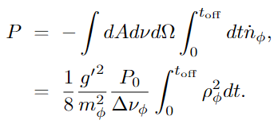
Stimulated Annihilation
Flux and Power
Production rate of photon number density :
$${\dot{n}}_{γ}=−{\dot{n}}_{φ}=4βn_{φ}^{2}σ_{0}(1 + 2f_{γ})$$
Given $S=n⋅c$, $P=∫SdAdν$:
Distinctive feature:
$$P∝ρ^{2}, P_{0}, t_{off}$$
Power of the outgoing wave
$$P_{0}=∫dAdνdΩn_{γ}$$
$Δν_{φ}$ Bandwidth of signal
$Δν_{φ}=2σ_{v}ν_{φ}$
$$σ_{v}$$
Velocity dispersion
$t_{off}$ working time of the emitter

Slide 11
$\text{Stimulated}$Annihilation
Impact from the ULDM motion
$$P∝\int_{0}^{t_{off}}{ρ_{φ}^{2}}dt$$
Cold ULDM pair:
Emitter
outgoing wave ${\vec{k}}_{0}$
$$2φ$$
$${\vec{k}}_{0}$$
$${\vec{k}}_{0}+{\vec{k}}_{−}=0$$
2R
$$P_{0}$$
$$P_{ }$$
Direction of the $Reflected photon$
Tele.
$$reflected photon$$
$${\vec{k}}_{−}$$
$${\vec{k}}_{−}=−{\vec{k}}_{0}$$
ULDM pair with $\vec{v}$:
Emitter
outgoing wave ${\vec{k}}_{0}$
$$2φ$$
$${\vec{k}}_{0}+{\vec{k}}_{−}=m{\vec{v}}_{1}+m{\vec{v}}_{2}=m\vec{v}$$
$${\vec{k}}_{0}$$
$$P_{0}$$
$$ω_{0}+ω_{−}=2m+𝒪(v^{2})$$
2R
$$θ$$
$${\vec{k}}_{−}$$
Direction of the $Reflected photon$
$$P_{ }$$
$$m\vec{v}$$
$${\vec{k}}_{−}≈−{\vec{k}}_{0}+m{\vec{v}}_{⊥}$$
Tele.
$$reflected photon$$
$$m{\vec{v}}_{⊥}$$
$⇒$ Effective collecting time: $t_{off} → t_{eff}∝\frac{R}{v_{⊥}}$
$$t_{eff}<h_{iono}=\frac{48 km}{c}$$
Impact from the Ionosphere
Can be ignored
Notes:
4-momentum conservation (laboratory reference system)

Slide 12
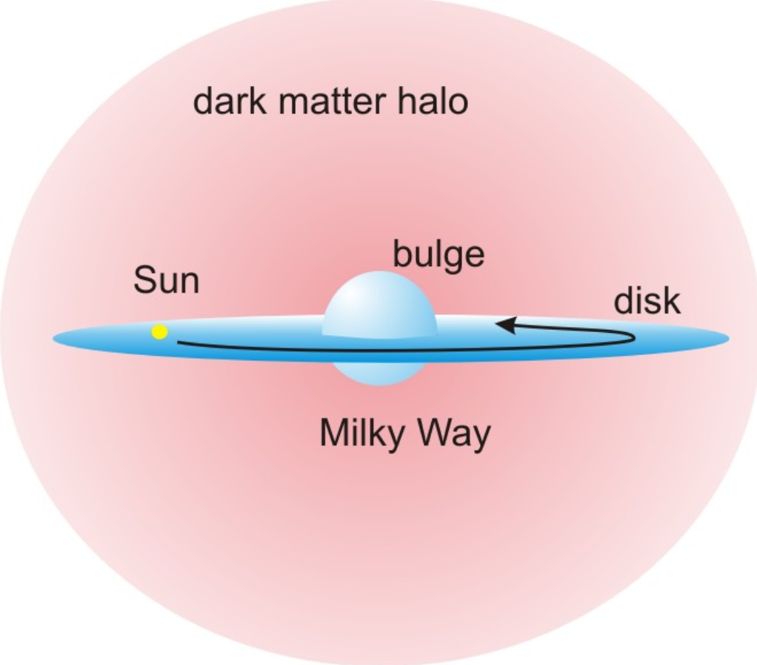
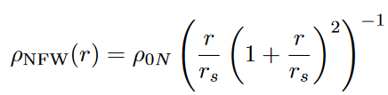
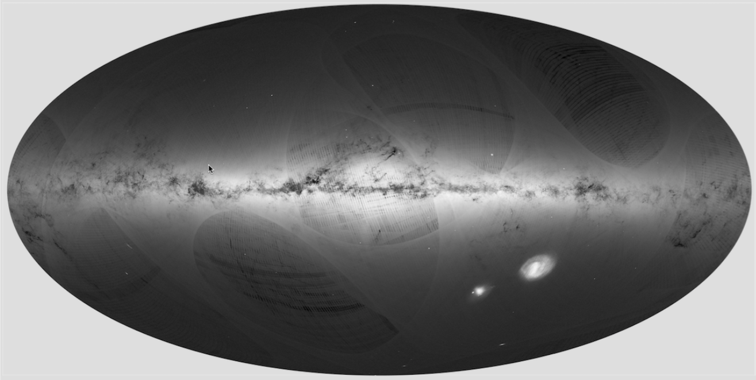
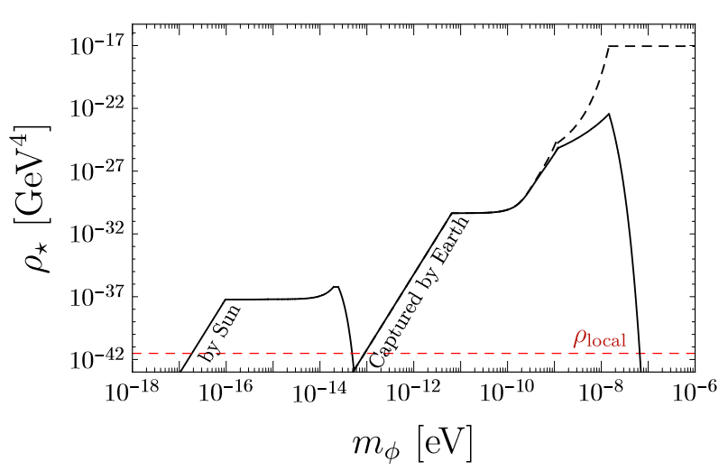
Local Halo
Iso-thermal Halo
$$ρ_{0}=0.\text{3 }\text{GeV}\text{/}{cm}^{3}$$
Base N-body Simulation
Local density
Density profile
M.S. Turner, Phys. Rev. D33 (1986) 889
Velocity dispersion
$$σ ≡ \sqrt{\left\langle \vec{v}⋅\vec{v} \right\rangle }/\sqrt{3}≃ 270/\sqrt{3}km/s$$
Caustic ring model
Base Triangular features
$→$ Density is dominated by the Big Flow
Local density
$$ρ_{0}=1−10 \text{GeV}\text{/}{cm}^{3}$$
L. D. Duffy and P. Sikivie, 0805.4556
Velocity dispersion
S. S. Chakrabarty, Y. Han, A. H. Gonzalez, P. S 2007.10509
$$σ<70 m/s$$
Earth halo and Sun halo
Triangular features in the Gaia skymap
Base ① numerical simulations of galaxy formation for fuzzy DM
② Quartic self-interactions + stimulated Capture
Density distribution
Velocity dispersion
$$σ=R_{⋆}/m_{φ}$$
Schive et al, 1406.6586
J. Veltmaat et al, 1804.09647, 1911.09614
Density $ρ_{⋆}$ of halo at $r=R_{e}$(Solid line) , $r=0$(dashed line)
Banerjee et al.1902.08212
Notes:
这个区域其他恒星的距离和旋转速度。另外，关于怎样精确确定银河系中恒星分布的方法也没有共识，使得问题更为复杂。在许多关于银河系内部暗物质的研究中，通常是选择-一个重子物质形态分布的模型,从而得到的结果可能是模型依赖的。因此，到现在为止，尽管有很多理论研究和观测的进步，银河系暗物质轮廓图依然未受实质限制。

Slide 13
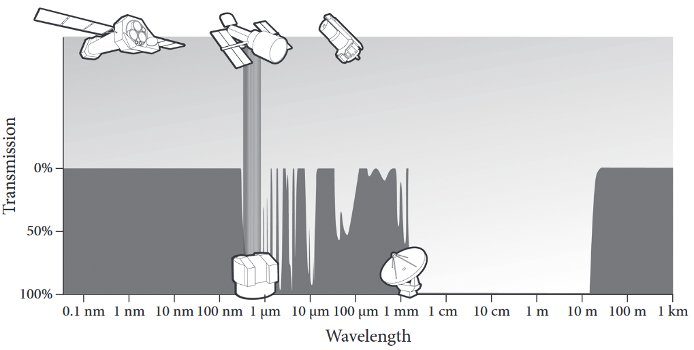
Result
LOFAR(The LOw-Frequency ARray)
Why LOFAR？
frequency
$$P∝\frac{1}{m_{φ}^{2}} , ρ^{2}$$
$12.3×10^{−8}$ eV=
30 MHz
10 MHz
=$4.1×10^{−8}$ eV
Total stations: 48
Each station:
Low-band antennas (LBA): 10—80 MHz
High-band antennas (HBA): 110—240 MHz
Element:
Dipole antennas
arXiv:1305.3550
https://doi.org/10.1016/j.asr.2018.06.047

Slide 14
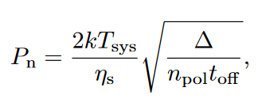
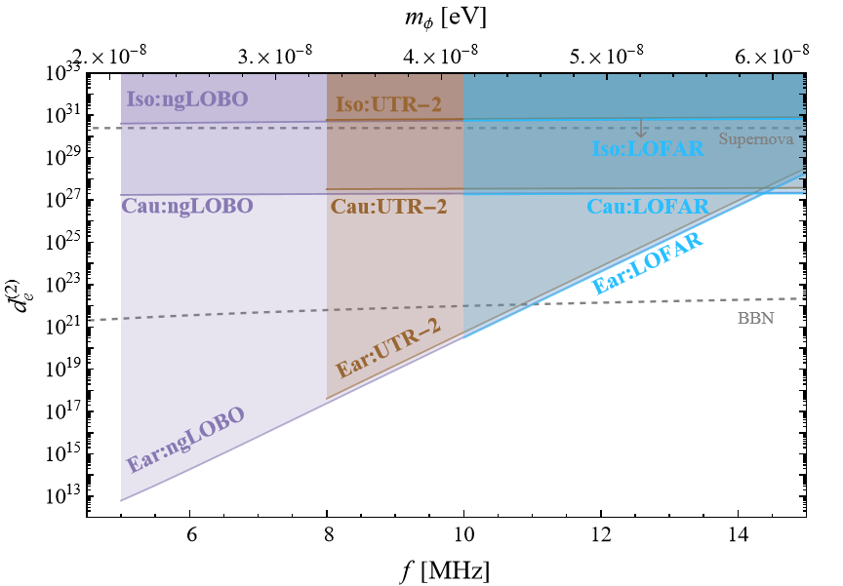
Result
Sensitivity
The noise
$$T_{sys}=T_{galactic}+T_{instr}+T_{CMB}+…$$
$T_{galactic}=1.23×{10}^{8}$ K ${\left(\frac{MHZ}{ν}\right)}^{2.55}$
$η_{s}=1$is the system efficiency
$n_{pol}=1 or 2$ is the number of polarization
The emitter and telescope
We set $P_{0}$= 50 MW and R = 50 m
Result
By requiring $P>P_{n}$, we have

Slide 15
Summary
Scalar ULDM is a well-motived DM candidate
Quadratic interaction with photon is largely unexplored
With Bose enhancement, we show that the stimulated Annihilation can enhance the annihilation signal
Base on the LOFAR, ngLOBO, UTR-2, we estimated the noise and get the projected limit for three different halos.

Slide 16
New physics Group In NNU
感谢您的垂听并期待宝贵意见!
第十七届 $TeV$ 工作组研讨会
23.12.16 南京

Slide 17
Backup Slides

Slide 18
Introduction
Higgs Naturalness Problem and Relaxion
Potential
mass term
periodic potential
During inflation, relaxion $φ$ evolve (down) in time
with Hubble friction term
$$=⇒$$
Effective mass $m_{h}$ of the Higgs $h$
evolve with $φ$
When $φ≤Λ/g$
Higgs $h$ spontaneous symmetry breaking occurs
e.g. $V=−\frac{1}{2}\left(Λ^{2}−gΛφ\right){\left|h\right|}^{2}+λ{\left|h\right|}^{4}$
$=⇒\left\langle h\right\rangle =\sqrt{\frac{\left(Λ^{2}−gΛφ\right)}{4λ}}$
The relaxion field $φ$ starts at a relatively large value (shown by the faded red dots) and then “slowly rolls” down the potential (as indicated by the green dashed arrow), decreasing in amplitude, which in turn decreases $m_{h}$
relaxion $φ$ evolve down in time, $⟨h⟩$ evolve up
$$=⇒$$
periodic potential evolve up
Due to Hubble friction, $φ$ “slowly rolls down” and eventually halts by the periodic potential and $m_{h}$ settles at
P. W. Graham et al, Phys. Rev. Lett. 115 (2015) 22, 221801
$$m_{h}\sim 125 GeV≪M_{Pl}$$
J. R. Espinosa et al, Phys. Rev. Lett.115 (2015) 25, 251803
Jackson Kimball et al, The Search for Ultralight Bosonic Dark Matter

Slide 19
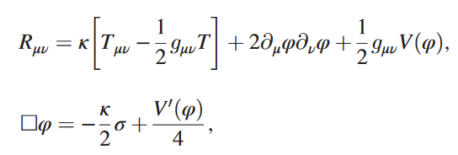
Introduction
Screening mechanism
A. Hees et al. 1807.04512
We assume that the field $φ$ is coupled to the light SM matter as
where $κ= 8πG/c^{4}$, $R$ is the Ricci scalar of the space-time metric $g_{μν}$, $φ$ is a dimensionless scalar field, standard model fields is $Ψ_{i}$
The field equations
Modeling $Ψ_{i}$as
spherically symmetric extended bodies that will be characterized by a radius $R_{A}$ and by a constant matter density $ρ_{A}$
At the Minkowskian order, with $T_{μν}= c^{2}ρu_{μ}u_{ν}$

Slide 20
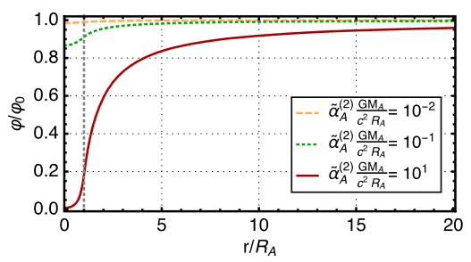
Introduction
screening mechanism
A. Hees et al. 1807.04512
The equation for the scalar field
The time-dependent solution
with the effective scalar charge
When ${\tilde{α}}_{A}^{(2)} >0$, there are parameter spaces give

Slide 21
Introduction
Quadratic interactions of a light relaxed-relaxion
Abhishek Banerjee et al. 2211.05174
We assume that the field $φ$ is coupled to the light SM matter as
a linear complex field $Φ=\left(ρ+f\right)exp⁡(\frac{iφ}{f})$, with charge conjugation $Φ→−Φ^{∗}$
UV completion
1-loop potential of φ,
The overall potential for φ can be written as
Relaxion mechanism
$\hat{H}$ belongs to a new hidden sector whose mass is being relaxed from some cut-off $Λ$ to its true vacuum expectation value$\hat{v}$.

Slide 22
Introduction
Quadratic interactions of a light relaxed-relaxion
Abhishek Banerjee et al. 2211.05174
The overall potential for $φ$ can be written as
Relaxion mechanism
we find the field stopping point as
Around the stopping point of $φ$ gives rise to linear and quadratic couplings of φ to the SM as
$$δ_{π/2}≪1$$

Slide 23
Stimulated Annihilation
Bose enhancement
Consider a process:
$$φ_{p_{1}} +φ_{p_{2}} ↔γ_{p_{3}} +γ_{p_{4}}$$
Variation of number density $n_{1}$ reads:
$H$ Hubble constant
$dΠ_{i}=\frac{g_{i}}{{\left(2π\right)}^{3}}\frac{d^{3}p}{2 E_{i}}$ phase space volume.
$ℳ$ Amplitude
$f_{i}$ : the phase space distribution
Where, $±$: applies to bosons(fermions)
Bose enhancement:
$$1+f_{γ}≫1$$
Scott Dodelson et al, Modern Cosmology, 2nd

Slide 24
Stimulated Annihilation
Bose enhancement
$$φ+φ→γ+γ$$
$$H_{int}=ℳ{\hat{a}}_{γ}^{+}{\hat{a}}_{γ}^{+}a_{φ}a_{φ}+h.c.$$
spontaneous Annihilation
Stimulated Annihilation
Initial state
$f_{φ}$ ULDMs with a particular momentum
$$\left|i\right\rangle =\left|f_{φ};f_{φ};0;0\right\rangle$$
final state
$f_{φ}−2$ ULDMs and $2$ photons each with the specific momentum and polarization
$$\left|f\right\rangle =\left|f_{φ}−1;f_{φ}−1; 1; 1\right\rangle$$
Creation and annihilation operators
$a_{φ}\left|f_{φ}\right\rangle =\sqrt{f_{φ}}\left|f_{φ}−1\right\rangle ,a_{φ}^{+}\left|f_{φ}\right\rangle =\sqrt{f_{φ}+1}\left|f_{φ}+1\right\rangle$
$a_{γ}\left|f_{γ}\right\rangle =\sqrt{f_{γ}}\left|f_{γ}−1\right\rangle , a_{γ}^{+}\left|f_{γ}\right\rangle =\sqrt{f_{γ}+1}\left|f_{γ}+1\right\rangle$
Initial state
$f_{φ}$ ULDMs with a particular momentum, $f_{γ}$ photons with the same momentum as the photons produced by the spontaneous annihilation
$$\left|i\right\rangle =\left|f_{φ};f_{φ};f_{γ};f_{γ}\right\rangle$$
final state
$\left|f\right\rangle =|f_{a}−1;f_{γ}+1;f_{γ}+1⟩$
Creation and annihilation operators
Same as the former

Slide 25
Stimulated Annihilation
Bose enhancement
$$i→f$$
$$φ+φ→γ+γ$$
$$H_{int}=M^{+}{\hat{a}}_{γ}^{+}{\hat{a}}_{γ}^{+}a_{φ}a_{φ}+h.c.$$
Spontaneous Annihilation
Amplitude $i→f$:
$$M_{i→f}=\left\langle f_{φ}−1;f_{φ}−1;f_{γ}+1;f_{γ}+1|H_{int}|f_{φ};f_{φ};0;0\right\rangle$$
$=M_{0}\sqrt{f_{φ}}\sqrt{f_{φ}}\sqrt{0+1}\sqrt{0+1}$
$$→ {\left|M_{i→f}\right|}^{2}=M_{0}^{2}f_{φ}^{2}$$
Stimulated Annihilation
Amplitude $i→f$:
$$M_{i→f}=\left\langle f_{φ}−1;f_{φ}−1;f_{γ}+1;f_{γ}+1|H_{int}|f_{φ};f_{φ};f_{γ};f_{γ}\right\rangle$$
$=M_{0}\sqrt{f_{φ}}\sqrt{f_{φ}}\sqrt{f_{γ}+1}\sqrt{f_{γ}+1}$
$$→ {\left|M_{i→f}\right|}^{2}=M_{0}^{2}f_{φ}^{2}{\left(f_{γ}+1\right)}^{2}$$

Slide 26
Stimulated Annihilation
Bose enhancement
$i→f$ ; $f→i$
$$φ+φ→γ+γ$$
$$H_{int}=M^{+}{\hat{a}}_{γ}^{+}{\hat{a}}_{γ}^{+}a_{φ}a_{φ}+h.c.$$
Spontaneous Annihilation
Amplitude $i→f$:
$$M_{i→f}=\left\langle f_{φ}−1;f_{φ}−1;f_{γ}+1;f_{γ}+1|H_{int}|f_{φ};f_{φ};0;0\right\rangle$$
$$→ {\left|M_{i→f}\right|}^{2}=M_{0}^{2}f_{φ}^{2}$$
$=M_{0}\sqrt{f_{φ}}\sqrt{f_{φ}}\sqrt{0+1}\sqrt{0+1}$
Amplitude $f→i$:
$$M_{f→i}=0$$
$$→ {\left|M_{f→i}\right|}^{2}=0$$
Stimulated Annihilation
Amplitude $i→f$:
$$M_{i→f}=\left\langle f_{φ}−1;f_{φ}−1;f_{γ}+1;f_{γ}+1|H_{int}|f_{φ};f_{φ};f_{γ};f_{γ}\right\rangle$$
$=M_{0}\sqrt{f_{φ}}\sqrt{f_{φ}}\sqrt{f_{γ}+1}\sqrt{f_{γ}+1}$
$$→ {\left|M_{i→f}\right|}^{2}=M_{0}^{2}f_{φ}^{2}{\left(f_{γ}+1\right)}^{2}$$
Amplitude $f→i$:
$$M_{f→i}=\left\langle f_{φ}+1;f_{φ}+1;f_{γ}−1;f_{γ}−1\left|H_{int}\right|f_{φ};f_{φ},f_{γ};f_{γ}\right\rangle$$
$$=M_{0}\sqrt{f_{φ}+1}\sqrt{f_{φ}+1}\sqrt{f_{γ}}\sqrt{f_{γ}}$$
$$→ {\left|M_{f→i}\right|}^{2}=M_{0}^{2}{\left(f_{φ}+1\right)}^{2}f_{γ}^{2}$$

Slide 27
Stimulated Annihilation
Flux and Power
Power:
On the other hand :
beam of radio radiation
Equivalent current source

Slide 28
$\text{Stimulated}$Annihilation
Impact from the ULDM motion
4-momentum conservation (In laboratory reference system)
$${\vec{k}}_{0}+{\vec{k}}_{−}=m{\vec{v}}_{1}+m{\vec{v}}_{2}=m\vec{v}$$
$$E_{0}=ω_{0}=m\left(1+\frac{1}{2}{\vec{v}}_{||}\right)+𝒪(v^{2})$$
Outgoing wave
$$ω_{0}+ω_{−}=2m+𝒪(v^{2})$$
$$E_{−}=ω_{−}=m\left(1−\frac{1}{2}{\vec{v}}_{||}\right)+𝓞(v^{2})$$
$$Reflected photon$$
Direction of the $Reflected photon$
$${\vec{k}}_{−}≈−{\vec{k}}_{0}+m{\vec{v}}_{⊥}$$
The reflect photon will have a displacement from the emitting point
Effective collecting time:
$$t_{off} → t_{eff}=C\frac{R}{v_{⊥}}$$
$$P_{0}$$
Emitter
outgoing wave ${\vec{k}}_{0}$
$$2φ$$
$$m{\vec{v}}_{||}$$
$${\vec{k}}_{0}$$
2R
$$χ$$
$$P_{ }$$
$${\vec{k}}_{−}$$
$$reflected photon$$
$$m{\vec{v}}_{⊥}$$
$$m\vec{v}$$
Detector

Slide 29
$\text{Stimulated}$Annihilation
Impact from the ionosphere
The height of the ionosphere $≈$ 48 km
$$h_{iono}=\frac{48 km}{c}≈160 μs$$
The effective height(time)
$$t_{eff}=C\frac{R}{v_{⊥}}=0.3\frac{50 m}{124 km/s}≈120 μs<h_{iono}$$
$$P∝\int_{0}^{t_{eff}}{ρ_{φ}^{2}}dt$$
Iso-thermal halo:
Caustic ring model:
$$t_{eff}=0.3\frac{50 m}{5 km/s}≈3000 μs$$
$$>h_{iono}$$
Earth halo：
$$t_{eff}=0.3\frac{50 m}{1.2 km/s}≈12500 μs$$
$$≫h_{iono}$$
But the density quickly diminishes to zero before reaching the ionosphere

Slide 30
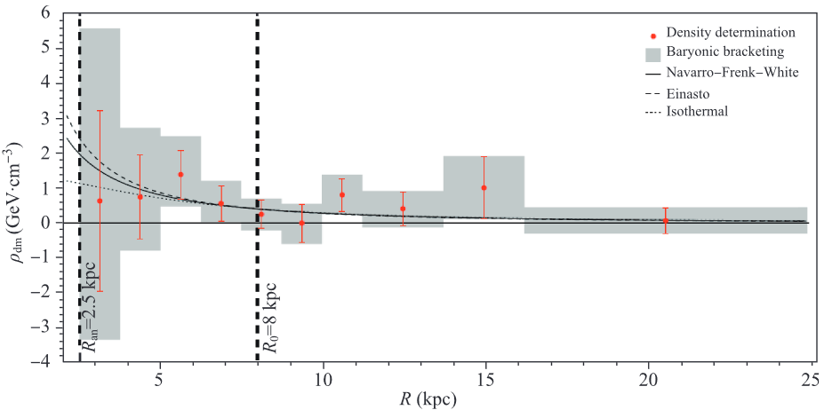
Local Halo
Iso-thermal Halo
Base: N-body Simulation
Local density
$$ρ_{0}=0.\text{3 }\text{GeV}\text{/}{cm}^{3}$$
Density profile
e.g.
Where $r_{s}$=20, $ρ_{0N}=0.3136 GeV/cm^{3}$
Velocity dispersion
$$σ ≡ \sqrt{\left\langle \vec{v}⋅\vec{v} \right\rangle }/\sqrt{3}≃ 270/\sqrt{3}km/s$$
Dark halo Models of Milky Way
vertical velocity
$${⟨v}_{⊥}⟩=\sqrt{\frac{2}{π}}σ=124 km/s$$
M.S. Turner, Phys. Rev. D33 (1986) 889
arXiv: 1504.03317
Notes:
这个区域其他恒星的距离和旋转速度。另外，关于怎样精确确定银河系中恒星分布的方法也没有共识，使得问题更为复杂。在许多关于银河系内部暗物质的研究中，通常是选择-一个重子物质形态分布的模型,从而得到的结果可能是模型依赖的。因此，到现在为止，尽管有很多理论研究和观测的进步，银河系暗物质轮廓图依然未受实质限制。

Slide 31
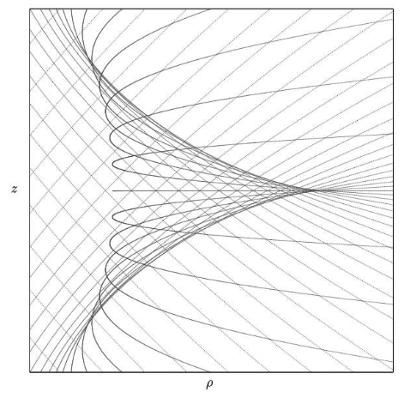
Local Halo
Caustic ring model
Base:
To describe the full phase space distribution of the Milky Way halo
Triangular features in the Gaia Sky map
Predict the existence of flow and caustic
Triangular features in the Gaia skymap
The local DM distribution is dominated by a single flow——Big Flow
Local density
$$ρ_{0}=1−10 \text{GeV}\text{/}{cm}^{3}$$
Velocity dispersion
$$σ<70 m/s$$
vertical velocity
DM trajectories forming a caustic ring of DM, in $ρ−z$ cross-section.
$$v_{⊥}<5 km/s$$
L. D. Duffy and P. Sikivie, 0805.4556
S. S. Chakrabarty, Y. Han, A. H. Gonzalez, and P. Sikivie 2007.10509
Notes:
Fig. 5 plots (ρ(α, η), z(α, η)) for continuous η, and discrete values of α. The lines in Fig. 5 are the trajectories of the particles forming the flow, except that positions are plotted as a function of age, whereas for ordinary trajectories position is plotted as a function of time. Let us call the lines of Fig. 5 “age trajectories”. Fig. 5 shows that particle density diverges on a closed line which has the shape of a isosceles triangle, but with cusps instead of angles. We call that shape a“tricusp”.

Slide 32
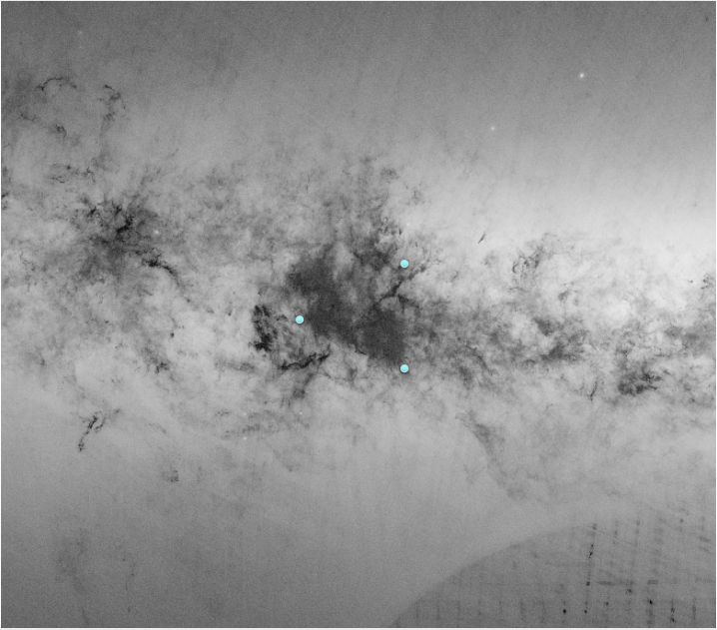
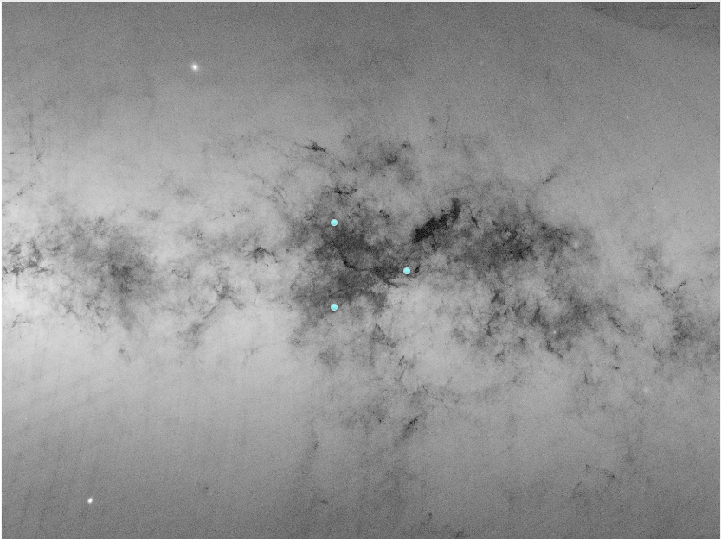
Local Halo
Caustic ring model
Base:
Triangular features in the Gaia Sky map
L. D. Duffy and P. Sikivie, 0805.4556
S. S. Chakrabarty, Y. Han, A. H. Gonzalez, and P. Sikivie 2007.10509
Notes:
Fig. 5 plots (ρ(α, η), z(α, η)) for continuous η, and discrete values of α. The lines in Fig. 5 are the trajectories of the particles forming the flow, except that positions are plotted as a function of age, whereas for ordinary trajectories position is plotted as a function of time. Let us call the lines of Fig. 5 “age trajectories”. Fig. 5 shows that particle density diverges on a closed line which has the shape of a isosceles triangle, but with cusps instead of angles. We call that shape a“tricusp”.

Slide 33
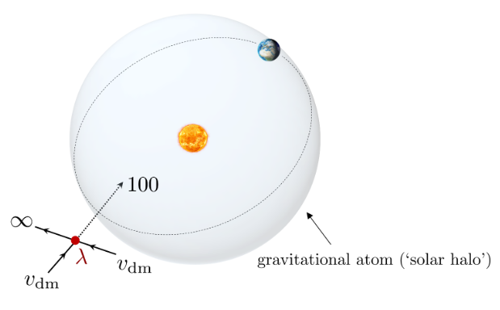
Local Halo
Earth halo and Sun halo
Formation V1
Base:
Large-scale numerical simulations of galaxy formation for fuzzy DM without and with the presence of baryons
Schive et al, 1406.6586
J. Veltmaat et al, 1804.09647, 1911.09614
$→$ Halo-like configuration can form in the central cores of galaxies
2. A generical Formation mechanism
$V_{ext}=−\frac{Gm_{φ}M_{ext}}{r}$ , $R_{⋆}>R_{ext}$
$$R_{⋆}≡\frac{M_{Pl}^{2}}{m_{φ}}\frac{1}{M_{ext}}$$
Gravitational potential :
Solution:
Gravitational atom Bound states: $ψ_{nlm}$
Unbound states: $ψ_{k}$
Quartic self-interactions:
$ψ_{k_{1}={mv}_{1}} +ψ_{k_{2}=mv_{2}}→ψ_{k_{3}=∞}+ψ_{100}$
DM can be trapped into a bound configuration via 2 to 2 process in quartic self-interactions
$ψ_{k}$ in the background can be captured into the ground state $ψ_{100}$
Gravitational focusing
When $\frac{λ_{dB}}{R_{⋆}}≫1$
(1) get stimulated
Dense halo
Budker et al. 2306.12477
Banerjee et al.1902.08212
Notes:
1 au (radius of Earth’s orbit, black line), 0.39 au (radius of Mercury’s orbit, red line) and 0.1 au (blue line).

Slide 34
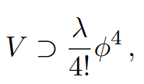
Local Halo
Earth halo and Sun halo
Formation V2
Base:
Large-scale numerical simulations of galaxy formation for fuzzy DM without and with the presence of baryons
Schive et al, 1406.6586
J. Veltmaat et al, 1804.09647, 1911.09614
$→$ Halo-like configuration can form in the central cores of galaxies
2. A generical Formation mechanism
Gravitational potential :
$V_{ext}=−\frac{Gm_{φ}M_{ext}}{r}$
②Unbound states
Solution:
①Gravitational atom Bound states
Quartic self-interactions:
DM can be trapped into a bound configuration via 2 to 2 process in quartic self-interactions
Unbound states in the background can be captured into the ground state
Gravitational focusing
Capture get stimulated
Dense halo
Budker et al. 2306.12477
Banerjee et al.1902.08212
Notes:
1 au (radius of Earth’s orbit, black line), 0.39 au (radius of Mercury’s orbit, red line) and 0.1 au (blue line).

Slide 35
Local Halo
Sun halo
Formation V3
Formation mechanism
$V_{ext}=−\frac{Gm_{φ}M_{ext}}{r}$
$$R_{⋆}≡\frac{M_{Pl}^{2}}{m_{φ}}\frac{1}{M_{ext}}$$
Gravitational potential :
②Unbound states
Solution:
①Gravitational atom Bound states
Quartic self-interactions:
$ψ_{k_{1}={mv}_{1}} +ψ_{k_{2}=mv_{2}}→ψ_{k_{3}=∞}+ψ_{100}$
Total mass $M_{⋆}$ of ULDM in ground state:
DM can be trapped into a bound configuration via 2 to 2 process in quartic self-interactions
Gravitational focusing
Capture get stimulated
Dense halo
Budker et al. 2306.12477

Slide 36
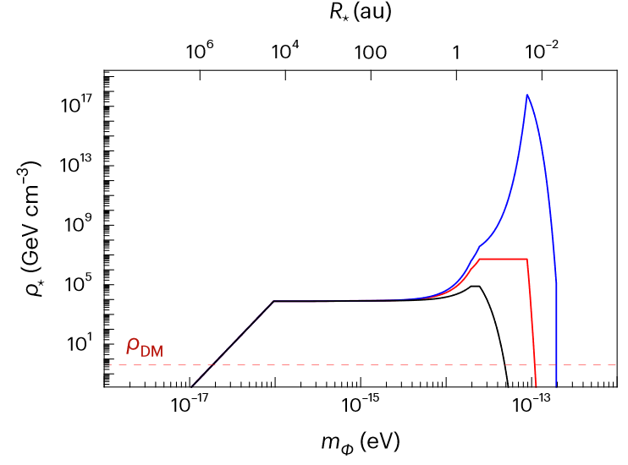
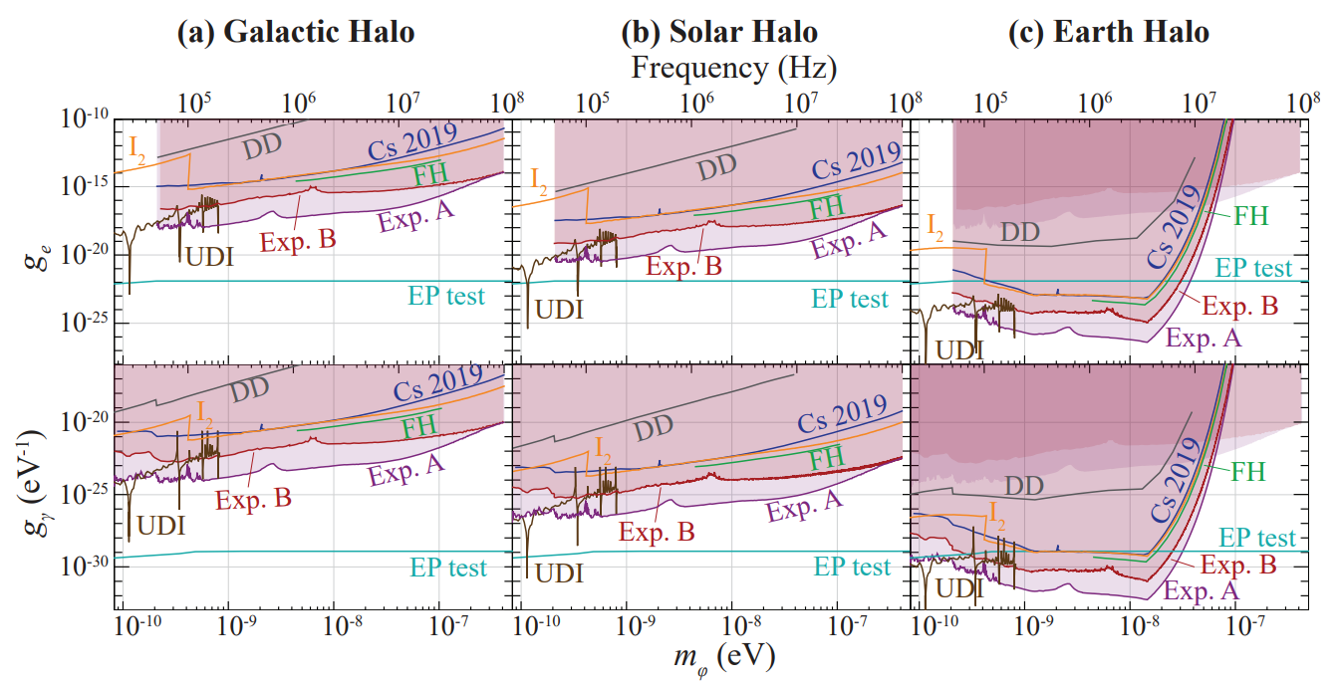
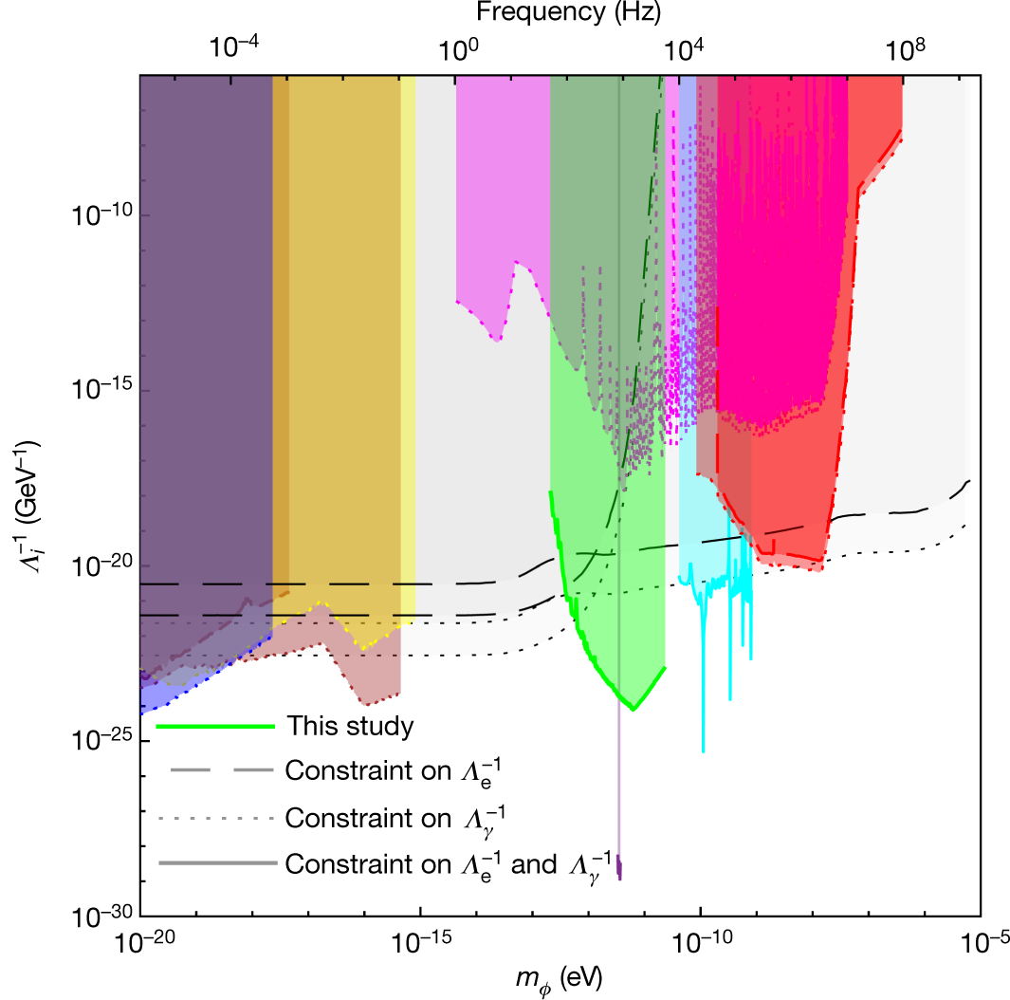
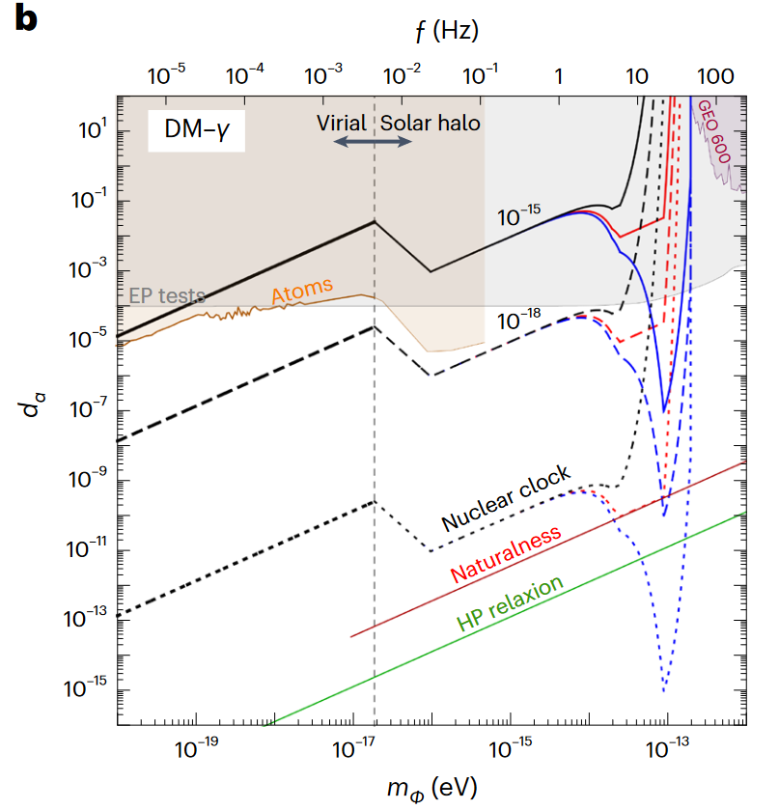
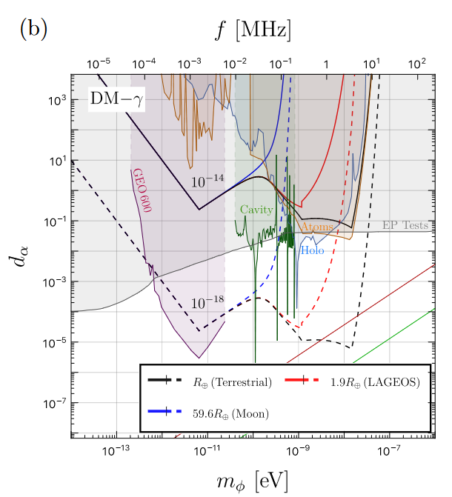
Local Halo
Search (linear)
Optical-spectroscopy
Oleg Tretiak et al., 2201.02042(PRL)
Gravitational-wave detector
For Earth Halo
Atomic clock
Yu-Dai Tsai et al. 2112.07674(NA)
For Sun halo
For Earth halo
S. M. Vermeulen et al., 2103.03783(Nature)
Notes:
optical-spectroscopy apparatus

