Slide 1

Levitodynamics with multi-stochastic forces and the dark matter detection in optical levitation experiment
Wenyu Wang
Beijing University of Technology
2023.12 @Nanjing

Slide 2
CONTENT
Introduction to levitation
Levitodynamics with multi-stochastic forces
The damping forces from different sources
The collision between levitated particle and dark matter
Conclusion
Collaboration with Xi Cheng, Ji-Heng Gao and Bin Zhu

Slide 3
Controlled levitation
From Science 374 eabg3027 (2021)

Slide 4
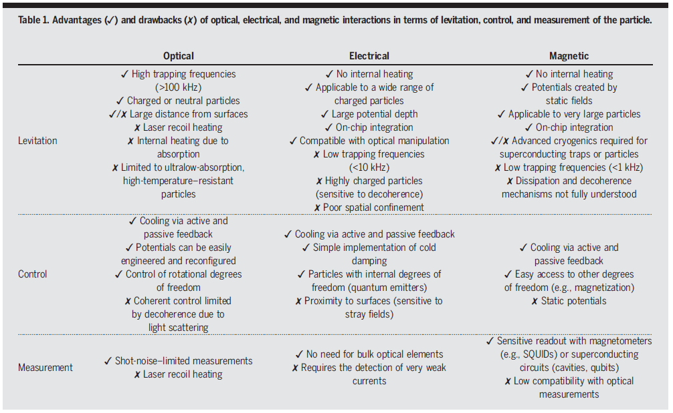

Slide 8


Slide 9
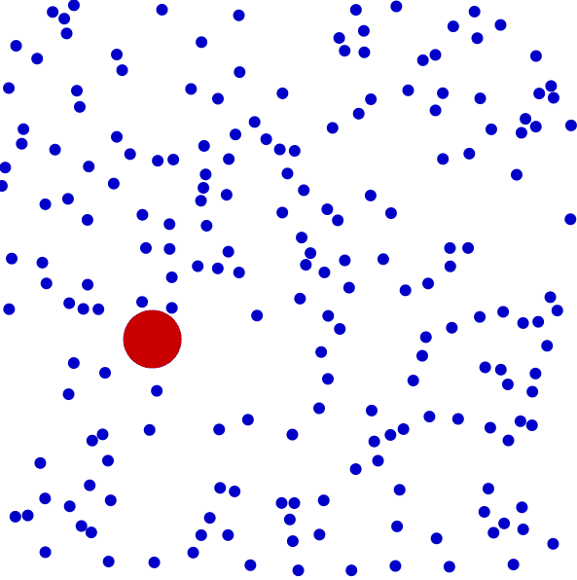

Slide 10
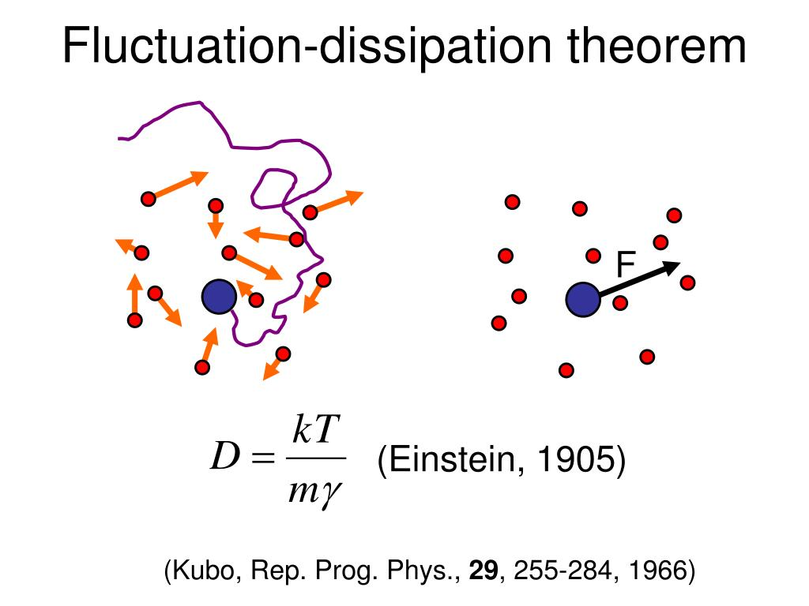

Slide 11
Energy flow of Brownian system
Fluctuation
Dissipation

Slide 12
Experimental
setup and measurement

Slide 13
WHY WE GO BEYOND SINGLE STOCHASTIC FORCE?

Slide 14
Multi-stochastic forces in levitation
Collisions with gas molecules in the vicinity;
Emission, absorption, and scattering of thermal electromagnetic radiation;
Noise in the trap center due to vibrations and/or stray fields;
Noise in the trap frequency caused by fluctuations in the electromagnetic fields generating the trapping potentials;
Cross-coupling to other thermal degrees of freedom in the particle's motion along orthogonal directions, rotation, or internal excitation;
The unknown interaction which can be dark interaction.

Slide 15
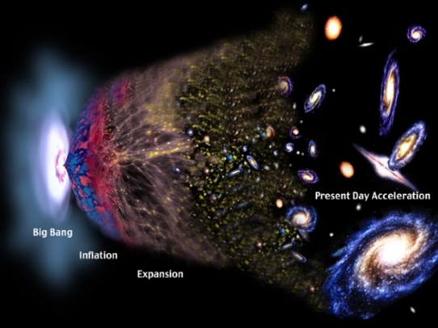
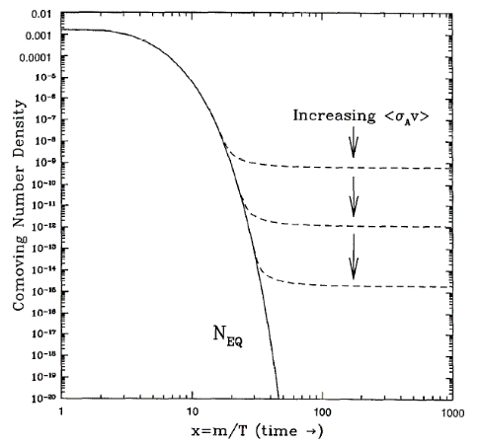
Reason for the extension in Multi-stochastic forces in levitation
Temperature not necessarily equals to the environment
Damping is changed in the operation.

Slide 16
Energy flow of Brownian system
Fluctuation
Dissipation

Slide 17
Levitodynamics with multi-stochastic forces

Slide 18
The forces we considered
The force arises from collisions between the levitated particle and the thermally moving molecules in the atmosphere.
The heating rate is attributed to the stochastic driving force arising from photon recoil kicks.

Slide 19
The forces we considered
The feedback optical force and the corresponding damping coefficient.
An additional stochastic force can be generated through collisions with the surrounding dark matter. Within the Langevin system, the interaction with dark matter is described by the damping coefficient and the driving force
Dark matter collision

Slide 20




 | Damping | Fluctuation
Thermal
Recoil
Feedback
Dark interaction

Slide 21




Total damping:
Stochastic damping:
Stochastic temperature:
Correlation function:
Langevin equation:

Slide 22

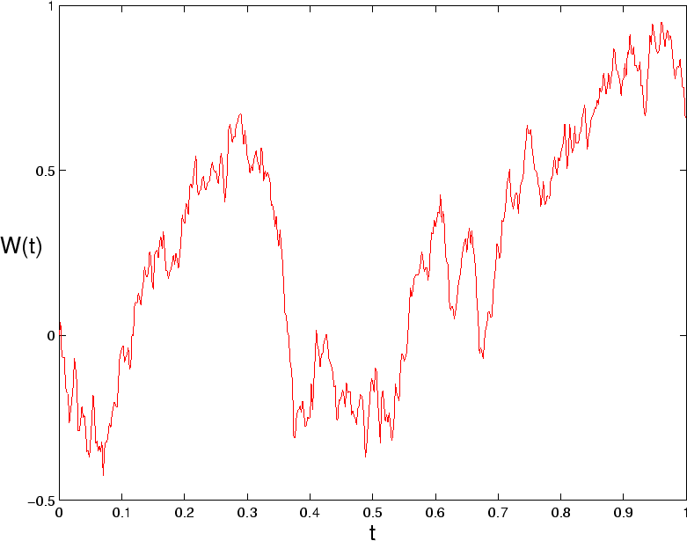
Stochastic differential equation:
Wiener processes:

Slide 23

Energy change:

Slide 24

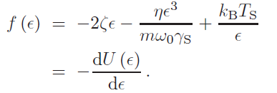
Choose
Then

Slide 25




The potential is
Boltzmann Gibbs distribution

Slide 26
The average energy
The effective temperature

Slide 27

The energy evolution
Approximately
Turn off feedback

Slide 28




Cooling limit:
Feedback damping dominant
Feedback optical force dominant

Slide 29
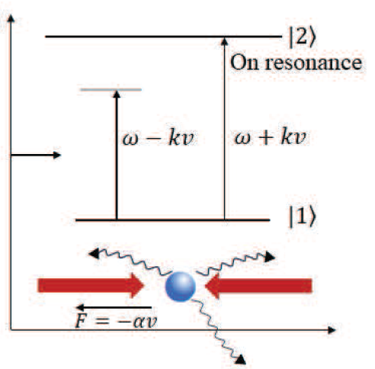
The damping forces from different sources
Isothermal drag
Photon recoil
Feedback
Dark matter

Slide 30

Isothermal drag
Mean free path
Determined by Knudsen number
Scale of the particle

Slide 31

Linearization

Slide 32


Photon recoil

Slide 33




Damping coefficient
Correlation function
Effective temperature

Slide 34

Feedback
Deterministic force

Slide 35
Collision between dark matter and levitated particle

Slide 36
From Camilo A. Garcia Cely

Slide 37
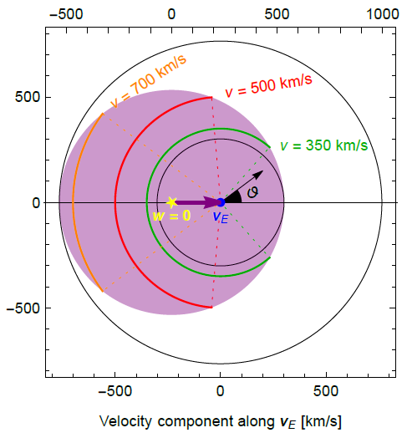
1. Failure of linearization!
2. Connection with the fundamental interaction?

Slide 38
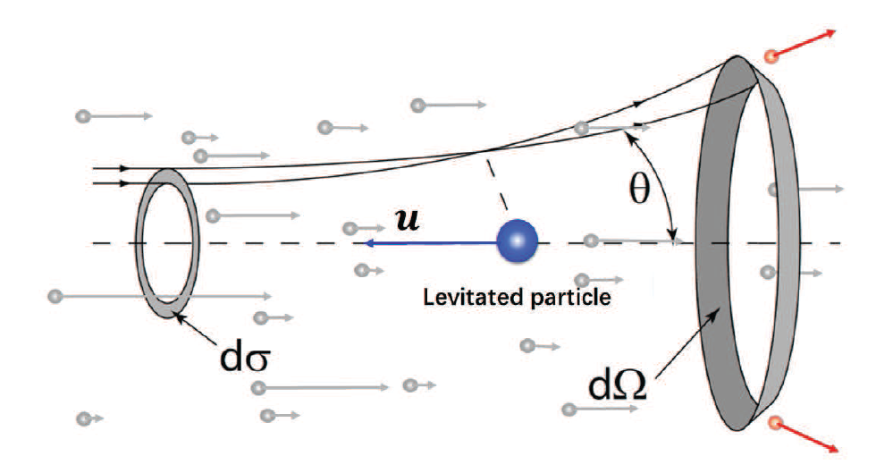


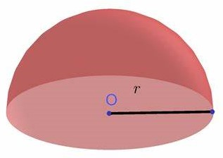

Slide 39
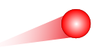



is the transfer cross section between fundamental particle and a macroscopic particle.
Dark matter
Macroscopic particle
Collision with atom
Collision with levitated particle

Slide 40
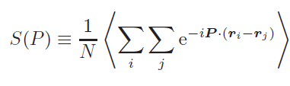


Static structure factor
Fundamental interaction to Damping:
Great enhancement by the coherence!

Slide 41
Searching for the Dark interaction in levitation experiment

Slide 42


Solution to Langevin system

Slide 43






Experimental measurement

Slide 44
POSTULATIONS
Multiple sources of stochastic force exist, each independently adhering the fluctuation-dissipation theorem.
The cooling feedback mechanism provides a damping coefficient and an optical force that also damps the levitated particle.
The levitated particle is assigned an effective temperature which may include contributions from dark interactions.
The motion of the levitated particle arises from the collective motion of microscopic particles, thereby enabling the dark damping to unveil interactions between elementary and macroscopic particles.

Slide 45


Test of effective temperature
Define
The Least Square Method gives
$θ1≠0, θ$₂$≠$1 will verify our theory.

Slide 46
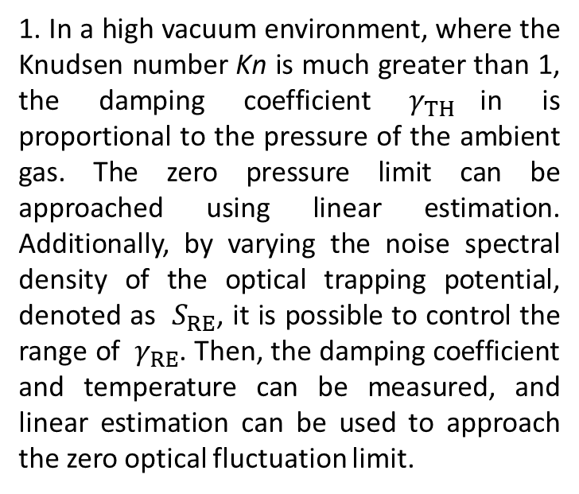
Experiment operation and analysis
1. In a high vacuum environment, where the Knudsen number Kn is much greater than 1, the damping coefficient $γ_{TH}$in is proportional to the pressure of the ambient gas. The zero pressure limit can be approached using linear estimation. Additionally, by varying the noise spectral density of the optical trapping potential, denoted as $S_{RE}$, it is possible to control the range of $γ_{RE}$. Then, the damping coefficient and temperature can be measured, and linear estimation can be used to approach the zero optical fluctuation limit.
2. In the absence of optical fluctuation and pressure, non-zero damping coefficients provide upper limits on the transfer cross section between dark matter and the levitated particle. Subsequently, by utilizing the static structure factor S(P) and atomic factor f(P), we can obtain constraints on the microscopic transfer cross-section between dark matter and fundamental particles.

Slide 47

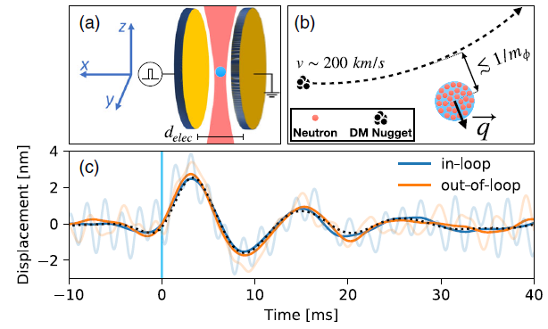

Limits from current experiments
PRL 116, 243601 (2016)
PRL 125, 181102 (2020)

Slide 48
CONCLUSION 1
The fluctuation term does not necessarily correspond one-to-one with the damping coefficient when the feedback loop is active. Total damping and Stochastic damping are introduced to differentiate between total damping and stochastic damping. The ratio of these coefficients distinguishes our levitodynamics from those with only single stochastic forces. Both feedback damping and optical damping can cool down the levitated particle.

Slide 49
CONCLUSION 2
The thermal drag, recoil, and feedback are studied. DM collisions cannot be treated in the same way as in fluid dynamics due to the failure of linearizing the velocity distribution. Although the dark damping coefficient is suppressed by the mass of the levitated particle, scattering can be coherently enhanced based on the scale of the component microscopic particle, the atomic form factor, and the static structure factor. Therefore, dark damping may offer insights into detecting the macroscopic strength of fundamental particles.

Slide 50
CONCLUSION 3
The operations of the levitation experiment are proposed. By precisely measuring the Lorentzian peak, a much more accurate damping coefficient can be obtained. As the thermal drag and recoil can be linearly estimated to approach zero limits, non-zero results at zero pressure and optical fluctuation can test our theory. Based on the current levitation results, we have

Slide 51
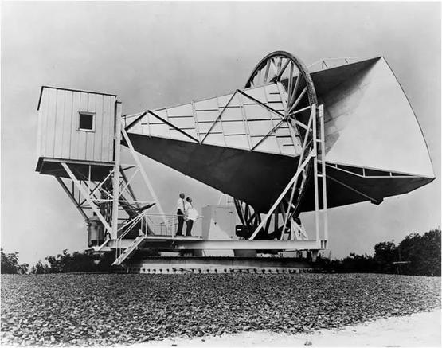
Extracting the dark damping from the damping coefficient is akin to removing noise in a radio telescope in the 1960s. The cosmic microwave background (CMB) was eventually discovered in the residual noise.
Similarly, dark damping may serve as an irremovable noise in levitodynamics, potentially leading to the revelation of hidden secrets in the future!

Slide 52
THANK YOU!

