Slide 1
Baryons in the light-front approach:
The three-quark picture
Zhen-Xing Zhao
Inner Mongolia University
河南师范大学
2023. 10
Phys.Rev.D 107 (2023) 11, 116025
In collaboration with Fu-Wei Zhang, Xiao-Hui Hu, Yu-Ji Shi

Slide 2
Outline
Introduction
Framework and some applications
Numerical results
Summary and outlook

Slide 3
Introduction

Slide 4
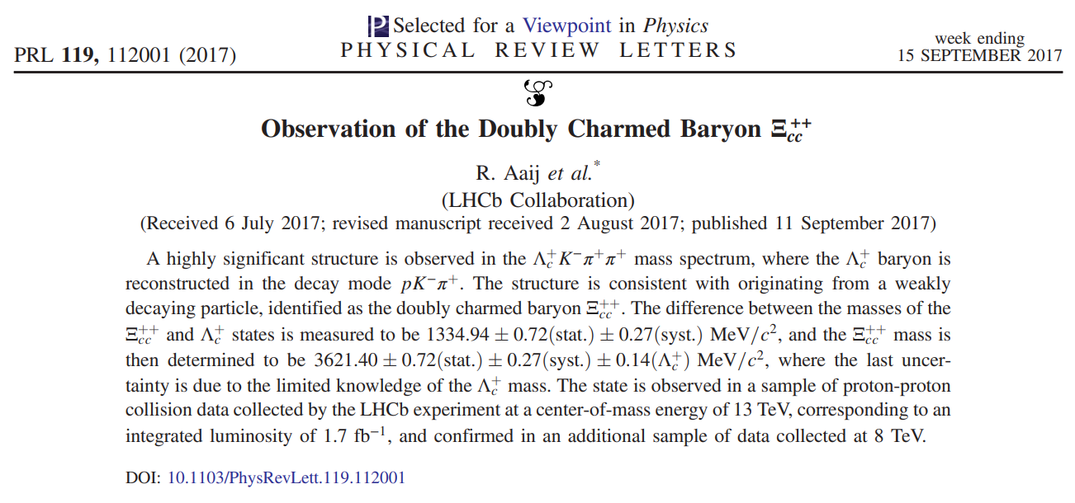
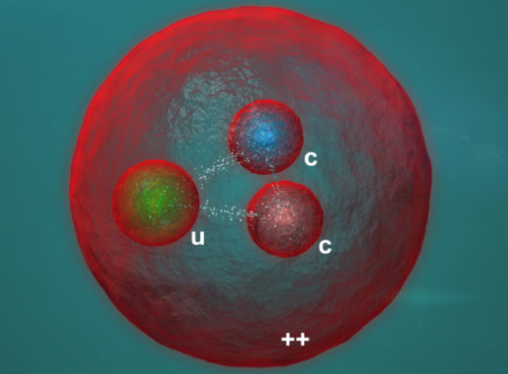
Observation of $Ξ_{cc}^{++}$
$$Ξ_{cc}^{++}→Λ_{c}^{+}K^{−}π^{+}π^{+}$$

Slide 5
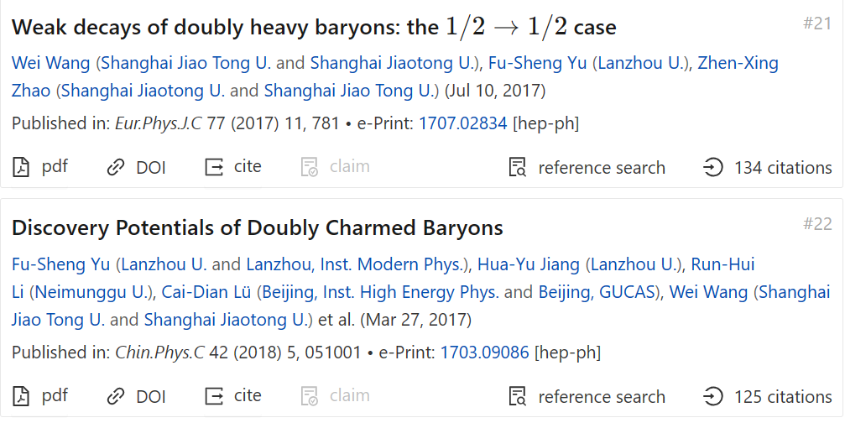
Observation of $Ξ_{cc}^{++}$
-- Test the standard model
-- Search for the origin of CP violation and new physics
-- Understand the strong interactions

Slide 6
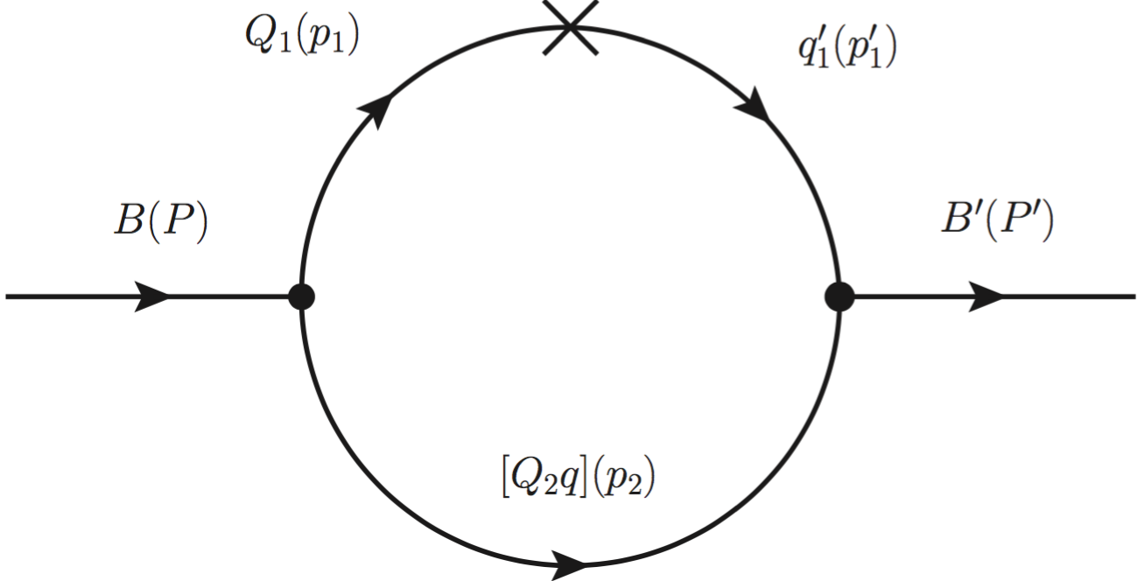
Light-front quark model—the diquark picture
diquark 0⁺ or 1⁺
H. W. Ke, X. Q. Li and Z. T. Wei, Phys. Rev. D 77, 014020 (2008)
H. W. Ke, X. H. Yuan, X. Q. Li, Z. T. Wei and Y. X. Zhang, Phys. Rev. D 86, 114005 (2012)
Some defects:
-- $Ξ_{bc}(bcq)$,
for c decay, bq -- diquark
for b decay, cq -- diquark
-- more parameters, such as $m_{di}$-- $m_{[ud]}$ and $m_{\{ud\}}$

Slide 7
Light-front quark model—the diquark picture
A Lorentz boost between $p_{2}$ and $\overline{P}$
H. W. Ke, X. H. Yuan, X. Q. Li, Z. T. Wei and Y. X. Zhang, Phys. Rev. D 86, 114005 (2012)
Chun-Khiang Chua, Phys. Rev. D 99, 014023 (2019)

Slide 8
Light-front quark model – the three-quark picture
S. Tawfiq, P. J. O’Donnell, and J. G. Körner, Phys. Rev. D 58, 054010 (1998)
H.-W. Ke, N. Hao, and X.-Q. Li, Eur. Phys. J. C 79, 540 (2019), ...
C.-Q. Geng, C.-W. Liu, and T.-H. Tsai, Phys.Lett.B 815, 136125 (2021), …
Y.-S. Li, and X. Liu, Phys.Rev.D 107, 033005 (2023), …
-- lack a proof of spin wavefunctions
-- shape parameters cannot be well determined
-- relation between the diquark picture and the three-quark picture

Slide 9
Framework and some applications

Slide 10
The baryon state
spin and momentum
color
flavor
$Λ_{Q}$
$$Σ_{Q}$$
$$Σ_{Q}^{∗}$$
$$(udQ)$$
Three different flavors

Slide 11
Color and spin wavefunctions
Color wf:
$$ε^{ijk}/\sqrt{6}$$
Flavor wf:
$Λ_{Q}=\frac{1}{\sqrt{2}}\left(ud−du\right)Q$ -- scalar (0⁺ )
$Σ_{Q}=\frac{1}{\sqrt{2}}\left(ud+du\right)Q=Σ_{Q}^{∗}$ -- axial-vector (1⁺ )

Slide 12
Spin wavefunction
Take $Σ_{Q}(udQ)$ as an example
where ud are considered as an axial-vector “diquark”
Step 1: In the rest frame of quark 2 and 3 – “diquark”

Slide 13
Spin wavefunction
Step 2: Couple the “diquark” to quark 1
Step 3: Tensor simplification
Lorentz boost plays a crucial role
Same method can be applied to multi-quark states!

Slide 14
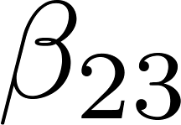
Momentum wavefunction
shape parameters

Slide 15
To determine the shape parameters
Take $Λ_{Q}$ as an example
Step 1: Calculate it in LFQM
Step 2: Use the definition of
Step 3: Extract the pole residue
M can be extracted!
Here contains $β_{1}$ and $β_{23}$

Slide 16
Form factors
$Λ_{b}→Λ_{c}$ Form factors
Step 1: Calculate the matrix elements in LFQM
Step 2: Write the matrix elements in terms of form factors
Step 3: Extract the form factors
f2, g1, g2 can also be obtained in a similar way
$Σ_{b}→Σ_{c}$, $Ξ_{cc}→Λ_{c}$ Form factors

Slide 17
The relation between the two pictures
$$Λ_{Q}$$
$$Σ_{Q}$$
Quark 3 and 2 form a diquark
normalization factor
A diquark bases
orthogonal
T matirx

Slide 18
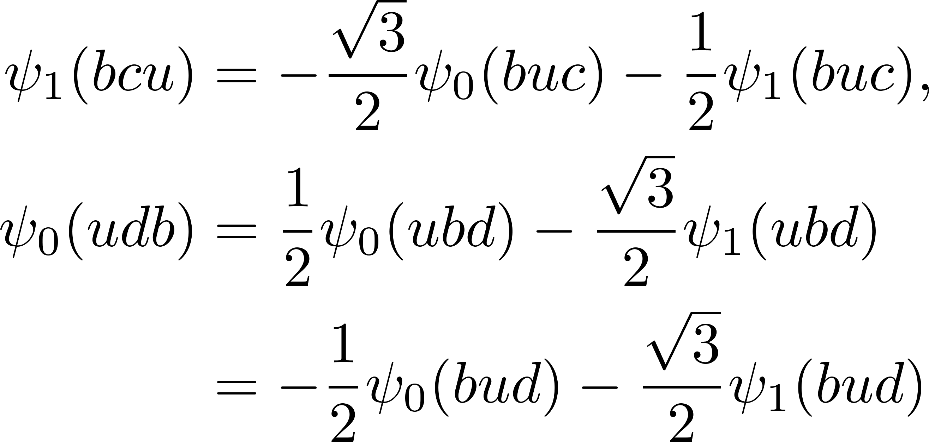
The relation between the two pictures
1. Calculate the overlap factors of
2. Calculate the overlap factors of
W. Wang, F.-S. Yu, and Z.-X. Zhao, Eur. Phys. J. C 77, 781 (2017)

Slide 19
Possibly better definitions of interpolating currents
Hermite conjugate $ψ_{0,1}$
Traditional definitions
Comments:
1. The factor $1/\sqrt{3}$
2. Let $v→0$ in -- in fact, we cannot do that.

Slide 20
Numerical results

Slide 21
Inputs and shape parameters
Inputs
Z.-G. Wang, Eur. Phys. J. C 68, 479 (2010)
Z.-G. Wang, Phys. Lett. B 685, 59 (2010)
Z.-G. Wang, Eur. Phys. J. A 45, 267 (2010)
$$Λ_{b}→Λ_{c}$$
$$Σ_{b}→Σ_{c}$$
$$Ξ_{cc}→Λ_{c}$$

Slide 22
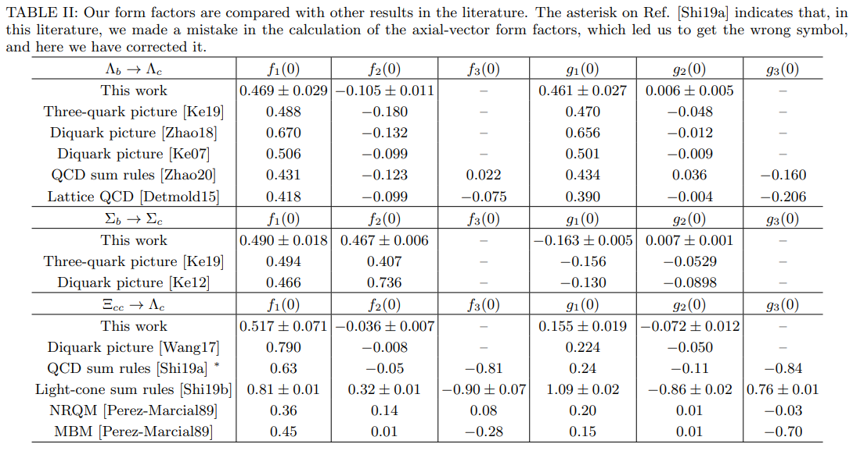
Form factors and comparison
Diquark picture

Slide 23
Decay widths and comparison

Slide 24
Summary and outlook

Slide 25
Summary
A three-quark picture in LFQM is built up using the quark spinors and Dirac matrices
The shape parameters are determined with the help of pole residue
The relation between the diquark picture and the three-quark picture is clarified
A small flaw?

Slide 26
Outlook
Various applications
Lorentz boost plays a crucial role when building the model-- Multiquark states? – the most famous X(3872)
Interpolating currents of baryons

Slide 27
To make a tetraquark state
Spin wf: S-wave
Building blocks:
Quark
Diquark
baryon
tetraquark state
RF of 23
RF of 123
RF of 12
RF of 34
RF of 1234
$0^{+}$ Diquark
$1^{+}$ Diquark

Slide 28
To make a tetraquark state
Momentum wf:
Color wf: 3*3*3*3
Flavor wf: SU(3)

Slide 29
Thank you for your attention!

