Slide 1
Wide Field Survey Telescope data on Dark matter constraints
Wentao Luo
紫金山暗物质研讨会
2023·12.30

Slide 2
目 录
Existing works on dark matter
01
Brief intro of WFST
02
WFST data on dark matter
03
Conclusion
04

Slide 3
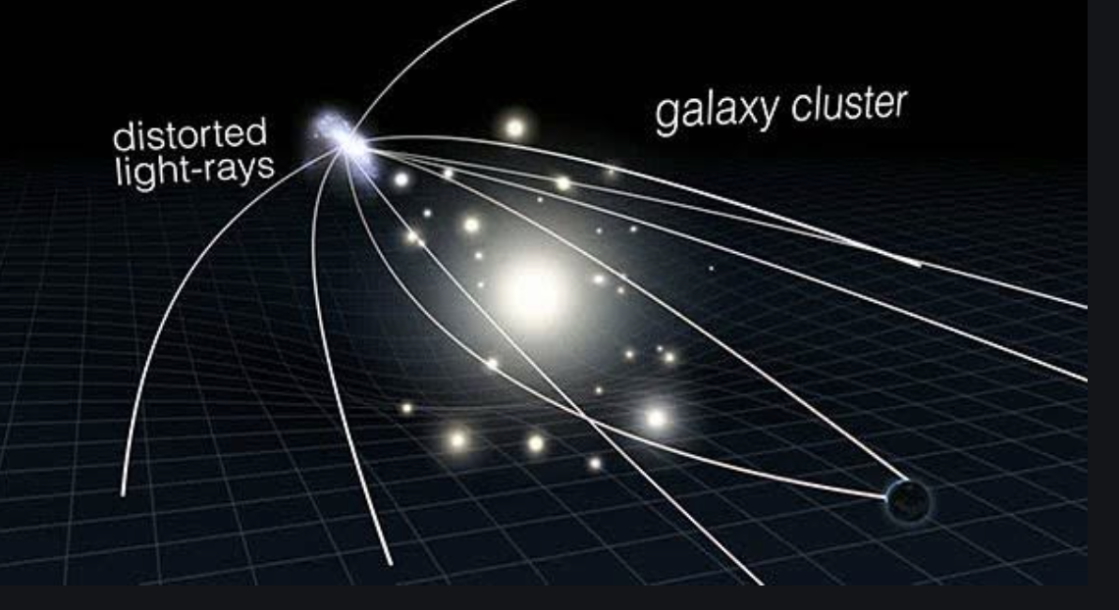
引力透镜是前景大质量天体引起光线偏折的现象

Slide 4
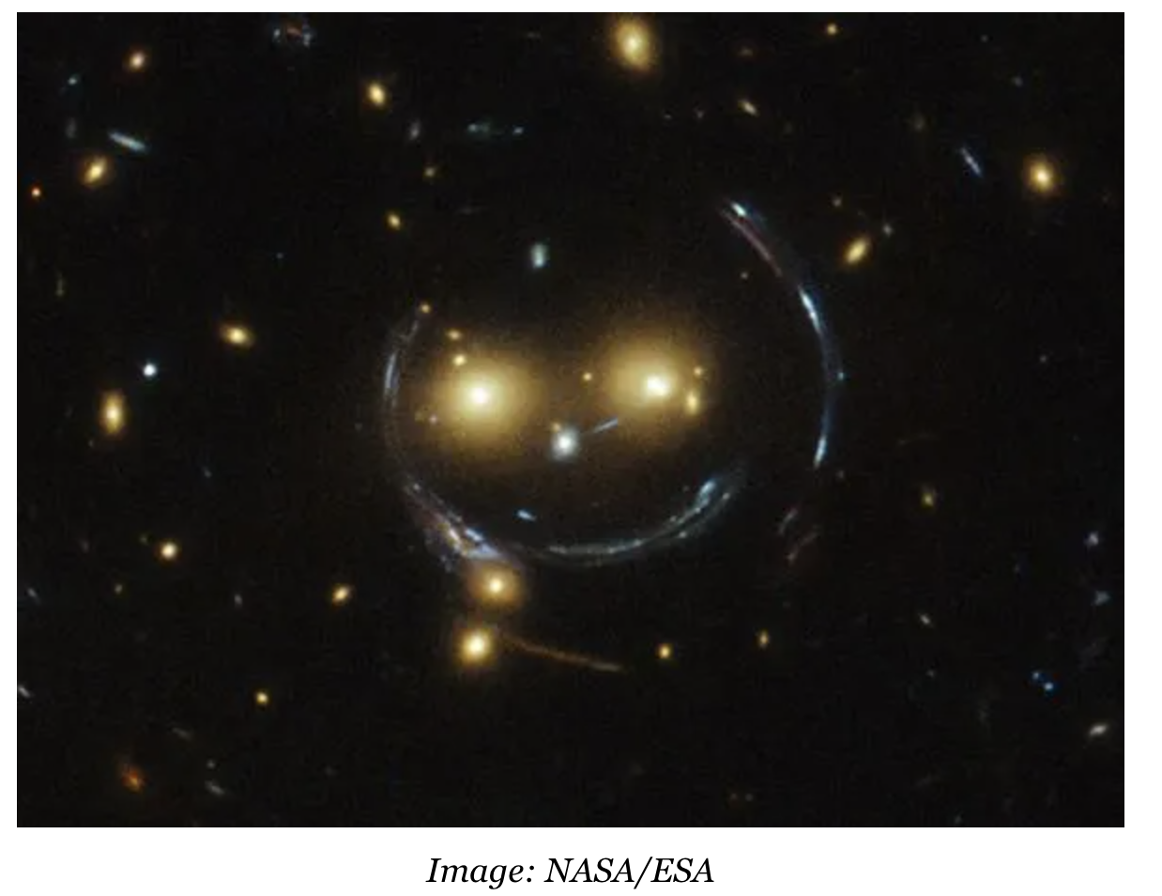
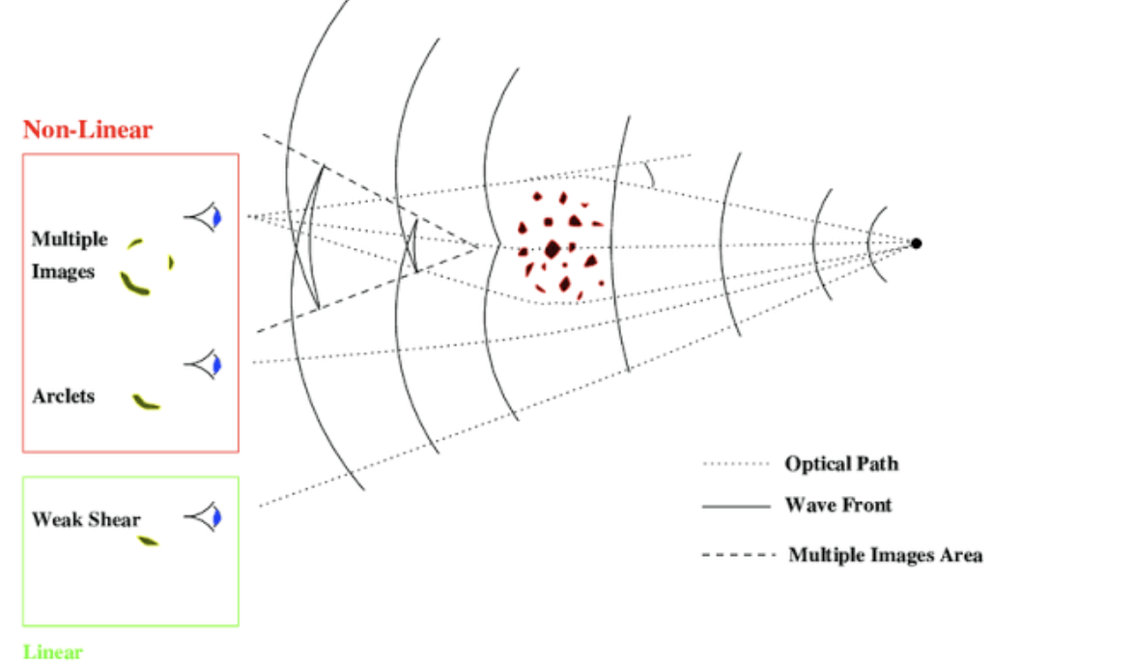
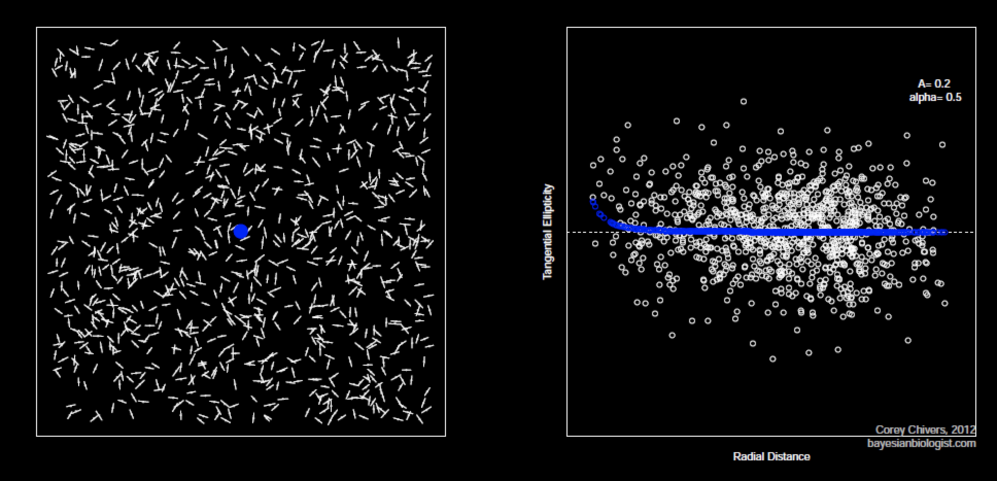

Slide 5
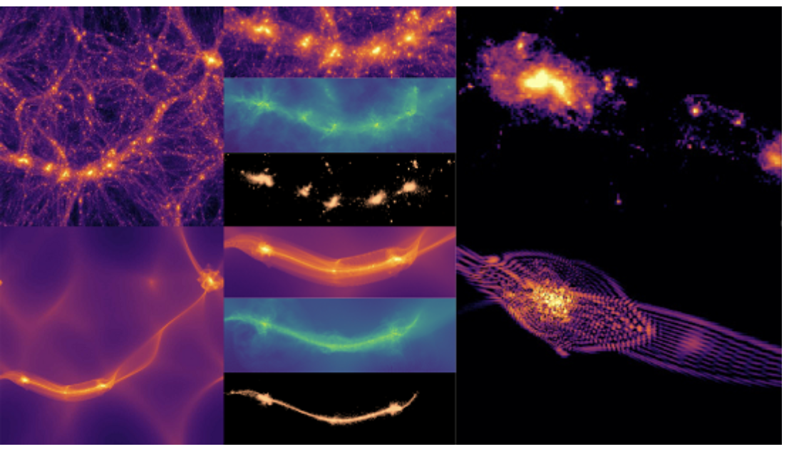
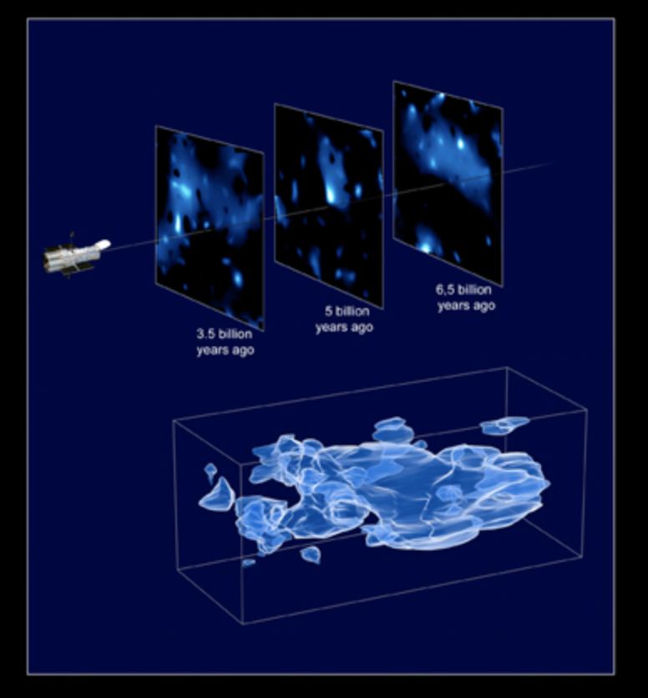
引力透镜不同粒子模型暗物质在天文尺度分布是不同的
冷暗物质
气体
聚集，结团
恒星，星系
轴子暗物质
气体
干涉，弥散
恒星，星系
P. Mocz + 2019 PRL
Credit: ESA

Slide 6
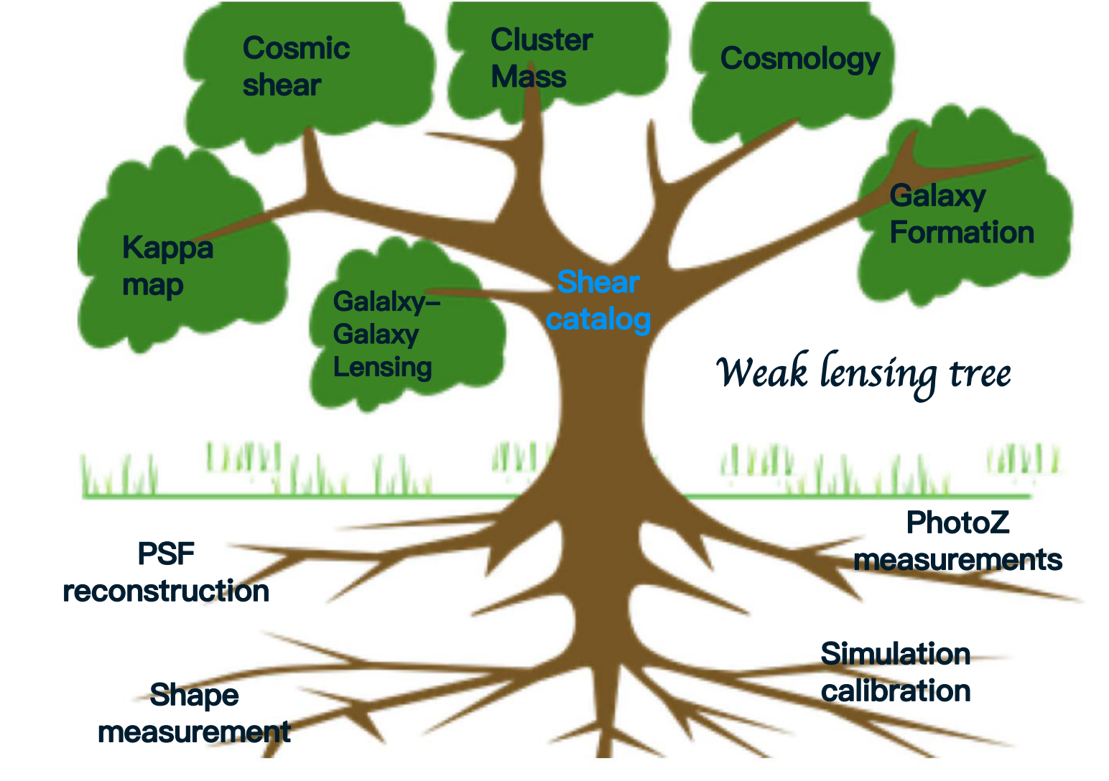
01. Weak Gravitational Lensing
论证背景

Slide 7
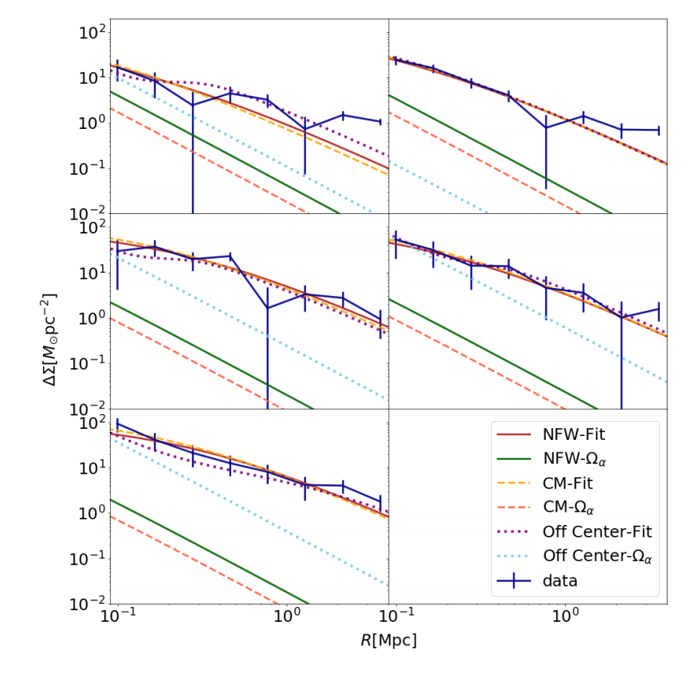
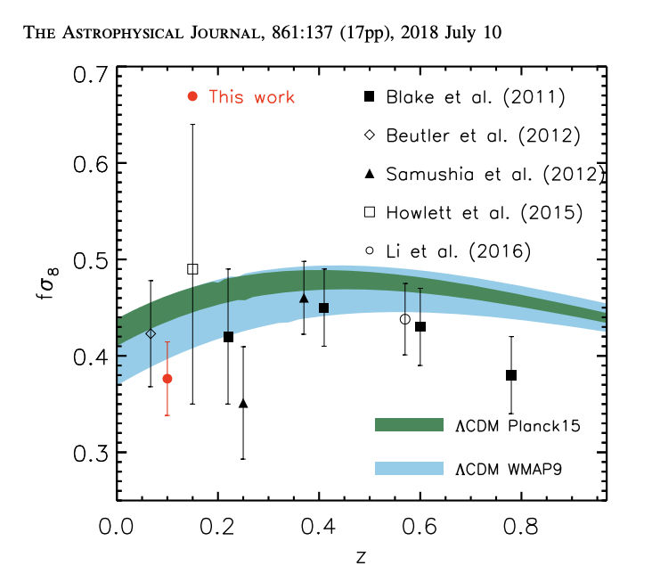
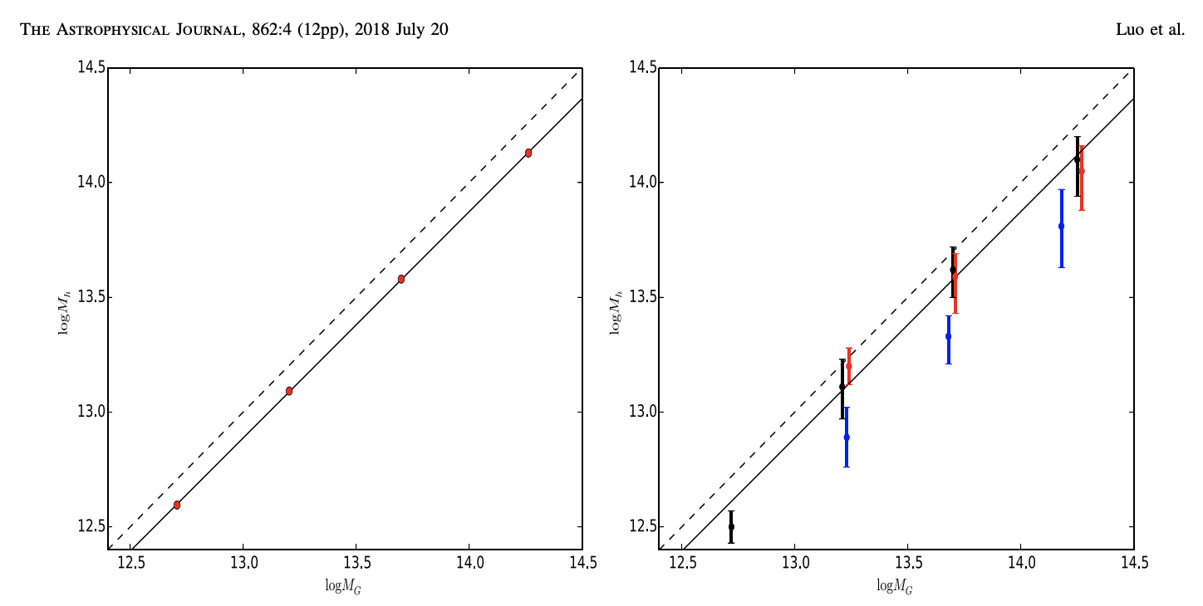
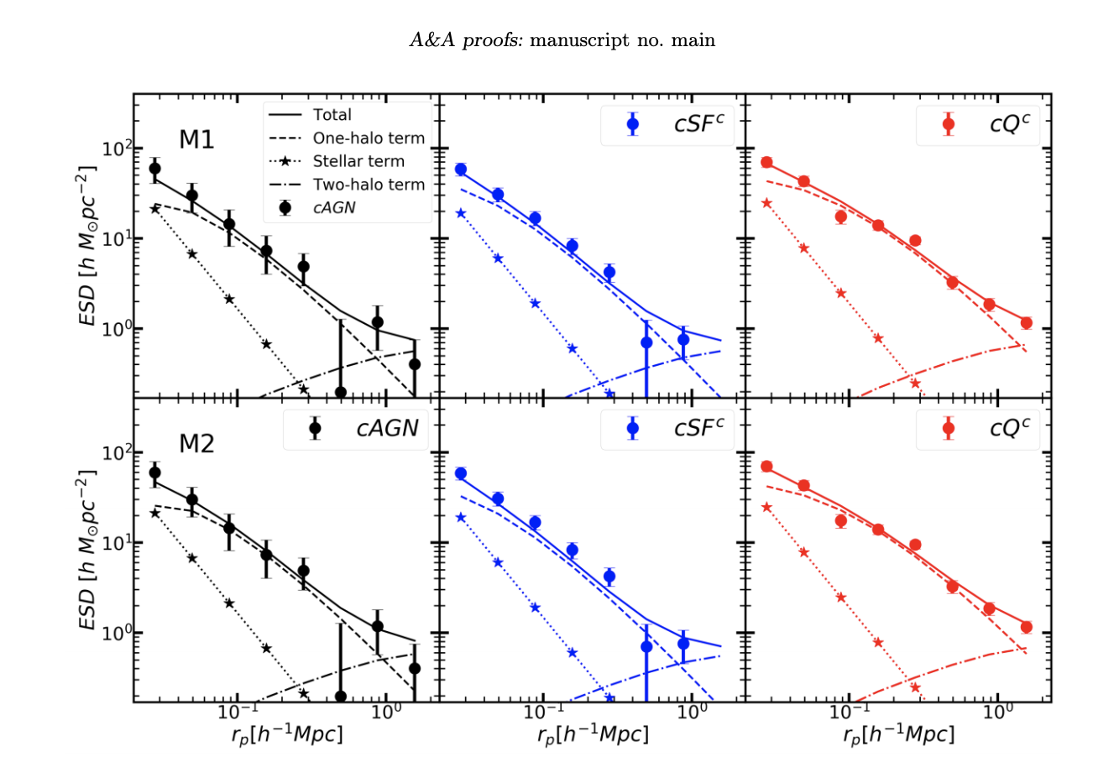
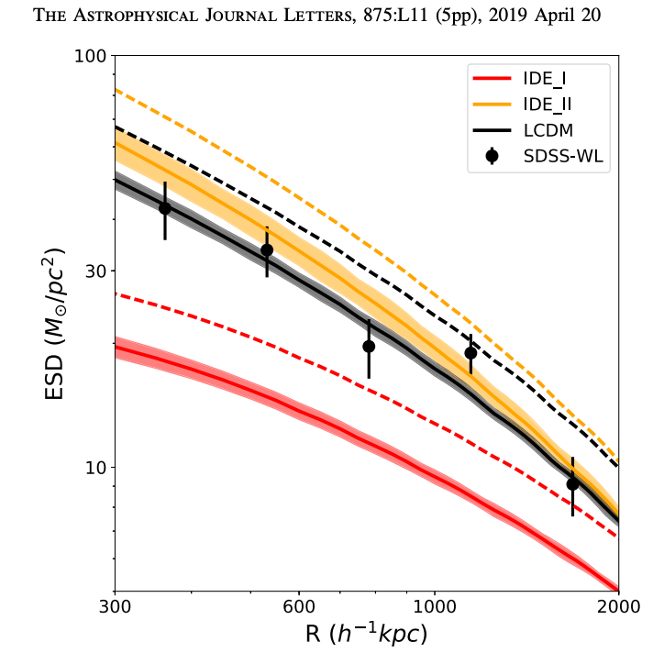
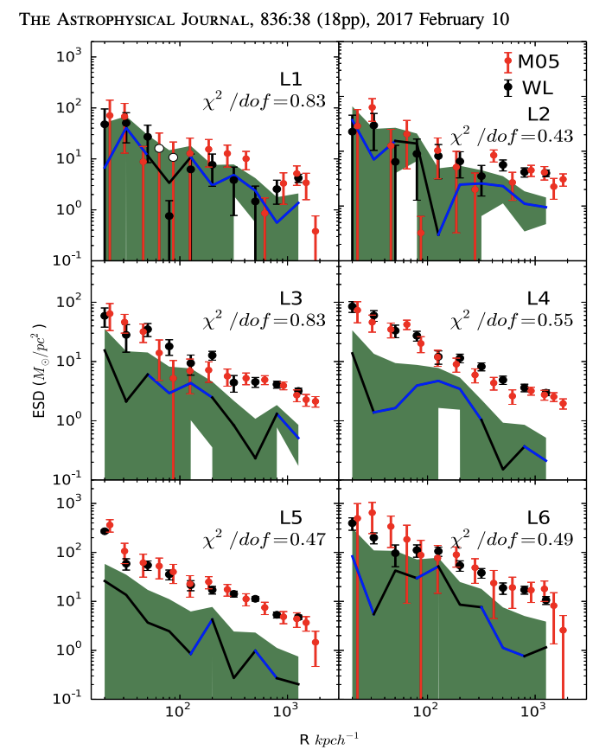
W.L.+ 2018 ApJ
Shi + 2018 ApJ
Chen + 2020
Zhang + 2021 A&A
Zhang + 2018 PRD
W.L. + 2017 ApJ
W.L.+ 2021 ApJ

Slide 8
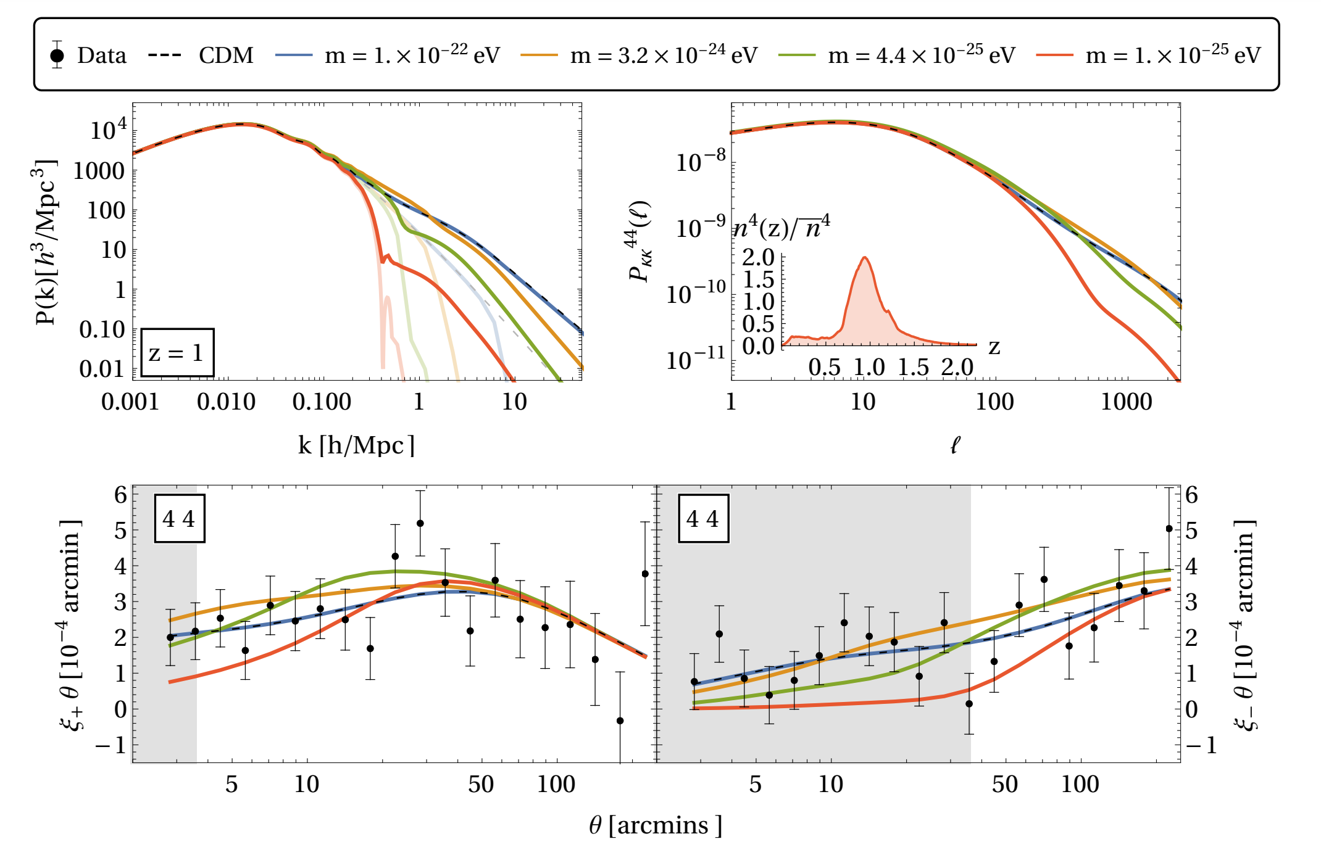
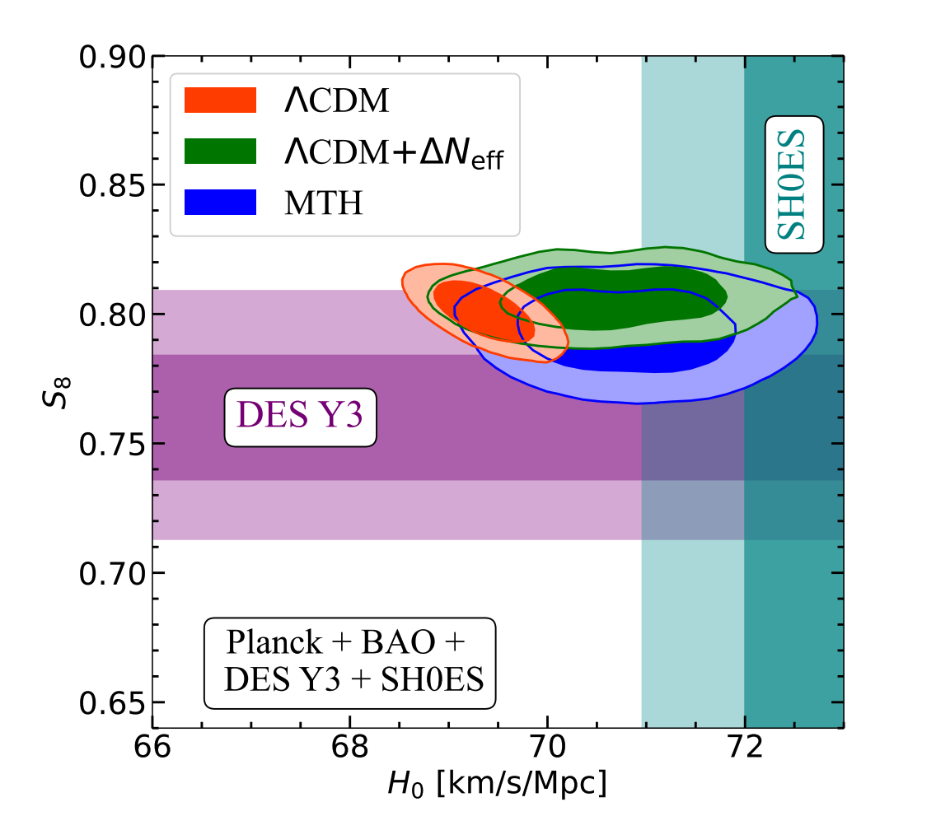

Slide 9
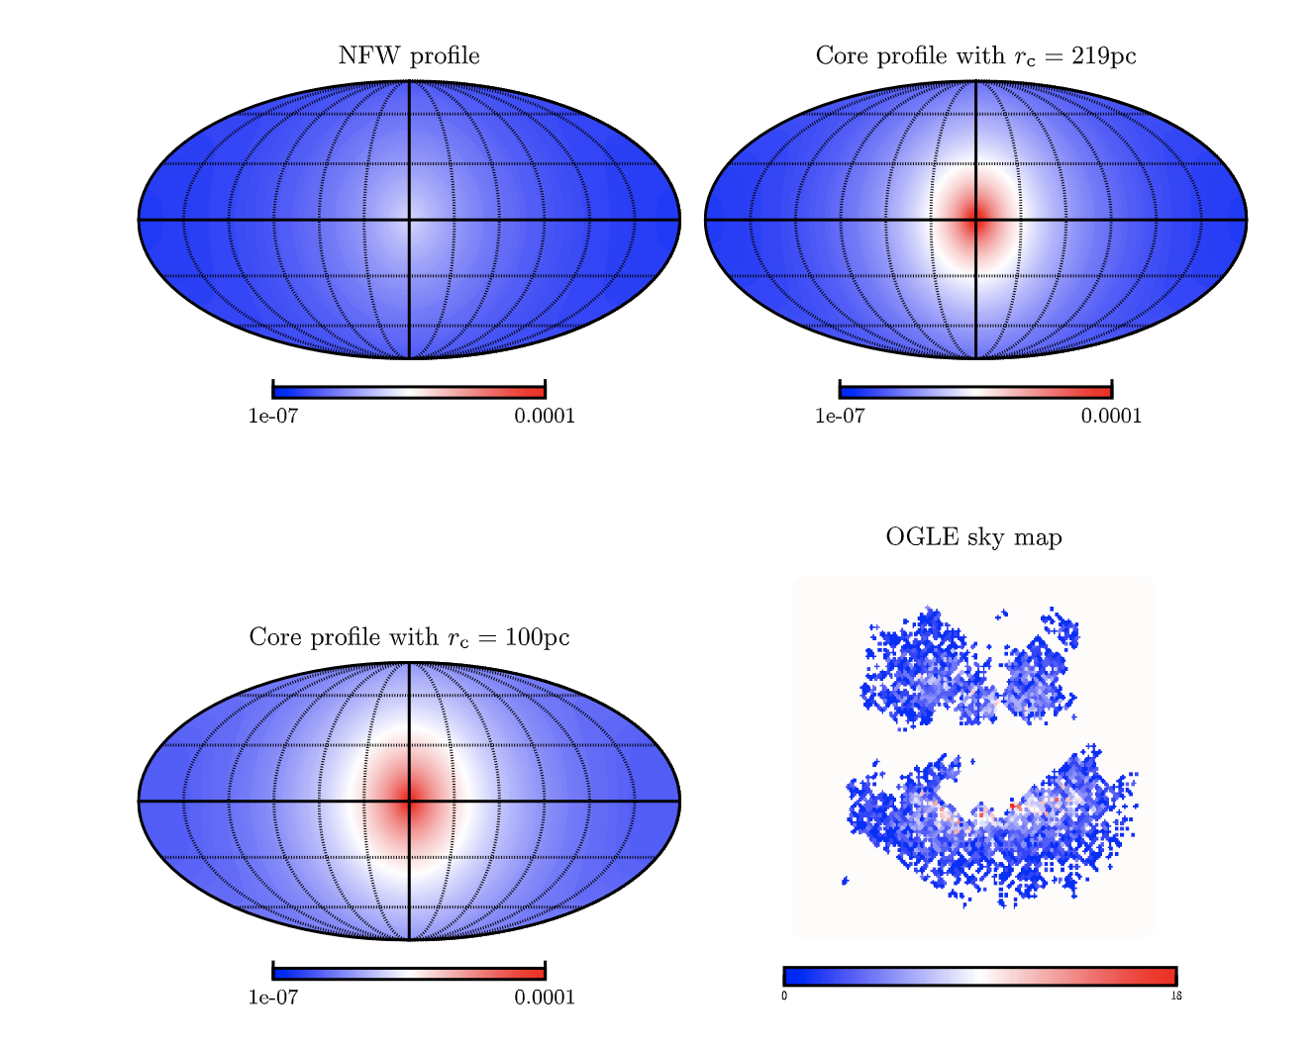
（Lin， Luo + 2023 ）

Slide 10
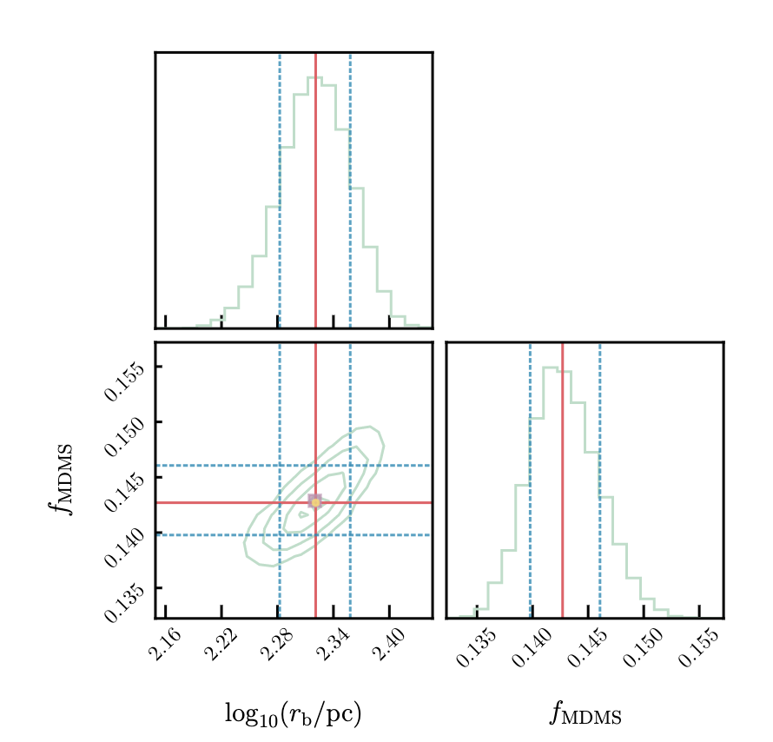
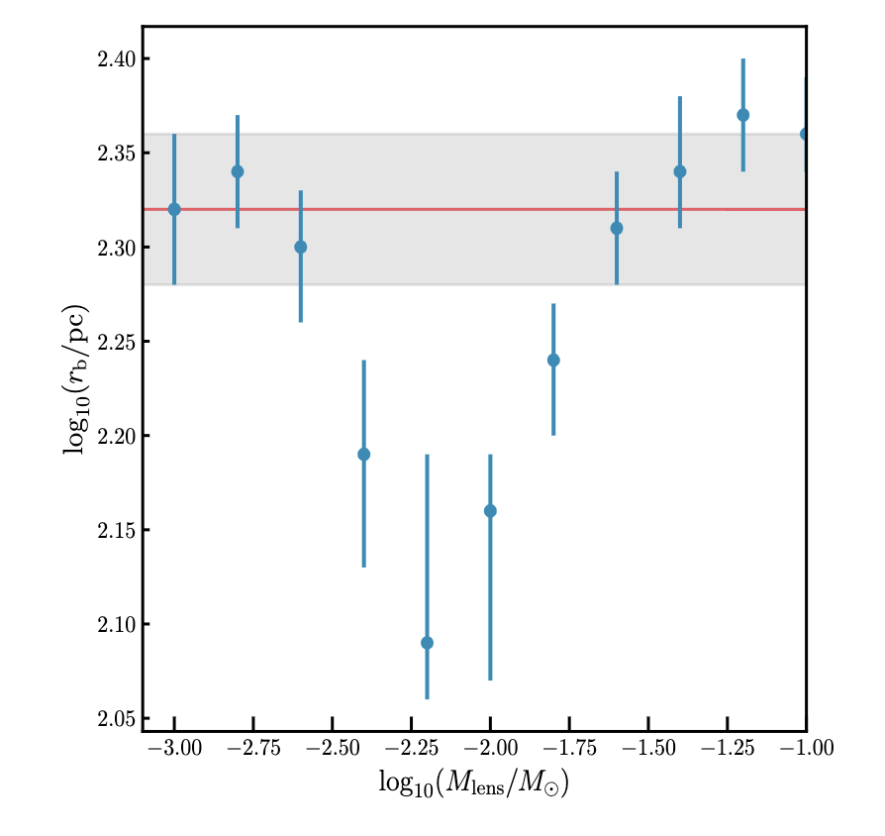
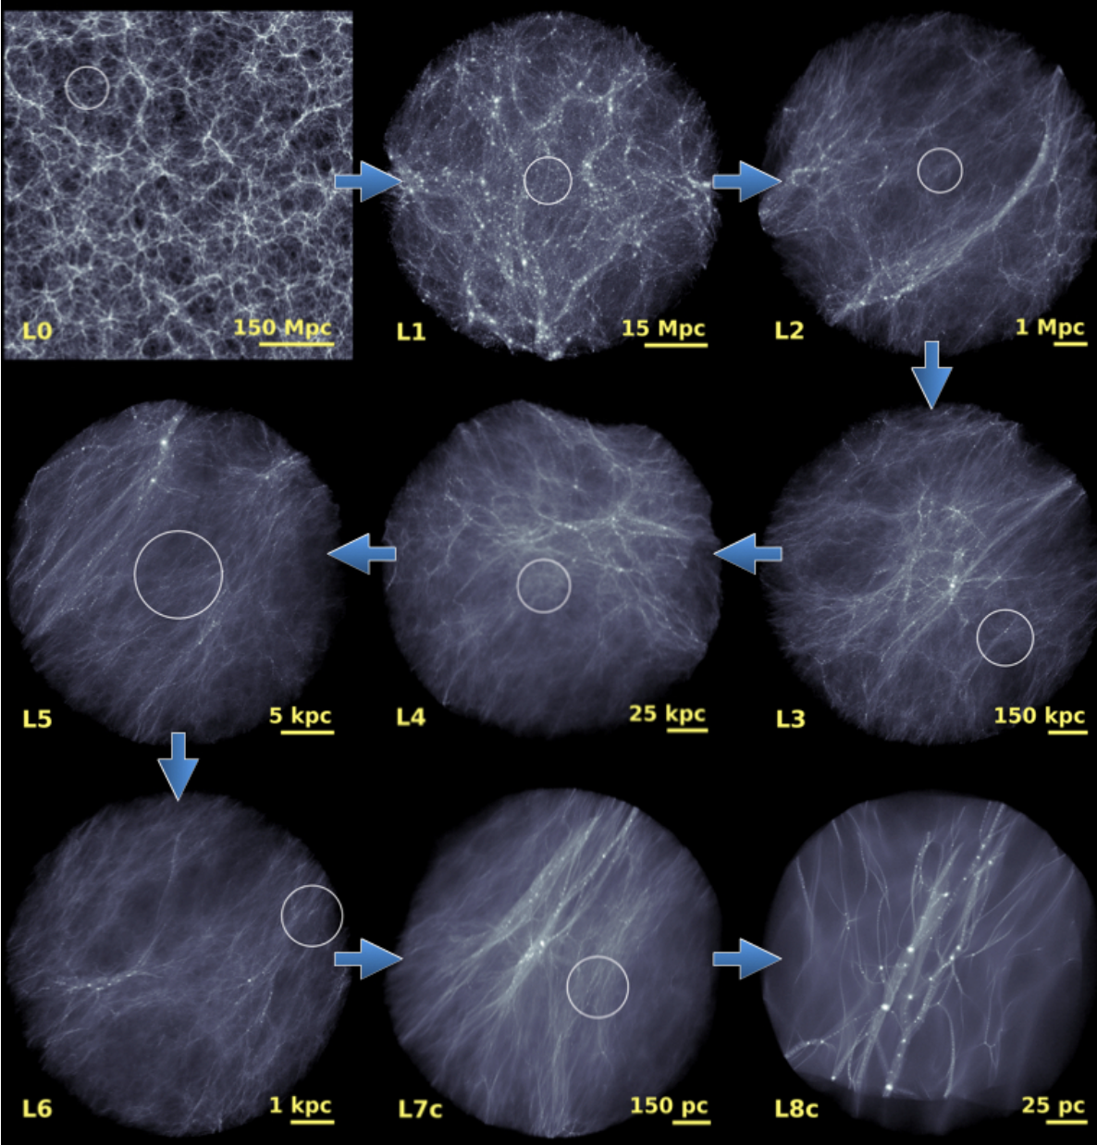
~10% dark matter exists in the form of MDMS？Wang + 2020 Nature also supports the claim.

Slide 11
Credit: Xu Kong, Tinggui Wang, Xianzhong Zheng, Ming Liang

Slide 13
LSST VS WFST Sciences
LSST | WFST
DESC | SN
Milky Way | Multimessenger
Transients(GW TO) | TDE/AGN
Solar System Object | Milky way, solar system objects, galaxy formation and cosmology

Slide 15
Notes:
观测将覆盖约50%的WFST DHu 巡天天区，分别为S27-2 天区和A27-2 天区，共计
54（27 × 2）个pointing。具体天区见下图。

Slide 16
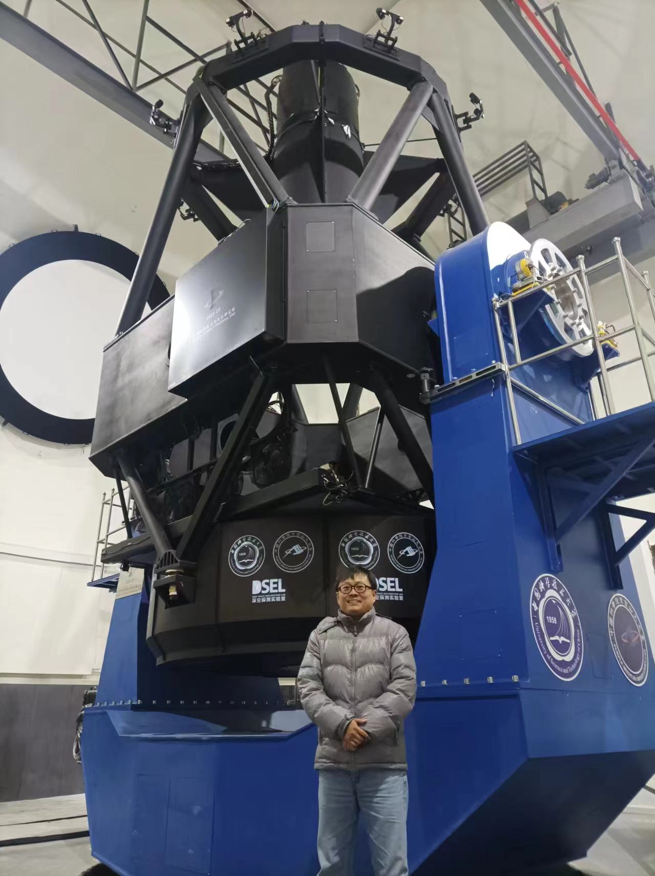
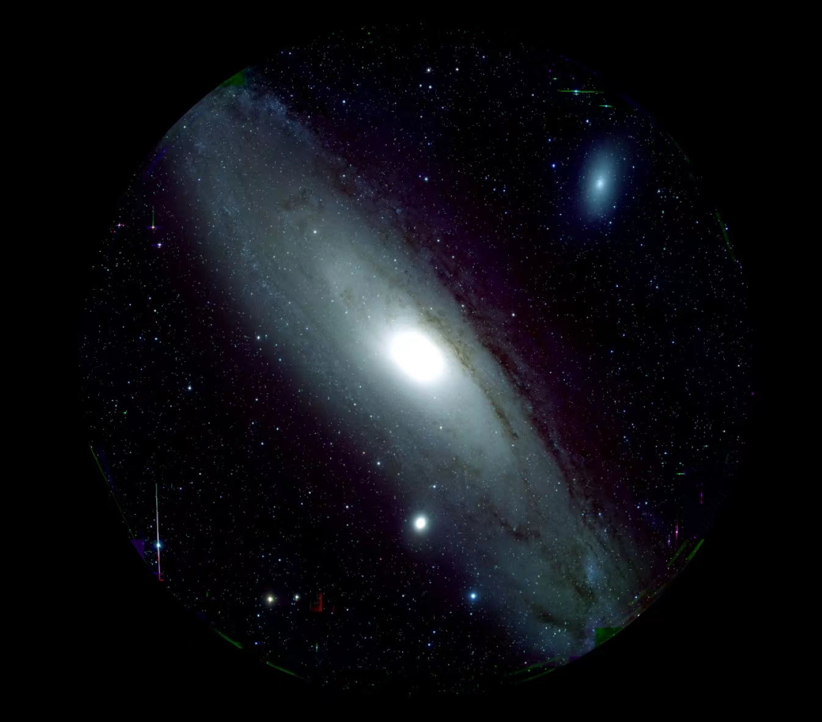
WFST first light （2023年9月17日）

Slide 17
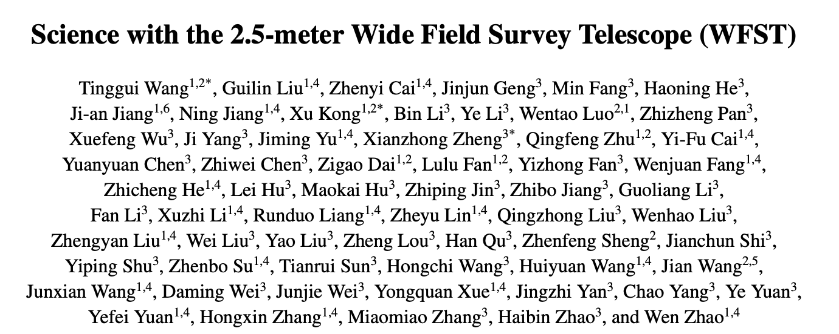
WFST science white paper

Slide 18
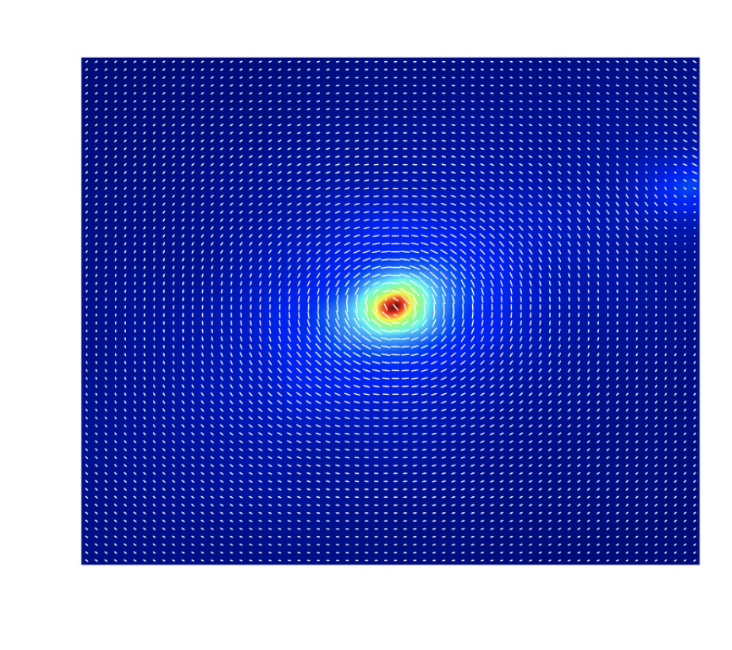
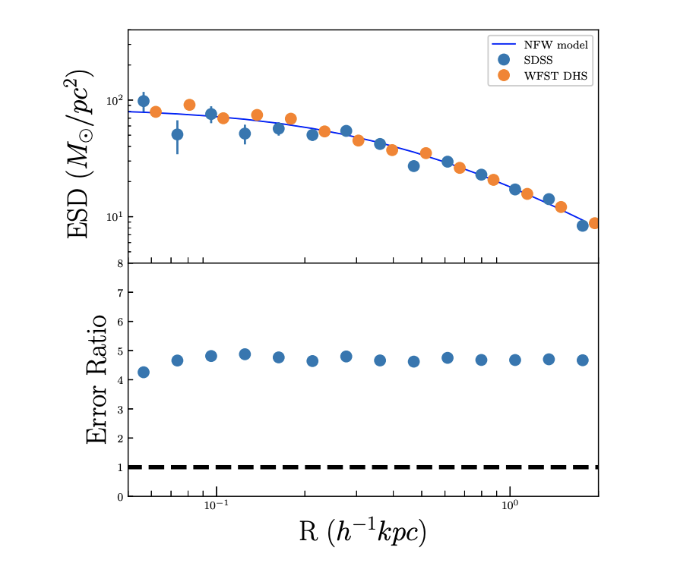
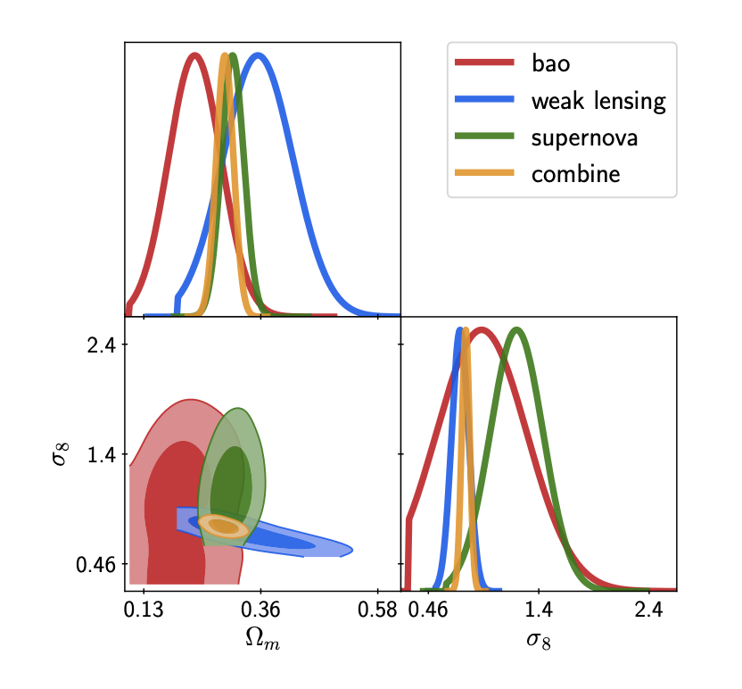

Slide 19
Conclusion
Astronomical data can be used to test not only the large scale distribution of dark matter, but also the properties of dark matter, e.g. fuzziness, PBH fraction.
WFST is a 2.5 meter telescope with 6 sq. deg field of view. There will be deep high cadence survey (covering 1200 sq.deg) and wide field survey (8000 sq. deg)
WFST data is a gold mine for gravitational lensing and can be used to probe dark matter large scale structure and dark matter propterty.

