Slide 1
New collects in exotics.
Massive axion search at CEPC (Kingman Cheung)
Neutrino NSI at CEPC (Yu Zhang & Jiajun Liao)
Lepton dipole form factors (Yu Zhang)
Heavy favor meson form-factors: QCD mass mechanism (Robert Craigs)
Lepton mass intrigues: Koide formula & models (Zheng Sun)
Tex write-up + plots. Half – one page each.

Slide 2
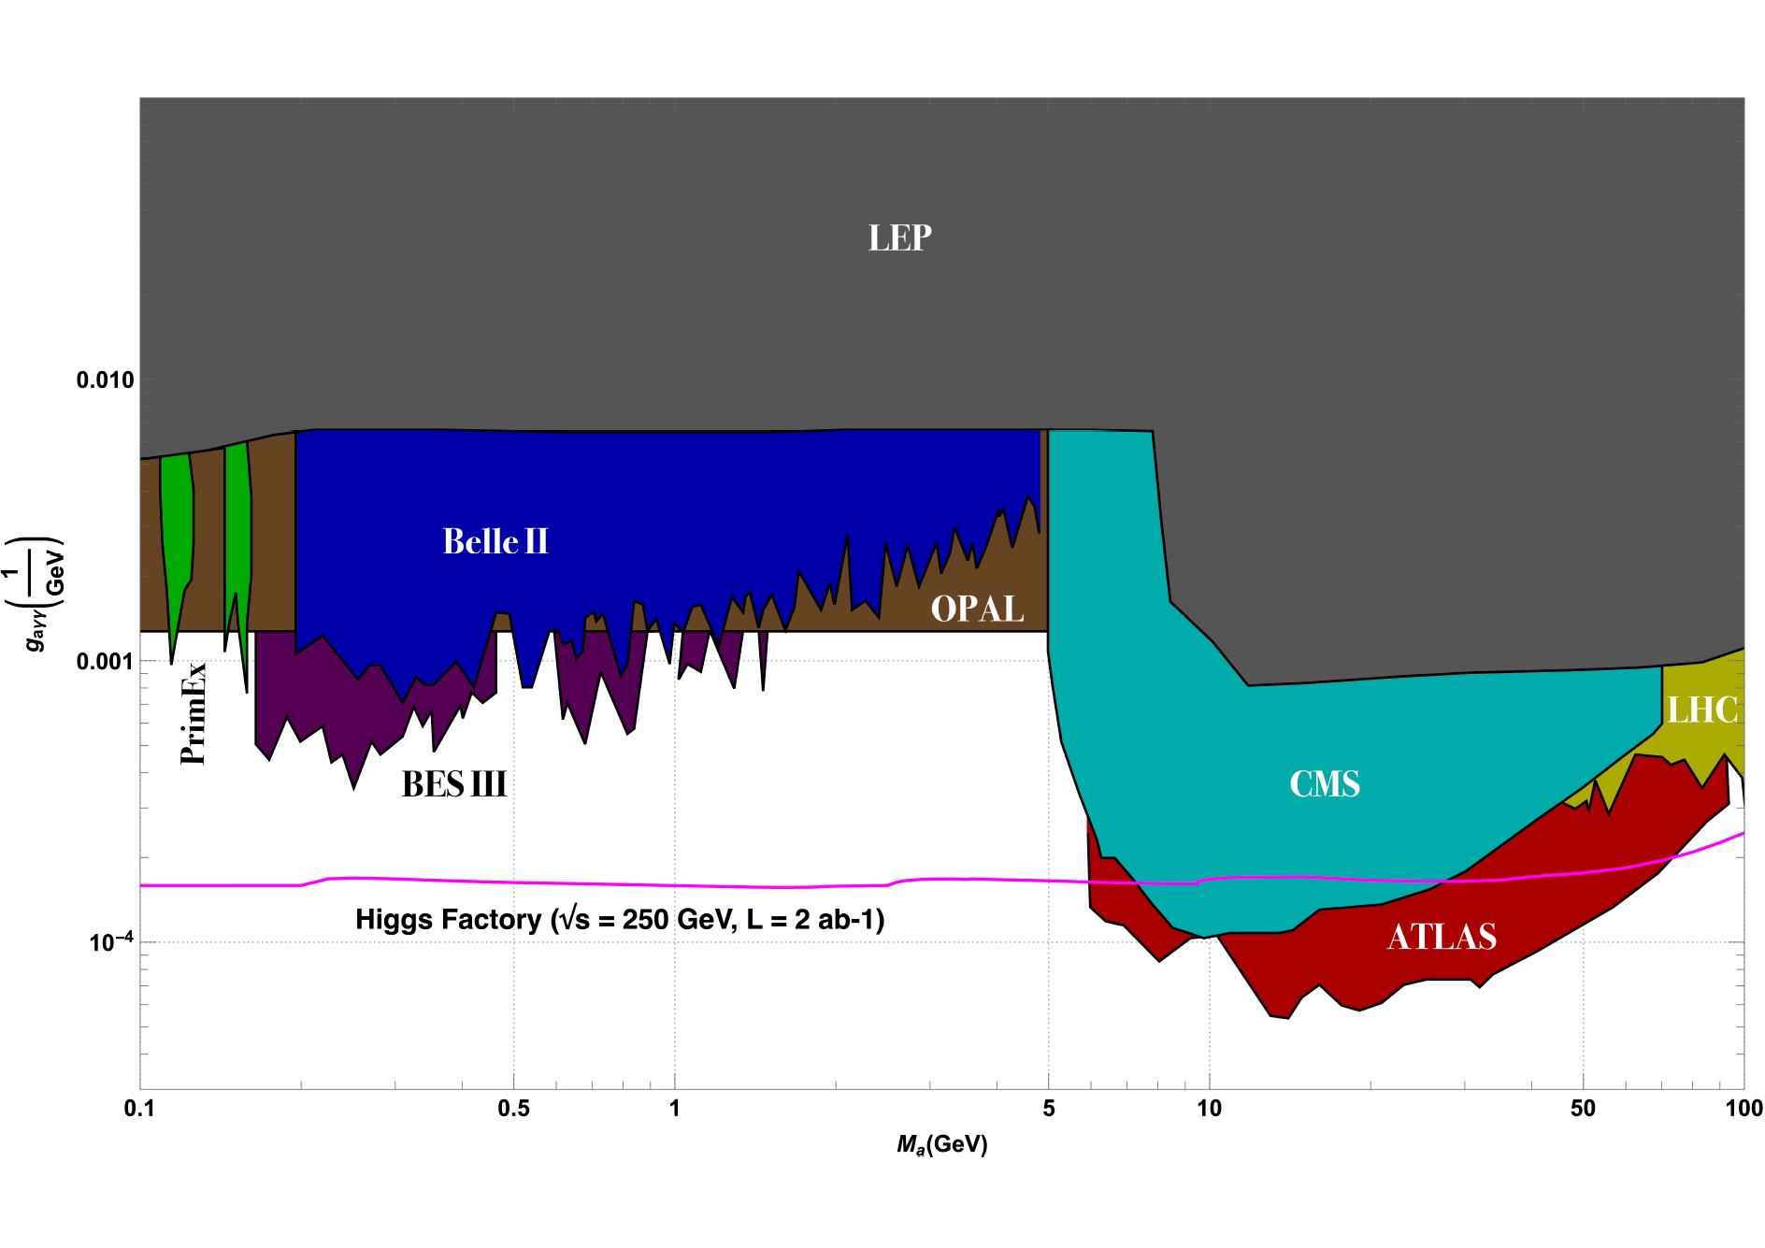
ALP sensitivity reach
CEPC

Slide 3
Lepton dipole form factors

Slide 5
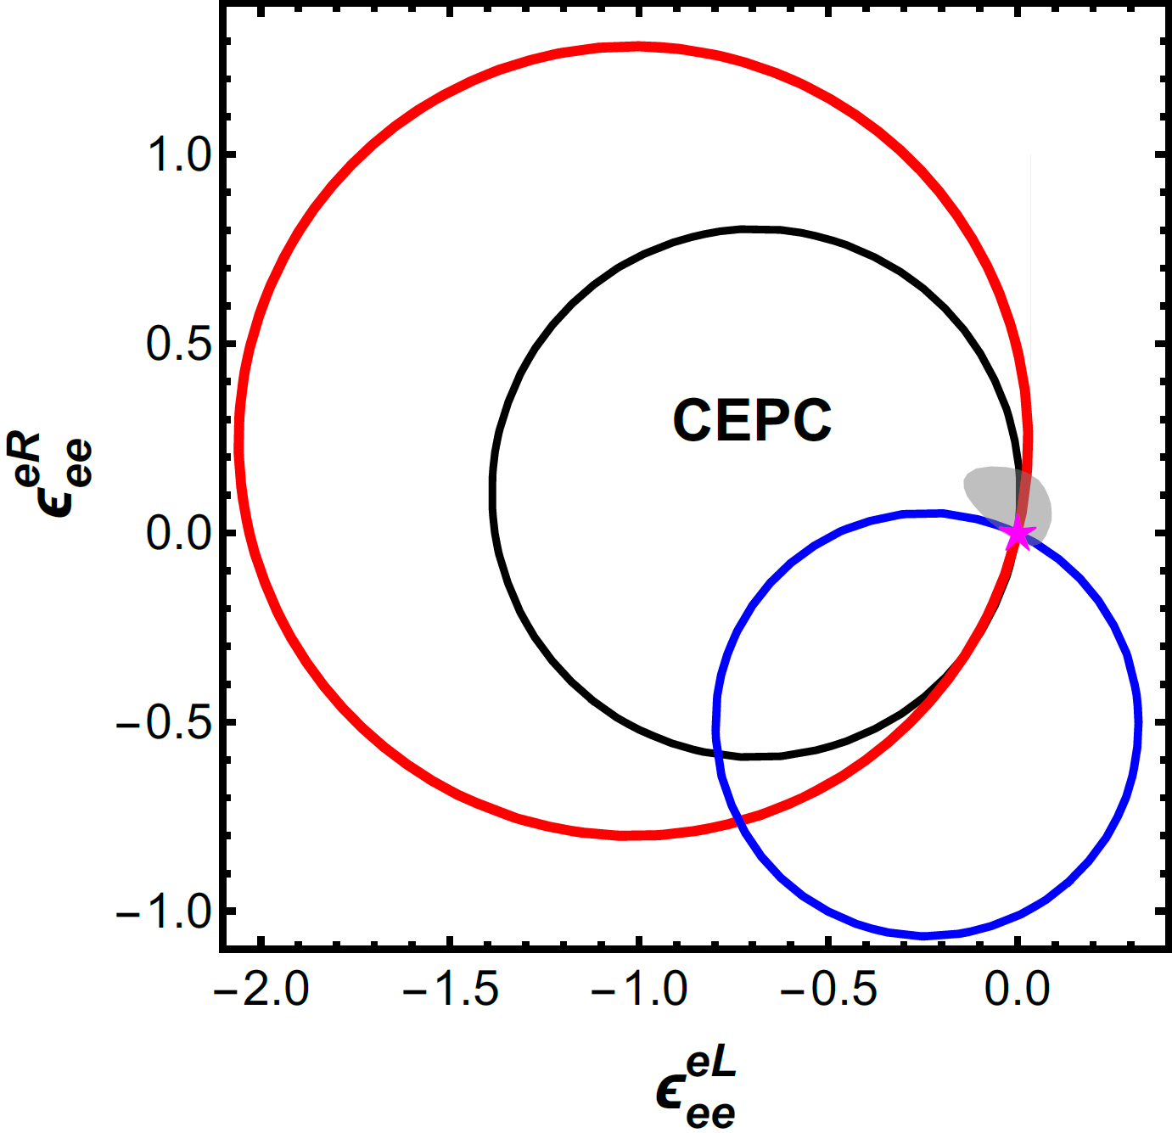
NSI search

Slide 6
Discussion of understanding the QCD’s mass generation
Status: CEPC’s luminosity in heavy-flavored meson will help measure the form-factors. So far dedicated studies are yet to be performed.

Slide 7
Koide’s mass formula, and extended Higgs sector models.
To certain level of precision
Yukawaon model: make Yukawas into Dim-5 and relate two Higgs’ vevs.
CEPC Possibility: would involve weakly interacting heavy scalars

