Slide 1
chiral magnetic effect in lattice gauge theory
Based on 0907.0494(Phys. Rev. D 80 (2009) 054503)
Kun Xu
2023/10/20

Slide 2
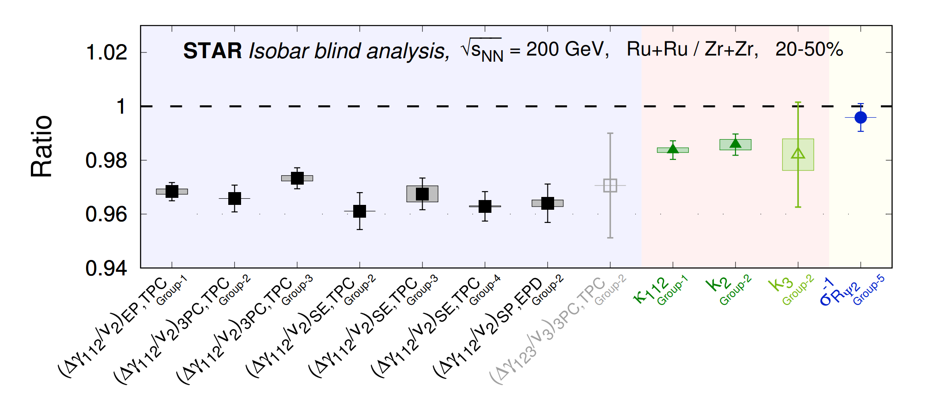
arXiv: 2109.00131
The fact that CME-sensitive observable ratios lie below unity leads to the conclusion that NO predefined CME signatures are observed in this blind analysis.

Slide 3
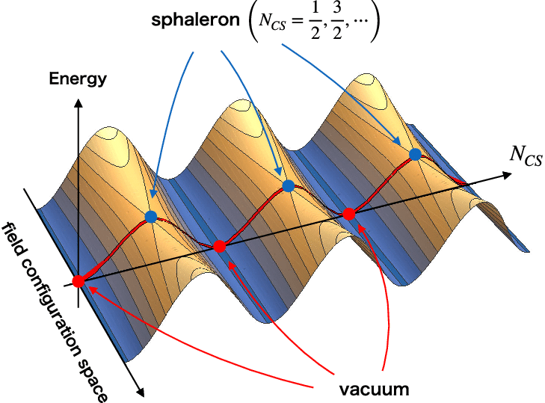
Topological winding number
gluon field strength tensor
Dual tensor
the difference between the number of left-handed quarks (NL) and right-handed (NR) quarks by an integer,
Axial-vector interaction

Slide 4
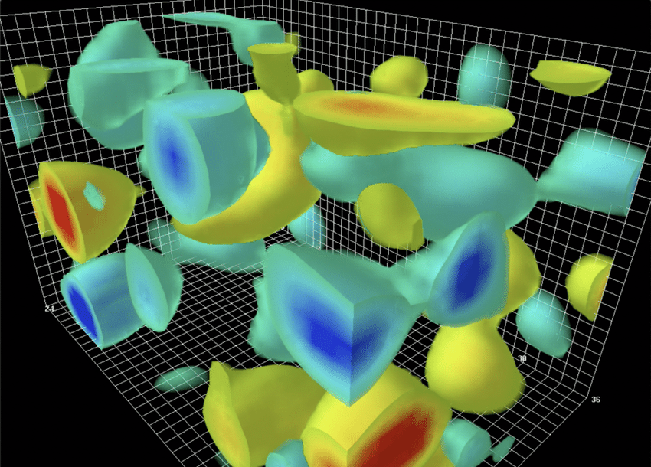
Topological winding number
the configurations with nonzero topological charge
Instanton, Q>0
Anti-Instanton, Q<0
gluon field strength tensor
Dual tensor
the difference between the number of left-handed quarks (NL) and right-handed (NR) quarks by an integer,
Axial-vector interaction

Slide 5
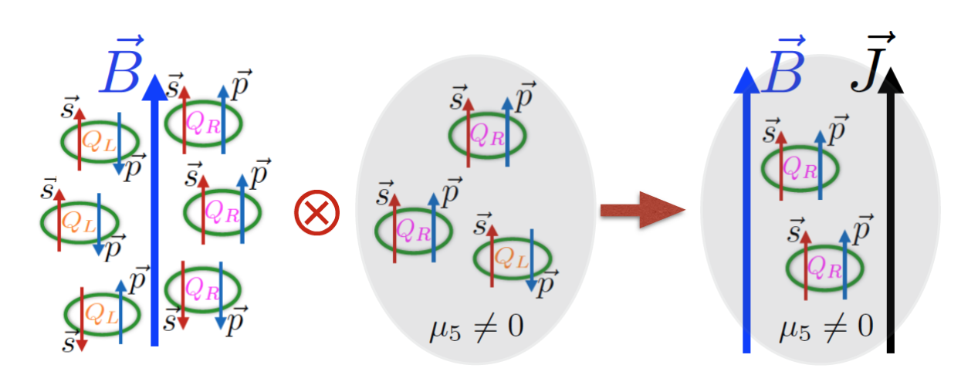
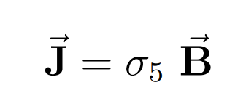
Chiral Magnetic Effect (CME)
1511.04050
This effect was called “event-by-event P- and CP-violation”, because this asymmetry implies that the difference of the numbers of quarks of different chiralities was created in a particular event due to quantum fluctuations of the topological charge.
(1)spatial separation of positive and negative electric charges along the direction of the magnetic field
(2)on nontrivial topological backgrounds of gluons

Slide 6
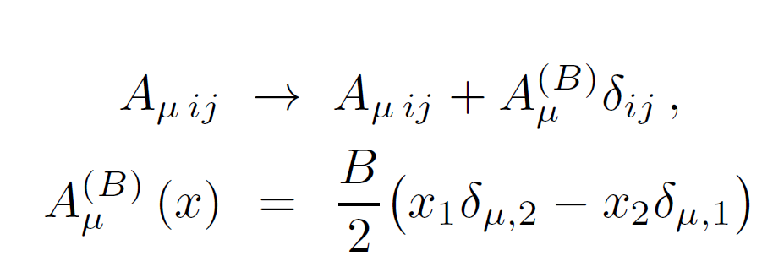
LATTICE setup
SU(2) lattice gauge
The critical temperature in SU(2) gauge theory is Tc = 313.(3)MeV
(1) only valence quarks interact with electromagnetic field
(2) quenched approximation: the effects of the virtual quarks on the gluon fields are neglected
Magnetic field:

Slide 7
(1) All studied CME relate observables are independent of the global charge of the gluon fields.
(2) Each gauge field configuration contains quite strong local fluctuations of the topological charge.
(3) The effect of the global topology is completely overshadowed by strong local fluctuations of the topological charge.

Slide 8
Observables and topology
local chirality: difference of the local densities of left- and right-handed quarks.
electromagnetic current
All other studied quantities are the powers and the products???

Slide 9
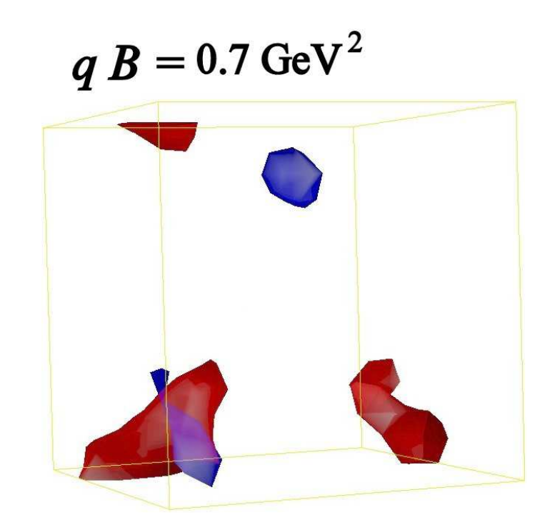
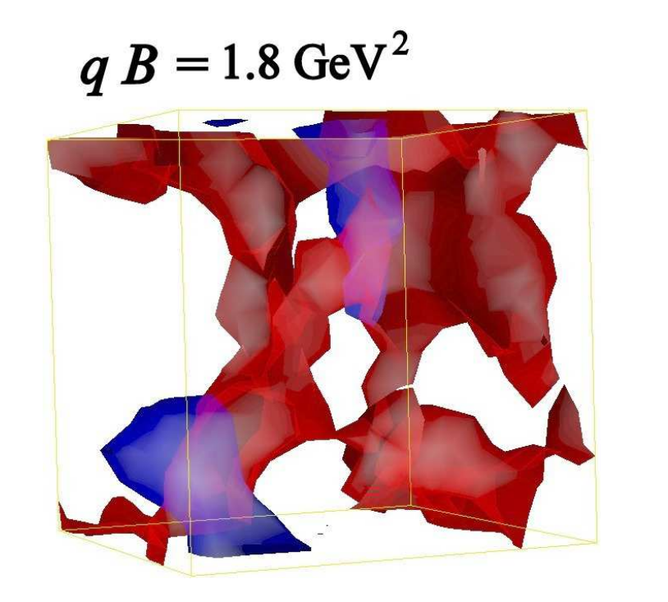
Red: positive
Blue: negative
1, the external magnetic field indeed induces a spatial excess of the electric charge density. The stronger the field the larger the excess.
2, the charge density is spatially extended along the direction of the magnetic field

Slide 10
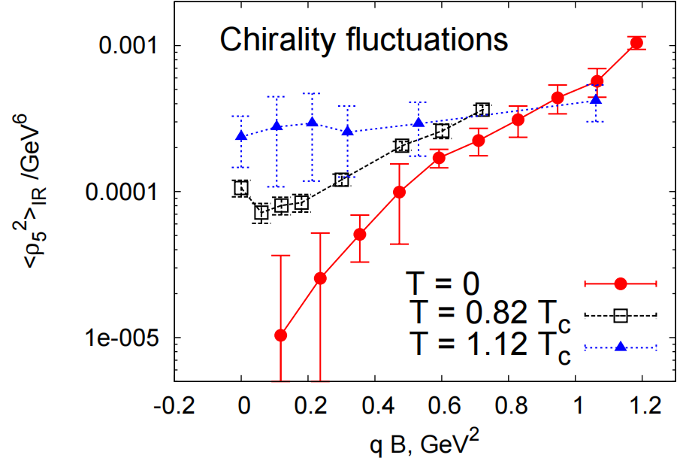
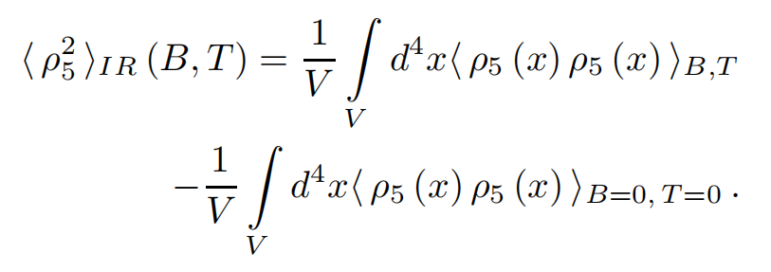
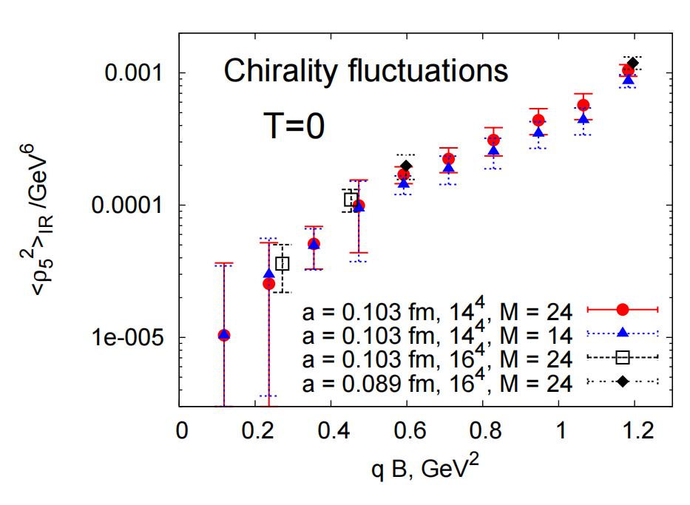
the square of the local chirality
in strong magnetic field, quark undergoes one-dimensional motion along the magnetic field, quark chirality can be efficiently changed in
local one-dimensional scattering processes on the fluctuations of gauge fields, where the spin is not affected but the momentum changes its sign.

Slide 11
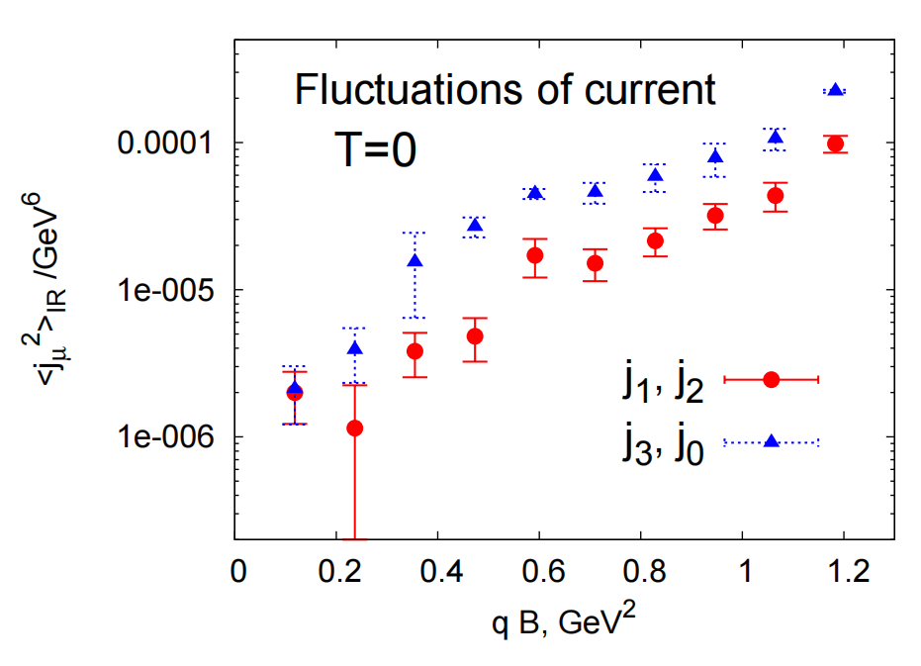
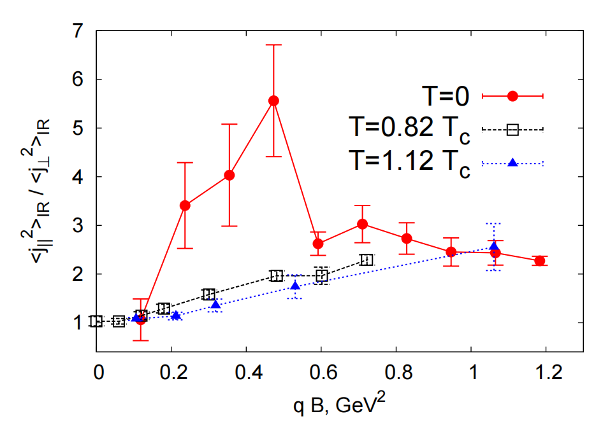
Globally non electric currents
Fluctuations of electromagnetic current

Slide 12
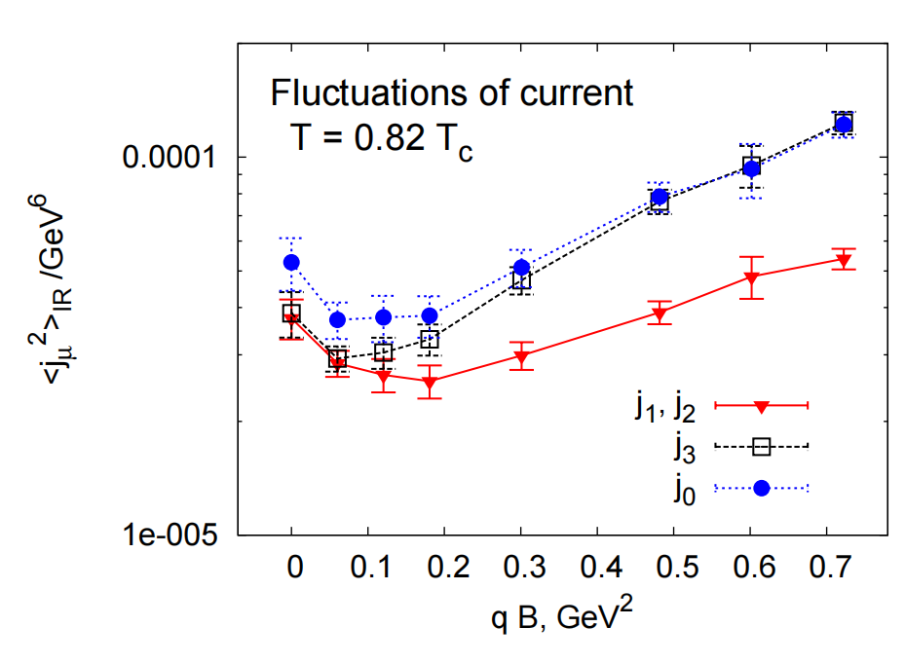
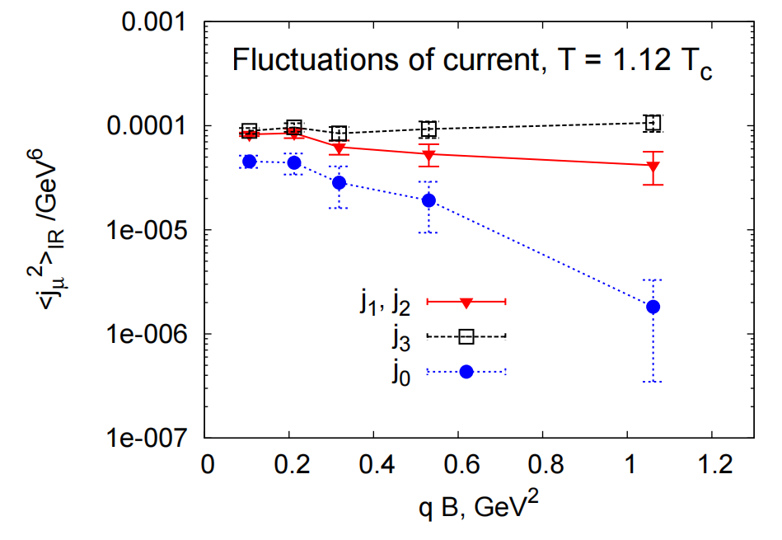
Globally non electric currents
Fluctuations of electromagnetic current

Slide 13
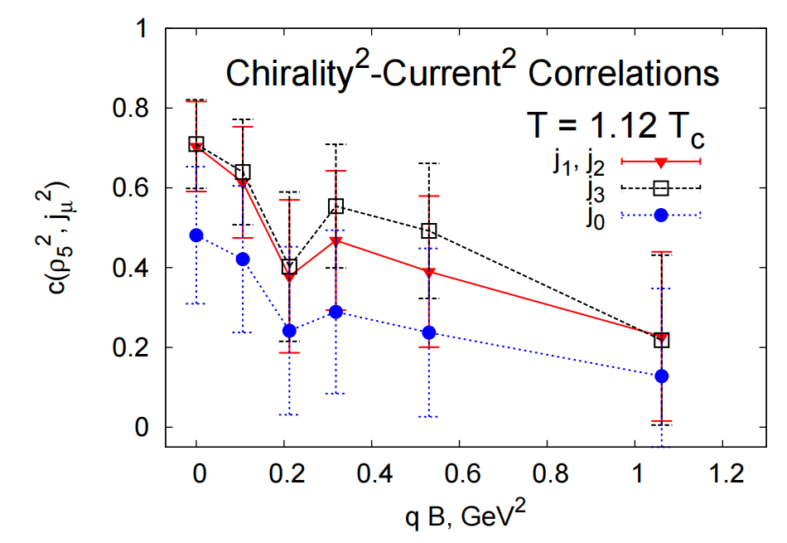
Chirality-current correlations
in the confinement phase

Slide 14
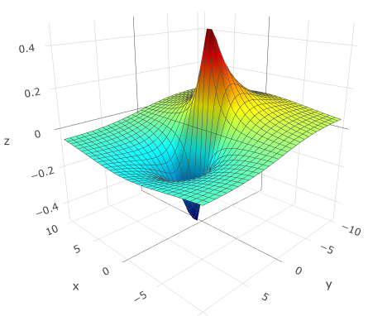
instanton-like configuration
instanton

Slide 15
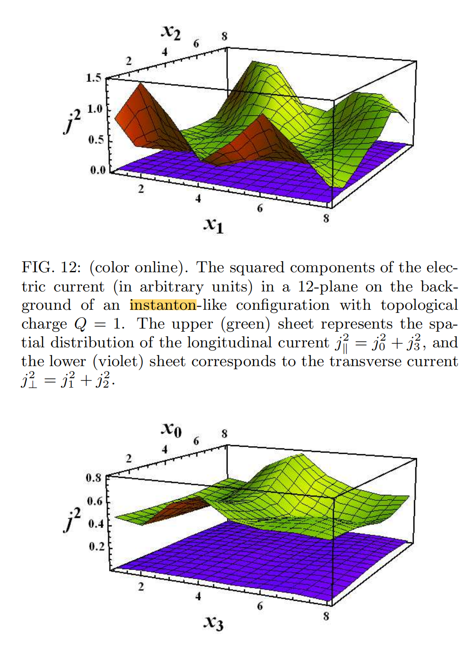
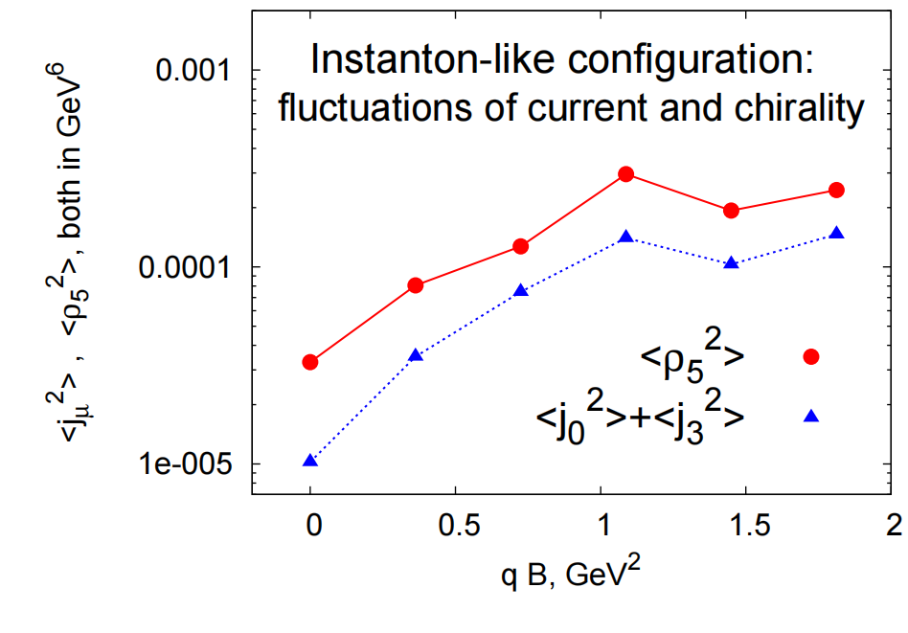
instanton-like configuration

Slide 16
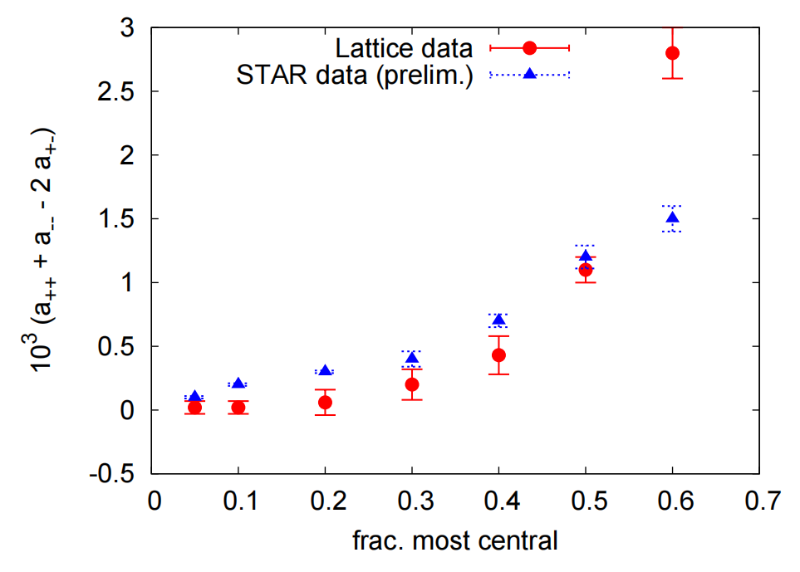
CHARGE ASYMMETRY: COMPARISON
WITH EXPERIMENT

Slide 17
Conclusion
The CME at the instanton-like configurations is much more pronounced compared to the real gluonic vacuum
On average the global chiral charge is zero, while the local fluctuations of the chiral density can be quite strong
We also found that the presence of a nonzero global topological charge in the real gluonic configurations leads to a little effect on the longitudinal currents. This happens because the influence of a global charge is largely overshadowed by strong local fluctuations of the topological charge. We conclude, that in our simulations the CME is realized at local lumps of topological charge in the gluonic configuration

