Slide 1
全吸收型Gamma谱仪文献调研
陈思远
MACE实验合作组会议
2023年11月8日

Slide 2
1
研究背景
RESEARCH BACKGROUND
4π全吸收型探测器优势
高本征探测效率
大立体角覆盖
本底甄别能力

Slide 3
1
研究背景
RESEARCH BACKGROUND
4π全吸收型探测器研究现状（高能物理）
Oreglia, Mark Joseph. Study of the reactions psi'--> gamma gamma psi. Stanford Univ., CA (USA), 1981.
Frlež, E., et al. "Design, commissioning and performance of the PIBETA detector at PSI." Nuclear Instruments and Methods in Physics Research Section A: Accelerators, Spectrometers, Detectors and Associated Equipment 526.3 (2004): 300-347.

Slide 4
1
研究背景
RESEARCH BACKGROUND
4π全吸收型探测器研究现状（核物理）
Jääskeläinen, M., et al. "The spin spectrometer: Design, instrumentation and response characteristics of 4πγ-ray multidetector system." Nuclear instruments and methods in physics research 204.2-3 (1983): 385-405.
Wisshak, K., F. Käppeler, and H. Müller. "Prototype crystals for the Karlsruhe 4π barium fluoride detector." Nuclear Instruments and Methods in Physics Research Section A: Accelerators, Spectrometers, Detectors and Associated Equipment 251.1 (1986): 101-107.
Heil, M., et al. "A 4πBaF2 detector for (n, γ) cross-section measurements at a spallation neutron source." Nuclear Instruments and Methods in Physics Research Section A: Accelerators, Spectrometers, Detectors and Associated Equipment 459.1-2 (2001): 229-246.
Guerrero, C., et al. "The n_TOF Total Absorption Calorimeter for neutron capture measurements at CERN." Nuclear Instruments and Methods in Physics Research Section A: Accelerators, Spectrometers, Detectors and Associated Equipment 608.3 (2009): 424-433.
He G. Z. 2006 Study on (n, γ) Reaction Cross Section Measurement with BaF2 Scintillation Detector, Ph. D. Thesis (Lanzhou: Lanzhou University) (in Chinese)

Slide 5
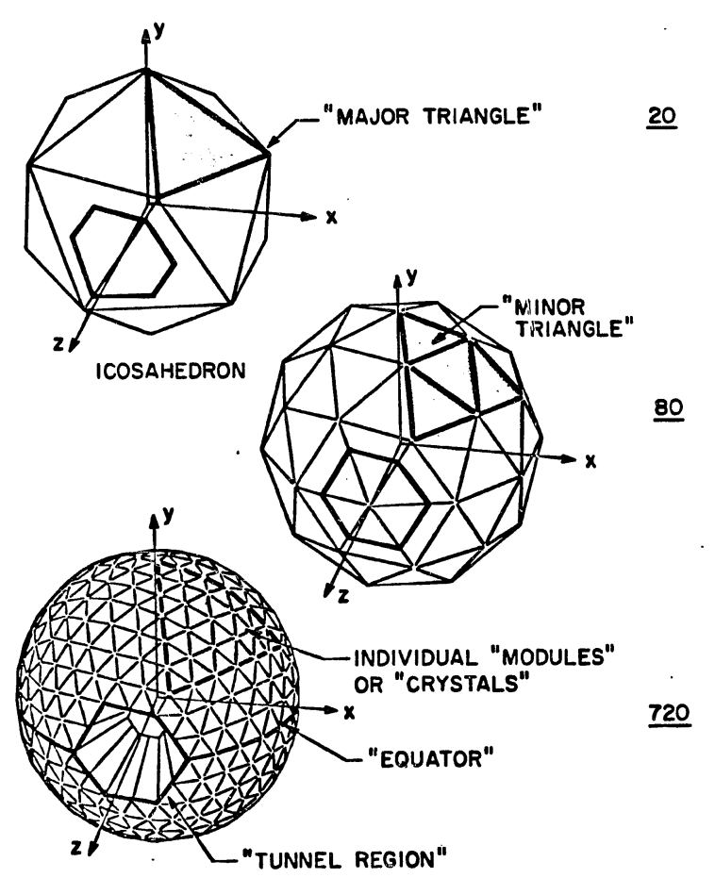
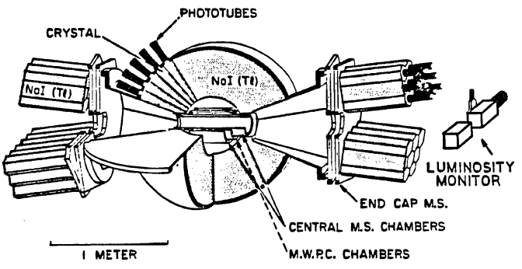
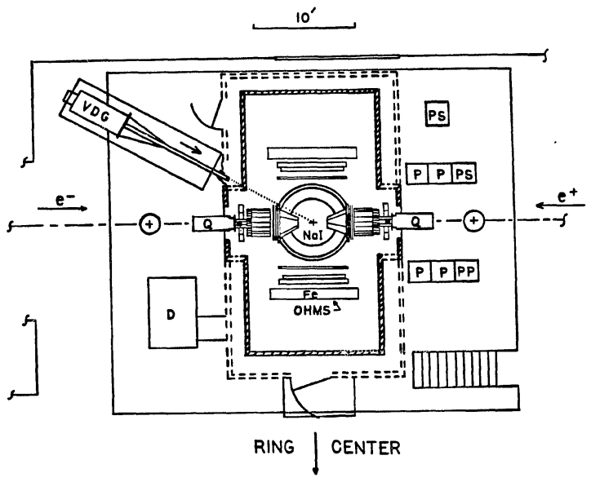
1
研究背景
RESEARCH BACKGROUND
4π全吸收型探测器研究现状（高能物理）
Oreglia, Mark Joseph. Study of the reactions psi'--> gamma gamma psi. Stanford Univ., CA (USA), 1981.
Gamma: about 550 MeV
Scintillator: NaI(Tl)
N_Crystals: 672
Resolution: 20% at 0.662 MeV

Slide 6
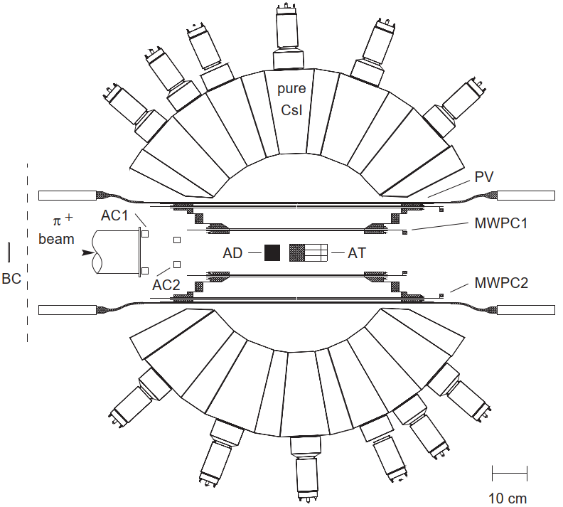
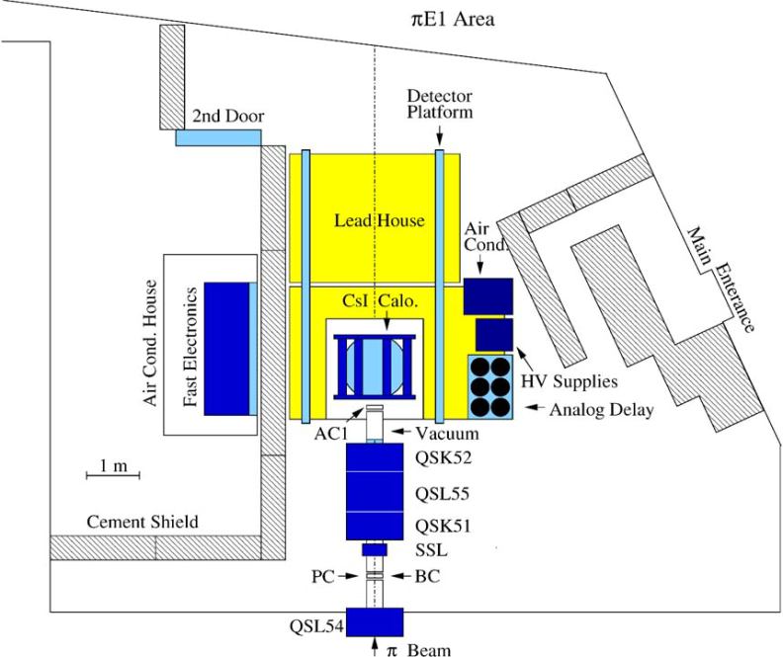
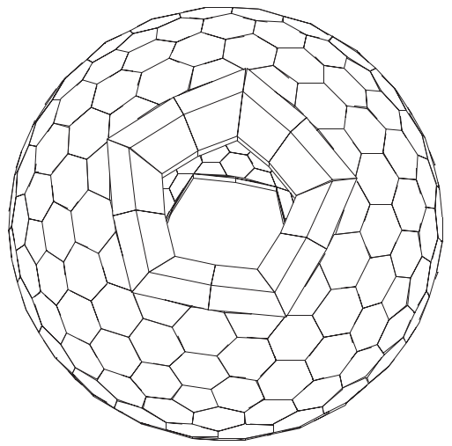
1
研究背景
RESEARCH BACKGROUND
4π全吸收型探测器研究现状（高能物理）
Frlež, E., et al. "Design, commissioning and performance of the PIBETA detector at PSI." Nuclear Instruments and Methods in Physics Research Section A: Accelerators, Spectrometers, Detectors and Associated Equipment 526.3 (2004): 300-347.
Gamma: 70 MeV
Scintillator: pure CsI
N_Crystals: 240
Resolution: 12.8% at 62.55 MeV,
10% at 128.70 MeV

Slide 7
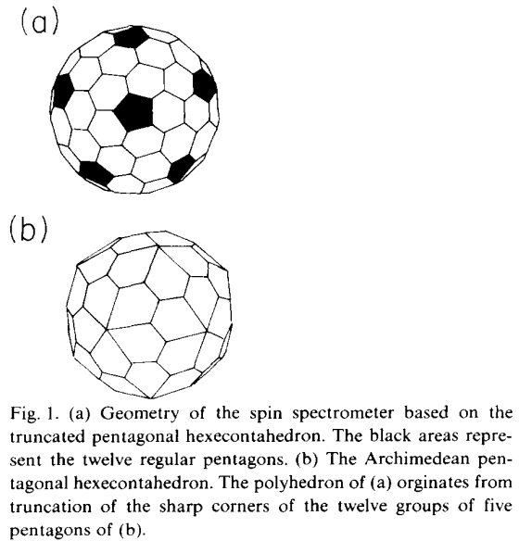
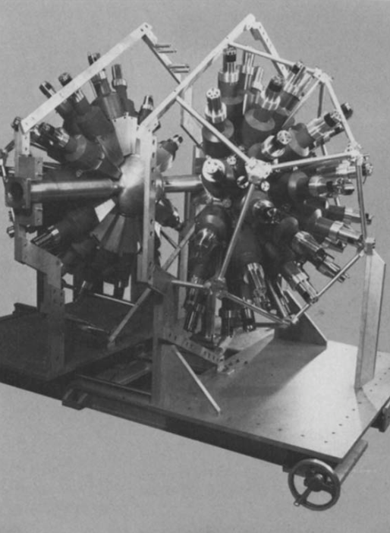
1
研究背景
RESEARCH BACKGROUND
4π全吸收型探测器研究现状（核物理）
Jääskeläinen, M., et al. "The spin spectrometer: Design, instrumentation and response characteristics of 4πγ-ray multidetector system." Nuclear instruments and methods in physics research 204.2-3 (1983): 385-405.
Gamma: Various
Scintillator: NaI(Tl)
N_Crystals: 72
Resolution: 9.9% at 0.662 MeV

Slide 8
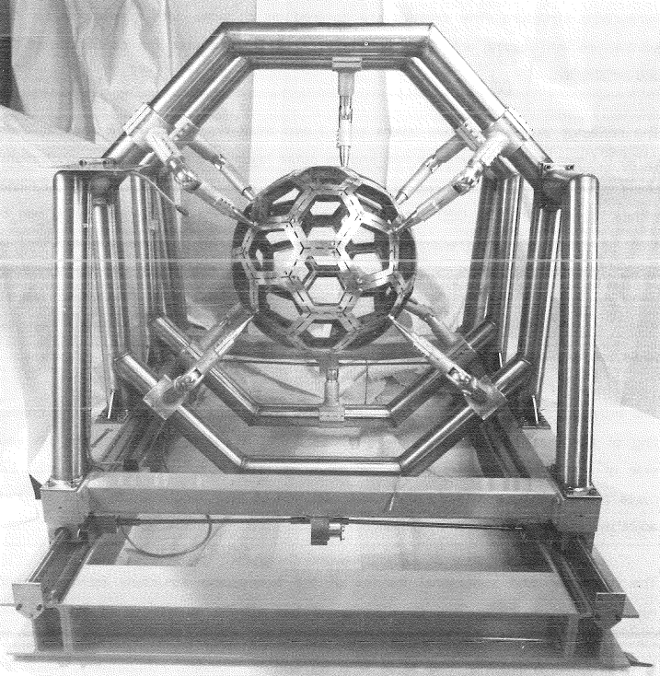
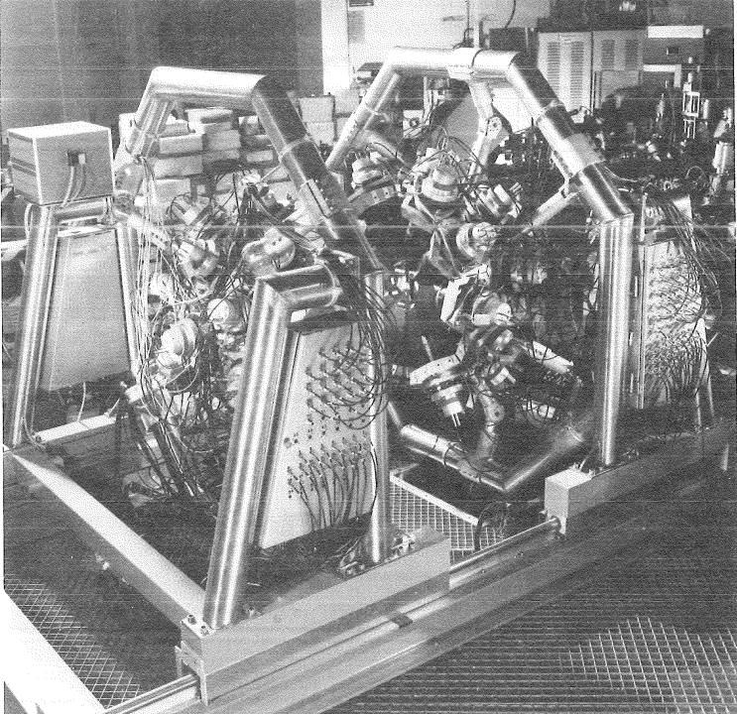
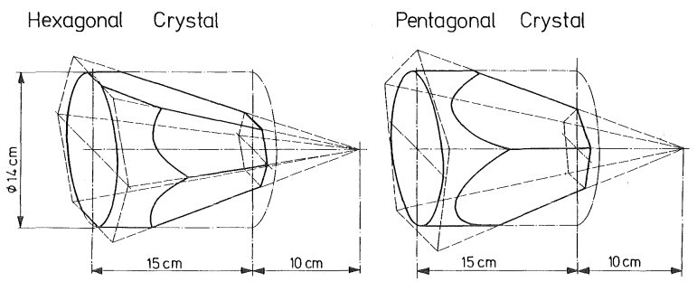
1
研究背景
RESEARCH BACKGROUND
4π全吸收型探测器研究现状（核物理）
Wisshak, K., F. Käppeler, and H. Müller. "Prototype crystals for the Karlsruhe 4π barium fluoride detector." Nuclear Instruments and Methods in Physics Research Section A: Accelerators, Spectrometers, Detectors and Associated Equipment 251.1 (1986): 101-107.
Gamma: Various
Scintillator: BaF₂
N_Crystals: 42
Resolution: 14% at 0.662 MeV, 7% at 2.5 MeV

Slide 9
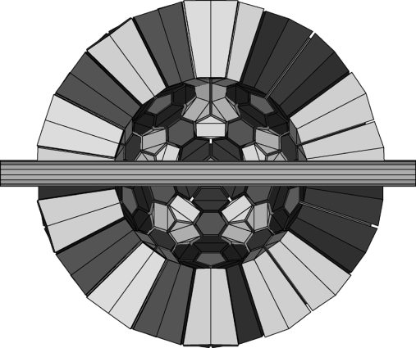
1
研究背景
RESEARCH BACKGROUND
4π全吸收型探测器研究现状（核物理）
Heil, M., et al. "A 4πBaF2 detector for (n, γ) cross-section measurements at a spallation neutron source." Nuclear Instruments and Methods in Physics Research Section A: Accelerators, Spectrometers, Detectors and Associated Equipment 459.1-2 (2001): 229-246.
Gamma: Various
Scintillator: BaF₂
N_Crystals: 162
Resolution: 9.0% at 1.173 MeV

Slide 10
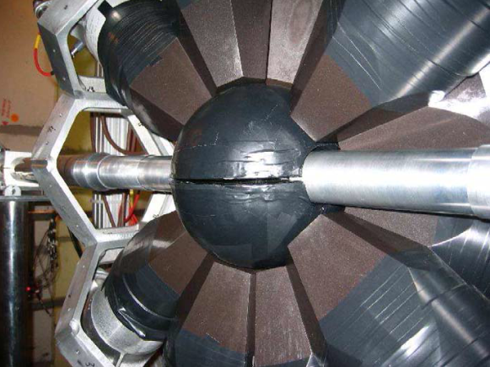
1
研究背景
RESEARCH BACKGROUND
4π全吸收型探测器研究现状（核物理）
Guerrero, C., et al. "The n_TOF Total Absorption Calorimeter for neutron capture measurements at CERN." Nuclear Instruments and Methods in Physics Research Section A: Accelerators, Spectrometers, Detectors and Associated Equipment 608.3 (2009): 424-433.
Gamma: Various
Scintillator: BaF₂
N_Crystals: 40
Resolution: ~15%

Slide 11
2
研究进展
RESEARCH PROGRESS
量能器工作计划
根据Full Simulation结果确定MACE实验对量能器的要求（能量、时间分辨率、探测效率）
封装方式、光耦合、光收集测试
样机、电子学、机械结构、制图

Slide 12
THANKS
感谢！

