Slide 1
Exotic Nuclear Shapes
Dario Vretenar
University of Zagreb

Slide 2
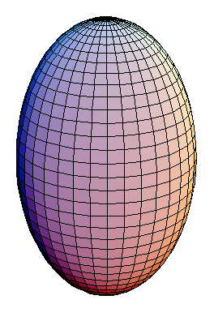
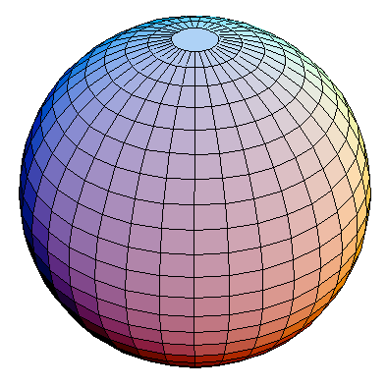
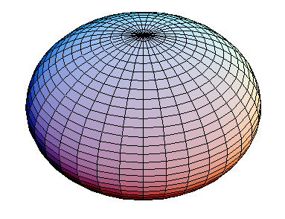
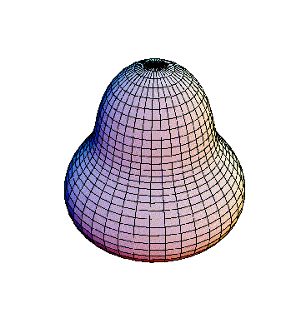
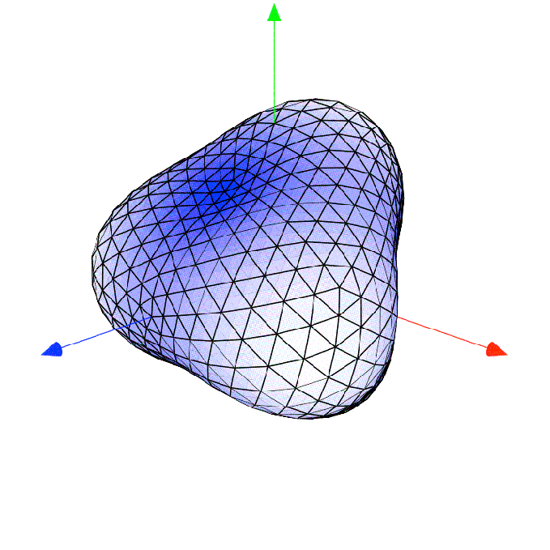
How can nucleonic matter support a diversity of shapes in finite systems?
Evolution of shell structures with nucleon number and/or angular momentum.

Slide 3
Multipole expansion of the nuclear surface

Slide 4
Stabilizing effect of closed shells →
spherical shape
Deformation-driving part of the effective interaction →
T=0 Qp∙Qn force
Shape transitions within a single nucleus (shape coexistence) or as a function of nucleon number (shape evolution), present universal phenomena that occur in light, medium-heavy, heavy and superheavy nuclei.

Slide 5
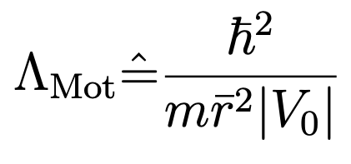
Localization and clustering in nucleonic matter
…quantality parameter:
➠ ratio of the zero-point kinetic energy of the confined particle to its potential energy.
inter-particle distance
depth of the potential
B. Mottelson ➠ the transition between a solid phase (small kinetic energy compared to the potential at equilibrium) and a liquid (relatively large kinetic energy in comparison to the depth of the potential) occurs for Λ_{Mot} ≃ 0.1.
For nuclear matter: the inter-nucleon distance ~ 1 fm, the strength of the nucleon-nucleon interaction |V₀|≃100 MeV, mc² ≃ 940 MeV ⇒ Λ_{Mot} ≃ 0.4 is a characteristic value for the nuclear quantum liquid phase.
J. P. Ebran, E. Khan, T. Nikšić, and D. Vretenar, J. Phys. G 44, 103001 (2017)

Slide 6
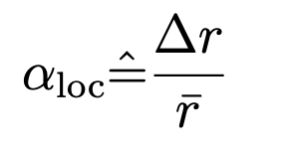
Liquid-cluster transition in finite nuclei
…the de Broglie wavelength for the motion of nucleons:
… for E ~ 0 and V = − V0 ⇒
… no nuclear mass or size dependence!
DEF. Localization parameter:
…spatial dispersion of single-nucleon wave functions:
For 𝛼_{loc} >>1 ⇒ delocalised orbits of individual nucleons (Fermi liquid phase).
When 𝛼_{loc} <<1 ⇒ localised nucleons (crystal-like structure).
For 𝛼_{loc} ≈ 1 the spatial dispersion of the single-nucleon wave function ≈ inter-nucleon distance ⇒ transition from the quantum liquid phase to a hybrid phase of cluster states.

Slide 7
Clusters in light alpha-conjugate nuclei
Self-consistent mean-field calculations based on nuclear energy density functionals (EDFs), with constraints on mass multipole moments.
The confining potential determines the energy spacings between single-nucleon orbitals in deformed nuclei, the localization of the corresponding wave functions, and the degree of nucleonic density clustering.
Important role of nuclear shape deformation: removes the degeneracy of single-nucleon levels associated with spherical symmetry.
²⁰Ne
Cluster states cannot be isolated from the continuum of scattering states ⇒ open quantum systems.

Slide 8
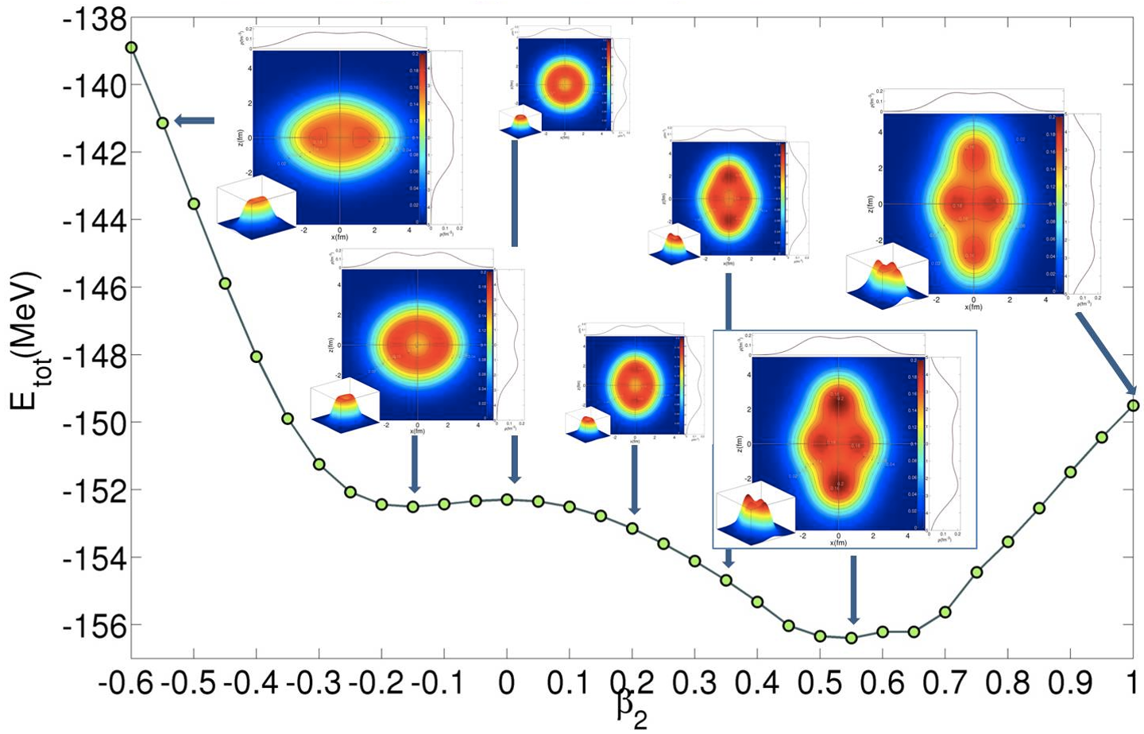
²⁰Ne: axial quadrupole constrained calculations

Slide 9
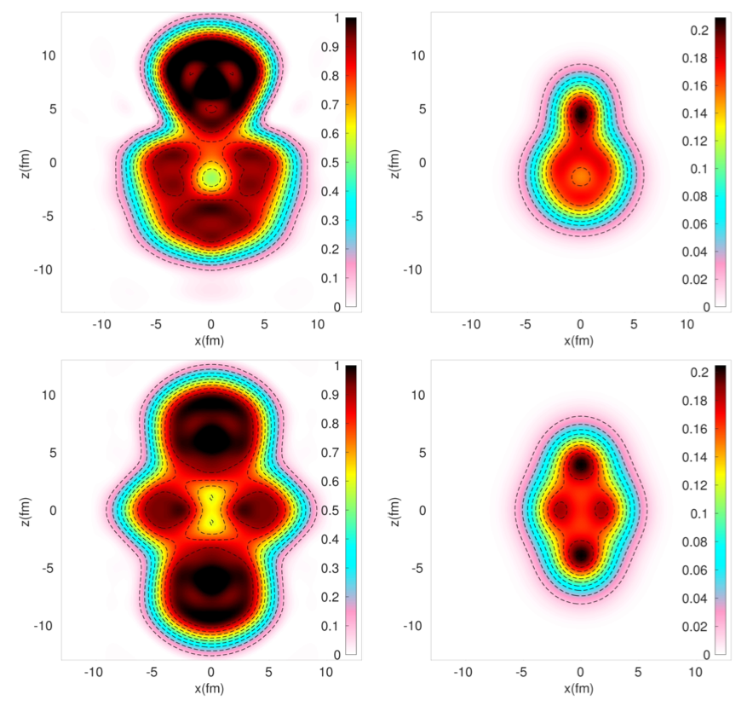
Nucleon localization functions:
kinetic energy density
density
current density
For homogeneous nuclear matter:
For the 𝛂-cluster (four particles):
Proton localization function
total density (in nucleon/fm³ )
²⁰Ne

Slide 10
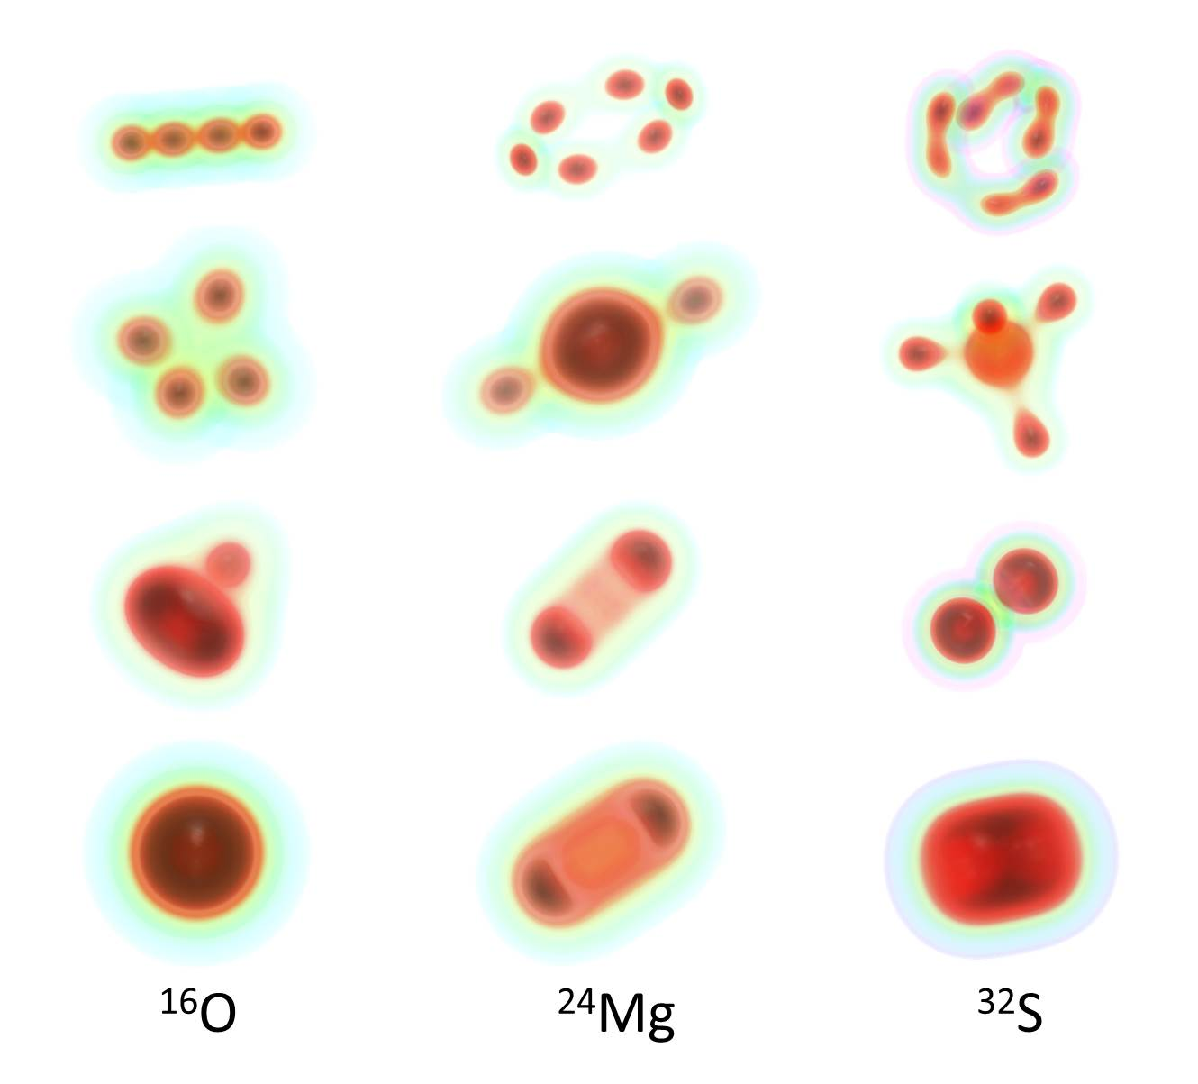
Intrinsic densities of deformation-constrained configurations in N = Z nuclei
Energy

Slide 11
Role of nuclear saturation ⇒ spontaneous αlpha-clustering at low density
⇒ locally enhances the nucleonic density toward its saturation value, thus increasing the binding of the system.
¹⁶O - SCMF calculation with a constraint on the monopole moment:

Slide 12
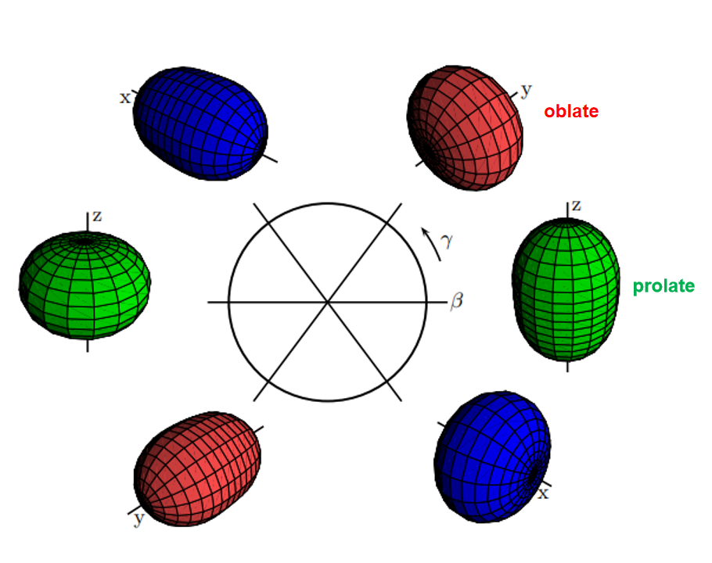
Quadrupole shapes

Slide 13
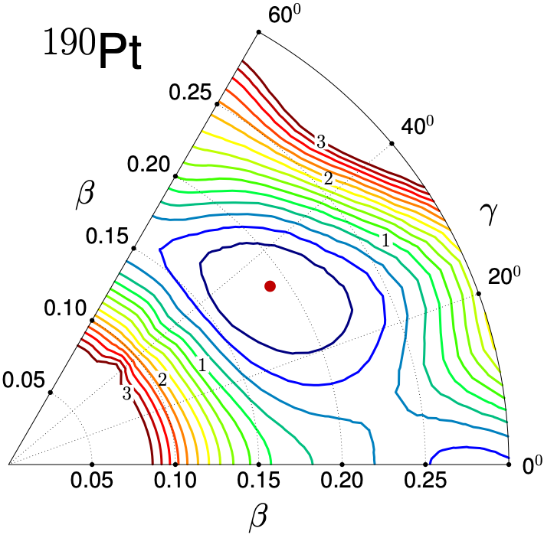
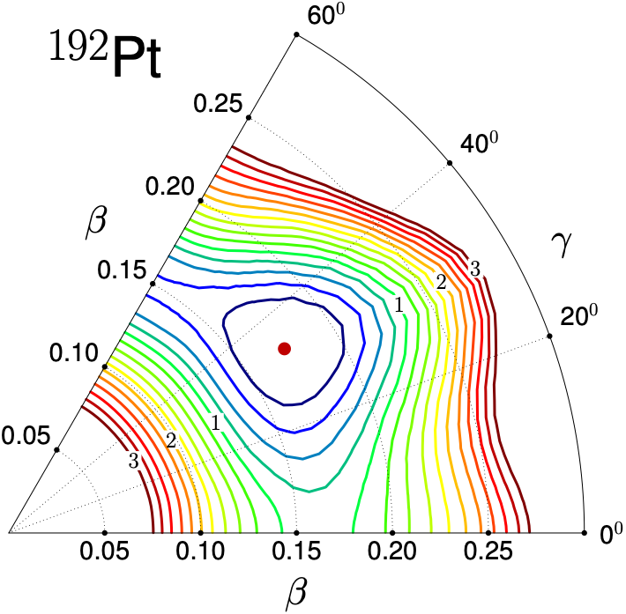
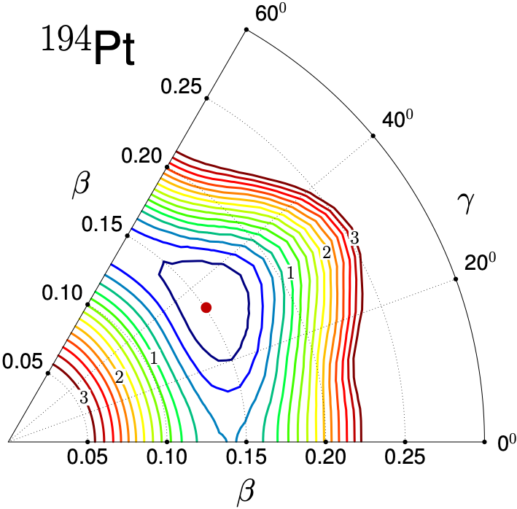
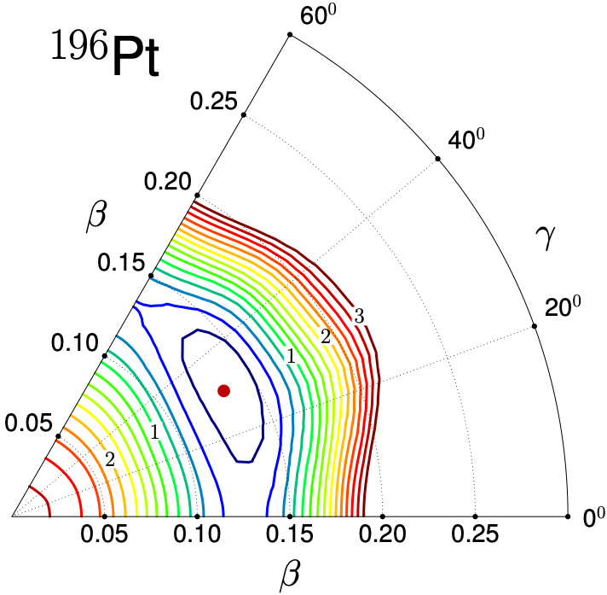
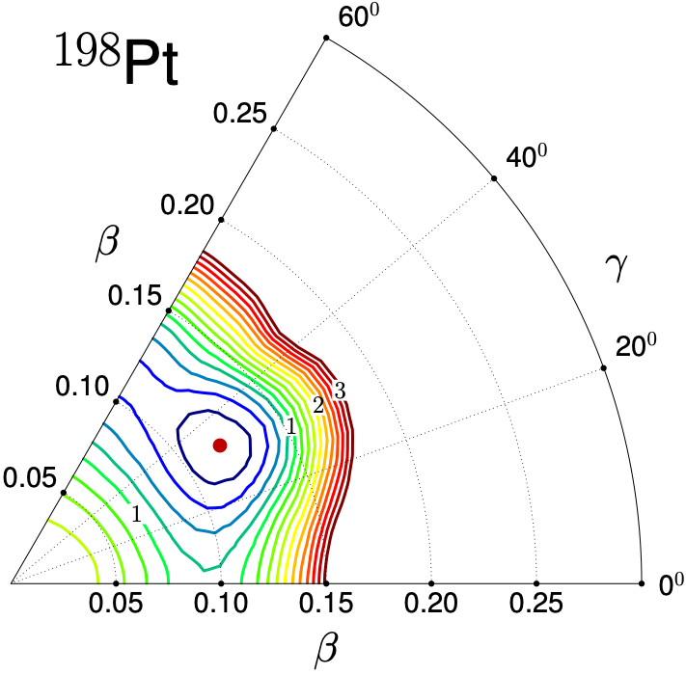
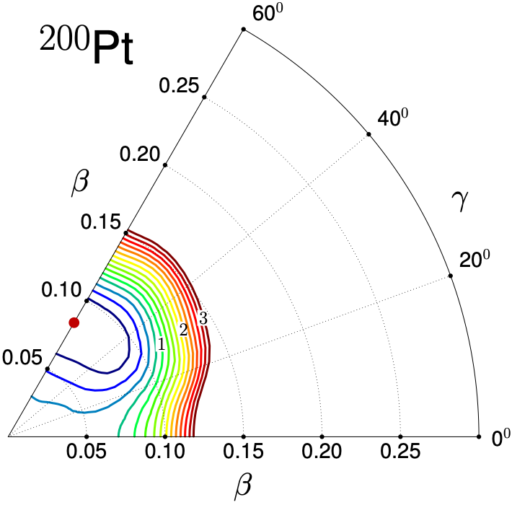
Evolution of nucleonic shells ⇒ gradual transition between equilibrium shapes
The constrained self-consistent mean-field method produces semi-classical
energy surfaces as functions of deformation parameters.

Slide 14
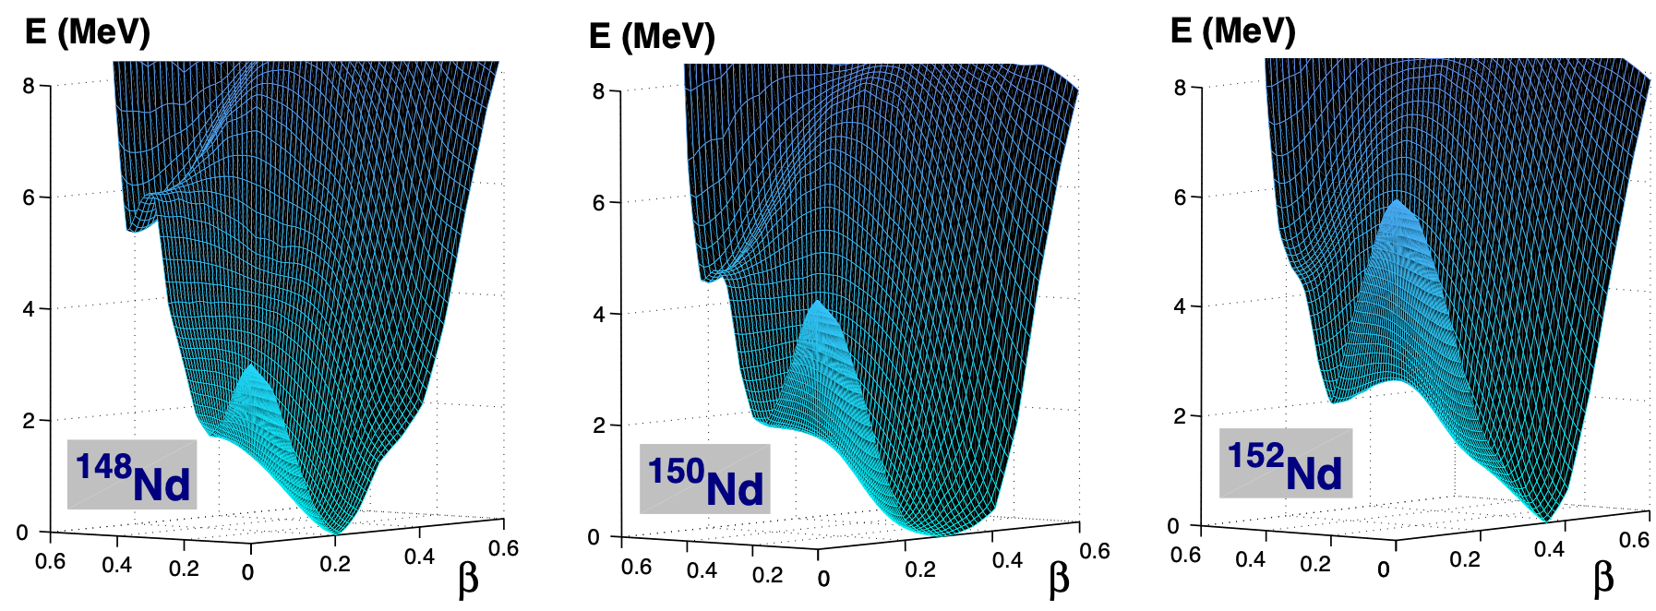
Evolution of nucleonic shells ⇒ phase transitions in equilibrium shapes
Ground-state shape transitions:
⇒ the physical control parameter - nucleon number - discrete integer values!
⇒ order parameters - expectation values of operators that as observables
characterize the state of a nuclear system.

Slide 15
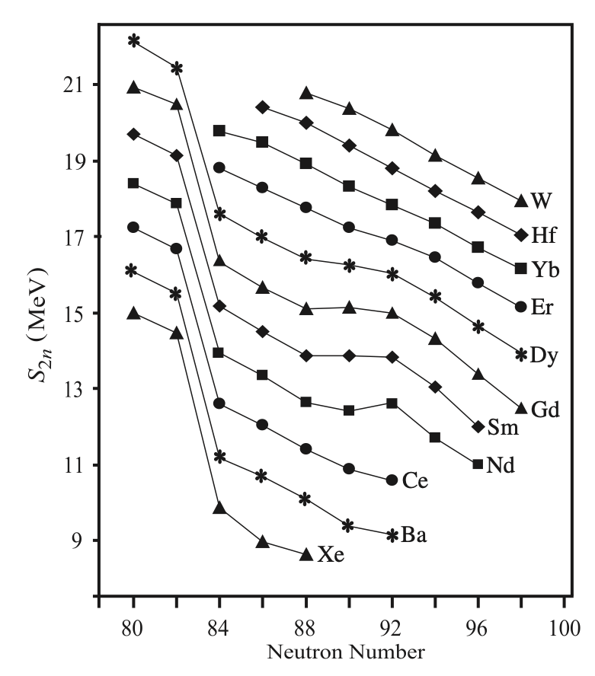
Nuclear shape (phase) transitions ⇒ Landau theory based on potentials:
⇒ direct computation of order parameters:
Both methods can be combined in a
microscopic beyond mean-field approach!

Slide 17
Order parameters:
A phase transition is characterized by a significant variation of one or more order parameters as functions of the control parameter.
How much are the discontinuities at a phase transitional point smoothed out in finite nuclei?
How precisely can a point of phase transition be associated with a particular isotope?

Slide 18
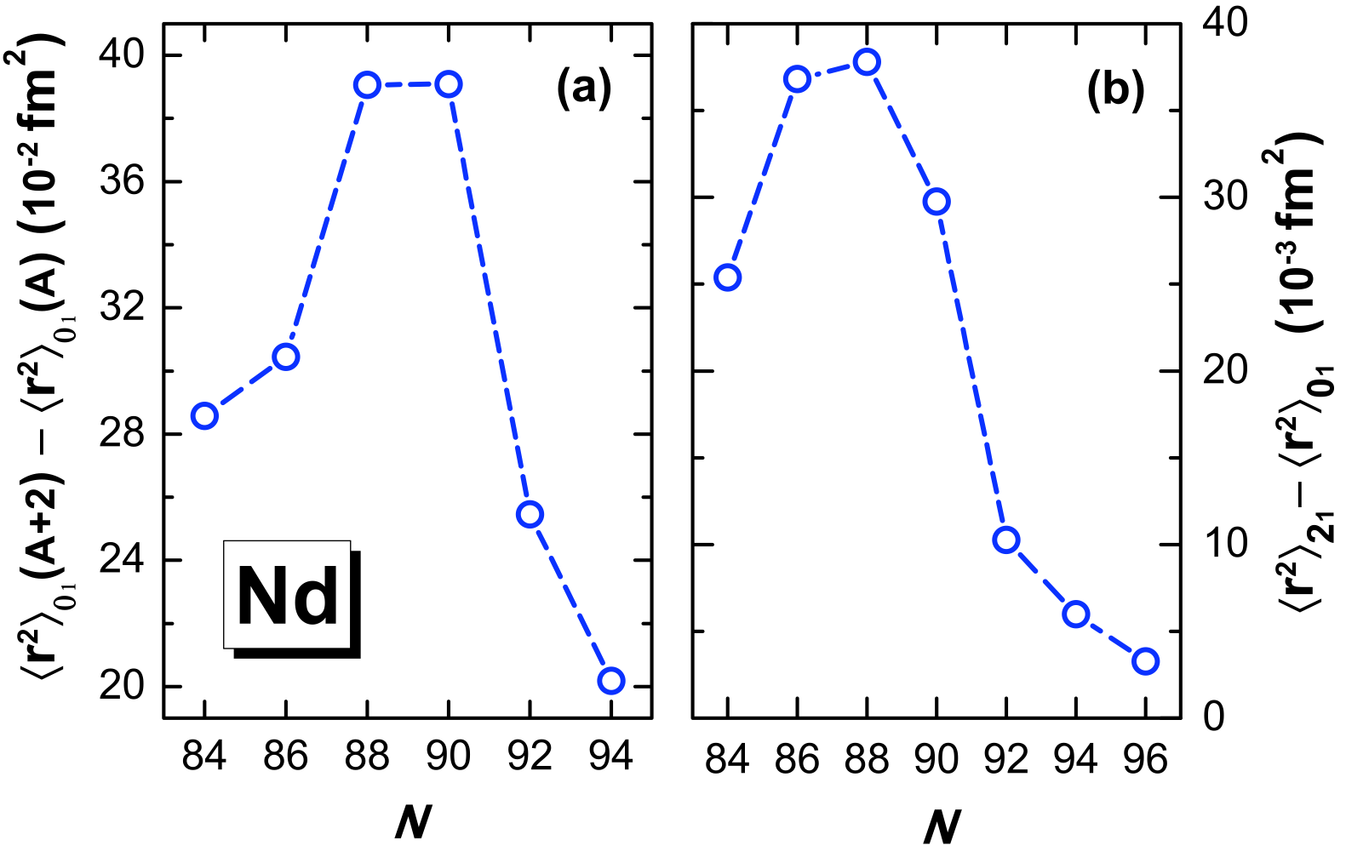
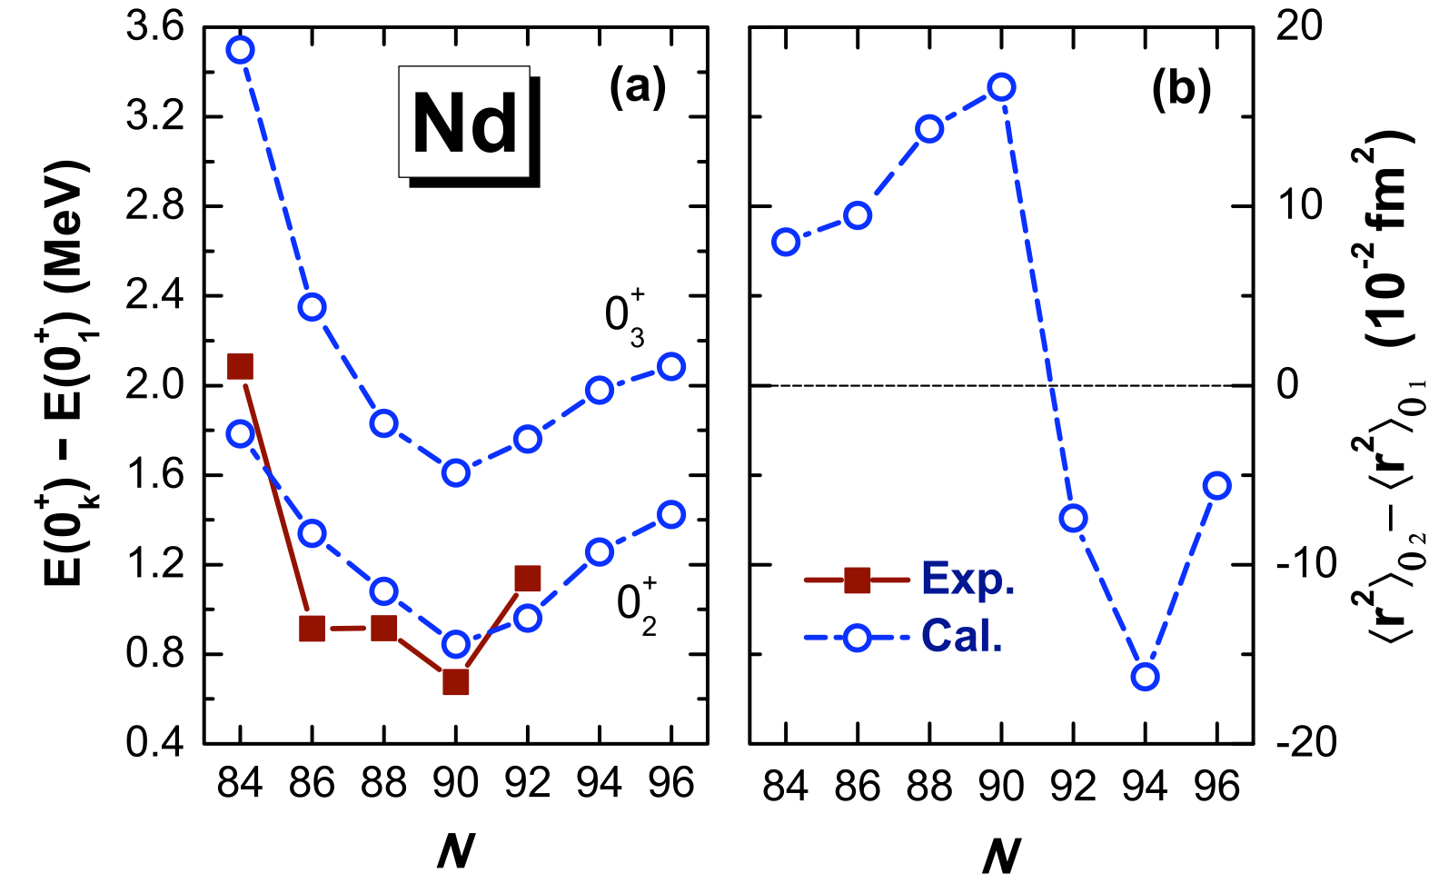
... using collective wave functions
obtained by diagonalization of the
five-dimensional Hamiltonian ...
... microscopic calculation of order
parameters for a ﬁrst-order transition
between spherical and axially
deformed shapes.

Slide 19
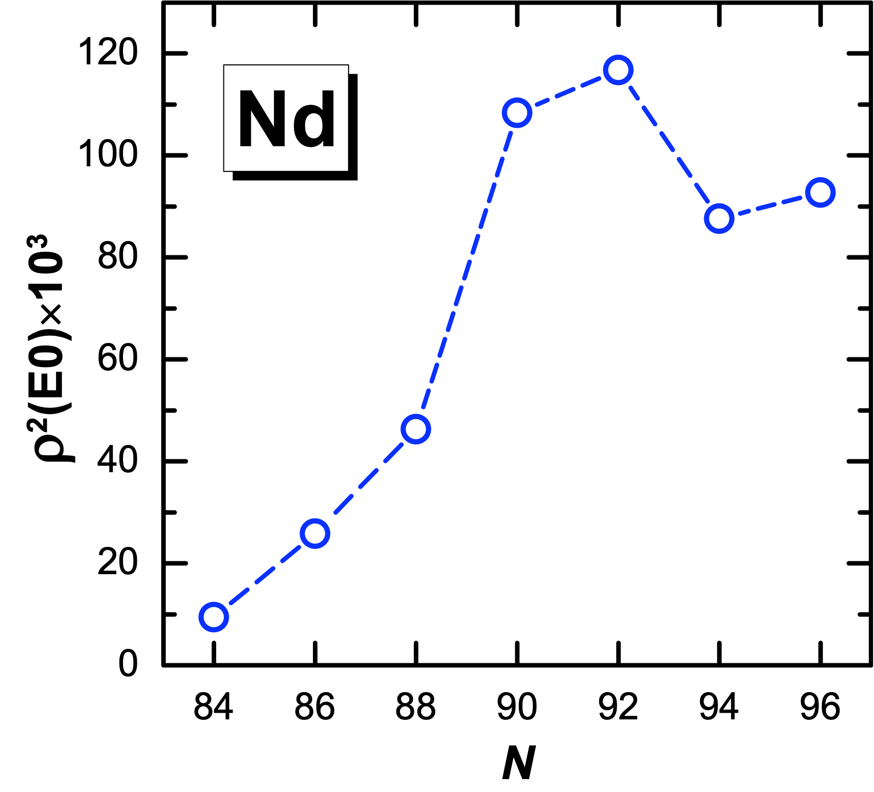
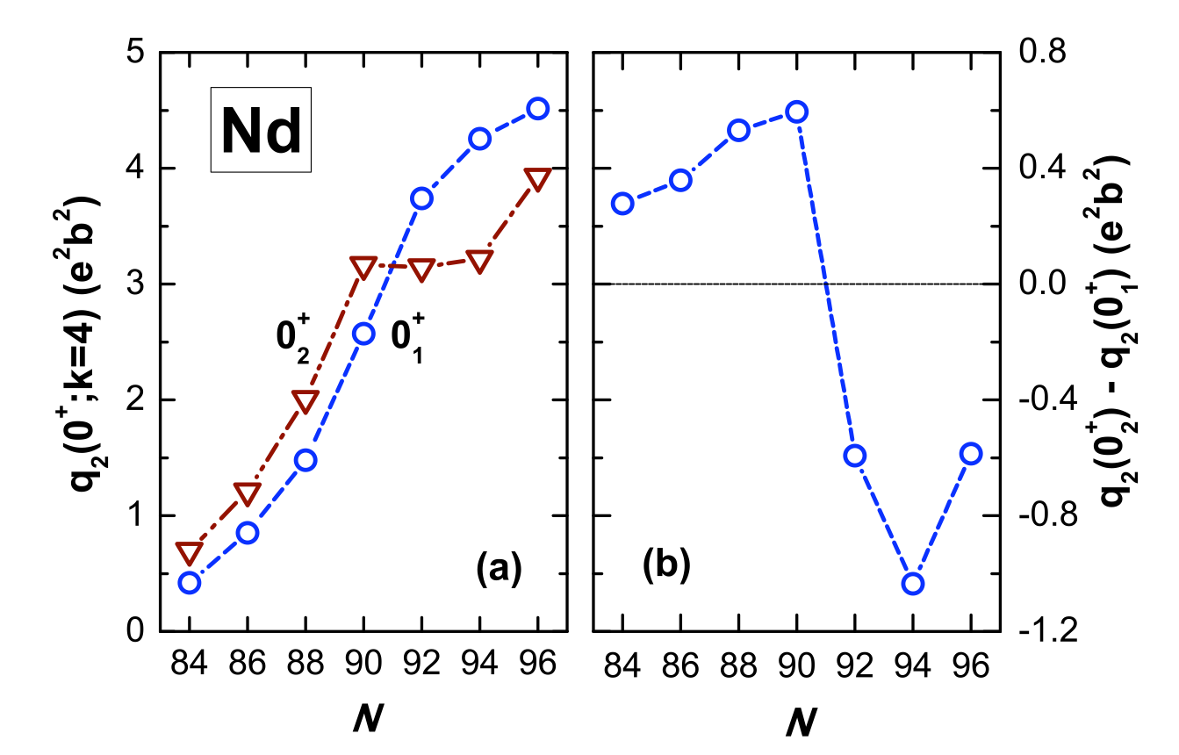
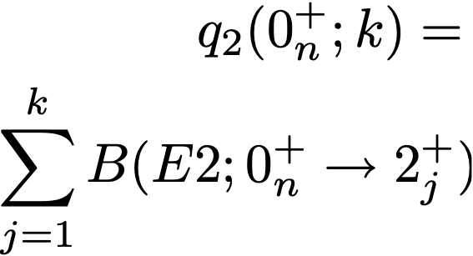
q-shape invariants:

Slide 20
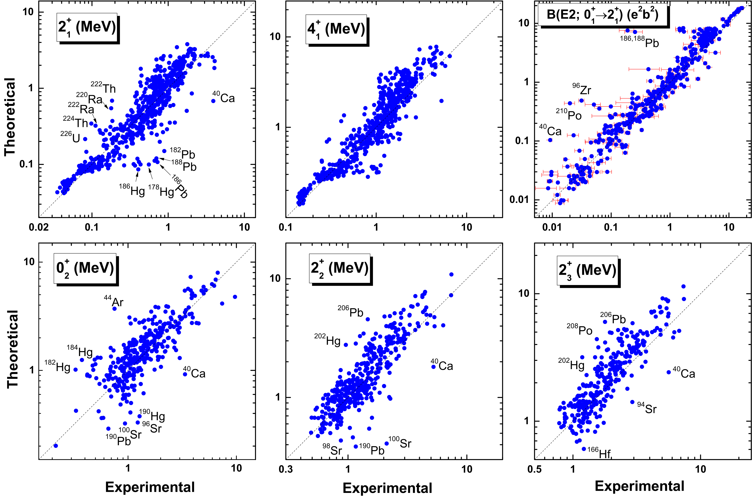
Global analysis of quadrupole shape invariants
Phys. Rev. C 95, 054321 (2017)
621 even-even nuclei:

Slide 21
…the lowest-order quadrupole invariants:
⇒ effective deformation parameters:
⇒ signatures of shape coexistence
Phys. Rev. C 95, 054321 (2017).

Slide 22
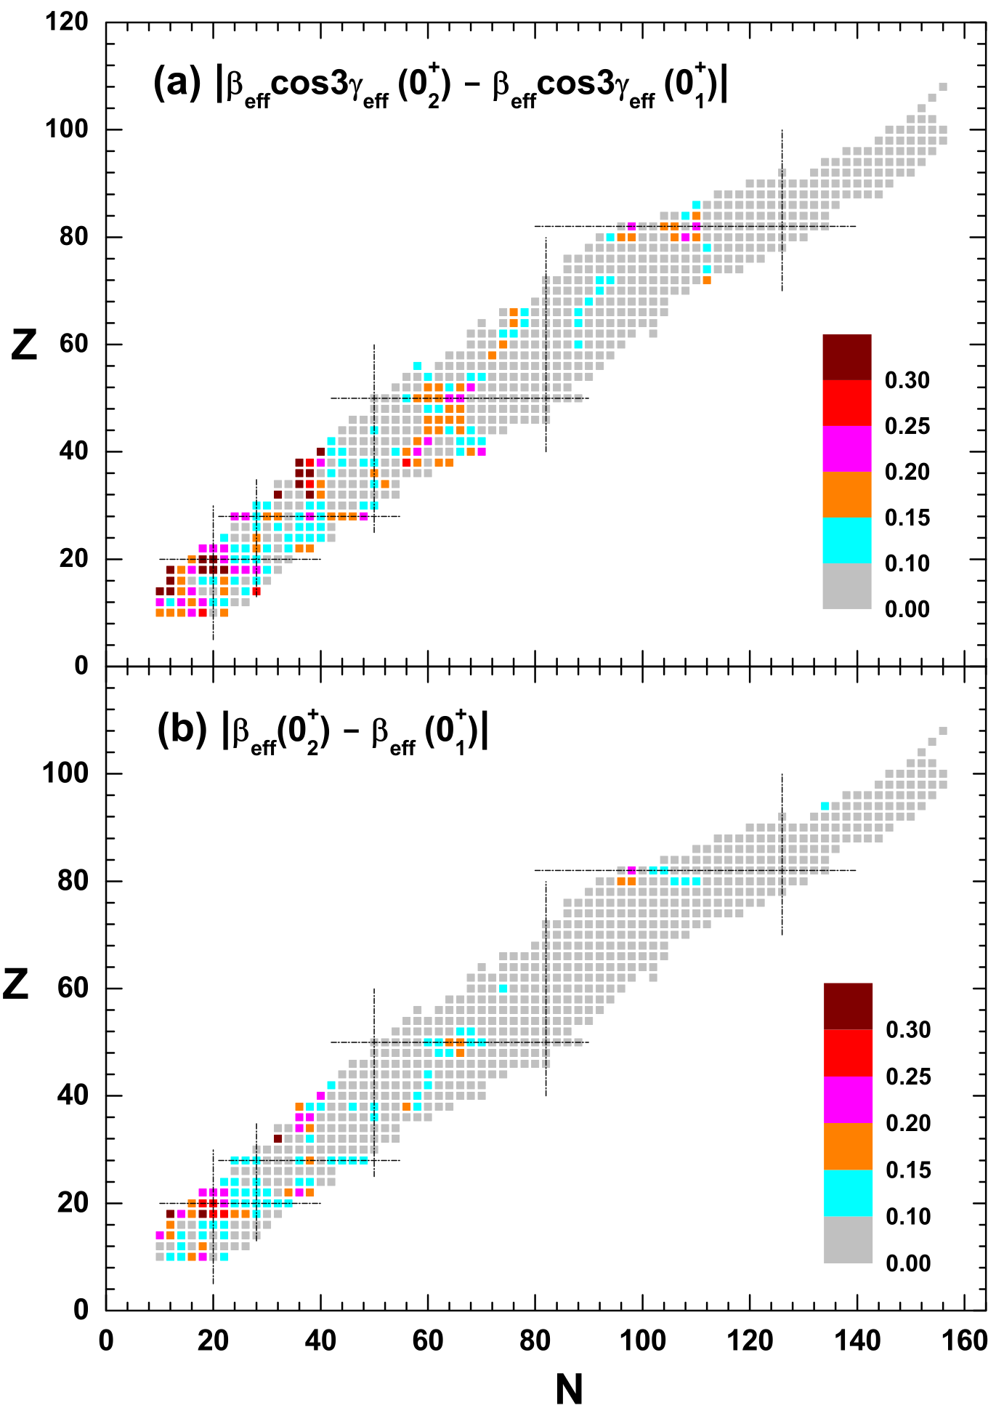
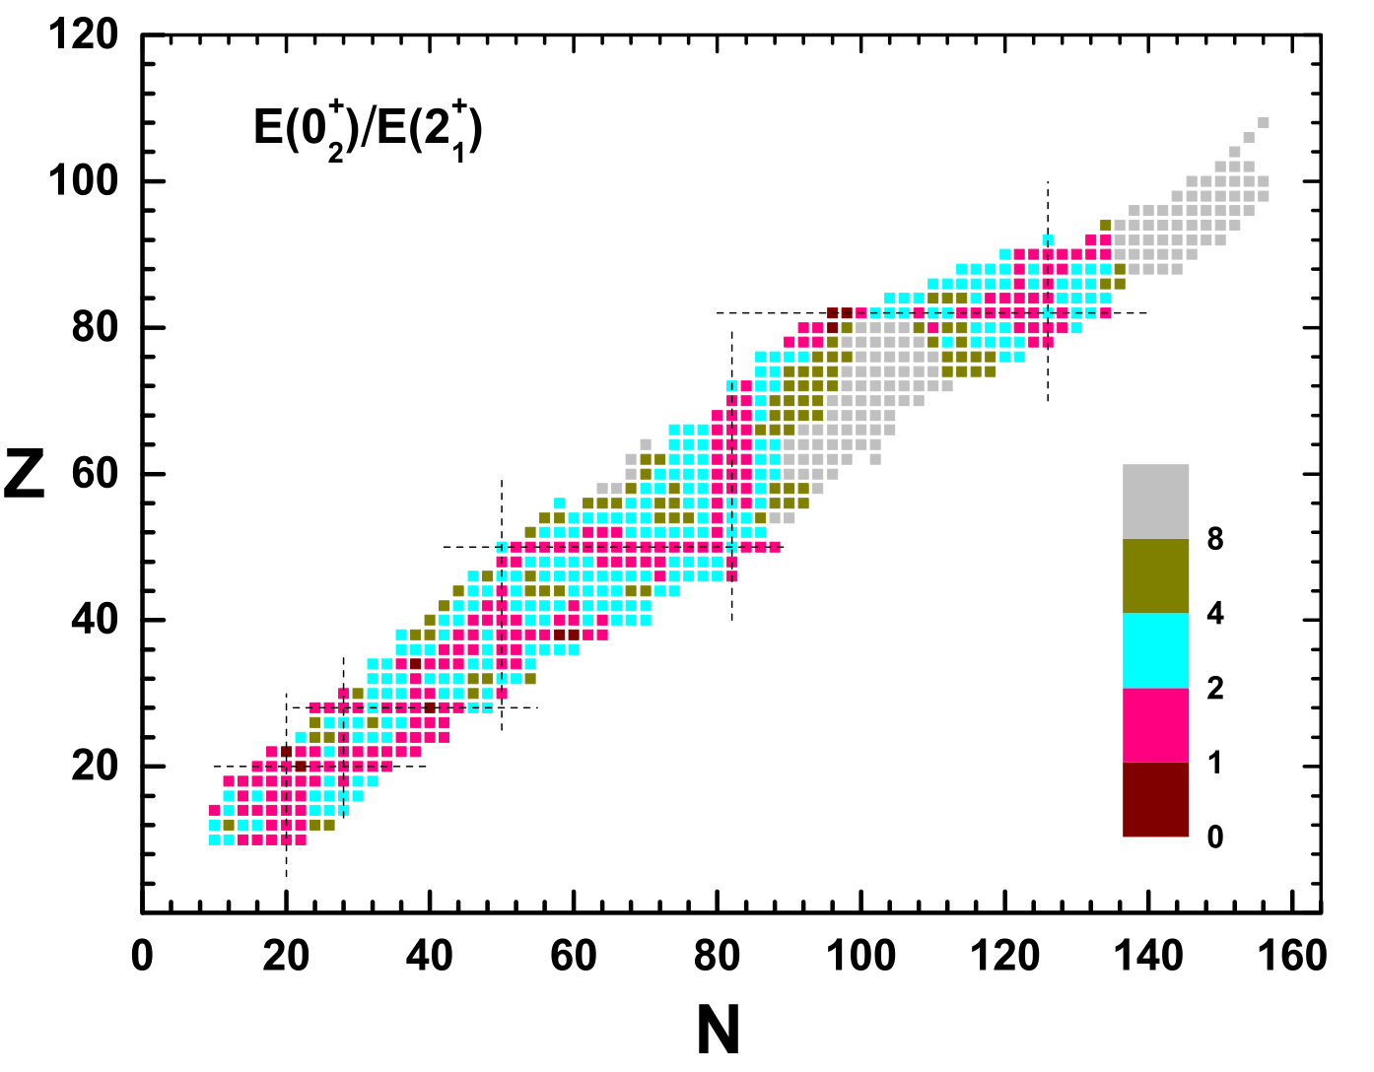
⇒ signatures of shape coexistence:
Large values of
and
First excited 0⁺ state low in energy compared to the first 2⁺.
Phys. Rev. C 95, 054321 (2017).

Slide 23
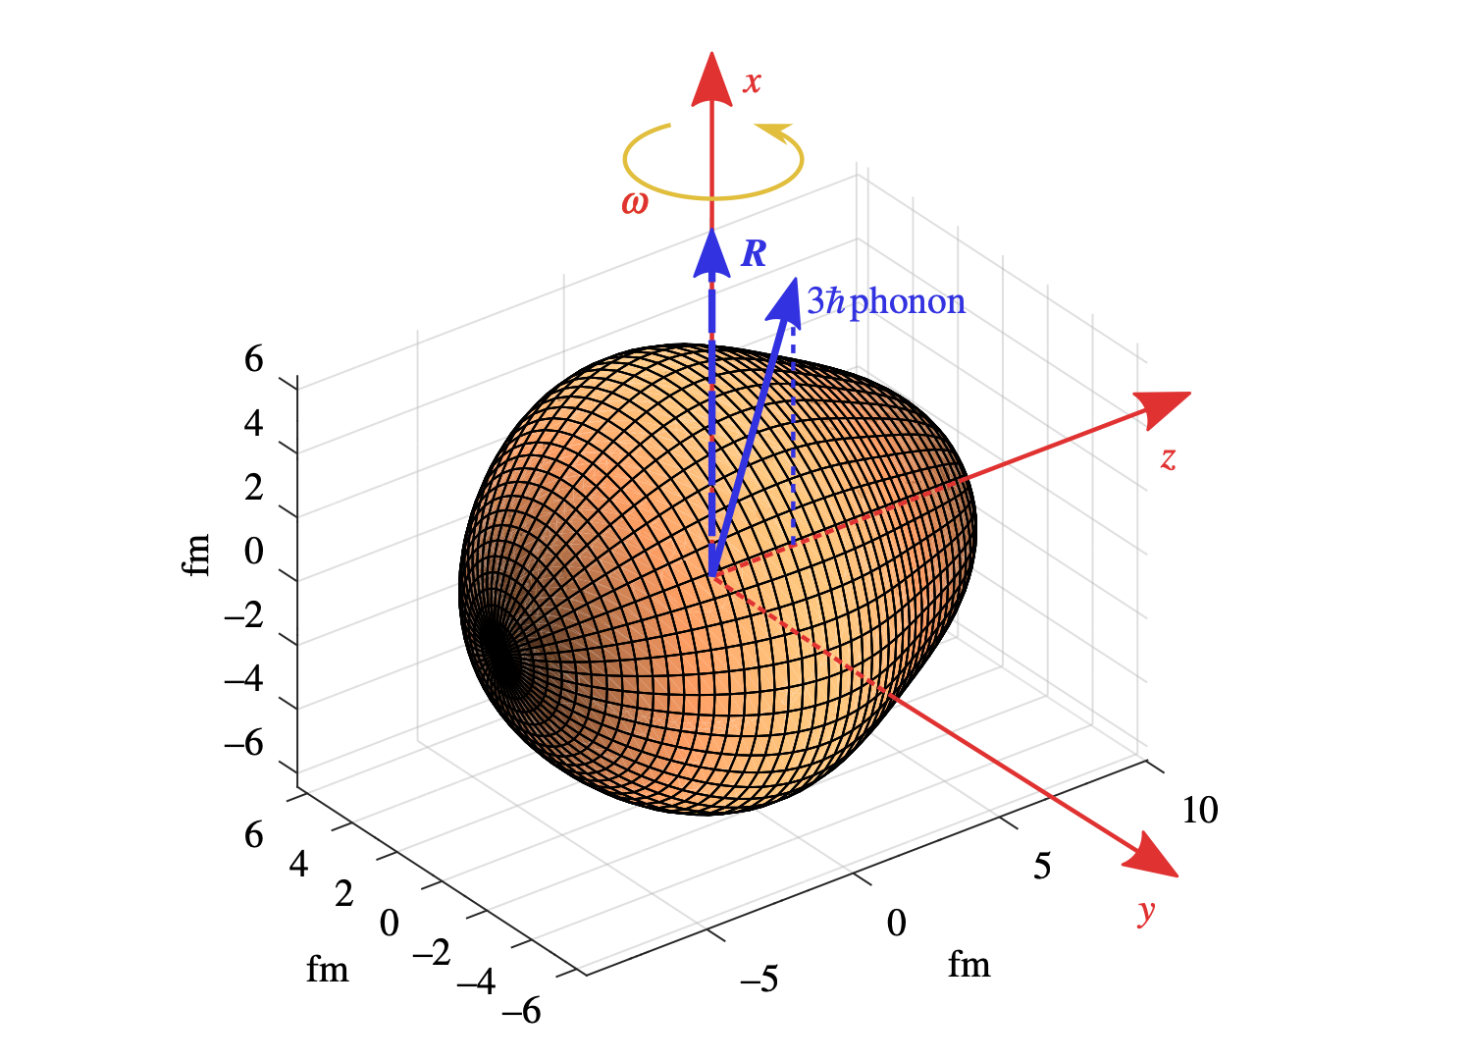
Pear-shaped nuclei
Butler PA. 2020 Pear-shaped atomic nuclei. Proc. R. Soc. A 476

Slide 24
Octupole deformed (pear-shaped) heavy nuclei:
Coupling of orbitals near the Fermi surface with quantum numbers (l, j) and (l+3, j+3) ⇒ reflection-asymmetric intrinsic shapes that develop either dynamically (octupole vibrations) or as static octupole deformations.

Slide 25
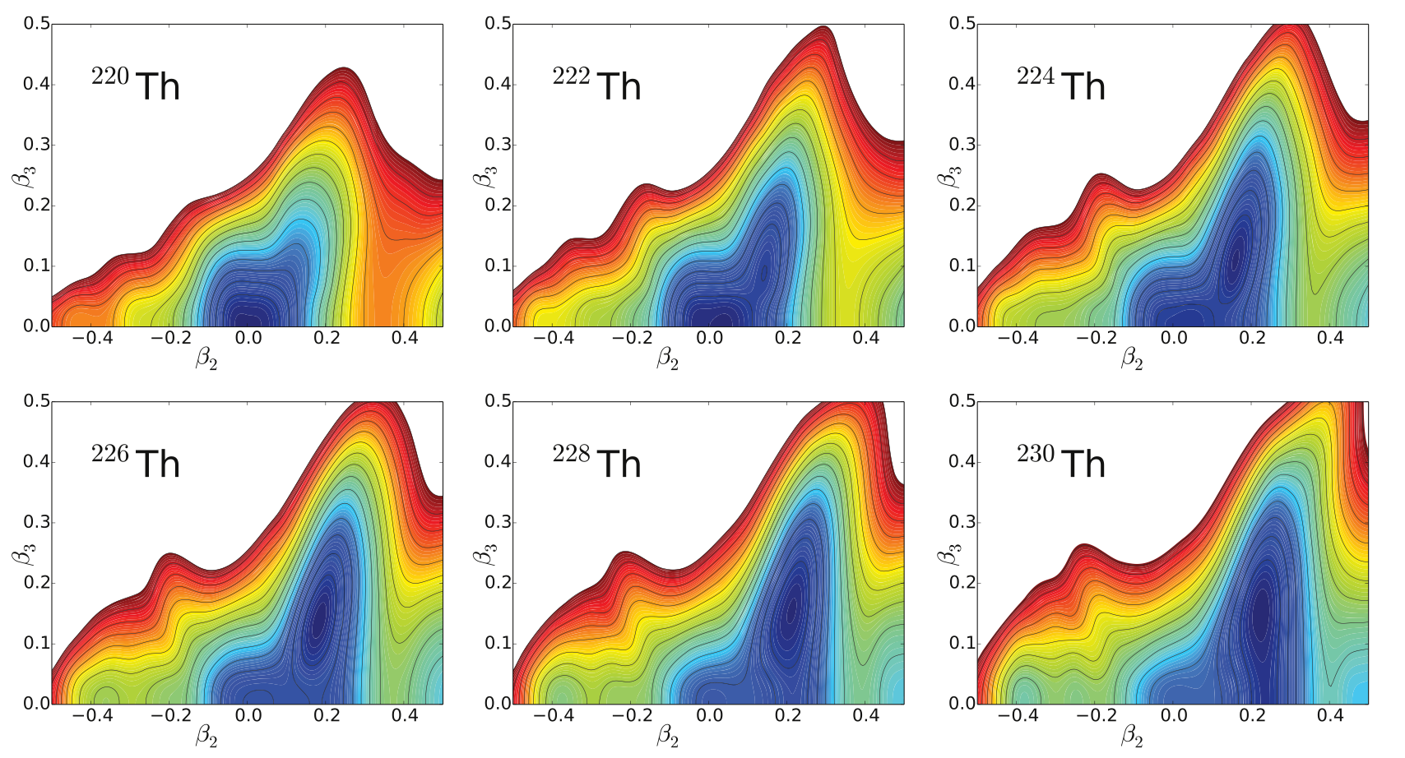
Quadrupole and octupole shape transition in thorium
J. Phys. G: Nucl. Part. Phys. 43 (2016) 024005
…quadrupole-octupole
collective Hamiltonian:

Slide 26
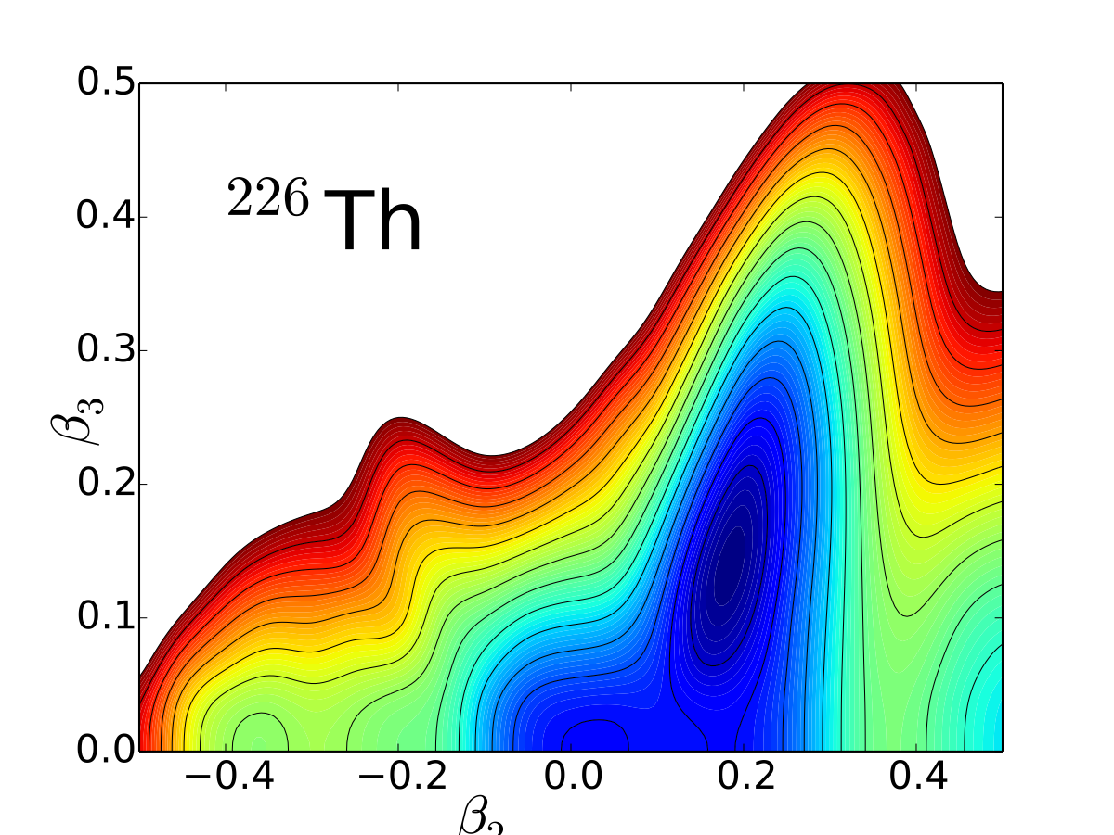
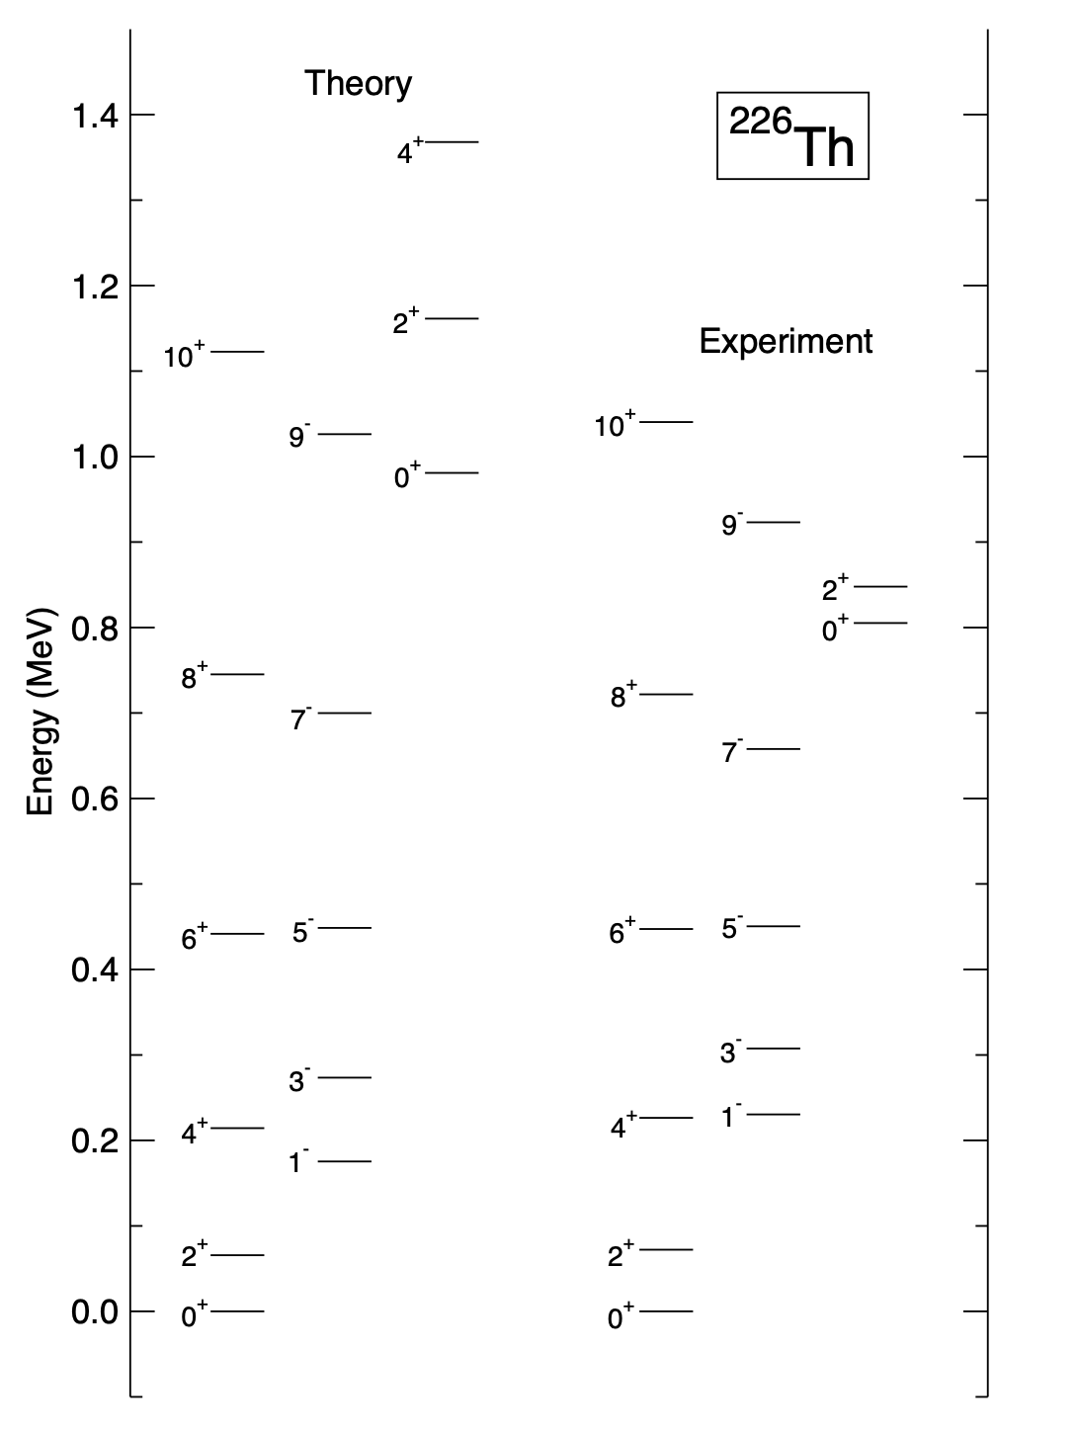
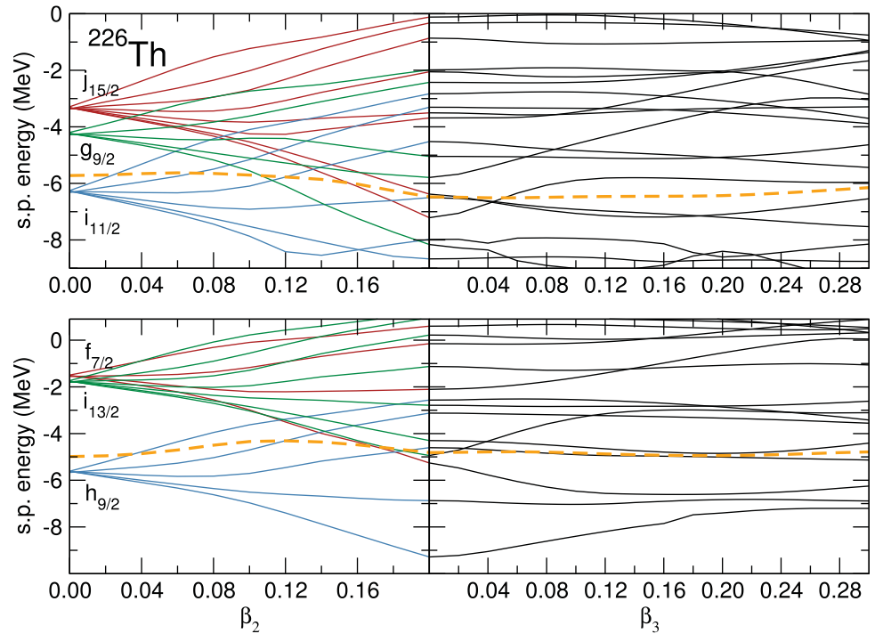

Slide 27
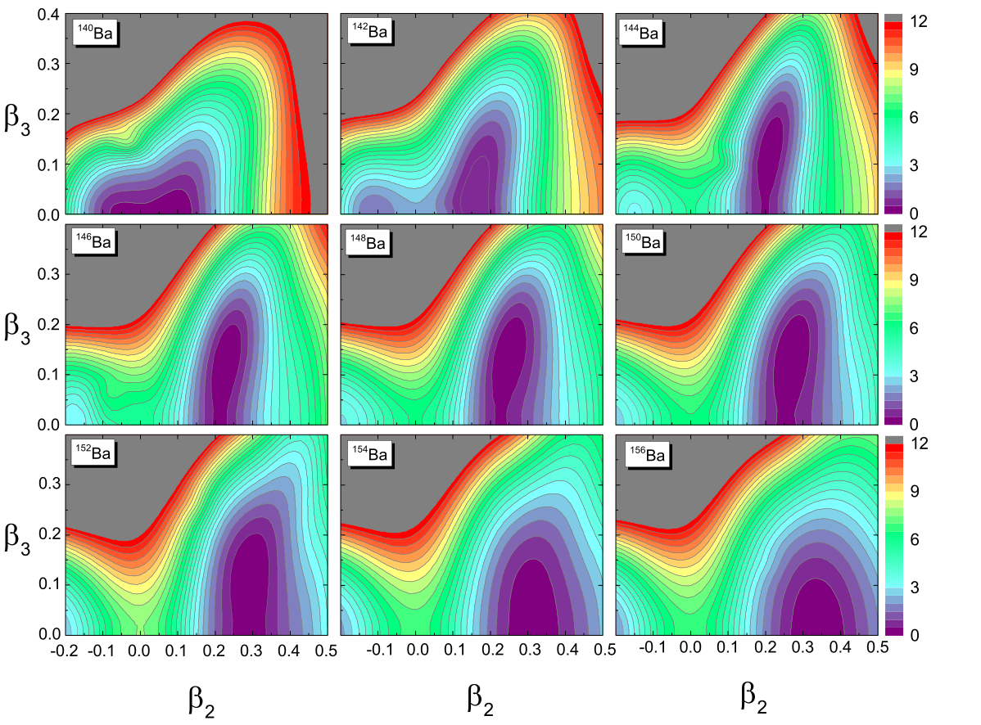
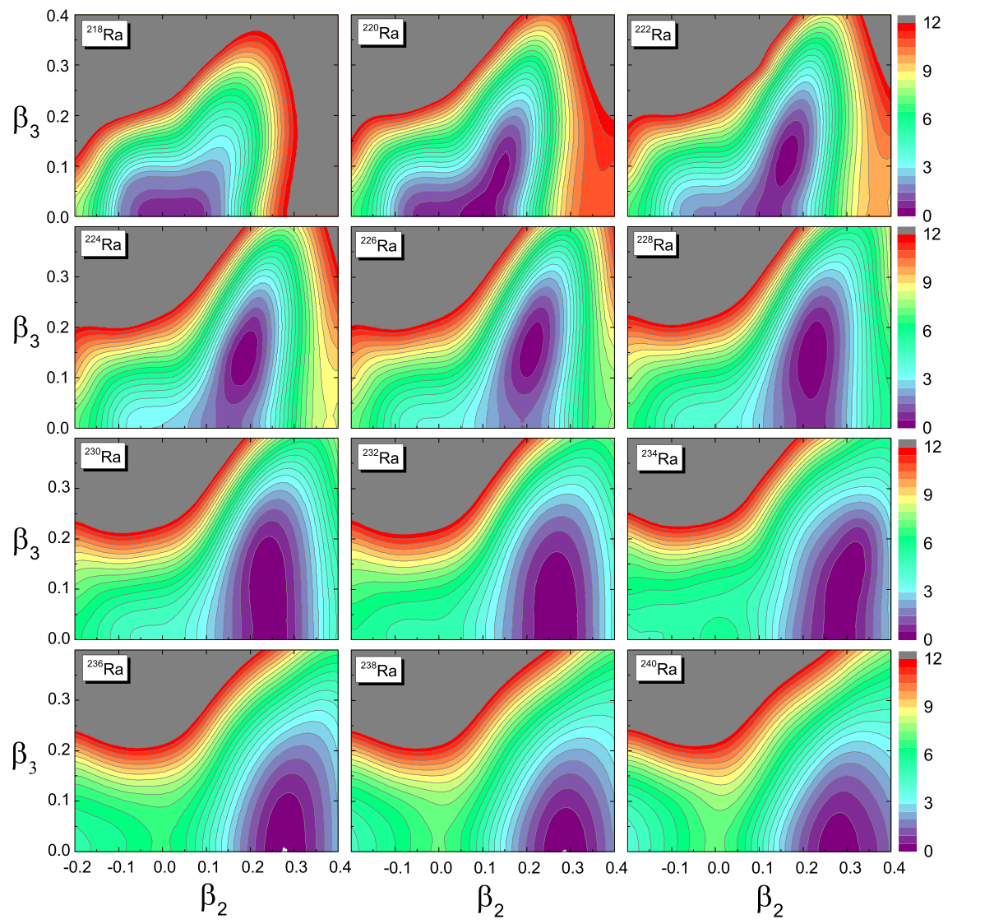
Systematics of reflection-asymmetric shapes
Phys. Rev. C 96, 054303 (2017)
Quadrupole and octupole deformation energy surfaces, low-energy excitation spectra and transition rates in the isotopic chains: Xe, Ba, Ce, Nd, Sm, Gd, Rn, Ra, Th, U, Pu, Cm, Cf, and Fm.

Slide 28
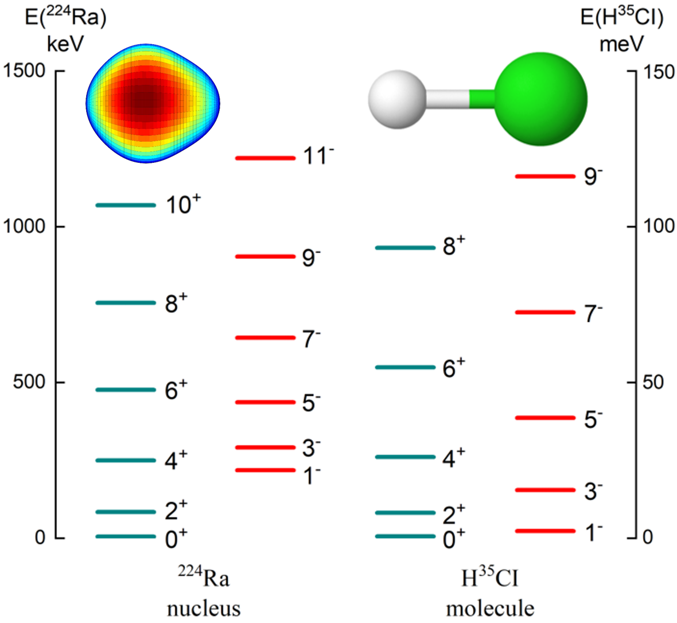

Slide 29
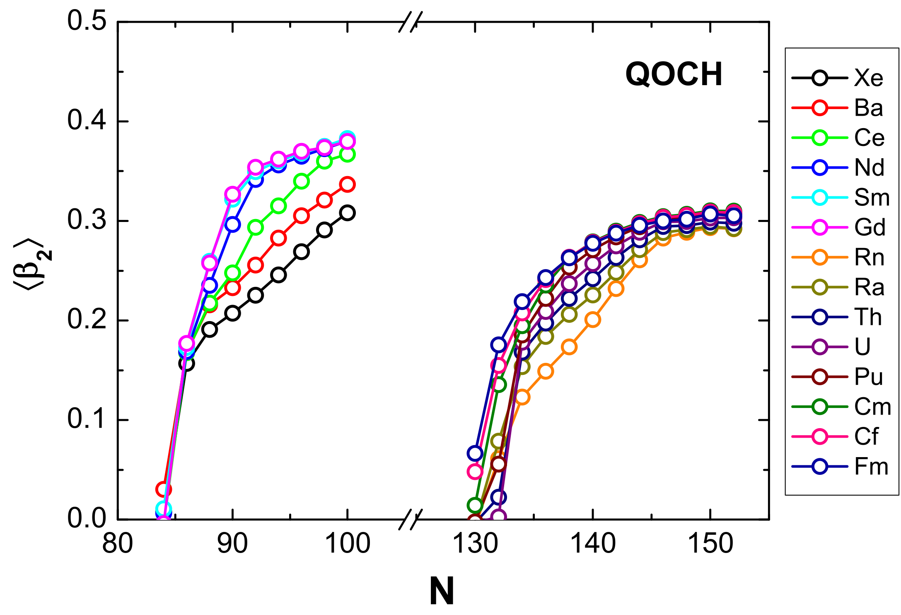
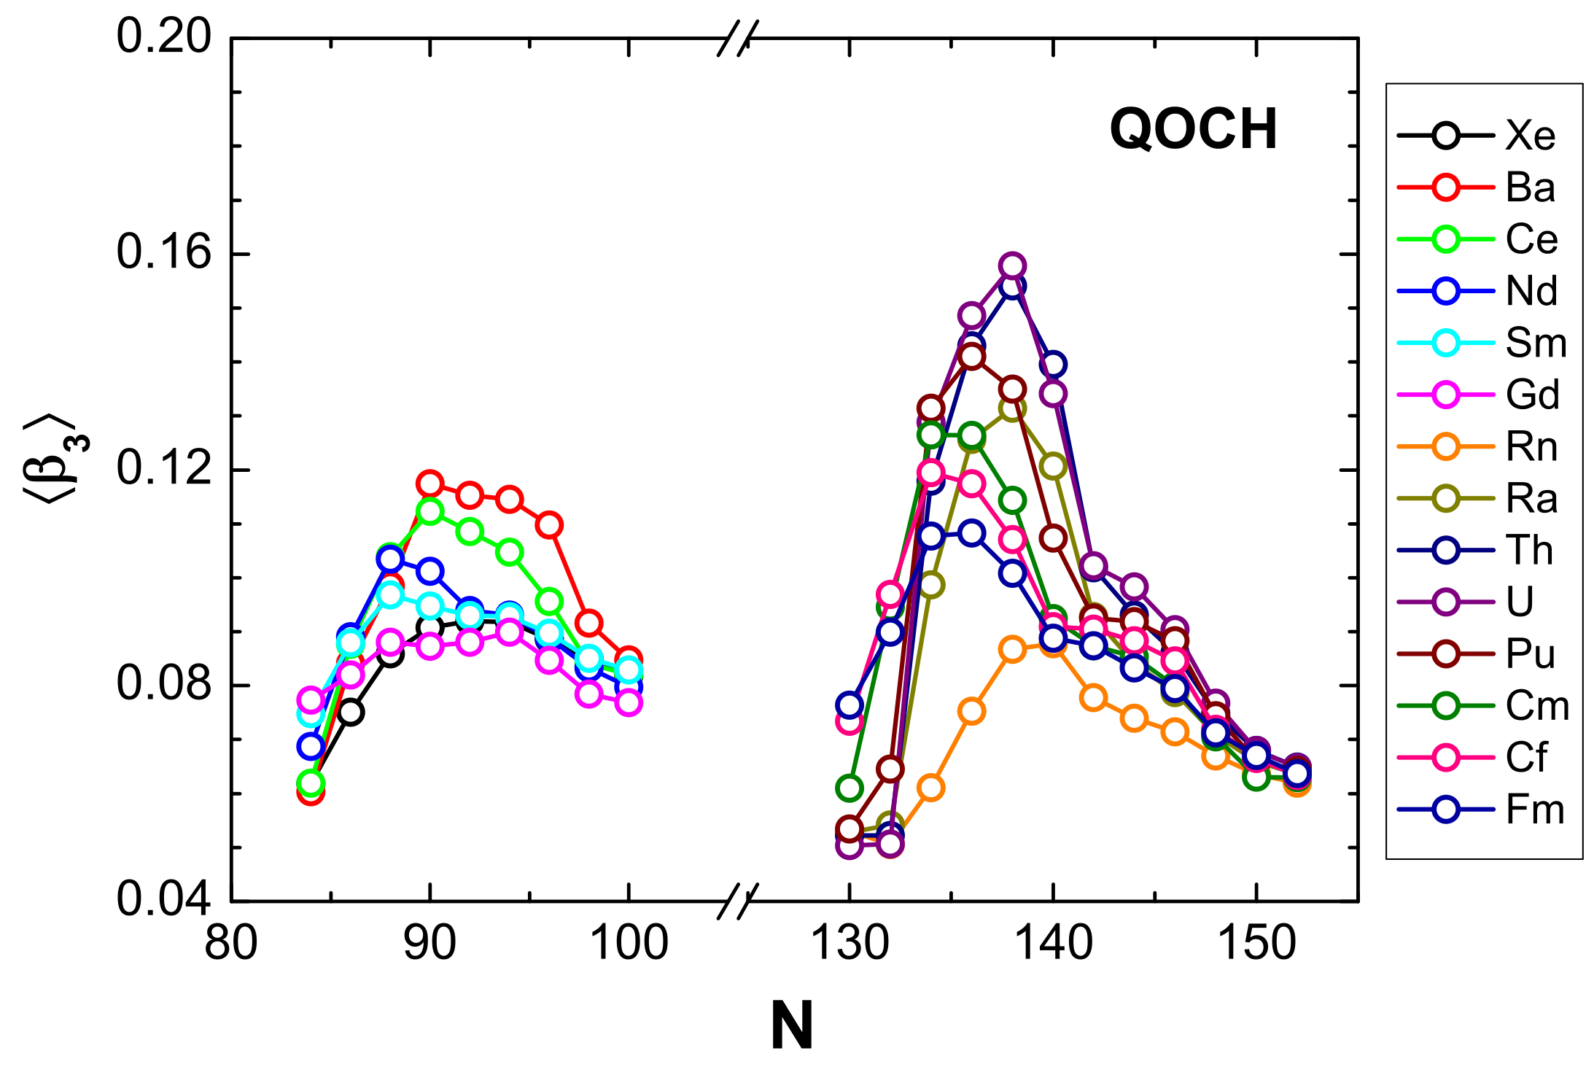
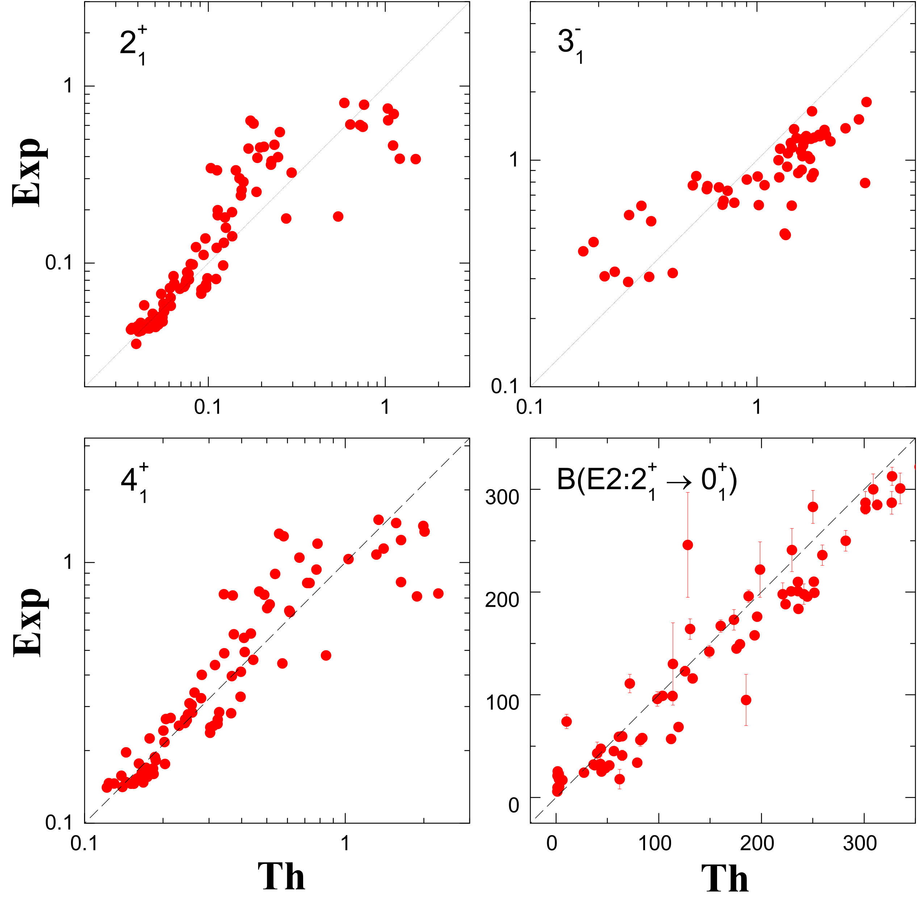
Mean values of the quadrupole and octupole deformations for the QOCH ground states 0⁺1.
…quadrupole-octupole
collective Hamiltonian:

Slide 30
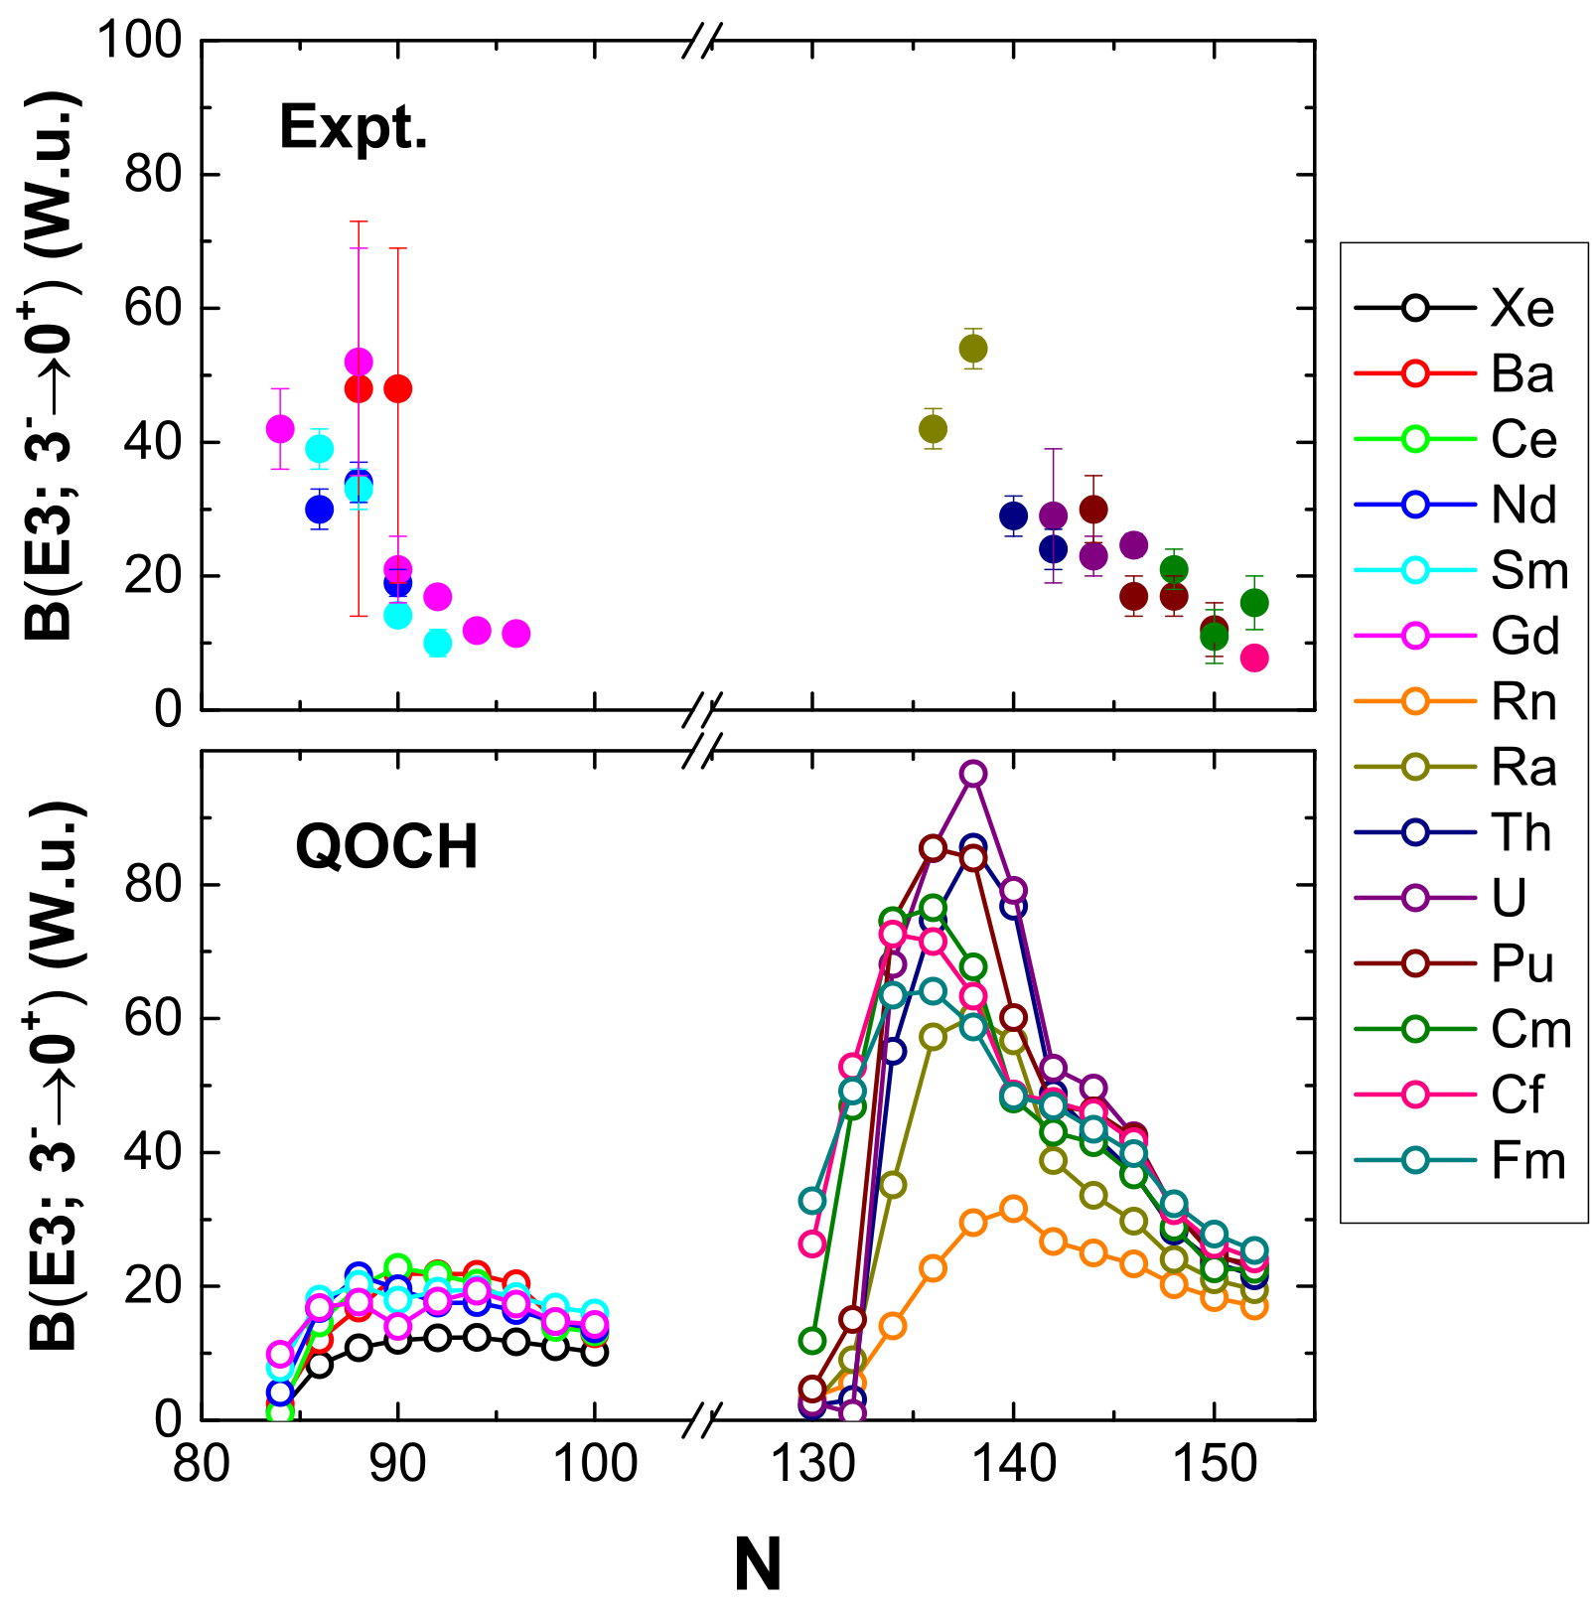
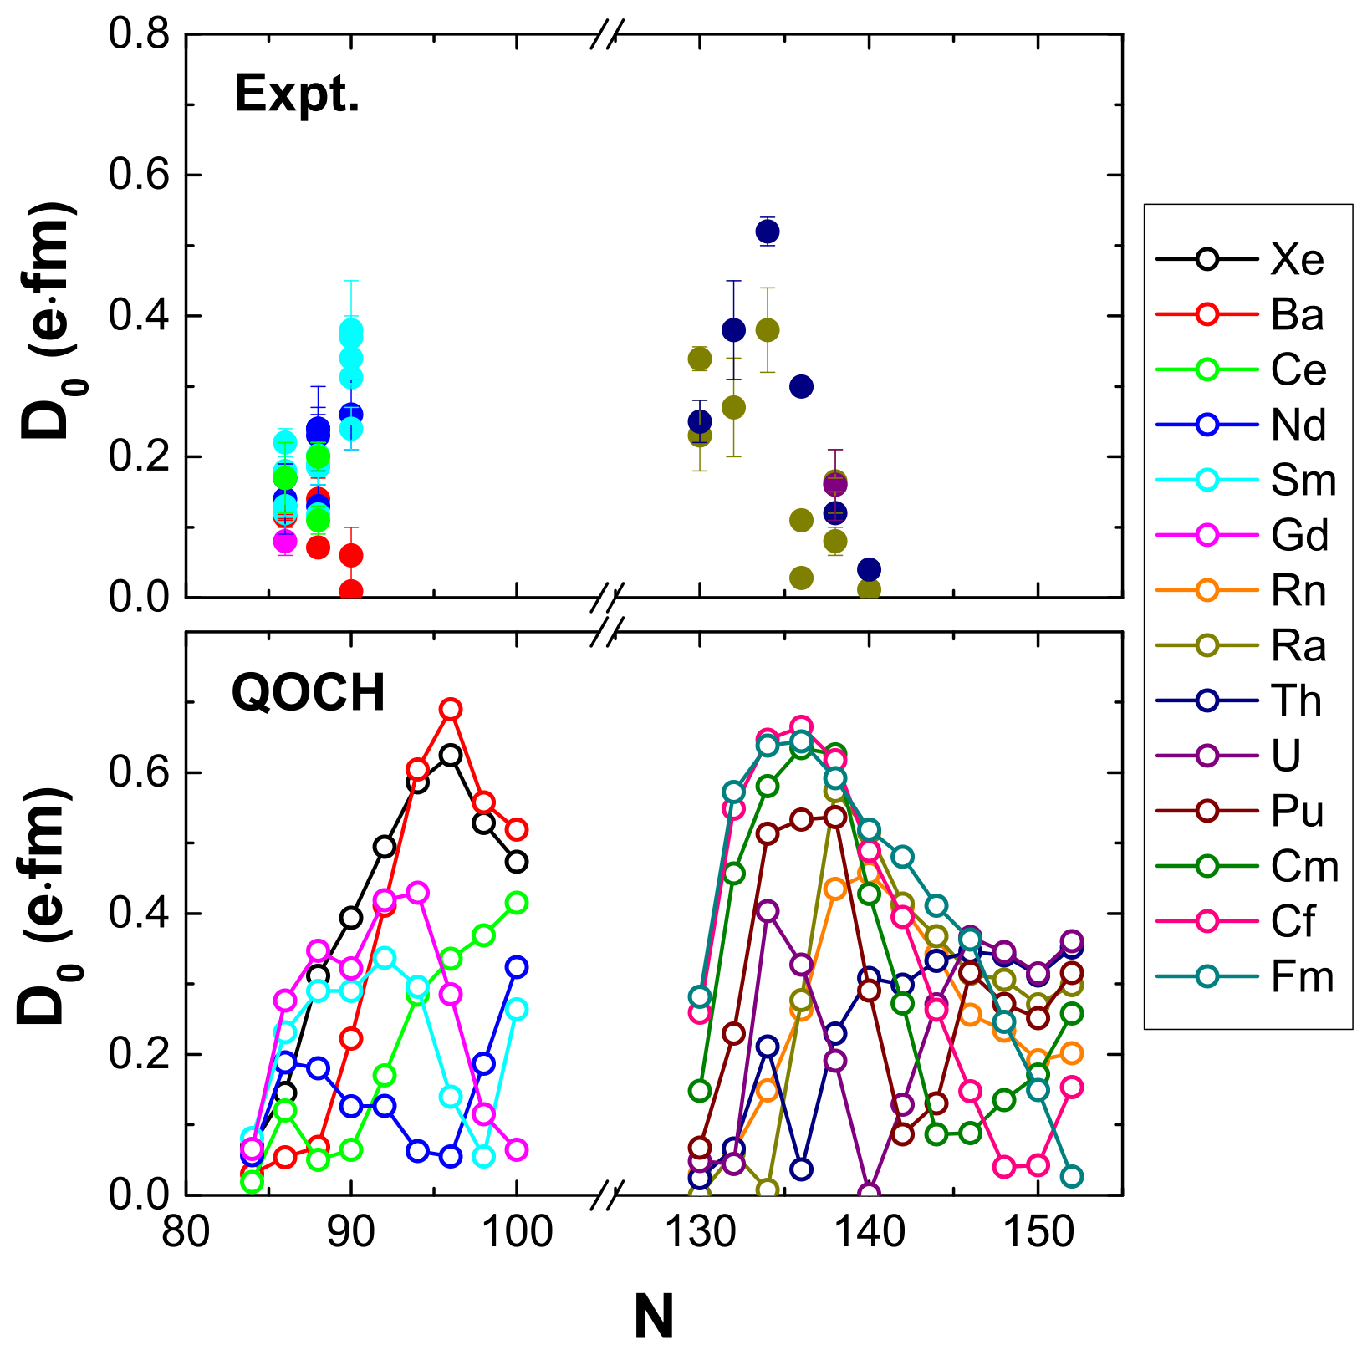

Slide 31
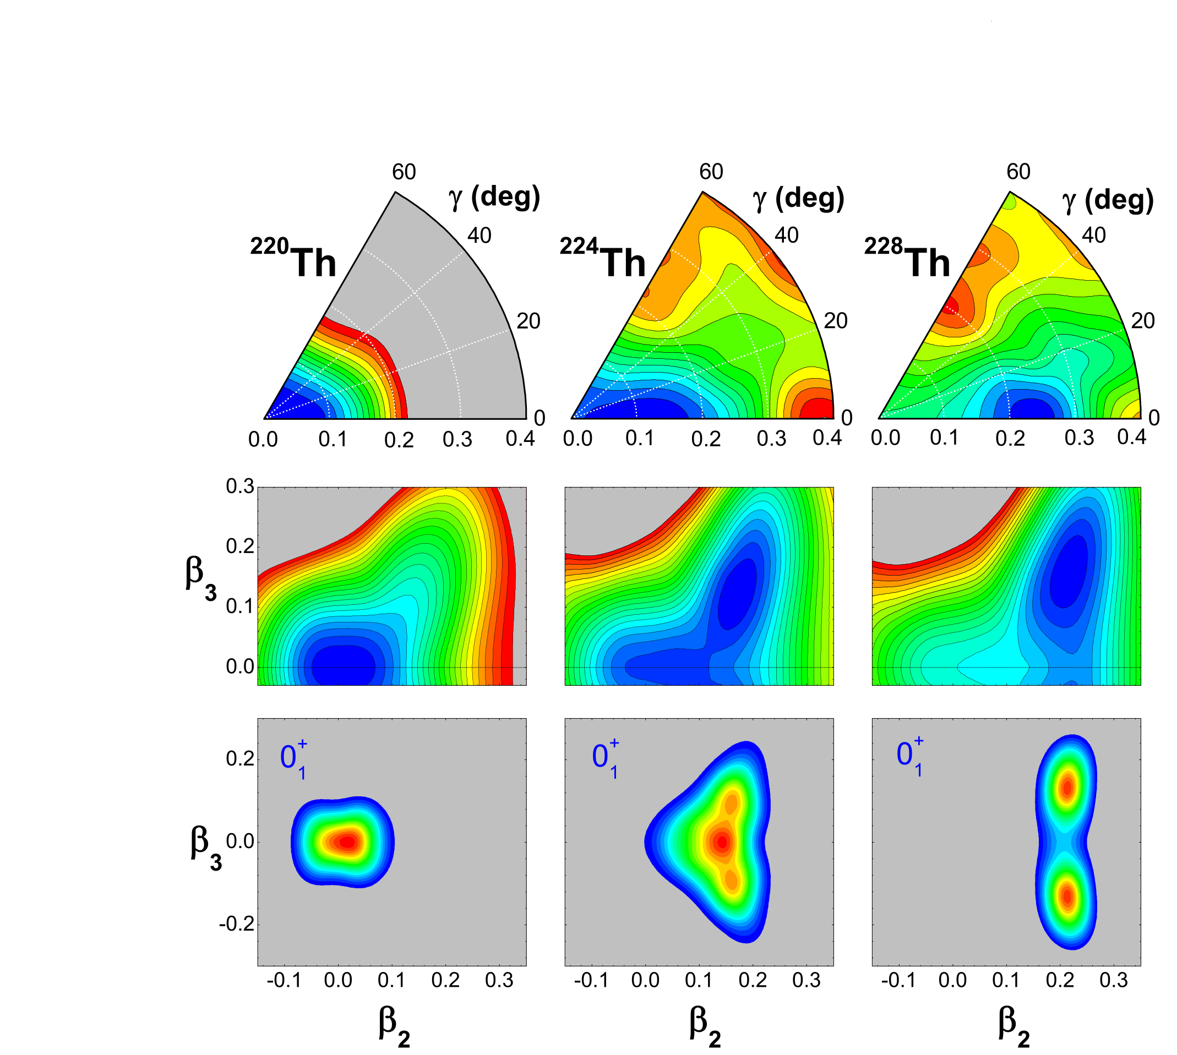
Simultaneous quadrupole and octupole shape transitions in Thorium
Z.P. Li, B.Y. Song, J.M. Yao D. Vretenar, and J. Meng, Phys. Lett. B 726 (2013) 866

Slide 32
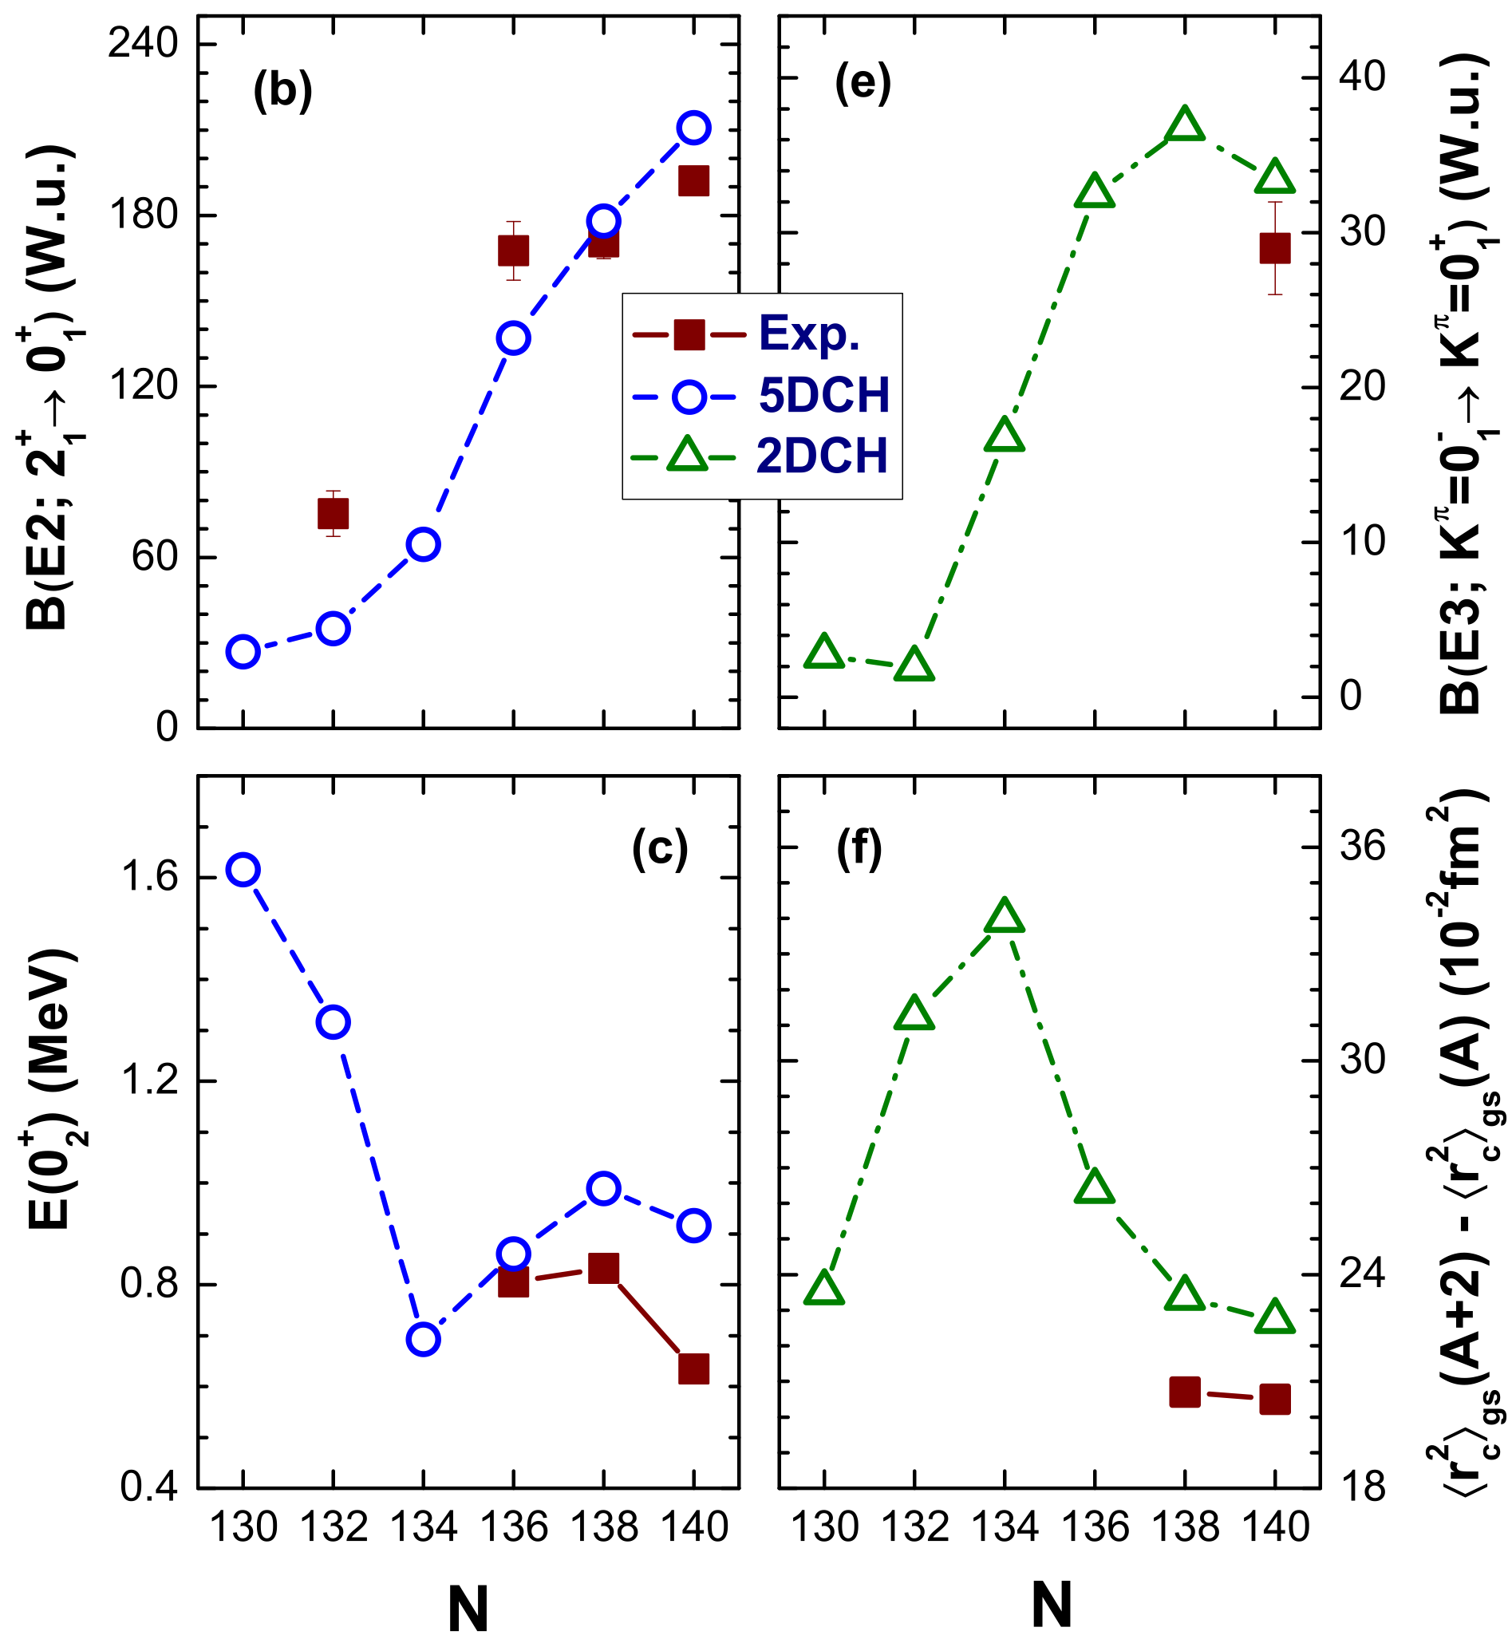

Slide 33
Extrapolation to Super-Heavy Nuclei
Much higher density of single-particle states close to the Fermi energy ➠ details of the evolution of deformed shells with nucleon number will have more pronounced effects on energy gaps, separation energies, Qα-values, band-heads in odd-A nuclei, K-isomers …
Much stronger competition between the attractive short-range nuclear interaction and the long-range electrostatic repulsion ➠ pronounced effects on the Coulomb, surface and isovector energies! Fast shape transitions! Exotic shapes!

Slide 34
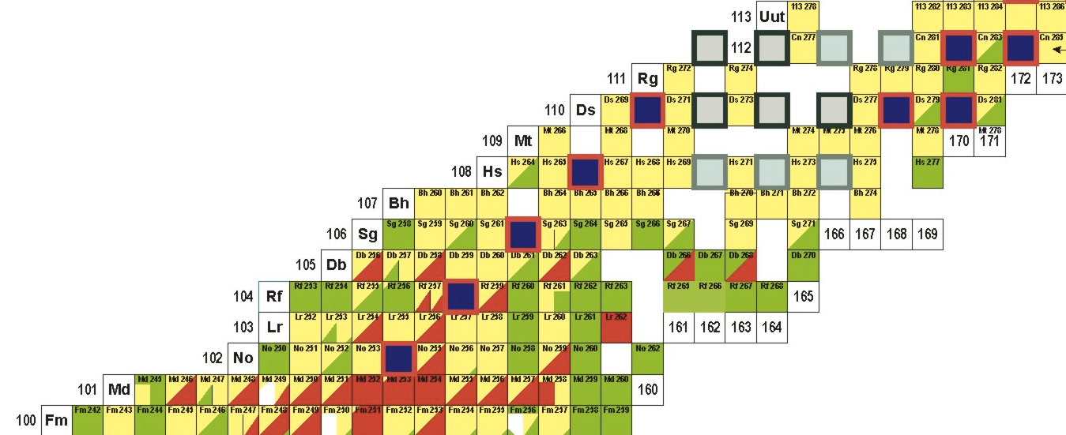
Transactinides

Slide 35
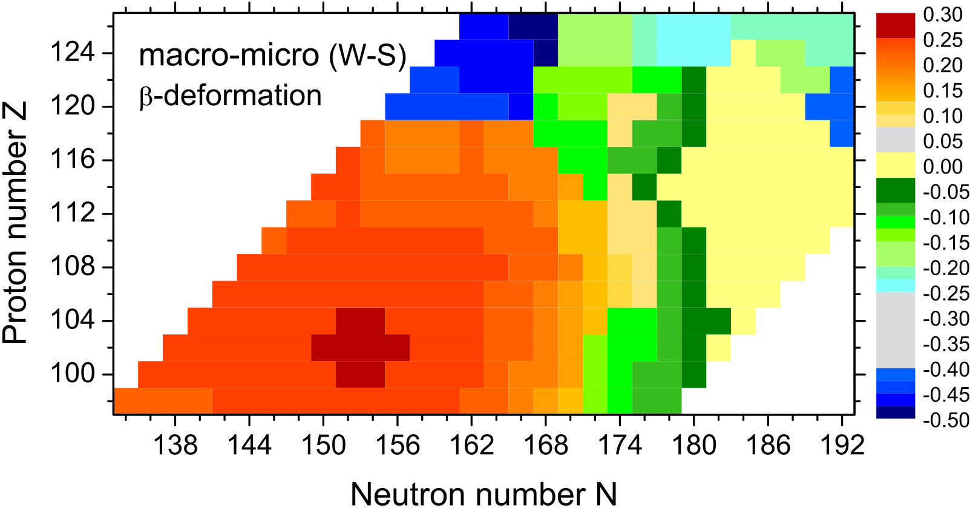
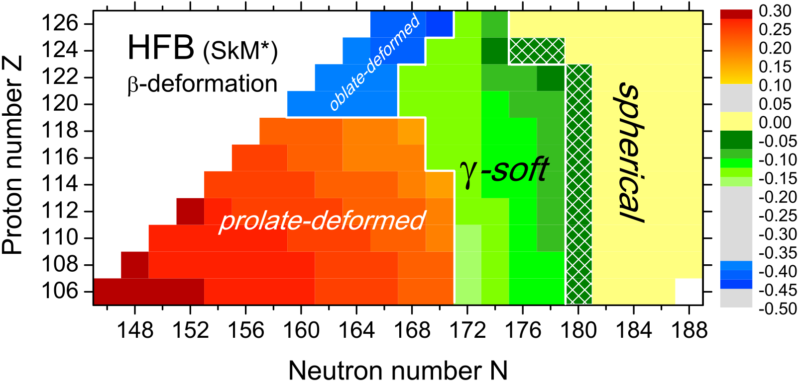
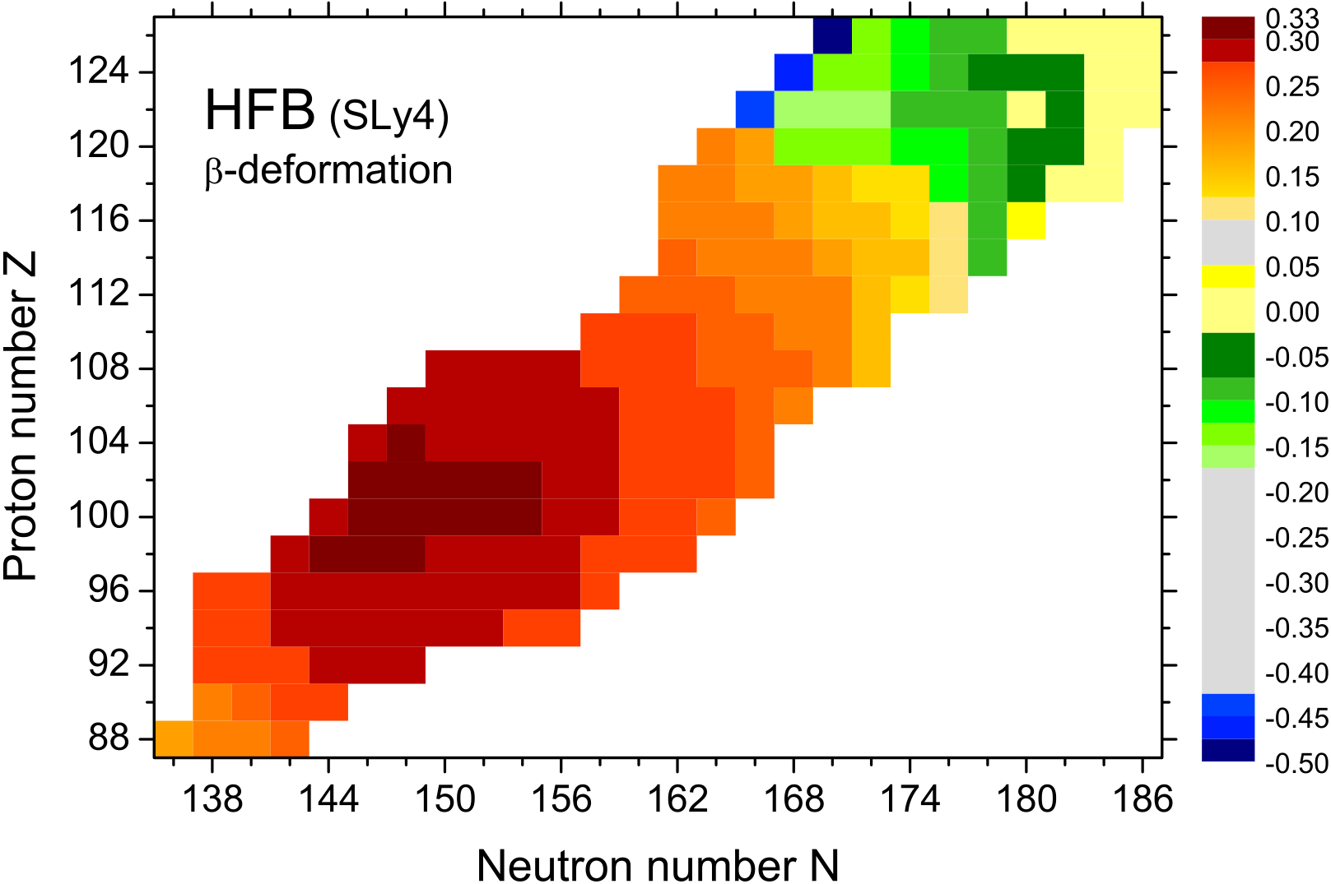
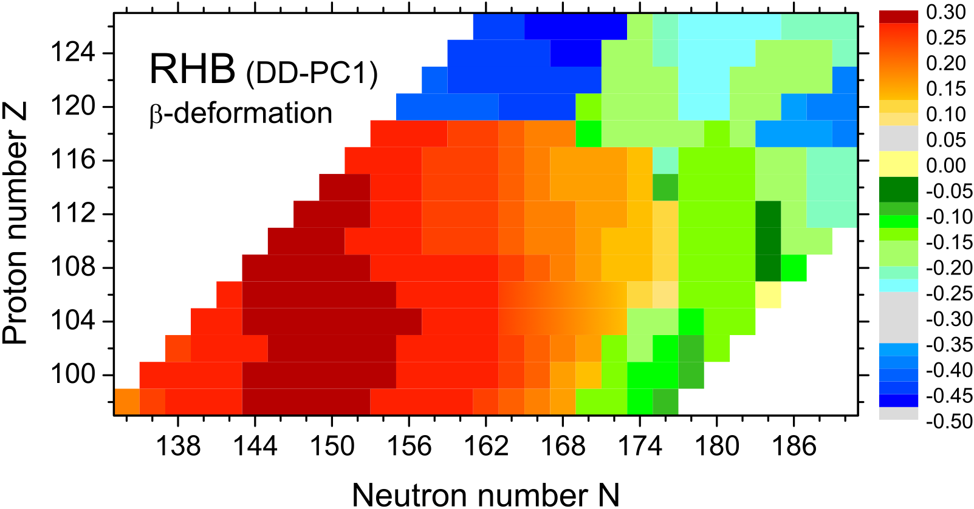
Shape transitions in super-heavy nuclei

Slide 36
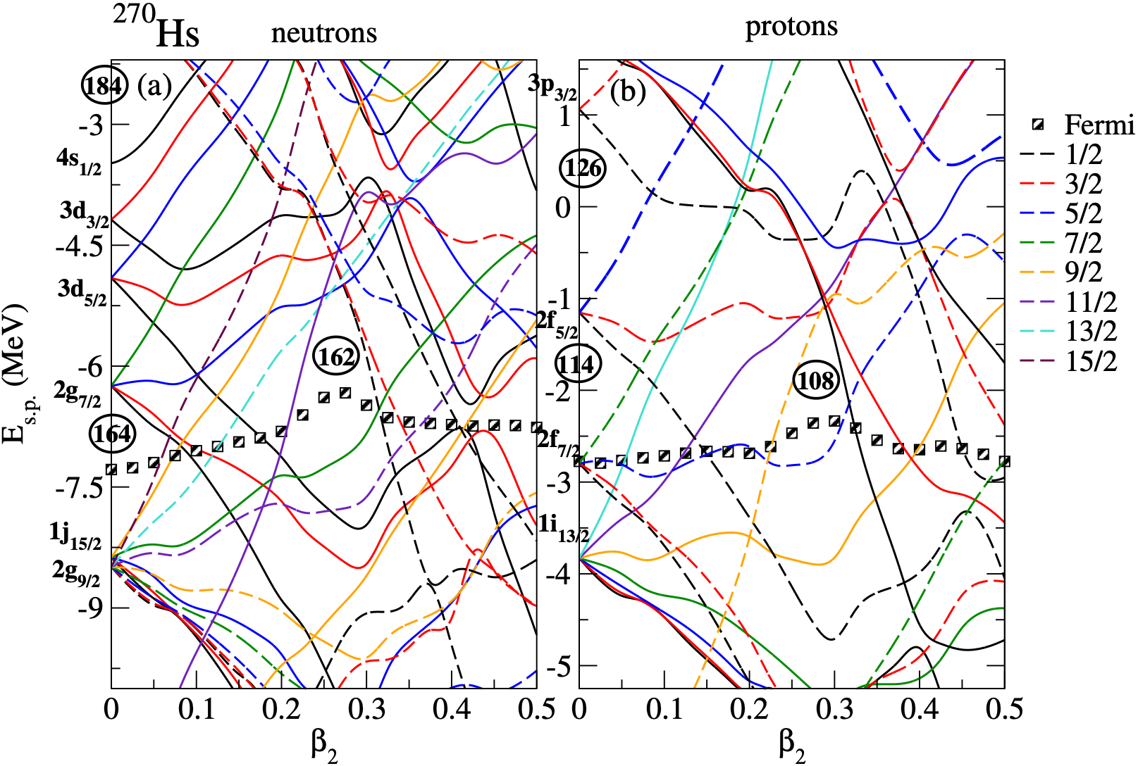
Energy gaps are small. Shape stabilisation depends on how fast the shell structures
vary with deformation!
Phys. Rev. C 88, 044324 (2013)

Slide 37
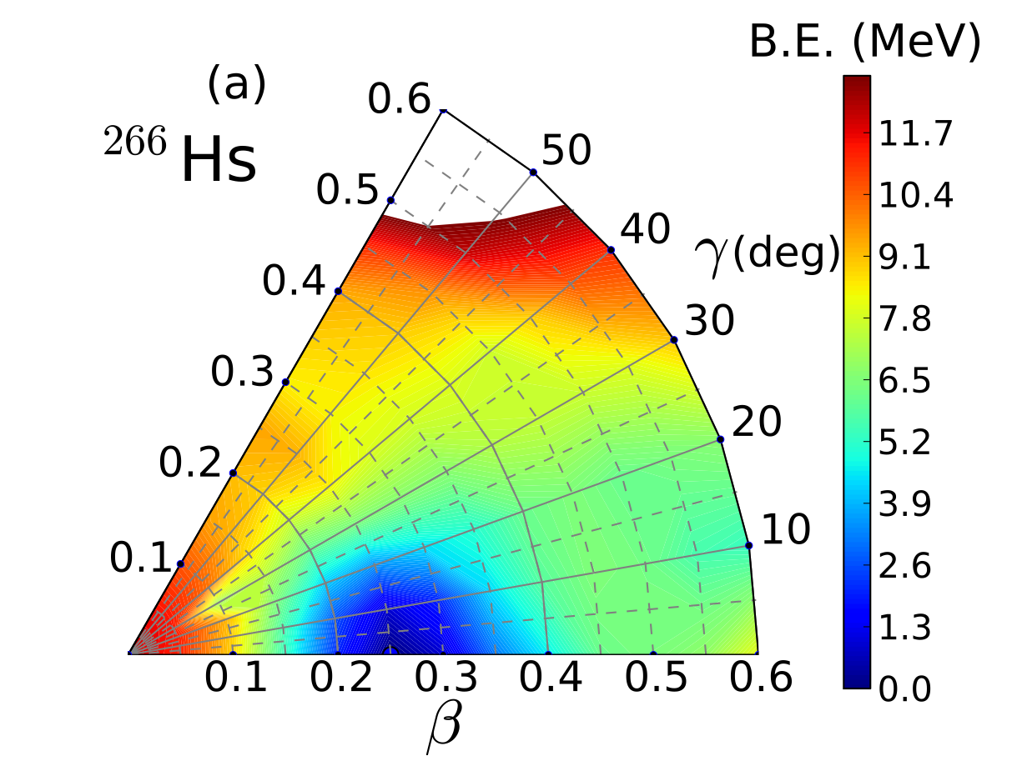
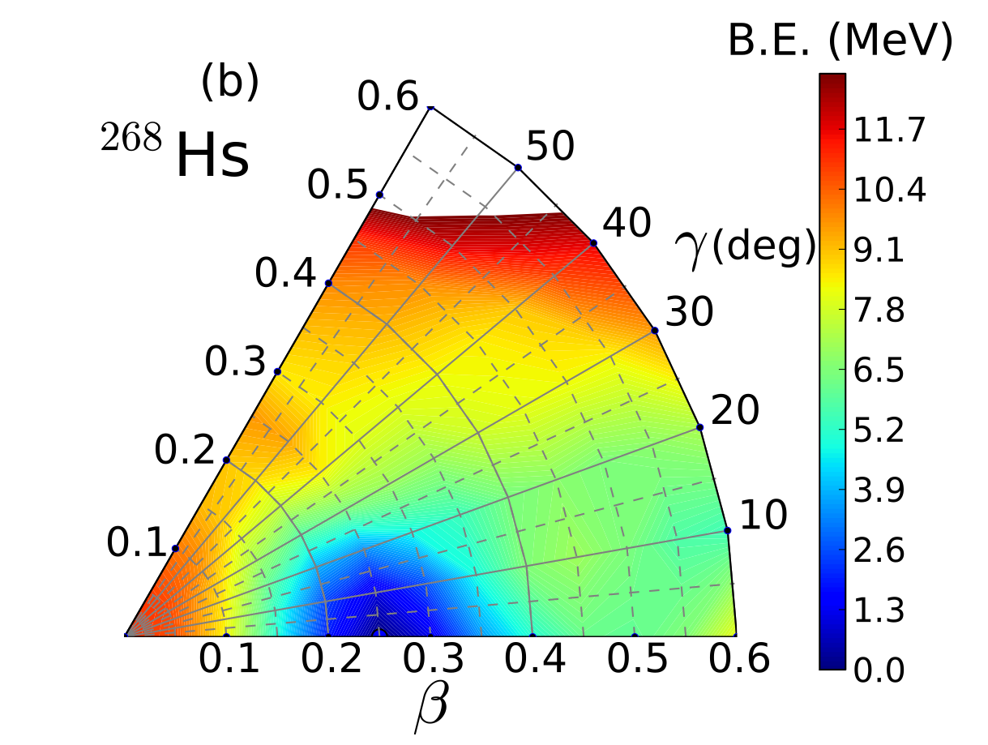

Slide 38
Triaxial shapes in the α-decay chain of ²⁹⁸120
Phys. Rev. C 86, 024317 (2012)
Fluctuations in shape degrees of freedom and configuration mixing ➠ influence on ground-state
properties and transitions!

Slide 39
RMF+BCS quadrupole and octupole constrained deformation energy surface of ²²⁶Th in the β₂ − β₃ plane.

Slide 40
Ternary quasifission in collisions of actinide nuclei
Octupole deformation effects: central collision of ²³⁸U + ²³⁸U at energy Ec.m. = 900 MeV.

Slide 42
Pairing effects: central collision of ²³⁸U + ²³⁸U at energy Ec.m. = 900 MeV.

Slide 44
Orientation effects: central (tail-to-tail) collision of ²³⁸U + ²³⁸U at energy Ec.m. = 1200 MeV.

Slide 47
Orientation effects: central (tail-to-side) collision of ²³⁸U + ²³⁸U at energy Ec.m. = 1300 MeV.
The average number of protons and neutrons in the heavy, and light fragments as functions of the c.m.s. energy for the central ²³⁸U + ²³⁸U collision, with tail-to-side initial orientation.

