Slide 1
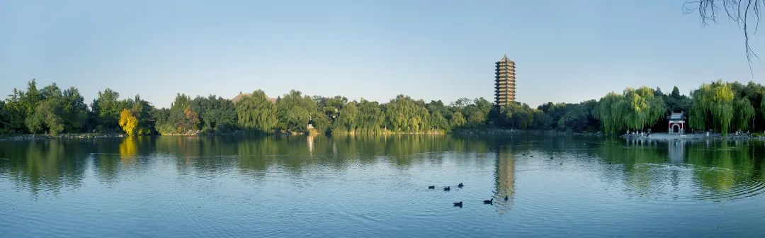

Exploring nuclear physics across energy scales 2024: intersection between nuclear structure and high energy nuclear collisions
Peking University, April 15-27, 2024
Constraining nuclear symmetry energy from heavy ion collisions
Zhigang Xiao | Tsinghua University
E-mail: xiaozg@tsinghua.edu.cn | http://info.phys.tsinghua.edu.cn/enpg

Slide 2
Outline
1. Introduction: From current status to motivations
2. Experimental results at CSHINE
3. Perspective with CEE
4. A novel probe to the nEOS*
5. Summary and outlook

Slide 3
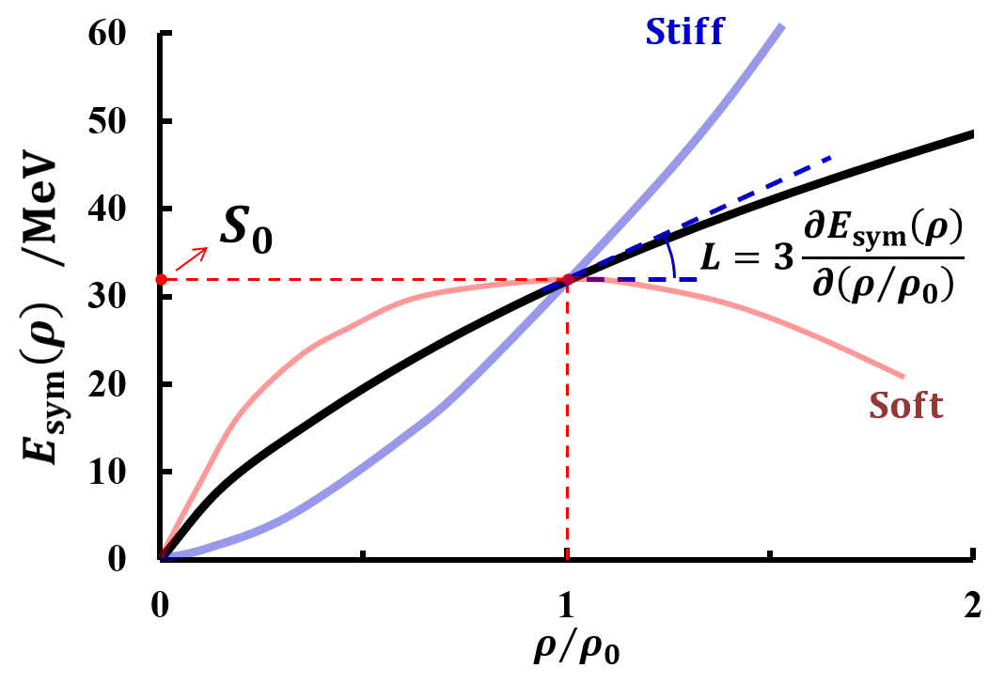
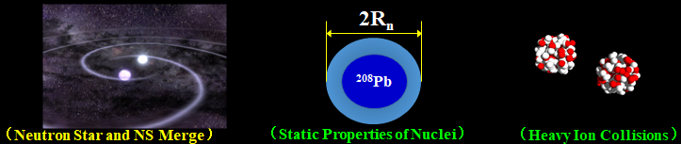
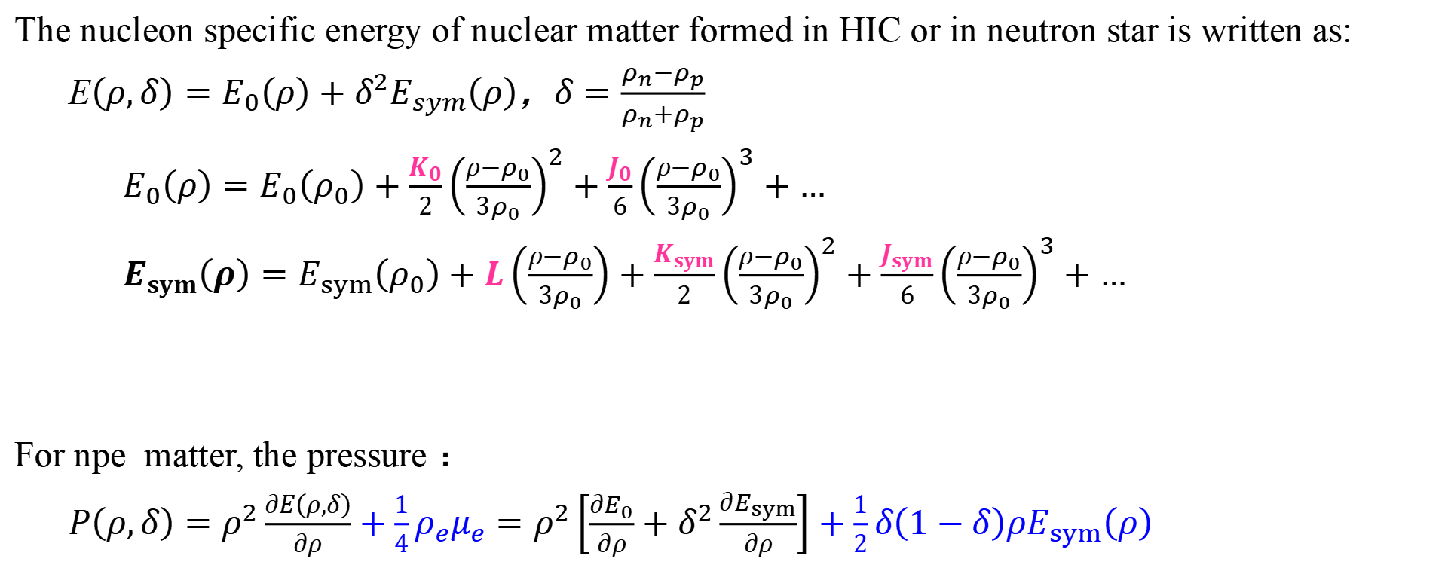
Nuclear Equation of State
The nucleon specific energy of nuclear matter formed in HIC or in neutron star is written as:
E$\left(ρ,δ\right)=E_{0}\left(ρ\right)+δ^{2}E_{sym}\left(ρ\right)$，$δ=\frac{ρ_{n}−ρ_{p}}{ρ_{n}+ρ_{p}}$
$E_{0}\left(ρ\right)=E_{0}\left(ρ_{0}\right)+\frac{K_{0}}{2}{\left(\frac{ρ−ρ_{0}}{3ρ_{0}}\right)}^{2}+\frac{J_{0}}{6}{\left(\frac{ρ−ρ_{0}}{3ρ_{0}}\right)}^{3}+…$
$E_{sym}\left(ρ\right)=E_{sym}\left(ρ_{0}\right)+L\left(\frac{ρ−ρ_{0}}{3ρ_{0}}\right)+\frac{K_{sym}}{2}{\left(\frac{ρ−ρ_{0}}{3ρ_{0}}\right)}^{2}+\frac{J_{sym}}{6}{\left(\frac{ρ−ρ_{0}}{3ρ_{0}}\right)}^{3}+…$
For npe matter, the pressure ：
$P\left(ρ,δ\right)=ρ^{2}\frac{∂E\left(ρ,δ\right)}{∂ρ}+\frac{1}{4}ρ_{e}μ_{e}=ρ^{2}\left[\frac{∂E_{0}}{∂ρ}+δ^{2}\frac{∂E_{sym}}{∂ρ}\right]+\frac{1}{2}δ\left(1−δ\right)ρE_{sym}\left(ρ\right)$
symmetry energy

Slide 4
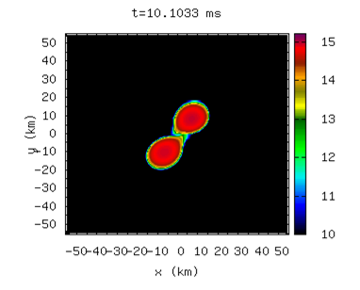
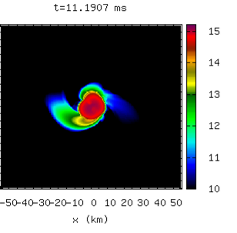
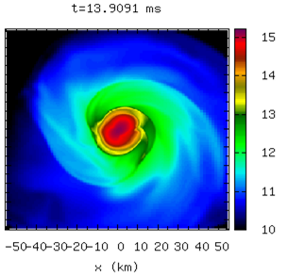
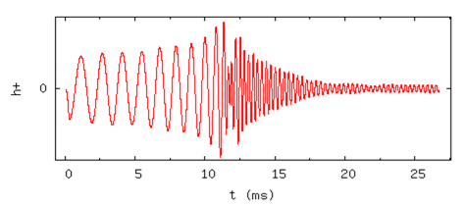



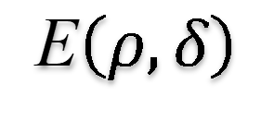
GW170817 and its relevance to nuclear EOS
GW170817 provides a new opportunities in the studies of nEOS
$$t=10 ms$$
$$t=11.2 ms$$
$$t=13.9 ms$$
E$\left(ρ,δ\right)$
R-M formular
GW
TOV Eq.
Λ∝(R/M)⁵
TOV equations:
$\frac{dℳ\left(r\right)}{dr}=4πr^{2}ε\left(r\right)$, $−\frac{d𝒫\left(r\right)}{dr}=\frac{Geℳ}{r^{2}}{\left(1−\frac{2Gℳ}{r}\right)}^{−1}\left(1+\frac{𝒫}{ε}\right)\left(1+\frac{4πr^{3}𝒫}{ℳ}\right)$

Slide 5
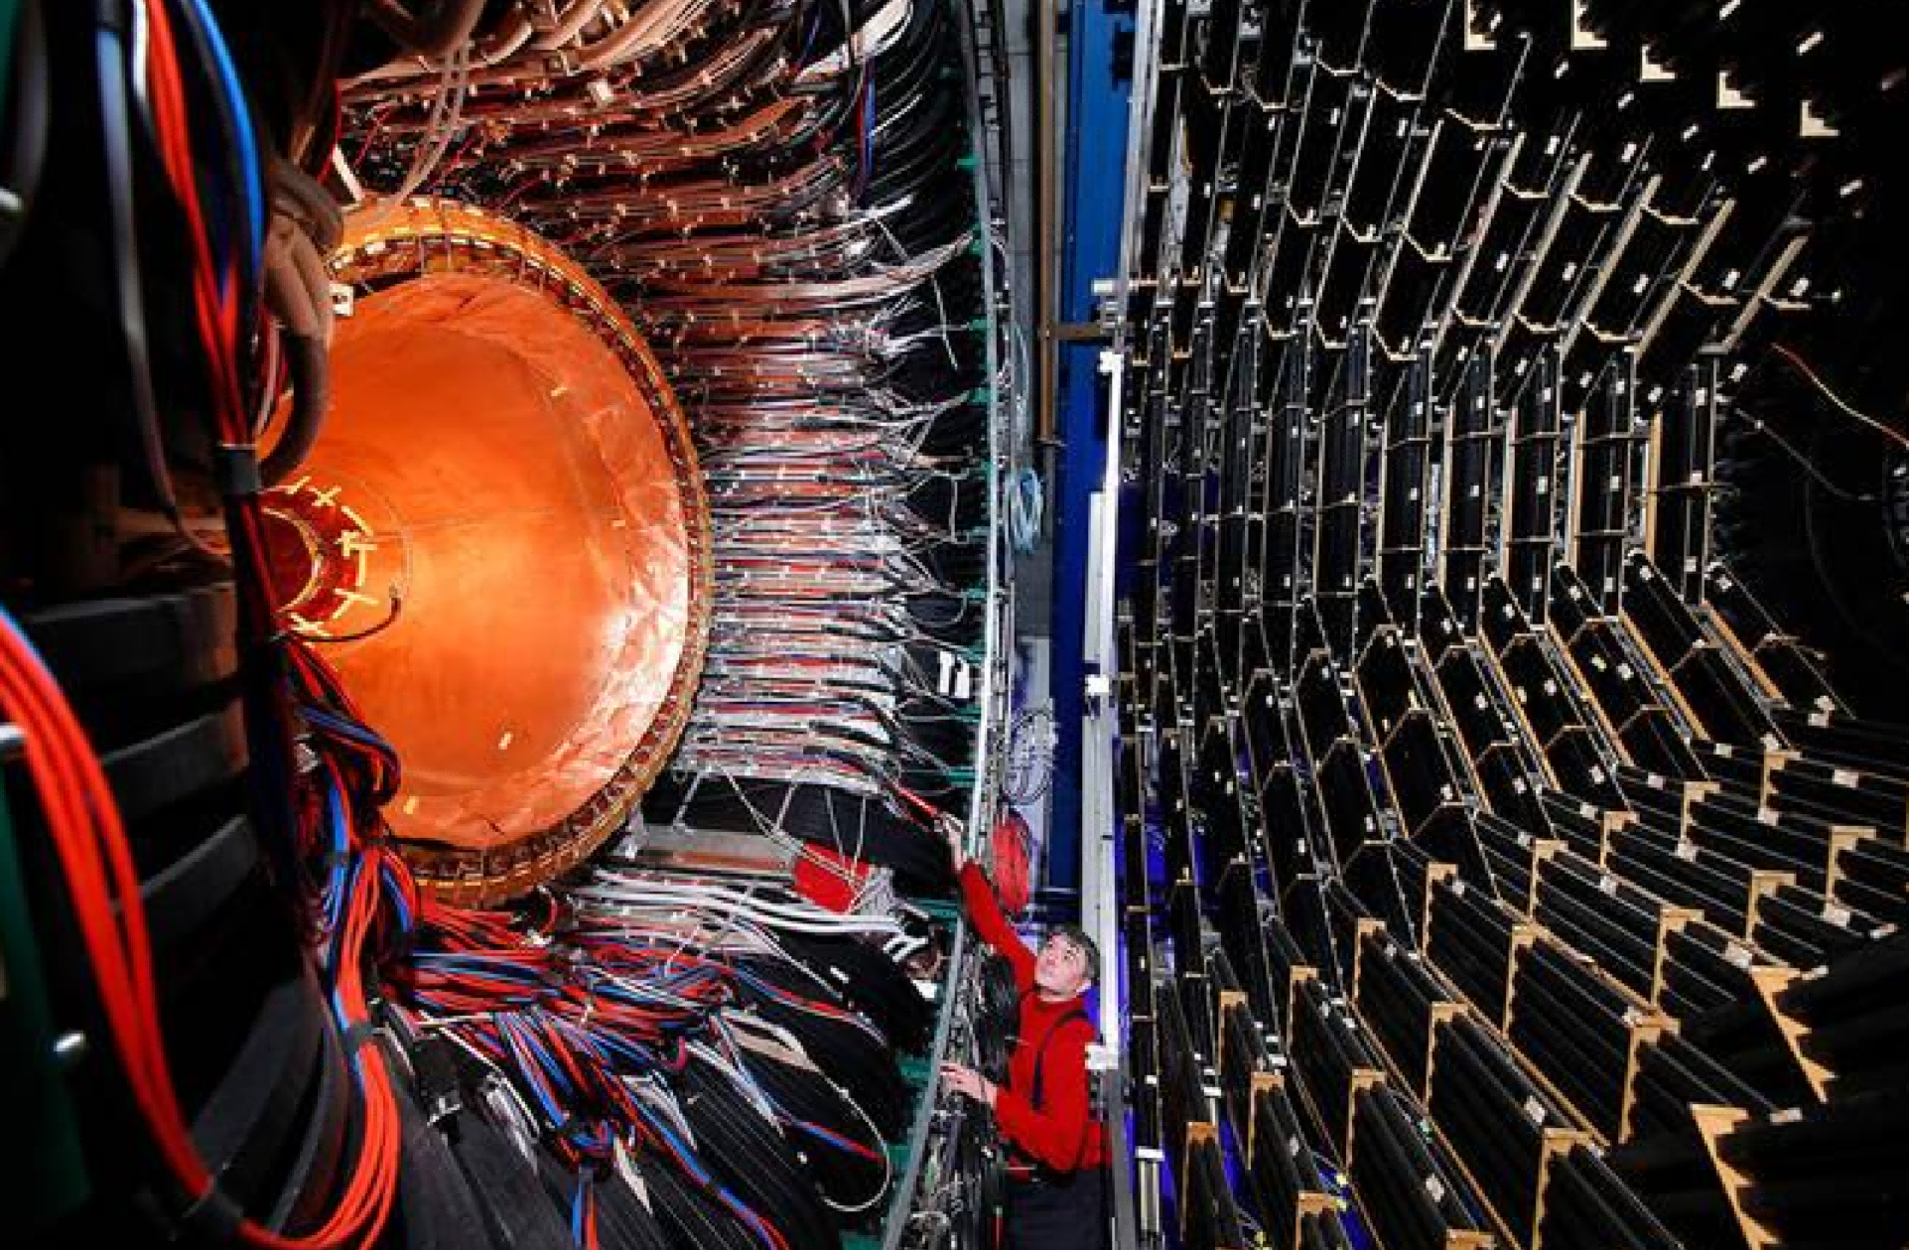
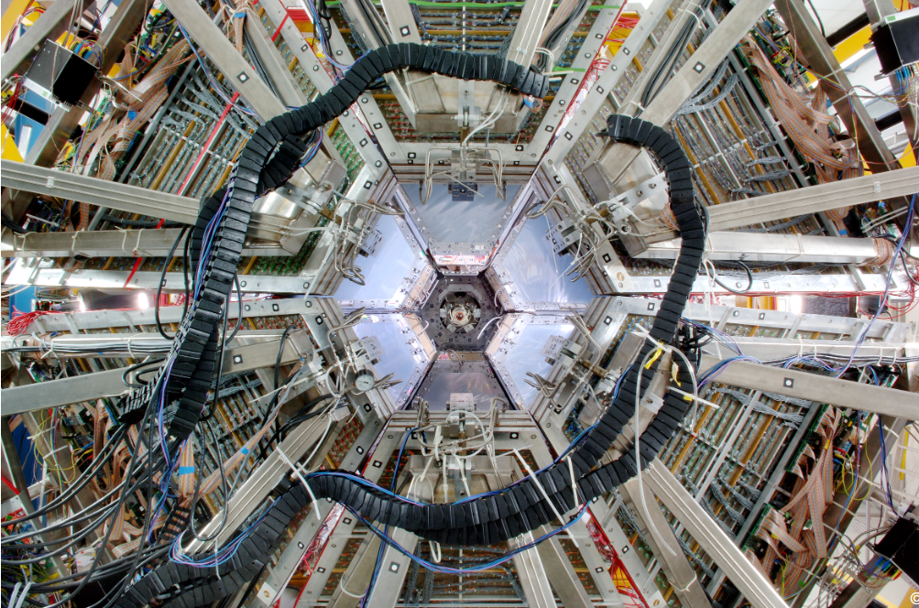
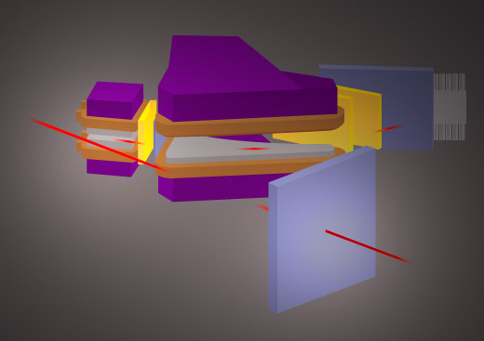
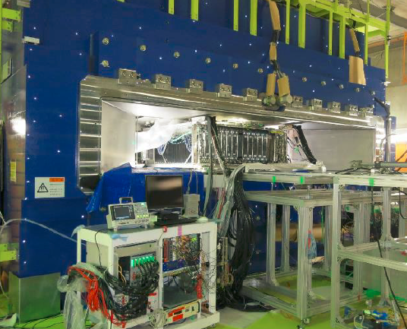
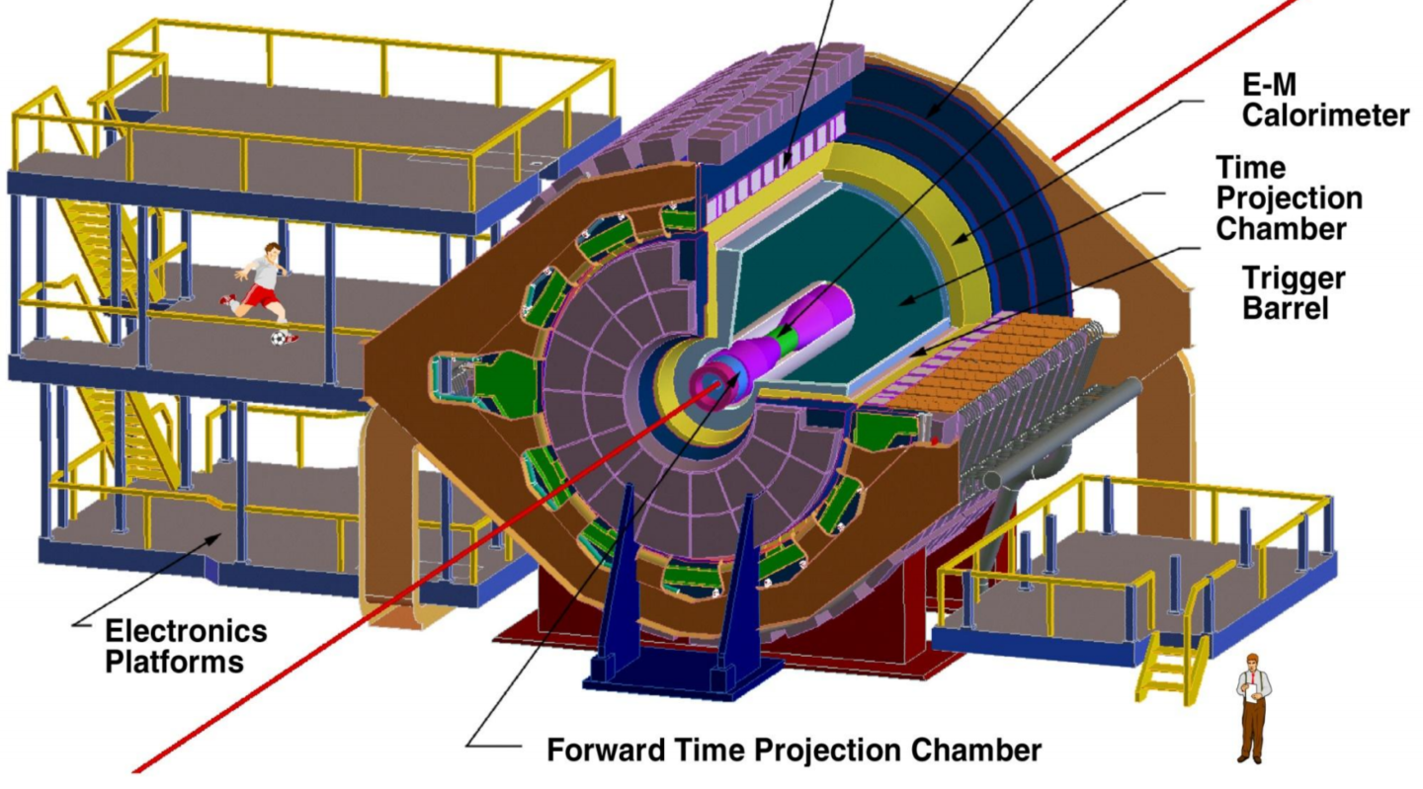
The world experiments for nuclear EOS
1. Plastic Ball at Bevalac
PRC 42, 640 (1990) ...
2. EOS at Bevalac
PRL 78, 2535 (1997); RPC 76, 3911 (1996); PRL 75, 2662 (1995) ...
3. FOPI at SIS
NPA 876, 1 (2012); NPA 848, 366 (2010); NPA781, 459 (2007) ...
4. KAOS at SIS
PRL 96, 072301 (2006); PRL 95, 012301 (2005) ; PRL 86, 1974 (2001)...
5. HADES at SIS
PRL 125, 262301 (2020); PRL 123, 022002 (2019) ; PRC 102, 024914 (2020) ...
6. SπRIT at RIBF
PRL 126, 162701 (2021); PLB 822, 136681(2021); PLB813, 136016 (2021)...
7. STAR-BES at RHIC
PRL128, 202303 (2022); PLB827, 137503 (2022)...
8. LAMPS at RAON
NIMB B 541 (2023) 260–263
and a lot more literatures...

Slide 6
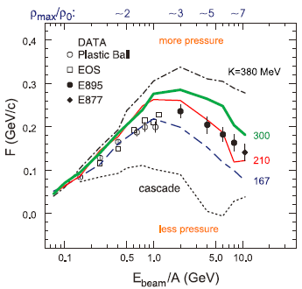
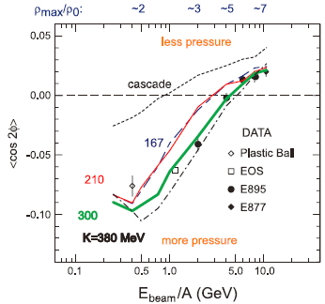
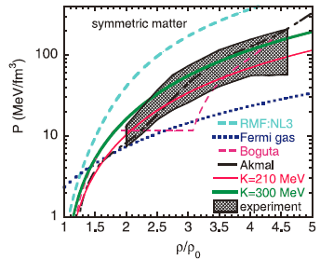
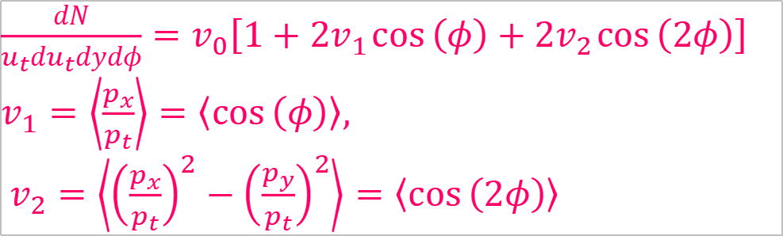
Early attempt: Extracting nEOS from flow ($v_{1}, v_{2}$)
Flow is formed in the collisions of two nuclei due to the compression and the pressure gradient developed in the colliding nuclei.
$\frac{dN}{u_{t}du_{t}dydφ}=v_{0}\left[1+2v_{1}\cos\left(φ\right)+2v_{2}\cos\left(2φ\right)\right]$
$v_{1}=\left\langle \frac{p_{x}}{p_{t}}\right\rangle =\left\langle \cos\left(φ\right)\right\rangle ,$
$v_{2}=\left\langle {\left(\frac{p_{x}}{p_{t}}\right)}^{2}−{\left(\frac{p_{y}}{p_{t}}\right)}^{2}\right\rangle =\left\langle \cos\left(2φ\right)\right\rangle$
P. Danielewicz, R. Lacey, and W. G. Lynch.
Determination of the equation of state of dense matter.
Science, 298,1592 (2002)

Slide 7
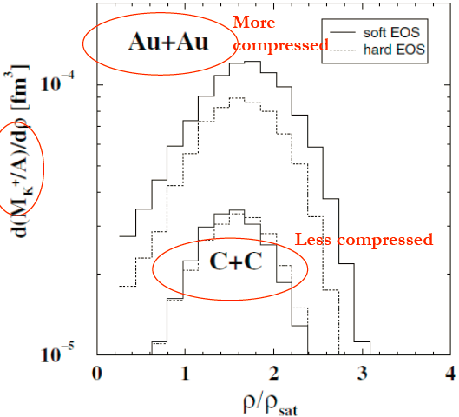
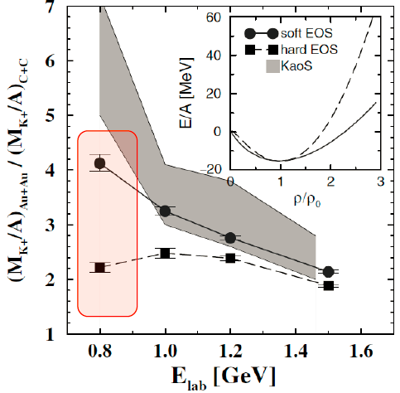
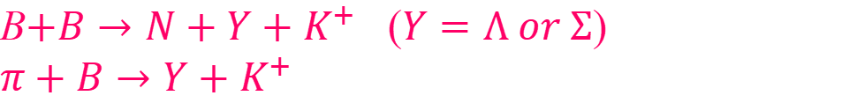
Extracting nEOS from $K^{+}$yield
Production yield of strangeness is related to the properties of the medium
B$+B→N+Y+K^{+}$ ($Y=Λ or Σ$)
$π+B→Y+K^{+}$
J. Aichelin and Che Ming Ko, PRL 55,2661 (1985)
C. Fuchs et al., PRL 86, 1974 (2001)
Insensitive in light system C+C; Higher sensitivity found at lower energies
KaoS Collaboration

Slide 8
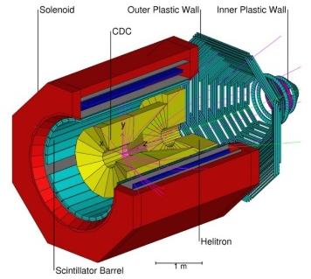
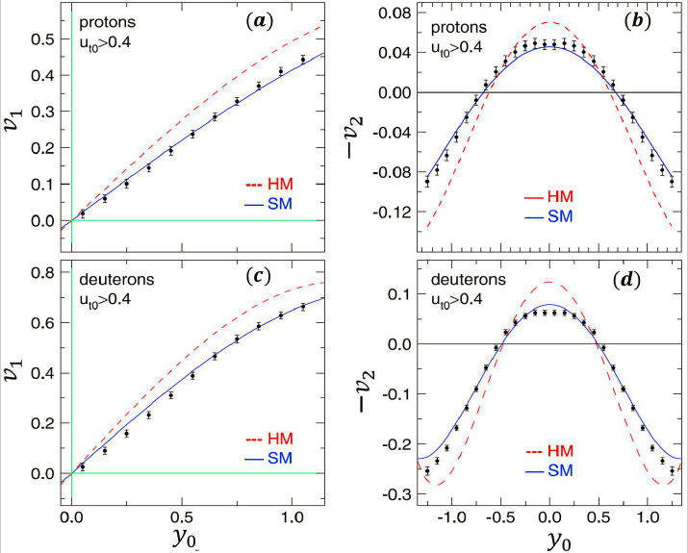
Extracting nEOS from flow ($v_{1}, v_{2}$)
The data favors a soft nuclear matter EOS!
$v_{i}=v_{i}\left(u_{t},y\right)$
Systematics of azimuthal asymmetries in heavy ion collisions in the 1 AGeV regime
W. Reisdorf et al for FOPI collaboration, NPA 876, 1 (2012)

Slide 9
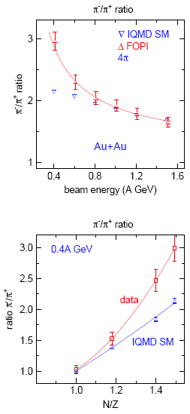
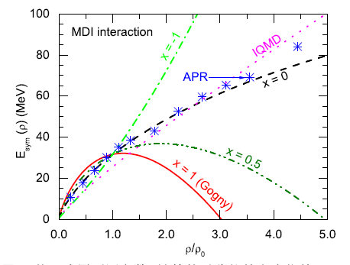
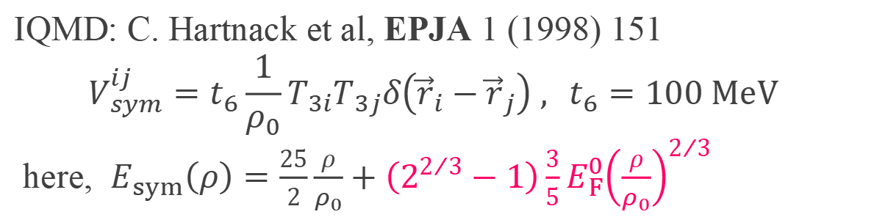
Extract the $E_{sym}\left(ρ\right)$ from ${π^{−}}/{π^{+}}$ ratio
IQMD: C. Hartnack et al, EPJA 1 (1998) 151
$$V_{sym}^{ij}=t_{6}\frac{1}{ρ_{0}}T_{3i}T_{3j}δ\left({\vec{r}}_{i}−{\vec{r}}_{j}\right) , t_{6}=100 MeV$$
here, $E_{sym}\left(ρ\right)=\frac{25}{2}\frac{ρ}{ρ_{0}}+\left(2^{2/3}−1\right)\frac{3}{5}E_{F}^{0}{\left(\frac{ρ}{ρ_{0}}\right)}^{2/3}$
Need a softer symmetry energy to make the pion production region more neutron-rich!
FOPI collaboration , NPA781 (2007) 459

Slide 10
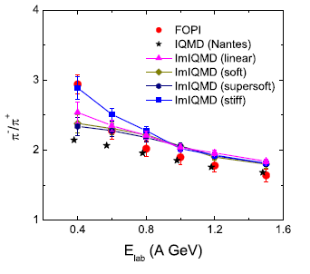
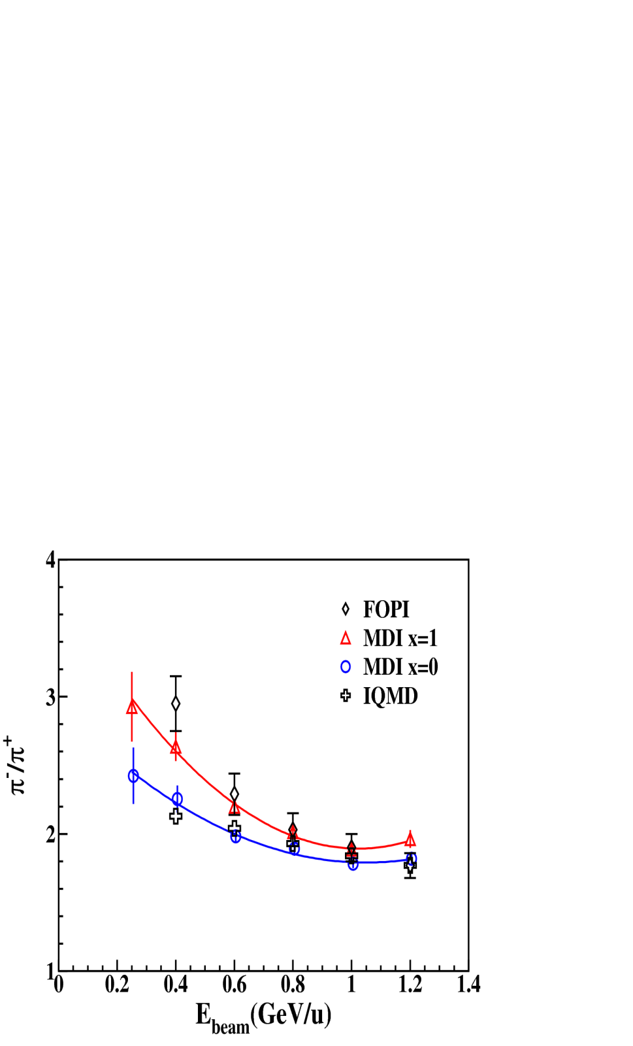
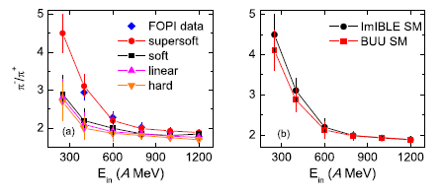
Model dependence of the probe of ${π^{−}}/{π^{+}}$ ratio
  Stiff
FZQ et al., PLB 683 (2010) 140
  Soft
XZG et al., PRL 102 (2009) 062502
XWJ et al., PLB 718 (2013) 1510
  or loss sensitivity on γ
J. Hong et al, PRC 90,024605(2010)

Slide 11
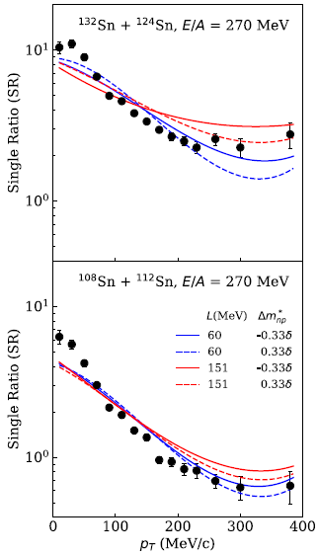
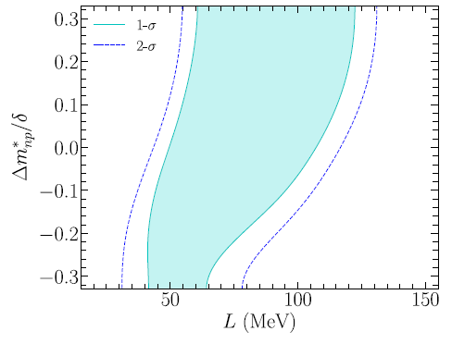



Update ${π^{−}}/{π^{+}}$ results by SπRIT experiment
$$P_{T}>200 {MeV}/c$$
$$32.5<S_{0}<38.1 MeV$$
$$42<L<117 MeV$$
Optical potential, non-resonant production and absorption etc …
J. Estee et al., PRL 126, 162701 (2021)

Slide 12
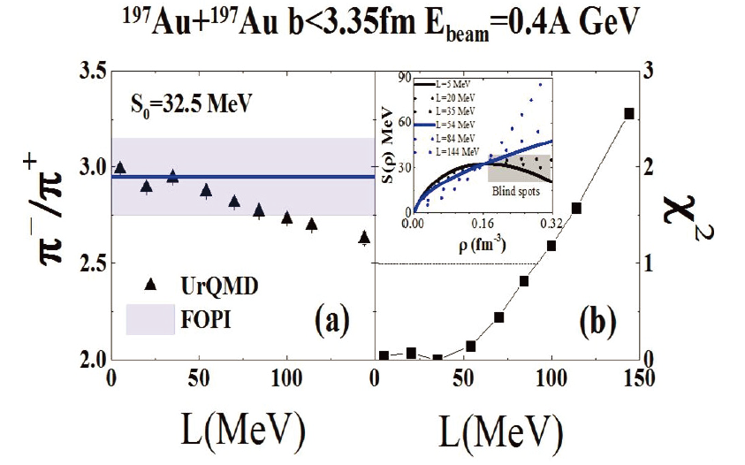
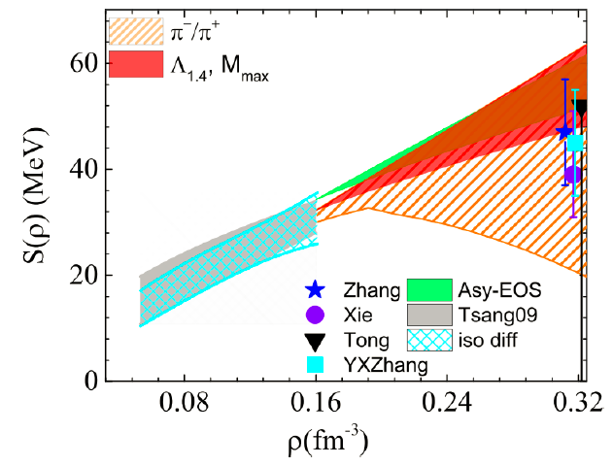
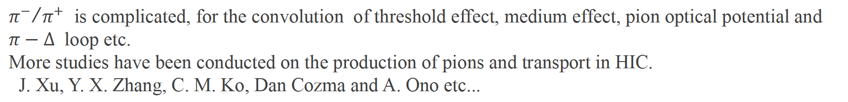
Revisit the ${π^{−}}/{π^{+}}$ in combination with GW170817
${π^{−}}/{π^{+}}$ is complicated, for the convolution of threshold effect, medium effect, pion optical potential and $π−∆$ loop etc.
More studies have been conducted on the production of pions and transport in HIC.
J. Xu, Y. X. Zhang, C. M. Ko, Dan Cozma and A. Ono etc...
Combine GW170817/HIC: $54<L<91 MeV$ 【Y.Y. Liu et al., PRC 103, 014616 (2021)】

Slide 13
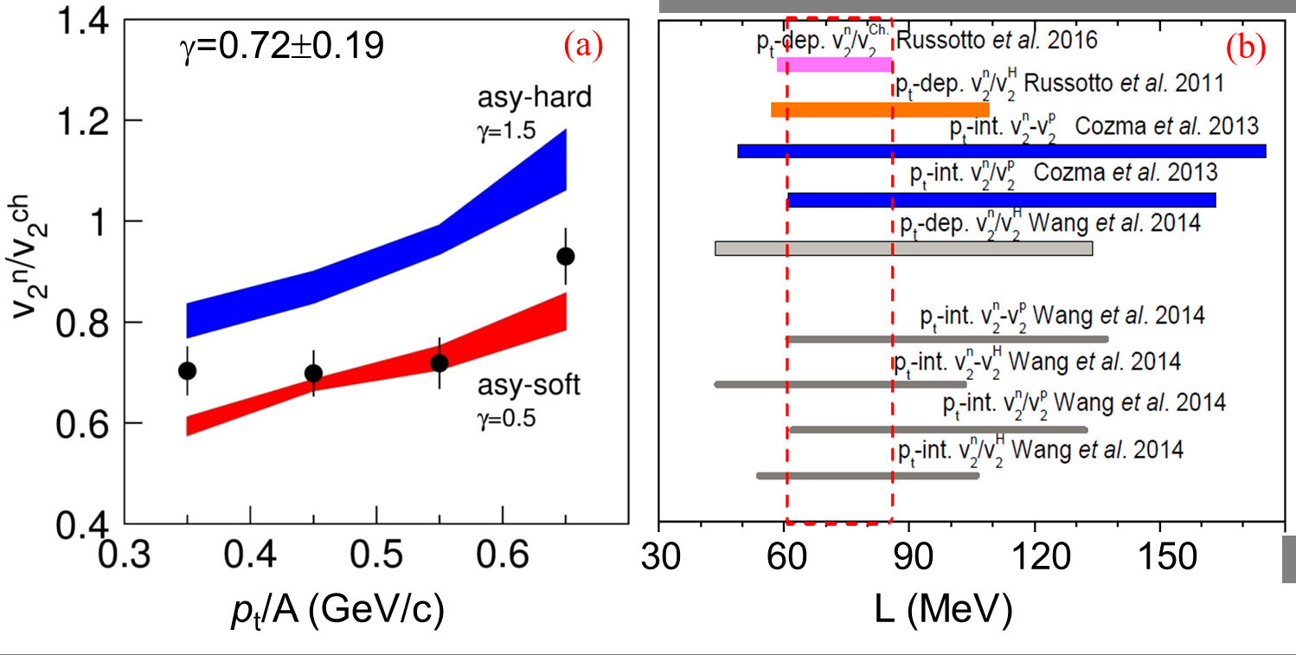
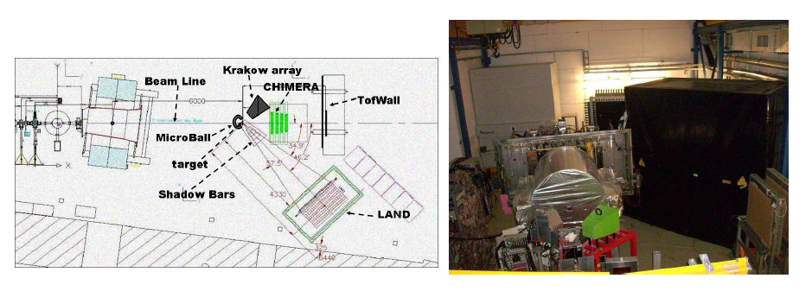
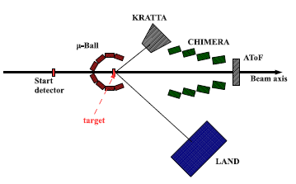
Extract the $E_{sym}\left(ρ\right)$ from $n/p$ differential flow
AnSYS-EOS collaboration
Y. Leifels et al
PRL71,963 (1993)
Russotto et al.,
PLB 697,471 (2011);
PRC 94, 034608 (2016)
$$E_{sym}\left(ρ\right)=12{\left(ρ/{ρ_{0}}\right)}^{2/3}+22{\left(ρ/{ρ_{0}}\right)}^{γ}$$
Yongjia Wang et al.，Frontiers of Physics, 15(4):1, 2020.

Slide 14
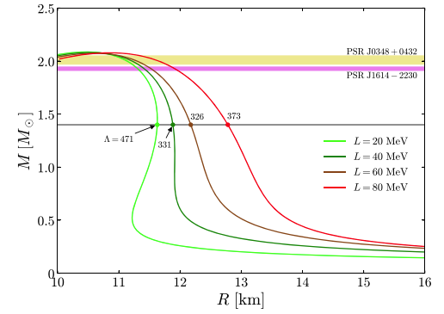
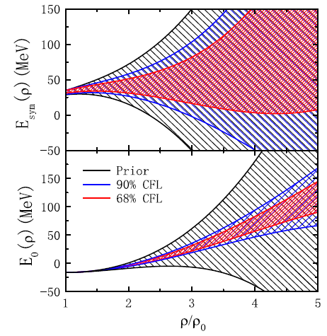
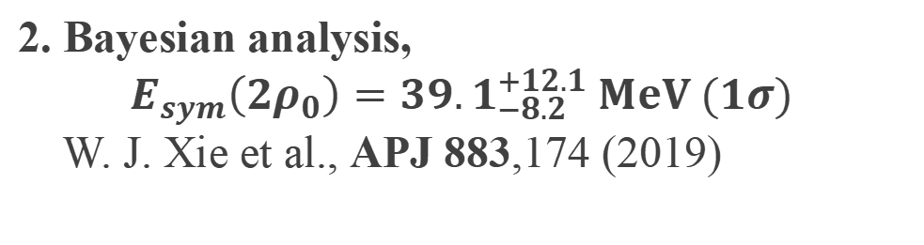
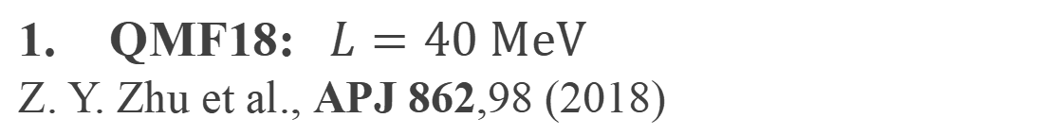
Combining GW170817 /PSRJ0740+6620 and HIC
$R_{1.4}={11.9}_{−1.4}^{+1.4} km$ , PRL, 121, 161101,2018; $R_{1.4}={10.8}_{−1.6}^{+2.1} km$ , PRL, 121, 091102,2018
QMF18: $L=40 MeV$
Z. Y. Zhu et al., APJ 862,98 (2018)
2. Bayesian analysis,
$$E_{sym}\left(2ρ_{0}\right)={39.1}_{−8.2}^{+12.1} MeV (1σ)$$
W. J. Xie et al., APJ 883,174 (2019)
N. B. Zhang et al., APJ 879, 99(2019)

Slide 15
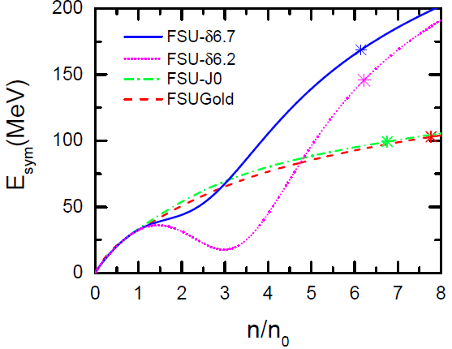
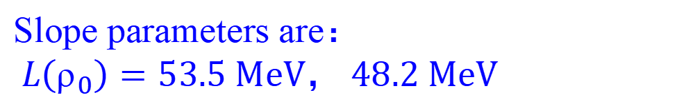
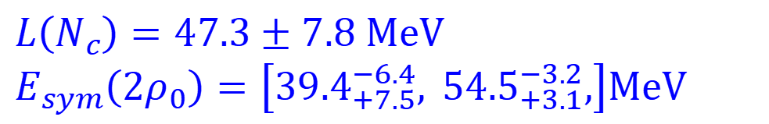
Combining GW170817 /PSRJ0740+6620 and HIC
3. Combing the neutron star merging and nuclear data
Y. Zhou et al., PRD99 121301(R) (2019)
$L\left(N_{c}\right)=47.3±7.8 MeV$
$E_{sym}\left(2ρ_{0}\right)=\left[{39.4}_{+7.5}^{−6.4},{ 54.5}_{+3.1}^{−3.2},\right]MeV$
4. Including $δ−σ$ coupling，one get two parameter sets FSU-δ6.7, FSU-δ6.2
F. Li et al., ApJ 929, 183 (2022)
Slope parameters are$：$
$L\left(ρ_{0}\right)=53.5 MeV$， 48.2 MeV

Slide 16
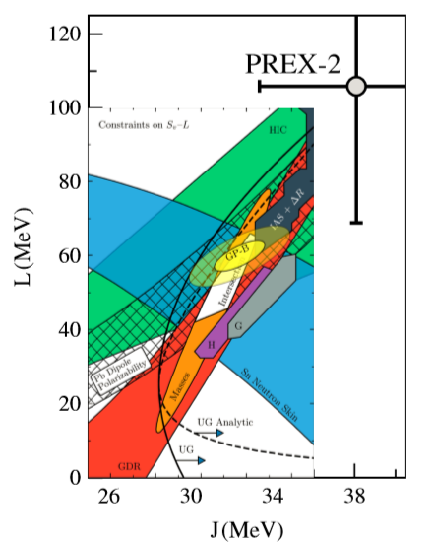
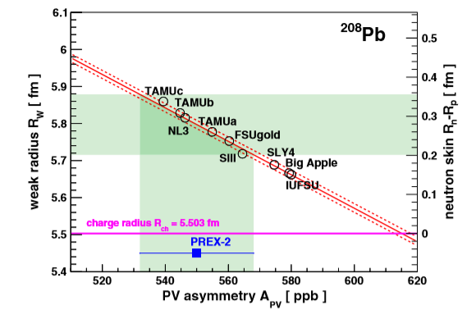
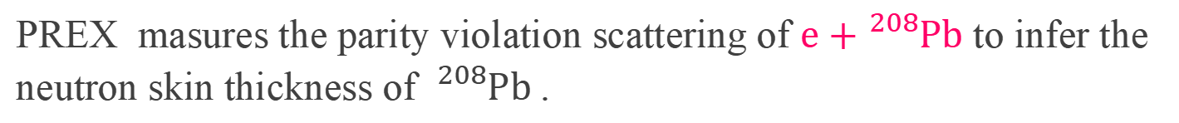



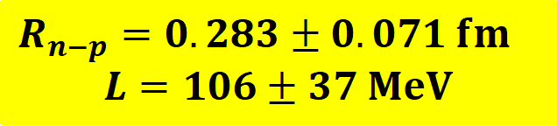
Recent progress of PREX2 experiment
$${}_{ }^{208}{Pb}$$
PREX masures the parity violation scattering of $e+{}_{ }^{208}{Pb}$ to infer the neutron skin thickness of ${}_{ }^{208}{Pb}$.
$$R_{n−p}$$
$$S_{0}(MeV)$$
$R_{n−p}=0.283±0.071 fm$
$$L=106±37 MeV$$
PREX collaboration., PRL 126, 172502 (2021)
B. T. Reed et al, PRL 126, 172503 (2021)

Slide 17
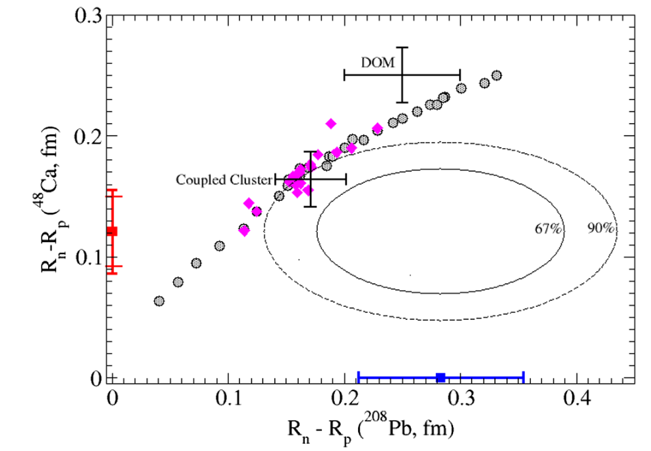
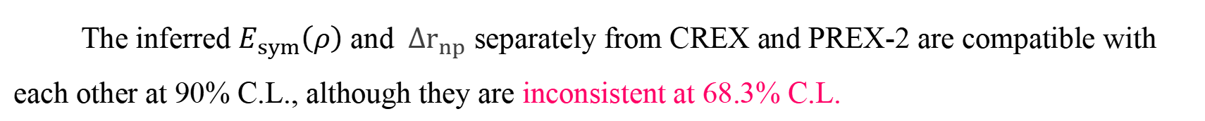



Conbined analysis of PREX-2 and CREX
Based on the same method，⁴⁸Ca has been measured:
$$∆r_{np}({}_{ }^{48}{Ca})=0.121±0.026(exp)±0.024\left(model\right) fm$$
D. Adhikari et al (CREX collab.) Phys. Rev. Lett. 129, 042501 (2022)
$$0.121 fm$$
⁴⁸Ca
The inferred $E_{sym}\left(ρ\right)$ and $∆r_{np}$ separately from CREX and PREX-2 are compatible with each other at 90% C.L., although they are inconsistent at 68.3% C.L.
CREX: small $∆r_{np}$, very soft $E_{sym}\left(ρ\right)$;
PREX-2: large $∆r_{np}$, rather hard $E_{sym}\left(ρ\right)$
P. Reinhard et al PRL. 129, 232501 (2022); Z. Zhang, L. W. Chen et al., PRC 108, 024317 (2023)

Slide 18




Combined fiducial constraint of $E_{sym}\left(ρ\right)$
Recent results on $L$
$$L=58±19 MeV$$
Recent results on $K_{sym}$
$$K_{sym}=−107±88 MeV$$
24 new analysis from the NS observables
In comparison to 2013 and 2016 survey.
In tention with the most recent PREX II results.
Bao-An Li et al., Universe 7, 182 (2021)

Slide 19




Some perspectives of near future: HADES experiment
PRL 125, 262301 (2020); PRL 123, 022002 (2019) ; PRC 102, 024914 (2020)
M. Lorenz presentation on Nusym23
Beam energy scan of Au+Au and C+C system;
Flow and pion ratio analysis ongoing
p-induced collisions planned for short range correlation studies

Slide 20


Some perspectives of near future: SπRIT Experiemnts
PRL 126, 162701 (2021); PLB 822, 136681(2021); PLB813, 136016 (2021)...
270 MeV/u ${}_{ }^{108,132}{Sn}+{}_{ }^{112,124}{Sn}$ , published
[${π^{−}}/{π^{+}}$ ratio， Flow， Light charged particles published]
345 MeV/u ${}_{ }^{136}{Xe}+{}_{ }^{112,124}{Sn}$ : June 2024
270 MeV/u ${}_{ }^{186，208}{Pb}+{}_{ }^{208}{Pb}$： in plan

Slide 21





Some perspectives of near future: LAMPS
LAMPS at RAON is nearly constructed. [NIMB B 541 (2023) 260–263]

Slide 22

So, a few words about constraining $E_{sym}\left(ρ\right)$
The $E_{sym}\left(ρ\right)$ is of significance, attracting theoretical and experimental efforts continuously...
Despite of the large progress of constraining $E_{sym}\left(ρ\right)$, there is still long way to go before arriving at an accurate and convincing results ,
In heavy ion collisions, it always comes togather with the complicated collision dynamics, particularly of the different transport of neutron and proton, in either free of bound states,
Further studies are required, and opportunities with HIRFL are open.

Slide 23

Opportunies with HIRFL
HIRFL： Heavy Ion Research Facility at Lanzhou
CSR： Cooling Storage Ring
SSC：
Kr： ~ 40 MeV/u
Sn： ~ 30 MeV/u
→Collisions dynamics and nEOS near ρ₀
CSR：
p： 2.8 GeV
C： 1.0 GeV/u
U： 0.5 GeV/u
→Collision dynamics, QCD phase diagram and nEOS near 2ρ₀
If equipped with an advance spectrometer：
→ Hyperon-N interactions

Slide 24


CSHINE and CEE experiments
Two experiments at HIRFL
CSHINE: Running, on RIBLL for HIC at Fermi energies
CEE: Under construction, on HIRFL-CSR in GeV/u energy region
CSHINE: Compact Spectrometer for Heavy IoN Experiment
CEE: HIRFL-CSR External-taget Experiment
400 channels
20000 channels

Slide 25
Outline
1. Introduction: From current status to motivations
2. Experimental results at CSHINE
3. Perspective with CEE
4. A novel probe to the nEOS*
5. Summary and outlook

Slide 26





  Introduction to CSHINE
Space-time volume of HIC： ${10}^{−14}m$ / ${10}^{−21}s$, we need a super camera
a Compact Spectrometer for Heavy IoN Experiment
PPAC for fission fragments
Total channels：~400，starting from 2014
CsI hodoscope for high energy γ
SSDT for LCP and IMFs
Initial motivation is to study the isospin physics in heavy ion fission reactions

Slide 27

Experiments and outputs of CSHINE
Beam time statistics:
I ：30 MeV/u* ⁴⁰Ar+¹⁹⁷Au (2014)
II：30 MeV/u ⁴⁰Ar+¹⁹⁷Au (2018)
III：25 MeV/u ⁸⁶Kr+²⁰⁸Pb (2019)
IV：25 MeV/u ⁸⁶Kr+¹²⁴Sn (2022)
V：25 MeV/u 124Sn+124Sn (2024)
Development of detector technologies:
NIMA 1053 168330 (2023)
NIMA 1029, 166461 (2022)
NST 33, 162(2022)
NIMA 1011, 165592 (2021)
NST 32, 4 (2021)
NIMA 701, 54 (2013) …
Papers of Exp./Phenome. studies:
PLB 850,138514 (2024)
PRC 107, L041601 (2023)
PLB 825, 136856 (2022)
PRC 95, 041602R (2017)
PRC 89, 064613 (2014)
NST 33, 40 (2022)
PLB 811, 135865 (2020)
PLB 797,134808 (2019)
PRC 91, 014617 (2015) …

Slide 28



Performance of CSHINE
LCPs in SSD
FF in PPAC

Slide 29








2.1 One-body isospin observable of $E_{sym}\left(ρ\right)$
Neutron abundence enhanced at smaller angle
30 MeV/u Ar+Au Reactions
$$p/d$$
$$t/d$$
$${{}_{ }^{3}{He}}/α$$
$${{}_{ }^{6}{He}}/α$$
$$\left\langle τ\right\rangle$$
Translate angular distribution of yield ratio to particle emission order
$$θ_{lab}$$

Slide 30



Constraining $E_{sym}\left(ρ\right)$ near $ρ≈ρ_{0}$
In wide angular range, we observed the variation of $δ_{n}/Z$ (relative neutron excess)
Using it as a probe of $E_{sym}\left(ρ\right)$, the slope parameter L is extracted.
$γ_{i}=0.46±0.025$ or
$L=47±14 MeV \left(CL=95\%\right)$ ($S_{0}=28.3MeV$)
Bao-An Li et al., Universe 7, 182 (2021)
our work
Question: It is only a qualitative description, can it be quantified, the emission time scale vs. N/Z？
R.S.Wang et al., PRC 89, 014613 (2014); Y. Zhang et al., PRC 95,041602(R) (2017)

Slide 31





2.2 Isospin Chronology
Can we measure the emission order of different particles?
HBT method: 1950s，Hanbury Brown and Twiss invented the intensity interferometry, and measured the angular size of Siris.
Siris
Hanbury Brown and Twiss， Nature 177， 27 （1956）
Hanbury Brown and Twiss， Nature 178， 1046（1956）
$$b$$
$L/d≈b/λ={10}^{7−9}$
Isospin Chronology: By measuring the emission time constant $τ$of particles with different N/Z，one infers the time scale of isospin relaxation of IDOF in HIC.

Slide 32


Application of HBT in nuclear physics
HBT is widely used in nuclear physics of wide energy range：to infer the space-time information of the source, to infer the interactions etc...
S. Koonin, Phys. Lett. B70, 43 (1977)
1960s, Goldhaber
π-π correlations
1977, S Koonin
Formation the p-p correlation
1990s, enormously applied in HIC
2006, ZGX et al., PLB 639, 436
Isospin effect of IMF-IMF correlation function in HIC
Soure function
$$\frac{1}{σ}\frac{dσ}{dp_{1}dp_{2}}=\int{dt_{1}dt_{2}\int{dr_{1}dr_{2}}}D\left(r_{1}t_{1},p\right)D\left(r_{2}t_{2},p\right)×\left\{\frac{1}{4}{\left|{1Ψ}_{p_{1}p_{2}}\left(r_{1}^{′},r_{2}\right)\right|}^{2}+\frac{3}{4}{\left|3Ψ_{p_{1}p_{2}}\left(r_{1}^{′},r_{2}\right)\right|}^{2}\right\}$$
Propagation and p-p wave function of relative motion
$$D\left(r,t,p\right)=\frac{1}{σ}\frac{dσ}{dp}\left[\frac{1}{π^{3/2}r_{0}^{3}}exp\left(−{\left(r−V_{0}t\right)}^{2}/r_{0}^{2}\right)\right]\left[\frac{1}{π^{1/2}τ}exp\left(−t^{2}/τ^{2}\right)\right]$$

Slide 33



Isospin chronology at CSHINE
Detector performance (granurality, resolution) suitable for HBT studies:
Should be able to see fine isospin effect
(b)
⁴He
p
d
t

Slide 34



Isospin Chronology results
Using CRAB model to fit the correlation function $C12 [1+R(q)]=\frac{ΣY12({\overset{⃑}{p}}_{1},{\overset{⃑}{p}}_{2})}{ΣY1({\overset{⃑}{p}}_{1}) Y2({\overset{⃑}{p}}_{2})}$
Source function:
$S\left(r,t\right)=c\exp\left(−\frac{r^{2}}{2σ_{r}^{2}}−\frac{t^{2}}{2τ^{2}}\right)$
$τ_{p}≈100 fm/c$
$σ_{r}≈1.6 fm$
Size of overlape region
$≈2×0.75A_{pro}$
Overlap

Slide 35






Isospin Chronology results
Velocity-cut analysis, provides the emission order of two unlike particles:
$τ_{p}>τ_{d}>τ_{t}$
i.e., averagely: neutron-rich triton is emitted earlier than proton
$$τ_{p}>τ_{d}$$
Consistent with :
$τ_{p}>τ_{d}>τ_{n}$
R. Ghetti et al., PRL 91, 092701 (2003).
$$τ_{p}>τ_{t}$$
$$τ_{d}>τ_{t}$$
Y. J. Wang et al., Phys. Lett. B 825, 136856 (2022)
n-n correlation function has been measured, stay tuned.
ImQMD simulations reveals that $E_{sym}\left(ρ\right)$ influences the time constant of ci-n and ci-p ;
A further question arises：Does formation of cluster matter?

Slide 36


2.3 Ping-pong emission modality
IDOF transport and clustering are two important features in HIC, Is there coupling between these two?
If yes, how? can we observe?
Initial
Final
Fragment 1(F_{H})
($7≤A≤14$)
Fragment 2 (F_{L})
( $A=3$: t or ³He)

Slide 37

















Anticorrelation of N/Z of the two emitted fragments
$F_{H}$ tag?
$${}_{ }^{7}{Be}$$
$${}_{ }^{7}{Li}$$
$${}_{ }^{8}{Be}$$
$${}_{ }^{8}{Li}$$
$${}_{ }^{9}{Be}$$
$${}_{ }^{9}{Li}$$
$${}_{ }^{10}B$$
$${}_{ }^{10}{Be}$$
$${}_{ }^{12}C$$
$${}_{ }^{12}B$$
$${}_{ }^{13}C$$
$${}_{ }^{13}B$$
$${}_{ }^{3}H$$
$$F_{L}$$
$${}_{ }^{3}{He}$$
The N/Z of the light fragment is anti-correlated with that of the tagging heavy fragment, demonstrating a ping-pong modality of emission in isospin!

Slide 38



Anticorrelation between the N/Z of light (A=3) and heavy fragments
$$δI_{H}=\frac{N_{H}−Z_{H}}{A_{H}}$$
- $R\left(t/{{}_{ }^{3}{He}}\right)$ splitted in two groups, depending on the N/Z of the heavy tagging fragment;
- Ping-pong modality: F_{H} is neutron-rich, $R\left(t/{{}_{ }^{3}{He}}\right)$ is smaller, and vise versa.
- $R\left(t/{{}_{ }^{3}{He}}\right)$ anti-correlated with $δI_{H}$, partly due to N, Zconservation of a finite system.

Slide 39



Compare with ImQMD calculations to constrain $E_{sym}\left(ρ\right)$
- $R\left(t/{{}_{ }^{3}{He}}\right)$ depends weakly on b, strongly on slope parameter L of $E_{sym}\left(ρ\right)$;
- $R−δI_{H}$ anti-correlation provides a sensitive probe to $E_{sym}\left(ρ\right)$,
- a soft symmetry energy with $γ=0.5$-0.7 ($L=49−60$ MeV) is inferred
This work
$$δI_{H}=\frac{N_{H}−Z_{H}}{A_{H}}$$
Y. J. Wang et al., PRC 107, L041601 (2023)

Slide 40





2.4 n-p bremsstralung radiation and the short range correlation in nuclei
- Strong short range correlation (SRC) exists in nuclei,
as a source of the uncertainty of $E_{sym}\left(ρ\right)$ at $ρ>ρ_{0}$ ^{[PRC 81, 064612 (2010)]}
- SRC is Isophobic (np/nn~np/pp~10),
- Most of our knowledge on SRC come from eA scattering,
- High momentum tail (HMT) of nucleons is a signature of SRC.
PPACs
SSD telescope
Vacuum Chamber
Beam
16-unit CsI(Tl) hodoscope：
each: $7cm×7cm×25cm$
Y. H. Qin et al., Nucl. Inst. Meth. A 1053 168330 (2023)

Slide 41




Bremsstrahlung photon production as a probe of SRC
So was pointed by H.Xue et al. in PLB 755, 486 (2016)
BUU model taking into account $np→npγ$
Results：HMT ration $R_{HMT}=15\%$，
90% CL supporting the existence of HMT
$np→dγ$ is at work
Y.H.Qin, Q. L. Niu et al., PLB850,138514 (2024)
A new experiment has been done, stay tuned.

Slide 42
Outline
1. Introduction: From current status to motivations
2. Experimental results at CSHINE
3. Perspective with CEE
4. A novel probe to the nEOS*
5. Summary and outlook

Slide 43


CEE: The spectrometer for nuclear matter studies
- CEE：HIRFL-CSR Extermal-target Experiment
The construction of CEE was started in August 2019, with support from NSFC and CAS
CEE Spectrometer：
Super-conducting Dipole Magnet
Si-PIX Beam Monitor (BM)
Time Projection Chamber (TPC)
T₀/Inner TOF (iTOF)
Endcap TOF (eTOF)
Multi-Wire Draft Chamber (MWDC)
Zero Degree Counter (ZDC)
Data Acquisition system (DAQ)
Trigger system (Trigger)
Clock system (Clock)
Technical Support
Slow Control (SC)

Slide 44




CEE Simulation studies: Coverage and PID
TPC acceptance
MWDC acceptance
TPC PID
CeeROOT Home page:
https://gitee.com/CEESM/CeeRoot
(Open source)

Slide 45




Simulation studies: PID with TOF
PID with Time of Flight (ToF) detector, fast simulation:
$β=L/t, \frac{∆β}{β}=\sqrt{{\left(\frac{∆L}{L}\right)}^{2}+{\left(\frac{∆t}{t}\right)}^{2}}$
iToF ∆t = 50 ps smearing
eTOF ∆t = 60 ps smearing
$\frac{∆L}{L}=5\%$smearing
iToF+TPC
eToF+MWDC

Slide 46







The potential observables for EOS studies at CEE
Using UrQMD + Geant4 simulation, one can identify the observables of nuclear EOS.
0.5 GeV/u ²⁰⁸Pb+ ²⁰⁸Pb:
$t/{{}_{ }^{3}{He}}$ Ratio
${π^{−}}/{π^{+}}$Ratio
2.8 GeV p+C, Ni, Ag, Ta:
$K_{s}^{0}$ production
Dong Guo et al., Eur. Phys. J. A 60, 36 (2024)
Studies of nuclear equation of state with the HIRFL-CSR external-target experiment

Slide 47






Intergration tests and mass productions of the subdetectors
Beam
Tests:
1) 2023.05
2) 2023.12
All subdetectors (prototype)
Clock system
Trigger system
DAQ system
a TPC track
TOF resolution
MWDC tracking
⁵⁵Fe source test

Slide 48



Future opportunities: CEE⁺ at HIAF
HI beam energy(A/Z=2) ~ 4.5 GeV/u <<>> Beam itensity HIAF/HIRFL: 10³ – 10⁴
Nuclear matter compressed: $ρ≳3−4ρ_{0}$
SRing:
Length: 273m
Rigidity: 13-15 Tm
CEE⁺
HFRS
MRing:
Length: 273m
Rigidity: 15 Tm
Low energy terminal
BRing1: Booster ring 1
Length: 600 m
Rigidity: 34 Tm

Slide 49
Outline
1. Introduction: From current status to motivations
2. Experimental results at CSHINE
3. Perspective with CEE
4. A novel probe to the nEOS
5. Summary and outlook

Slide 50




Motivation to measure the IVR effect
Coulomb force: leads to Coulomb polarization (Oppenheimer et al., 1935)
Isovector force: leads to isovector reorientation (IVR)
Due to the difference of nuclear forces neutron and proton experiences, extra rotation occurs！
Isovector force
  Attractive to $p$, repulsive to $n$
  $F_{v}∝δ^{2}\frac{dE_{sym}}{dρ}\frac{dρ}{dr} \left(δ=\frac{ρ_{n}−ρ_{p}}{ρ}\right)$
  Cleanly sensitive to $E_{sym}\left(ρ\right)$
$$n$$
$$p$$
PRL 115, 212501 (2015); PRC 101, 024603 (2020)
No Experimental evidences have ever been reported so far!

Slide 51




Beam time on BigRips at RIKEN has been approved
Dpol
$\vec{d}$ beam above 100 MeV/u
Simultaneous measurement of p and n
BigDpol
Experimental Area
Two polarimeters to be installed to monitor the polarization of d beam

Slide 52



















Deuteron Breakup distribution
$$P_{zz}=1$$
$$b$$
$$5 fm$$
$$6 fm$$
$$7 fm$$
$$8 fm$$
$$9 fm$$
$$10 fm$$
$$Total$$
$$γ=0.5$$
${\vec{p}}_{x}^{p}−{\vec{p}}_{x}^{n}$ → deflection difference of p and n;
${\vec{p}}_{x}^{p}+{\vec{p}}_{x}^{n}$ → deflection of the CM of p and n;
$$γ=0.6$$
$$γ=0.7$$
$$γ=0.8$$
Results: ${\vec{p}}_{x}^{p}−{\vec{p}}_{x}^{n}$distribution is asymmetric!
Notes:
Z方向极化的束流，已进行φ角随机化。使用${\vec{p}}^{p}+{\vec{p}}^{n}$确定反应平面（xOz），将该平面中与z轴垂直的方向定义为x方向，从而建立坐标系。
主要特征：
$p_{x}^{p}+p_{x}^{n}$ 始终为负，并随b的增大而增大，所以可以通过对$p_{x}^{p}+p_{x}^{n}$取截断来限制碰撞参数b。
b=5-7fm时，$p_{x}^{p}−p_{x}^{n}$ 分布随 γ 的变化不明显；b=8-10fm时变化显著，可以提取观测量。

Slide 53













Deuteron Breakup distribution
Unpolarized
$$b$$
$$5 fm$$
$$6 fm$$
$$7 fm$$
$$8 fm$$
$$9 fm$$
$$10 fm$$
$$Total$$
$$γ=0.5$$
$$γ=0.6$$
$$γ=0.7$$
$$γ=0.8$$
Results: ${\vec{p}}_{x}^{p}−{\vec{p}}_{x}^{n}$distribution is asymmetric!
Notes:
非极化束流，确定反应平面的方法与极化束流相同。除 $p_{x}^{p}+p_{x}^{n}$ 随b的增大而增大外，其他特征几乎完全消失。

Slide 54









$p_{x}^{ }$ distribution at varying γ
By varying the γ, the left-right asymmetry of $p_{x}^{ }$ distribution varies!
$$P_{zz}=1$$
$$P_{yy}=1$$
Unpolarized
$$p_{x}^{p}<p_{x}^{n}$$
$n$ outside
$$p_{x}^{p}>p_{x}^{n}$$
$p$ outside
$P_{zz}=1$ & $P_{yy}=1$: trends for different $γ$ are similar
Unpolarized: symmetric distribution
strong $F_{v}$ weak $F_{v}$
Notes:
在取cut1和cut2之后，不同极化情况下的 $p_{x}^{p}+p_{x}^{n}$ 分布。可以看到Y方向极化和Z方向极化的分布随γ的变化趋势基本一致，而非极化情况的分布总是平坦的，并且事件数低一个量级。这就说明，即使束流的极化率不高（比如50%、甚至30%），极化带来的特征也应该是非常明显的。
横轴负半轴$（p_{x}^{p}<p_{x}^{n}$）代表中子在外质子在里（即P9的示意图所展示的情况），正半轴则相反。两种情况之比的变化趋势在下一页PPT中展示。

Slide 55



Experimental effect prediction
$R=N\left(p_{x}^{p}>p_{x}^{n}\right)/N\left(p_{x}^{p}<p_{x}^{n}\right)$
$γ$ increases by $0.1$, $R$ doubles !
Effects pronounced with $P_{zz}$ and $P_{yy}$
solid (dashed) lines = with (without) detector uncertainties.
( PDC: 1mm; TOF 0.24 ns)
Notes:
如图所示，紫色线示意非极化，因为分布平坦所以该比值始终为1.
如果体系中库仑力主导（Fc > 2Fv），质子感受到排斥力，更有可能在外面出射，即R>1；
如果体系中同位旋矢量力主导（Fc < 2Fv），则中子更有可能在外面出射，即R<1。
图中主要特征：
四条曲线趋势都是正相关：$γ↑ ⇒\frac{dE_{sym}}{dρ}↓ ⇒F_{v}↓$
Sn-124 两种极化方式结果基本一致
Sn-112 相对 Sn-124 整体抬高（$δ↓ ⇒\frac{dE_{sym}}{dρ}↓ ⇒F_{v}↓$，同位旋矢量力更小，使得库仑力占主导，R整体抬高）
Pb-208 相对 Sn-124 整体抬高（$Z↑ ⇒F_{c}↑$，库仑力更大，使得库仑力占主导，R整体抬高）

Slide 56

5. Summary and outlook
－A tiny and transisient compressed nuclear matter is created in heavy ion collisions, offering the opportunities to study the nuclear EOS. Particularly the not-well-determined symmetry energy term, becomes a frontier in many nuclear labs.
－The CSHINE in operation provides new opportunities to study the isospin dynamics in HIC at Fermi energies, including isospin chronology, isospin ping-pong modality and bremsstrahlung γ emission. Our extraction of $E_{sym}\left(ρ\right)$ is in accordance with existing results.
－The CEE under construction offers new opportunies for $E_{sym}\left(ρ\right)$ studies at supra-saturation densities.
－Isovector reorientation effect of deuteron scattering on heavy target offers a novel and sensitive probe to $E_{sym}\left(ρ\right)$.
Thank you for your attention！

Slide 57

Isospin effects of IMF-IMF correlation function
IMF correlation in Ar+¹²⁴Sn is stronger than that in Ar+¹¹²Sn , likely originating from the isospin difference of the two systems：
$E_{sym}(ρ)δ^{2}$ is at work!
~50 fm/c time resolution achievable.
ZGX，R. J. Hu, H. Y. Wu et al., PLB 639,436 (2006)

