Slide 1
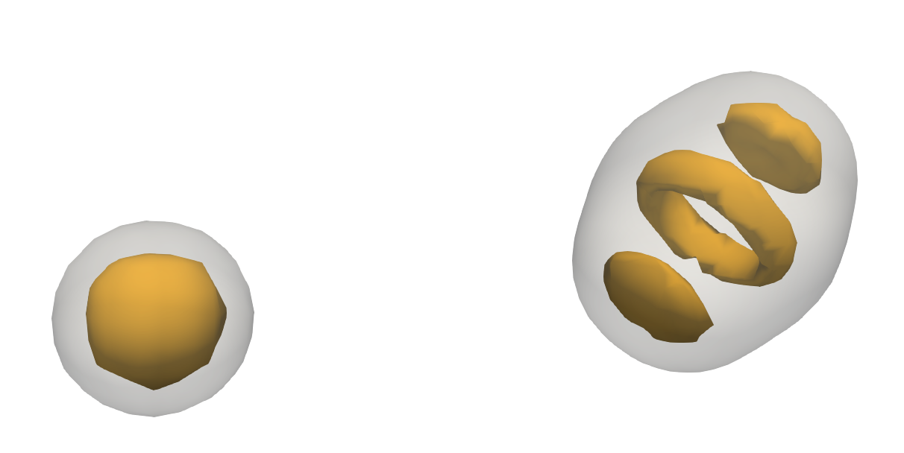
Nuclear Structure in the Era of Bayesian Analyses​
Kyle Godbey
Slides with videos:
https://docs.google.com/presentation/d/12fXgFym5_syMTsAt7qP1DkE1gf_IqQ3ggjprophj-YU/edit?usp=sharing

Slide 2
Talk Outline
Brief overview of some Bayesian resources ​
(Relatively) Recent highlights from the nuclear structure​ community
Perspectives on a credible Bayesian future​

Slide 3
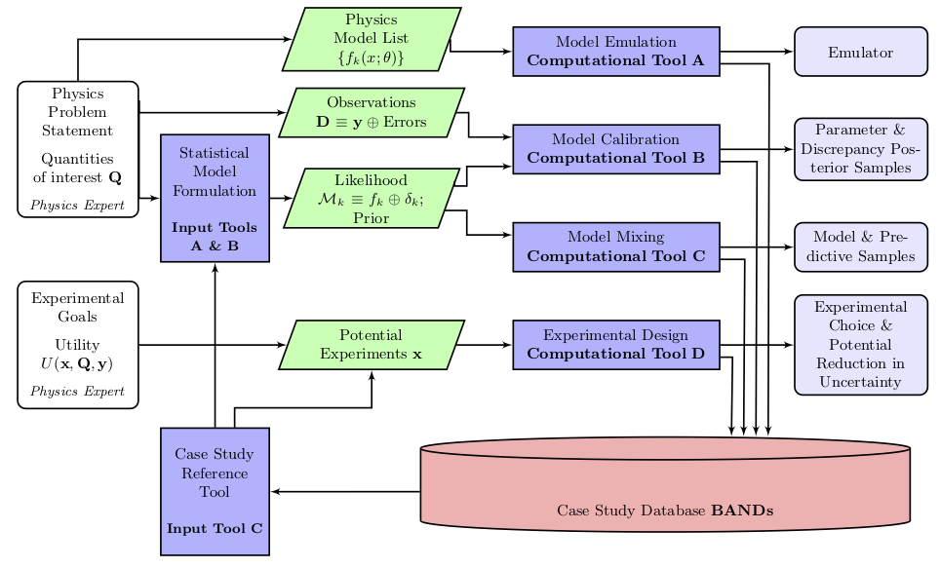
https://bandframework.github.io/

Slide 4
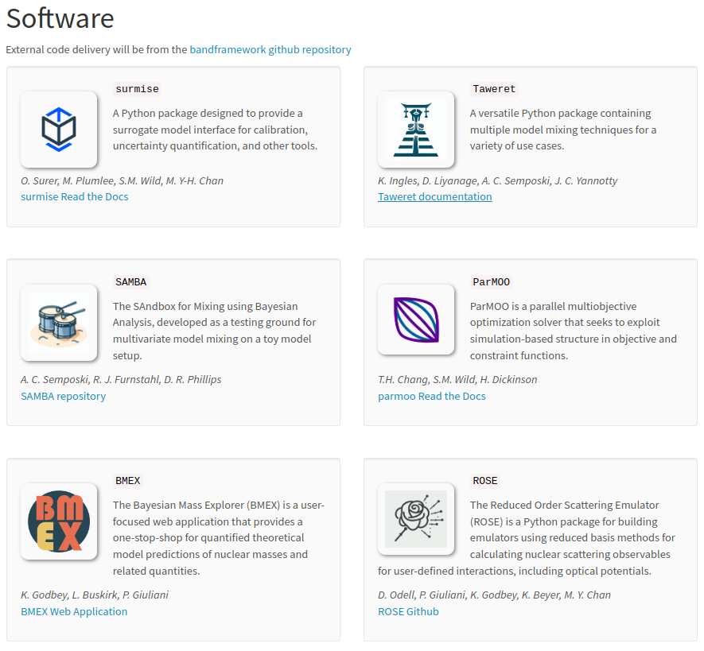
Online:
https://bandframework.github.io/
On GitHub:
https://github.com/bandframework/bandframework
https://bandframework.github.io/

Slide 5
Slide from Pablo Giuliani

Slide 6
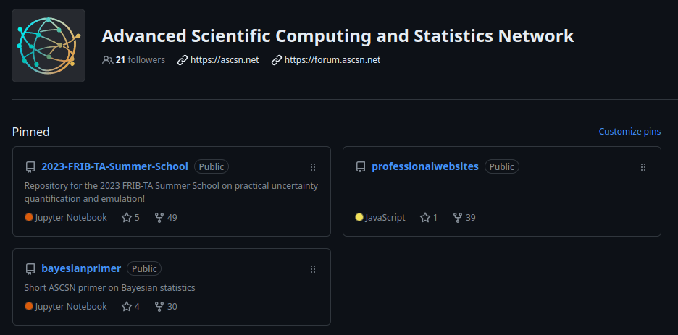
https://github.com/ascsn

Slide 7
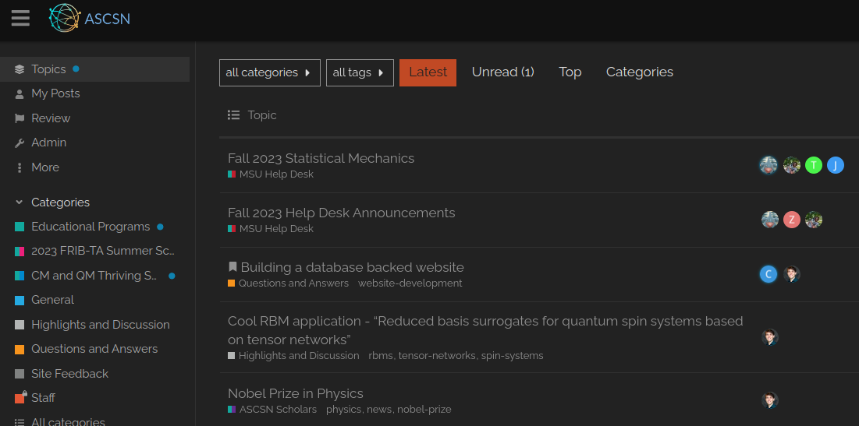
https://forum.ascsn.net

Slide 8
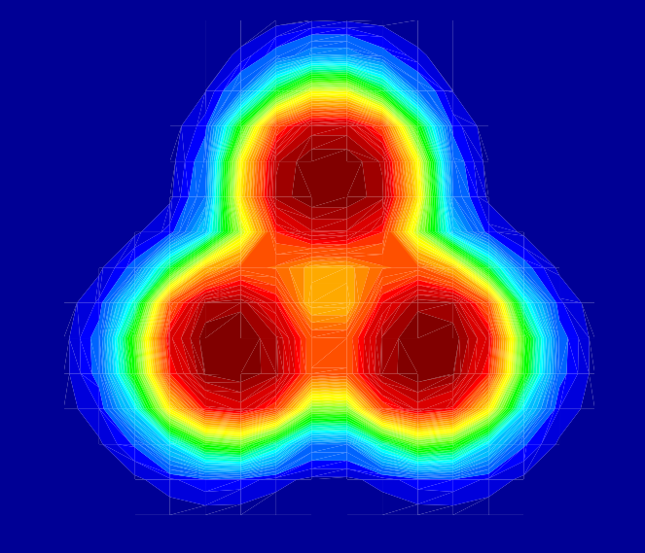
Highlights

Slide 9
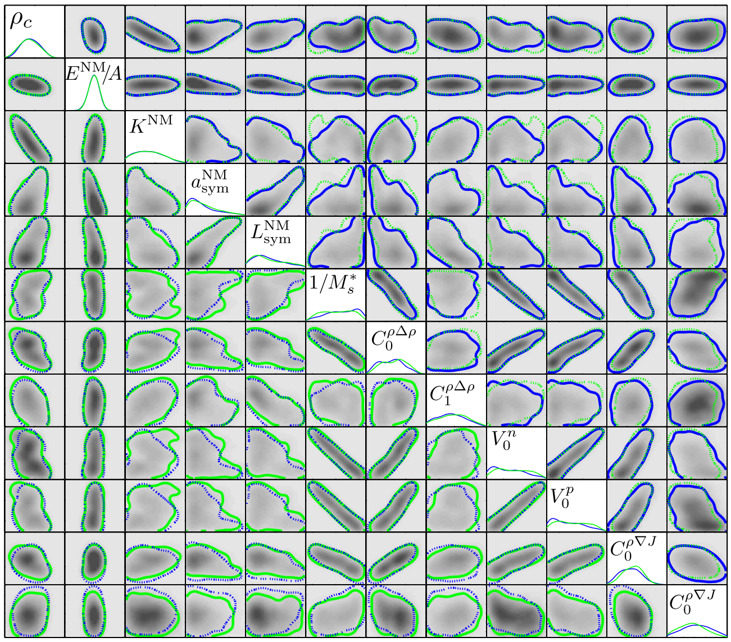
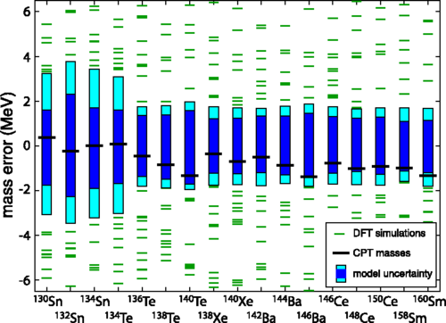
EDF Calibration
Image Credit:
J. D. McDonnell, N. Schunck, D. Higdon, J. Sarich, S. M. Wild, and W. Nazarewicz, Uncertainty Quantification for Nuclear Density Functional Theory and Information Content of New Measurements, Phys. Rev. Lett.114, 122501 (2015).

Slide 10
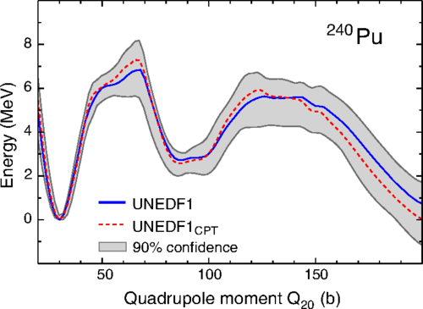
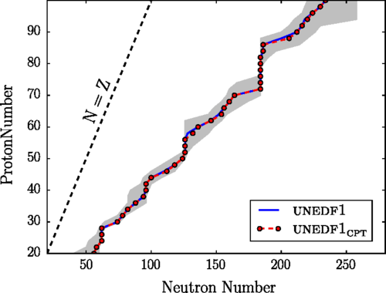
Image Credit:
J. D. McDonnell, N. Schunck, D. Higdon, J. Sarich, S. M. Wild, and W. Nazarewicz, Uncertainty Quantification for Nuclear Density Functional Theory and Information Content of New Measurements, Phys. Rev. Lett.114, 122501 (2015).

Slide 11
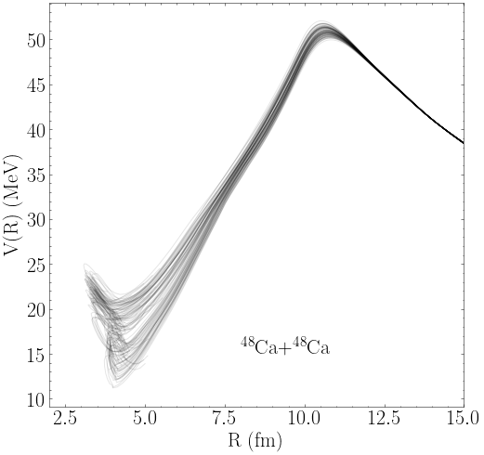
Image Credit:
K. Godbey, A. S. Umar, and C. Simenel, Theoretical uncertainty quantification for heavy-ion fusion Phys. Rev. C 106, L051602

Slide 12
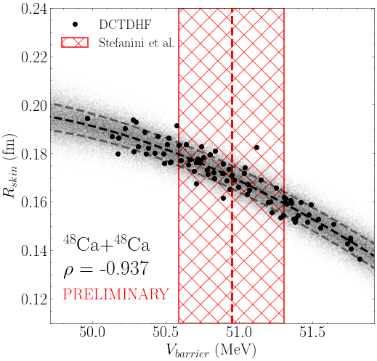
Image Credit:
K. Godbey, A. S. Umar, and C. Simenel, Theoretical uncertainty quantification for heavy-ion fusion Phys. Rev. C 106, L051602

Slide 13
A Remark on Bayesian Analysis
A cornerstone: Bayesian Calibration
Keep in mind that your statistical model is important as well!
Borrowed from:
W. Nazarewicz, INT 22-1, 3/27-4/2 2022

Slide 14
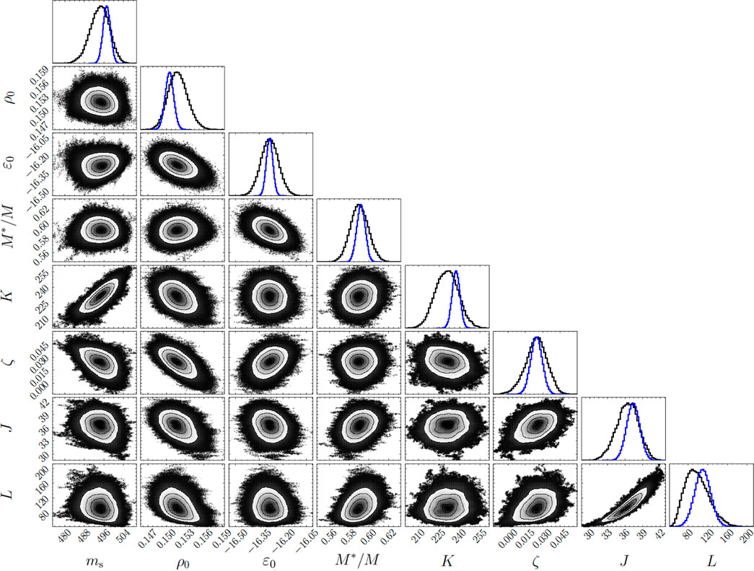
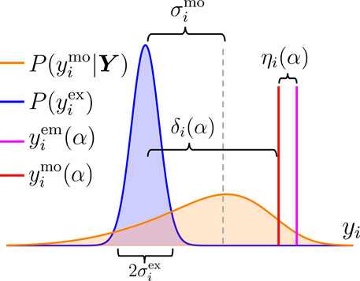
Image Credit:
P Giuliani, K Godbey, E Bonilla, F Viens, J Piekarewicz, Bayes goes fast: Uncertainty quantification for a covariant energy density functional emulated by the reduced basis method, Front. Phys., 10 (2023).

Slide 15
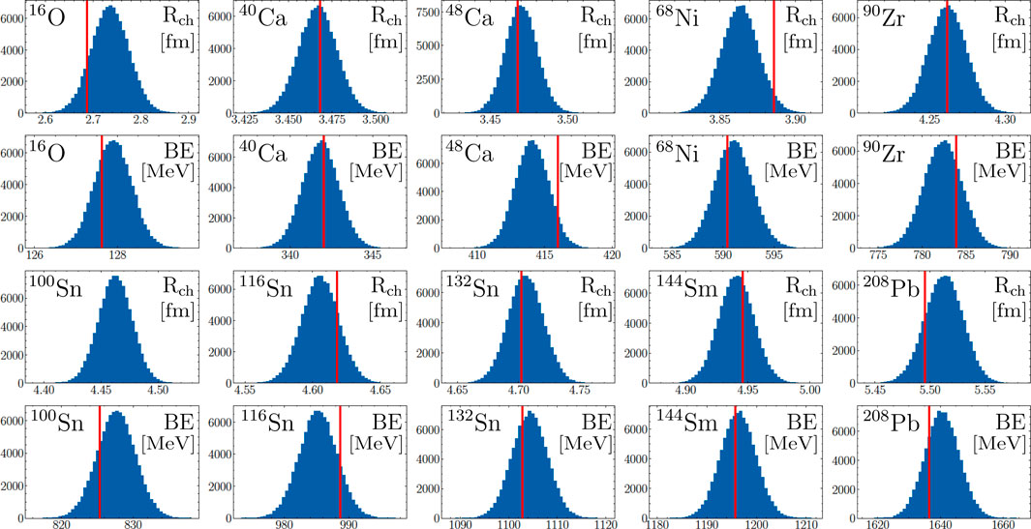
Image Credit:
P Giuliani, K Godbey, E Bonilla, F Viens, J Piekarewicz, Bayes goes fast: Uncertainty quantification for a covariant energy density functional emulated by the reduced basis method, Front. Phys., 10 (2023).

Slide 16
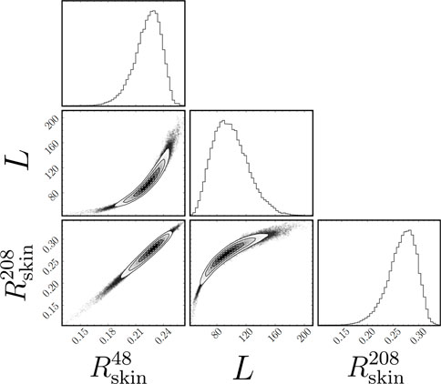
Image Credit:
P Giuliani, K Godbey, E Bonilla, F Viens, J Piekarewicz, Bayes goes fast: Uncertainty quantification for a covariant energy density functional emulated by the reduced basis method, Front. Phys., 10 (2023).

Slide 17
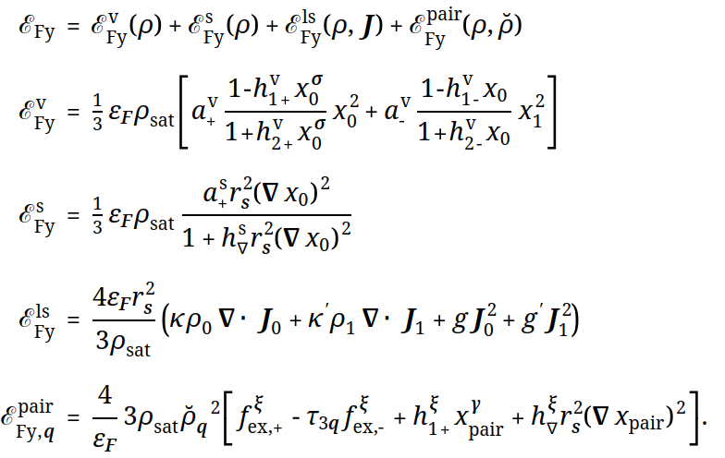
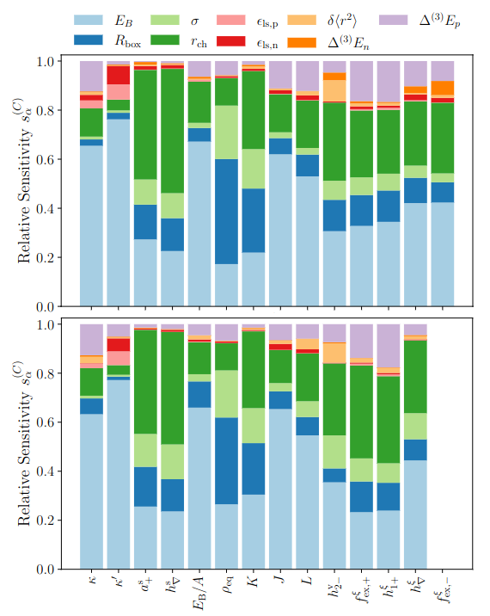
Image Credit:
P.-G. Reinhard, J O'Neal, S M. Wild, W Nazarewicz, Extended Fayans energy density functional: optimization and analysis, Submitted

Slide 18
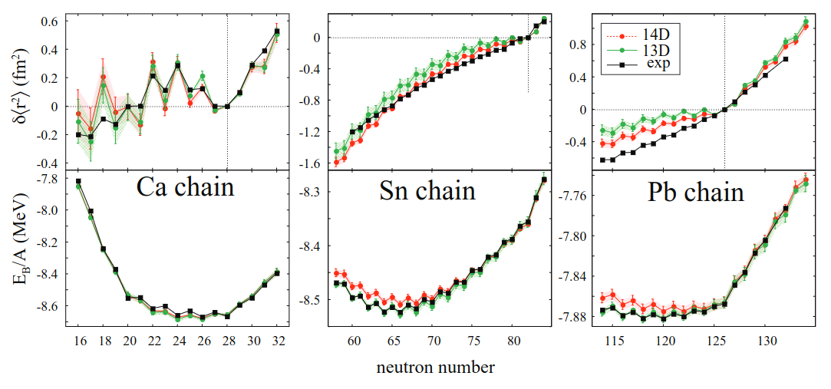
Image Credit:
P.-G. Reinhard, J O'Neal, S M. Wild, W Nazarewicz, Extended Fayans energy density functional: optimization and analysis, Submitted

Slide 19
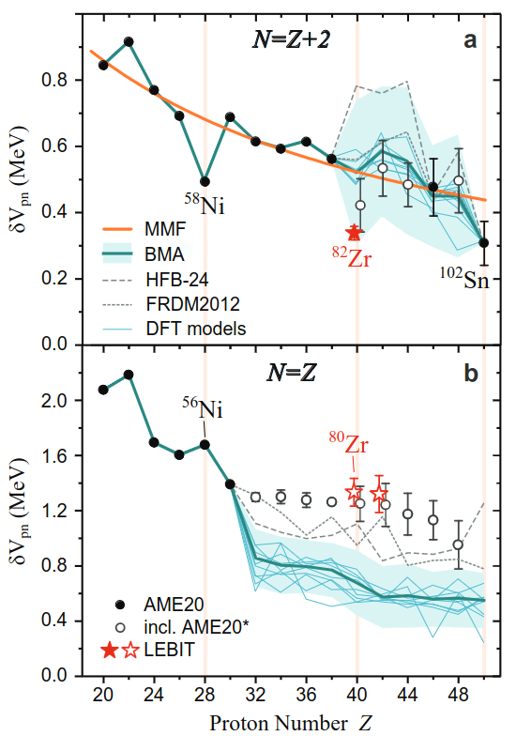
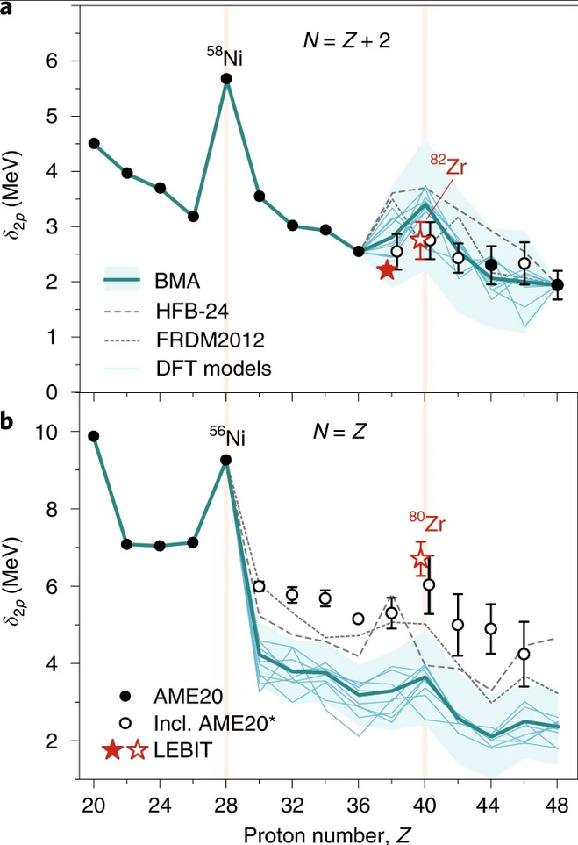
Image Credit:
Pablo Giuliani
Model 1
Model 2
Objective:
Data y
Estimate ynew with quantified uncertainties within a statistically justified framework
Collection of
Models {M1, M2}
Target prediction
Image Credit:
A. Hamaker et al., Nature Physics 17, 1408 (2021)

Slide 23
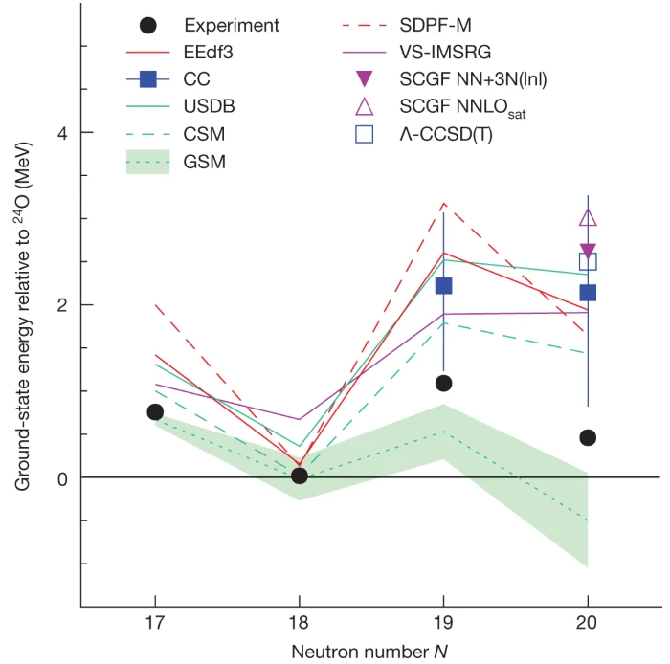

Slide 26
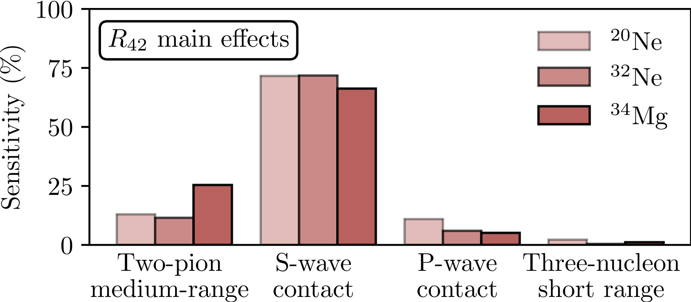

Slide 28
What’s Next?

Slide 29
Areas of Need
Continued investment in interdisciplinary collaboration
Embrace open-source/open-science principles
Try to ensure accessibility and availability of results and methods

Slide 30
Reproducibility and Accessibility
A few challenges include:
Agility in the face of new data
Efficiency of calibration
Distribution of Bayesian posteriors (not just samples!)
Traceability and reproducibility of results
Y. Yamauchi, L. Buskirk, P. Giuliani, K. Godbey, Normalizing Flows for Bayesian Posteriors: Reproducibility and Deployment, (submitted) (2023).

Slide 31
Reproducibility and Accessibility
Our approach: use an ML approach to learn normalizing flows for the high-dimensional posterior distributions
Y. Yamauchi, L. Buskirk, P. Giuliani, K. Godbey, Normalizing Flows for Bayesian Posteriors: Reproducibility and Deployment, (submitted) (2023).

Slide 32
Reproducibility and Accessibility
Our approach: use an ML approach to learn normalizing flows for the high-dimensional posterior distributions
Y. Yamauchi, L. Buskirk, P. Giuliani, K. Godbey, Normalizing Flows for Bayesian Posteriors: Reproducibility and Deployment, (submitted) (2023).

Slide 33
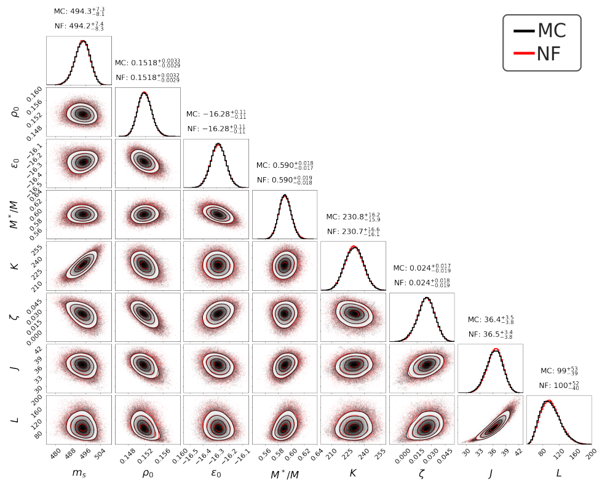
Y. Yamauchi, L. Buskirk, P. Giuliani, K. Godbey, Normalizing Flows for Bayesian Posteriors: Reproducibility and Deployment, (submitted) (2023).

Slide 34
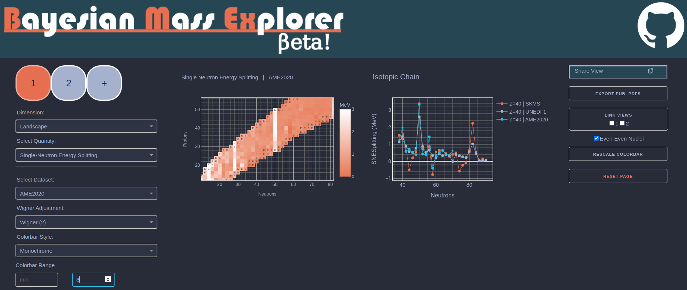
Infrastructure Development
https://bmex.dev

Slide 35
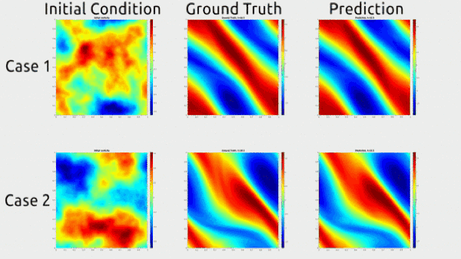
Current Ideas for Dynamics

Slide 36
Current Ideas for Dynamics

Slide 37
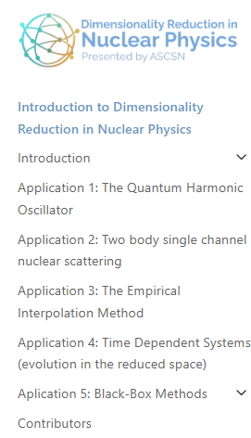
Always accepting new examples!
https://dr.ascsn.net

Slide 38
https://github.com/ascsn

Slide 39
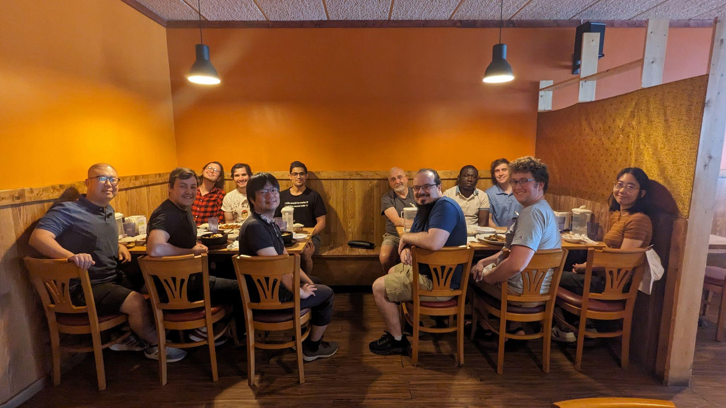
Immense Gratitude to All Collaborators!
Funding
DOE NNSA Grant No. DE-NA0004074
DOE Grant Nos. DE-SC0013365, DE-SC0023175
NSF CSSI Program No. 2004601
Computing Resources
Australian National Computational Infrastructure Raijin and Gadi
Oak Ridge Leadership Computing Facility Summit and Frontier
Argonne Leadership Computing Facility Polaris
Texas A&M High Performance Research Computing Terra and Ada
Michigan State University HPCC

Slide 40
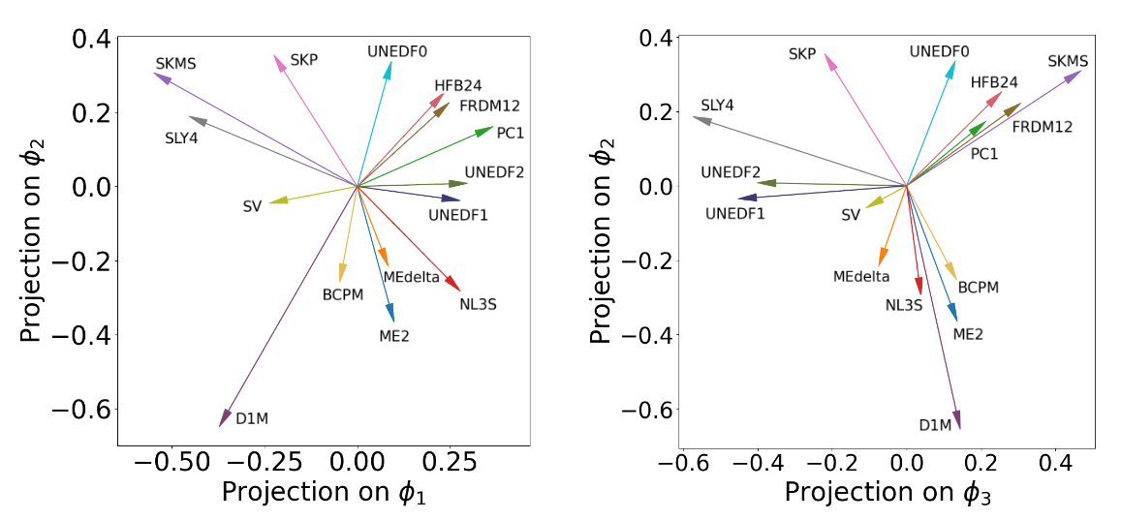

Slide 41
Path(s) Forward
Low-energy, heavy ion reactions are very likely to be informative for questions across the nuclear science community
Continued developments in time-dependent microscopic many-body theories are vital

Slide 42
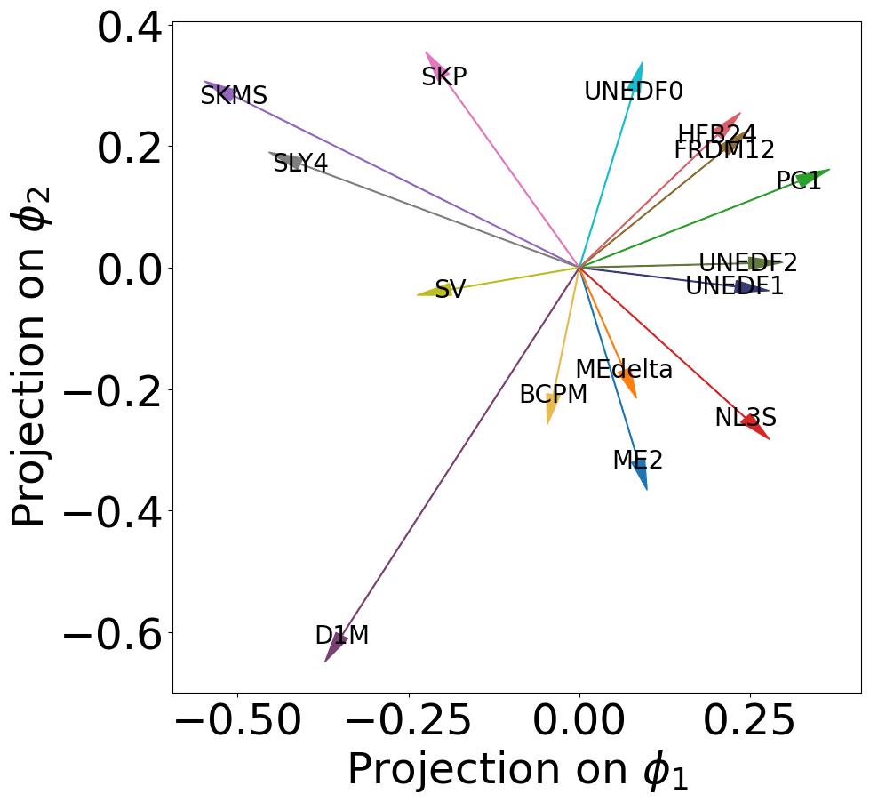
Other Avenues?
Something currently being explored is reducing the dimensionality of our model space for Bayesian model mixing

Slide 43
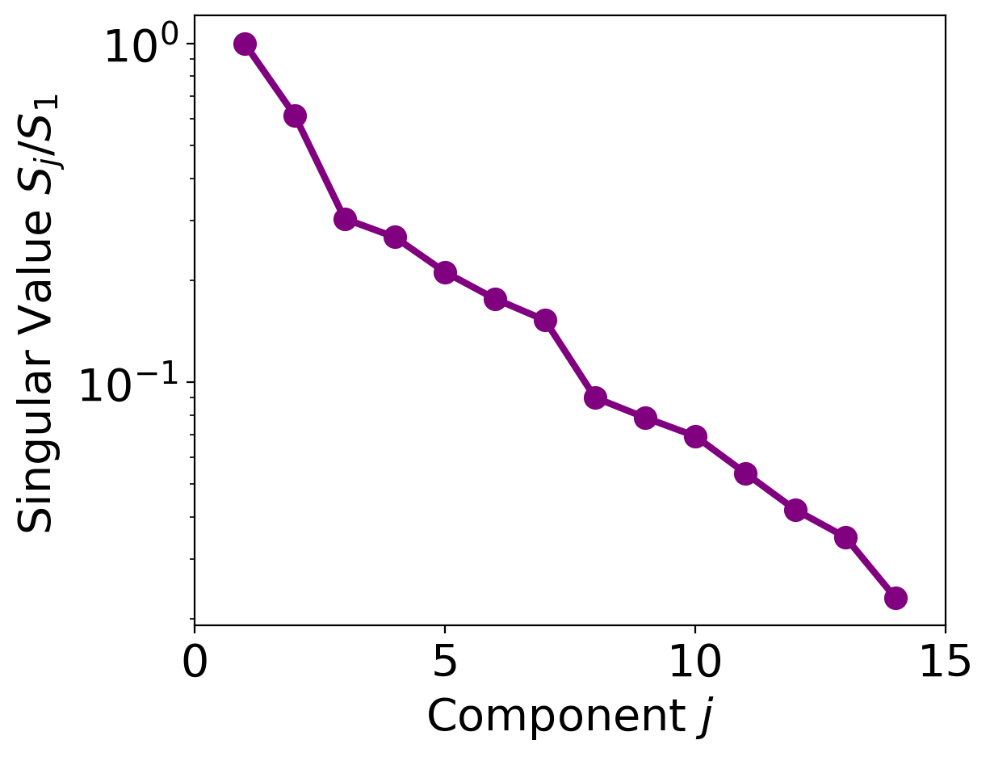
Other Avenues?
Something currently being explored is reducing the dimensionality of our model space for Bayesian model mixing

Slide 44
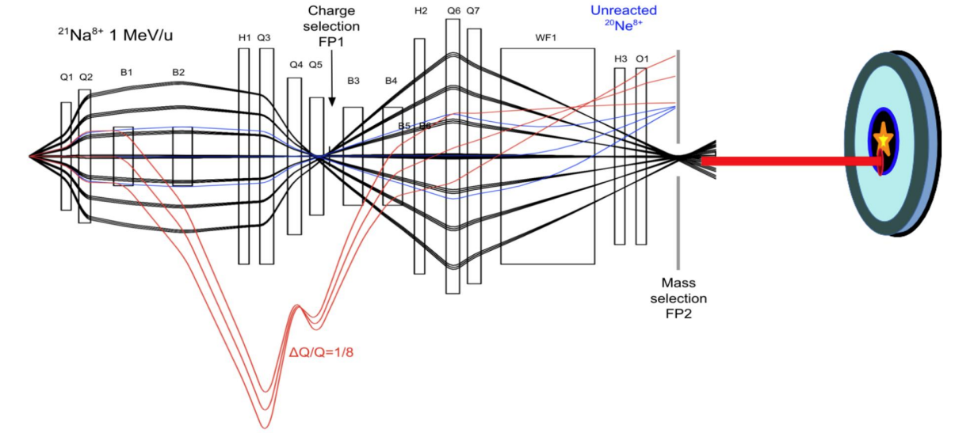
Dimensionality Reduction
PRELIMINARY
Fast
Accurate

Slide 45
Correlations Between Structure and Reactions
V_{barrier} is a quantity extracted from fusion cross sections
Nothing precludes a comparison to cross sections directly

