Slide 1




Emulators for nuclear physics across energy scales
Xilin Zhang
Facility for Rare Isotope Beams
Michigan State University
Exploring nuclear physics across energy scales 2024: intersection between nuclear structure and high energy nuclear collisions, Beijing, China, April 2024

Slide 2
Outline
What is an emulator and why do we care?
Data-driven emulators (e.g., in heavy-ion collision physics)
Model-driven emulators (e.g., in low-energy nuclear physics)
The hybrid
Summary

Slide 3
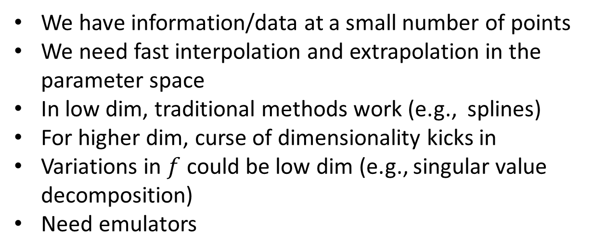



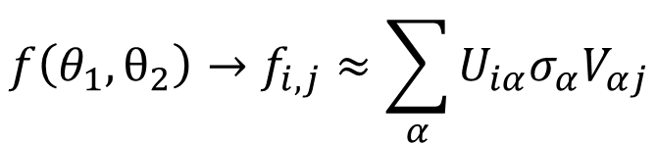
Emulator for interpolation & extrapolation
Input
Output
.
.
$$f:θ→S$$
$$θ_{2}$$
x
We have information/data at a small number of points
We need fast interpolation and extrapolation in the parameter space
In low dim, traditional methods work (e.g., splines)
For higher dim, curse of dimensionality kicks in
Variations in $f$ could be low dim (e.g., singular value decomposition)
Need emulators
.
$$θ_{1}$$
$$f\left(θ_{1},θ_{2}\right)→f_{i,j}≈\sum_{α}{U_{iα}σ_{α}V_{αj}}$$

Slide 4
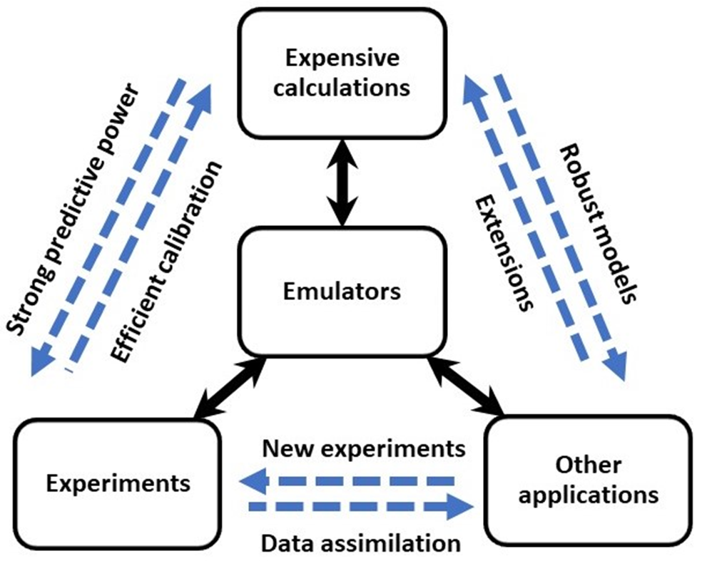
Emulator: an “interface” for complex modeling
Application in Bayesian analysis
Application in collaborations
Part of larger simulations
Its robust extrapolation capability
…
From 2110.04269

Slide 5
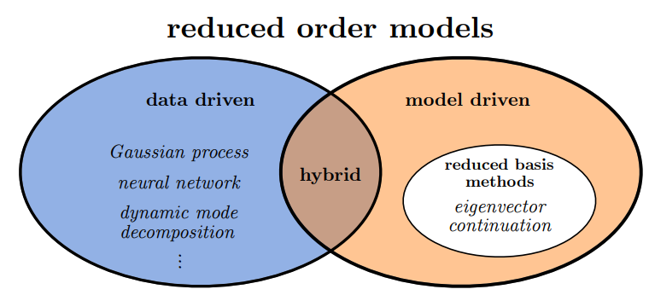
Emulators: two main types and their hybrid
“Eigenvector continuation with subspace learning”
Dillon Frame et. al., Phys.Rev.Lett. 121 (2018) 3, 032501, 1711.07090
From 2310.19419
nonintrusive
agnostic of physics and requires more training data
Intrusive
but includes more physics and requires less training data
“BUQEYE Guide to Projection-Based Emulators in Nuclear Physics,” C. Drischler, J.A. Melendez, R.J. Furnstahl, A.J. Garcia, and XZ, 2212.04912
“Training and projecting: A reduced basis method emulator for many-body physics,” Edgard Bonilla, Pablo Giuliani, Kyle Godbey, Dean Lee, Phys.Rev.C 106 (2022) 5, 054322, 2203.05284
“Model reduction methods for nuclear emulators, ” J.A. Melendez, C. Drischler, R.J. Furnstahl, A.J. Garcia, XZ, 2203.05528
“Eigenvector Continuation and Projection-Based Emulators,” Thomas Duguet et.al., 2310.19419

Slide 6
Data-driven emulators
Learning from scratch

Slide 7
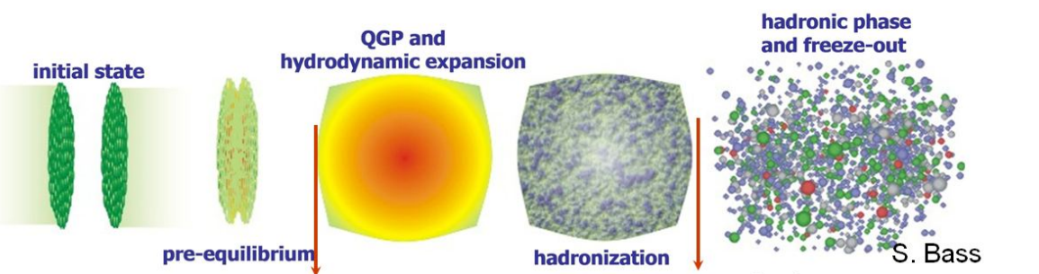
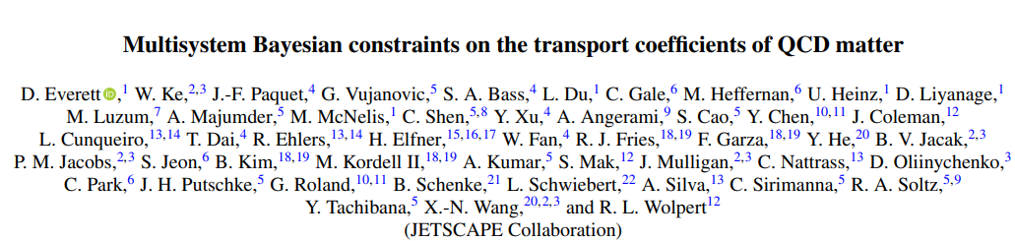
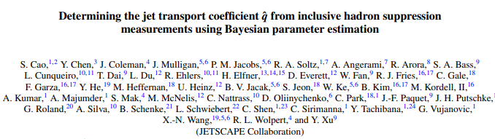
Data-driven emulators in heavy-ion collision physics
Taken from 1310.0222
Emulator: Gaussian process
Initial state emulators for varying nuclear models?

Slide 8
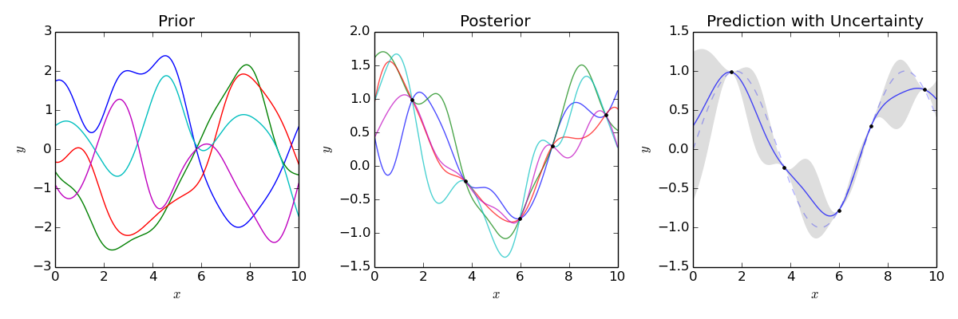
Data-driven emulators
Gaussian process
Output
Think in a space of smooth functions
Input

Slide 9
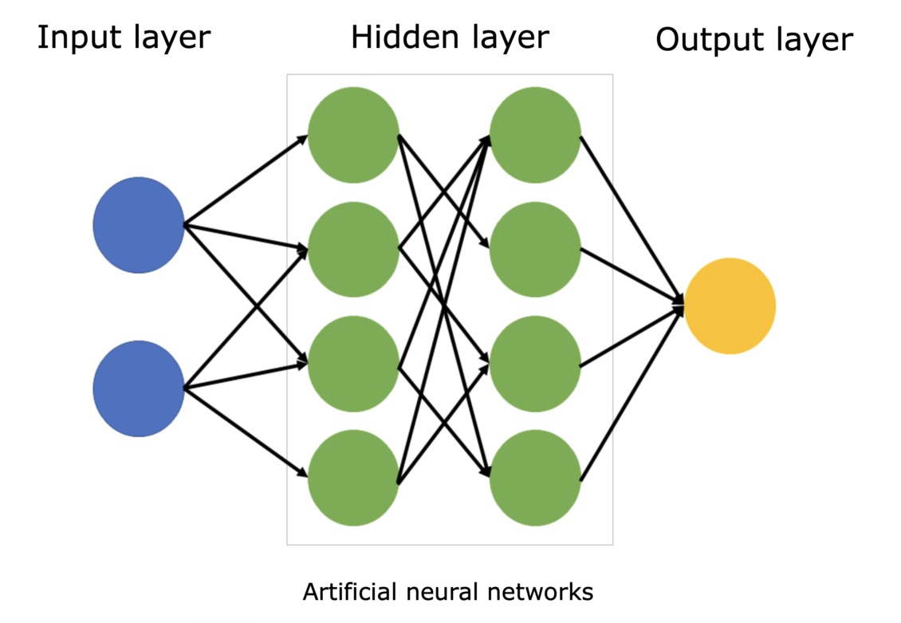
Data-driven emulators
Neural networks
Mimicking neurons in brains
→ universal functions with hyperparameters → conditioned/trained on data
→ interpolation and extrapolation
Parametrized matrix model
Also considered as hybrid
Patrick Cook et.al., 2401.11694

Slide 10
Model-driven emulators
Model order reduction

Slide 11
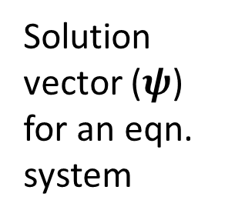
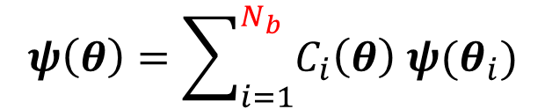
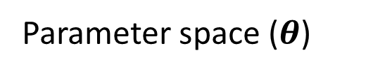


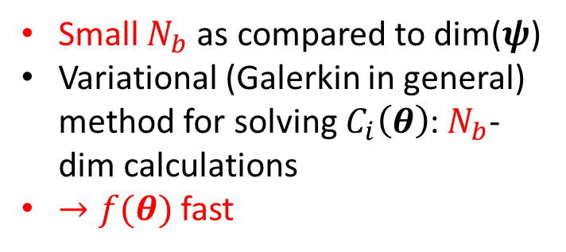
Model driven: Reduced basis method
. . .
. . .
Solution vector ($ψ$) for an eqn. system
$$ψ\left(θ\right)=\sum_{i=1}^{N_{b}}{C_{i}\left(θ\right) ψ(θ_{i})}$$
Parameter space ($θ$)
Small $N_{b}$ as compared to dim($ψ$)
Variational (Galerkin in general) method for solving $C_{i}\left(θ\right)$: $N_{b}$-dim calculations
$→f(θ)$ fast
$$θ_{2}$$
$$θ_{1}$$

Slide 12
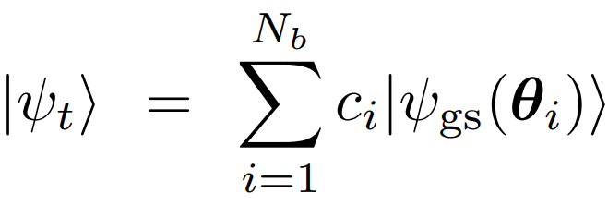
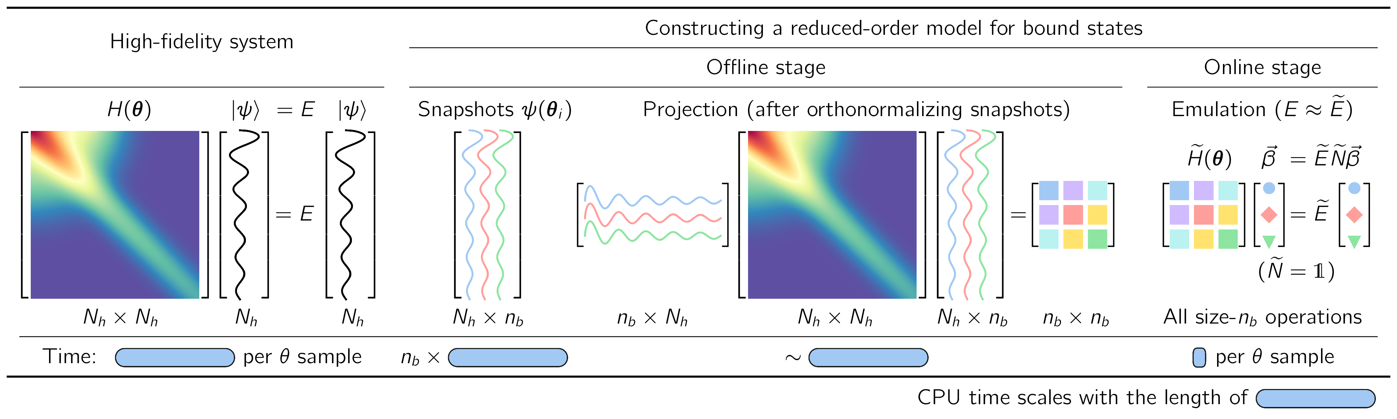
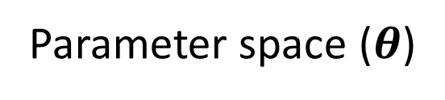
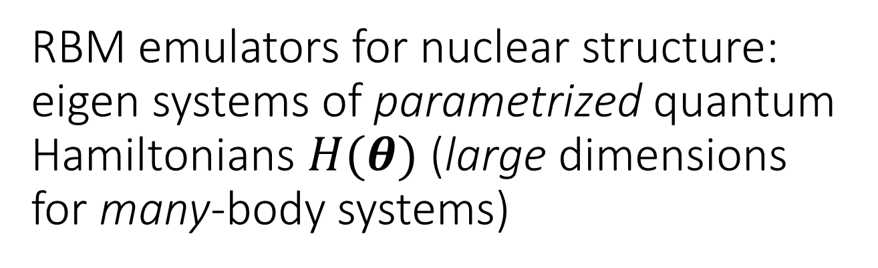

RBM emulators for nuclear structure: eigen systems of parametrized quantum Hamiltonians $H(θ)$ (large dimensions for many-body systems)
Parameter space ($θ$)
.
.
$$θ_{2}$$
x
.
$$θ_{1}$$

Slide 13
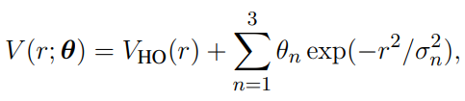
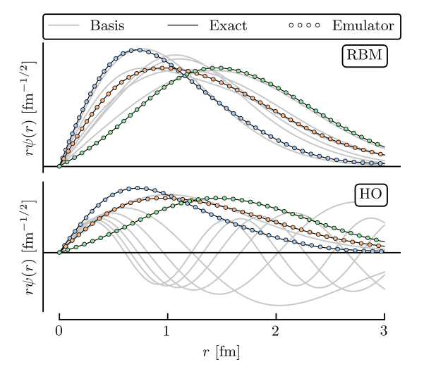
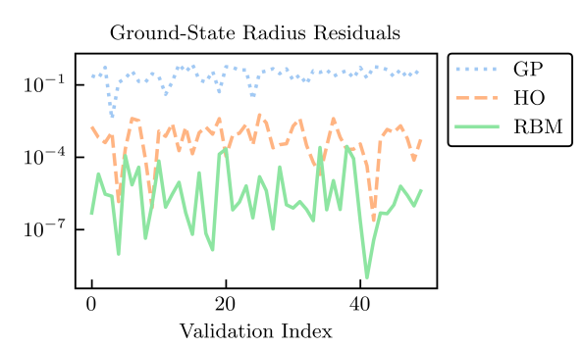
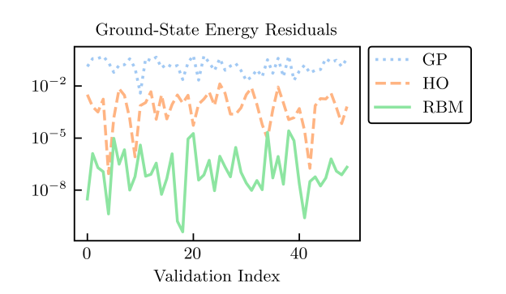
A simple demo
6 training points in 3-dim space

Slide 14
RBM emulator for ab initio nuclear structure calculations
A. Ekström and G. Hagen
Global sensitivity analysis of bulk properties of an atomic nucleus
Phys.Rev.Lett. 123 (2019) 25, 252501, 1910.02922
S. König, A. Ekström, K. Hebeler, D. Lee, A. Schwenk
Eigenvector Continuation as an Efficient and Accurate Emulator for Uncertainty Quantification
Phys. Lett. B 810 (2020) 135814
arXiv:1909.08446
“about 1 Million sample in 16-dim space, 20 years calculation → 1 hour on a standard laptop."
He-4
More recent advances in Kyle Godbey’s talk

Slide 15
RBM emulator for density functional theory
“Bayes goes fast: Uncertainty Quantification for a Covariant Energy Density Functional emulated by the Reduced Basis Method,” Pablo Giuliani, Kyle Godbey, Edgard Bonilla, Frederi Viens, Jorge Piekarewicz, 2209.13039
In Kyle Godbey’s talk
“Emulating generator coordinate method with extended eigenvector continuation: Lipkin-Meshkov-Glick model,”
Q.Y. Luo, X. Zhang, L.H. Chen, J.M. Yao 2404.08581
Other interesting applications can be found in the reviews

Slide 16
Relevance for relativistic heavy-ion physics?
Initial state variation due to nuclear structure calculations
Sampling of nucleon density distributions in nucleus
How to do it?
Model-driven emulators for relativistic hydrodynamic simulation?

Slide 17
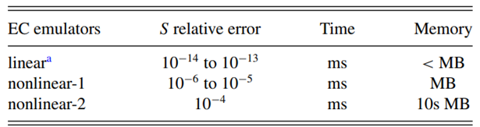

RBM emulators for nuclear continuum: linear equation (large dimensions for few-body systems)
$\left[E−H\left(θ\right)\right]\left|ψ\left(θ\right)\right\rangle =0$ for a given scattering $E:$ for modeling nuclear scatterings and reactions based on nucleon-nucleon interactions.
“Efficient emulators for scattering using eigenvector continuation,”R. J. Furnstahl, A. J. Garcia, P. J. Millican, and XZ, PLB 809, 135719 (2020) [2007.03635]
Developed RBM emulator for two-body scatterings
“Fast emulation of quantum three-body scattering”,
XZ and R.J. Furnstahl, Phys. Rev. C 105, 064004 (2022), 2110.04269
Introduced a concept of emulator in emulator

Slide 18
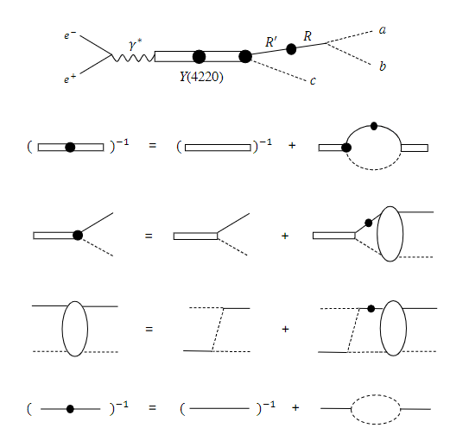
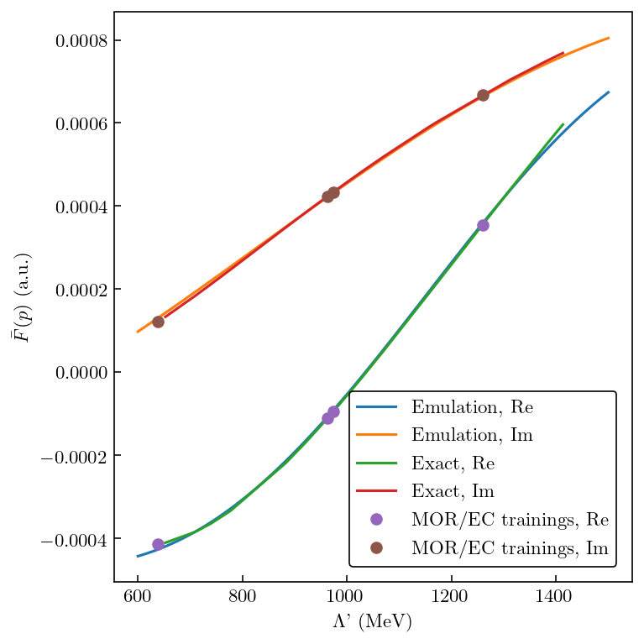
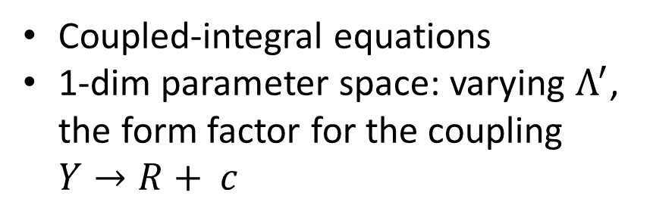


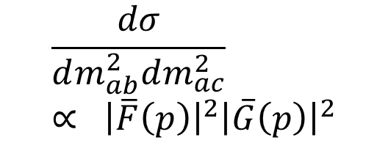
RBM emulators for hadronic reactions
$$\frac{dσ}{dm_{ab}^{2}dm_{ac}^{2}}∝ {\left|\overline{F}\left(p\right)\right|}^{2}{\left|\overline{G}\left(p\right)\right|}^{2}$$
$$e^{+}+e^{−}→J/ψ+π+ π$$
$Y$
In collaboration with
Satoshi Nakamura (Shandong U.)
Coupled-integral equations
1-dim parameter space: varying $Λ^{′}$, the form factor for the coupling $Y→R+ c$

Slide 19
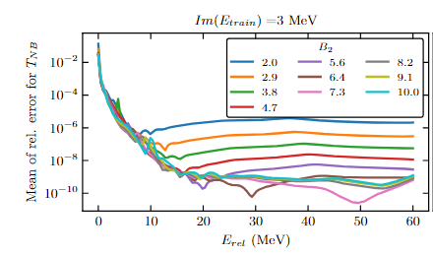



Emulating nuclear continuum states in the energy complex plane & for other parameters
Scattering between particle and compound target (two-body target here)
Emulation in 4-dim space (including two and three-body force parameters)
$$Im(E)$$
$$Re(E)$$
$$θ$$
A new way to infer continuum physics from bound-state-like computations
Emulation for the input parameters

Slide 20
Are continuum emulators relevant for high energy nuclear physics (e.g, EIC and UPC)?
Nuclear continuum emulation: initial nuclear state and hadronic final state interactions
The lepton interaction vertices (short-time scale physics) recasted in terms of hadrons
If so, need high-energy physicists’ participation in developing continuum emulators

Slide 21
Hybrid

Slide 22
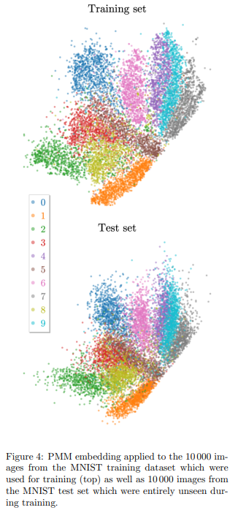
Hybrid of data and model driven emulators
Data-driven (black-box) RBM and dynamic mode decomposition (DMD)
The PMM work (Patrick Cook et.al., 2401.11694) takes a step further: a new machine learning platform, e.g., for image classification
Other approaches being developed in the field of model reduction by embracing machine learning

Slide 23
Summary
Emulators are critical for accessing complex models (e.g., model fitting and uncertainty quantification)
Both model and data-driven are being applied in different nuclear physics areas
Nuclear structure emulator could be relevant for connecting nuclear structure and high-energy nuclear collisions
Is nuclear continuum emulator relevant for EIC and UPC physics?

Slide 24
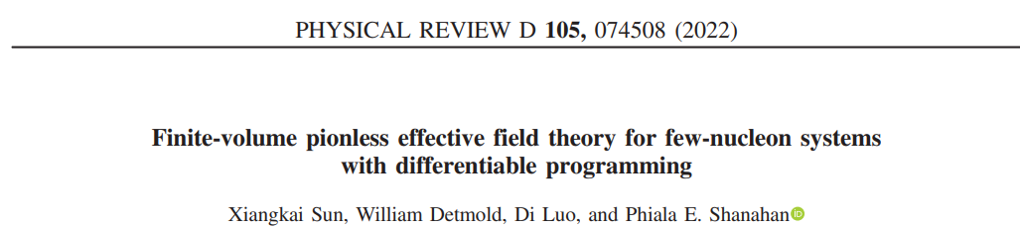
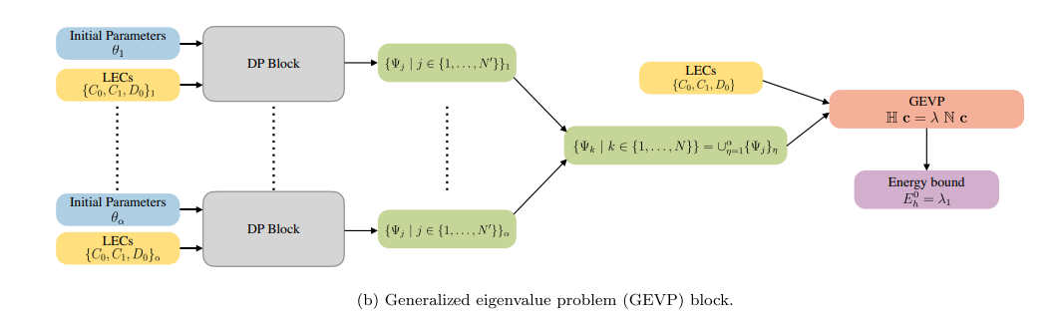
RBM emulators for calibrating model to Lattice QCD results

