Slide 1
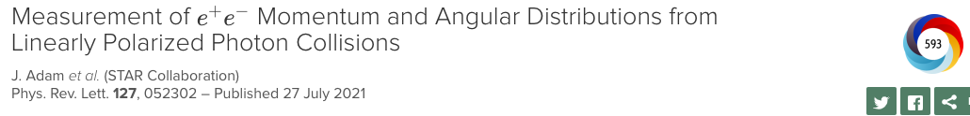
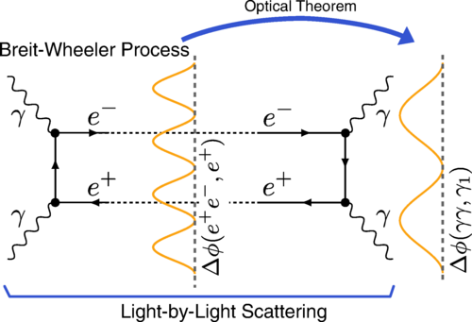



Measurements of nuclear charge and mass radii in Ultra-Peripheral Nuclear Collisions
Zhangbu Xu
(Kent State Univerity)
Basic pure EM process in Heavy-ion collisions
charge radius of ¹⁹⁷Au/²³⁸U at RHIC
mass radius at RHIC
neutron skin of isobar (⁹⁶Zr, ⁹⁶Ru)
Summary
04/25/2024

Slide 2
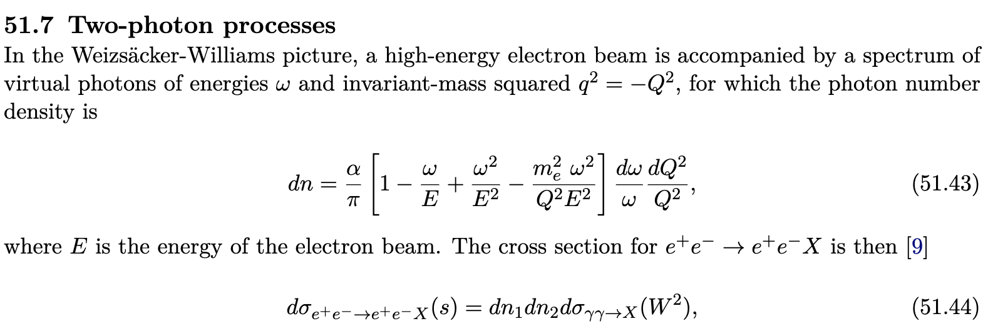
Two-photon QED in Particle Data Book
Two cutoffs:
ω<E
Q>0

Slide 3
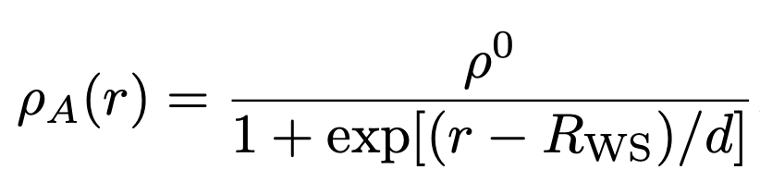
Natural extension to Heavy Ions
arXiv:1005.3531, unpublished
S. Klein, et al. Comput.Phys.Commun. 212 (2017) 258-268

Slide 4
Lowest-order QED calculation

Slide 5
Initial Transverse Momentum Broadening
arXiv:1005.3531, unpublished
Zha, et al., arXiv: 1812.02820
M. Vidovic, et al., Phys.Rev. C47 (1993) 2308
Is photon pt really driven by uncertainty principle
and independent of position-momentum correlation?
S. Klein, et al. Comput.Phys.Commun. 212 (2017) 258-268
ω/γ≲kt<<ω
Higher-order/virtuality cancels to 1/γ²~=10⁻⁴
NLO QED coupling constant α=1/137

Slide 6
Initial Transverse Momentum Broadening
arXiv:1005.3531, unpublished
Zha, et al., arXiv: 1812.02820
M. Vidovic, et al., Phys.Rev. C47 (1993) 2308
Is photon pt really driven by uncertainty principle
and independent of position-momentum correlation?
S. Klein, et al. Comput.Phys.Commun. 212 (2017) 258-268
we can afford many mistakes in the search.
The main thing is to make them as fast as possible.
– John Archibald Wheeler
doi:10.1063/1.3120895
ω/γ≲kt<<ω
Higher-order/virtuality cancels to 1/γ²~=10⁻⁴
NLO QED coupling constant α=1/137

Slide 7
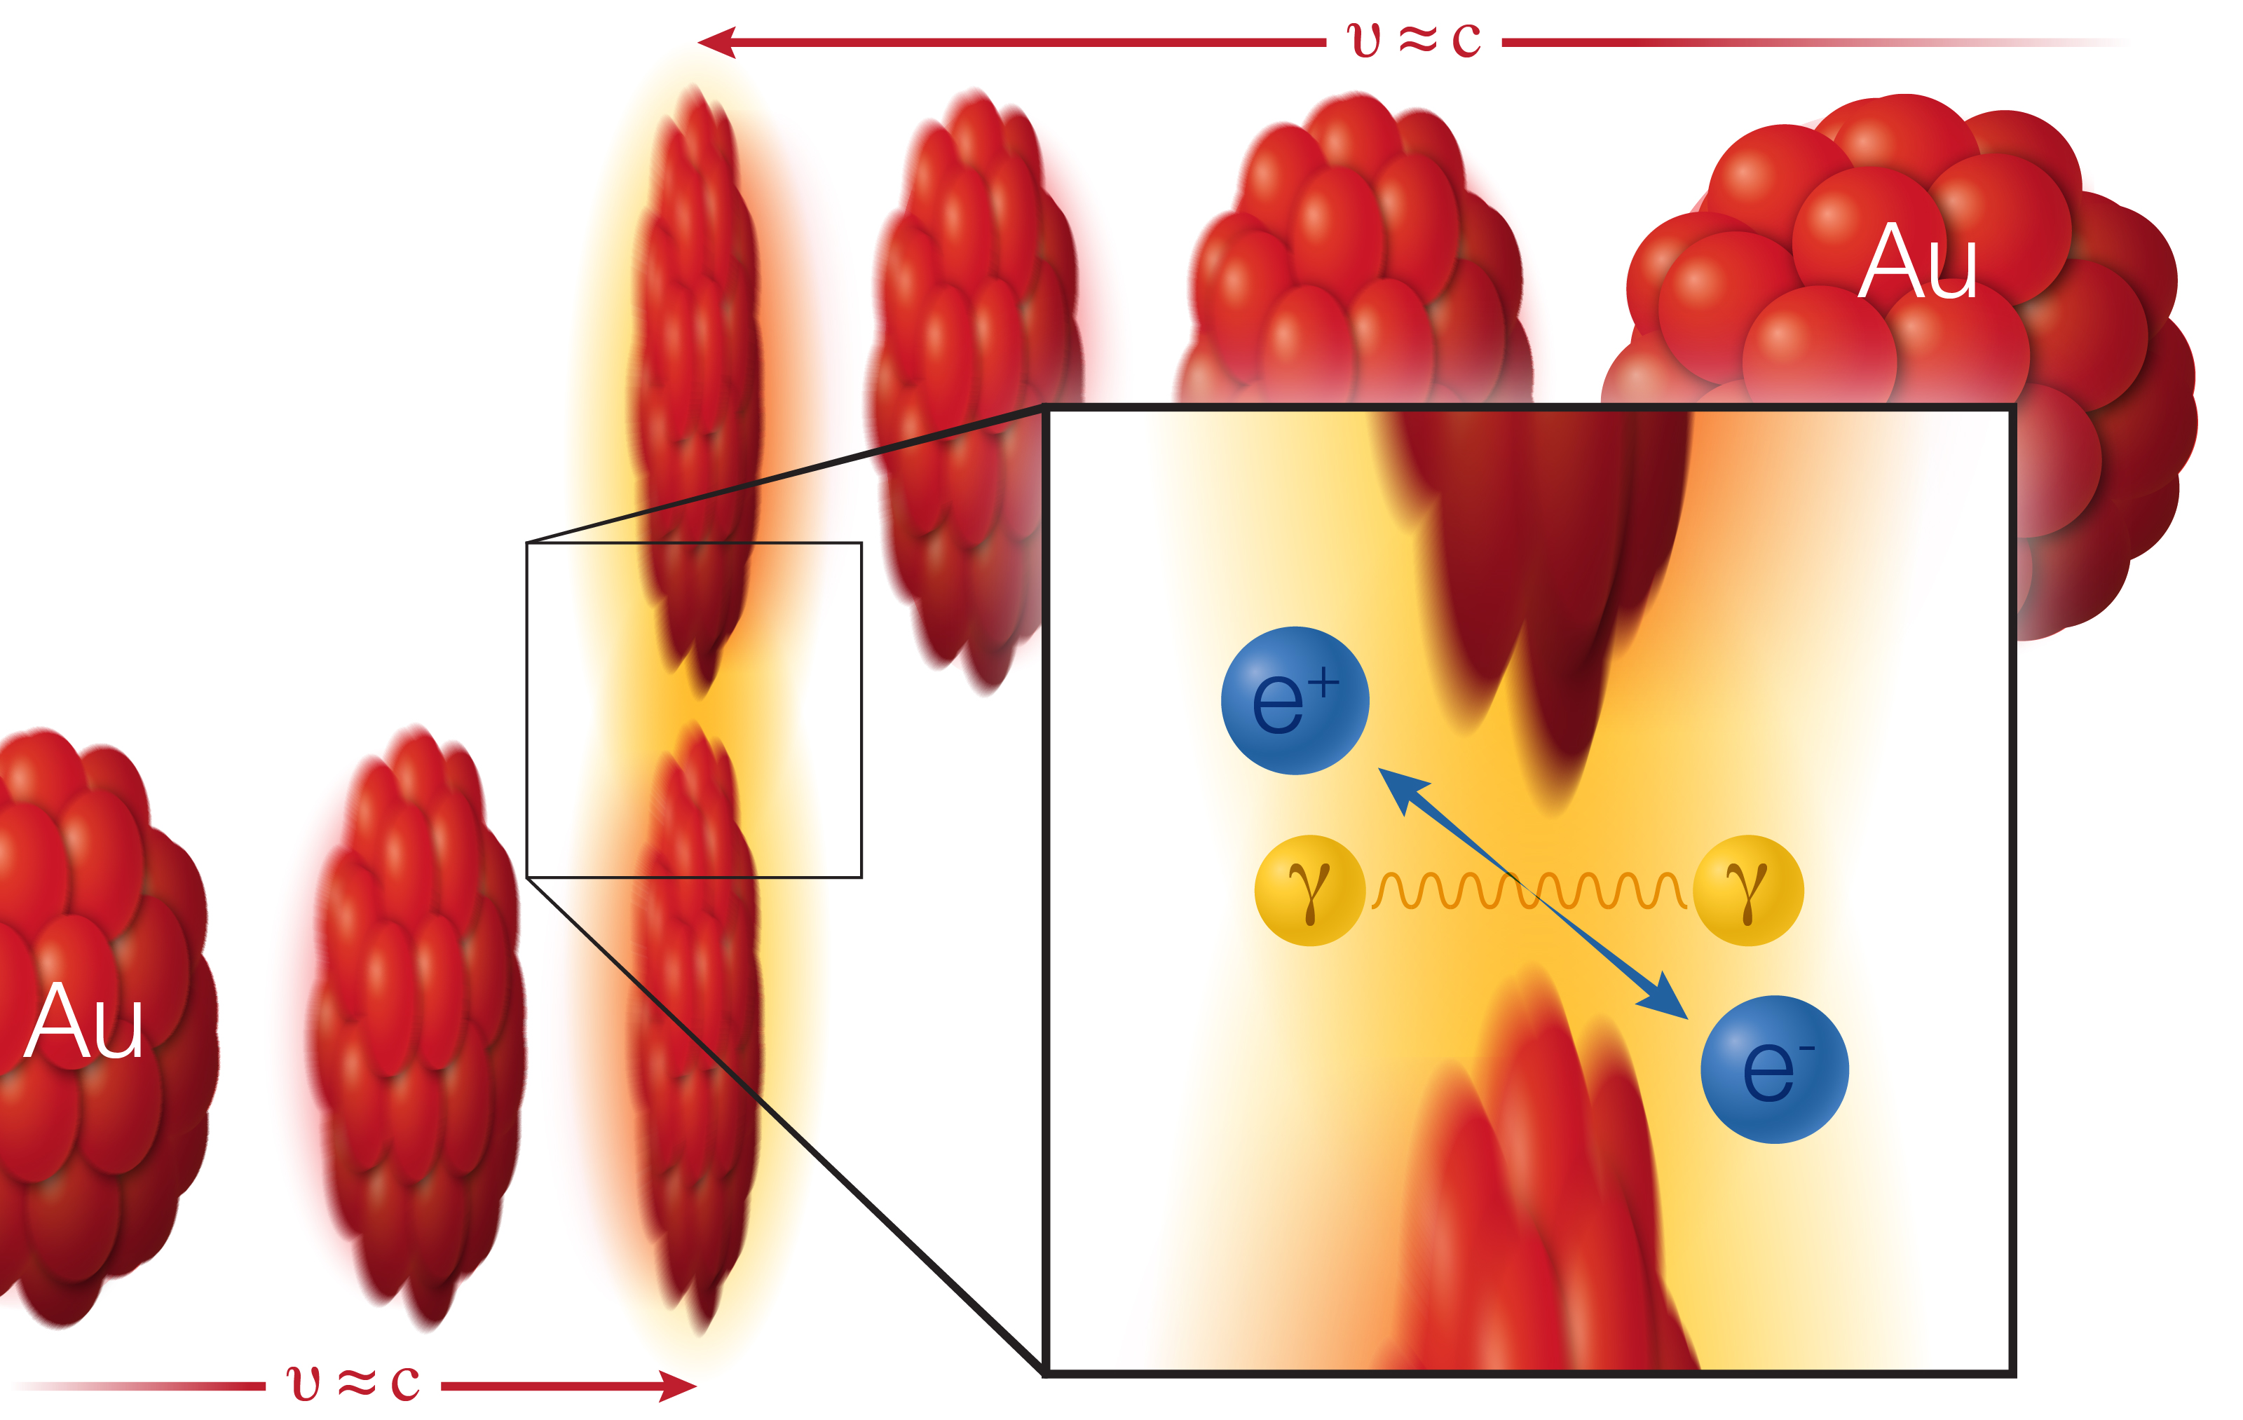
Ultra-Peripheral Collisions
Two gold (Au) ions (red) move in opposite direction at 99.995% of the speed of light (v, for velocity, = approximately c, the speed of light). As the ions pass one another without colliding, two photons (γ) from the electromagnetic cloud surrounding the ions can interact with each other to create a matter-antimatter pair: an electron (e⁻) and positron (e⁺).

Slide 8
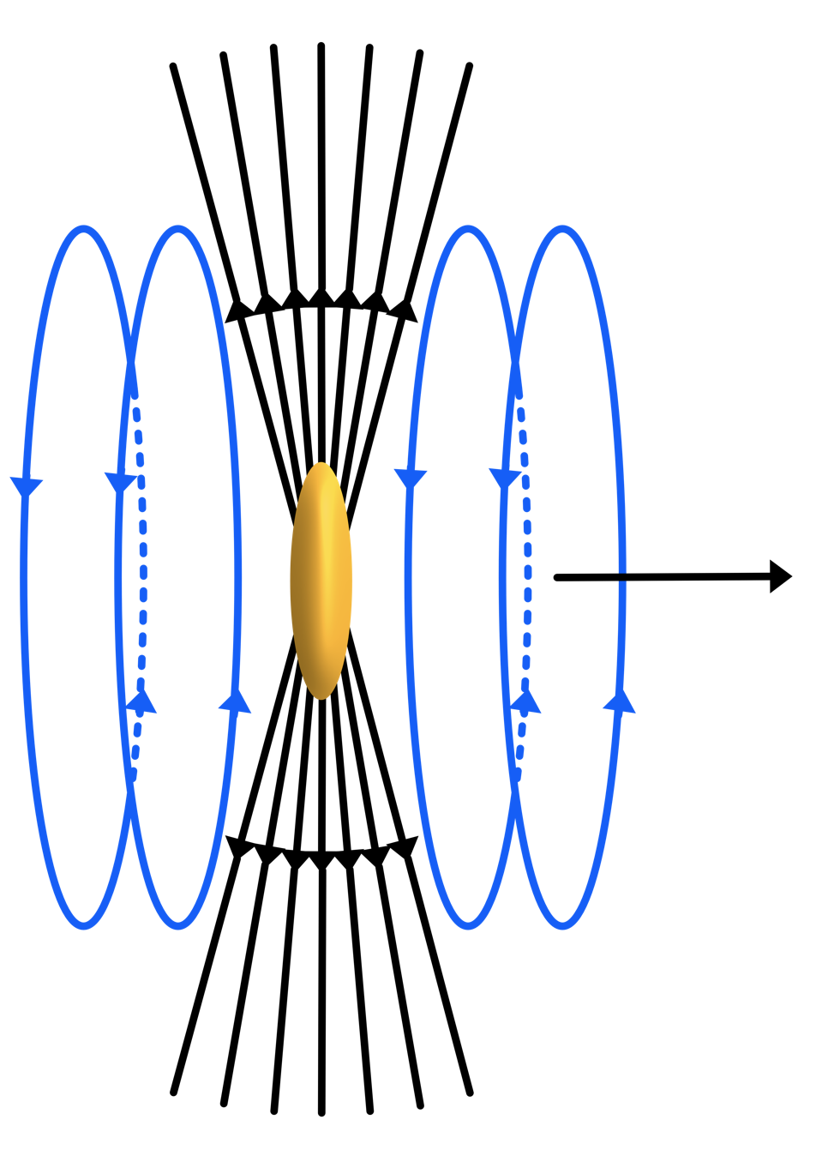
Well understood kinematics
ρ,φ,ω<±0.2% <±2% <±2%
photon p_{T} is simply due to finite electric field projection in the longitudinal direction,
It is classic EM field and not due to uncertainty principle of p_{T}~=1/R
𝐸 field has a z-component
B field is in x-y plane
➔
ExB has p_{T} component

Slide 9
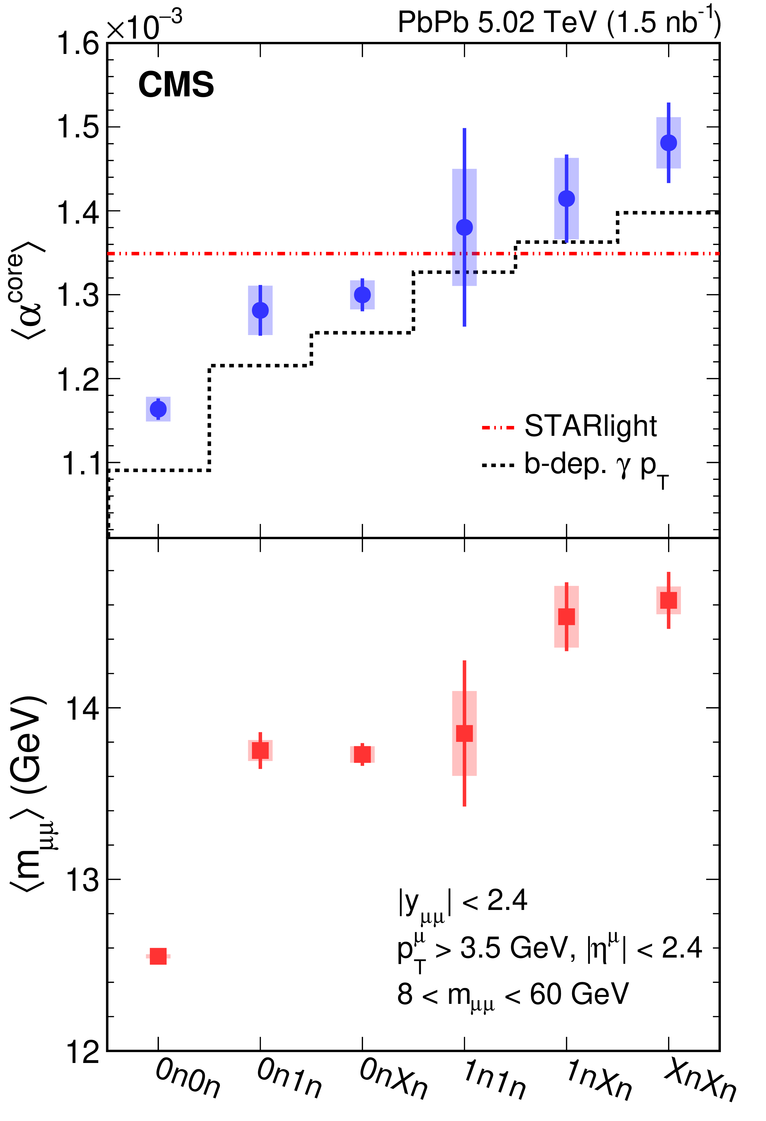
Photon TMD in UPC
CMS Abstract: “This observation demonstrates the transverse momentum and energy of photons emitted from relativistic ions have impact parameter dependence. These results constrain precision modeling of initial photon-induced interactions in ultra-peripheral collisions. They also provide a controllable baseline to search for possible final-state effects on lepton pairs resulting from the production of quark-gluon plasma in hadronic heavy ion collisions.”
https://news.rice.edu/2021/09/20/physicists-probe-light-smashups-to-guide-future-research-2/

Slide 10
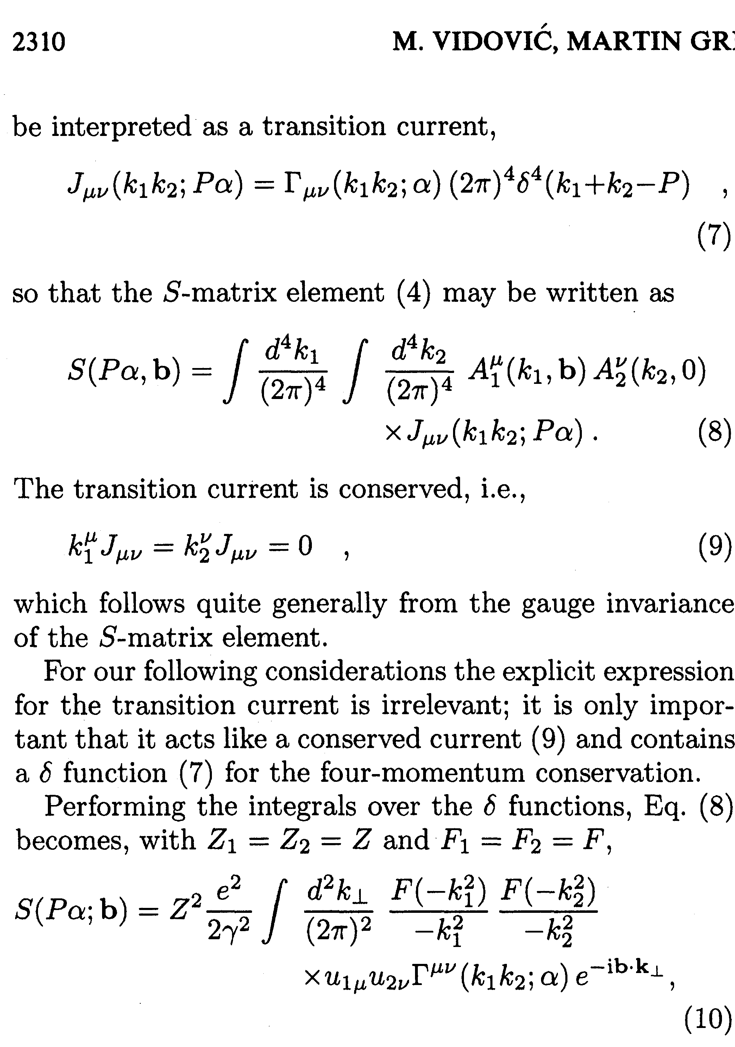
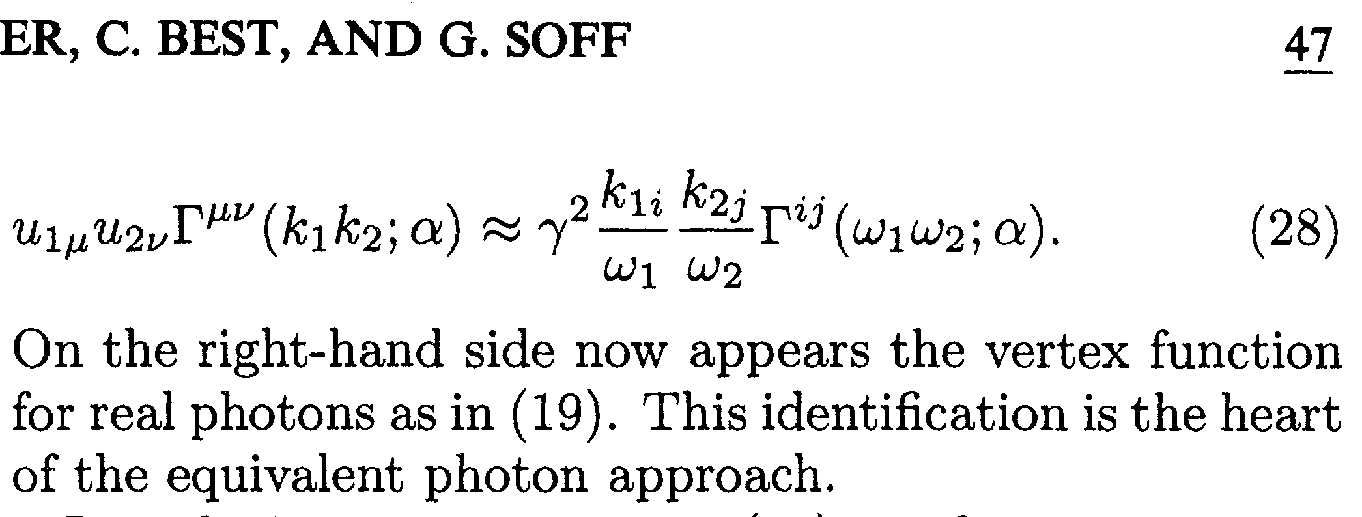
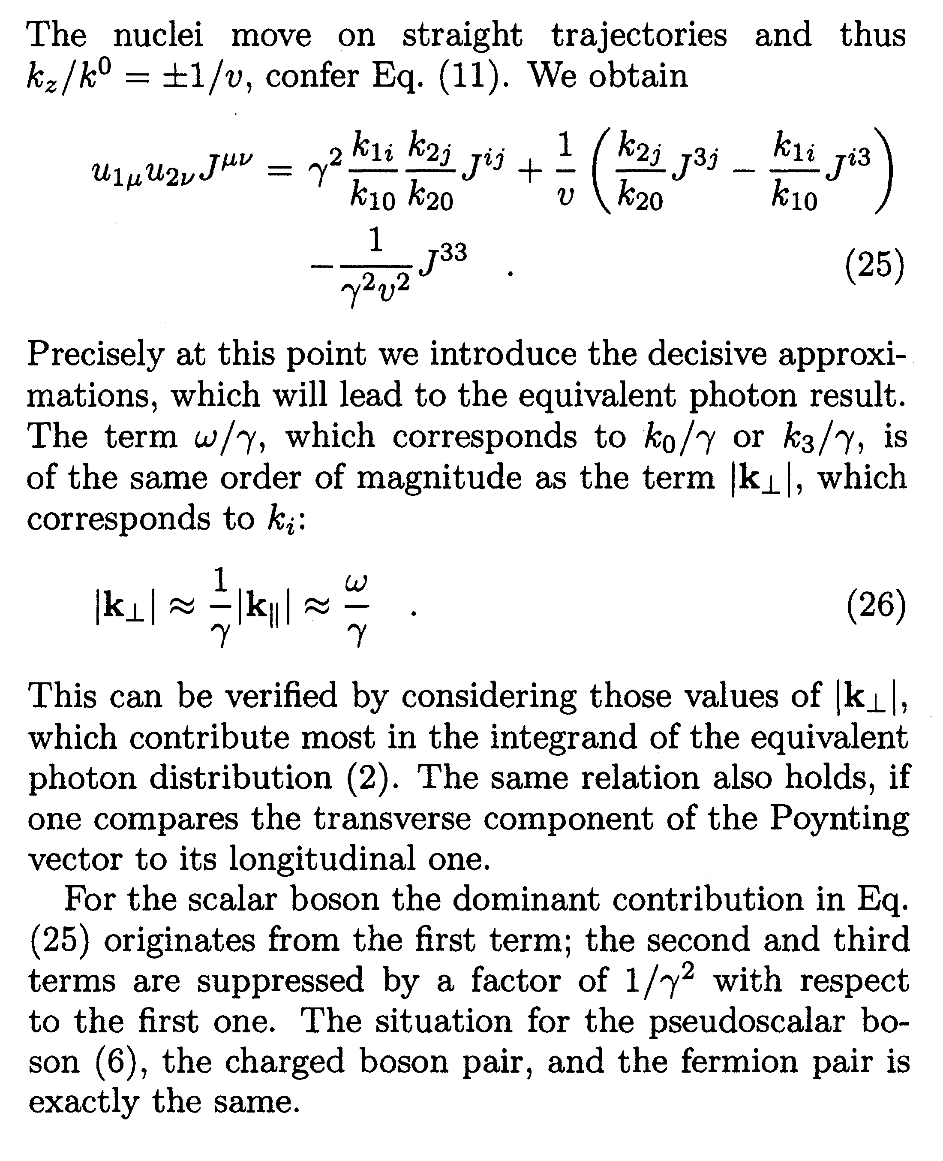
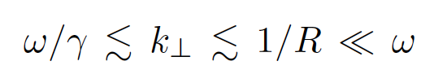
Criteria of a Breit-Wheeler process
Vidovic et al., PRC 1993
To qualify as a Breit-Wheeler process
from Coulomb field:
X.F. Wang et al., PRC 2023

Slide 11

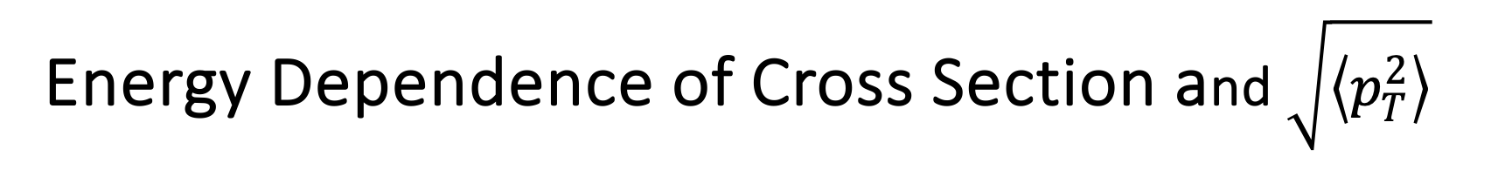
Energy Dependence of Cross Section and $\sqrt{\left\langle p_{T}^{2}\right\rangle }$
The kinematics of the Breit-Wheeler process are
sensitive to the details of the nuclear charge distribution
X. W, J.D. Brandenburg, L. Ruan, F. Shao, Z. Xu, C. Yang, and W. Zha. Phys. Rev. C 107, 044906 (2023)

Slide 12
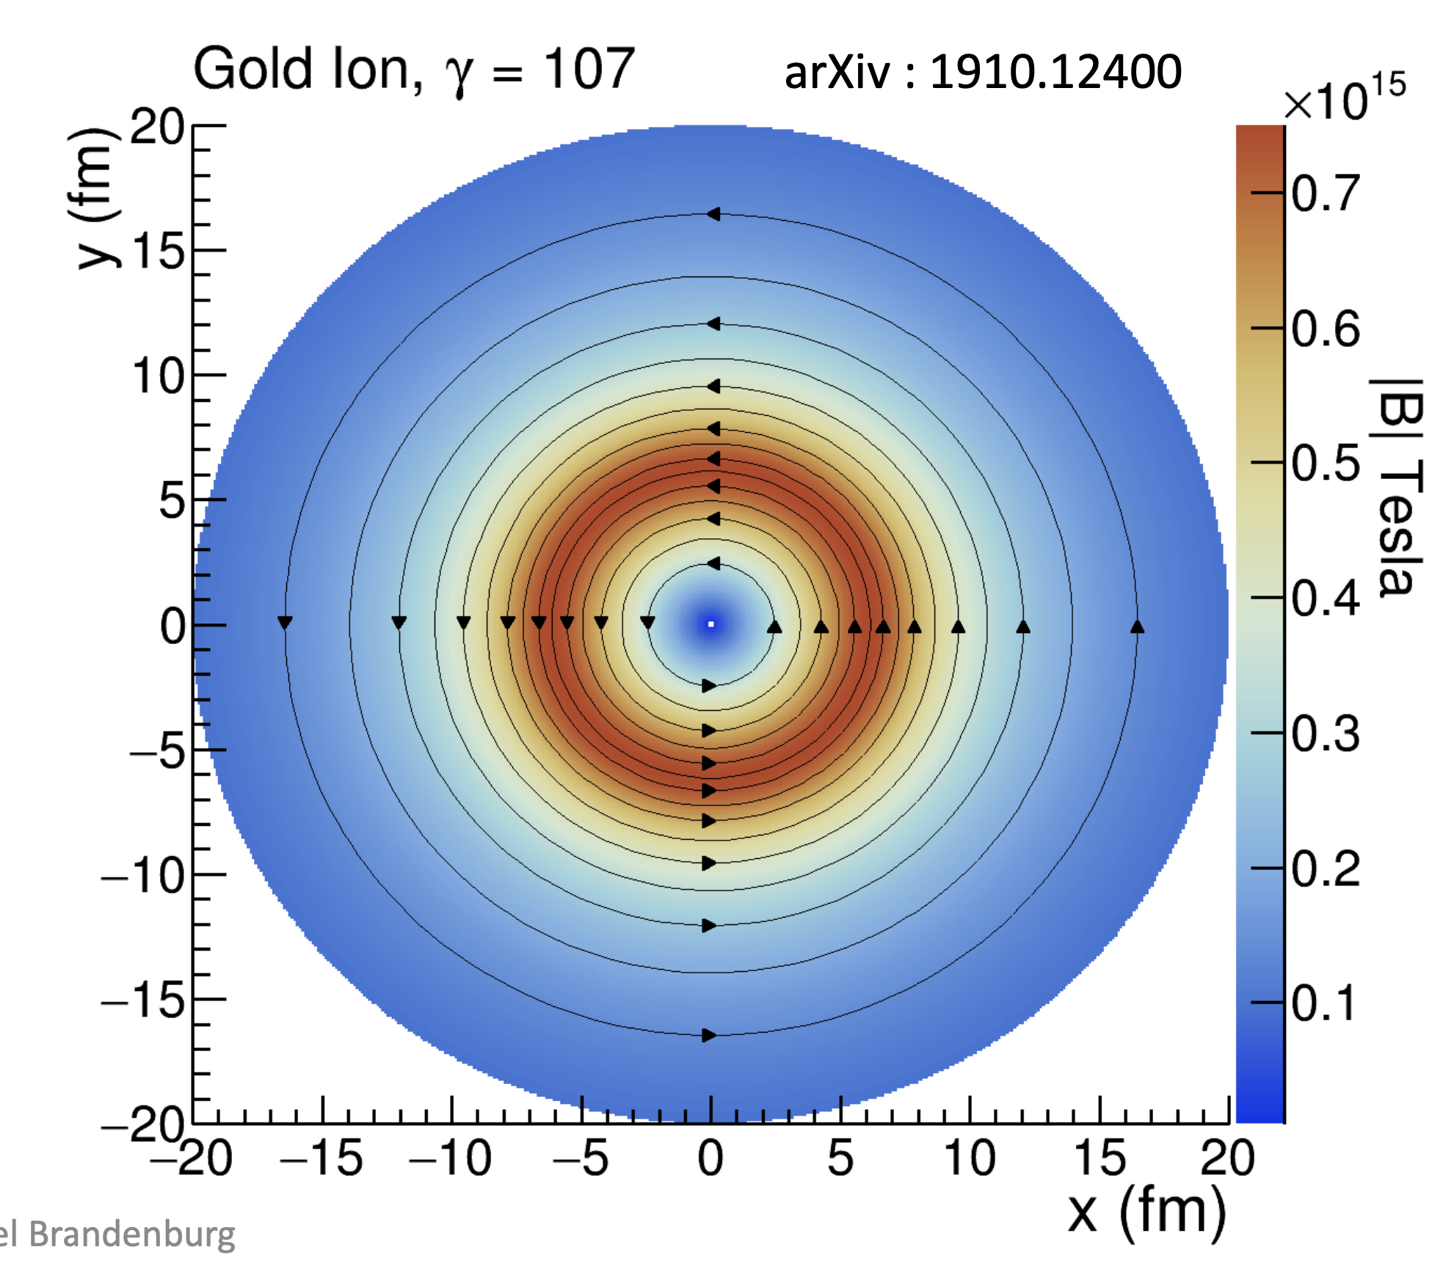


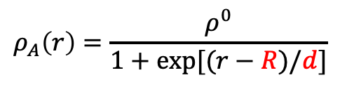
Application: Mapping the Magnetic Field
R. D. Woods and D. S. Saxon, Phys. Rev. 95, 577–578 (1954)
Woods-Saxon:
$$ρ_{A}\left(r\right)=\frac{ρ^{0}}{1+exp⁡[(r−R)/d]}$$
R: charge radius, d: skin depth
Nuclear charge distribution
Biot-Savart Law
constrain
Magnetic field
EPA
The kinematics of Breit-Wheeler process

Slide 13
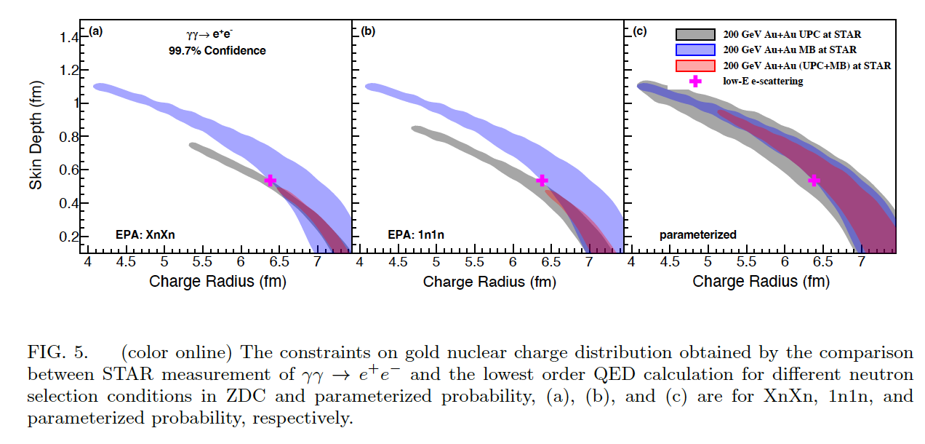
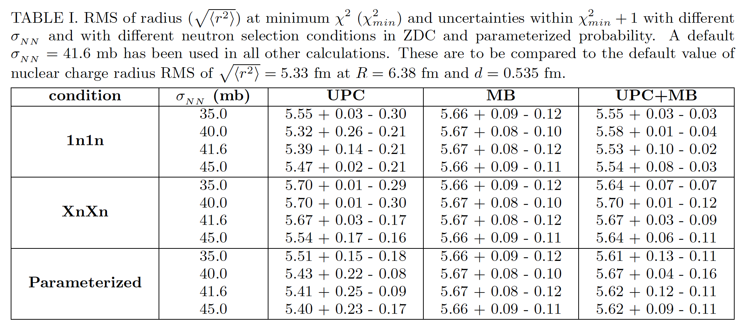
Constraint on charge distribution with precision
Using LO QED to calculate Breit-Wheeler
process to match data with least-chi2
UPC consistent with nominal nuclear geometry
Peripheral collisions systematically larger
X.F. Wang, arXiv:2207.05595

Slide 14
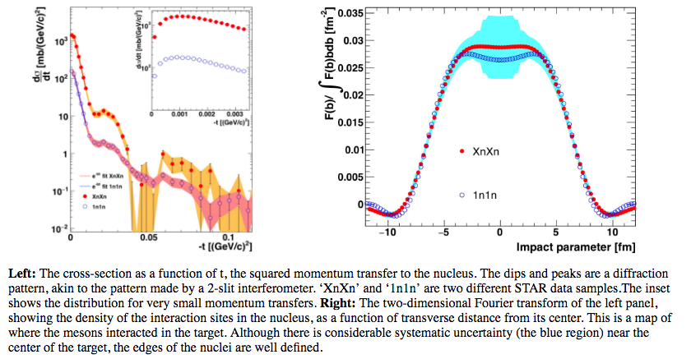
Imaging the nucleus with high-energy photons
Long history with some puzzling mysteries (20+ years):
Diffractive |t| pattern qualitatively resembles what it should be
Extracted radius is way too large (+1fm)
Cross sections are used for comparison to theory
Photon energy is 50-100GeV in the target frame
Klein and Mantysaari, Nature Reviews Physics 1 (2019) 662
ALICE, JHEP06 (2020) 35
STAR, PRC 96 (2017) 54904

Slide 15
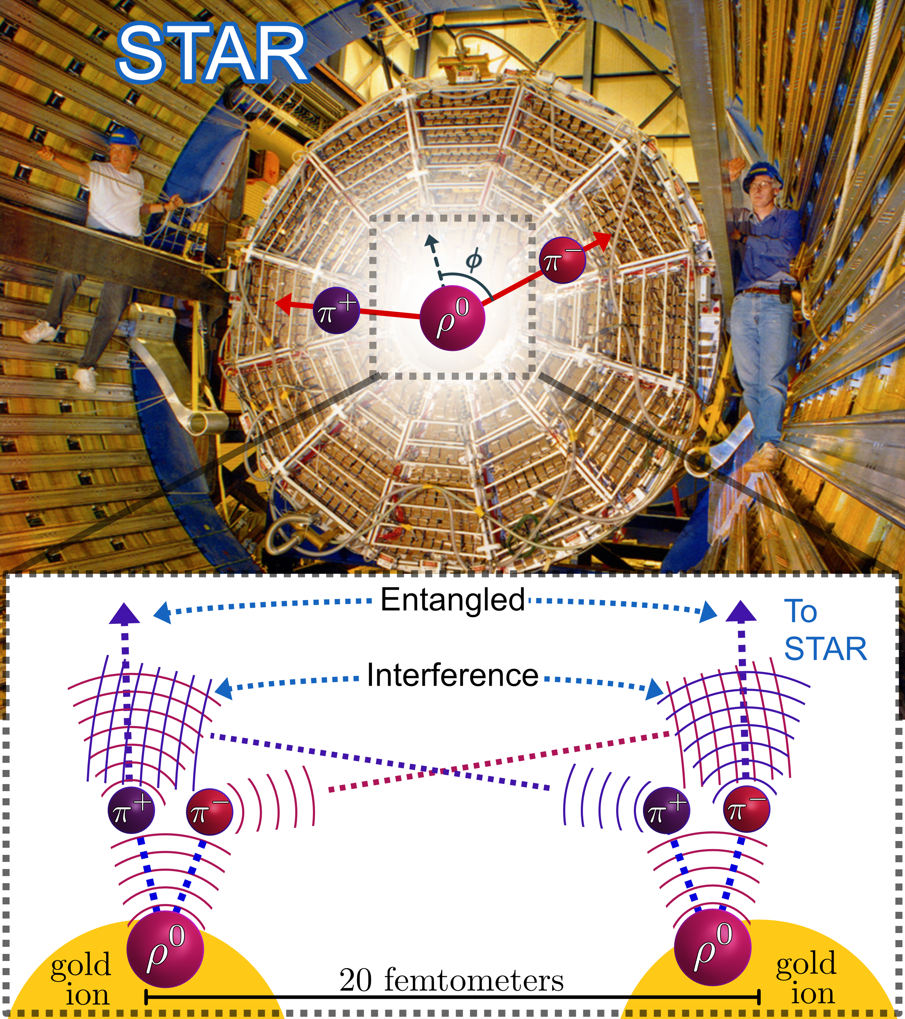

Spin Interference Enabled Nuclear Tomography
STAR, arXiv:2204.01625
Teaser:
Polarized photon-gluon fusion reveals quantum wave interference of non-identical particles and shape of high-energy nuclei

Slide 16
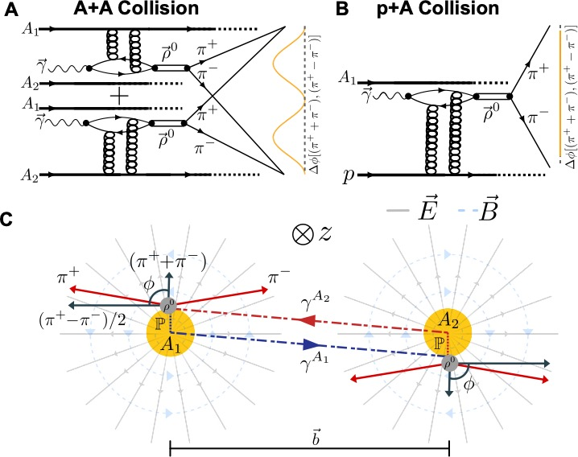
Three Ingredients
Linearly Polarized photoproduction of vector meson
At a distance with two wavefunctions
(180º rotation symmetry)
Entanglement between π± from ρ decay
and interference between identical pion wavefunction
IF I have said that this is what reality is without
any experimental evidence, most people would
have thought that I am crazy.
“Truth is Stranger than Fiction,
but it is because Fiction is obligated
to stick to possibilities; Truth isn’t.”
– Mark Twain
查王妹，周剑等原创性的理论模型

Slide 18
Different radius from different angle?

Slide 19
Precision radius measurement with interference
STAR, arXiv:2204.01625
Azimuthal variation due to:
Photon linear polarization,
Spin transfer to VM
Photon finite k_{T}
VM spin 1 decay to spin 0 pions
Interference along impact parameter
These image blurring effects can be improved with the angular dependence

Slide 20
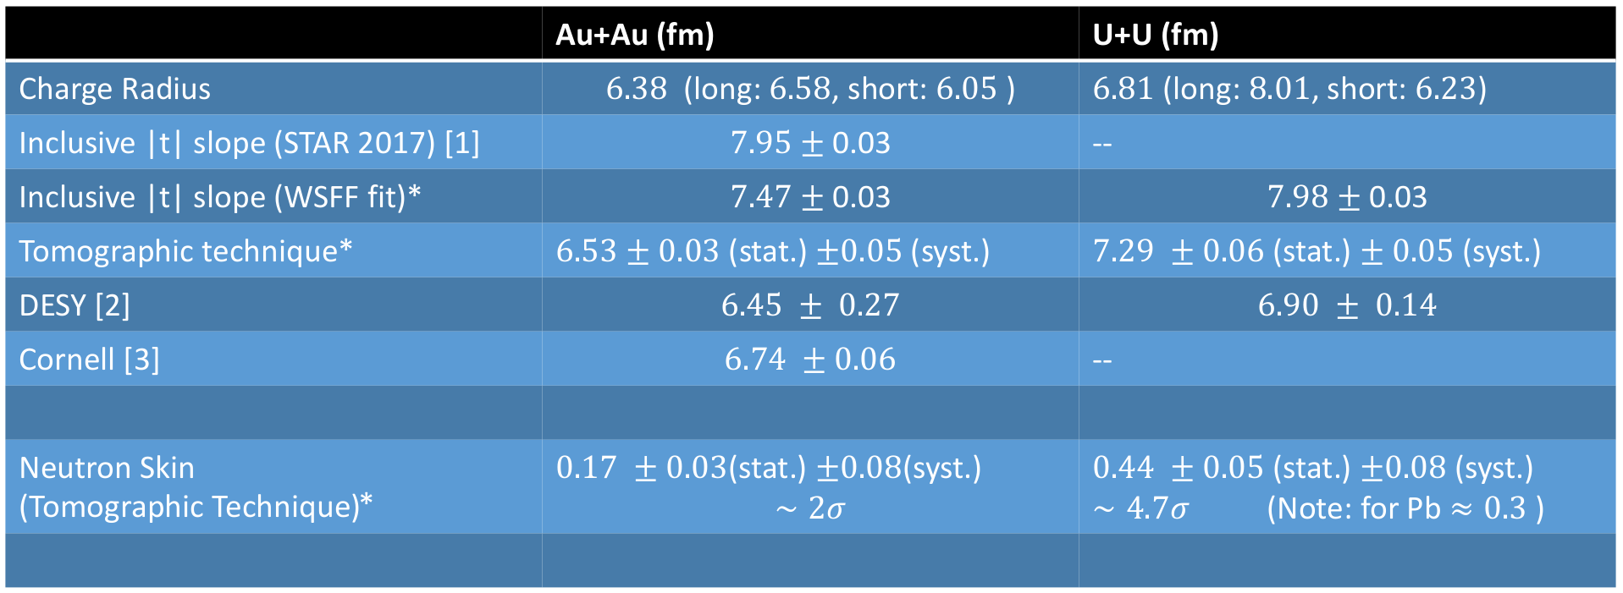
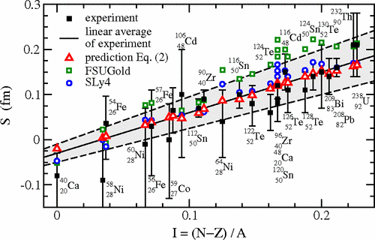
Extracted neutron skins and comparison to world data
M. Centelles, X. Roca-Maza, X. Viñas, and M. Warda
Phys. Rev. Lett. 102, (2009) 122502
GIULIANO GIACALONE, July 22, 2022

Slide 21
Extracted neutron skins and comparison to world data
M. Centelles, X. Roca-Maza, X. Viñas, and M. Warda
Phys. Rev. Lett. 102, (2009) 122502
GIULIANO GIACALONE, July 22, 2022

Slide 22
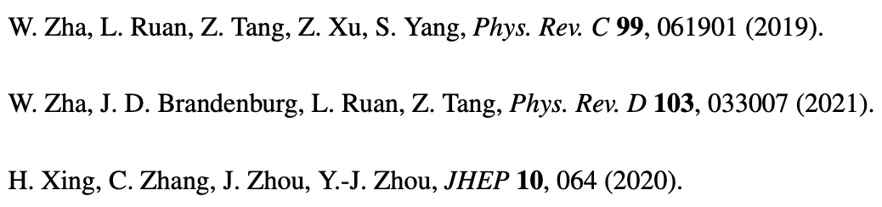
Comparison to models
STAR, arXiv:2204.01625
Comparison to models with the interference effect
Model I:
VM production cross section from HERA ep data
Glauber with smooth NN overlap function
Model II:
dipole model with gluon saturation in A+A

Slide 23
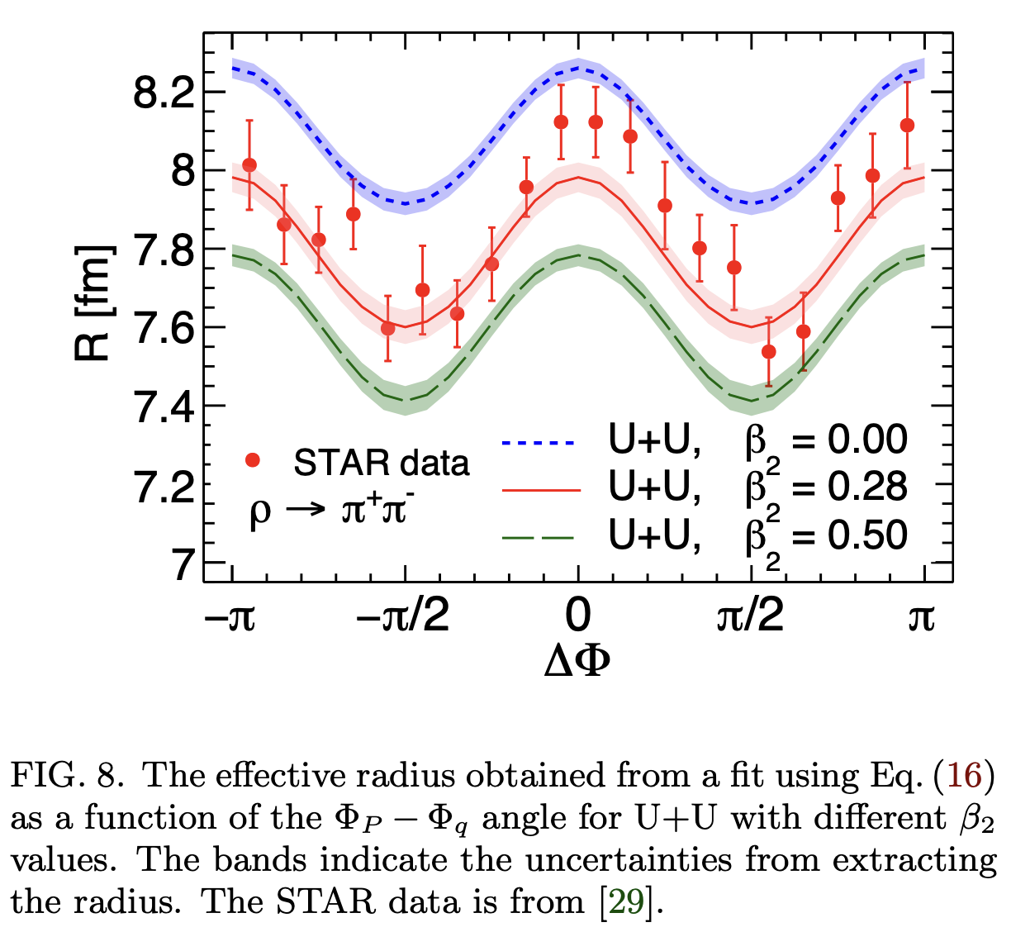
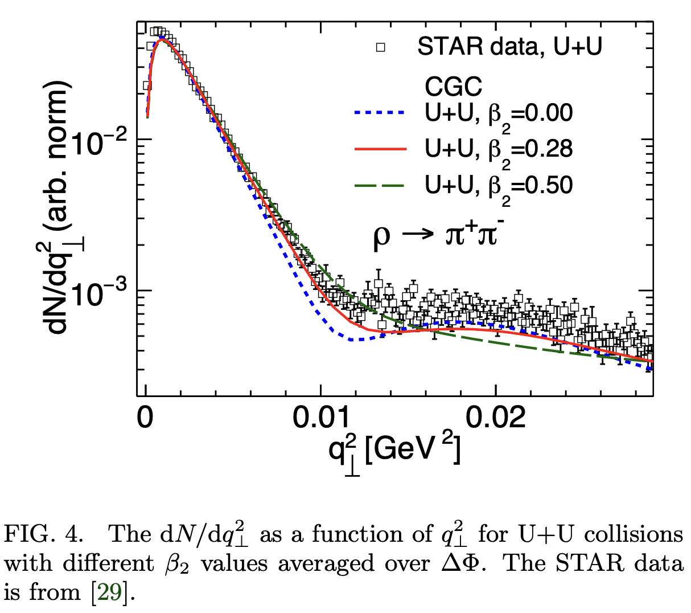
Extracting deformation in ²³⁸U
Effects of nuclear structure and quantum interference on diffractive vector meson production in ultra-peripheral nuclear collisions
Heikki Mäntysaari, Farid Salazar, Björn Schenke, Chun Shen, Wenbin Zhao
Phys.Rev.C 109 (2024) 2, 024908; e-Print: 2310.15300 [nucl-th]

Slide 24
Improvements of future measurements
Both interference and Woods-Saxon models only describe the first peak well
The neutron skin syst. uncertainty mainly due to WS vs Gaussian,
and the actual distribution seems to
be flatter (more prominent second peak)
STAR, arXiv:2204.01625

Slide 25
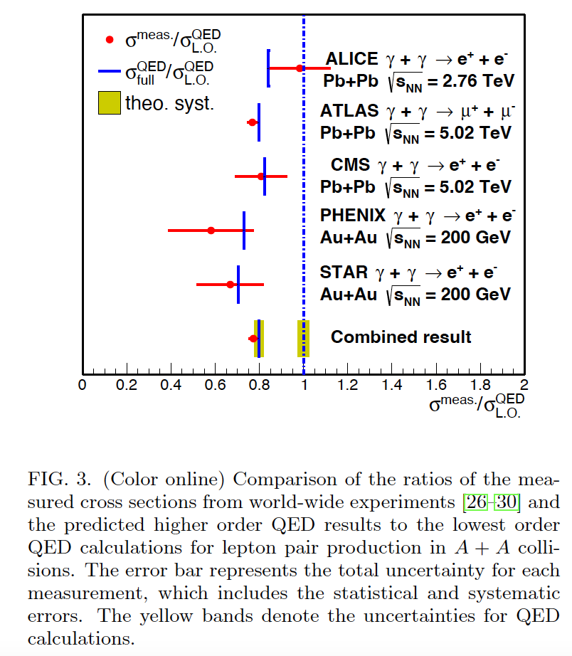
Radius Measurements from RHIC to LHC?
Is the charge radius
consistent with
low energy measurement?
Is there significant Coulomb
correction at LHC energy (20%)?
Will all these affect measurement
of g-2 of tau?
RMS of charge radius of Pb (LHC) best fit: 4.91fm
Standard charge radius from low energy: 5.51fm
Tang and Zha, arXiv:2103.04605;

Slide 26
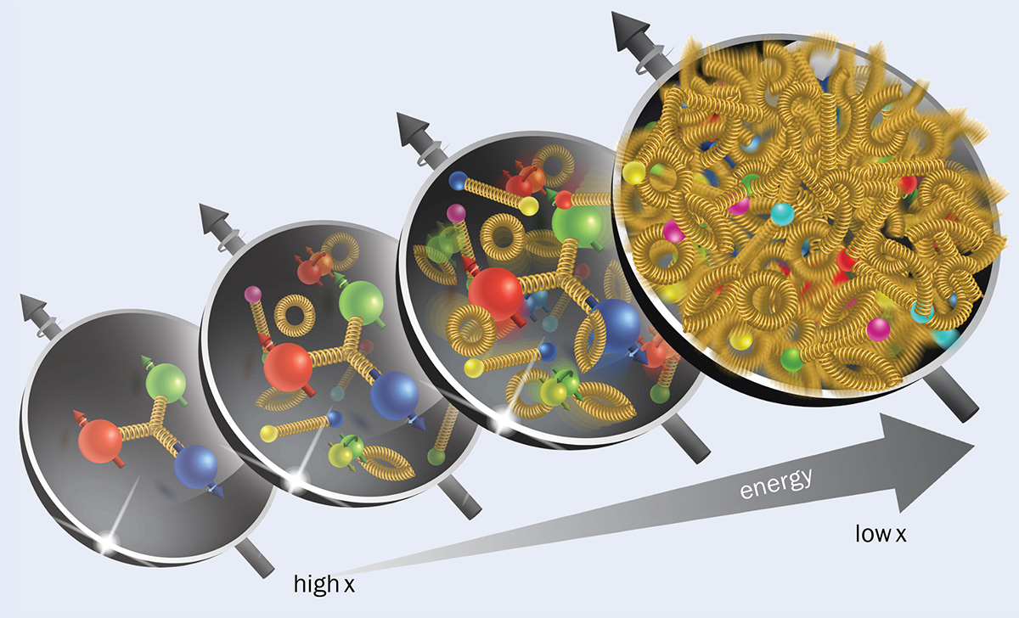
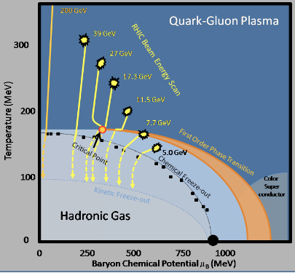
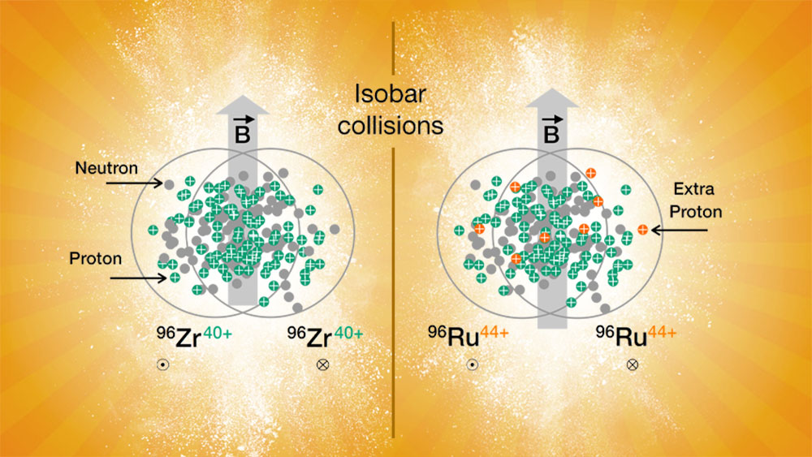
Smallest nuclear structure: baryon junction
Zhangbu Xu
(Kent State Univerity)
Basic pure EM process in Heavy-ion collisions
Constrain charge radius at RHIC
Constrain mass radius at RHIC
Constrain neutron skin in isobar (Zr,Ru)
Summary
04/25/2024

Slide 27
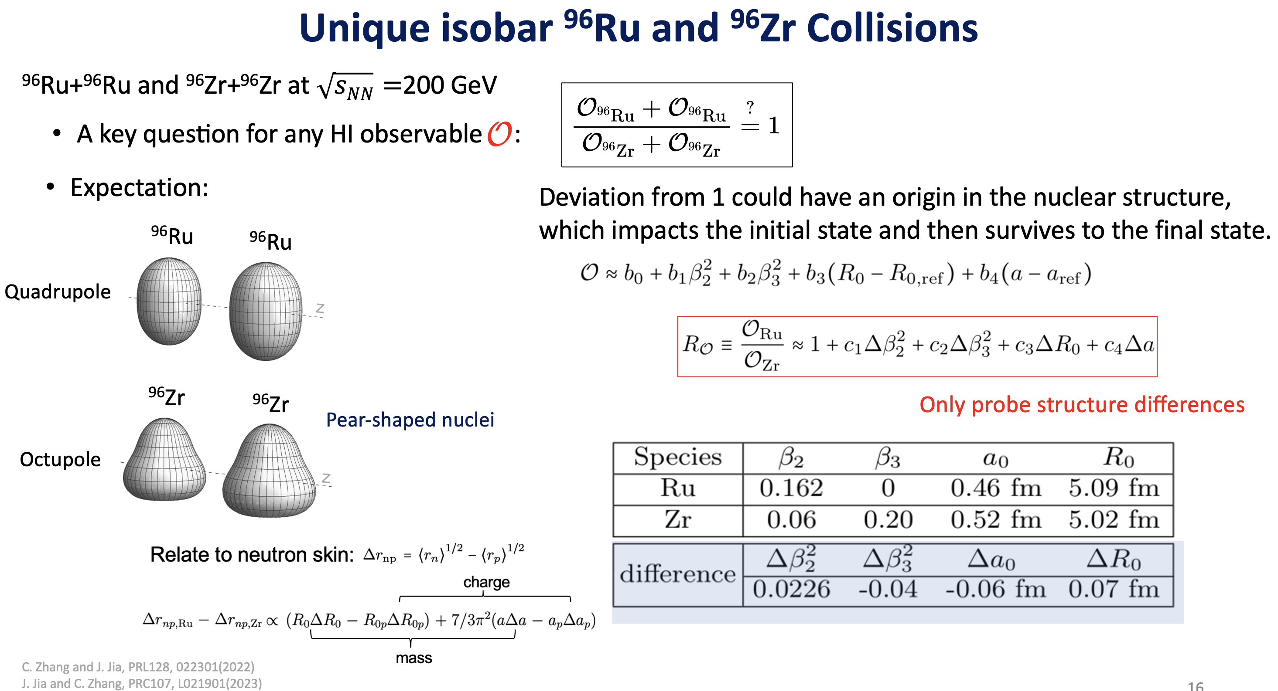
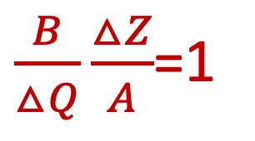
$\frac{B}{△Q}\frac{△Z}{A}$=1
Net baryon
----------------------
Net Charge Diff
Chunjian Zhang (Sunday Talk)
Haojie Xu (Monday Talk)

Slide 28
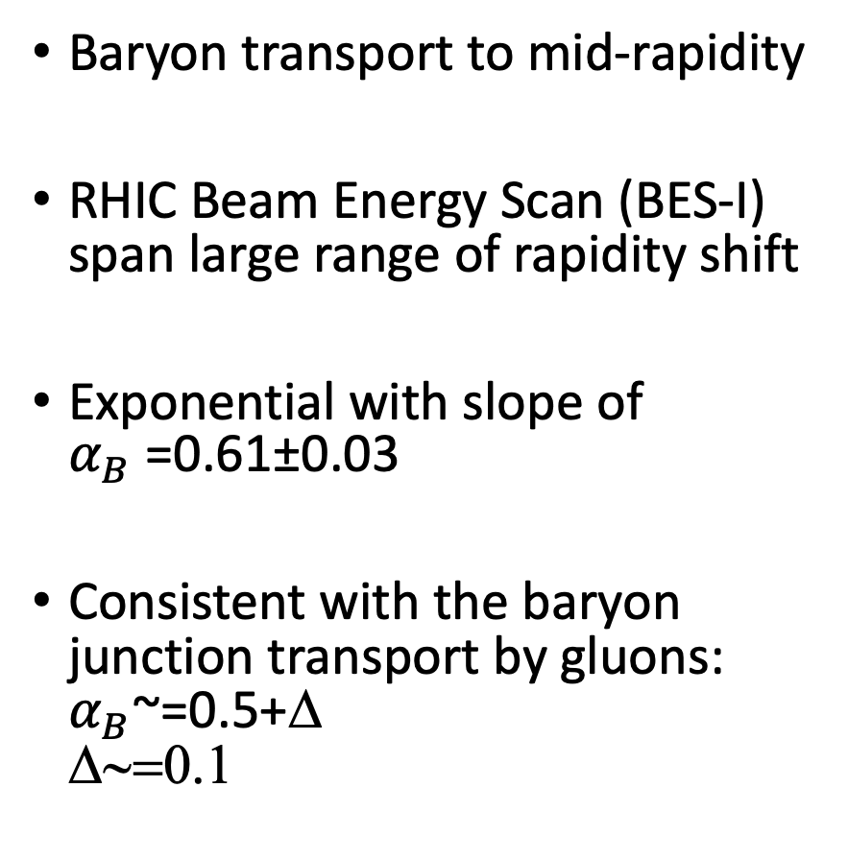
Quantifying baryon number transport
Baryon transport to mid-rapidity
RHIC Beam Energy Scan (BES-I) span large range of rapidity shift
Exponential with slope of
$α_{B}$=0.61±0.03
Consistent with the baryon junction transport by gluons:
$α_{B}$~=0.5+Δ
Δ∼=0.1
STAR, Phys. Rev. C 79 (2009) 34909; 96 (2017) 44904
arXiv:2205.05685
No one has ever measured charge transport before

Slide 29
From baryon stopping:
B*(ΔZ/A)~=2x10⁻³
Charge stopping:
ΔQ ~=1x10⁻³
科大唐泽波学生

Slide 30
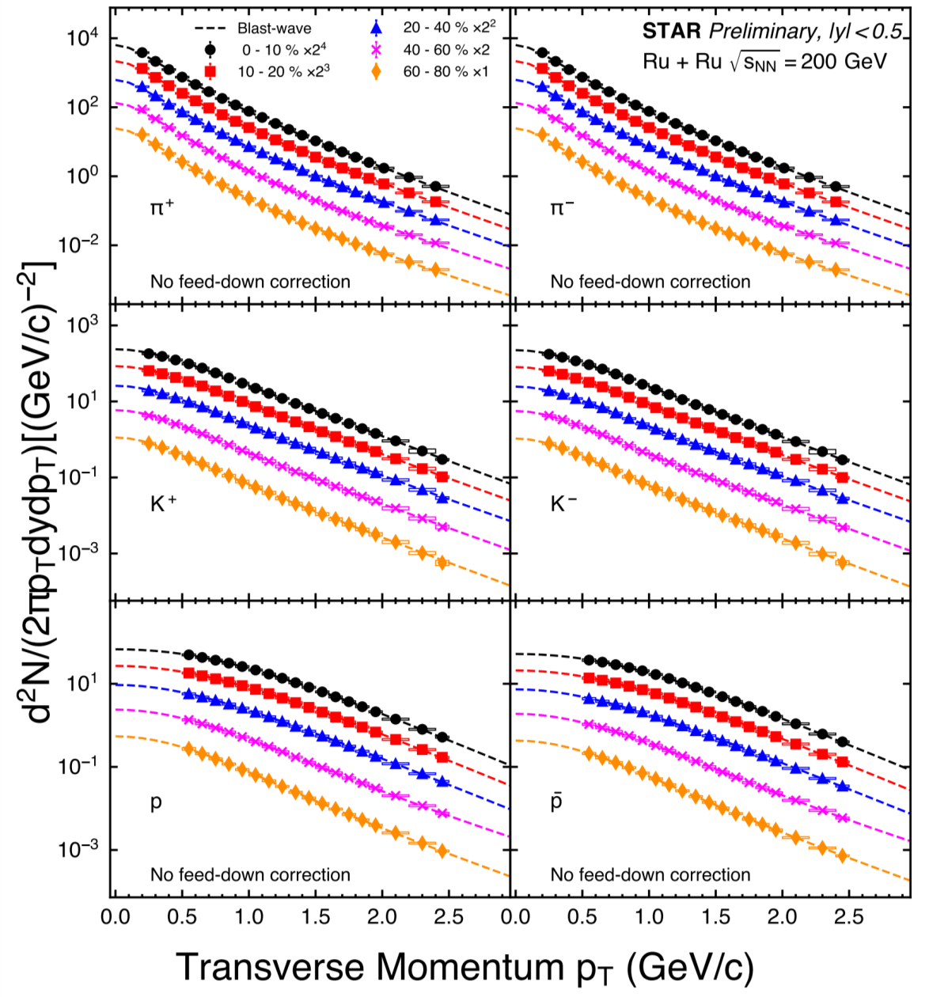
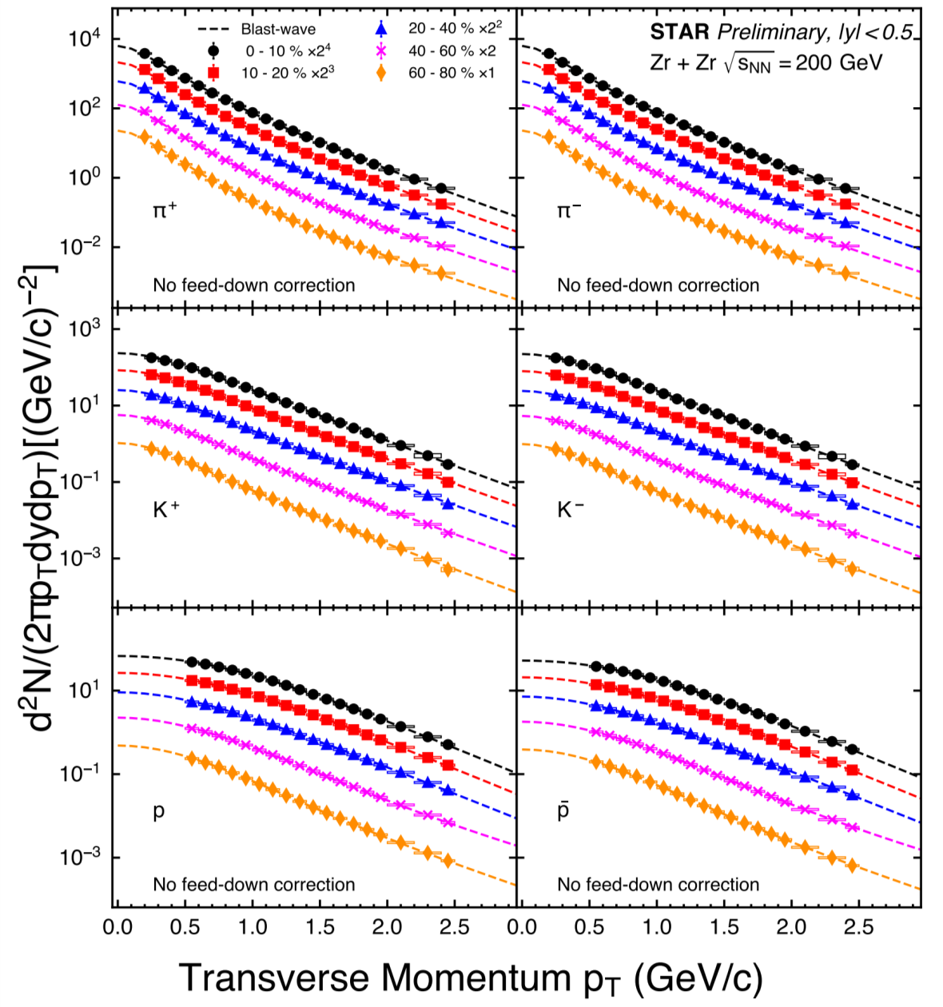
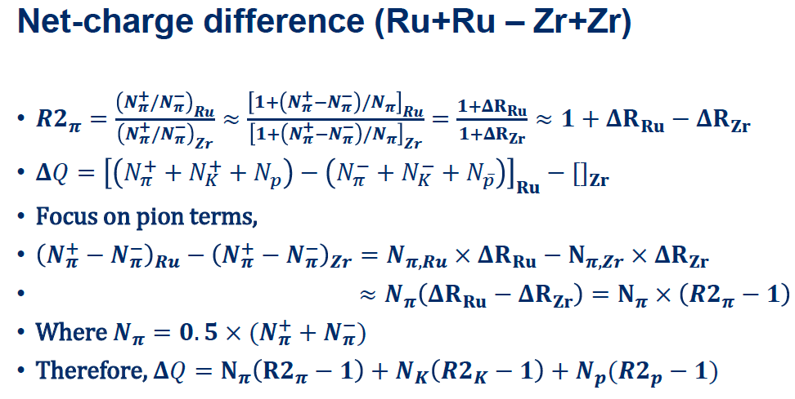
Identified hadron spectra to low momentum

Slide 31
Small Multiplicity Mismatch, Big Physical Effect?
STAR Collaboration, Phys. Rev. C 105 (2022) 14901
“Search for CME with Isobar Collisions”
Multiplicity mismatch is from 0.5% (central) to 10% (peripheral)

Slide 32
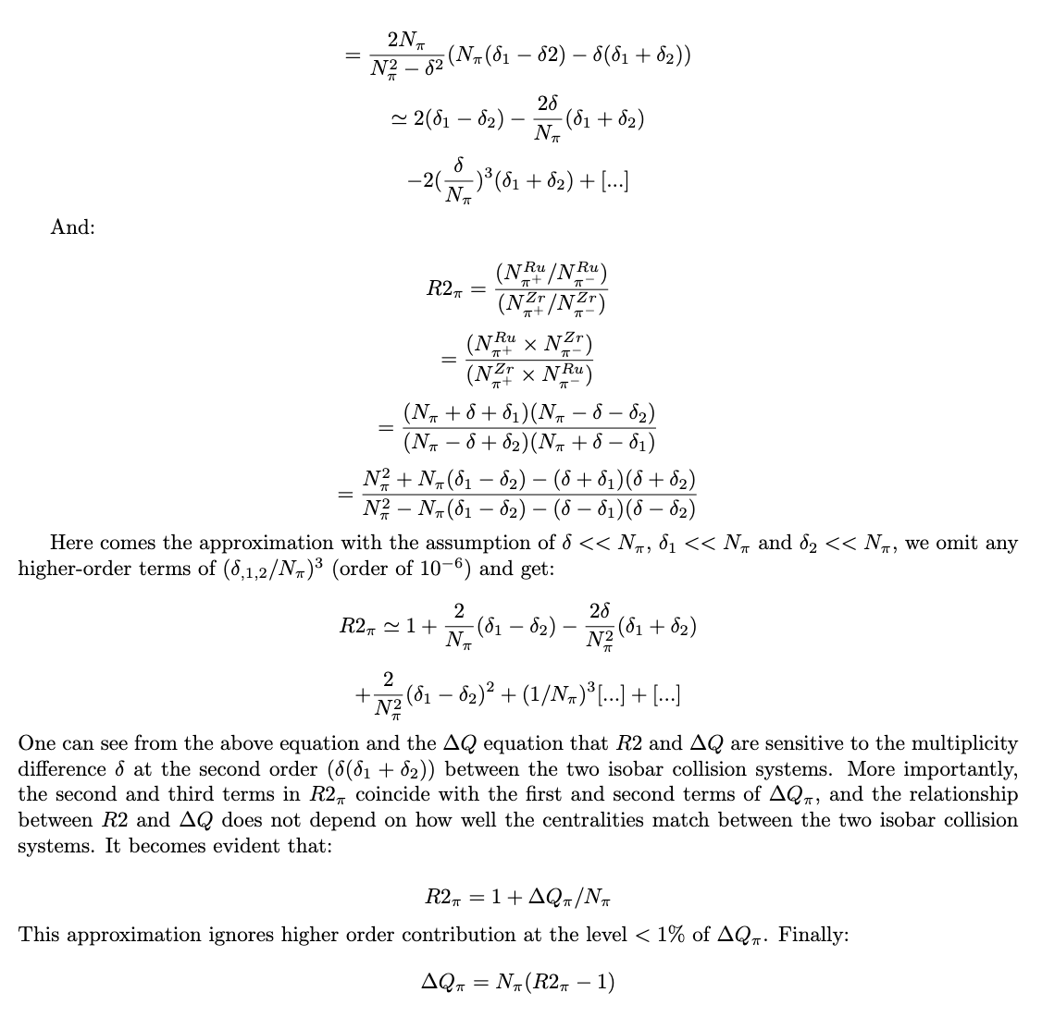
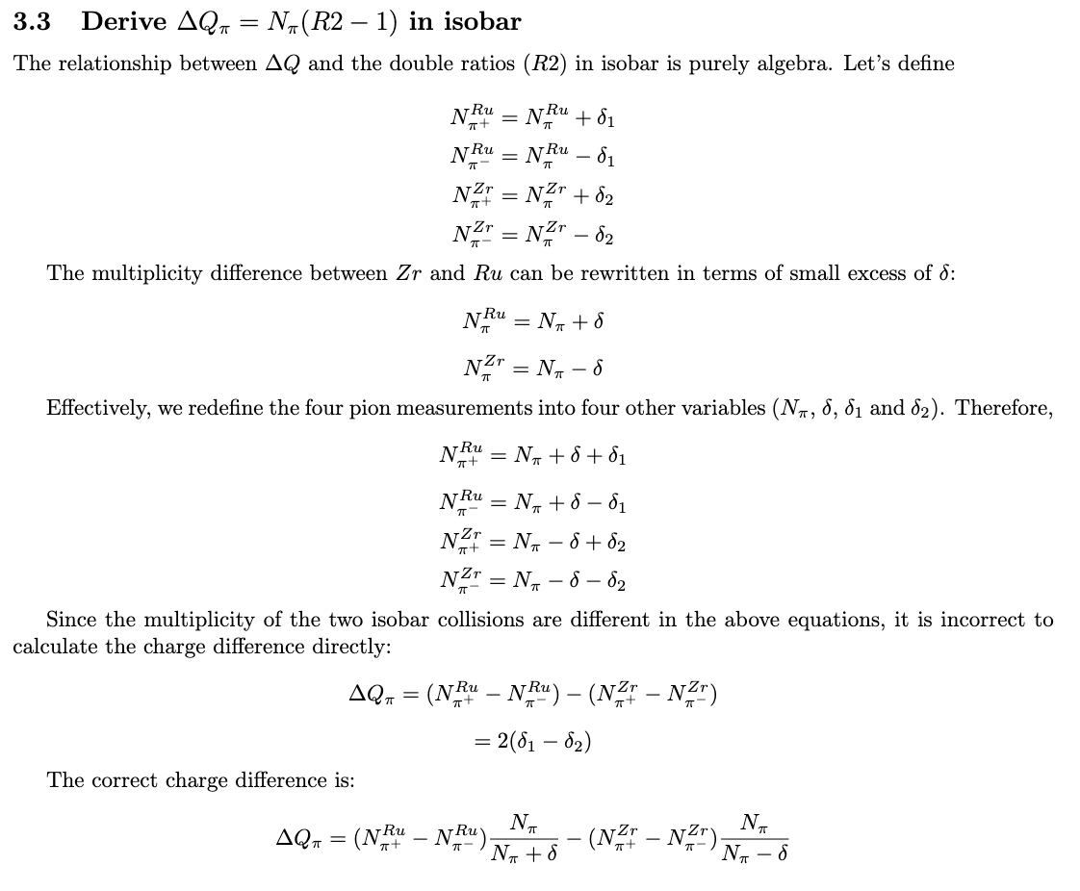
Power and Simplicity of Double Ratio

Slide 33
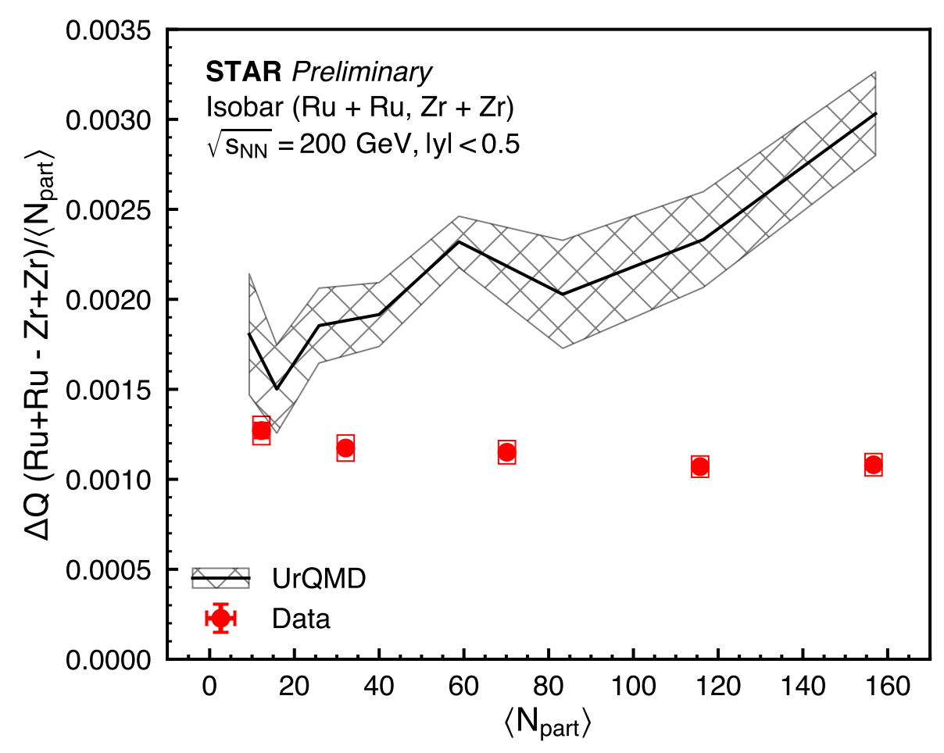
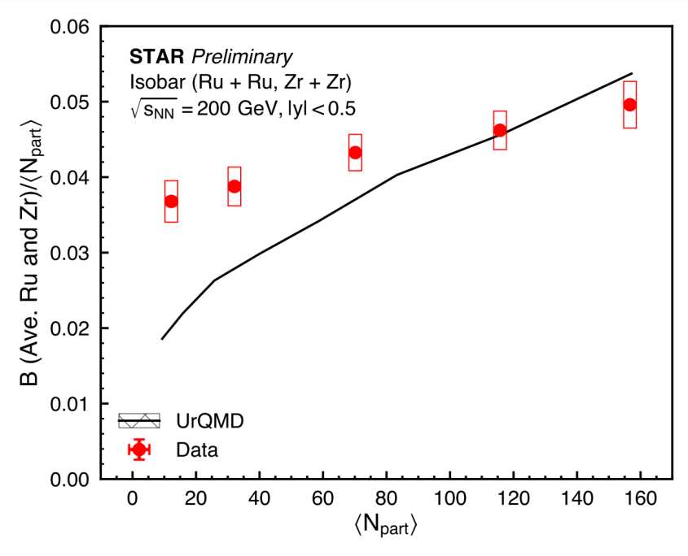
Separate charge and baryon transports
Charge number transport
Baryon number transport
Tommy Tsang (KSU) for STAR, APS GHP 2023
UrQMD matches data on charge stopping better in peripheral; better on baryon stopping in central
overpredicts charge stopping in central; underpredicts baryon stopping in peripheral

Slide 34
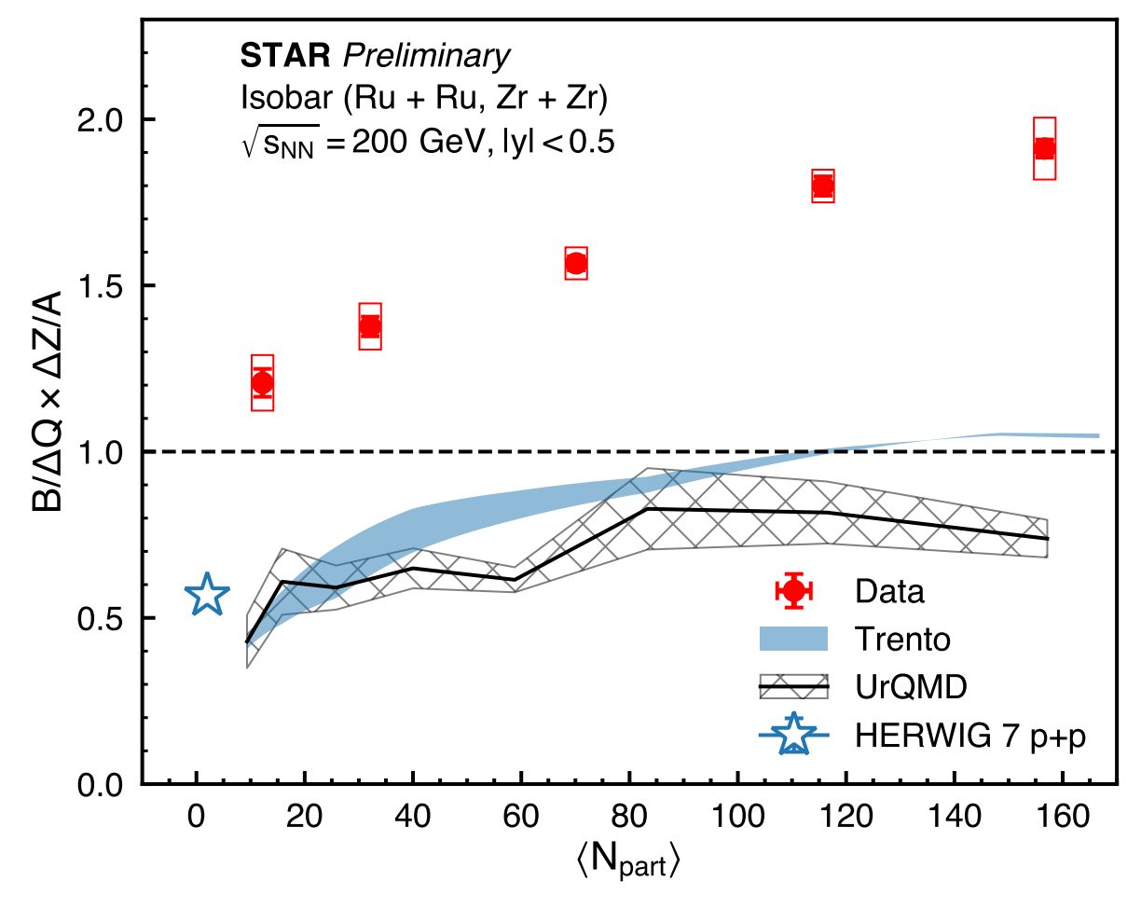
Ratio of baryon over charge transports
Tommy Tsang (KSU) for STAR, QM, APS GHP 2023
Experimental data:
More baryon transported to C.O.M than charge by about
a factor of 2
Model simulations:
Less baryon transported to C.O.M frame than charge
Pure geometry:
with neutron skin predicts the right centrality dependence
(Trento, Haojie Xu, Monday Talk)

Slide 35
Wendi Lv, et al.
arXiv:2309.06445

Slide 36
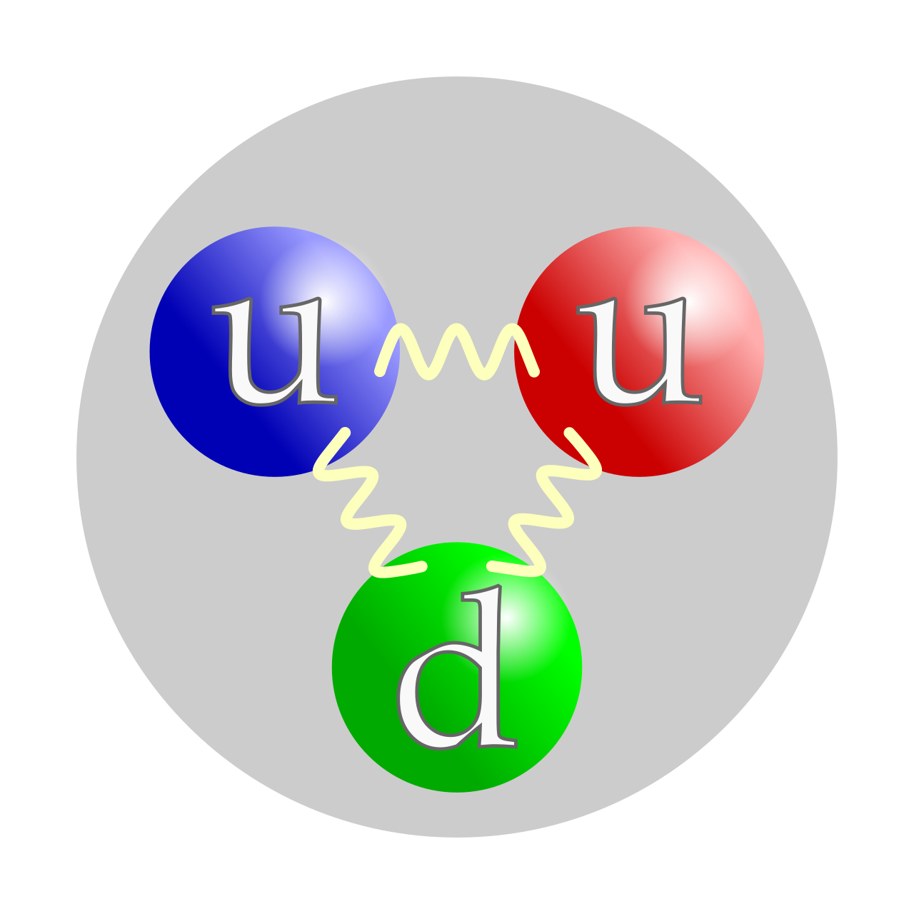
Baryon Number (B) Carrier
https://en.wikipedia.org/wiki/Quark
B=1
Textbook picture of a proton
  Lightest baryon with strictly conserved baryon number
  Each valence quark carries 1/3 of baryon number
  Proton lifetime >10³⁴ years
  Quarks are connected by gluons
Alternative picture of a proton
  Proposed at the Dawn of QCD in 1970s
  A Y-shaped gluon junction topology carries baryon number (B=1)
  The topology number is the strictly conserved number
  Quarks do not carry baryon number
  Valence quarks are connected to the end of the junction always
[1]: Artru, X.; String Model with Baryons: Topology, Classical Motion. Nucl. Phys. B 85, 442–460 (1975).
[2]: Rossi, G. C. & Veneziano, G. A; Possible Description of Baryon Dynamics in Dual and Gauge Theories. Nucl. Phys. B 123, 507–545 (1977)

Slide 37



Measurements of quark baryon number?
$$\frac{1}{3}$$
$$\frac{1}{3}$$
Textbook picture of a proton
  Lightest baryon with strictly conserved baryon number
  Each valence quark carries 1/3 of baryon number
  Proton lifetime >10³⁴ years
  Quarks are connected by gluons
Alternative picture of a proton
  Proposed at the Dawn of QCD in 1970s
  A Y-shaped gluon junction topology carries baryon number (B=1)
  The topology number is the strictly conserved number
  Quarks do not carry baryon number
  Valence quarks are connected to the end of the junction always
Neither of these postulations has been verified experimentally
$$\frac{1}{3}$$
1
[1]: Artru, X.; String Model with Baryons: Topology, Classical Motion. Nucl. Phys. B 85, 442–460 (1975).
[2]: Rossi, G. C. & Veneziano, G. A; Possible Description of Baryon Dynamics in Dual and Gauge Theories. Nucl. Phys. B 123, 507–545 (1977)

Slide 38
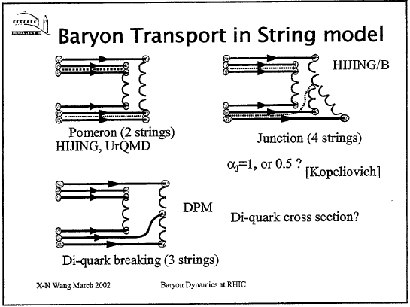
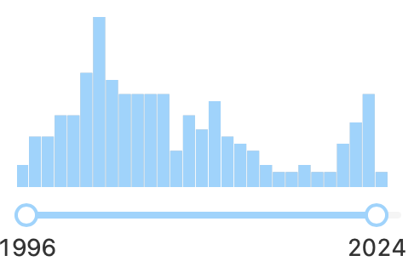
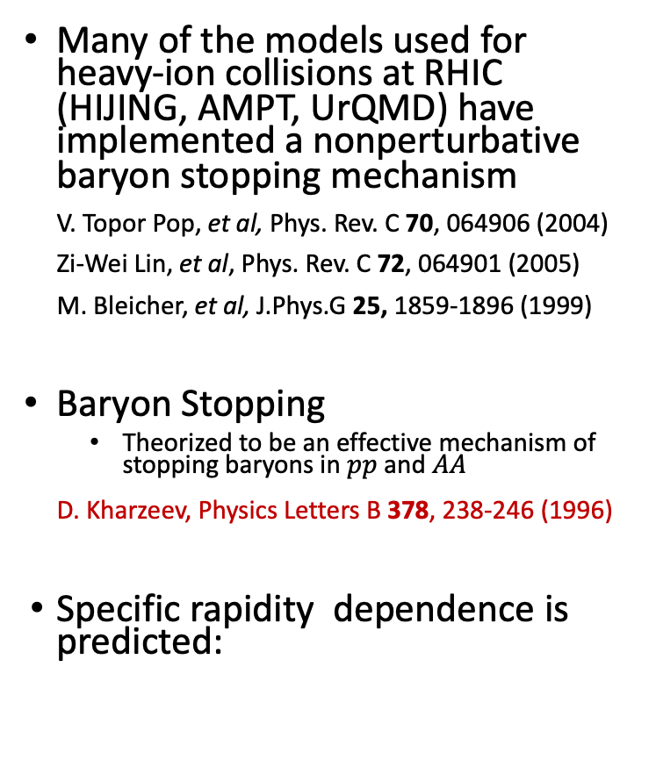
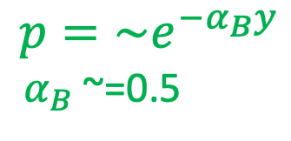
Model implementations of baryons at RHIC
Many of the models used for heavy-ion collisions at RHIC (HIJING, AMPT, UrQMD) have implemented a nonperturbative baryon stopping mechanism
V. Topor Pop, et al, Phys. Rev. C 70, 064906 (2004)
Zi-Wei Lin, et al, Phys. Rev. C 72, 064901 (2005)
M. Bleicher, et al, J.Phys.G 25, 1859-1896 (1999)
Baryon Stopping
  Theorized to be an effective mechanism of stopping baryons in $pp$ and $AA$
D. Kharzeev, Physics Letters B 378, 238-246 (1996)
Specific rapidity dependence is predicted:
2003 RBRC Workshop on “Baryon Dynamics at RHIC”
D. Kharzeev, Physics Letters B 378, 238-246 (1996)
“Can gluons trace baryon number?”
“Science, however, is never conducted as a popularity contest...” --- Michio Kaku
BUT citations ARE
$$p=\sim e^{−α_{B}y}$$
$α_{B}$~=0.5

Slide 39
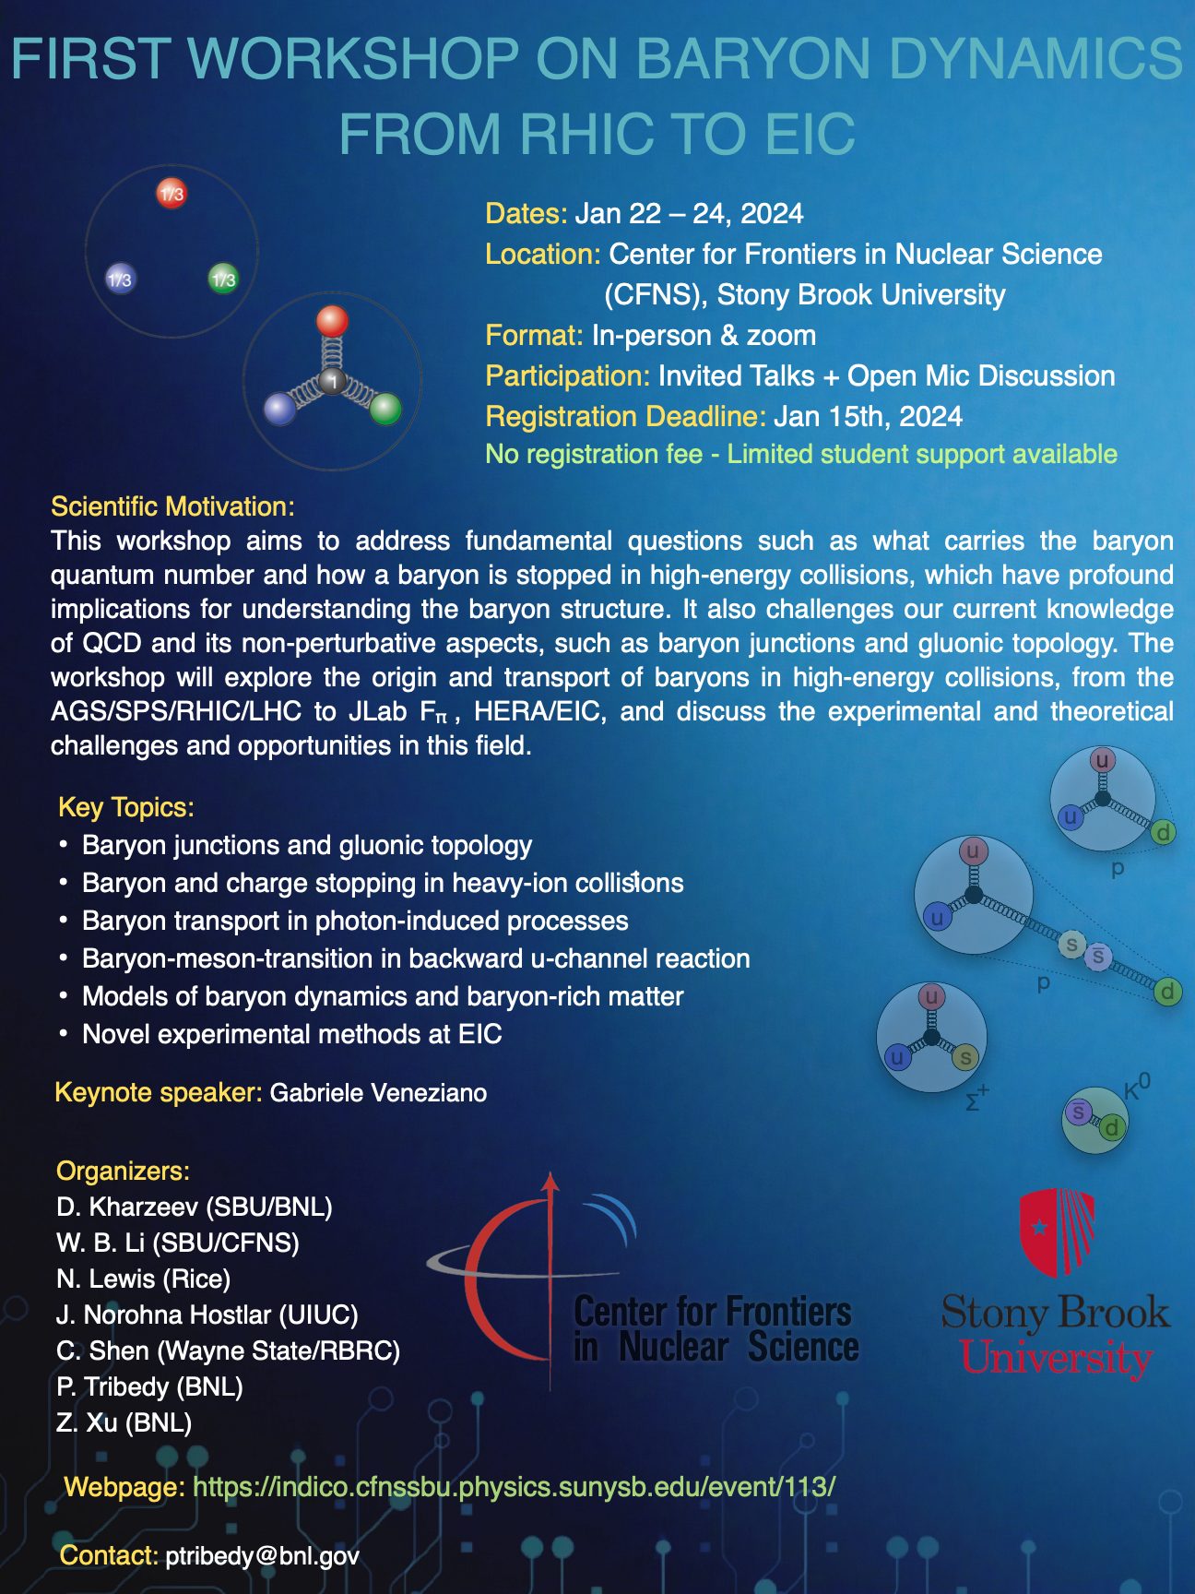
There is only one way to construct a gauge-invariant state vector of a baryon from quarks and gluons
It is evident from the structure of ( 1) that the trace of baryon number should be associated not with the valence quarks, but with a non-perturbative configuration of gluon fields located at the point x - the “string junction” .

Slide 40
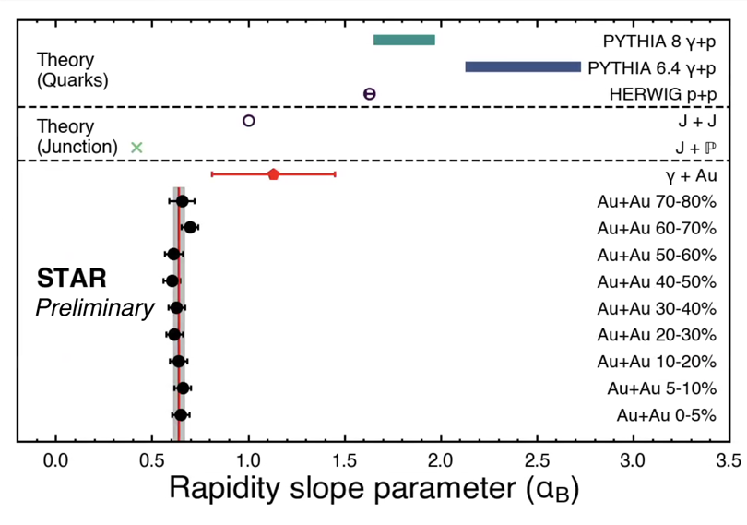
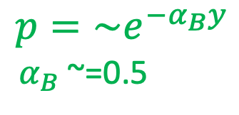
Three approaches toward tracking the origin of the baryon number
STAR Method:
Charge (Q) stopping vs baryon (B) stopping:
if valence quarks carry Q and B,
Q=B at middle rapidity
B/Q=2
Kharzeev-STAR Method:
If gluon topology (J) carries B as one unit, it should show scaling according to Regge theory
α_{Β}=0.61
Artru Method:
In γ+Au collision, rapidity asymmetry can reveal the origin
α_{Β}(A+A)=0.61< α_{Β}(γ+A)=1.1< α_{Β}(PYTHIA)
$$p=\sim e^{−α_{B}y}$$
$α_{B}$~=0.5

Slide 41
Summary and Perspectives
Possible systematical deviation in peripheral at RHIC and central collisions at LHC due to final-state B-field effect
Model: QED+final-state B-field to match data
RHIC data with more central collisions and high statistics (2023-2025)
Derive Pb charge radius from LHC data
Isobar collisions reveals a centrality dependence between baryon and charge stopping, consistent with neutron skins in Zr vs. Ru
Precise QED calculations and matching experimental data with high statistics from initial photon collisions
Vector Meson Production with Quantum Entanglement provides very precise mass radius measurement
Both measurements provide a good constraint on quark and gluon distributions at high energy

Slide 42
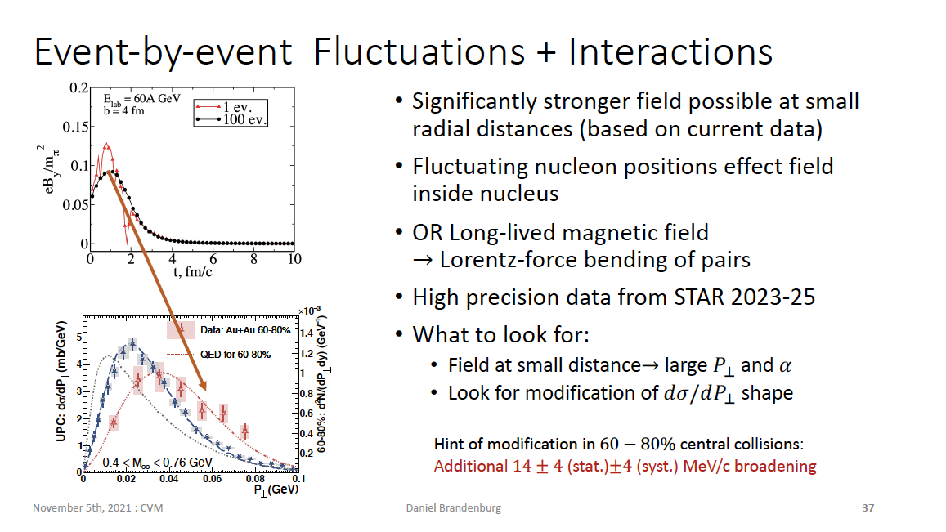

Slide 43
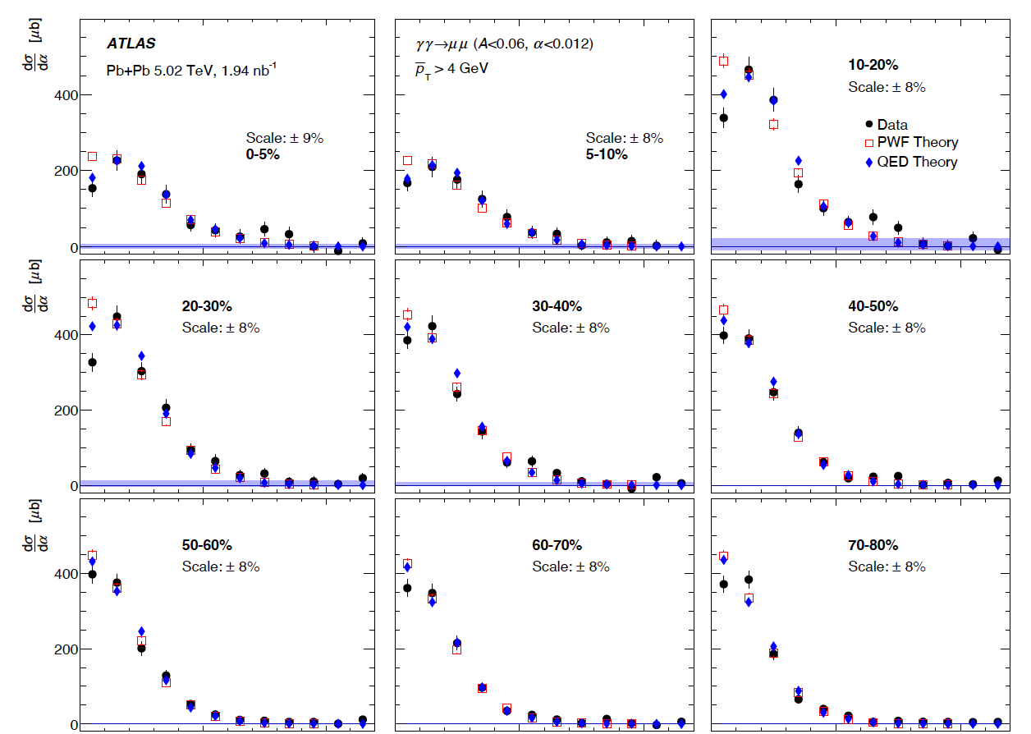




Most Precision test in Central Pb+Pb at LHC
Under what condition do these photons interact as real photons?
  Photon Wigner Function (PWF)
  formalism & LO-QED formalism agree very well
  How to understand the minor differences between them?
  $$ω/γ≲k_{⊥}≲ 1/R≪ω,$$
  $$\frac{\sqrt{2}}{γ}≲\frac{π}{2}α≲\frac{\sqrt{2}}{ωR}≪1$$
  Possible difference between data
  and QED due to final-state B-field?
$$Δφ$$
$$α ≡1 − {Δφ}/π$$
$$α$$
ATLAS, arXiv:2206.12594; PRL 2018

Slide 44


Most Precision test in Central Pb+Pb at LHC
Under what condition do these photons interact as real photons?
  Photon Wigner Function (PWF)
  formalism & LO-QED formalism agree very well
  How to understand the minor differences between them?
  $$ω/γ≲k_{⊥}≲ 1/R≪ω,$$
  $$\frac{\sqrt{2}}{γ}≲\frac{π}{2}α≲\frac{\sqrt{2}}{ωR}≪1$$
  Possible difference between data
  and QED due to final-state B-field?
$$Δφ$$
$$α ≡1 − {Δφ}/π$$
ATLAS, arXiv:2206.12594; PRL 2018
$$α$$

Slide 45
Radius Measurements from RHIC to LHC?
Is the charge radius
consistent with
low energy measurement?
Is there significant Coulomb
correction at LHC energy (20%)?
Will all these affect measurement
of g-2 of tau?
RMS of charge radius of Pb (LHC) best fit: 4.91fm
Standard charge radius from low energy: 5.51fm
Tang and Zha, arXiv:2103.04605;

Slide 46
Are there final-state QED effects?
Precision data with
QED theory comparisons:
Both on-going at LHC and RHIC
How about azimuthal anisotropy
relative to reaction plane?
STAR Beam Use Request (2023-2025):
https://drupal.star.bnl.gov/STAR/system/files/BUR2020_final.pdf

