Slide 1
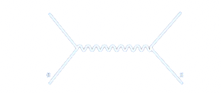


QGP Overview: Theory and Phenomenology
Exploring nuclear physics across energy scales Beijing, April 15 -27, 2024
Xin-Nian Wang (LBNL)

Slide 2
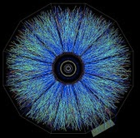
Quantum Chromodynamics
SU(3) gauge symmetry (non-Abelian)
    Asymptotic freedom at short distance
    Confinement at long distance
Chiral symmetry and its spontaneous breaking
    Goldstone boson and chiral condensate
Scale and U_{A}(1) anomaly
….
Notes:
F_{\mu\nu}^a=\partial_\mu A_\nu^a-\partial_\nu A_\mu^a +gf^{abc}A^b_\mu A^c_\nu
{\cal L}_{\rm QCD}=\bar\psi[\gamma^\mu(i\partial_\mu+gT_aA^a_\mu)-m]\psi -\frac{1}{4}F^a_{\mu\nu}F_a^{\mu\nu}
4B=\langle \frac{\alpha_s}{12\pi} F^{\mu\nu}F_{\mu\nu}\rangle \neq 0
Many properties of QCD at finite temperature arise from the breaking and restoration of symmetries. These also give rise to many scales in an approximate conformal theory. This is also the focus of this workshop on nuclear physics across many scales in high-energy heavy-ion collisions.

Slide 3

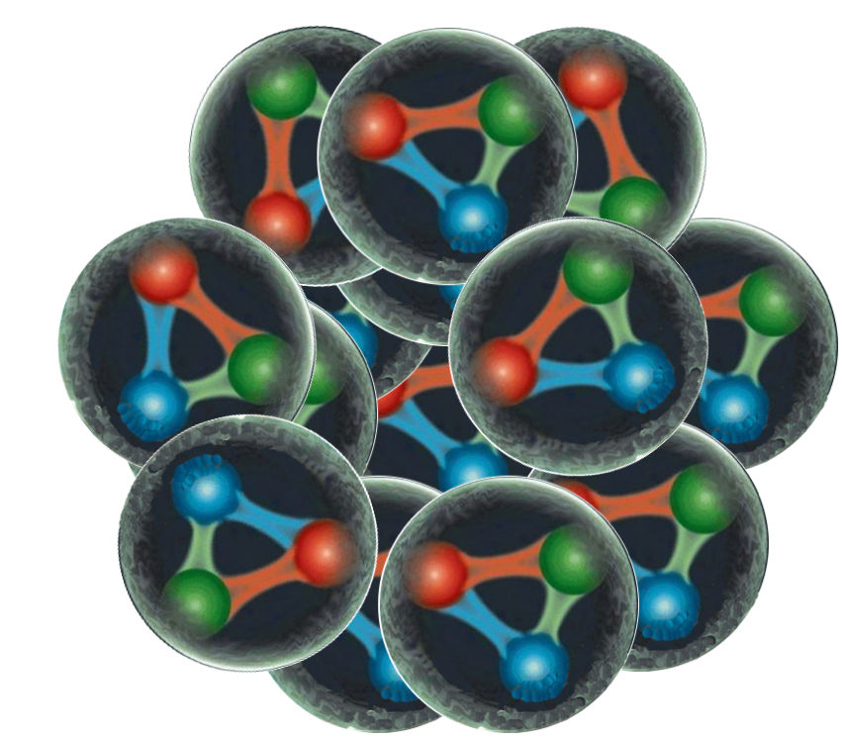
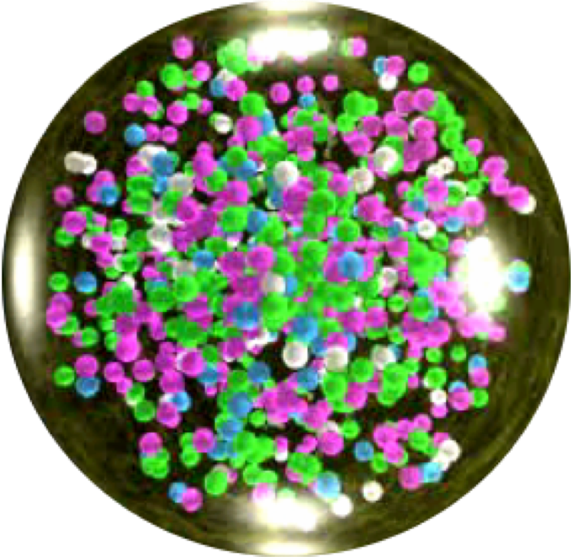




New state of matter: quark-gluon plasma (QGP)
nucleus + nucleus
Characterization of liquid QGP,
Mapping the phase diagram of QCD
Hard microscopy of QGP to see how quarks and gluons conspire to make a liquid-like medium.
Bayesian inference and machine learning

Slide 4
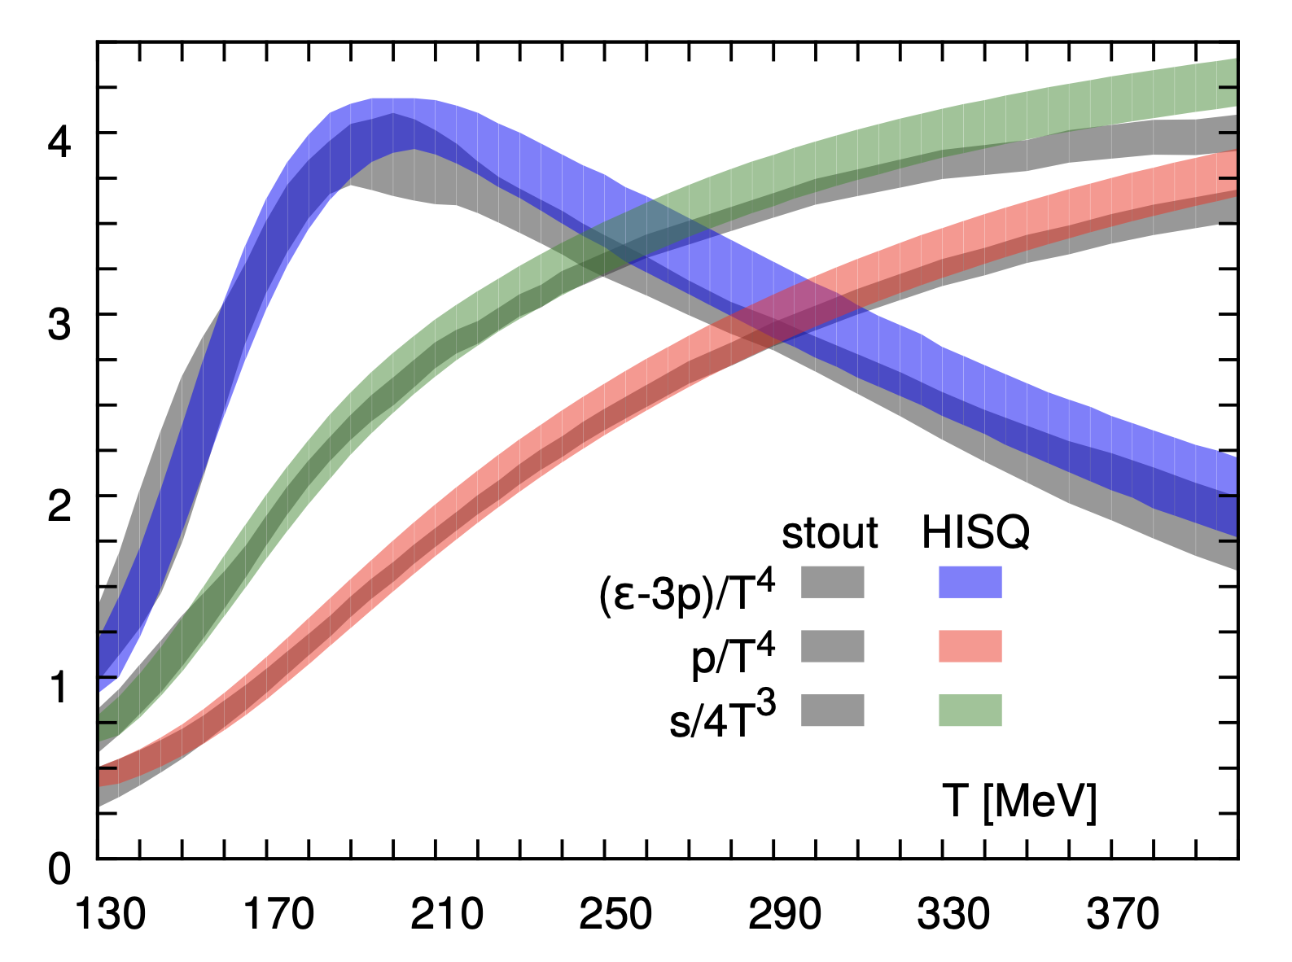
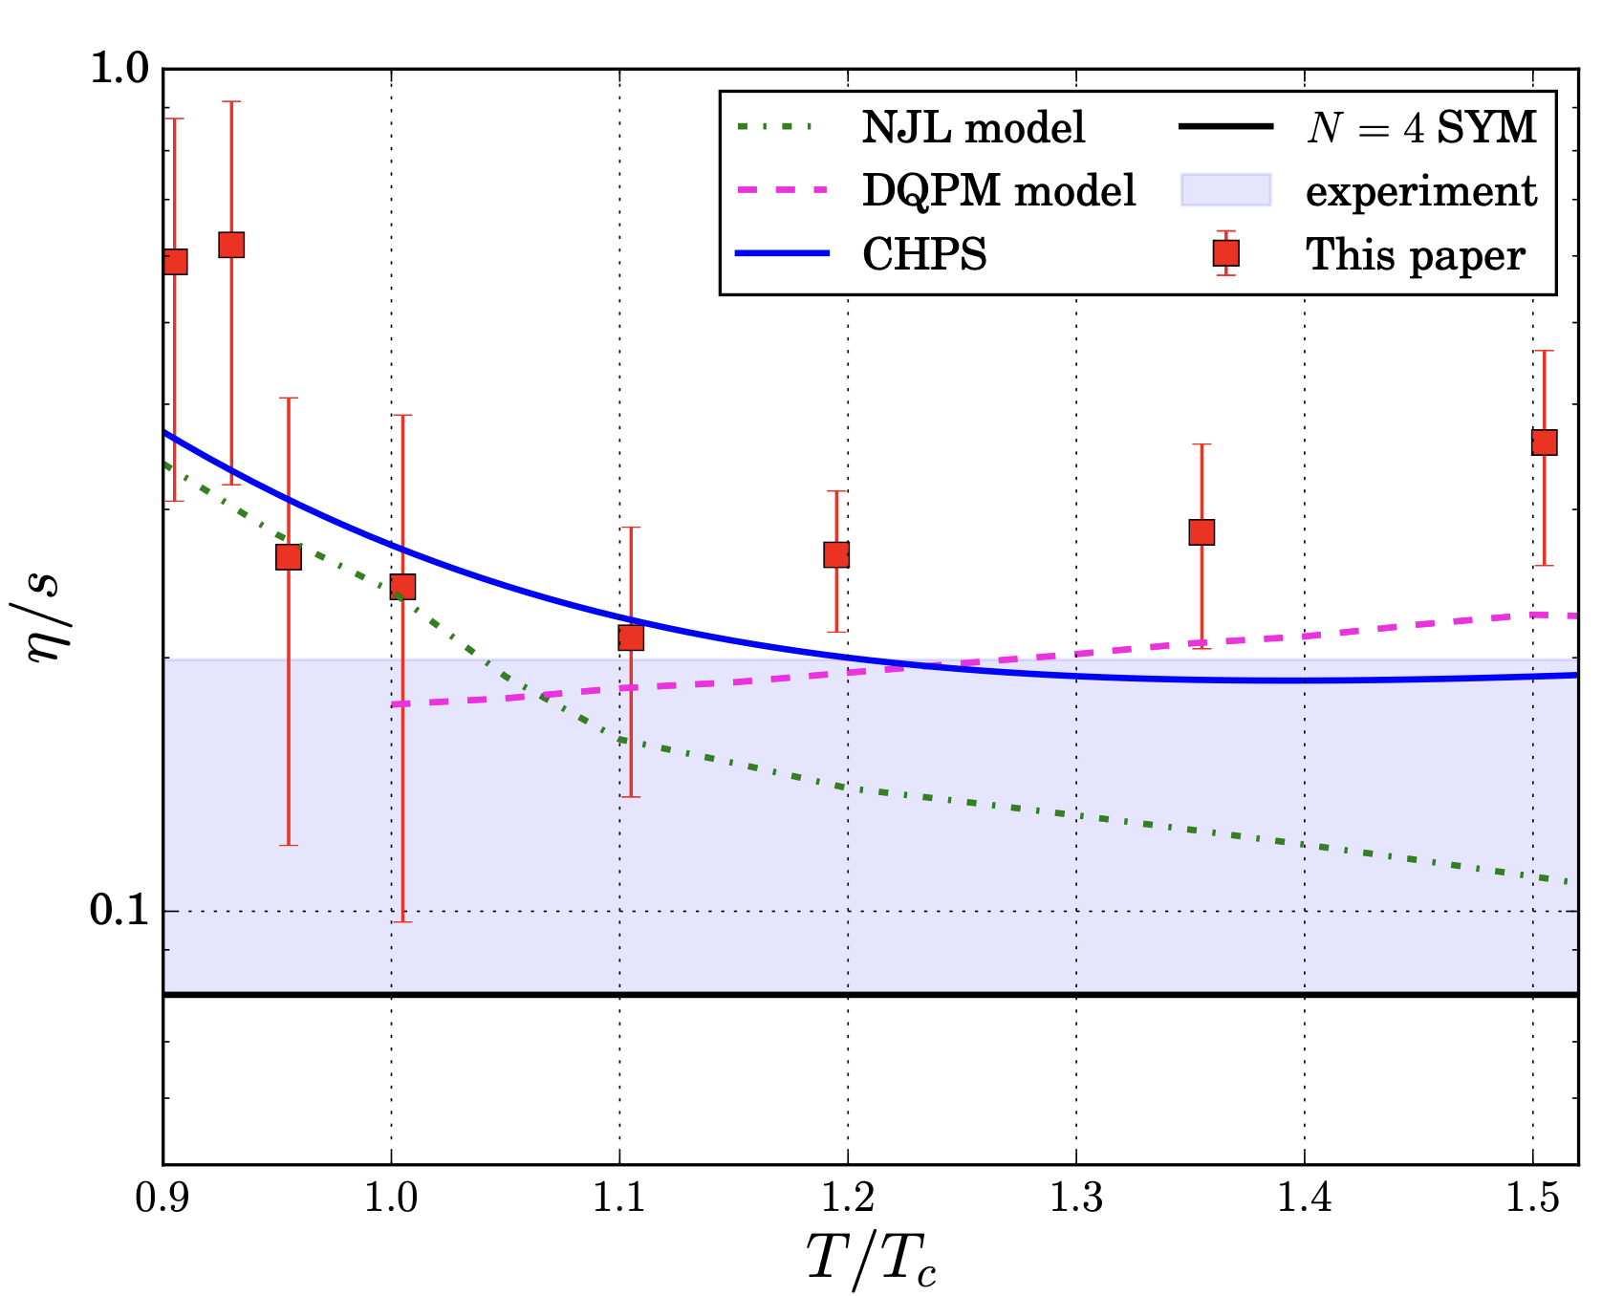
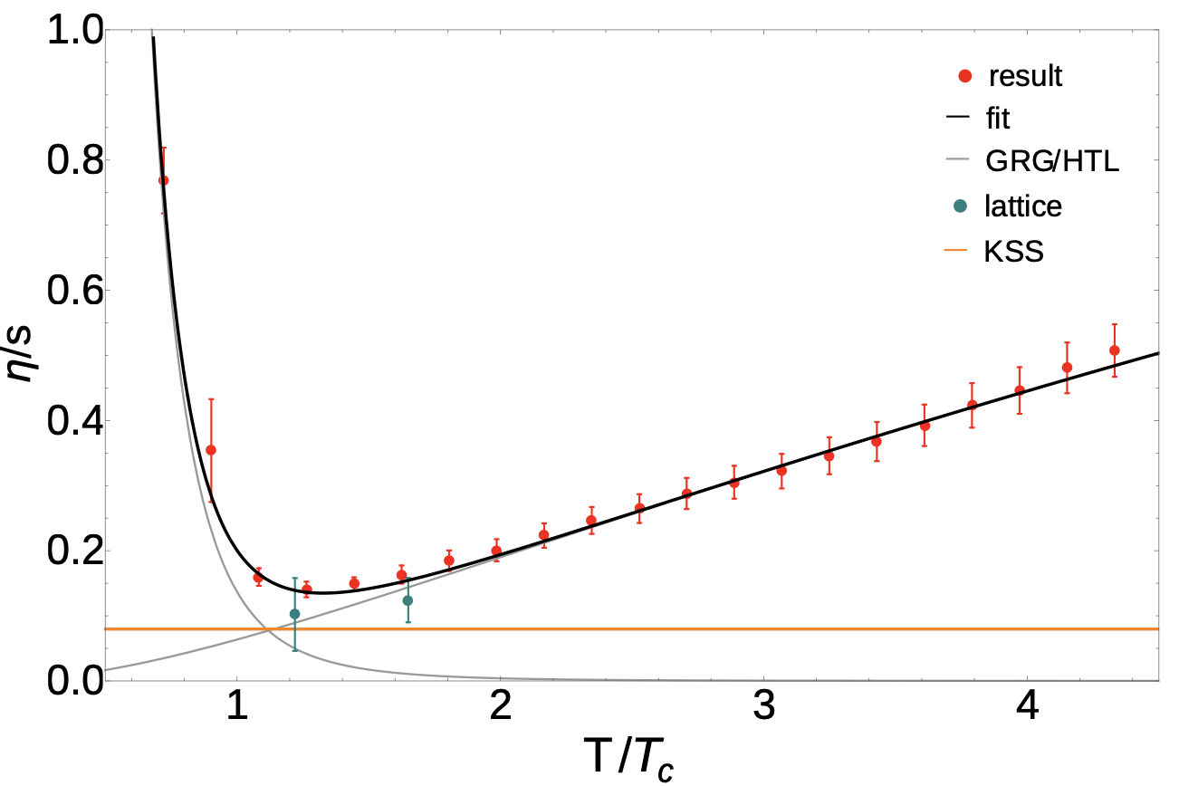
Phases and properties of QCD matter
Nf=2+1, physical pion mass continuum extrapolated
Shear viscocity of hot QCD matter
CHPS
HotQCD:e-Print:1407.6387;
Wup-Bud: e-Print: 1309.5258
glue-matter lattice QCD
e-Print: 1701.02266
Chiral crossover T_{c}=156.5 (1.5) MeV with physical pion mass
CHPS: MEM FRG spectral
e-Print: 1411.7986
HotQCD: e-Print: 1812.08235;
Wup-Bud: e-Print: 2002.02821
NJL model
e-Print:1305.7180
DQPM transport model
e-Print: 1605.02371
Notes:
High T phase is well studied on the by now. The chiral crossover temperature is determined at 1% accuracy. Efforts have been focused on calculating transport coefficient. But…, so one has to resort to analytic continuation and model calculations

Slide 5
Properties of QGP in A+A Collisions
Multi-messenger study of dynamics and properties of QGP
Soft probes: collective flow - bulk properties, EoS, transport properties, initial conditions
EM Probes: EM emission – Temperature, EM response, medium modification of resonances
Hard probes: Jet quenching, heavy quarks– Jet transport coefficients, diffusion constant
Notes:
One must rely mostly on phenomenological extraction of these transport coefficients from experimental data
Truly a multi-messenger problem
Involves multiple probes, ranging from long to short short range properties according to the energy scale of the probes

Slide 6
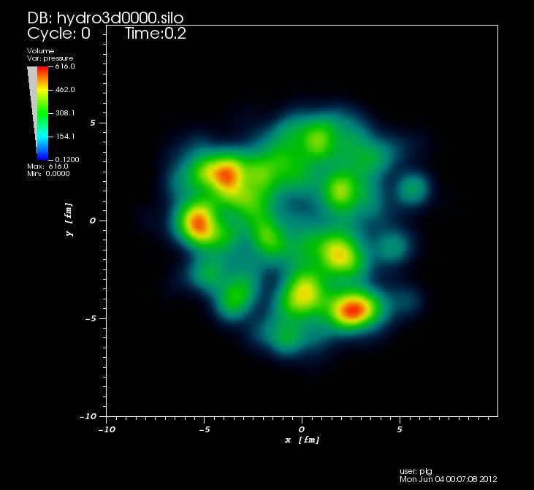
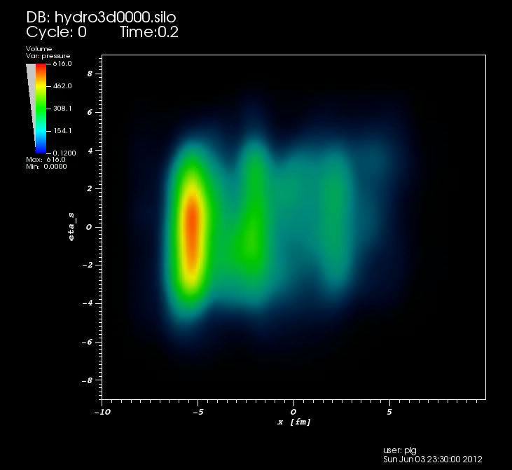
Collective flow of QGP
Hydrodynamics:
  a low-momentum effective theory
  Inputs from first principle QCD (lattice QCD)
  EoS p(ε), transport coefficients ξ(T), ζ(T) (??)
  Initial condition: parton prod. & thermalization
y
x
η
Initial thermalization: hydrodynamic attractors, hydrodynamization, anisotropic hydrodynamics, kinetic theory, etc
x
(3+1)D viscous hydro (CLVisc) with
AMPT initial condition (LG Pang 2018)
Notes:
Even though there are still a lot or theoretical issues need to be addressed, …., it is still the most successful model to describe data
T^{\mu\nu}=(\epsilon + P)u^\mu u^\nu - P g^{\mu\nu} +\Delta T^{\mu\nu}
\Delta T^{\mu\nu}=\eta (\Delta^\mu u^\nu+\Delta^\nu u^\mu) + (\frac{2}{3}\eta-\zeta)H^{\mu\nu}\partial_\rho u^\rho
\partial_\mu T^{\mu\nu}=0

Slide 7
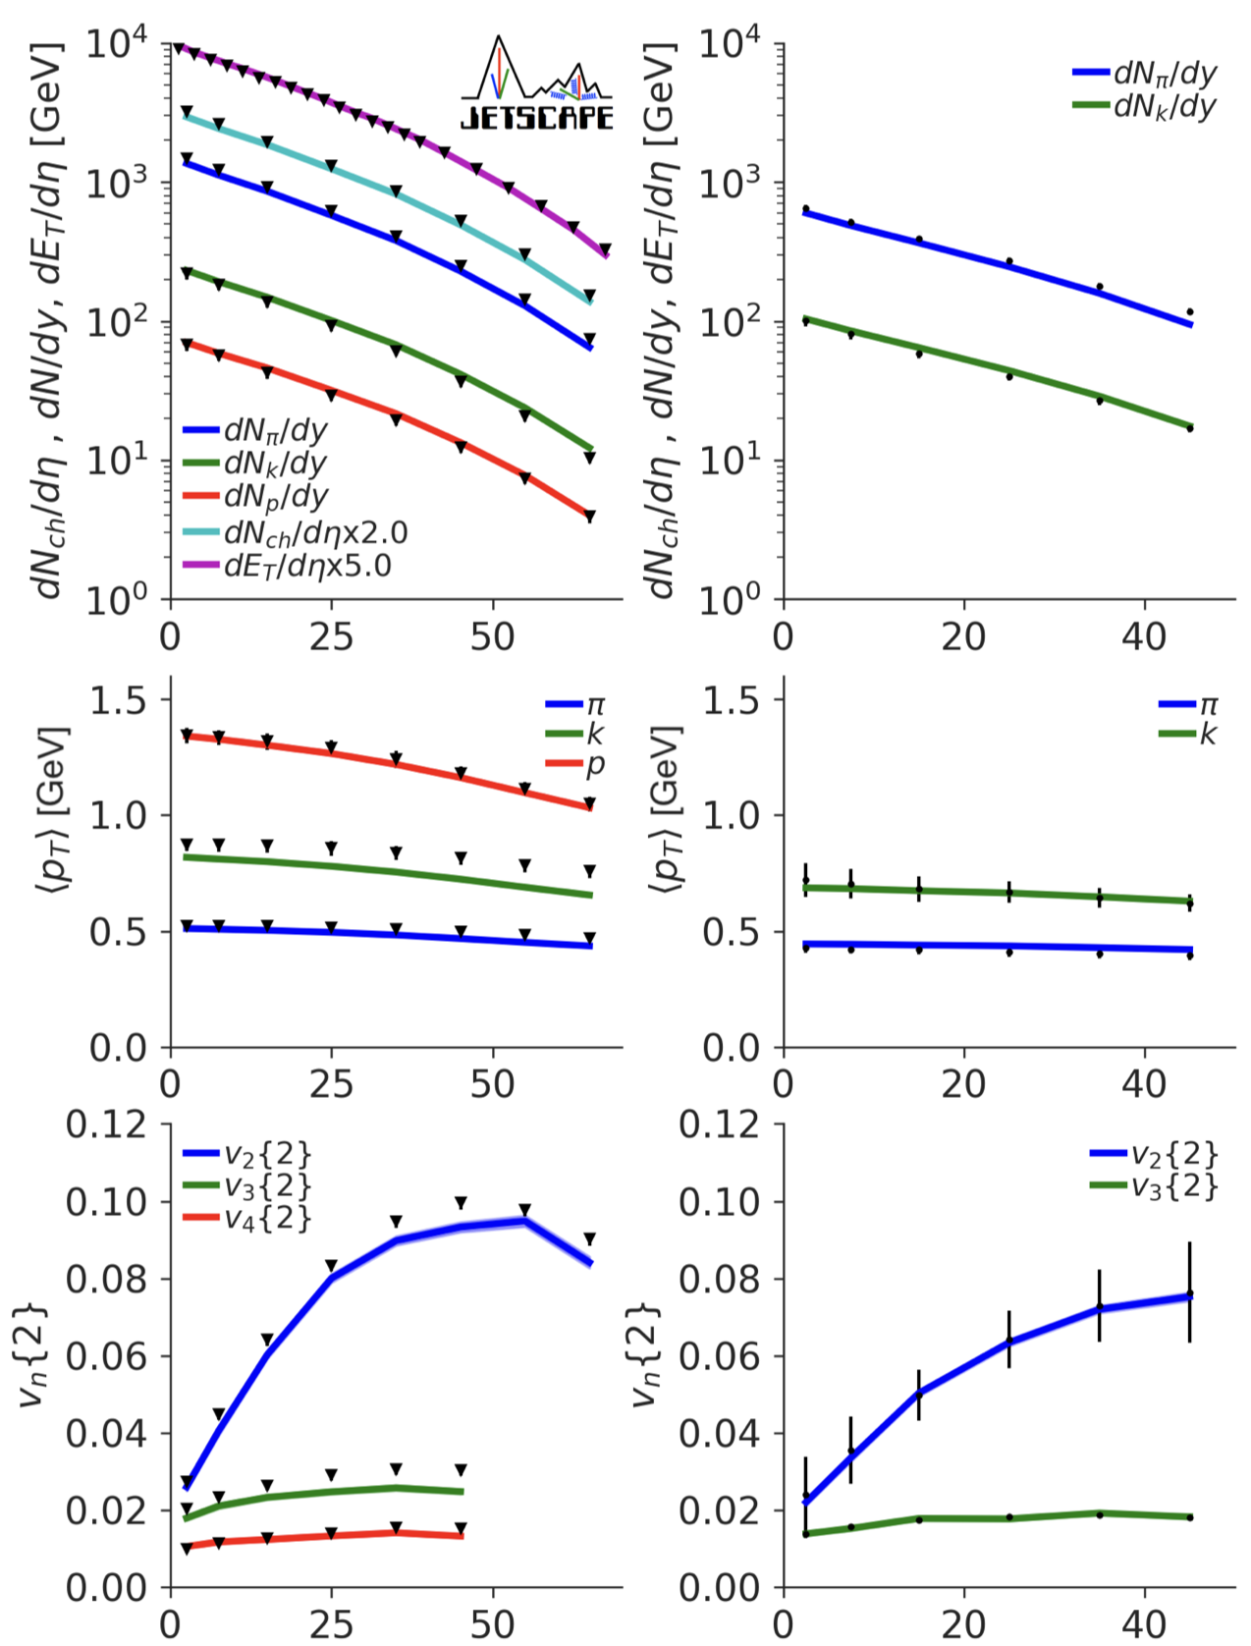
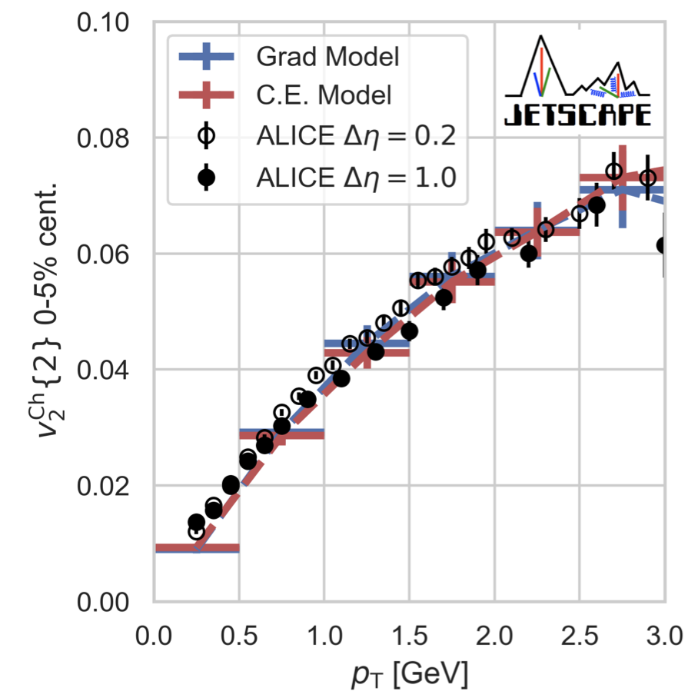
“CMB” of the little bang: Anisotropic flow of QGP
LHC
RHIC
arXiv: 2010.03928
Centrality %
Notes:
f(\phi)=f_0\left[1+2\sum_{n=1} v_n \cos n(\phi-\Psi_n)\right]
\Psi_n=\frac{1}{n}\arctan\frac{\langle p_T\sin(n\phi)\rangle}{\langle p_T\cos(n\phi)\rangle}

Slide 8
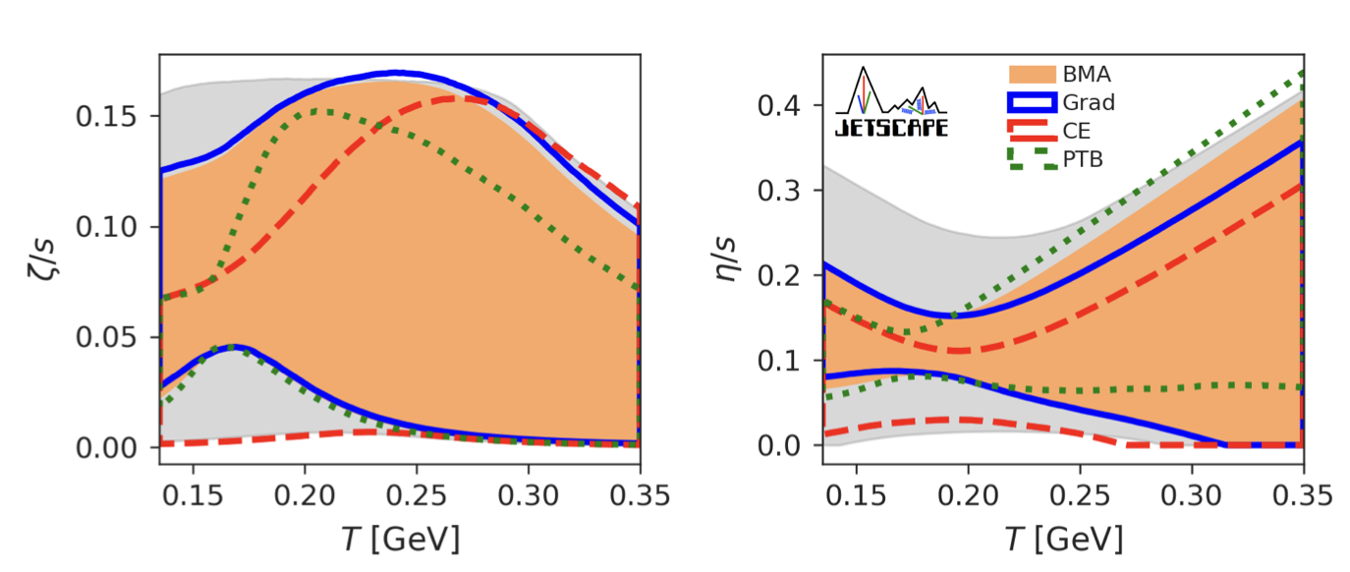
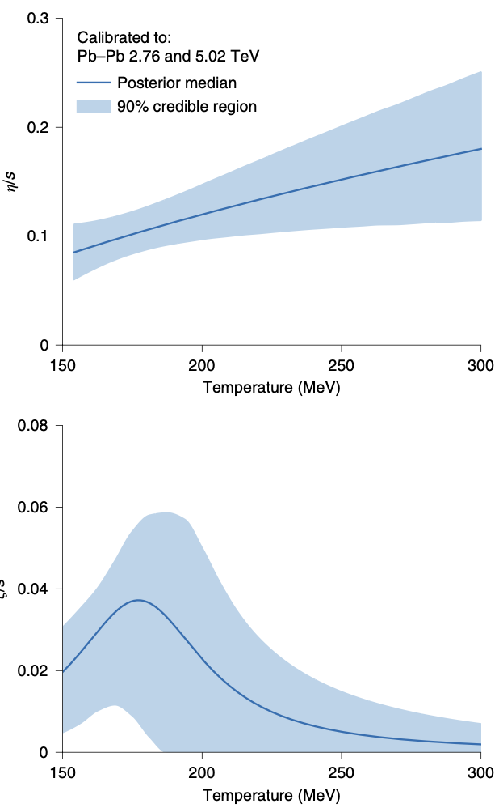
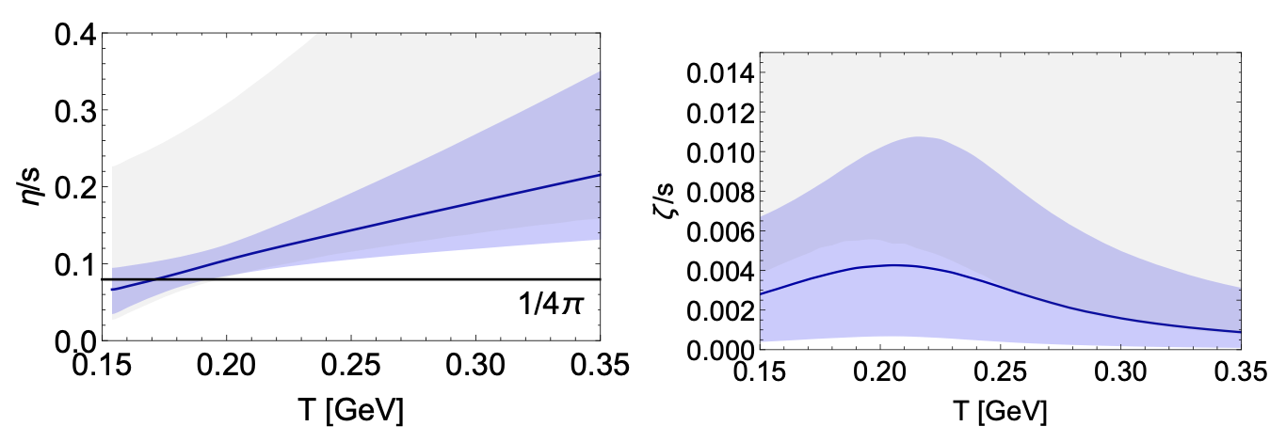
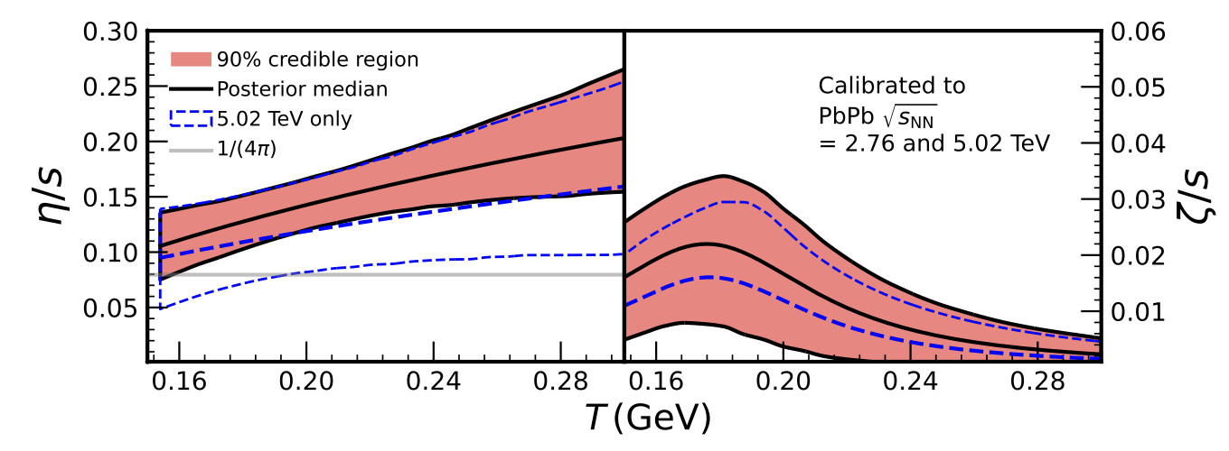
Bayesian inference of transport coefficients
Duke
Nature Phys. 15 (2019) 11, 1113
trajectum
e-Print: 2010.03928
2011.01430
2+1D viscous hydro
Trento initial condition
Hadr transpt: SMASH, UrQMD
e-Print: 2111.08145
e-Print: 2010.15130; 2010.15134
Uncertainties:
modeling of initial condition (short distance correlation, early non-equilibrium evolution), transition to hadron transport ( resonances) etc.
Parkkila, et al.
Notes:
In last decade, efforts in Bayesian inference have flourished, the method enables one to use data and constrain multiple model parameters.
These are collaborative efforts (like JETSCAPE and BAND) involving a spectrum of people in statistics, computer scientists experimentalists and theorists.
2+1d hydro + emulations
There are differences among these inferences due to modelling differences, or model uncertainty,
It describes how a prior belief of the distribution of certain physical parameters will be updated to the posterior distribution after comparing theory with new experimental data, as encoded in the likelihood fun
\mathcal{P}^{(i)}(\boldsymbol{x}|\mathbf{y}_{\exp}) = \frac{\mathcal{P}^{(i)}(\mathbf{y}_{\exp}|\boldsymbol{x}) \mathcal{P}(\boldsymbol{x}) }{\mathcal{P}^{(i)}(\mathbf{y}_{\exp})}
ction that quantifies the model’s descriptive power

Slide 9
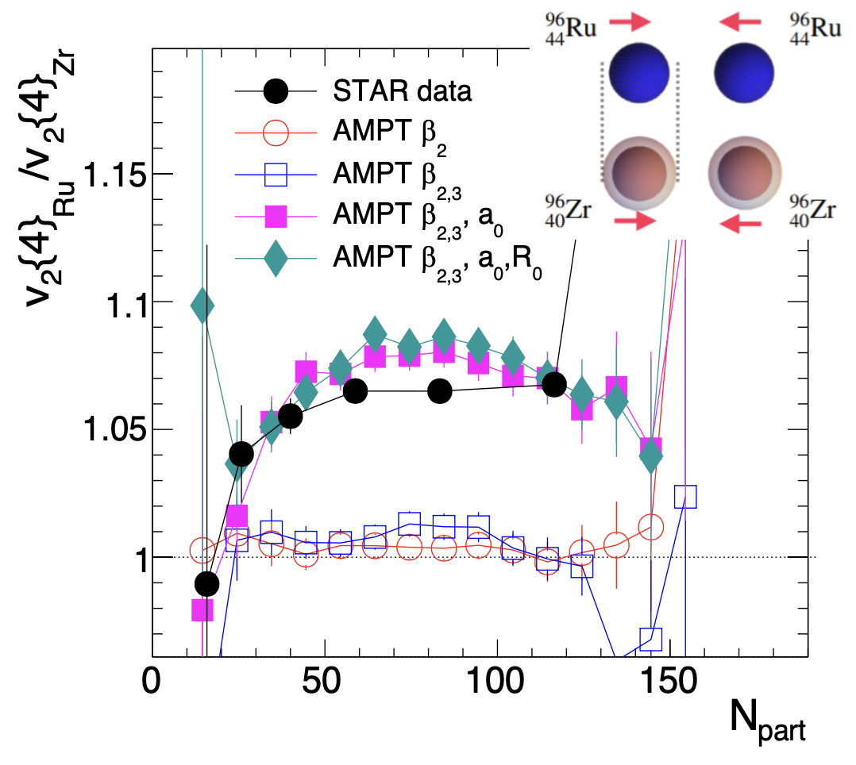
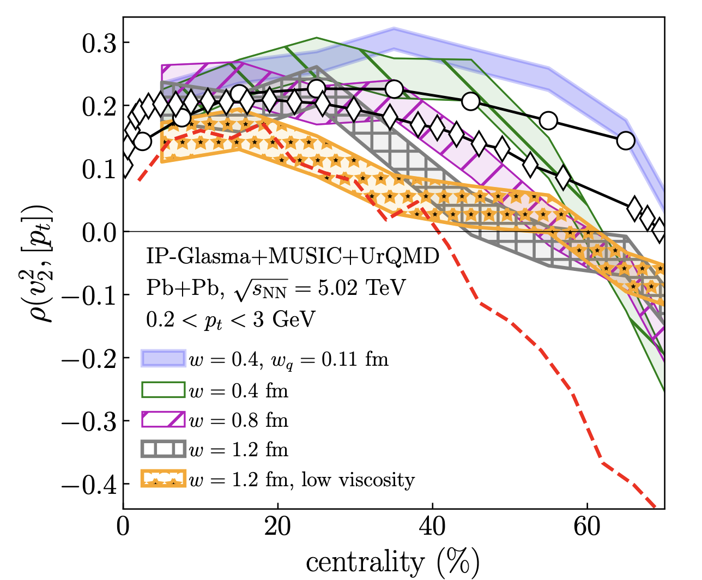
Separating initial conditions and dynamics
Pearson correlation coefficient
e-Print:1601.04513
Nuclear structure & initial conditions
Nuclear deformation,
Neutron skin,
Triaxility
…
Nucleon size,
nucleon sub-structure
….
e-Print: 2206.10449
e-Print: 2111.02908
Notes:
To reduce some of the theoretical uncertainties , many new observables are proposed, for example rho is mainly sensitive to the initial condition, nucleon size sub-nucleon structure
Another observable is ratio of flow quantities of different isobar collisions,
\rho(v_n^2,[p_t])=\frac{\langle\delta v_n^2 \delta[p_t]\rangle}{\sqrt{\langle(\delta v_n^2)^2\rangle\langle (\delta[p_t])^2\rangle}}

Slide 10
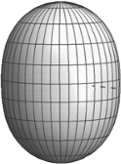
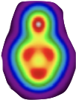

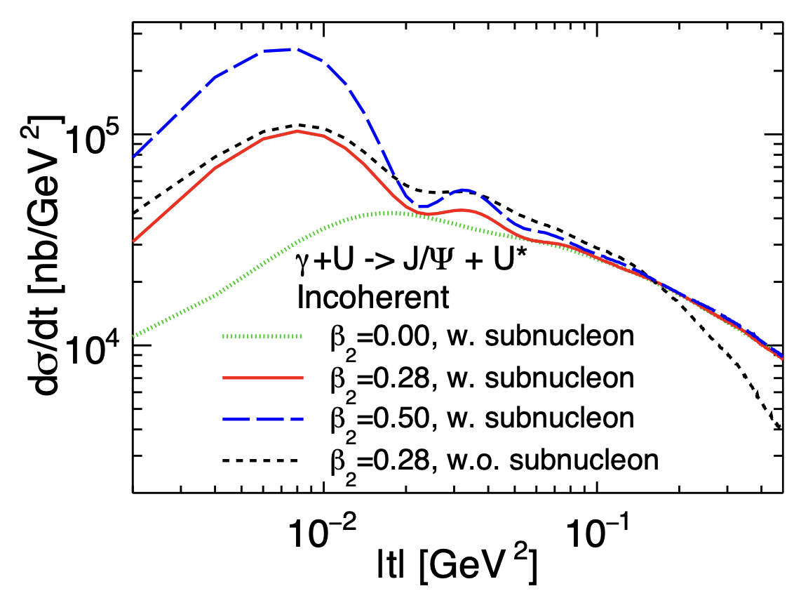
Nuclear structure at multi-scales in UPC & DIS
Vector meson production in UPC & DIS
γ*
ρ, φ, J/ψ
Nuclear shape
Nucleon clustering
sub-nucleon structure
A
A*
[arXiv:2312.07467]
Diffractive cross of γ*+A → V+A*
Sensitive to nuclear shape at small |t|
Sensitive to sub-nucleon structure at large |t|
Mantysaari, Schenke, Chun Shen and Wenbin Zhao, PLB 833 (2022), 137348; PRL 131.062301.

Slide 11
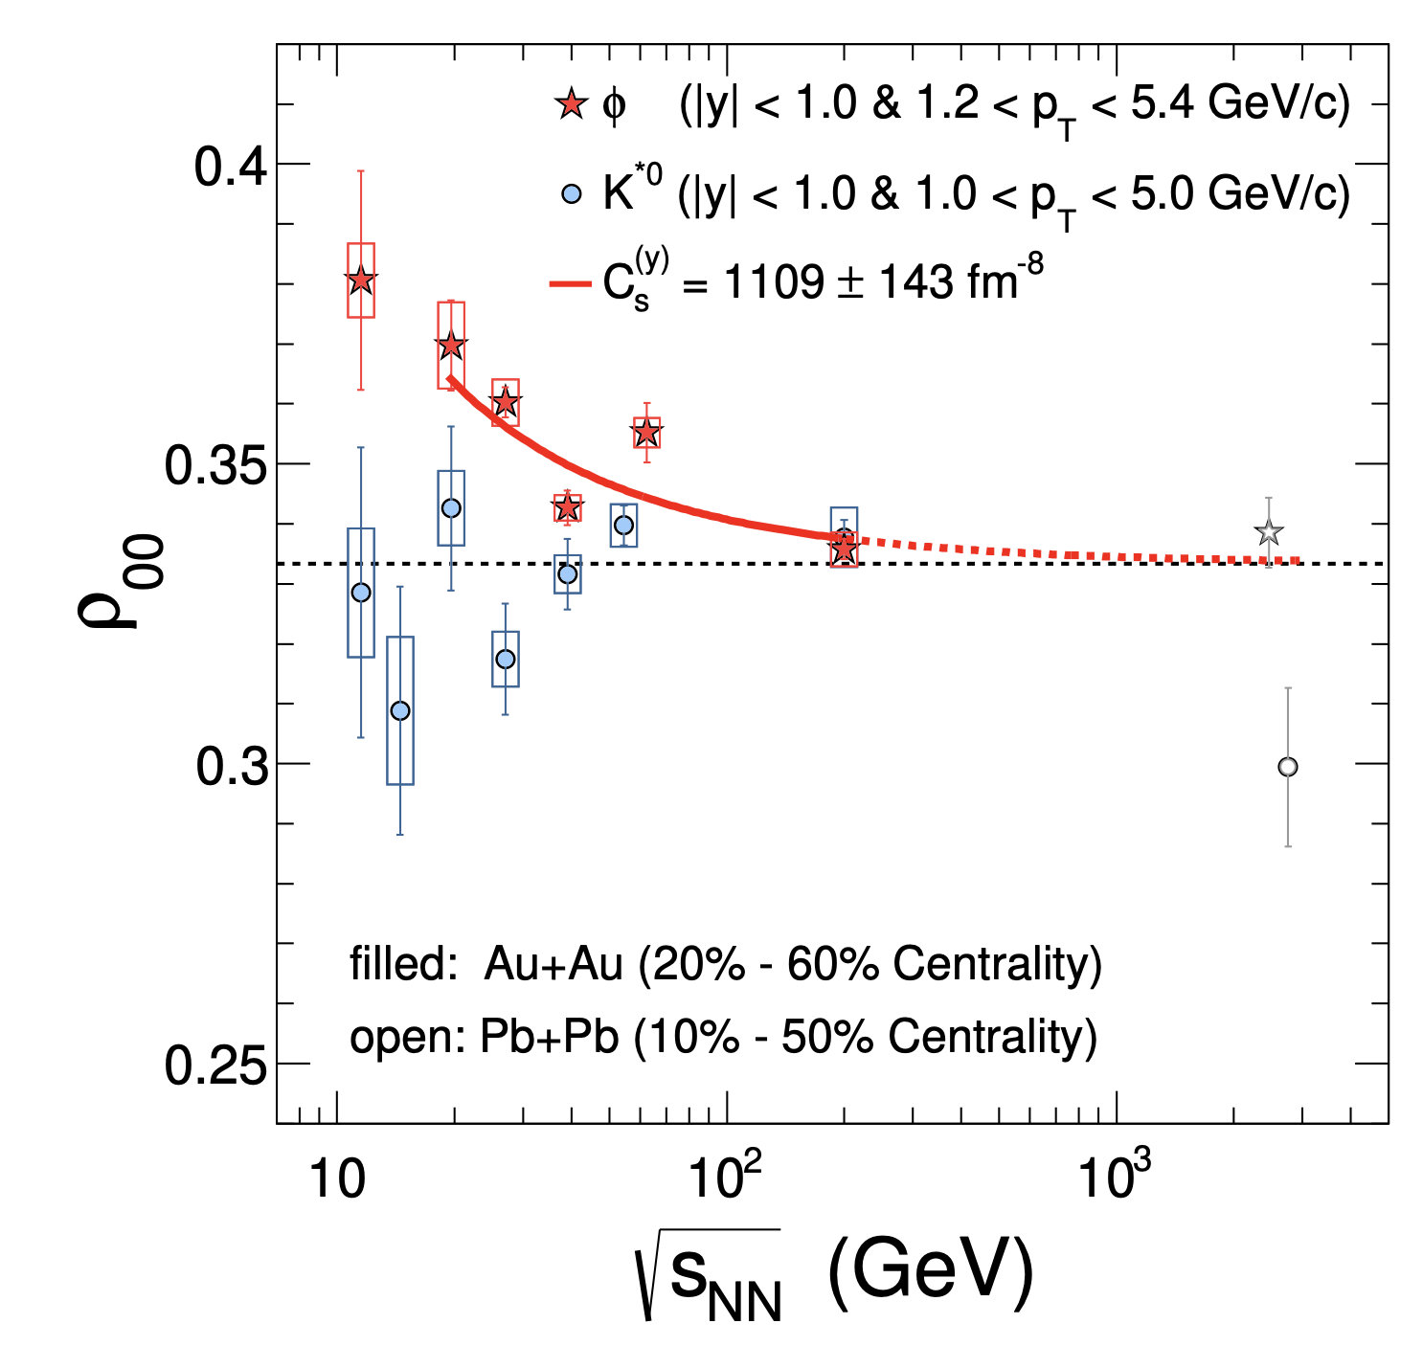
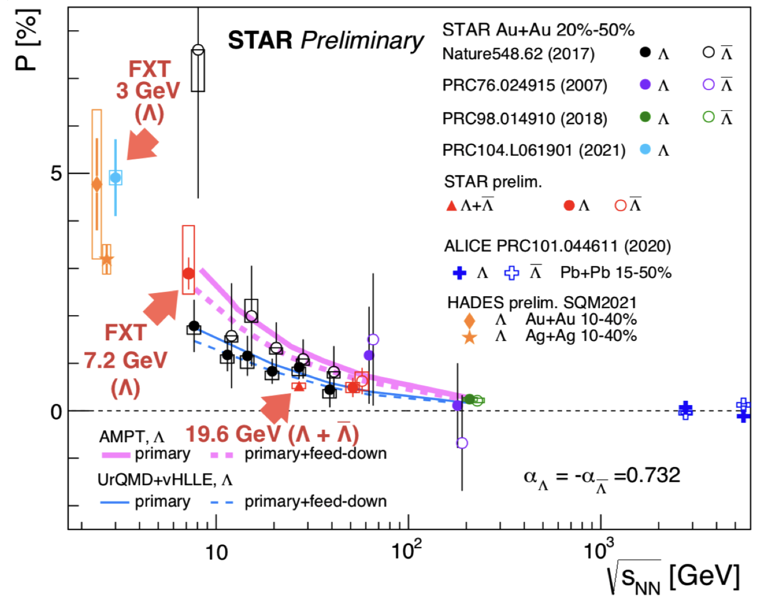
Spin dynamics in heavy-ion collisions
Liang & Wang,
PRL94(2005)102301
Smoke ring structure
Vector meson spin alignment
STAR
y
x
z
Nature 614, 244 (2023)
Sarkar, QM23
Sheng, Oliva, Liang, Wang and XNW, PRL 131, 042304 (2023)
e-Print: 1605.04024
Shear induced spin polarization
Spin transport theory
Spin hydrodynamics
CME (a few percent level signal)
e-Print: 2102.11919
Notes:
Because of the geometry of nucleus-nucleus collisions, non-central collisions have enormous amount of orbital angular momentum L,
This is one discovery during the last decade that has open a new window to many new properties of QGP, and many theoretical studies,
P_q\approx -\pi\frac{\mu p}{m_q^2}\sim \frac{\omega}{T}
\rho_{00}\approx \frac{1}{3}+\frac{g_\phi^2}{m_\phi^2 T_{\rm eff}^2}(C_1B^2\phi +C_2 E^2_\phi)
{\cal R}=\langle\frac{\vec\omega\cdot(\hat t\times \vec v)}{|\hat t\times v|}\rangle

Slide 12
Hard and EM probes in heavy-ion collisions
Inelastic energy loss
Jet transport coefficient:
Elastic energy loss
photons
Jet 1
Heavy mesons
soft hadrons
q
Prompt γ emission
Hadron properties in medium
Parton energy loss
Jet suppression
Jet-hadron correlation
Heavy meson modification
EM response
Multiple scattering
p_{T} broadening
Medium response
Heavy quark diffusions
q
dileptons
Jet 2
Notes:
To probe QGP properties at short length scale, one needs hard and EM probes

Slide 13
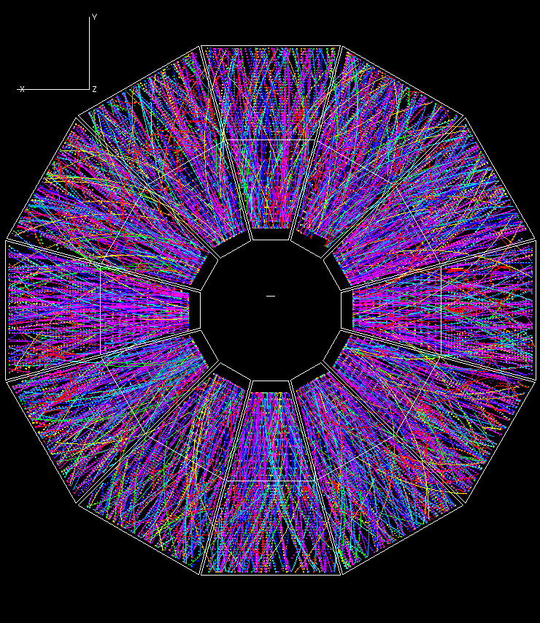
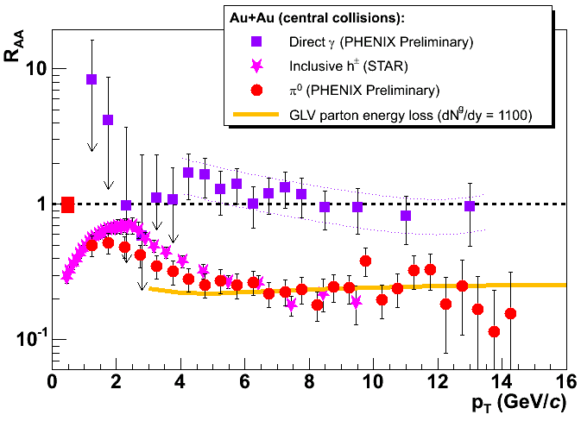
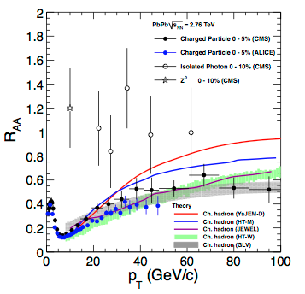
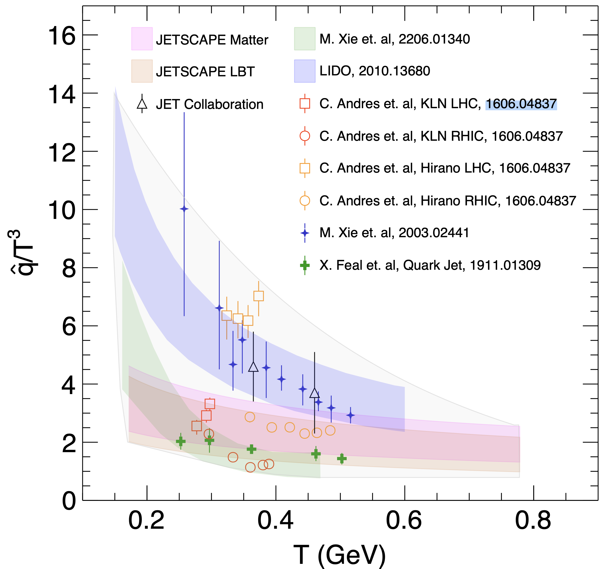
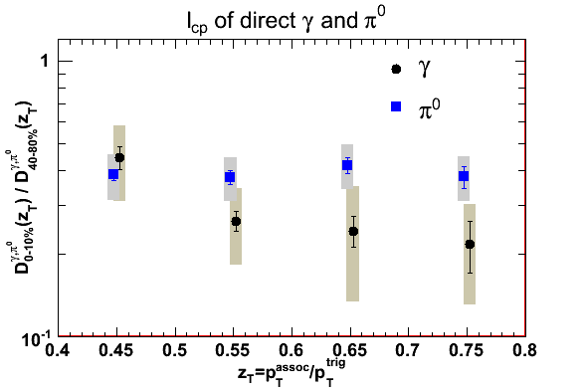
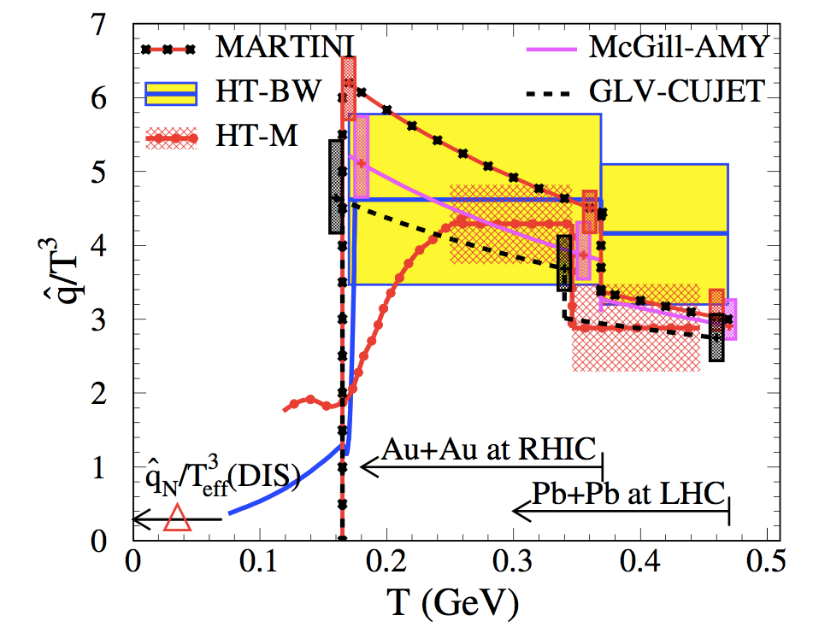
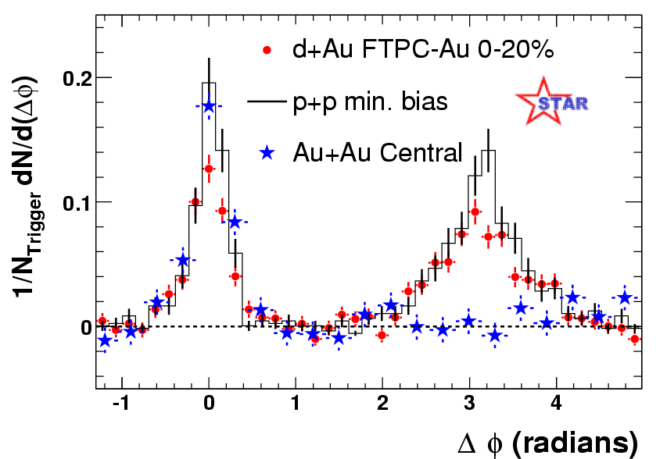
Jet Quenching at RHIC & LHC
BDMPS’96
JET Collaboration: e-Print: 1312.5003
Pedestal&flow subtracted
e-Print: 2203.16352
Notes:
The observation of jet quenching phenomena in single high pt hadron spectra at RHIC more than two decade ago was a major discovery, It has since then become the focus of many experimental and theoretical studies at both RHIC and LHC,
The first systematic comparison of data with different models by JET collaboration, show

Slide 14
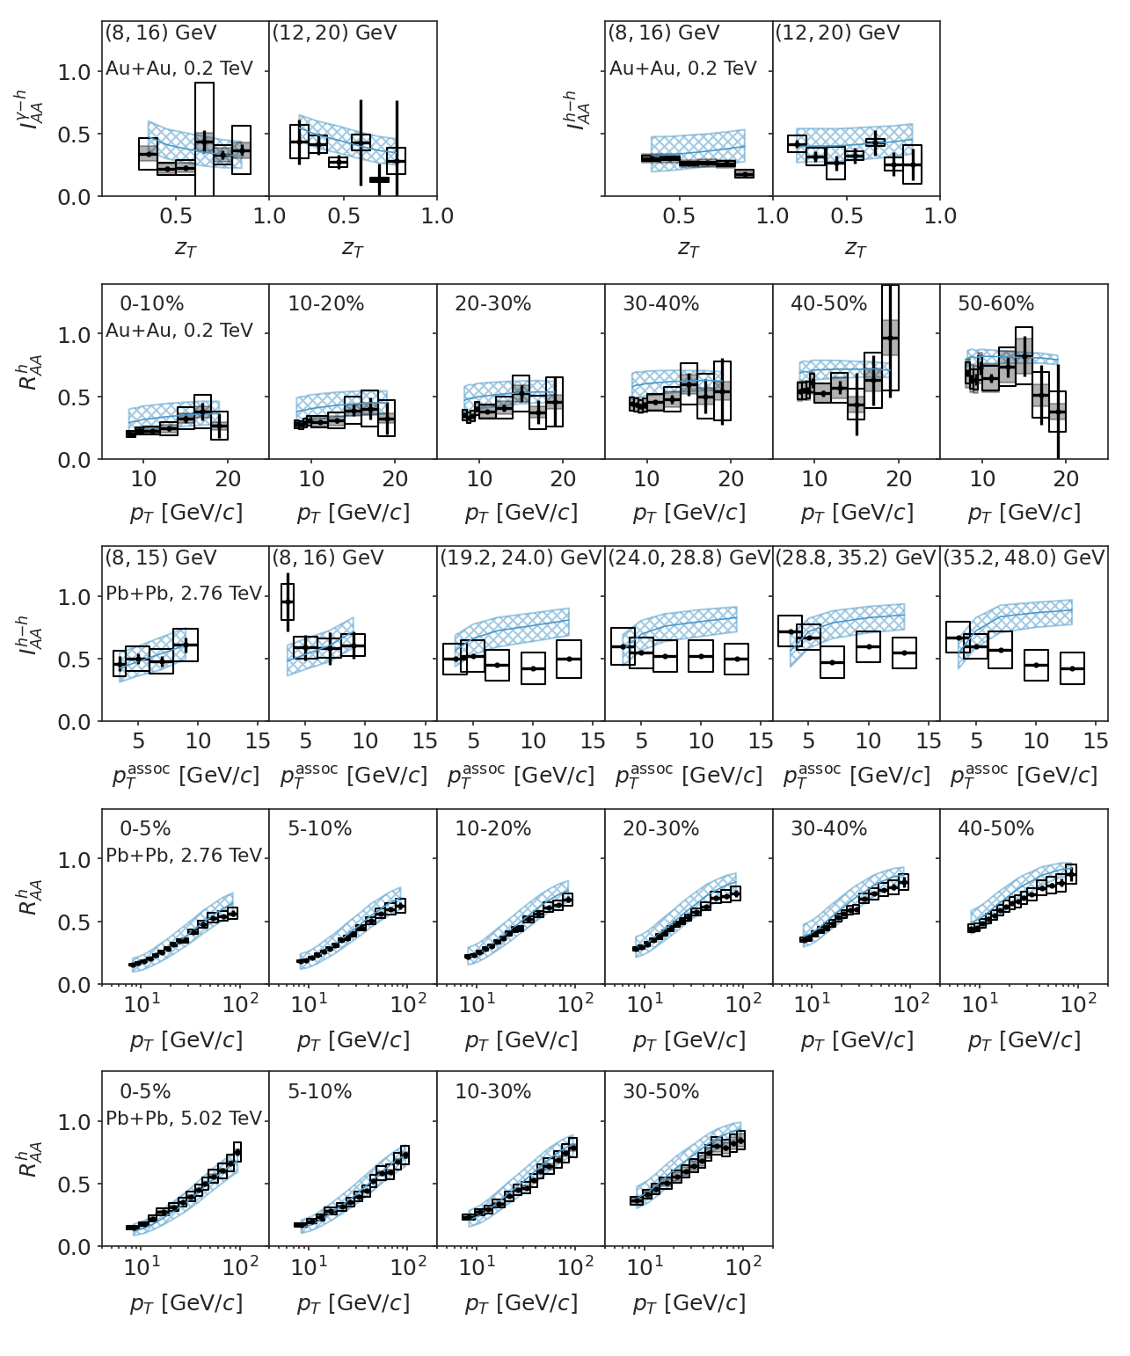
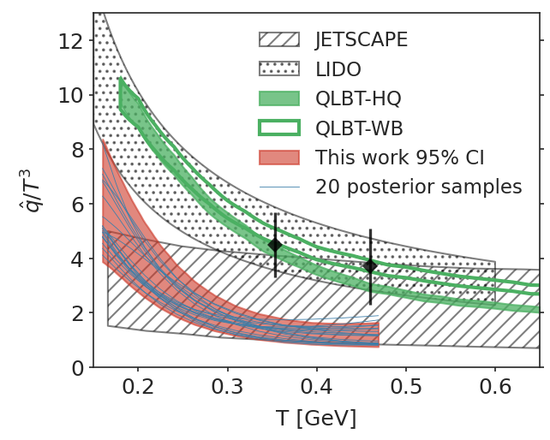
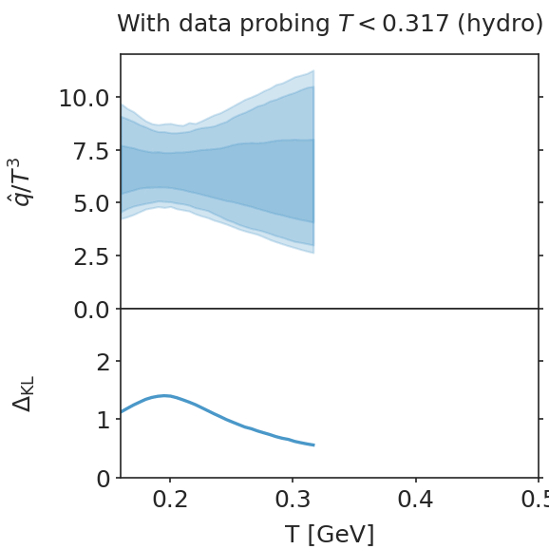
Bayesian inference of jet transport coefficient
Strong T-dependence
Weak E-dependence
LIDO
e-Print: 2010.13680
JETSCAPE
e-Print: 2102.11337
Information-Field approach to priors is free of long-range correlation
QLBT:
e-Print: 2107.11713
IF Bayesian
e-Print: 2206.01340
Xie, Ke, Zhang & XNW, PRC 108, L011901 (2023)
JET
e-Print: 2208.14419
Notes:
We are not done with hadron spectra and correlations, they can provide stringent constraints on qhat especially dihedron and gamma/Z-hadron correlations

Slide 15
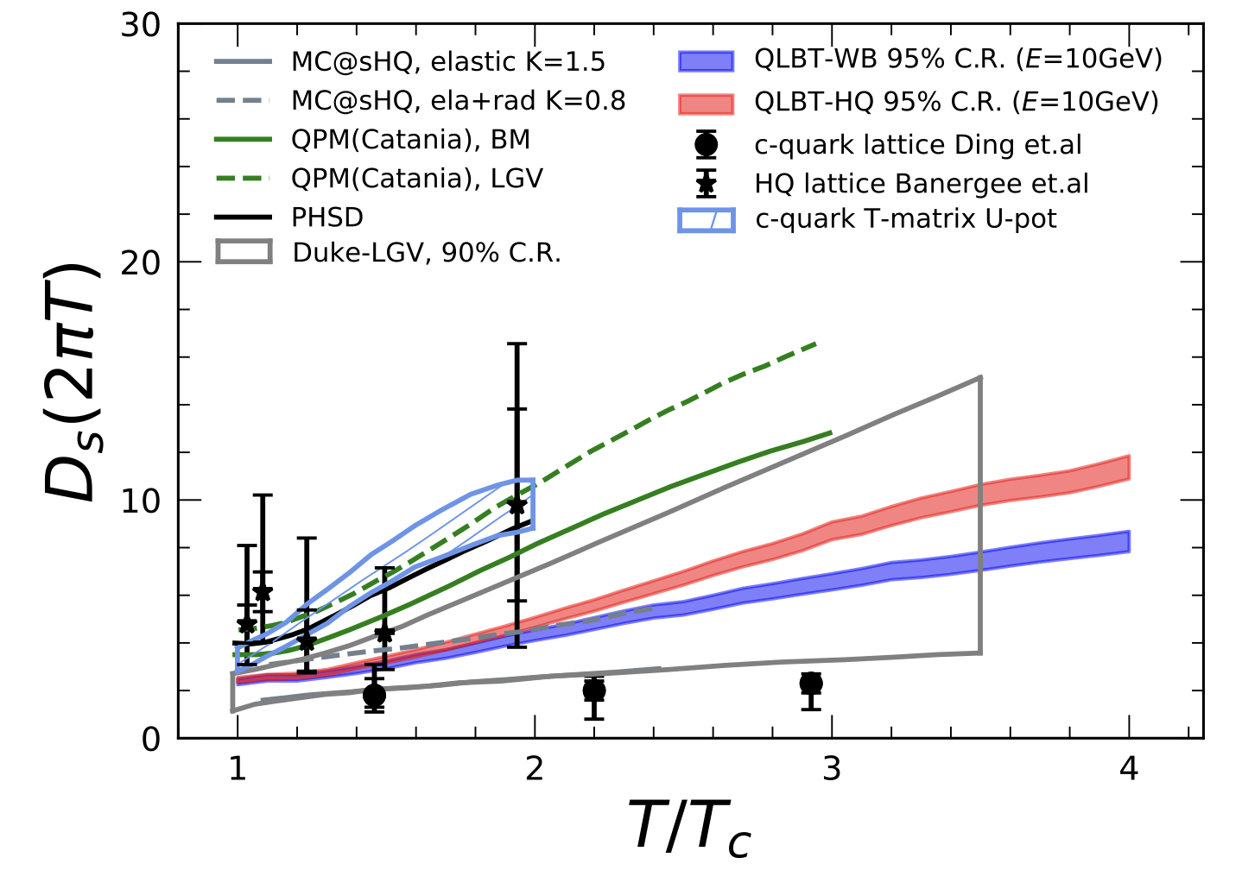
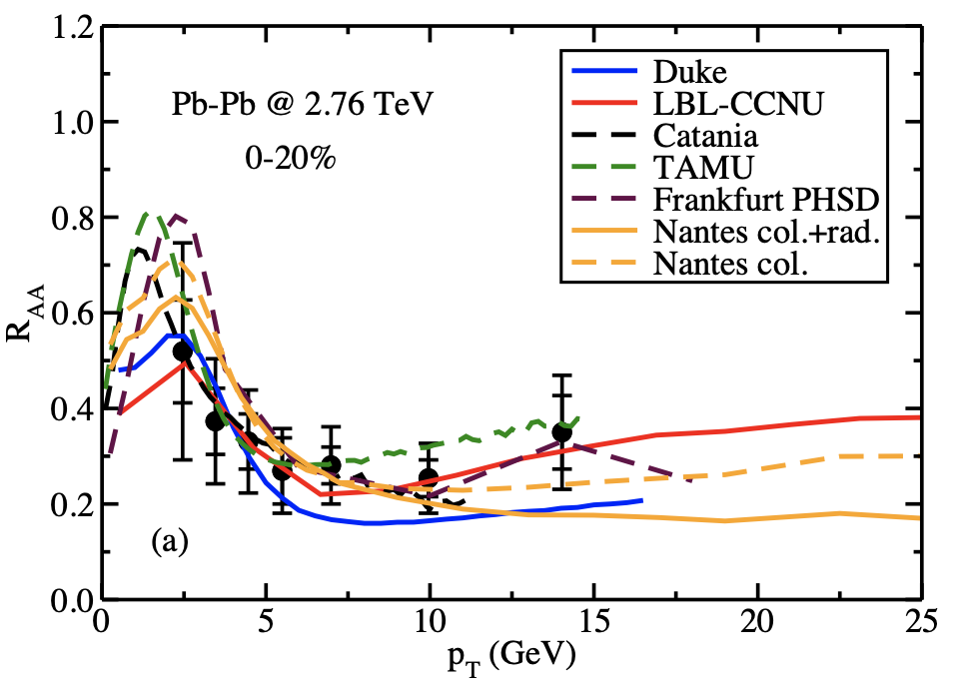
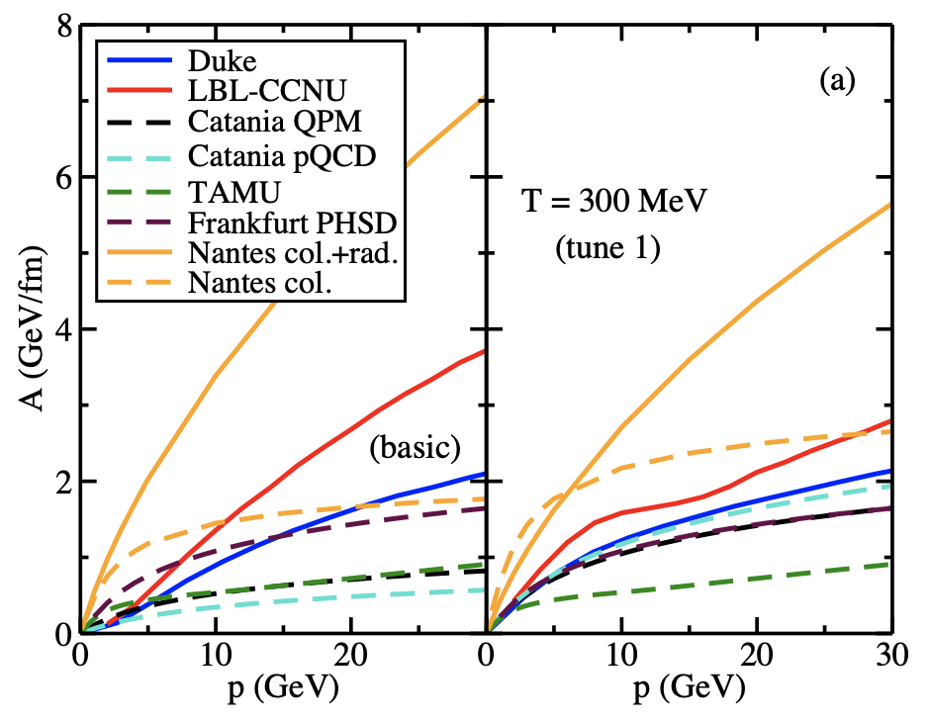
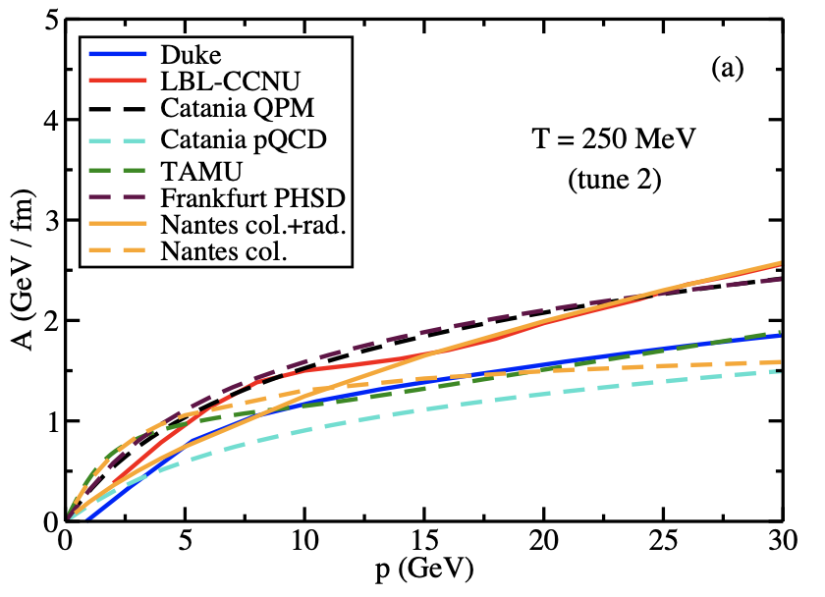
Heavy quark transport coefficient
e-Print: 2107.11713
Heavy quark transport dynamics:
Elastic vs inelastic processes, quasi-particle
Bulk matter evolution: flow and initial conditions
Hadronization: coalescence
Heavy meson transport in QGP and hadronic matter
High pt contributions from gluon fragmentation
e-Print: 1803.03824
e-Print: 1809.07894
Common bulk medium
Notes:
Two concerted efforts have been made to extract heavy quark diffusion constant, these large model uncertainties arise from

Slide 16
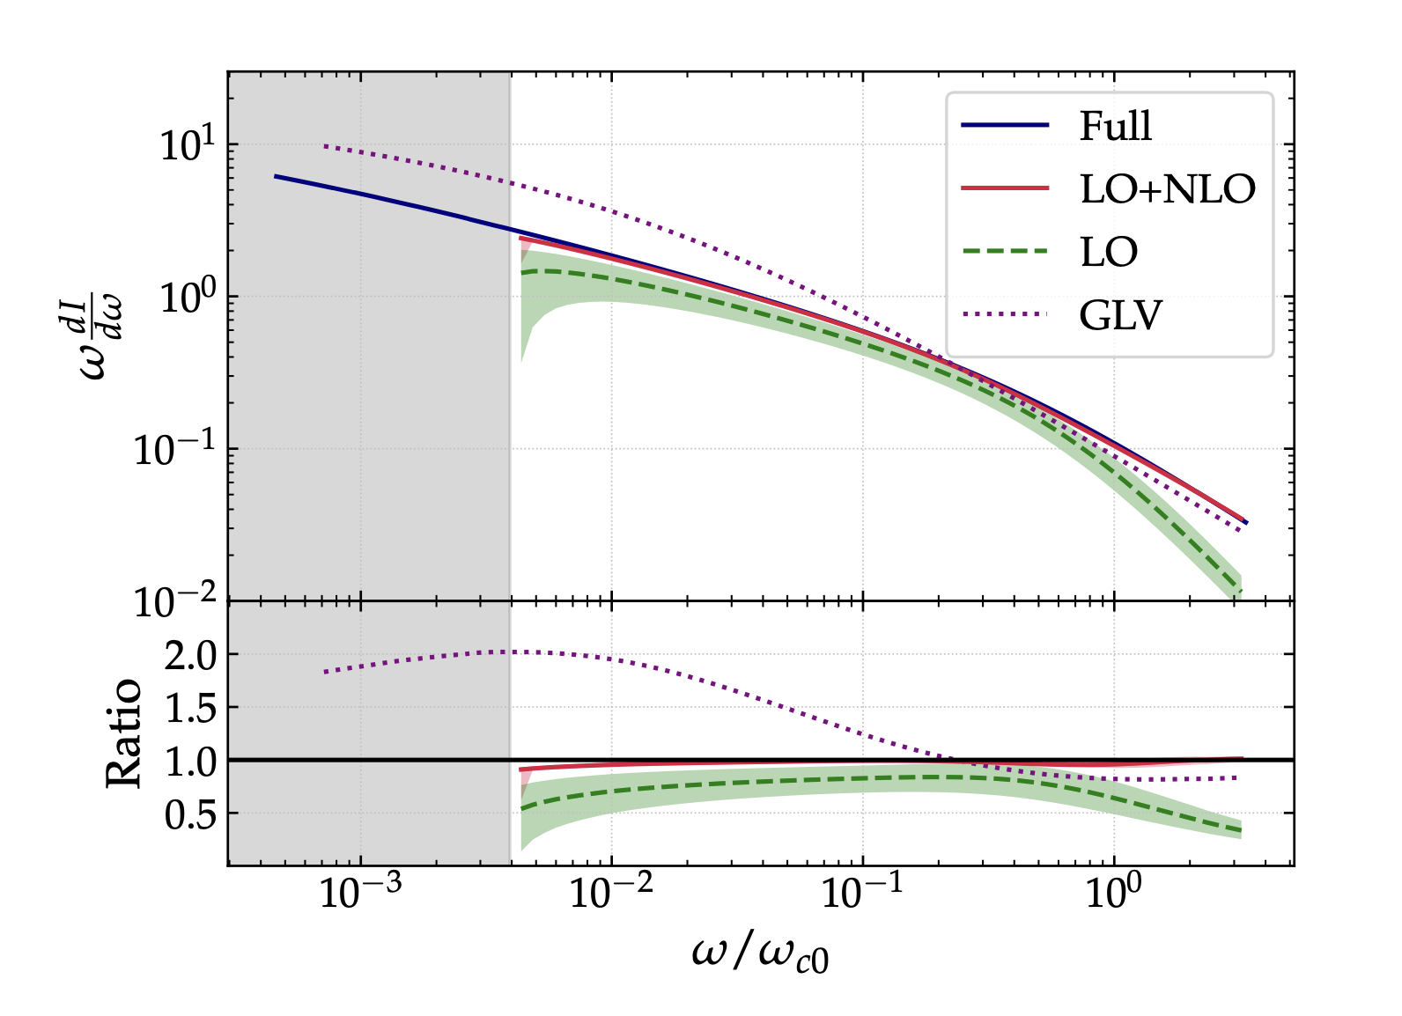
Parton energy loss and broadening
Improved opacity expansion
Overlapping formation times
Resummation of multiple emissions
Corrections due to flow and density gradient (beyond eikonal)
  Gradient tomography
Non-local quantum correction
e-Prints: 2009.13667, 1903.00506, 1910.02032
e-Print: 2111.05348
e-Prints: 2011.06522, 2002.01517
e-Prints: 2202.08847; 2204.05323
e-Prints: 2109.12041, 2203.09407
Notes:
These theoretical developments will eventually lead to improved modeling of jet transport in medium
Q_s^2\simeq \langle k_\perp^2 \rangle_{\rm median} \propto L^{1+2\sqrt{\bar\alpha}}:

Slide 17
Jets and their substructures
Space-time structure of medium-induce gluon emission, color-(in)coherence
  VLE before formation time +MIE(no coherence)+VE
  Multi-stage & muti-scale jet in-medium evolution
Inclusion of medium response
  LBT, JEWEL, MATTER+LBT …
Hadronization & recombination
  Resolving RAA and jet v2 puzzle
Jet substructure and grooming & clustering
  soft drop grooming: reducing non perturbative effect
  Clustering: perturbative splitting
  proxy of formation time
e-Prints: 1301.6102, 1801.09703,
1907.04866
jet parton
e-Print: 1503.03313, 0804.3568, 1705.00050
recoil parton
e-Print: 2103.14657
Back-reaction
(particle hole)
t₂
z_{g}
e-Prints: 1402.2657, 1502.01719, 1704.05066
t₃
θ_{g}
1-z_{g}
e-Print: 2012.02199
t₁
Notes:
Tremendous theoretical efforts have also been made in using jet substructures to understand parton dynamics in both vacuum and medium

Slide 18
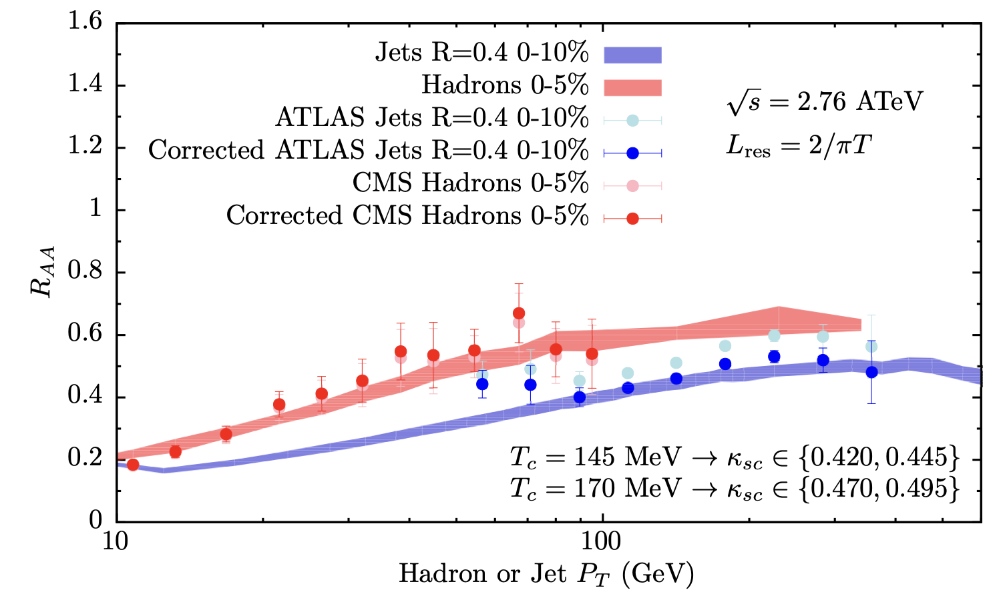
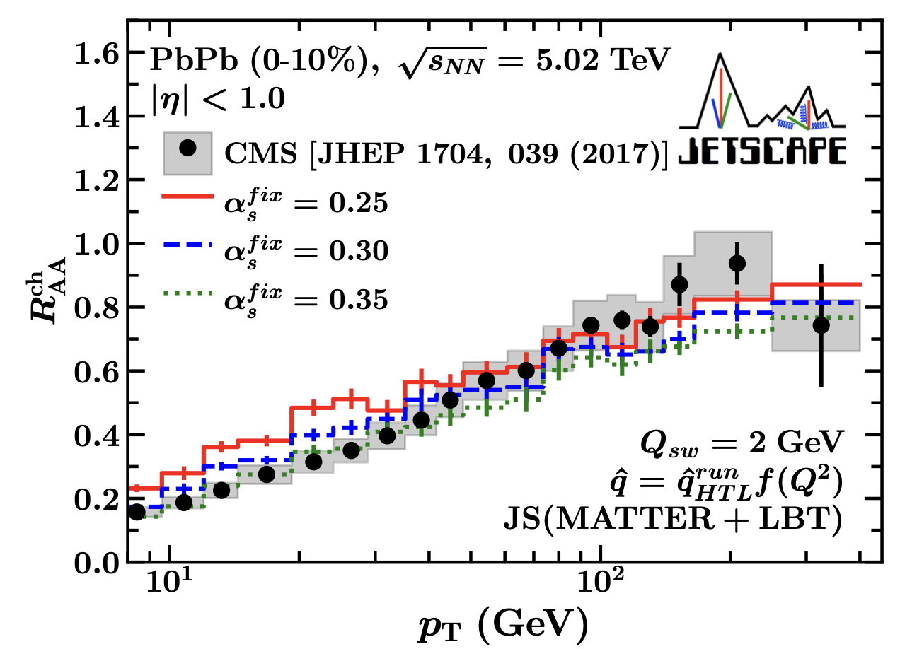
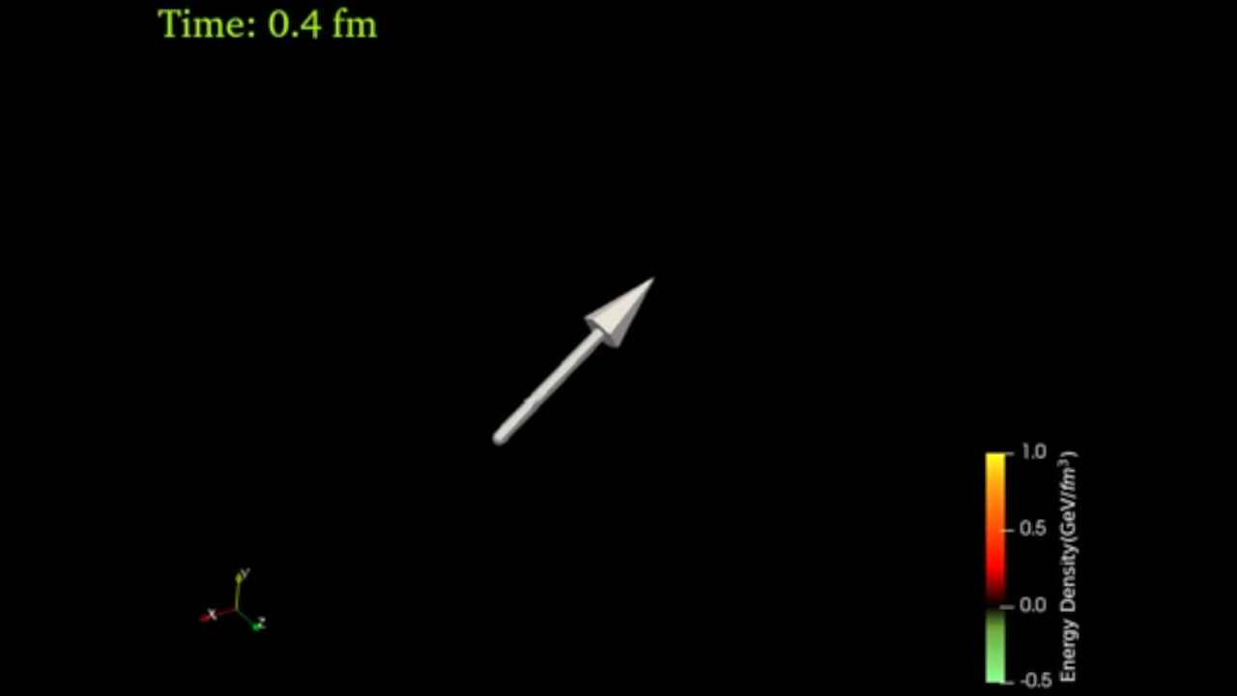
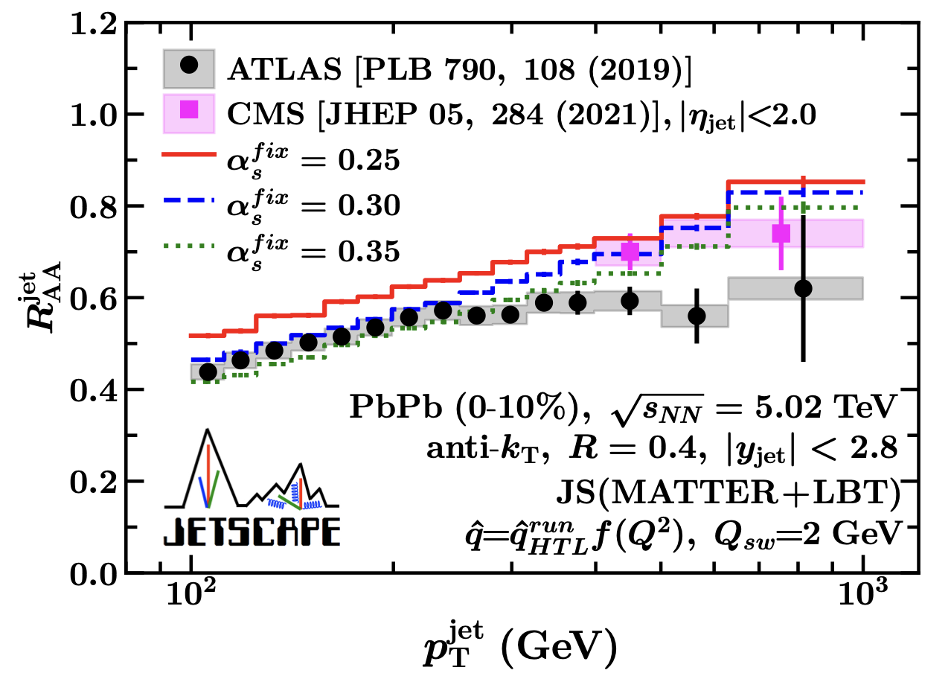
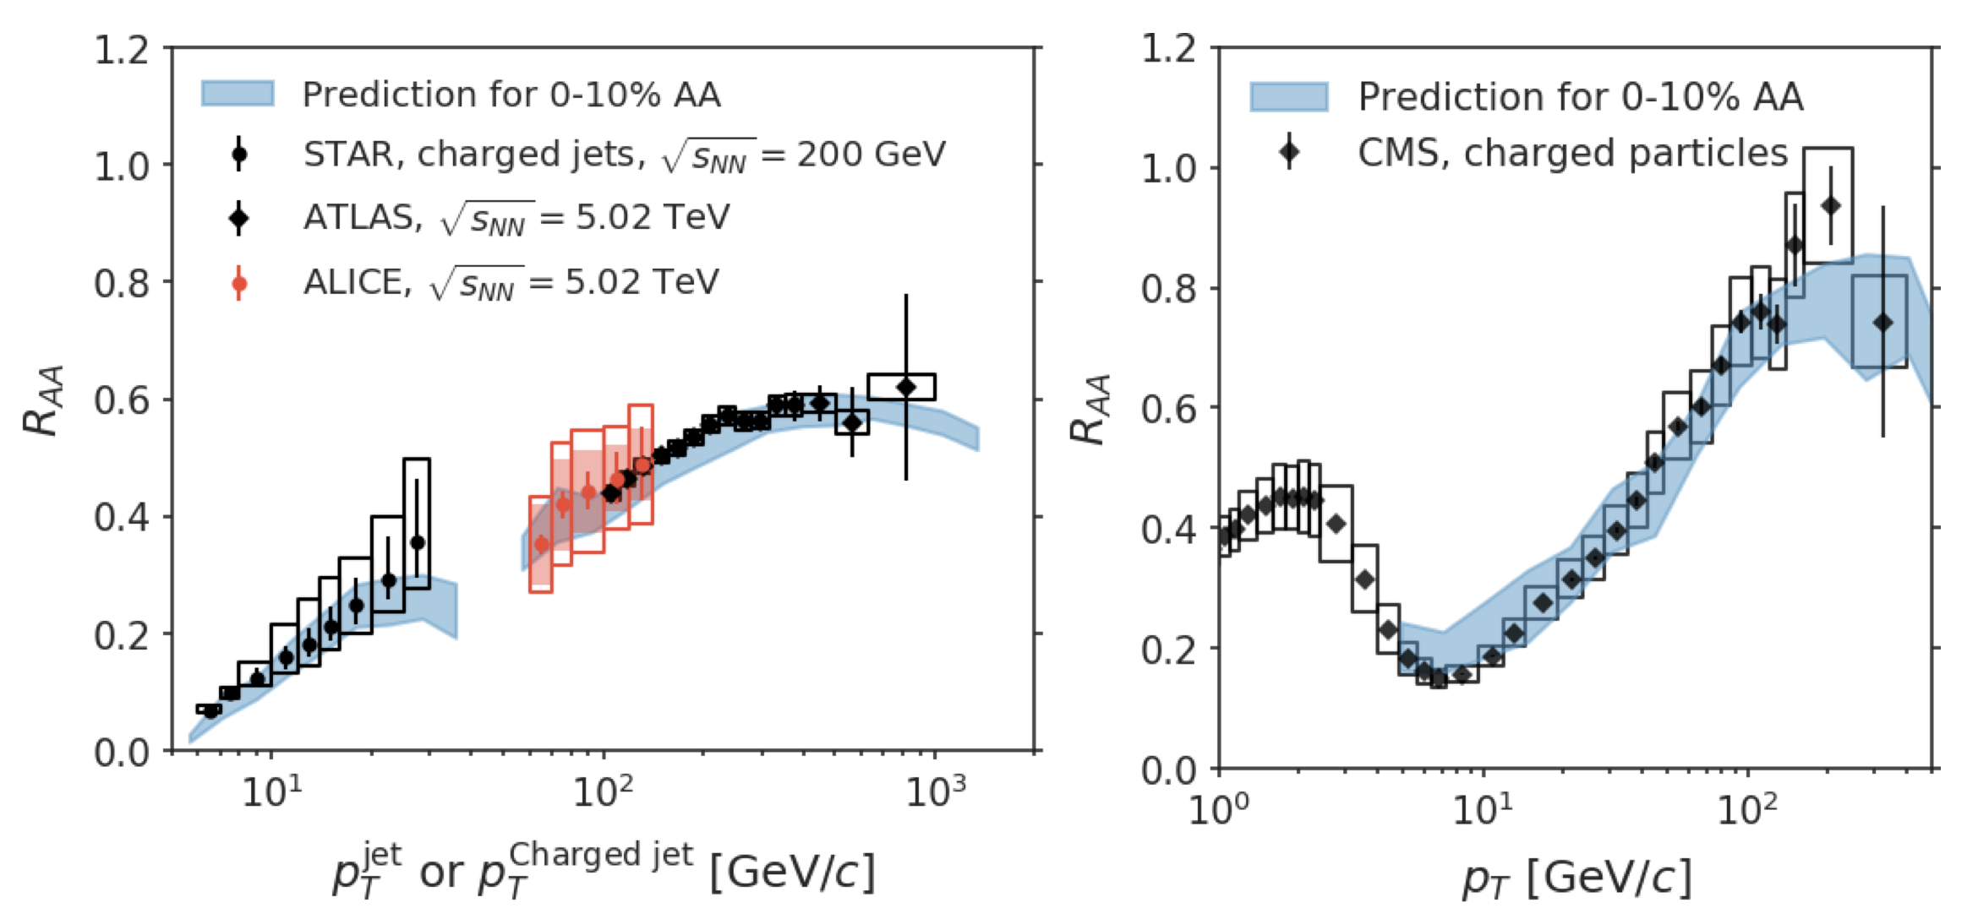
Jet suppression & medium response
Suppression of single jets and charged hadrons
Inclusion of medium response necessary!
Hybrid
e-Print:1808.07386
e-Print:2204.01163
LIDO
e-Print: 2010.13680
MATTER + LBT
Notes:
In order to Simultaneous description of hadron and jet RAA need to include jet-induced medium response

Slide 19
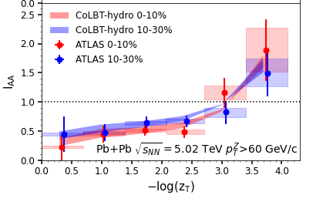
Medium modification of γ-jets
Enhancement of soft hadrons at large angles
r
z_{T}=p_{T}^{h}/p_{T}^{γ}
Chen, Cao, Luo, Pang & XNW, 2005.09678
e-Print: 2101.05422
CoLBT

Slide 20
Search for jet-induced diffusion wake
γ-triggered-jet-hadron correlation
Diffusion (DF) wake leads to depletion of soft hadron yield in the back of jet direction
Yang, Luo, Chen, Pang & XNW, PRL130, 052301(2023)
Jet
MPI
x
DF-wake
y
η_{s}
Jet-distr
MPI
DF-wake
Notes:
Diffusion wake a universal phenomenon accompanying the projectile induced Mach wake

Slide 21
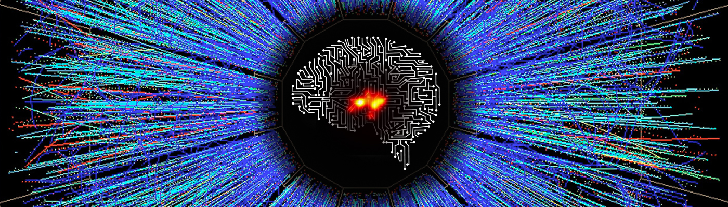
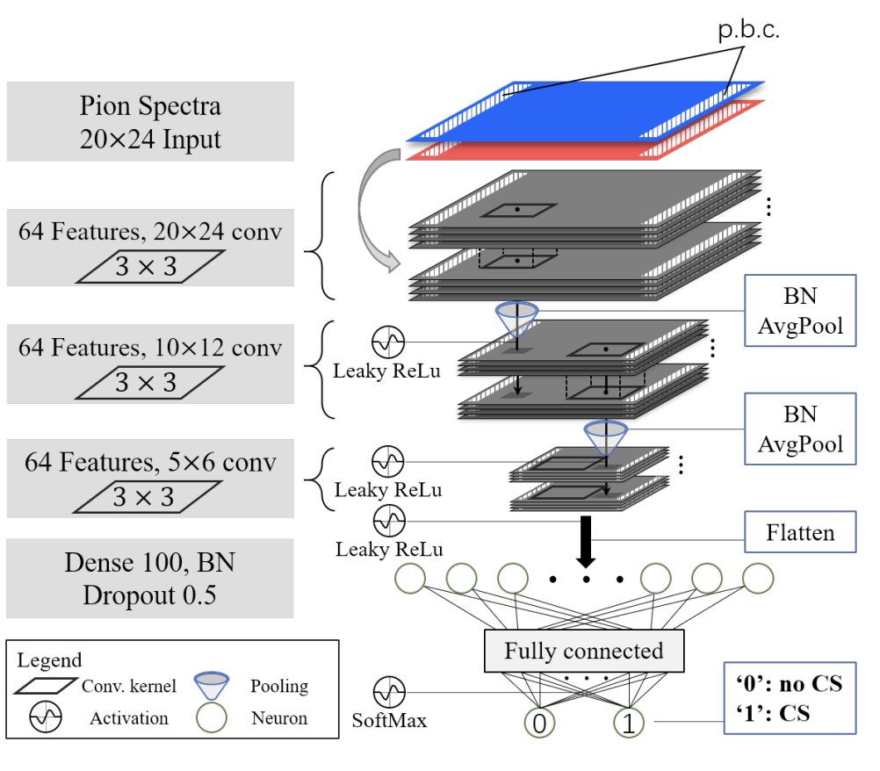
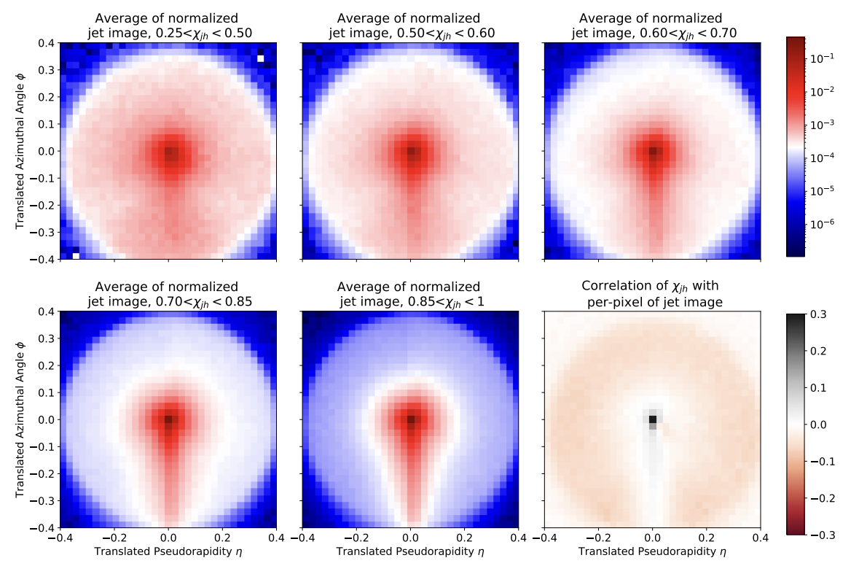
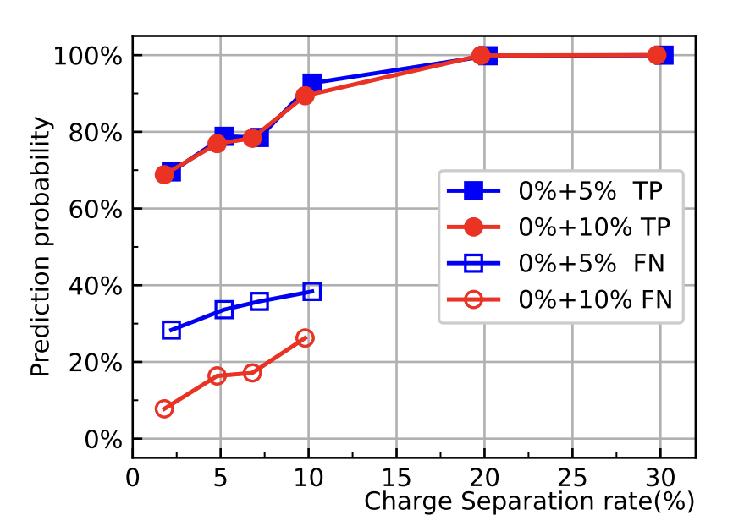
AI/ML in Heavy-ion physics
DCNN (Deep convolutional neural network)
Jet-tomographer
EoS-meter
CME-meter
Use jet imagine to predict jet energy loss & initial prod point
e-Print: 1612.04262
e-Print: 2105.13761
e-Print: 2106.11271, 2012.07797
Notes:
To go beyond conventional characterization of event structures, and explore correlation and structure in higher dimensions, AI/ML have been proved to be very successful, and this has been demonstrated in analyzing simulated heavy-ion collisions
Using DCNN trained on images of events from hadron phase space distributions, one can

Slide 22
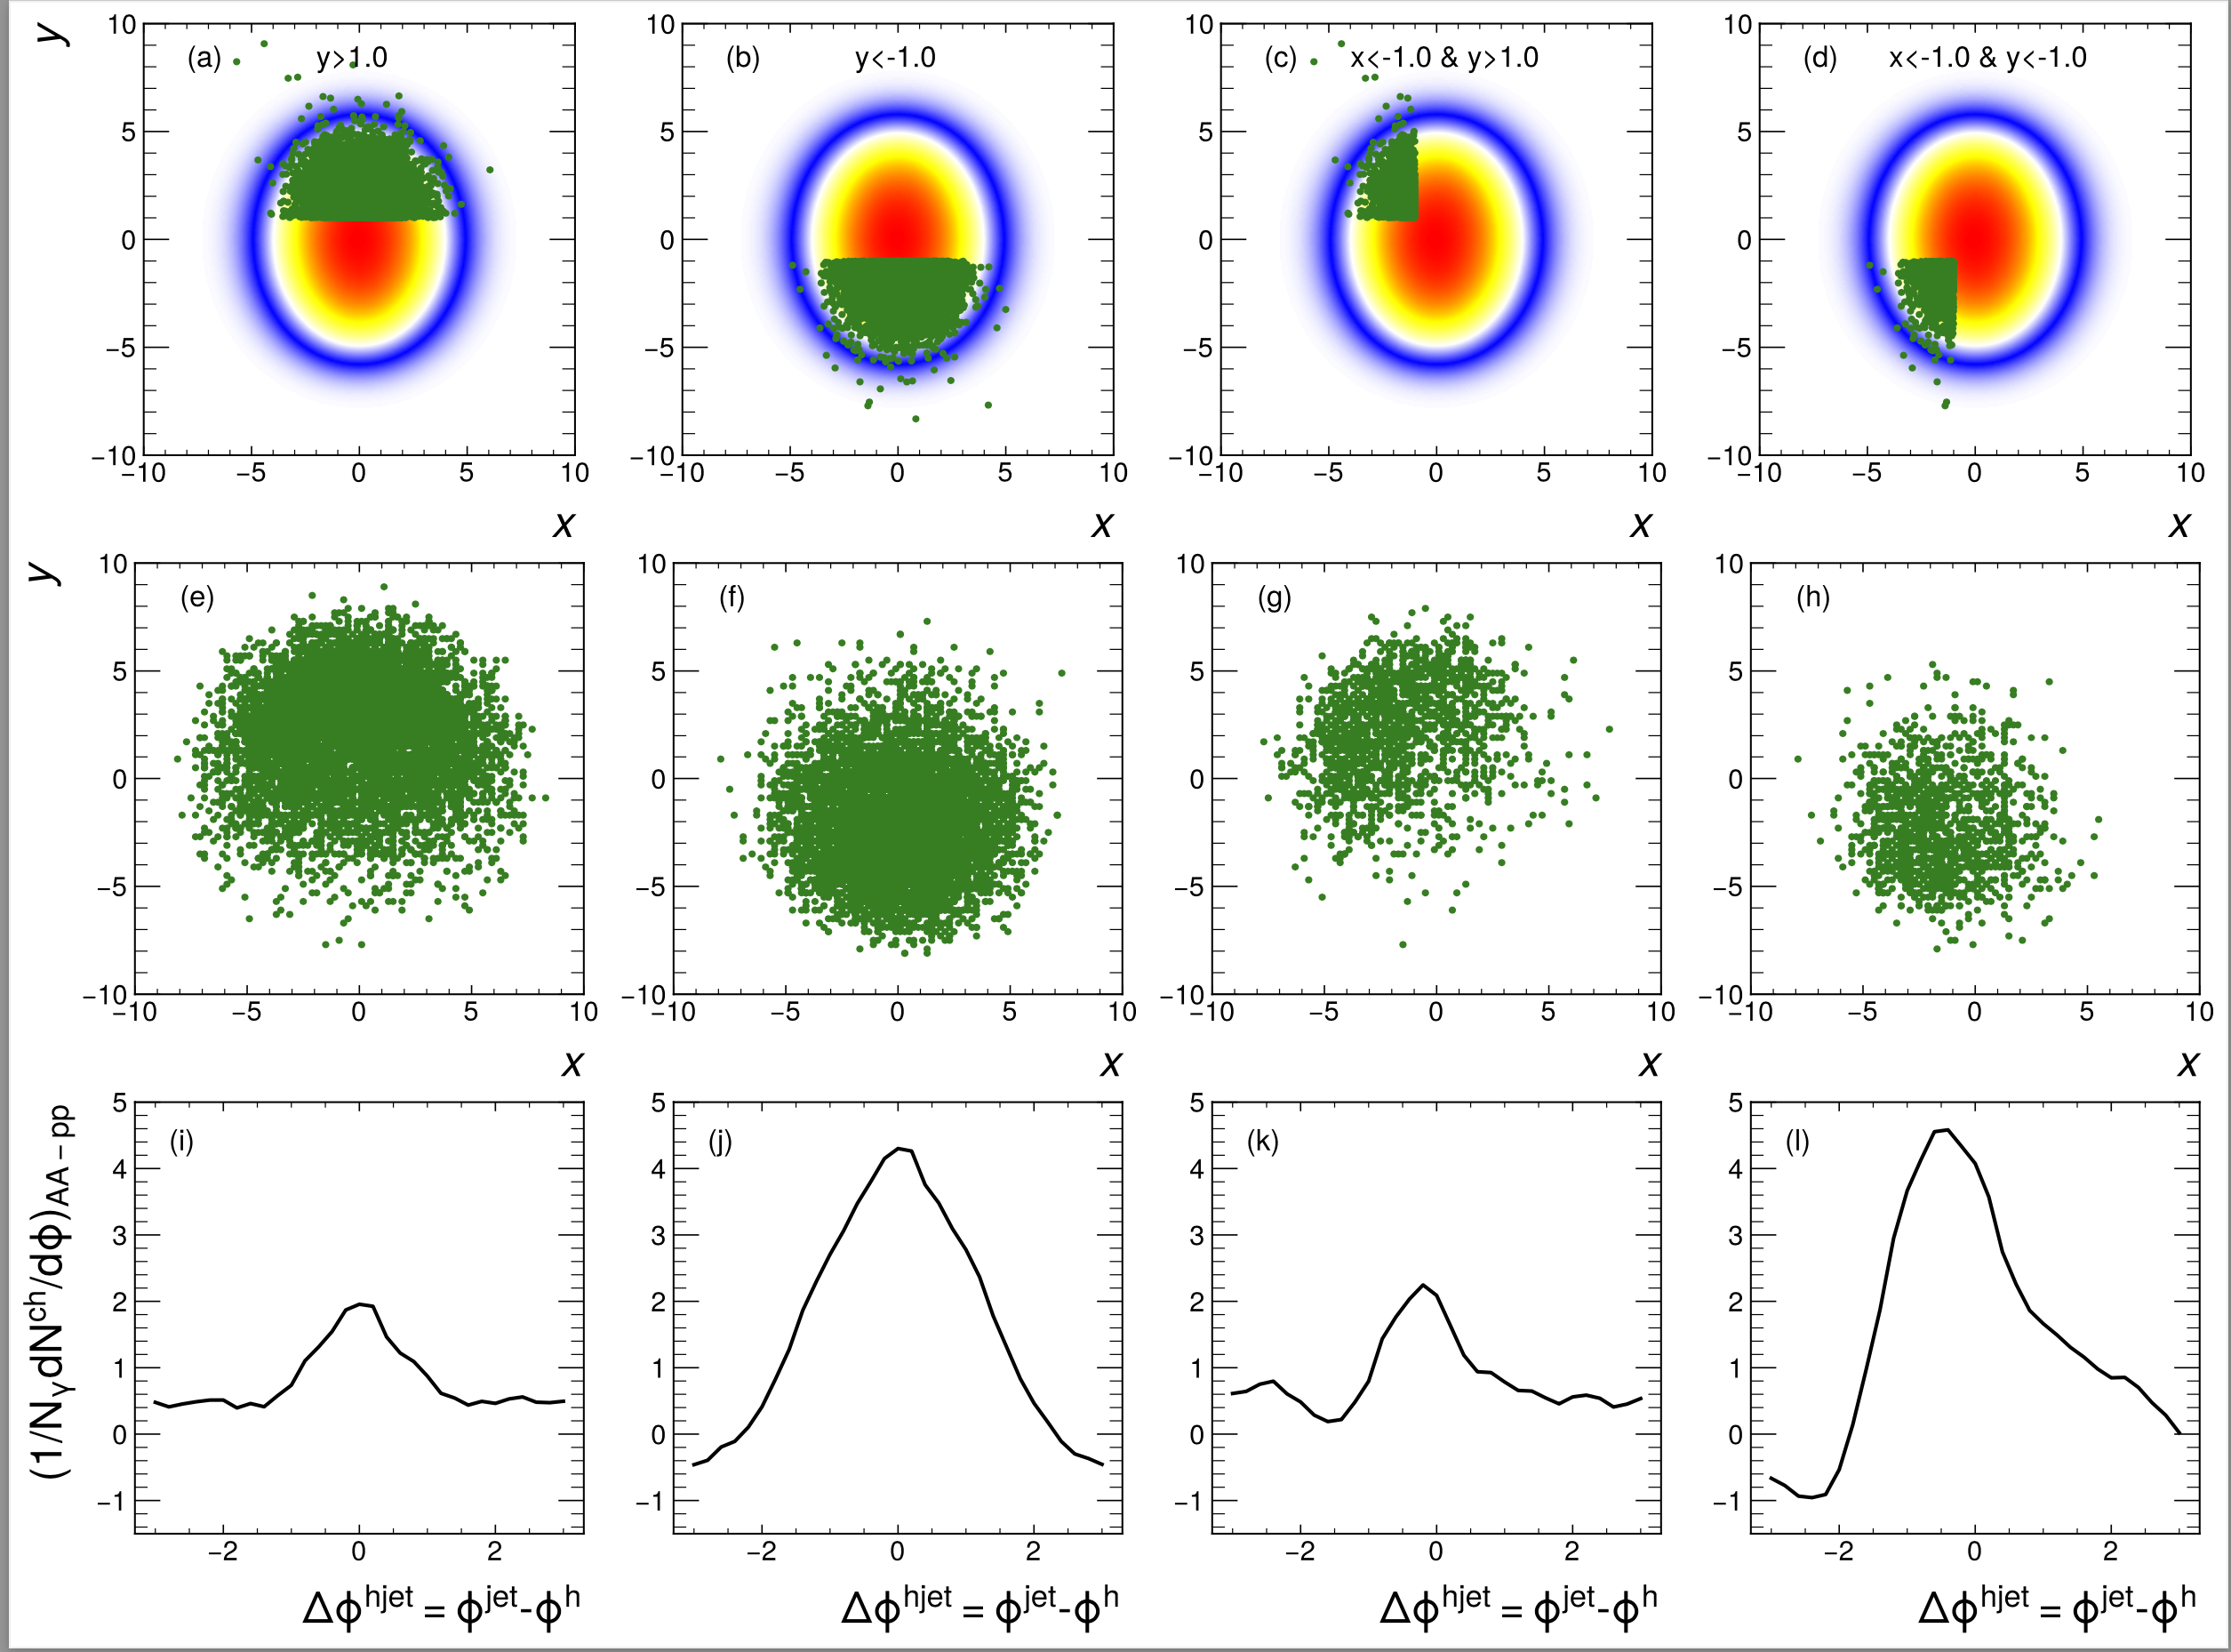
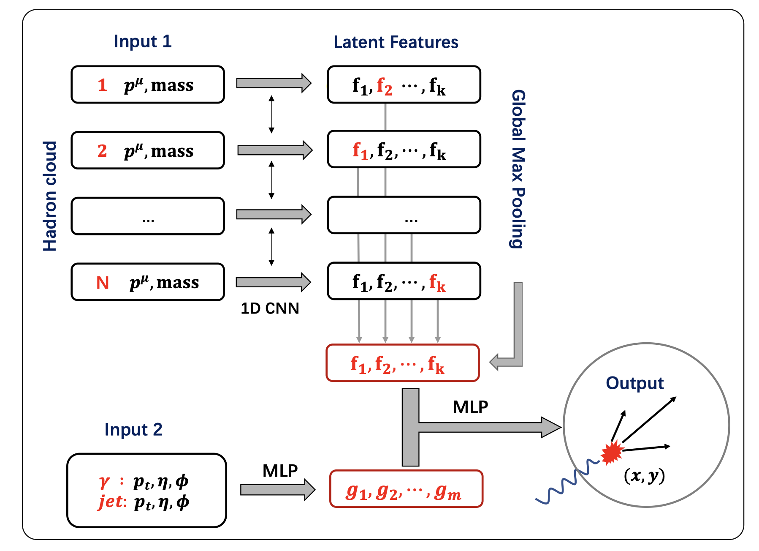
Deep learning assisted jet tomography
PCN (point cloud network)
DL network selection
Actual distribution
γ-soft hadron correlation
Yang, He, Chen, Ke, Pang & XNW, EPJC 83 (2023)652
Notes:
Recently, the point could network as been applied to predict the transverse position of the initial jet production vertices

Slide 23
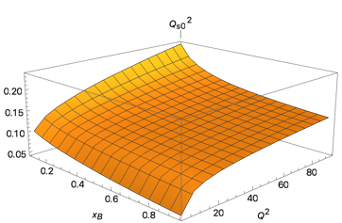




Connection to physics at EIC
e
e
TMD gluon distr.
gluon saturation scale
Parton energy loss in cold nuclear medium, saturation scale in jet-nucleon interaction
Hadronization mechanism
Jet modifications
Connection to small systems of strongly interaction matter: initial conditions
Collection phenomena in EIC (flow?)
e-Print: 2104.04520
1907.11808
Notes:
\dfrac{d N_g }{d l_{\perp}^2 dz}=
\int_{y^-}^\infty d y_1^- \left[ \rho_A(y_1^-,\vec{y}_{\perp}) \dfrac{2\pi\alpha_s}{N_c} \pi \int \dfrac{d k^2_{\perp}}{(2\pi)^2} \frac{\phi_N(0,\vec{k}_{\perp})}{{k}_{\perp}^2} \right]
\pi\dfrac{\alpha_s}{2\pi}P_{qg}(z)\frac{C_A}{l_{\perp}^2}\mathcal{N}_g(\vec{l}_{\perp},\vec{k}_{\perp})
\mathcal{N}_g^{\textsl{static+soft}}
=\int \frac{d\varphi}{2\pi} \frac{2\vec{k}_{\perp}\cdot\vec{l}_{\perp}}{(\vec{l}_{\perp}-\vec{k}_{\perp})^2} \left( 1-\cos[\frac{(\vec l_\perp -\vec k_\perp)^2}{2q^-z(1-z)}
y_1^-]\right)
\mathcal{N}_g^{\textsl{static+soft}}
=\int \frac{d\varphi}{2\pi} \frac{2\vec{k}_{\perp}\cdot\vec{l}_{\perp}}{(\vec{l}_{\perp}-\vec{k}_{\perp})^2} \left( 1-\cos[\frac{(\vec l_\perp -\vec k_\perp)^2}{2q^-z(1-z)}
y_1^-]\right)
\int dy^- \hat{q}_A(y^-) \equiv Q_s^2(x_B,Q^2, b_\perp) =\frac{4\pi^2 C_A}{N_c^2-1} t_A(b_\perp)
\int \frac{d^2k_\perp}{(2\pi)^2} \alpha_{\rm s}(\mu) \phi(x_G, k_{\perp},\mu^2),

Slide 24
Summary
Precision quantification of QGP properties and initial conditions
  Transport properties, initial conditions (nucleon structure): multi-correlation observbales
  Jet transport coefficient: precision jet substructure, high precision di(γ/Z⁰)-hadron correlation (high Lum LHC, RHIC: sPHENIX, STAR )
  Jet-induced medium response; improved & refined jet tomography
Spin dynamics: broaden the study of spin polarization (alignment): a window to emerging properties of QGP
Theoretical advancement: precision calculations (NLO, resummation, gradient corrections etc), initial thermalization
AI/ML tools essential for precision quantification of QGP properties: demand for computing resources; implementations in data analyeses

Slide 27
Jet structure and Medium response

Slide 28



EM emissions from the evolving QGP
e-Print: 2106.11216
2008.02902
Sources:
Direction production: nPPF
Thermal production QGP: hydro evolution
Thermal production HG: hadron properties
Pre-eq contribution:
Sensitive to pre-eq dynamics,
medium transport properties
Jet-medium
interaction → 10%
e-Print: 2207.12513
Out-eq contribution:
hadronic transport
e-Print: 2111.13603
Bayesian analysis including photons and dileptons!
Notes:
One of the new theory efforts is to estimate pre-eq
some data still show enhanced EM emission at low pt, and larger photon v2, tension between STAR and PHENIX will be resolved in the future

