Slide 1
Prof. Dr. Dr.h.c. Rudolf Bock *1927 - 2024
50 Years of international Friendship and close Collaborations
Prof. Dr. Dr. h.c. Rudolf Bock,
Prisoner of War in the USSR,
Founding Father of GSI’s
Heavy Ion Research Program
Builder of GSI’s great
International scientific networks:
with LBL Berkeley, JINR Dubna,
IMP LanZhou, IAE China, CERN…
Nestor of the School of German
Relativistic Heavy Ion & Plasma Experimentalists.
R. Stock, PBM, R. Santo, H. Gutbrod, Wessels, Oertzen

Slide 2
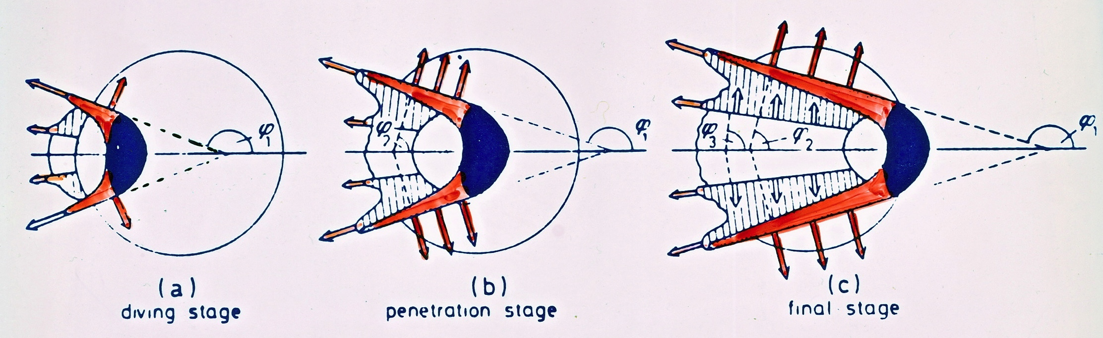
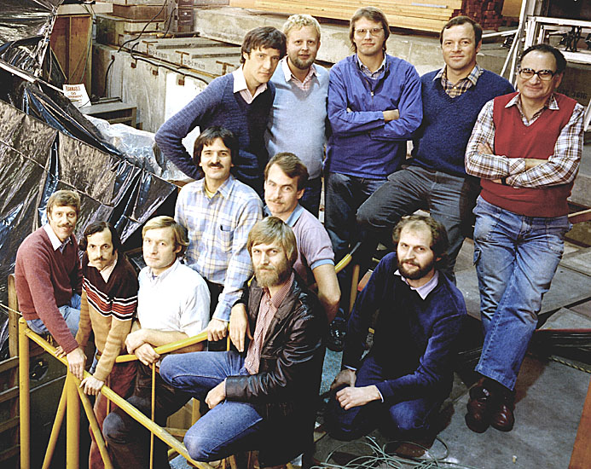
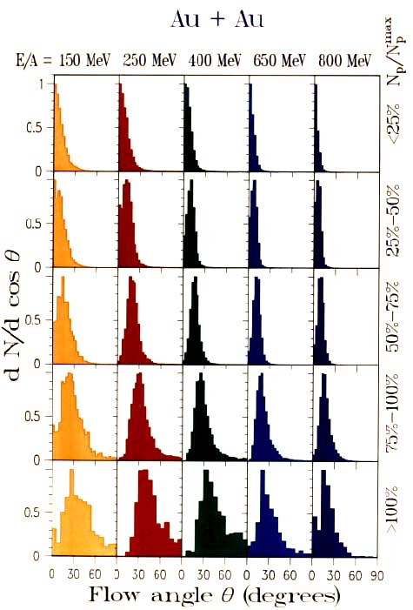
Rudolf Bock‘s 1982 GSI/LBL Plastic Ball
Discovery of predicted Sidewards Flow!
Sidewards Peaks of Alphas from Nuclear Mach Shock Waves reported:
H. Baumgardt, E. Schopper, J. Schott 1974/75 Dubna/LBL in AgCl
Predicted 1974 by H.Stöcker, W. Scheid, W. Greiner - to be confirmed
GSI-LBL-Marburg collaboration

Slide 3









MAGIC: Matter, Astrophysics, Gravitationalwaves => Ion Collisions
- Hot & Dense QCD Matter - and the
* Strange Charm and Beauty * of international Collaborations
M. Omana Kuttan, S. Soma, S. Schramm†, J. Steinheimer, H. Stoecker* FIAS K. Zhou CUHKSZ
L. Rezzolla, L. Weih, A. Motornenko, Pia Jakobus**, E. Most & V. Vovchenko, U. Houston
Institut für Theoretische Physik, Goethe Univ. *GSI Darmstadt, **Monach Univ. Hamburg

Slide 4
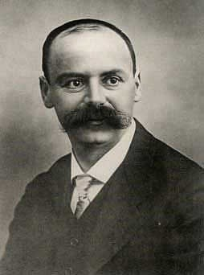
Matter, Gravity, Neutron Stars and BHs
1915 A. Einstein, born in Ulm, published Gen.Relativ.:
Gravity governs the motion of masses and light
by curving spacetime.
1915 Karl SchwarzSchild, born 1873 in Frankfurt,
solved General Relativity: Black Holes - static piont sources …
1916 Karl’s last article: a “Neutron Star” - solution of GR: NS !!
SchwarzSchild died in WW I just after publishing these articles…
SchwarzSchild’s solutions of GR: black holes & neutron stars
Add Einstein‘s Gravitational Waves - we see a whole new Universe!

Slide 5
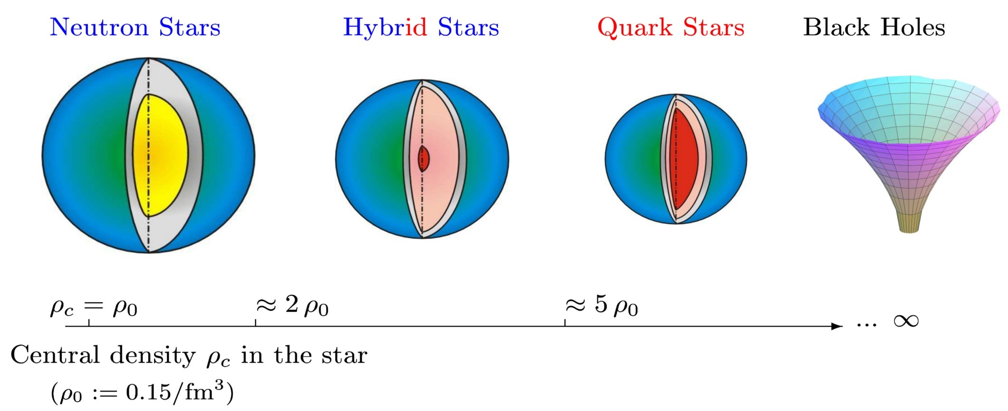
Neutron Star, Quark Star, Black hole ?
The Universe in the Lab ?
Where do the Elements come from ?
What ist the Structure of Matter – from Nuclei to Stars ?
From Neutron Stars to Heavy Ion Collisions !?

Slide 6
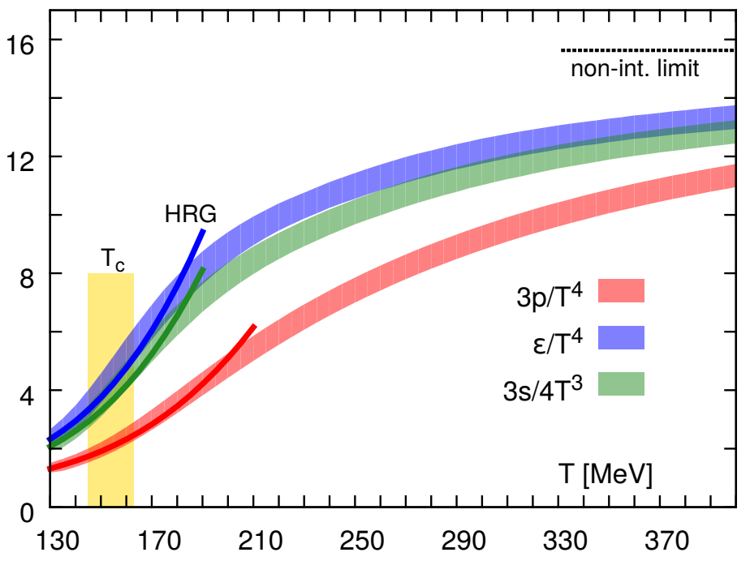
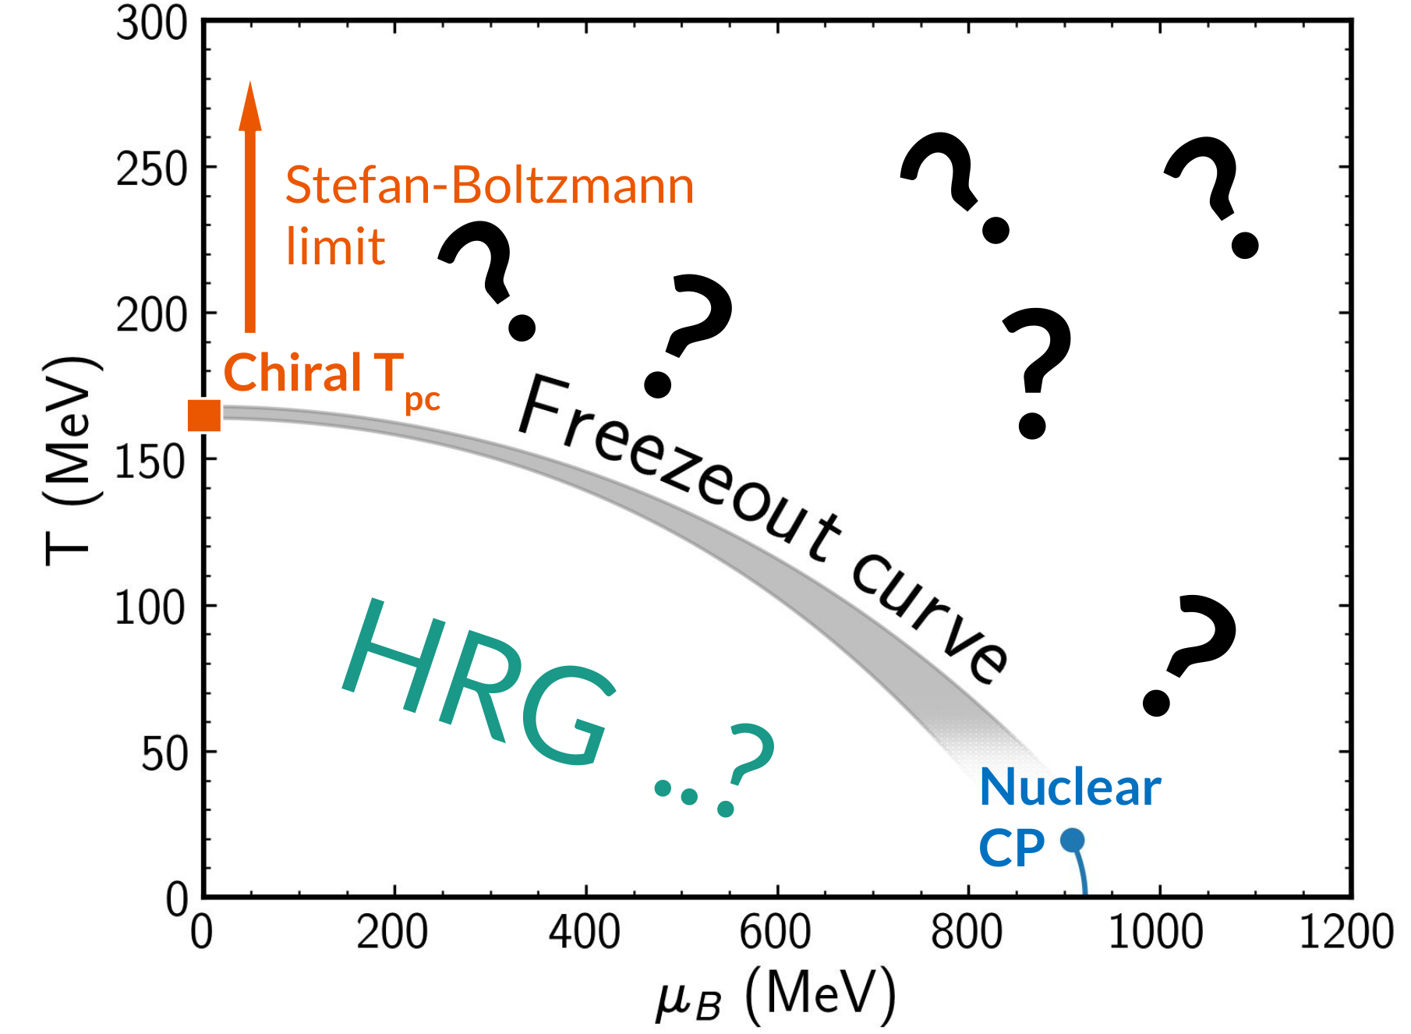
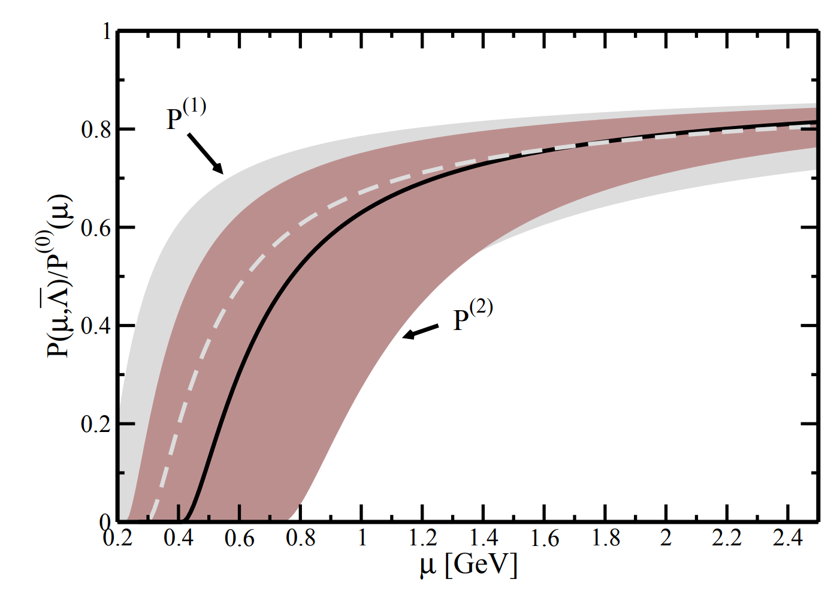
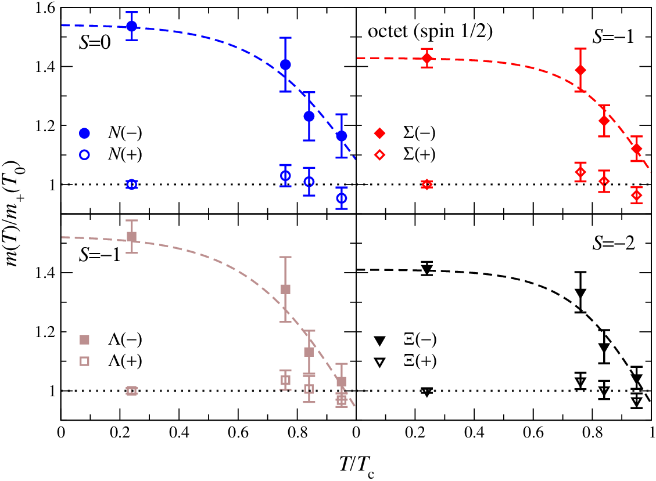
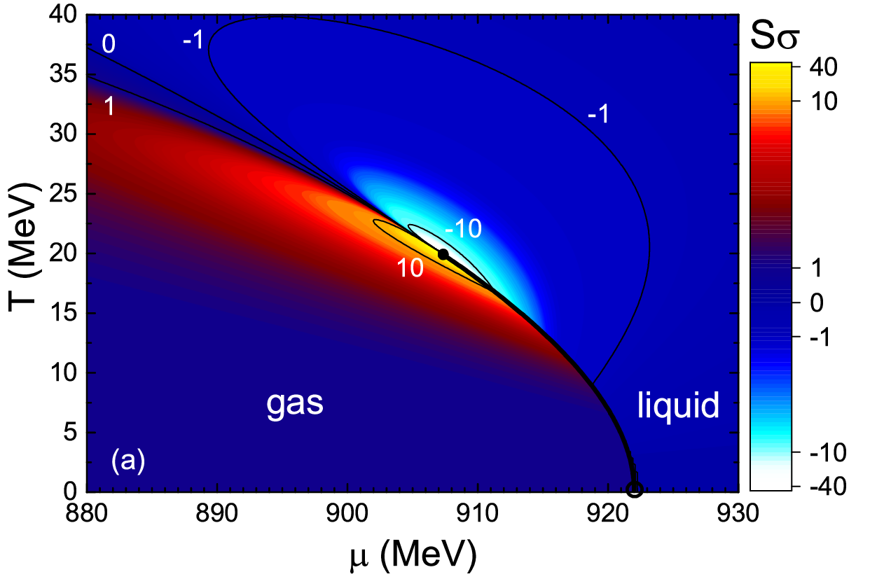
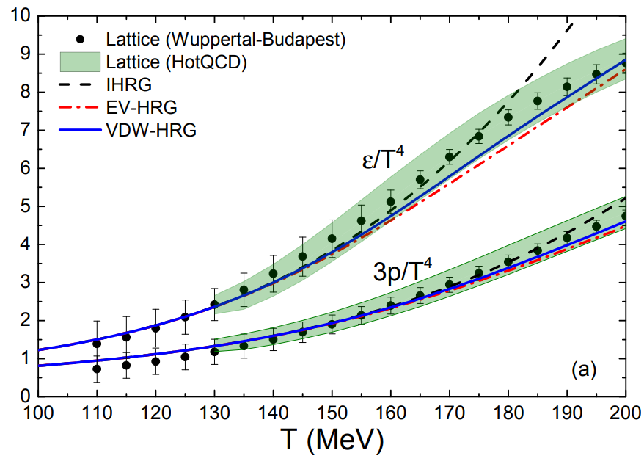
QCD phenomenology for the EoS: CMF
Stefan-Boltzmann limit μ_{B}=0 HotQCD, 1407.6387
Stefan-Boltzmann limit T=0
A. Kurkela, P. Romatschke,
A. Vuorinen, 0912.1856
Parity doubling G. Aarts et al., 1710.08294
Nuclear matter properties
J. Pochodzalla et al., Phys.Rev.Lett. 75 (1995)
V. Vovchenko et al., 1506.05763
Hadron Resonance Gas
Vovchenko,
Gorenstein,
Stoecker,
1609.03975

Slide 7
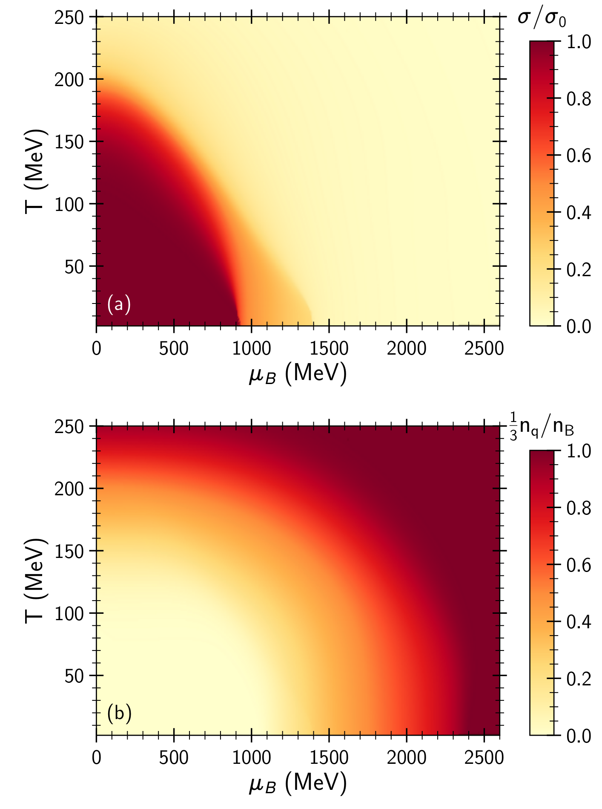
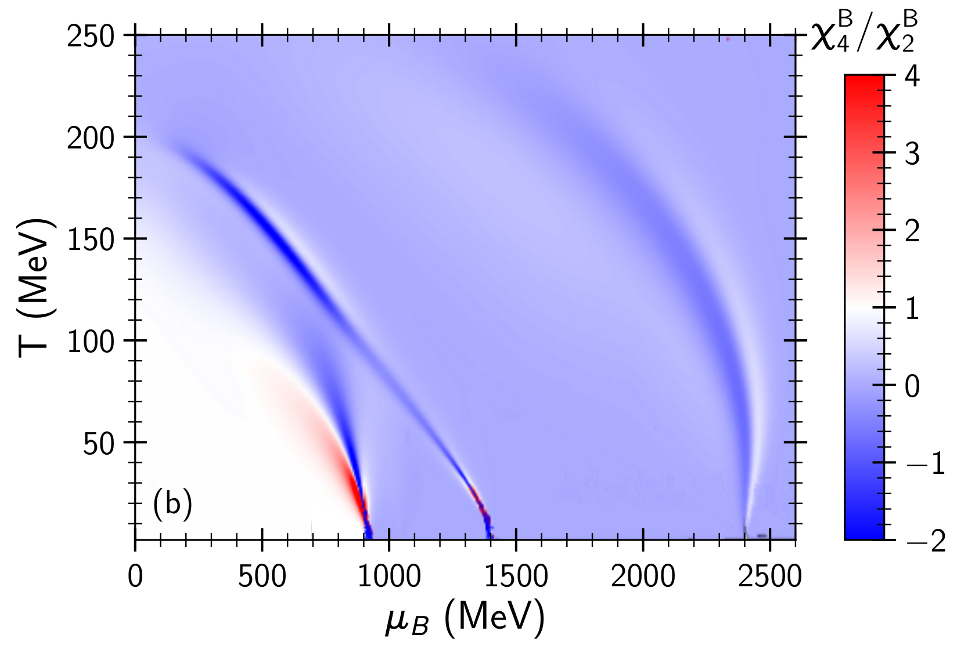
Kurtosis and the phase diagram
Quark fraction
Quark
Matter
_{Quarks+hadrons,}
_{Chiral condensate=0}
_{Chiral condensate}
Dilute
hadrons
Hadronic liquid

Slide 8
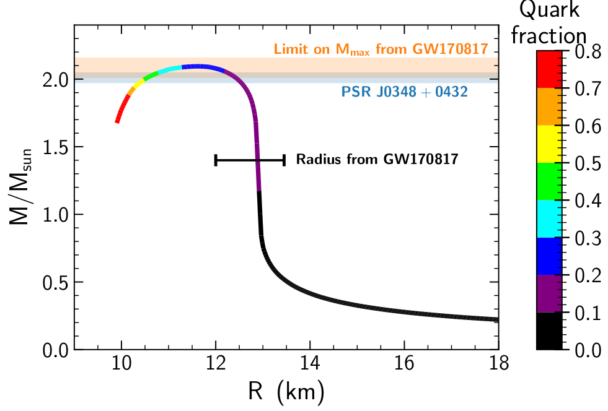
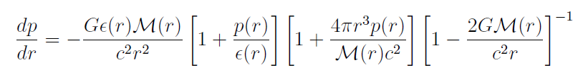
Neutron Stars Mass vs. Radius in CMF
Anton Motornenko
Features:
Maximum TOV
NS-mass observed
< 2.1x M_solar GW170817
Radii ~ 13km observed
Neutron Star’s relativistic
EoS at high 𝝁_{B} must agree with lattice QCD data at low 𝝁_{B}
Anton Motornenko, V.Vovchenko, J.Steinheimer, Stefan Schramm, H.Stoecker 1809.02000, NPA (2019), QM’19 Wuhan

Slide 9
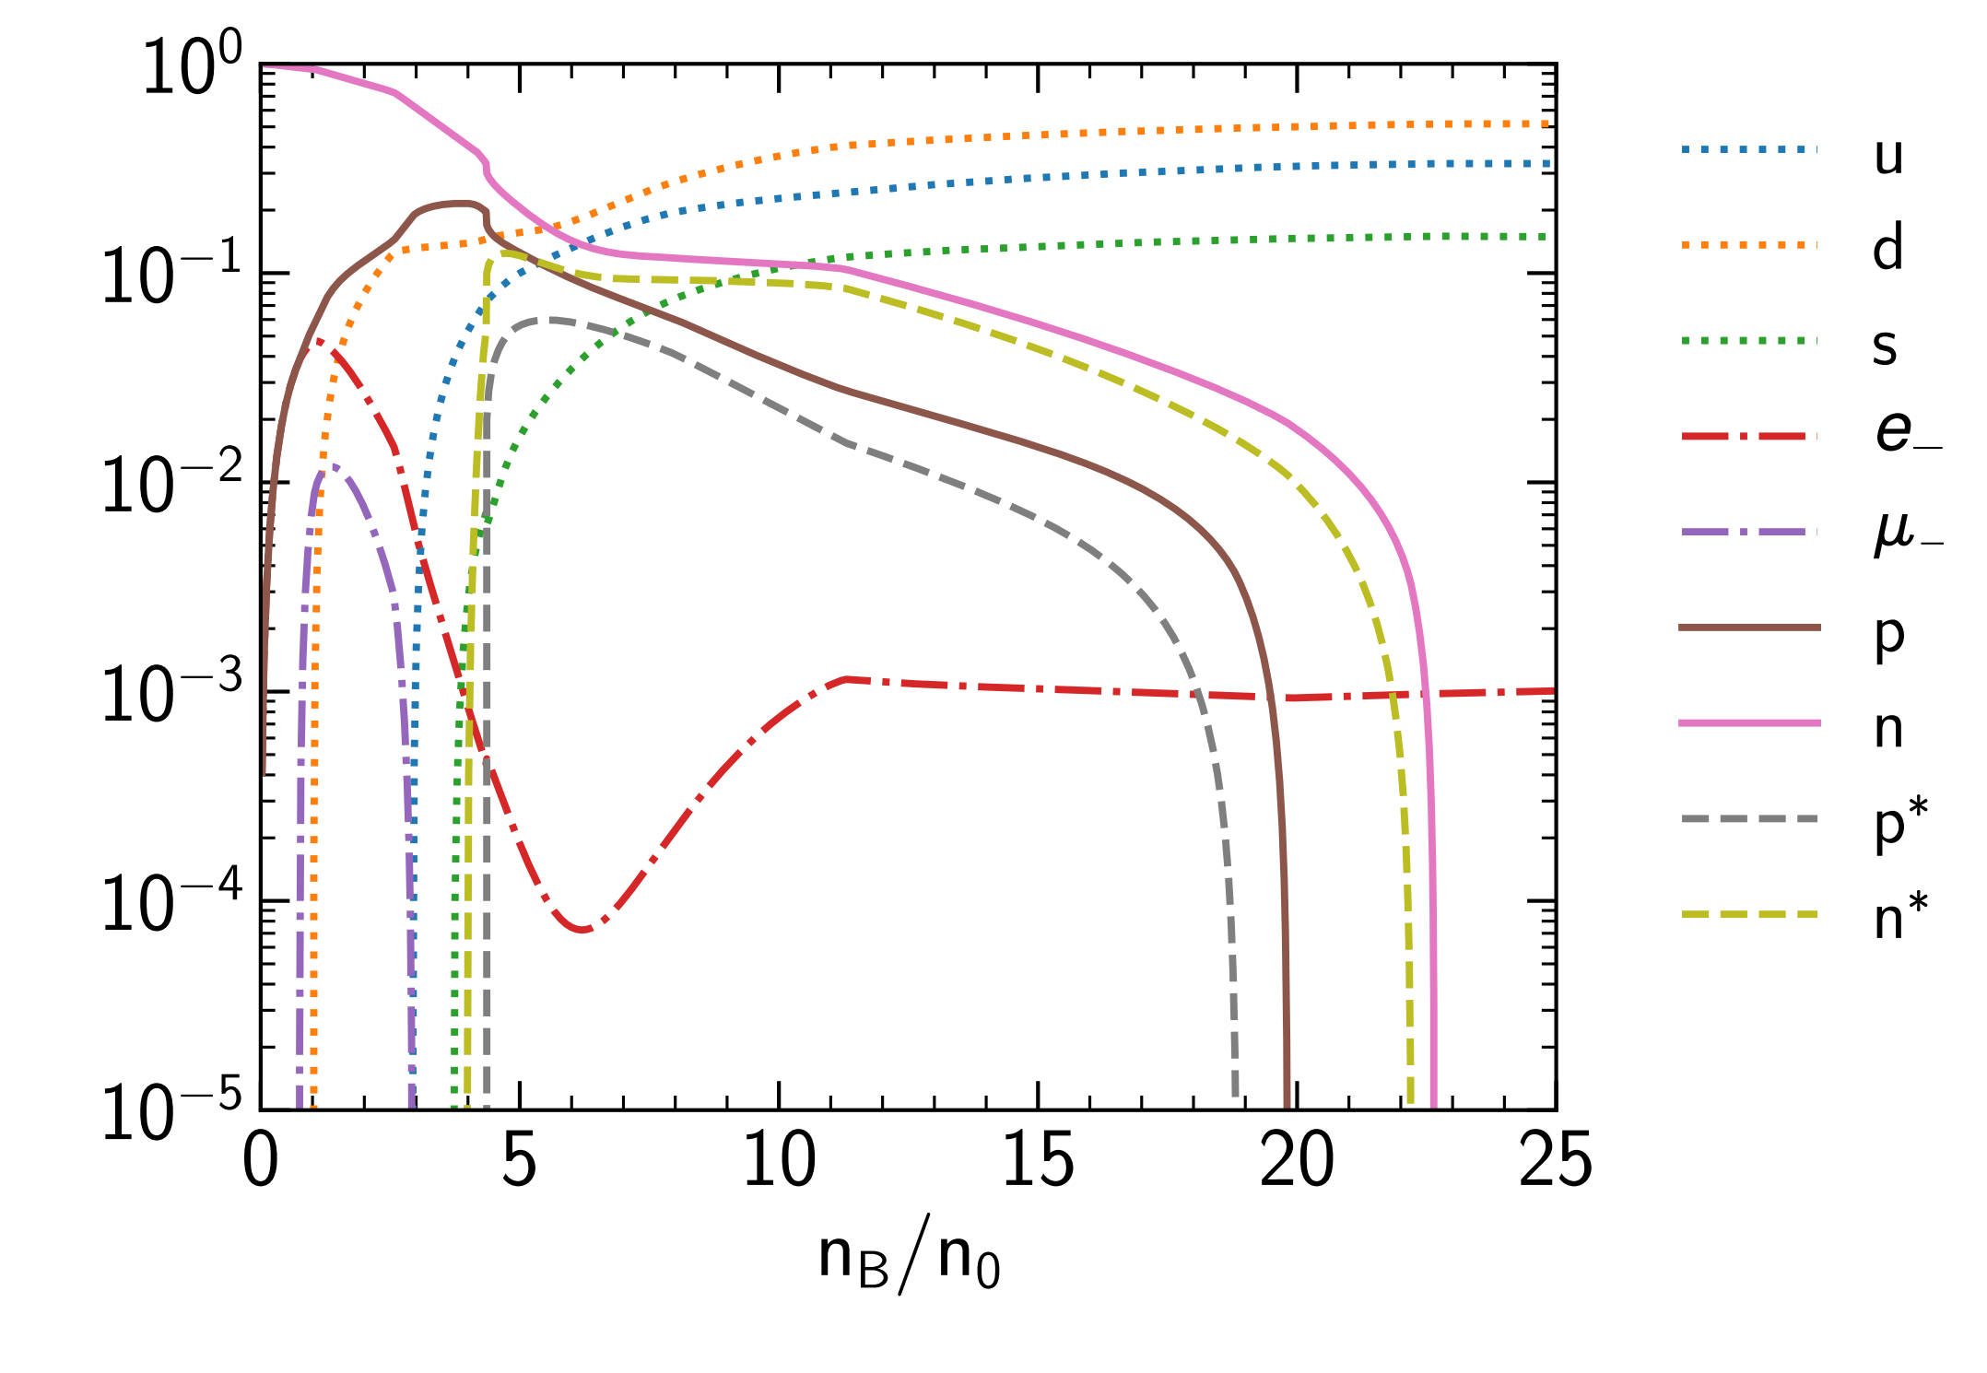
CMF - Equation of state at T=0: Neutron Stars
Equation of state for neutron stars:
T=0
Electric charge is zero
Leptons are included
No nuclear ground state
Chiral transition is at n≈4n₀
Quark matter is at n≈23n₀
Hyperons at T=0 are suppressed by hard-core repulsion (nevertheless are present at T ≠ 0)
Strange quarks are included
A. Motornenko, Jan Steinheimer
Quarks
Particle yields normalized to baryon density:

Slide 10
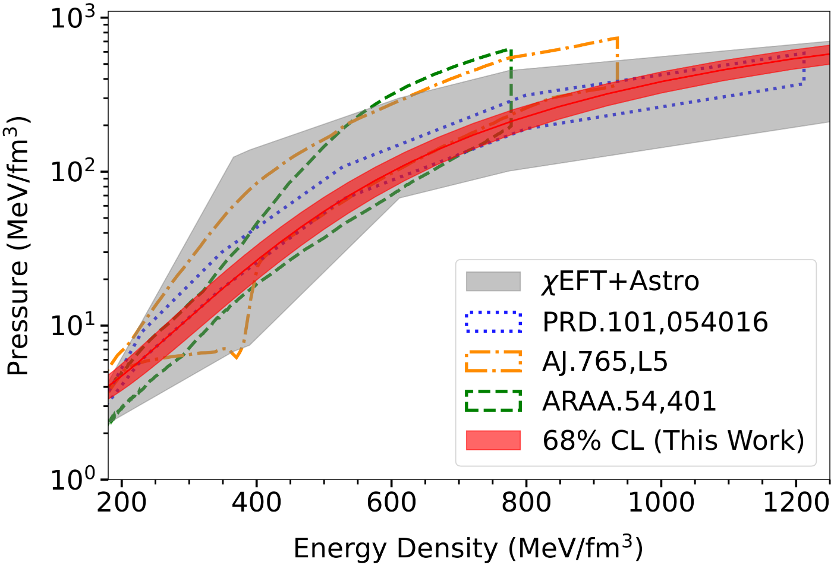
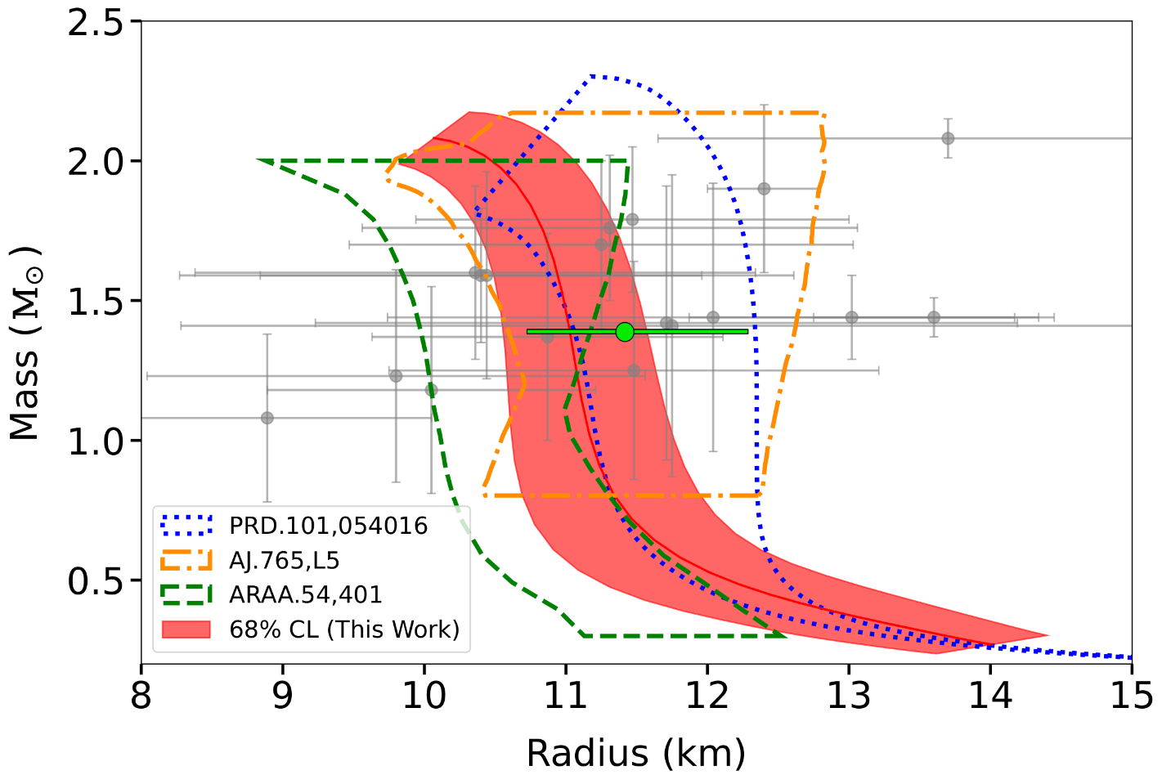
Constraining the Neutron Star Equation of State: A Deep Learning Approach
Dr. Shriya Soma, Prof. Kai Zhou, H.Stoecker et al., PRD 107 (2023) 083028
R (1.418 M⊙) = 11.36 ^{+0.95} km
_{-0.63}
Compatible with the 2M⊙ constraint
PRD : Fujimoto et al.
AJ : Steiner et al.
ARAA : Özel et al.
[NICER, April APS meeting (2024),
2404.07936]
[Antoniadis et al., Science, 340 (2013) 6131, Fonseca et al., ApJL 915 (2021) 1]
n_Max
< 8n_0
PSR J0437-4715

Slide 11
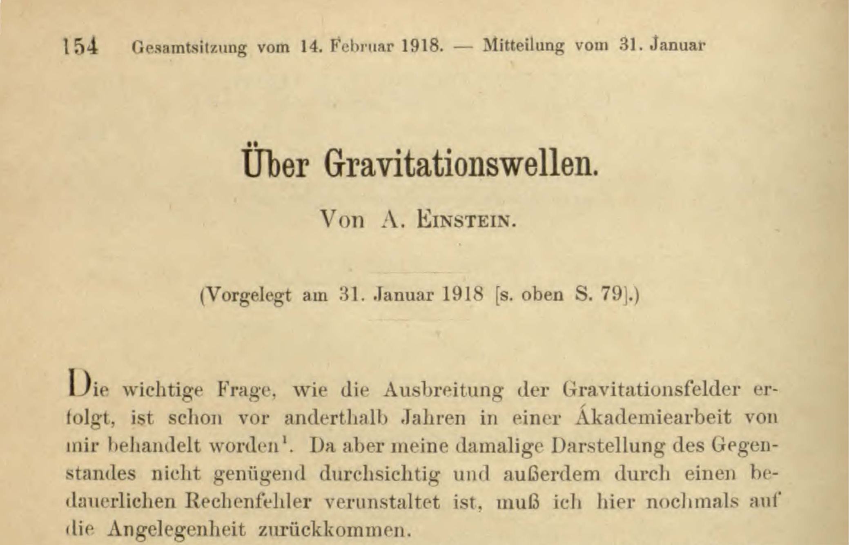
Sitzungsberichte der Königlich-Preußischen Akademie der Wissenschaften
Einstein‘s First work on Gravitational Waves, Juni 1916, was …wrong…

Slide 12
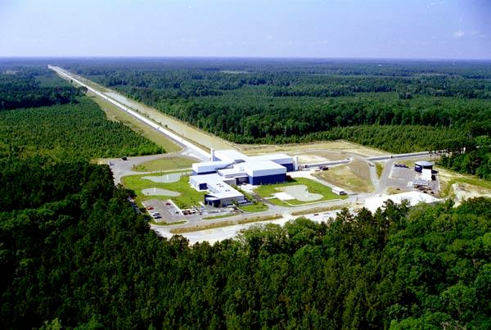
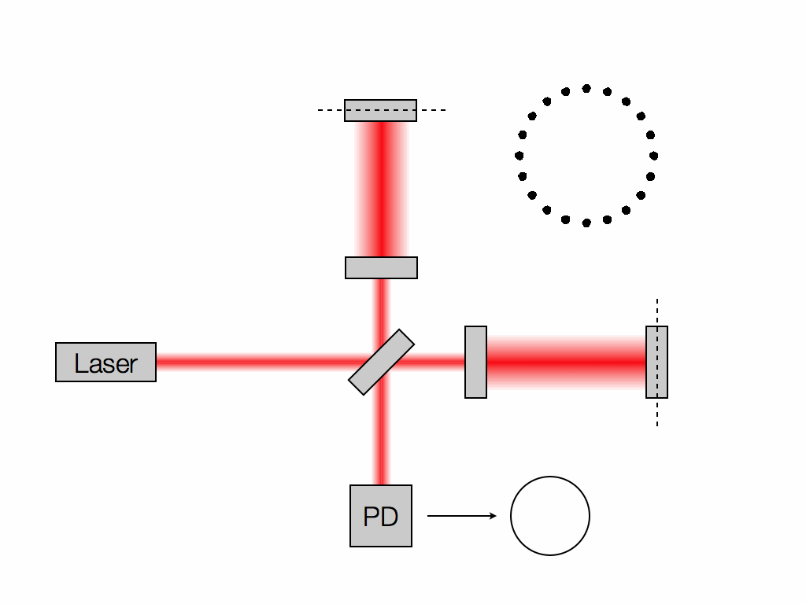
Gravitational Waves discovered
Collision of 2 Neutron Stars GW170817
Masses of BHs: 1.4 &1.4 Solar Masses
Distance to Earth Gpc
Length Difference 10^-21 m
Credit: Les Wade from Kenyon College.

Slide 13



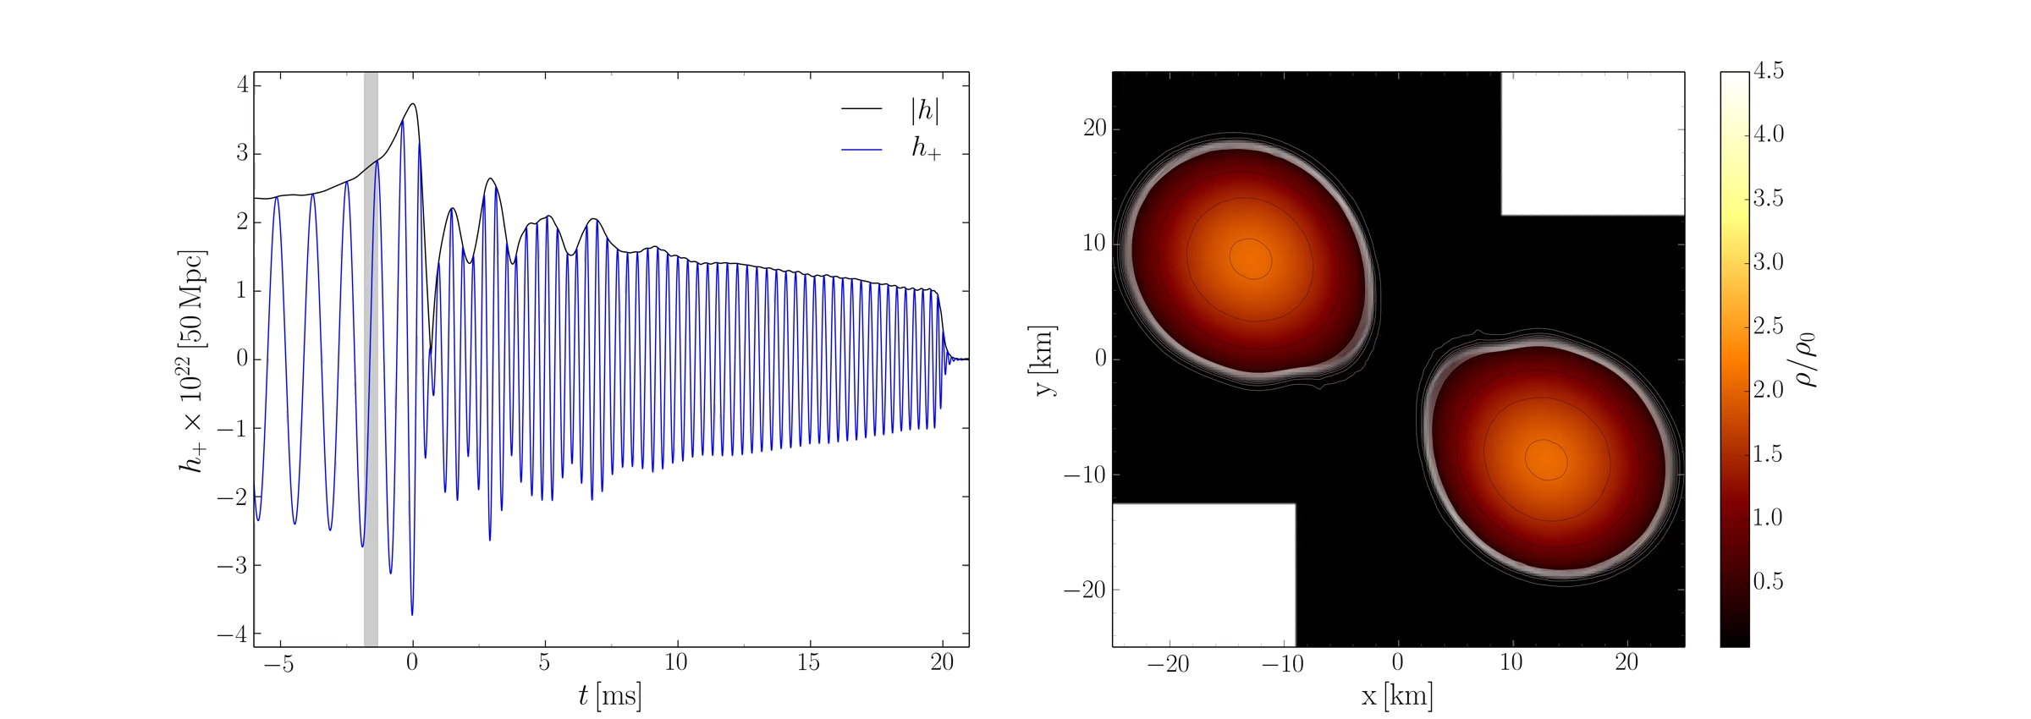
Disco-Fox, Merengue and Tango- Phase, Luciano Rezzolla et al.
300Hz - 3000Hz

Slide 14
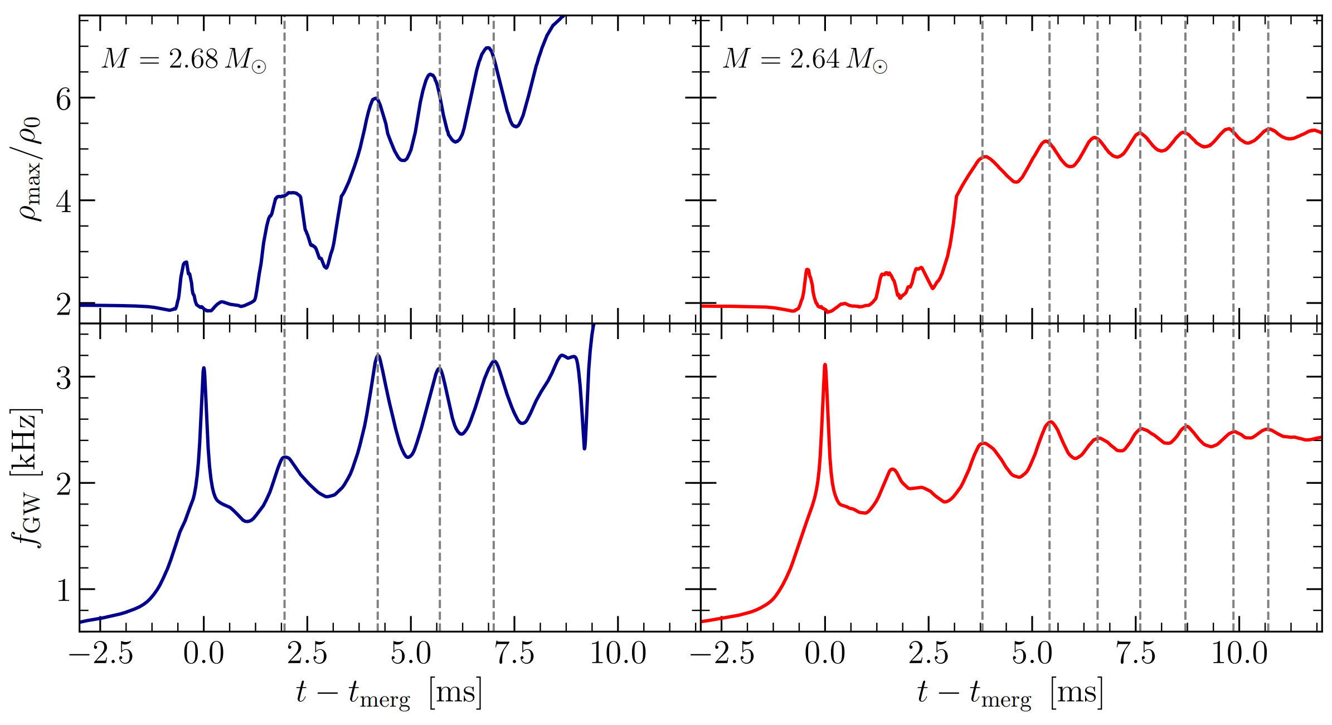
Gravitational Wave Emission from BNSM !
“high-mass” binary
“low-mass” binary
Time dependence of instantaneous GW frequencies
- perfectly in phase with maximum density peaks

Slide 15
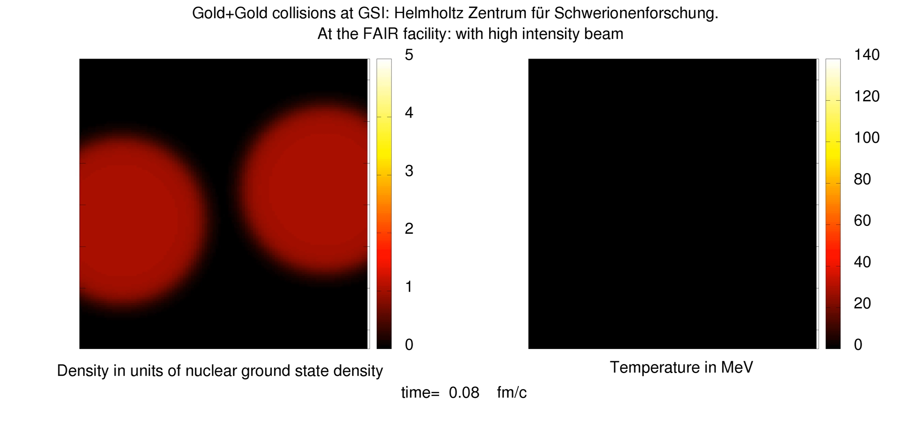
The CMF model applied in fluid dynamical simulations of HIC
Relativistic 4D Hydrodynamics for Heavy Ion Collisions@FAIR
Jan Steinheimer , FIAS Frankfurt
Special Relativistic 3+1Dim Hydrodynamics for Heavy Ion Collisions
’80-/’90-ies : G.Graebner, D.Rischke, et al., ITP, Goethe University

Slide 16
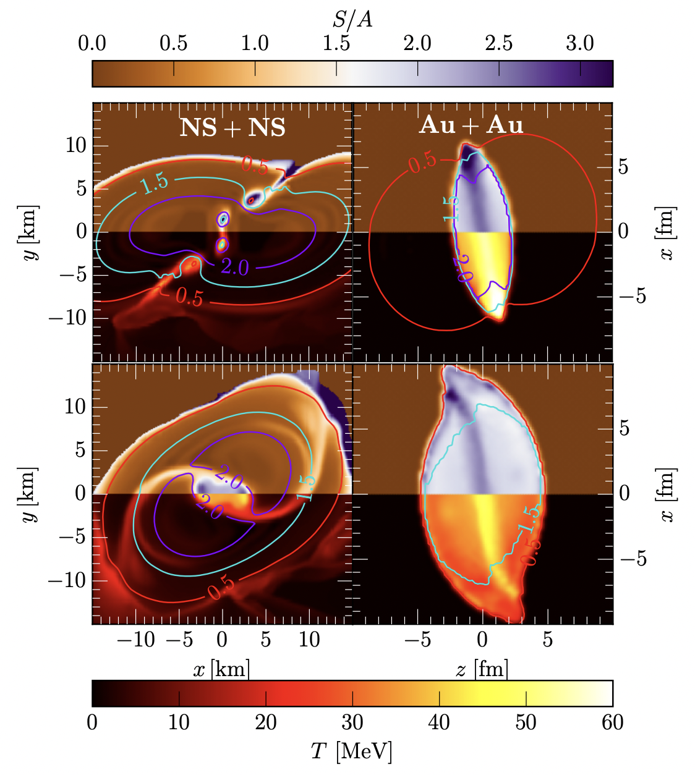
Entropy per Baryon S/A (top colormaps) and
Temperature T (bottom colormaps)
for a BNS merger (NS+NS) with total mass M_{tot} = 2.8 M_{sun} (left panels) and a
Au + Au HIC at E_{lab} = 450 MeV (right panels).
Colored lines mark density contours in units of n_sat.
snapshots in different rows refer to
t = −2, 3 ms before and after merger for the BNS, respectively, and to
t = ±5 fm/c before and after the full overlap for the HIC.
E. Most, A. Motornenko et al, PLB

Slide 17
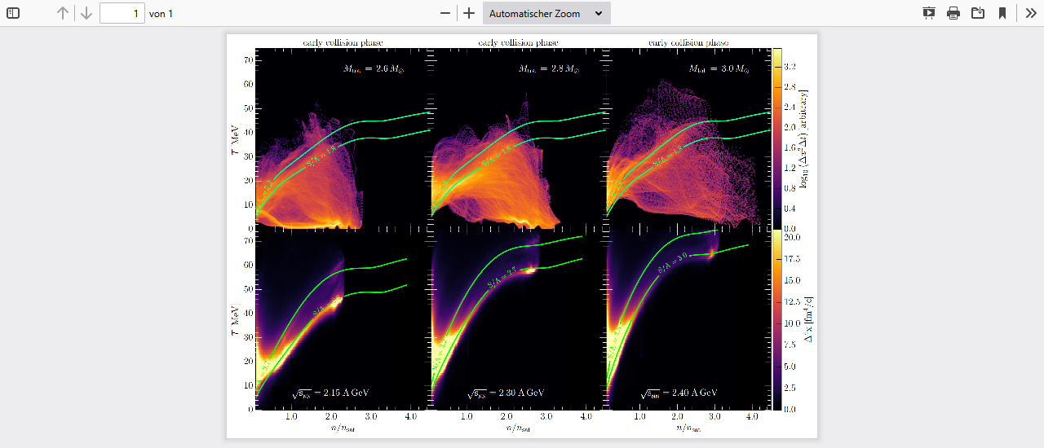
T(n), S/A in
Binary
Neutron
Star
Collision
T(n), S/A in
Binary
Heavy Ion
Collision
Neutron Star S/A > 2, increases with NS mass
GSI/FAIR S/A > 2, increases with E_LAB
Tune Kern-Kern => Stern-Stern EoS in the LAB!
E.Most, A.Motornenko, J. Steinheimer, L. Rezzolla, H.St., PLB

Slide 18
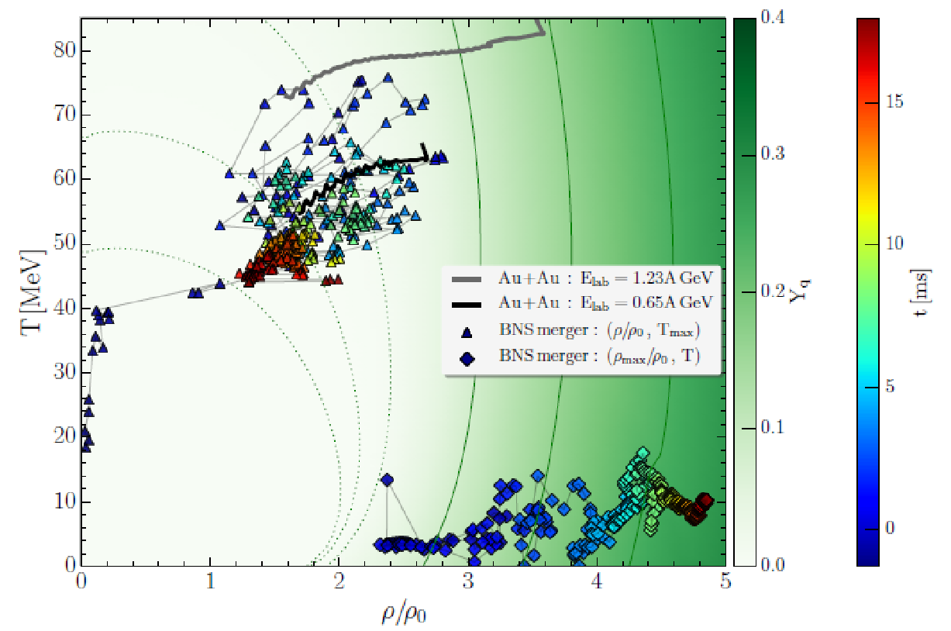
Where it’s hot and dense in neutron star mergers and HIC
Separation of hot hadronic corona and dense, cold quark matter core
Heavy ion Collisions GSI + FAiR same environment as
Bin. Neutron Star mergers

Slide 19

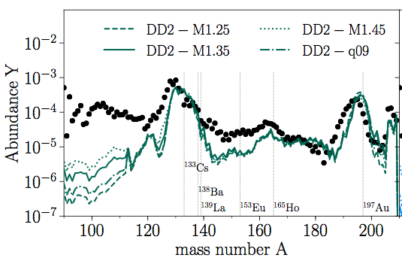


Light-Flash signals Creation of new Elements
Bovard, et al. 2017
Relative Abundance of cosmic elements
Simulation vs.
Observation
T. Kodama ‘77 GW170817
produces lots of
Gold, Platinum:
10x M_earth !
Tell Your politicians !
We found TONS of Gold!
Die Neutronenstern Kollision
GW170817 erzeugte Gold & Platin : 10 mal die Masse der Erde!
Wir sind (Neutronen-) Sternen Staub !

Slide 20
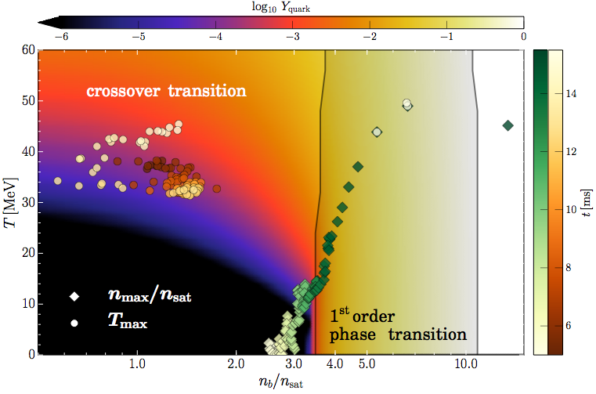
T, n Evolution in the phase diagram
Evolution of the max. temperature and density.
Quarks appear early on in Torus: T~50 MeV
Once core reaches density n/n_0 ~ 3.5, transition into SQM occurs

Slide 21
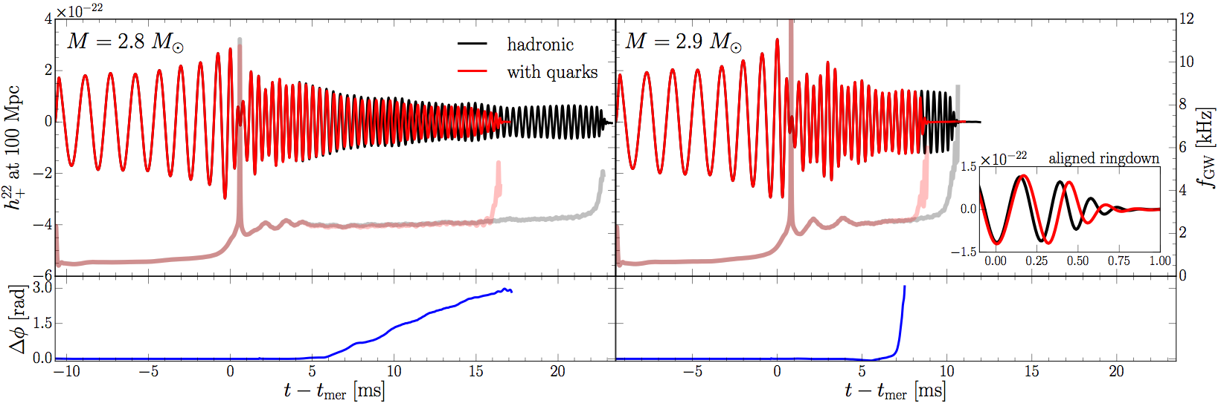
Gravitational Wave Emission from BNSM- ML!
“low-mass” binary
“high-mass” binary
In low-mass binary, after ~ 5 ms, quark fraction is large enough to change quadrupole moment and yield differences in the waveforms.
In high-mass binary, phase transition takes place rapidly after ~ 5 ms
. Waveforms are similar but ringdown is different (free fall for PT).
Mismatch hadronic inspiral and post-merger phase:
clear Signature of Quark Matter - crossing or 1.OPT ?

Slide 22
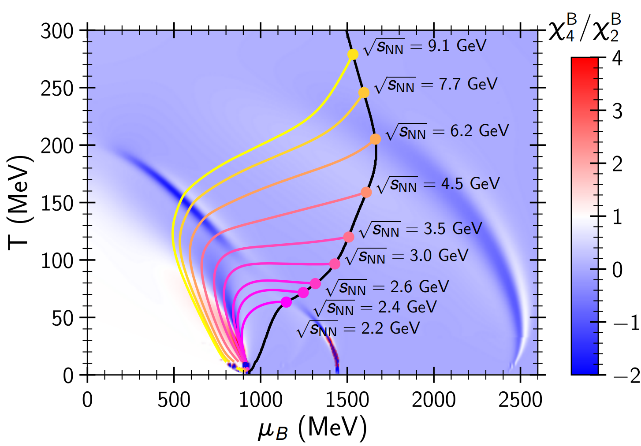
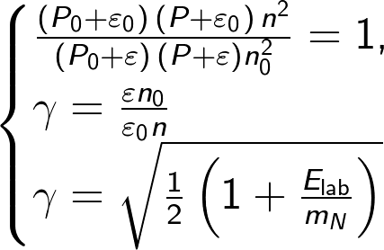
Probing phase diagram of CMF in heavy ion collisions
Isentropes (S/A = const) illustrate hydrodynamical evolution of the central region in heavy ion collision.
Initial entropy per baryon S/A, was estimated by Taub adiabat (shock wave solution):
(A. H. Taub, Phys. Rev. 74, 328 (1948))
P₀, ε₀, and n₀ correspond to the initial pressure, energy density, and baryon density in the local rest frame of each slab

Slide 23

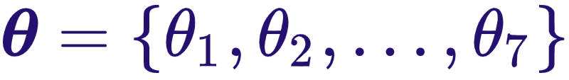
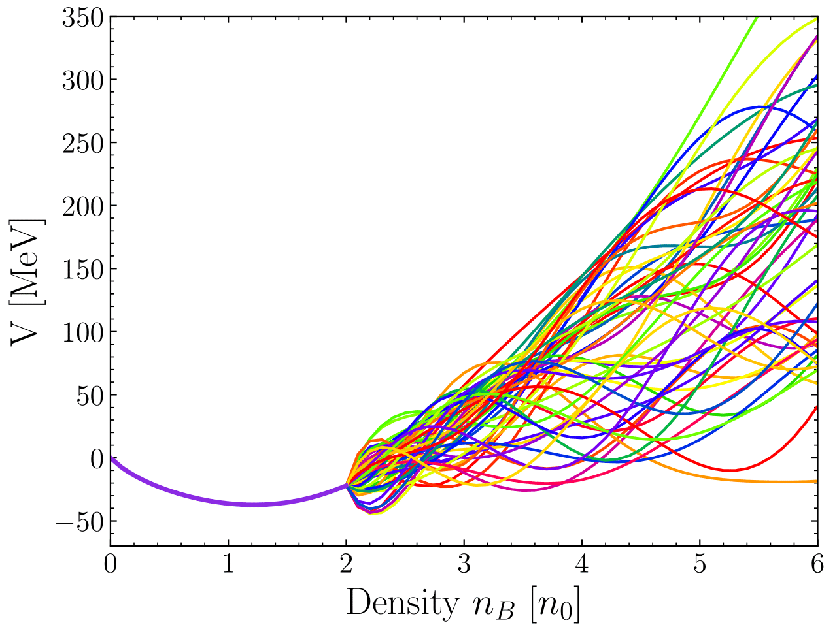
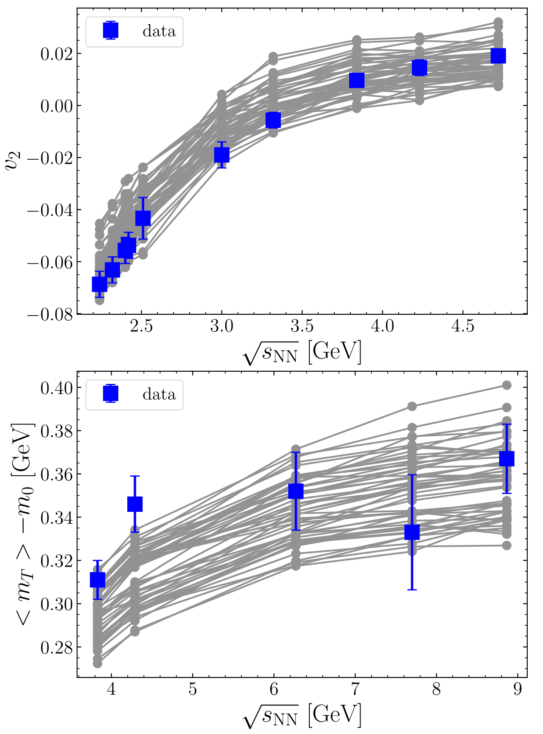
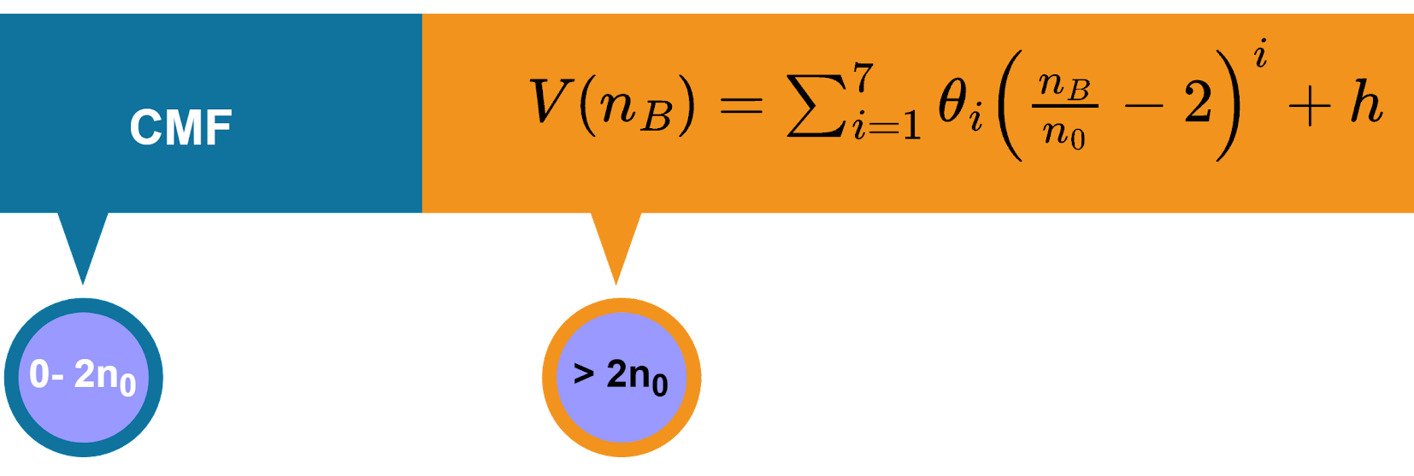
Bayesian inference of the EoS:
? New State of Chiral Baryon Resonance Matter n/n_0 ~ 3 ?
M. Omana Kuttan, K. Zhou, J. Steinheimer H.Stöcker et al ArXiv:2211.11670, PRL 2023
***Front Page of Phys. Rev. Lett.***
The data,
UrQMD with density dependent potentials
7th degree polynomial for potential above 2n₀
is used to constrain the parameters
E895
E877
E895
E895
STAR
(E895) Phys. Rev. Lett. 83, 1295 (1999)
(CERES), Nucl. Phys. A 698, 253 (2002)
(FOPI), Phys. Lett. B 612, 173 (2005)
(STAR), Phys. Rev. C 86, 054908(2012)
(STAR), Phys. Rev. C 103, 034908 (2021)
(HADES), Phys. Rev. Lett.125, 262301 (2020)
(STAR), Phys. Lett. B 827, 137003(2022)
FOPI, HADES
E917
E917
NA49
We constrain the polynomial coefficients
NA49
STAR
(E917), Phys. Rev. C 66, 054901 (2002)
(NA49), Phys. Rev. C 73, 044910 (2006).
(STAR), Phys. Rev. C 96, 044904(2017)
Notes:
we can use this model to learn further about the eos.
if we parameterise the eos as…
and use the experimental data of …,
we can try to constrain the coefficients through the bayesian inference procedure

Slide 24
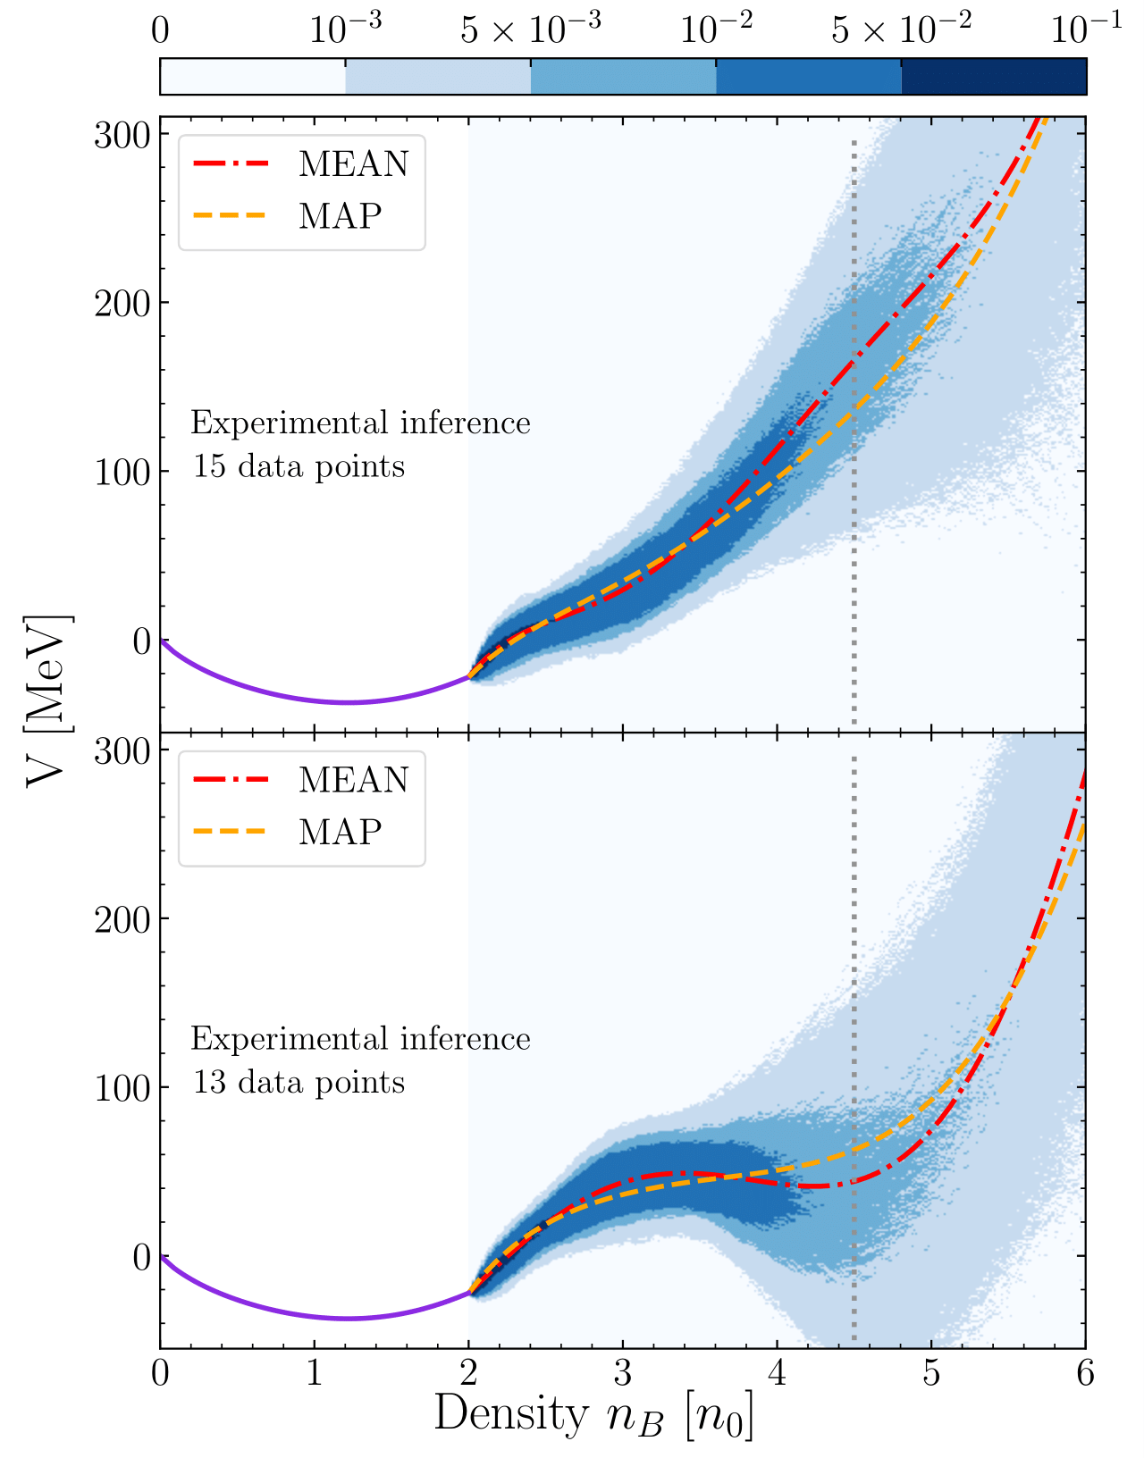
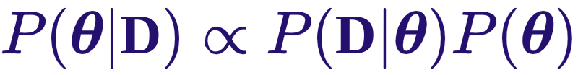
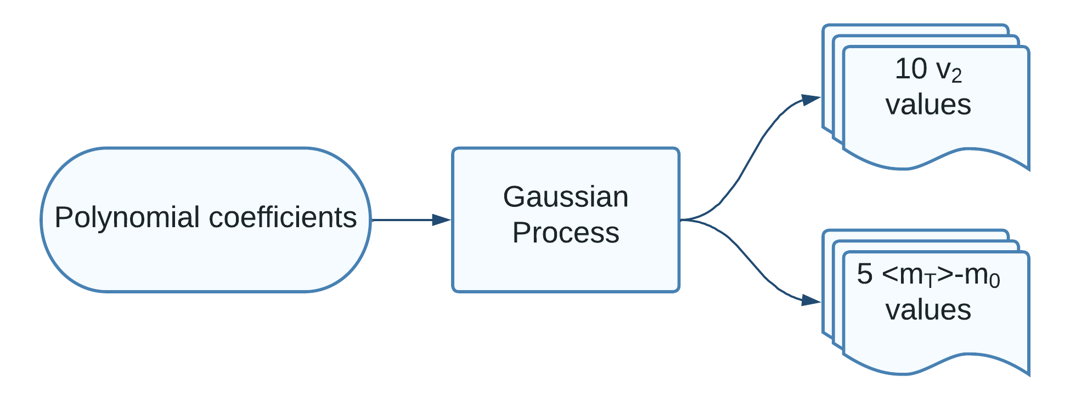
The inferred posteriors
M.Omana Kuttan, K. Zhou, J.Steinheimer, H. Stöcker et al Phys. Rev. Lett.2023
arXiv:2211.11670
Gaussian Process models trained as
fast emulators
Good constraints up to 2.5 n₀
Constraints above 3 n₀ data dependent
<m_{T}> - m₀ data at low density and energy
Density isomer 3 - 5 n₀ created ?
Trapped ? Metastable ? Strange Matter ?
AGS E917 <m_{T}> - m₀ data incl..
AGS E917 <m_{T}> - m₀ data dropped
Notes:
However, the model is too slow and we need to train fast emulators for urqmd. using this emulator and exp data, we can construct the posterior distribution of high density eos
we see..two distinct behaviors depending on the choice of eos
Posterior proportional to likelihood weighted prior

Slide 25
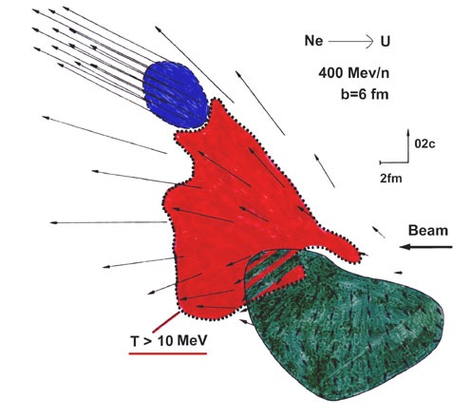
Why Nuclear Collective Flow ?
H.Stöcker, J. Maruhn, W. Greiner, PRL 44 (1980) 725
„alphas“
3+1Dim Non-relativ. Hydrodynamics
NO Spectators in H.I. collisions –
pressure gradient yields collective flow of all particles !
v1 = px(y) / pt(y)
nuclear Barometer !
V1 measures p(n,T), nuclear Equation of State (EoS)
„alphas“

Slide 26
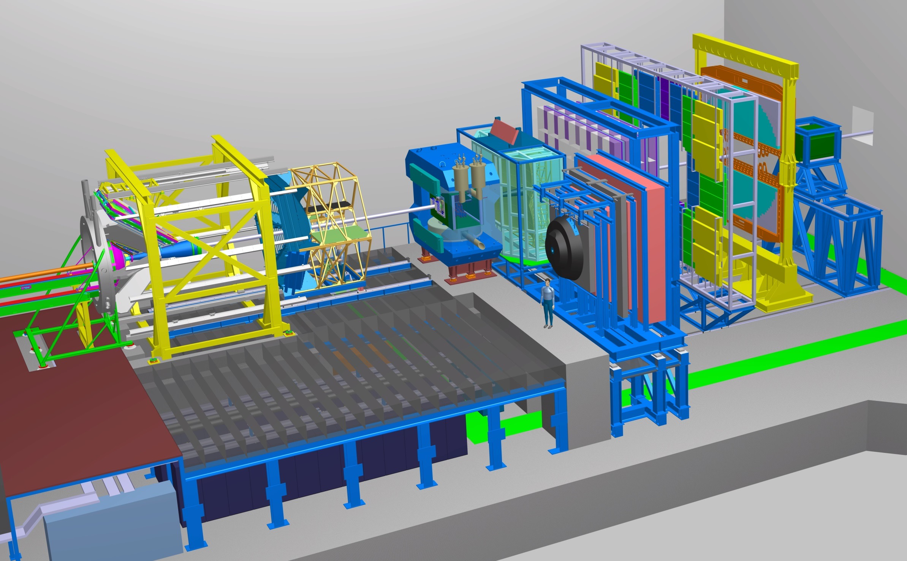
The CBM experiment
Transition
Radiation
Detector
Time of Flight
Detector
Ring
Imaging
Cherenkov
Dipol
Magnet
Silicon
Tracking
System
HADES
p+p, p+A
A+A (low mult.)
Micro
Vertex
Detector
Muon
Detector
Projectile
Spectator
Detector
DAQ/FLES HPC cluster
2/27/2018
H. Stoecker FAIR Discoveries

Slide 27


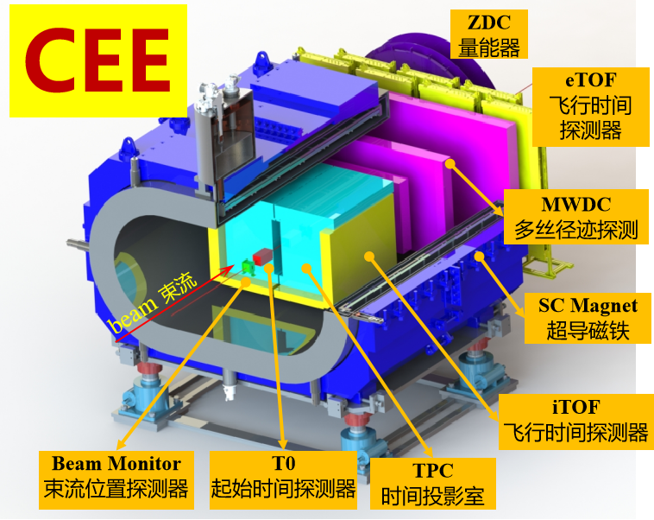
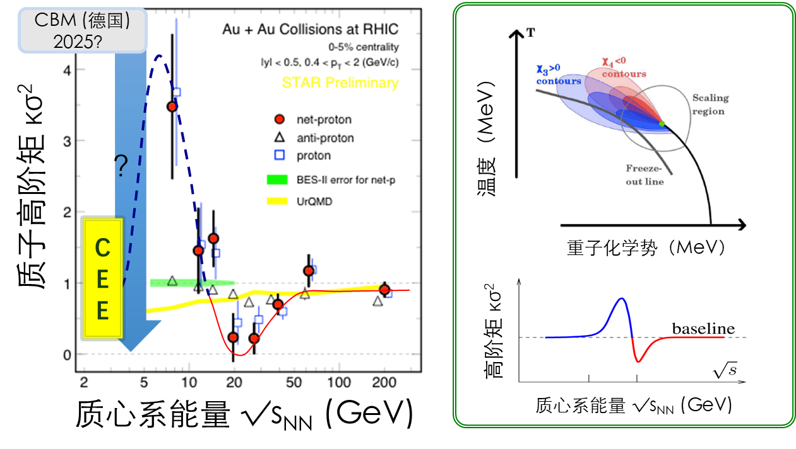
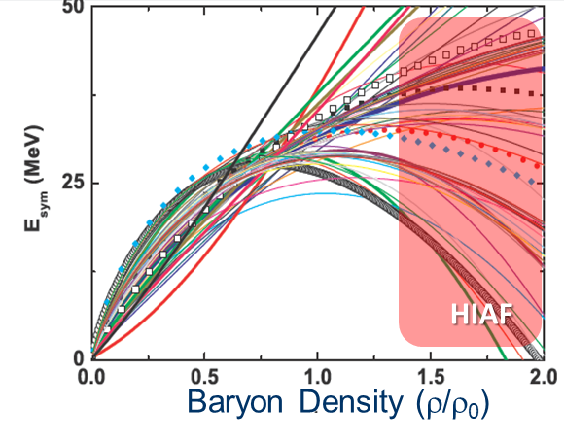
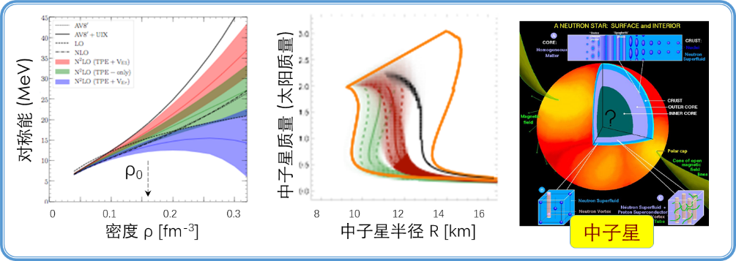
HIAF
Study of the QCD Phase Structure and Symmetry Energy
Search for QCD critical point
CSR External-target Experiment
plan to be finished with construction in 2024
operation at HIRFL-CSR (Lanzhou) first
move to HIAF once its construction is complete
Study nuclear matter EOS, especially E_{sym}(ρ)
27

Slide 28
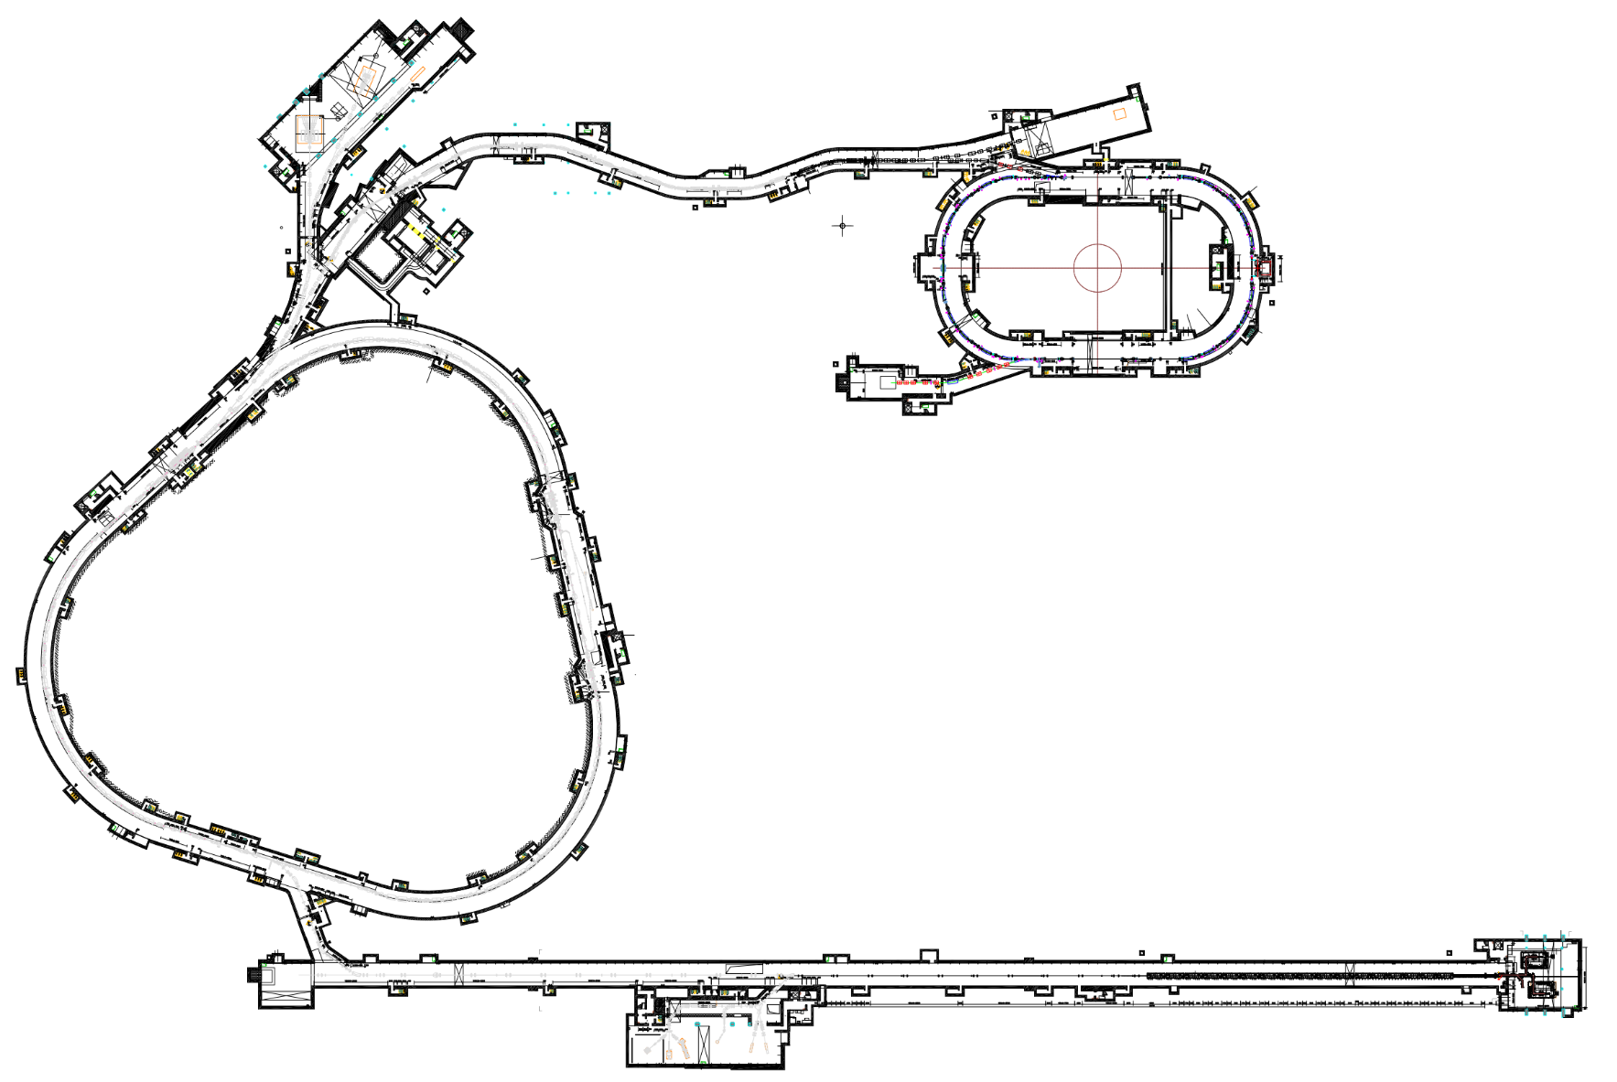
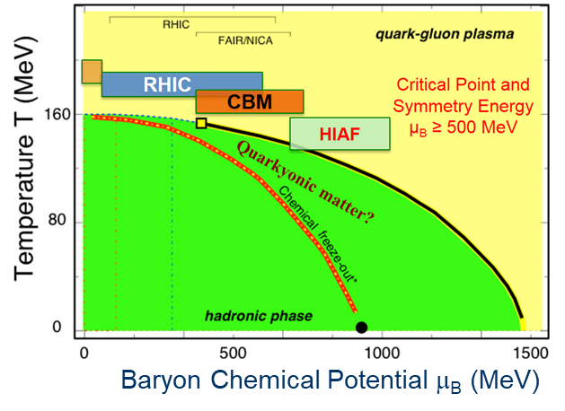
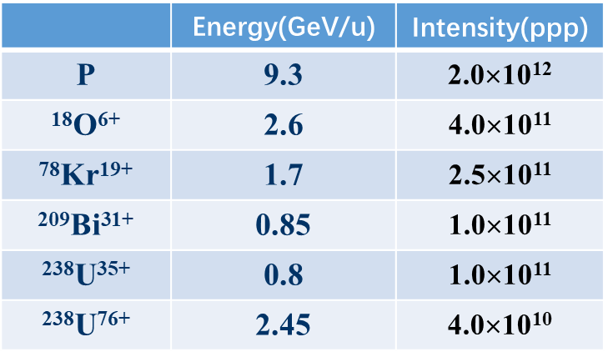
HIAF简介
High energy station
HFRS: Radioactive beam line
L: 192m, Bρ: 25 Tm
Nuclear Matter study
Hyper-nuclear
High energy irradiation
SRing
Spectrometer ring
Circumference: 273m
Rigidity: 13-15 Tm
BRing
Fast cycle ring
Circumference: 590 m
Rigidity: 34 Tm
iLinac
Superconducting linac
Length:100 m
Energy: 17-22 MeV/u(U³⁵⁺⁻⁴⁵⁺)
SECR
Superconducting
ECR source
28
Notes:
主要目标（核物理）
描述核物质的QCD相图：低温高密区QCD 相结构 (物质结构)
- 夸克禁闭
- 手征对称自发破缺
- 临界点、相边界 …

Slide 29
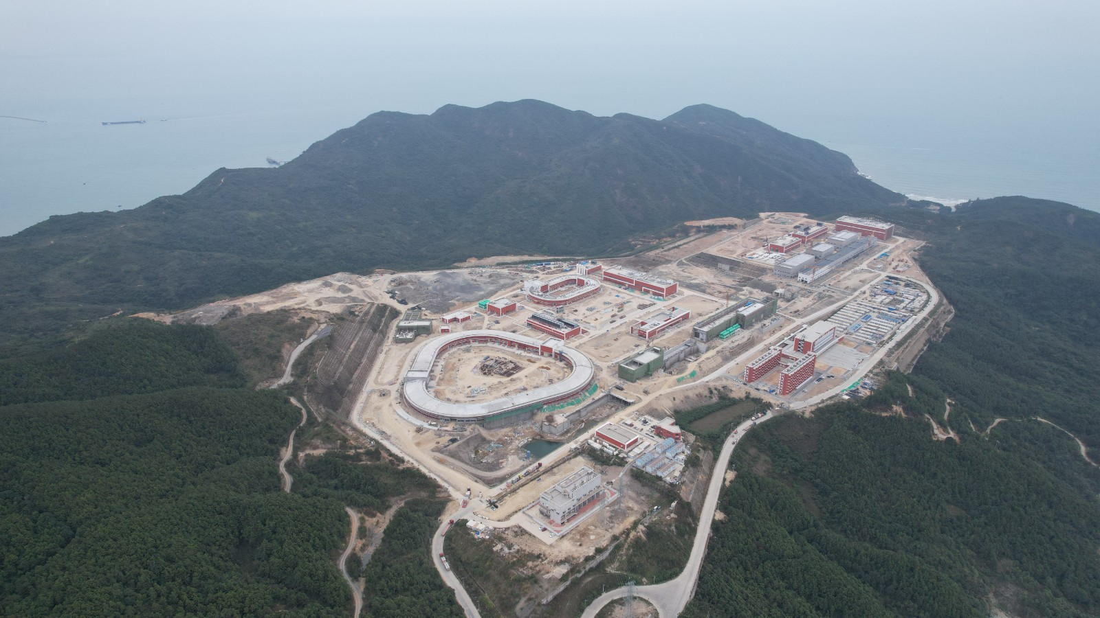
Civil engineering
2024.2
效果图
29
Notes:
HIAF国投建筑面积3.6万平方米，预计2023年6月完成全部土建。地方投资的土建预计2023年10月份完工。2025年中期具备实验条件
地下隧道：BRing-高能综合终端-HFRS-外靶终端-SRing-高能量密度终端隧道土建施工已完成，正在开展束流前端及超导直线加速器隧道土建施工，预计2022年底完成隧道主体结构封顶及部分回填工作。
地上单体：运行楼施工已全部完成，等待验收；三号综合站房、综合测试大厅、制冷中心等已封顶，正在开展机电设备安装；后勤区变电站、给水机房建成投产，科学之门、值班楼及污水处理机房等主体结构已封顶

Slide 30
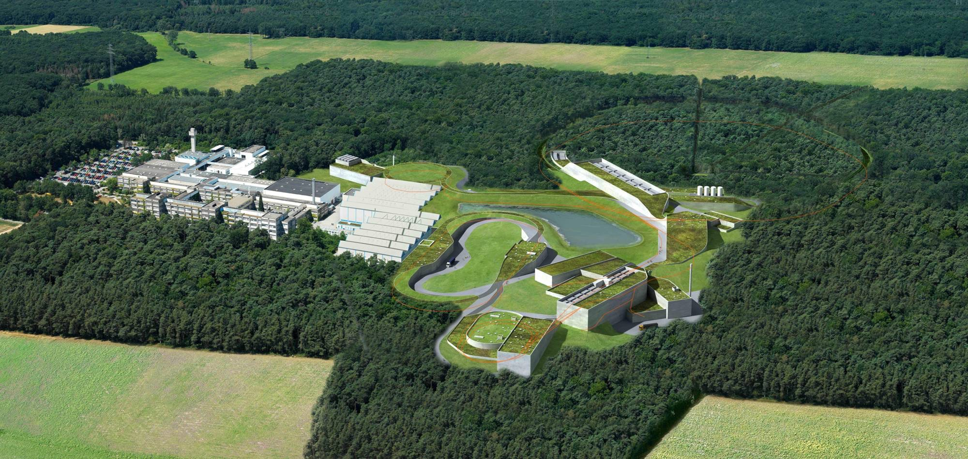



















Death-Star- Machines: GSI-FAIR-HIAF-NICA-STAR
Germany EU China Russia USA
NeutronStars made in Heavy Ion Collisions ?
Strange Charm and Beauty of International Collaboration
Observers
Poland
Slovenia
Russia
Rosatom
Finland
France
Germany
India
Italy
Spain
Sweden
Romania
Austria Czech
Hungary
China
H. Stoecker FAIR Discoveries
UK
11.11. 2019

Slide 31







FAIR: a world-wide project
FAIR governed by international convention
  9 shareholders:
  + 1 associated partner:
  + 1 aspirant partner:
  Over 3000 Scientists and Engineers from all over the world
Scientists from More than 200 institutions from 53 countries (orange + blue)
Finland
France
Germany
India
Poland
Romania
Russia
Slovenia
Sweden
UK

Slide 32


GSI and FAIR – The Facility
GSI, existing (upgraded to integrate with FAIR)
UNILAC
SIS 100
SIS18
HITRAP
FRS
FAIR,
under construction
ESR
100 m
CRYRING
HESR
FAIR-Phase 0 –
Start in 2018!
Super FRS
CR
FAIR key features
intensity for wide range of ions
storage rings
antiproton beams
ESR, CRYRING, & HITRAP are part of the FAIR MSV

Slide 33


SIS100 Tunnel –
Technical Building Installation

Slide 34

Ongoing: Early science program FAIR Phase-0
Started in 2019, annual runs of ~110 days until FAIR operation
up to 90 % speed of light
Ion species: H⁺,..., U⁹²⁺
heavy-ion synchrotron
SIS 18
linear accelerator
UNILAC
PHELIX
M-branch
Z6
Fragment Separator
HHT
Ion
sources
storage ring ESR
8 % - 15 % speed of light
X0
SHE
HITRAP
HADES
Cave A
miniCBM
CRYRING
R3B
Science while commissioning FAIR
latest call: 124 proposals submitted
1729 participants of proposals
From institutes in 45 countries

Slide 35


Accelerator progress
  December 2023
  Successfull completion of the first thermal cycle of the SIS100 string.
  February 2024
  Quadrupoles with vacuum chambers for beam line section T1S2 during pre-assembly in testing hall.

Slide 36

Prospects and timeline
APPA Laser
SIS100
until 2028
UNILAC
HITRAP
SIS18
ESR
CBM
CRYRING
Super-FRS
after 2028
First Science +
Next steps
MSV completion
NUSTAR HEB
Continuation of APPA, CBM and NUSTAR experiments in existing facility
APPA, NUSTAR and PANDA investigate options for further experiments at green lines
36

Slide 37
Death-Star- Machines: GSI-FAIR-HIAF-NICA-STAR
Germany EU China Russia USA
NeutronStars made in Heavy Ion Collisions ?
Strange Charm and Beauty of International Collaboration
Observers
Poland
Slovenia
Russia
Rosatom
Finland
France
Germany
India
Italy
Spain
Sweden
Romania
Austria Czech
Hungary
China
H. Stoecker FAIR Discoveries
UK
11.11. 2019

Slide 38


Slide 39

Death-Star- Machines - FAIR HIAF NICA STAR
NeutronStar matter in the Lab - Heavy Ion Collisions

Slide 40
It started all 50 years ago, at Dubna´s Syncrophasotron and Berkeley´s Bevalac

Slide 41


Then young theorists waiting for data…

Slide 42




Discovery of predicted Nuclear Collective Flow
Courtesy Karlheinz Kampert
1984
Sphericity Analysis:
rotationally symmetric ellipsoid inclined wrt beam axis by flow angle Θ calculated from momenta of particles:
H.Stöcker, Maruhn, Greiner, PRL 44 (1980) 725
$$F_{ij}=\frac{1}{2}\underset{ν}{∑}{\overset{⃗}{p}}_{i}(ν){\overset{⃗}{p}}_{j}(ν)/m(ν)$$
(kinetic energy flow)
PB Data confirmed hydro flow calculations
- and ruled out intranuclear cascade

Slide 43




Discovery of predicted „Squeeze-Out“
1989
Aspect ratios of half-axes at $y_{mid}$
Ch. Hartnack IQMD, v2=(px^2-py^2)/pT^2
first indications by Diogene experiment
90°
H. Gutbrod, K.H.Kampert, B.W: Kolb,
A.M. Poskanzer, H.G. Ritter, H.R. Schmidt; Phys. Lett. B216 (1989) 267
Au+Au at 400 AMeV
Courtesy:
Karlheinz Kampert
90°
Note, this was the forerunner
of the Fourier expansion analysis
backward
midrapidity
forward
Opened a new window to the fireball

Slide 44
Discovery of the predicted Sidewards Flow!
1984
Courtesy Karlheinz Kampert

