Slide 1


Triaxial Shapes and Rotational Energies of Atomic Nuclei
Takaharu Otsuka
Exploring nuclear physics across energy scales 2024:
Intersection between nuclear structure and high energy nuclear collisions
Peking University
April 21 (20-22), 2024
Y. Tsunoda (CNS, U. Tokyo), N. Shimizu (Tsukuba), Y. Utsuno (JAEA),
T. Abe (Keio U.), H. Ueno (Riken)

Slide 2
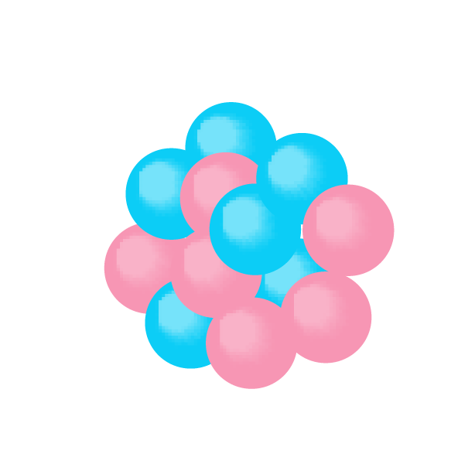
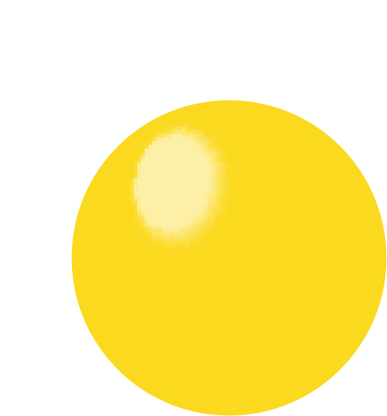
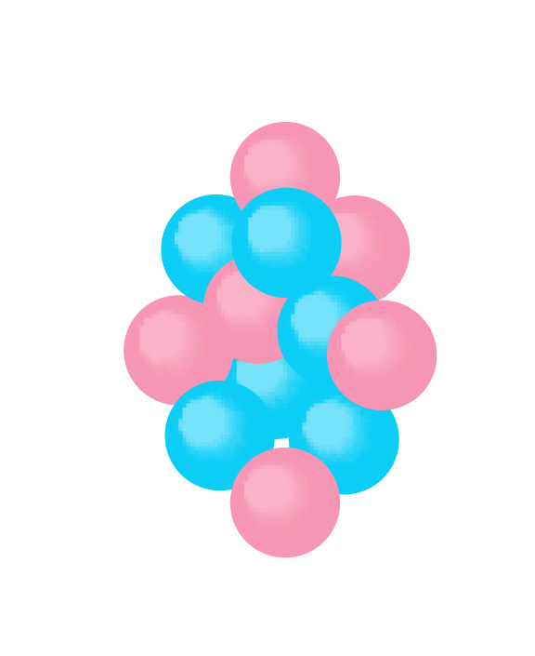
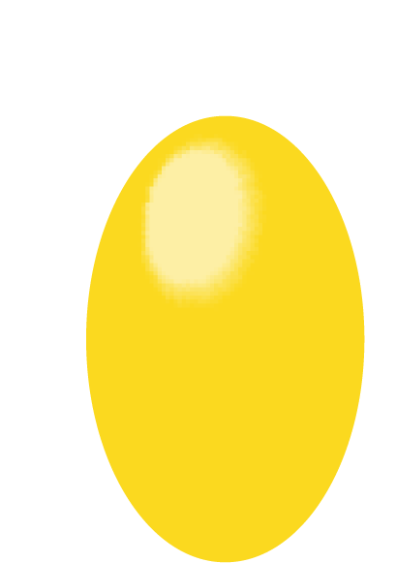
Some models of atomic nuclei in nuclear physics were conceived based on intuitions obtained in the 1950’s. A good example is a liquid drop model and related works.
atomic nucleus as
multi-nucleon system
liquid drop of uniform density
sphere
Many nuclei exhibit strong deformation
(long axis ∼ 1.3 x short axis)
described by Bohr Hamiltonian
(Aage Bohr and B.R. Mottelson, 1952)
ellipsoid
Nilsson model (1955), DFT models,
Interacting Boson Model (1975)
Those are excellent pieces of physics ideas. However, quantum many-body approaches may provide us with different pictures. ➔ This talk

Slide 3
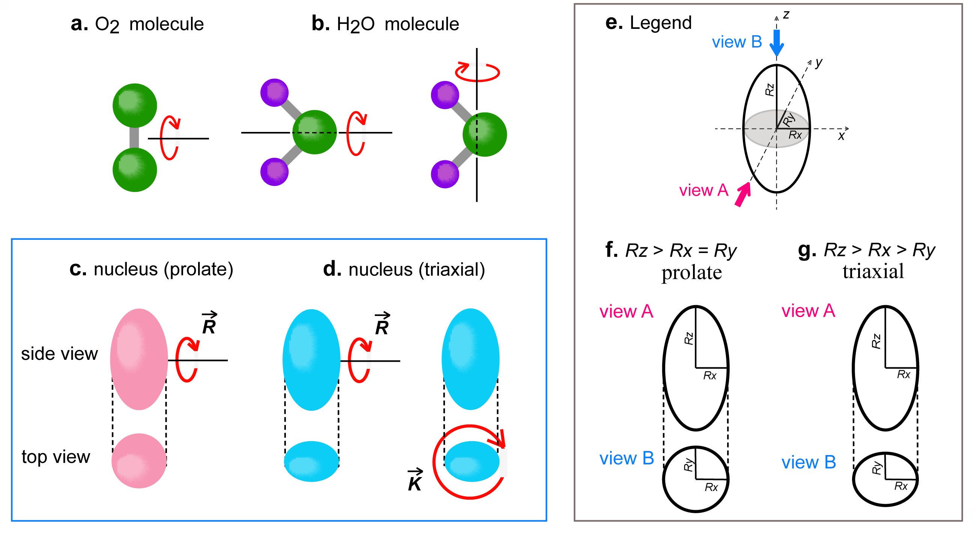
Types of rotations in molecules and nuclei

Slide 4
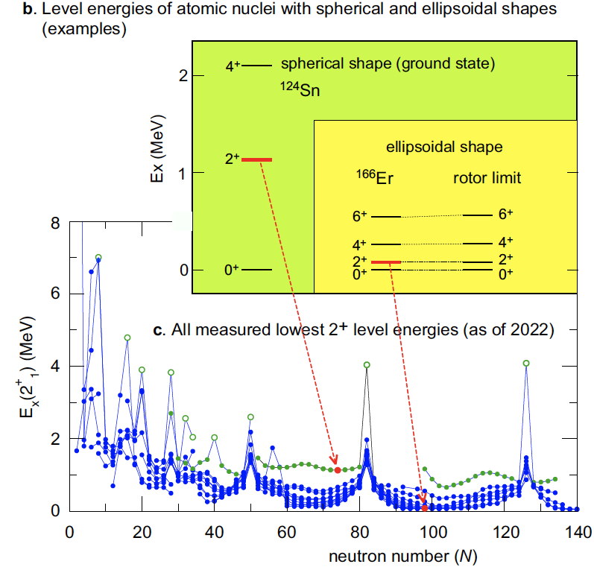
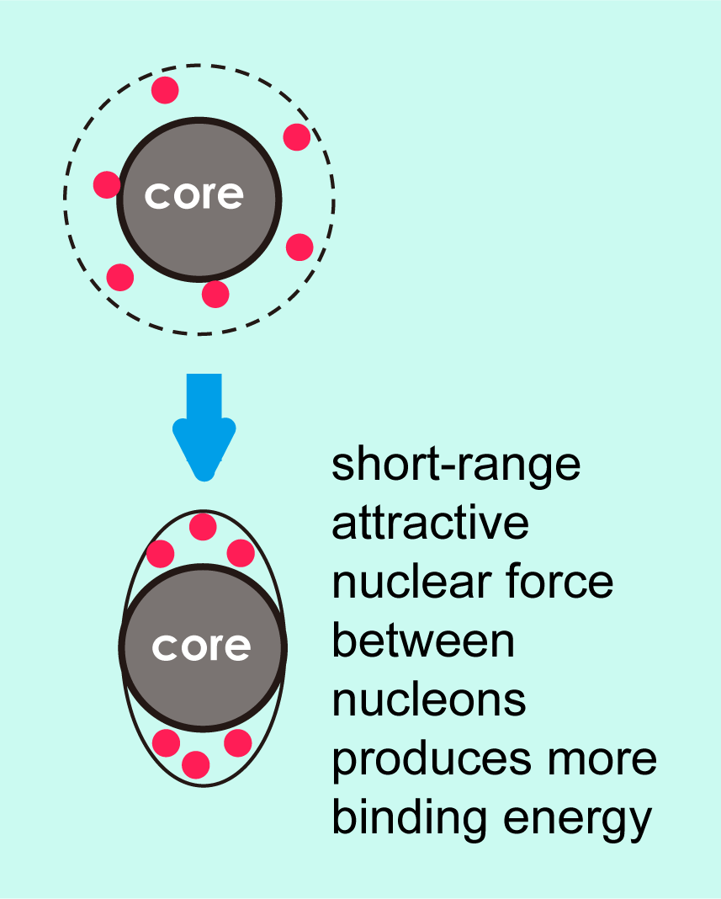
Why is the deformation a “must” in (most of) heavy nuclei ?
valence nucleons are sparsely configured because of the shell structure
range of nuclear forces
<<
size of single-particle orbital
(the bigger the heavier)

Slide 5
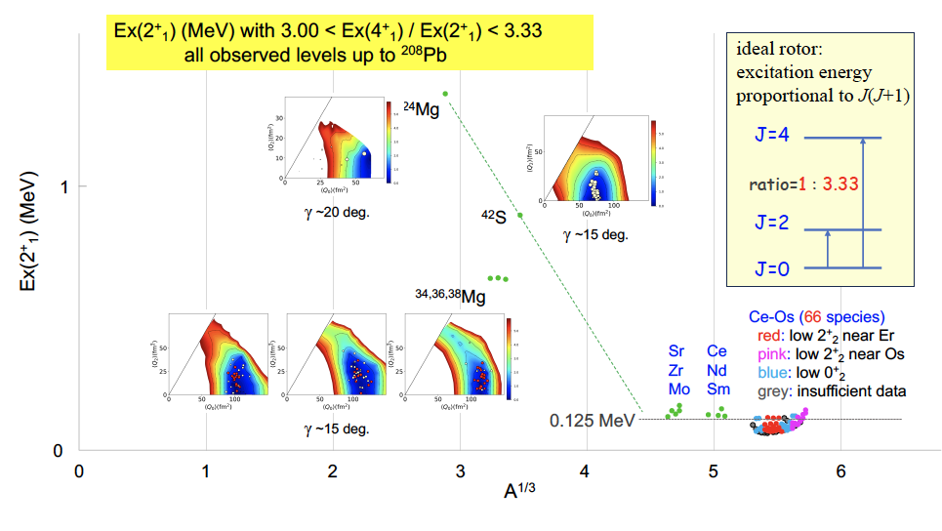
Appearance of (ground-state) rotational bands in nuclei

Slide 6
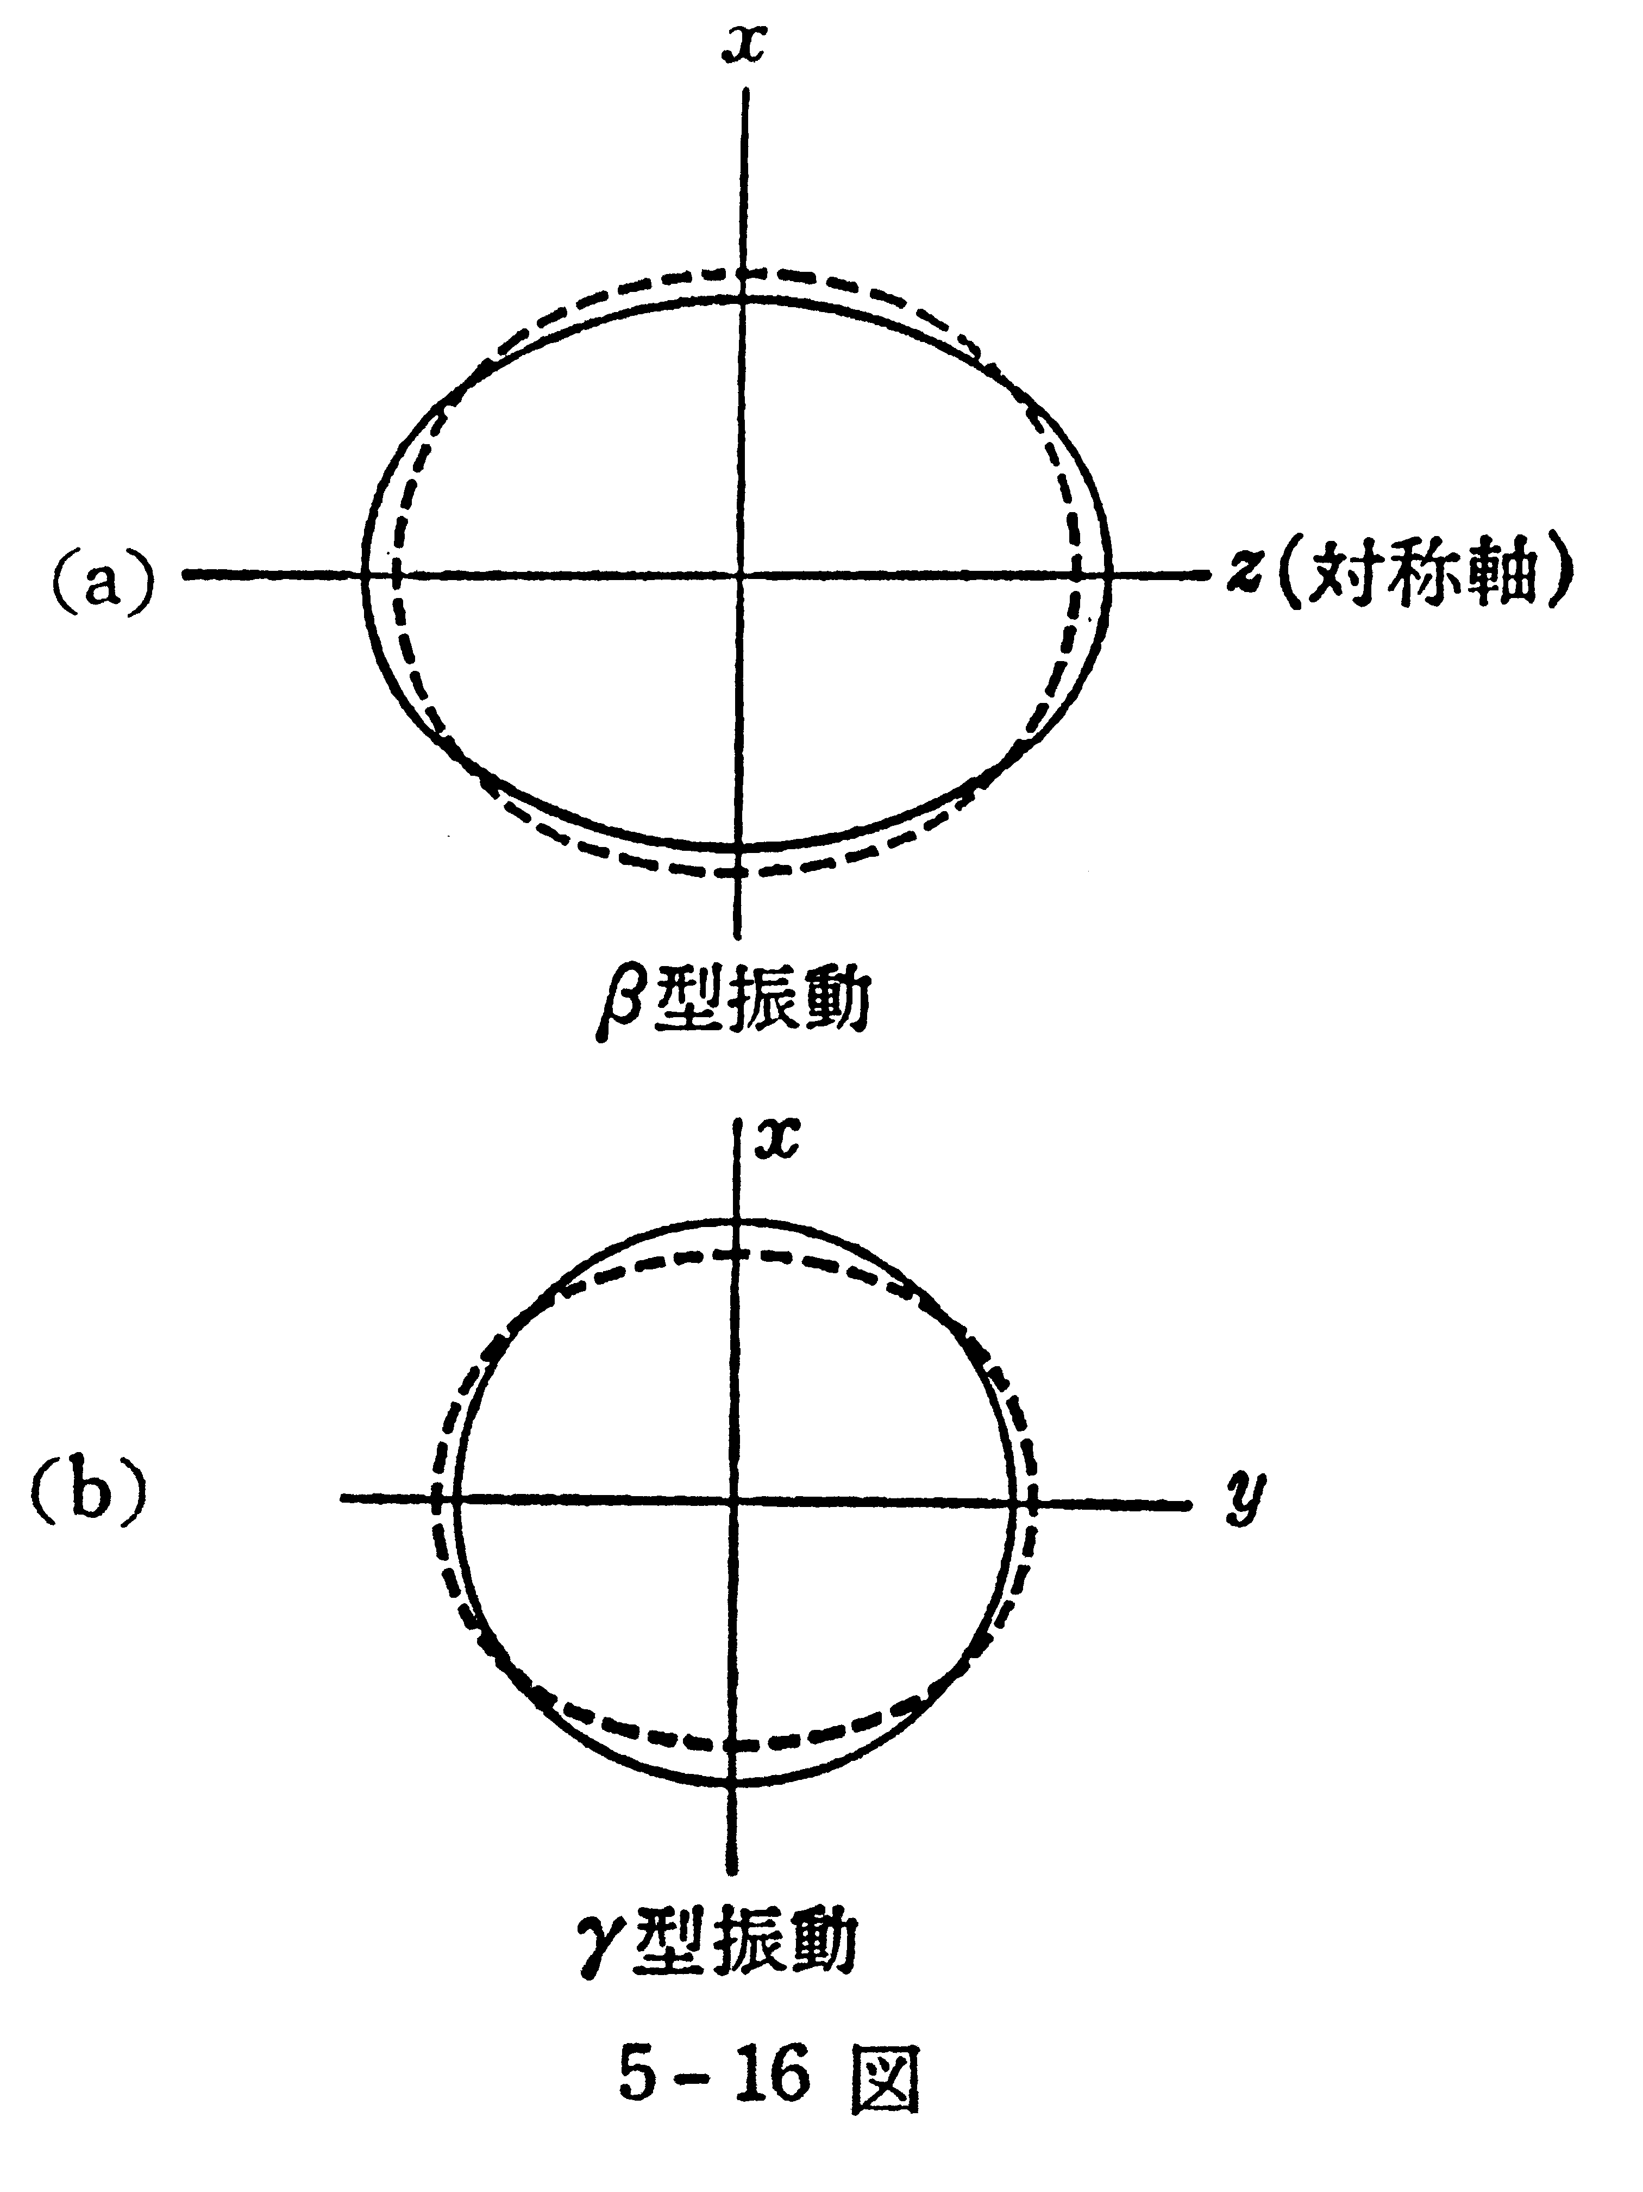
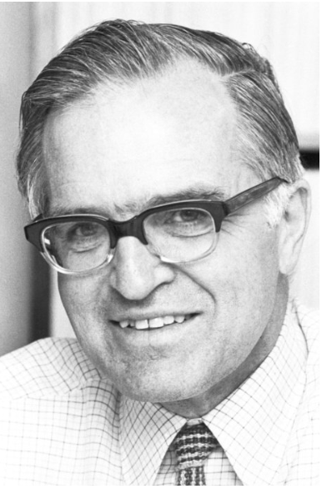
A case of the textbook example:
原子核 by M. Nogami
Aage Bohr
Novel Prize Lecture
(1975)
¹⁶⁶Er
γ – vibration
phonon
excitation
Aage N. Bohr, 1922-2009
Nobel Foundation archive
Axially symmetric
prolate ellipsoid
(equilibrium)

Slide 7
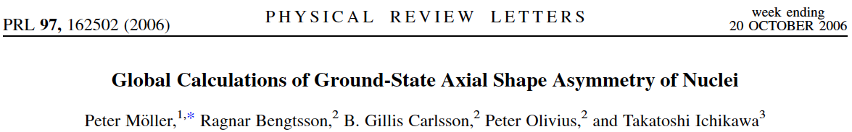
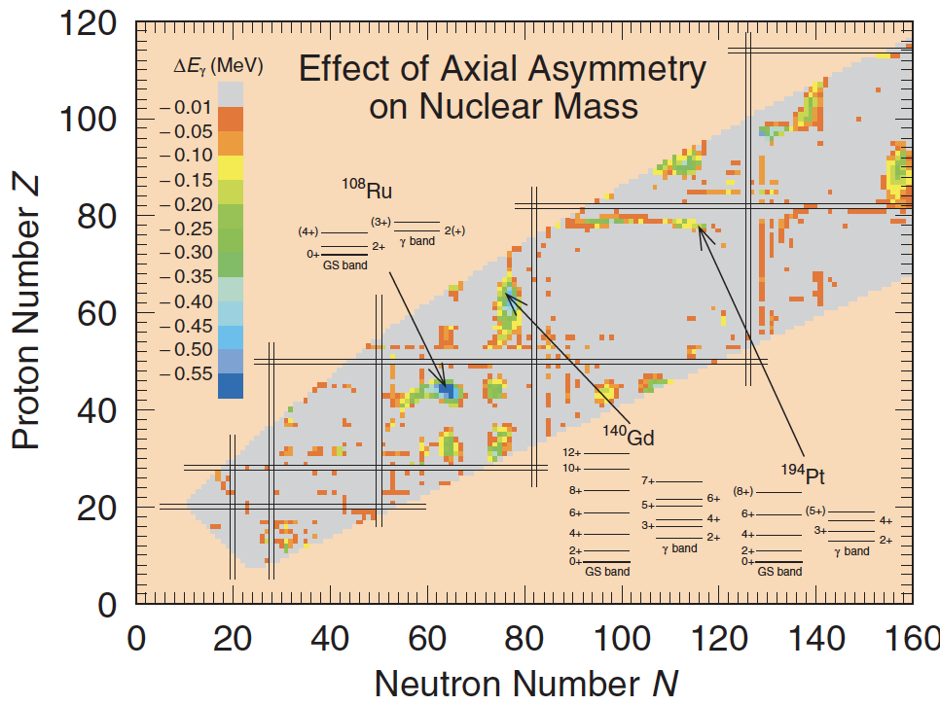
Conventional view
¹⁶⁶Er
Axial symmetry
supposed to
dominate
the region of
current interest
a la Aage Bohr

Slide 8
Revisit with Monte Carlo Shell Model
3s_{1/2}
Effective interaction: G-matrix* + V_{MU}
* Brown, PRL 85, 5300 (2000)
2d_{5/2}
1g_{9/2}
2p_{1/2}
Nucleons are excited fully within this model space (no truncation)
1f_{5/2}
0i_{13/2}
0h_{9/2}
We performed Monte Carlo Shell Model (MCSM) calculations, where the largest case corresponds to the diagonalization of 3.9 x 10 ³¹ dimension matrix.
Its recent extension, Quasiparticle Vacua Shell Model (QVSM)* is used,
for most of the calculations to be shown. * Shimizu et al, PRC 103, 014312 (2021)
2p_{3/2}
2p_{3/2}
1f_{7/2}
1f_{7/2}
0h_{11/2}
0h_{11/2}
1d_{3/2}
0g_{7/2}
70
2s_{1/2}
1d_{5/2}
0g_{9/2}
¹¹⁰Zr
40
+ HFB (number VAP, J VBP) + GCM for γ
proton
neutron
V_{MU} : same interaction for the description of shell evolution in exotic nuclei

Slide 9
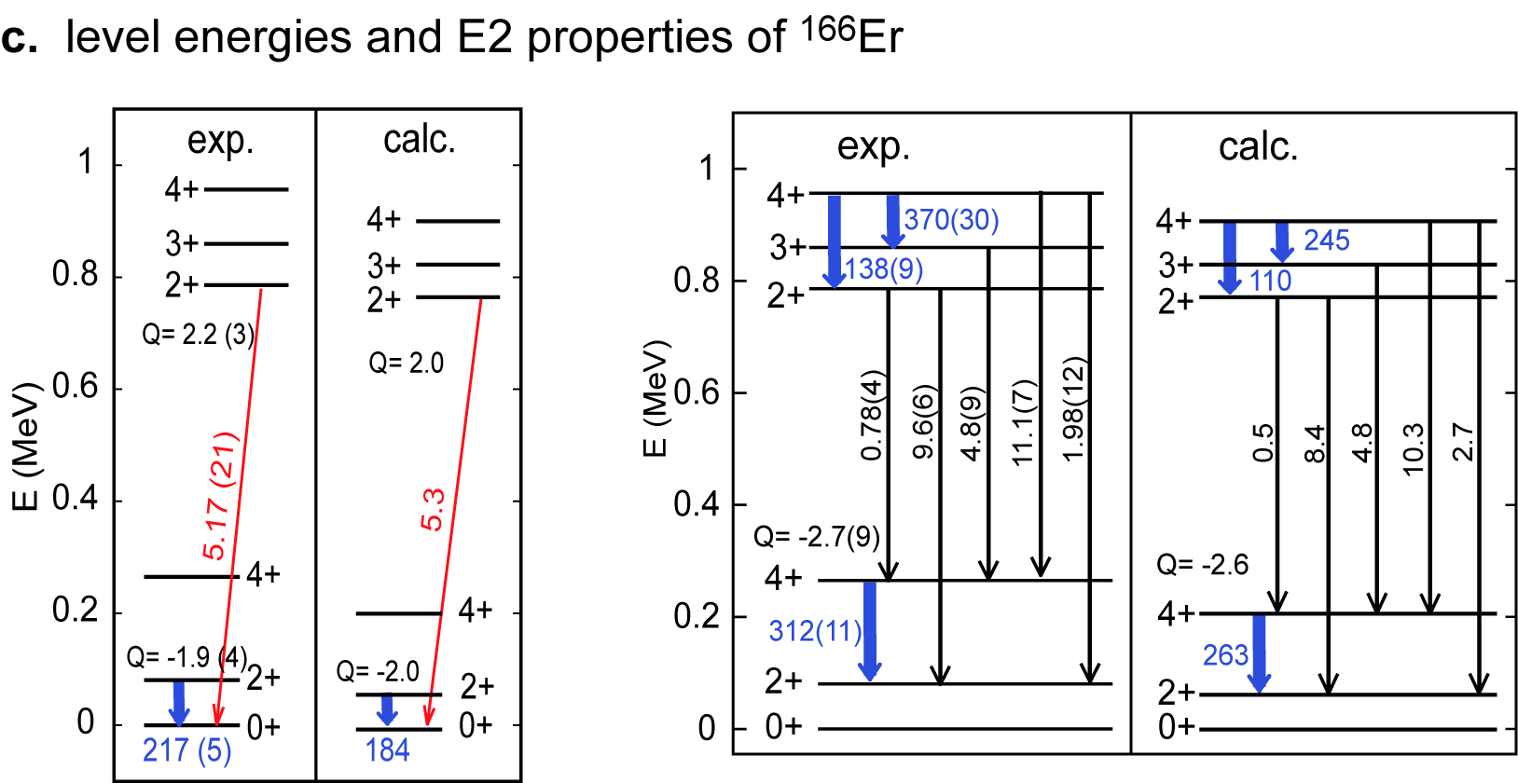
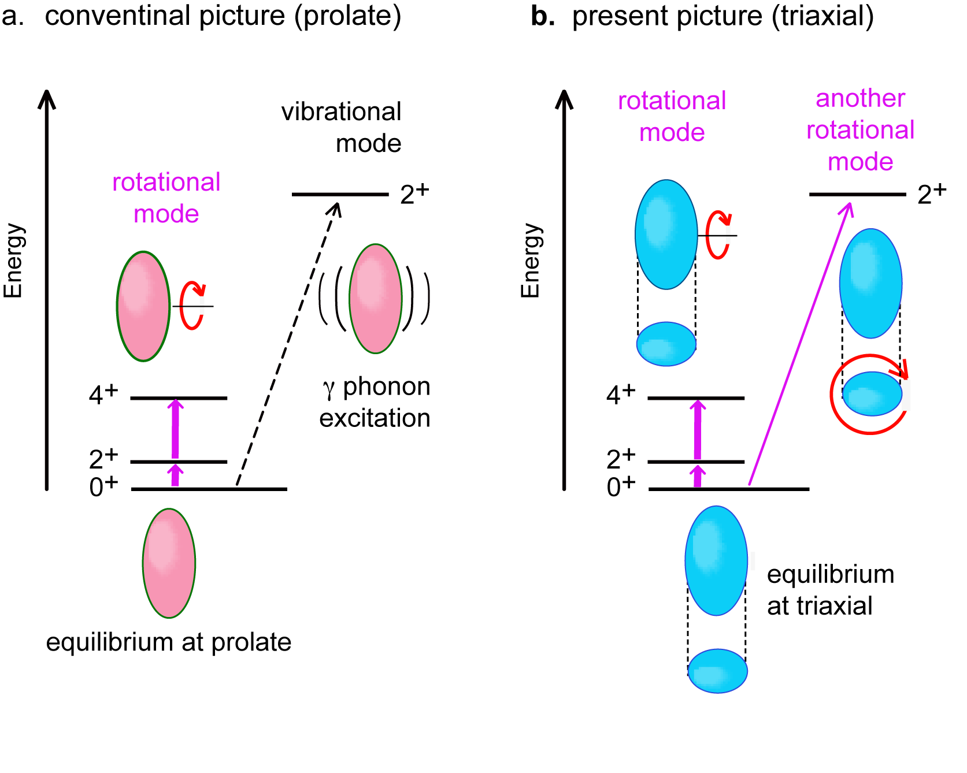
Aage Bohr’s
picture
Our picture
Result of MCSM calculation (CI calculation)
E2 quantities in W.u.
K = 2
R
K
K = 0
ellipse
circle
J = R + K
(cannot rotate)
The CI result points to a triaxial shape with axis ratio, 1.00 : 1.06 : 1.35.
No hint of vibrational excitation.

Slide 10
Basic formulation of Monte Carlo Shell Model
N_{B} : number of basis vectors
eigenstate
N_{p} : number of (active) particles
N_{sp} : number of single-particle states
amplitude
a
n-th basis vector (Slater determinant)
Projection op.
Superposition of original single-particle state
Minimize E(D) with respect to D utilizing
Quantum MC and variational methods
Step 1 : Shift randomly matrix matrix D. (The initial guess can be taken from Hartree-Fock.)
Select the one producing the lowest E(D) (rate < 0.1 %)
Step 2 : Polish D by means of the conjugate gradient (CG) method variationally.

Slide 11
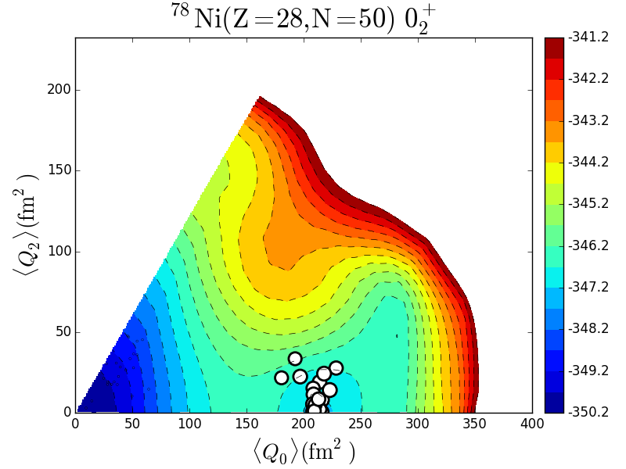
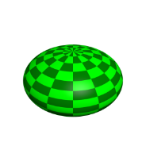
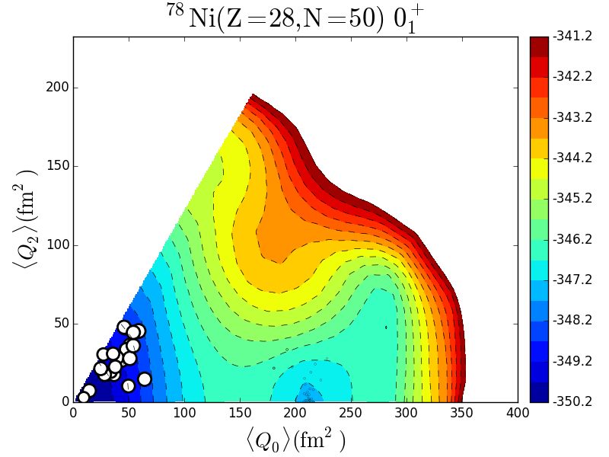
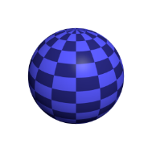
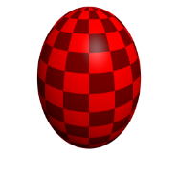

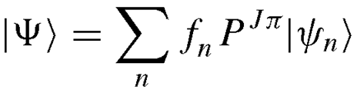
Identification of nuclear shape by T-plot of MCSM
T-plot of 0⁺ states of ⁷⁸Ni (Z=28, N=50)
Location of circle: shape
quadrupole deformation of
unprojected MCSM basis vector
Area of circle: importance
overlap probability between each projected
basis vector and the eigen wave function
Potential energy surface (PES) is calculated by
Constrained HF for the same interaction
oblate
0⁺₂
0⁺₁
spherical
prolate
angular-momentum, parity projection
Slater determinant
Y. Tsunoda, et al.
PRC 89, 031301 (R) (2014)
MCSM eigen wave function
MCSM basis vector

Slide 12
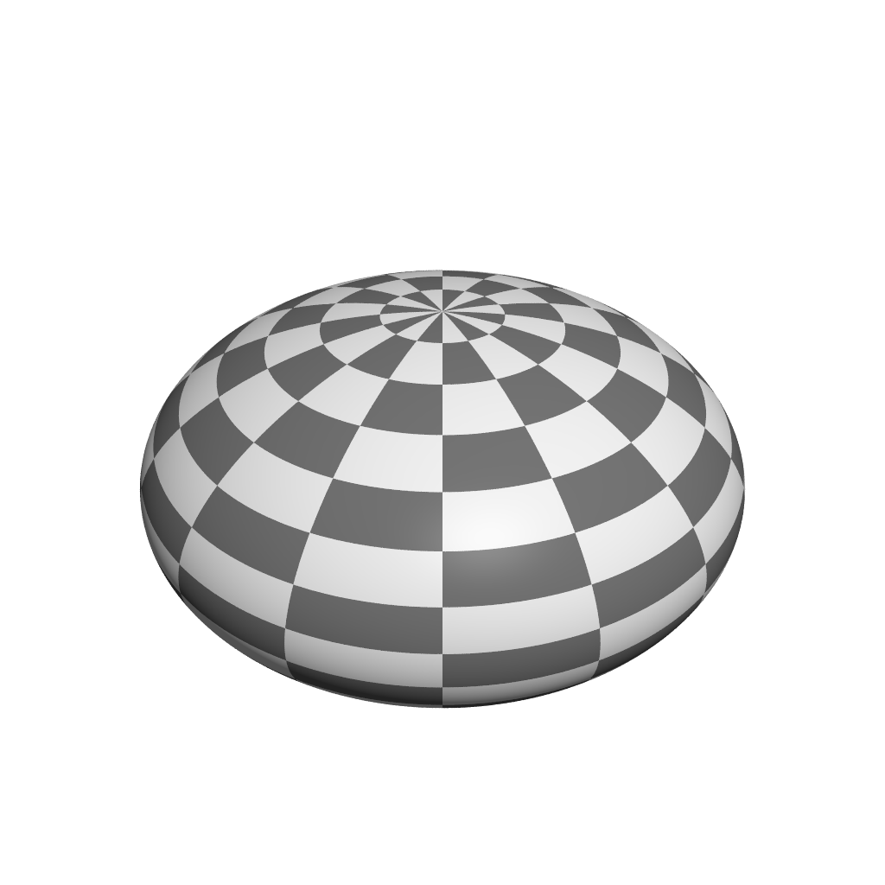
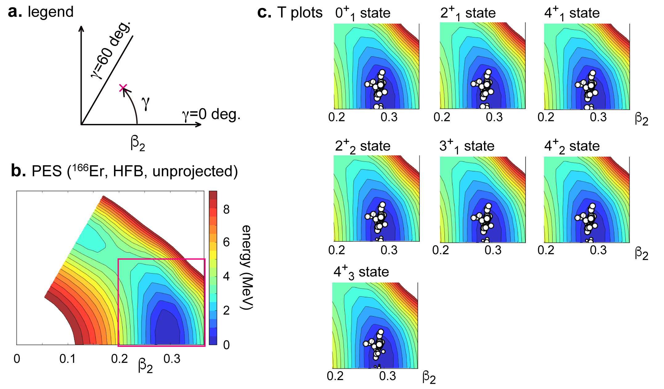
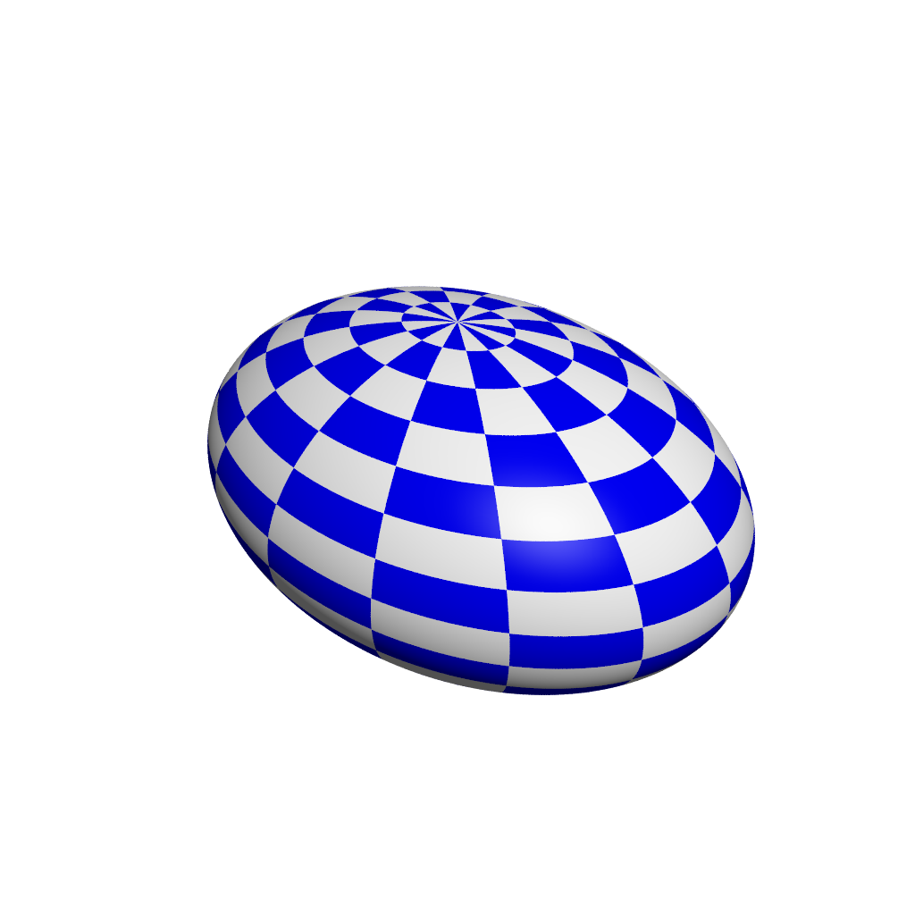
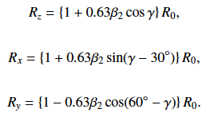
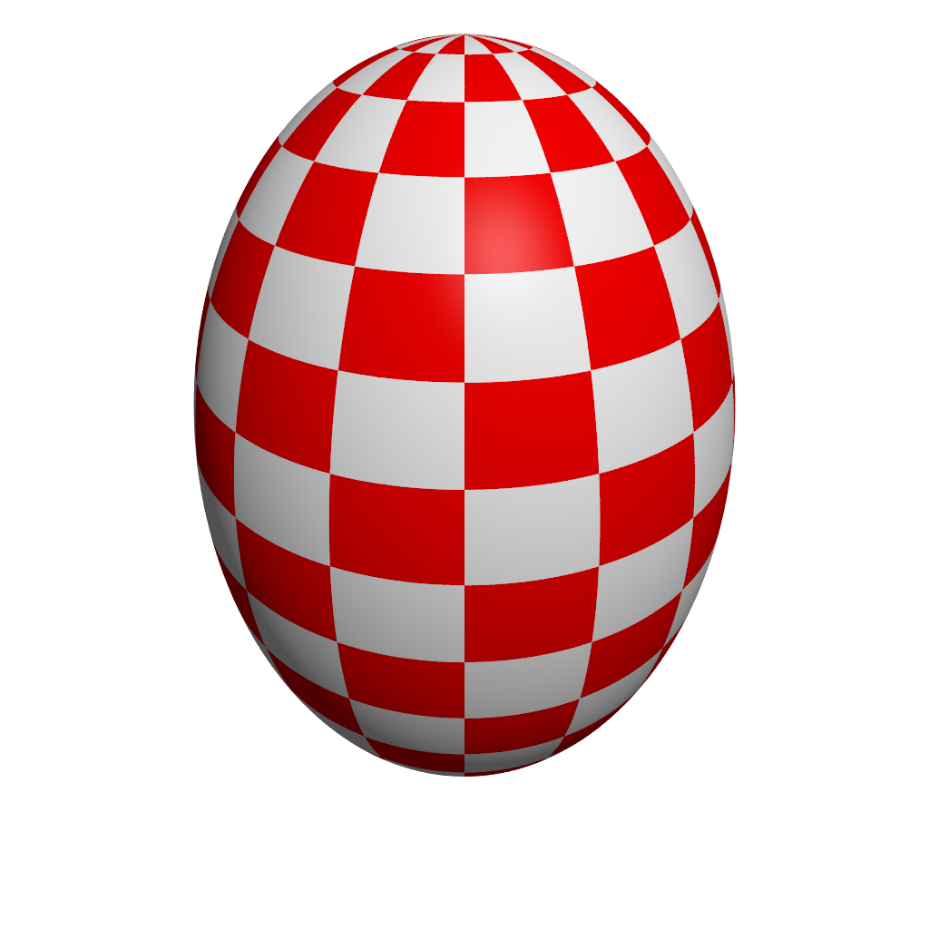
Shape variables and their visualization for the ground and lowest states of ¹⁶⁶Er
oblate
T-plot: Distribution of basis vectors
triaxial
triaxial with
<γ> = 8.4 deg
prolate
triaxial with
<γ> = 9.1 deg
<γ> = 9.5 deg
cut
Similar result from Kumar invariant
<γ> ~ 9.2 deg, <β₂> ~ 0.30

Slide 13
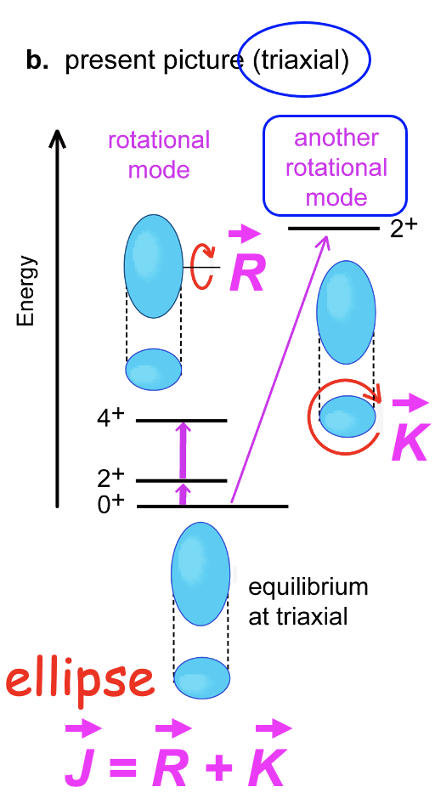
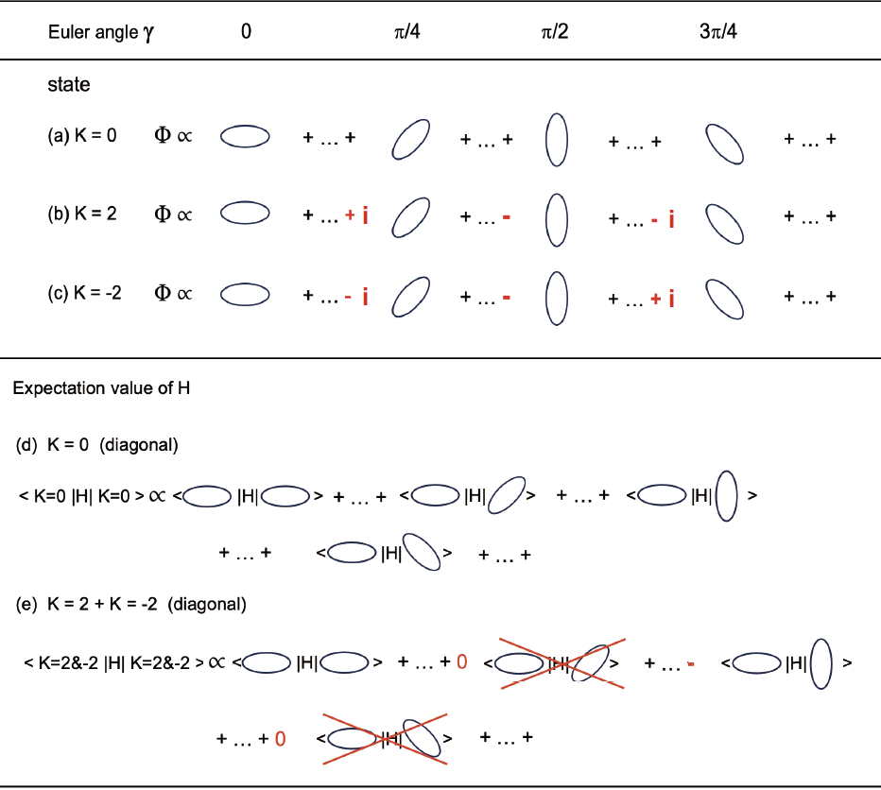
finite triaxial deformation → more binding energy
opposite

Slide 14
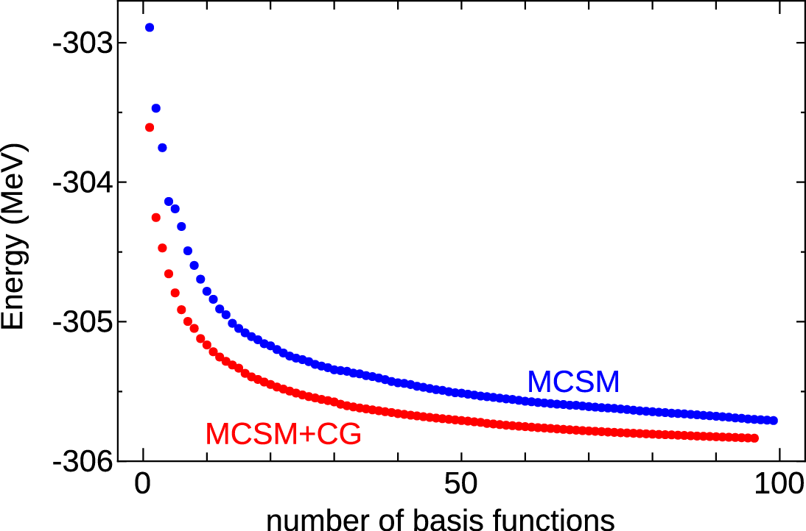
By including more basis vectors, we can get closer to exact solutions.
The MCSM calculation is carried out by
successive search of basis vectors:
⁶⁴Ge in pfg9-shell, 10¹⁴dim
a
The n=1 basis vector is fixed first by
stochastic and variational searches for
the most optimal D^{(n=1)} matrix.
The initial guess for this search can be a
mean-field solution, and we go beyond.
The n=2 basis vector is fixed next, under
the presence of the n=1 basis vector.
Number of basis vectors
(deformed Slater determinants)
The n=3, 4, … basis vectors are fixed likewise,
driving the result closer to the exact solution.
Notes:
14

Slide 15
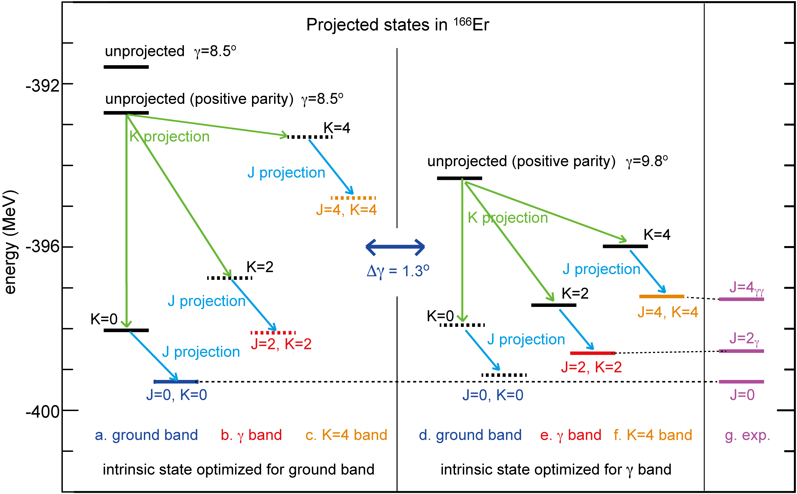
Projection of the first basis vector

Slide 16
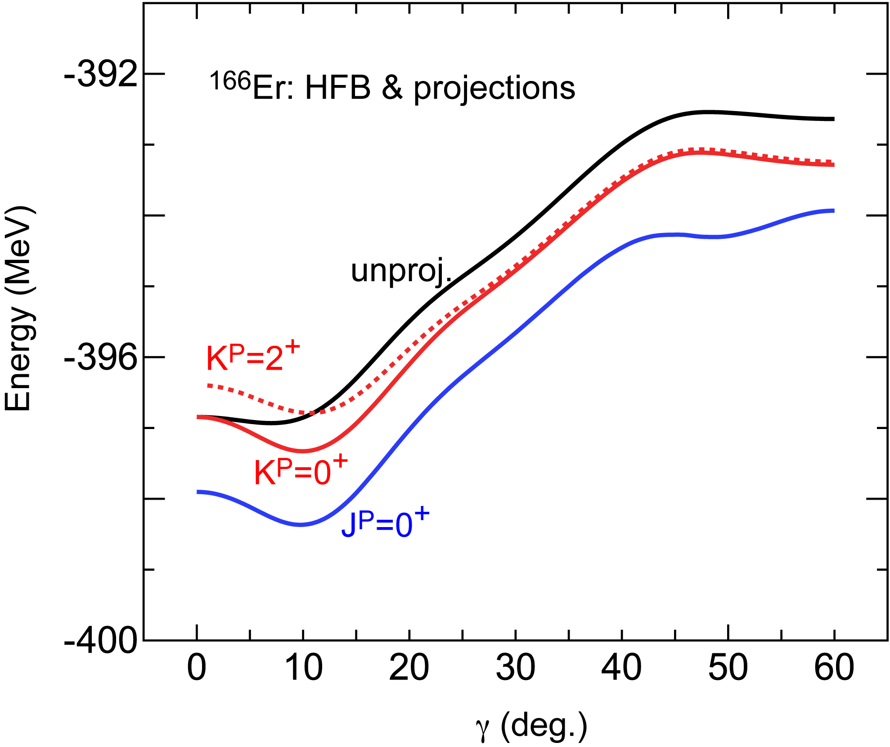
Along the cut in the PES
HFB with good particle number
for the same Hamiltonian
lowering of K=0 projected state
basic triaxiality
gives more binding energy
Triaxiality is not
a characterless fluctuation

Slide 17
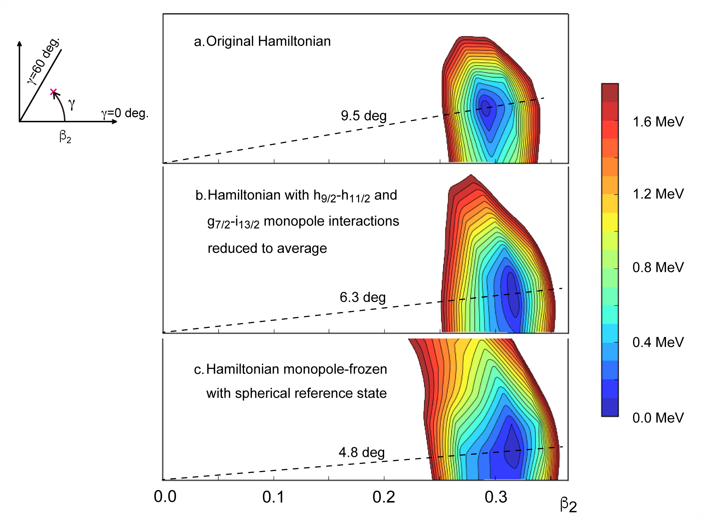
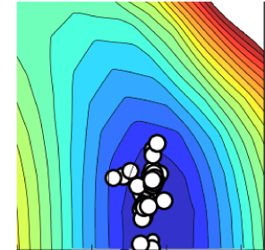
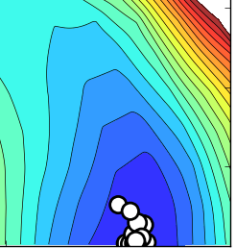
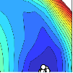
PES near the minimum: refined contour plots
T plot of 0⁺₁ state
Original Hamiltonian
minimum is 0.4 MeV
below prolate energy
two most attractive
monopole interactions
h_{11/2}-h_{9/2} and g_{7/2}-i_{13/2} are weakened to
average value
minimum is 0.1 MeV
below prolate
monopole interactions
are replaced by constant SPEs assessed
for spherical reference state (Monopole-Frozen)
minimum is 0.1 MeV
below prolate

Slide 18
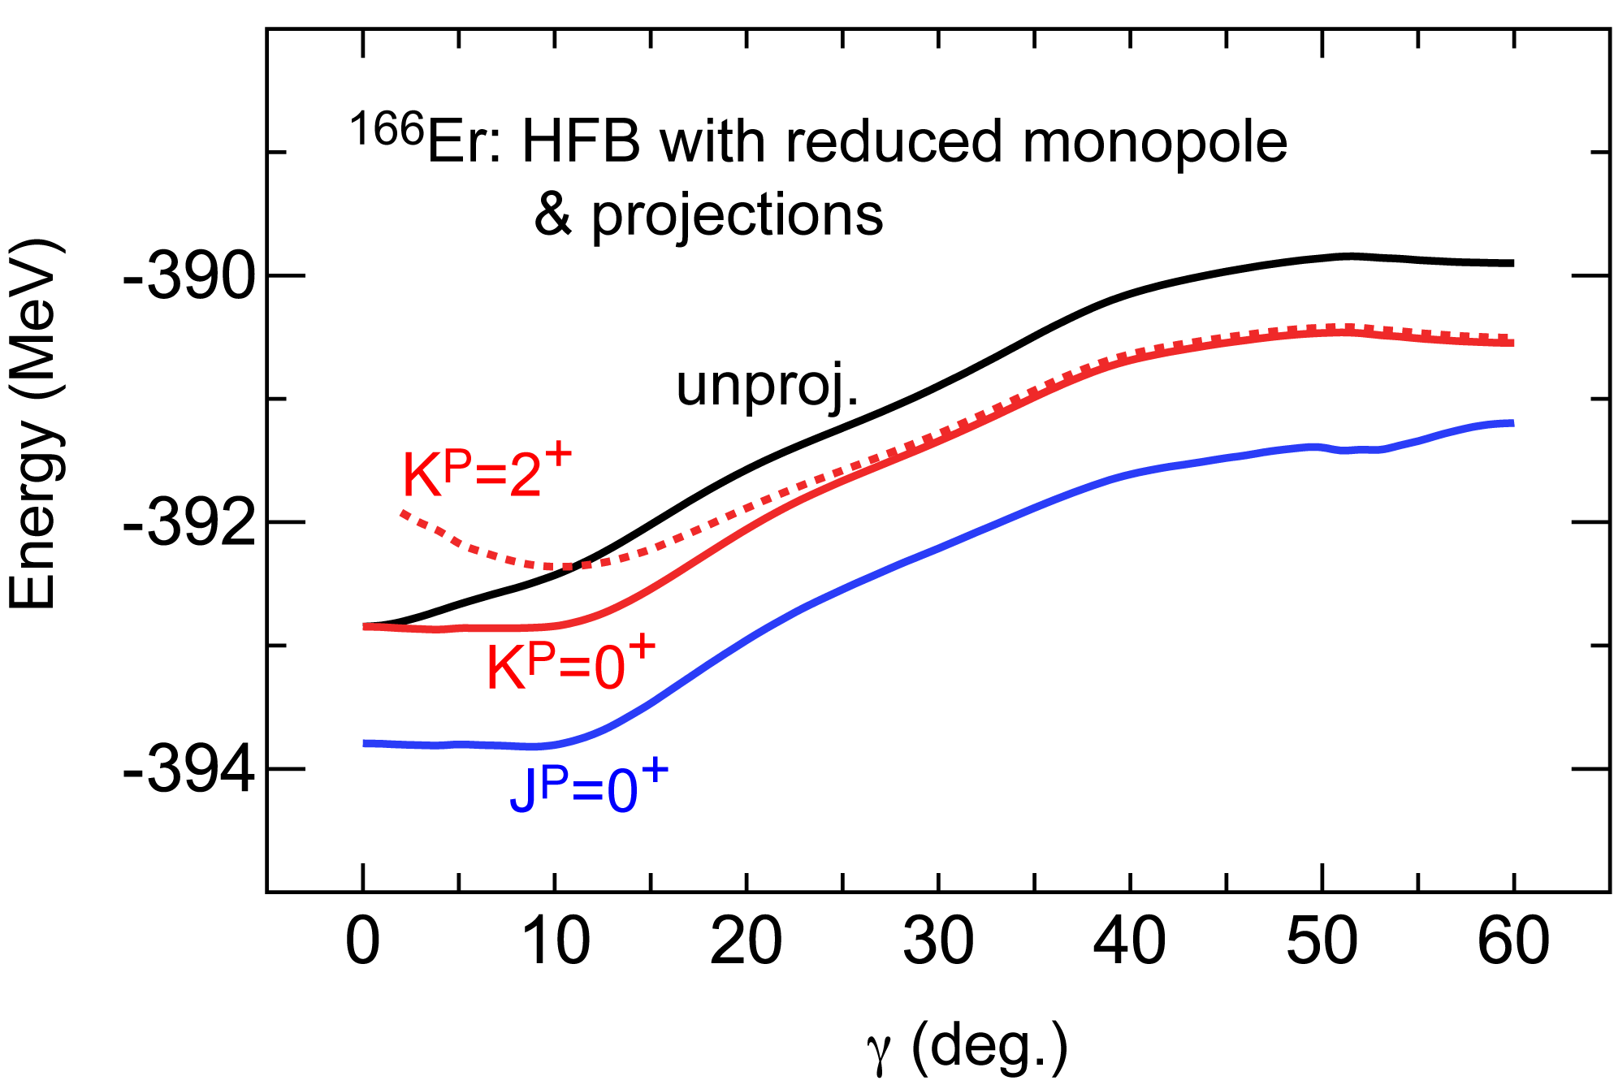
Another origin of triaxial shape
with full tensor int.
Profound minimum
is gone, if the
tensor force is off
Prominent triaxiality due to monopole interaction of the tensor force through a self-organization mechanism.
Feature for unprojected state.

Slide 19
A possible candidate of the underlying mechanism for the triaxial shape
and its robustness
Closely lying single-particle orbits of the same parity → axial symmetry
A different mechanism must be present in nuclear system !
A single-particle orbit with large j (e.g. h_{11/2}) can produce sizable triaxiality (i.e., Q₂), if the number of particles in the orbit is appropriate.
Proton single-particle orbit with large j _{p} and neutron orbit with large j _{n} are coupled by the monopole interactions of the central and tensor forces, as it occurs in the shell evolution.
triaxiality
(Q₂)
triaxiality
(Q₂)
neutron h_{9/2}
proton h_{11/2}
j’ = l - ½
j = l + ½
extra energy gain

Slide 20
Two origins and two appearances
1. Basic (modest) triaxiality due to symmetry restoration
If only this works, gamma is typically 3 degrees.
2. Prominent triaxiality due to symmetry restoration
gamma ranges from 6 degrees to 14 degrees or more
in heavy nuclei.
In lighter nuclei, gamma may be larger

Slide 21
¹⁵⁴Sm : basic triaxiality (gamma~3.3 deg.) in the ground band
prominent triaxiality (gamma~13 deg.) in the beta+gamma bands

Slide 22
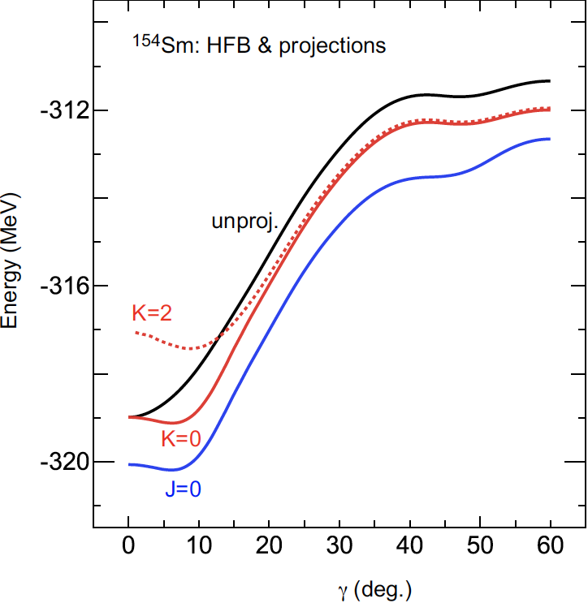
¹⁵⁴Sm HFB
weak tensor monopole effect
from full Hamiltonian
deep jump ~ 7 MeV
4 MeV in ¹⁶⁶Er
There is a tendency
towards a prolate
shape in ¹⁵⁴Sm

Slide 23
Origin of the infamous J(J+1)-K² rule of rotational excitation energy
conventional description
present view
classical mechanics
quantum mechanics for many-body system
time t, angle Ω(t)
rotation of rigid body
eigenstate with angular momentum h J
- superposition of states at varying angles
time t₀, angle Ω₀
- Hamiltonian H, including
interactions, couples
states at different angles
H
- resultant excitation energy
depicts the J(J+1) – K² rule
for strong deformation
quantization of free rotation of this rigid body
→ eigenstate with angular momentum h J
- superposition of states
at varying angles
- this rule arises from
specific angle dependence
of mixing patterns, which
is governed by J
- for axially symmetric shape,
J(J+1) rule is suggested
- lower K and J provide more binding energies
- just kinetic energy, no
interaction
- this feature is general and robust

Slide 24
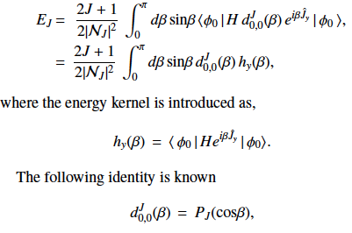


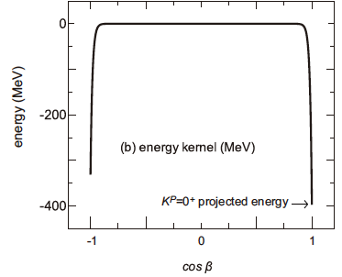
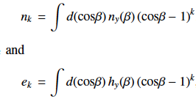
From the lowest and next-to-leading orders,
Direct link between the rotation and interactions.
Required condition : strong deformation.
From the next-next-to-leading order,
J(J+1) and {J(J+1)}² terms
Nothing but frequently used empirical fit formula
in molecular physics & chemistry; no longer empirical
Power counting of ( )^{k}
, in

Slide 25
Systematic behaviors
Gamma=3.3 deg

Slide 26
Summary
1. Triaxial deformation occurs virtually in all deformed nuclei, because it gives
more binding energy than traditionally believed prolate (axially symmetric)
deformation. The triaxiality is NOT a fluctuation, but a BINDING mechanism.
K projection is crucial. Example: ¹⁵⁴Sm.
“basic triaxiality created by symmetry restoration”
2. triaxiality occurs due to the tensor + central forces
in selected nuclei, for instance ¹⁶⁶Er, through self-organization mechanism.
“monopole-(interaction) induced prominent triaxiality”
2. Rotational excitation energy proportional to J(J+1) – K² is derived
in quantum many-body approach, without resorting to the quantization
of classical rigid body (like symmetric top). Applicable to molecules, too.
Quantum view of rotation ←→ excitation energies

Slide 27
Experimental test of triaxiality is crucial
Direct measurement of the shape is most desirable
Relativistic Heavy-Ion Collision
Can cover basic triaxilality
Multiple Coulomb excitation (initiated by Doug Cline)
involves several states
already provided with consistent data with strange interpretation

Slide 28
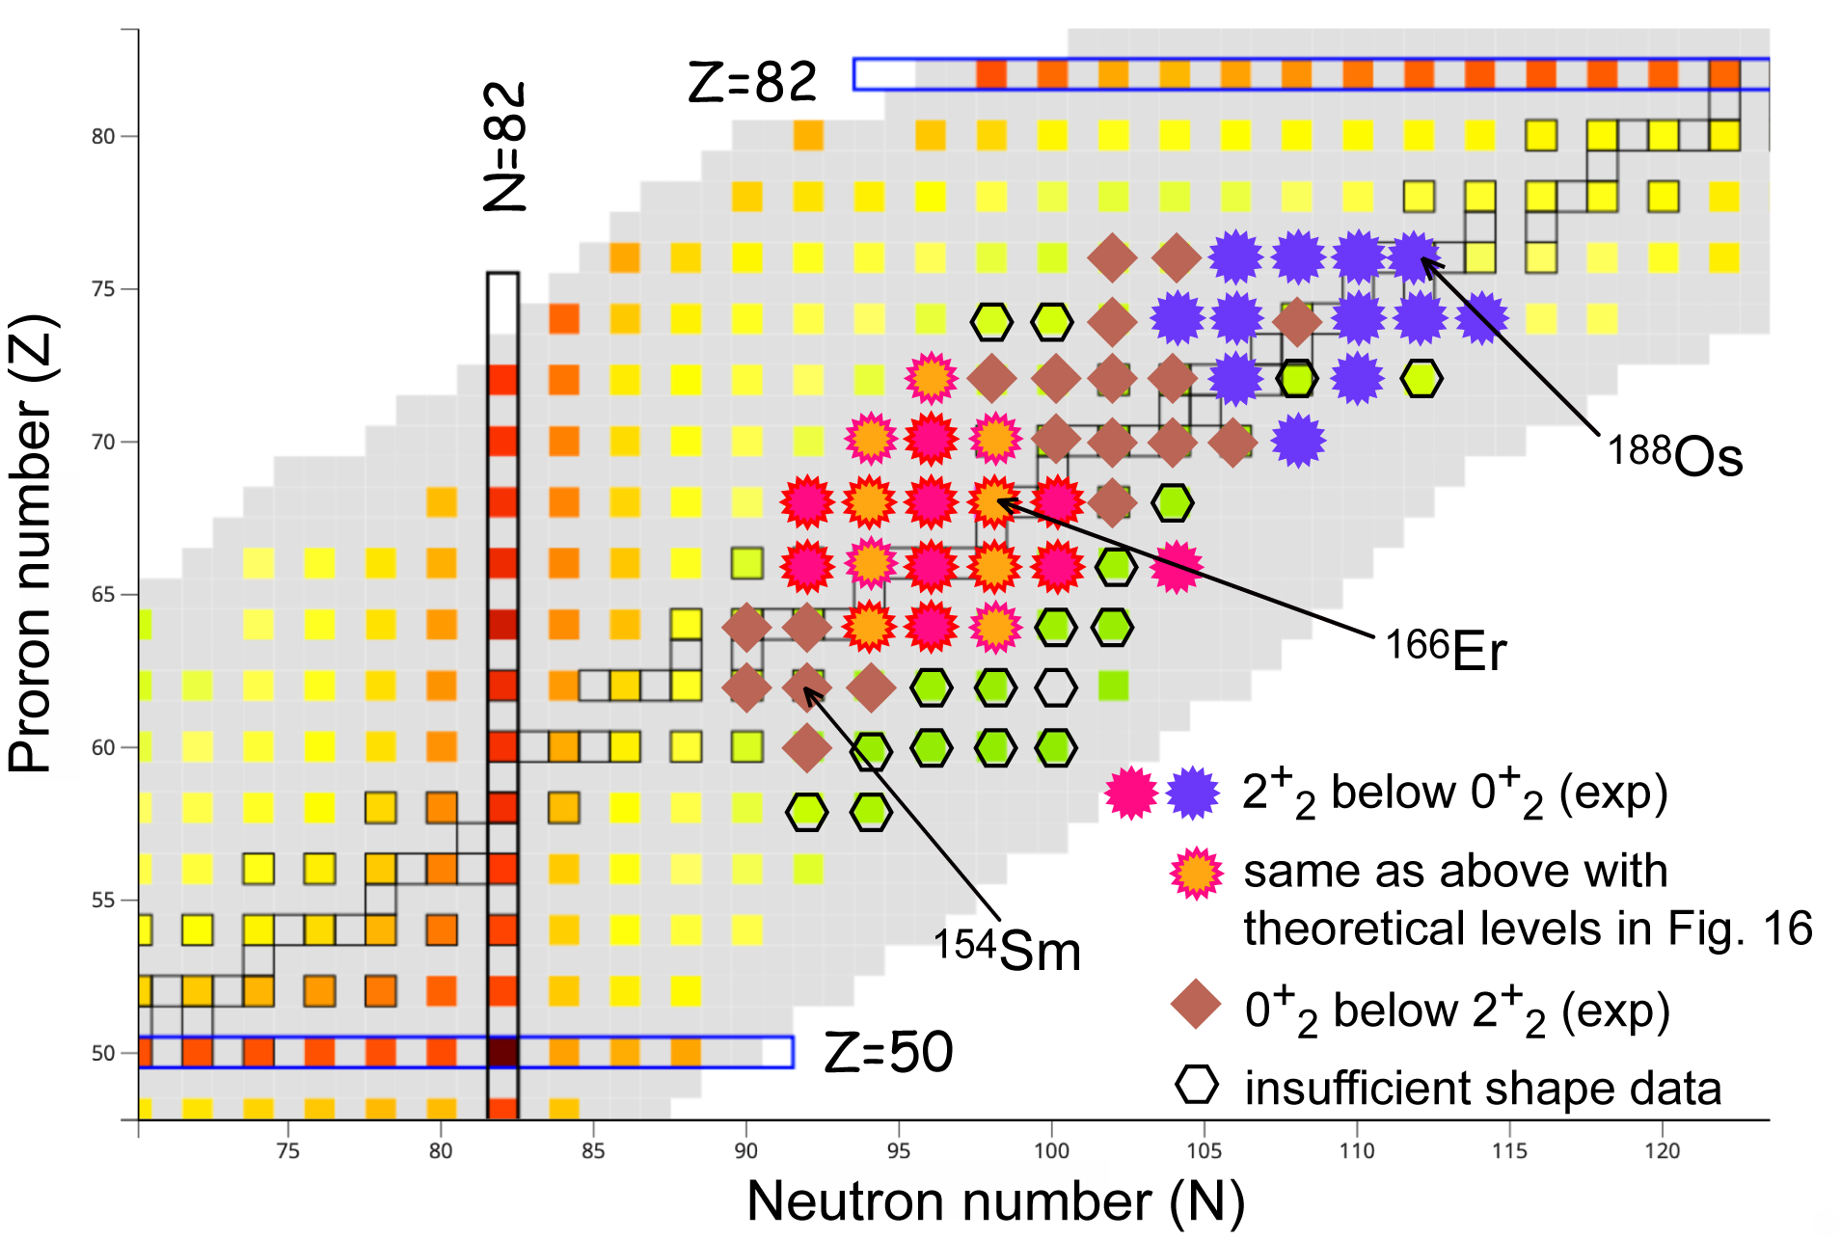
Appearance of prominent triaxial shapes

Slide 30
E N D
Thank you for your attention

Slide 31
Why is the deformation a “must” in (most of) nuclei ?
valence nucleons are sparsely
configured because of the shell structure
range of nuclear forces
<<
size of single-particle orbital
(the bigger the heavier)

Slide 32
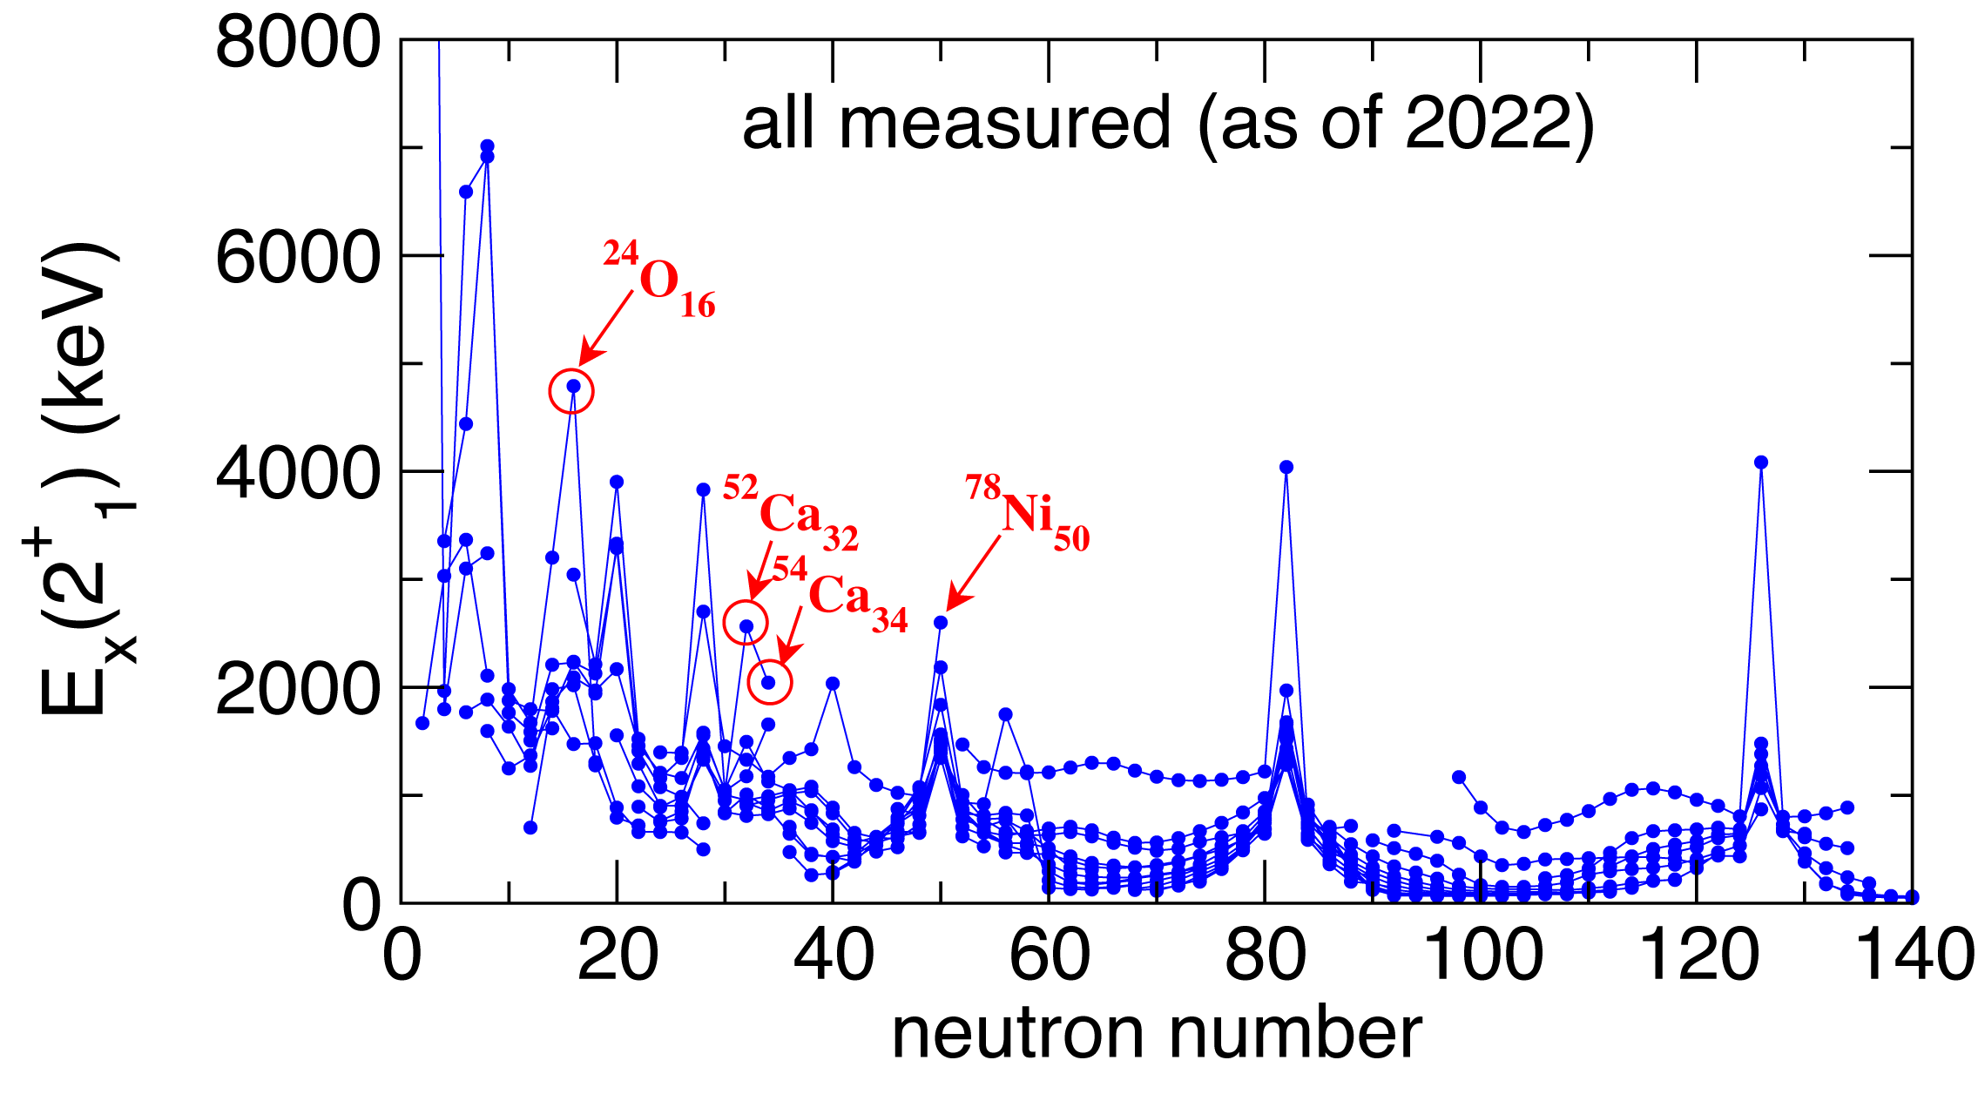
We now move on to “shapes”.
Observed excitation energies of the first excited 2⁺ states of even-even nuclei
What happens here ?
What happens in heavy deformed nuclei, where the structure is not of single-particle nature, but is dominated by strong ellipsoidal deformation.

Slide 33
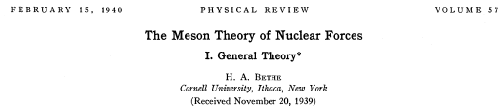
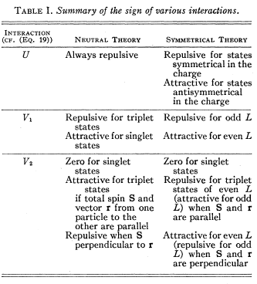
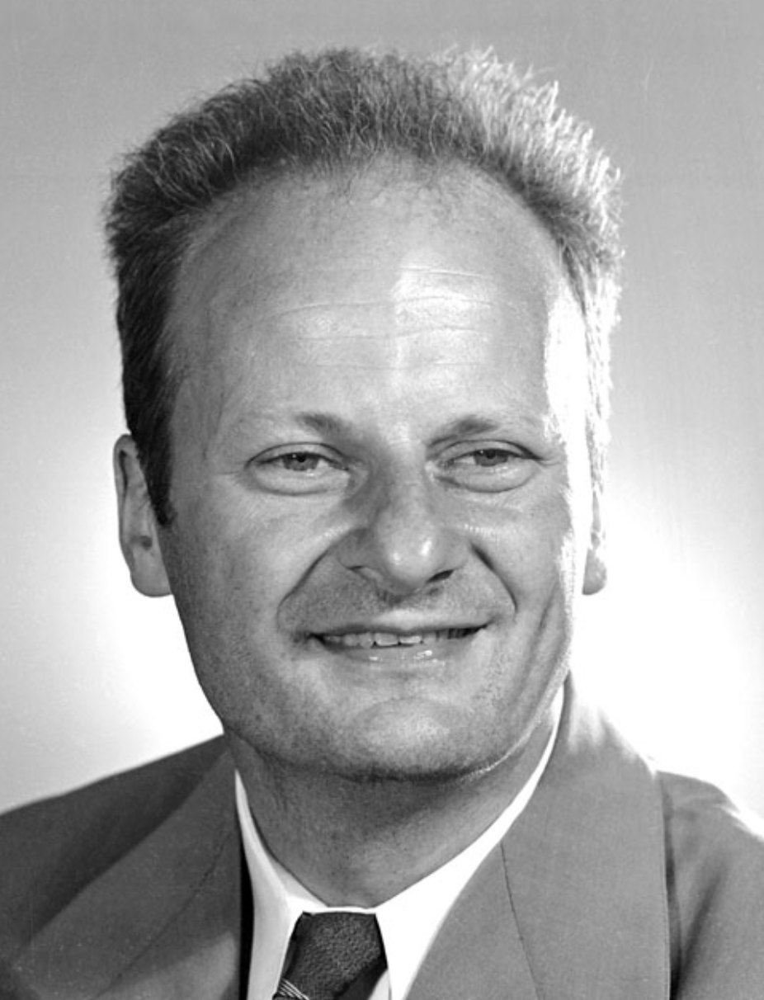
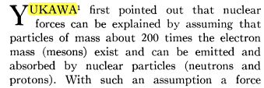
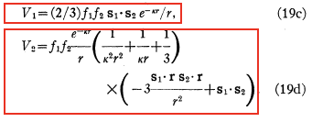


Slide 34
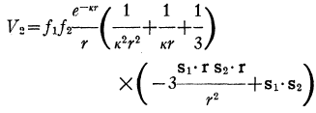
The tensor force is expressed as
This is equivalent to another standard expression:
Tensor force :
V_{T} = (τ₁τ₂) ( [σ₁σ₂]⁽²⁾ Y⁽²⁾ (Ω) ) Z(r)
contributes
only to S=1 states
relative motion
π meson : primary source
σ .
σ .
π
nucleon
nucleon
ρ meson (~ π+π) : minor (~1/4) cancellation
Ref: Osterfeld, Rev. Mod. Phys. 64, 491 (92)
It is analogous to dipole-dipole interactions in the electro-magnetic forces,
but the nuclear tensor force is strong.

Slide 35
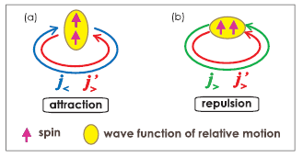
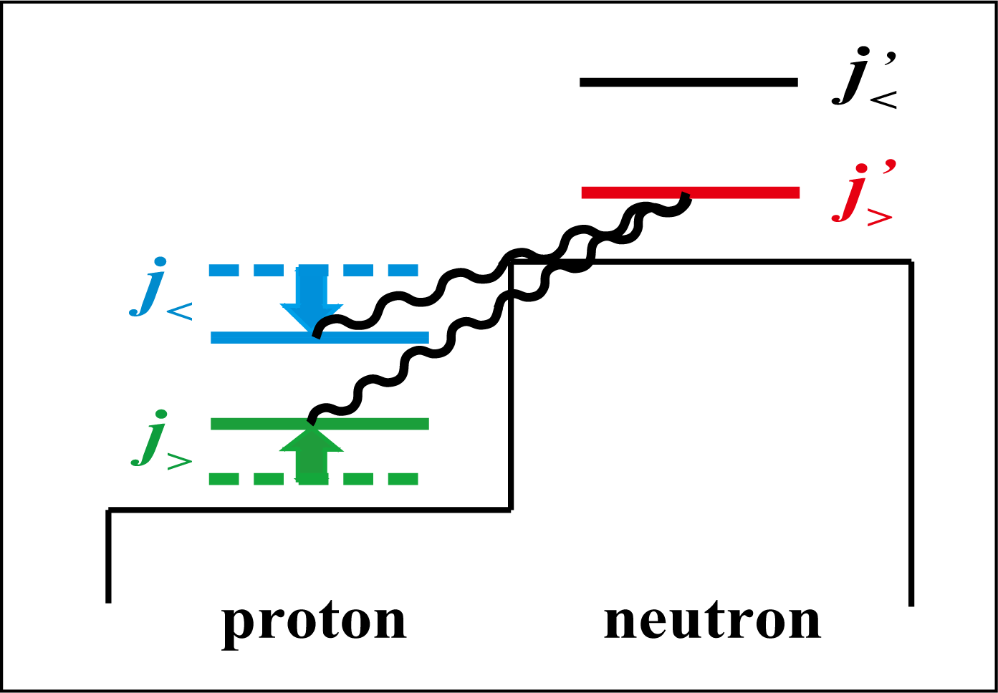
Monopole interactions depict robust features
for Central force
Stronger attraction between single-particle orbits of similar radial wave functions
ex.: f _{7/2} – f _{5/2}, g _{9/2} – h _{11/2}
cf: Federman-Pittel (1977)
for Tensor force
(long-range part,
or 1π, 2π exchange)
j> = l + ½
j< = l - ½
for Three-nucleon force (Δ-hole) : overall repulsive effect

Slide 36
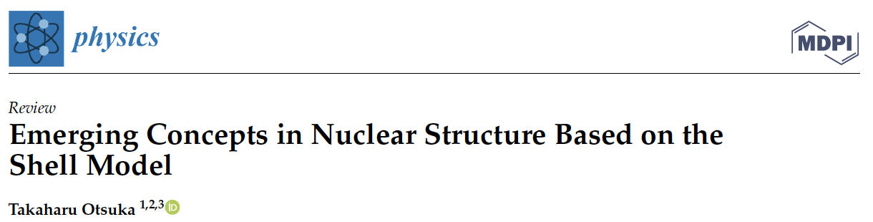
Physics 2022, 4, 258–285.
https://doi.org/10.3390/physics4010018
Special Issue "The Nuclear Shell Model 70 Years after Its Advent: Achievements and Prospects"
edited by A. Gargano, G. De Gregorio and S. M. Lenzi
Shell evolution due to the monopole interaction
Type II shell evolution and shape coexistence
Triaxiality dominance in heavy nuclei as a consequence of the
self-organization due to the monopole-quadrupole interplay ⬅ a bit more progress
←→ traditional prolate dominance picture
New neutron dripline mechanism due to the monopole-quadrupole interplay, exemplified for F, Ne, Na and Mg isotopes
besides the traditional mechanism with single-particle nature
Alpha-clustering is not included

Slide 37

18 + 12 strongly deformed nuclei with triaxiality in the neighborhood of ¹⁶⁶Er – EXPERIMENTAL -
(triaxiality means (Ex(2⁺₂) < Ex(0⁺₂) ; 66 strongly deformed (Ex(4⁺₁) / Ex(2⁺₁) > 3.00) nuclei in total)
Besides existing Coulex data,
could we observe their shapes by Relativistic
Heavy-Ion Collisions at LHC ?
(cf: Giacalone et al.)
Extended scissors mode
(rolling mode) is another
possibility to be studied in
HIγS and RCNP.
Hyper nuclei (with Λ particle) are another possibility in
J-Lab and JPARC.
no sufficient shape data
0⁺₂ lower than 2⁺₂

Slide 38


Variations as Z and/or N changes (examples)
¹⁶⁶Er
γ =8.4 deg
¹⁶²Er
¹⁷⁰Er (not triaxial)
higher
lowest yrare
is 0⁺, not 2⁺
~ prolate
¹⁶⁴Dy
no major change
¹⁵⁸Gd
γ =5.9 deg
γ =7.4 deg
Coulex exp. showed consistent
γ values
Cline et al. (1986)
Fahlander et al. (1990)
Werner et al. (2005),
for which natural interpretation is the triaxiality in the ground states.
higher
levels of ¹⁶⁶Er

