Slide 1
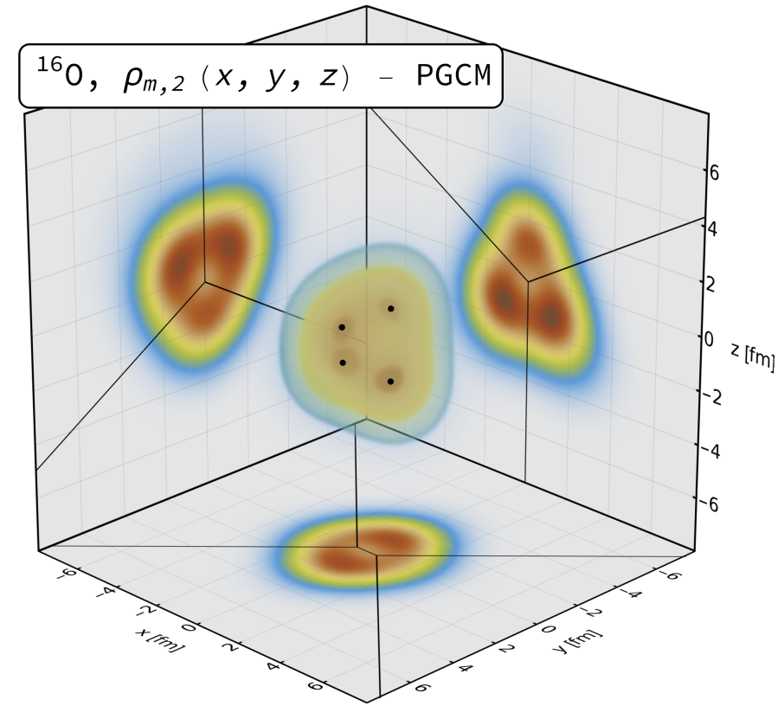
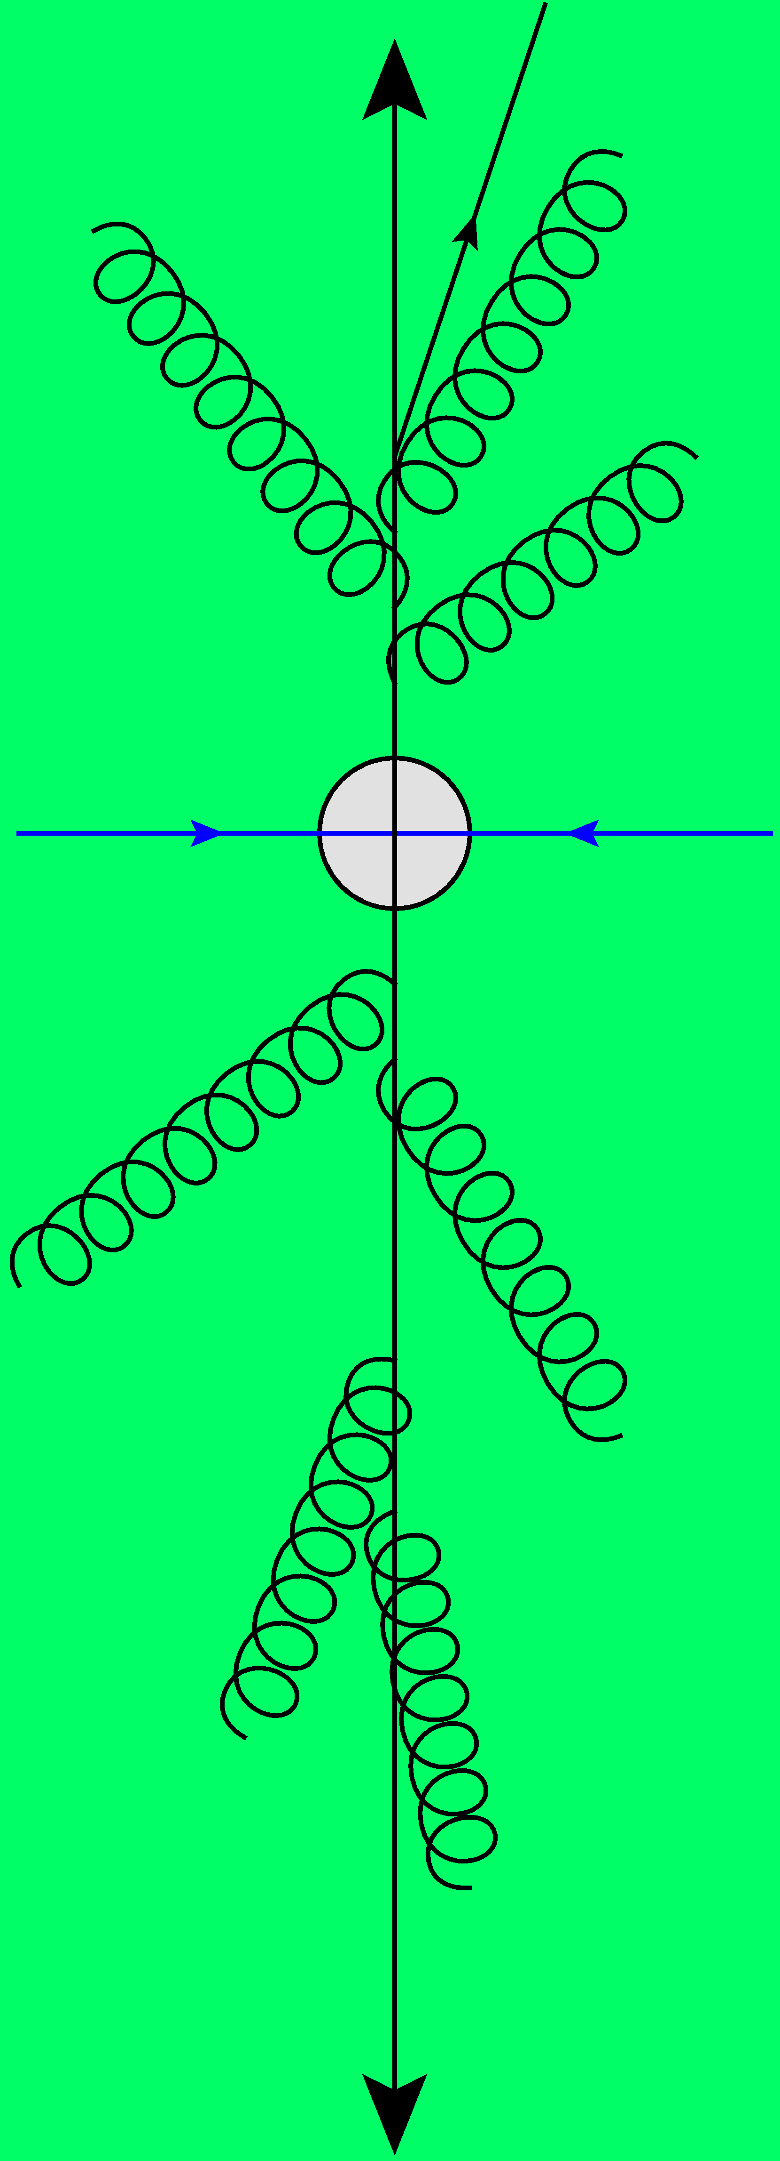
O+O and impact of clustering in high-energy collisions
Interplaying nuclear structure and quark-gluon plasma
2402.05995 (Giuliano Giacalone, Benjamin Bally, Govert Nijs, Shihang Shen and et al) and to appear
Wilke van der Schee
RHIC nuclear structure workshop, Beijing
21 April 2024

Slide 2
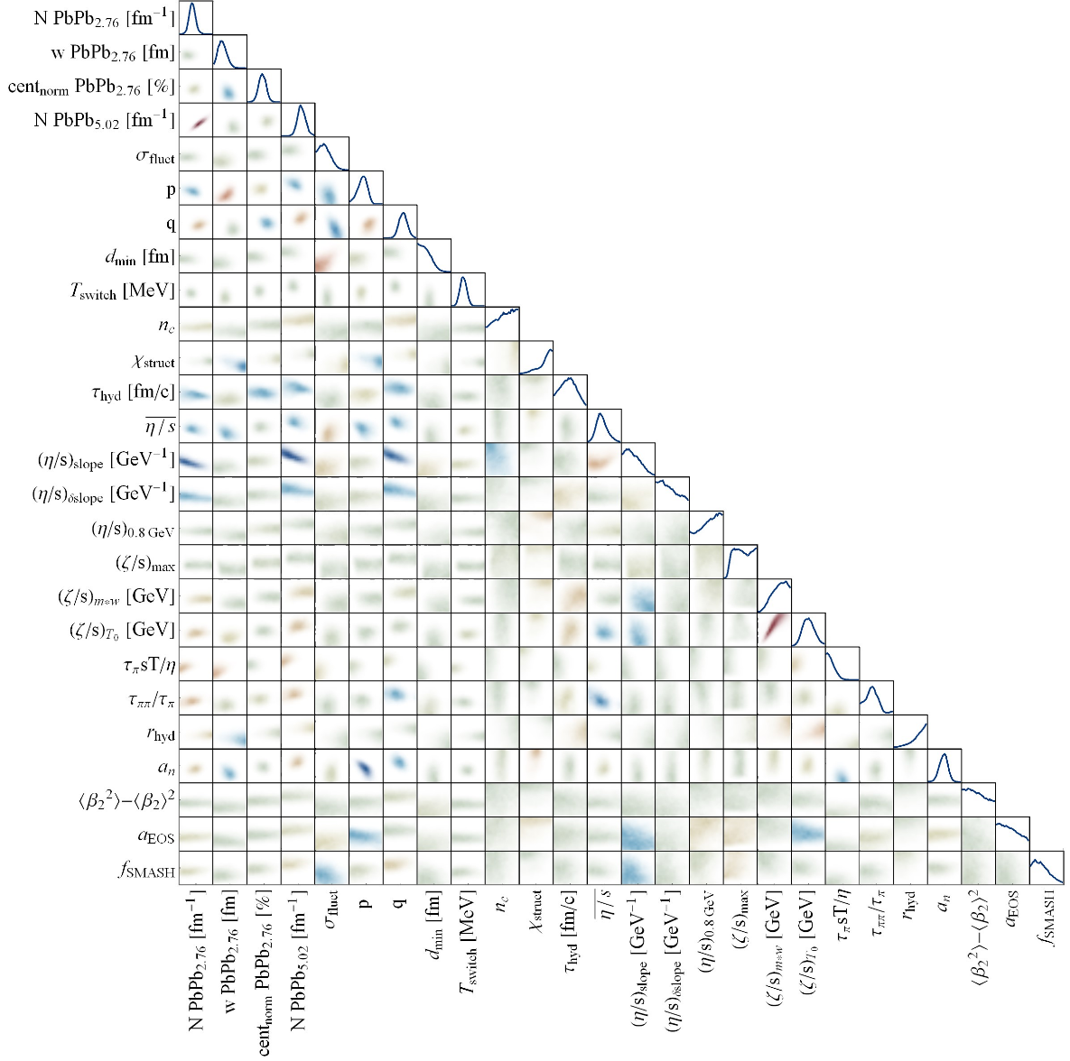
Outline
Wilke van der Schee, CERN/Utrecht
Brief introduction on alpha clustering
Even more brief introduction on Trajectum
Some very preliminary (=unfinished) results

Slide 3
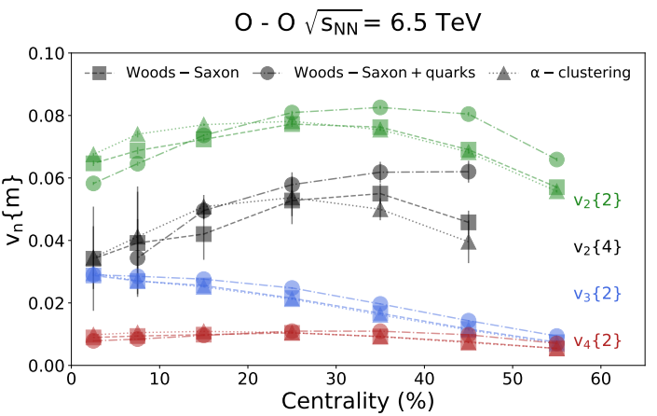
Oxygen nuclear structure
See also Guo-Liang Ma on 22.04
The relatively obvious approach: compare spherical with 4-alpha initial condition
Wood-Saxon: spherical
Wood-Saxon + quarks: same but with finer substructure / more fluctuations
Alpha clustering: NLEFT
Some differences can be seen, but is the interpretation unique? Even `quarks’ can cause differences
Nicholas Summerfield, Bing-Nan Lu, Christopher Plumberg, Dean Lee, Jacquelyn Noronha-Hostler and Anthony Timmins, 16O16O collisions at RHIC and the LHC comparing α clustering vs substructure (2021)
See also Maciej Rybczynski, Milena Piotrowska and Wojciech Broniowski, Signatures of α clustering in ultra-relativistic collisions with light nuclei (2017)

Slide 4
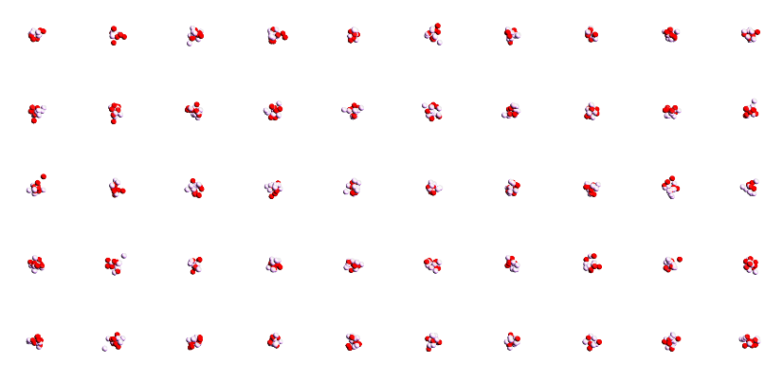
Oxygen nuclear structure
Comparing two state-of-the-art microscopics with old profile (MAP run with 1M hydro events per run)
3pF: 3 parameter Wood-Saxon Fermi fit from 1976 with d_{min}
VMC: Variational Monte Carlo to sample wave function with advanced nucleon interaction
NLEFT: Nuclear Lattice Effective Field Theory, ground state with `pin holes‘ (no repulsive interaction implemented)
Trento works quite well for v₂, are the sizes similar? Dissimilar for isobars.
Emmi task force, Heidelberg (2022)
D. Lonardoni, A. Lovato, Steven C. Pieper and R.B. Wiringa, Variational calculation of the ground state of closed-shell nuclei up to A=40 (2017)

Slide 5
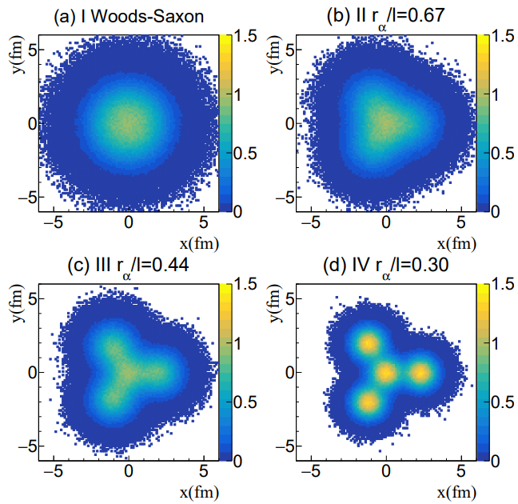
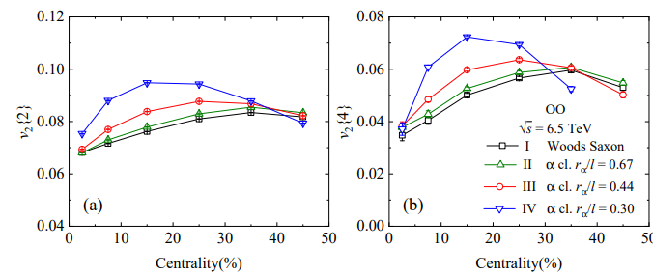
Oxygen nuclear structure
Comparing regular tetrahedrons of varying side lengths
Size alpha clusters is fixed by charge radius
Again relatively large difference, except for case II (?):
Yuanyuan Wang , Shujun Zhao, Boxing Cao, Hao-jie Xu and Huichao Song, Exploring the compactness of α cluster in the 16 O nuclei with relativistic 16O+16O collisions (2024)

Slide 6
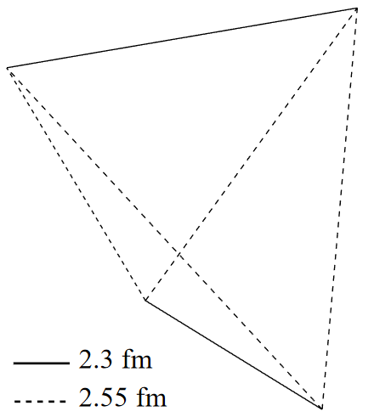
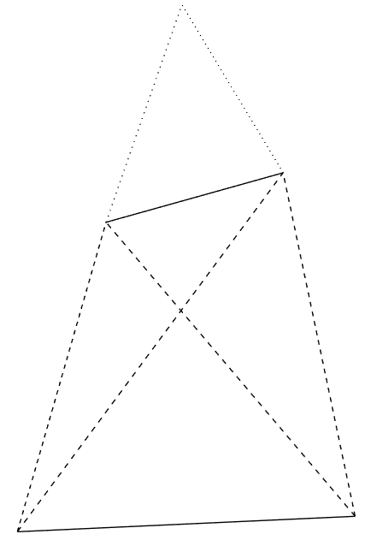
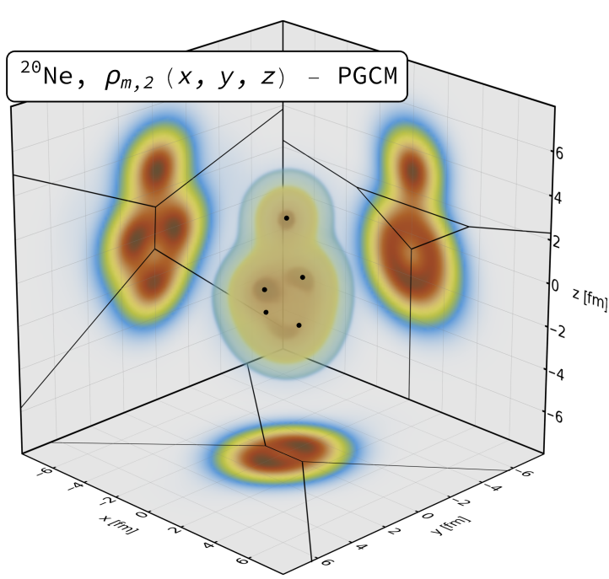
Alphas from nuclear structure
Two big surprises (at least to me ☺)
O-16 alphas do not form a regular tetrahedron (!) → more like two coupled rods 2.4 fm not too far from case II previous slide (3.0 fm) Similar results in NLEFT
Ne-20 alphas do not form a bipyramid (!) → seemingly randomly placed on top… (was a challenge to find due to breaking of symmetry, credit to Benjamin)
Of course the intuition of alphas as point particles with interaction energy is really quite naïve…
Yuanyuan Wang , Shujun Zhao, Boxing Cao, Hao-jie Xu and Huichao Song, Exploring the compactness of α cluster in the 16 O nuclei with relativistic 16O+16O collisions (2024)

Slide 7
Trajectum
Quite straightforward to use (see param file, right)
Includes analyse routine
Parallelised: can analyse unlimited number of events
http://sites.google.com/view/govertnijs/trajectum
http://wilkevanderschee.nl/trajectum

Slide 8
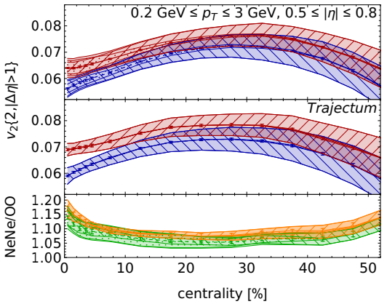
Oxygen nuclear structure
Can we do this more systematically?
Parameters such as viscosities are highly correlated
Take random sample of `probable’ parameter settings
Compute one standard deviation systematic uncertainty
Systematic uncertainty comparable to differences due to nuclear structure – may be difficult to `see’ alpha clustering
Giuliano Giacalone, Benjamin Bally, Govert Nijs, Shihang Shen et al,The unexpected uses of a bowling pin: exploiting 20Ne isotopes for precision characterizations of collectivity in small systems (2024)

Slide 9
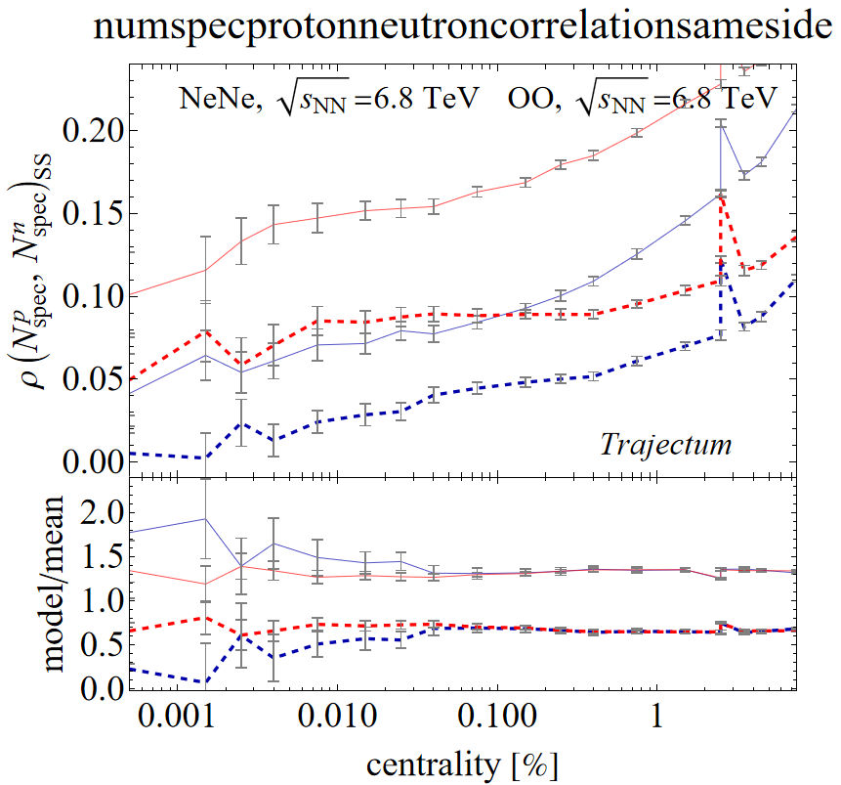
A novel idea? Correlations between spectators
Alphas should correlate proton and neutron spectators, if alpha is ‘missed’
Compare with same nucleus with isospin `shuffled’ nucleons
Especially for Neon (?)
Qualitatively differs from looking at v2 etc
Potentially interesting for neutron skin Pb-208 as well
First version seemed to work: (dashed = shuffled, red =Neon)
To appear with Govert

Slide 10
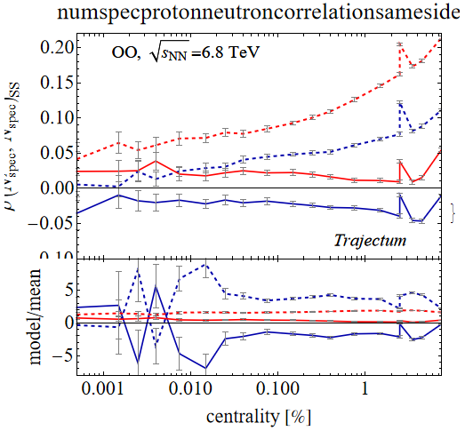
A novel idea? Correlations between spectators
Implemented relatively advanced spectator model (unfinished)
Spectators cluster depending on density / distance
Clusters decayed using Gemini
Seems to have a big effect:
Solid has advanced spectator model
Blue is ‘shuffled’
Can we get the clustering under control? Improve the model?
To appear with Govert

Slide 11
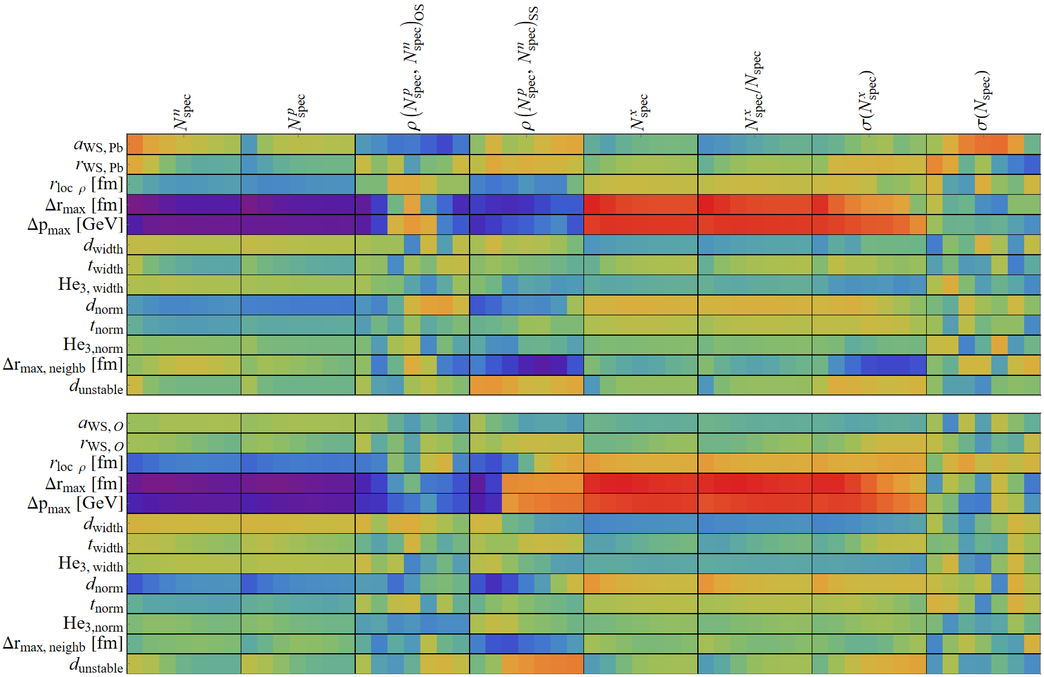
Small Bayesian scan of spectator model
Quite some parameters, but most related to deuteron, triton and He-3 not very important
Pb-208
O-16
To appear with Govert

Slide 12
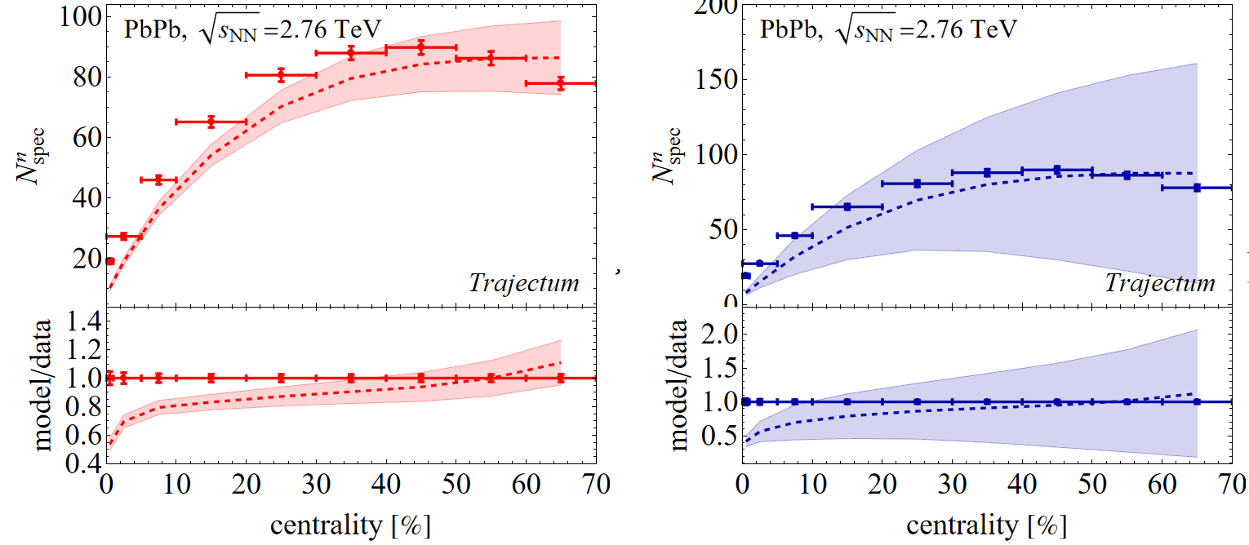
Spectators in Pb-208
Still significant problem with prior (right) and posterior (left). Also, no good data exists..
Can we get the clustering under control? Improve the model?
To appear with Govert

Slide 13
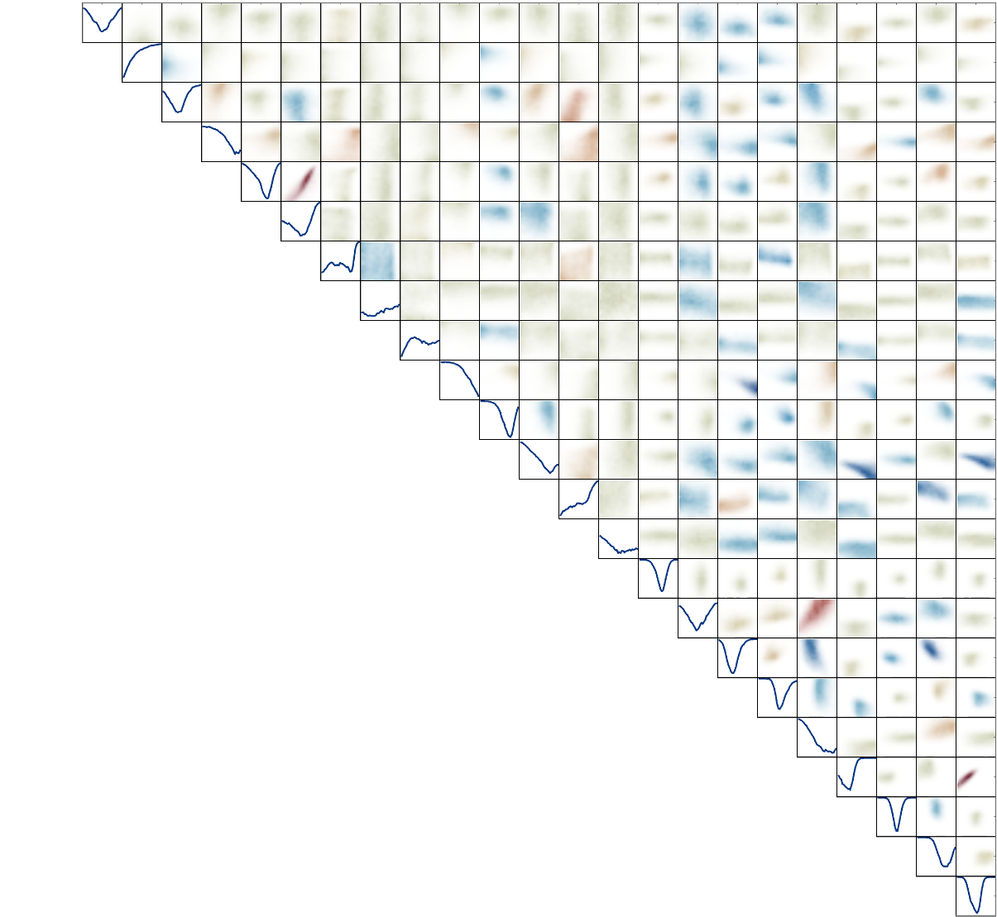
Alpha clustering in O-16 and RHIC
Tried to give an overview what is done and known
Varying alpha-clustered versus spherical O-16
Has the disadvantage that it’s a counterfactual comparison; we don’t have spherical O-16
Quite curious that O-16 seems an irregular tetrahedron
Exciting progress using spectators (?)
Several features to be studied more carefully/improved
A lot of opportunity for new type of measurements in ZDC
Correlations with e.g. v2 at mid-rapidity?
Neon needed for percent level science; start campaign now?

