Slide 1

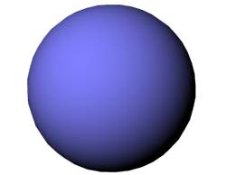
Impact of nuclear shapes
in low-energy heavy-ion reactions
Kouichi Hagino
Kyoto University, Kyoto, Japan
Low-energy Nuclear Reactions: overview
Role of deformation in sub-barrier fusion reactions
Probing nuclear shapes in quasi-elastic scattering
4. Summary
Workshop on “Exploring Nuclear Physics across Energy Scales 2024”, Beijing, China, 2024.4.23

Slide 2






Introduction: low-energy nuclear reactions
elastic scattering
inelastic scattering
transfer rections
breakup reactions
fusion reactions
nucleus: a composite system
various sort of reactions
elastic scattering
inel. scattering
fusion

Slide 3
Introduction: low-energy nuclear reactions
elastic scattering
inelastic scattering
transfer rections
breakup reactions
fusion reactions
nucleus: a composite system
various sort of reactions
an interplay between nuclear
structure and reaction
shapes, excitations, …..
elastic scattering
inel. scattering
fusion

Slide 4
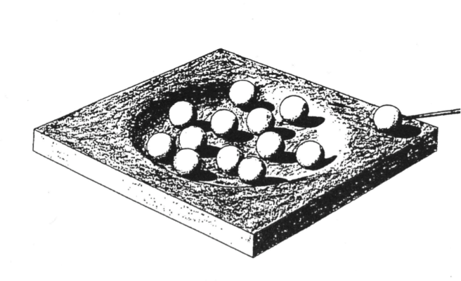
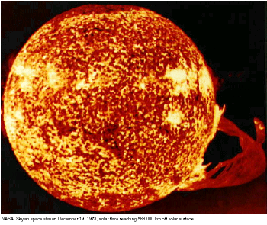
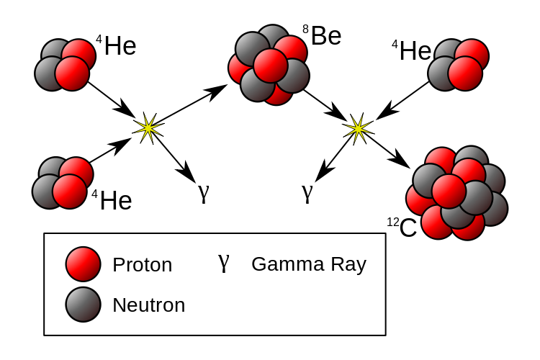
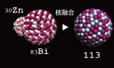
Fusion reactions: compound nucleus formation
P
compound
nucleus
P+T
T
cf. Bohr ‘36
energy production
in stars (Bethe ‘39)
nucleosynthesis
superheavy elements
Fusion and fission: large amplitude motions of quantum many-body
systems with strong interaction
microscopic understanding: an ultimate goal of nuclear physics

Slide 5
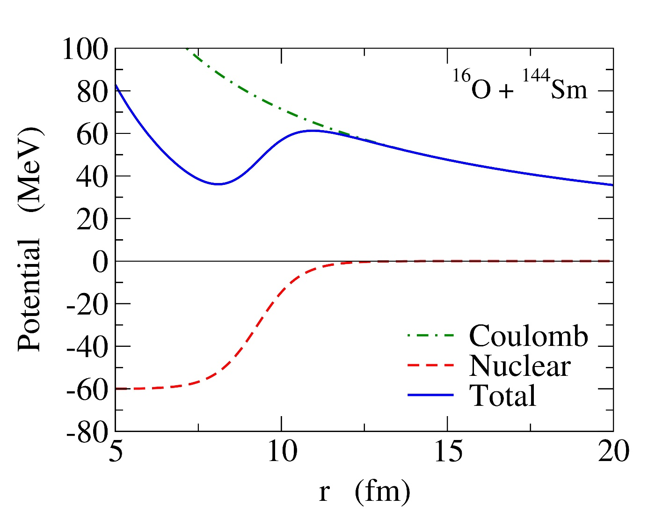
Coulomb barrier
1. Coulomb interaction
long range, repulsion
2. Nuclear interaction
short range, attraction
E
Quantum tunneling
Potential barrier
(Coulomb barrier)
Fusion: takes place by
overcoming
the barrier
the barrier height → defines the energy scale of a system
Fusion reactions at energies around the Coulomb barrier

Slide 6
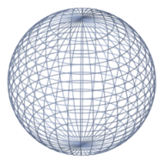
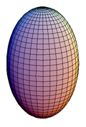
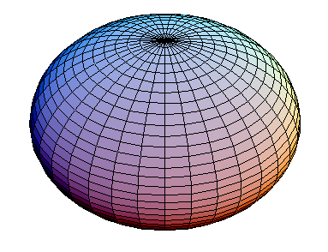
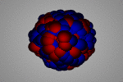
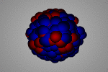
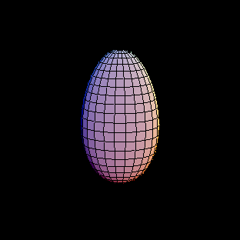
Low-energy heavy-ion fusion reactions and quantum tunneling
Fusion with quantum tunneling
with many degrees of freedom
- several nuclear shapes
- several surface vibrations
several modes and adiabaticities
- several types of nucleon transfers
Tunneling probabilities: the exponential E dependence
→ nuclear structure effects are amplified

Slide 7
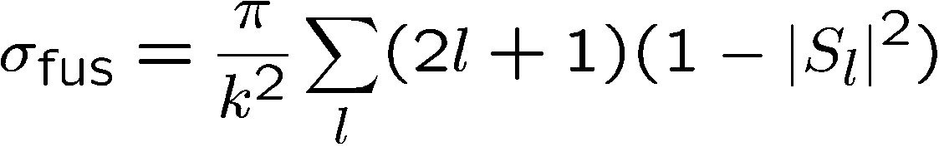
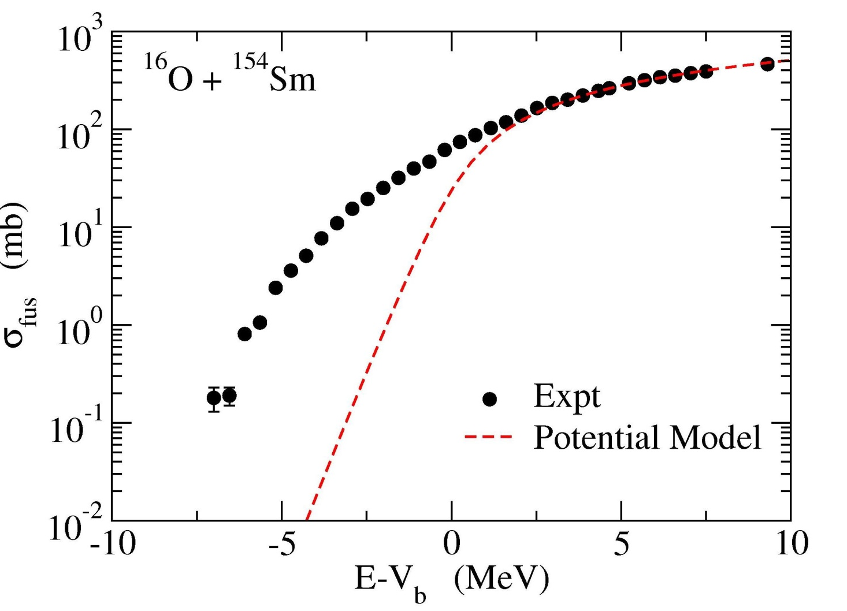
Discovery of large sub-barrier enhancement of σ_{fus} (~80’s)
the potential model: inert nuclei (no structure)
potential
model

Slide 8
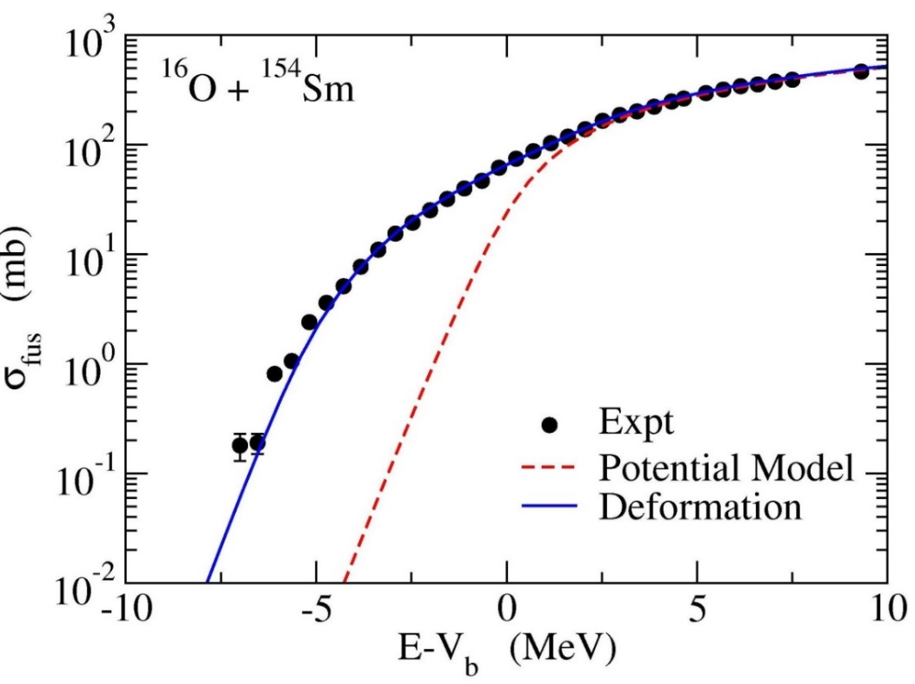
¹⁵⁴Sm : a typical deformed nucleus
¹⁵⁴Sm
(MeV)
0.903
8⁺
deformation of ¹⁵⁴Sm
0.544
6⁺
0.267
4⁺
K. H. and N. Takigawa,
Prog. Theo. Phys.128 (‘12)1061.
0.082
2⁺
0
0⁺
¹⁵⁴Sm
rotational spectrum

Slide 9
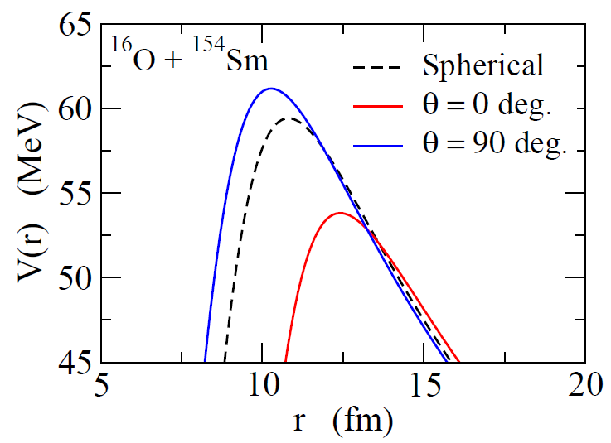
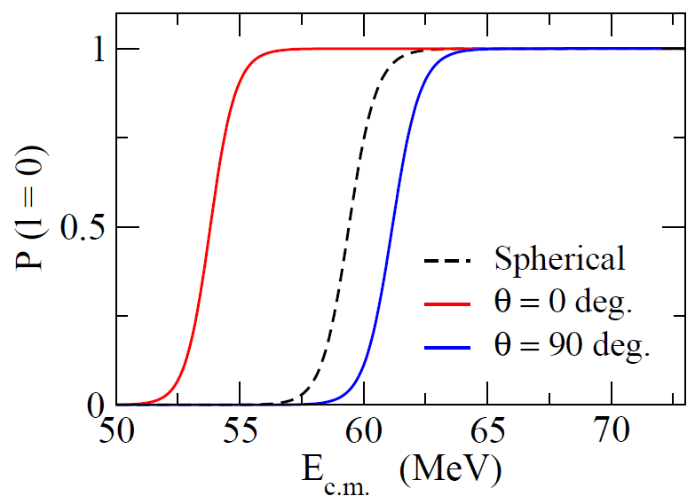
Effects of nuclear deformation
¹⁵⁴Sm : a typical deformed nucleus
¹⁵⁴Sm
¹⁵⁴Sm
¹⁶O

Slide 10
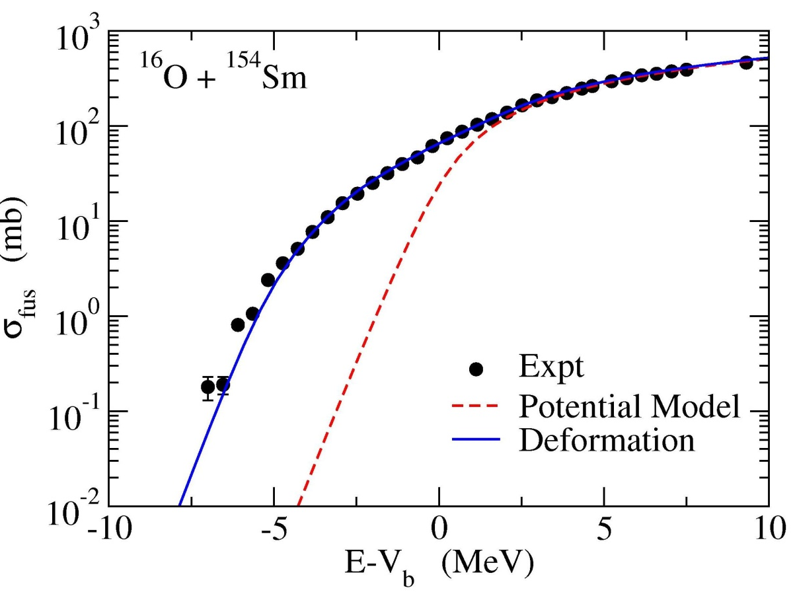
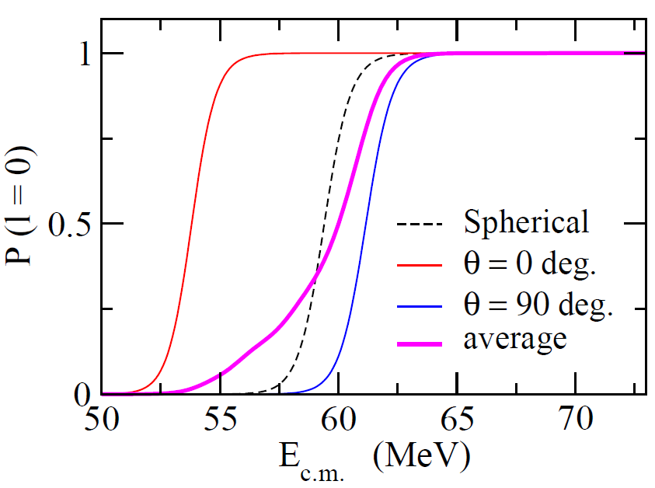
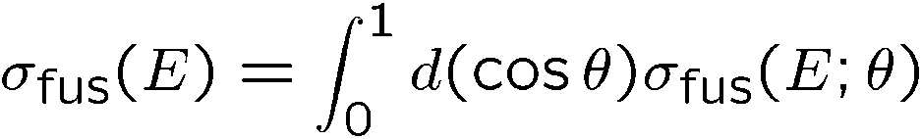
Effects of nuclear deformation
¹⁵⁴Sm : a typical deformed nucleus
¹⁵⁴Sm
deformation
¹⁵⁴Sm
¹⁶O
Fusion: strong interplay between
nuclear structure and reaction

Slide 11

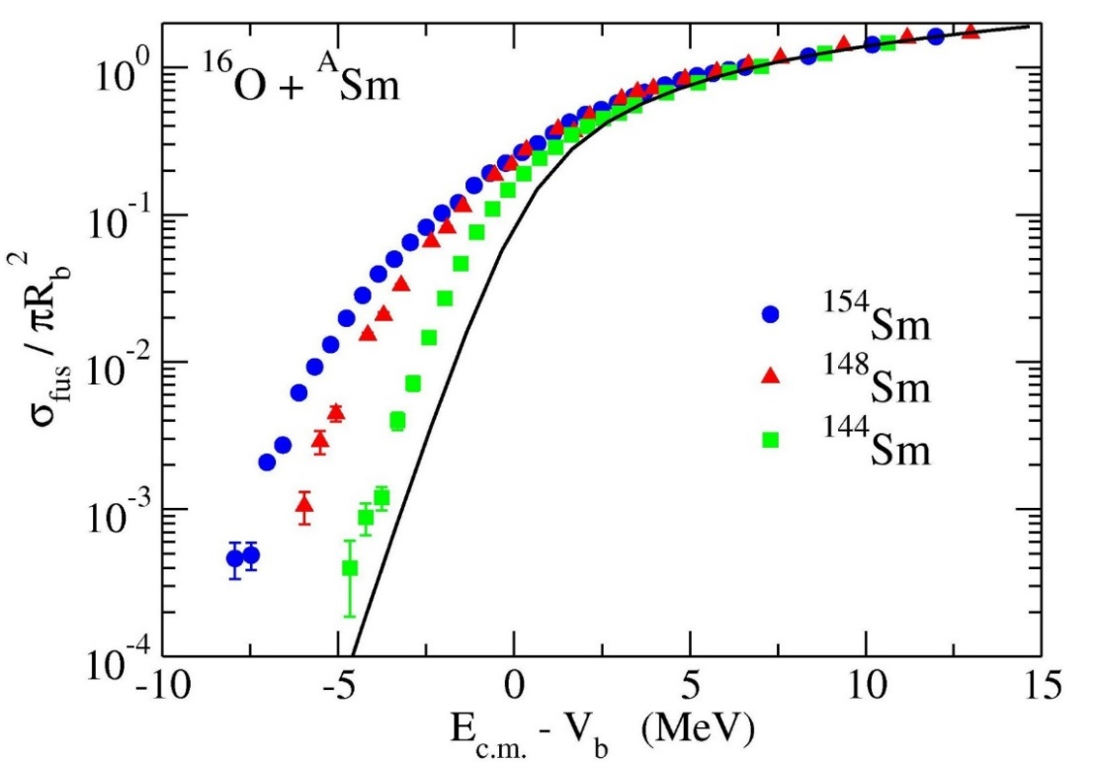
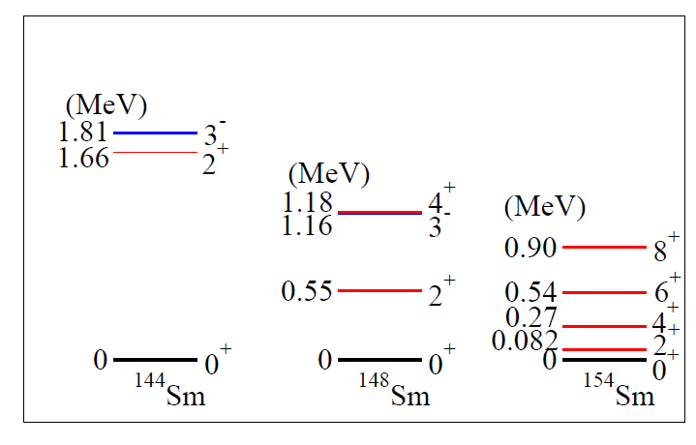
similar enhancement
for non-deformed nuclei
deformation
strong correlation
with nuclear spectrum
→ coupling assisted
tunneling phenomena

Slide 12
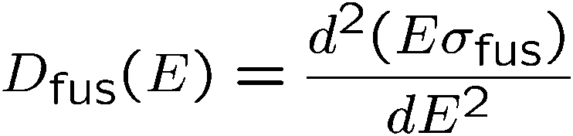
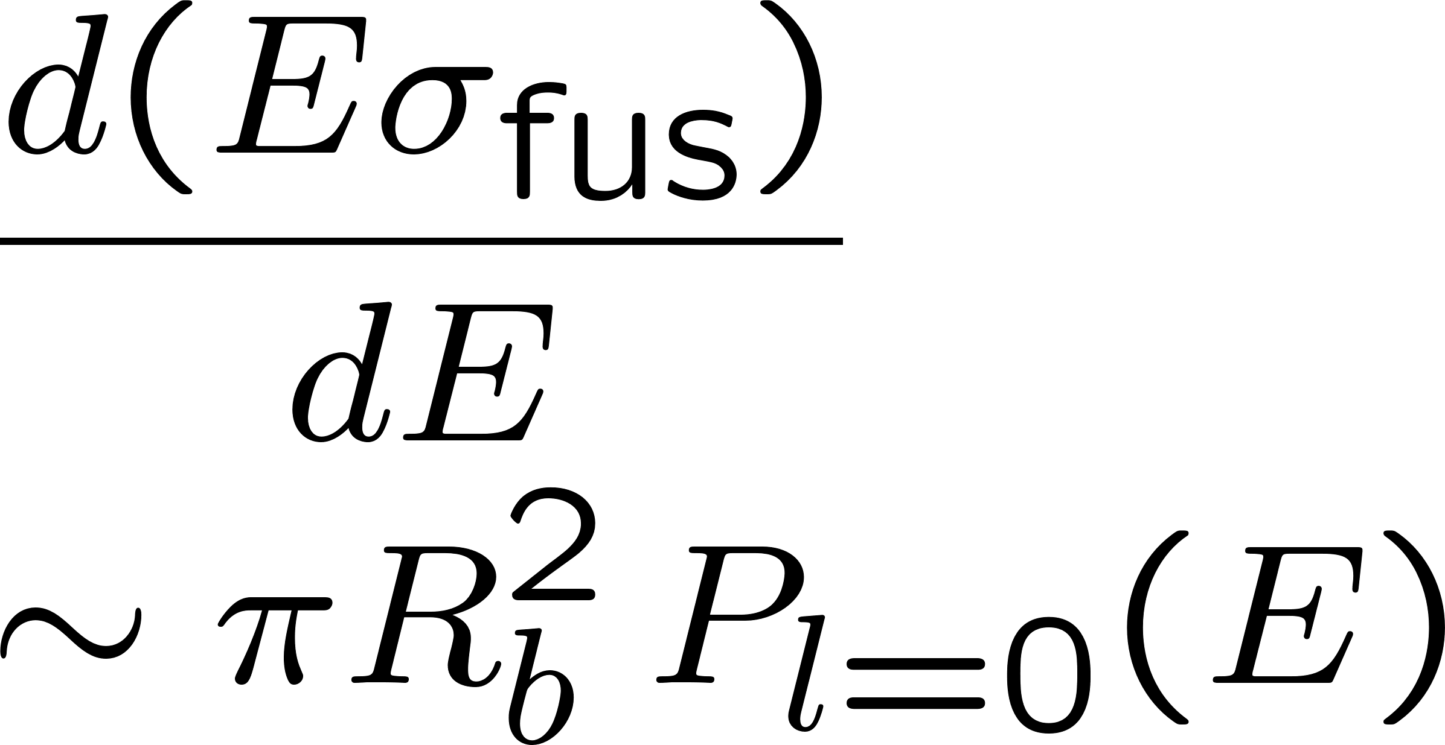
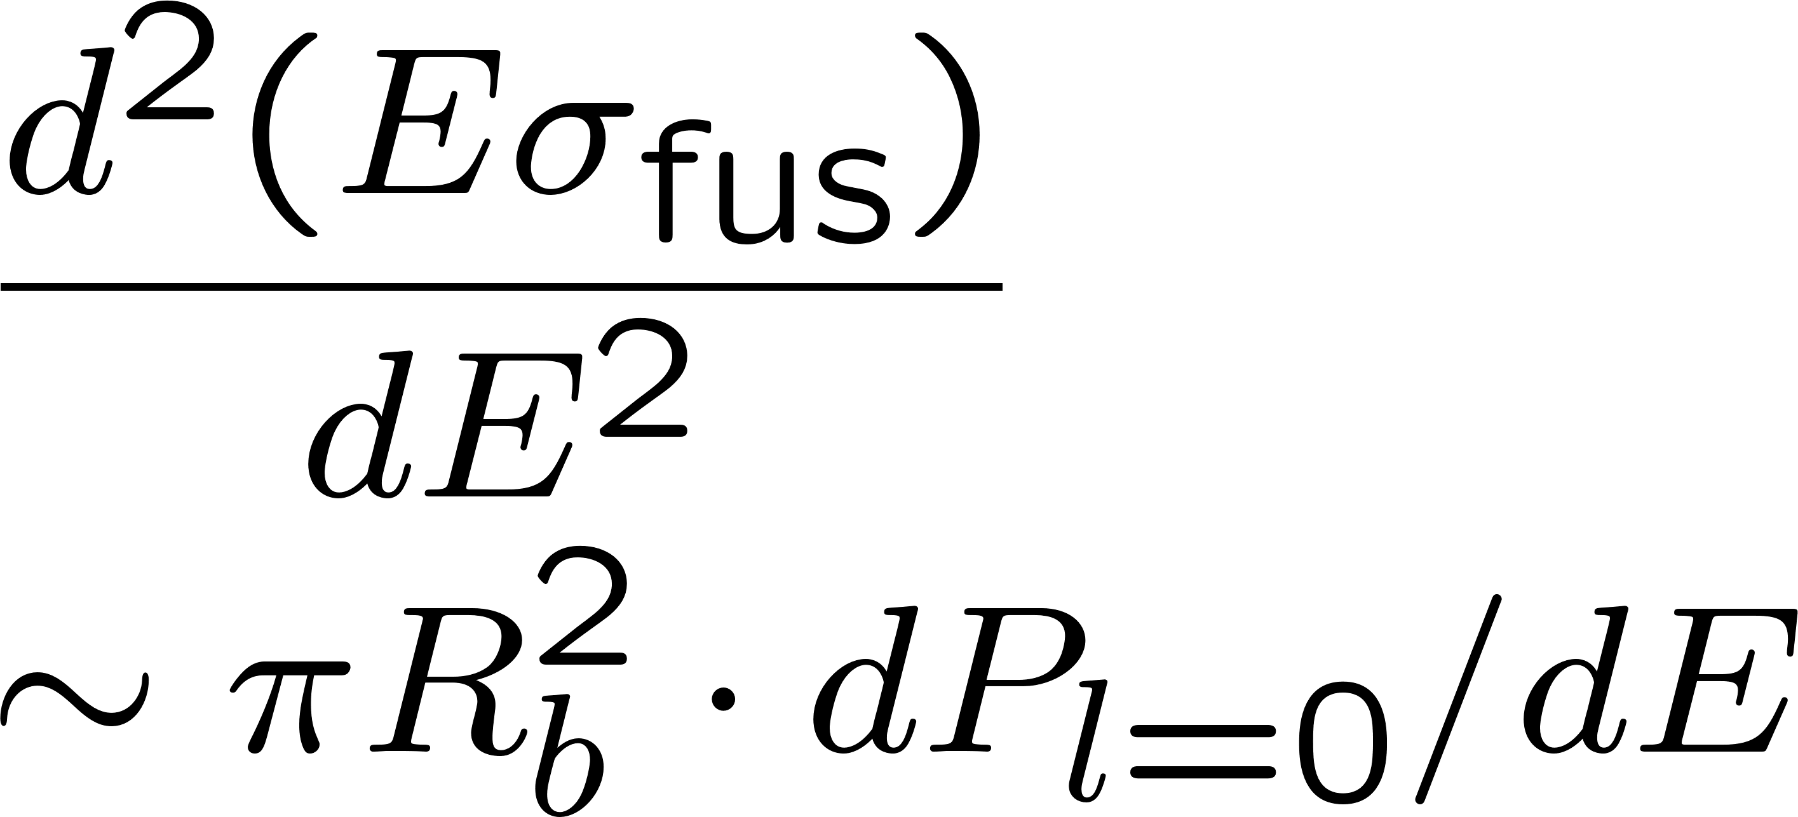

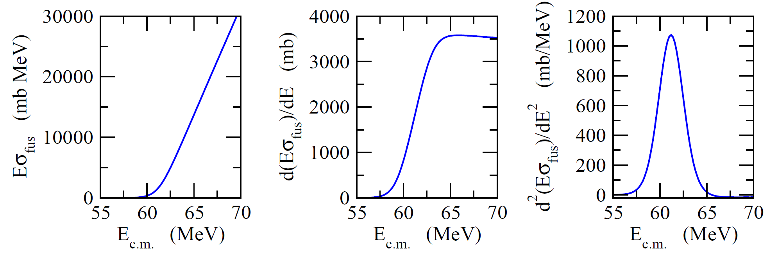
Fusion barrier distribution
N. Rowley, G.R. Satchler, and P.H. Stelson, PLB254 (‘91) 25
V_{b}
K.H. and N. Takigawa, PTP128 (‘12) 1061
Notes:
very nice way to present the channel coupling effects

Slide 13
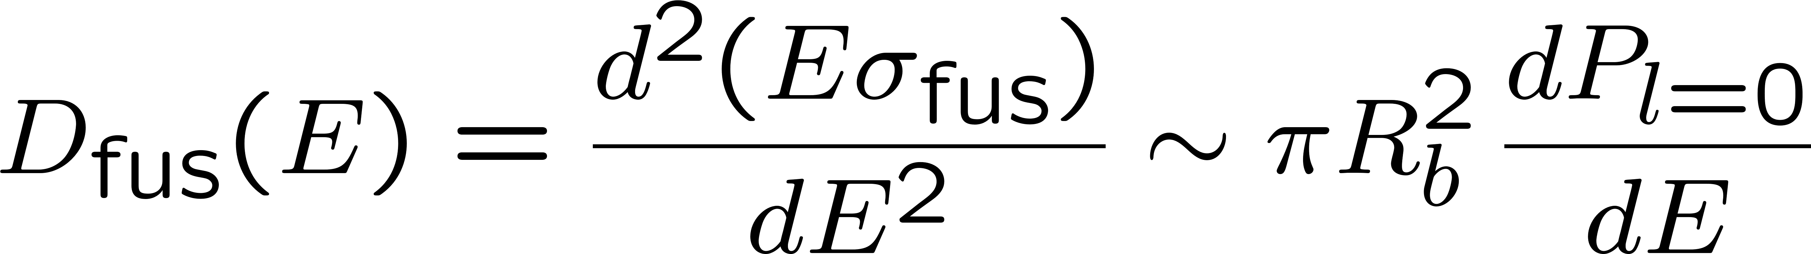
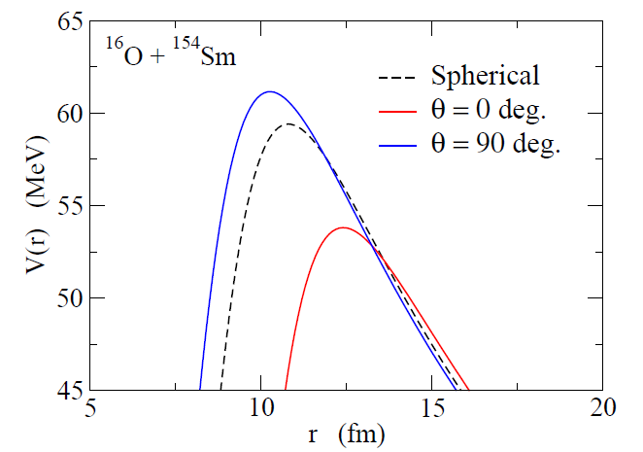
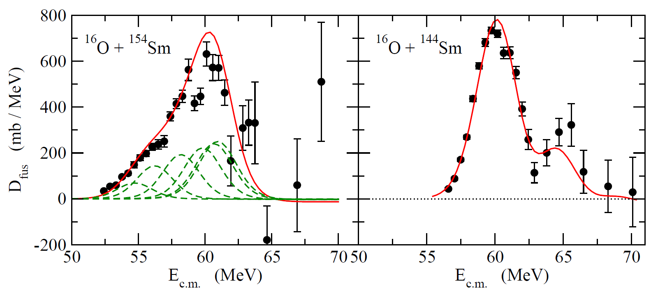
Fusion barrier distribution (Rowley, Satchler, Stelson, PLB254(‘91))
Data: J.R. Leigh et al.,
PRC52 (‘95) 3151

Slide 14
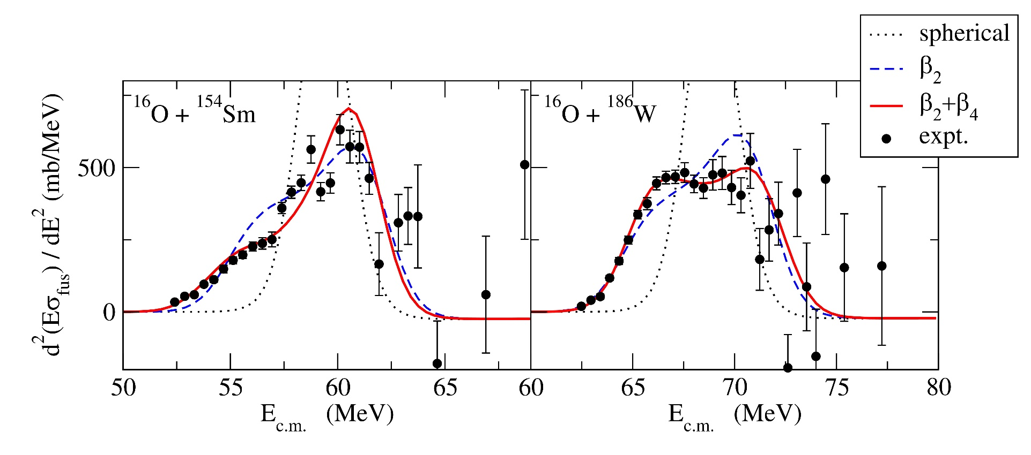
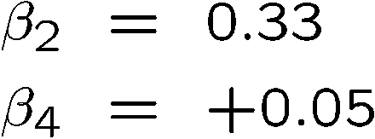
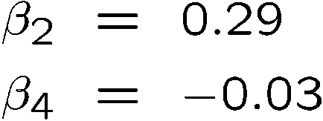
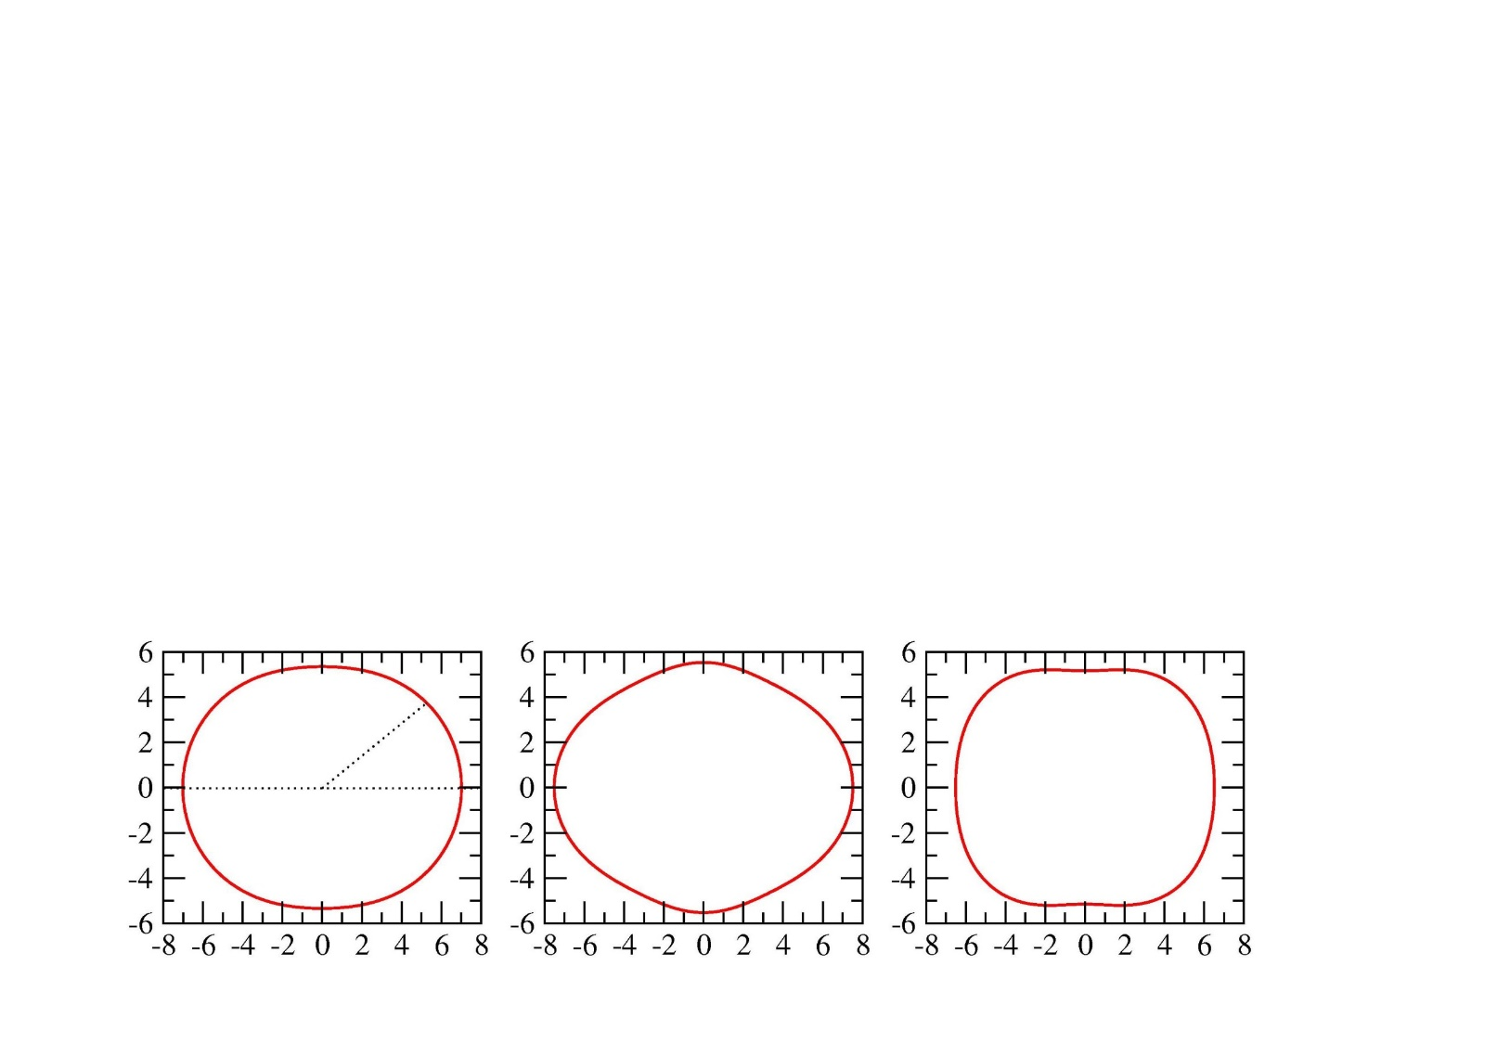
sensitive to the sign of β₄!
Fusion as a quantum tunneling microscope for nuclei

Slide 15
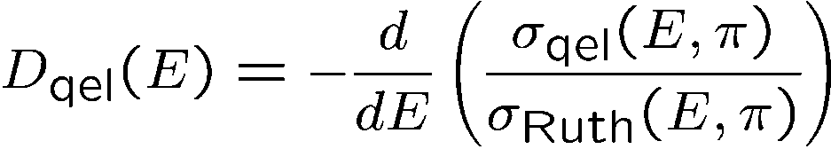
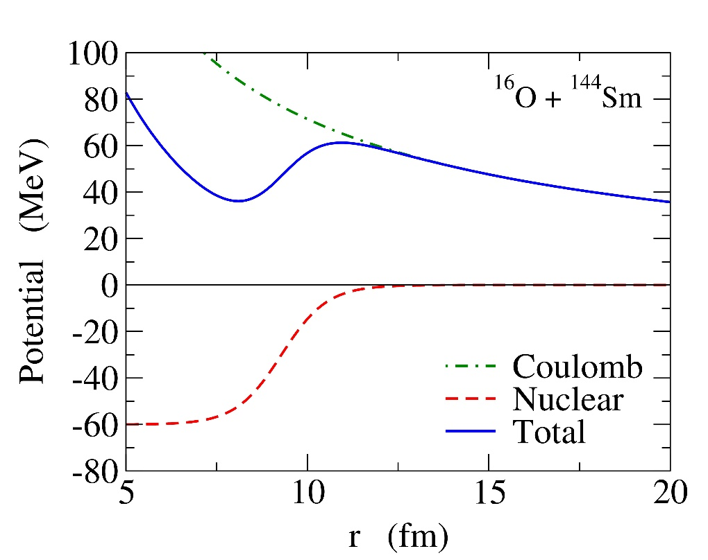
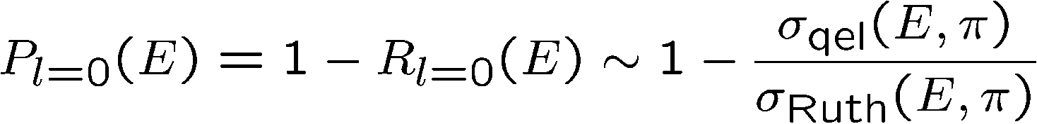
Quasi-elastic barrier distribution
Quasi-elastic scattering:
H. Timmers et al., NPA584(’95)190
A sum of all the reaction processes other than fusion
(elastic + inelastic + transfer + ……)
fusion
Quasi-elastic

Slide 16
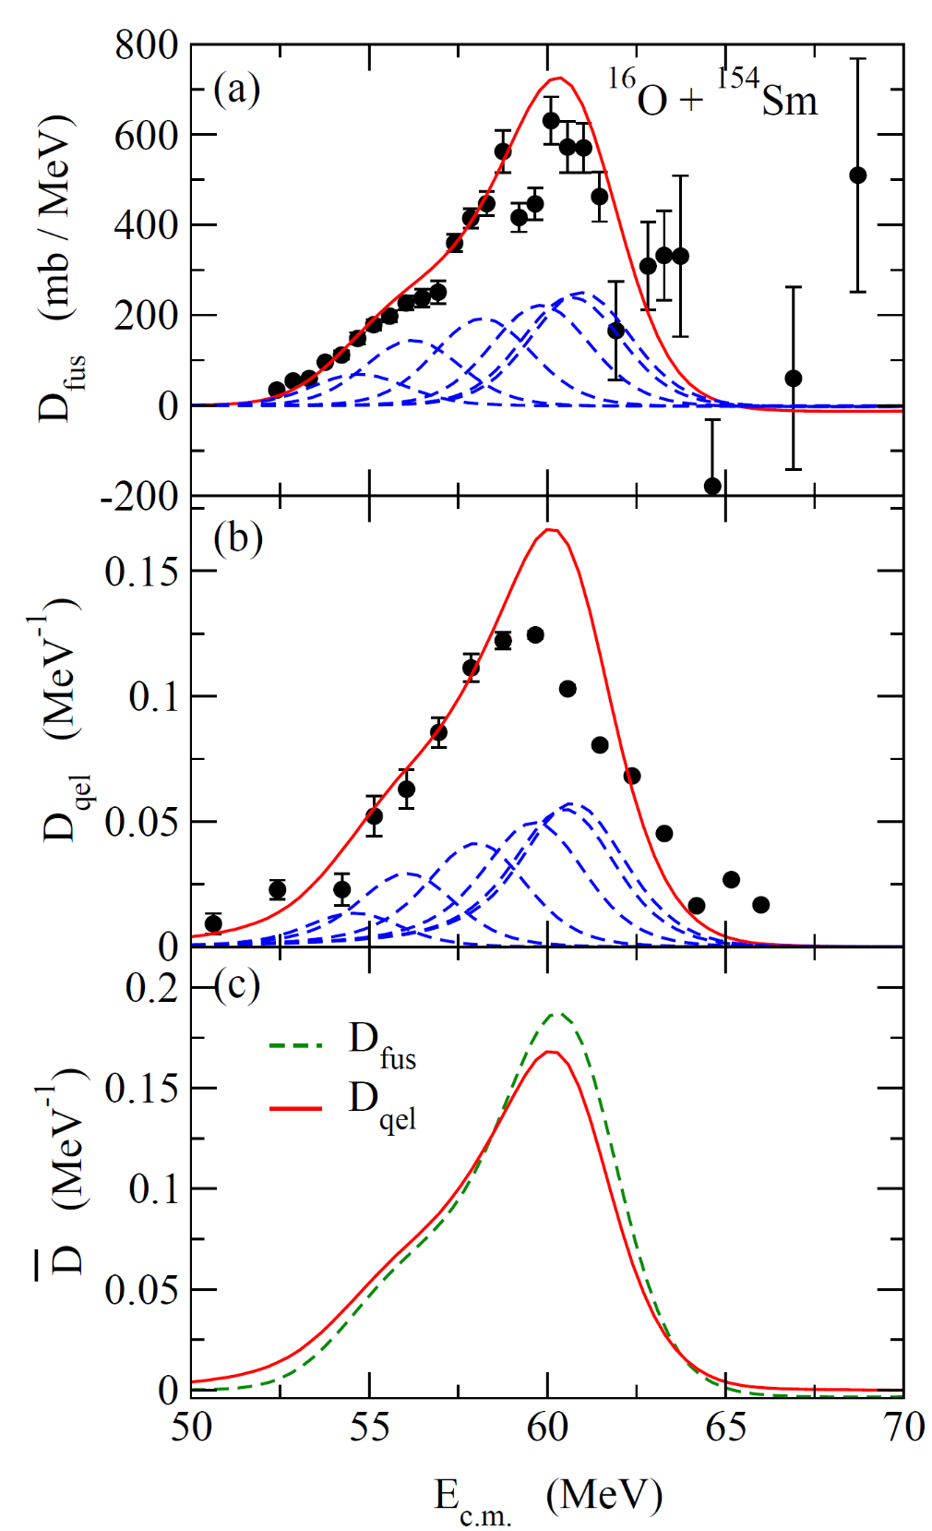
D_{fus} and D_{qel}: behave similarly
to each other
cf. Application to reactions
relevant to SHE
⁴⁸Ca + ²⁴⁸Cm → ²⁹⁶₁₁₆Lv*
T. Tanaka et al.,
JPSJ 87 (‘18) 014201
PRL124 (‘20) 052502
⁵¹V + ²⁴⁸Cm → ²⁹⁹119*
M. Tanaka et al.,
JPSJ 91 (‘22) 084201
K.H. and N. Rowley, PRC69(’04)054610

Slide 17
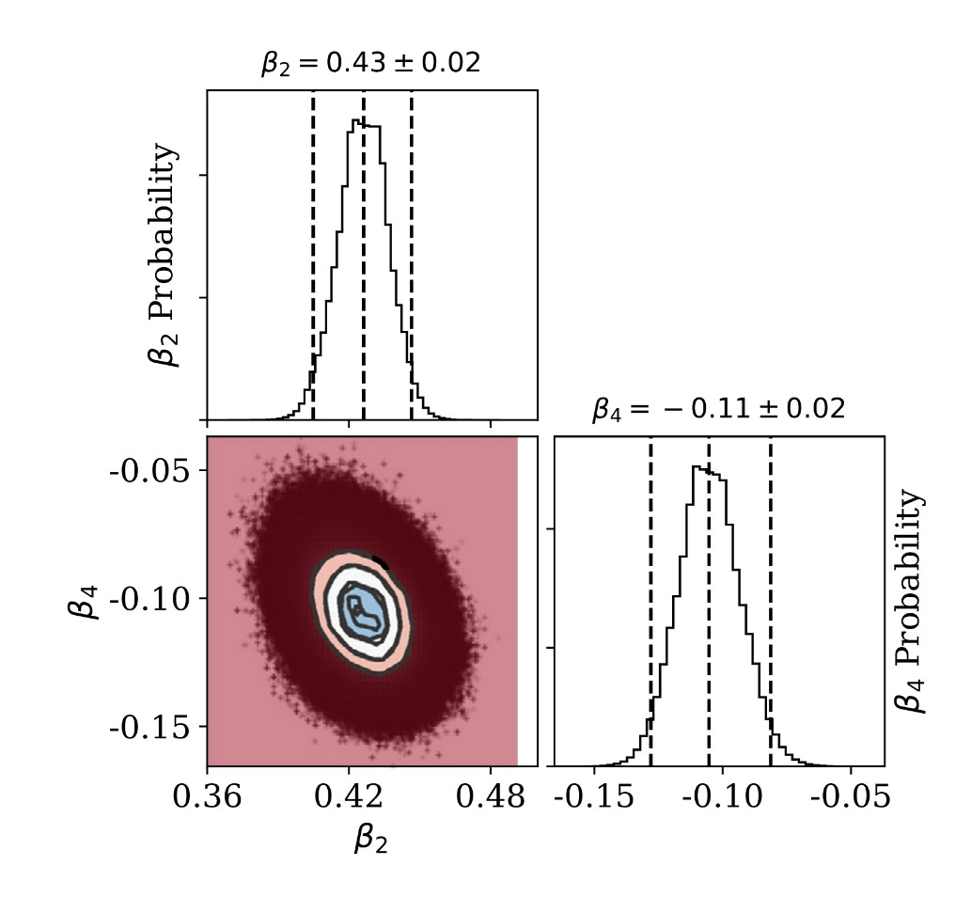
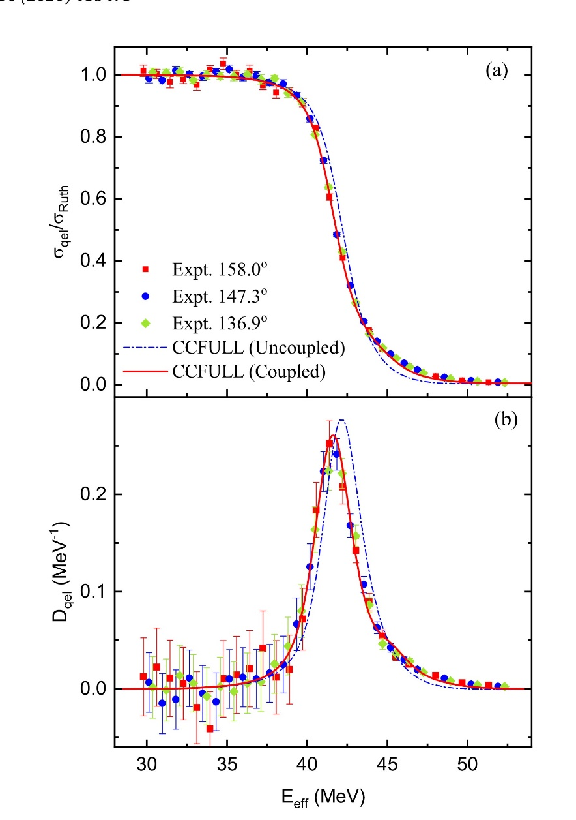
Determination of β₄ of ²⁴Mg with quasi-elastic scattering
Y.K. Gupta, B.K. Nayak, U. Garg, K.H., et al., PLB806, 135473 (2020).
β₂ = 0.43 +/- 0.02
²⁴Mg + ⁹⁰Zr
Bayesian analysis
β₄ = 0.11 +/- 0.02
high precision determination of β₄
→ for the first time
cf. (p,p’): β₄ = -0.05 +/- 0.08
R. De Swiniarski et al., PRL23, 317 (1969)

Slide 18
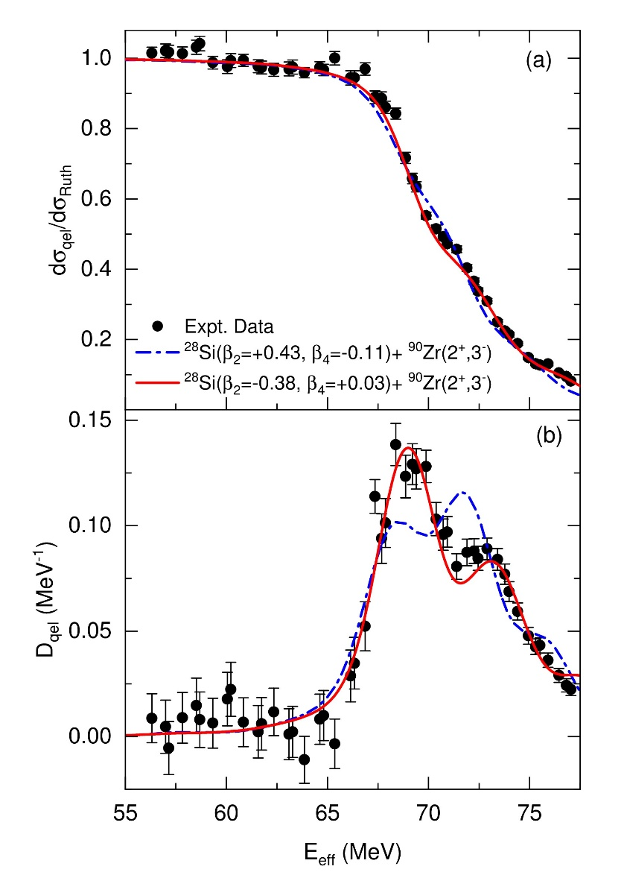
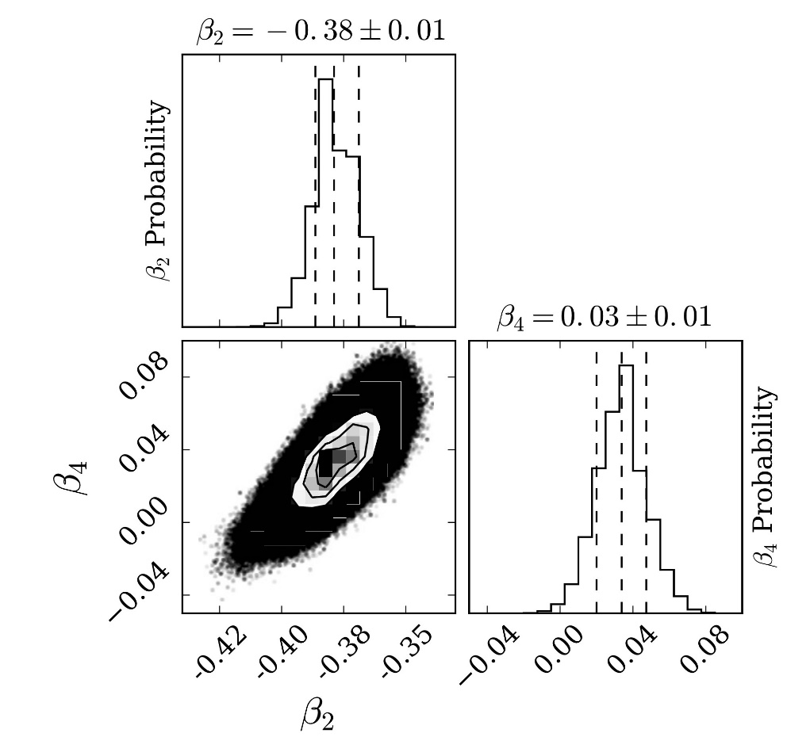
Determination of β₄ of ²⁸Si with quasi-elastic scattering
Y.K. Gupta, V.B. Katariya, G.K. Prajapati, K.H., et al., PLB845, 138120 (2023).
²⁸Si + ⁹⁰Zr
β₂ = -0.38 +/- 0.01
Bayesian analysis
β₄ = 0.03+/- 0.01
cf. (n,n’): β₄ = 0.20 +/- 0.05
G. Haouat et al., PRC30, 1795 (1984)

Slide 19

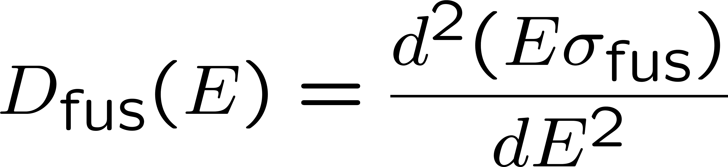
Summary
Heavy-ion fusion reactions around the Coulomb barrier
Strong interplay between nuclear structure and reaction
Quantum tunneling with various intrinsic degrees of freedom
Role of deformation in sub-barrier enhancement
amplified
deformation
Fusion barrier distribution
Quasi-elastic barrier distribution
sensitive to the nuclear structure
recent applications to ²⁴Mg, ²⁸Si + ⁹⁰Zr → determination of β₄

