Slide 1
Nuclear shape phase transition in relativistic density functional theory
Exploring nuclear physics across energy scales, April 23, 2024
Zhipan Li （李志攀）
Southwest University, Chongqing, China

Slide 2
Outline
1. Introduction
Microscopic collective Hamiltonian
Results and Discussion
  Quadrupole shape phase transition (SPT) and shape coexistence (SC)
  Octupole SPT and parity doublets
  Impact of deformation and orientation on HIC
4. Summary and outlook

Slide 3

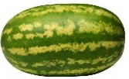

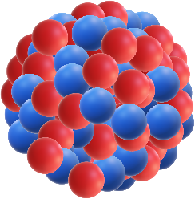



Nuclear shapes
Spherical
Prolate
Oblate
……
Triaxial
Octupole
Tetrahedron
Notes:
The nucleus exhibits rich shapes, such as ….

Slide 4
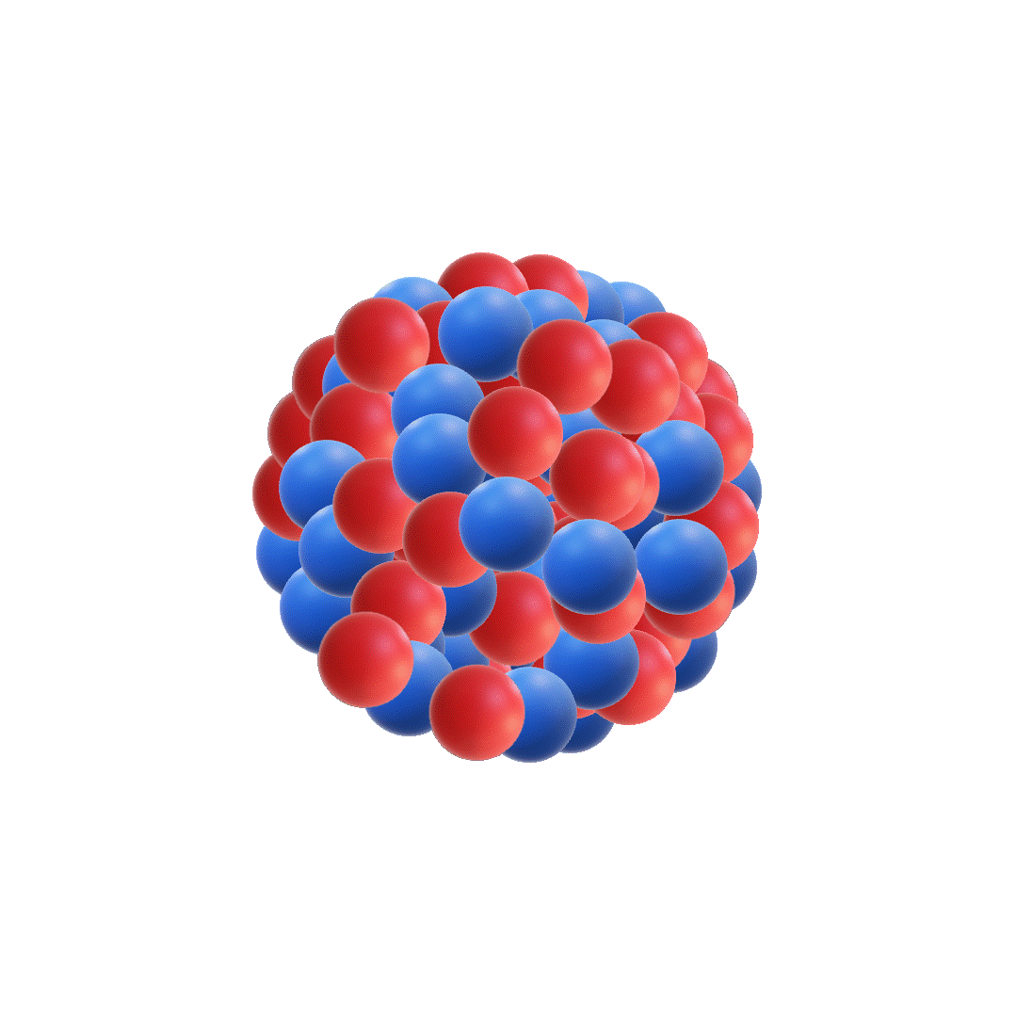
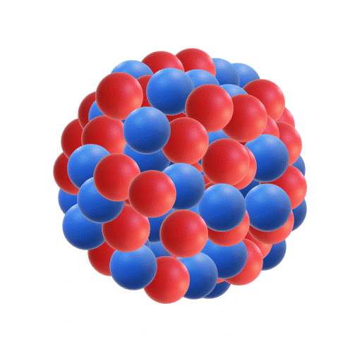
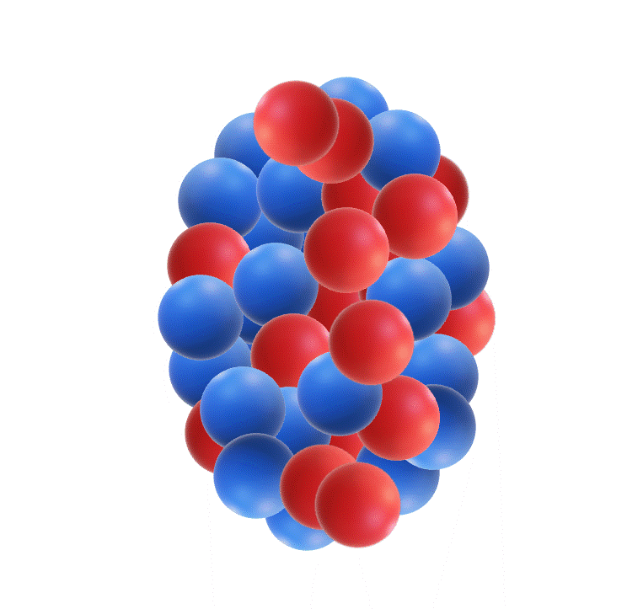
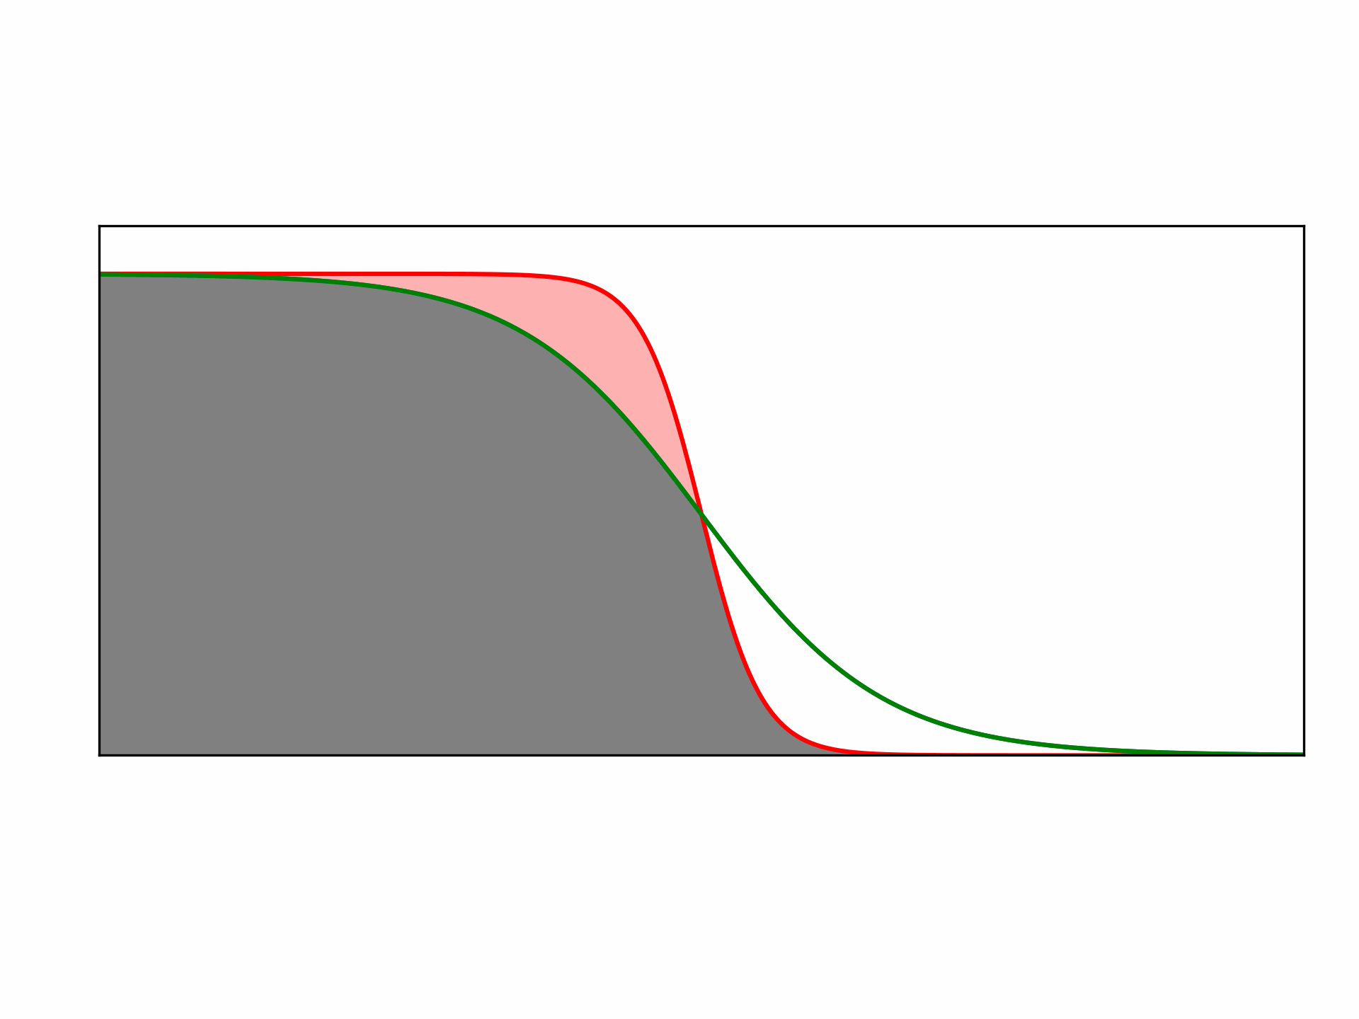
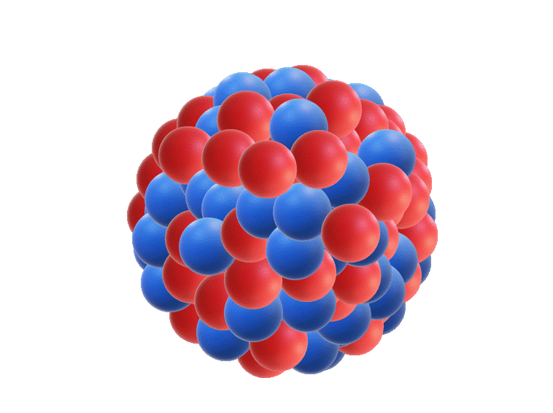
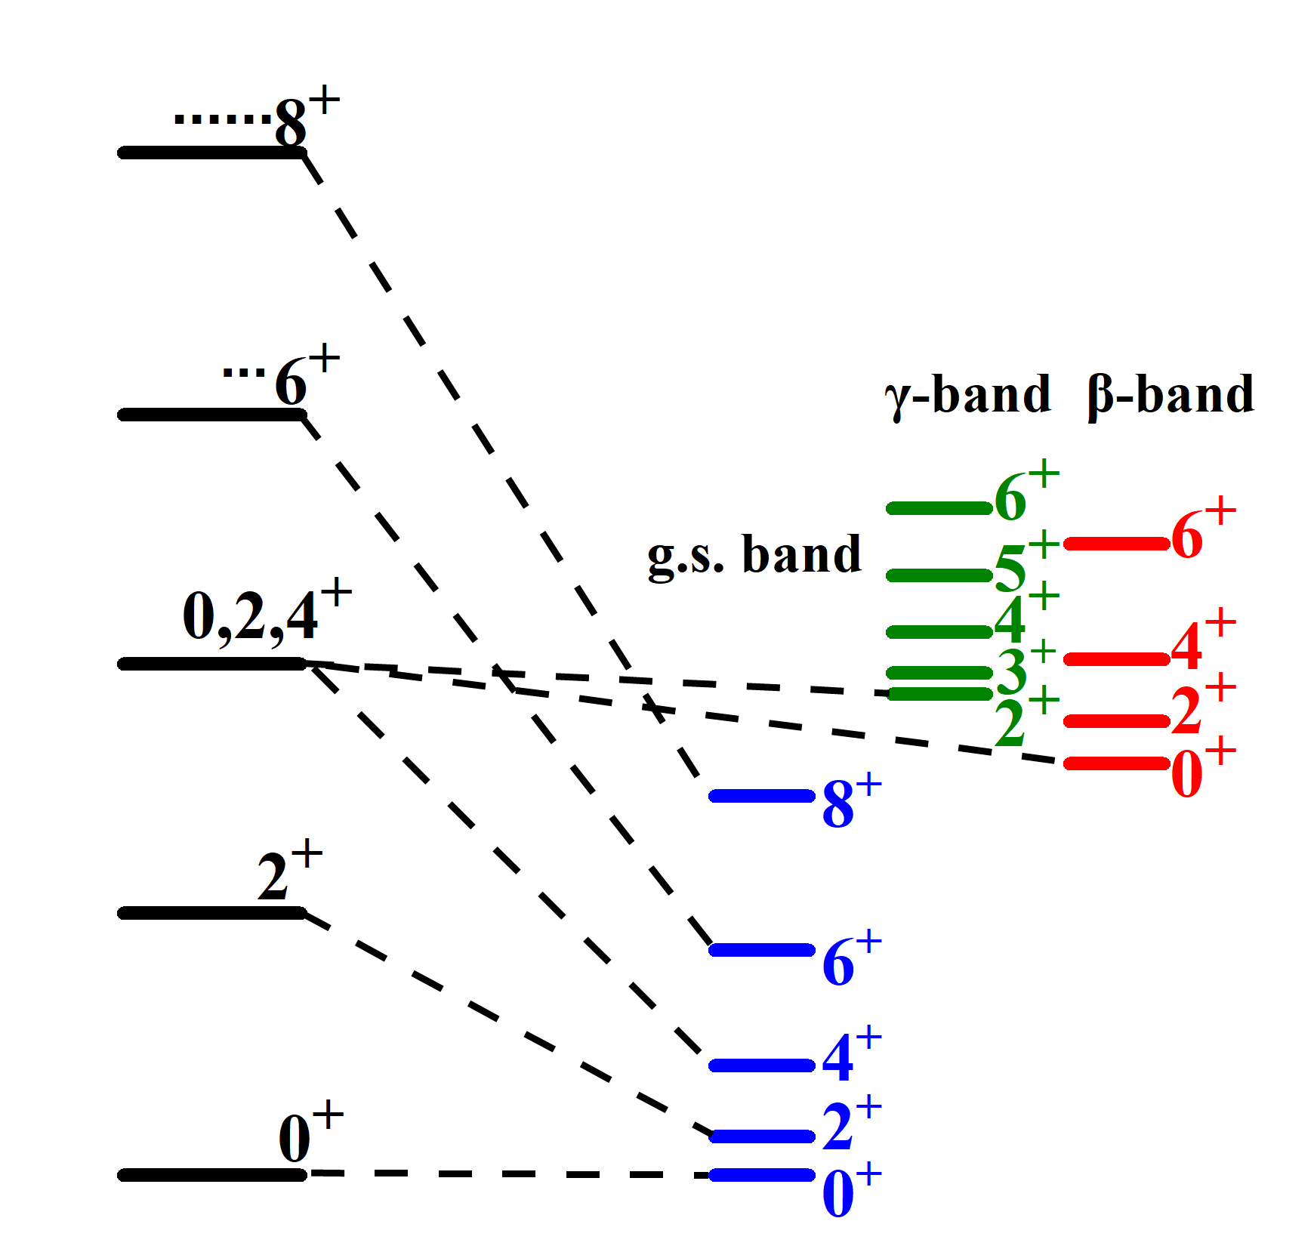
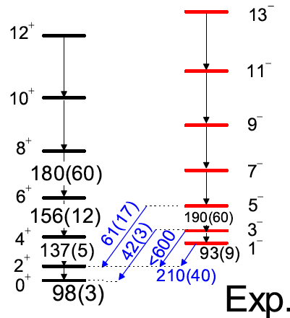
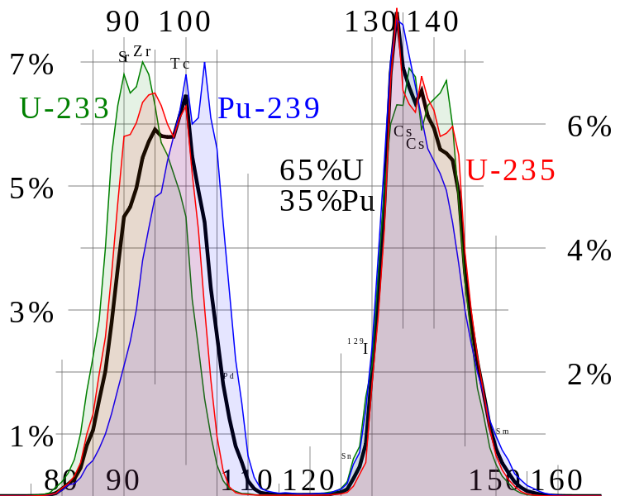
Large Amplitude Collective Motion (LACM)
v²
…
ε
Vibration
Rotation
Fission
Pairing Vib.
²⁰⁴Hg(³He,n)²⁰⁶Pb
PRL39, 987(1977)
4
Notes:
These shapes are generally not static, At low-energies, the system will do collective motions around their equilibrium shape., they mainly expressed as the surface vibrations, rotations, fission, nucleon pairings vibrate around Fermi surface, and so on. They will be reflected in the positive-parity low-lying spectrum. The vibrational limit with equal space energy levels, while the rotational bands proportional to J^2, low-lying negative-parity band for octupole, yield distributions of fission fragments, new state in the two-nucleon transfer reaction. …
低能激发的原子核展现出丰富的大振幅集体运动，如表面振动、转动、核裂变、以及费米面附近核子对的振动等。这些运动模式反映在如下的观测量里，如等间距的振动谱、J2依赖的转动谱、低位的八极负宇称、裂变的产物分布、双核子转移反应中的对振动激发态等等。

Slide 5
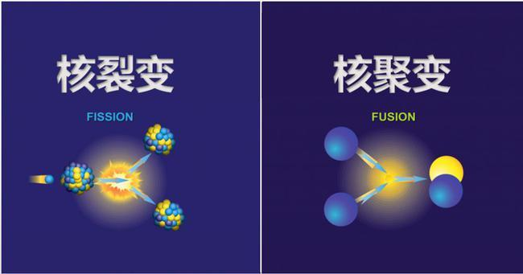
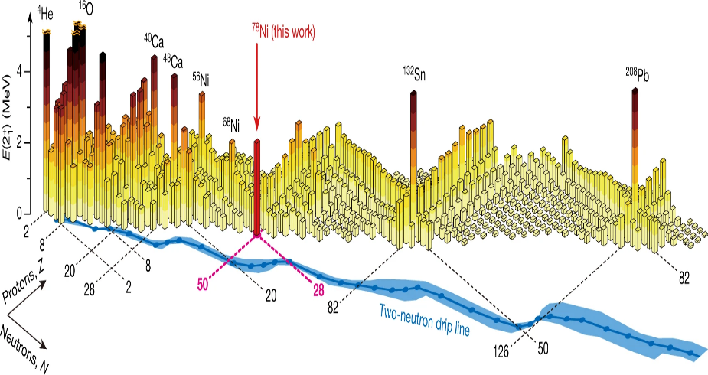
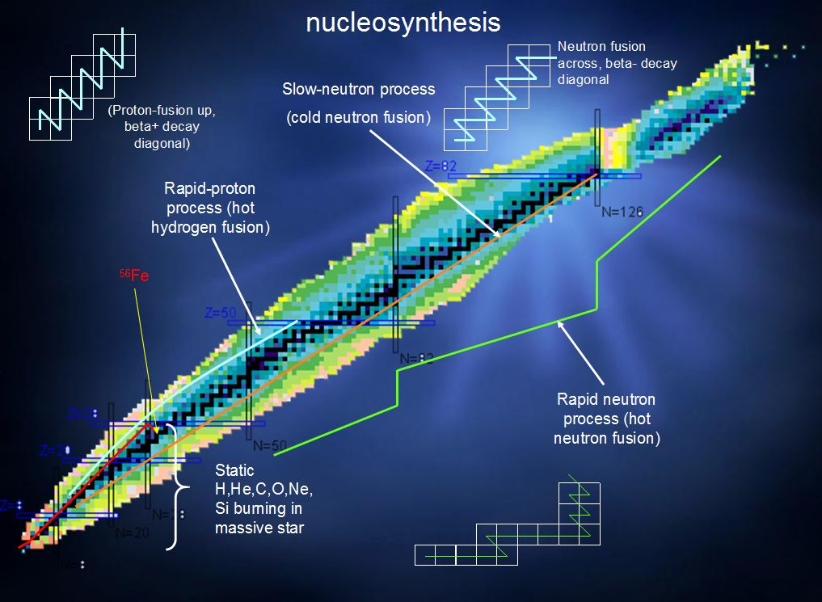
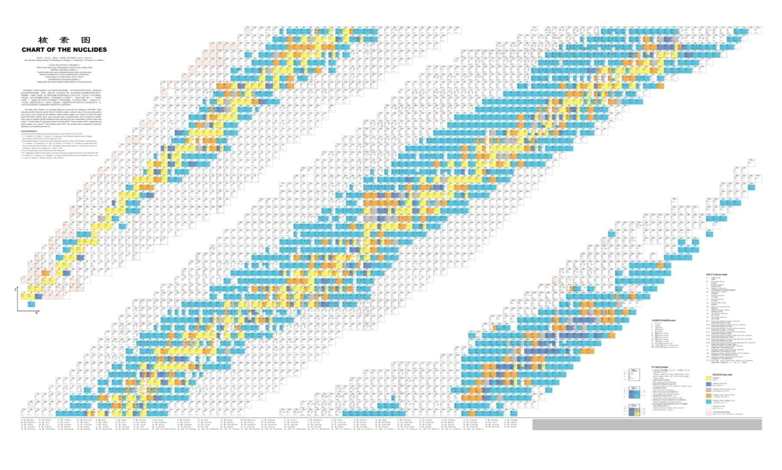
Nuclear shapes and LACM
Nature 569, 53 (2019)
Nuclear shapes and LACM
Structure: shell, SPT, SC,
effective interactions…
Reaction: fission, HIC, fusion …
Astrophysics: r process,
rp process, supernova …
Nuclear data, engineering
5
Notes:
Nuclear shapes and collective motion are crucial for the nuclear structure: like to reveal the shell structures, SPT, SC, etc. They also play important roles on nuclear reaction, like fission, HIC, and on astrophysics. The related excitation states and decays are the basic contents for nuclear data.

Slide 6
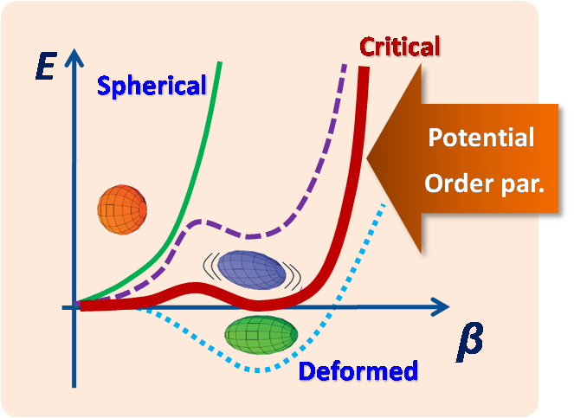
Shape phase transition
用途广泛的核物理
E(5)
X(5)
Casten, Nat. Phys. 2, 811 (2006).
Phase diagram
Cejnar, Jolie & Casten, RMP82, 2155 (2010).
Notes:
Concerning the nuclear structure, in the last two decades, the very attractive topic is the shape phase transition, which describes the rapid transitions between competing ground-state shapes induced by changing the nucleon numbers. Mainly appear in the transitional region. Here is the phase diagram, which describes four typical shapes, spherical , prolate, oblate, gamma-soft, and two critical points. Generally, the deformed gamma-soft shape can be regarded as a critical point in between prolate-oblate shape phase transition.

Slide 7
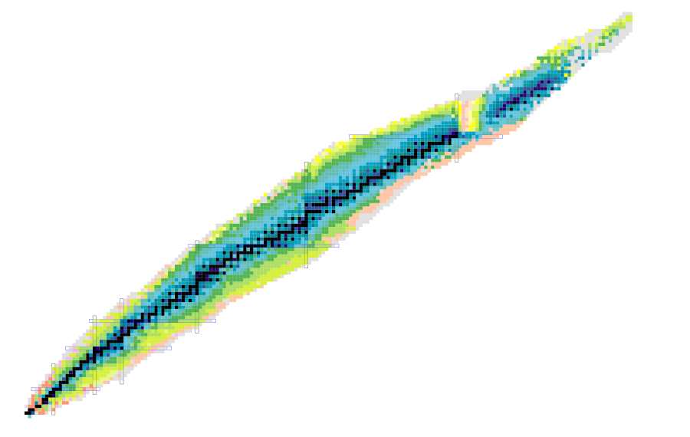
SPT within relativistic DFT
M Das, et al., NPA 1019, 122380 (2022)
Y-T Qiu, et al., PRC 106, 034301 (2022)
D Bonatsos, et al., PLB 829, 137099 (2022)
T Naz, et al., NPA 979, (2018)
S Quan, et al., PRC 97, 031301 (2018)
Y Fu, et al., PRC 97, 014311 (2018)
A Karim, S Ahmad, PRC 92, 064608 (2015)
P Ring, et al., IJMPE 20, (2011)
BK Agrawal, et al., PRC 63, 024002 (2001)
T Sil, et al., PRC 63, 064302 (2001)
W Zhang, et al., PRC 81, 034302 (2010)
BK Agrawal, et al., PRC 62, 044307 (2000)
ZP Li, et al., PRC 80, 061301 (2009)
ZP Li, et al., PRC 79, 054301 (2009)
……
SE Agbemava, et al., PRC 99, 014318 (2019)
ZP Li, et al., PLB 726, (2013)
J-Y Guo, et al., PRC 82, 047301 (2010)
SK Patra, et al., PRC 80, 034312 (2009)
……
Z=92
Z=82
XQ Yang, et al., PRC 103, 054321 (2021)
T Naz, et al., NPA 987, (2019)
K Nomura, et al., PRC 89, 024312 (2014)
P Sarriguren, et al., PRC 77, 064322 (2008)
R Fossion, et al., PRC 73, 044310 (2006)
……
N=126
V Kumar, et al., NPA 1022, 122429 (2022)
KE Karakatsanis et al., PRC 105, 064310 (2022)
P Kumar, et al., EPJA 57, 36 (2021)
NJA Awwad, et al., PRC 101, 064322 (2020)
K Nomura, et al., PRC 102, 034315 (2020)
T Bayram, S Akkoyun, PS 87, 065201 (2013)
J Xiang, et al., NPA 873, (2012)
H Mei, et al., PRC 85, 034321 (2012)
GA Lalazissis, et al., NPA 597, (1996)
……
Z=50
M Aggarwal, et al., NPA 1044, 122843 (2024)
A Karim, et al., PAN 85, (2022)
P Kumar, SK Dhiman, NPA 1001, 121935 (2020)
Y El Bassem, M Oulne, NPA 987, (2019)
A Karim, et al., IJMPE 27, 1850024 (2018)
W Zhang, YF Niu, PRC 96, 054308 (2017)
K Nomura, et al., PRC 96, 014304 (2017)
K Nomura, et al., PRC 96, 064316 (2017)
ZP Li, et al., PRC 81, 034316 (2010)
T Niksic, et al., PRL 99, 092502 (2007)
GA Lalazissis, et al., NPA 586, (1995)
……
000
N=82
Z=28
Z=20
N=50
Z=8
N=20
N=28
N=8
https://www.nndc.bnl.gov/
7
Notes:
Since the talk is focus on the study of SPT in relativistic DFT, here I just summarize the progress of such studies in different mass regions in the last decades. Covering From medium to superheavy mass regions.

Slide 8
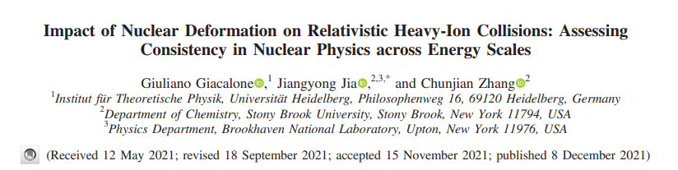
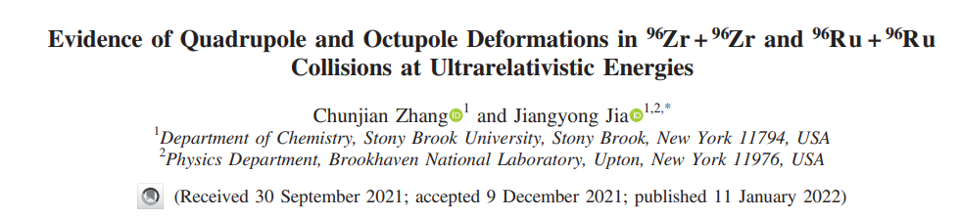
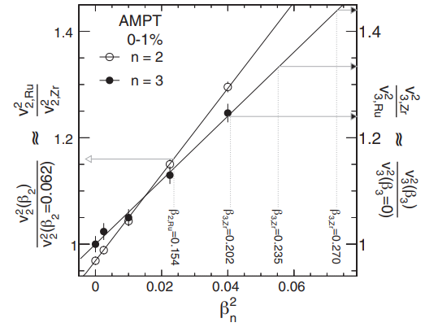
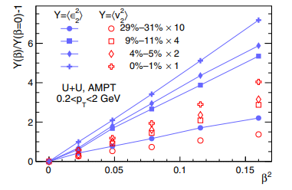

Impact of deformations on HIC
PRL127, 242301(2021)
PRL128,022301(2022)
$$v_{n}^{2}∝\left\langle ε_{n}^{2}\right\rangle ∝β_{n}^{2}$$
Notes:
Concerning the nuclear reaction, very recently, Jia Jiangyong and his collaborators have investigated the impact of nuclear defomations on the relativistic HIC. They compared the theoretical results with experimental data and examined the squared mean of the anisotropic flow of nuclear reaction final states in ultra-central non-polarized collisions and found it to be proportional to the square of the nuclear deformation parameter, beta_n.

Slide 9
Outline
1. Introduction
Microscopic collective Hamiltonian
Results and Discussion
  Quadrupole shape phase transition (SPT) and shape coexistence (SC)
  Octupole SPT and parity doublets
  Deformation and orientation effects on HIC
4. Summary and outlook

Slide 10

Collective degrees of freedom
Deformations, Euler angles, Pairing tensor …
Time: ~10⁻²⁰s
$$λ$$
adiabatic
……
Time: ~10⁻²²s
Notes:
Firstly, let’s see the typical time scale for two kinds of motion. the time scale for nucleon is about 10-22s，while The time scale of LAMC is about 10-20s，which allows us to adopt the adiabatic approximation, namely to introduce a series of collective degrees of freedom, like deformations beta, euler angles, pairing tensor, and so on. Finally, we can construct a collective Hami. Based on the collective degrees of freedom.

Slide 11




Collective Hamiltonian
Vibration
Rotation
Determine B, J, V from microscopic model
Time: ~10⁻²²s
Notes:
Where the vib part is expressed as second-order derivatives to beta, alpha…, B is the mass tensor. This is the rotational part and Jk are the MOI, Vcoll is the multi dimensional collective potential. The dynamics of CH is fully determined by these collective parameters, so whether they can be determined from microscopic model?
其中振动由集体自由度的二阶微分描述，B为质量张量，该项为转动项，Jk为转动惯量，Vcoll为集体势能曲面。这些集体参量完全确定了该哈密顿量的动力学性质，是否能从微观层次直接计算呢？答案是肯定的

Slide 12
Microscopic collective Hamiltonian
Cranking
PRC109, 044319 (2024)
PC-PK1: Zhao, ZPLi, Yao & Meng, PRC 2010
Time: ~10⁻²²s
Notes:
Yes, it is. Here, we start from the relativistic density functional theory, which are expressed as a functional of a series of densities. Alpha, beta, gamma…. Are the parameters, and here we use PC-PK1 functional. Then we can calculate the collective parameters based on the cranking approximation. Details can be found in our recent paper. Finally, we derive a microscopic collective Hamiltonian.
从协变密度泛函理论出发，前天鹏巍老师已介绍，此处不再赘述，采用推转近似即可计算MOI和B等，这些均是由CDFT计算得到的占据几率，准粒子能量，角动量矩阵元或多极矩矩阵元等，我们的这篇文章给出了对形状、对张量的统一推导的表达式。由此，我们构建了基于CDFT的微观集体哈密顿量。

Slide 13
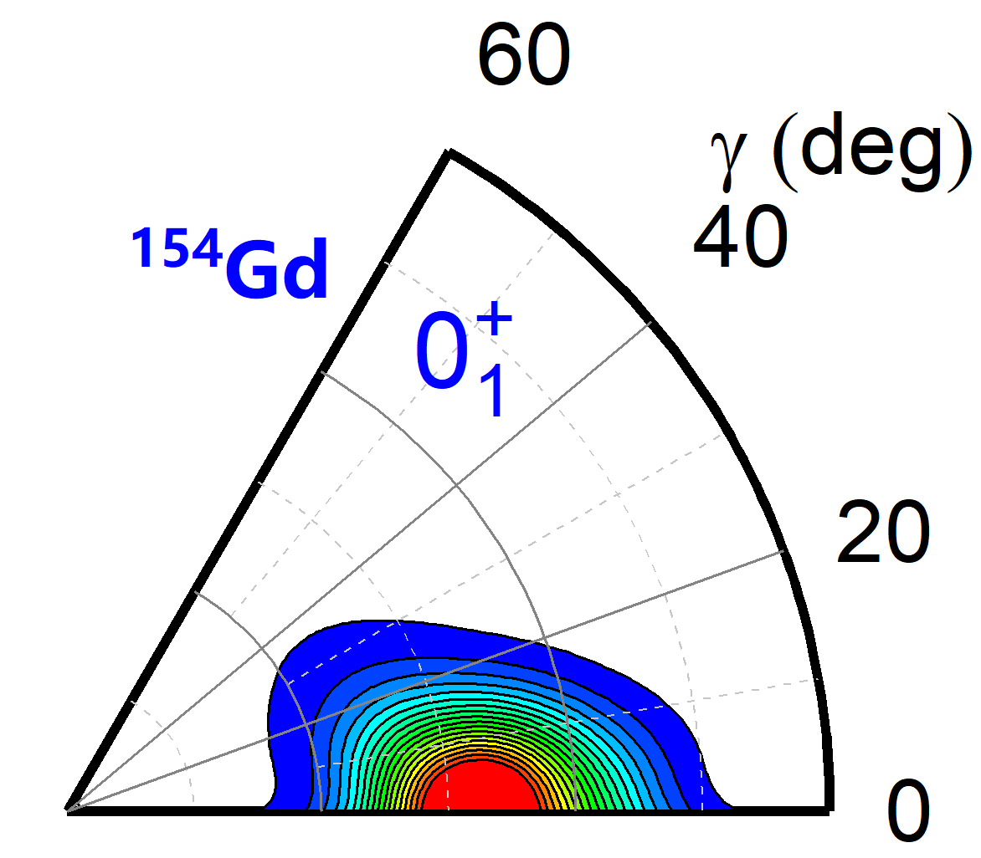
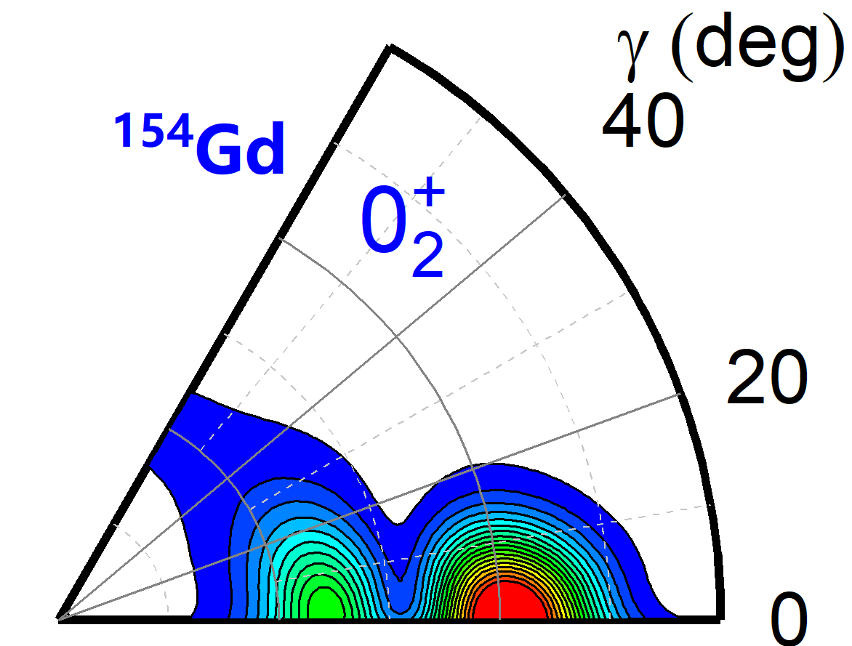
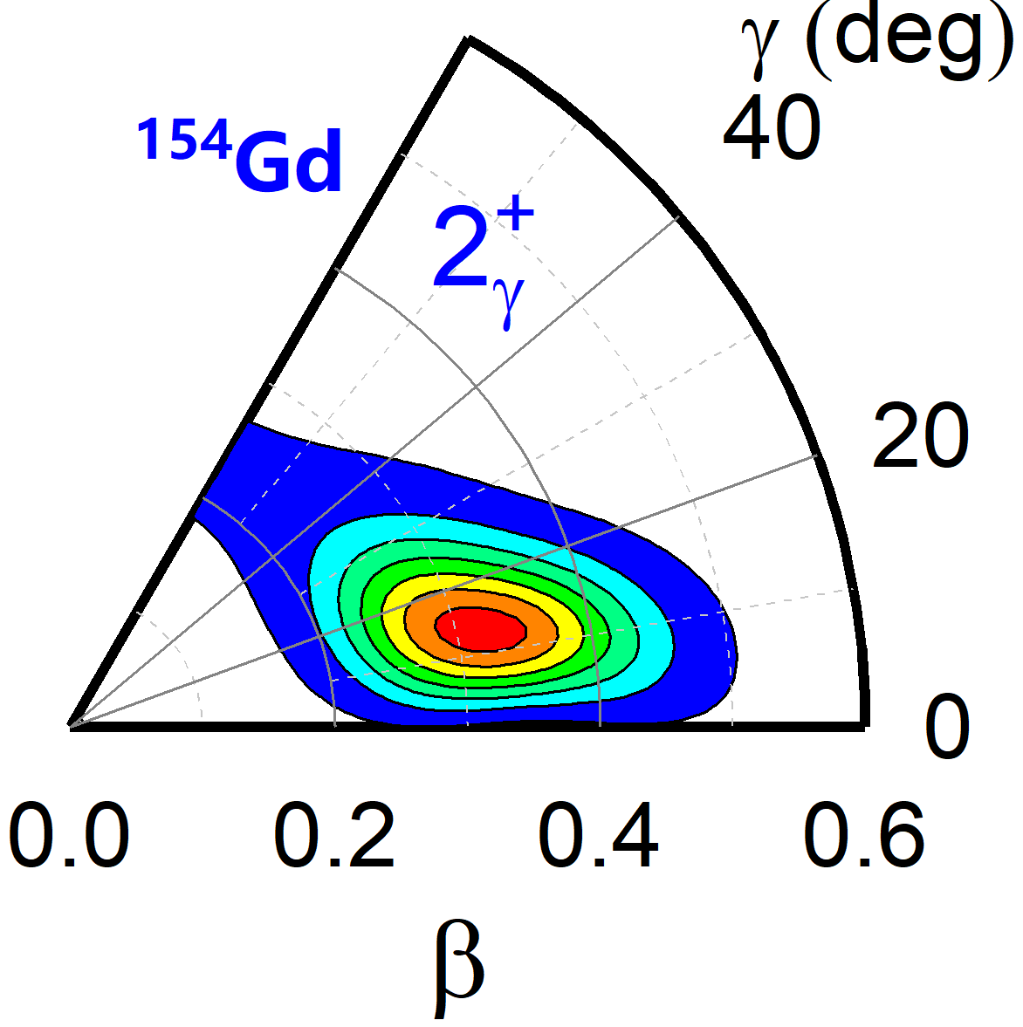
Microscopic collective Hamiltonian
CH
Solve eigen equation
Notes:
Solve the eigen equation, we can obtain the low-lying spectrum and EM transitions and compared with the data. And also to analyze the structure of excitation states using the probability density distributions.
求解其本征方程，即可得到核低激发谱，电磁跃迁，可直接与实验比较。同时还可以分析基态、激发态的集体空间的概率分布，分析其结构特性。

Slide 14

Results 1
Quadrupole Shape phase transition
& shape coexistence

Slide 15
Masses and Low-lying excitations
5DCH based on PC-PK1: Reproduce exp. data well
g.s. 0⁺
Lu, Li, ZPLi, Yao & Meng, PRC91, 027304 (2015)
Yang, Zhao & ZPLi, PRC107, 024308 (2023)
Notes:
Firstly, we show that the microscopic CH based PC-PK1 functional can reproduce the masses and low-lying excitations of even-even nuclei well. In particular, the B(E2, 2->0) are in very good agreement with the data, indicating that the quadrupole deformations are well reproduced.
首先，我们这里展示了基于PC-PK1泛函的5DCH对质量、四极激发态、电磁跃迁等的描述，质量方面的前天鹏巍老师已介绍过，此处不再赘述。激发态方面，我们发现理论和实验较好符合，尤其是对于基态带BE2跃迁。因此，我们可以进一步采用BE2提取基态和激发态形变，进而分析原子核的形状共存问题

Slide 16
Quadrupole deformation β
Yang, Wang, Zhao & ZPLi, PRC104, 054312 (2021)
http://nuclearmap.jcnp.org
Rapid transition (β~0 → well deformed) in medium and heavy mass region
Notes:
Here, we show the systematic results for the quadrupole deformation beta, light cyan means near spherical, warm colors for prolate and cold colors for oblate. We found quite rapid transition from near spherical to well deformed in the medium and heavy region;
black boxes denote nuclei with triaxial deformations, 107 e-e triaxial nuclei in the transitional regions, accompany with prolate-oblate shape phase transition.
The onset of defromations along proton and neutron shells indicate the possible shell quench and shape coexistence.

Slide 17
Quadrupole deformation β
Yang, Wang, Zhao & ZPLi, PRC104, 054312 (2021)
http://nuclearmap.jcnp.org
Rapid transition (β~0 → well deformed) in medium and heavy region
107 e-e triaxial nuclei in the transitional regions N~76, 116;
Onset of deformation at N~20, 28, 50, 82; Z~50, 82: shell quench.
Notes:
Here, we show the systematic results for the quadrupole deformation beta, light cyan means near spherical, warm colors for prolate and cold colors for oblate. We found quite rapid transition from near spherical to well deformed in the medium and heavy region;
black boxes denote nuclei with triaxial deformations, 107 e-e triaxial nuclei in the transitional regions, accompany with prolate-oblate shape phase transition.
The onset of defromations along proton and neutron shells indicate the possible shell quench and shape coexistence.

Slide 18
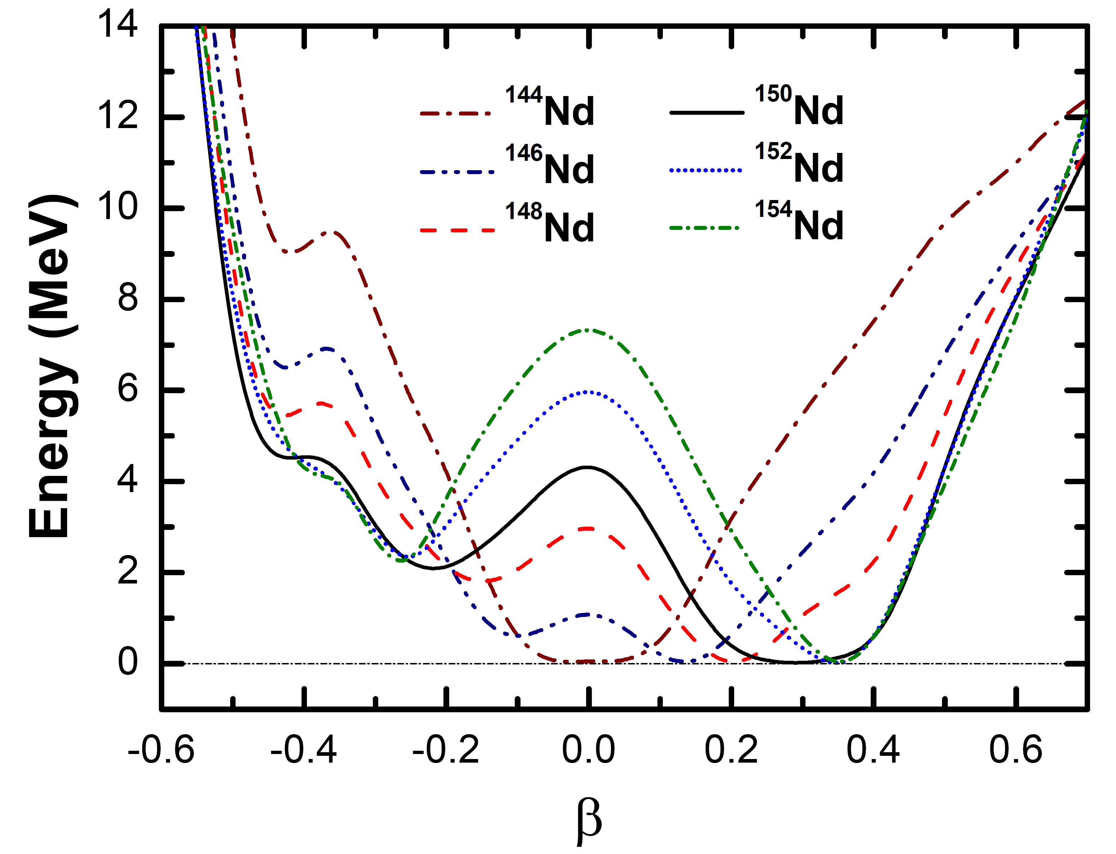
Shape phase transition – axially symmetric
ZPLi, Niksic, Vretenar, Meng, Lalazissis, Ring, PRC79, 054301 (2009)
Notes:
Here, we take the typical example to show the SPT, namely the rare earth region. A rapid shape transition from a spherical 144Nd to well deformed 152Nd is observed, with the critical nucleus 150Nd characterized by a very soft potential. The SPT is reflected in the rapid evolution of the energy ratios and BE2 transitions.

Slide 19
Shape phase transition – γ-soft
ZPLi, Niksic, Vretenar, Meng, PRC81, 034316 (2010)
g.s. 0⁺ w.f.
Notes:
In the Xe and Ba region, SPT involving gamma-soft is observed. The PES illustrate a beautiful transition from near spherical to the critical point with both beta and gamma soft and then to deformed gamma-soft nucleus. The beta and gamma fluctuations of the g.s. calculated from the wf are shown here, the critical nucleus present pronounced quantum fluctuations in both beta and gamma degrees of freedom.

Slide 20
Shape phase transition – prolate-oblate
Yang, Wang, Xiang, Wu, ZPLi, PRC103, 054321 (2021)
Notes:
sublead region exhibits prolate-oblate shape phase transition. Here we show the shape transition of Platinum isotopes, from prolate to gamma-soft then to oblate and finally to spherical. The corresponding spectroscopic quadrupole moments change sharply from large nagtive value to positive values denoting oblate shapes.

Slide 21
SPT with shape coexistence (SC)
Xiang, ZPLi, Long, Niksic, Vretenar, PRC98, 054308 (2018)
𝛾
Notes:
SPT is often accompanied with SC, like the neutron-deficient side of rare earth isotopes, medium deformed triaxial shape coexisted with a large prolate shape is predicted in 134Nd

Slide 22
Shape coexistence (SC)
Good agreement for g.s. & gamma band
0₂⁺ band: larger MOI and B(E2)
ρ²(E0)=44.6, comparable to that of ⁹⁸Sr (~51)
Xiang, ZPLi, Long, Niksic, Vretenar, PRC98, 054308 (2018)
Notes:
the calculated low-lying spectrum are in good agreement with the available data and results from Gogny D1S. The very low-lying gamma band and strong interband BE2 indicate the triaxial character of g.s., while the 02+ band with compressed spectrum and large BE2 may correspond to a large prolate shape.
The low-lying gamma band indicate that these bands are built on the soft triaxial shape. The 02 band has compact spectrum means larger MOI than that of g.s. band, B(E2) values are also very large, more than 2 times. This means that this band must built on a large deformed shape. These are also reflected in the collective wfs, where peaks are found in the triaxial minimum and large prolate minimum, respectively.
The E0 transition is about 45, which is comparable to that of well-known shape coexisting nucleus 98Sr.

Slide 23
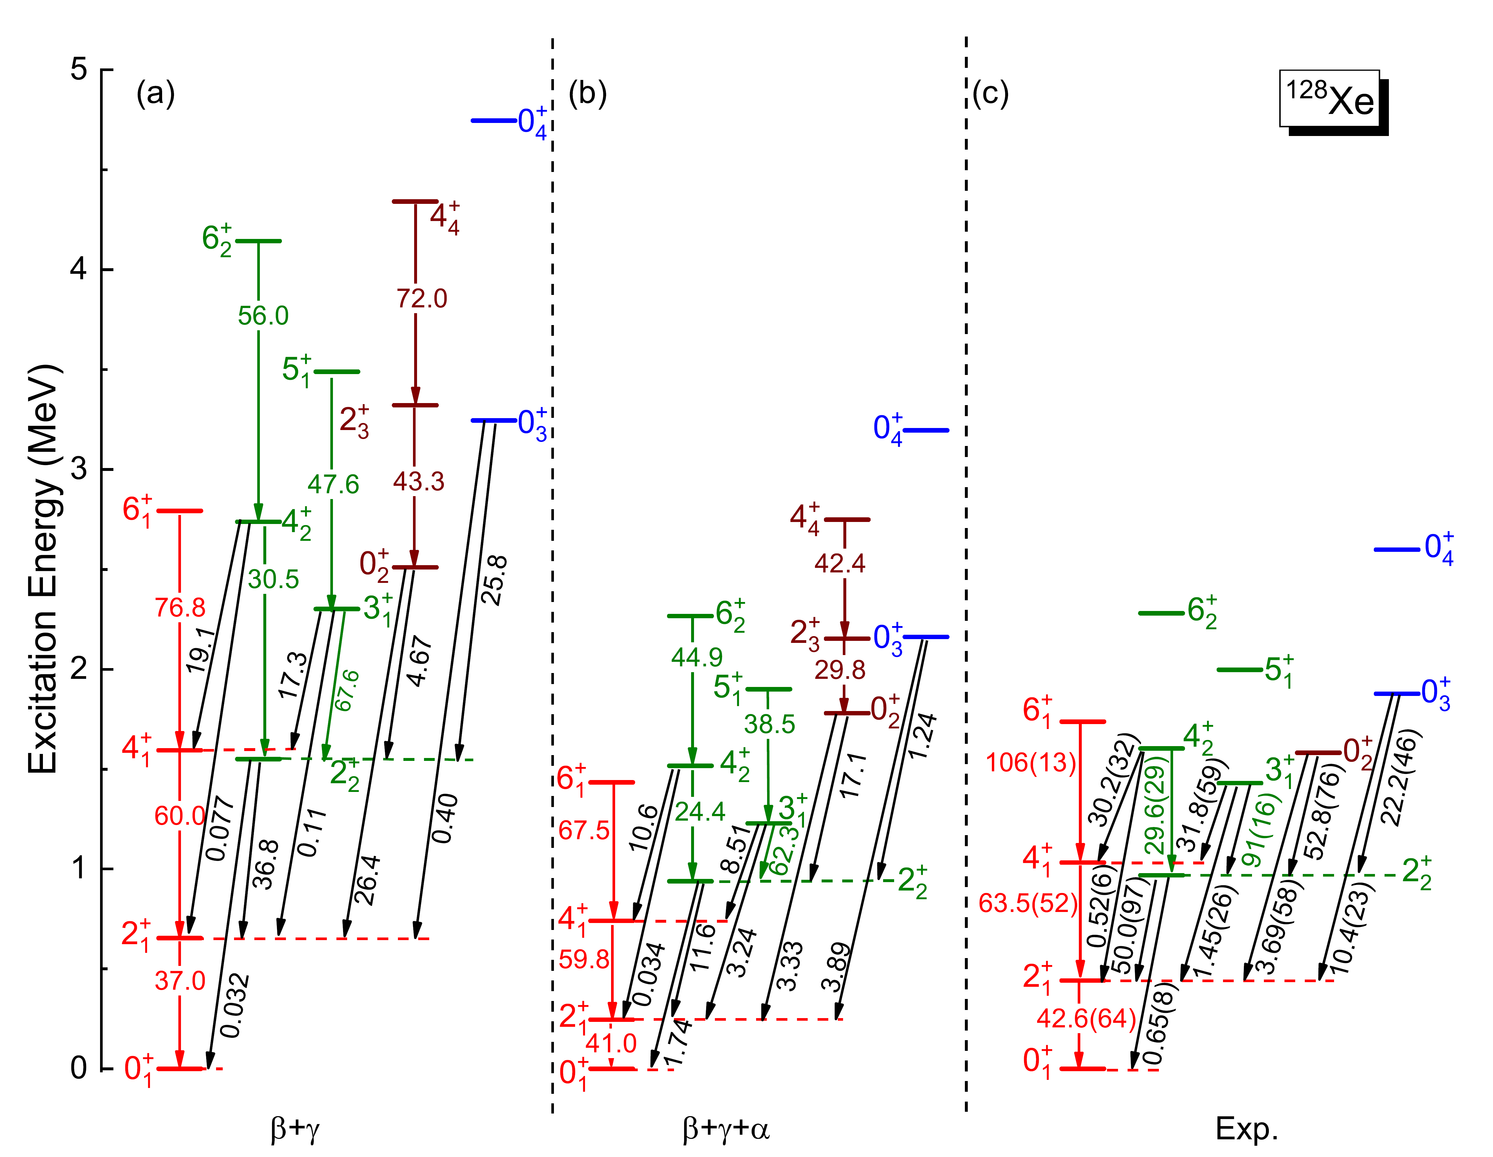
Impact of pairing vibration
g.s.
β
Spectrum compressed
Interband transitions improved
Xiang, ZPLi, et.al., PRC109, 044319 (2024)
Notes:
In addition to shape vibration, pairing vibration also plays essential role on the low-lying excitation. Recently, we have extended the triaxial collective Hamiltonian to include pairing vibration and taken the gamma-soft 128Xe as an example. The inclusion of pairing vibration lowers the spectrum significantly, particular for the 0+ states. and reproduce the data very well. It is also emphasized that the important interband transitions are improved. The g.s. fluctuation is also squeezed by including pairing vibration.
最近，我们把5DCH拓展至包含对振动，以三轴软128Xe为例，计算了其低激发谱和电磁跃迁，对振动的加入使整个能谱压低，与实验符合很好！这些关键的带间跃迁也得到较大的改善。

Slide 24
Results 2
Octupole SPT and parity doublets

Slide 25
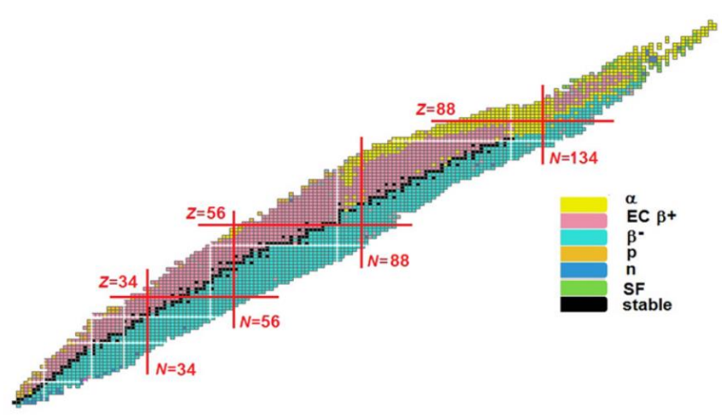

Exp. progress on octupole correlations
A Pandey, et al., CPC 47.8:084002(2023)
D Stramaccioni, et al., ll NCC 45.5(2022)
BF Lv, et al., PRC105, 044319(2022)
S Chakraborty, et al.,PRC30, 2150030(2021)
DA Testov, et al., PRC103, 044321(2021)
B Ding, et al., PRC95, 024301 (2017)
XC Chen, et al., PRC94, 021301 (2016)
L Capponi, et al., PRC94, 024314 (2016) …
XC Han et al., IJMPE32.10: 2340003(2023)
S Anuj, et al., PS98.9: 095302(2023)
X Xiao, et al., PRC106, 064302(2022)
CJ Zhang and JY Jia, PRL128, 022301(2022)
WZ Xu et al., PLB833, 137287(2022)
CG Wang et al., PRC106, L011303(2022)
A Mukherjee, et al., PRC105, 014322(2022)
S Rajbanshi, et al., PRC104, 064316(2021)
S Bhattacharyya, et al.,PRC.100,014315(2019)
ET Gregor, EPJA53, 50(2017)
……
PA Butler, PS 99(3), 035302(2024)
E Rey-herme, et al., PRC108, 014304(2023)
P Spagnoletti, et al., PRC105,024323(2022)
K Yadav, et al., PRC105,034307 (2022)
PA Butler, et al., PRL124, 042503(2020)
MMR Chishti, et al., Nat. Phys.(2020)
TA Berry, et al., PRC101,054311(2020)
D Ralet, et al.,PLB797,134797(2019)
E Verstraelen,et al.,PRC100.044321(2019
AE Barzakh, et al., PRC99，054317(2019)
Pragati, et al., PRC97,044309(2018)
M Spieker, et al.,PRC97, 064319(2018)
TC Hensley, et al., PRC96 034325(2017)
E Parr, et al., PRC94，014307 (2016)
H Mach, et al.,EPJA16172(2016)
……
\\
NT Brewer, et al., NPA1039: 122738(2023)
A Yagi et al., PRC105, 044325 (2022）
B Olaizola, et al., PRC104, 034307(2021)
SJ Zhu, et al, PRL124, 032501(2020)
S Guo, et al., PLB 135572(2020)
CM Petrache, et al., PRC102, 014311(2020)
C Morse, et al., PRC102 : 054328(2020)
SNT Majola, et al., PRC100,034322(2019)
S Bhattacharyya, et al.,PRC.98,044316(2018)
B Bucher, et al., PRL118, 152504(2017)
EH Wang, et al., EPJA53, 234(2017)
J Wisniewski, et al., PRC96.064301(2017)
B Bucher, et al., PRL116, 112503(2016) ……
Butler JPG43, 073002 (2016)
Butler & Nazarewicz, RMP68, 349 (1996)
……
Notes:
With the development of experimental techniques, especially the rare isotope facilities, the data on the negative parity bands and octupole correlations grow significantly. Here are some selected works in recent years in the four typical mass regions for octupole correlations.

Slide 26
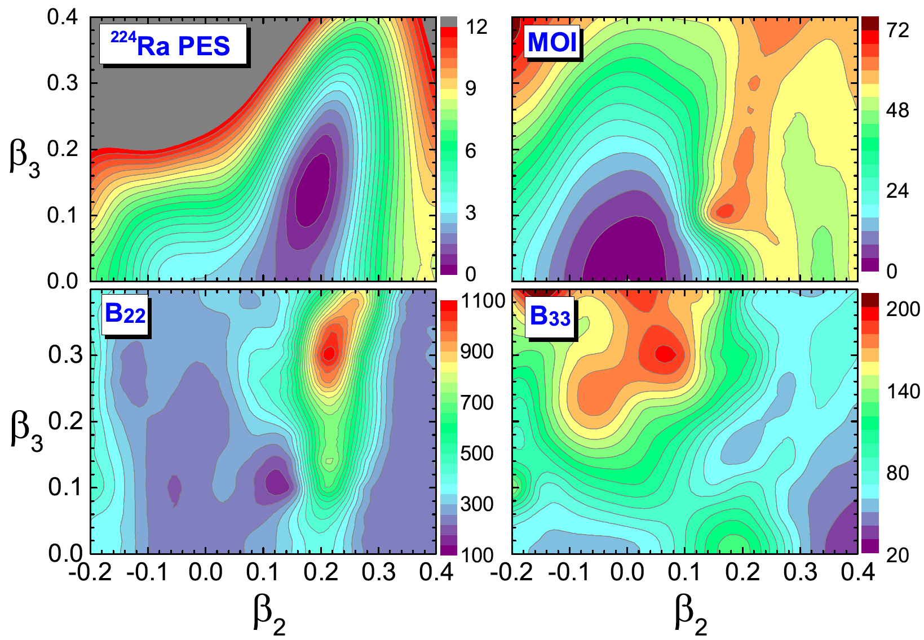
Octupole deformation in ²²⁴Ra
PES of ²²⁴Ra
Low-lying spectrum of ²²⁴Ra
Sun, Quan, ZPLi, et. al., PRC 100, 044319 (2019)
Notes:
Here, we take 224Ra as an example to show the pes in the beta2, beta3 plane. A global minimum is found at beta3=0.15, a typical pear shape. The theoretical spectrum is in good agreement with data, especially for the very low-lying negative-parity band and B(E3) transitions. These all indicate that 224Ra is a well octupole deformed nucleus.

Slide 27
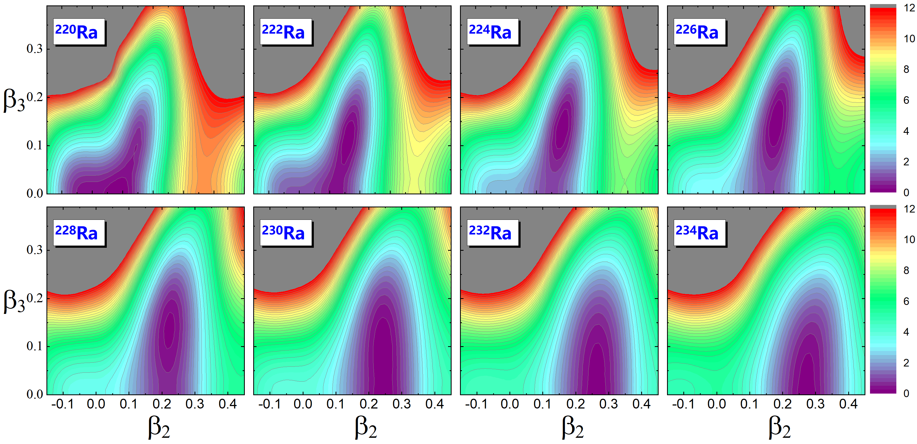
Octupole SPT in Ra isotopes
Near spherical – octupole deformed – octupole-soft
Notes:
Here we analyze the quadrupole-octupole shape transition in Ra isotopes. From 220Ra to 234Ra, the nucleus evolves from a near-spherical shape to a stable octupole deformation, and then to octupole-soft.

Slide 28
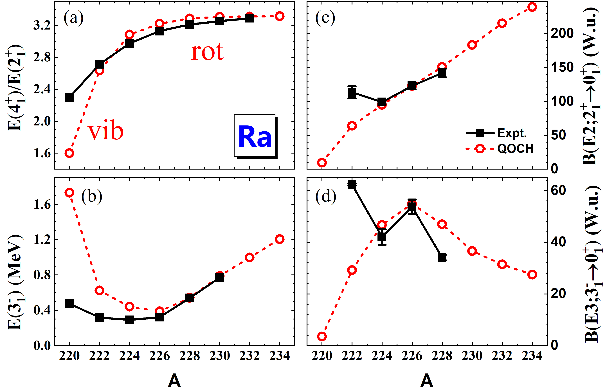
Octupole SPT in Ra isotopes
Characteristic collective observables
Quadrupole : a smooth transition from vibrator to rotor
Rapid onset of octupole deformation
Notes:
Then, we show the evolution of characteristic collective observables of Ra isotopes, upper panels for quadrupole and lower panels for octupole. A smooth transition from vibrator to rotor is found for quadrupole evolution, while a rapid onset of octupole deformation is observed in these isotopes. The deviations for lighter isotopes may be attributed to the exclusion of triaxial degrees of freedom.

Slide 29
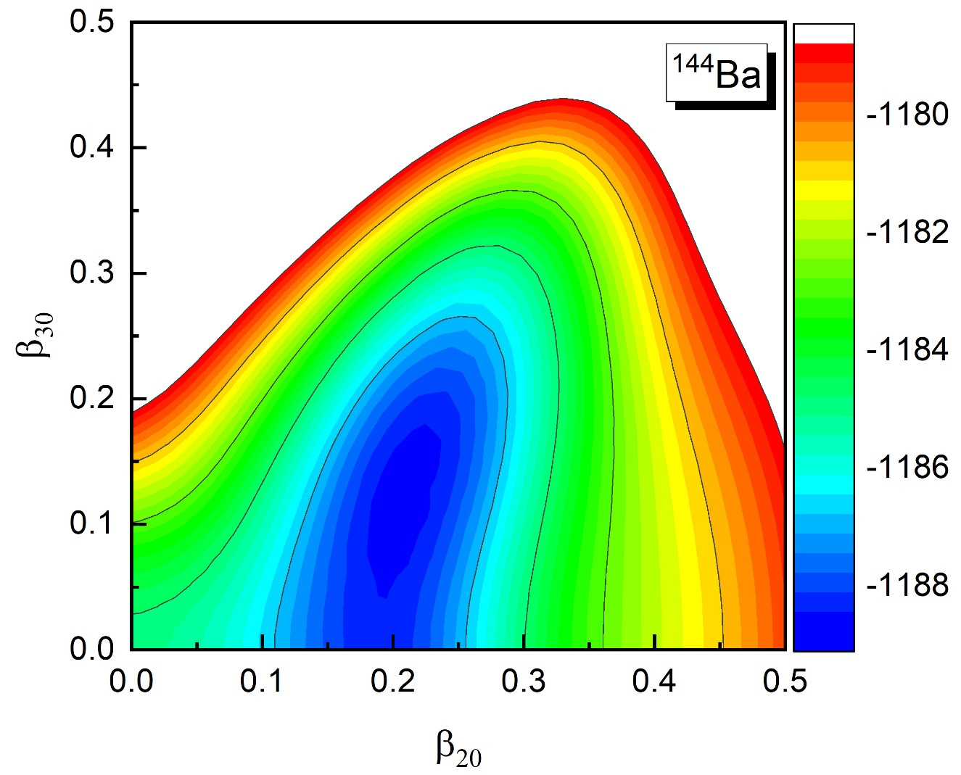
Triaxial octupole
β₂₀~0.2，β₃₀~0.14
Notes:
Very recently, we try to incorporate the triaxial-octupole degree of freedom, and take the nucleus 144Ba as an example to show the results. It has a global minimum at beta30~0.14
统一描述原子核的低激发模式需要包含尽可能全面的集体自由度，最近，我们把模型拓展至包含三轴八极自由度，这里以144Ba为例，首先给出了其轴对称四极、八极势能曲面，存在八极极小点，

Slide 30
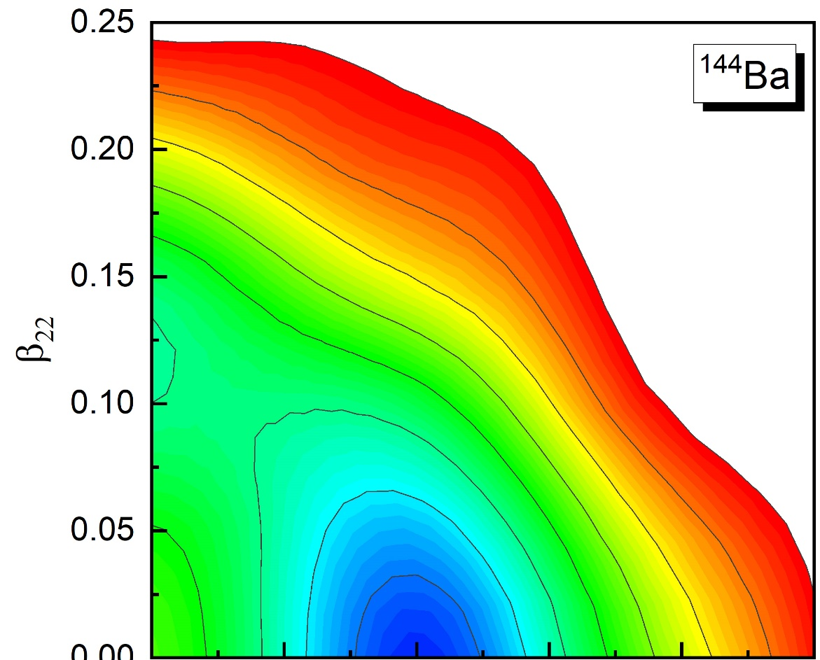
Triaxial octupole
Notes:
Still in beta22 direction

Slide 31
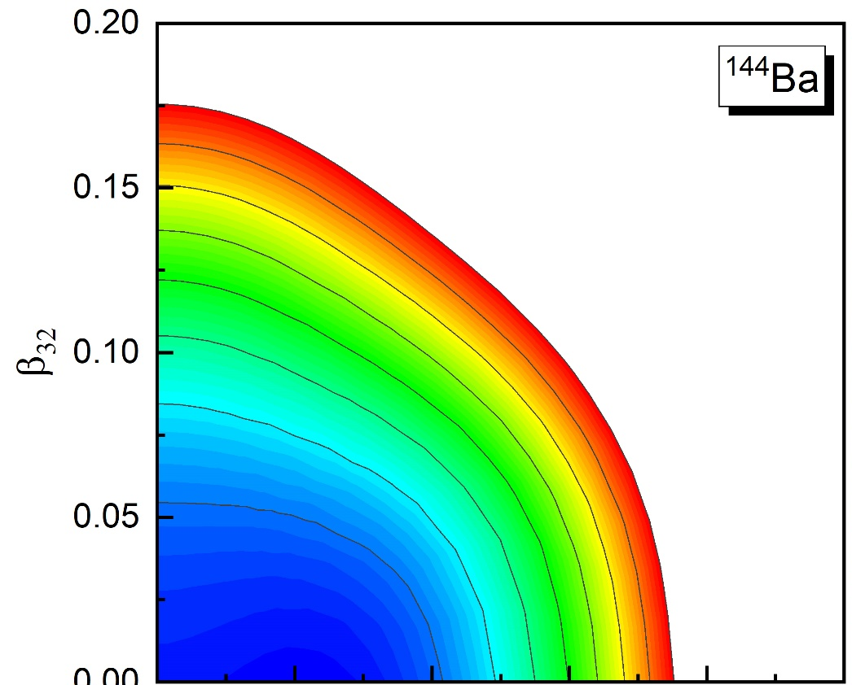
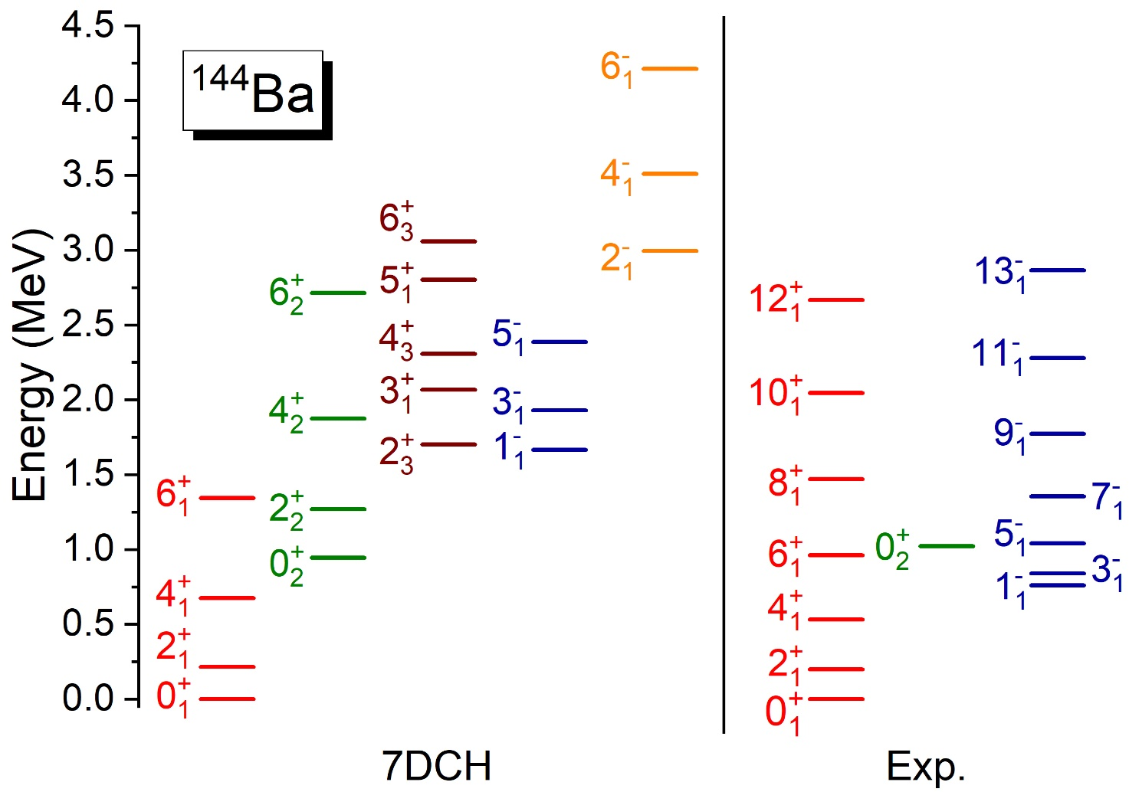
Triaxial octupole
Preliminary results
Xiang, Zhao, ZPLi, et.al., in preparation
Notes:
But quite soft along beta32. Here we show the preliminary result for low-lying spectrum. The full set for both positive and negative parity bands are obtained and comparable with data.

Slide 32
Results 3
Impact of deformation and orientation on HIC
Notes:
Finally, I will briefly introduce our recent studies on the impact of deformation and orientation on HIC

Slide 33
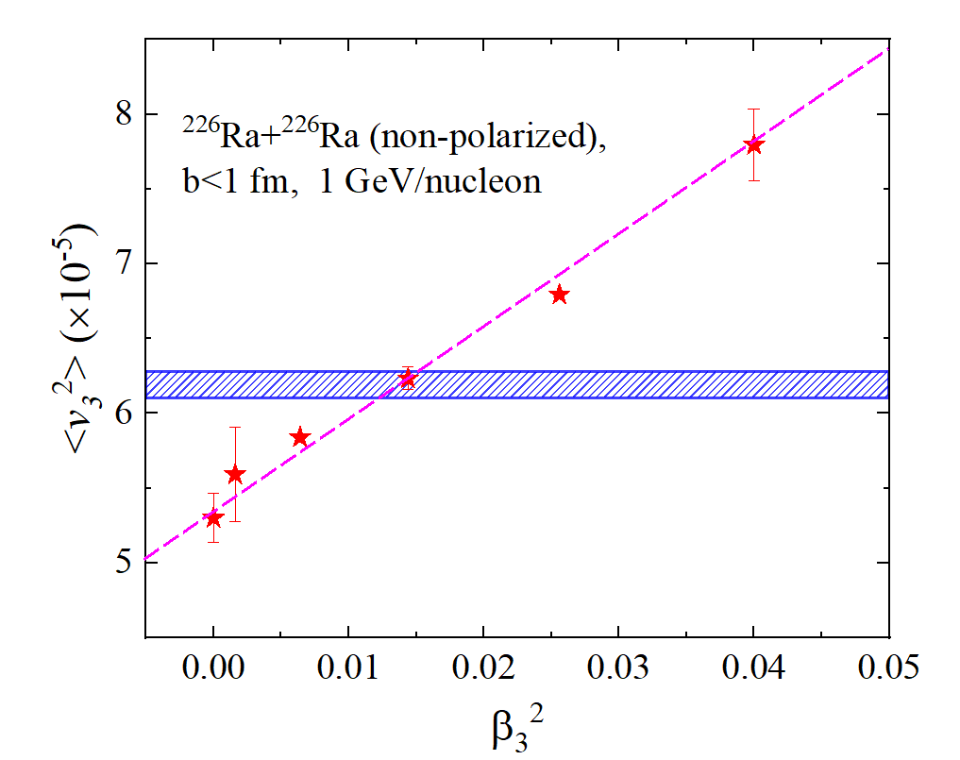
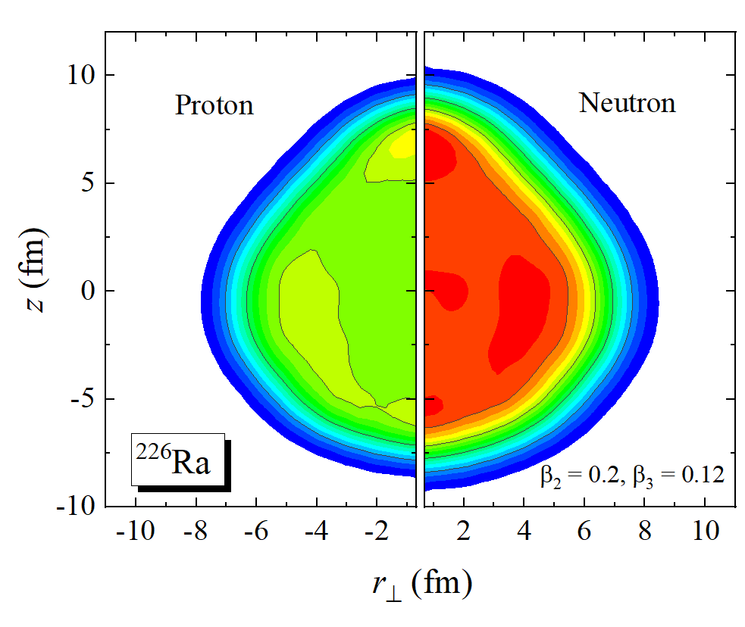
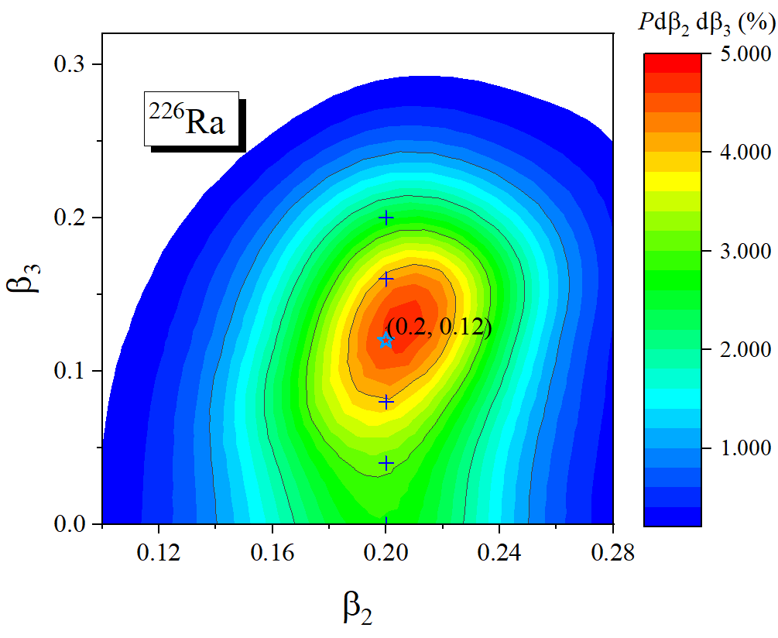
Impact of deformation on HIC
IBUU; E_{beam} = 0.5 GeV/u
²⁴Mg
Bertsch & Gupta, Phys. Rep. 160, 189 (1988)
G.-C. Yong, Phys. Rev. C 93, 014602 (2016).
minimum
with shape fluctuation
Fang, Yang, Chen, Nishimura, ZPLi, PRC108, 034607 (2023)
Notes:
Recently, taking the well deformed 24Mg as an example, we have analyzed the impact of quadrupole deformation and orientation on the HIC using isospin-dependent BUU model. For the ultra central body-body collision, we can observe clearly the elliptic flow and it decreases as the projectile rotated due to the reduced initial eccentricity of the overlap.
we further discussed the impact of octupole deformation and shape fluctuations on heavy ion collisions. The unpolarized ultracentral collision shows that the v3^2 is basically propotional to the beta3^2. The blue band is the result by mixing all the configurations with the probabilities shown by the color contour calculated by our microscopic CH. It is consistent with the result of the minimum. Means that for this well octupole deformed nuclei, there is no obvious flow effect caused by shape fluctuations.
the impact of octupole deformation and shape fluctuations on heavy ion collisions we further discussed the impact of octupole deformation and shape fluctuations on heavy ion collisions. The probability of the nucleus staying at various deformation points can be calculated through wave functions. Specifically, the density of the PES minima is depicted in the graph on the right. We conducted simulations of heavy ion collisions with completely random shapes and orientations.
The left graph displays the results with fixed orientation and shape. The points we selected are beta2 = 0.2, while beta3 = 0, 0.04, 0.08, ..., 0.20. Due to the constant value of beta2, v2 almost completely overlaps. Meanwhile, the linear variation of beta3 leads to changes in v3. The black spheres represent reactions with fixed orientation but random shapes, and the results are almost consistent with those of the minima.
This is because the average shapes is the same as the minima. The graph on the right depicts collisions with uncertain orientations. As beta3 increases, the event distribution of v3 spreads outward, resulting in an increase in the mean square of v3. However, we did not observe flow effects caused by fluctuations because the mean square of v3 is proportional to the mean square of beta3.

Slide 34
Orienting heavy-ion collision events
Yang, Fan , ZPLi, Nishimura, PLB848, 138359 (2024)
Notes:
For well deformed nuclei, like 238U, here we attempt to determine the initial collision orientation. We trained a neural network, convolutional orientation filter, using anisotropic flow, charged particle multiplicity, and other information as input, and six angle categories as output.

Slide 35
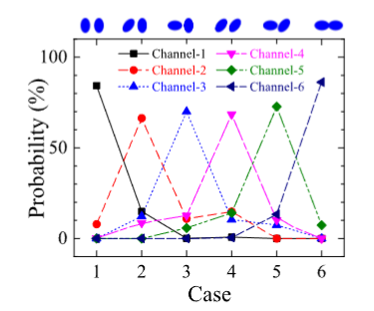
Orienting heavy-ion collision events
Other related studies:
Yang, Fan , ZPLi, Nishimura arXiv:2403.19208 (2024)
Notes:
This illustrates the distribution of each predicted channel on real events. It can be noted that there is about 70% to 80% accuracy. Would a loss of over 20% in accuracy affect the observables? We further examined the observables for realistic calculations and ML results. There is almost no difference between them. This indicates that using neural networks to identify heavy ion collision events is feasible.

Slide 36
Summary and outlook
Collective Hamiltonian based on relativistic DFT
  Study SPT from both mean-field PESs and BMF spectrum
Application to the interesting topics
  Global description of nuclear deformations & SPT in Nd, Xe, Pt isotopes
  Octupole SPT in Ra is analyzed.
  Impact of deformations on anisotropic flows & orienting HIC events
Outlook: Triaxial octupole deformation in some mass region;
Shape fluctuations of soft nuclei on HIC …

Slide 37
Thank you for your attention!
J. Meng, P. W. Zhao, Y.L. Yang & Y.K. Wang Peking University
D. Vretenar & T. Niksic University of Zagreb
P. Ring TUM
S. Nishimura & Z. X. Yang RIKEN
W. H. Long Lanzhou University
J. Xiang Chongqing Normal Uni.
J. Zhao Pengcheng Lab.
Nuclear Physics Group Southwest University

Slide 38
Additional materials

Slide 39
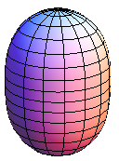
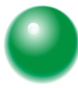

Microscopic core-quasiparticle coupling model
Spectrum of odd-A nucleus
ph
Int.
pp
Int.
ph
Int.
A-1
A+1
Notes:
Furthermore, using the CH to treat the even cores and add one quasiparticle, we can describe the odd-mass nucleus. The couplings between them take these forms, the reduced quadrupole and octupole moments and paring gaps are all determined from the microscopic calculations.

Slide 40
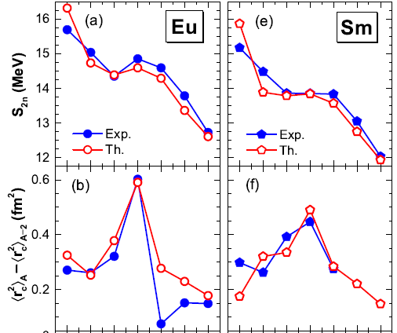
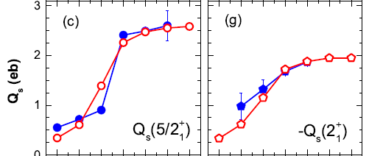
Shape phase transition in odd nuclei
Quan, ZPLi, Vretenar, Meng, PRC97, 031301(R) (2018)
Eu
Sm

Slide 41
Theoretical models for nuclear shapes and low-lying spectrum
Density functional theory and Beyond Mean Field method
EF Zhou, et al., PRC109, 034305 (2024)
FF Xu, et al., PRC109, 014311 (2024)
J Zhao and ZG Wu, PRC109, 014303 (2024)
X Yin, et al., PRC109, 024322 (2024)
YL Yang, et al., PRC107,024308 (2023)
R Rodríguez-Guzmán, et al., PRC108, 024301 (2023)
YT Rong, et al. PLB840: 137896 (2023)
AA Ben Mennana and M Oulne, NPA1034 122644 (2022)
K Nomura, PRC105, 044306 (2022)
JL Egido and A Jungclaus, PRL125, 192504 (2022)
D Bonatsos, et al., PLB137099 (2022)
XQ Yang, et al., PRC103, 054321 (2021)
P Kumar and SK Dhiman, NPA1001: 121935 (2020)
FQ Chen and QB Chen,PLB808,135620 (2020) ……
Shell model
JA Lay, et al., PLB137719 (2023)
J Zhang, et al., PRC107, 024305 (2023)
AE Stuchbery and JL Mood, physics4030048 (2022)
OM Molchanov, et al., PRC105, 034306 (2022)
P Van Isacker and M Reimund, PRR4,L022031(2022)
SM Lauber, et al., JPG: NPP48 095107 (2021)
N Yoshinaga, et al., PTEP04, 063D01 (2021)
XT He and YC Li, PRC102, 064328 (2020)
N Behera, et al., IJP&AP58,342 (2020)
……
Interaction boson model
N Gavrielov, PRC108, 014320 (2023)
BY Hu, et al., JPG: NPP 50.2: 025107 (2023)
W Teng., et al., SSPMA53 242011 (2023)
CF Mu and DL Zhang, CTP74, 025302 (2022)
K Nomura, PRC105, 054318 (2022)
AJ Majarshin, et al., PRC104, 014321 (2021)
M Böyükata, et al.,EPJA57 (2021)
N Gavrielov, et al.,PS95, 024001 (2020)
JE Garcia-Ramosa and K Heyde, et al., PRC102, 054333 (2020)
M Seidi and H Sabri, APPB51, 2139 (2020) …
Phenomenological collective model, particle rotor model
YY Wang, et al., IJMPE 32.10: 2340010 (2023)
AX Li, et al., SB14122578 (2022)
R Budaca, et al., PRC106, 014311 (2022)
O Vallejos and J Barea, PRC 104, 014308 (2021)
DJ Rowe, PRC101, 054301 (2020)
YP Wang, et al., PRC102, 024313 (2020) …
Macro and micro model
Z Song, et al., CTP75, 025303 (2023)
R Budaca, et al., EPJA59.10: 242 (2023)
SS Nayak and G Mukherjee,NPA1023 122449 (2022)
P Alexa, et al., PRC106, 054304 (2022)
A Gaamouci, et al., PRC103, 054311 (2021)
LA Malov, et al.,PRC104, 064303 (2021) …
41
Notes:
The theoretical research on the shape of the nuclei and the low-lying spectrum mainly includes the following methods, such as DFT+BMF, various shell model methods, particle rotor models, etc.

Slide 42
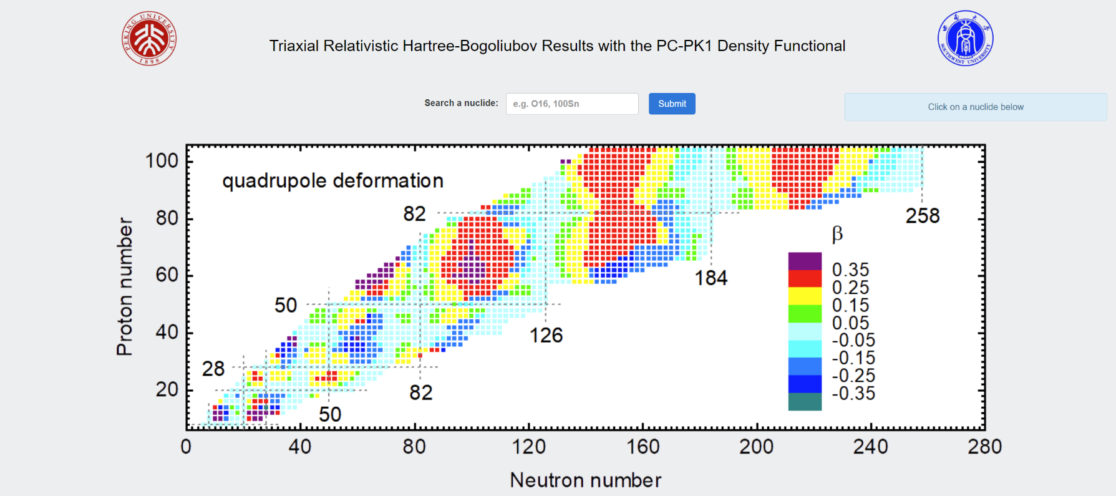
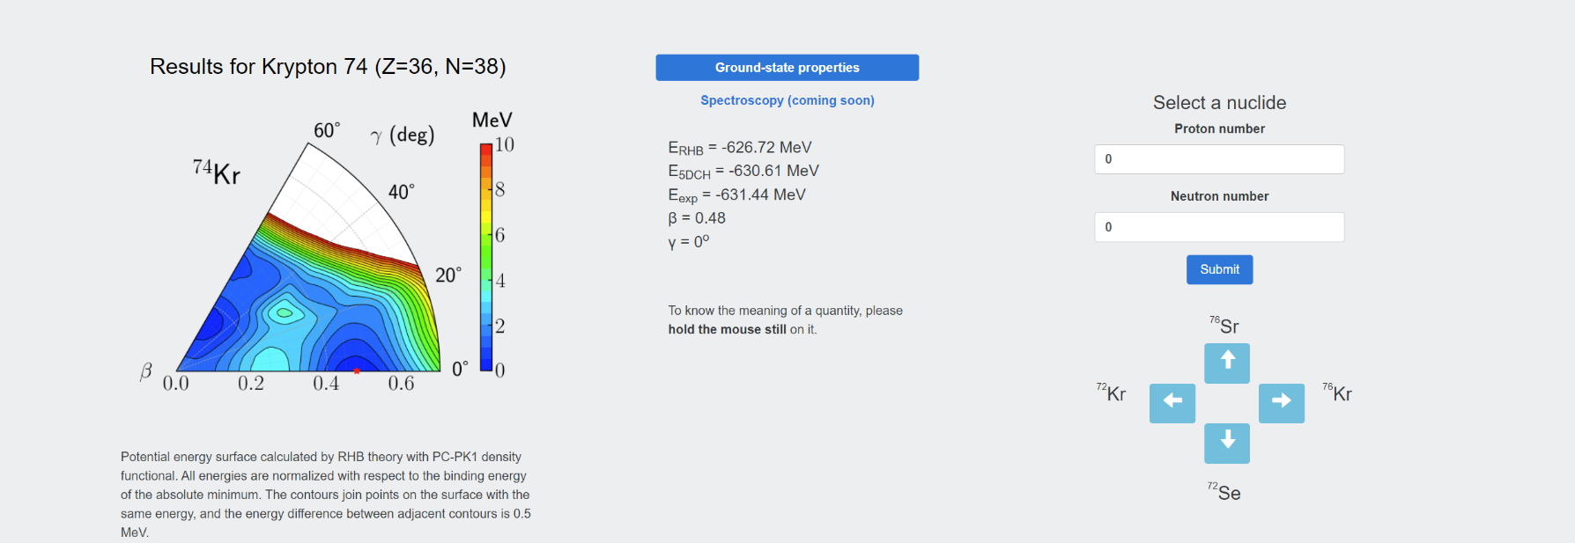
Online data base
http://nuclearmap.jcnp.org

Slide 43
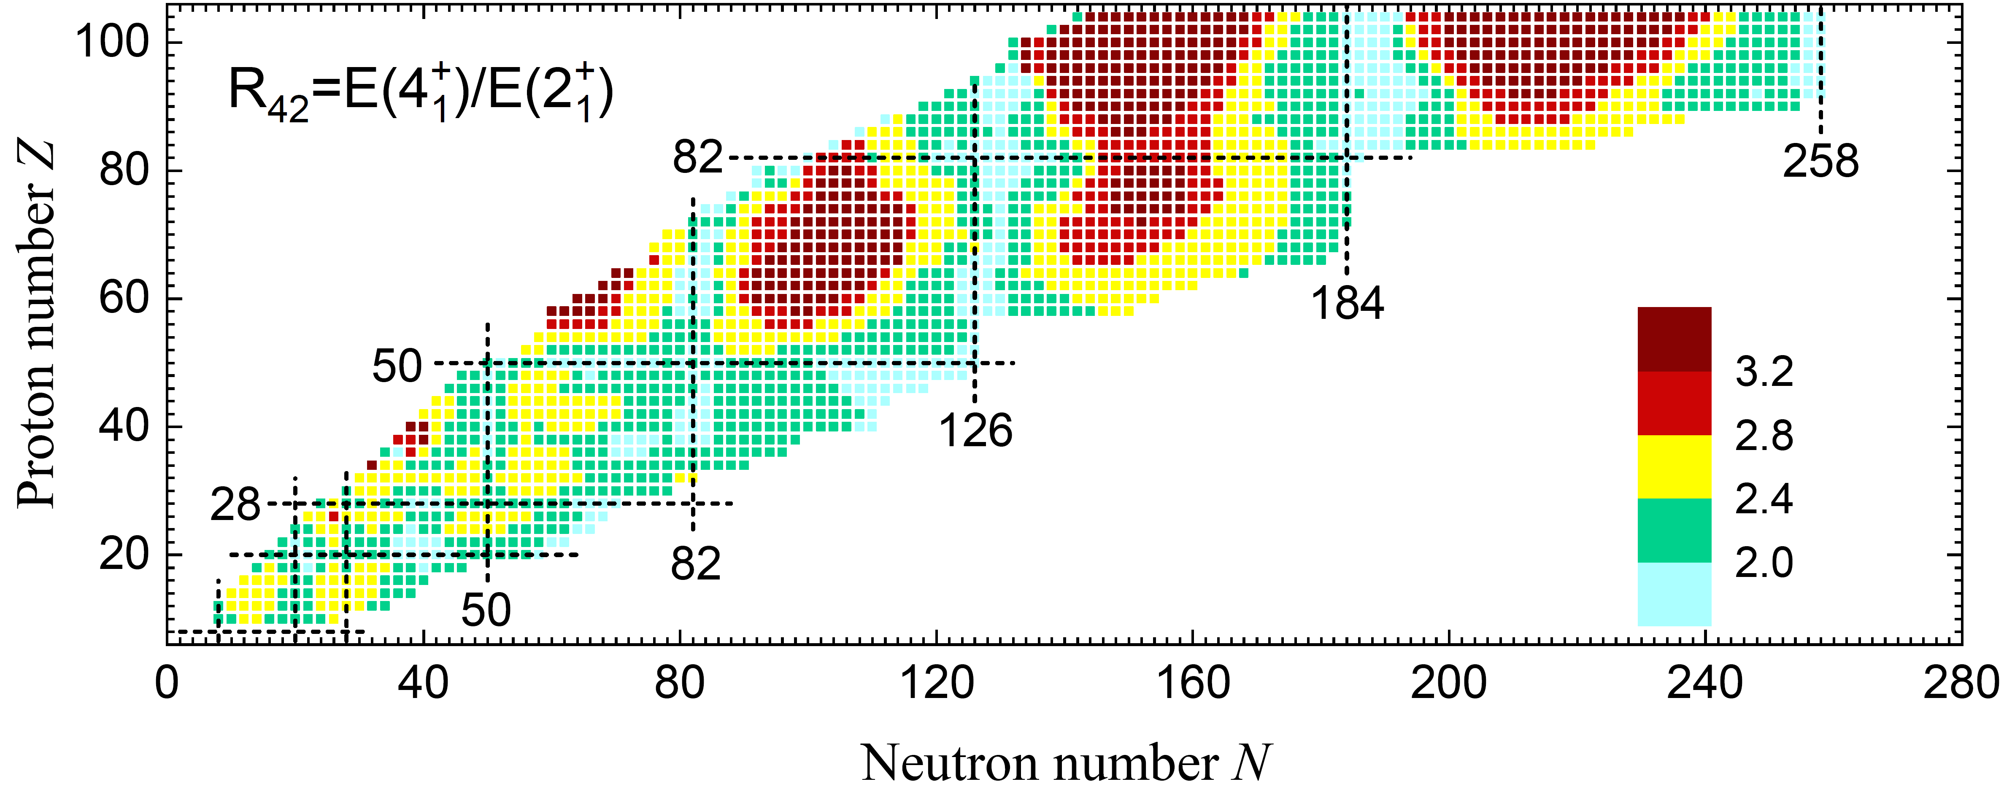
R₄₂
Yang, Wang, Zhao & ZPLi, PRC104, 054312 (2021)
Notes:
Near spherical around magic numbers, with some exceptions at N~50, Z~28, 50, 82
Most of the deformed nuclei are prolate ($β>0$), warm colors. The nuclei with oblate deformation are mainly distributed in $(N,Z)\text{\sim }\text{(60,40), (150, 60).}$
The quadrupole deformation of most nuclei is in the range of $−0.35<β<0.35$.
Some nuclei exhibit quadrupole deformation up to $β≃0.5$.

Slide 44
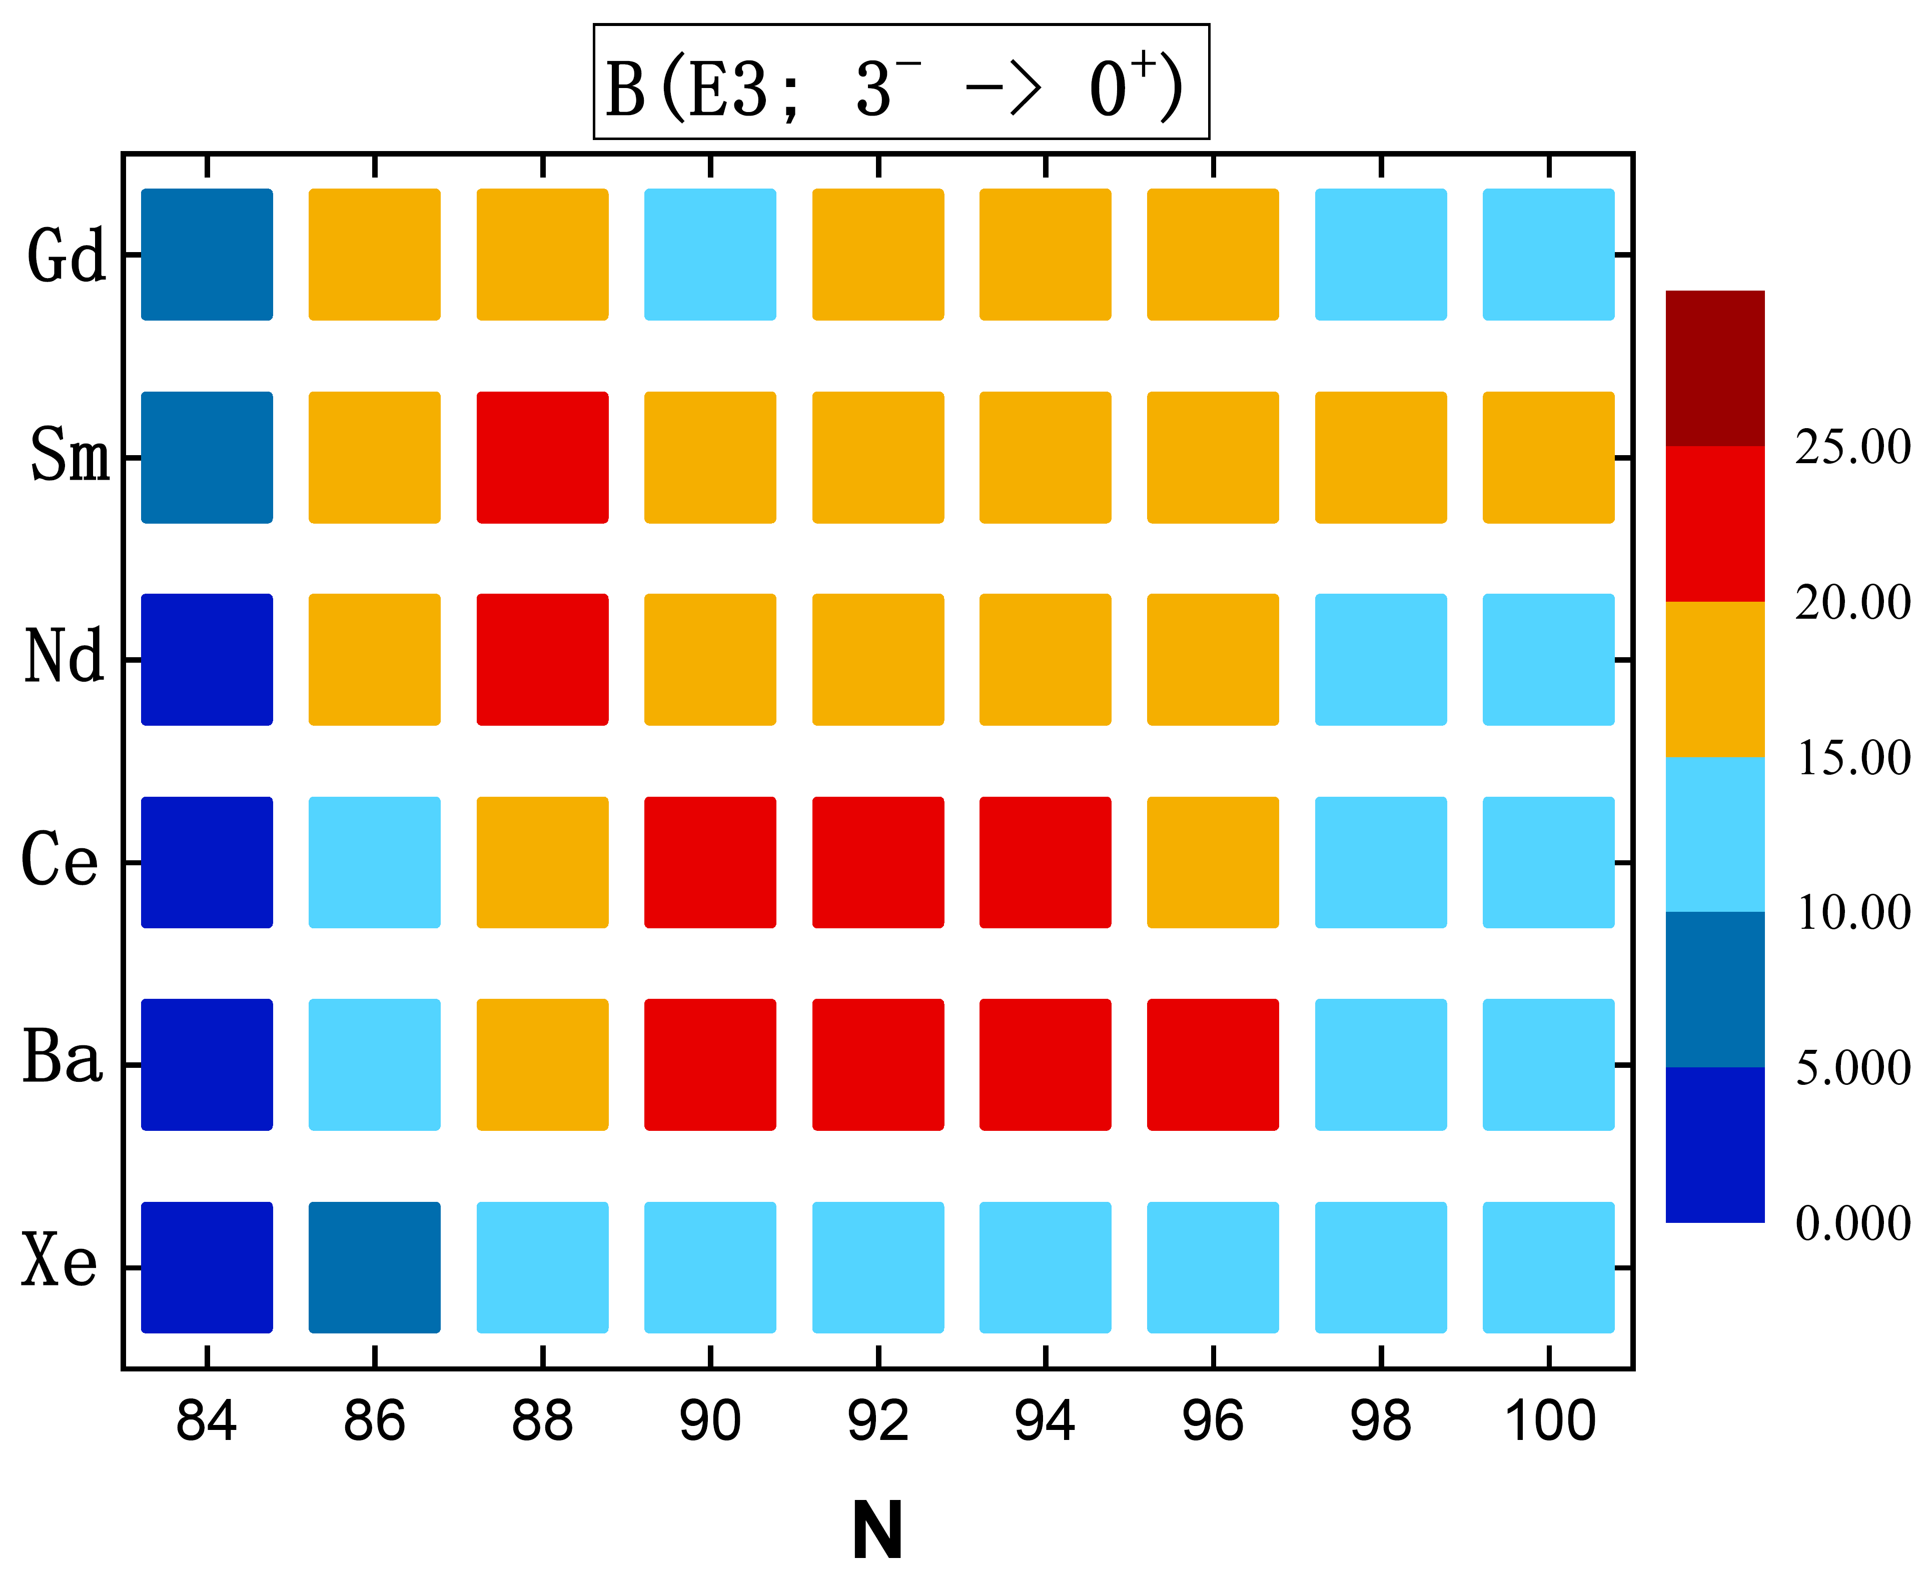
Octupole deformation
B(E3;3⁻ → 0⁺)
Notes:
系统研究了Xe, Ba稀土区，及Rn，Ra，锕系区。这里给出了理论计算的3-到基态的约化电八极跃迁几率，大的B(E3)指示原子核存在八极形变。对于Xe, Ba稀土区，我们发现Ba，Ce同位素链在N=90-96具有八极形变，而Nd、Sm、Gd在这片区域均具有较强的八极关联。Ra及锕系核则在N=134-140形成明显的八极形变，对于N=142-146，结合势能曲面，发现这些核主要为八极软核。

Slide 45
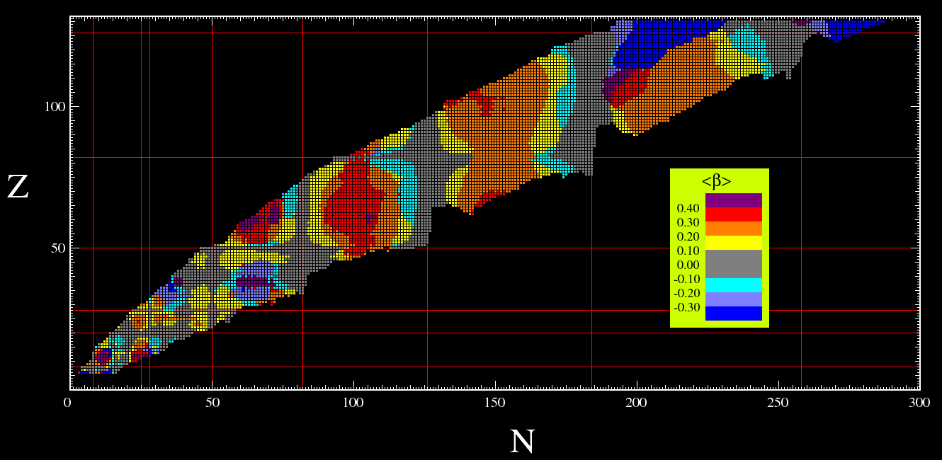
Quadrupole deformation β
HARTREE-FOCK-BOGOLIUBOV RESULTS BASED ON THE GOGNY FORCE (cea.fr)
Consistent with the results from HFB with Gogny force

