Slide 1
Exploring nuclear physics across energy scales 2024:
Intersection between nuclear structure and high energy nuclear collisions
Machine learning in nuclear physics at low and intermediate energies
Yingxun Zhang
China Institute of Atomic Energy
Wanbing He, Qingfeng Li, Yugang Ma, Zhongming Niu, Junchen Pei
2024.4.23

Slide 2
Outline
1, Embracing the machine learning: low and intermediate nuclear physics
2, Methodology of ML and its applications of ML in low-intermediate energy nuclear physics
3, Probing the neutron skin of unstable nuclei with low-intermediate energy HICs
4, Outlook

Slide 3
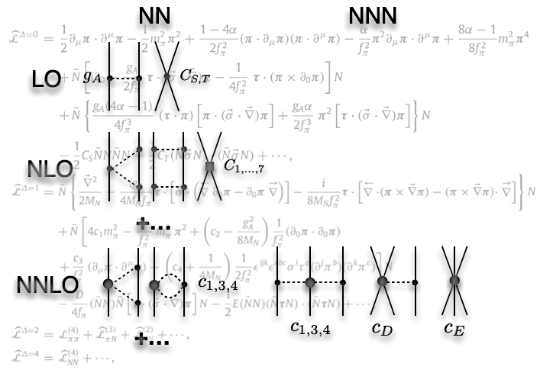
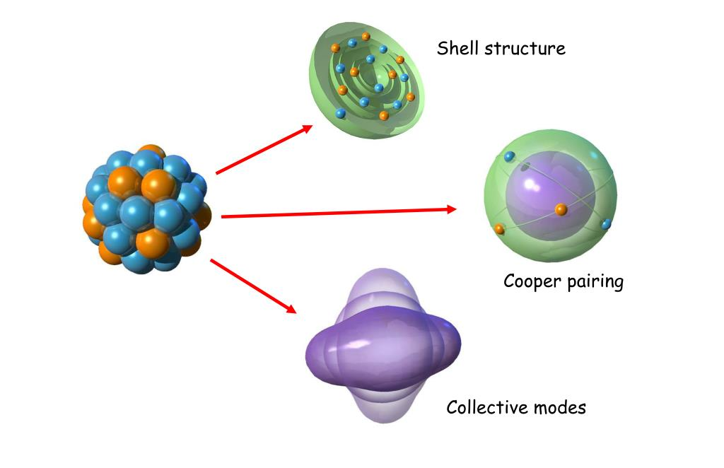
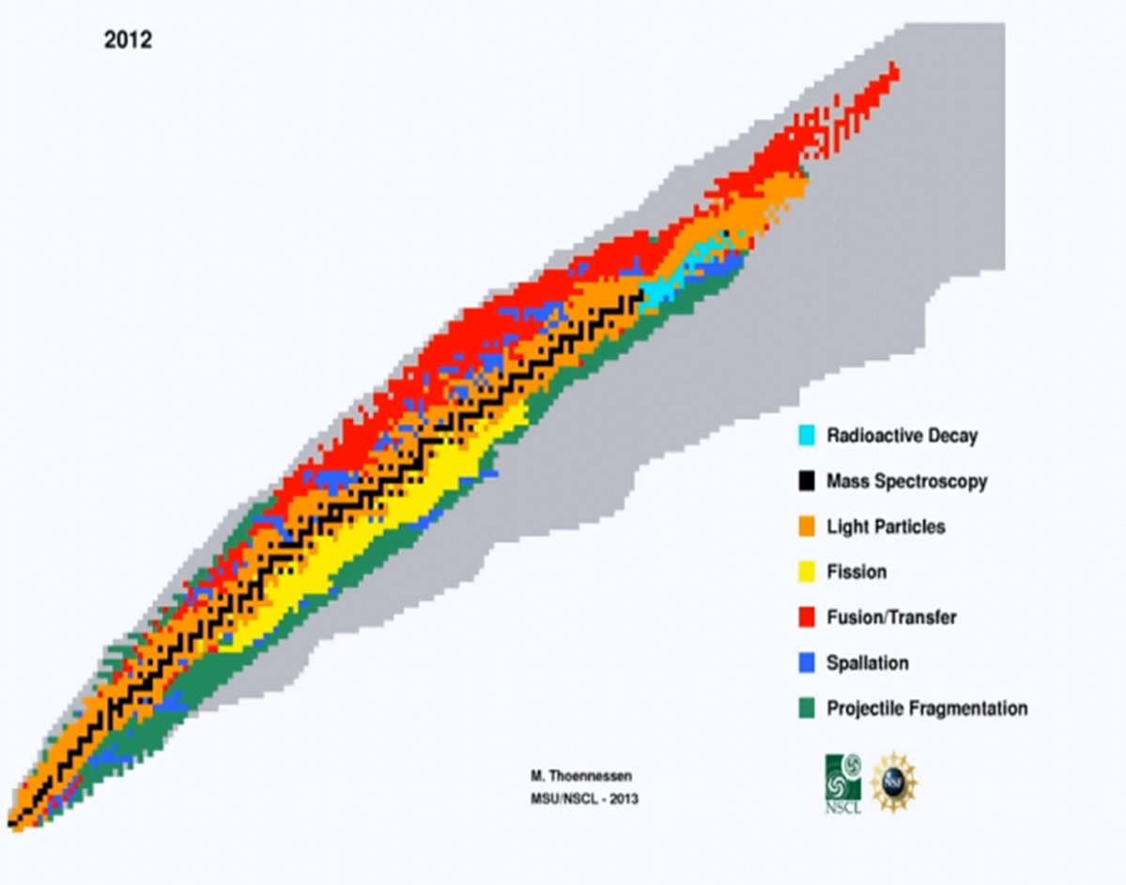
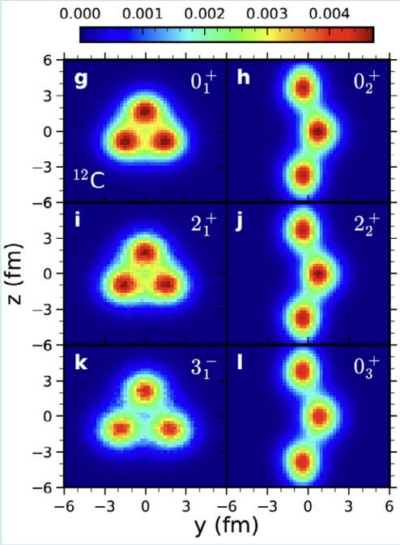
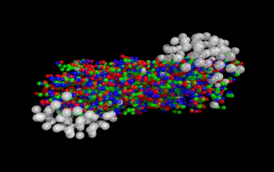

Embracing the machine learning: low and intermediate nuclear physics
the nature of Nuclear force:
Nuclear structure evolution
properties of the nuclei
Cluster and its influence in reactions
Heavy ion collision mechanism
Dense matter in Universe

Slide 4
“This scientific infrastructure is reaching scales and complexities that require computational methods for tasks such as anomaly detection in operational data.
New methodologies are needed to detect anomalies and to optimize operating parameters, predict failures as well as to discover new optimization algorithms”

Slide 5
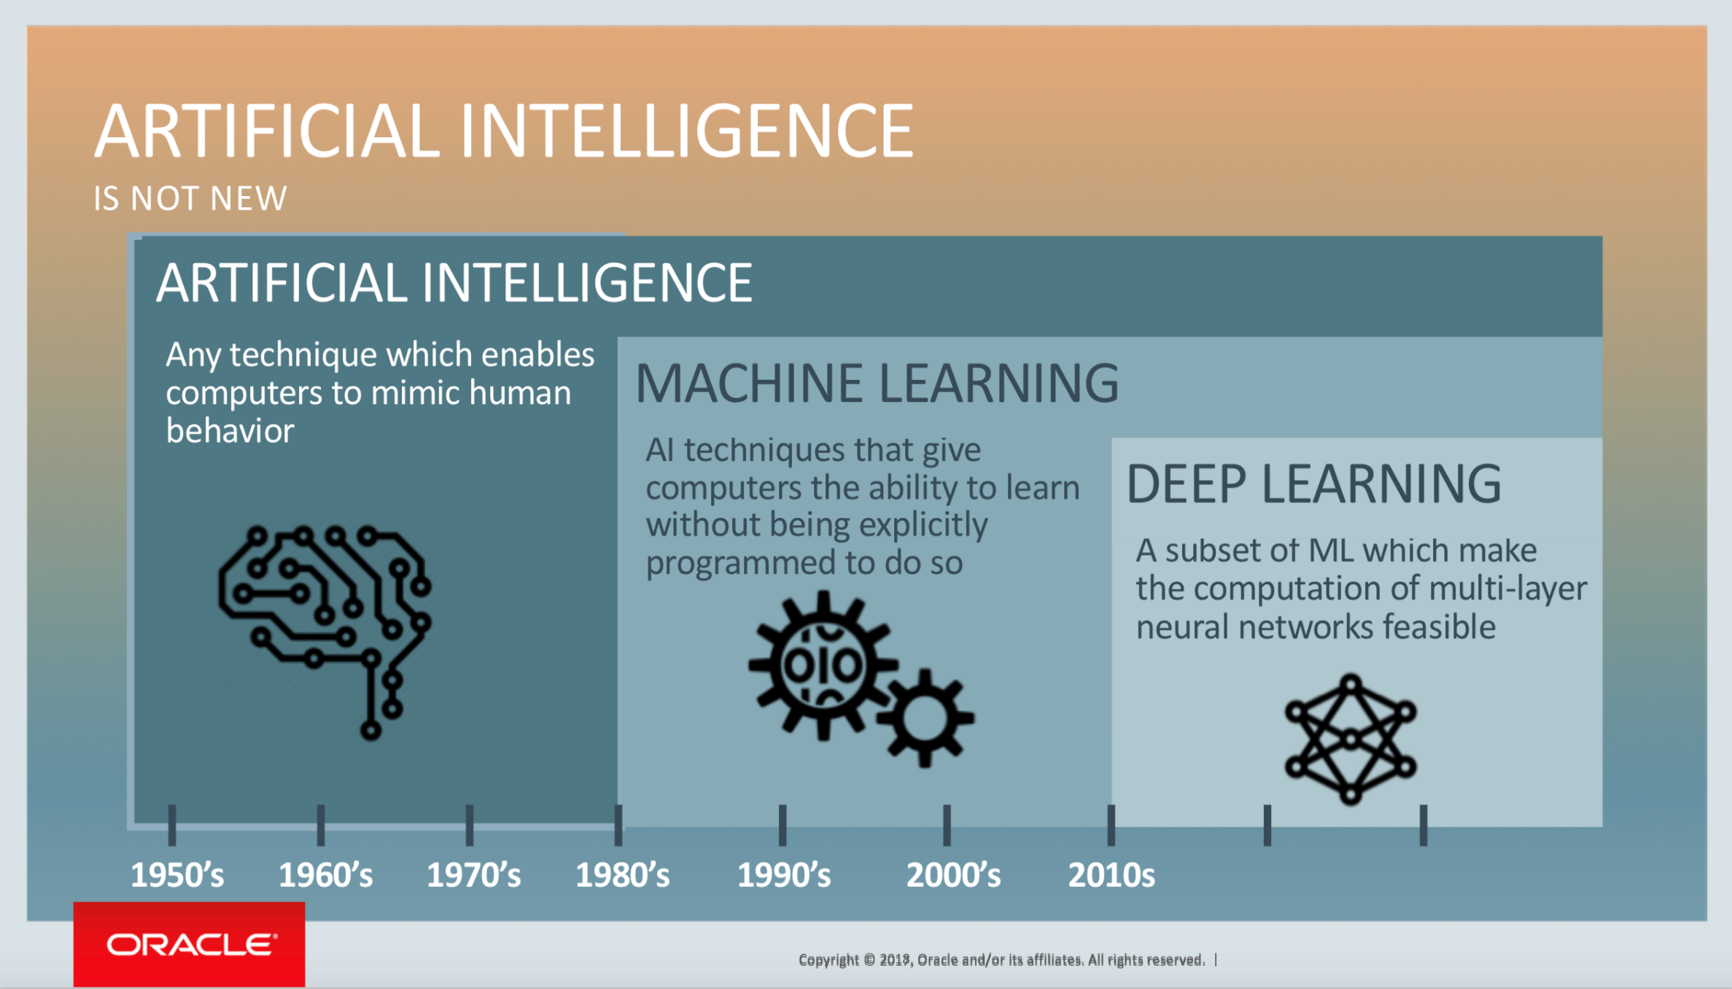
Generally, ML algorithms are used to automatically learn the mapping relationship between input variables and output variables from data.
Notes:
AI (Artificial Intelligence) is a broad field , ML and DL are two subfields. Machine learning provides the foundation for training models and making predictions, while deep learning, with its sophisticated neural networks, enables the extraction of intricate features and representations from data.

Slide 6
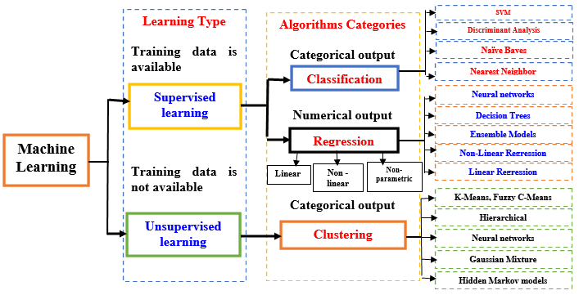
functionals
Approximating functions
Solving differential and difference equations
Approximating and sampling probability distributions
Notes:
A Mathematical Perspective on Machine Learnining, Weinan E, https://www.mathunion.org/

Slide 7
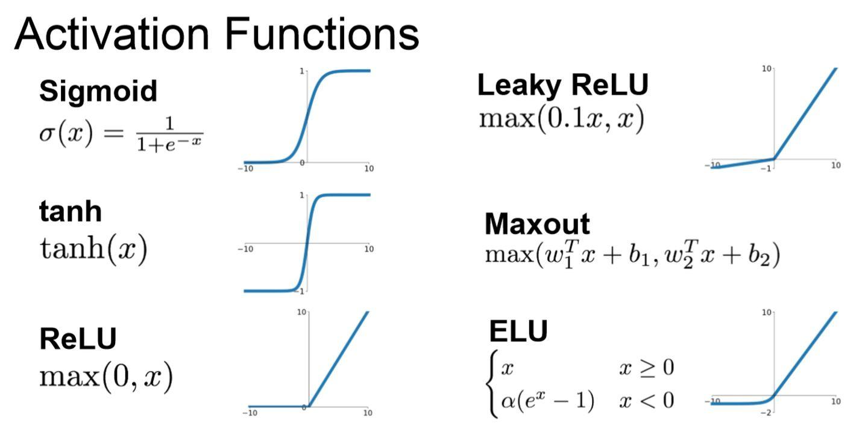

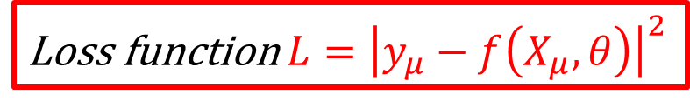

Neural network
d_{ij}
Network predictions
Training data
True value $y_{μ}$
Back propagation
Loss function $L={\left|y_{μ}−f\left(X_{μ},θ\right)\right|}^{2}$

Slide 8
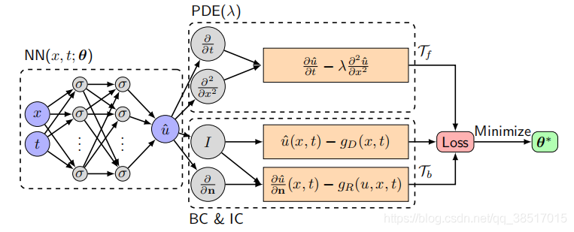
SEM
Lu Lu, et al., arXiv: 1907.04502v2.
PINN

Slide 9
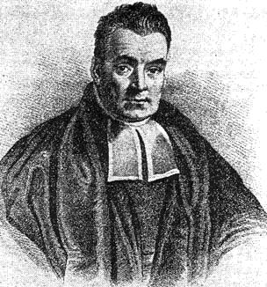
Bayesian inference
Bayes theorem
P(A|B) is the conditional probability of event A given that event B has occurred,
P(B|A) is the conditional probability of event B given that event A has occurred,
P(A) and P(B) are the probabilities of events A and B occurring independently.
It provides a way to update our beliefs or knowledge about an event or hypothesis based on new evidence or data.
Notes:
In words, Bayes' theorem allows us to compute the probability of event A given the occurrence of event B by multiplying the prior probability of event A (our initial belief) by the likelihood of event B given event A, and then dividing it by the overall probability of event B.

Slide 10
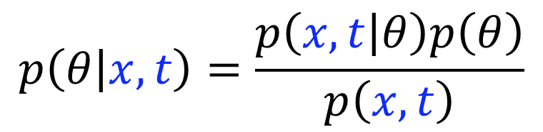

Applications of ML in low-intermediate energy nuclear physics
Approximating functions and inference
BNN
$$p\left(θ | x,t\right)=\frac{p\left(x,t | θ\right)p\left(θ\right)}{p\left(x,t\right)}$$
$$θ=\{a, b_{j}, c_{j}, d_{ij}\}$$
Notes:
BNNs treat the weights and biases in the network as random variables rather than fixed values. This allows for the estimation of a probability distribution over the weights and biases, which captures the uncertainty in the model.

Slide 11
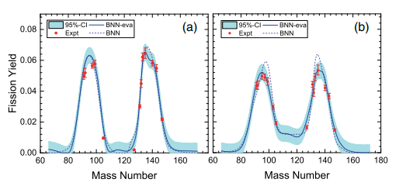
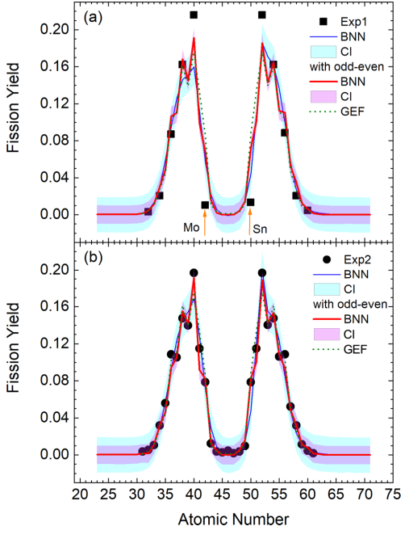
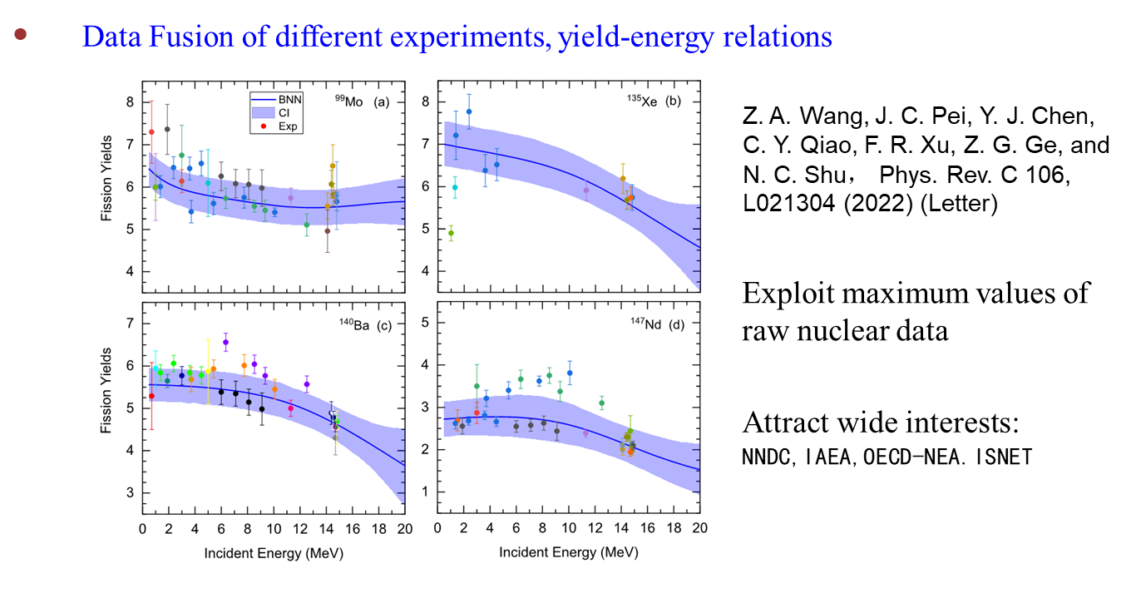
Incomplete fission yields
Discrepant charge yields
Z.A. Wang, J.C. Pei, Y. Liu, Y. Qiang
Phys. Rev. Lett. 123, 122501 (2019)
C. Y. Qiao, J. C. Pei, Z. A. Wang, Y. Qiang, Y. J. Chen, N. C. Shu, and Z. G. Ge, Phys. Rev. C 103, 034621 (2021)

Slide 12
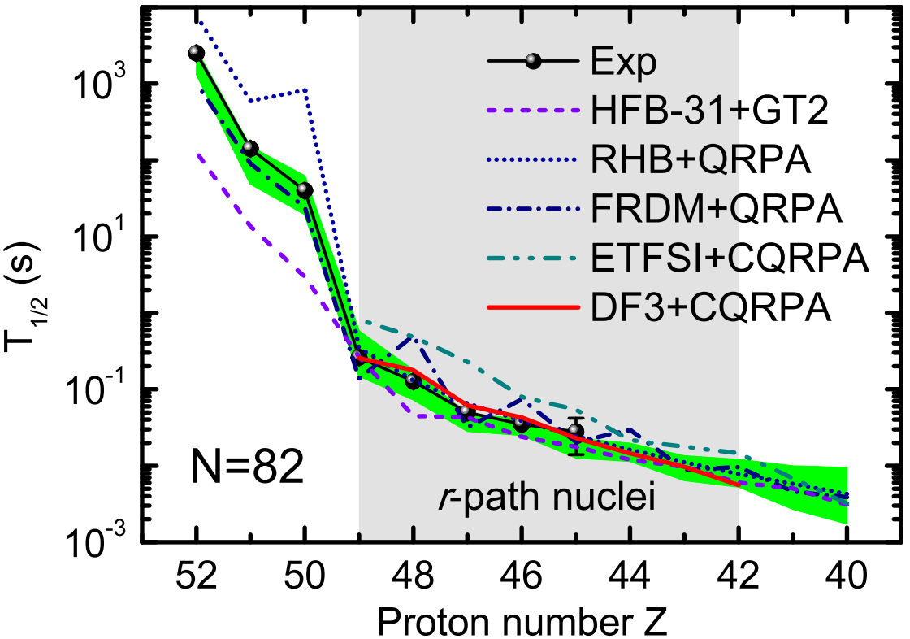

Introduction
β-decay half-lives from machine learning
 | T_{1/2}<10⁶ s | T_{1/2}<10³ s | T_{1/2}<1 s
a/f | 0.806 | 0.630 | 0.563
BNN-I2 | 0.477 | 0.354 | 0.238
BNN-I4 | 0.400 | 0.315 | 0.204
FRDM+QRPA | 0.819 | 0.597 | 0.391
RHB+QRPA | 1.884 | 1.620 | 0.463
The BNN-I4 approach well reproduces the experimental data, even completely agree with the experimental data within uncertainties for short-lived nuclei.
When extrapolate from known region, the results of other models generally agree with BNN-I4 predictions within uncertainties.
Z. M. Niu et al., PRC 99, 064307 (2019)

Slide 13
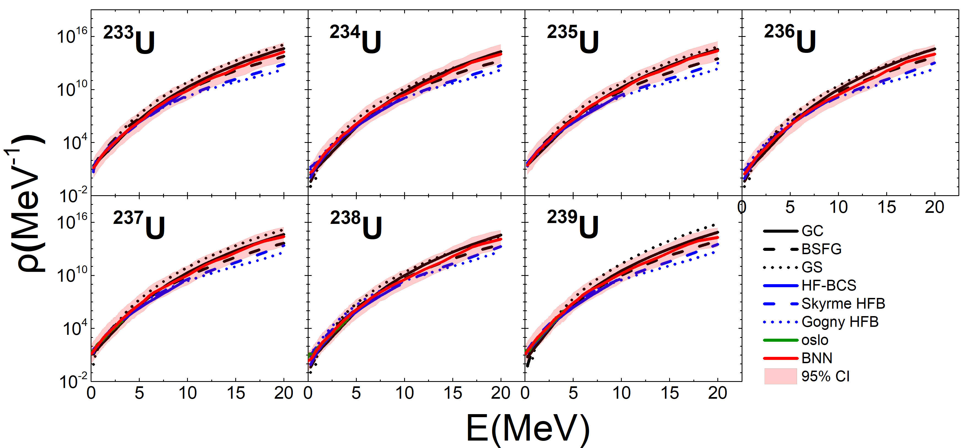
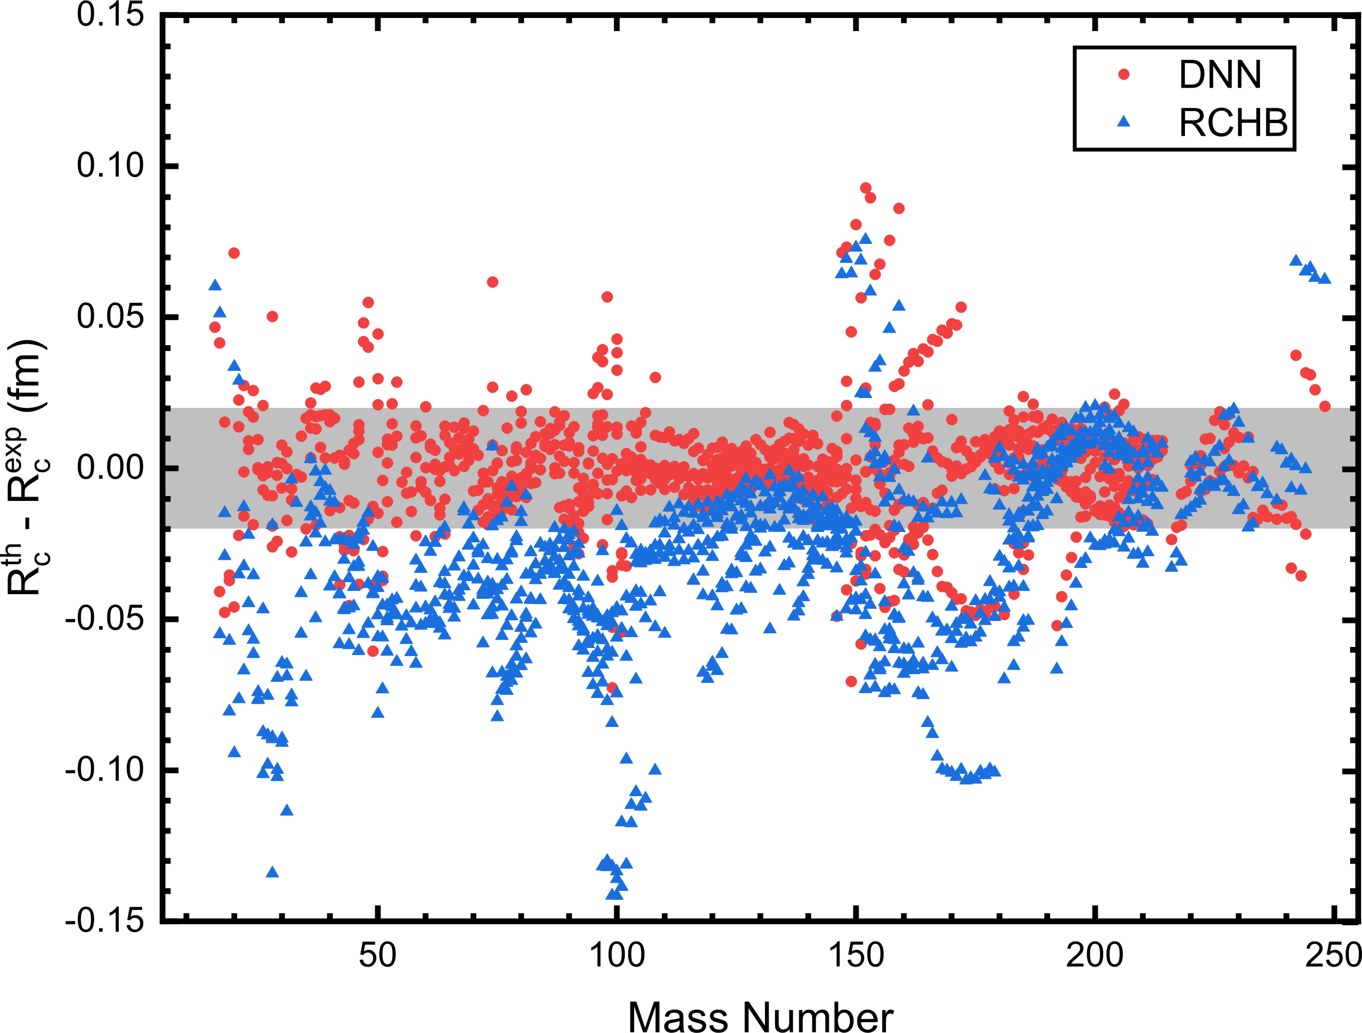
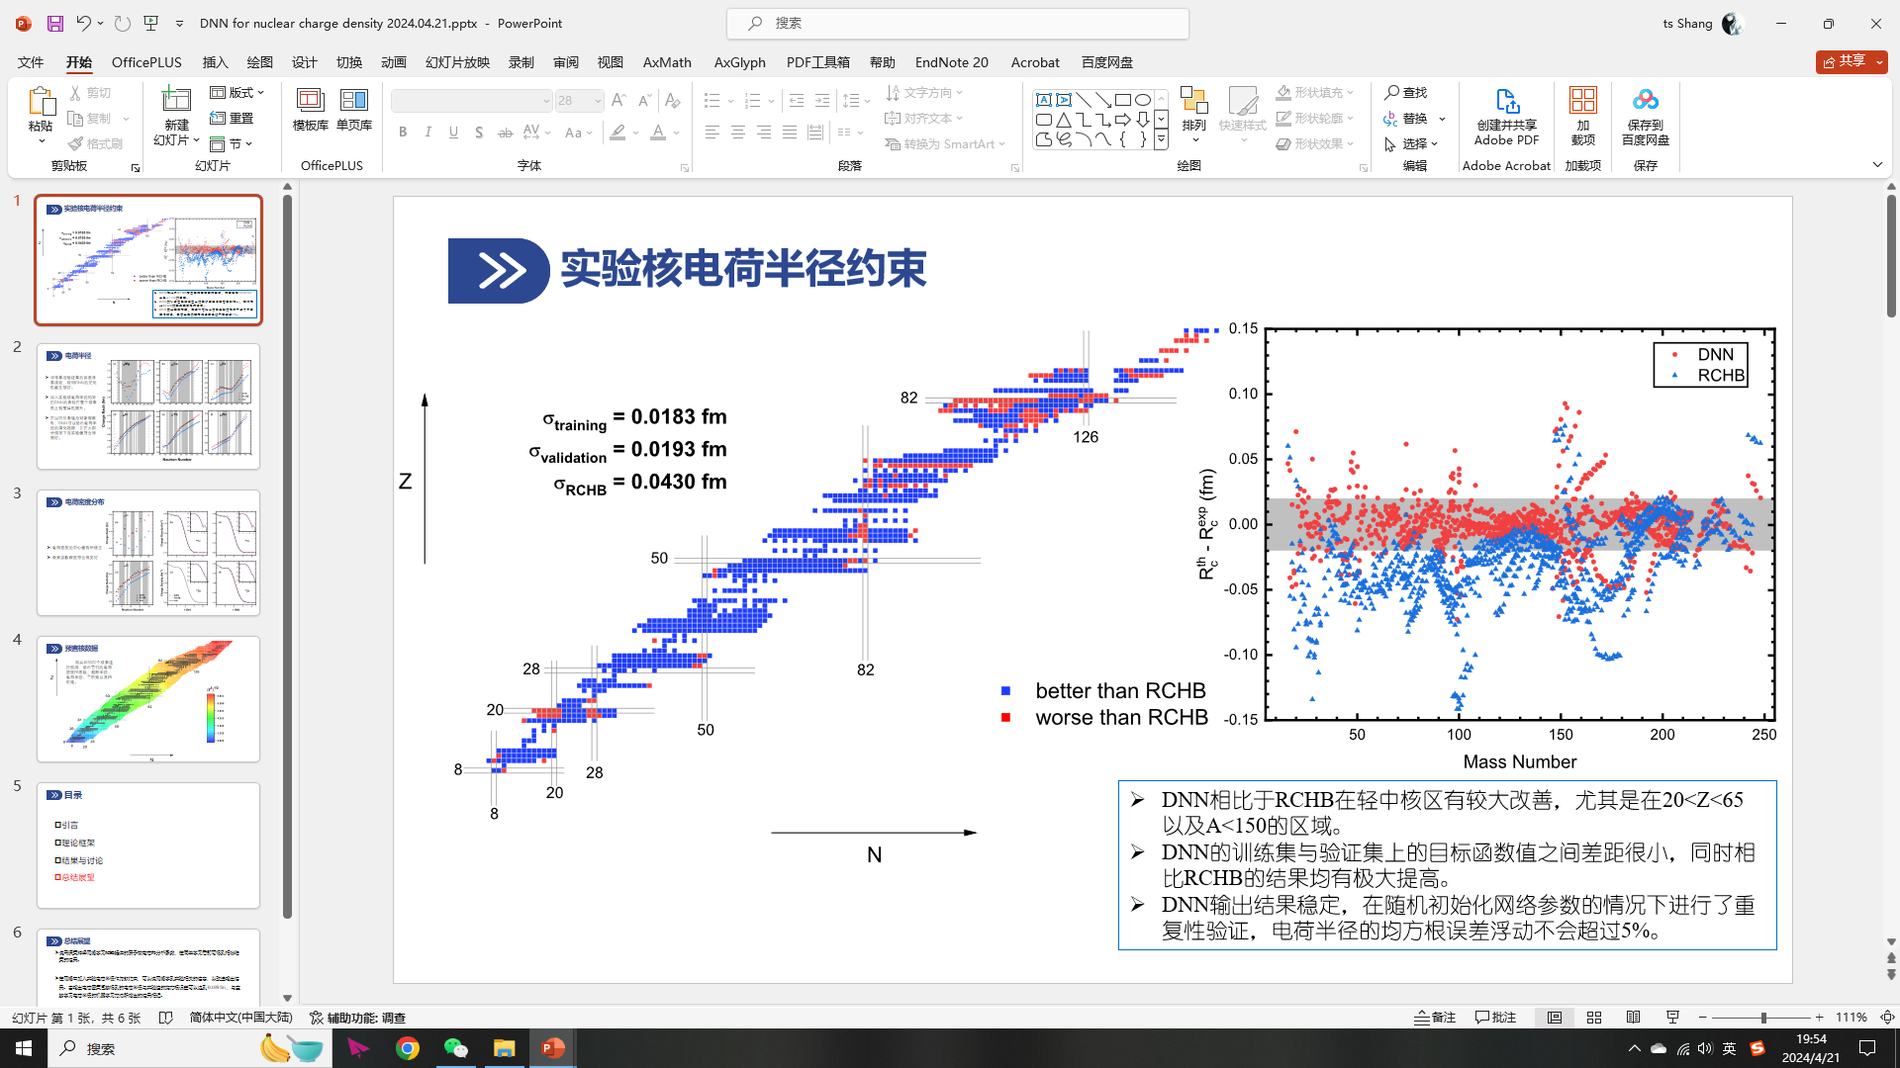
Mass model
Nuclear level density
XYWang, YCui, et al., CPC2024
Z. M. Niu, and H. Z. Liang, PLB 778, 48 (2018).
fragment production
Charge radius
Jian Li, et al., arXiv:2404.09558
Chun-Wang Ma, et al., CPC 44, No. 12 (2020) 124107

Slide 14
retrace the initial orientation of deformed nucleus-nucleus collisions
Zu-Xing Yang, Xiao-Hua Fan, Zhi-Pan Li, et al., Phys. Lett. B 848 (2024) 138359

Slide 15
Liquid-Gas phase transition
R. Wang, Y.G. Ma, et al., PRR 2, 043202 (2020)
Notes:
the autoencoder method is adopted to study the nuclear liquid-gas-phase transition. The encoder encodes
the input event-by-event charge-weighted charge multiplicity distribution of quasiprojectile fragments to a latent variable,
whereas the decoder part tries to decode the latent variable back to the original distribution. The averaged latent
variable P(T′ap) as a function of the apparent temperature T′ap or the excitation energy per nucleon Eex=A exhibits
a sigmoid pattern.

Slide 16
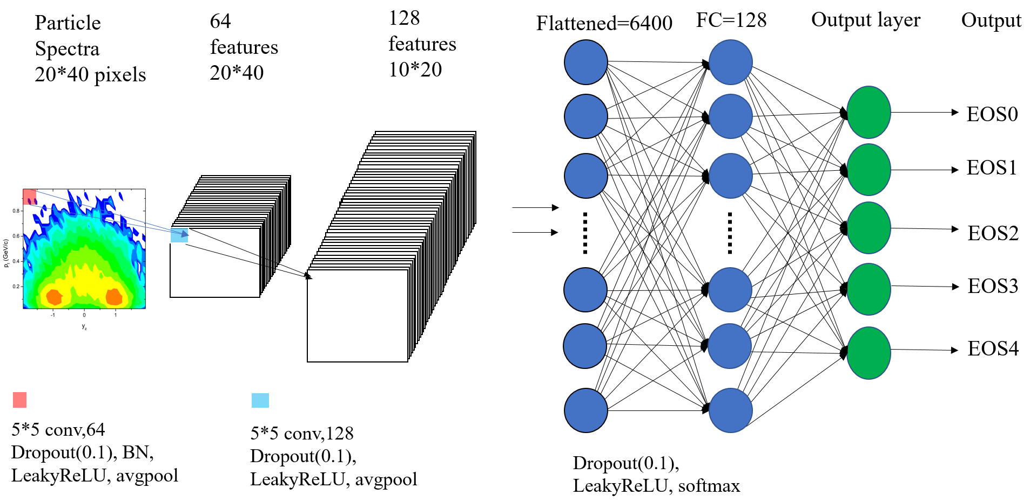
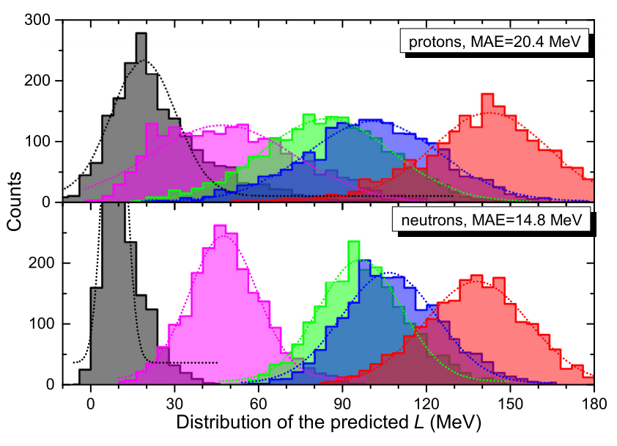
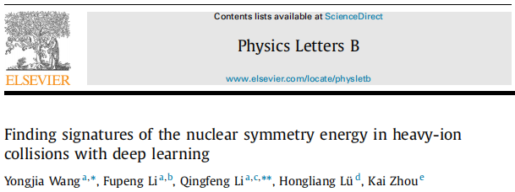
The density-dependent nuclear symmetry energy E_{sym}(ρ)
Physics Letters B 822 (2021) 136669
Fingerprints of E_{sym}(ρ) on the transverse momentum and rapidity distributions of protons and neutrons can be identified by convolutional neural network algorithm.
Slide from Yongjia Wang

Slide 17
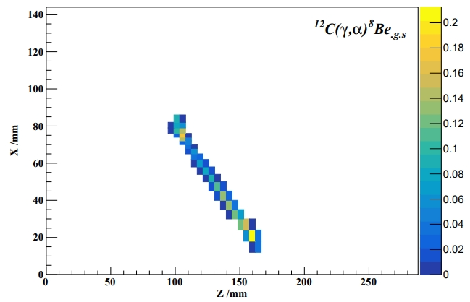
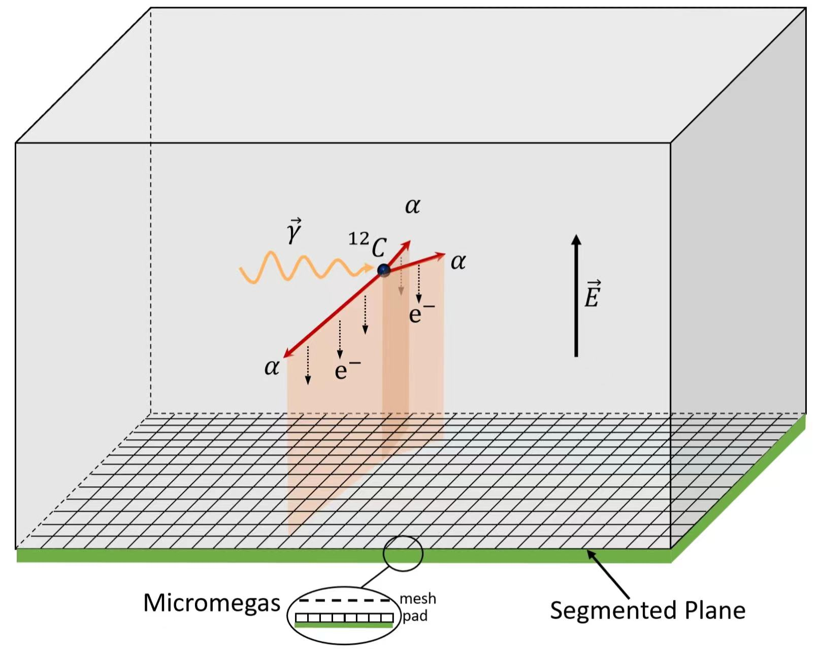
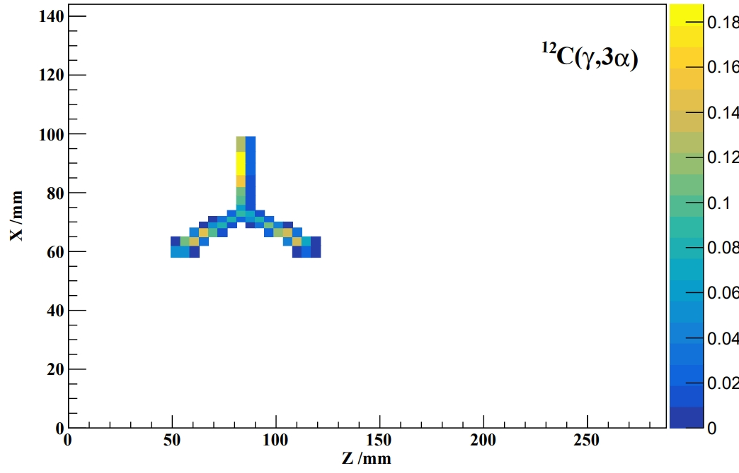
Reconstructing reaction signal and events
Provided by Wan-bin He
ML in AT-TPC
Using VGG-16、ReNet-18、ResNet-34 into AT-TPC for reconstructing the reaction signal and events

Slide 18
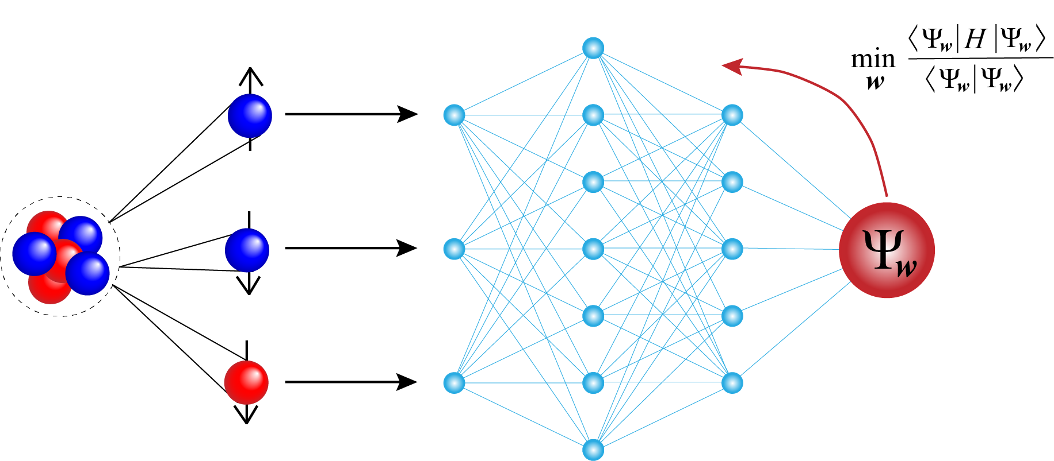
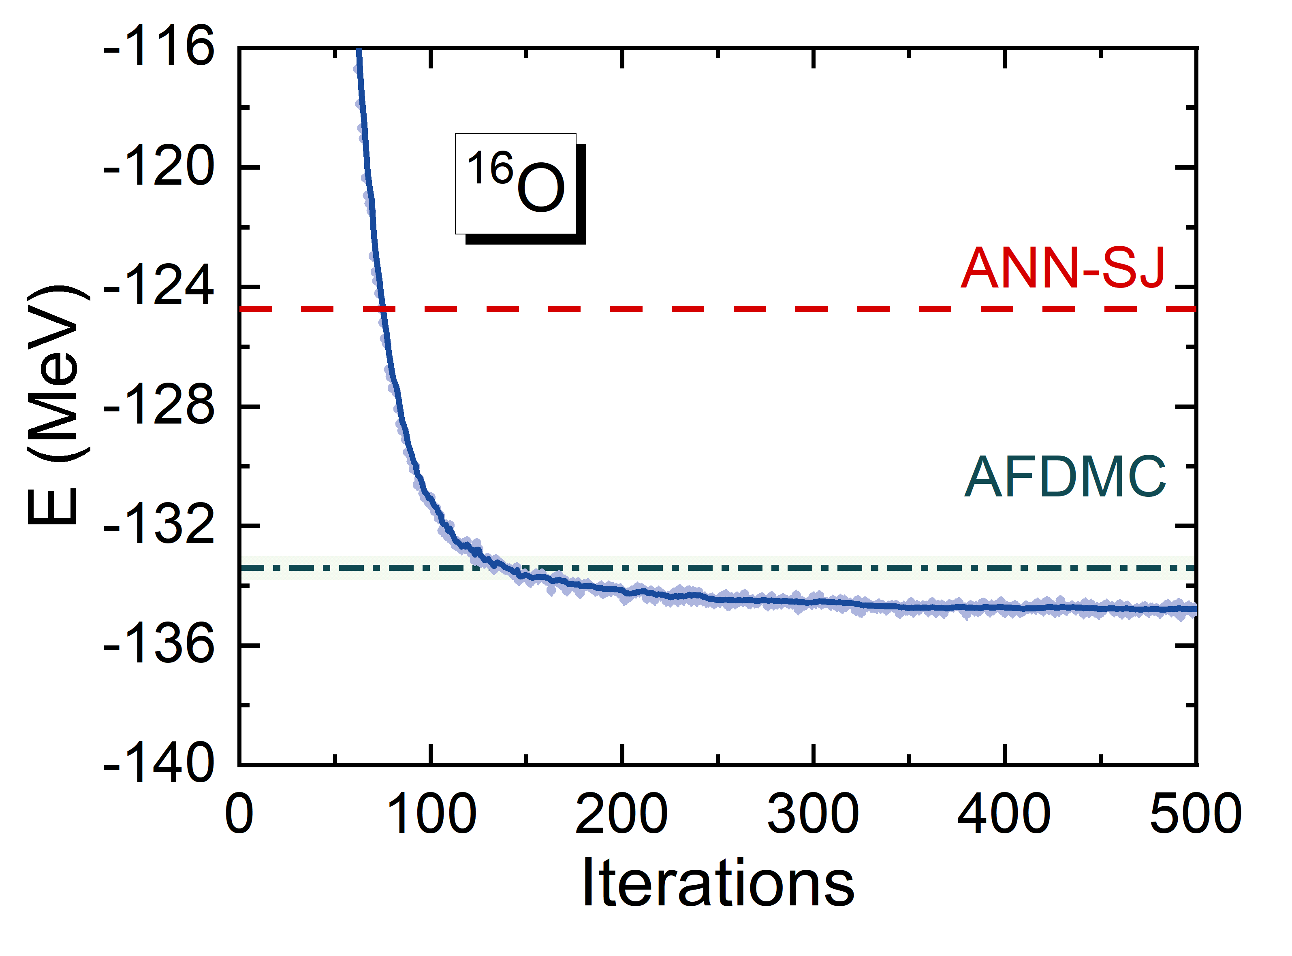
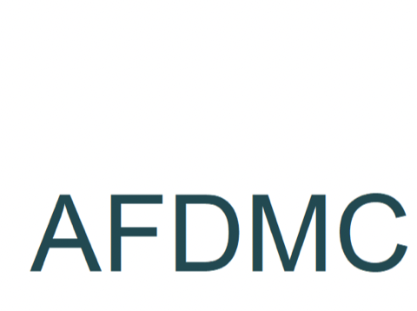
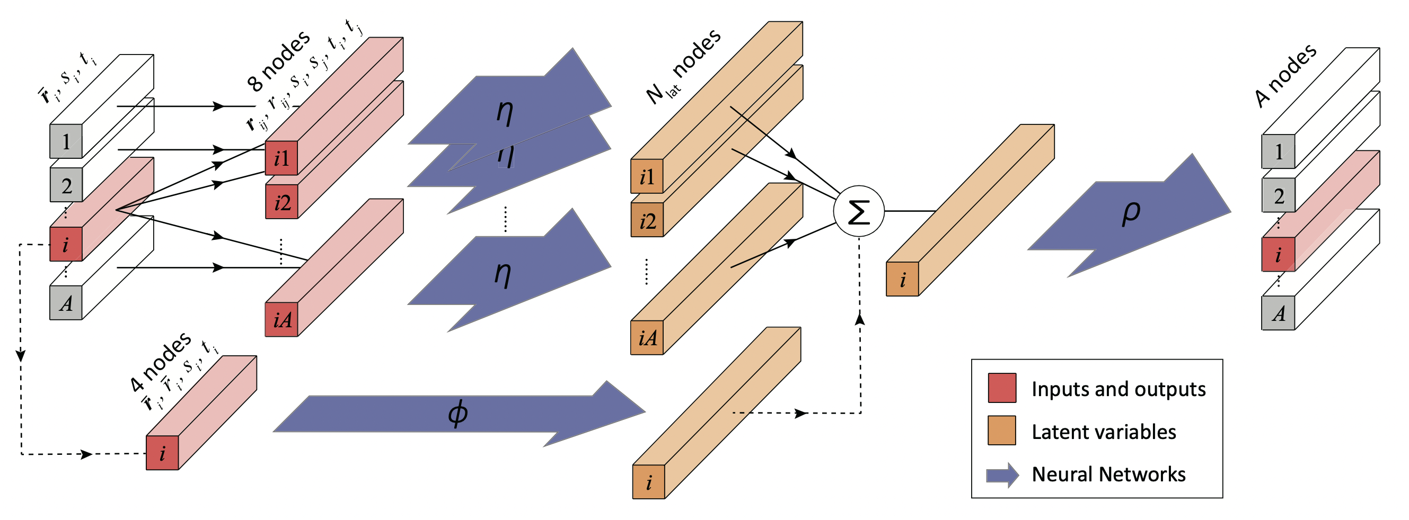
Deep-learning QMC: FeymanNet
FeymanNet: Variational Monte Carlo + Deep Neural-Networks
Among the most accurate neural-network trial wave function!
Unsupervised learning
Yang, Zhao, Phys. Lett. B 835, 137587 (2022)
Yang, Zhao, Phys. Rev. C 107, 034320 (2023)
Physical symmetry helps !
An accurate and polynomial scaling solution to nuclear many-body problem.

Slide 19
Approximating and sampling probability distributions

Slide 20
Symmetry energy from HICs
P. Moreforce, C.Tsang, Y. Zhang, et al., PLB799(2019)135045
C.Y. Tsang, et al., accepted by PLB 2024
For Standard Skyrme interaction,

Slide 21
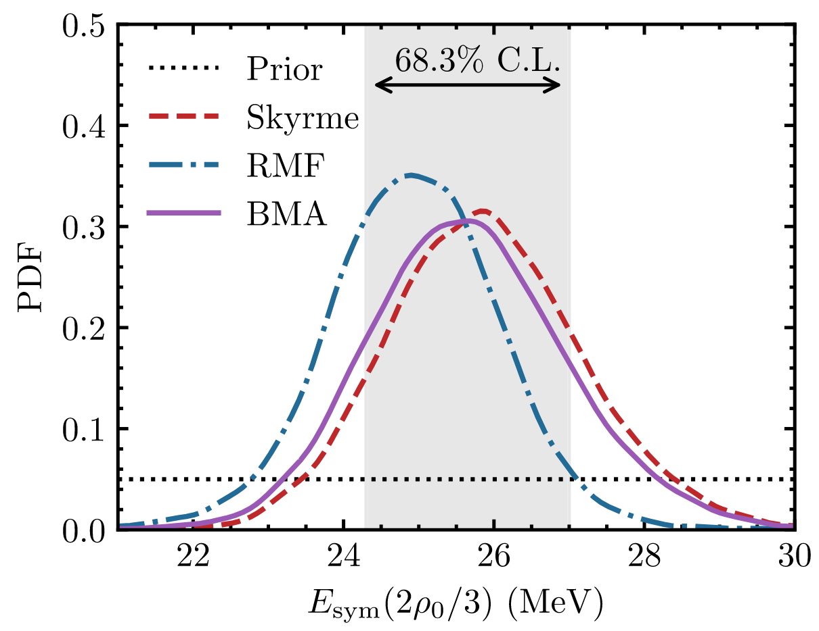
Symmetry energy from neutron skin and Neutron stars
M. Qiu et al., PLB 849, 138435 (2024)

Slide 22
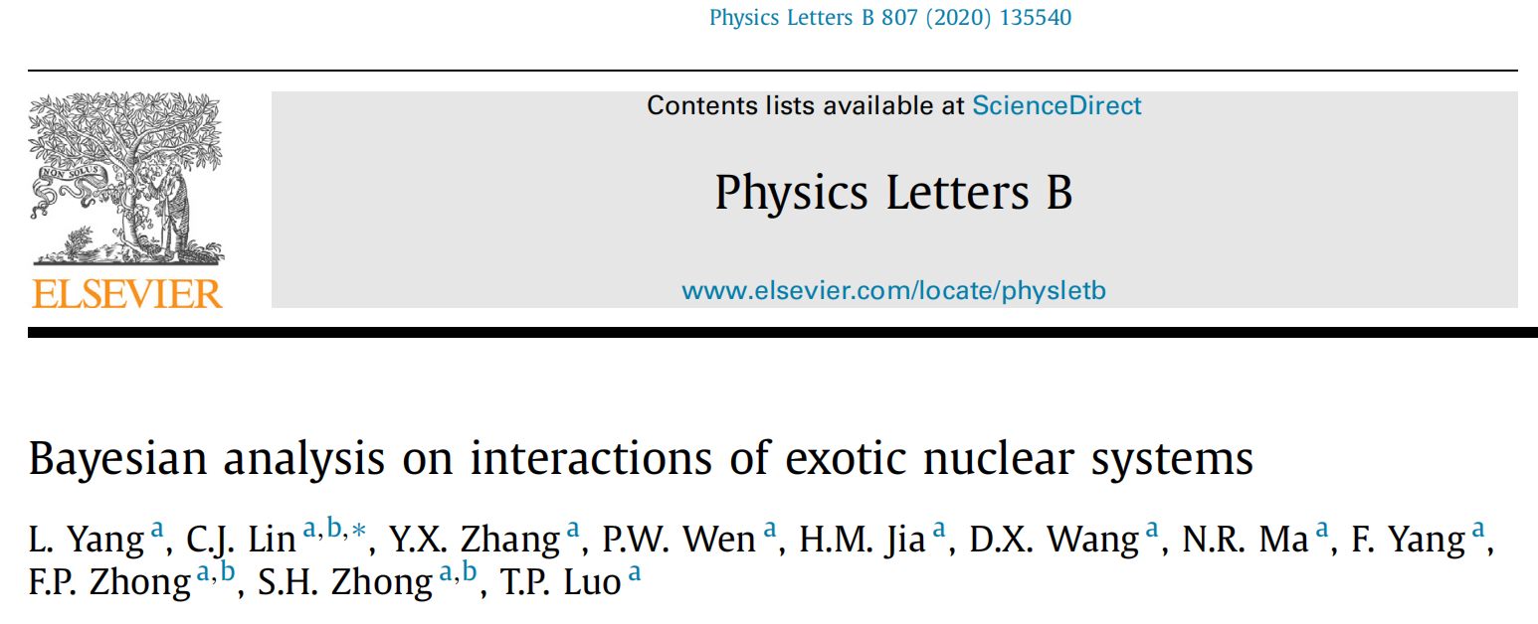
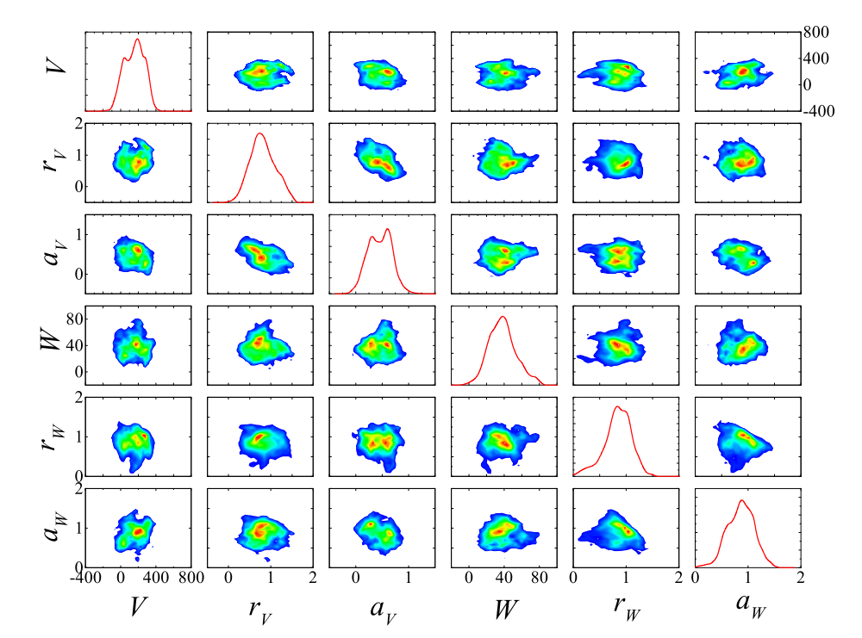
OMP parameters from reaction data
02 机器学习
冯郑业
Yongjia Wang (王永佳)

Slide 23
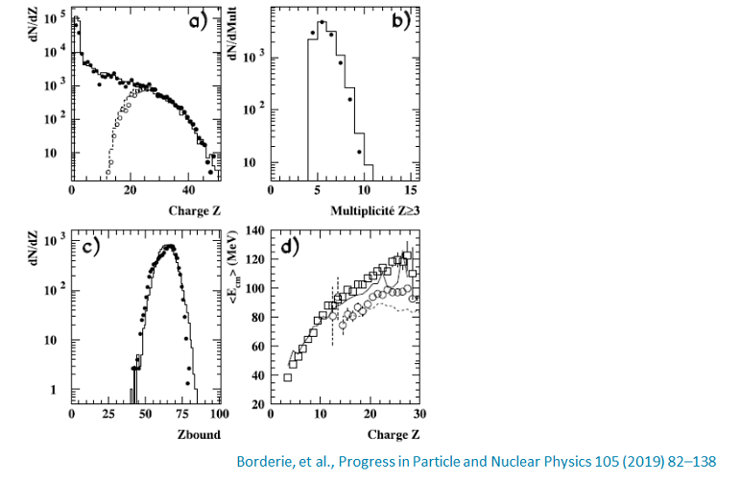
Reconstructing the Impact parameter distribution
inherent fluctuation kernel
One-to-many !

Slide 24
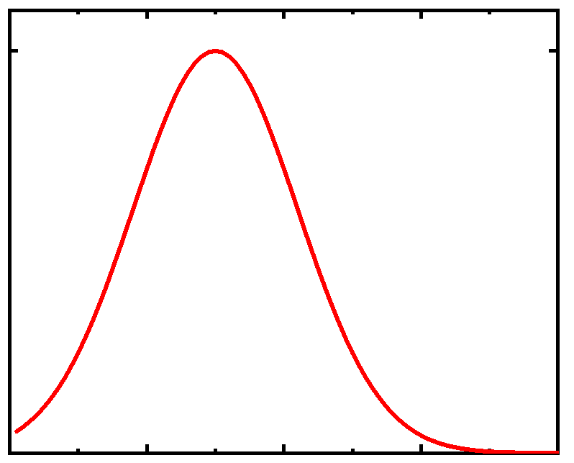
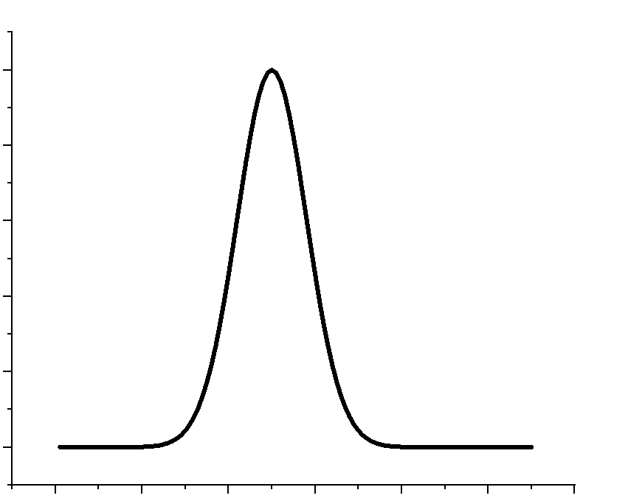

EOS,
Impact parameter b
theoretical
datasets
X
Transport model
Reaction mechanism
（initialization，NN scattering，MF）
Inference EOS and b
Supervised (FNN/CNN)
Exp.
datasets
Unsupervised (K-means/Bayesian method)
2024/4/21
24
24

Slide 25
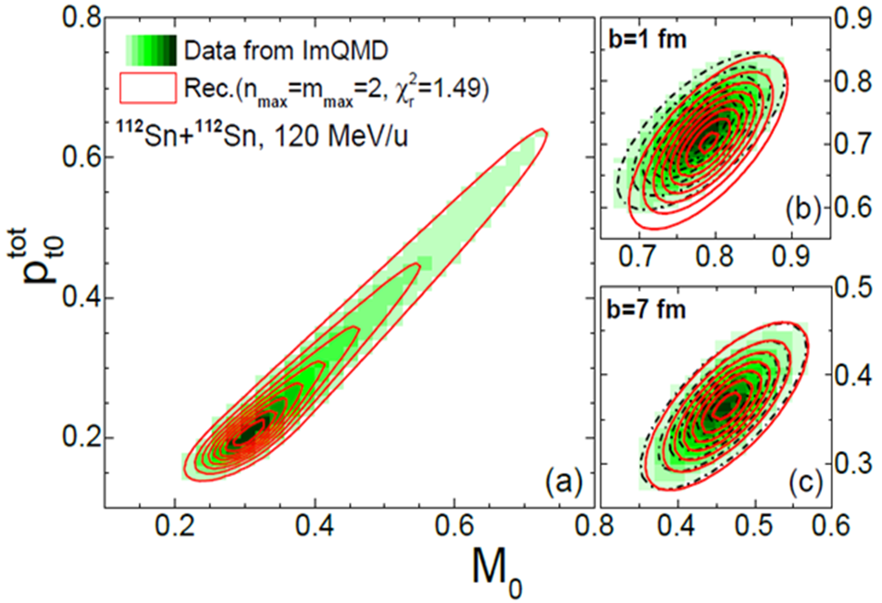

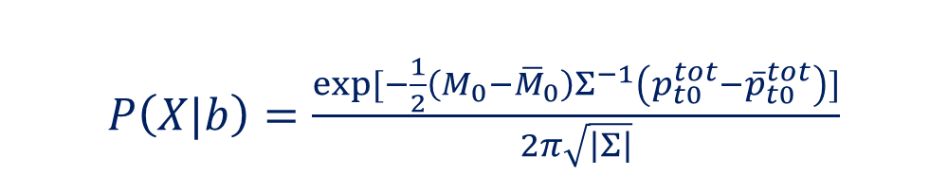



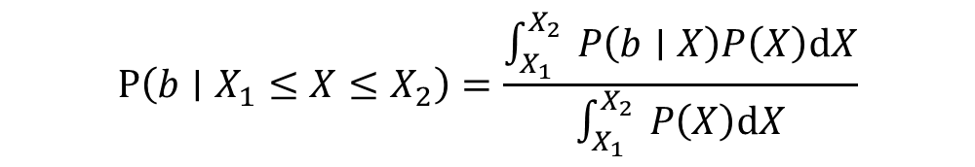
Reconstructing the impact parameter distribution by a Bayesian method
$P\left(X|b\right)=\frac{\exp{[−\frac{1}{2}\left(M_{0}−{\overline{M}}_{0}\right)Σ^{−1}\left(p_{t0}^{tot}−{\overline{p}}_{t0}^{tot}\right)]}}{2π\sqrt{\left|Σ\right|}}$
$$P\left(b ∣ X\right)=\frac{P\left(b\right)P\left(X ∣ b\right)}{P\left(X\right)}$$
欲得$P\left(b ∣ X\right)$，则须知$P\left(X ∣ b\right)$
$P\left(X\right)=\int_{0}^{∞}{ }P\left(b\right)P\left(X ∣ b\right)db$
$$P\left(b∣X_{1}≤X≤X_{2}\right)=\frac{\int_{X_{1}}^{X_{2}}{ }P\left(b∣X\right)P\left(X\right)dX}{\int_{X_{1}}^{X_{2}}{ }P\left(X\right)dX}$$
$$=\frac{P\left(b\right)}{c_{X_{1}}−c_{X_{2}}}\int_{X_{1}}^{X_{2}}{ }P\left(X∣b\right)dX$$

Slide 26
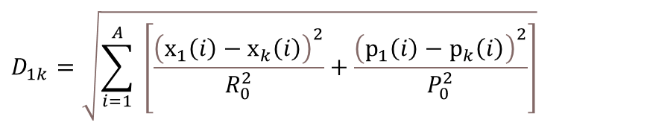

$${\vec{X}}_{a}=\{{\vec{x}}_{1}/R_{0},…, {\vec{x}}_{A}/R_{0},{\vec{p}}_{1}/P_{0},…, {\vec{p}}_{A}/P_{0}\}$$
Li Li, Xiang Chen, Ying Cui, Zhuxia Li, Yingxun Zhang*, PRC108, 034613 (2023)
$$D_{1k}=\sqrt{\sum_{i=1}^{A}{ }\left[\frac{{\left(x_{1}\left(i\right)−x_{k}\left(i\right)\right)}^{2}}{R_{0}^{2}}+\frac{{\left(p_{1}\left(i\right)−p_{k}\left(i\right)\right)}^{2}}{P_{0}^{2}}\right]}$$
Fluctuations come from the initialization and random scattering! Fluctuation can be approximated by a Gaussian form.

Slide 27
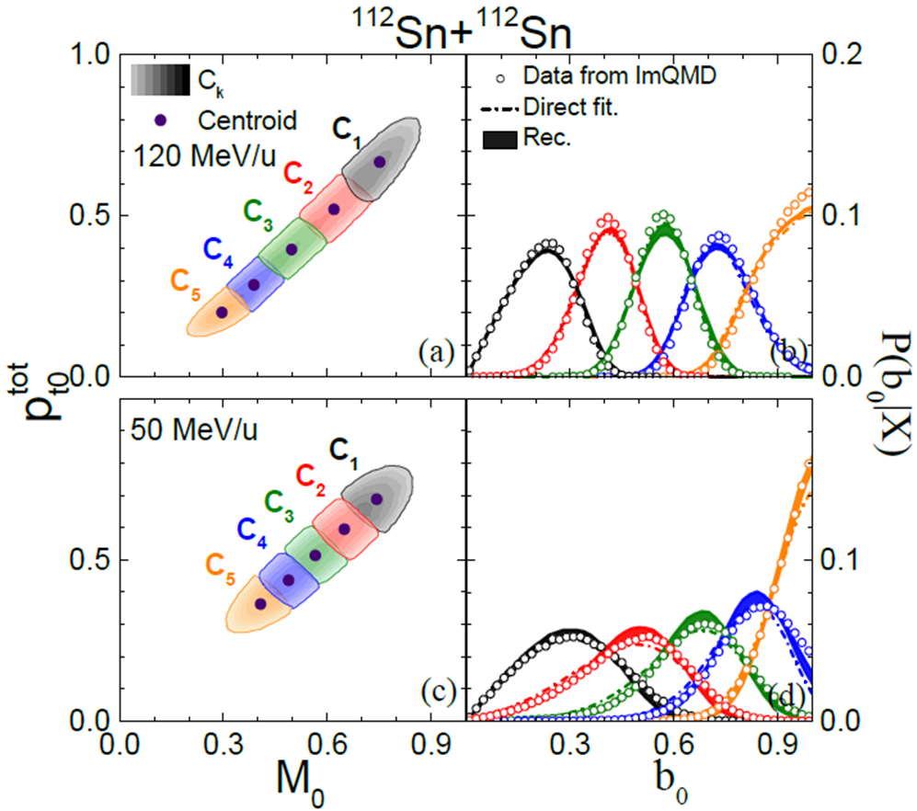
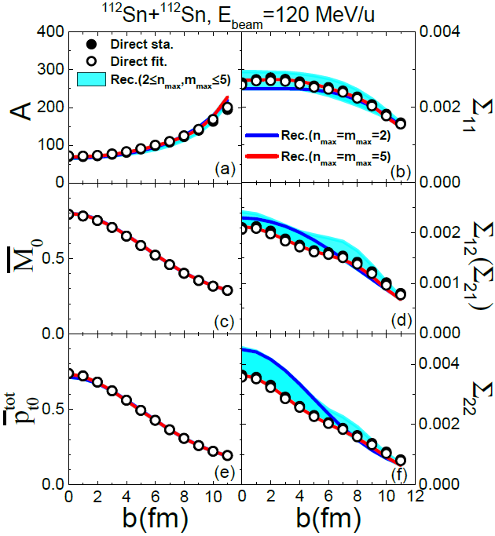
X. Chen, L. Li, Y. Cui, J. P. Yang, Z. X. Li, Y. X. Zhang, Phys. Rev. C 108, 034613 (2023).
The deviation can be used to understand the non-Gaussian fluctuation

Slide 28
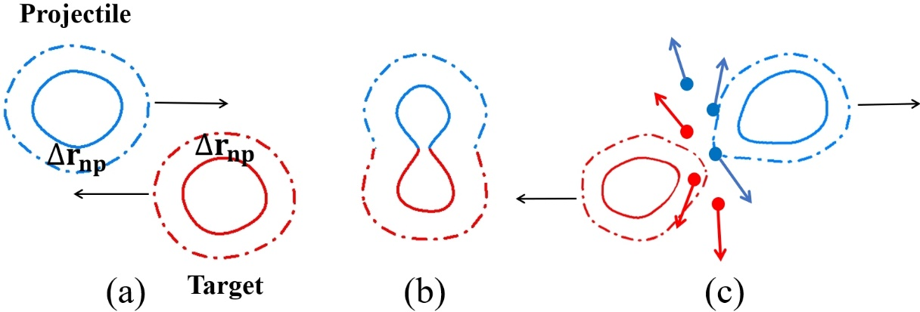
Probing the neutron skin of unstable nuclei with low-intermediate energy HICs
(${}_{}^{132,124}{Sn}+{}_{}^{124}{Sn}$) peripheral collisions

Slide 29
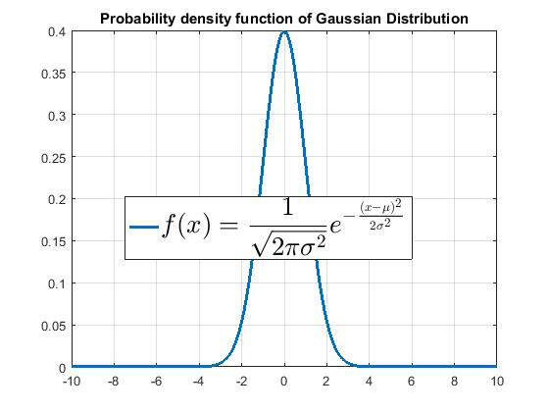


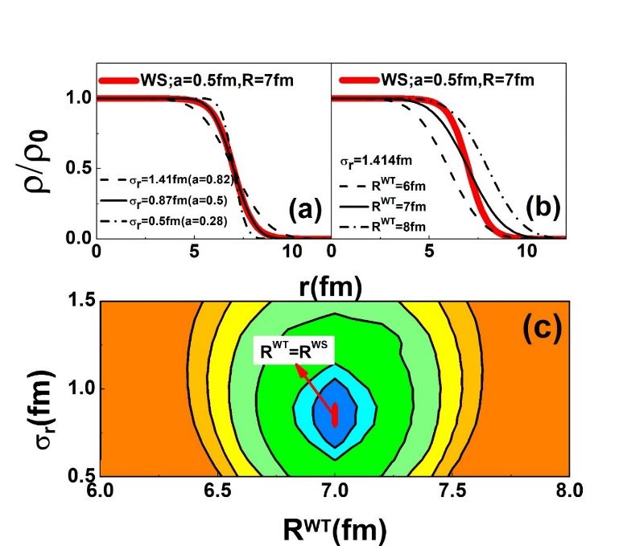
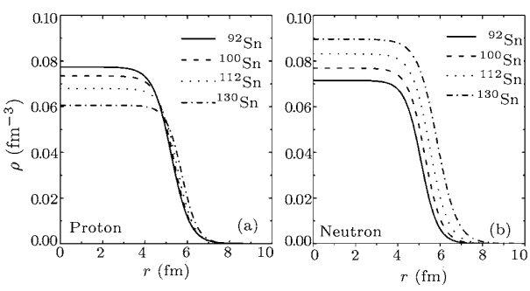
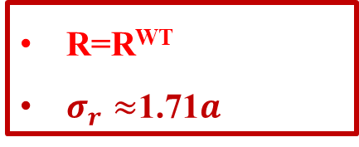
‘Consistent’ treating the initialization and propagation.
    R and BE are calculated under the same Hamiltonian
    Find the centroid distributions and then sampling
restricted density variational method (RDV)
Junping Yang, Yingxun Zhang*, et al., PRC104, 024605 (2021)
Liu Min et al 2006 Chin. Phys. Lett. 23 804
R=R^{WT}
$σ_{r}≈$1.71$a$

Slide 30
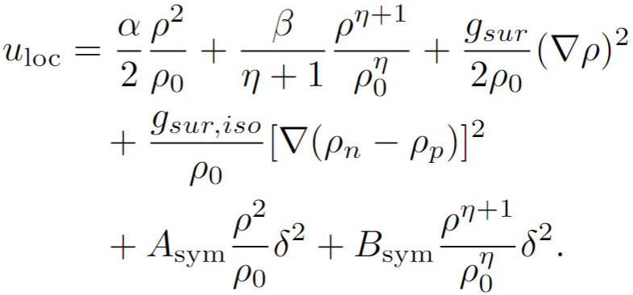
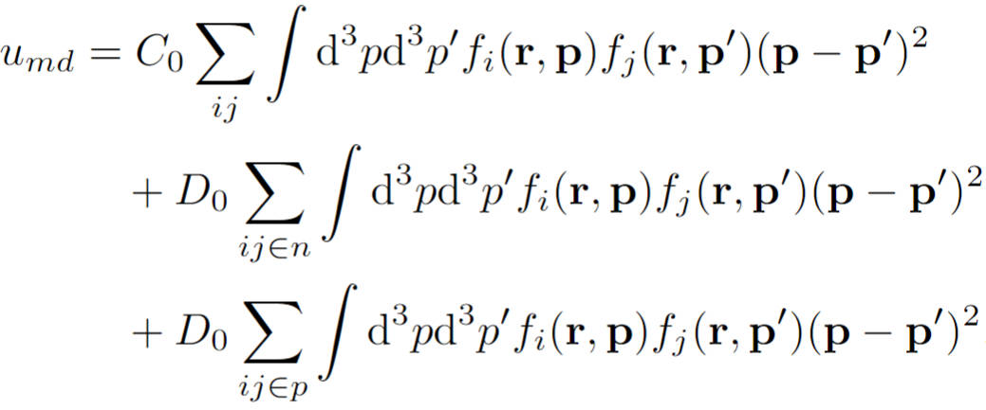
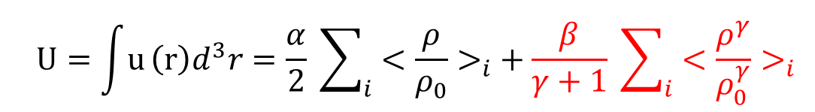
Accurate treating the nonlinear density dependent interaction term
Junping Yang, Yingxun Zhang*, et al., PRC104, 024605 (2021)
$$\frac{β}{γ+1}\sum_{i}{<{\frac{ρ^{γ}}{ρ_{0}^{γ}}>}_{i}≈\frac{β}{γ+1} \sum_{i}{<{\frac{ρ}{ρ_{0}}>}_{i}^{γ}}}+O(ρ)$$
Deviation: ~30 %
ImQMD-L
$$\frac{β}{γ+1}\sum_{i}{<{\frac{ρ^{γ}}{ρ_{0}^{γ}}>}_{i}}$$
$$\dot{{\vec{p}}_{i}}=−\frac{∂U_{3}}{∂R_{i}}=−\frac{β}{γ+1}\frac{∂}{∂R_{i}} \sum_{m}{<{\frac{ρ}{ρ_{0}}>}_{m}^{γ}}$$
Deviation: < 5 %

Slide 31
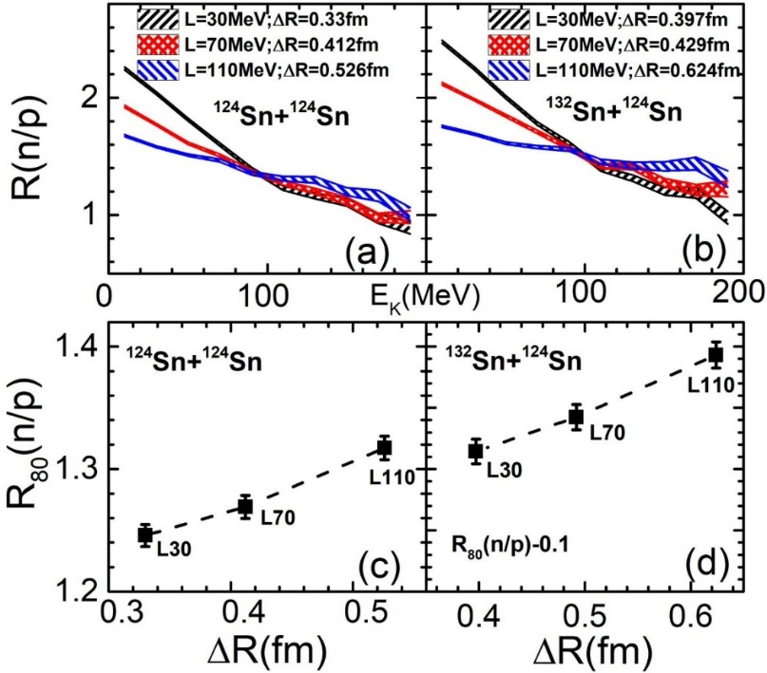




Cross sections of heavy residues, $σ_{A>100},δσ_{A>100}$and
$$neutron proton yield ratios R(n/p)$$
Junping Yang, Xiang Chen, Cui ying, Zhuxia Li, and Yingxun Zhang. Universe 2023, 9(5), 206
$$δσ_{A>100}=σ_{A>100}\left(A_{sys}\right)−σ_{A>100}\left(B_{sys}\right)$$
$$δR=∆R\left(A_{sys}\right)−∆R(B_{sys})$$
$R(n/p)、R_{80}(n/p)$ is sensitive to neutron skin。
$σ_{A>100}、δσ_{A>100}$ a probe of neutron skin

Slide 32
Outlook
ML should play more important roles in dealing with nuclear theories and experiments.
The development of efficient optimized algorithms is crucial
Involving physics in ML methods is important, for developing new ML algorithms and overcome the nonphysical predictive and big-data requirements.
Use ML on quantum computing, which can also boost ML in treating extremely large database

Slide 33
Thanks to all my collaborators, and Yongjia Wang, Zhen Zhang, Jian Li, et al. for providing me the interesting slides
Thanks for your attention!

