Slide 1
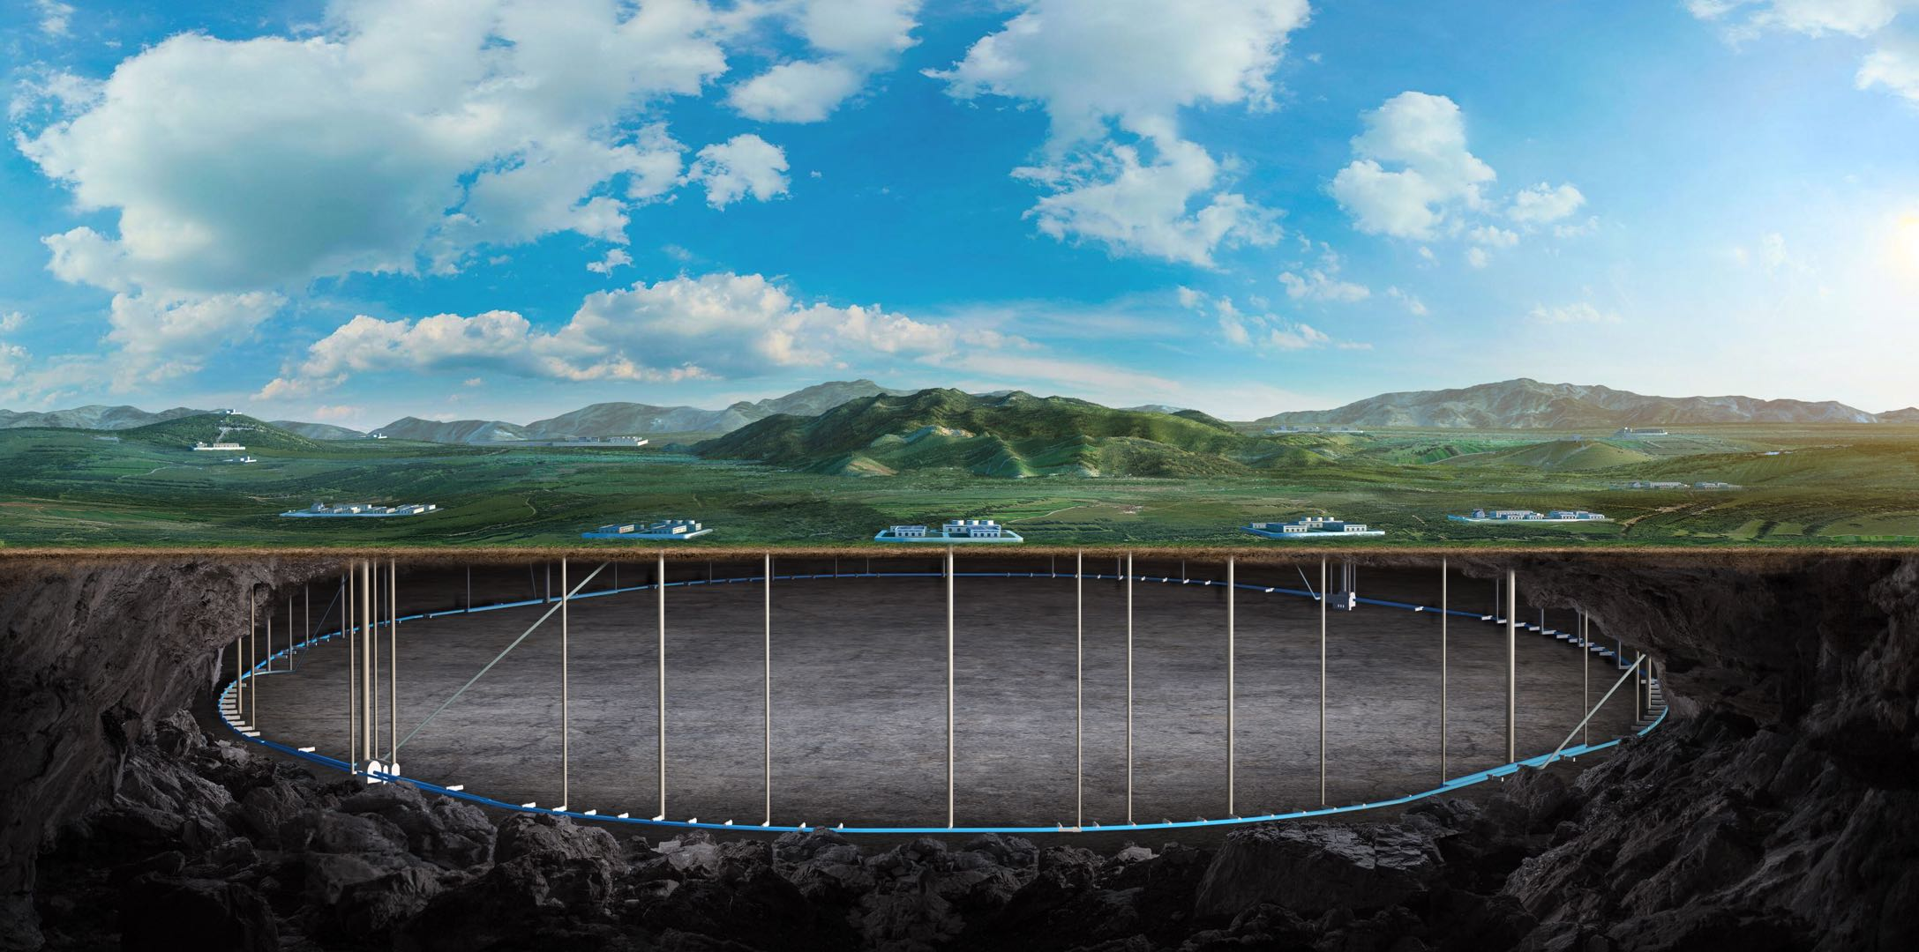
CEPC SRF system design and R&D status
Peng Sha
On behalf of IHEP SRF team
20-21. Nov. 2023, Peking, The 11th IHEP-KEK SCRF Collaboration Meeting

Slide 2
Content
TDR design of CEPC SRF system
SRF technology R&D and EDR plan
Summary

Slide 3
Design Requirement and Challenges of SRF System
CEPC collider 50 MW | Energy (GeV) | Current (mA) | RF voltage (GV)
Z | 45.5 | 1345 | 0.1
W | 80 | 140 | 0.7
H | 120 | 27.8 | 2.2
ttbar | 180 | 5.6 | 10
Higgs priority
- timeline and performance priority
Upgradable
- power (luminosity) and energy upgrade
Low cost (especially first stage)
- staged cost and in-kind contribution
Max luminosity for each mode
- up to 50 MW SR power per beam
Seamless mode switch
- switch among H/W/Z/(ttbar)
45.5-180 GeV double-ring collider with a full energy booster, RF system cost and reliability
6.6/30 GV total RF voltage, cavity G & Q, heat load
1.3 A beam current, 100 km large ring, low cavity RF voltage, beam-cavity interaction
60/100 MW SR power, coupler capacity and match
6 kW HOM power / cell, HOM damper, #CAV in CM

Slide 4
Design Features of SRF System
Share cavities for the two rings for H and ttbar (low cost)
Shared cavities for H/ttbar, separate cavities for W/Z
Save 2.2/10 GV, reduce by half cavities, klystrons, cryogenics construction and operation cost
Cons: double coupler power, half filling of both collider and booster
RF system optimized for Higgs (Higgs priority)
Coupler power, cavity and cell number, cavity gradient, HOM power, Qin match, beam-cavity interactions (FM/HOM CBI, RF transient), cavity material, operating temperature, Q₀, number of cavities in a module, module heat load, HOM damper, cavities per klystron, power overhead for LLRF... Balance all the parameters with technology maturity, reliability, performance degradation, operational margins, cost, risk and maintenance.
RF system for W, Z and ttbar (mode switch and max luminosity)
Due to the wide range of machine parameters, it is impossible to have a single common SRF system for the highest possible luminosity in each mode. A staged SRF complex with bypass lines for both collider and booster is inevitable.
W: fully share and use half of the Higgs cavities per ring due to similar beam parameters
Z: only low power Z can use Higgs cavities (half parking cavities). 1-cell cavity for > 10 MW to 30 / 50 MW.
ttbar: reuse Higgs (& Z) cavities, add new 5-cell cavities. Add more 9-cell cavities for the booster.
Add new RF power sources for Z and ttbar
Bypass the low current cavities for both collider and booster

Slide 5
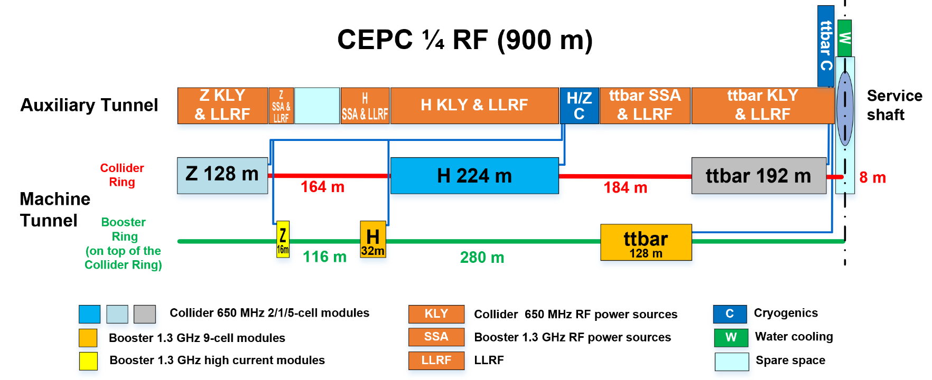
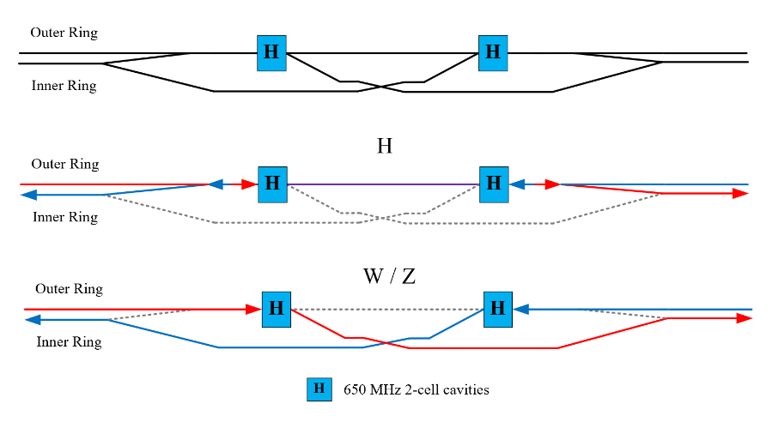
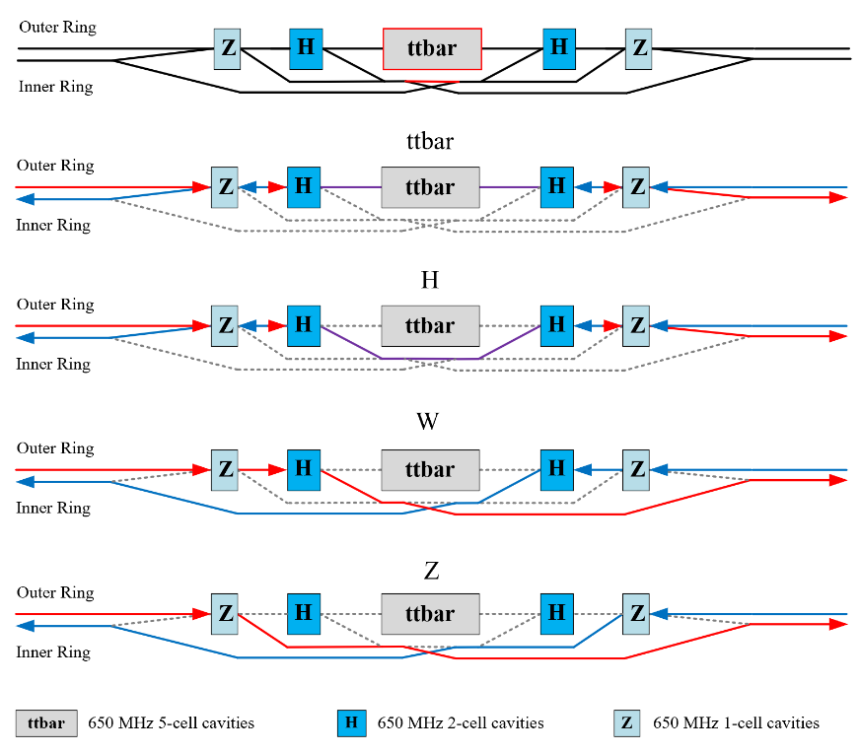
CEPC RF Layout
Collider RF Staging and Bypass Scheme
Bypass booster H cavities for low luminosity Z (< 10 MW) operation.
2x3.7 km long straight section, 2x1.8 km RF section
3 km RF module footprint, 2 km RF module
628 650 MHz cavities, 352 1.3 GHz cav, total 980 cav, 4900 cells

Slide 6
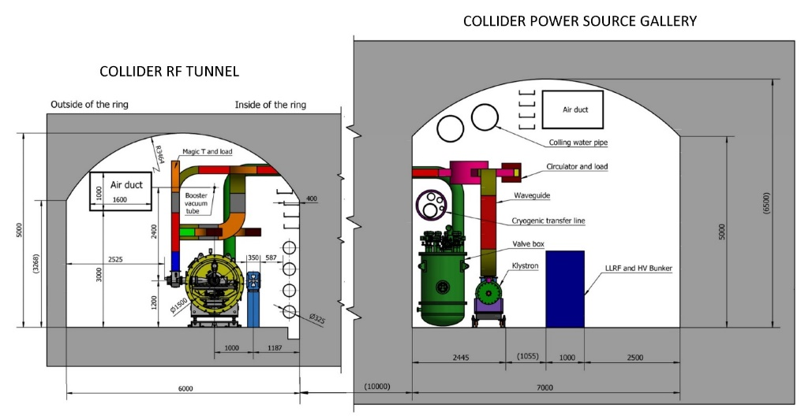
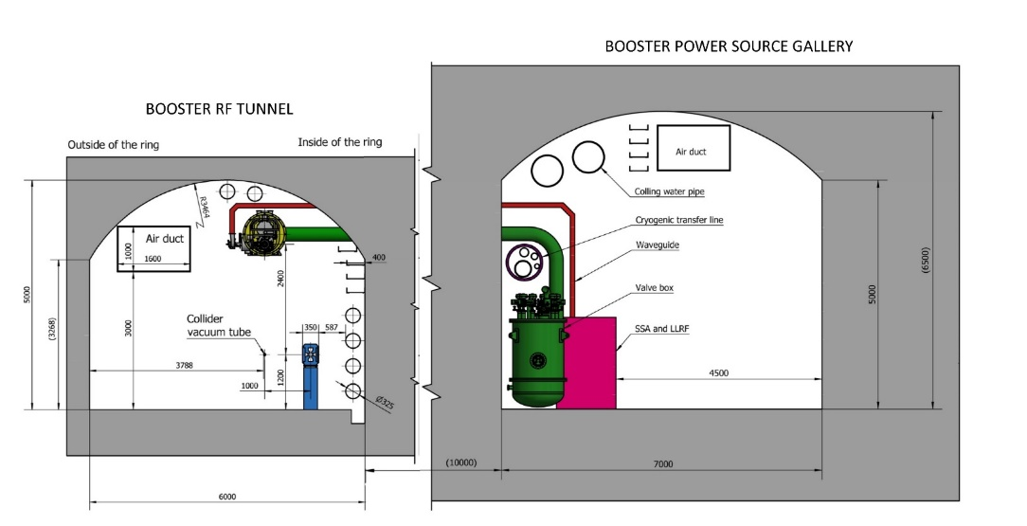
CEPC RF Tunnel
650 MHz cryomodules mounted on tunnel floor. Cavities operate in CW mode.
1.3 GHz cryomodules hung from ceiling at a different beamline height and in between collider cryomodule sections. Cavities operate in fast voltage ramp mode.

Slide 7
CEPC Collider Ring 650 MHz RF Parameters
30/50 MW SR power per beam for each mode. Higgs/ttbar shared cavities for the two rings. W/Z separate cavities. HL-Z cavities bypass. | ttbar 30/50 MW |  | Higgs 30/50 MW | W 30/50 MW | Z 10 MW | Z 30/50 MW
 | New cavities | Higgs cavities
Luminosity / IP [10³⁴ cm⁻²s⁻¹] | 0.5 / 0.8 |  | 5 / 8.3 | 16 / 26.7 | 38 | 115 / 192
RF voltage [GV] | 10 (6.1 + 3.9) |  | 2.2 | 0.7 | 0.12 | 0.12 / 0.1
Beam current / beam [mA] | 3.4 / 5.6 |  | 16.7 / 27.8 | 84 / 140 | 267 | 801 / 1345
Bunch charge [nC] | 32 |  | 21 | 21.6 | 22.4 | 22.4 / 34.2
Bunch length [mm] | 2.9 |  | 4.1 | 4.9 | 8.7 | 8.7 / 10.6
650 MHz cavity number | 192 | 336 | 192/336 | 96 / 168 / ring | 48 / ring | 30 / 50 / ring
Cell number / cavity | 5 | 2 | 2 | 2 | 2 | 1
Gradient [MV/m] | 27.6 | 25.2 | 24.9 / 14.2 | 15.9 / 9.1 | 5.4 | 17.4 / 8.7
Q₀ @ 2 K at operating gradient | 3E10 | 3E10 | 3E10 | 3E10 | 3E10 | 2E10
HOM power / cavity [kW] | 0.4 / 0.66 | 0.16 / 0.26 | 0.4 / 0.67 | 0.93 / 1.54 | 1.9 | 2.9 / 6.2
Input power / cavity [kW] | 188 / 315 | 71 / 118 | 313 / 298 | 313 / 298 | 206 | 1000
Optimal Q_{L} | 1E7 / 6E6 | 9E6 / 5.4E6 | 1.6E6 / 9.5E5 | 8E5 / 2.7E5 | 1.4E5 | 1.5E5 / 3.8E4
Optimal detuning [kHz] | 0.01 / 0.02 | 0.02 / 0.03 | 0.1 / 0.2 | 0.7 / 2 | 7 | 6.7 / 21.7
Cavity number / klystron | 4 / 2 | 2 | 2 | 2 | 2 | 1
Klystron power [kW] | 800 | 800 | 800 | 800 | 800 | 1200
Klystron number | 48 / 96 | 168 | 96 / 168 | 96 / 168 | 48 | 60 / 100
Cavity number / cryomodule | 4 | 6 | 6 | 6 | 6 | 1
Cryomodule number | 48 | 56 | 32 / 56 | 32 / 56 | 16 | 60 / 100
Total cavity wall loss @ 2 K [kW] | 12.1 | 7.1 | 3.9 / 2.3 | 1.6 / 0.9 | 0.1 | 0.45 / 0.2
ttbar and Higgs half filled with common cavities for two rings, W and Z with separate cavities for two rings.
High luminosity Z upgrade use high current 1-cell cavity with RF bypass.
Add more 2-cell cavities for Higgs 50 MW upgrade.
Add 5-cell cavities for ttbar while using the original 2-cell Higgs cavities.
Fundamental mode instability of Z-mode due to large detuning will be suppressed by RF & beam feedback.
No beam feedback needed for HL-Z because of deep damping 1-cell cavities.

Slide 8
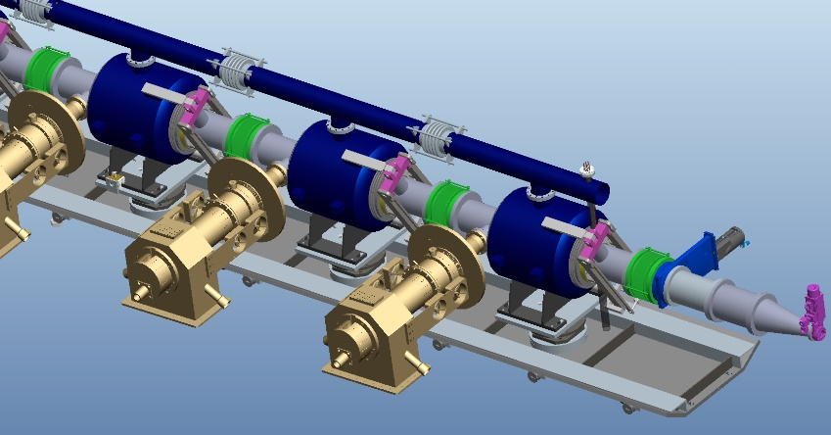
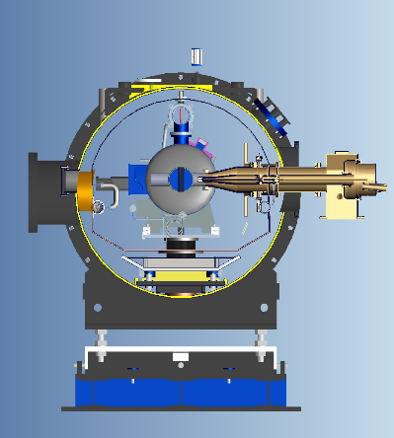
Collider 650 MHz Cryomodule
The collider Higgs mode will require 30 MW SR power per beam and will use a 650 MHz RF system with 192 2-cell cavities.
Each of the 11 m-long collider cryomodules will contain six 650 MHz 2-cell cavities.
Each cavity will have two detachable coaxial HOM couplers mounted on the cavity beam pipe with a HOM power handling capacity of 1 kW. Additionally, each cryomodule will have two beamline HOM absorbers at room temperature outside the vacuum vessel with a HOM power handling capacity of 5 kW each.

Slide 9
Beam Cavity Interaction
CEPC large ring features:
Large circumference and small revolution frequency (3 kHz, dense beam spectrum)
W and Z low energy and small radiation damping
Low injection energy of Booster
Beam cavity interaction issues:
Transient beam loading of beam gaps for beam abort, ion-clearing or in bunch trains
Fundamental mode (FM) induced coupled bunch instabilities (CBI), due to large cavity detuning (low RF voltage and high current) and the parked cavities
Higher-order-modes (HOM) induced coupled bunch instabilities
Less cavities and cells are preferred to have high stored energy and low impedance.
Details in CEPC TDR

Slide 10
CEPC Booster Ring 1.3 GHz RF Parameters
30/50 MW Collider SR power per beam. 30 GeV injection. Higgs & ttbar half filled. Higgs on-axis injection with bunch swapping. Z injection from empty ring. | ttbar 30/50 MW |  | Higgs 30/50 MW on-axis | W 30/50 MW | Z 30/50 MW
 | New cavities | Higgs cavities
Extraction beam energy [GeV] | 180 |  | 120 | 80 | 45.5
Extraction average SR power [MW] | 0.05 |  | 0.5 / 0.67 | 0.02 / 0.04 | 0.05 / 0.1
Bunch charge [nC] | 1.1 |  | 0.78 (20.3)* | 0.73 | 0.81
Beam current [mA] | 0.12 / 0.19 |  | 1 / 1.4 | 3.1 / 5.3 | 16 / 30
Injection RF voltage [GV] | 0.761 |  | 0.346 | 0.3 | 0.3
Extraction RF voltage [GV] | 9.7 (7.53 + 2.17) |  | 2.17 | 0.87 | 0.46
Extraction bunch length [mm] | 1.8 |  | 1.86 | 1.3 | 0.75
Cavity number (1.3 GHz 9-cell) | 256 | 96 | 96 | 96 | 32
Module number (8 cavities / module) | 32 | 12 | 12 | 12 | 4
Extraction gradient [MV/m] | 28.3 | 21.8 | 21.8 | 8.7 | 13.8
Q₀ @ 2 K at operating gradient | 2E10 | 3E10 | 3E10 | 3E10 | 3E10
Q_{L} | 4E7 | 4E7 | 1.2E7 | 7.3E6 / 4.4E6 | 1.2E7 / 6.3E6
Cavity bandwidth [Hz] | 33 | 33 | 110 | 178 / 296 | 111 / 208
Peak HOM power per cavity [W] | 0.5 / 0.8 |  | ~ 75 / ~ 100 | 11.8 / 19.6 | 146 / 272
Average HOM power per cavity [W] | 0.2 / 0.32 |  | ~ 10 / ~ 15 | 3.8 / 6.3 | 80 / 150
Input peak power per cavity [kW] | 8.3 / 9.2 | 5.1 / 5.9 | 22 / 32 | 10.9 / 18.1 | 17 / 32
Input average power per cavity [kW] | 0.3 | 0.2 | 6.5 / 9.2 | 0.3 / 0.5 | 2.5 / 4.5
SSA power [kW] (1 cavity / SSA) | 10 | 10 | 25 / 30 | 25 / 30 | 25 / 40
Total cavity wall loss @ 2 K [kW] | 0.36 | 0.05 | 0.5 | 0.02 | 0.08
1.3 GHz 9-cell cavities
Higgs and ttbar booster are half filled for the injection timing with Collider ring.
Transient beam loading for Higgs on-axis injection tolerable (both at injection and extraction).
Increased average HOM power of HL-Z requires ERL-type 1.3 GHz cryomodule (HOM absorber at low temperature between cavities). Four cryomodules for Z with RF bypass, also to reduce impedance and increase current limit.
High gradient high Q 9-cell cavities for ttbar.
Narrow bandwidth high gradient cavity voltage ramping through the multipacting region to be studied. Counter-phasing ramp.
* The small bunch charge number before the parenthesis is for the bunches injected from the linac. The large bunch charge number in the parenthesis is for the bunches injected back from the Collider ring during the swap-out injection at Higgs energy.

Slide 11
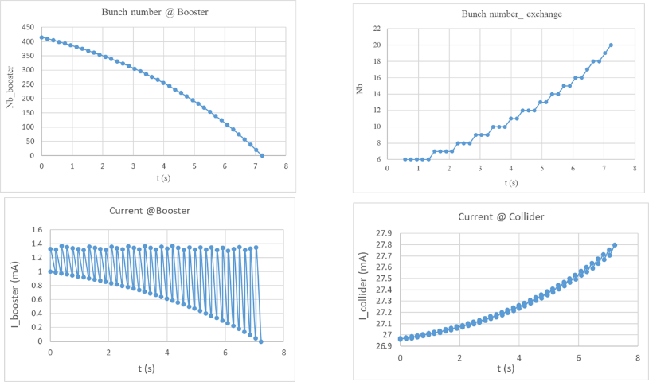
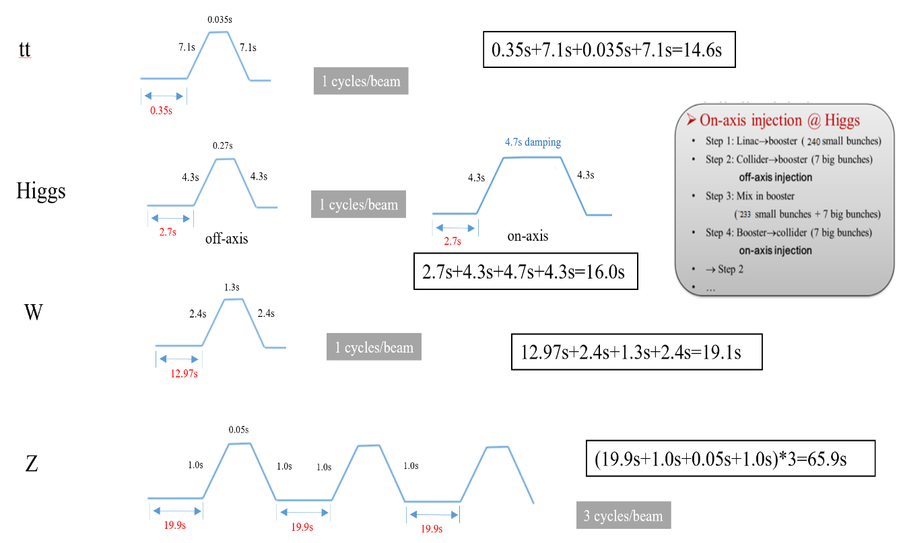
Booster Ramp and Duty Factors
Booster cavities operate in fast ramp mode, and the beam energy increases almost linearly with time. The total RF voltage must be increased during the energy ramp to keep the synchrotron tune constant.
Cryogenic, RF power and HOM power duty factor change with the cavity voltage, Q0, ramp time, circulating and swapping bunch charge, bunch length, beam current, etc. Big impact on Higgs on-axis injection.

Slide 12
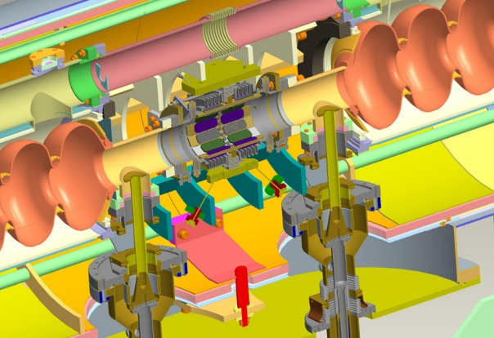
Booster 1.3 GHz Cryomodule
TESLA/TTF/Euro-XFEL/ILC/LCLS-II/SHINE type 1.3 GHz cryomodule will be used for the Booster. Each of the 12-meter-long cryomodules contains eight 1.3 GHz 9-cell cavities, with each cavity having two welded HOM couplers on the cavity beam pipe. No superconducting magnet and cold BPM in the module.
Due to the high beam current and high HOM power per cavity in the high luminosity Z mode (up to 30 mA for injection into the empty Collider ring), an ERL-type 1.3 GHz cryomodule with a HOM absorber at 100 K between cavities will be used instead of the low current TESLA cavities for Higgs, W and tt̄ mode. To reduce the impedance, the Z-mode beams will only go through Z-cavities and bypass the Higgs and tt̄ cavities.

Slide 13
CEPC Power and Energy Upgrade Plan
 | Baseline |  |  | Power Upgrade |  |  | Energy Upgrade
 | Higgs | W | Z | Higgs | W | Z | tt̄
Collider SR power / beam [MW] | 30 |  |  | 50 |  |  | 30 |  | 50
Beam energy [GeV] | 120 | 80 | 45.5 | 120 | 80 | 45.5 | 180
Luminosity / IP [10³⁴ cm⁻²s⁻¹] | 5 | 16 | 115 | 8.3 | 26.7 | 192 | 0.5 |  | 0.8
Collider 650 MHz cavities | 2-cell |  | 1-cell | 2-cell |  | 1-cell | Add 5-cell | Existing 2-cell | Add 5-cell | Existing 2-cell
RF voltage [GV] | 2.2 | 0.7 | 0.12 | 2.2 | 0.7 | 0.1 | 10 (6.1 + 3.9) |  | 10 (6.1 + 3.9)
Beam current / ring [mA] | 16.7 | 84 | 801 | 27.8 | 140 | 1345 | 3.4 |  | 5.6
Cavity number | 192 | 96×2 | 30×2 | 336 | 168×2 | 50×2 | 192 | 336 | 192 | 336
Cryomodule number | 32 | 32 | 60 | 56 | 56 | 100 | 48 | 56 | 48 | 56
Klystron number | 96 | 96 | 60 | 168 | 168 | 100 | 48 | 168 | 96 | 168
Klystron power [kW] | 800 | 800 | 1200 | 800 | 800 | 1200 | 800 | 800 | 800 | 800
Collider 4.5 K equiv. heat load [kW] | 44.4 | 28.1 | 15.2 | 41.9 | 20 | 20.1 | 128.3 |  | 128.3
Booster 1.3 GHz cavities | 9-cell |  |  | 9-cell |  |  | Add 9-cell | Existing 9-cell | Add 9-cell | Existing 9-cell
Extraction RF voltage [GV] | 2.17 | 0.87 | 0.46 | 2.17 | 0.87 | 0.46 | 9.7 (7.53 + 2.17) |  | 9.7 (7.53 + 2.17)
Beam current [mA] | 1 | 3.1 | 16 | 1.4 | 5.3 | 30 | 0.12 |  | 0.19
Cavity number | 96 | 96 | 32 | 96 | 96 | 32 | 256 | 96 | 256 | 96
Cryomodule number | 12 | 12 | 4 | 12 | 12 | 4 | 32 | 12 | 32 | 12
SSA number | 96 | 96 | 32 | 96 | 96 | 32 | 256 | 96 | 256 | 96
SSA power [kW] | 25 | 25 | 25 | 30 | 30 | 40 | 10 | 10 | 10 | 10
Booster 4.5 K equiv. heat load [kW] | 7.8 | 3.1 | 3.5 | 8.1 | 3.2 | 3.7 | 11.4 |  | 11.4
Total RF length [m] | 704 | 704 | 384 | 1088 | 1088 | 608 | 2368 |  | 2368
Total 4.5 K equiv. heat load [kW] | 52.2 | 31.2 | 18.7 | 50.0 | 23.2 | 23.8 | 139.7 |  | 139.7

Slide 14
Content
TDR design of CEPC SRF system
CEPC SRF technology R&D and EDR plan
Summary

Slide 15
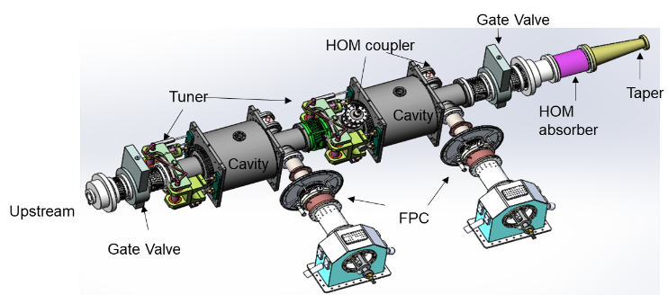
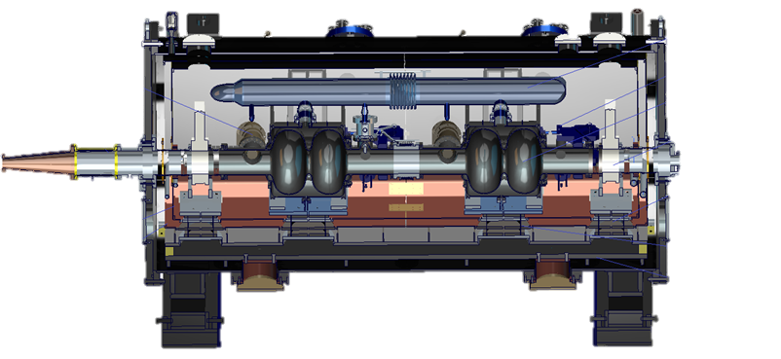
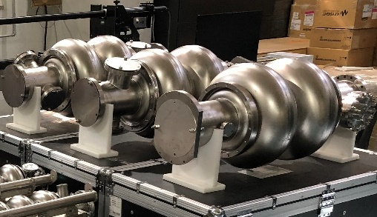
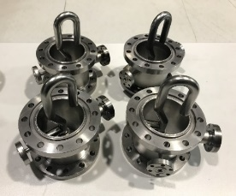
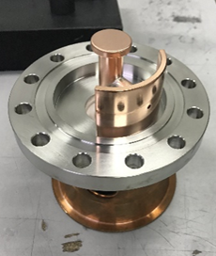
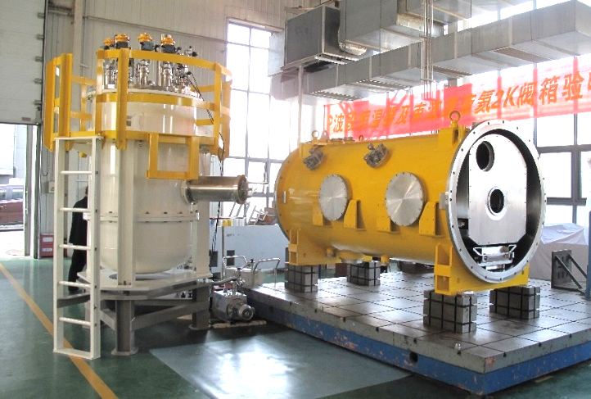
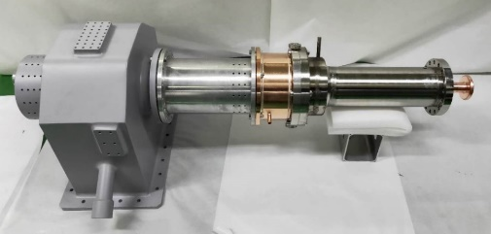
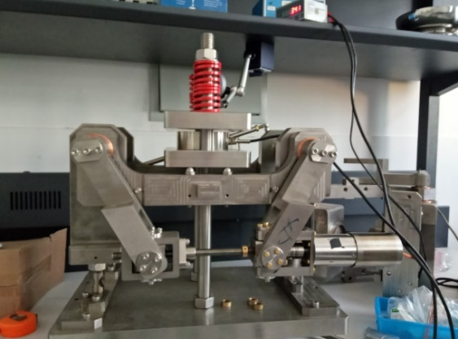
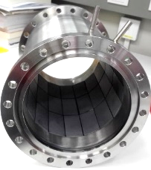
CEPC 650 MHz Test Cryomodule
A 650 MHz test cryomodule has been developed at IHEP, which included two 650 MHz 2-cell cavities, couplers, tuners...
Cavities dressed

Slide 16
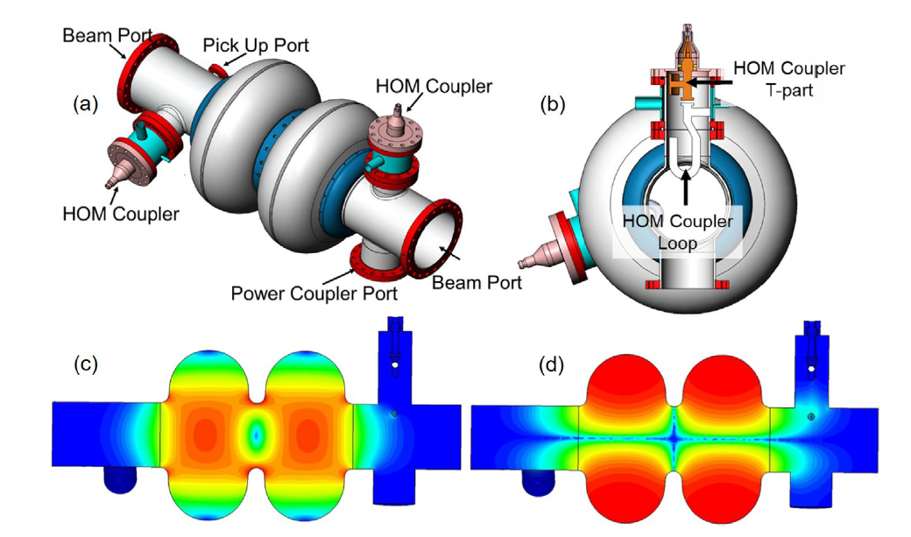
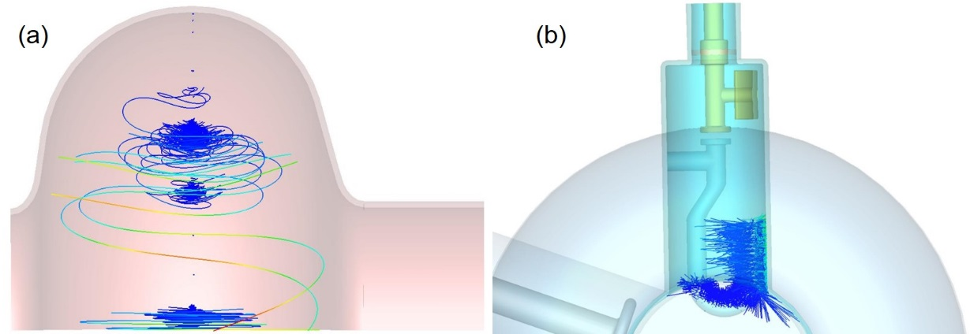
RF Design of 650 MHz 2-cell cavity
RF Parameter | Value | Unit
E_{peak}/E_{acc} | 2.35
B_{peak}/E_{acc} | 4.2 | mT/(MV/m)
R/Q | 211 | Ω
G | 279 | Ω
Cavity model with HOM couplers (a) and the profile from power coupler side (b) and the electric (c) and magnetic (d) field distribution
Multipacting occurs at the equator region for the cavity (a) and the loop-part for the HOM coupler (b).
Nuclear Science and Techniques 30, 155 (2019)

Slide 17
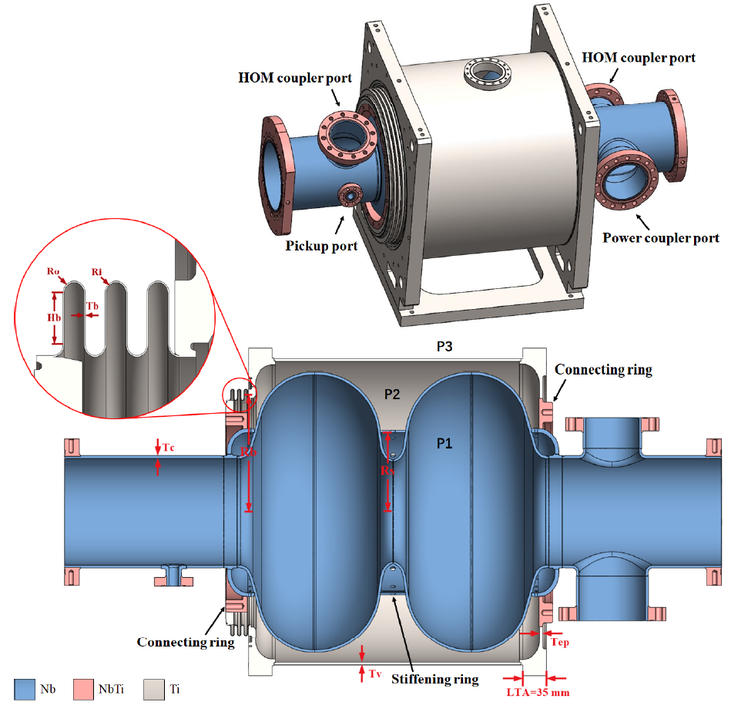
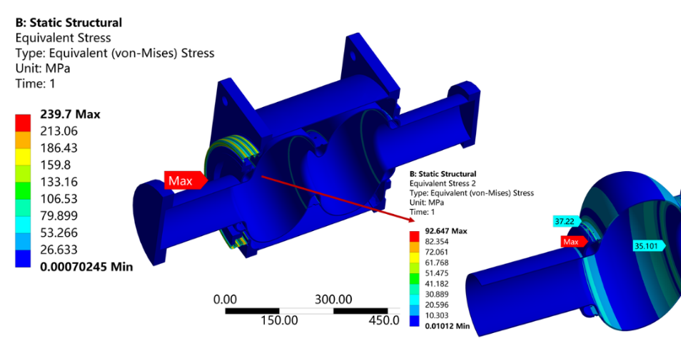
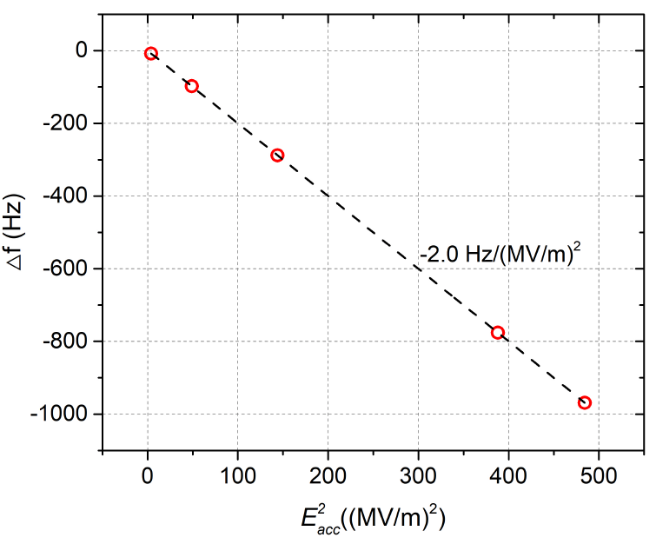
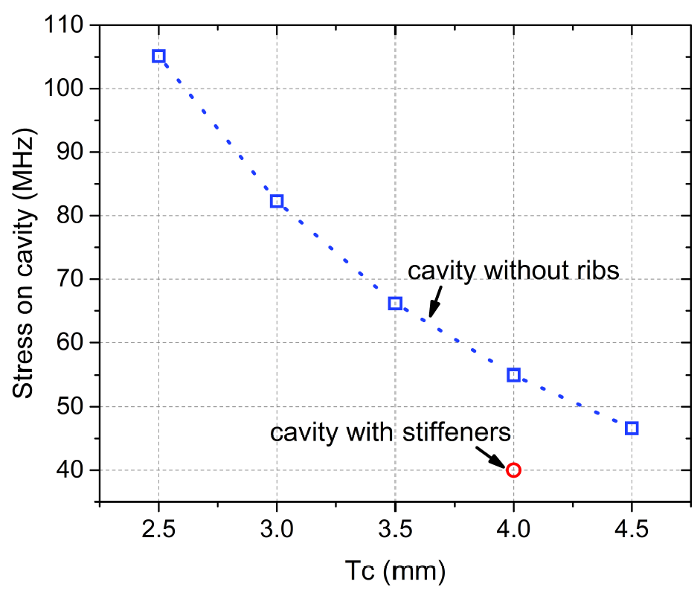
Mechanical design of 650 MHz 2-cell cavity
RF design
Mechanical model
The stress distribution of the dressed cavity
Nuclear Inst. and Methods in Physics Research, A 1031 (2022) 166590
Simulation of cavity wall thickness, 4 mm adopted
Lorentz force detuning

Slide 18
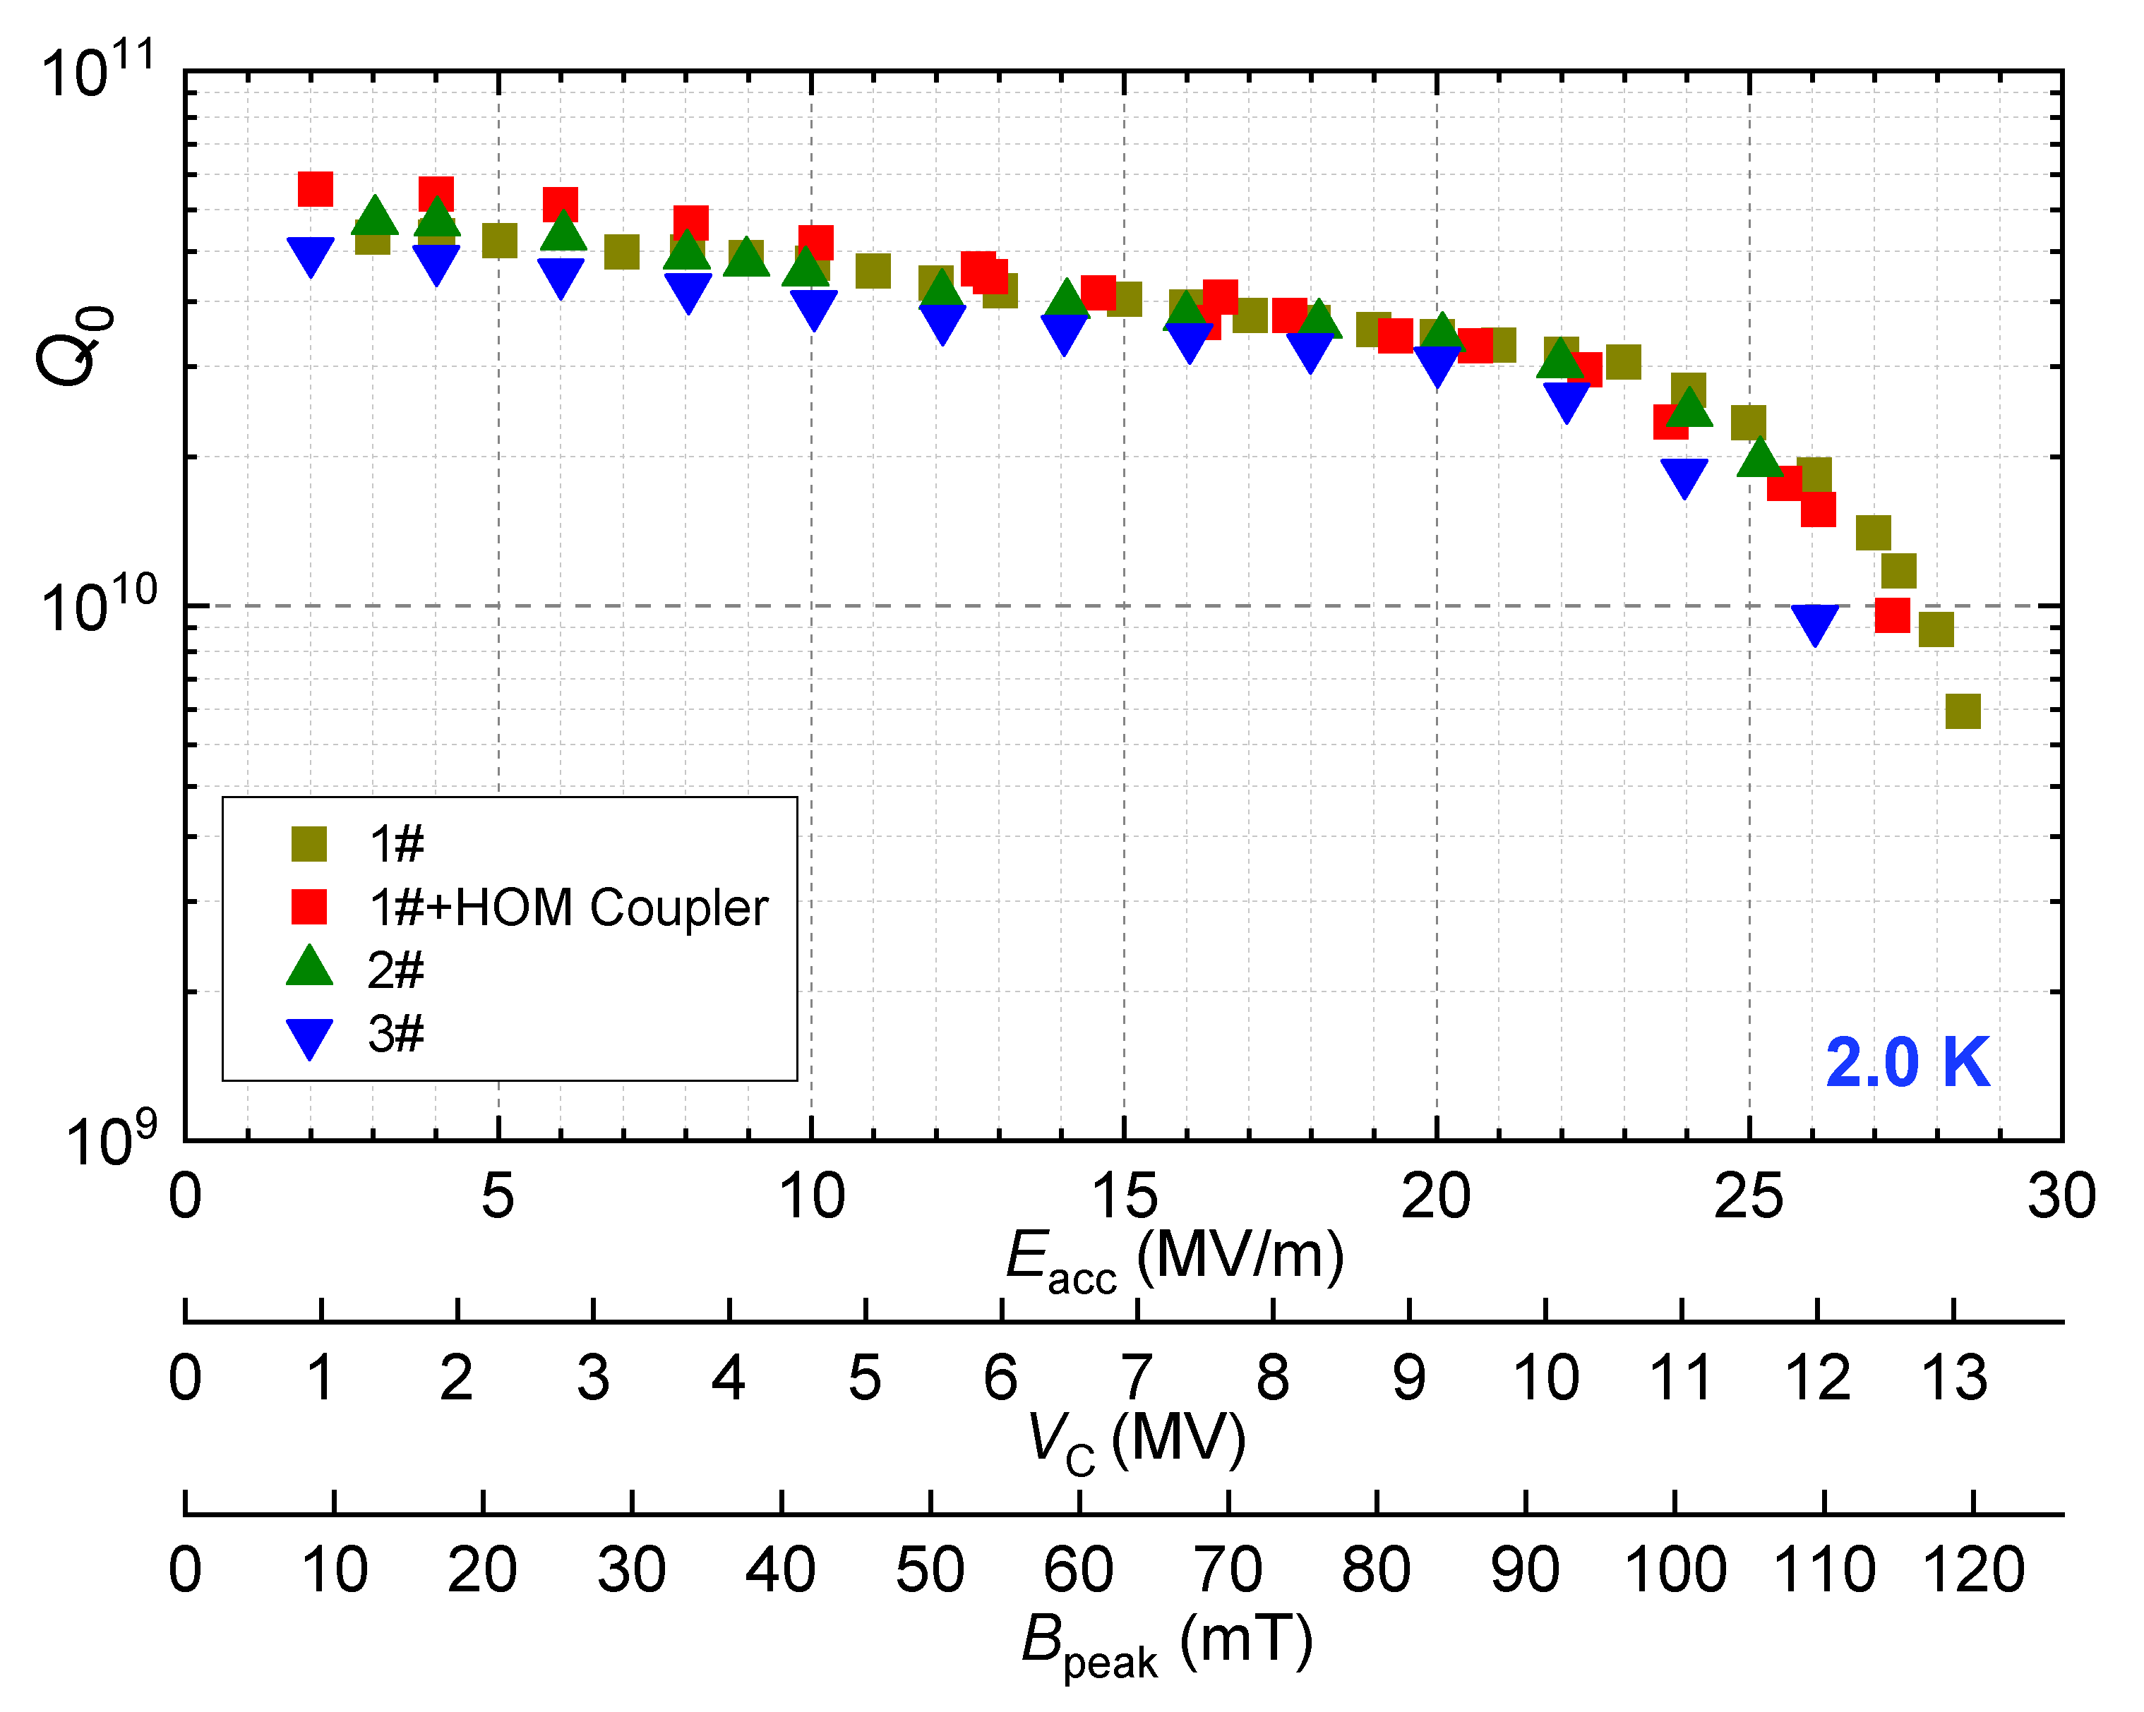
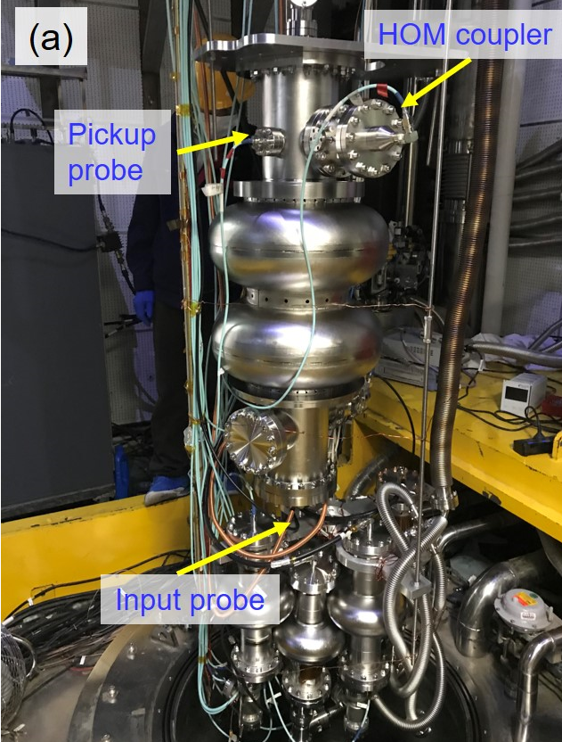
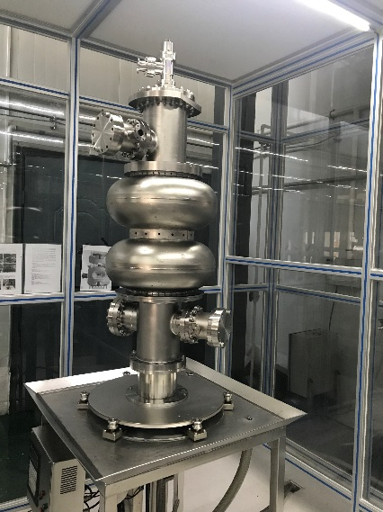
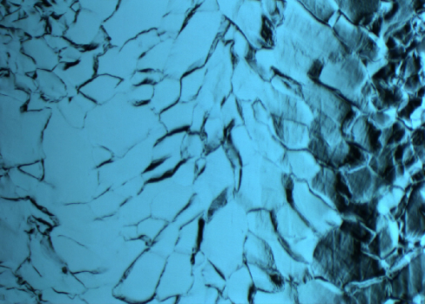
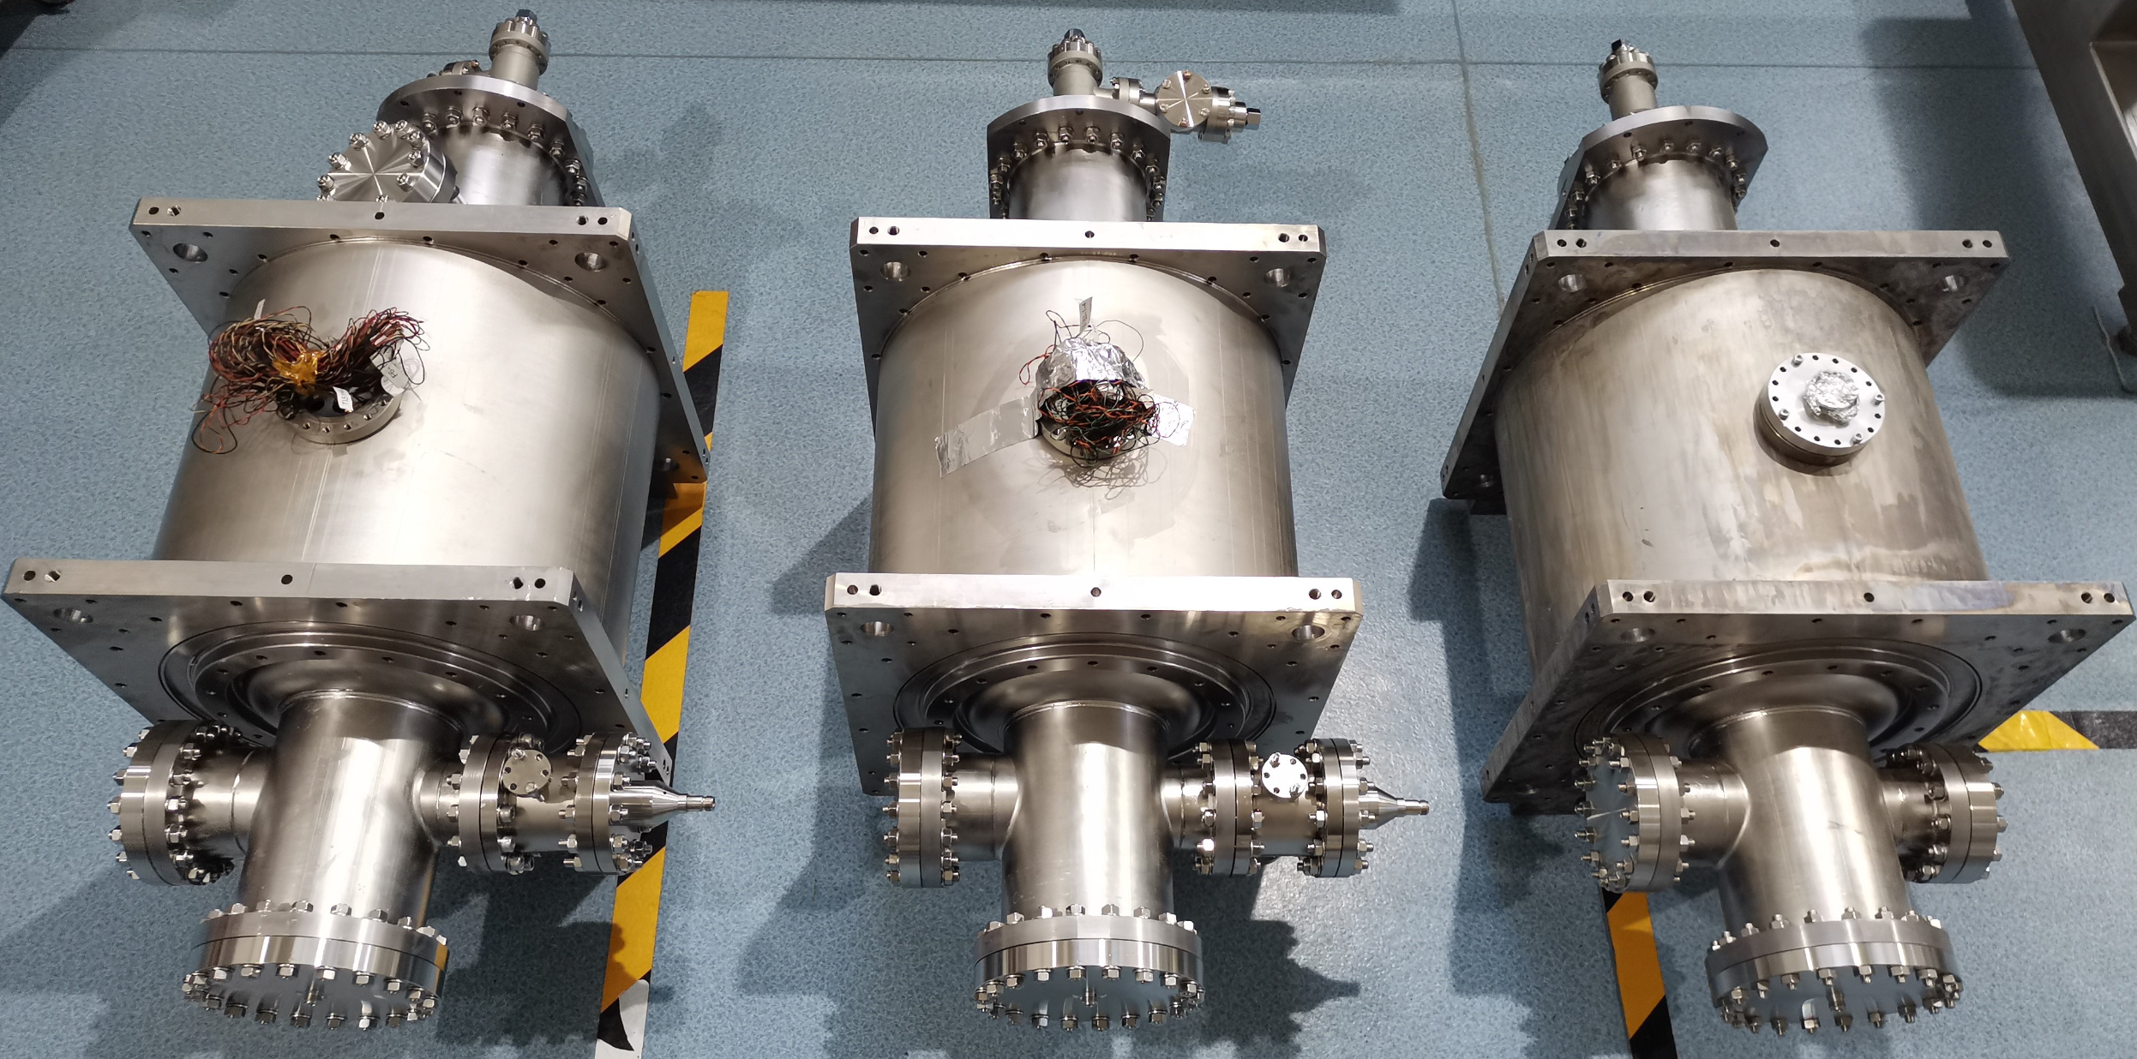
Surface process and vertical test
Three 650 MHz 2-cell cavities were fabricated, buffered chemical polished (BCP) and tested, which all exceeded 3E10@20MV/m.
28 MV/m
BCP
High-pressure rinse
Vertical test
Image of equator
Cavities dressed
Vertical test results
Nuclear Inst. and Methods in Physics Research, A 993 (2021) 165080

Slide 19
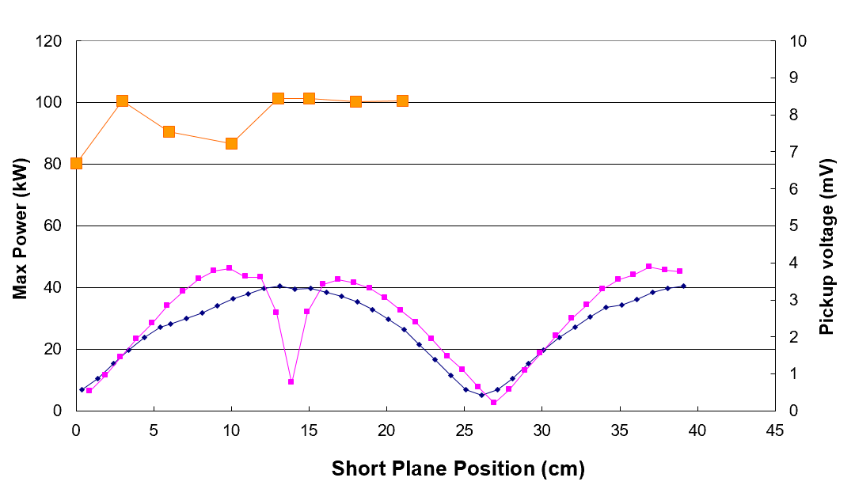
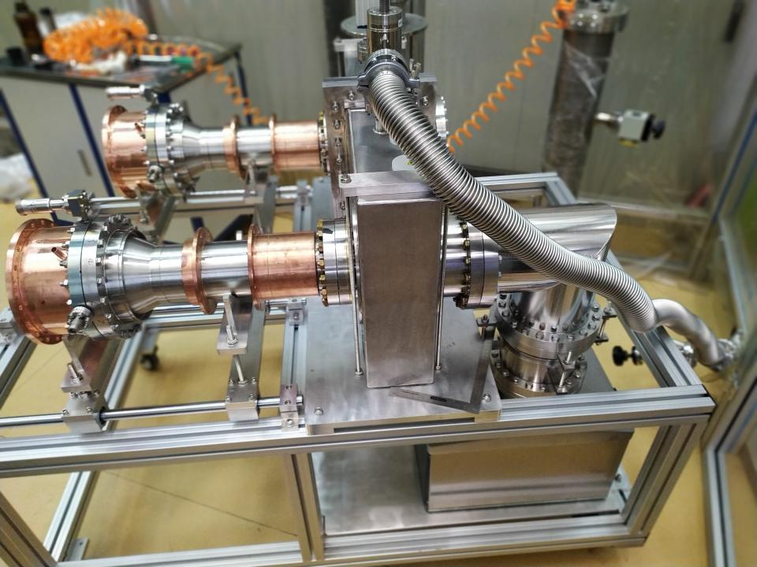
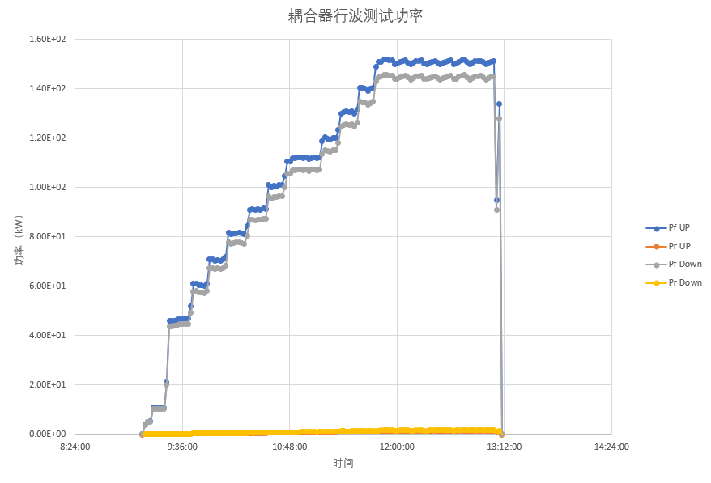
650 MHz fundamental power coupler
650 MHz fundamental power coupler tested to TW (travelling wave) 150 kW (SSA power limit), SW (standing wave) 100 kW (corresponding to 400 kW TW power at the window, exceeds CEPC spec). One of the world highest variable couplers.
Bellow on inner conductor. Inner conductor water cooling. Outer conductor He gas cooling.
TW high power test to 150 kW
Window SW field and power

Slide 20
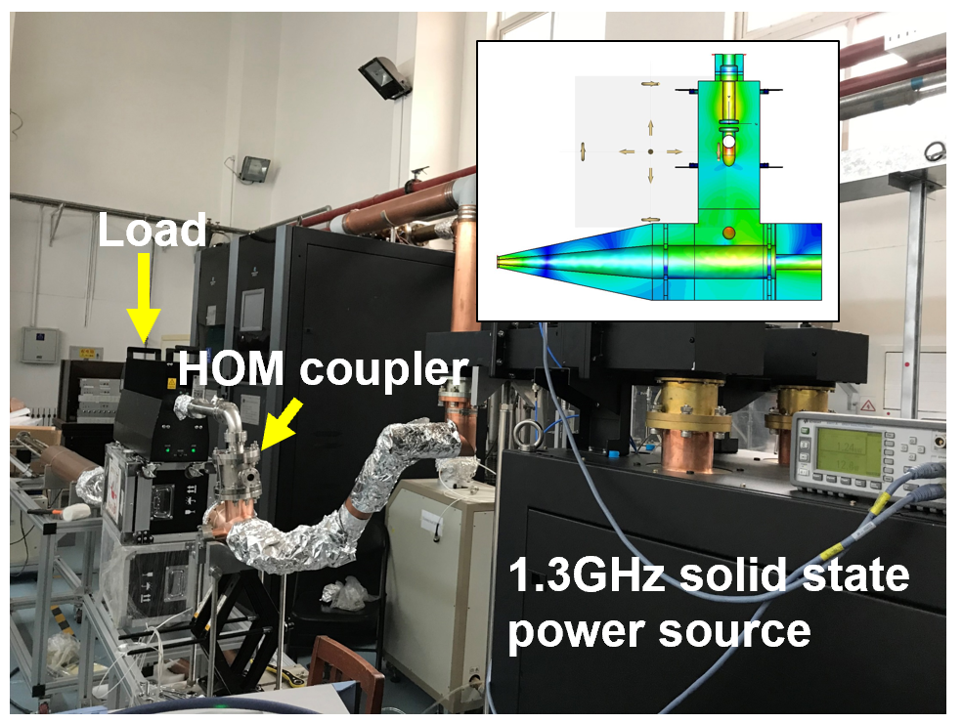
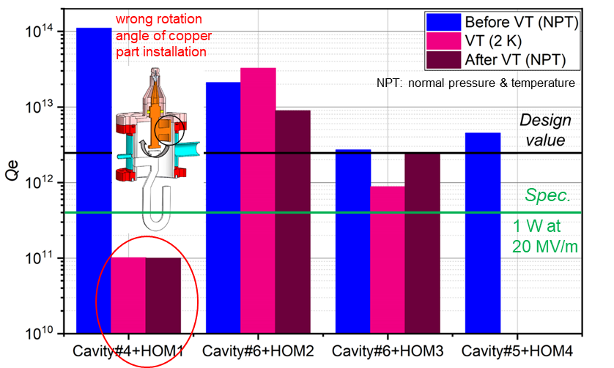
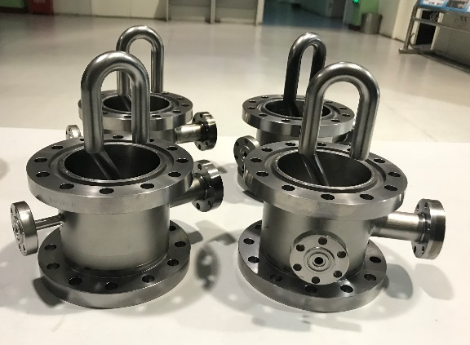
HOM coupler
1.3 kW during the high power test, exceeds CEPC spec (> 1 kW).
Fundamental mode rejecting Q_{e}: results before and after VT are repeatable if installed correctly. In the module: HOM1 6.8E13, HOM2 1.9E13. HOM3 2.1E12. No tuning needed.
High power test of HOM coupler
Nuclear Inst. and Methods in Physics Research, A 951 (2020) 163094

Slide 21
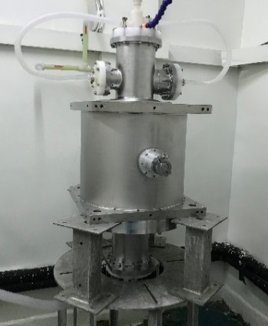
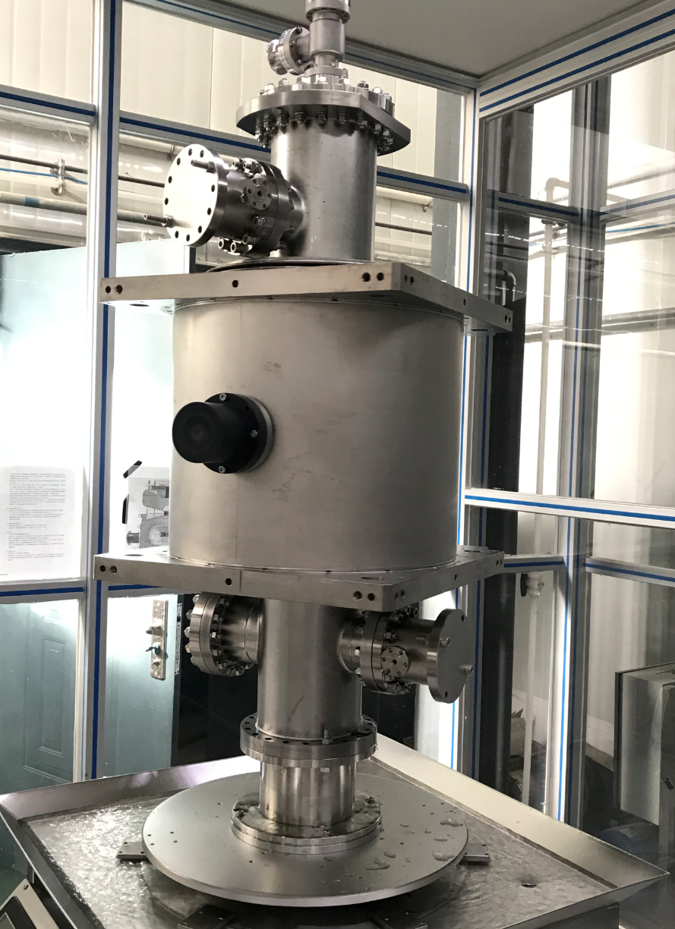
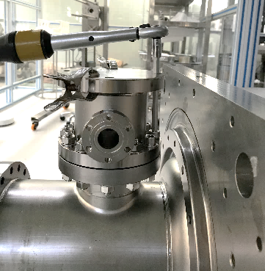
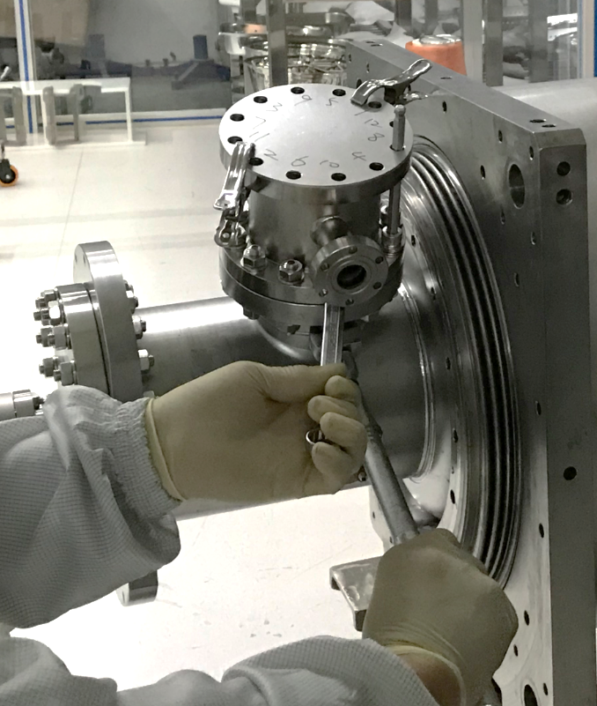
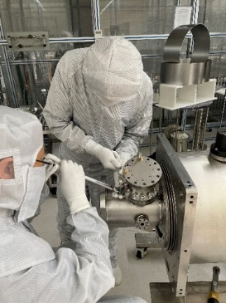
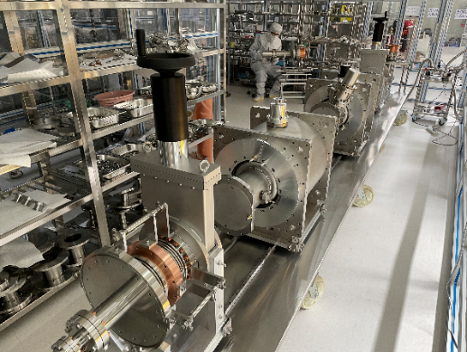
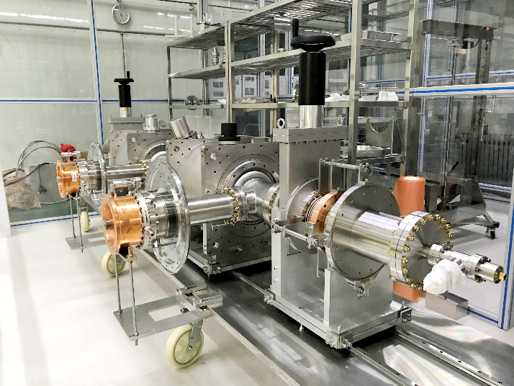
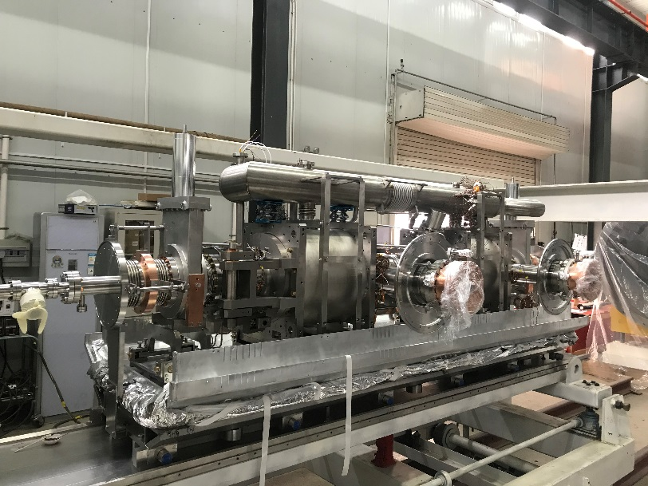
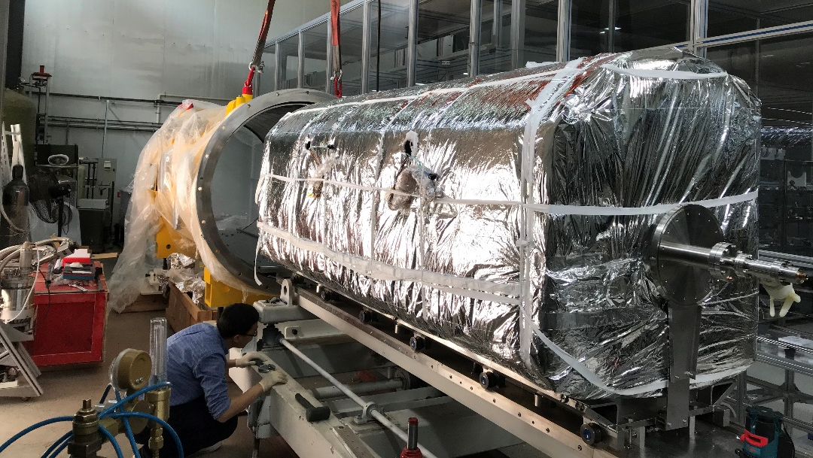
Assembly of cavity string

Slide 22
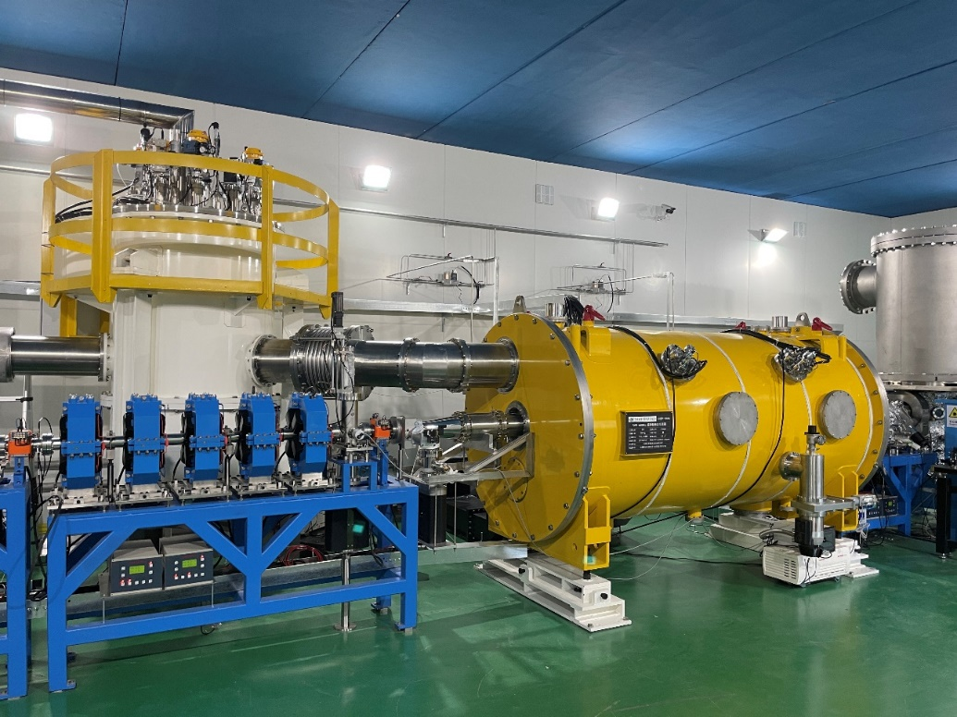
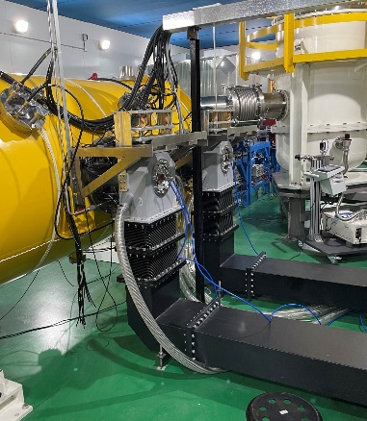
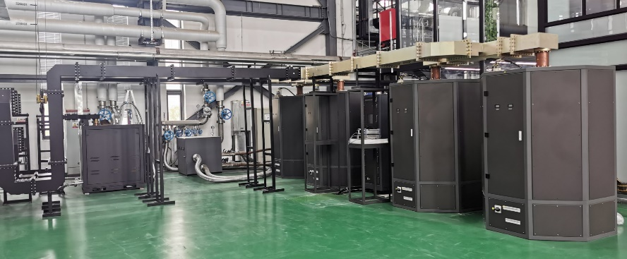
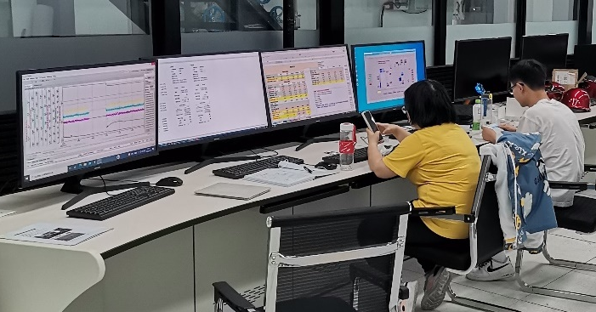
Cryogenic test
Cavity frequency, HOM coupler double notch filter, tuner, vacuum, cryogenics perform well.
2E10 @ 8 MV/m during horizontal test , which might be limited by the outer conductor helium gas cooling of the input coupler.
EDR R&D plan:
Solve coupler GHe cooling issue of the test cryomodule. Achieve 2E10@15 MV/m operation with beam.
Replace with high Q cavity and variable coupler. Demonstrate 3E10@25 MV/m in the test module.
Design, build and test a CEPC 650 MHz 6x2-cell cryomodule prototype and meet CEPC spec.

Slide 23
EP of 650 MHz 1-cell: High Eacc
The average removal at the equators (3, 4) is 71% of beam pipes (1, 6) during the conventional electro-polishing (EP) process (17.5 °C), while > 75% is perfect.
The average removal at the equators (3, 4) is 86% of beam pipes (1, 6) during the cold EP process (12 °C) .
More uniform removal achieved by cold EP.
EP of 650 MHz 1-cell cavity
Red arrows and numbers indicate the locations for thickness measurements
Surface removal of the conventional EP (17.5 °C)
Surface removal of the cold EP
(12 °C)
Nuclear Science and Techniques 33, 125 (2022)

Slide 24
High Eacc
2-step baking of 75 °C 4 h + 120 °C 48 h

Slide 25
Nitrogen doping: High Q
Nitrogen doping of 650 MHz
1-cell cavity: 3/60 + 10 um EP
IEEE Transactions on Applied Superconductivity, vol. 33, no. 9, 2024
Vacuum, temperature and RGA during nitrogen doping

Slide 26
Mid-T furnace baking: High Q
Mid-T furnace baking of 650 MHz
1-cell cavity: 300C 3h
Vacuum, temperature and RGA during mid-T furnace baking

Slide 27
Nitrogen doping VS mid-T baking
Compared with nitrogen doping, mid-T indicates higher Q.
Similar results were also obtained for 650 MHz cavities at FNAL.

Slide 28
1.3 GHz Cryomodule (Details: Feisi’s talk)
World’s first 1.3 GHz cryomodule with 8 mid-T (medium-temperature furnace bake) 9-cell cavities.
Mid-T bake has distinct advantages over N-doping. Will be used in CEPC and other SRF projects.
Parameters | IHEP Mid-T CM Horizontal Test | LCLS-II & HE Spec | CEPC Booster Higgs mode Spec
Avg. usable CW E_{acc} | > 23 MV/m | 2.7×10¹⁰ @ 16 & 20.8 MV/m | 3.0×10¹⁰ @ 21.8 MV/m
Avg. Q₀ @ 21 MV/m | 3.6×10¹⁰ |  | 3.0×10¹⁰
EDR R&D plan:
Build two more high Q 1.3 GHz modules to meet CEPC Higgs spec by supporting domestic FEL projects. Minimum statistics of mid-T module.
Design high current high Q ERL-type 1.3 GHz module for Z-pole. In synergy with ERL-FEL EUV project. (hope to collaborate with KEK)
130 MV operation: radiation＜0.08 mSv/h (spec 0.5 mSv/h), dark current < 1 nA

Slide 29
EDR and Future Plan for CEPC SRF
 | 2023 | 2024 | 2025 | 2026 | 2027 | 2028 | 2029 | 2030 | 2031 | 2032 | 2033 | 2034-2035 | 2036-2045 | 2046-2047 | 2048 | 2049-2053
EDR
Civil construction
Acc. construction & installation
Commission & operation |  |  |  |  |  |  |  |  |  |  |  |  | H | Z | W | ttbar
SRF system engineering design | Layout, cost, module, beam-cavity, LLRF, interfaces …
650 MHz test module (2x2-cell) | Beam operation, replace with high Q cav & variable coupler
650 MHz H module (6x2-cell) | Design | pCM fabrication |  | pCM test | Prepare | Production of 32 CM / 192 2-cell CAV for 30 MW H |  |  |  | Installation, Commissioning |  |  | Op & +24 CM | Operation | Op | Op
1.3 GHz H module | High Q module | Mass production of modules with SCM and BPM |  | pCM fabrication | pCM fab | pCM test | Production of 12 CM / 96 9-cell CAV |  |  | Installation, Commissioning |  |  | Operation
1.3 GHz Z module (high current) |  | Design and R&D |  |  | pCM fabrication |  | pCM test |  | Production of 4 CM / 32 9-cell CAV |  | Installation, Commissioning |  | Operation | Op
650 MHz HL-Z module | Conceptual design. 500 MHz high current module production. |  |  |  | Design and R&D |  |  |  |  |  |  | Produce and Install 60+40 1-cell CM | Production | Op
ttbar cavity and module | Design and R&D of high gradient high Q and new material (Nb3Sn etc.) 650 MHz and 1.3 GHz cavities and module for ttbar |  |  |  |  | High G & Q and new material cavities for ttbar Design and R&D |  |  | pCM fabrication and test |  |  |  | Production and Installation of 48 CM / 192 650 MHz 5-cell CAV 32 CM / 256 1.3 GHz 9-cell CAV |  |  | Op
30-year plan. CEPC EDR, construction, installation, commission, operation and upgrade. Push SRF technology frontiers in high gradient, high Q, high current, high power and new material in synergy with storage ring light sources, FELs and other SRF projects in China and the world.

Slide 30
SRF System Risks and New Ideas
Input coupler: Matching and coupling adjusting range: key issue of a green accelerator, same as klystron efficiency. Most critical RF part: high power, low heat load, high reliability, long lifetime. If fails, input power reduction, cavity number and cost increases, extra RF power, cavity contamination, RF trips...
RF voltage operation margin, standby cavities and power sources
Preventing and mitigating cavity Q₀ degradation, as well as enough margin of cryogenics capacity
Power overhead for Z-pole mode LLRF control
LLRF control of multi-cavity fed by one klystron
New material (thin film e.g. Nb3Sn) (collaborate with PKU, IMP, KEK and other labs)
Multi-cavity high current cryomodule (collaborate with CERN), HOM coupler and mode propagation
RF power transfer from H to Z to have less klystrons? Waveguide loss, group delay.
Add 1.3 GHz 9-cell cavities instead of 650 MHz 5-cell cavities for ttbar collider ring?

Slide 31
The new SRF facility (1)
A new SRF facility has recently been developed at Platform of Advanced Photon Source Technology R&D (PAPS), which is just close to the High Energy Photon Source (HEPS).
This new SRF facility, which is well equipped, can fulfil the requirements of SRF for CEPC.

Slide 32
The new SRF facility (2)
Duration: 2017~2021
Area: 4500 m²
Capacity: 200 SRF cavities / year (post process, cryogenic test and integration, etc). CEPC needs 1012 SRF cavities in total (H/W/Z/ttbar), which can be completed in ~5 years.

Slide 33
The new SRF facility (3)
RF power source: solid state amplifier (162.5/325/500/650 MHz, 1.3 GHz)
Clean room
Horizontal test stand
Low-level RF
Vertical test stand

Slide 34
The new SRF facility (4)
Vacuum furnace: Nitrogen doping, annealing, baking
Pre-tuning of 1.3 GHz 9-cell cavity
Optical inspection
Vertical test Dewar
Electro-polishing
Pure water system
Furnace for Nb3Sn coating
Vertical test of SRF cavities

Slide 35
The new SRF facility (5)
Facilities (capability per year) | Devices | Tests since 2021 | Related Projects
VT stand (400 cavities) | 166 MHz / 325 MHz / 500 MHz / 650 MHz / 1.3 GHz CAV | ~ 160 | HEPS/BEPCII-U/CEPC/CSNS-II/SHINE/DALS/HALF/(CiADS)
HT stand (20 modules, including assembly) | 1.3 GHz CAV | ~ 20 | CEPC/SHINE/DALS/HEPS/(BEPCII-U/CSNS-II)
High power test stand (200 couplers) | Coupler / Circulator / RF load / Copper cavity | ~ 20 | HEPS/SHINE/DALS/CSNS-II/(HALF)
Clean assembly and HPR | 166MHz / 325MHz / 500MHz / 650MHz / 1.3 GHz CAV | ~ 160 | HEPS/CEPC/CSNS-II/SHINE/DALS/BEPCII-U/(HALF)
Vacuum furnace | 650 MHz / 1.3 GHz CAV | ~ 50 | CEPC/CSNS-II/SHINE/DALS
Notes:
（2页PPT）梳理本行政组在相关方向已经掌握的技术能力，进行陈述；明确列出本行政组的技术实力在国内加速器界、国外加速器界所处的水平

Slide 36
Summary
CEPC TDR SRF system layout and parameters are designed to meet physics run requirement (Higgs first, upgradable, low cost for first-stage, mode-switching) by RF staging and bypass with different SRF systems and by exploiting the most advanced technology.
During the five-year TDR phase, major SRF components and cryomodules developed with domestic industries reached good performances, but not all ready for construction.
EDR phase work planned for SRF system design optimization, components R&D and yield study, full-scale module prototyping and mass production preparation toward the construction stage.
We will continue to gain SRF experience by supporting other SRF projects in China.
We hope to collaborate with PKU, CERN (FCC-ee), KEK, INFN, DESY, JLAB and other labs in the SRF system design and technology development for the next high-energy lepton collider to be realized soon.

Slide 37
Z-pole Operation with Higgs 2-cell Cavities
The HOM power limit per cavity and the fast-growing coupled-bunch instabilities (CBI) driven by both fundamental modes (FM) and higher-order modes (HOM) impedance of the RF cavities will determine to a large extent the highest beam current and luminosity obtainable in the Z mode.
Using Higgs 2-cell cavities, Z mode can only operate at low luminosity and low power (up to about 10 MW SR power per beam).
The low luminosity Z mode will use 48 cavities per ring and park the other 48 cavities in the ring.
However, the beam will go through all the 96 cavities and interact with the cavity impedance. Therefore, the parking cavities will be kept at 2 K to extract the HOM power.
They will be symmetrically detuned to cancel FM impedance and adjust the variable input coupler to high loaded Q with a narrow bandwidth to avoid FM CBI.

Slide 38
High Current 650 MHz Cavity for HL-Z mode
For high luminosity Z, i.e., 30 and 50 MW SR per beam, 30 and 50 KEKB / BEPCII type high current SRF-cavity cryomodules for each ring will be chosen as the baseline due to their excellent HOM damping.
The high current beam will bypass the Higgs / $t\overline{t}$ cavities. The cryomodule will have only one 1-cell cavity inside with HOM absorbers at room temperature.
The cavity number is a balance between the input power and the stored energy per cavity for the sake of FM CBI and transient beam loading. Fewer cavities and cell numbers are preferred to have high stored energy and low impedance. The counter-phasing operation method (originated at KEKB) could be used to further increase the cavity stored energy.
A multi-1-cell-cavity cryomodule with deep HOM damping (CERN LHC type) will be developed as an alternative.

Slide 39
High Current 650 MHz Cavity for HL-Z mode
Based on the successful construction and stable operation of BEPCII 500 MHz cavity system. Small batch production for HEPS, BEPCII-U and HALF (~ 4).
Higher gradient (x3, 18 MV/m) and Q (x20, 2E10), 2 K operation
Higher input power (x10, 1 MW per cavity, two couplers and two 600 kW klystrons as alternative).
Deep HOM damping.

