Slide 1
High Q 1.3 GHz Cryomodule Development
Jiyuan Zhai (IHEP)
11th IHEP-KEK SCRF Collaboration Meeting
IHEP, Beijing, China, 20 November 2023

Slide 2
Outline
Introduction
Cryomodule assembly
Cryomodule horizontal test
Summary

Slide 3
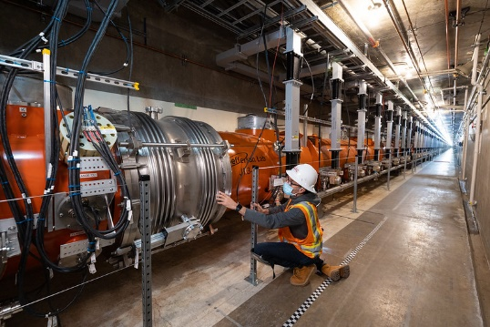
Introduction
1.3 GHz superconducting cavity and cryomodule are the core technology of many large scientific facilities under construction and planning in China and the world.
IHEP is developing 1.3 GHz high Q cavity and cryomodule for high repetition rate FEL (SHINE , DALS and S3FEL) and future collider (CEPC), which affects the machine cost and cryogenic power consumption.
FEL：
Europe XFEL（100 cryomodules, operation）
USA LCLS-II（39 CMs, operation ）
USA LCLS-II-HE（23 CMs, construction）
China SHINE（75 CMs, construction ）
China S³FEL（26 CMs, approved）
China DALS（R&D）
High energy particle collider ：
CEPC (356 9-cell cavities, R&D)
ILC (8000+8000 cavities, R&D）
1.3 GHz 9-cell superconducting cryomodules of LCLS-II

Slide 4
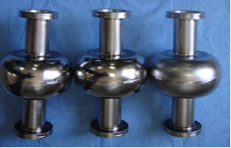
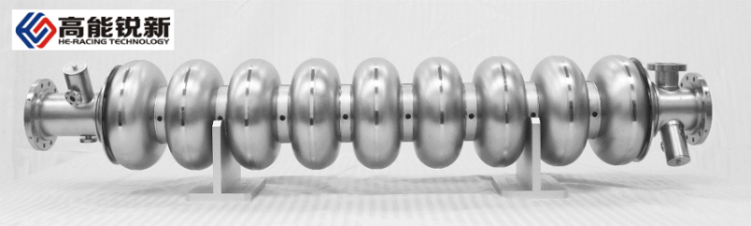

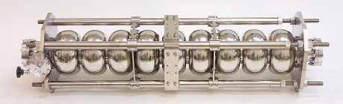
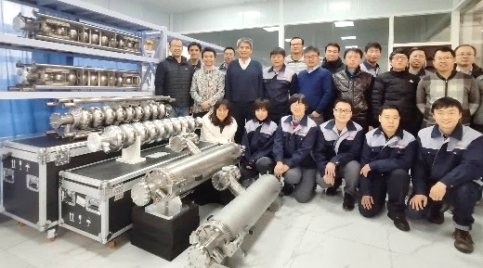
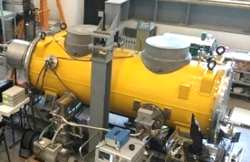
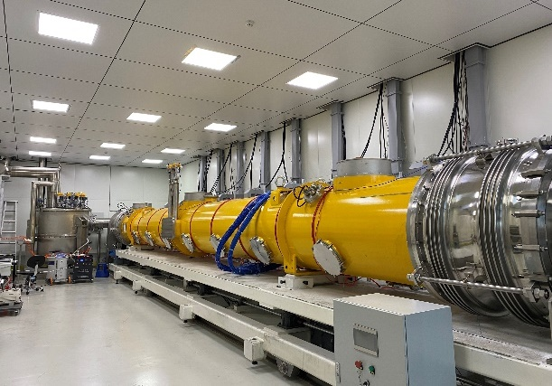
History of 1.3 GHz SRF R&D at IHEP
2005-2015
2016-2020
2021-2025
2026-2035
Early research,
Technology R&D
Technology transfer,
Performance breakthrough
Cavity mass production,
Cryomodule prototyping
Cavity and cryomodule mass production
Engage in these projects:
SHINE (600 CAV, 75 CM）
S³FEL (208 CAV, 26 CM）
Other CW and pulsed FELs
CEPC booster (352 cavities)
ILC (8000+8000 cavities)
…
High Q high gradient and new material R&D
88 9-cell cavities
by HERT
1-cell and 9-cell cavities
ILC test cryomodule
Collaboration with KEK (single cells R&D, three 9-cell cavities testing, training young people), FNAL, JLAB, DESY …
HERT 11 TESLA 9-cell cavities
EP 9-cell 36 MV/m (reach ILC spec)
Mid-T 5E10@21 MV/m (world record)
4 BCP + 4 mid-T high Q cavities delivered to SHINE
EP collaboration with KEK
1.3 GHz mid-T high Q module

Slide 5
Mid-T Bake Technology Development
Pioneering work on mid-T bake of Fermilab and KEK
  Fermilab: in-situ mid-T bake of assembled cavity [S. Posen, SRF19 MOP043 (Jul. 2019), PHYSICAL REVIEW APPLIED 13, 014024 (2020) ]. Developed initially for quantum applications to remove Nb₂O₅ layer, enabling high Q at mK and low photon counts.
  KEK: regular furnace mid-T bake of unassembled cavity [K. Umemori, TTC meeting at CERN, Feb. 2020; H. Ito, et al, Prog. Theor. Exp. Phys. 2021, 071G01]. Simplified the implementation of mid-T bake. High Q preserved after HPR.
IHEP mid-T furnace bake R&D on 9-cell cavities and cryomodule
  Further simplified furnace mid-T bake procedure and successfully applied it for the first time to 1.3 GHz 9-cell cavities in Oct. 2020 [F. He, et al, Superconductor Science and Technology, 34 (2021) 095005].
  14 mid-T 9-cell cavities have been tested (2020-2022). Eight of them assembled into a cryomodule and achieved world leading high gradient and world record high Q in June 2023.
  JLAB, DESY and SARI (SHINE) successfully followed up on mid-T bake cavities with further studies.
Notes:
On Monday, we heard about Mid-T bake studies for SHINE. Here we’re seeing some of the work done by the team at IHEP on mid-T baking. They have very nice results on both 650 MHz cavities and 1.3 GHz 9-cell cavities. You can see a Q of 6.4e10 at 30 MV/m and performance on 9-cells that substantially exceed requirements for various relevant machines.

Slide 6
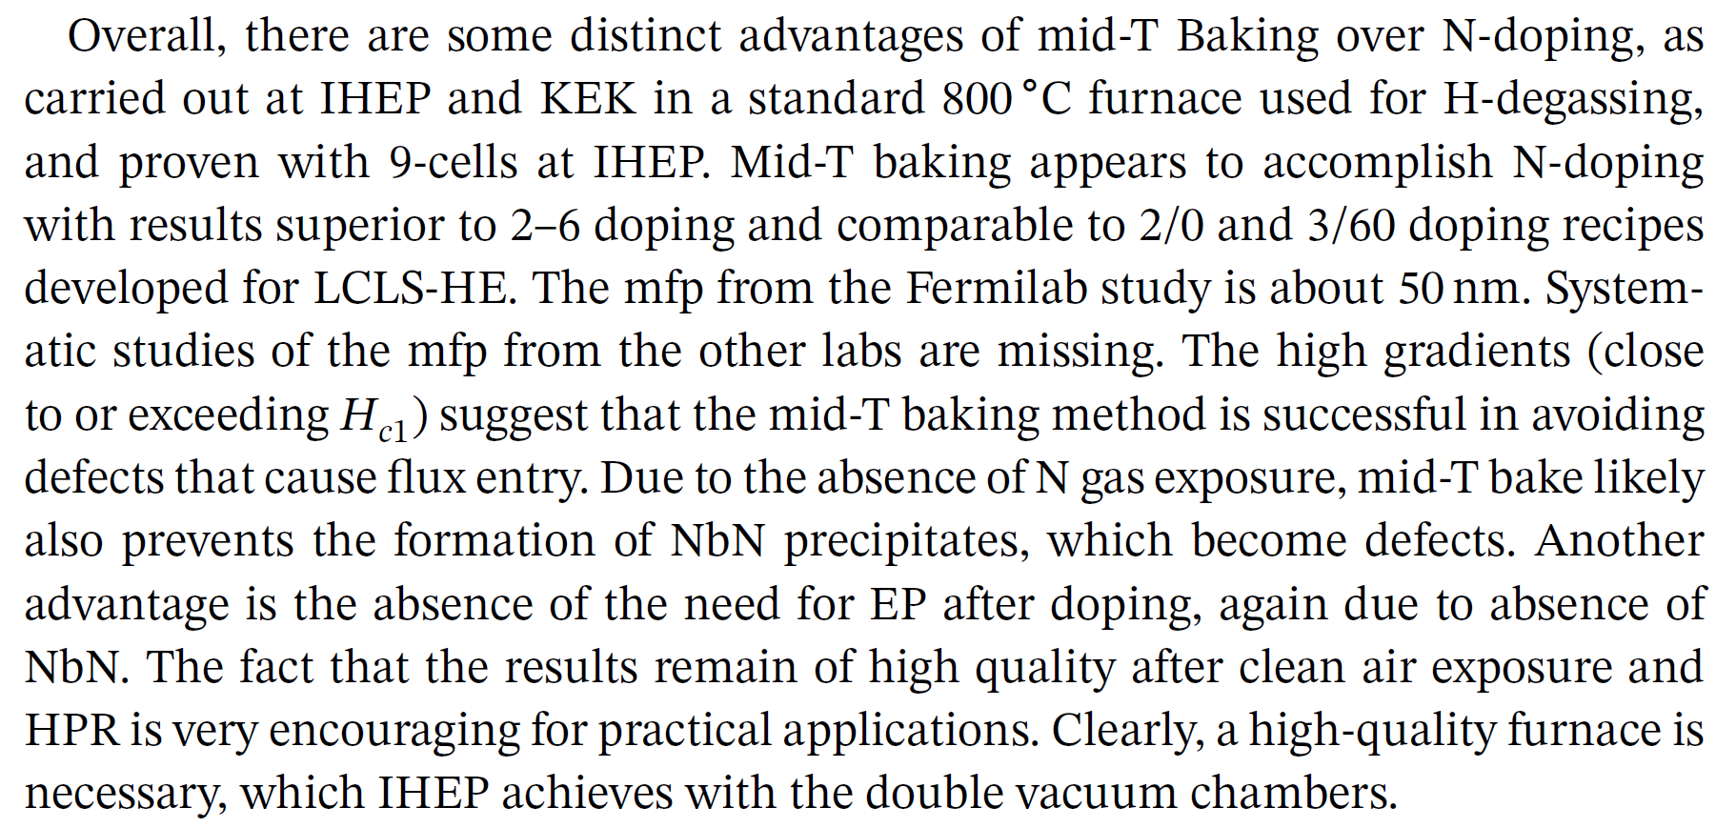
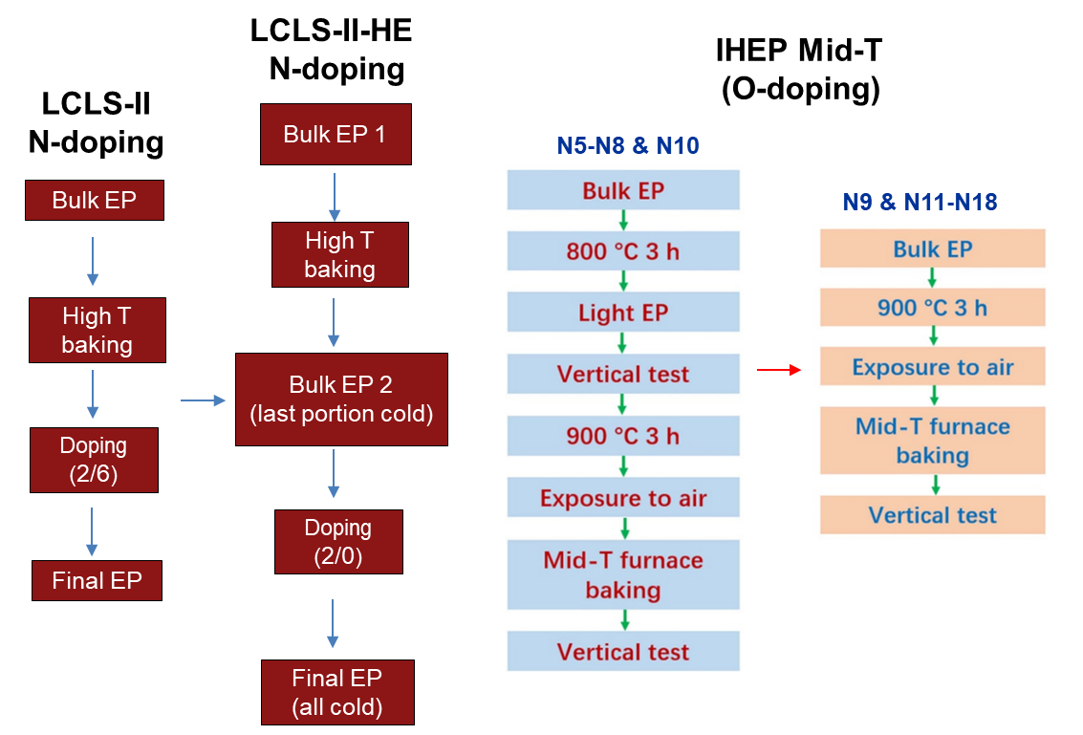
Mid-T Furnace Bake Advantages and Application
  In Hasan Padamsee’s new SRF book [Superconducting Radiofrequency Technology for Accelerators: State of the Art and Emerging Trends, Wiley, 2023], Chapter 4 is focused on mid-T bake. He pointed out the distinct advantages of Mid-T bake over Nitrogen-doping:
IHEP’s mid-T recipe: 1 EP vs 3 EPs of N-doping, stable and reliable (100 % yield of 9-cell cavities).
Fermilab has decided to use mid-T furnace bake for 36 PIP-II 650 MHz β=0.61 5-cell cavities in 2023.
SHINE, CEPC, CW upgrade of Euro-XFEL and other projects are also considering to use mid-T furnace bake for large number of cavities.

Slide 7
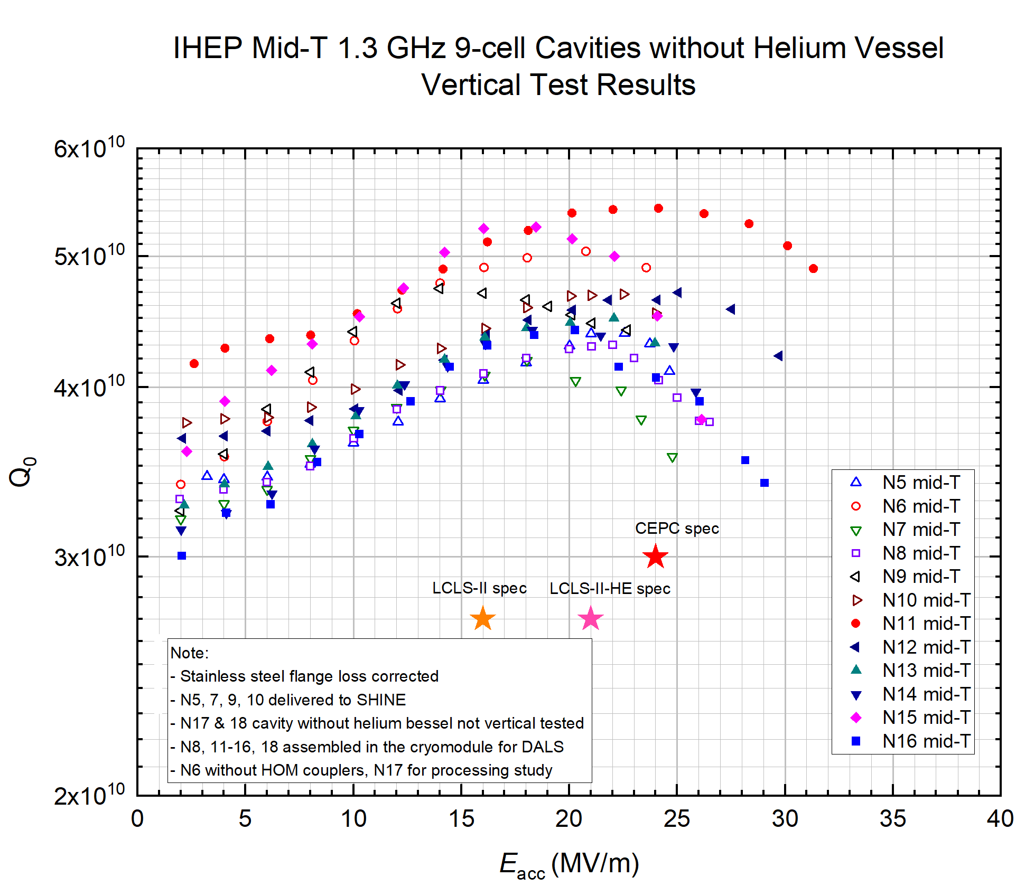
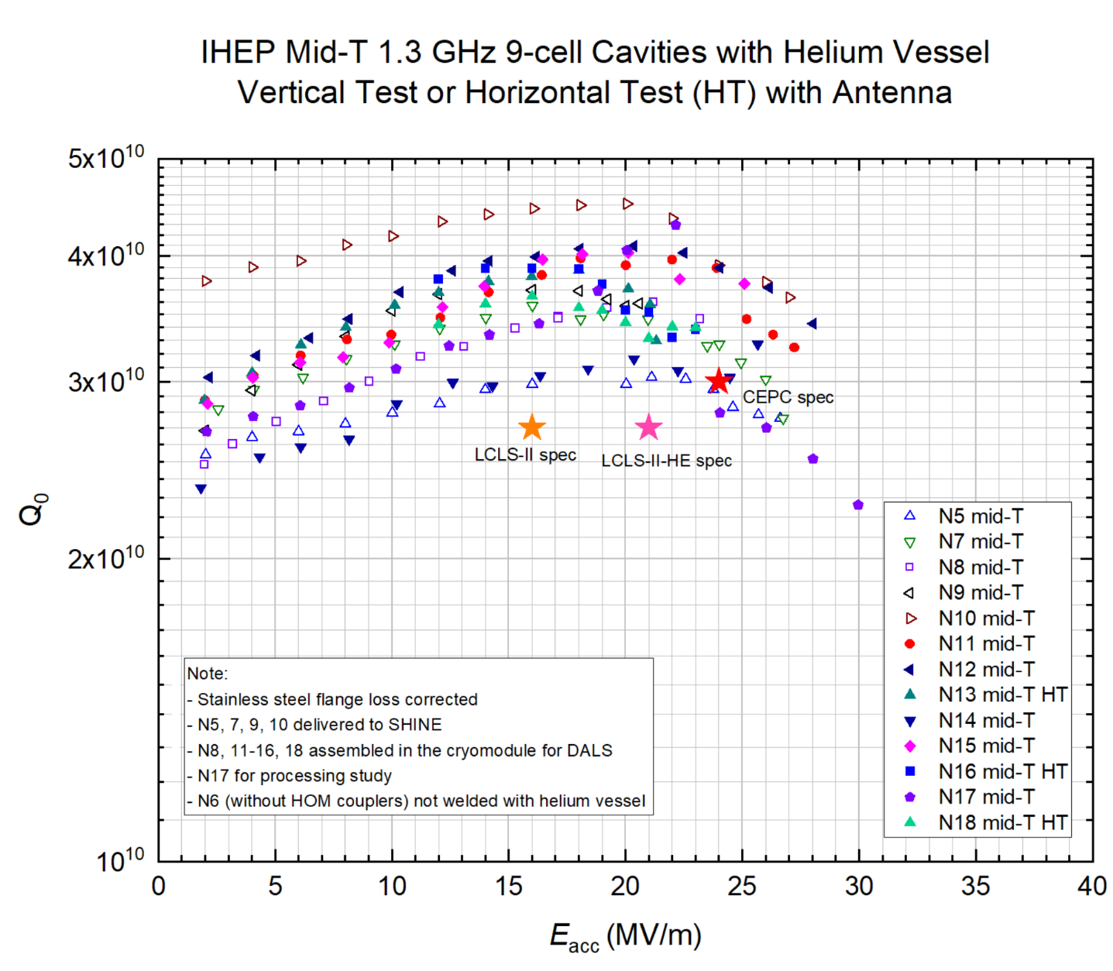
Vertical Test Results of Mid-T Bake 9-cell Cavities at IHEP
Average Q₀ 4.5E10 at 16~21 MV/m of 12 mid-T 9-cell cavities. Q₀ corrected for stainless steel flange loss (0.8 nΩ) in order to compare with module test results directly.
Due to tight schedule, no time to warm-up and cool down some of the jacketed cavities to recover the degraded Q₀ after quench or with not-optimized fast cool down.

Slide 8
Outline
Introduction
Cryomodule assembly
Cryomodule horizontal test
Summary

Slide 9
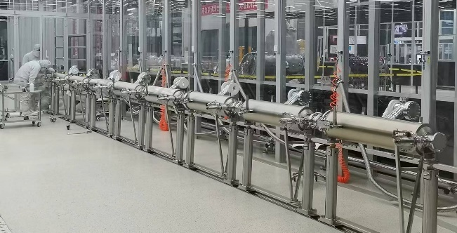
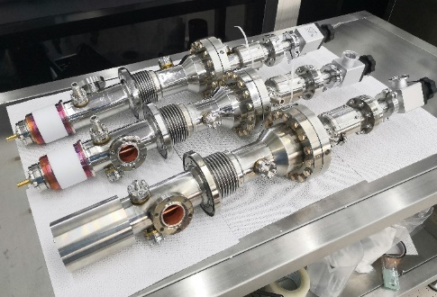
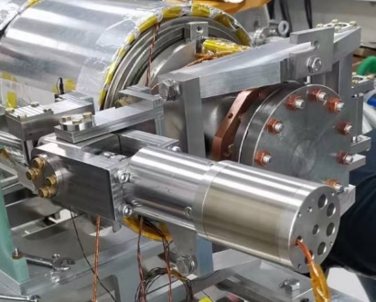
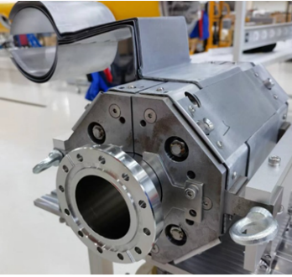
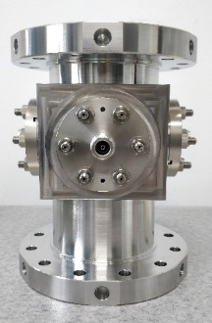
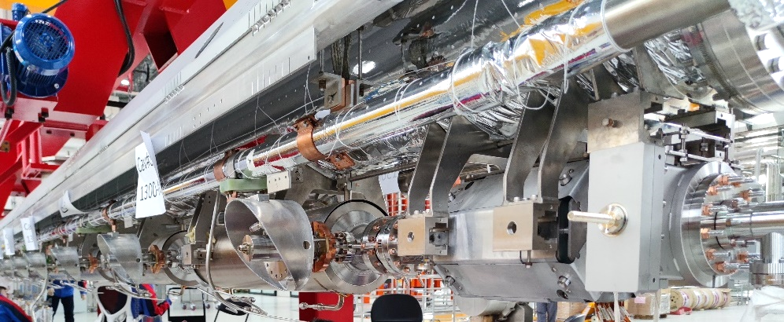
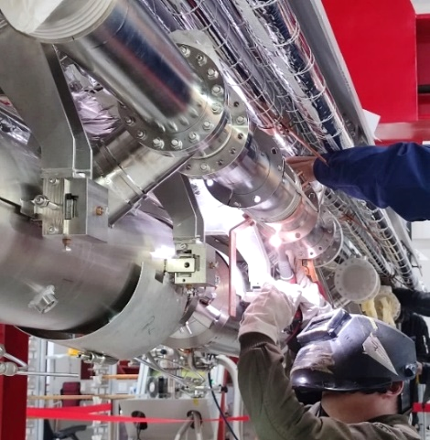
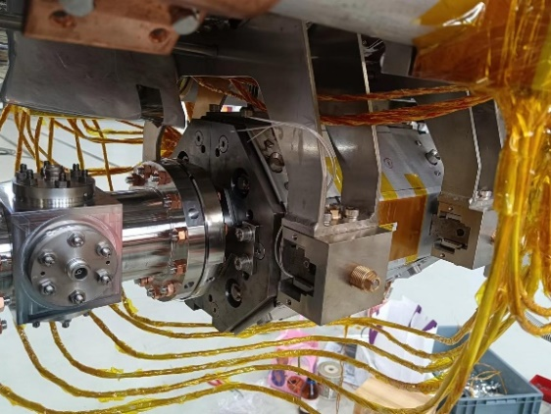
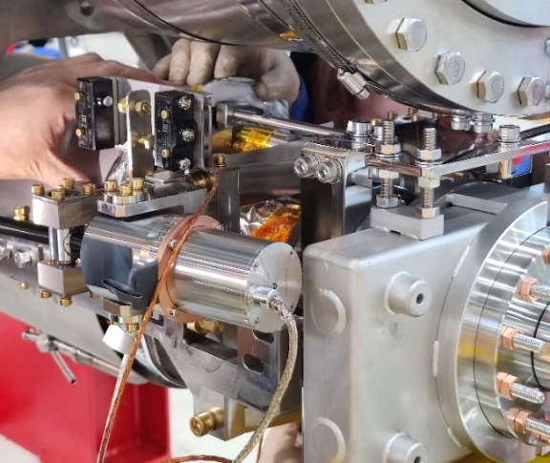
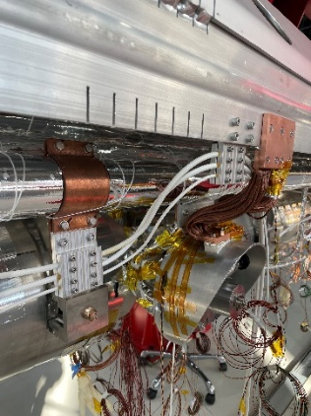
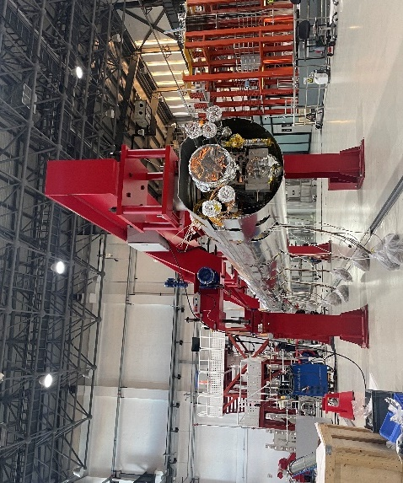
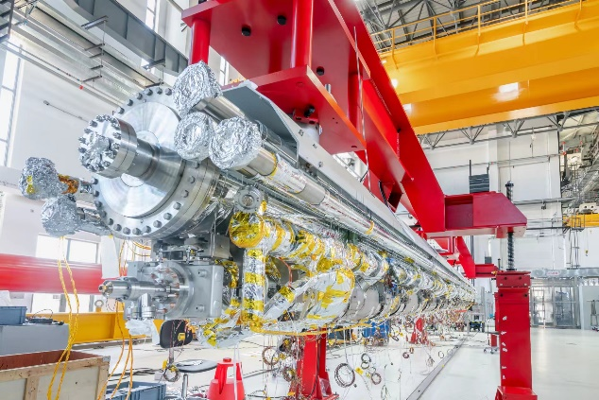
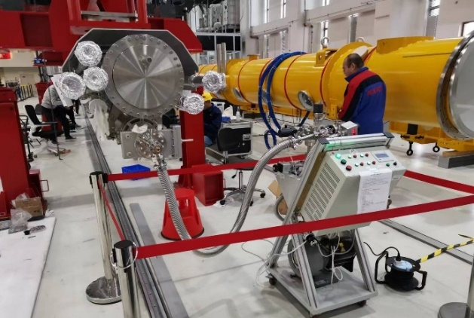
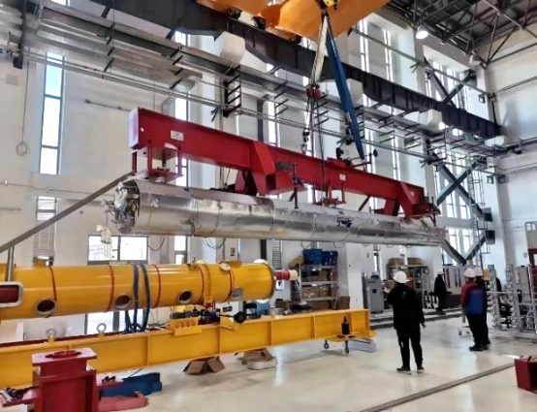
Cryomodule Assembly
First assembly: October 31, 2022 - January 13, 2023
Second assembly: March 31 - May 14, 2023

Slide 10
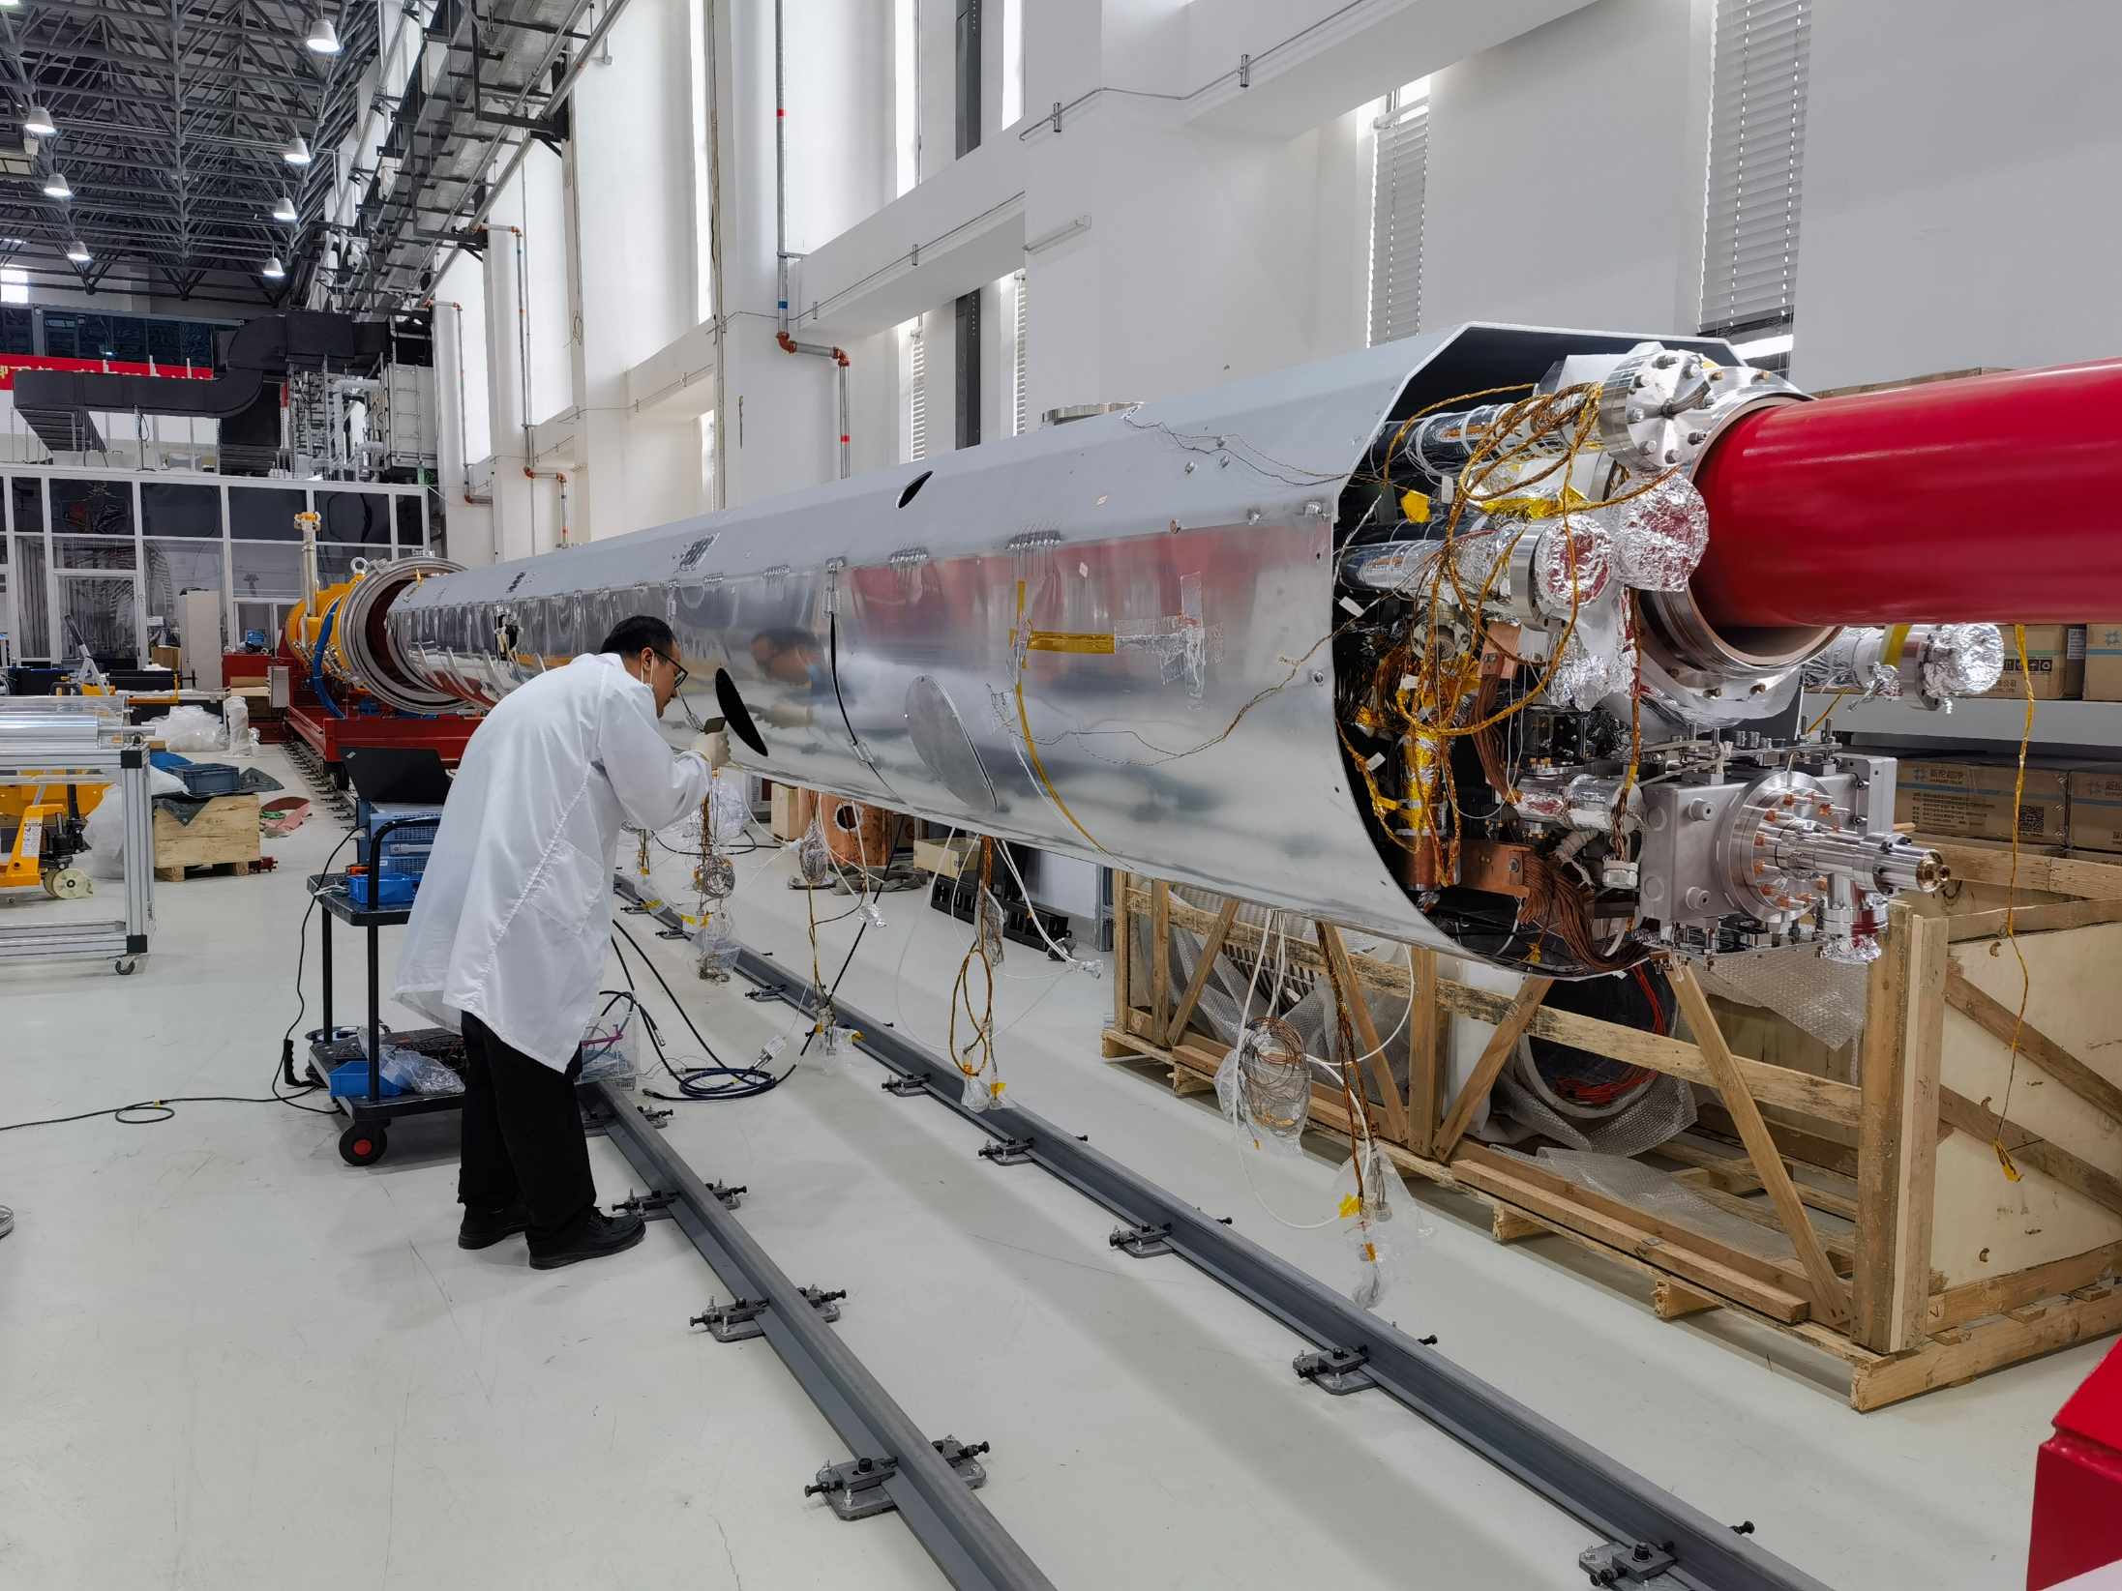
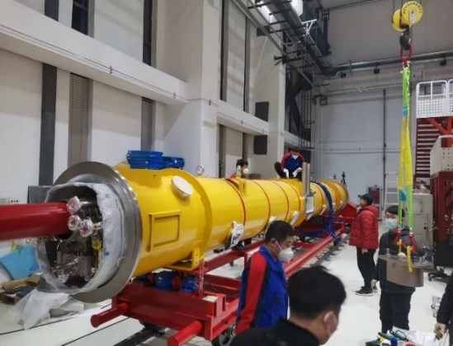
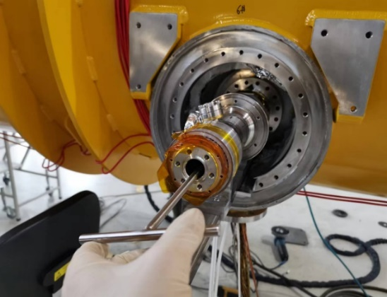
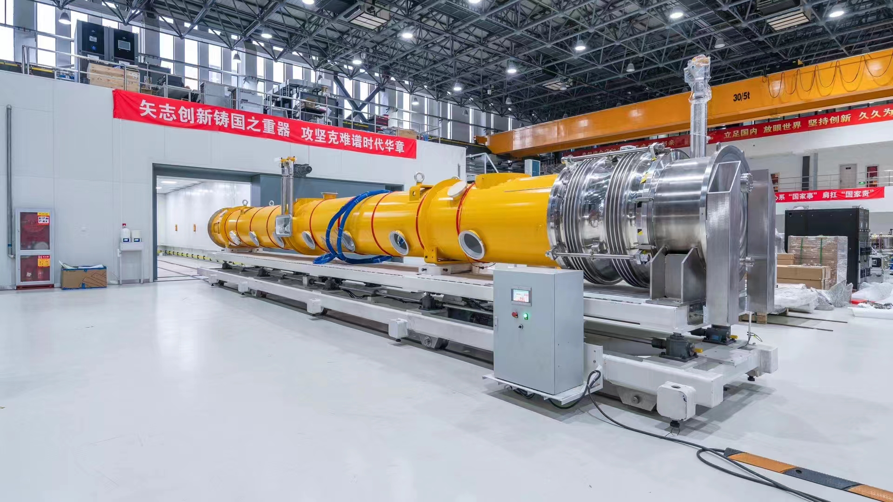
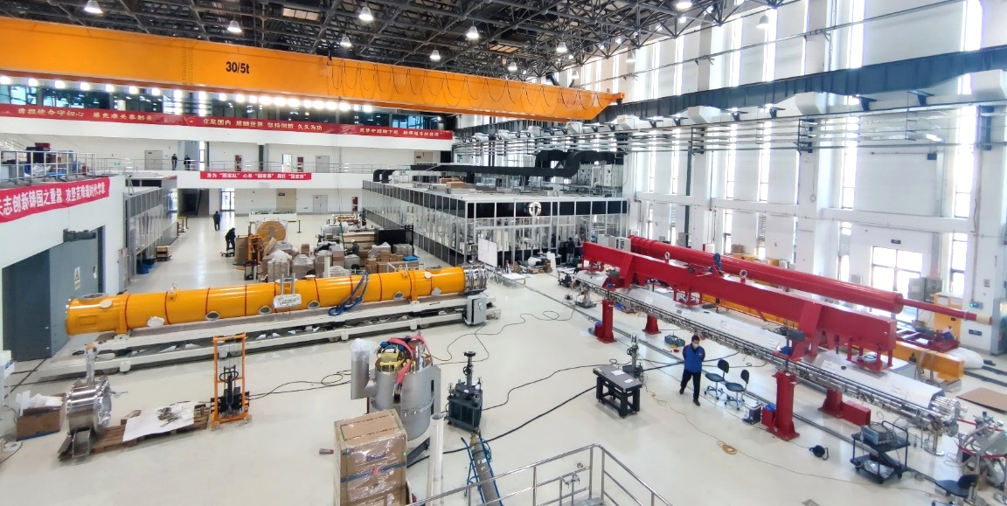
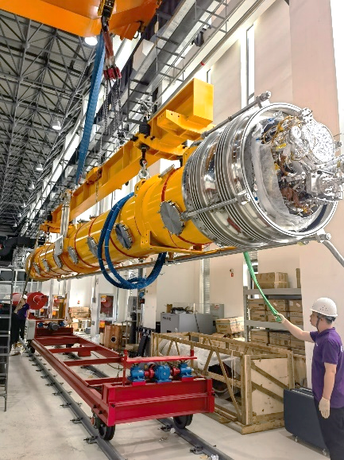
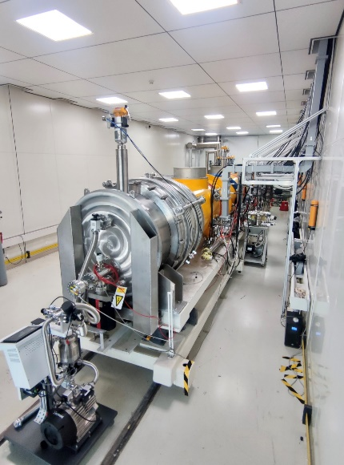
Cryomodule Assembly

Slide 11
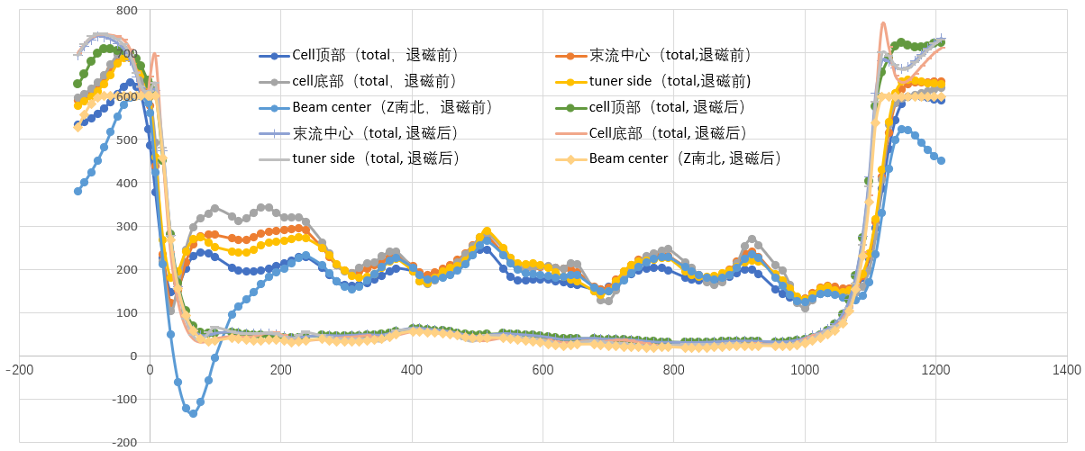
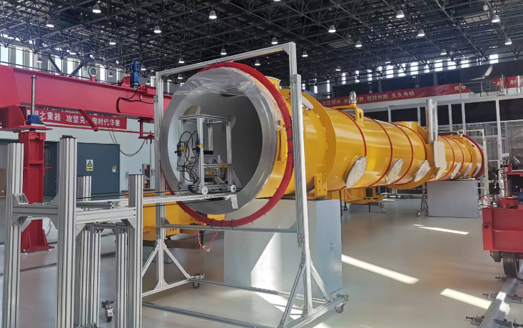
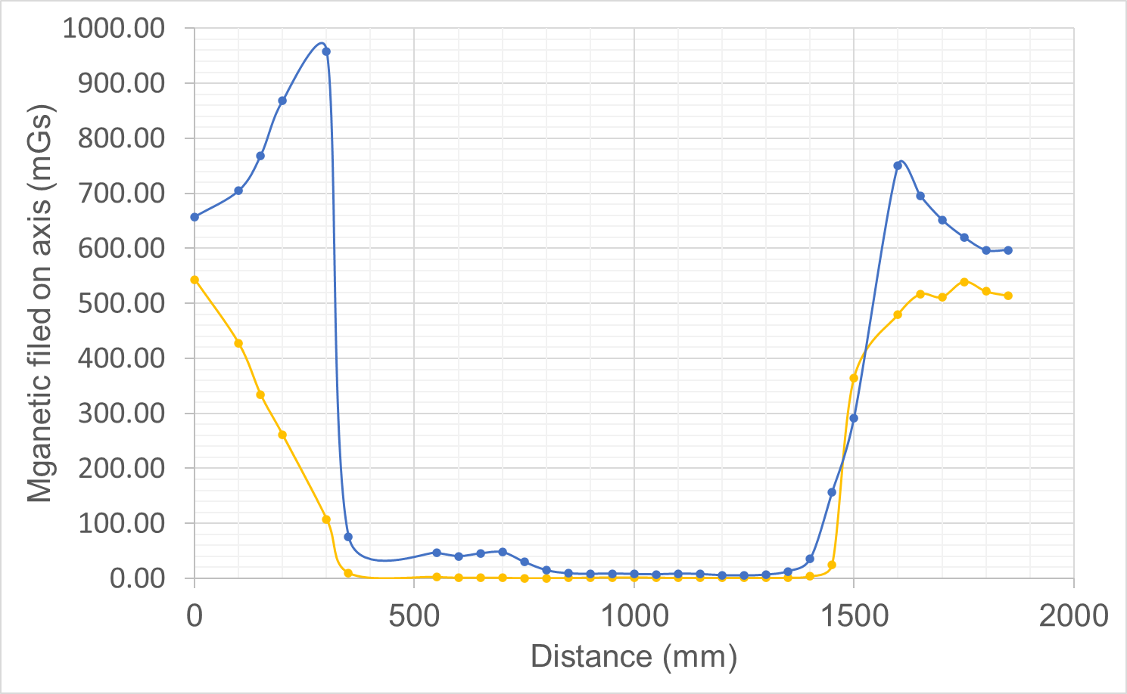
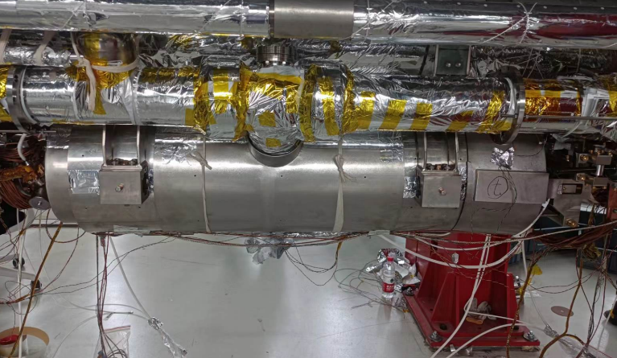
Magnetic Field Control
Vacuum vessel degaussing
Measured in 500 mGs earth magnetic environment (50 mGs inside cryomodule vacuum vessel)
Average field:
East-west: 2.2 mGs
North-south: 26.1 mGs
North-south
East-west
Cavity cells: 350 - 1400 mm
Double-layer magnetic shield

Slide 12
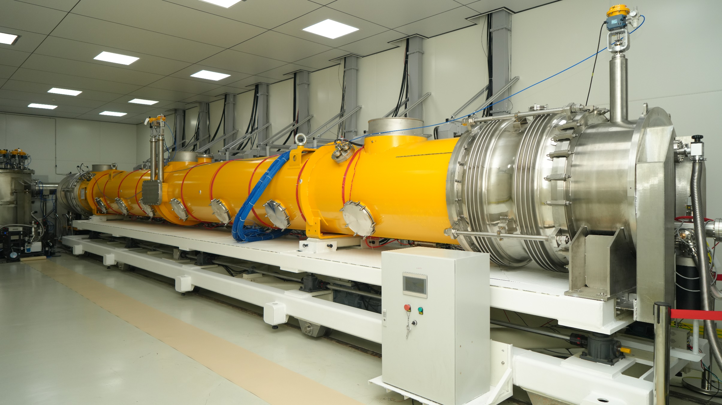
World’s First Mid-T 1.3 GHz Cryomodule

Slide 13
Outline
Introduction
Cryomodule assembly
Cryomodule horizontal test
Summary

Slide 14
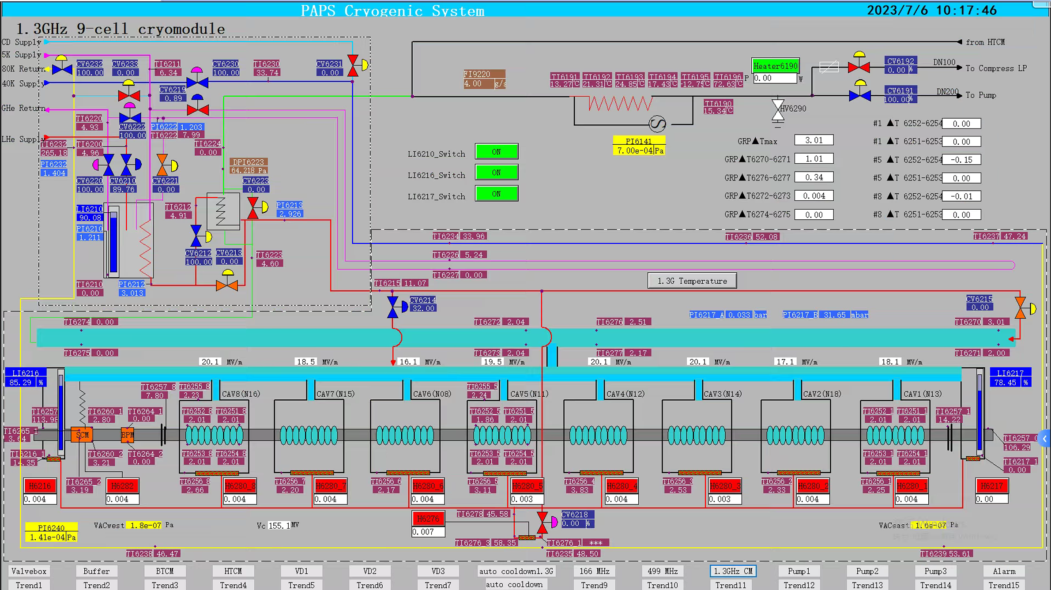
Cryomodule Cooldown

Slide 15
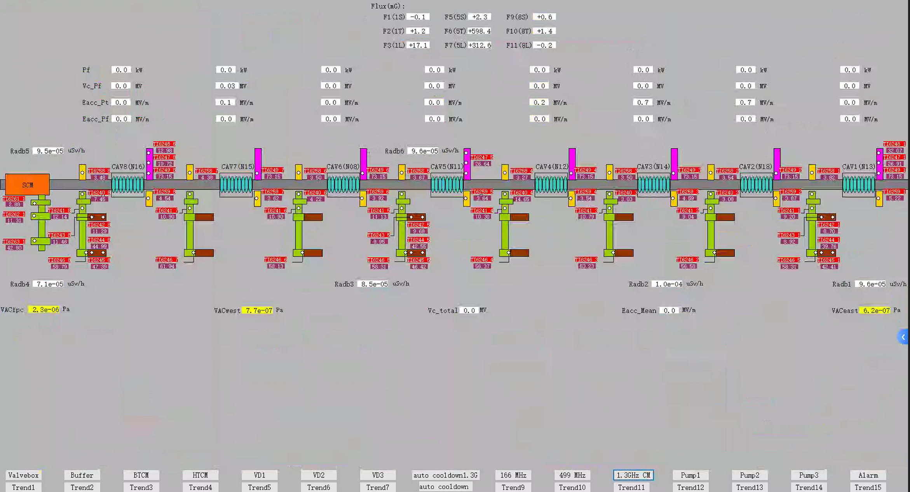
Cryomodule Cooldown
Instrumentation: 9 flux gates, 143 temperature sensors, 6 radiation detectors…
Monitor overheating of the HOM coupler caused by poor thermal conduction.
Able to calculate heat load of the input coupler at 2 K, 5 K and 40-70 K.

Slide 16
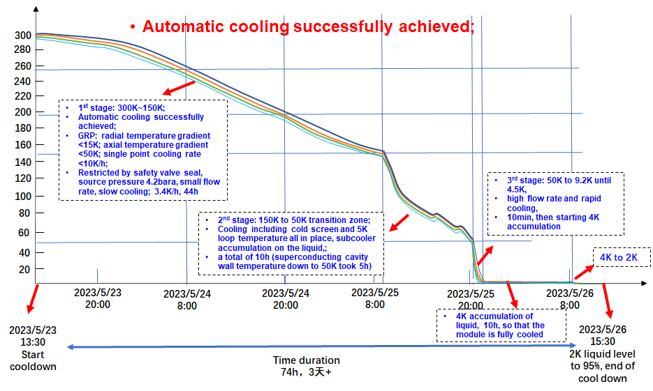
Cryomodule Cooldown

Slide 17
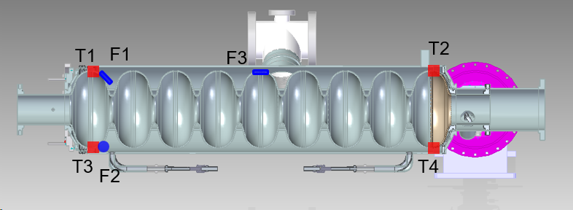
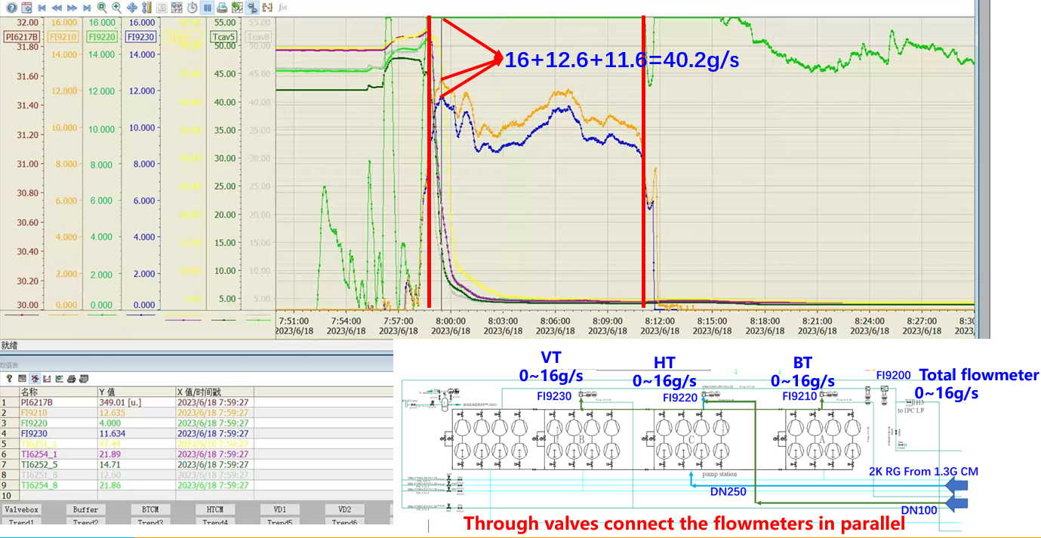
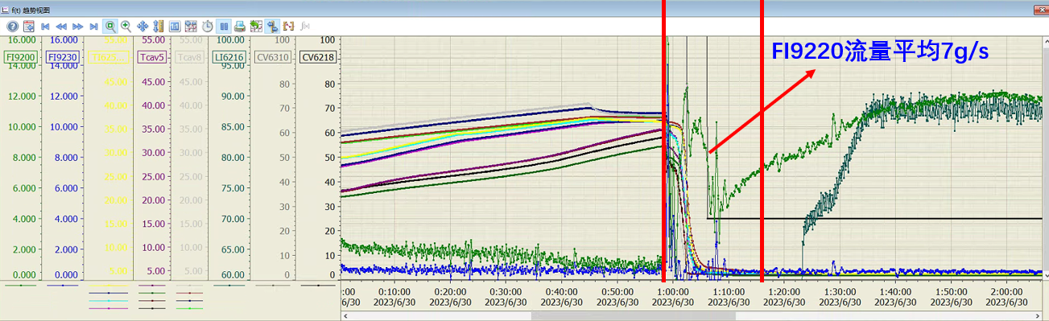
Fast / Slow Cooldown and Magnetic Field at 2 K
Flux1: CAV1 45° tilt
Flux5: CAV5 45° tilt
Flux2: CAV1 transverse Flux10 CAV8 transverse Flux7: CAV5 axial
Flux11: CAV8 axial
Flux gate |  | CAV# | Magnetic field at 2 K (mG) (1st / 2nd assembly)
Inside Helium Vessel (on cavity wall) | 45 deg tilt | 1 | 2.9 / - 0.3
 |  | 5 | 5.452 / - 1.5
 |  | 8 | -
 | Transverse | 1 | - 8.9 / - 8.231
 |  | 5 | -
 |  | 8 | 26.52 / 5.326
 | Axial | 1 | - 0.1 / -
 |  | 5 | - 0.565 / 1.301
 |  | 8 | - 5.519 / 0.409
Outside Helium Vessel (between two shields | Axial | 1 | 16.19
 |  | 5 | 18.87
 |  | 8 | 85.76

Slide 18
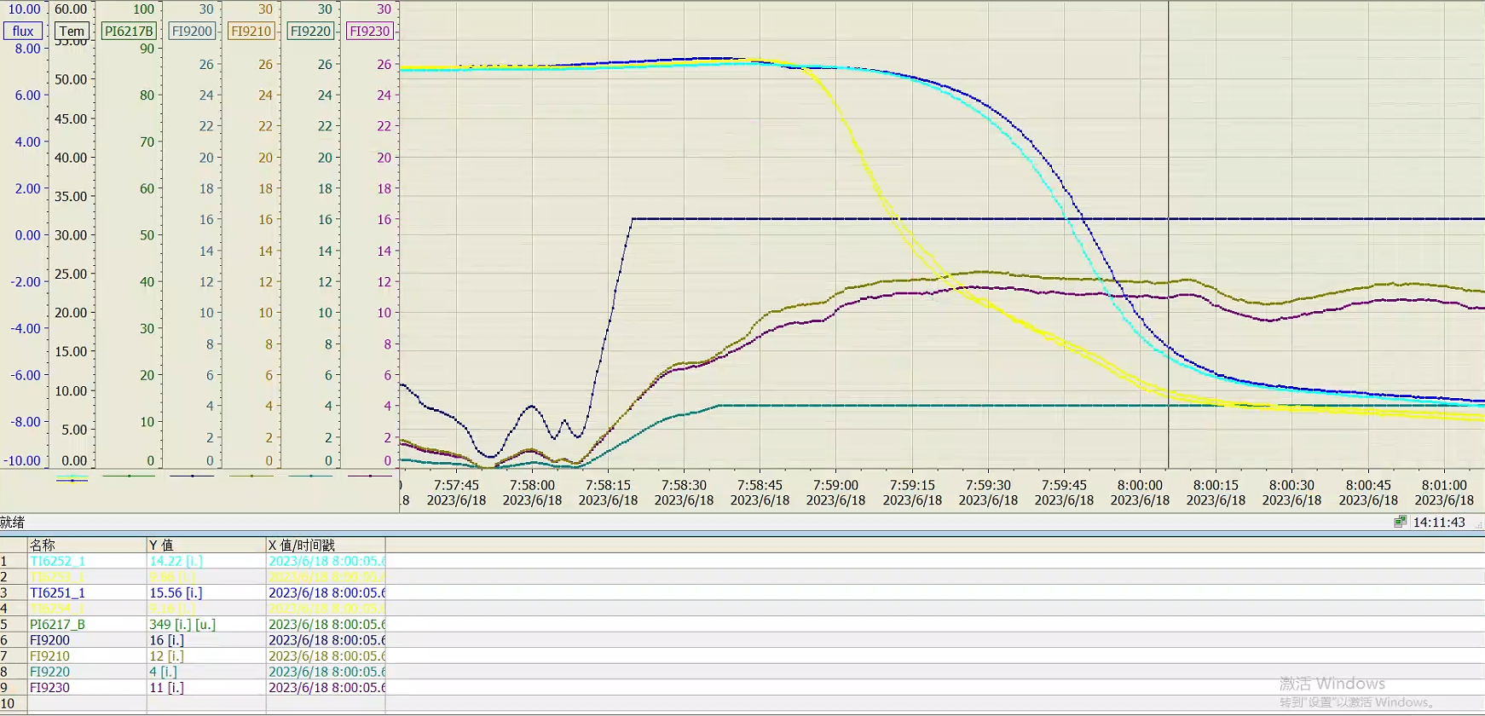
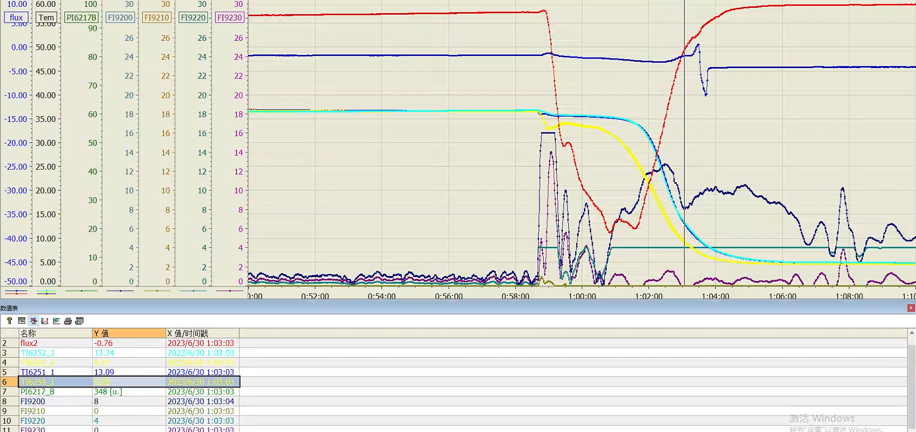
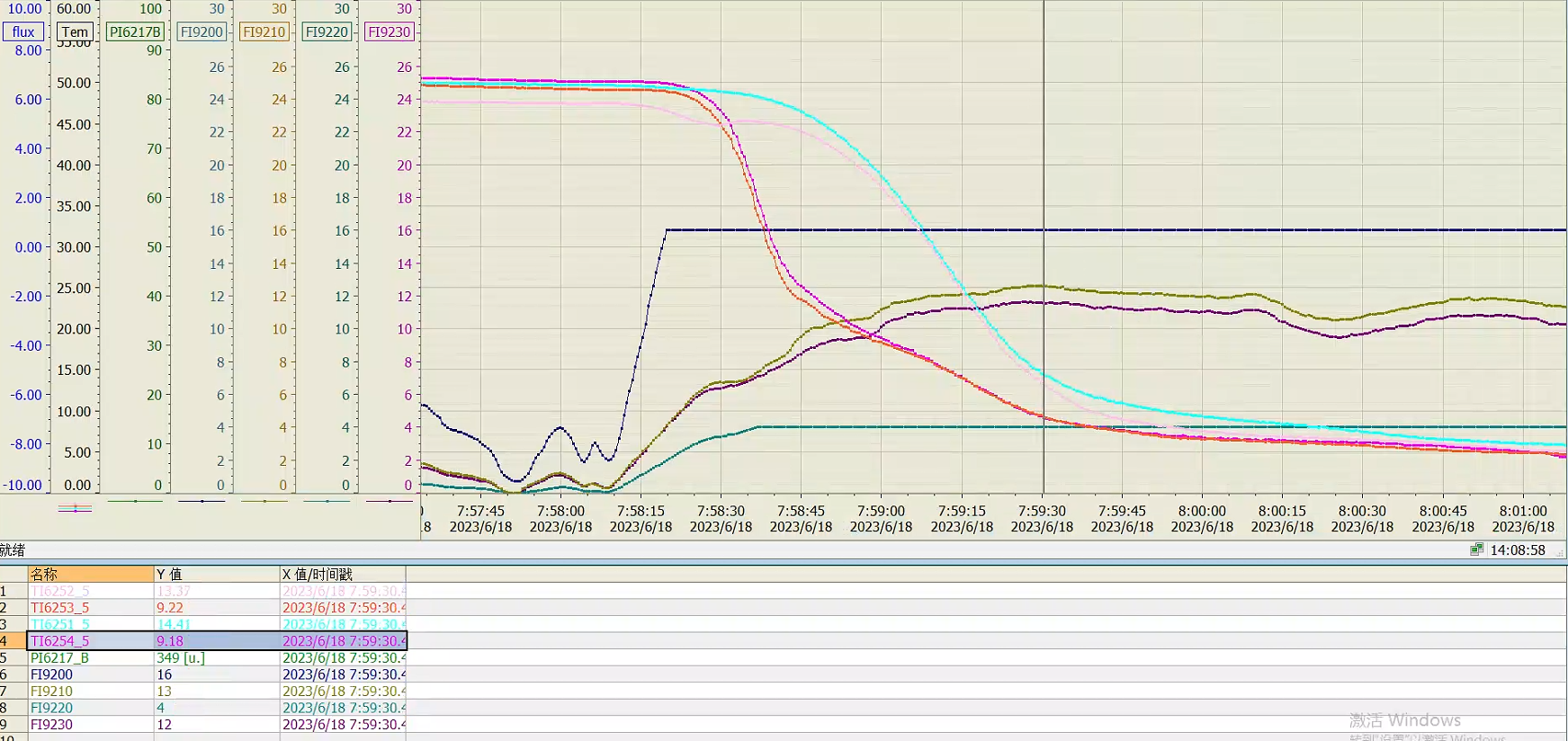
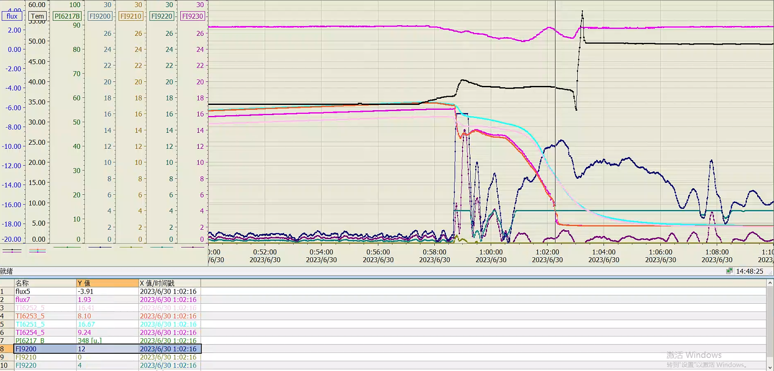
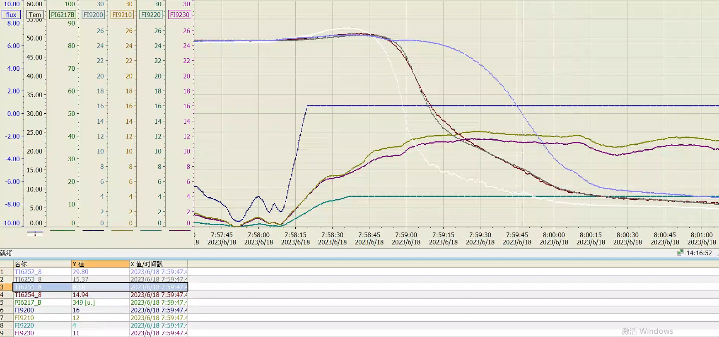
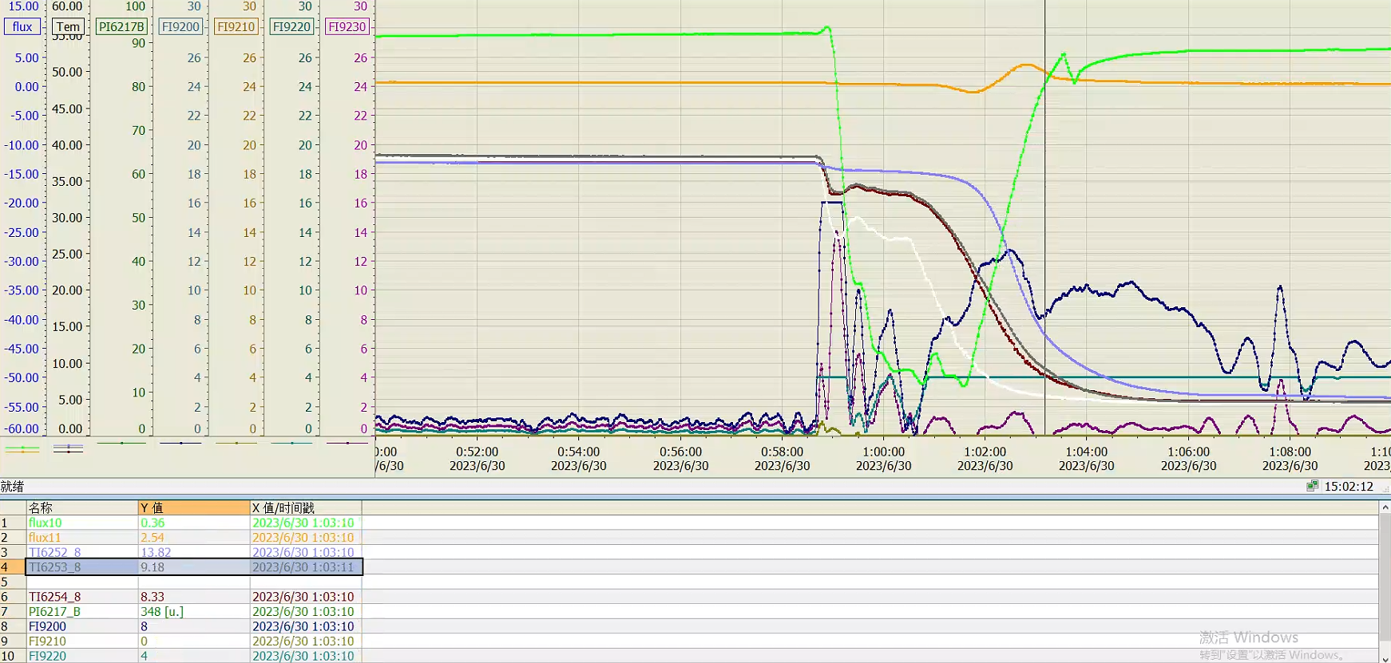
Temperature Difference of Fast / Slow Cooldown
> 40 g/s
8~12g /s
ΔT: top (T1, T2) to bottom (T3, T4) temperature difference of a cell
CAV#1
CAV#1
CAV# | Cool down rate* [g/s] | 1#cell ΔT [K] | 9#cell ΔT [K] | 45° [mG] | Trans-verse [mG] | Axial [mG]
1 | > 39 | 6.4 | 3.6 | NA** | NA** | --
5 | > 41 | 5.23 | 3.94 | NA** | -- | NA**
8 | > 39 | 5.76 | 5.57 | -- | NA** | NA**
1 | 8 | 3.89 | 3.96 | -1.84 | -0.49 | --
5 | 12 | 7.45 | 7.49 | - 3.91 | -- | 1.93
8 | 8~11 | 12.16 | 4.64 | -- | 0.36 | 2.54
CAV#5
CAV#5
CAV#8
CAV#8
* when cell bottom reaches critical temperature of 9.2 K
** data acquisition problem

Slide 19
Cavity Processing
High Q TESLA cavities (MP band at 17-24 MV/m) sometimes need more multipacting processing than EP+120C baseline cavities, especially in the module. Not field emission processing.
Two of the eight (25 %) cavities show repetitive quenching similar as LCLS-II-HE modules (90 % cavities in 5 modules). Better than first assembly and testing. Reasons to be investigated.
Cavity processing duration: 2023.5.28 8:00 to 5.29 19:00. First day: CAV#2/3/4/6/8 processing, 5# input coupler out gassing. Second day: 1/3/5/6/8# input coupler warm part outgassing.
1#: 5.28 10:16-10:40, 2 quenches at 20-21 MV/m.
2#: 5.28 9:29-13:26, 14 quenches at < 14 MV/m, 12 quenches at 17-19 MV/m. HOM2 heating and quench at > 20 MV/m with X-ray
3#: 5.28 9:17-10:40, no MP quench.
4#: 5.28 13:02-13:30, 1 quench at 19 and 23 MV/m.
5#: 5.29 outgassing by pulsed processing, reach 26 MV/m after 80 min. Quench number NA.
6#: 5.28 12:42-12:49, no MP quench.
7#: 5.28 10:30-13:05, no MP quench.
8#: 5.28 10:37-15:50, 57 quenches at 17-24 MV/m.

Slide 20
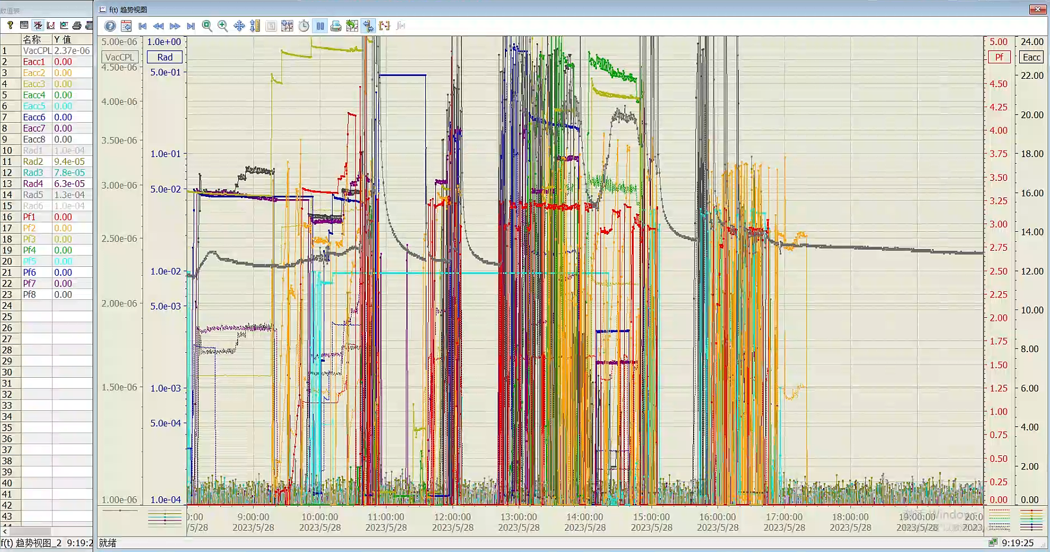
Cavity Processing of 5.28

Slide 21

Cavity Processing of 5.29

Slide 22
Flow Meter Calibration and Module Static Heat Load
Close JT valve CV6214, cool down valve CV6215 and endcap pre-cool down valve CV6218 before measurement.
Large static heat load. SHINE prototype module is similar. A discussion topic in the coming TTC meeting at Fermilab. LCLS-II data will be presented.
Heater power | Mass flow rate | Mass flow -1.11 | Heat load | Initial LHe Level | Final LHe Level | Error | Date
W | g/s | g/s | W | % | % | %
0 | 1.11 |  | 25.18 | 79.995 | 75.004 |  | 2023-6-29
5 | 1.39 | 0.28 | 31.98 | 79.995 | 75.004 | 0.69 | 2023-6-26
10 | 1.59 | 0.47 | 36.64 | 79.995 | 75.004 | -0.32 | 2023-6-26
15 | 1.80 | 0.69 | 41.84 | 79.995 | 75.007 | 0.21 | 2023-6-27
20 | 2.02 | 0.91 | 47.09 | 79.995 | 75.004 | 0.71 | 2023-6-27
30 | 2.44 | 1.33 | 57.41 | 98.919 | 86.816 | 1.14 | 2023-6-28
40 | 2.80 | 1.69 | 65.93 | 79.991 | 75.007 | -1.25 | 2023-6-28
50 | 3.26 | 2.15 | 77.25 | 79.991 | 75.011 | 0.63 | 2023-6-28

Slide 23


Module 2 K Heat Load at 133 MV and 174 MV
RF Voltage, cool down (date) | Measurement Date | Mass flow [g/s] | Q_{dyn}[W] (Latent heat method) | Q_{dyn}[W] (Heater Cal. Method) | Q_{dyn}[W] (DS LHe Level method) | Q_{dyn}[W] (US LHe Level method) | Total 2K Heat Load [W] (Latent) | Total 2K Heat Load [W] (Heater)
133 MV, fast cool down (6.1) | 6.12 | 3.746 | 60.5±1.9 | 57.0±1.7 | 49.1±1.6 | 60.0±4.6 | 86.3±1.4 | 81.5±2.3
133 MV, fast cool down (6.1) | 6.12 | 3.823 | 62.3±1.9 | 58.7±1.7 | 48.1±1.6 | 69.9±4.6 | 88.1±1.4 | 83.2±2.3
133 MV, slow cool down (6.19) | 7.3 | 3.602 | 57.2±1.9 | 53.9±1.7 | 39.5±1.6 | 50.4±4.6 | 83.0±1.4 | 78.4±2.3
133 MV, slow cool down (6.19) | 7.4 | 3.642 | 58.4±1.9 | 54.8±1.7 | 20.8±1.6 | 45.2±4.6 | 83.9±1.4 | 79.2±2.3
174 MV, fast cool down (6.1) | 6.12 | 5.624 | 103.8±1.9 | 104.4±1.7 |  |  | 129.6±1.4 | 132.9±2.3

Slide 24


Average Q₀ at 133 MV and 174 MW
Single cavity Q₀：
Average Q₀ of 8 cavities：
RF Voltage, cool down (date) | Measurement Date | Average E_{acc} [MV/m] | Q_{dyn} [W] | Average Q₀
133 MV, fast cool down (6.1) | 6.12 | 15.9±0.9 | 60.5±1.9 | (3.6±0.4)E10
133 MV, fast cool down (6.1) | 6.12 | 15.9±0.9 | 62.3±1.9 | (3.5±0.4)E10
133 MV, slow cool down (6.19) | 7.3 | 16.1±0.9 | 57.2±1.9 | (3.8±0.4)E10
133 MV, slow cool down (6.19) | 7.4 | 16.1±0.9 | 58.4±1.9 | (3.7±0.4)E10
174 MV, fast cool down (6.1) | 6.12 | 20.9±1.2 | 104.4±1.7 | (3.6±0.4)E10

Slide 25


Single Cavity Q₀ at 16 MV/m
JT valve fixed at 20 %
 | Cav1 | Cav2 | Cav3 | Cav4 | Cav5 | Cav6 | Cav7 | Cav8
2 K dynamic load [W] | 7.36±1.7 | 10.0±1.7 | 8.03±1.7 | 6.84±1.7 | 6.84±1.7 | 7.10±1.7 | 10.5±1.7 | 6.18±1.7
Cavity Q₀ [e10] | 3.68±0.95 | 2.72E±0.56 | 3.38±0.82 | 3.96±1.09 | 3.97±1.09 | 3.79±1.01 | 2.58±0.52 | 4.36±1.30

Slide 26
Comparison of Cavity Performance in VT and CM
Cavity Serial # | CAV# in DALS-CM1 | Bare Cavity Vertical Test |  |  |  | Jacketed Cavity Vertical Test |  |  |  | Cryomodule Test |  |  |  | Note
stainless steel flange loss corrected for Q₀ |  | Max Eacc [MV/m] | Q0 at 16 MV/m [1E10] | Q0 at 21 MV/m [1E10] | Q0 at 23 MV/m [1E10] | Max Eacc [MV/m] | Q0 at 16 MV/m [1E10] | Q0 at 21 MV/m [1E10] | Q0 at 23 MV/m [1E10] | Max Eacc [MV/m] | Usable Eacc [MV/m] | Q0 at 16 MV/m [1E10] | Q0 at 21 MV/m [1E10]
N5 | / | 24.6 | 4.0 | 4.4 | 4.3 | 26.6 | 3.0 | 3.0 | 3.0 | / | / | / | / | delivered to SHINE
N6 | / | 23.6 | 4.9 | 5.0 | 4.9 | / | / | / | / | / | / | / | / | bare tube without HOM
N7 | / | 24.8 | 4.1 | 4.0 | 3.8 | 26.7 | 3.6 | 3.5 | 3.3 | / | / | / | / | delivered to SHINE
N8 | CAV6 | 26.5 | 4.1 | 4.3 | 4.2 | 23.2 | 3.5 | 3.6 | 3.5 | 25.0 | 24.0 | 3.8 | 3.8 | in CM1
N9 | / | 22.7 | 4.7 | 4.5 | / | 20.6 | 3.7 | / | / | / | / | / | / | delivered to SHINE
N10 | / | 24.0 | 4.4 | 4.7 | 4.6 | 27.0 | 4.5 | 4.4 | 4.2 | / | / | / | / | delivered to SHINE
N11 | CAV5 | 31.3 | 5.1 | 5.4 | 5.4 | 27.2 | 3.8 | 4.0 | 3.9 | 26.5 | 23.8 | 4.0 | 4.0 | in CM1
N12 | CAV4 | 29.7 | 4.4 | 4.6 | 4.6 | 28.0 | 4.0 | 4.1 | 4.0 | 27.7 | 24.5 | 4.0 | 4.0 | in CM1
N13 | CAV1 | 24.0 | 4.4 | 4.5 | 4.4 | 23.3 | 4.2 | 4.4 | 4.3 | 26.6 | 24.1 | 3.7 | 3.3 | in CM1
N14 | CAV3 | 25.9 | 4.3 | 4.4 | 4.3 | 25.7 | 3.0 | 3.1 | 3.0 | 24.6 | 26.9 | 3.4 | 3.5 | in CM1
N15 | CAV7 | 26.1 | 5.2 | 5.0 | 5.0 | 25.1 | 4.0 | 3.9 | 3.8 | 21.7 | 21.3 | 2.6 | / | in CM1
N16 | CAV8 | 29.1 | 4.3 | 4.2 | 4.0 | 29.1 | 4.3 | 4.3 | 4.1 | 25.9 | 25.8 | 4.4 | 4.7? | in CM1
N17 | / | / | / | / | / | 30.0 | 3.4 | / | / | / | / | / | / | for further study
N18 | CAV2 | / | / | / | / | 32.0 | 2.6 | 2.5 | 2.5 | 19.2 | 18.5 | 2.7 | / | in CM1
Average all |  | 26.0 | 4.5 | 4.6 | 4.5 | 25.7 | 3.8 | 3.8 | 3.7 | / | / | / | / | Average Q0 from total dynamic heat load: 3.8E10@16 MV/m, 3.6E10@21 MV/m
Average of CAVs in CM1 |  | 27.5 | 4.5 | 4.6 | 4.6 | 26.7 | 3.7 | 3.7 | 3.6 | 24.7 | 23.6 | 3.6 | 3.8?

Slide 27

Cryomodule Performance
Parameters | IHEP Mid-T CM test results | LCLS-II, SHINE Spec | LCLS-II-HE Spec | LCLS-II 40 CMs average | LCLS-II-HE 5 CMs average | LCLS-II or-HE Best CM
CM usable RF voltage (MV) | > 191.2 | 128 | 173 | 158 | 203 | 209
Average usable E_{acc} (MV/m) | > 23.1 | 16 | 20.8 | 19 | 24.4 | 25.1
CM 2 K heat load @ 128 MV (W) | 83.5 | 93 | / | - | / | -
Average Q₀ @ 16 MV/m | 3.8×10¹⁰ | 2.7×10¹⁰ | / | 2.8×10¹⁰ | / | 3.7×10¹⁰
CM 2 K heat load @ 173 MV (W) | 133 | / | 137 | / | - | 115
Average Q₀ @ 21 MV/m | 3.6×10¹⁰ | / | 2.7×10¹⁰ | / | 3.1×10¹⁰ | 3.27×10¹⁰

Slide 28





Stable Operation
Continuous stable operation for 12 hours at 133 MV (each cavity working at 16.0 ~ 16.1 MV/m)
Coupler cold window maximum temperature < 100 K；Radiation dose ＜0.08 mSv/h
Eacc
radiation
Coupler warm part temperature

Slide 29


Radiation Dose
Test method
Each of the eight superconducting cavities powered to 16 MV/m, and the radiation dose parameters of each cavity were monitored separately.
Test results
CAV1: onset@10 MV/m，~5 uSv/h
CAV6 : onset@10.8 MV/m，~13 uSv/h，
Other cavities: NO FE
8 cavities radiation dose ＜0.08 mSv/h (spec 0.5 mSv/h)
CAV6: onset
@10.8 MV/m
CAV1: onset
@10 MV/m

Slide 30




Dark Current
Faraday cup
The dark current is smaller than the spec (1 nA)

Slide 31




Microphonics
Spec: Δf (Peak to Peak) < 10 Hz
Test result：
  ± 4 Hz（3 MV/m open loop, eight cavities）
  ± 7 Hz（8 MV/m open loop, eight cavities）
  ± 4 Hz（16 MV/m closed loop, two cavities）
GDR open or closed, calculate detuning with the phase: $Δf=\left(f_{0}/2Q_{L}\right)⋅tan\left(Δφ\right)$
Open loop @ 8 MV/m
Closed loop @ 16 MV/m

Slide 32





Tuner
Cavity initial freq at 2 K
Parameters | Value
Motor tuner tuning range | > 400 kHz
Motor tuner tuning resolution | 0.16 Hz / step
Piezo tuner tuning range | ~ 900 Hz
Piezo tuner resolution | < 1 Hz

Slide 33




Input Coupler Qe
Qe tuning range large than 4E6 ~ 1.1E8
编号 |  | 初始数据 |  |  | Min |  |  | MAX |  |  | 最终状态
 | 腔频 | 半带宽[ms] | QL | Pin | 半带宽[ms] | QL | Pin | 半带宽[ms] | QL | Pin | 半带宽[ms] | QL
CAV01 | 1300.000000 | 3.46 | 4.08E+07 | 32W | 0.34 | 4.04E+06 | 50W | 9.74 | 1.15E+08 | 50W | 3.54 | 4.17E+07
CAV02 | 1299.999965 | 3.5 | 4.13E+07 | 32W | 0.277 | 3.20E+06 | 50W | 10.2 | 1.20E+08 | 50W | 3.48 | 4.10E+07
CAV03 | 1299.999985 | 3.49 | 4.11E+07 | 41W | 0.25 | 3.00E+06 | 50W | 11.38 | 1.34E+08 | 50W | 3.51 | 4.14E+07
CAV04 | 1299.999965 | 3.49 | 4.11E+07 | 50W | 0.21 | 2.43E+06 | 50W | 11.84 | 1.40E+08 | 50W | 3.5 | 4.12E+07
CAV05 | 1299.999995 | 3.04 | 3.58E+07 | 50W | 0.293 | 3.40E+06 | 50W | 124.7 | 1.47E+09 | 50W | 3.06 | 4.11E+07
CAV06 | 1299.999975 | 3.43 | 4.05E+07 | 50W | 0.173 | 2.04E+06 | 50W | 11.18 | 1.32E+08 | 50W | 3.53 | 4.16E+07
CAV07 | 1300.000055 | 3.55 | 4.19E+07 | 50W | 0.23 | 2.70E+06 | 50W | 11.38 | 1.34E+08 | 50W | 3.56 | 4.20E+07
CAV08 | 1299.999955 | 3.46 | 4.08E+07 | 50W | 0.223 | 2.36E+06 | 50W | 9.3907 | 1.12E+08 | 50W | 3.47 | 4.09E+07

Slide 34

HOM Coupler Fundamental Mode Qe
Max fundamental mode power ≈ 21 dBm < 1 W @ 16 MV/m

Slide 35



HOM Coupler HOM Qe (Hongjuan’s talk)
TM110
TM011
少部分模式能传输一部分能量到第二个腔及第三个腔
Trap mode
Trap mode
Trap mode
TE111
Single cavity
TM111
Cavity string
Qe of 360 high-order modes in 8 cavities < 1E6

Slide 36




Superconducting Magnet
Quadrupole 20 A, Corrector 8 A
0.1 A/s ramp up and down (monitor temperature)
2 h stable operation
Quench test（max coil temperature 7.45 K, quench voltage < 32 V）
Degaussing (magnetic field at cavity#8 < 8.5 mGs）

Slide 37
Summary of the Mid-T Cryomodule Performance
Parameters | Design value | Test Data
Cavity number | 8 | 8
Operation temperature | 2 K | 2 K
Total heat load @ 16 MV/m | 130 W @ 2 K | 83.5 W @ 2 K @ 16 MV/m
Working frequency | 1.3 GHz | CAV1-8: 1.3 GHz
Average Eacc | > 16 MV/m | > 23.1 MV/m
Total RF voltage | > 128 MV | > 191.2 MV
Average Q₀ @ 16 MV/m | > 2E10 | 3.8 E10
Fundamental mode power of HOM coupler @ 16 MV/m | < 1 W | < 1 W
HOM Qe of the first 3 passbands | < 1E6 | < 1E6
Input coupler operation power | 4-7 kW | Large than 4 kW
Input coupler Q_{ext} | 4.1E+07 | FPC1-8: 4E6 ~ 1.1E8
Tuning range Q_{ext} | 4E6 ~ 1.1E8 | Larger
Motor tuner tuning range | 400 kHz | ＞ 400 kHz
Piezo tuner tuning range | 1 kHz | ~ 900 Hz
Max integral field gradient of quadrupole | 2.0 T (15.8 A) | 2.64 T (20 A)
Max integral field of the correctors | 0.005 T-m | 0.018 T-m (HC) 0.017 T-m (VC)

Slide 38
Summary of the Mid-T Cryomodule Performance
Parameters | Test Data | Note
Total 2 K heat load @ 21 MV/m | 133 W @ 2 K | Better than LCLS-II-HE spec（137 W）
Cryomodule 2 K static heat load | 25.2 W @ 2 K | Need to be reduced
Average Q₀ @ 21 MV/m | 3.6 E10 | Better than design spec of LCLS-II-HE（2.7E10 @ 21 MV/m）
Operation stability @ 128 MV | Stable in 12 hours at 16 MV/m. Temperature of coupler cold window < 100 K | Meet LCLS-II spec
Stable operation without coupler door knob air cooling | Stable in 12 hours at 16 MV/m | Meets the operation requirement
Microphonics | GDR open loop @ 3 MV/m δf（peak-peak）4 Hz, @ 8 MV/m = 7 Hz; Closed loop @ 16 MV/m δf（peak-peak）= 4 Hz | Better than LCLS-II spec（peak-peak < 10 Hz）

Slide 39
Future Work
Optimize VT procedure of jacketed cavity to have similar Q₀ with bare cavity (for mass production without VT of bare cavities).
Reduce module static heat load (LCLS-II data at TTC meeting).
Investigate the relation of Q₀ with different cooldown speed, top to bottom cavity temperature difference at critical temperature, flux expulsion, remnant magnetic field and thermal current etc.
Investigate gradient drop of individual cavities and avoid systematic risk.
Investigate cavity processing and input coupler outgassing issues and reduce processing time.
Increase cavity gradient, reduce Q spread. Statistics with more mid-T cavities and cryomodules.

Slide 40

IHEP 1.3 GHz SRF team with Dalian DICP (DALS) and Shenzhen IASF (S3FEL) colleagues and the review experts

Slide 41
Summary
IHEP successfully developed the world's first medium temperature baked (mid-T) high Q 1.3 GHz cryomodule. Total RF voltage and cryogenic heat load reached design goal, with its eight 9-cell cavities achieving an unprecedented high average Q of 3.8E10 at 16 MV/m and 3.6E10 at 21 MV/m. The module can operate stably up to a total CW RF voltage greater than 191 MV, with an average cavity CW gradient of more than 23 MV/m.
Main performance of the module meets the requirement of DALS, S3FEL and SHINE, and is beyond LCLS-II-HE spec. Especially the average Q₀ at 21 MV/m is better than the state-of-the-art nitrogen-doping modules of LCLS-II-HE. Demonstrated the feasibility and advantages of mid-T cavities to be used in high Q superconducting accelerator.
We will make more mid-T module prototypes for SHINE and S3FEL in next few years.
We appreciate KEK colleagues for nearly 20 years kind support and fruitful collaboration on 1.3 GHz SRF technology with IHEP. Hope to continue to collaborate on high gradient high Q 1.3 GHz cavity and cryomodule as well as its high current application.

Slide 42














Introduction: SRF Accelerator Research
Institutes, Infrastructures, Projects and Industry in China
Operation
Construction
BEPCII
and Upgrade
ADS
injector I
HEPS
in Beijing
IHEP PAPS
SRF lab
Design and R&D
CEPC in China
(site to be decided)
IHEP
CIAE
PKU
1 GeV proton
linac
DICP
IMP
PKU FEL
DALS in Dalian
CAFe in Lanzhou
16 GeV
XFEL
SSRF and SHINE
and large SRF lab
in Shanghai
Teng Tan, TTC2020
CAEP
HALF in Hefei
SARI
CTFEL in Chengdu
USTC
CSNS-II and SAPS
and large SRF lab
in Dongguan
NSRRC
IHEP
TPS in Hsinchu
IMP
IASF
S3FEL and SRF lab
in Shenzhen
CiADS and HIAF
and large SRF lab in Huizhou

Slide 43
SRF Accelerator Projects in China
 | Operation | Construction | Design & R&D | Sum
Collider | BEPCII (1.89 GeV, 2 CAV, since 2006) | BEPCII upgrade (2.35 GeV, 4 CAV, complete in 2024) | CEPC (45.5-180 GeV, 288 ~ 980 CAV) … | 2 circular colliders tau-charm, Z, W, Higgs, ttbar
Synchrotron Light Source | BSRF (2.5 GeV, 2 CAV, since 2006) SSRF (3.5 GeV, 3 CAV, since 2009) | HEPS (6 GeV, 10 CAV, complete in 2025) HALF (2.2 GeV, 1 CAV, complete in 2028) | SAPS (3.5 GeV, 4 CAV) … | 5+ light sources 3rd & 4th generations 2.2 ~ 6 GeV
FEL | PKU FEL & DC-SRF Gun (30 MeV, 3 CAV) CTFEL (10 MeV, 2 CAV, since 2017) | SHINE (8 GeV, 616 CAV, complete in 2027) S3FEL (2.5 GeV, 224 CAV, complete in 2031) CTFEL upgrade (50 MeV) | DALS (1 GeV, 96 CAV) CAEP XFEL (pulsed hard X-ray, 16 GeV) … | 7+ FELs 2 hard X-ray 1 soft X-ray 1 EUV, 1 IR, 2 THz
Proton & Heavy Ion | ADS injector I (10 MeV, 14 CAV, since 2016) CAFe (25 MeV, 23 CAV, since 2017) | CiADS (0.5 GeV, 151 CAV, complete in 2025) HIAF (4.25 GeV/u, 96 CAV) CSNS-II (300 MeV, 54 CAV, complete in 2028) | CSNS-III (1 GeV) ADS (1 GeV) CIAE proton linac (1 GeV) … | 6+ proton & heavy ion SRF accelerators
Sum | Operating 6 facilities ~ 50 cavities | Constructing 9 projects ~ 1200 cavities by 2028 ~ 40 billion CNY | Proposing 6+ projects 2000+ cavities
https://indico.ihep.ac.cn/event/20622/contributions/143812/attachments/73313/89533/SRF%20activities%20in%20China.pdf

