Slide 1
HOM damping studies for SRF cavities at IHEP
Hongjuan Zheng
11th IHEP-KEK SCRF Collaboration Meeting, 20-21 November 2023, Beijing

Slide 2
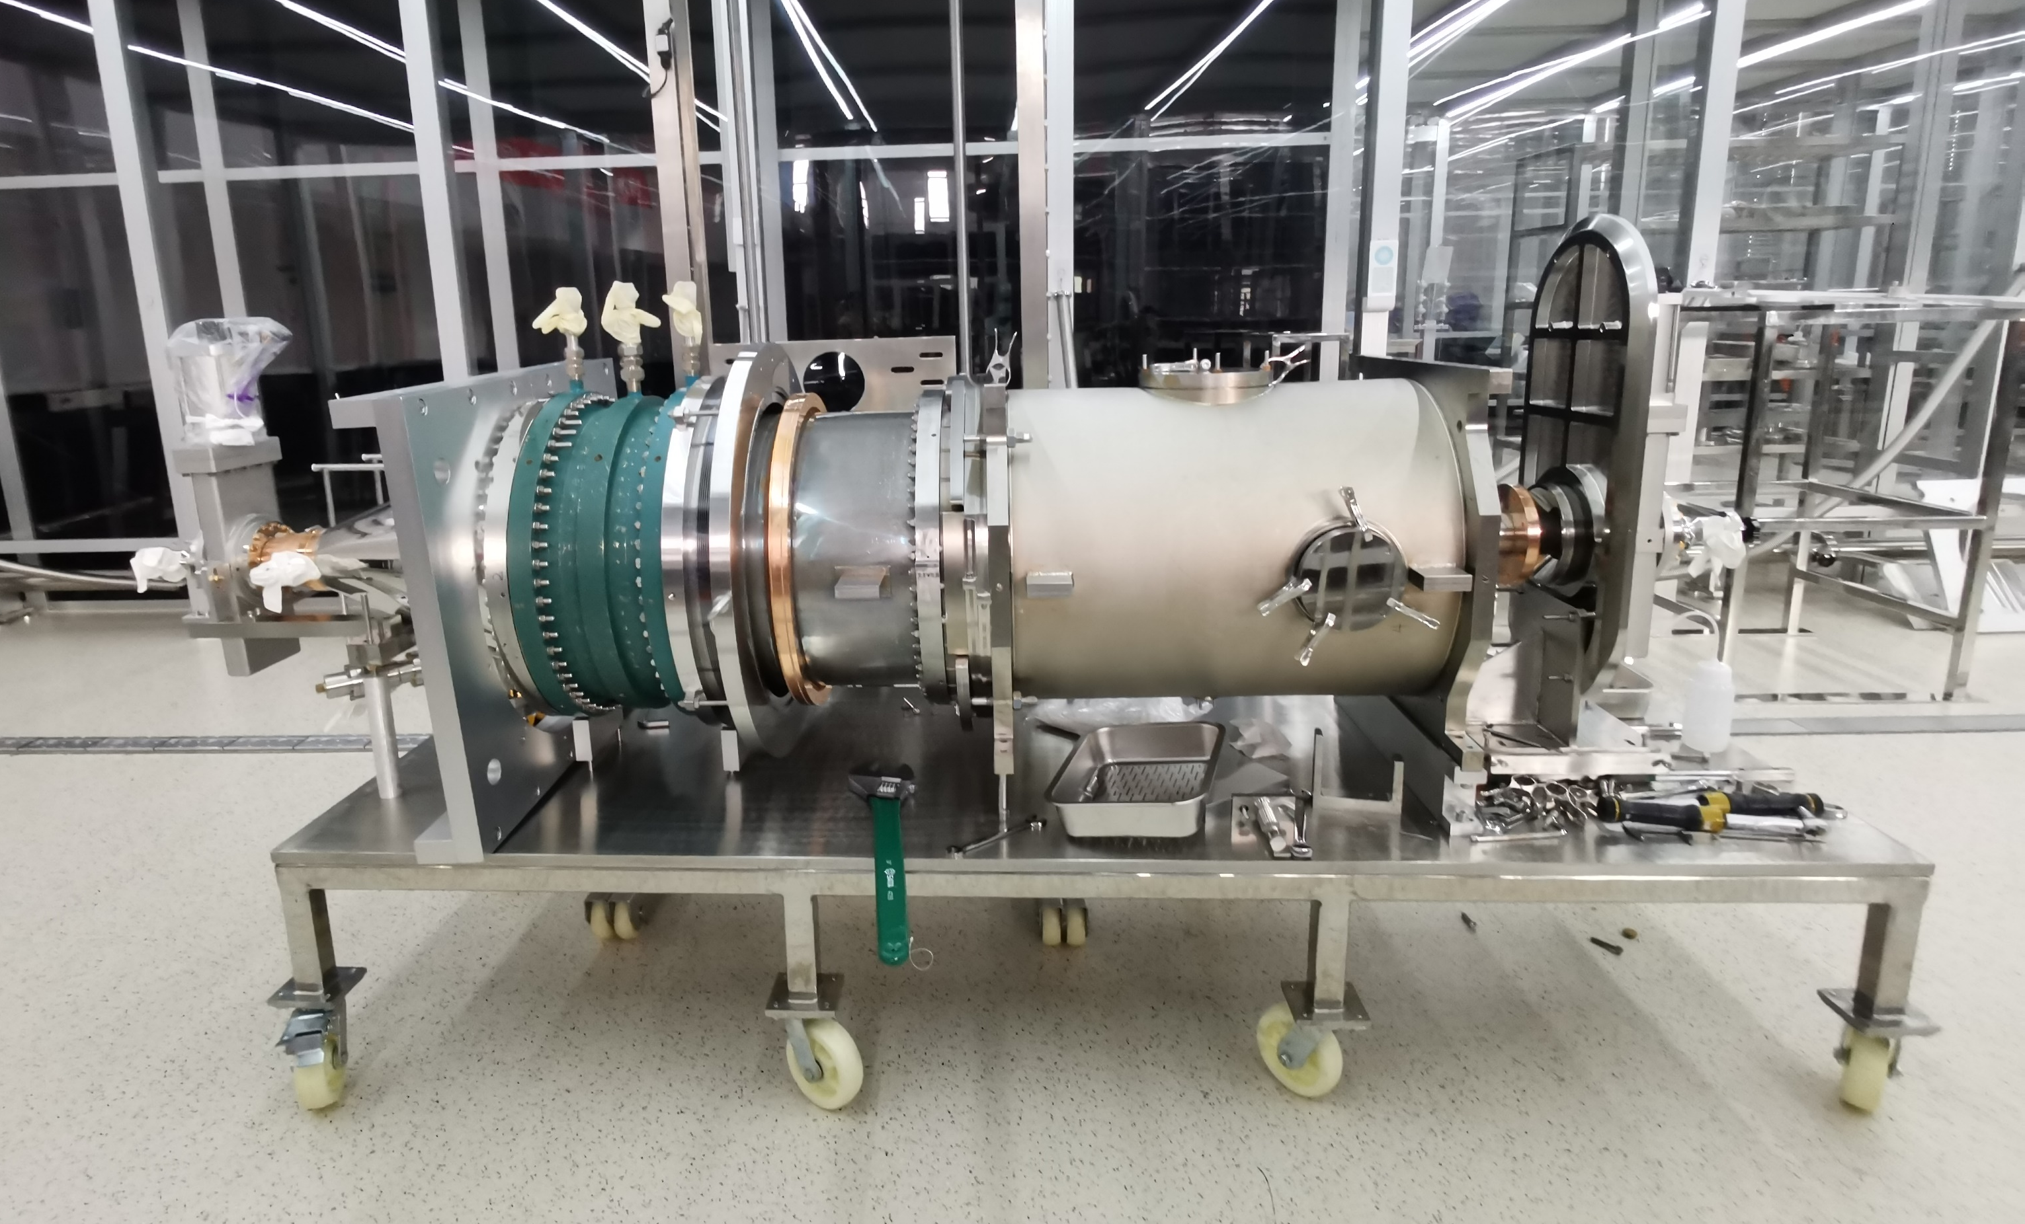
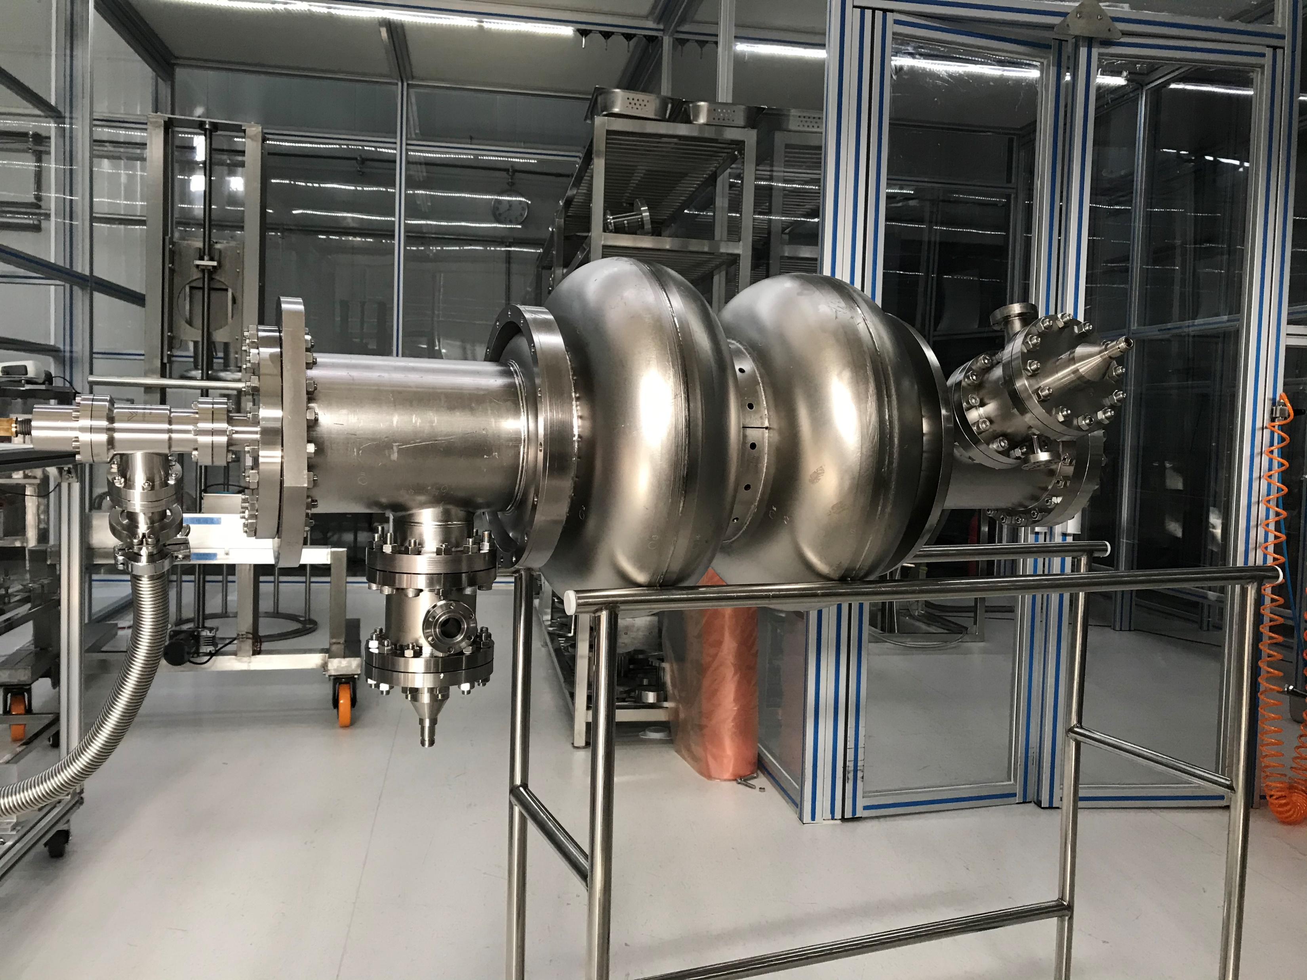
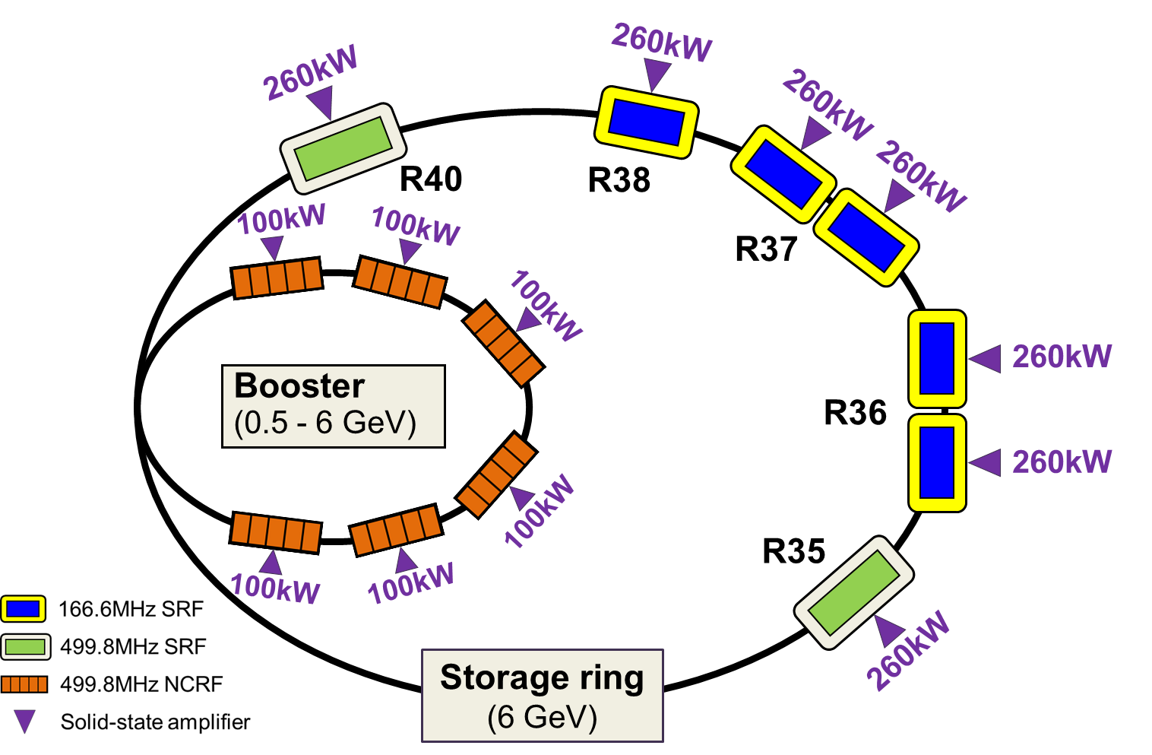
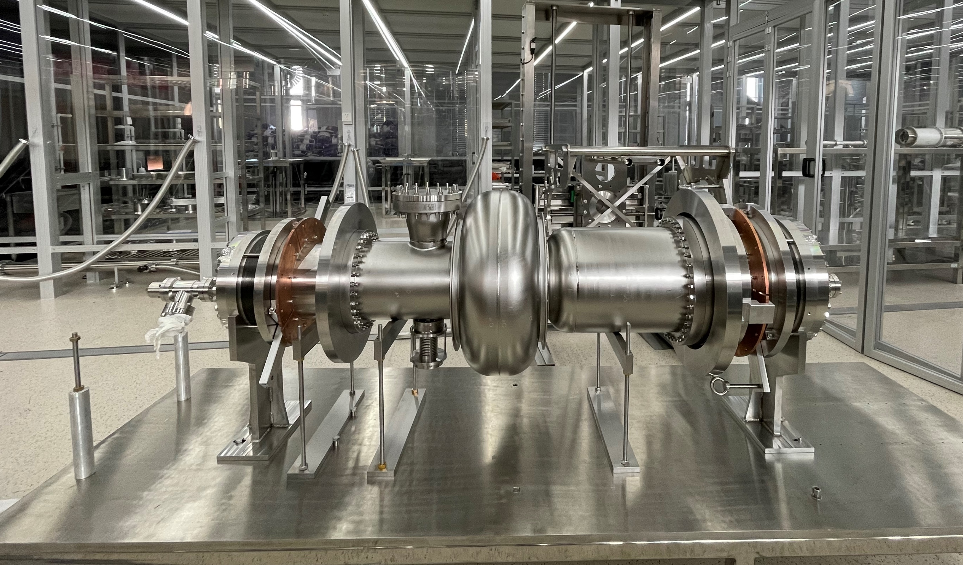
Outline
Storage ring 166.6 MHz
Collider 650MHz 2-cell
CEPC
HEPS
Booster 1.3GHz 9-cell
3rd harmonic 499.8 MHz

Slide 3

HOM damping studies for CEPC

Slide 4
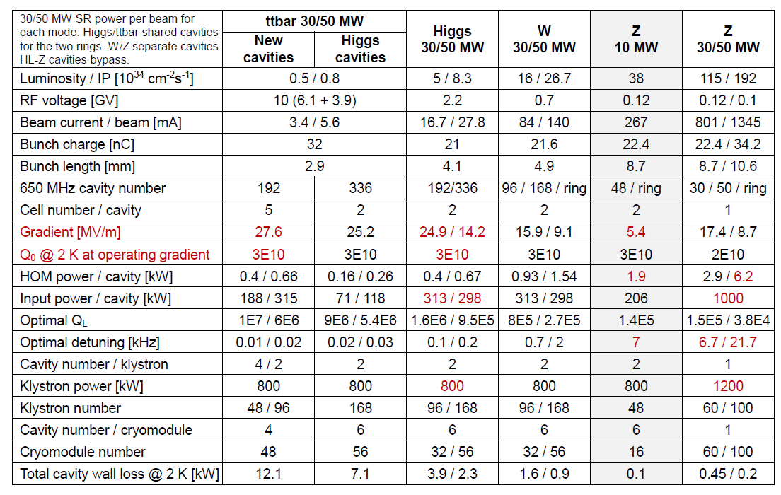
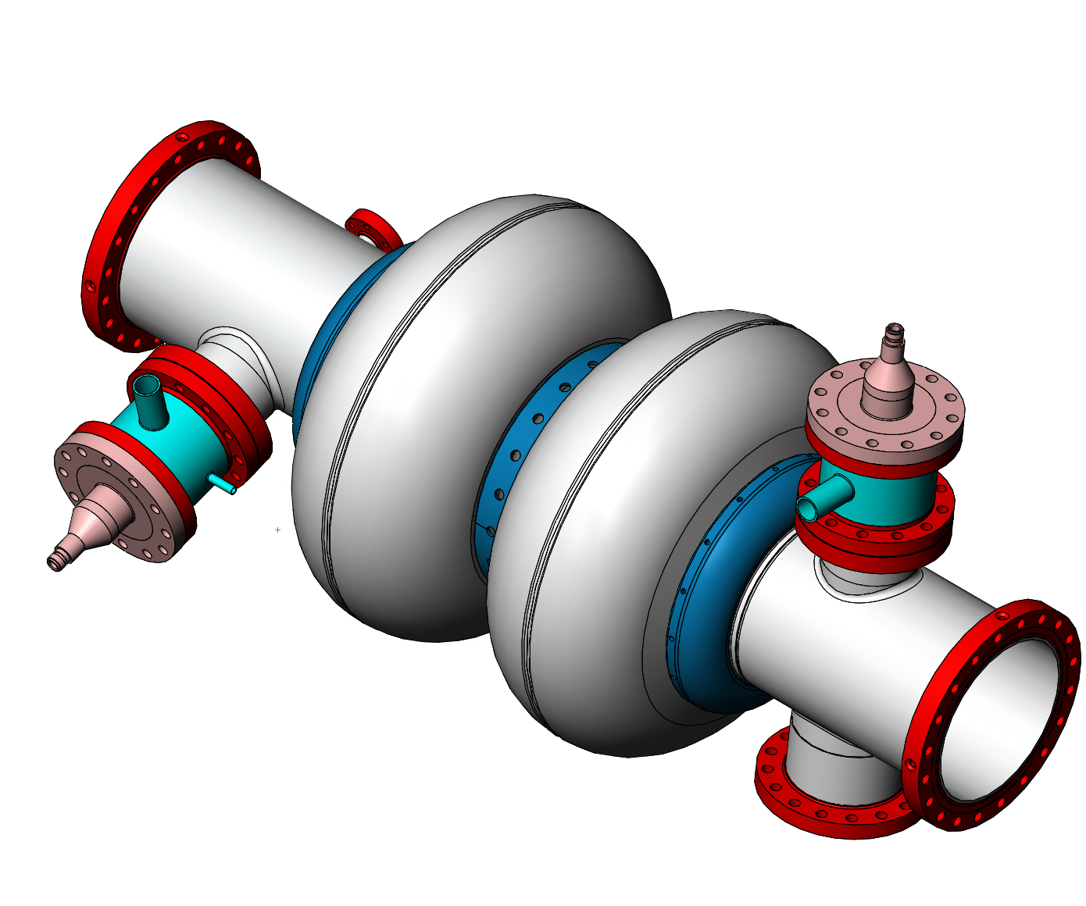
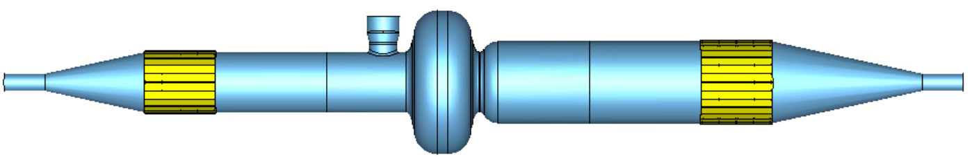
CEPC TDR parameters (collider)
H/W/Z: 2-cell with 2 HOM coupler
HL-Z: single-cell with enlarged beam pipe and absorber

Slide 5
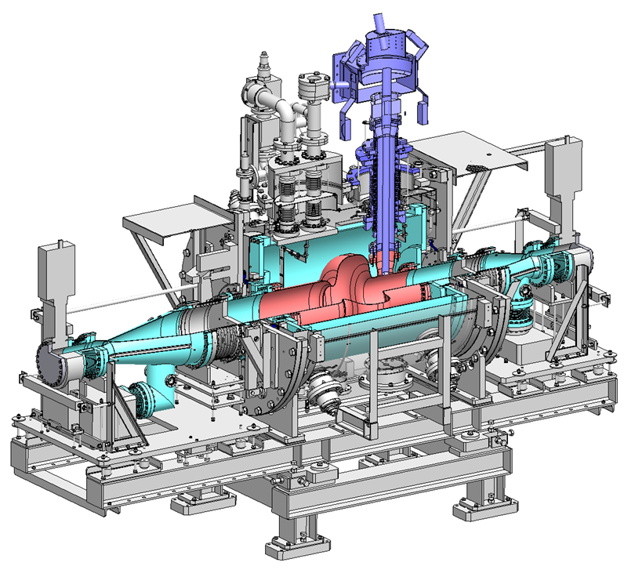
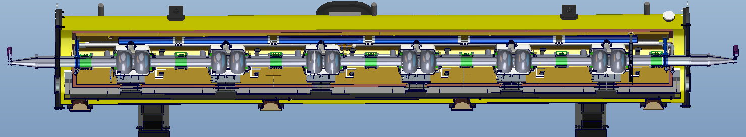
Damping scheme (collider)
HOM coupler (cryogenic) with HOM absorber (room temperature)
HOM couplers mounted on the cavity beam pipe with a HOM power-handling capacity of 1 kW.
Beamline HOM absorbers at room temperature with a HOM power-handling capacity of 5 kW.
HL Z: single-cell with HOM absorber
Single-cell with absorber
HOM coupler
Absorber
Absorber
HOM coupler

Slide 6
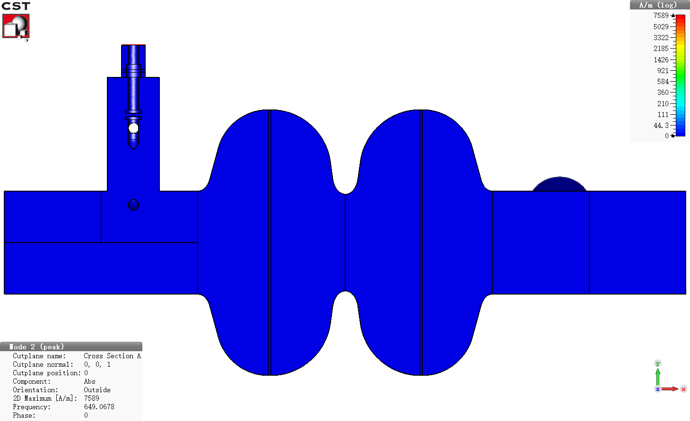
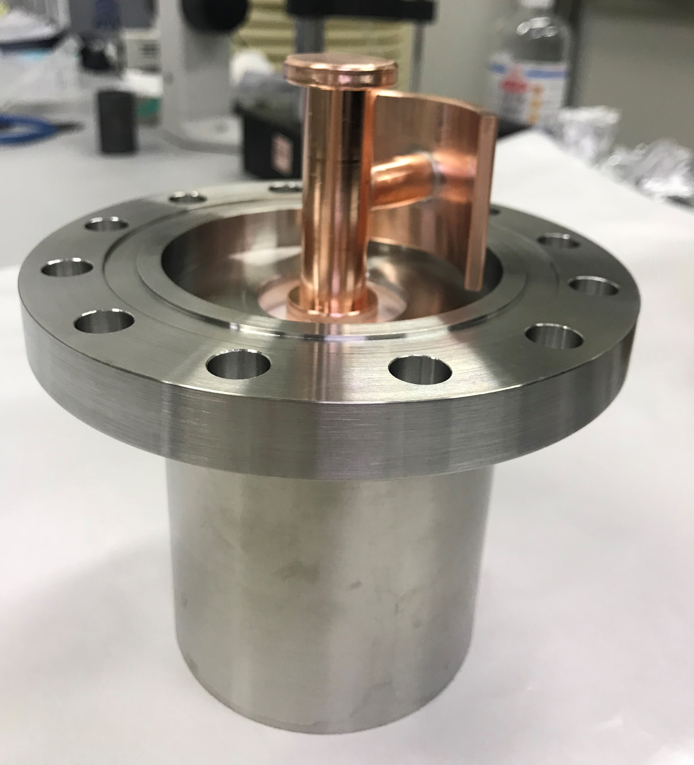
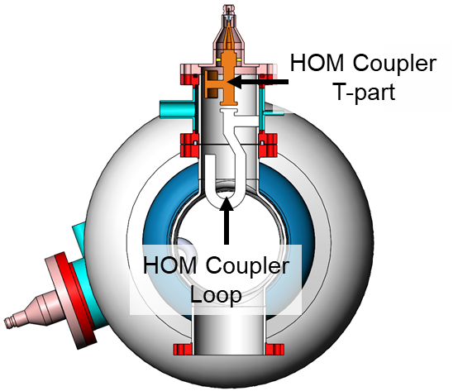
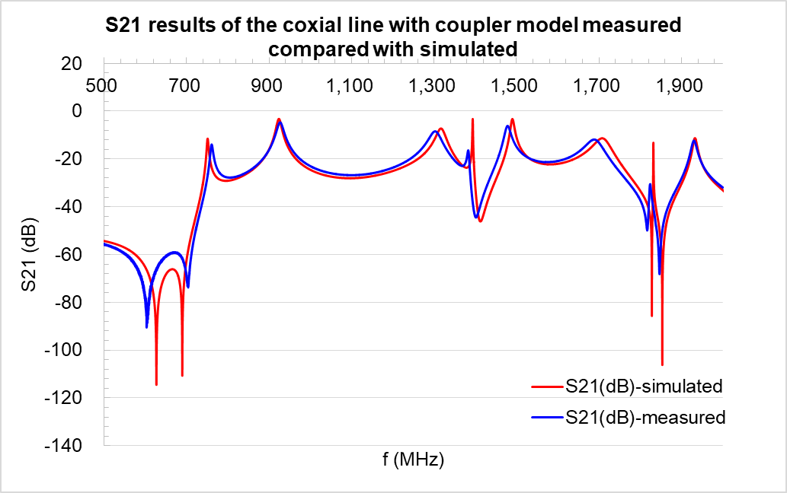
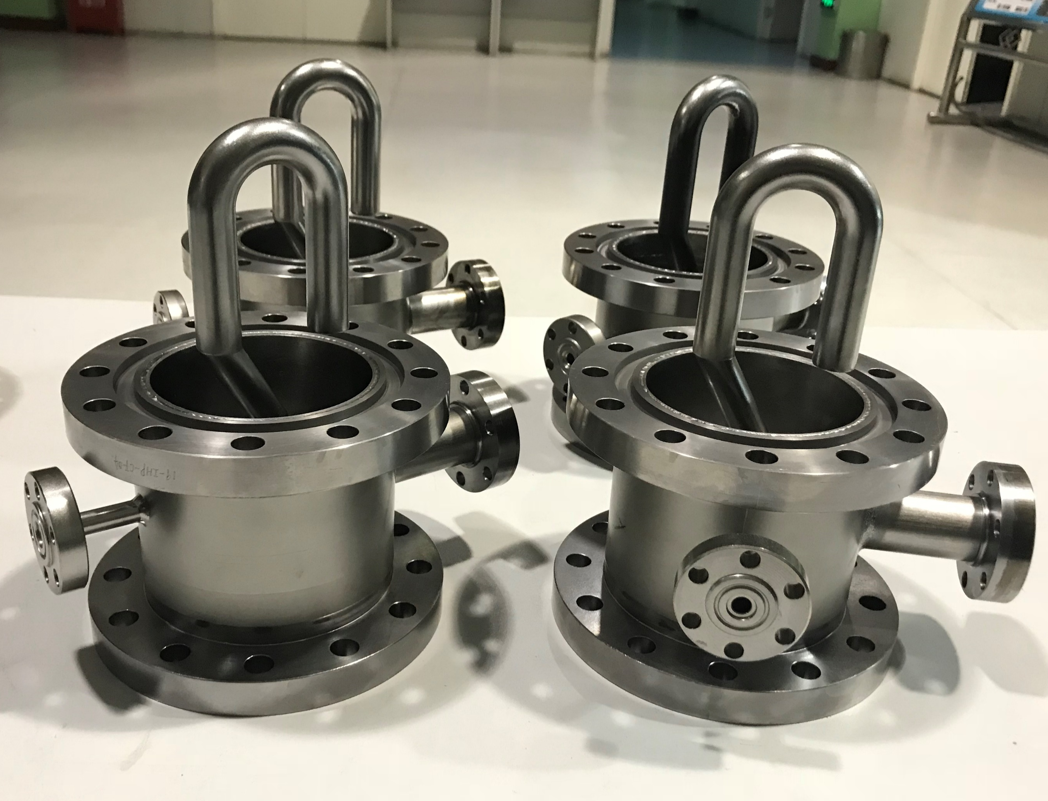
HOM coupler for 2-cell cavity
Design scheme of HOM coupler: double-notch, coaxial LC filter
Wide bandwidth for fundamental mode
No need tuning for fundamental mode in actual
Damping requirement for fundamental mode (TM010): Qe >1×10¹¹
TM010 H-field
Double-notch

Slide 7
Damping results (collider)
The cut-off frequencies for the TM01 mode and TE11 mode are approximately 1.35 GHz and 1.04 GHz, respectively.
For the 10 MW Z mode, a 100 ms longitudinal and 1 ms transverse bunch-by-bunch feedback system is necessary and sufficient to mitigate the instability.
HOM frequency spread of cavities (~1MHz) can help to relax the requirements by 10~100 times.
cut-off of TM01: 1.35GHz
cut-off of TE11: 1.04GHz

Slide 8
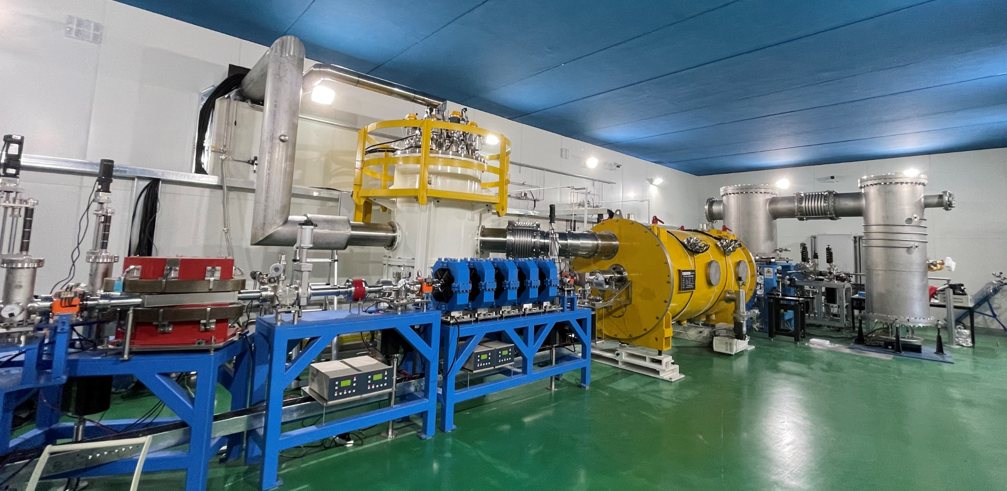
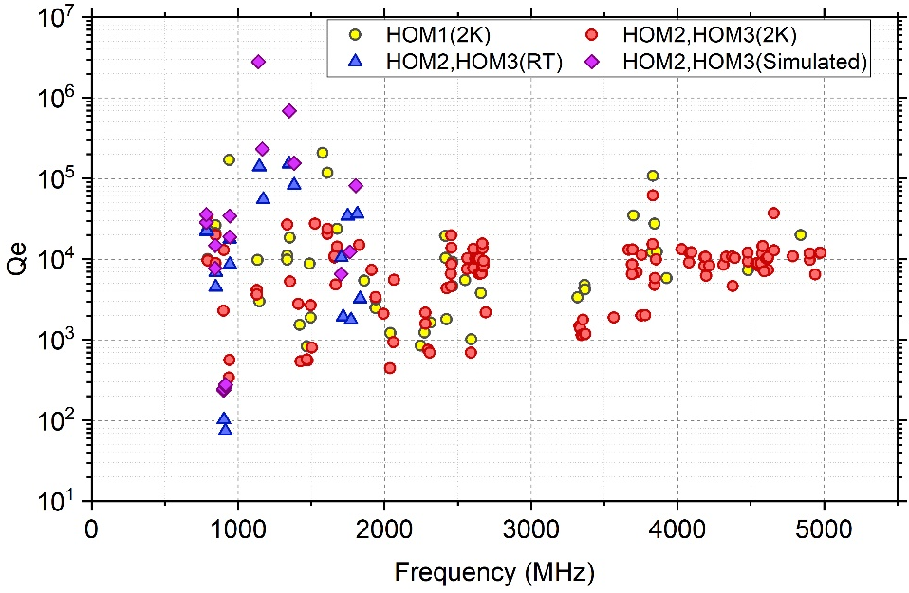
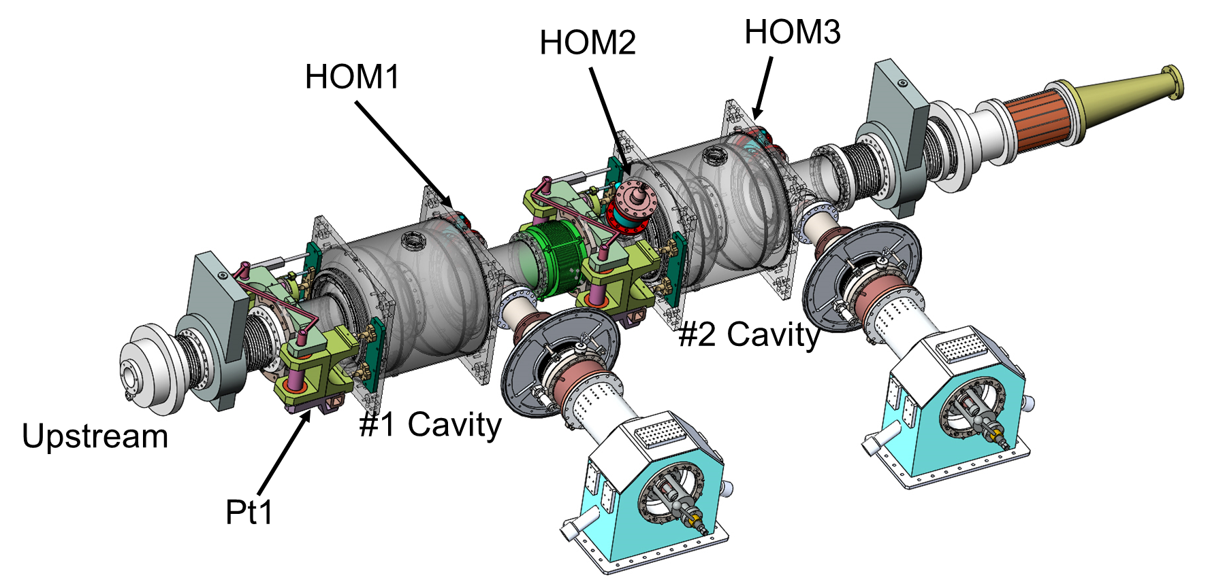
CEPC 650 MHz Test Cryomodule
Modul installation in beamline, 2 K cool down test. Three HOM couplers were installed on the cavity string.
Qe for TM010 measured at 2K: 6.8╳ 10¹³, 1.9 ╳ 10¹³, 2.1 ╳ 10¹²
Damping for HOMs: Qe~10⁴
HOM absorber

Slide 9
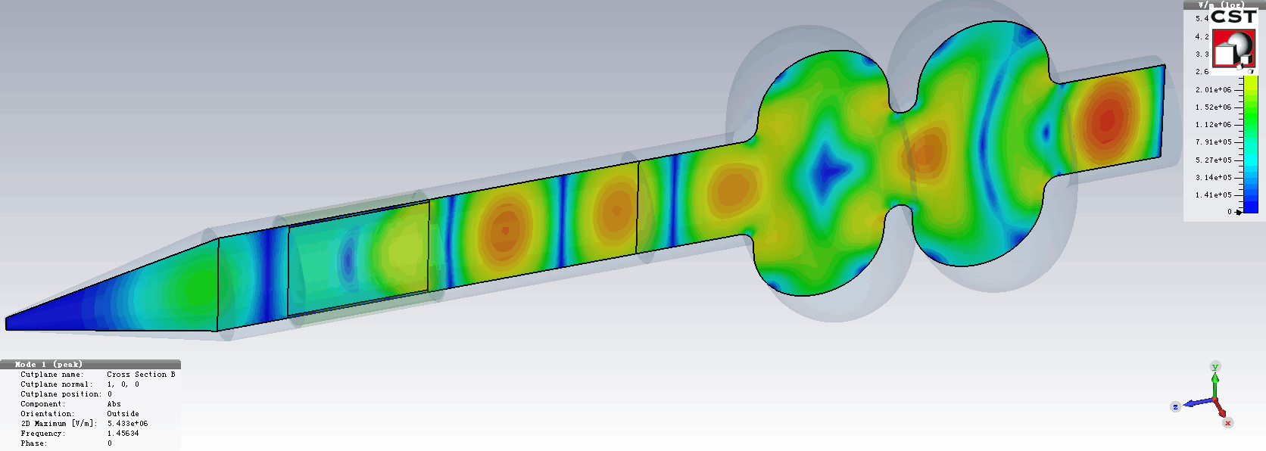
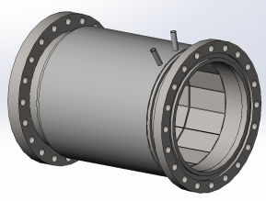
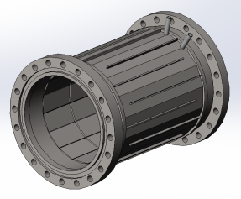
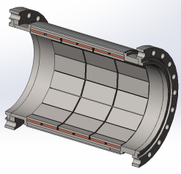
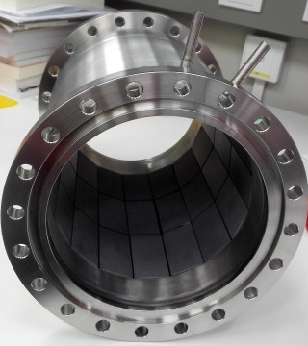
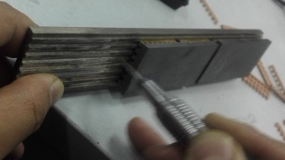
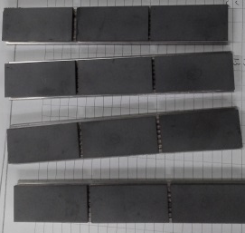
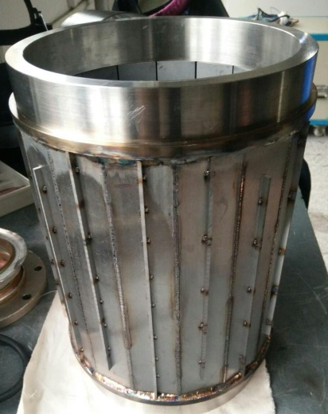
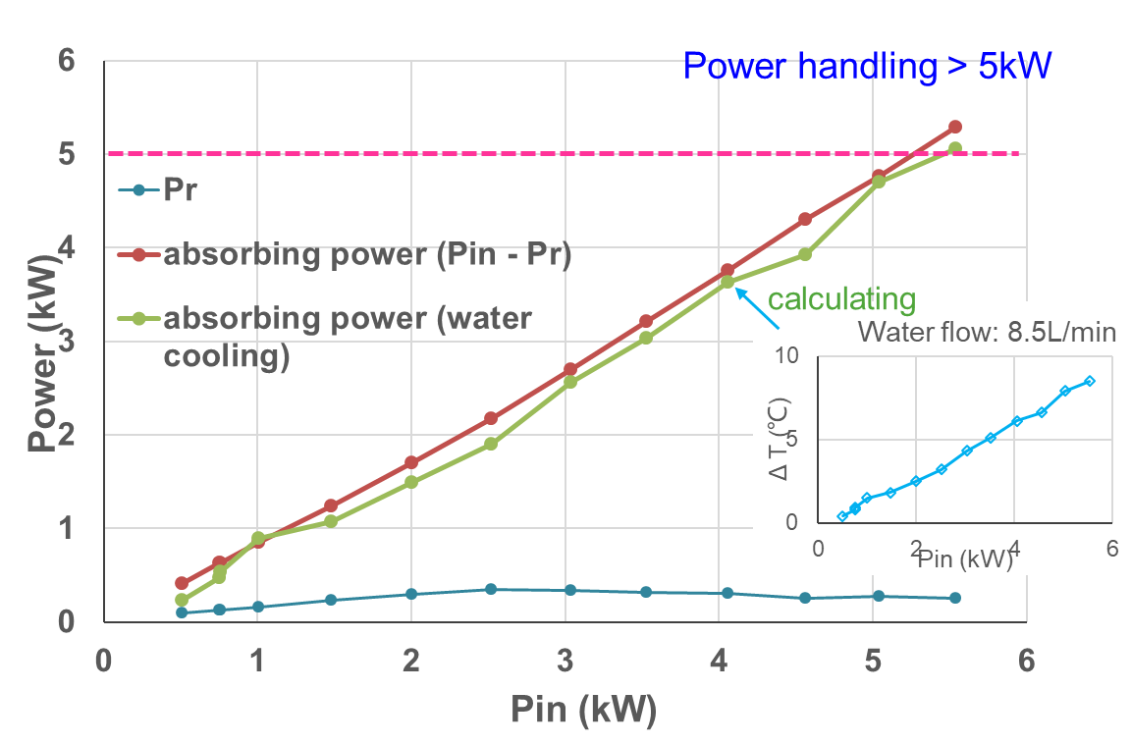
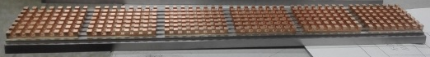
HOM absorber
Fanbo Meng
Due to short bunch length thus wide HOM frequency range, SiC+AlN composite is chosen for cavity HOM absorbing material.
5 kW high power test show high absorbing efficiency, meets CEPC spec.
SiC+AlN composite bricks brazed on copper and then on kovar plate

Slide 10
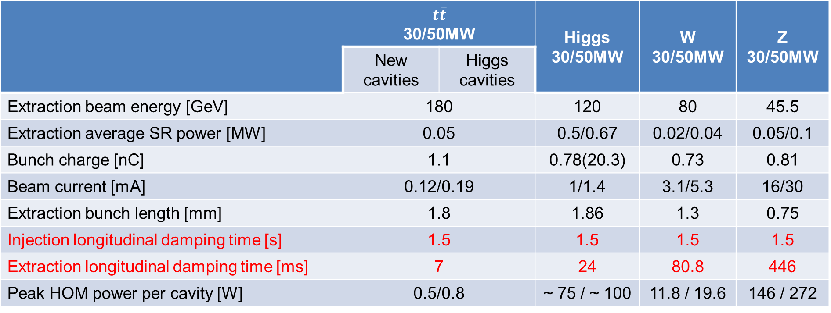
Damping requirements (booster)
The growth time of the coupled bunch instability for all the higher order modes is much shorter than the radiation damping time during injection.
Assumed bunch-by-bunch transverse feedback time of 10 ms and longitudinal feedback time of 200 ms, almost all modes are safe.
 | $$t\overline{t}$$ 30/50MW |  | Higgs 30/50MW | W 30/50MW | Z 30/50MW
 | New cavities | Higgs cavities
Extraction beam energy [GeV] | 180 |  | 120 | 80 | 45.5
Extraction average SR power [MW] | 0.05 |  | 0.5/0.67 | 0.02/0.04 | 0.05/0.1
Bunch charge [nC] | 1.1 |  | 0.78(20.3) | 0.73 | 0.81
Beam current [mA] | 0.12/0.19 |  | 1/1.4 | 3.1/5.3 | 16/30
Extraction bunch length [mm] | 1.8 |  | 1.86 | 1.3 | 0.75
Injection longitudinal damping time [s] | 1.5 |  | 1.5 | 1.5 | 1.5
Extraction longitudinal damping time [ms] | 7 |  | 24 | 80.8 | 446
Peak HOM power per cavity [W] | 0.5/0.8 |  | ~ 75 / ~ 100 | 11.8 / 19.6 | 146 / 272

Slide 11
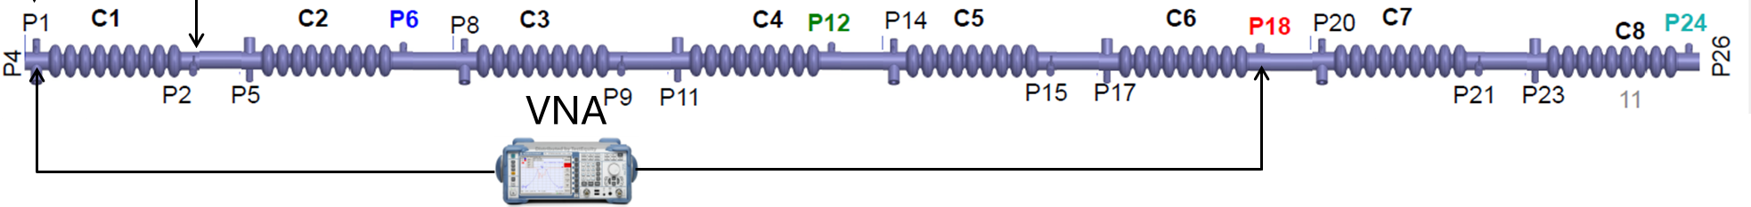
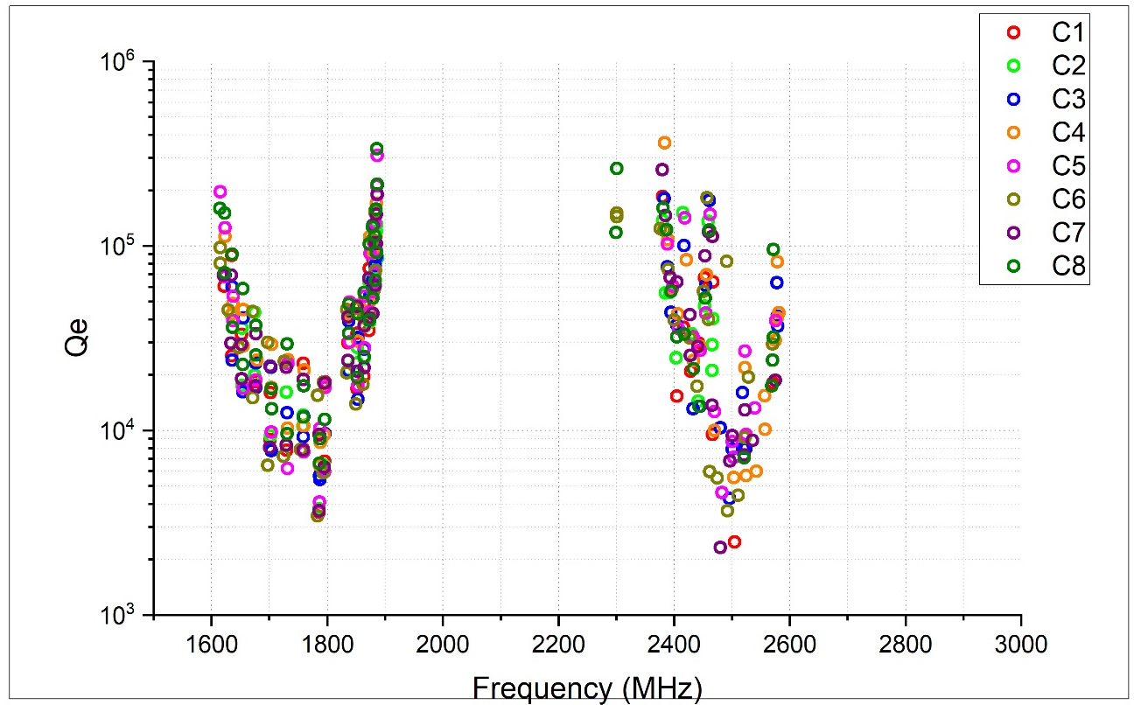
HOM Qe of single-cavity@ 2K
High risk HOMs: dipole bands 1&2&3, monopole bands 2
cut-off of TE11: 2.25GHz
HOM damping in single cavity:
TE111: 1600MHz-1800MHz
TM110: 1800MHz-1900MHz
TM011: 2350MHz-2450MHz
TM111: 2400MHz-2600MHz
Quadrupole bands 1: 2300MHz-2330MHz
TM110
TM011
cut-off of TM01: 2.92GHz
TE111
Single cavity
TM111

Slide 12
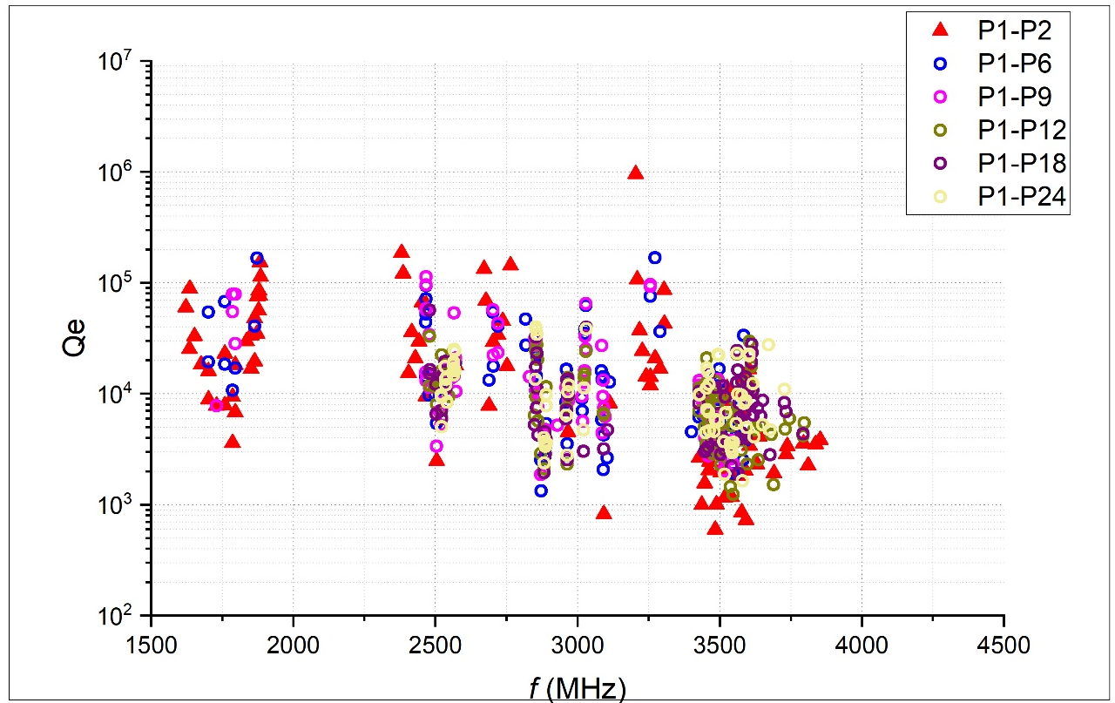
HOM Qe of multi-cavity @ 2K
High risk HOMs: dipole bands 1&2&3, monopole bands 2
cut-off of TE11: 2.25GHz
cut-off of TM01: 2.92GHz
HOM propagating in multi-cavities:
Modes frequency f<1.79GHz cannot propagate to cavity C2; (TE111 mode)
Modes frequency 1.79GHz<f<2.48GHz can propagate to cavity C3 and then stopped; (TM110&TM011 mode) The number of modes propagated to the second and third cavities are greatly reduced.
Modes frequency 2.49GHz<f<2.60GHz can propagate to cavity C9; (TM111 mode) The magnitude of Qe is the same.
Modes frequency 2.67GHz<f<2.76GHz can propagate to cavity C3; (TM020 mode)
Trap mode
Trap mode
Trap mode
Trap mode
Cavity string

Slide 13

HOM damping studies for HEPS

Slide 14
Main parameters (Storage ring)
Parameter | Value
Circumference [m] | 1360.4
Beam energy [GeV] | 6
Beam current [mA] | 200
Total SR loss per turn (w/ IDs) [MeV] | 4.14
Total power loss to SR [kW] | 828
Synchrotron tune w/o HC | 8.213×10⁻⁴
Momentum compaction | 1.88×10⁻⁵
Radiation damping time (τx) [ms] | 10.85
Radiation damping time (τy) [ms] | 20.62
Radiation damping time (τz) [ms] | 18.76
Main rf frequency [MHz] | 166.6
Total rf voltage (w/ HC) [MV] | 5.16
Harmonic rf frequency [MHz] | 499.8
Double-frequency radio-frequency (rf) system.
166.6 MHz is the fundamental frequency.
499.8 MHz is the third harmonic.

Slide 15
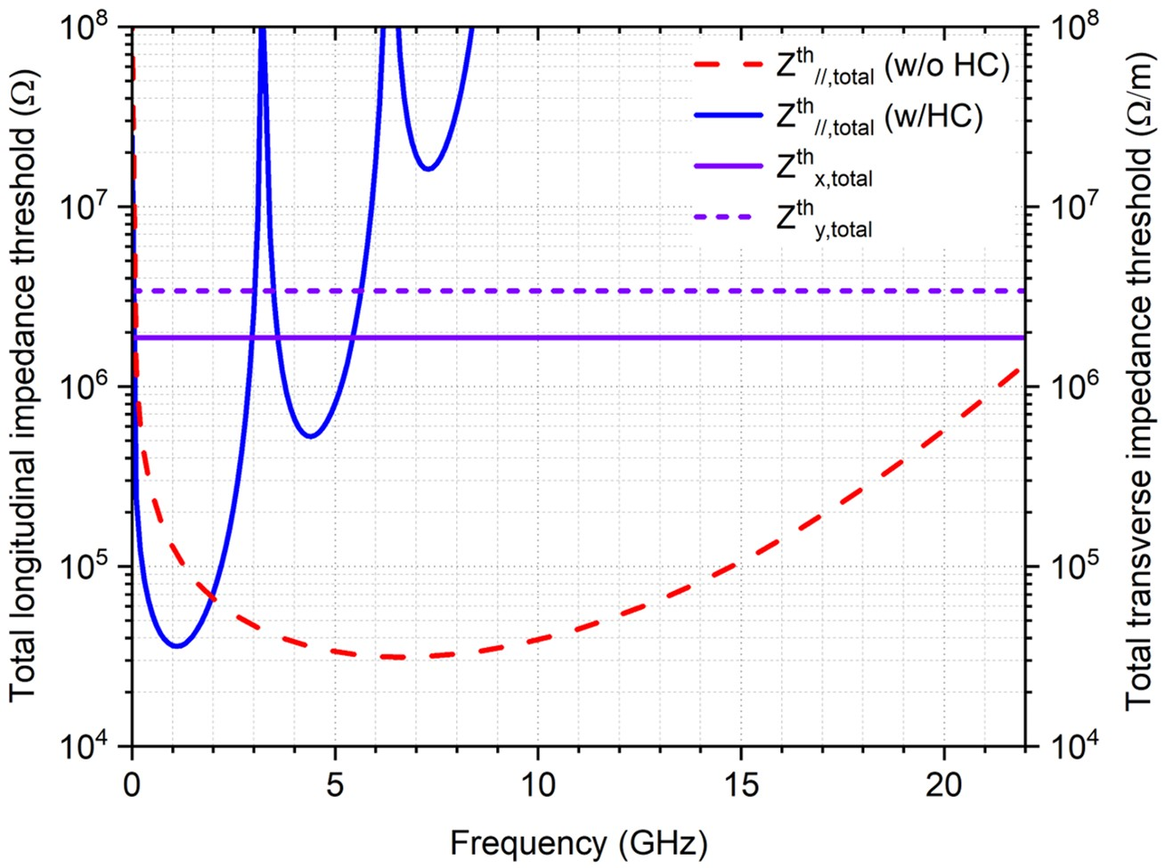
Challenge of HOM damping
HOM damping is one of the key points and difficulties in the design of HEPS SRF system:
Heavy damping to avoid CBI, even lower threshold was desired when third harmonic cavities came into play (Qe:10²~10³ ).
Low-frequency HOMs with large R/Qs.
Preserving the compactness of the overall cavity geometry.
Impedance threshold
2.1GHz

Slide 16
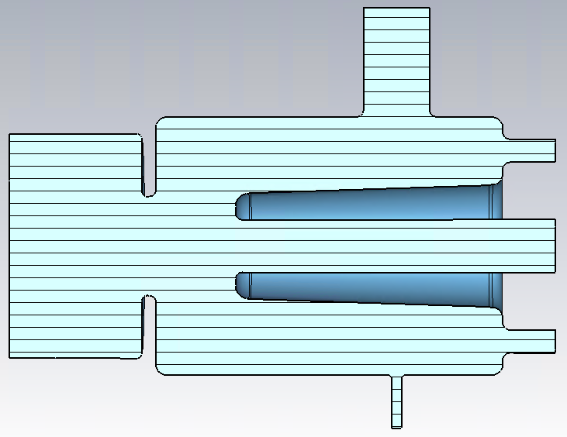
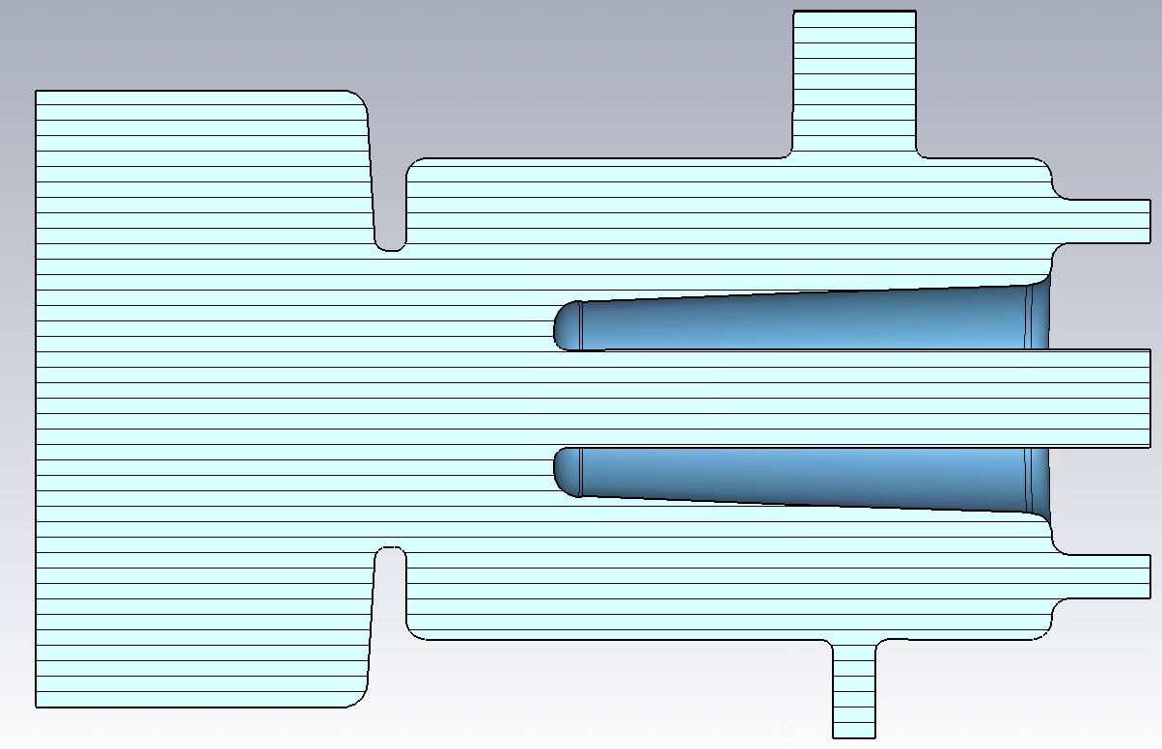
Evolution of 166.6MHz cavity design
The increase of beam pipe diameter is mainly determined by the transmission and the suppression of higher order modes.
d_LBP (mm) | Cut off f (MHz) | Trapped modes
170 | fc TM01: 1350 fc TE11: 1034 | M2/M3/M4/M5/M6 D1/D2/D3/D4
340 | fc TM01: 675 fc TE11: 586 | M2 D1
505 | fc TM01: 454 fc TE11: 348 | None
d_LBP=170mm
d_LBP=340mm
d_LBP=505mm
HEPS-TF PoP cavity
Enlarge BP cavity
HEPS LBP cavity

Slide 17
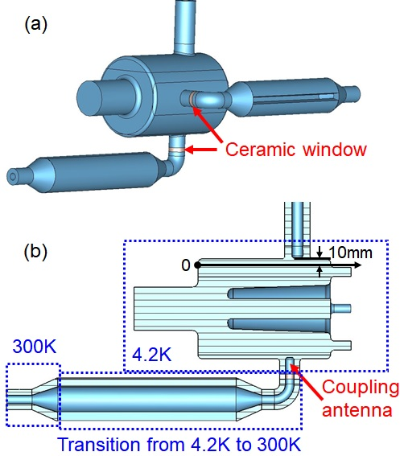
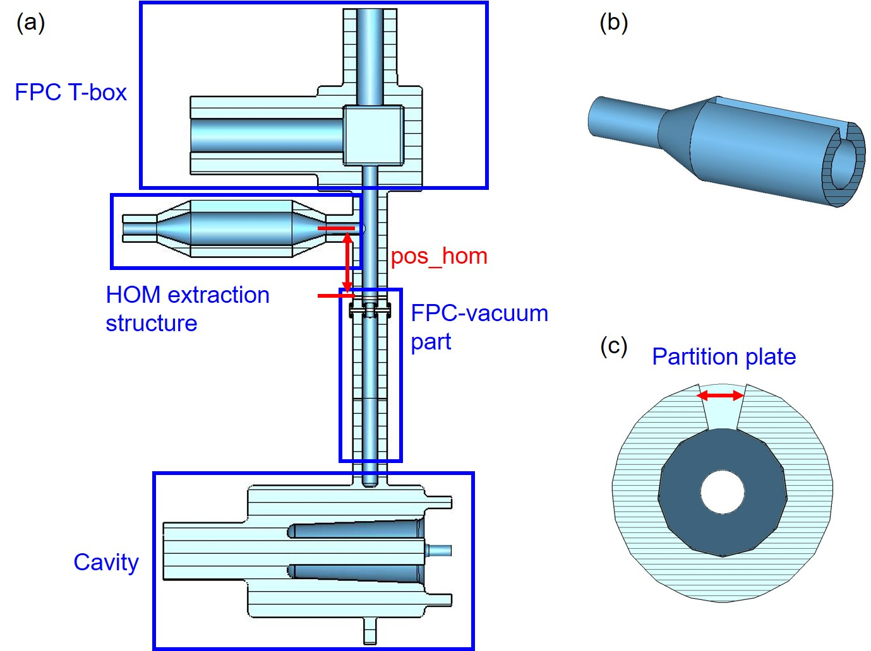
Damping design for PoP cavity
HOMs extracted by the FPC and transmitted through a C-waveguide (CWG) and subsequently damped in a conventional rf load outside the cryomodule.
No additional ports are required on cavity.
Simplifying the cryomodule design.
Can not meet the CBI requirements.
Dipole modes with two polarizations call for two CWGs.
The damping results meet the CBI requirements.
High-power ceramic windows needed for the CWGs. It will increase the operational risk.
CWG on-cell
Coupling through FPC
 | M2 | D1_1 | D1_2 | M3
Qe^{th} w/o HC | 2.2╳10³ | 3.3╳10³ | 1.8╳10³ | 2.3╳10³
Qe^{th} w/ HC | 3.4╳10² | 3.3╳10³ | 1.8╳10³ | 3.9╳10²
Qe (CWG-FPC) | 2.4╳10³ | 4.1╳10¹³ | 3.2╳10⁴ | 4.7╳10³
Qe (CWG on-cell) | 2.4╳10² | 1.3╳10² | 1.6╳10² | 48

Slide 18
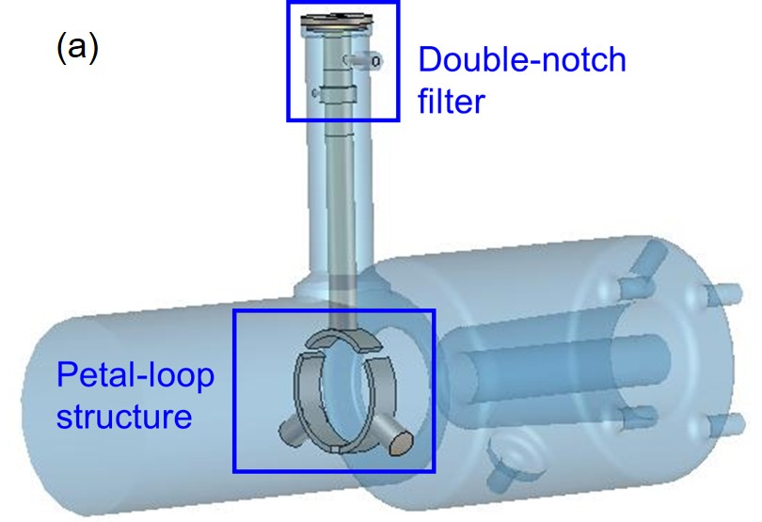
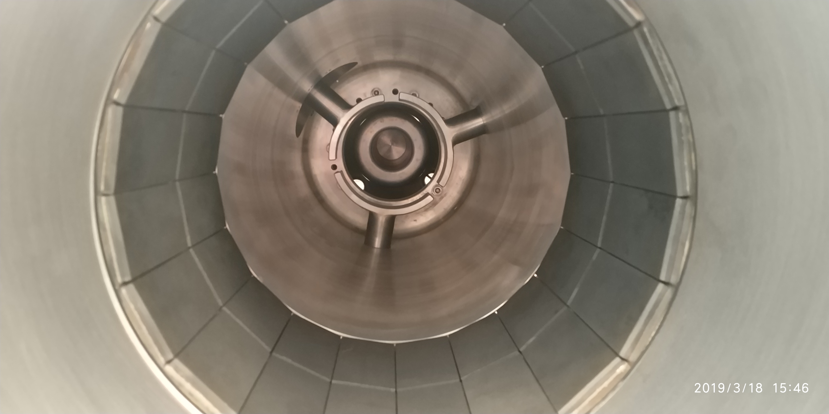
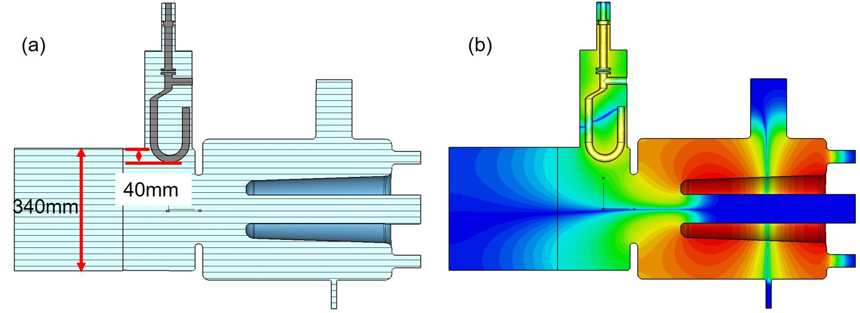
Damping design for enlarged BP cavity
Petal-loop HOM coupler
The coupler consists of a petal loop, a coaxial section and a double-notch filter.
An aluminum mockup was produced.
Issues like chemical treatment and cleaning, as well as cooling of the petal rings, are challenges to be solved.
The measured Qe for M2 is 2.7╳10³, ,which is far from satisfying the required damping (Q_{e}^{th}= 3.4╳10²).
Hook HOM coupler
No high-power ceramic window.
Compactness and complicated design.
A notch is needed.
Only a small portion of M2 mode is propagating to the beam tube where the coupler is located.
The optimized Qe for M2 is 4.8╳10⁴, which is far from satisfying the required damping (Q_{e}^{th}= 3.4╳10²).

Slide 19
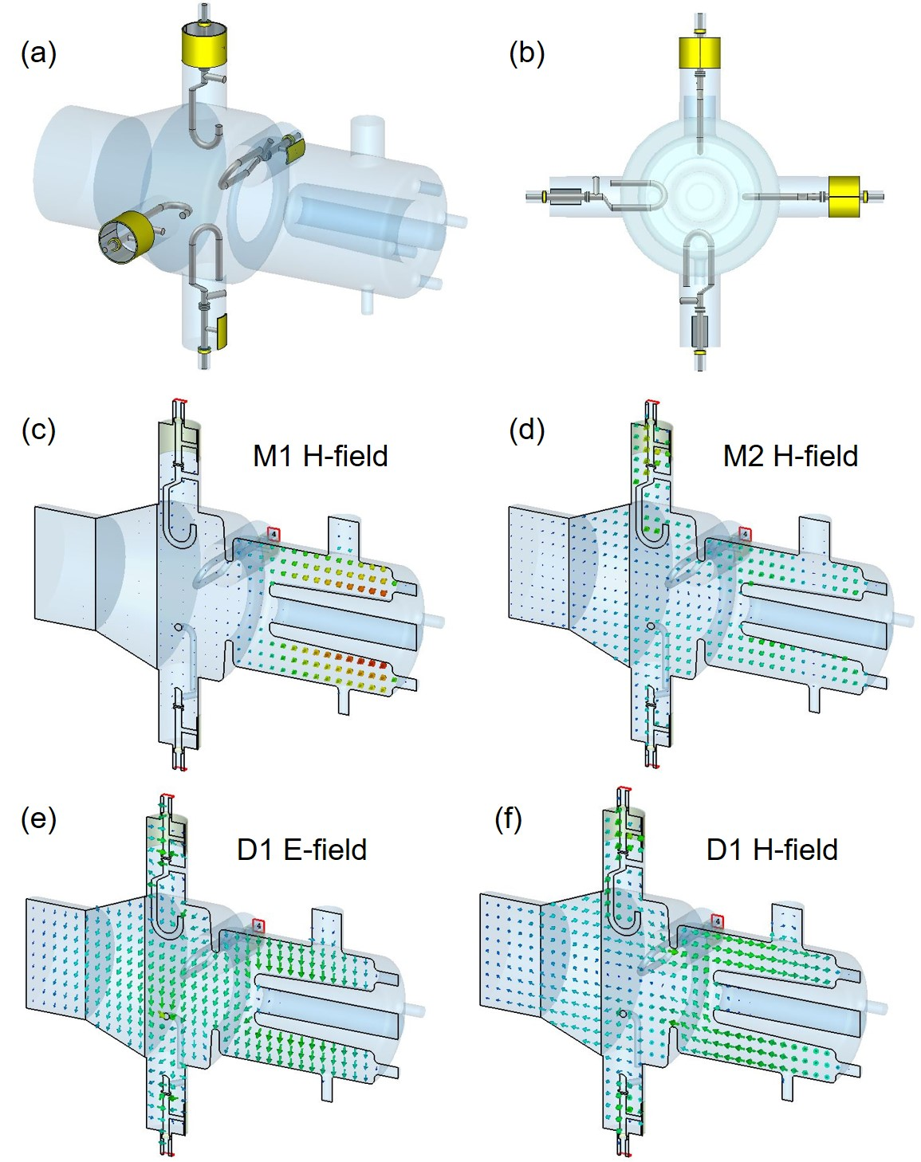
Damping design for locally enlarged BP
To suppress M2 effectively, the beam tube diameter was locally enlarged to 500 mm, so that the mode can escape the cavity.
A notch filter is added to reject the power of the fundamental mode.
A large portion of the energy for the modes except M2 and D1 will propagate along the beam tube and be absorbed by the downstream HOM damper.
Total Qe of the fundamental mode is 1.4╳10⁹.
The damping results meet the CBI requirements.
 | M2 | D1_1 | D1_2
Z^{th} w/o HC | 7.48╳10⁴ | 3.73╳10⁵ | 3.73╳10⁵
Z^{th} w/ HC | 1.17╳10⁴ | 3.73╳10⁵ | 3.73╳10⁵
Z | 5.77╳10³ | 1.64╳10⁵ | 2.11╳10⁵

Slide 20
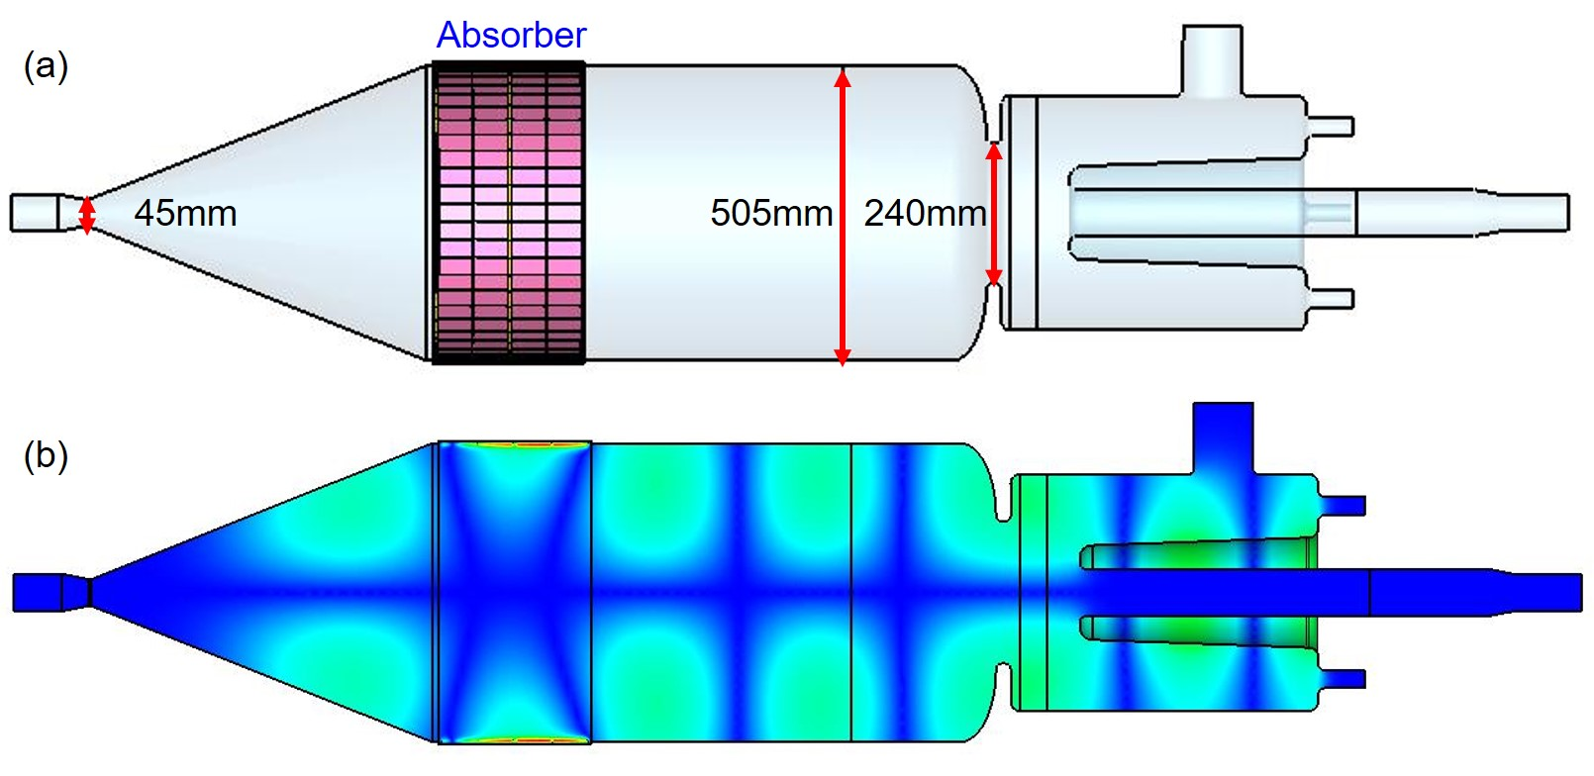
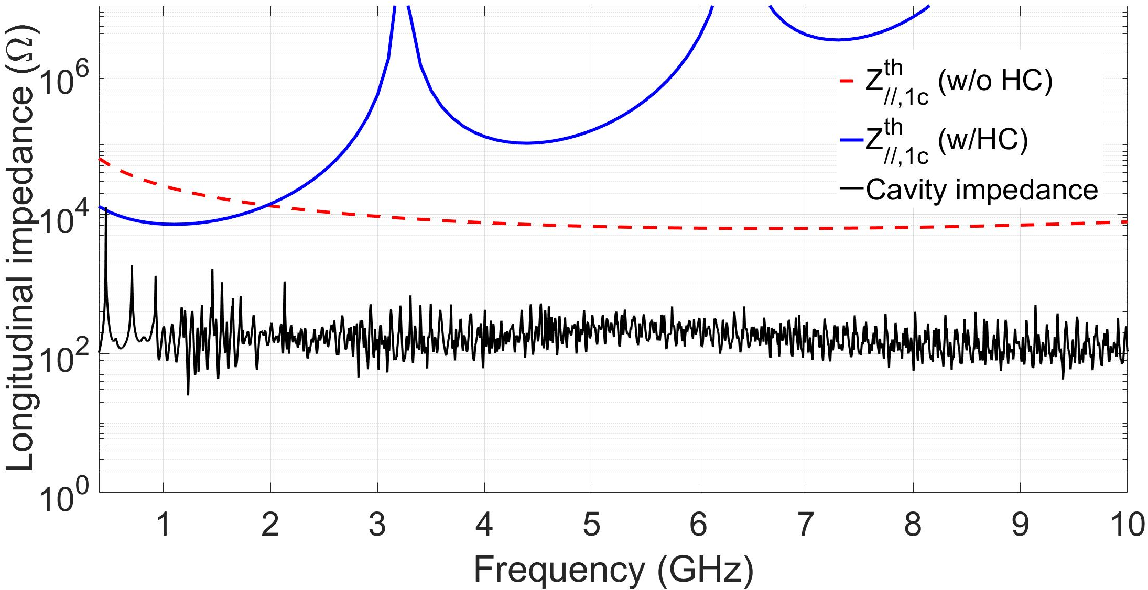
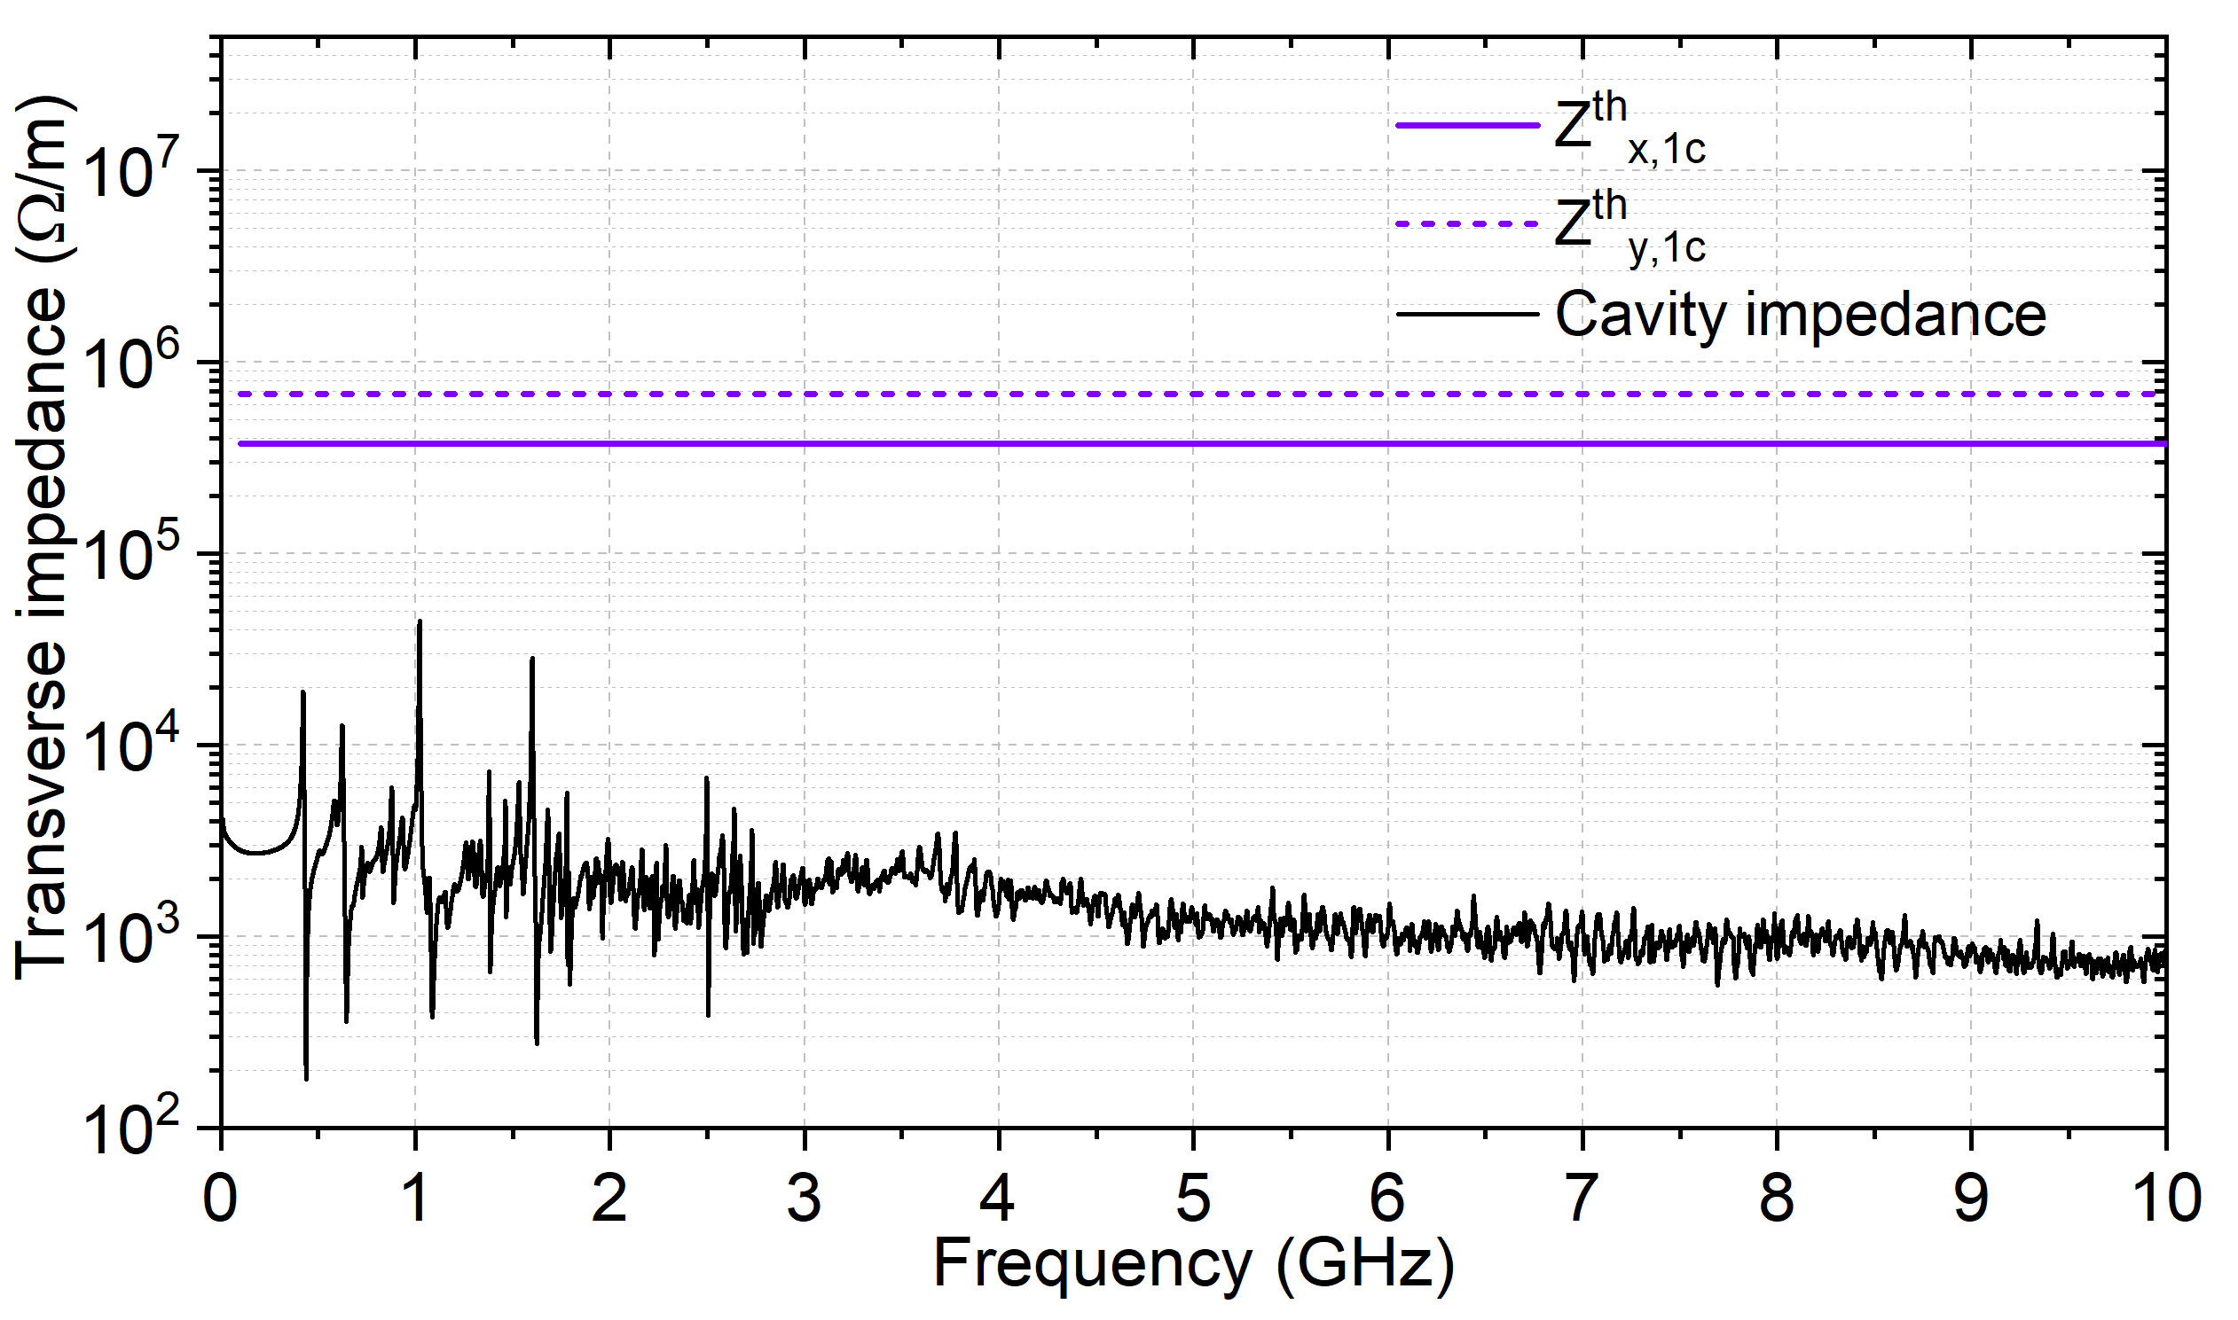
Baseline design of HOM damping
The four hook HOM coupler design meets the CBI requirements and can be realized in actual, if its complexity is not taken into account.
Ultimately, a straightforward method of using only the HOM absorber on an enlarged beam pipe was adopted.
This scheme brings challenges to the development of the ferrite absorber with an inner diameter of 505 mm.
M2 H-field

Slide 21

HOM power analysis with different filling pattern
The loss factor is calculated to be 2.5 V/pC for HOMs with a natural bunch length of 5.06mm. The average HOM power losses can be calculated as single pass excitation by kqI.
The accurate estimation of the HOM power is depended both on the beam parameters and the geometry design of the cavities.
There are two different operation mode for the HEPS storage ring: high charge and high luminosity.
 | High charge | High luminosity
Bunch rms length (σ_{z}) [mm] | 5.06 | 5.06
Loss factor for HOM (k_{HOM}) [V/pC] | 2.54 | 2.54
Beam current [mA] | 200 | 200
Bunch number | 63 | 680
Bunch charge [nC] | 14.41 | 1.33
Average HOM power [kW] | 7.32 | 0.68

Slide 22
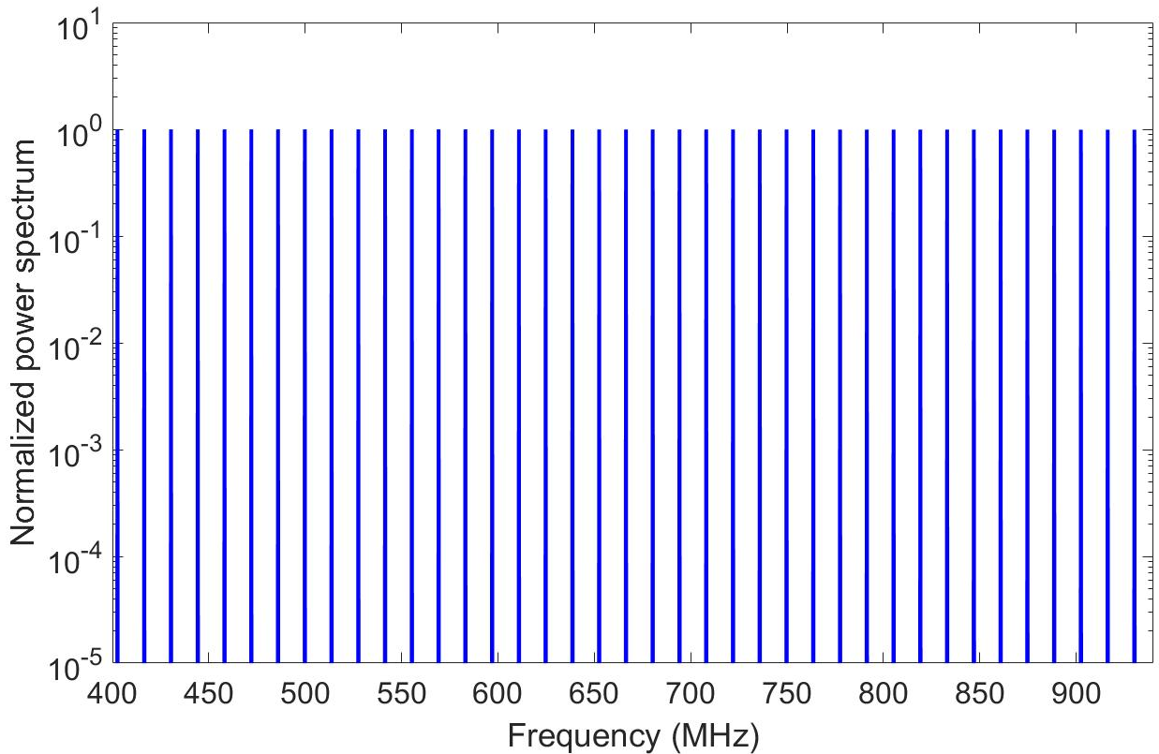
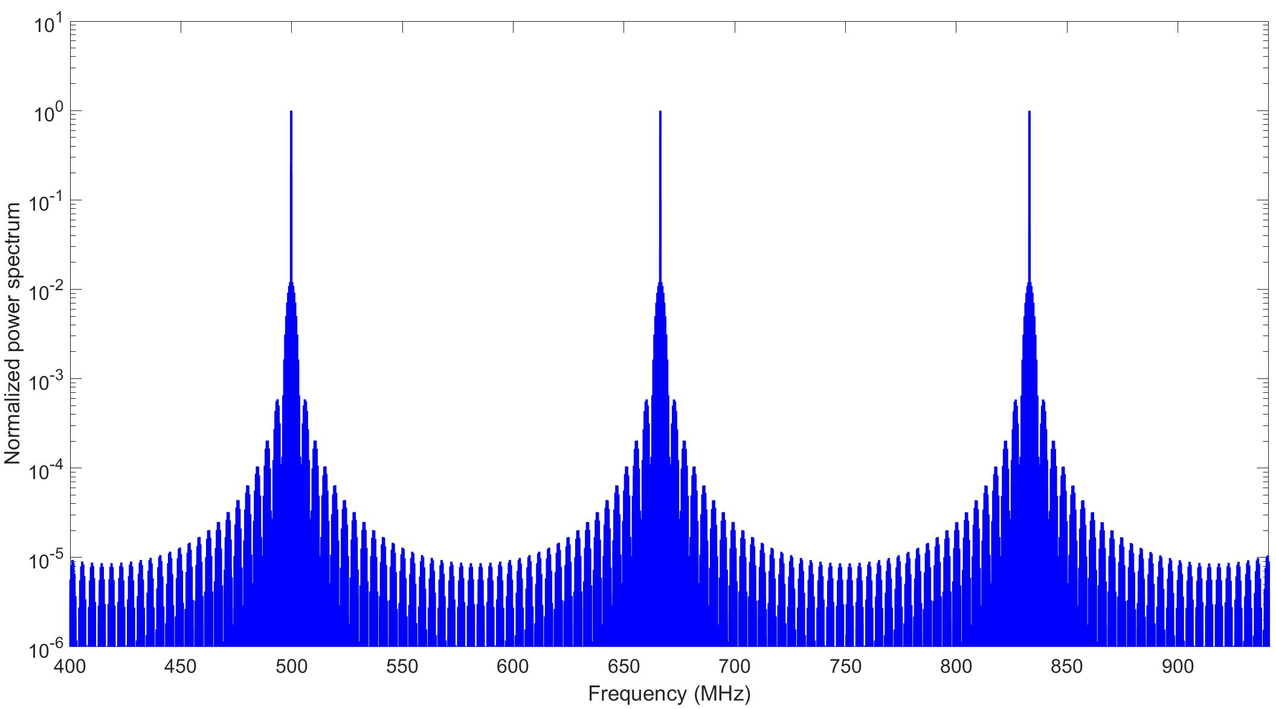
HOM power analysis with different filling pattern
RF buckets: 756.
High charge operation: the beam contains 63 bunches, a simple uniform filling scheme is considered.
High luminosity operation: the beam contains 680 bunches, 1/2/4 trains are considered.
High charge
High luminosity with 2 trains
1/t_{bb}=12 rf buckets=13.9MHz
1/t_{bb}=1 rf buckets=166.6MHz

Slide 23
HOM power analysis with different filling pattern
RF buckets: 756.
High charge operation: the beam contains 63 bunches, a simple uniform filling scheme is considered.
High luminosity operation: the beam contains 680 bunches, 1/2/4 trains are considered.
The HOM power of different filling patterns are all smaller than the averaged HOM power.
 | High charge |  | High luminosity
 | P (W) | P^{avg} (W) | P (W) [1 train] | P (W) [2 train] | P (W) [4 train] | P^{avg} (W)
300<f<941MHz | 214 | 498 | 7.3 | 7.4 | 7.4 | 46
941<f<23060MHz | 6697 | 6817 | 614.9 | 615 | 615.1 | 629
Total | 6911 | 7315 | 622.2 | 622.4 | 622.5 | 675

Slide 24
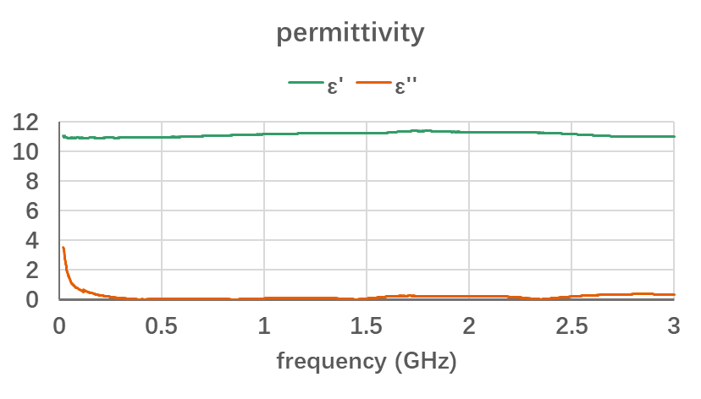
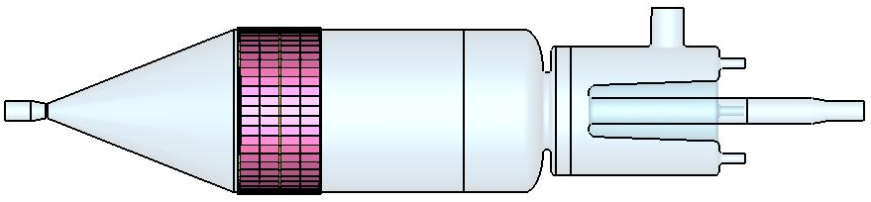
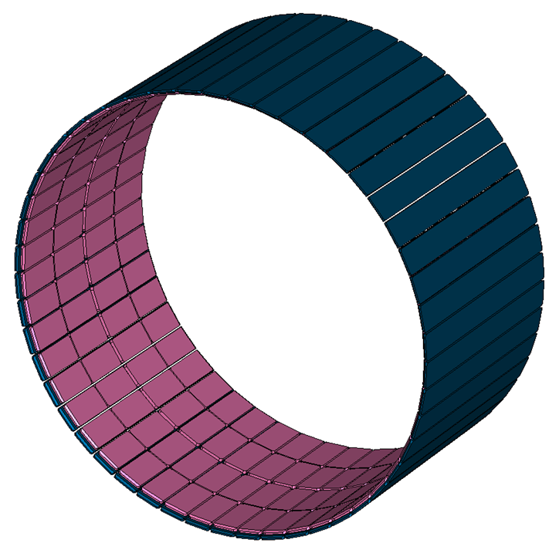
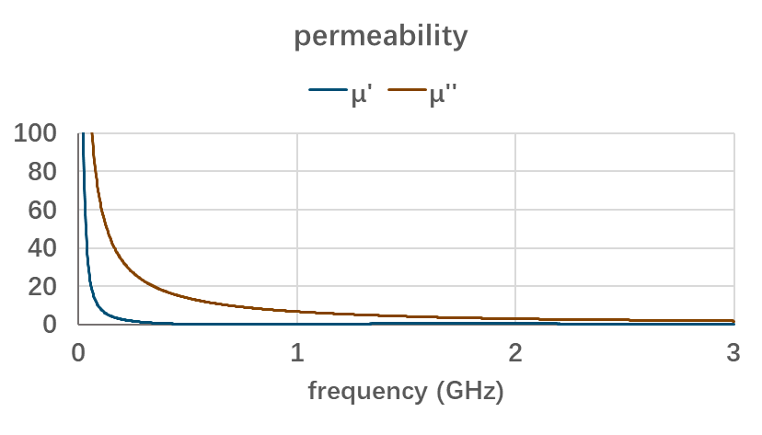
HOM Absorber (on 166.6MHz cavity)
Fanbo Meng
Design power 10 kW.
Damper inner diameter is 505mm
Polygon with 50 edges to fit circular
4 ferrite chips on each edge
Total 50×4=200 ferrite chips

Slide 25
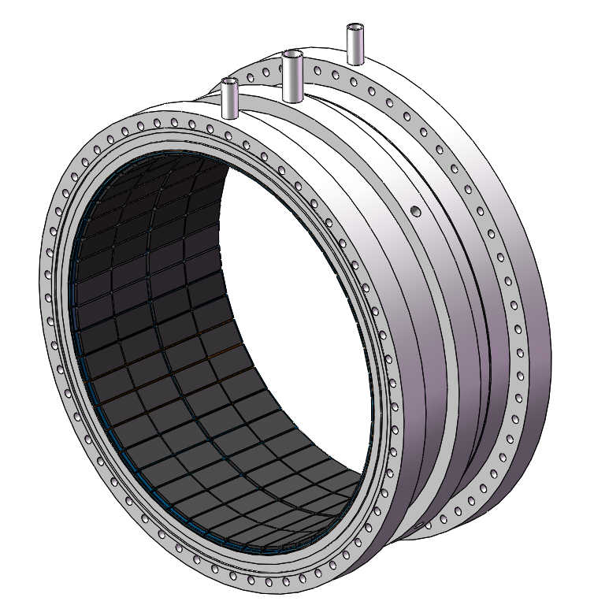






HOM Absorber (on 166.6MHz cavity)
Fanbo Meng
RF power: 10kW
Water flow rate: 9L/min
The max temperature of ferrite: 58℃
Mechanical structure of damper
Water cooling simulation
Ferrite defect location 3D reconstruction
Ferrite defect ultrasound detection

Slide 26


HOM Absorber (on 166.6MHz cavity)
Fanbo Meng
D1
M2
D2
High power test in vacuum
M3
Damping results by horizontal test
Vacuum: 1e-6
Absorbing power: 10kW
No extra degassing

Slide 27

Summary
For CEPC 650 MHz 2-cell cavity, a double-notch hook HOM coupler design was proposed, the damping results can meet the requirements.
Five different design schemes were proposed to satisfy the beam stability requirements for HEPS. Each design scheme can extract HOM power to a certain extent. Finally, considering the simplicity of the superconducting cavity system design and the stability of long-term operation, the straightforward damping method popular for storage ring cavities taking large beam currents was adopted.

Slide 28


Thank You for Your Attention!
CEPC
HEPS

