Slide 1
Thin film SRF cavity R&D at IHEP
Jin Dai
IHEP, CAS
11th IHEP-KEK SCRF Collaboration Meeting
Beijing, 20 Nov 2023

Slide 2
Outline
Copper Niobium Sputtering Cavities
Introduction
Substrate cavities
Copper surface preparation
- SUBU chemical polishing
- Centrifugal barrel polishing
- Electrochemical polishing
Inner surface inspections
DCMS coating
HiPIMS coating
Nb3Sn Superconducting Cavities
Setup of the furnace
Nb3Sn coating

Slide 3
Copper Niobium Sputtering Cavities

Slide 4
Introduction
Nb/Cu study at IHEP launched in 2017
A small working group (~7 persons, ~2-3 FTEs): physicists, engineers and postgraduates
Main interests: Nb/Cu, Nb3Sn/Cu, NbN/Cu

Slide 5
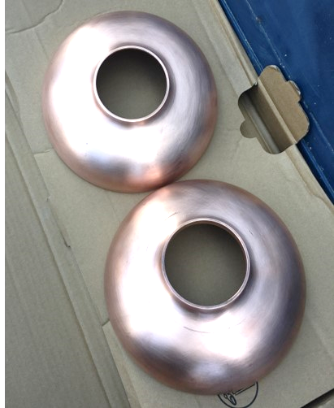
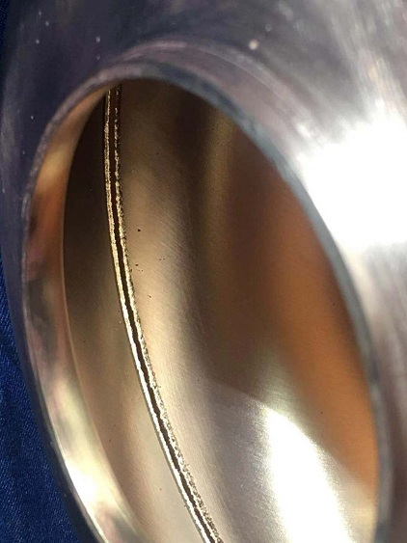
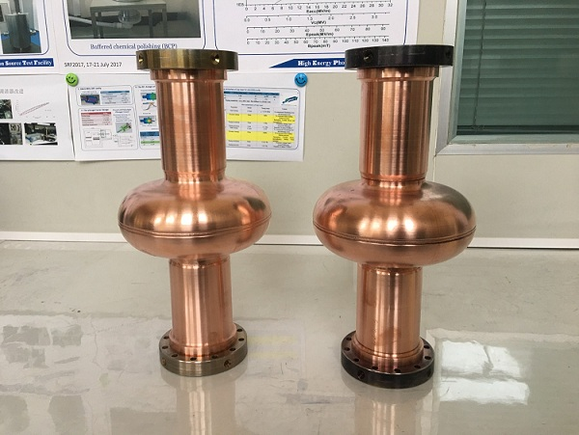
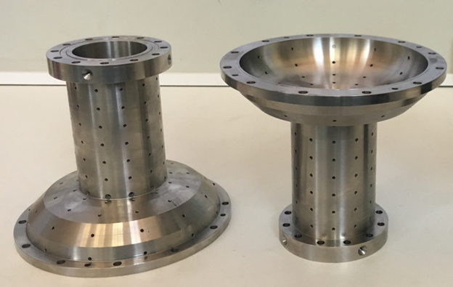
Substrate cavities
Copper cavities
- 1.3GHz mono-cell shape with beam pipe extensions
- ASTM C10100 copper, deep drawing + electron-beam welding
- 4 copper cavities produced
Sample holder cavities
- copper samples can easily fixed on beam pipe, cell, iris, equator
- 2 stainless-steel cavities produced

Slide 6
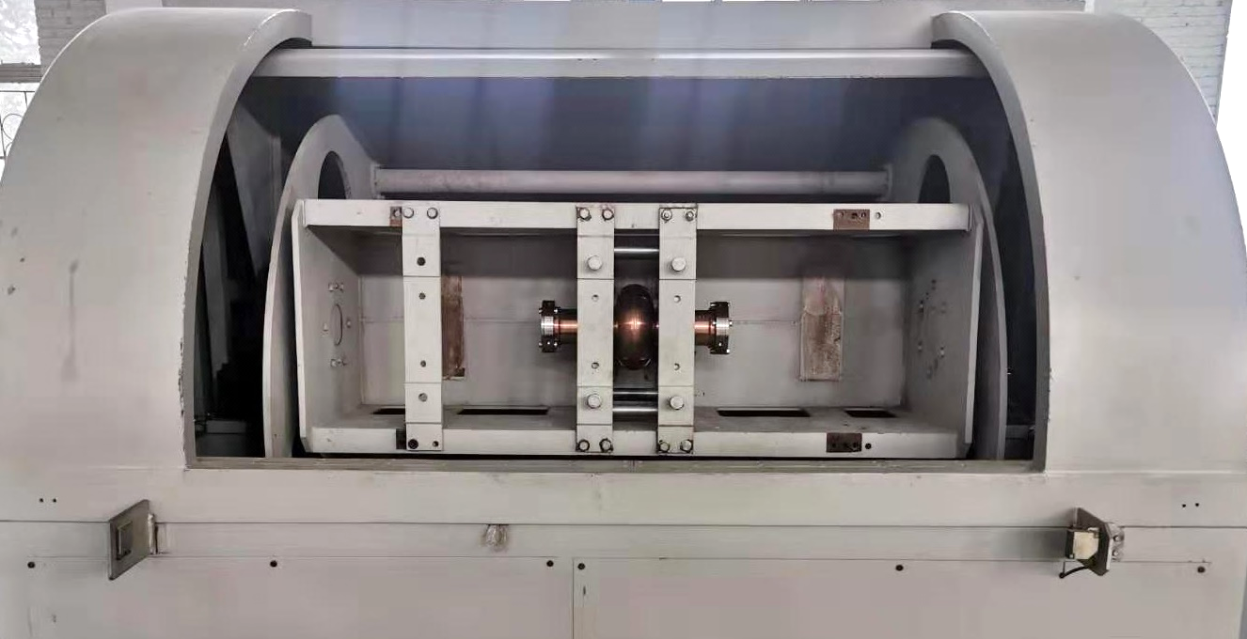
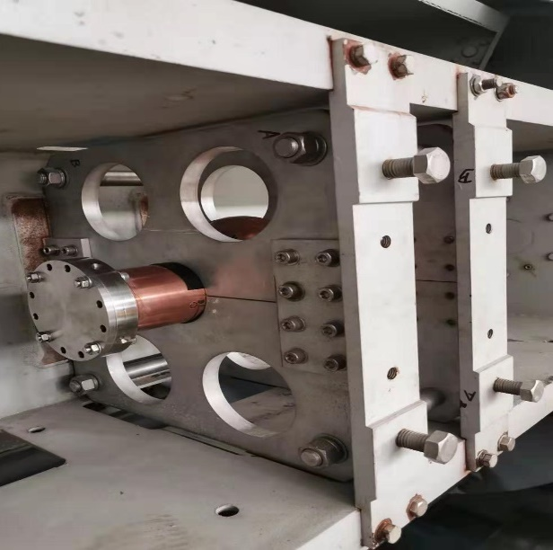
Centrifugal barrel polishing (CBP)
Centrifugal barrel polishing system previously developed for 1.3GHz 9-cell bulk-Nb cavity was used for copper cavities
The copper cavity is fixed on a cage that rotates around the equipment axis, and then it can rotate on its own. These two rotational degrees of freedom allow the abrasive inside to polish different positions in the cavity

Slide 7
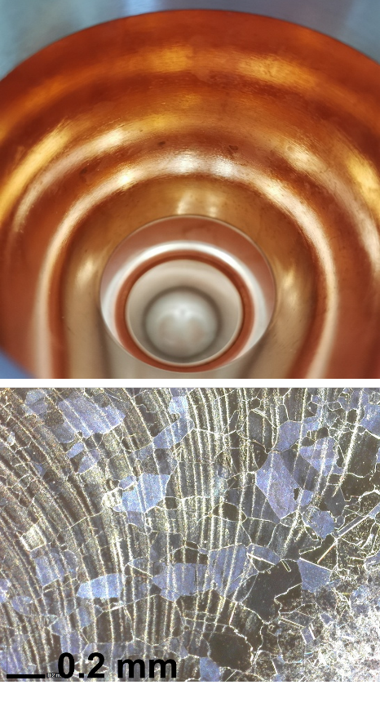
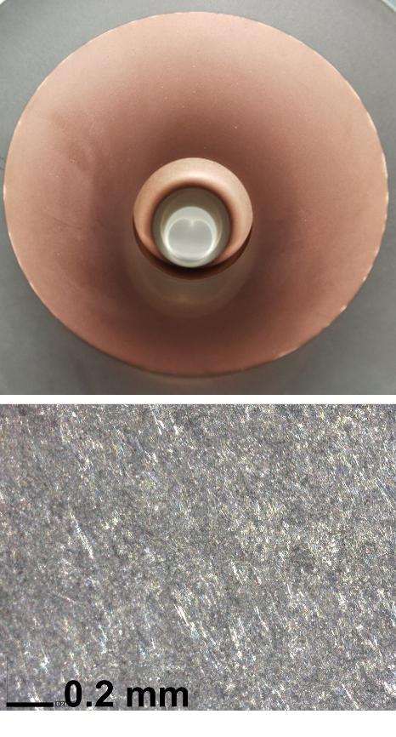
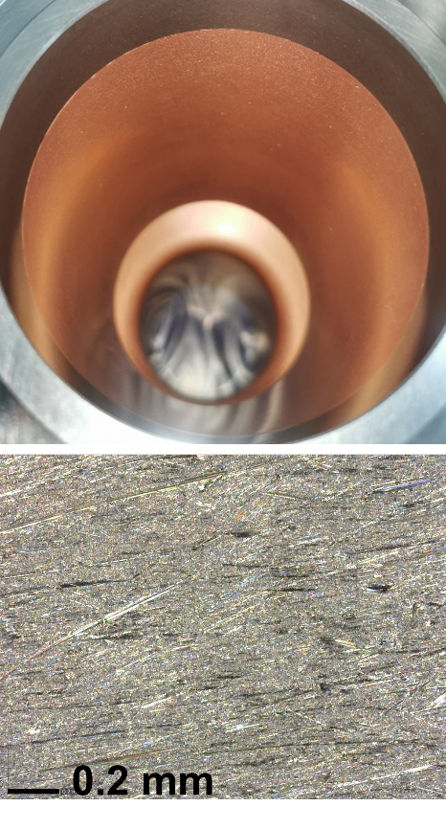
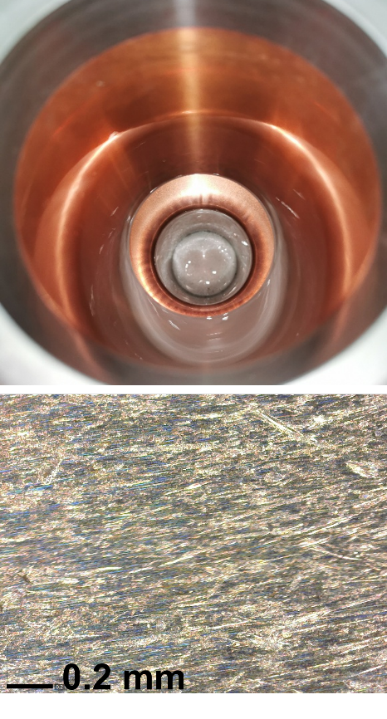
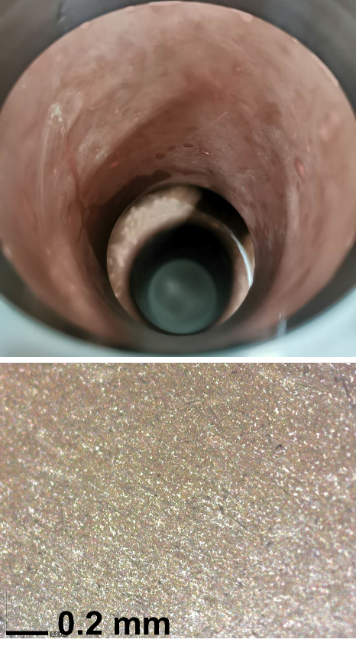
CBP: original recipe
90RPM
Before polishing
Ceramic triangles
(50 hours)
RG-22 resin cones
(25 hours)
3µm diamond suspensions & 5mm hardwood blocks
(38 hours)
0.04µm non-stick colloidal silica
(90 hours)

Slide 8
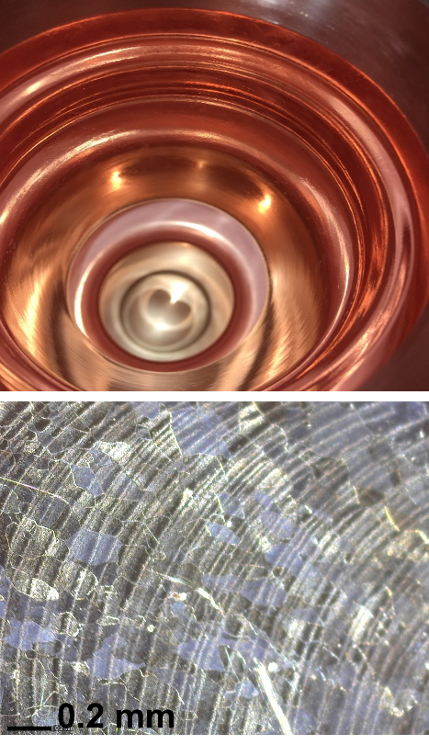
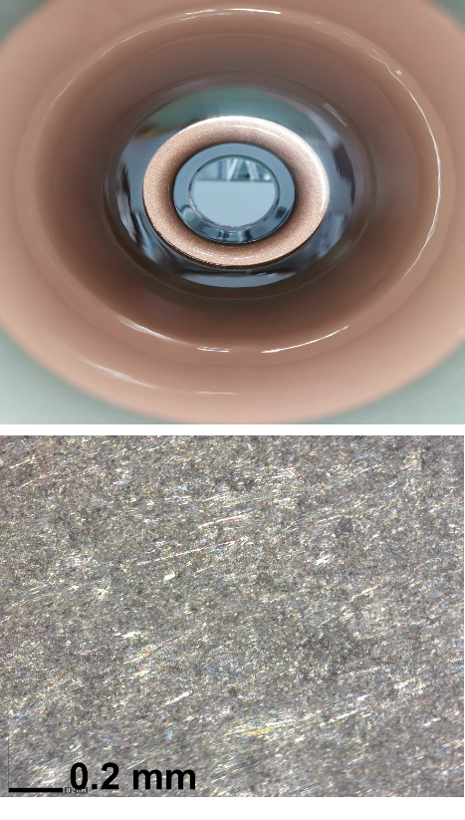
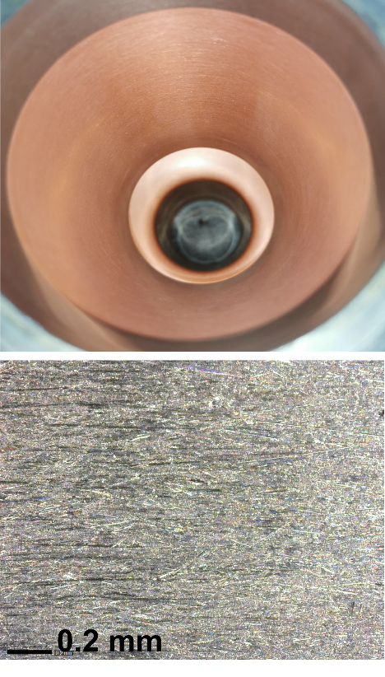
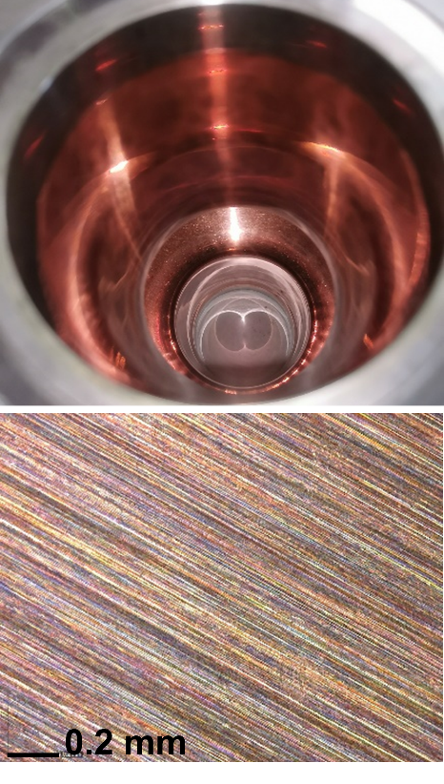
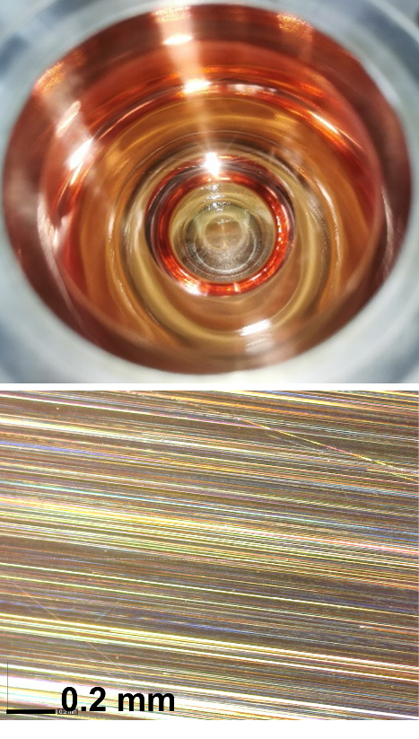
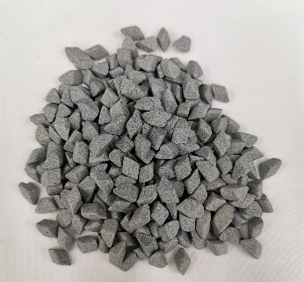
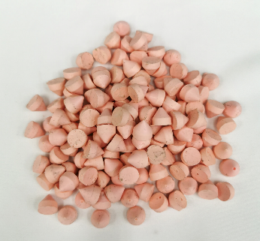
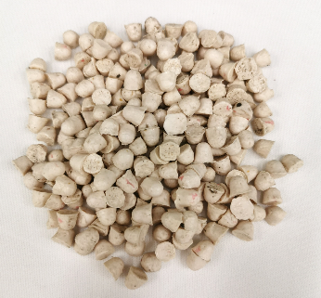
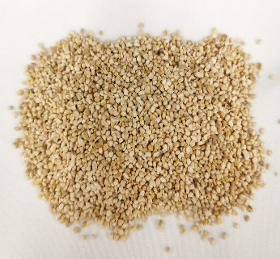
CBP: new recipe
90RPM
Before
polishing
Corundum angle cut triangles
(6mm*6mm, 240-grit)
(50 hours)
1000-grit resin cones
(10mm*10mm)
(25 hours)
2000-grit resin bullets
(25 hours)
Corncobs & metal polishing paste
(5 hours)

Slide 9
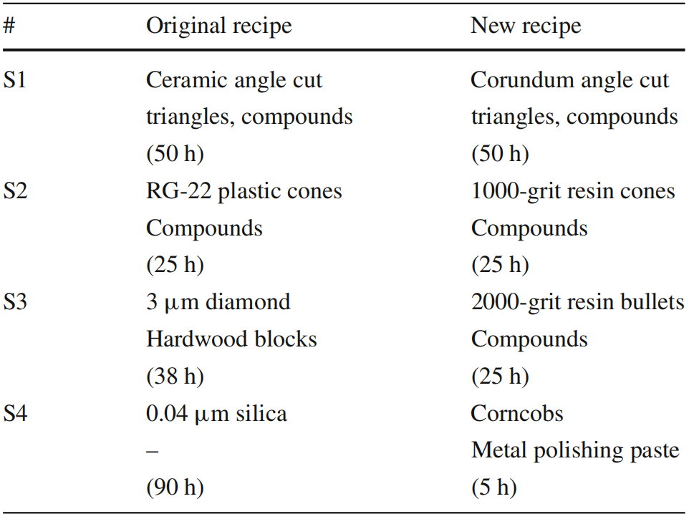
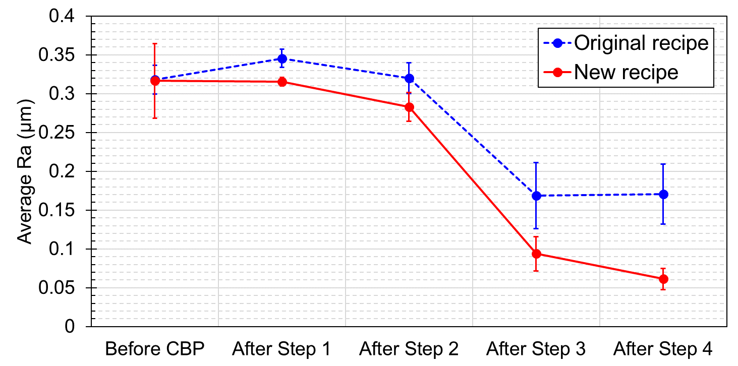
CBP: comparison
With the new recipe, after 5 hours of final polishing, a mirror-like surface was finally created, and the roughness further improved to be 60 nm
Average roughness of the copper cavity surface after each polishing step by using two different recipes
F. Yang et al., Radiation Detection Technology and Methods 5, 33-41 (2021). DOI: https://doi.org/10.1007/s41605-020-00215-8

Slide 10
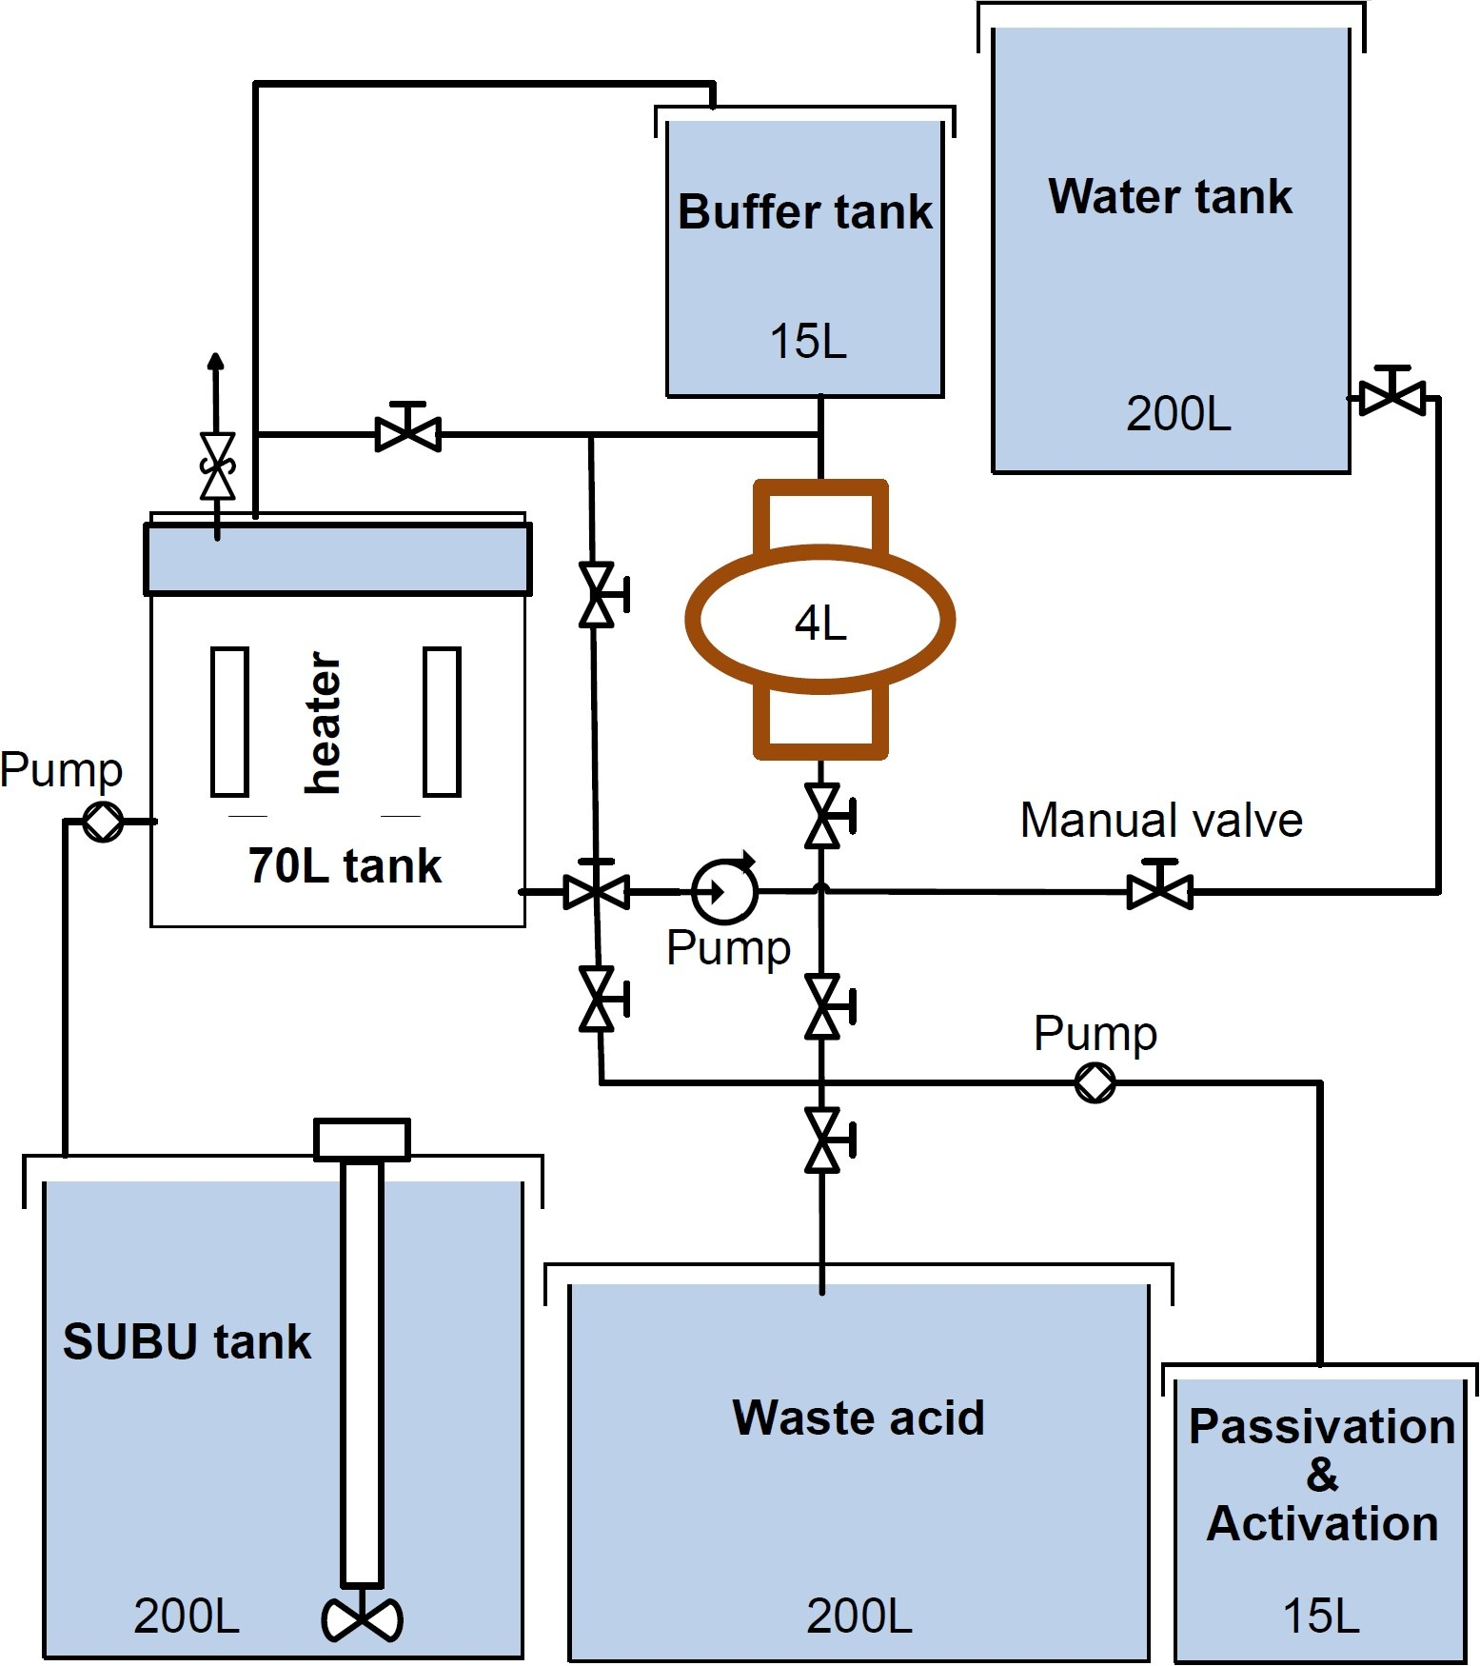
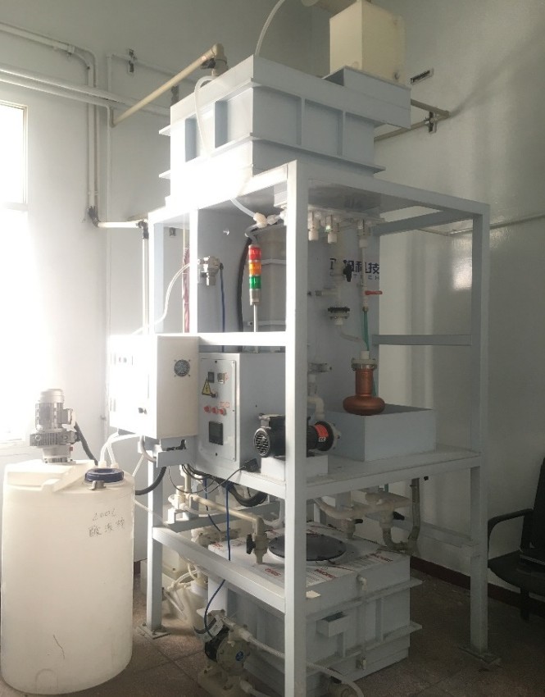
SUBU system
Enclosed design
- Single sided polishing, saving half of the acid solution and related post-processing costs
- Prevent acid gas from entering the environment at high-temperature
- The copper cavity is not exposed to the atmosphere, which can prevent internal surface oxidation
Buffer box
Pure water tank
Heating box
Copper cavity
Passivation barrel
SUBU preparation barrel
Waste acid tank
F. Yang, et al., Journal of Instrumentation 16, P06031 (2021).

Slide 11
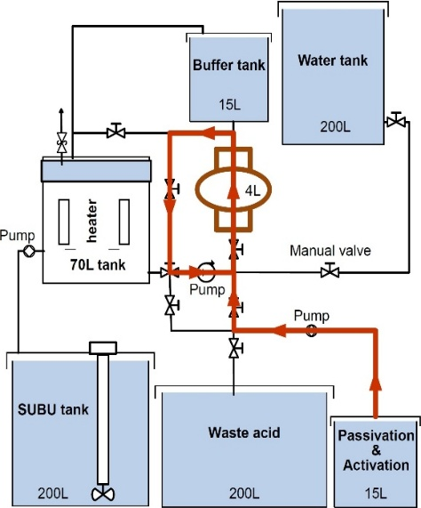
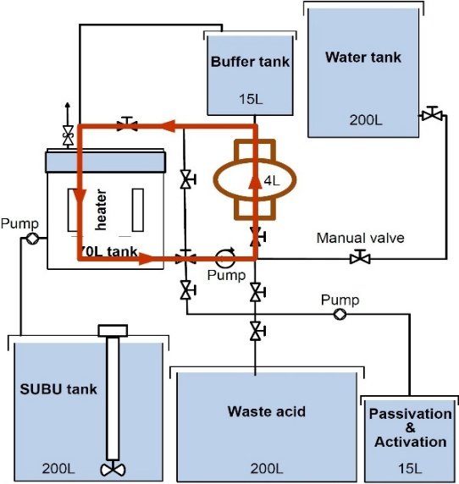
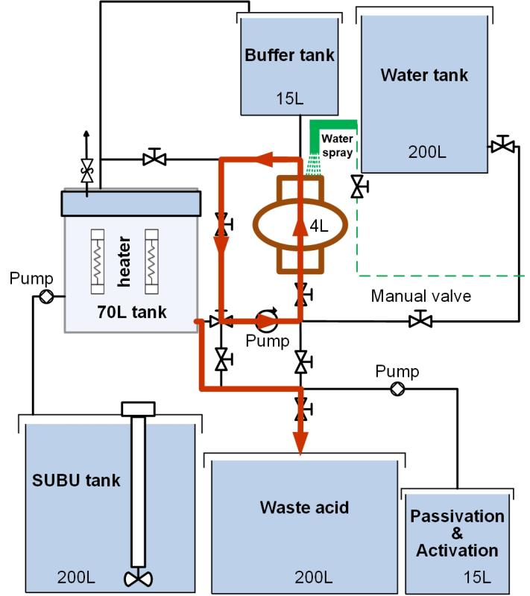
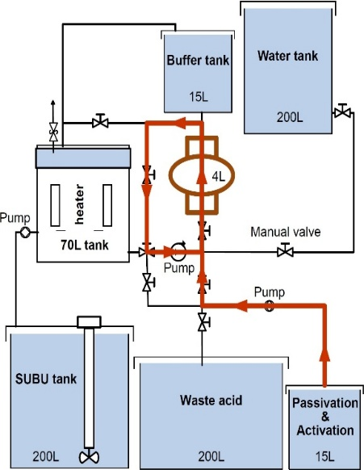
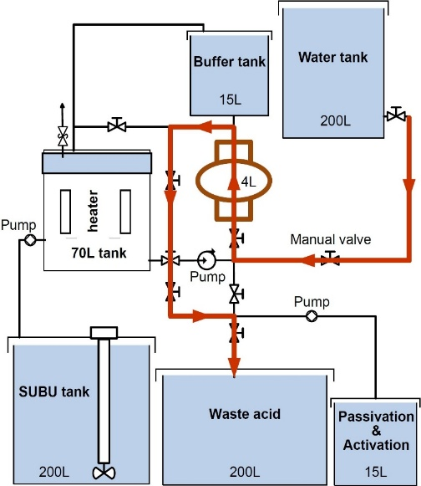
SUBU processes
SUBU solution: followed CERN recipe, sulfamic acid, hydrogen peroxide solution, ammonium citrate, n-butanol and deionized water
Activation
SUBU
Cooling
Passivation
Dilution, rinsing
F. Yang, et al., Journal of Instrumentation 16, P06031 (2021).

Slide 12
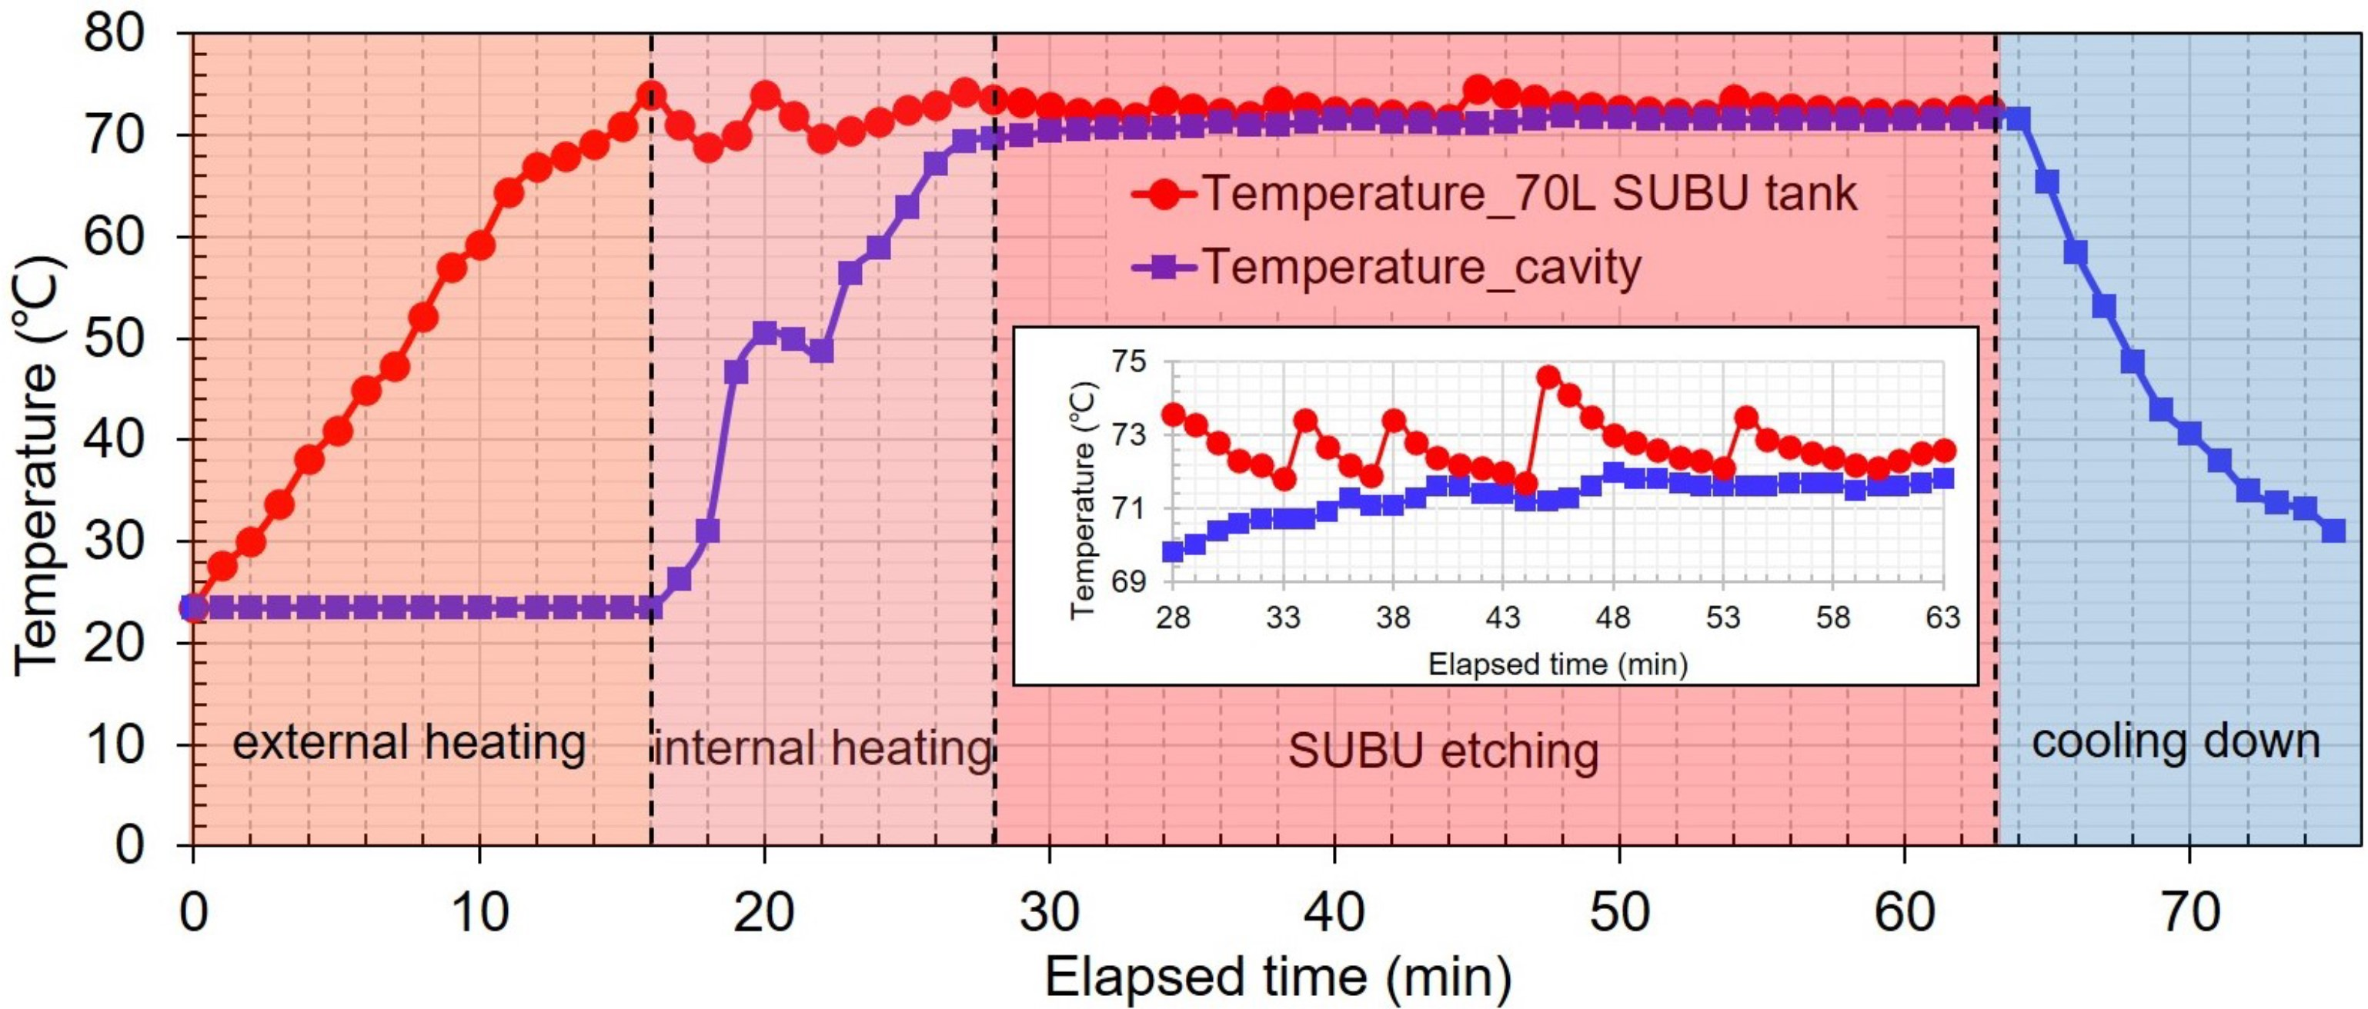
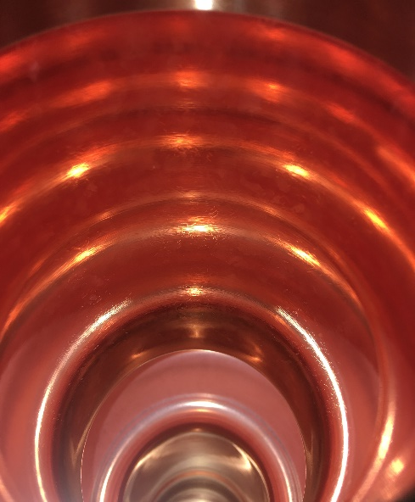
SUBU results
Temperature kept at 72 degC during SUBU
Post-SUBU cooling step added to prevent oxidation, 72 degC -> 25 degC in 10’
Copper surface after SUBU was smooth and bright, average Ra = 0.12 µm

Slide 13
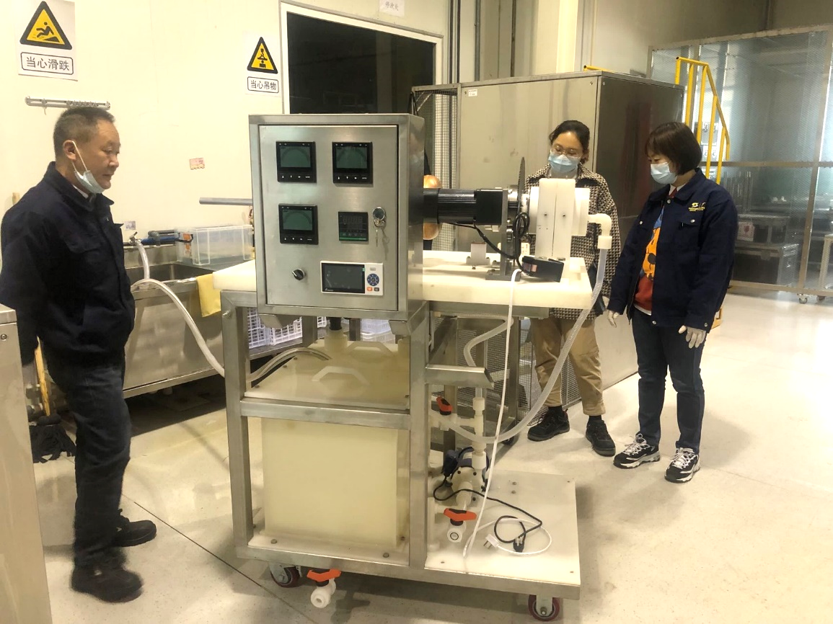
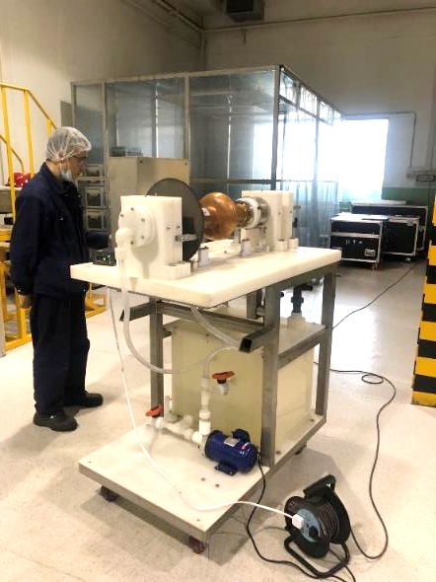
Electrochemical polishing
EP system developed and under commissioning
EP solution: Phosphoric acid (85%), Buthanol (99%), ratio 3:2

Slide 14
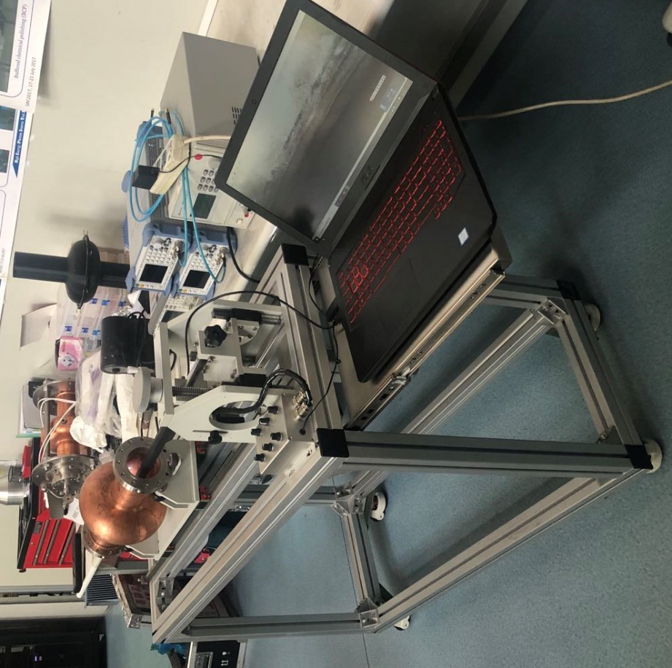
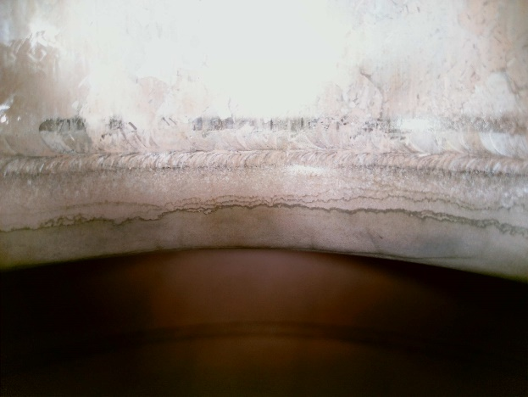
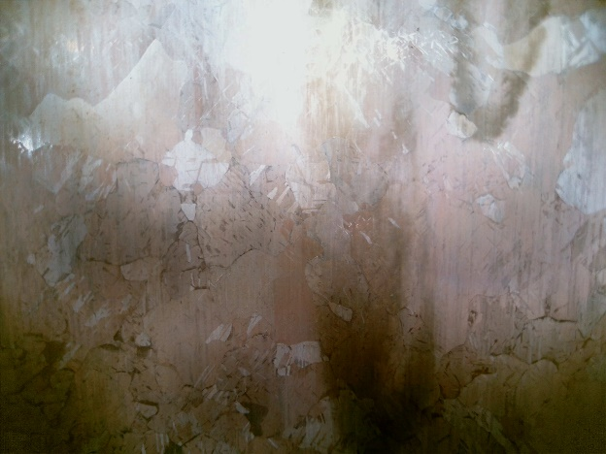
Cavity inner surface inspection
Optical inspection system developed for cavity surface examination (after chemical or sputtering)
- Cavity movement: cavity rotation, cavity translation
- Camera movement: up and down translation, left and right swing
- 8 LED lamps inside the cavity with independent brightness control
Cavity beam tube and cell clearly photographed without dead zone
Iris
Cell

Slide 15
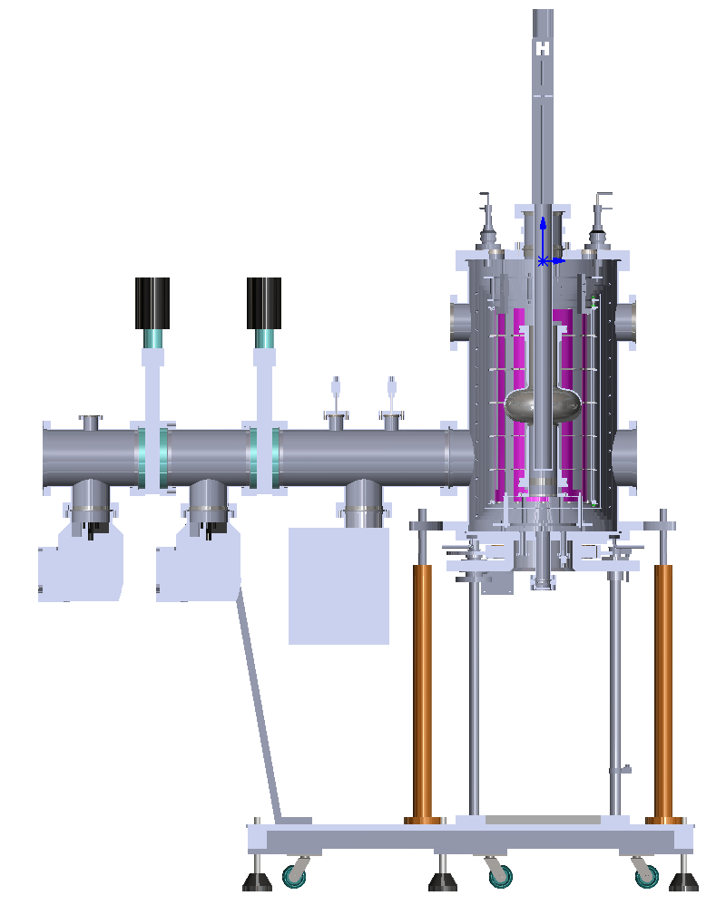
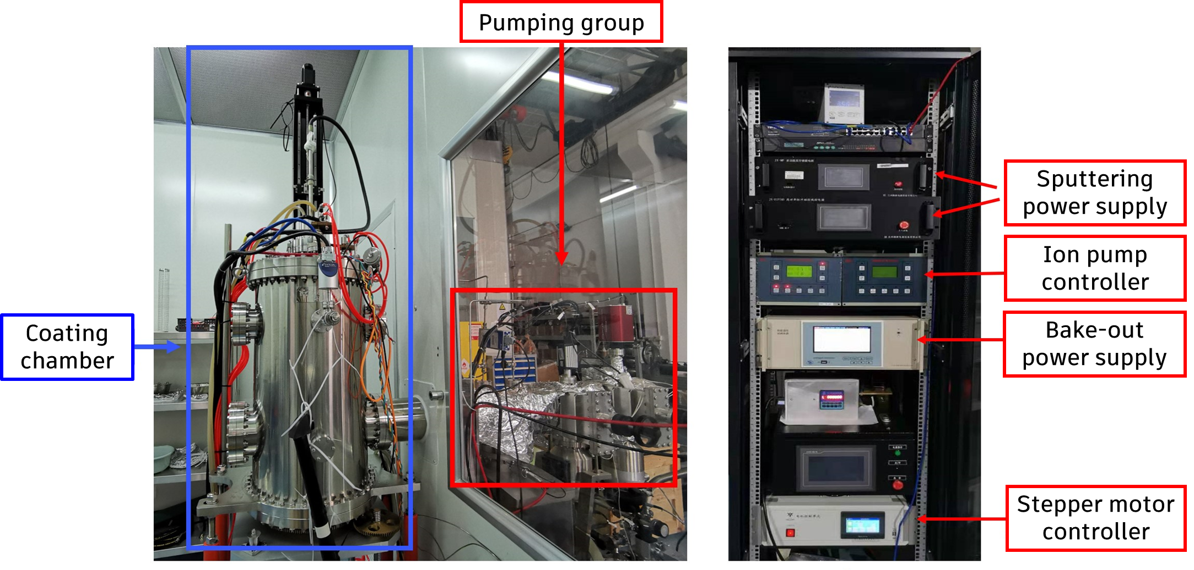
Magnetron sputtering system (DCMS)
DCMS sputtering system developed for 1.3GHz mono-cell cavity Nb coating
- Vacuum inside the coating chamber: 3E-9 mbar
- Diameter of niobium target: 45 mm
- 2 permanent magnetic rings (width: 20mm, 1.35 Telsa) placed concentrically inside Nb target
- South poles of the two magnetic rings were close to each other, a titanium ring of 15 mm length placed in the middle for isolation and positioning

Slide 16
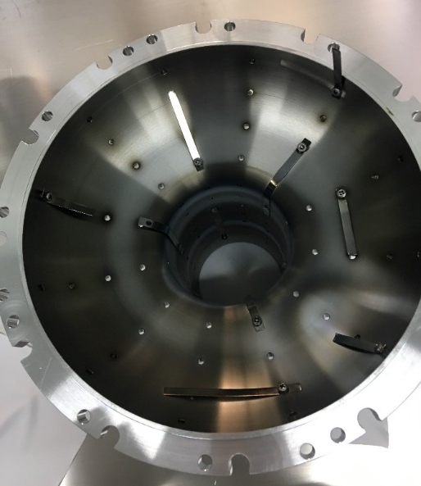
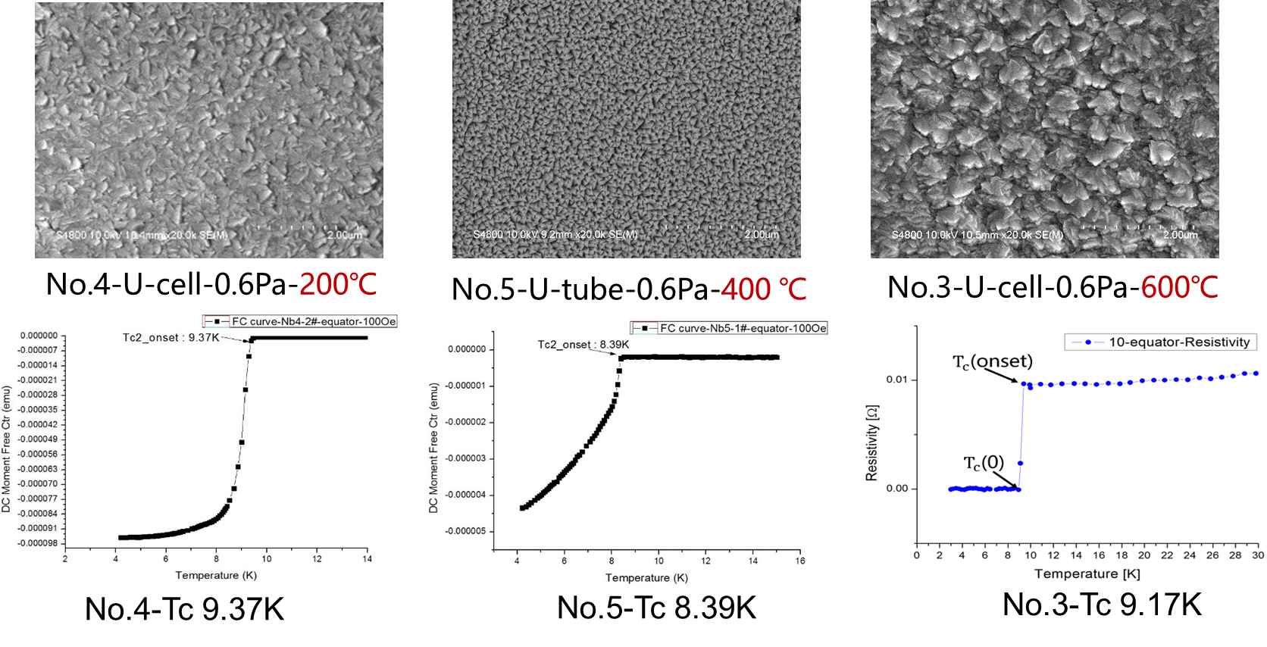
Sample coating results
High temperature create cluster morphology with lower Tc
Chose 200 degC as the coating temperature

Slide 17
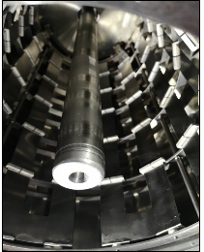
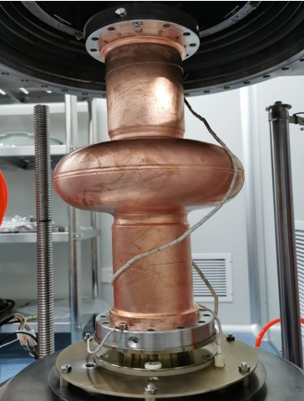
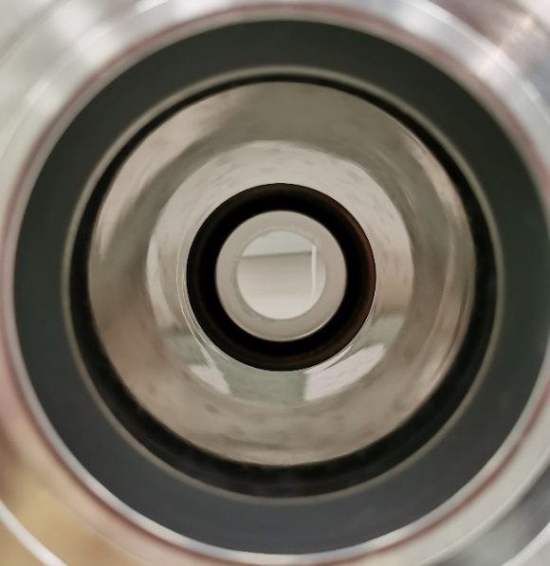

Nb coating
Substrate baked at 400 degC for 48 hours, then cooled to 200 degC to start coating
Vacuum inside the coating chamber: 3 E-9 mbar
Krypton pressure: 0.5 Pa
Duty ratio 0.6, discharge current 3 A
Magnet movement speed: 1 mm / s
Target Nb thickness: 2 μm

Slide 18
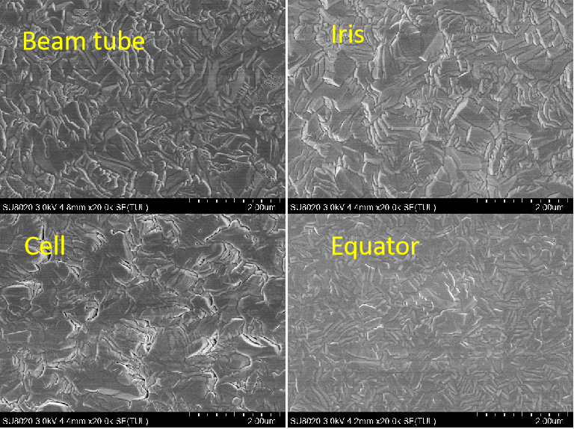
Results
Sample coating prior to cavity coating to examine film qualities
SEM results show that the grain growth at the beam tube, iris and equator was compact. However, there were holes in the film at the cell site, and the grains could not grow together completely.
This may be due to the irregular shape of the cell part of the ellipsoidal cavity, the niobium atoms cannot be vertically incident on the cell surface, resulting in the deposition quality of the niobium atoms on the cell is inferior to other positions.

Slide 19
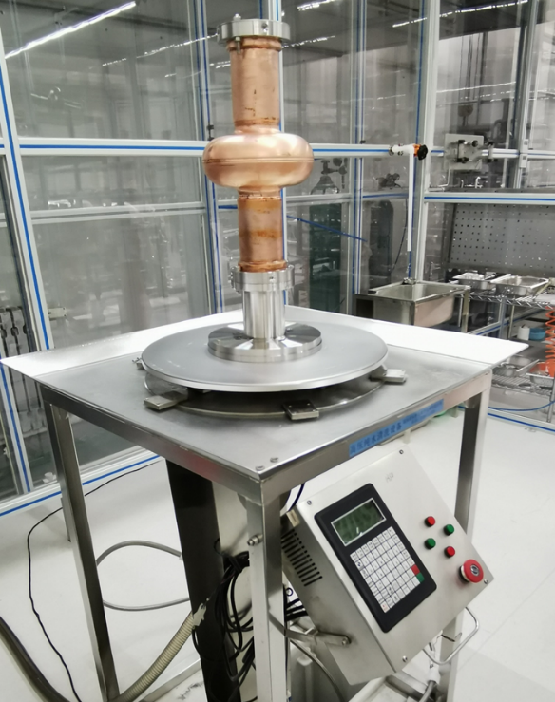
Rinsing
Ultra-pure water rinsing (18 MΩ) and clean assembly in Class-100 clean room
Cavity rotates at a constant speed of 4 RPM
The spray bar reciprocates on the axis of the cavity. The speed of passing through the beam tube is 70 mm/min, and the speed of passing through the cell part is 30 mm/min
The set pressure was 8 bar for four times of cleaning
Pressure tests also be conducted on the niobium film and found that it did not detach under high pressure water flushing at 50 bar

Slide 20
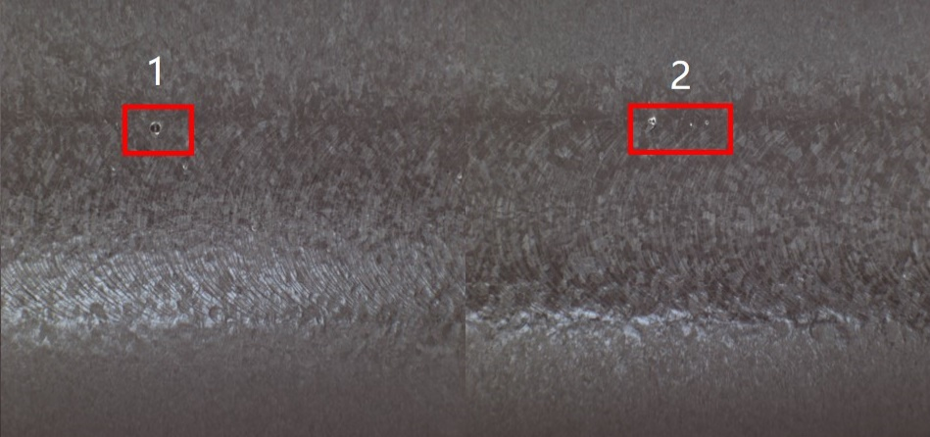
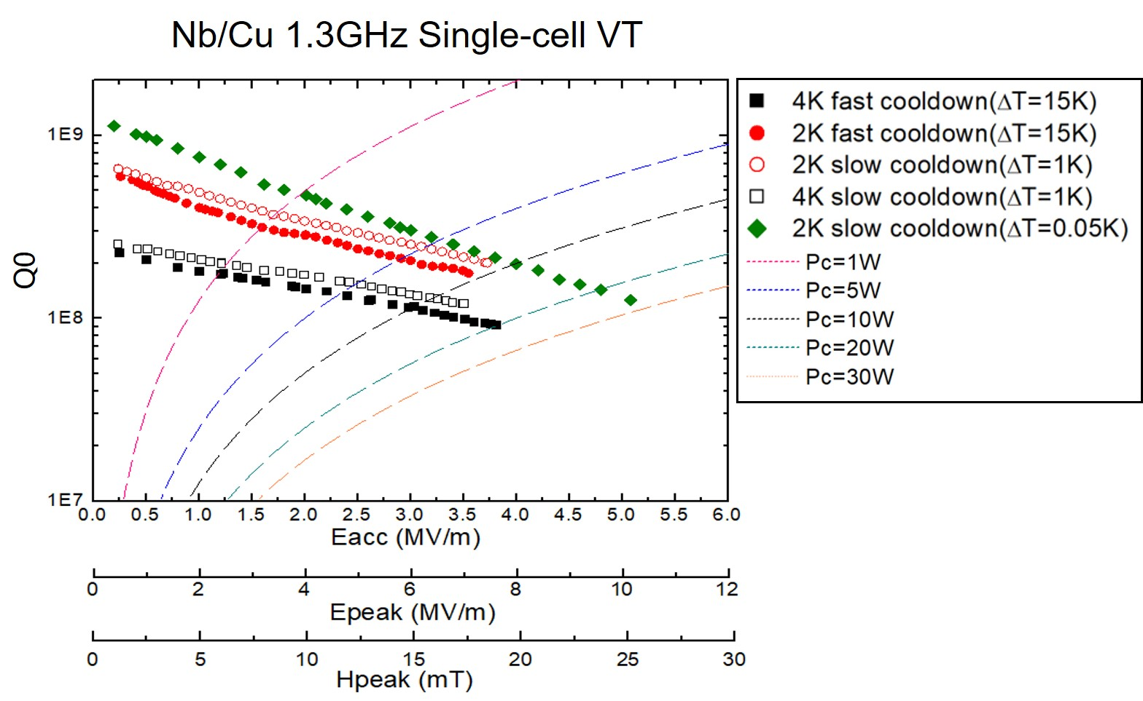
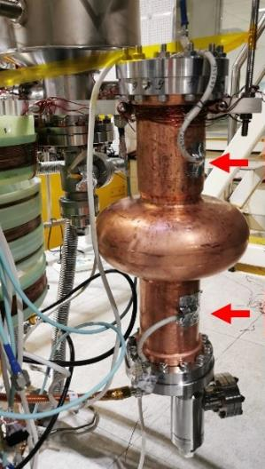
VT results
Eacc reached 5 MV/m with Q0 > 110⁸
Defects on equator found in later inspections after VT

Slide 21
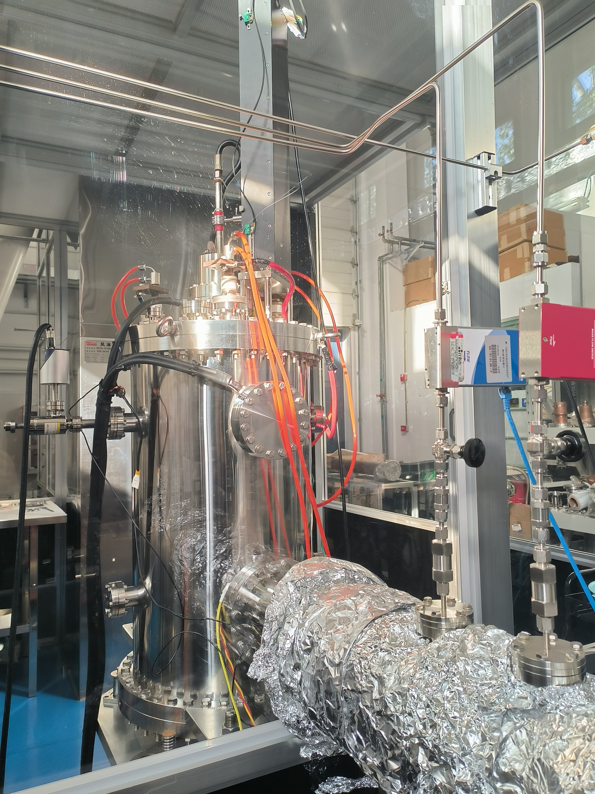
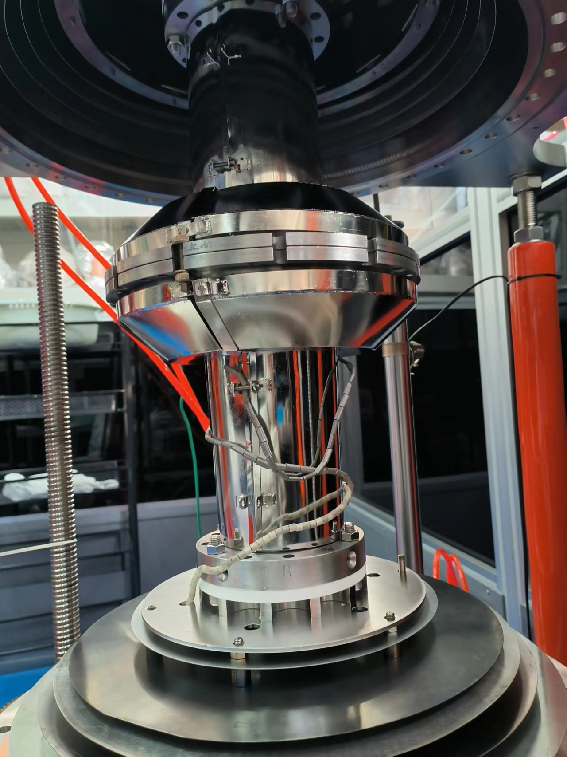



Cylindrical HiPIMS cavity system
chamber for 1.3 GHz SRF cavities
Niobium cathode RRR~300
base pressure in the low 10E-9 mbar range
residual gas analyzer
movable magnetrons 1mm/s
Coating temperatures 200℃
Water cooled
Substrate preparation is SUBU
Assembly in clean room
Coating with Kr
Huttinger Electronics TruPlasma Highpulse DC Unit:
10 kW max average power delivered
voltage up to 1 kV
pulse width up to 1000 us
frequency up to 10 KHz
Nb/Cu dummy cavities have been produced both by DCMS and HiPIMS

Slide 22















HiPIMS without bias voltage
tube
iris
cell
equator
cell:cross-section
cell: FIB-SEM
94A
Tc 9.1K
Tc 9.08K
Tc 7.4K
Tc 9.4K
Tc 9.12K
Tc 9.23K
128A
Tc 9.34K
Tc 9.14K
272A
94A, 531V, 30us, 740Hz, 65KW, 0.72Pa
128A, 456V, 30us, 1000Hz, 135KW, 0.61Pa
272A, 388V, 25us, 653Hz, 300KW, 0.61Pa
The use of short pulses and increasing the peak current had been found to have limited improvement in the quality of the Nb film.

Slide 23















HiPIMS studies with biased substrate
cell: cross-section
silicon substrate
cell: cross-section
copper substrate
tube
iris
cell
equator
0V
Tc 9.19K
50V
Tc 9.20K
100V
Tc 9.23K
0V, 70A, 674V, 41us, 1200Hz, 59KW, 0.69Pa
50V, 145, 618V, 100us, 308Hz, 101KW, 0.69Pa
100V, 134A, 599V, 100us, 300Hz, 100KW, 0.69Pa
HiPIMS with 100V bias voltage can effectively improve the quality of Nb film.

Slide 24
Nb3Sn Superconducting Cavities

Slide 25

Setup of the furnace
Manufacturer: Shanghai Sanjing Vacuum Equipment Co., Ltd.
Main Configurations:
two separate vacuum systems and two separate heaters;
heaters, thermocouples and 7-layer thermal shields are installed in the outer chamber;
the outer chamber is evacuated by an dry pump, and the vacuum can reach 1 × 10⁻³ Pa;
the inner chamber made of Nb (RRR~50) is evacuated by an oil-free molecular pump and a dry pump, and the vacuum can reach 5 × 10⁻⁶ Pa at room temperature and 1 × 10⁻⁴ Pa at 1200 ºC;
the highest temperature of cavity is 1300 ºC, while the crucible can reach 1400 ºC.
Schematic of the new dual-vacuum furnace developed for the Nb₃Sn coating of 1.3 GHz 1-cell cavity.

Slide 26






Nb3Sn coating
Sn
SnCl2

Slide 27

Coating process
Degassing: 200ºC, >10h;
nucleation: 500ºC, 5h;
(3) ramp-up: 12ºC/h;
(4) coating:
  furnace1200ºC, 3h;
  Crucible 1300ºC, 3h;
(5) annealing: 1200ºC, 2h;
(6) cool down

Slide 28



Cooling rate experiment
Various cooling rates were tried during the vertical tests of Nb3Sn, which demonstrated very different results.
< 0.1 K
Cernox sensors
(Up and down)
Fast cooling
Slow cooling

Slide 29


Vertical test results of S25
~3E9 at low fields
7.6E8 @ 6.4 MV/m, which was limited by RF power.
Low-temperature baking of 120C 48h was also conducted, which had little effects.
Images of the same equator region of S25 cavity before (a) and after (b)
Nb3Sn coating. Several small defects existed on some welding zones are circled
in red (c) and (d).

Slide 30


S22、S27
The results of S22 and S27 were almost the same as S25.
S22
S27

Slide 31



Characterization
Samples #2-#5 were $5×5×2.8 {mm}^{3}$ in size for XRD, R-T and SEM measurements.
R-T
XRD
SEM
Setup

Slide 32
Summary
The CBP polishing recipe has been established, the SUBU chemical polishing system has been put into use, and the electrochemical polishing system is under commissioning
DCMS has completed the cavity coating and vertical test, and HiPIMS has entered the sample coating stage
The Nb3Sn coating equipment is operating normally and has completed vertical test of three thin film cavities

Slide 33
Thanks

