Slide 1
Lambda hyperon polarization in relativistic heavy ion collisions from the chiral kinetic approach
Yifeng Sun , and Che Ming Ko Phys.Rev.C 96 (2017) 2, 024906
Spin Polarizations in a Covariant Angular-Momentum-Conserved Chiral Transport Model
Shuai Y.F. Liu, Yifeng Sun, and Che Ming Ko
Phys.Rev.Lett. 125 (2020) 6, 062301

Slide 2
CHIRAL KINETIC APPROACH
In the frame that rotates with an angular velocity
Coriolis force
In the absence of collective flow, the origin of the rotational frame is stationery in the fireball frame. In this case, $\dot{r}={\dot{r}}^{′},p=p^{′}$
$$\sqrt{G}=1+aλ|p|(ω∙b)$$

Slide 3
In the local rest frame of the fluid and assuming an equilibrium Boltzmann distribution at temperature T ,the average spin of massless spin-1/2 fermions is then
vorticity field can lead to the spin polarization of a massless fermion

Slide 4
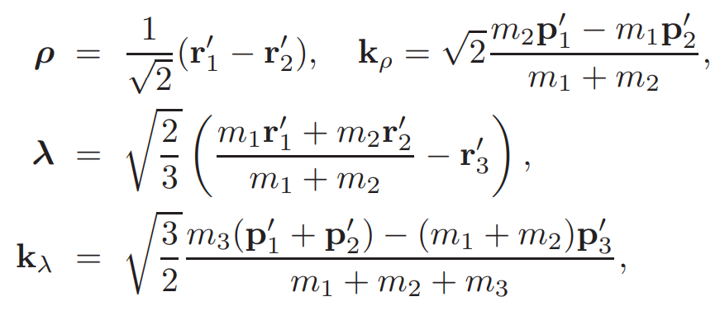
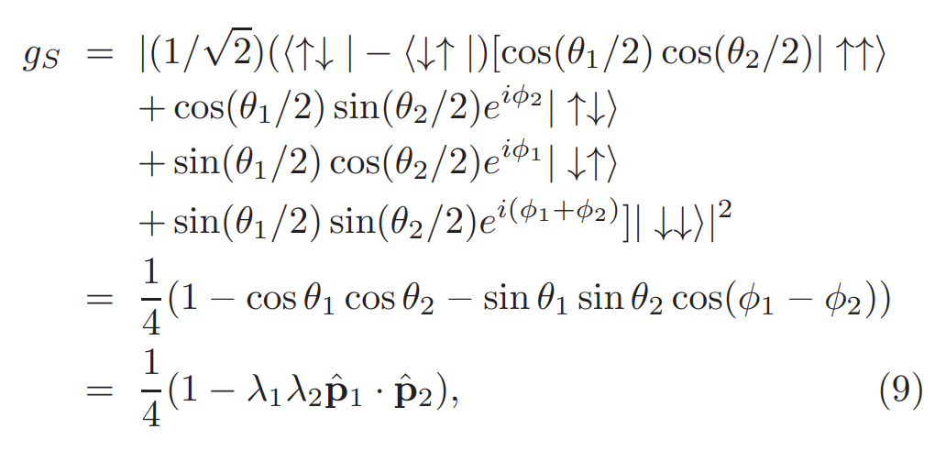
the coalescence model for hyperon production
spin state of Λ is determined by the spin state of its constituent s quark. u and d quarks to form a spin-singlet state.

Slide 5
INITIAL CONDITIONS AND THE VORTICITY FIELD
the string-melting version of AMPT model,with a = 0.5 and b = $0.9 {GeV}^{−2}$in the Lund string fragmentation function and impact parameter b = 8.87 fm and constant cross section of 10 mb
The vorticity field ω is related to the velocity field $v(r, t)$ of partons in a local cell by
$$ω =\frac{1}{2}∇×u$$
with $u = γv$and $γ =1/\sqrt{1−v^{2}}$.
Their average spin and polarization along the y direction
$$S=\frac{\sum_{i}{λ_{i}\hat{p_{i}}/2}}{\sum_{i}{1}},P_{y}=2S_{y}$$

Slide 6
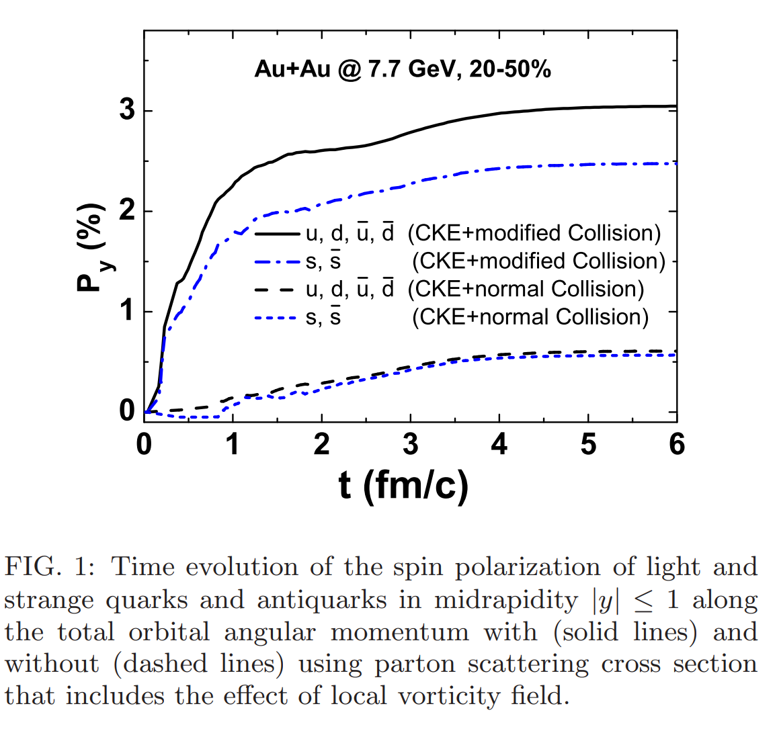
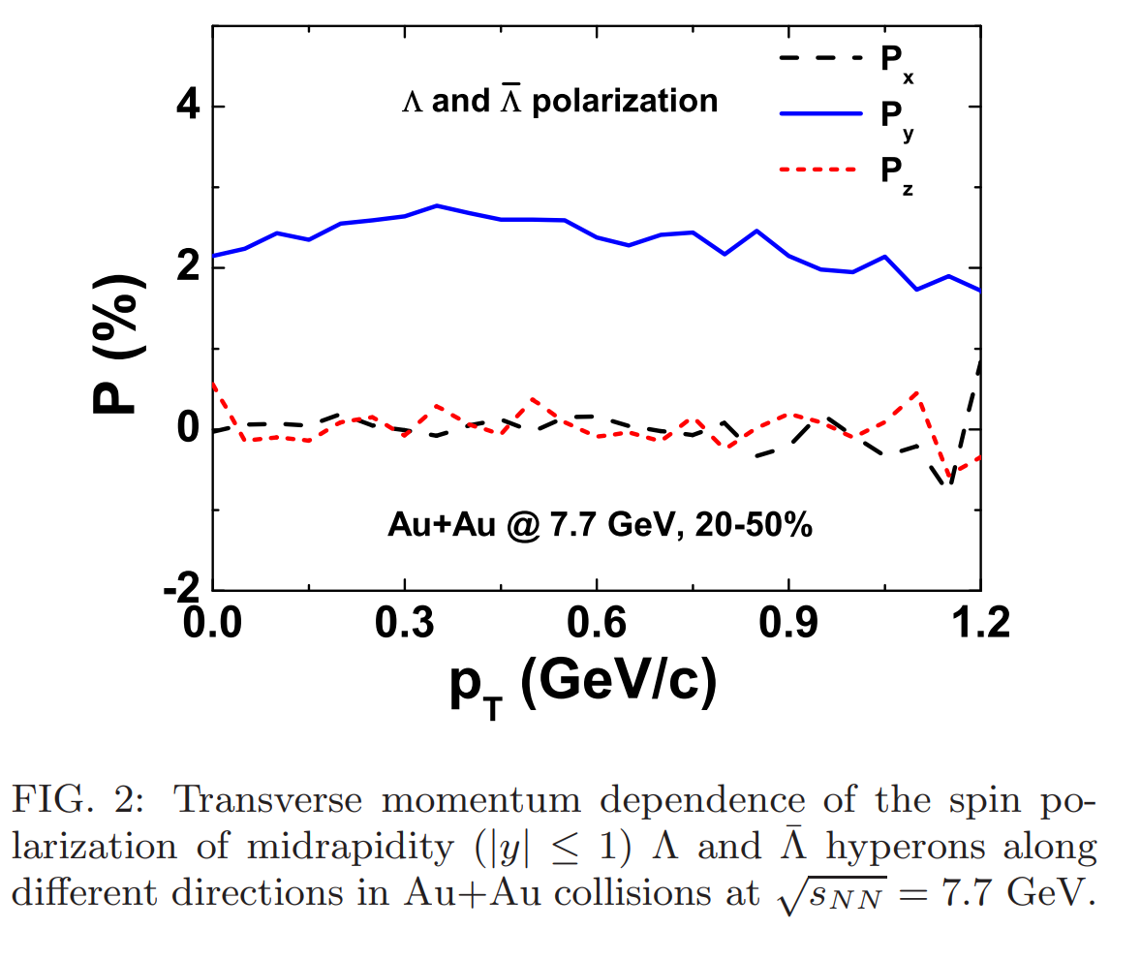

Slide 7
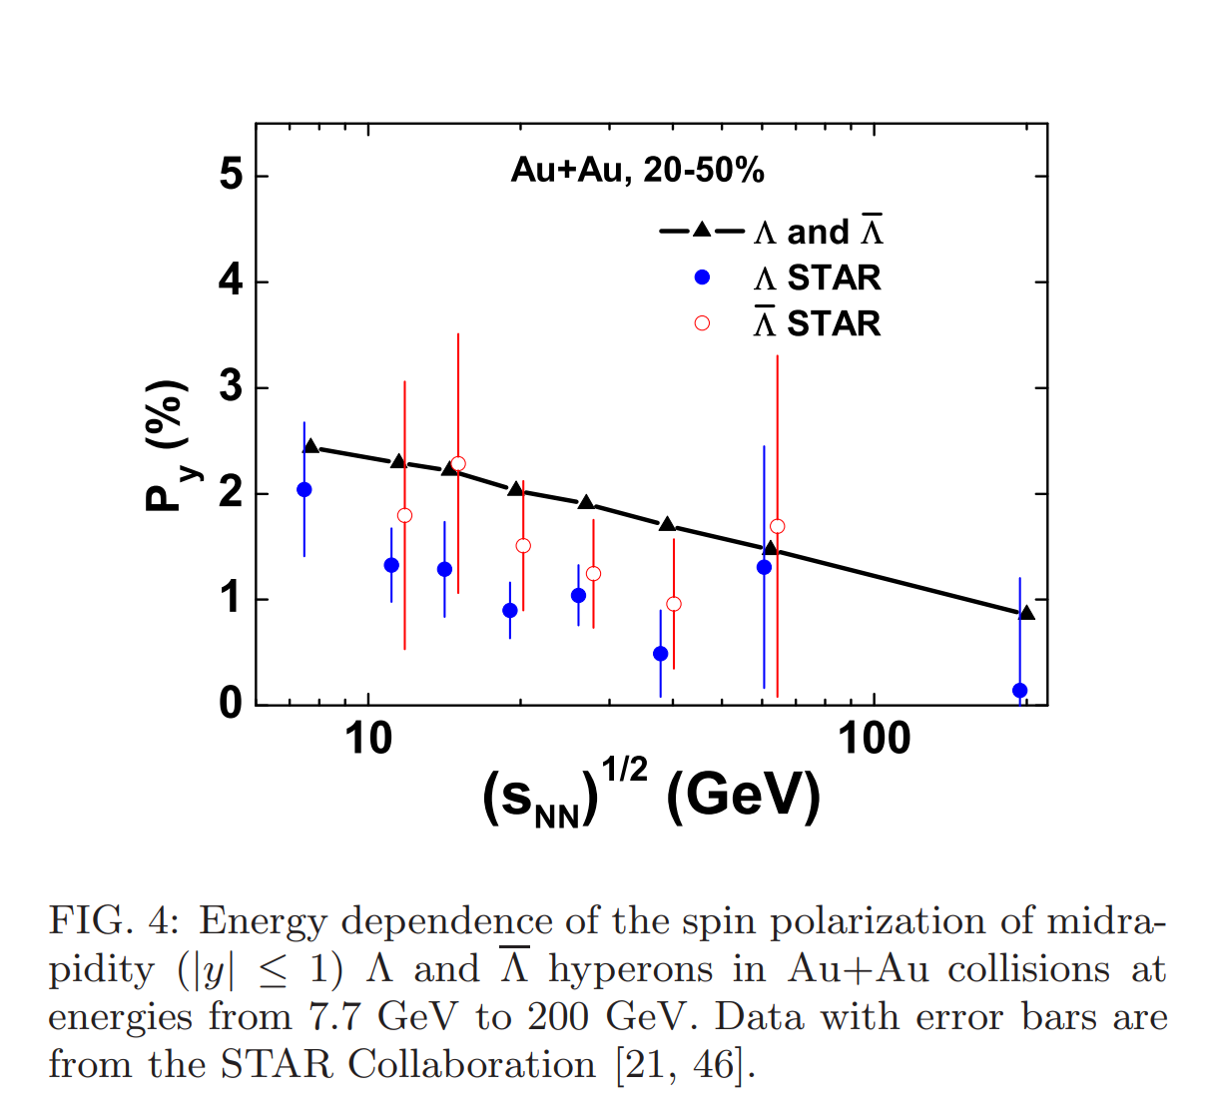

Slide 8
Spin Polarizations in a Covariant Angular-Momentum-Conserved Chiral Transport Model
Using a covariant and angular-momentum-conserved chiral transport model, which takes into account the spin-orbit interactions of chiral fermions in their scatterings via the side jumps, we study the quark spin polarization in quark matter.

Slide 9
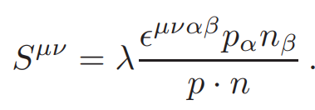
a covariant four-dimensional angular momentum tensor for a particle
spin tensor
To have a definite helicity for the massless particle further requires

Slide 10
In a two-body scattering for collisions,a covariant way the
conservation of total angular momentum
Momentum can be obtained from p by a rotation of angle
The value of the rotation angle φ depends on the angular distribution of the scattering cross section. Similarly, the relative distance ∆′ can be obtained from ∆ via

Slide 11
the spin polarization densities can be expressed as
the first term is the usual contribution from the spin of a particle
the latter term generates from the orbital motions of particles , since it is proportional to the vorticity field generated from the orbital motions of particles
distribution of spin polarization
It differs from the previous definition
$$S=\frac{\sum_{i}{λ_{i}\hat{p_{i}}/2}}{\sum_{i}{1}},P_{y}=2S_{y}$$

Slide 12
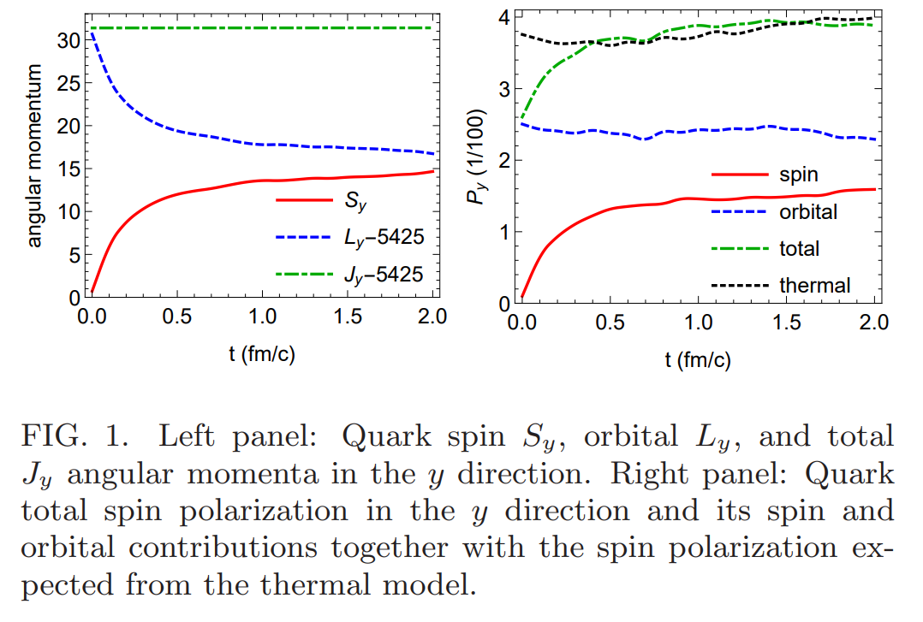
In a box
Their initial momenta, they are taken to have a Boltzmann distribution at a temperature of 300 MeV and a flow profile $γv = 2ω × (x, 0, 0),$where $v$ is the flow velocity, and $ω = (0, 0.12, 0){(fm/c)}^{−1}$

Slide 13
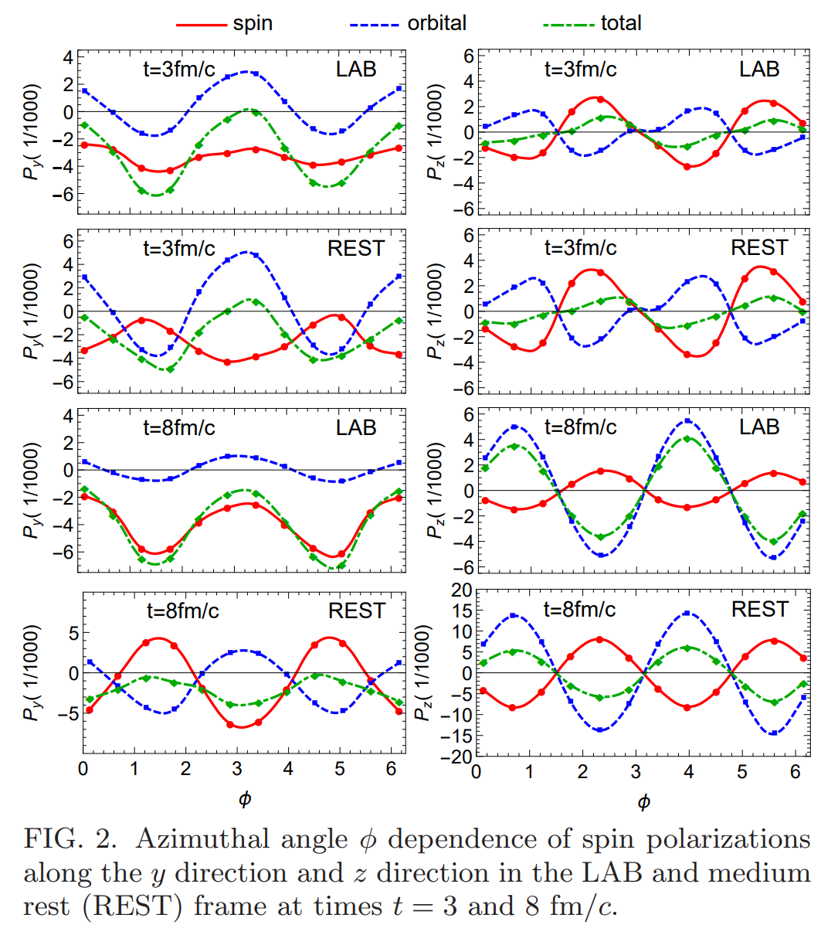
In Au + Au collisions at √s = 200 GeV and at impact parameter b = 8.87 fm,
initial quark and antiquark phase-space distributions from AMPT
Py have similar azimuthal angle dependence
$−a + b cos⁡2φ$
Pz have similar azimuthal angle dependence
$−a − b sin⁡2φ$

Slide 14
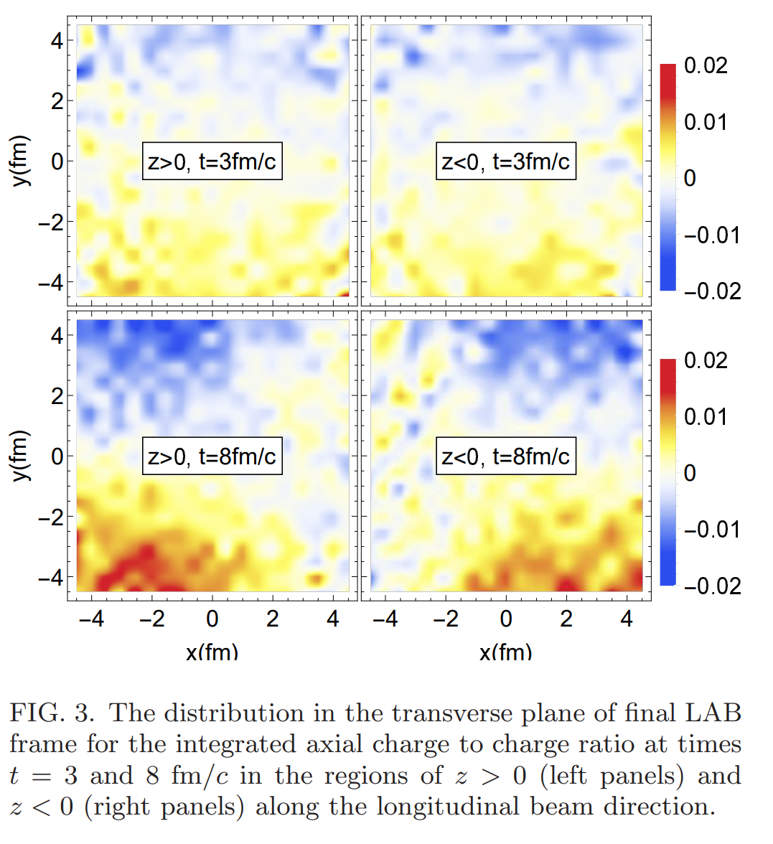

Slide 15
Thanks

