Slide 1
Introduction
On behalf of JUNO DCI group
JUNO DCI Tutorial in Kaiping, Feb 27, 2024

Slide 2
Tutorial arrangement
Three hands-on sections in this tutorial
Prerequisites and basic operations
How to access DCI with certificates?
How to use DIRAC web to submit and check your jobs?
Data management
How to access data in DCI?
How to share your data with others?
Job submission
How to submit jobs with API and tools provided?
How to make a large number of job submission easier?
Documents can refer to
https://juno.ihep.ac.cn/~offline/Doc/user-guide/dcomputing/introduction.html

Slide 3
Goal of the tutorial
JUNO users know how to use JUNO DCI resources
Running JUNO offline activities: simulation, reconstruction, analysis……
Sharing JUNO data among different data centers
Encourage more people to use DCI, also welcome advanced users to contribute, making DCI more convenient and better to serve JUNO experiment
Students can share experiences with each other
Advanced users can develop new tools to share with others

Slide 4
Questions and Feedback
On-site tutors today
Giuseppe Andronico
Joao Pedro Athayde Marcondes de Andre
Xiaomei Zhang
Xuantong Zhang
Advanced users: CaiLiang, ….
Off-site contacts
Livenote page
https://jupyter.ihep.ac.cn/78yqFSorQPmbxy_tCFvXZA
Maillist:
juno-dci-training@ihep.ac.cn
Other group members in DCI can help

Slide 5
UI for Hands-on practice
UI need to contain IHEPDIRAC client
IHEPDIRAC is installed in cvmfs (/cvmfs/dcomputing.ihep.ac.cn)
Any linux machines with cvmfs installed or IHEPDIRAC client installed
Public machine
IHEP login node: lxslc7, or CNAF, or IN2P3, or JINR
Private machine
To install IHEPDIRAC client, you need about ~2GB space

Slide 6
In this talk
A general overview of DCI
Why need Distributed Computing Infrastructure (DCI)?
How does DCI work?
Get ready to use DCI

Slide 7
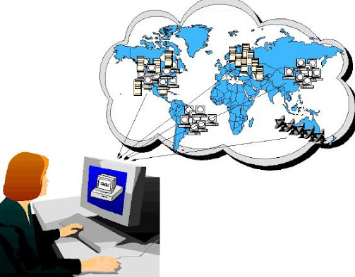
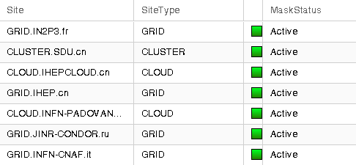
Why need distributed computing?
JUNO is an international experiment, and resources are provided from several data centers around the world
IN2P3, IHEP, JINR, CNAF, SDU……..
How to use resources in these distributed data centers?
How to access and share data among these distributed data centers?

Slide 8
DCI (Distributed Computing Infrastructure) provides solutions
DCI is a system which can integrate heterogeneous resources，hide complexity from users, and provide a simple way for users to use distributed resources with
Global “ID” to identify each user
Unique interface for job submission and data access
This tutorial will tell you how to get global “ID” and how to use the interface
Cluster
Distributed Computing System
Grid
Physicist
User
interface
Cloud
SE

Slide 9
DCI vs. local cluster
Similar procedure
Need authentication to tell the system who you are
DCI: “ID” (proxy certificate) ; Cluster: Account/password
Interface or commands to submit jobs or access data
Jobs: JSUB vs. Hep_Sub, Data: DFC vs. local
Access JUNO software from CVMFS
Differences in interface or commands: Remote vs Local
In DCI, jobs are running in remote resources
In DCI, data is accessed from remote storage
Physicist
User
Local
interface
Cluster
Password
Distributed Computing System
Cluster
interface
Remote
Physicist
User
Grid
Cloud
Notes:
Most of users are very familiar with cluster

Slide 10
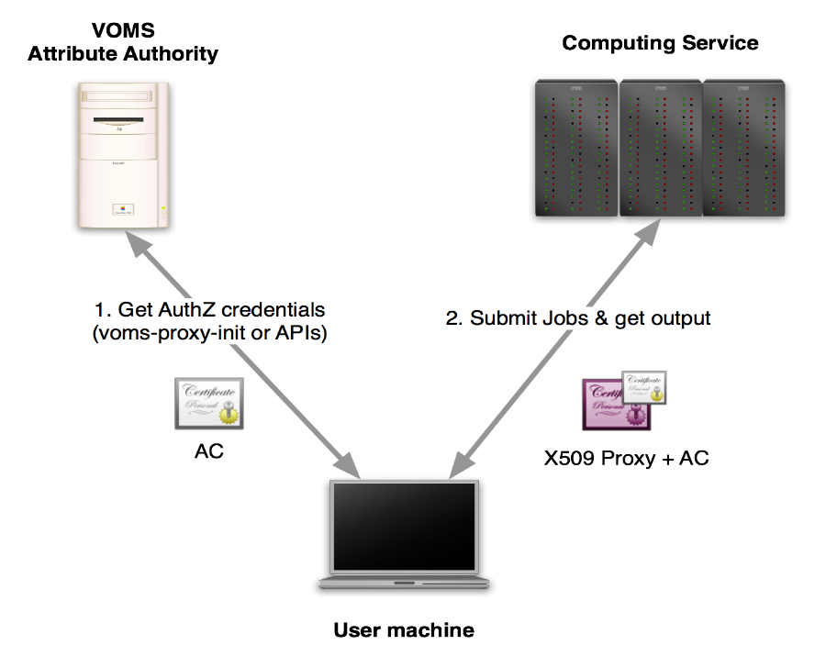
How does DCI accept you ?
Global authority and authentication system in DCI
User “ID” (proxy certificate) which consists of “X509 cert info” + “VOMS info”
X509 certificate – user identify info
VOMS – the experiment (VO) users belong to
All the systems and services in DCI can identify “ID” and do translations between “ID” and local accounts
In future, “ID” will migrate from certificate to token (more convenient, only one step)
X509/proxy certificate -> token
VOMS -> IAM
Notes:
How does DCI work? Use voms-proxy-init to get such “ID”. All the systems and services in DCI can identify “ID” and do translations…. Therefore, when users use these IDs to submit jobs or get output, the systems can allow you to use services as local users.

Slide 11
How does DCI run your jobs?
Submission interface and tools
DIRAC API
JSUB
Production System
DIRAC
Just like a global “cluster”
Interface with local “clusters” in each site
Receive jobs to put into queue and schedule jobs to proper resources
Resource in sites
Jobs reach and run in work nodes
More details of submission interface and tools refer to “Job submission” section on 10th ,Feb
Physicist
User
Production
Manager
JSUB
ProdSys
DIRAC Interface
DIRAC
site
site
site
site
Worknode
Pilot
Notes:
There are three layers of DCI for jobs

Slide 12
How do you use data in DCI?
In distributed computing environment, data is located in different data centers
Data can’t be accessed locally
Dirac File Catalogue (DFC)
Just like a “global” file system, make remote data look like “local” by providing a global view and a unique interface
Interface with different SEs
With LFN, data locations are transparent to users
SE （Storage Element）
File system where data is stored, with grid protocols for data movements between SEs
Normally users don’t need to directly visit SE
FTS ( File Transfer System)
Help massive data replication between SEs
Jobs
Users
Logical File Name
Dirac File Catalogue
Physical File Name
StoRM
EOS
dCache
data
data
data
Transfer
FTS
Notes:
They has grid protocols supported

Slide 13
Resources in JUNO distributed computing
The ratio HS06 to cores depends strongly on hardware. What we have vary in the range 10-25 HS06 per core, roughly. So we have about 3k~5k cores now
Sites | 2024 |  |  | 2025
 | CPU (KHS06) | Disk (PB) | Tape (PB) | CPU (KHS06) | Disk (PB) | Tape (PB)
IHEP | 180 | 8 | 4 | 180 | 12 | 7
CNAF | 20 | 3 | 1 | 20 | 6 | 4
IN2P3 | 15 | 0.2 | 2 | 15 | 0.2 | 3
JINR | 120 | 10 | 10 | 150 | 15 | 15
MSU

Slide 14
Official and individual usage
Official production uses ProdSys (Production System)
MC production need to share among groups or across different data centers
Larger scale, standard pattern, need more storage space
Individual usage uses JSUB or DIRAC API
Individual simulation, reconstruction or analysis
Small scale, more flexible, can be customized
All output is available via DFC
In some sites such as IHEP, output available in your local cluster might also be directly accessible without DCI credentials

Slide 15
How to prepare DCI environment?
Before using JSUB or Prod system and accessing DFC, DCI client environment is needed
The DCI client is available in IHEP CVMFS (/cvmfs/dcomputing.ihep.ac.cn) (Recommended)
In login nodes with CVMFS clients installed, you can directly set up DCI environment
source /cvmfs/dcomputing.ihep.ac.cn/dirac/IHEPDIRAC/bashrc
Another way is to install DCI client in your own machine
The install script is available to download from this link:
http://dirac-code.ihep.ac.cn/juno/install/installJUNODIRAC.sh
Required OS: Linux, Centos7, 2GB disk space

Slide 16
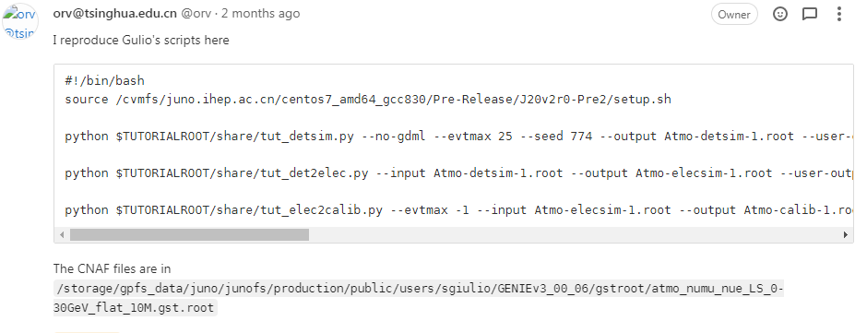
How to apply official production?
Official production is taken care by data production AFG
https://juno.ihep.ac.cn/mediawiki/index.php/Analysis_Foundation_Groups/Data_production
Consider to join the group
The DFC directory under /juno/production
Disk space is negotiated through data production AFG

Slide 17
Procedure for individual users
Get Grid Certificate and join JUNO VO
Set up DCI environment and prepare proxy with cert
Use DIRAC interface or JSUB to create and submit jobs to the DCI
Check job status from JSUB or DIRAC commands or web portal
Output is available from DFC
This tutorial will focus on how to use DCI for individual researchers

