Slide 1
Job submission to DCI
Xiaomei Zhang
JUNO hands-on tutorial in Kaiping
2023.1.10

Slide 2
Main DCI interface for job submission
DIRAC command and API for standard job submission
  Easy to begin, but complicated when used for large number of submissions
  But most flexible to fit in any use cases
  Can be used for advanced users and special use cases
JSUB
  Suitable for large number of submissions
  Friendly user interface and make physics analysis easy, also used for small MC production
  Designed for individual users, flexible, easy to customize
ProdSys
  Aim to make large productions easy for the production group
  Can take care of both workflow and dataflow
  Now only open to production group with production role
  Not covered today – see DocDB-8164

Slide 3
Basic job submission
with DIRAC interface

Slide 4
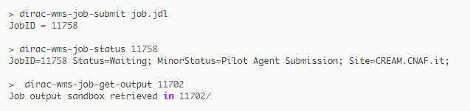
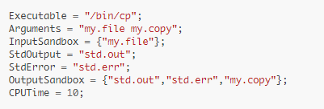
Job submission with JDL
JDL stands for Job Description Language
  standard way of job description in the Grid/gLite environment
Prerequisites before submissions
  DIRAC Commands for submission
  JDL files
    Provide parameters to define your jobs

Slide 5
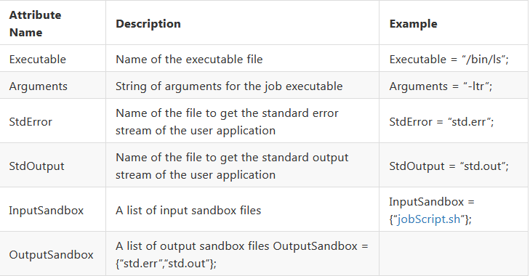
Parameters in JDL 1/3
You can put your running bootstrap shell script here, when jobs arriving in work nodes, this script will be started
Remember to put all the files needed for running your programs here in order to ship them to work nodes

Slide 6
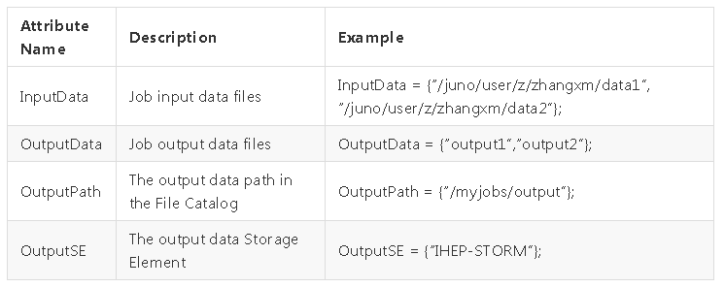
Parameters in JDL 3/3
Jobs will be sent to where data is located
Outputdata will be collected and registered in DFC with “outputpath”

Slide 7
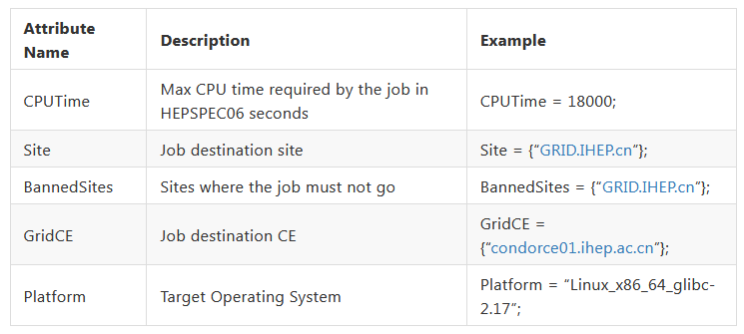
Parameters in JDL 2/3
You can check out more parameters:
https://dirac.readthedocs.io/en/latest/UserGuide/GettingStarted/UserJobs/JDLReference/index.html

Slide 8
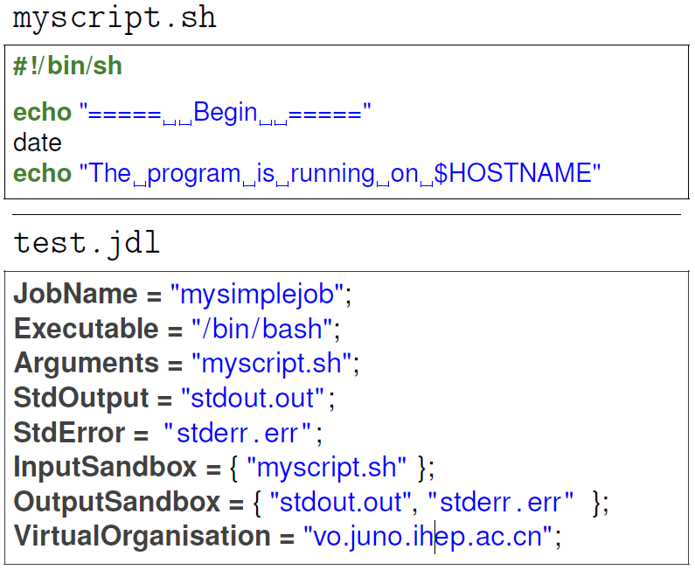
Submit your first job with JDL 1/2
Create the myscript.sh and test.jdl files

Slide 9
Submit your first job with JDL 2/2
Submit job:
  % dirac−wms−job−submit test.jdl
    JobID = 5923594
Check job status
  % dirac−wms−job−status 5923594
    JobID=5923593 Status=Waiting; MinorStatus=Pilot Agent
    Submission; Site=ANY;
  % dirac−wms−job−get−output 5923594
    Job output sandbox retrieved in /afs/ihep.ac.cn/users/j /jpandre/dirac/5923594/
  % cat 5923594/stdout.out
    ===== Begin =====
    Sun Jul 21 10:01:13 CST 2019
    The program is running on idirac−20190721−095925−12c787ff

Slide 10
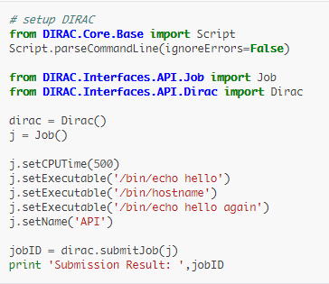
Job submission with DIRAC API
DIRAC API is written in Python
Using the API classes it is easy to write small scripts or applications to manage user jobs and data
Main Classes used
  Dirac
    Submit jobs to the Grid, monitor them and retrieve outputs
  Job
    Define Job parameters

Slide 11
Functions in Job Class
Frequently used
job.setDestination(‘GRID.IHEP.cn')
job.setExecutable('myScript.py')
job.setInputData(['/juno/user/z/zhangxm/test/test.root'])
job.setInputSandbox([‘config.txt'])
job.setOutputSandbox([‘myScript.log',‘myScript.root'])
job.setJobGroup(‘Muon_Prod01')
job.setLogLevel('debug')
Job.setOutputData(lfns, outputSE=None, outputPath='')
Advanced
job.setNumberOfProcessors(numberOfProcessors=None, minNumberOfProcessors=None, maxNumberOfProcessors=None)
job.setExecutionEnv({'<MYVARIABLE>':'<VALUE>'})

Slide 12
Functions in Dirac Class
Frequently used:
  dirac.submitJob(job, mode='wms')
  dirac.getJobStatus(jobID)
  dirac.getOutputSandbox(jobID, outputDir=None, oversized=True, noJobDir=False, unpack=True)
    {'OK': True, 'Value': ['Job__Sandbox__.tar.bz2']}
More:
  dirac.selectJobs( status='Failed', owner=‘zhangxm', site=‘GRID.IHEP.cn')
    {'OK': True, 'Value': ['25020', '25023', '25026', '25027', '25040']}
  dirac.rescheduleJob(12345)
    {'OK': True, 'Value': [12345]}
Most of functions are consistent with DIRAC commands ( dirac-wms-* )

Slide 13
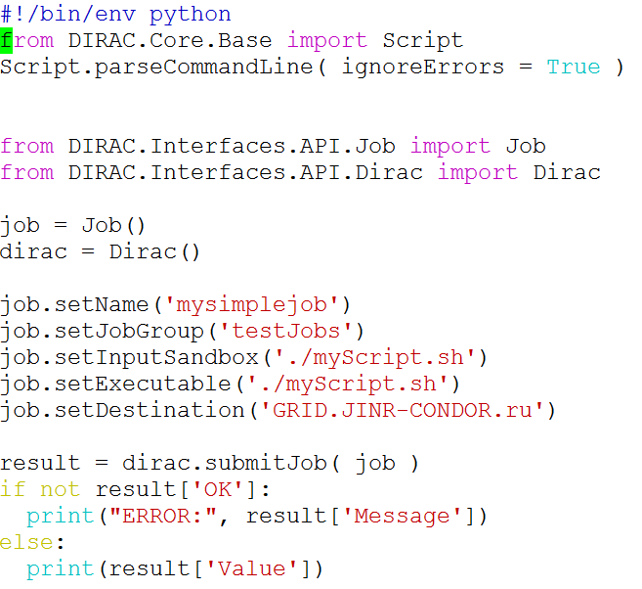
Submit your jobs with DIRAC API
Need two files: test.py, myScript.sh
Submit jobs: chmod 755 testAPI.py; ./testAPI.py

Slide 14
Exercise 1: Submit a simple job
Submit your first job with DIRAC commands
Submit your first job with DIRAC API
Remember:
  Prepare the files for submission
  Check your job status
  Retrieve your log

Slide 15
Exercise 2: Submit a Juno job
Submit a juno job with output data
  Modify myScript.sh to run juno job (detsim or more)
  Retrieve the output back after your job was done
    Use outputData
    The default path is /juno/user/x/xxx/ (LFN), can be defined with outputPath
    Try to find your ROOT output files from DFC
Remember:
  Given job might run anywhere you cannot use any “local” file paths!
  CVMFS and DFC are your friend

Slide 16
Exercise 3: Submit a Juno job with input data
In previous exercises we ran detsim
  No input needed ⇒ easier to handle
Now, let’s try to run a job using an input!
  For example, run elecsim on previous output
Option 1:
  Add InputData field to JDL file
  Path should correspond to DFC path!
Option 2:
  Instead of using InputData, get data in your shell script which will run in the work node
    dirac-dms-* or API to download file
    Use xrootd for local access (Advanced!)

Slide 17
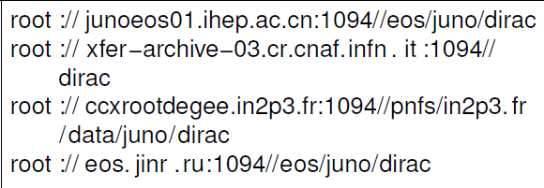
More exercises
If you’ve completed previous exercises, try to find out how you’d like to do a few different things & test them out:
  Send job to specific site, output to specific SE and register in DFC
    Instead of using outputData
  Submit many similar jobs with one submission
    Eg. change only random seed, use different files as input data
  Submit analysis jobs with your own algorithms to run in DCI
    Put your algorithms in “inputsandbox” to be shipped to the running node
    Note: the size of inputsandbox limitation is 10MB. It is good to keep as small as you can
  Submit jobs with local access to several data files in one job
    Use xrootd for local access
    Need to know where the file is
    Need to know xrootd path
    for each site
    Need to know which site jobs are
    running

Slide 18
JSUB

Slide 19
JSUB 1/2
  JSUB is able to take care of a batch of jobs in one submission ( a task)
  Ease the process of physics analysis and small simulation in DCI
  Automatically take care of life cycle of analysis tasks
  Life cycle of a task
    split->submit->run->status monitor->output retrieval -> reschedule
  Everything done in JSUB can be implemented also in the ways of API and JDL, but more complicated
reschedule
submit
split
Job1
.
.
.
run
output
Dirac
Task
worknode
SE
jobn
Batch
Monitor

Slide 20
JSUB 2/2
Tool developped by Xianghu Zhao and Yifan Yang (postdoc @IHEP)
Resources from Yifan:
  DocDB-7303: JSUB tutorial
  https://jsubpy.github.io/
Xianghu and Yifan finished his postdoc. . .
  For now things work, and we will try to maintain it. . .
  But current DCI manpower is very limited. . .
Let us know if you’d like to help maintain JSUB!

Slide 21
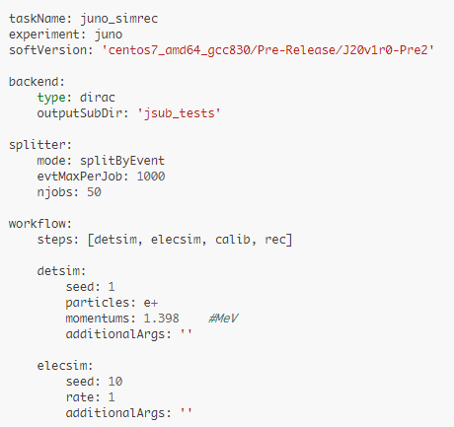
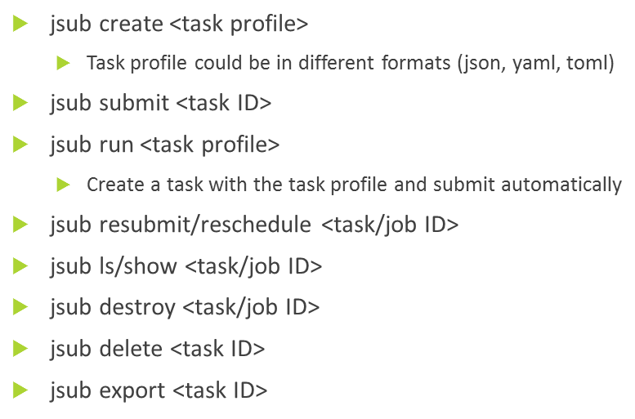
User Interface: commands and steering file
Steering file supports YAML format to define your physics tasks
  Workflow and steps
    detsim, elecsim, calib, rec or analysis algorithms
  Splitter
    splitByJobvars, splitByEvent
  Software version
  Backend
Steering file
Command line and API to submit and manage tasks
  Submit/Resubmit/Reschedule……
Job submission API
Job submission command

Slide 22
Getting started with JSUB 1/2
JSUB config file ( .jsubrc):
  package: [jsub_juno, jsub_dirac]
  taskDir: ## Location to put task information files; may need big space for log and output files
    location: /path/to /my/jsub/manager/folder
  backend:
    default: dirac
An example: /cvmfs/dcomputing.ihep.ac.cn/frontend/jsub/1.2/install/jsub/jsub/support/jsubrc.example
Activate JSUB:
  % source /cvmfs/dcomputing.ihep.ac.cn/frontend/jsub/activate.sh −e juno
Get dirac environment ready
  export DIRAC=/cvmfs/dcomputing.ihep.ac.cn/dirac/IHEPDIRAC source $DIRAC/bashrc
  Dirac-proxy-init –g juno_user

Slide 23
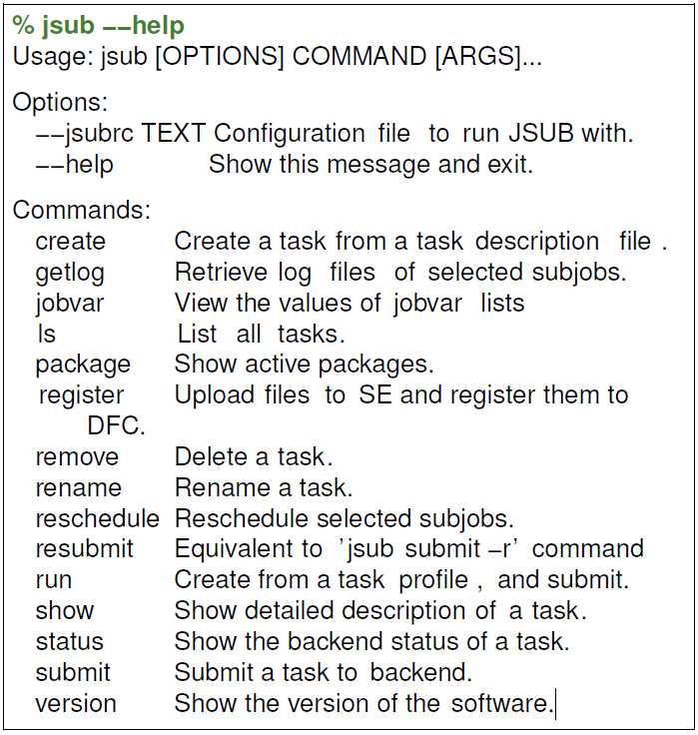
Getting started with JSUB 2/2

Slide 24
Examples of steering file/ job definition file
JSUB examples can be found in CVMFS directory:
  /cvmfs/dcomputing.ihep.ac.cn/frontend/jsub/1.2/install/jsub/examples/juno/
The available examples:
  101_detsim.yaml – How to submit detsim jobs
  102_simrec.yaml – How to submit multi-steps jobs
  103_jobvar_splitter.yaml – How to use more flexible splitter
  104_elecsim.yaml -- How to submit jobs with input data
  105_analysis.yaml -- How to submit jobs with your own algorithms
Notes:
  To avoid blocking the queue and wait for a long time, don’t set evtMaxPerJob and njobs to be small enough

Slide 25
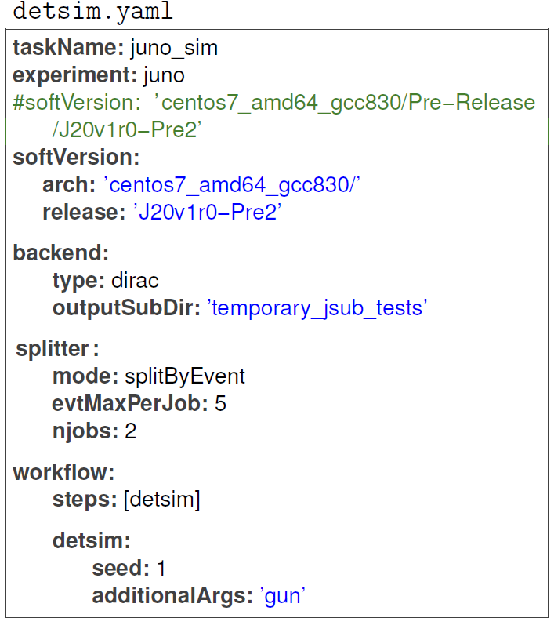
Example of detsim.yaml

Slide 26
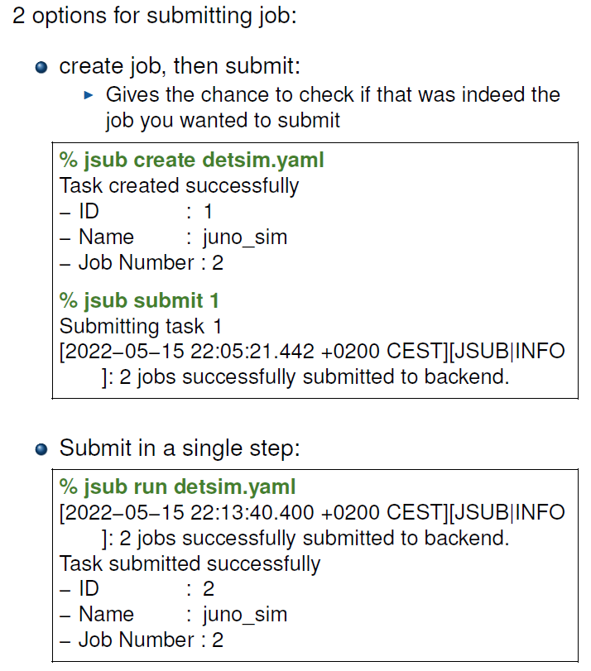
Submitting job

Slide 27
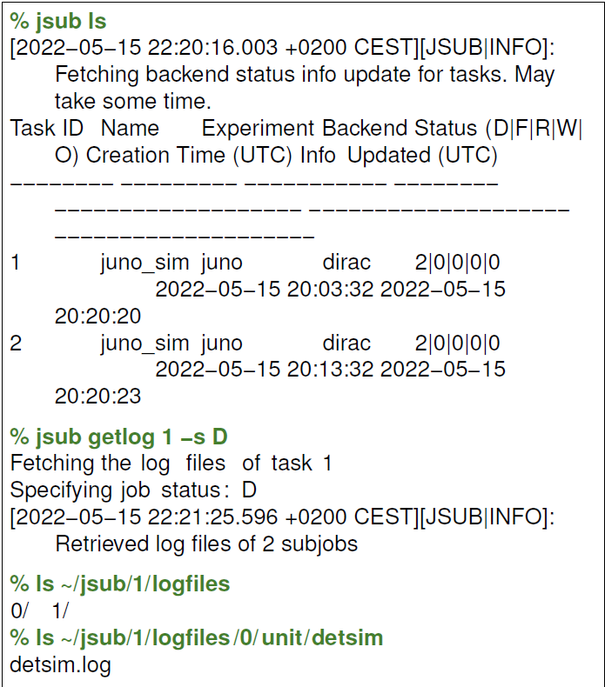
Job management

Slide 28
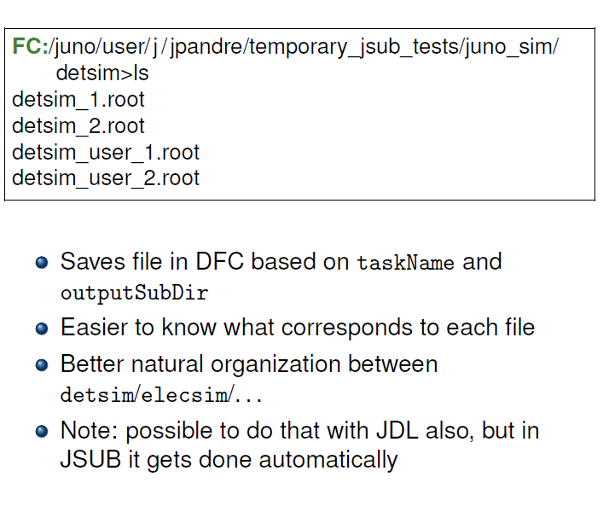
Check job outputs

Slide 29
Exercise1: submit your first job with JSUB
Submit detsim jobs and check job outputs
Submit multi-steps jobs
  Combination of detsim, elecsim, cal and rec
Try to understand
  How are the output files organized?
  How are the log files organized?
  How to reschedule the failed jobs?
  How to add different options to run JUNO applications?
  How to check status of your jobs from DIRAC job monitoring?
Also you can think about
  Submit job to specific site
  Submit ‘gun’ with specific positions along z axis

Slide 30
More exercises
If you’ve completed previous exercises, try to find out how you’d like to do a few different things & test them out:
  Submit jobs with input file lists (eg. elecsim)
    If you had to run elecsim from the detsim generated, how would you do?
  Use jobvar to create multiple similar configuration simulations
  Submit jobs with your own algorithms

Slide 31
Exercise with input files
For simplicity, you consider the files produced by the first detsim with JSUB
  Option 1: assign input file is to list the filenames in a text file
    input_filename:
    type: lines_in_file
    file: ‘./lfnlist.txt’
  Option 2:
    Use metadata defined in DFC to know the list of files as inputs
    input_filename:
    type: find_lfns
    path: '/juno/user/.../test'
    metaspec: ' "Size>1000" "CreationDate>2010-01-01" '

Slide 32
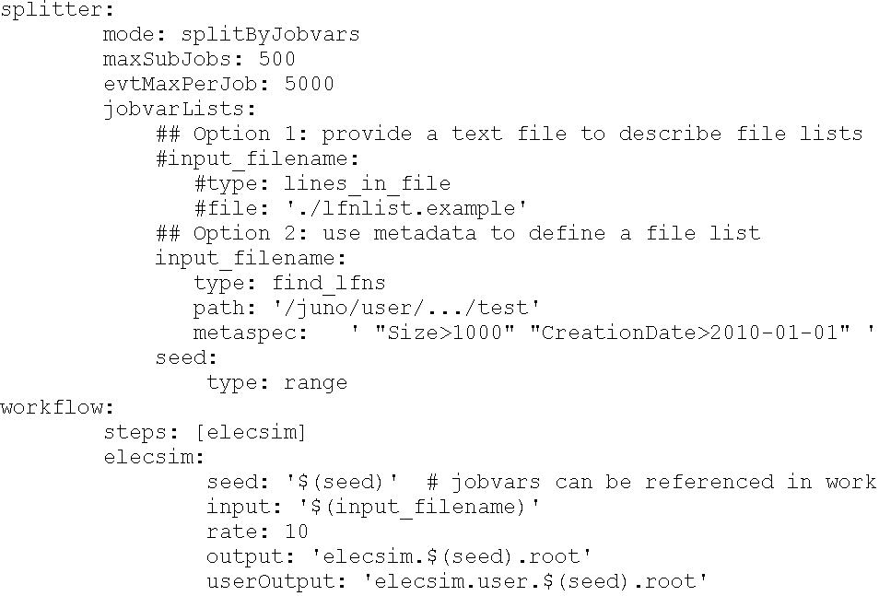
Example of input files

Slide 33
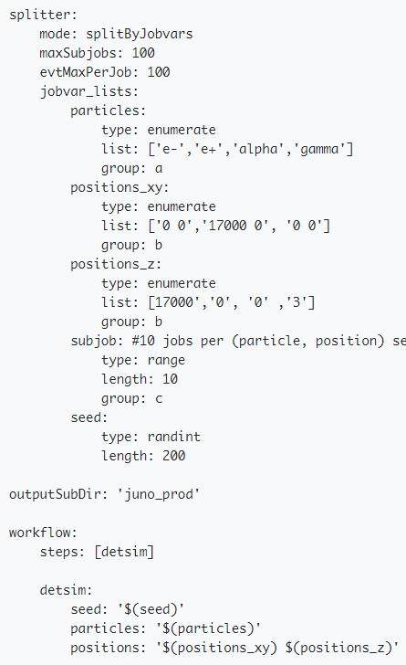
Exercise with Jobvars
Simulating multiple similar configurations with Jobvars
  This is very useful if you want to simulate many similar jobs with varying inputs
    Different particles: e+, e-…..
    Different positions: x, y, z
    Different momentums
  Change splitter from splitByEvent to splitByJobvar for more flexibility
    splitByJobvar can create variables to provide a group of parameters for workflows
      variables in different group make cartesian product
      variables in same group select the shortest length

Slide 34
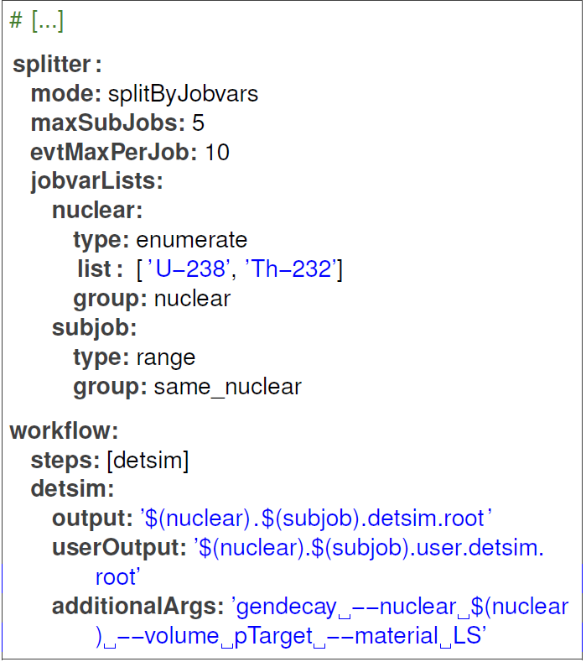
Examples of Jobvars

Slide 35
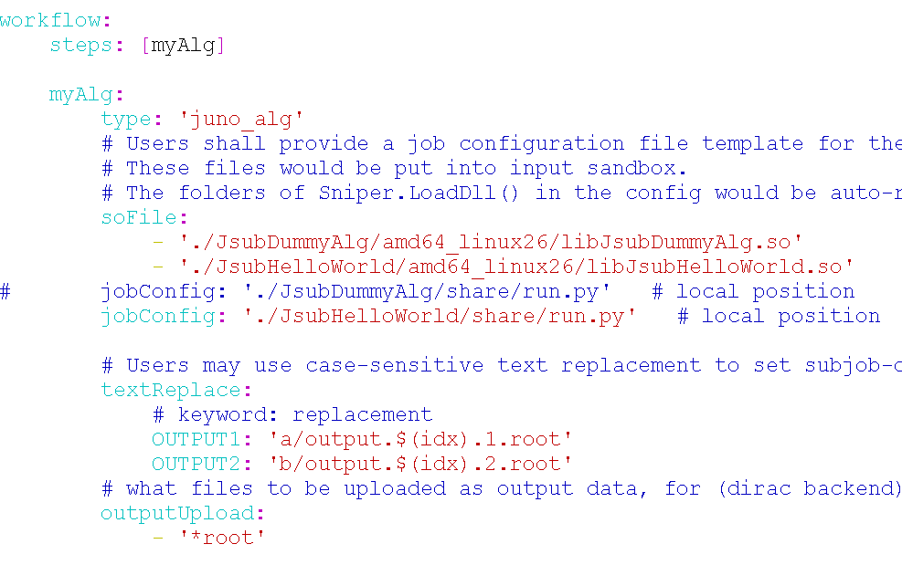
Example of analysis

Slide 36
ProdSys

Slide 37
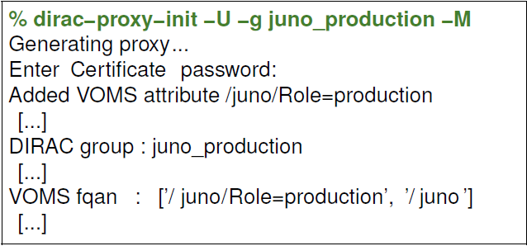
Introduction
ProdSys is defined for MC production tasks
  Convenient for large scale MC productions
  Not so flexible for individual analysis just as JSUB or API
Before using ProdSys, be sure that
  You are holding a certificate with production role
  DIRAC env is ready and proxy is initiated as “juno_production”

Slide 38
Get started
Get steering files (.ini file) template file
  ihepdirac-juno-make-productions --example > prod.ini
According to the tasks, write your steering file based on template file
Check your production parameters with “–dryrun”
  ihepdirac-juno-make-productions --ini myprod.ini --dryrun
Submit your production
  ihepdirac-juno-make-productions --ini myprod.ini

Slide 39
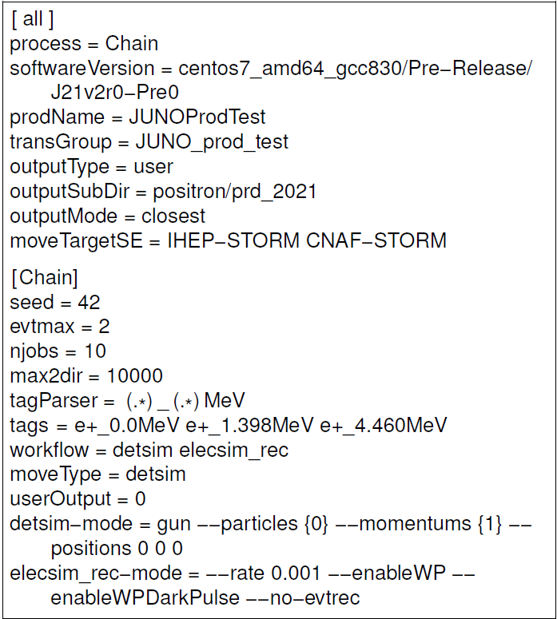
Steering file to define your tasks

Slide 40
Thank you for your attention!

