Slide 1

Welcome !

Slide 2

Introduction to IHEP
Jun Cao
Institute of High Energy Physics
Chinese Academy of Sciences

Slide 3
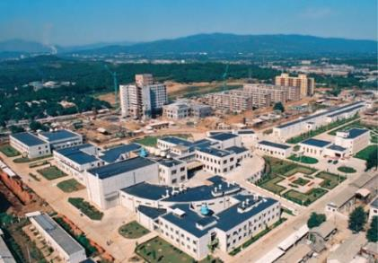
1950
1953
1958
1973
IHEP
History
Institute of Modern Physics
Institute of Physics
Institute of Atomic Energy
Institute of High Energy Physics
IHEP’ real start is from the construction of Beijing Electron Position Collider (BEPC) in 80’s, and now is a large and comprehensive center for HEP and multi-disciplinary research
Frontiers of Basic Science
Strategic High-Tech
Multi-disciplinary research
Particle Physics
Astroparticle Physics
Accelerator Physics
and Technologies
Radiation Technologies
and Applications
Accelerator-based HEP Experiments
Particle Astrophysics & Neutrino Experiments
Particle Detection and Electronics
Particle Physics Theory
High Luminosity Electron Accelerators
High Intensity Proton Accelerators
Applied Research and Technology Transfer
Synchrotron Radiation & Applications
Neutron Scattering & Applications
Nuclear Analytical Techniques & Applications
1500 permanent staff, 170 postdocs, 700 students, 300 visiting students, ~¥3B/yr (€0.4B)
3

Slide 4
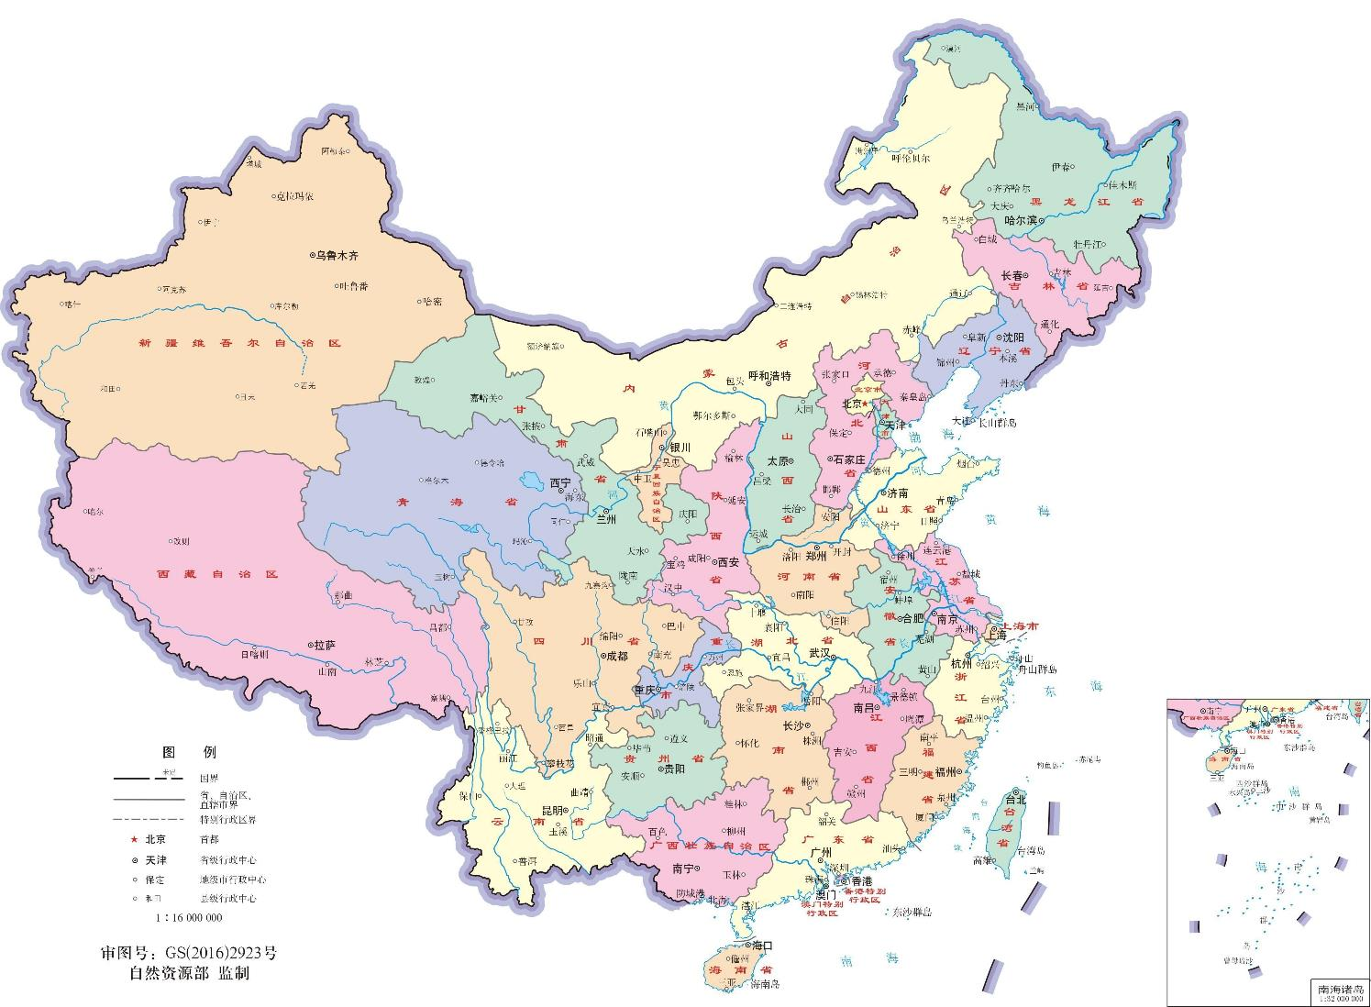
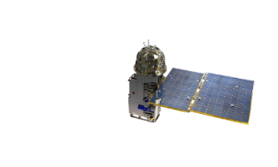
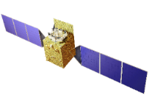
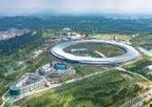
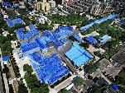
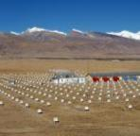
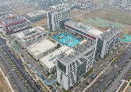
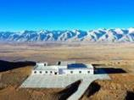
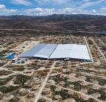
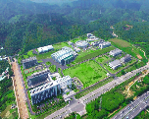
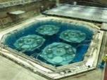
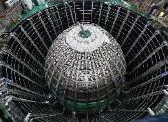
IHEP Large Science Facilities
GECAM
Gravitational wave EM Counterpart All-sky Monitor
HXMT
Insight Hard X-ray Modulation Telescope
Huairou Campus
HEPS High Energy Photon Source
  YBJ (retired)
  International Cosmic Ray Observatory
IHEP, Beijing Campus
BEPC Beijing Electron-Positron Collider
Jinan Campus
AliCPT
Ali CMB Polarization Telescope
LHAASO
Large High-Altitude Air Shower Observatory
Daya Bay (retired)
Daya Bay Reactor Neutrino Experiment
JUNO
Jiangmen Underground Neutrino Observatory
Dongguan Campus
CSNS China Spallation Neutron Source

Slide 5
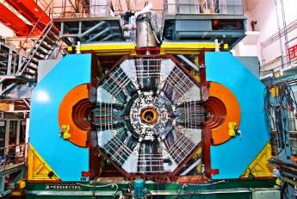
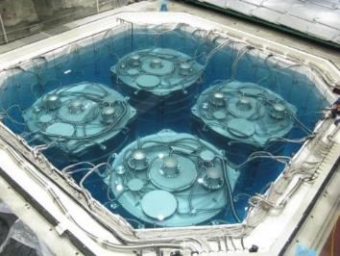
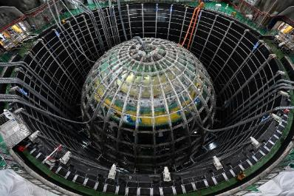
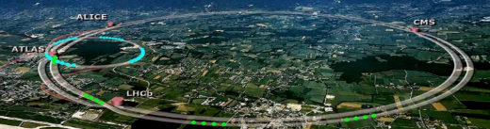
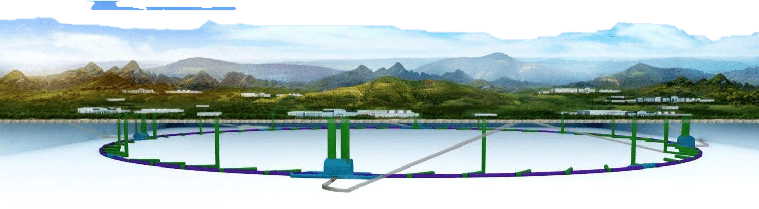
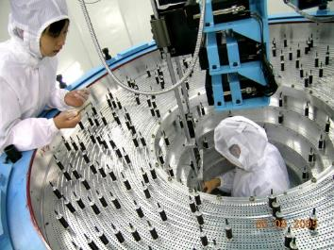
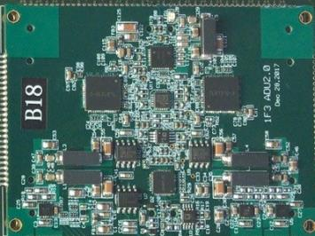
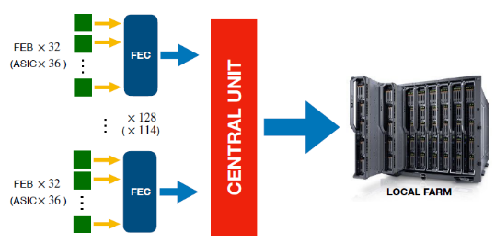
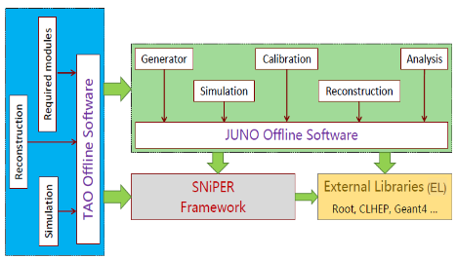
Particle Physics – Experimental Physics Division
180 staff, 397 temporary (including postdoc, students), totaled 574 people
Complete chain of design, construction, and operation of large-scale experiments, R&D of advanced technology
Charm Physics
BESIII, BelleII, PANDA, GlueX
Neutrino Physics
Daya Bay, JUNO, EXO, DarkSide, COMET
High Energy Frontier
CEPC, LHC (ATLAS/CMS/LHCb)
Detector
Electronics
Trigger, DAQ, DCS
Software

Slide 6
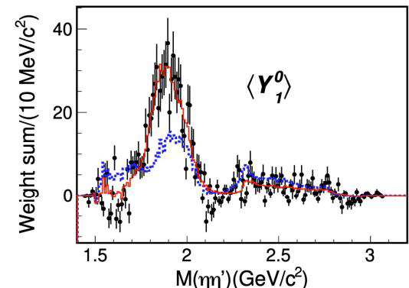
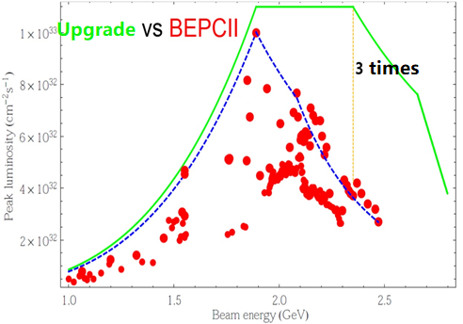
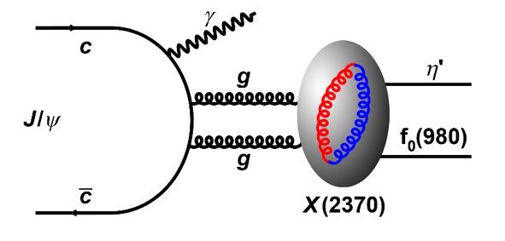
BESIII
BEPC/BES (1980s) → BEPCII/BESIII (2009-now), on charm physics
Collaboration: ~600 members from 85 institutions in 17 countries
55 fb⁻¹ data, more than 600 papers, exciting results on exotic hadrons (26 new hadrons by BESIII), form factors, hyperon physics, charmed meson and baryon decays
Upgrade to be completed in 2024 → Luminosity × 3 @4.7 GeV
Discovery of exotic 𝟏⁻ ⁺ isoscalar 𝛈_{𝟏}(𝟏𝟖𝟓𝟓), PRL 2023
X(2370) mass and J^{PC} (0⁻⁺) agrees with glueball, PRL 2024
BEPCII-upgrade with higher Lum at >4 GeV, new CGEM tracker

Slide 7
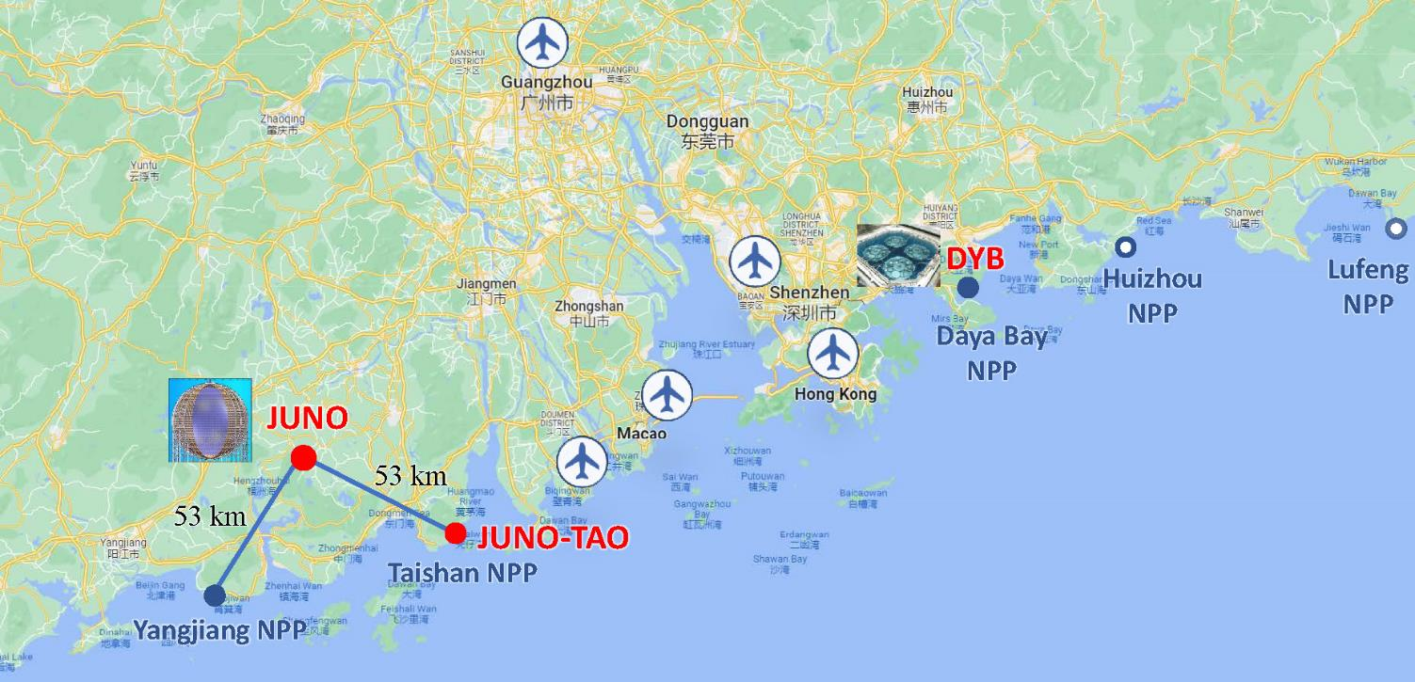
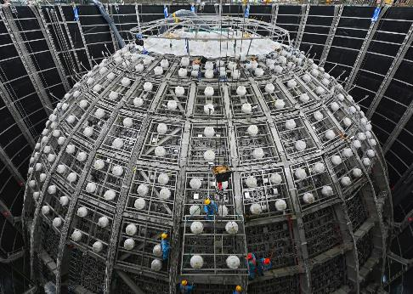

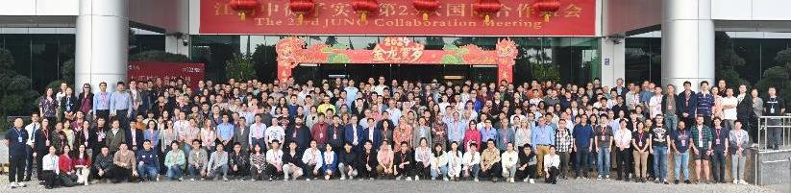
Jiangmen Underground Neutrino Observatory (JUNO)
IHEP neutrino program started from Daya Bay, measured θ₁₃ in 2012
JUNO proposed in 2008 for mass ordering, 20 kton LS, 700 m underground, 3% energy resolution
Rich physics program in solar, supernova, atmospheric, geo-neutrinos, proton decay, exotic searches
Approved in 2013. Construction in 2015-2024. Lifetime 30 years. JUNO-0νββ ~2030
74 institutions, >700 collaborators
Asia: China (34), Taiwan,China (3) Thailand (3), Pakistan, Armenia
Europe: Italy (8), Germany (7), France (5), Russia (3), Belgium, Czech, Finland, Latvia, Slovakia, UK
America: Brazil (2), Chile (2), USA (2)
2 cores, 9.2 GW_{th}
6 cores, 17.4 GW_{th}

Slide 8
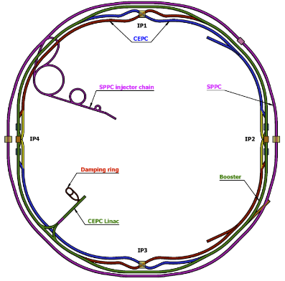
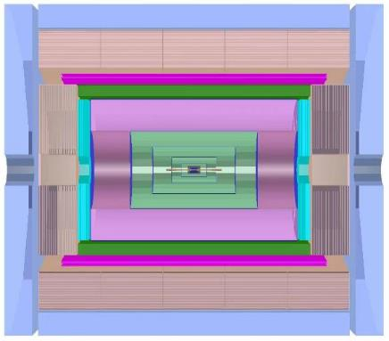
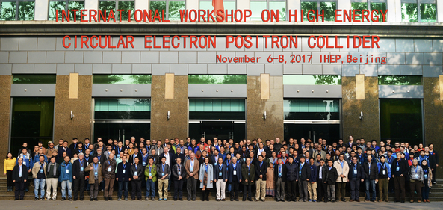
High Energy Frontier
Participating in CERN experiments ATLAS and CMS group each has ~10 FTE, ~10 papers/year w/ major contribution
  Higgs properties, BSM/SUSY particles, precision EW
  Detector upgrade: lead HGTD (ATLAS), participate in ITK (ATLAS), HGCAL (CMS), UT ( LHCb)
LHCb team established since 2018. Physics interests on heavy hadron spectroscopy and CKM
CEPC as an e⁺e⁻ Higgs (+W, Z, top) factory.
  CEPC Accelerator Technical Design Report (TDR) (2023) → Engineering Design Report (EDR)
  “4th Detector Concept” based on the PFA calorimeter (CDR in 2025). R&D on glass scintillator.
Muon+ Yoke
PFA Hadron Calorimeter
PFA EM Calorimeter
Drift chamber for PID
Silicon tracker
Solenoid Magnet (3T/2T)
Ring length ~ 100 km
Core team consists of ~ 400 people mainly from China
4th Detector Concept

Slide 9
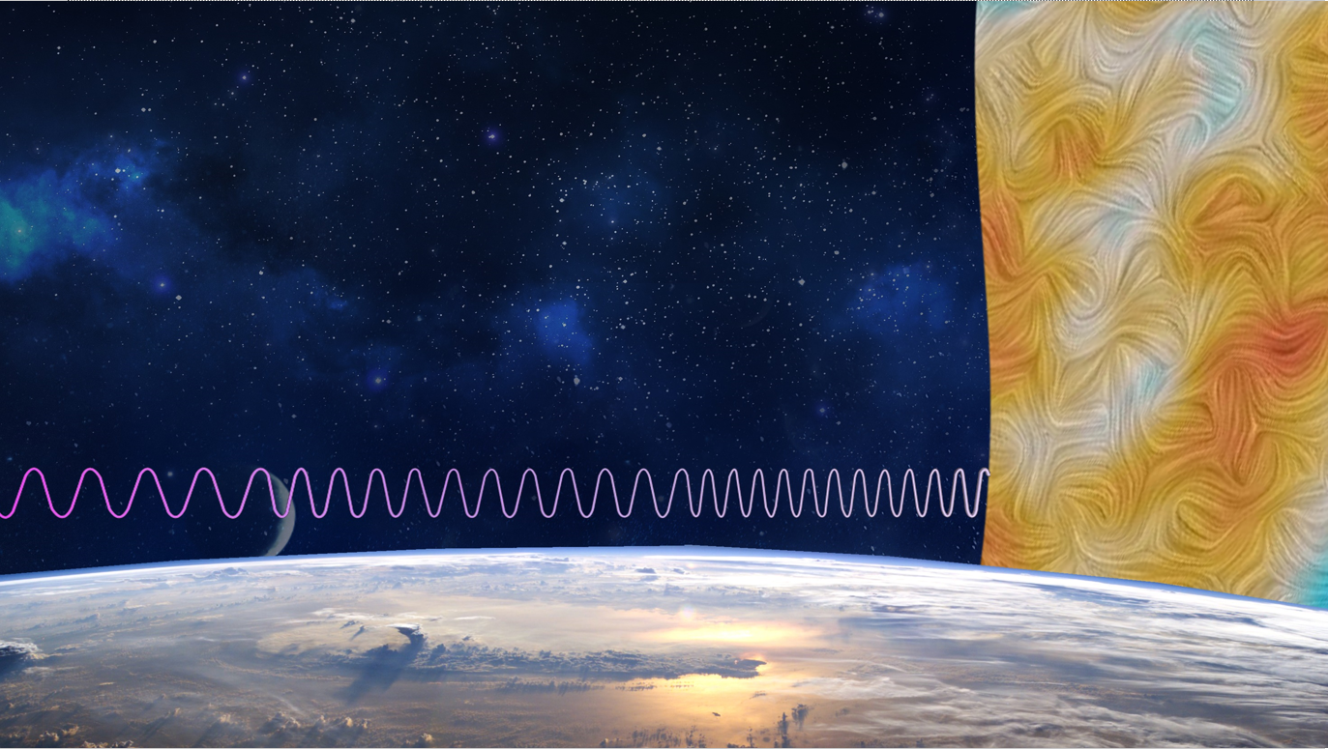
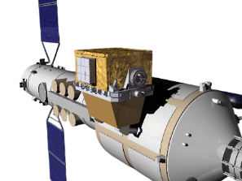
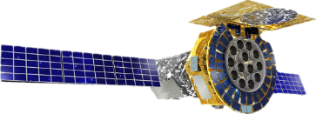
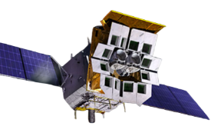
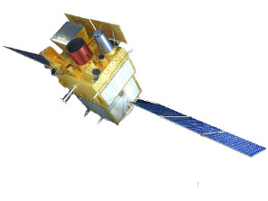
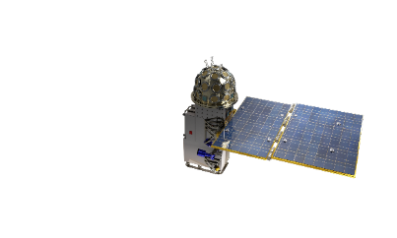
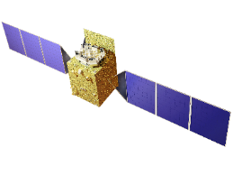
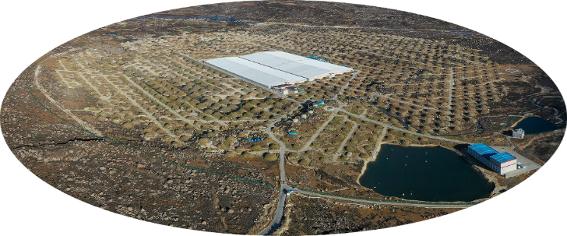
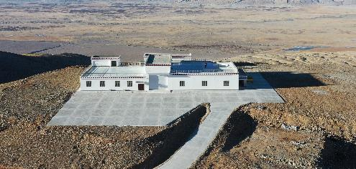
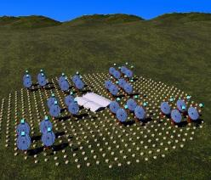
Particle Astrophysics Division
170 staff, 200 temporary
The origin of cosmic rays
Extreme gravity and magnetic fields of black holes/neutron stars
Primordial gravitational waves and cosmic expansion
HERD (2027)
Under construction
eXTP (2030)
In operation
EP/FXT (2024-)
SVOM/GRM (2024-)
Primordial gravitational waves
（ultra-high energy scale）
Insight-HXMT (2017-)
GECAM (2020-)
X-ray
Gamma-ray
UHE gamma-ray
Ali-CPT
(microwave)
LACT
(under development)
LHAASO

Slide 10
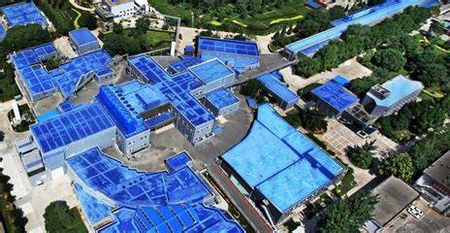
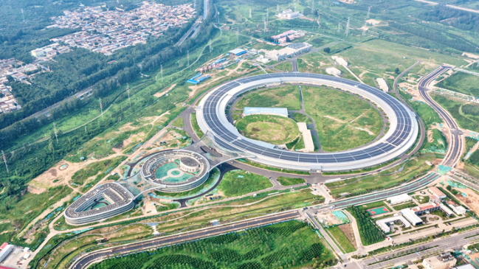
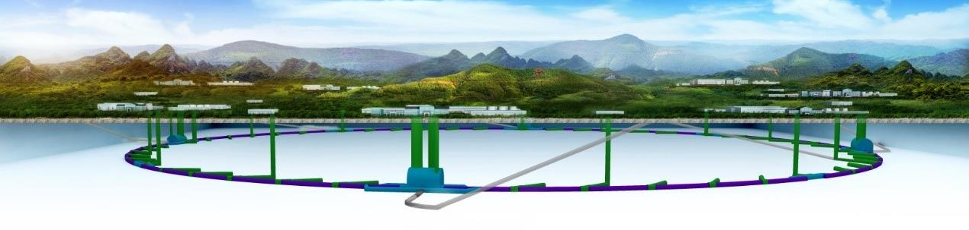
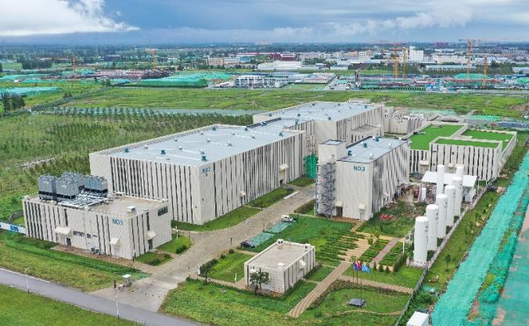
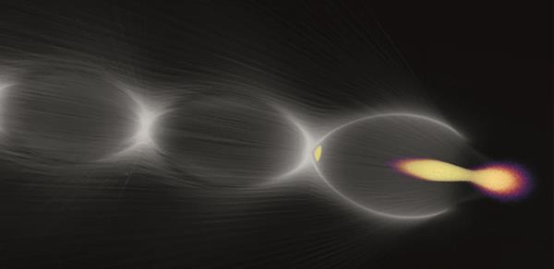
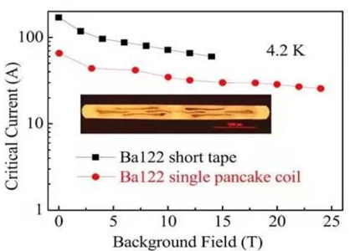
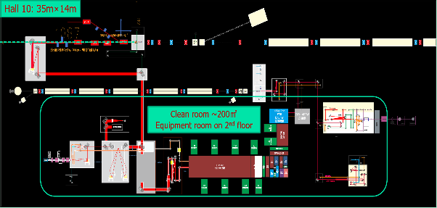
Accelerator Technology – Accelerator Division
241 staff, 200 temporary
BEPC
HEPS
CEPC
World’s first Iron-based Super-conducting solenoid coil at 24T
Backup solution for CEPC linac
Wakefield Acc.
Test facility to be built at BEPCII
Accelerator key technology R&D platform

Slide 11
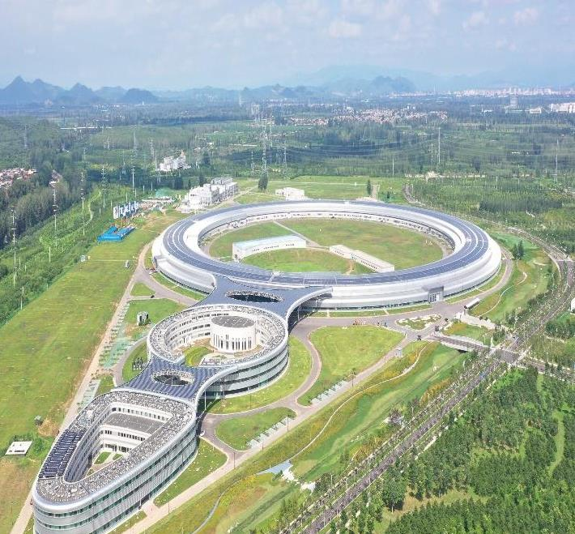
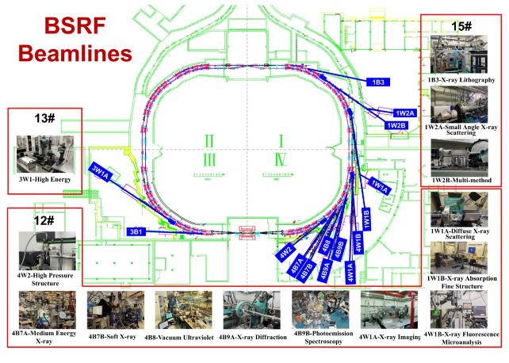



Light Source, Neutron Source, Multi-Disciplinary
Multi-Disciplinary Division, 223 staff, 289 temporary
HEPS Beamline phase-I
HEPS
14 lines
4th-gen SR, 6 GeV Brightness >1×10²² Construction: 2019-2025
14, >80 lines
China Spallation Neutron Source (100 kW), operation since 2018
Upgrading to CSNS-II (500 kw) (9→20 lines)
R&D: Southern Advanced Photon Source
Dongguan Branch, 345 Staff, 179 Temporary

Slide 12
DNTA, TPD, Computing Center
Division of Nuclear Technology and Application (and Jinan Branch)
  58 staff, 47 temporary
  Focus on instrumentation, engineering and system development
  Nuclear medical imaging; Non-destructive testing (NDT); Radiation safety monitoring
Theoretical Physics Division
  26 staff, 60 temporary.
  One of the best theory groups in China
  Hardon physics; LQCD; Neutrino; Higgs/TeV physics; Precision QCD+EW; Cosmology
Computing Center
  44 staff, 39 temporary
  100k CPU cores, 100 PB disk storage, 100 PB tape storage
  LHCb Tier-1 site, ATLAS and CMS Tier-2 sites
  Advanced computing, storage, and network technology; software development; AI and QC

Slide 13




International Cooperation
International Cooperation is an essential element of IHEP
Participate in large international projects
  ATLAS, CMS, LHCb, ILC, BELLE II, PANDA, AMS, COMET,
  EXO/nEXO, and DarkSide
Welcome international partners to join China-based projects
  BESIII, Daya Bay, JUNO, LHAASO, CEPC, eXTP, HERD, etc.
Dozens of agreements with universities and institutions around the world.
Bilateral cooperative meetings
  IHEP-KEK, IHEP-INFN, IHEP-CERN, … …
  France-China Particle Physics Laboratory (FCPPL)
The international travel has almost recovered from pandemic.

Slide 14
Thank for your attention!
And enjoy your time in Beijing!

