Slide 1


Nucleon-nucleon correlations in two-proton radioactivity
Simin Wang (S. M. Wang)
Fudan University
Sep, 2024
Collaborators: W. Nazarewicz, F. R. Xu, M. Pfützner, I. Mukha,
R. J. Charity, ﻿L. G. Sobotka, A. Volya, Z. H. Li …

Slide 2
Outline
Introduction
  Exotic structures
  Rare decay modes
Method
  Theoretical status
  Gamow coupled-channel method
  Time-dependent approach
What can we learn from exotic 2p decay
  Decay dynamics
  Nucleon-nucleon correlations

Slide 3
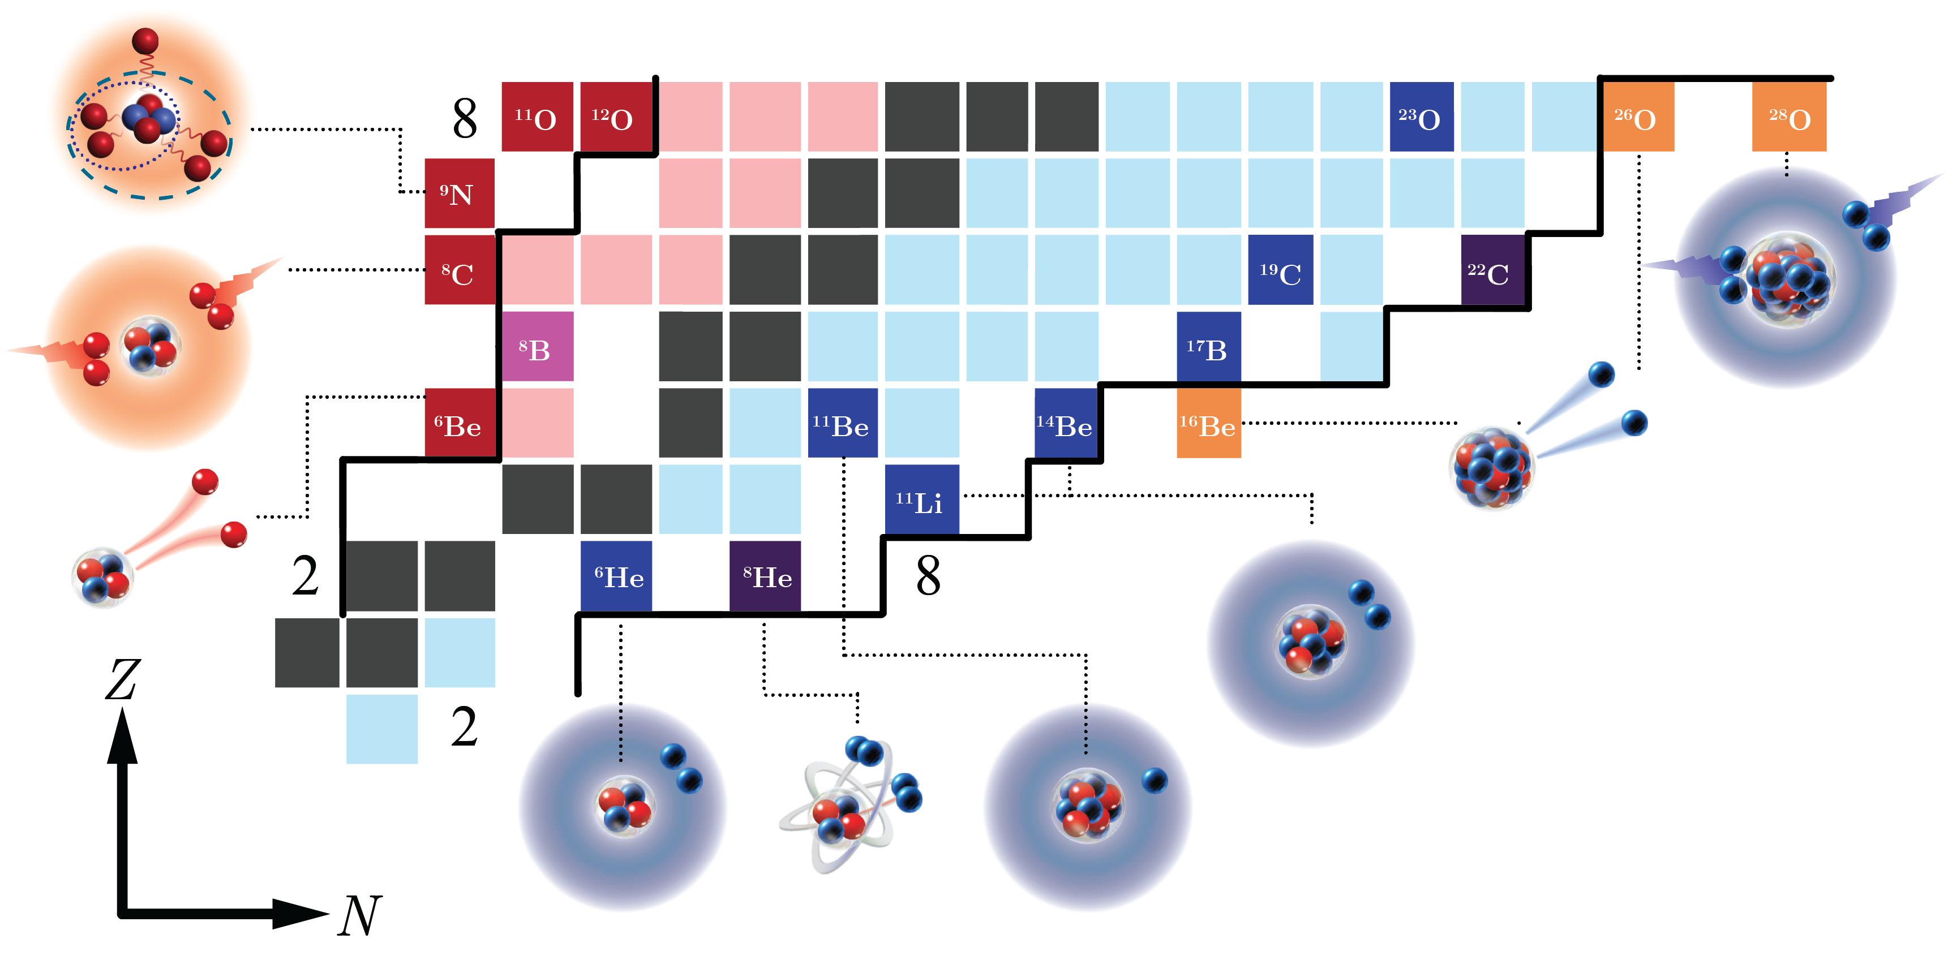
Rich phenomena towards the dripline
Closed quantum system
Open quantum system
Discovered
nuclides
Unknown
Dripline
Halo & clustering
Exotic decay
Deformation
New magic number
…
Introduction
Method
2p decay
Exotic structures
Rare decay modes

Slide 4
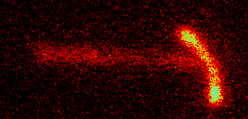
Exotic two-proton (2p) decay
Open quantum systems
2p decay
⁴⁵Fe
g.s. 2p emitters: ⁴⁵Fe, ⁴⁸Ni, ¹⁶Ne, ⁶Be ...
Multi-particle decay: ⁸C, ¹⁸Mg (2p+ 2p)
⁹N (p+2p+ 2p), ²⁸O (2n+2n) …
See Nakamura’s talk
﻿Y.B. Zeldovich, Sov. Phys. JETP 11, 812 (1960)
﻿J. Giovinazzo et al., Phys. Rev. Lett. 89, 102501 (2002)
V. Goldansky, Nucl. Phys. 19, 482 (1960)
K. Miernik et al., Phys. Rev. Lett. 99, 192501 (2007)
Introduction
Method
2p decay
Exotic structures
Rare decay modes

Slide 5
Asymptotic nucleon-nucleon correlation
K. Miernik et al. Phys. Rev. Lett. 99, 192501 (2007)
⁴⁵Fe
’
p-shell
sd-shell
’
T.B. Webb et al. Phys. Rev. C ﻿100, 024306 (2019)
Introduction
Method
2p decay
Exotic structures
Rare decay modes

Slide 6
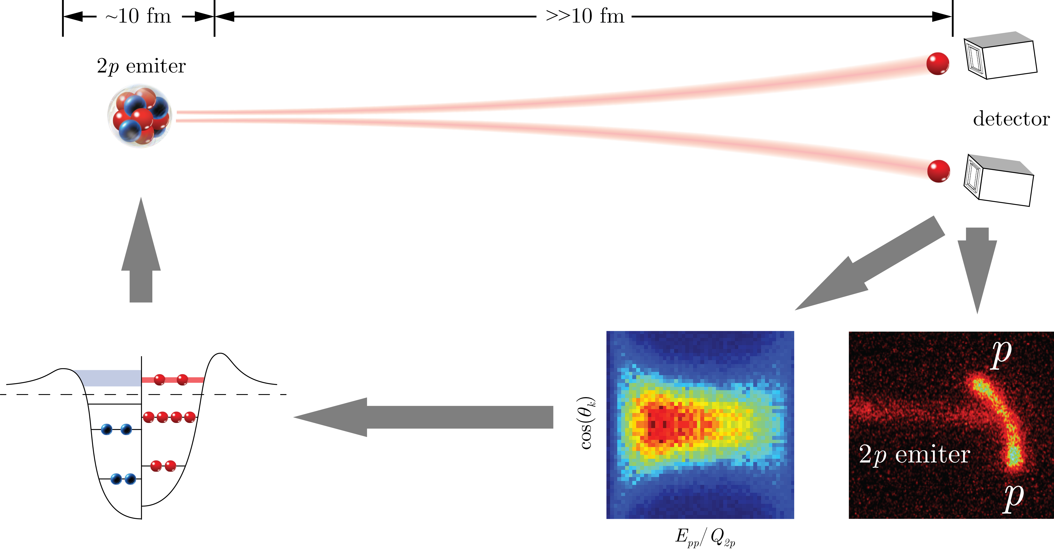
Structure Asymptotic observables
Structure
Decay & reaction
macroscopic distance
pairing correlation
structure
Self-consistent model
’
Numerical method
“characteristics”
“fingerprint”
K. Miernik et al., Phys. Rev. Lett. 99, 192501 (2007)
Introduction
Method
2p decay
Exotic structures
Rare decay modes

Slide 7
Theoretical status
HH: Hyperspherical harmonics
CI: Configuration interaction (shell model)
DFT: Density functional theory
SMEC: Shell model embedded in the continuum
GSM: Gamow shell model
GCC: Gamow coupled channel
TD: Time dependent approach
  Jacobi coordinates
See Witała and Hiyama’s talks
See Xu’s talks
M. Pfützner, I. Mukha, SW, Prog. Part. Nucl. Phys. 132, 104050 (2023)
Introduction
Method
2p decay
Theory status
GCC
TD

Slide 8
Gamow coupled-channel (GCC) method
The 3-body Hamiltonian can be written as:
Total wave-function
valence protons deformed core
  Jacobi coordinates
    No spurious center-of-mass motion
    Correct 3-body asymptotic behavior
  Berggren basis
    Bound, scattering, and Gamow states
    Structure and decay information
Berggren basis
Bottom line: to analyze how nuclear structure impacts 2p decay properties.
SW and W. Nazarewicz, Phys. Rev. Lett. ﻿120, 212502 (2018)
Introduction
Method
2p decay
Theory status
GCC
TD

Slide 9
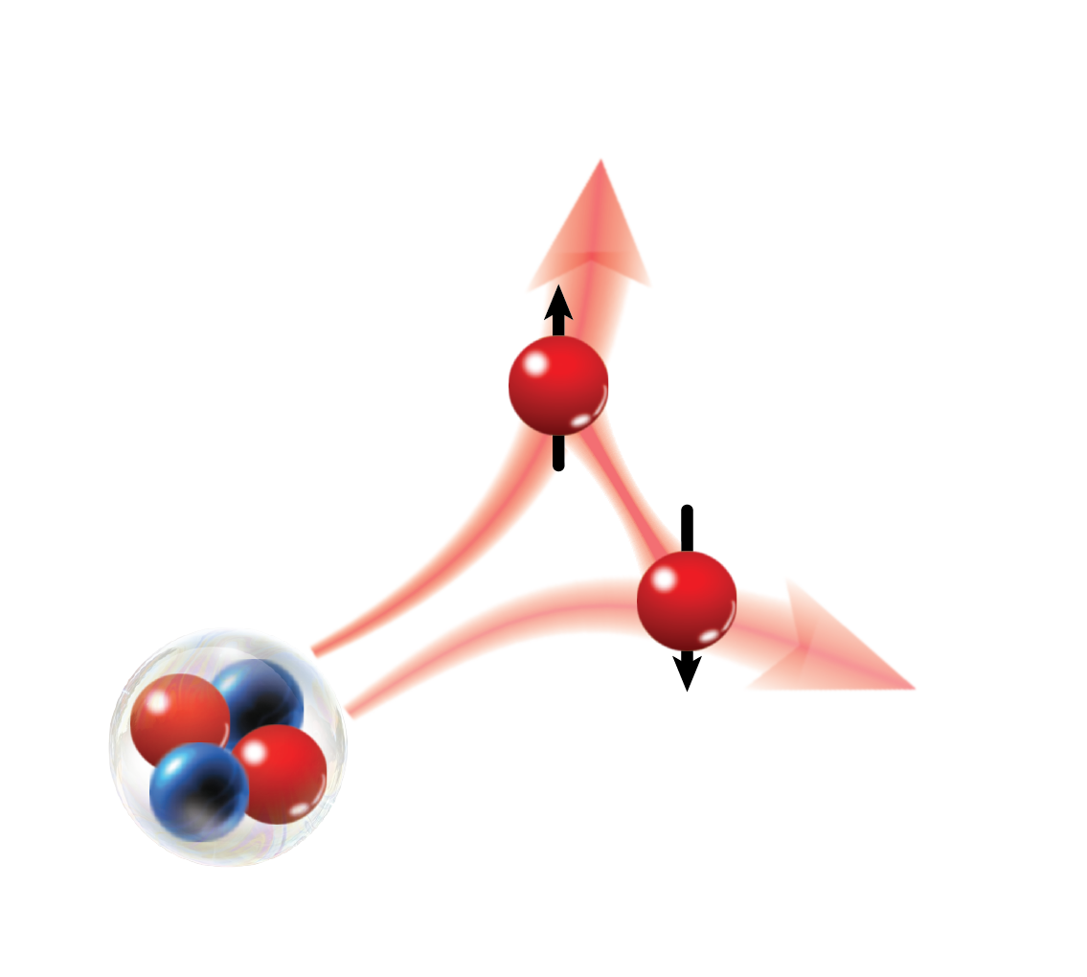
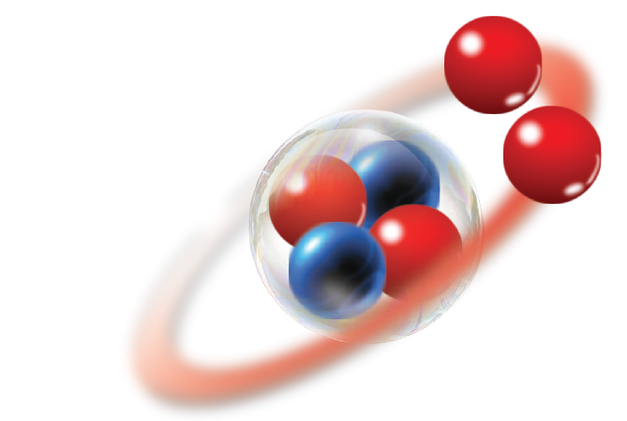
Time dependent (TD) approach
Dynamics and mechanism of 2p decay
Time evolution operator
  Time propagator can be expanded with Chebyshev polynomials.
  Configuration mixing and proper asymptotic behavior.
Open quantum system
Configuration mixing
BEC-like
Pairing
BCS-like
Correlation
GCC
~500 fm
High precision in asymptote
Coulomb field
SW and W. Nazarewicz, Phys. Rev. Lett. 126, 142501 (2021)
Introduction
Method
2p decay
Theory status
GCC
TD

Slide 10
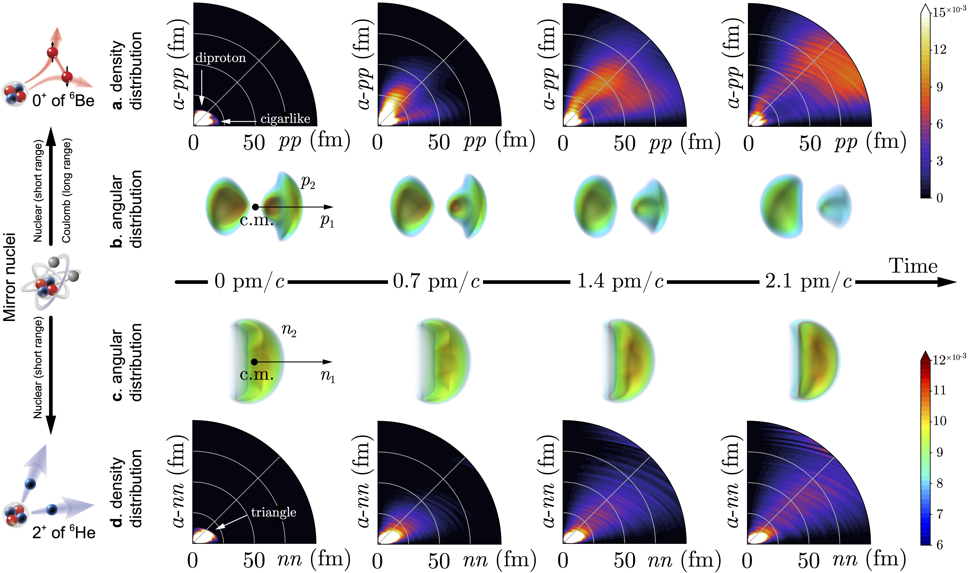
Ground-state of ⁶Be
Probability current
  Particle number changes in V
SW et al., Phys. Rev. C 99, ﻿054302 (2019)
Introduction
Method
2p decay
Decay dynamics
Correlation

Slide 11
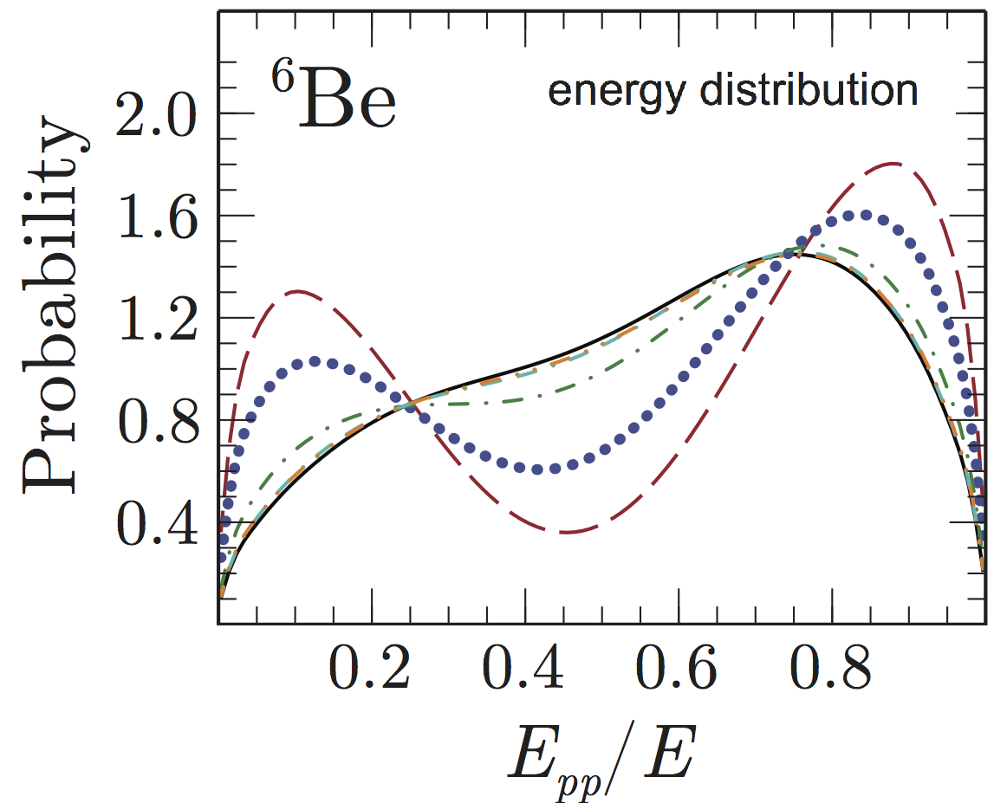
2p decay in ⁶Be
Protons inside nucleus
Two types of tunneling:
diproton (primarily)
cigarlike
Diproton branch bends
due to Coulomb repulsion
Asymptotic correlation begin to converge
SW and W. Nazarewicz, Phys. Rev. Lett. 126, 142501 (2021)
Introduction
Method
2p decay
Decay dynamics
Correlation

Slide 12
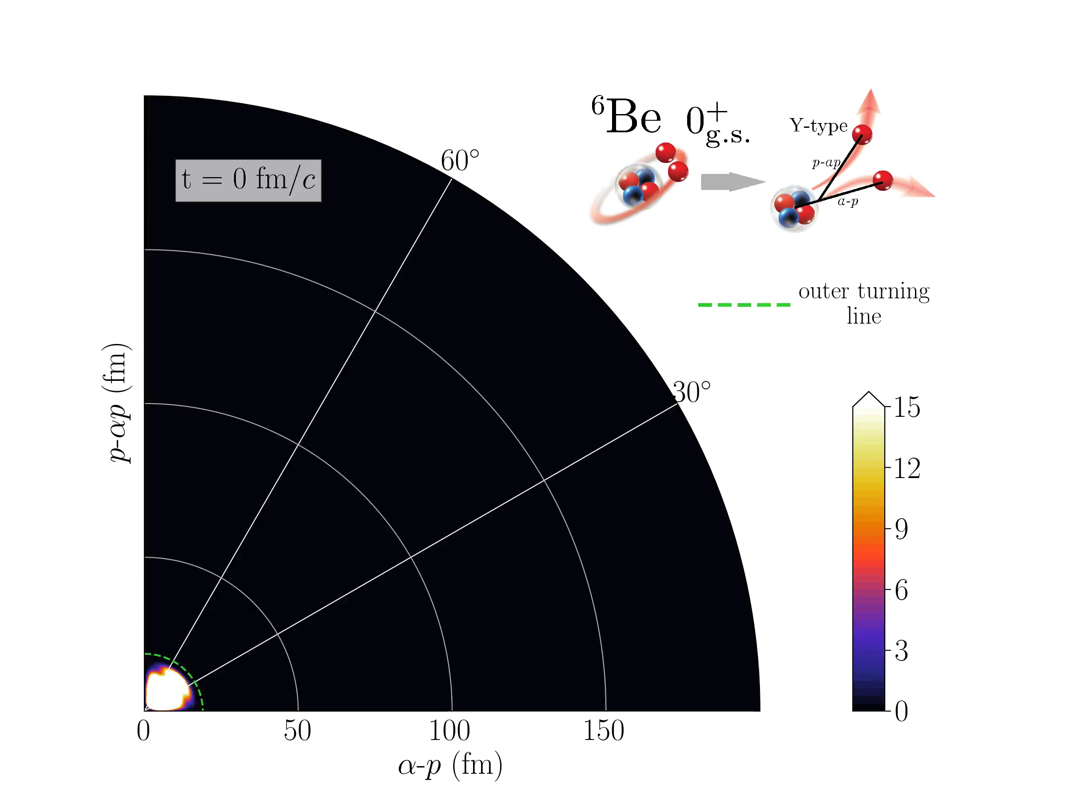
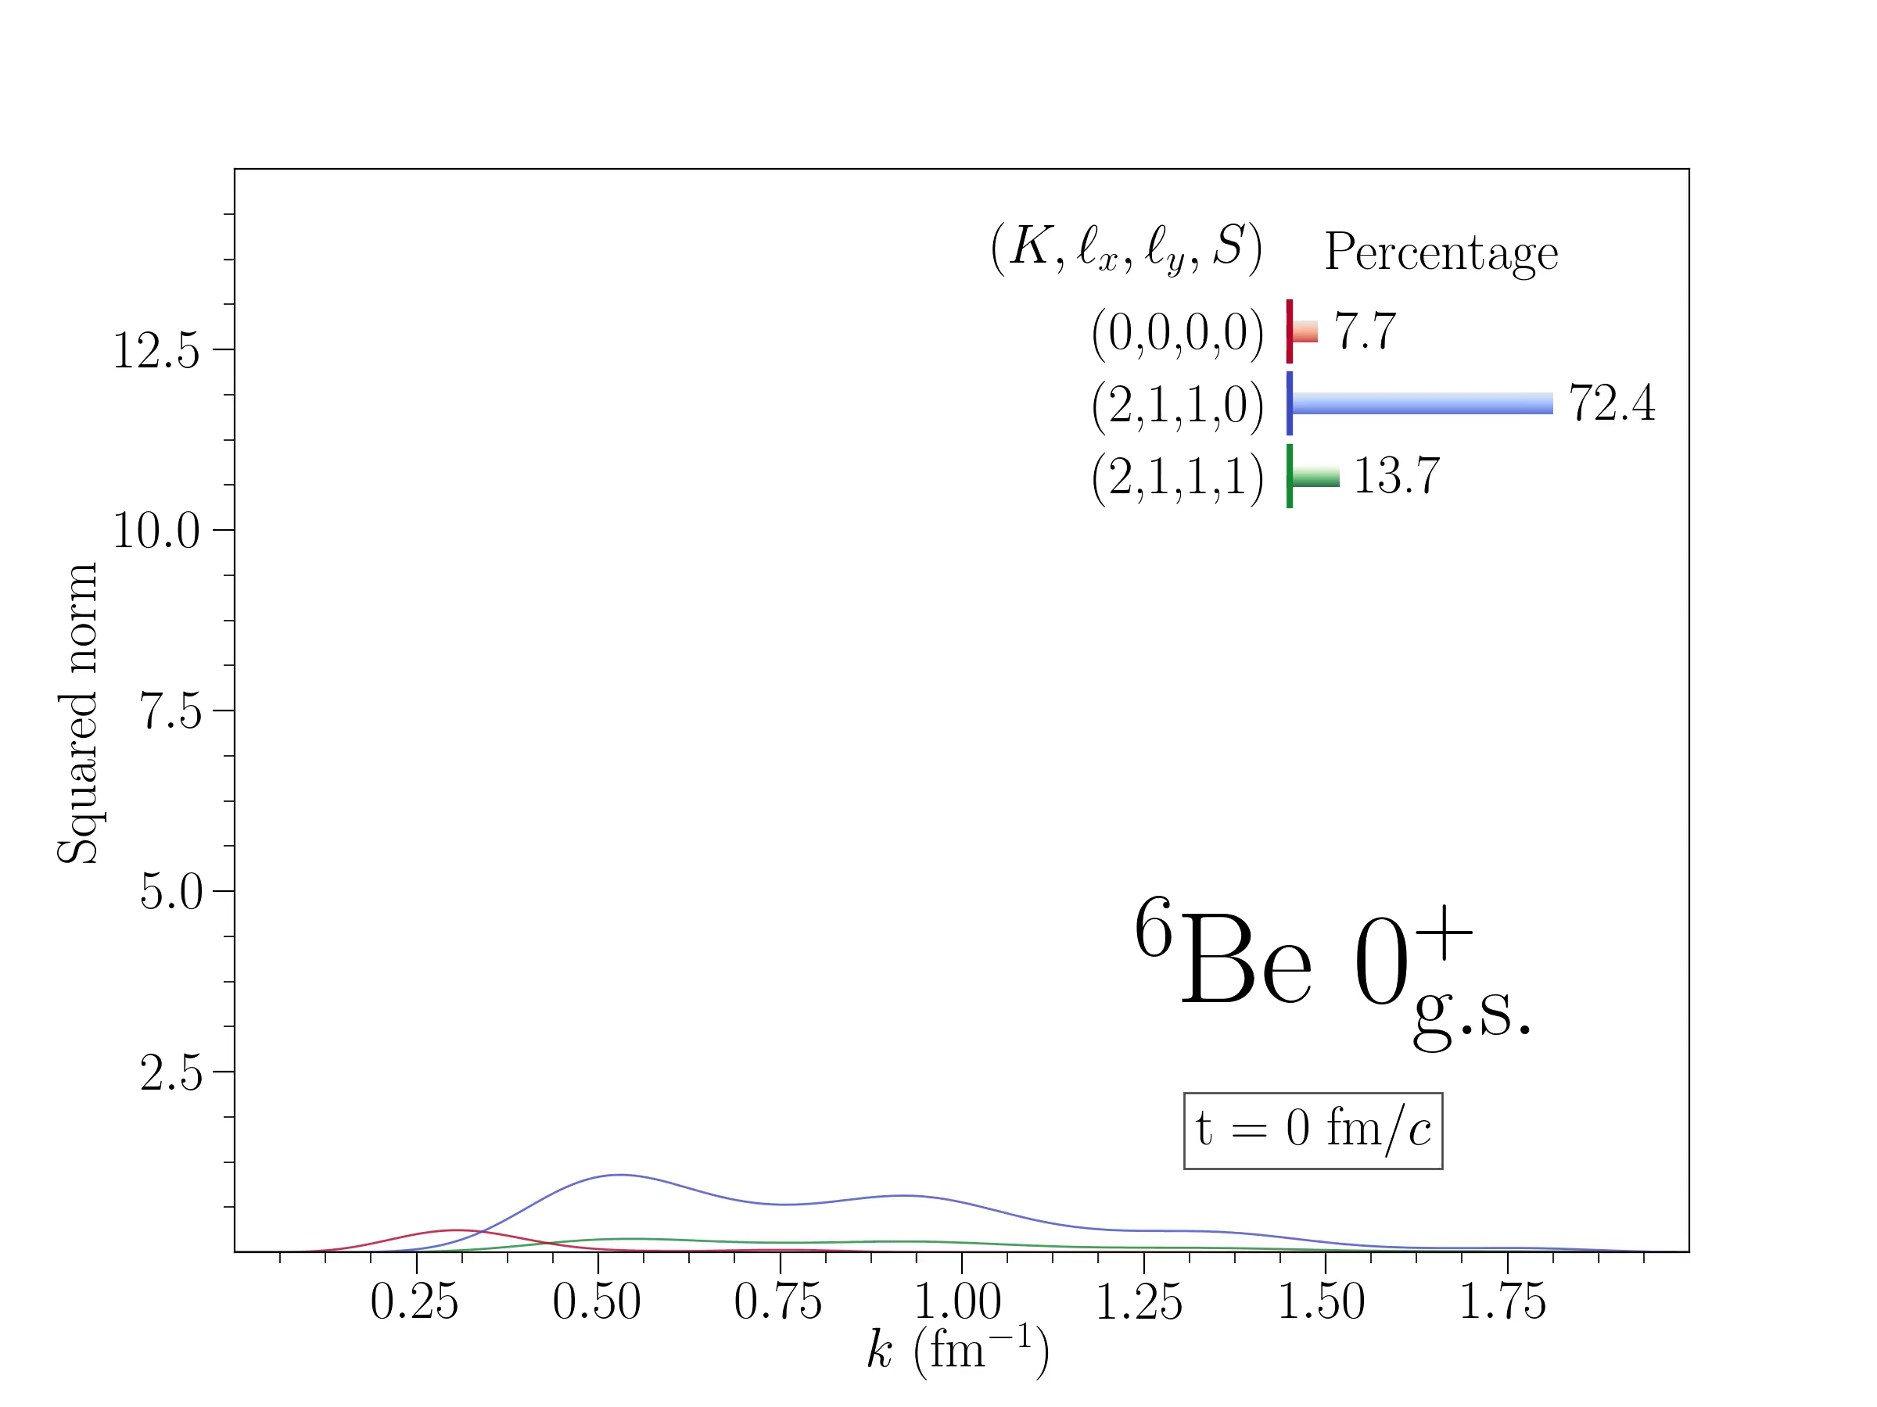
Density and configuration evolution
Density evolution in Jacobi-Y coordinate
Configuration evolution of ⁶Be
s wave
p wave
Protons are emitted simultaneously.
Gradual transition from p wave to s wave during the 2p decay process.
SW and W. Nazarewicz, Phys. Rev. Lett. 126, 142501 (2021)
Introduction
Method
2p decay
Decay dynamics
Correlation

Slide 13
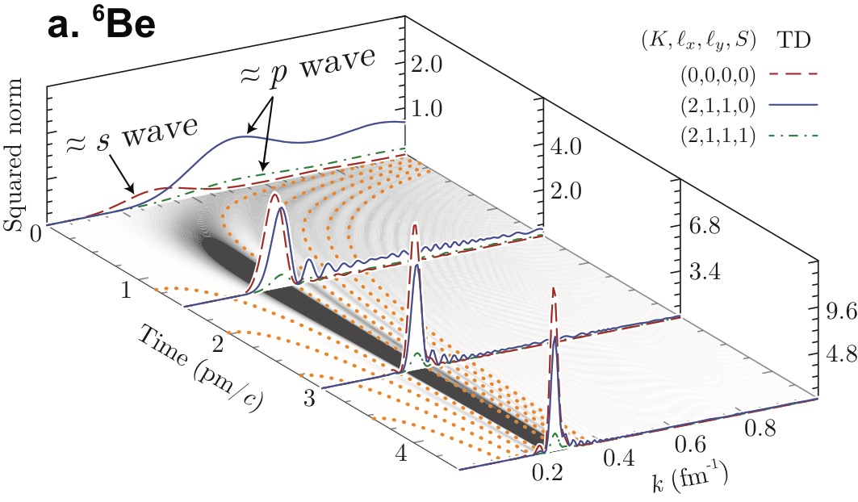
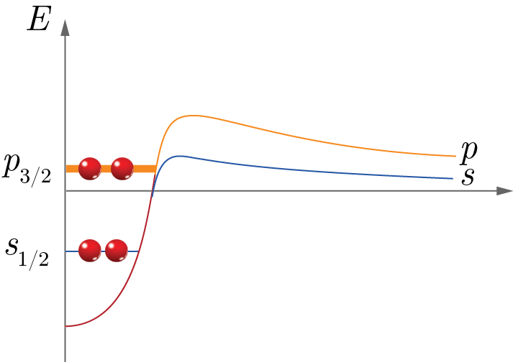
Density evolution of ⁶Be
Jacobi
Single-particle
(s, s)
(p, p)
(d, d)
(f, f)
(0, 0)
dinucleon
Dinucleon needs both positive- and negative-parity orbitals.
Diproton structure forms a bridge from p wave to s wave.
SW and W. Nazarewicz, Phys. Rev. Lett. 126, 142501 (2021)
Introduction
Method
2p decay
Decay dynamics
Correlation

Slide 14
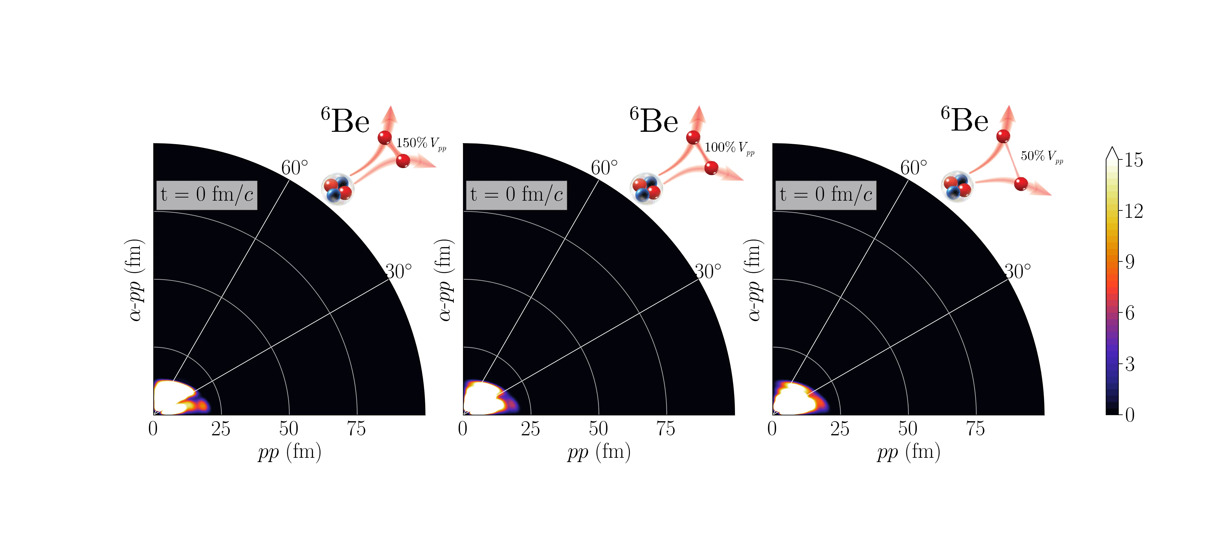
Decay dynamics depends on pairing
The decay dynamics as well as correlation strongly depend on the pairing strength.
Strong pairing results in a larger decay width, which indicates that pairing will benefit the 2p tunneling.
Introduction
Method
2p decay
Decay dynamics
Correlation

Slide 15
Asymptotic correlations
E_{pp} and Y-type angular correlations are strongly impacted by nucleon-nucleon interaction.
Introduction
Method
2p decay
Decay dynamics
Correlation

Slide 16
Energy dependence of the correlation in ⁶Be
E
Deviates from Breit-Wigner due to the threshold proximity.
The threshold effect is channel-dependent.
﻿I. A. Egorova et al., ﻿Phys. Rev. Lett. 109, 202502 (2012)
Introduction
Method
2p decay
Decay dynamics
Correlation

Slide 17
Energy dependence of the correlation in ⁶Be
The weights of different components change as energy increases.
Result in a energy-dependent correlation.
SW, W. Nazarewicz, A. Volya, and Y.G. Ma, Phys. Rev. Res. 5, 023183 (2023)
Introduction
Method
2p decay
Decay dynamics
Correlation

Slide 18
Non-exponential decay
Survival probability
Spectral function
Complex-energy Gamow state
Expanded on harmonic oscillator basis
The time evolution of a resonance contains exponential (resonant) and powered (scattering) decays.
When the decay width is large enough, scattering feature is dominated.
SW, W. Nazarewicz, A. Volya, and Y.G. Ma, Phys. Rev. Res. 5, 023183 (2023)
Introduction
Method
2p decay
Decay dynamics
Correlation

Slide 19
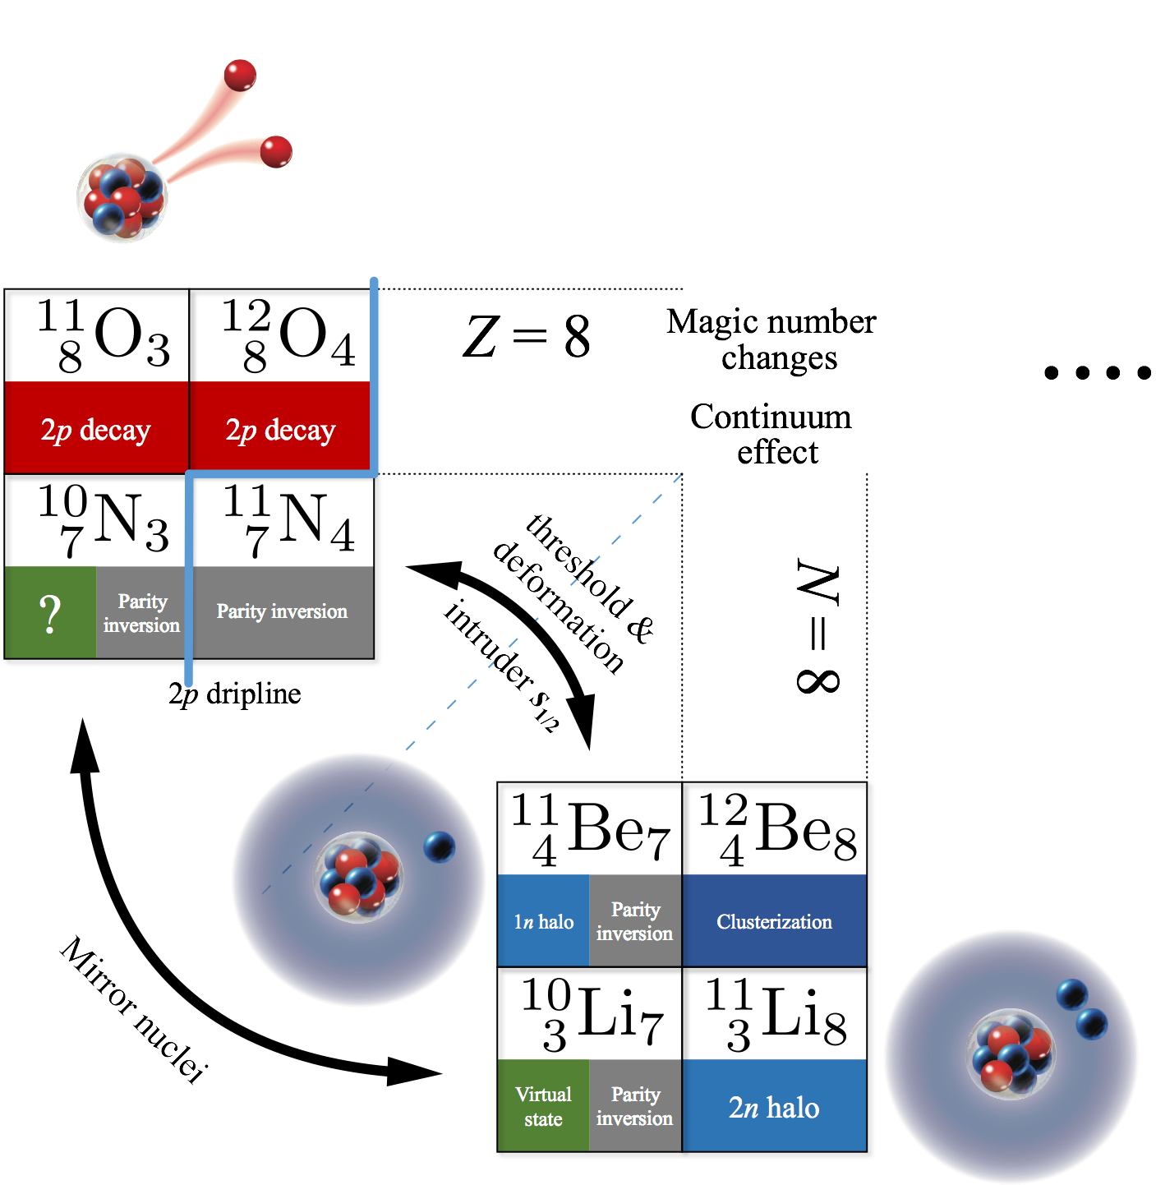
Discovery of ¹¹O
?
Introduction
Method
2p decay
Decay dynamics
Correlation

Slide 20
Predicted spectrum and correlation of ¹¹O
Measured spectrum of ¹¹O
Density distribution
Asymptotic correlation of ¹¹O
SW et al., J. Phys. G ﻿49, 10LT02 (2022)
T. Webb et al., Phys. Rev. Lett. 122, 122501 (2019)
Introduction
Method
2p decay
Decay dynamics
Correlation

Slide 21
Predicted spectrum and correlation of ¹¹O
Updated spectrum of ¹¹O
Density distribution
Asymptotic correlation of ¹¹O
SW et al., J. Phys. G ﻿49, 10LT02 (2022)
T. Webb et al., Phys. Rev. Lett. 122, 122501 (2019)
Introduction
Method
2p decay
Decay dynamics
Correlation

Slide 22
Correlations in heavy-mass nuclei
Preliminary
SW and W. Nazarewicz
Introduction
Method
2p decay
Decay dynamics
Correlation

Slide 23
Correlations in other few-body decay
T-type
SW et al., J. Phys. G ﻿49, 10LT02 (2022)
Y. R. Lin and SW
L. Zhou et al., Nucl. Sci. Tech 35, 107 (2024)
4p (2p+2p) decay of ¹⁸Mg.
Multi-proton emissions.
Correlation changes when Q → 0.
Introduction
Method
2p decay
Decay dynamics
Correlation

Slide 24










Thank you for your attention!
Summary
2p decay
  Exotic 3-body mechanism
  Impacted by decay and structure properties
Nucleon-nucleon correlations
  Connection to nuclear inner structure
  Testing quantum mechanics
Acknowledgements
  W. Nazarewicz
  I. Mukha
  L. G. Sobotka
  Z. H. Li
…
  F. R. Xu
  M. Pfützner
  R. J. Charity
  A. Volya
  …

Slide 25
Questions
What’s the difference between 2p and 2n decay?
Difference between complex scaling and Berggren basis
Correlations evolutions during the decay process
Any simultaneous multi-particle emissions? Any 2p decay from excited states?
Is the decay dynamics depends on the production process?
Other situations that can probe non-exponential decay?
Is the two-step 2n decay of ²⁸O have similar correlation, like the case of ¹⁸Mg?

Slide 26
Backup

Slide 27
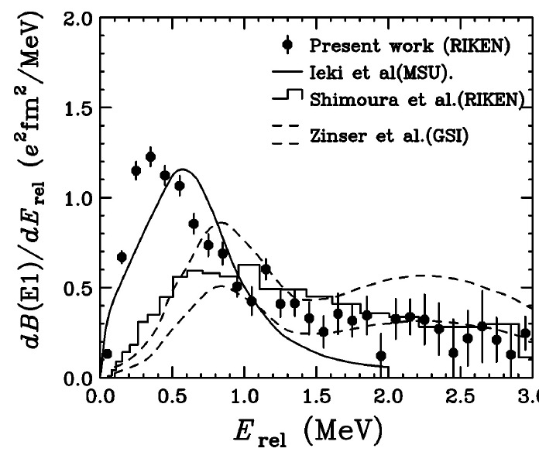
Short & mid long range correlations
Structure
Decay & reaction
macroscopic distance
¹²C
’
﻿T. Nakamura et al., Phys. Rev. Lett 96, 252502(2006)
T.B. Webb et al. Phys. Rev. C ﻿
100, 024306 (2019)

Slide 28
Predicted spectrum and structure of ¹¹O
Measured spectrum of ¹¹O
Calculated spectra of ¹⁰N, ¹¹O
Density distributions of ¹¹O and ¹¹Li
T. Webb et al., Phys. Rev. Lett. 122, 122501 (2019)
The detected broad peak can be reproduced by four states rather than one.
Mirror systems ¹¹O and ¹¹Li.

Slide 29
Predicted spectrum and structure of ¹¹O
Measured spectrum of ¹¹O
Asymptotic correlation of ¹¹O
Updated spectrum of ¹¹O
SW et al., J. Phys. G ﻿49, 10LT02 (2022)
T. Webb et al., Phys. Rev. C 101, 044317 (2020)
The correlation and updated spectrum suggest multiple states in the broad resonance of ¹¹O.

Slide 30
Survival probability of resonant states
SW, W. Nazarewicz, A. Volya, and Y.G. Ma, Phys. Rev. Res., accepted (2023)

Slide 31
Observed 2p emitters

Slide 32
Correlations of light-mass nuclei

Slide 33
Lifetime of ⁶⁷Kr probes deformation evolution
valence
SW and W. Nazarewicz, Phys. Rev. Lett. ﻿120, 212502 (2018)
1/2[321] becomes available for the valence protons when β₂ close to -0.3, which dramatically increases the 2p decay width of ⁶⁷Kr. As a result,
Decay primarily depends on small angular momentum components.

Slide 34
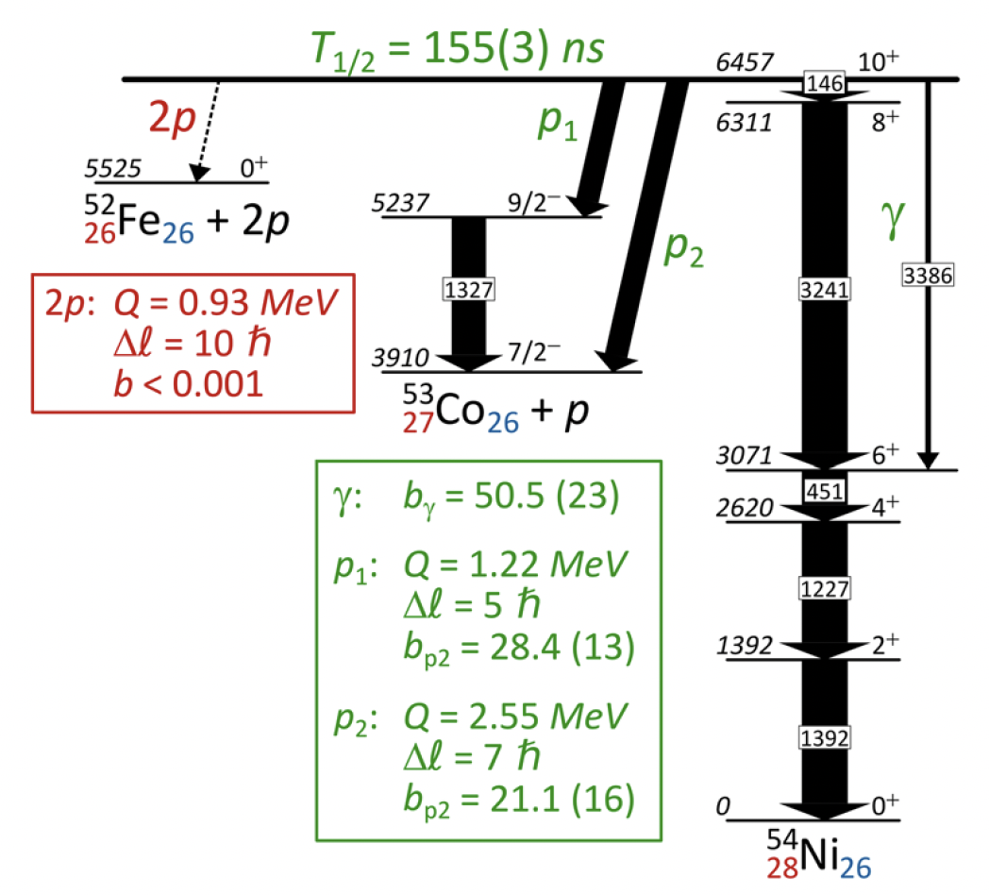
Decay property of ^{54m}Ni
> Gs
~ ps
See D. Rudolph’s talk
J. Giovinazzo et al., Nat. Comm. 12, 4805 (2021)
Lifetime strongly depends on the decay energy and channels.
Branching ratio is less than 10⁻²¹ for 2p decay.

Slide 35
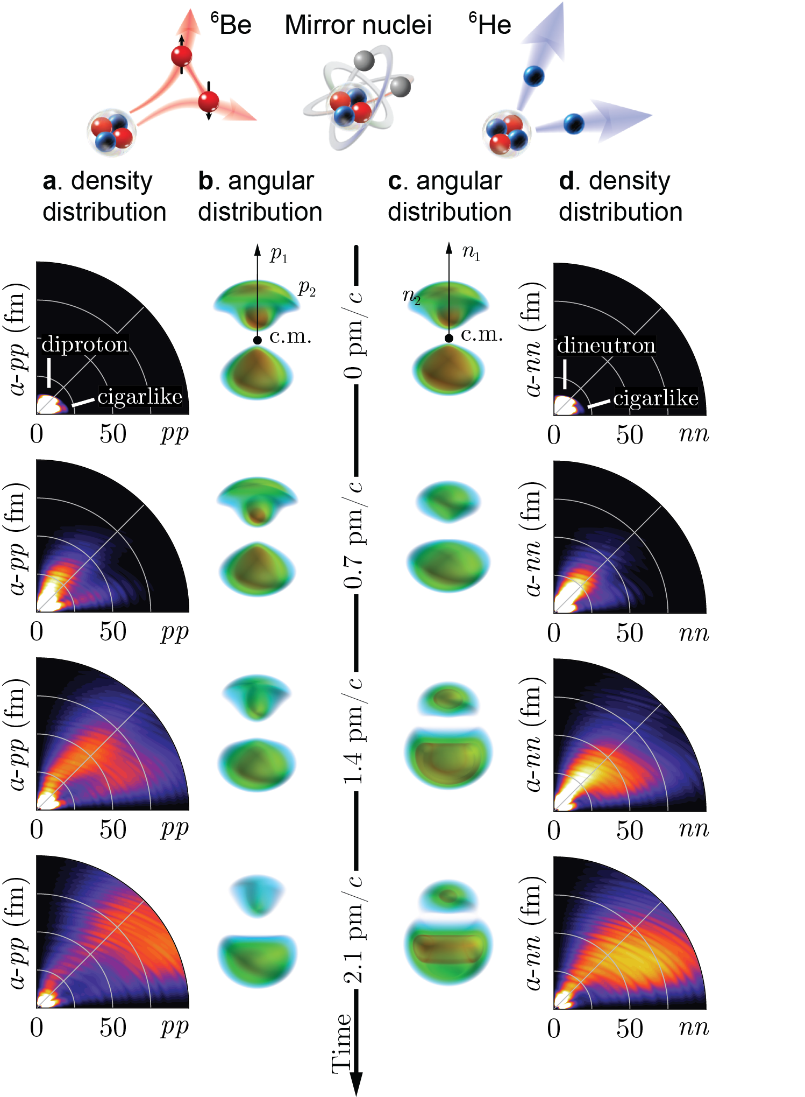
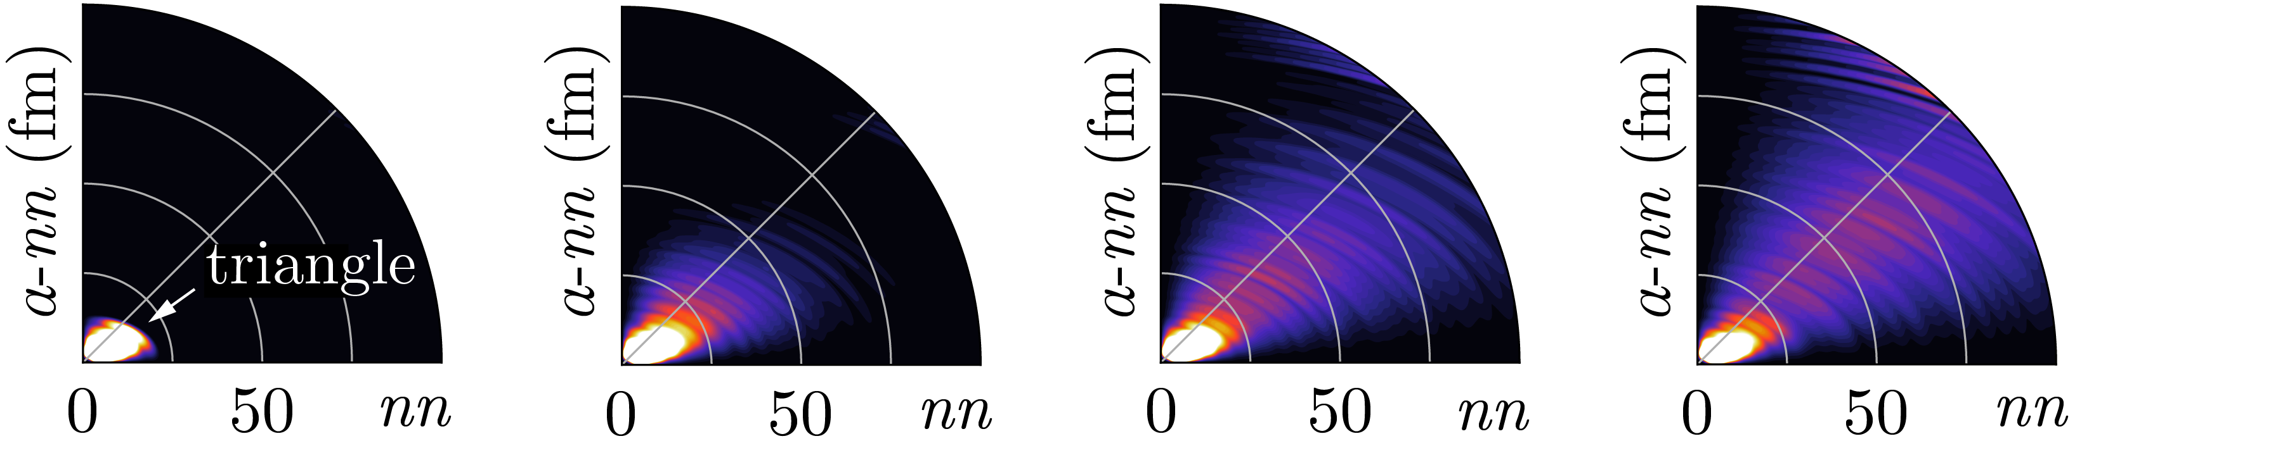
Time evolution of ⁶He’
⁶He’
SW and W. Nazarewicz, Phys. Rev. Lett. 126, 142501 (2021)

