Slide 1
Structure of multi-neutron systems
Emiko Hiyama (Tohoku Univ./RIKEN)

Slide 2
n
n
n
n
4n breakup threshold
E(MeV)
Exp.
～3 MeV
～-1.0 MeV
Γ=2.6 MeV (Upper limit)

Slide 3
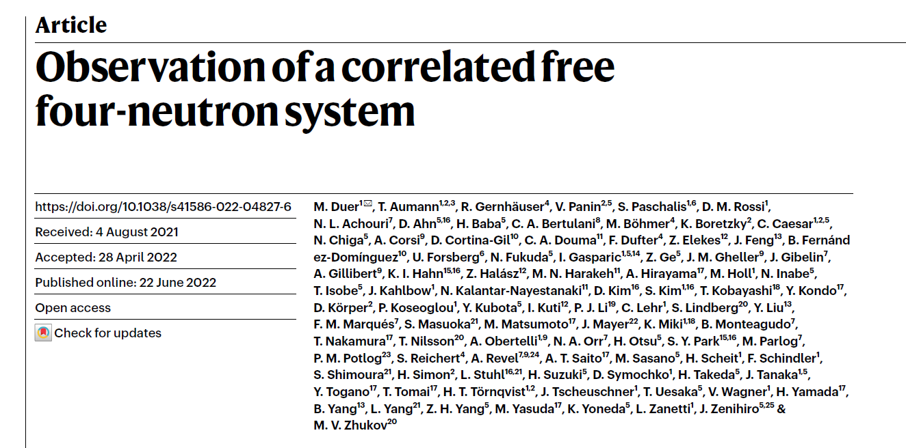
Just recently, experimentally, one peak near 4n breakup threshold in the cross section
has been reported.
Question: ・Can we describe observed 4n system
using realistic NN interaction?
How do we interpret this experimental data theoretically?

Slide 4
So far, there have been positive and negative theoretical results.
Positive result:
A.M. Shirokov et al., PRL117, 182502 (2016).
Non-core shell model calculation+JISP16 NN interaction
Er=0.8 MeV with Γ=1.4 MeV
S. Gandolfi et al., PRL118, 232501 (2017)
Quantum Monte Calro Method +Chrial (NNLO) interaction+Woods
Saxon-well : extrapolation
Er=1.84 MeV with Γ=0.282 MeV

Slide 5
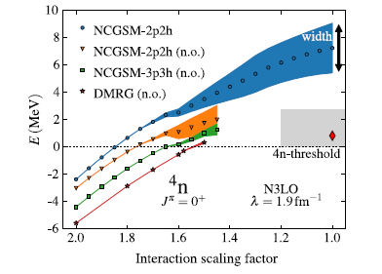
Not positive , not negative result
K. Fossez et al., PRL119, 032501 (2017)
no-core Gamow shell model+ N3LO, JISP16
Er～ 7 MeV, Γ ～3.5 MeV to 3.7 MeV
Much higher energy and
broader width than observed data
f xV_{NN}
Scaling factor

Slide 6
Negative results
n
n
n
n
Introduce our paper
First, let me explain my method for this calculation.

Slide 7
Our few-body caluclational method
Gaussian Expansion Method (GEM) , since 1987
,
・A variational method using Gaussian basis functions
・Take all the sets of Jacobi coordinates
Developed by Kyushu Univ. Group,
Kamimura and his collaborators.
Review article :
E. Hiyama, M. Kamimura and Y. Kino,
Prog. Part. Nucl. Phys. 51 (2003), 223.
High-precision calculations of various 3- and 4-body systems:
Exotic atoms / molecules ,
3- and 4-nucleon systems,
multi-cluster structure of light nuclei,
Light hypernuclei,
3-quark systems,

Slide 8
Benchmark-test 4-body calculation : Phys. Rev. C64 (2001), 044001
by 7 groups
⁴He
①
②
n
n
③
p
p
④
4 nucleon
bound state
⑤
Realistic NN
force: AV8’
⑥
Only two-body NN interaction
⑦

Slide 9
Benchmark-test calculation of the 4-nucleon bound state
Good agreement among 7different methods
In the binding energy, r.m.s. radius and wavefunction density
GEM
ours
Exp. -28.33
MeV
Notes:
ours

Slide 10
NN: AV potential (Central +spin-orbit +tensor)
+
n
n
T_{NNN}= 1/2
A phenomenological three-body force
p
p
we use
T=1/2 three-body force.
⁴He
To distinguish proton or neutron,
we use isospin.
Proton=> t=1/2, t_{z}=+1/2
Neutron=>t=1/2,t_{z}=-1/2
This potential has been applied to ⁴He.
E. Hiyama, B.F. Gibson and M. Kamimura, Phys. Rev. C 70 (2004) 031001(R)
T_{z}= 1x1/2+2x(-1/2)=1/2

Slide 11
20.36
3N+N
20.58
³He+n
0⁺
20.31
0⁺
20.21
2
2
19.82
³H+p
0⁺
0.0 MeV
0⁺
0.0 MeV
1
(-28.30 MeV)
1
(-28.44)
E_{x}
E_{x}
EXP
CAL
⁴He
⁴He
AV8 NN +Coulomb potential + three-body force reproduce the
data.

Slide 12
NN: AV potential (Central +spin-orbit +tensor)
+
n
n
T_{NNN}= 1/2
A phenomenological three-body force
p
p
we use
T=1/2 three-body force.
⁴He
To distinguish proton or neutron,
we use isospin.
Proton=> t=1/2, t_{z}=+1/2
Neutron=>t=1/2,t_{z}=-1/2
This potential has been applied to ⁴He.
E. Hiyama, B.F. Gibson and M. Kamimura, Phys. Rev. C 70 (2004) 031001(R)
T_{z}= 1x1/2+2x(-1/2)=1/2
Apply to nnnn system

Slide 13
T_{nnn}=3/2
n
n
n
n
We need T=3/2
three-body force.
But, we have no idea
how much attraction
we need.
⁴n
Tz(nnn)=3x(-1/2)=-3/2
For 4n system, we need T=3/2 three-body force. We use the
same potential with T=1/2, but, different parameter of W₁.
W₁(T=3/2)= free b₁=4.0fm => W₁ should be adjusted so as to reproduce
the observed 4n system
W₂(T=3/2) = +35 MeV b₂=0.75

Slide 14
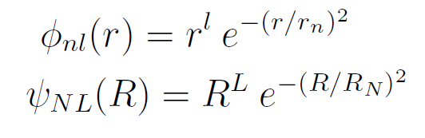
The observed 4n system was reported from the bound region to resonant region.
In order to obtain energy position (E_{r}) and decay width (Γ), we use complex
scaling method.
The energy pole is stable
with respect to θ.
Re(E) corresponds to energy
With respect to 4n breakup threshold.
Im(E) corresponds to Γ/2.
4n breakup threshold

Slide 15
energy trajectory of J=0+ state changing W₁

Slide 16
In order to reproduce the data of 4n system,
We need W₁(T=3/2)= -36 MeV～-30MeV.
It should be noted that W₁(T=1/2)=-2.04 MeV
to reproduce the observed binding energy
of ⁴He, ³He and ³H.
Attraction is 15 times
Stronger.
Exp.
W₁(T=3/2)= free b₁=4.0fm
W₂(T=3/2) = +35 MeV b₂=0.75 fm
Question: W₁ value for T=3/2 is reasonable?
To check the validity of three-body
force, we calculate the energies
of ⁴H,⁴He(T=1),⁴Li.
It is noted that I took benchmark test of
4n with Faddeev-Yakubovsky method by Lazauskas. My result is the same as that by FY.

Slide 18
Exp. ⁴H (-5.29 MeV)
If we use W₁=-36MeV～-30 MeV
to reproduce the observed data of 4n,
We have strong binding energies
of ⁴H, ⁴He (T=1) and ⁴Li.
This result is inconsistent with
the data of A=4 nuclei.
The J=2⁻ state of A=4 nuclei
should be resonant states.
Conclusion: to reproduce the data of 4n, unlikely attractive three-body
force is required.

Slide 19
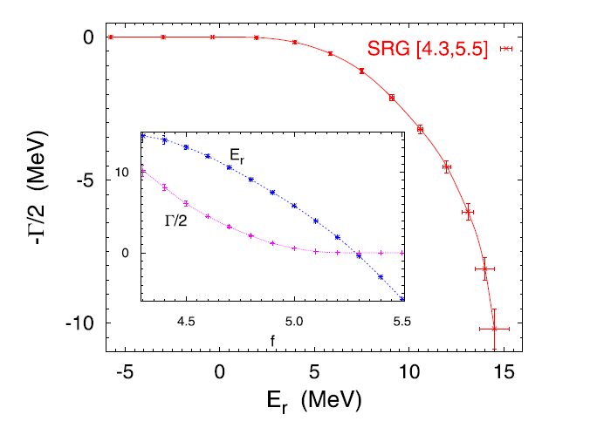
Deltuva, Physics Letters B 782, 238 (2019).
Faddeev Yakubovsky method+SRG potential (based on AV18 potential)
fxV(¹s₀)
Scaling factor: f<4.3=> no resonant state

Slide 20
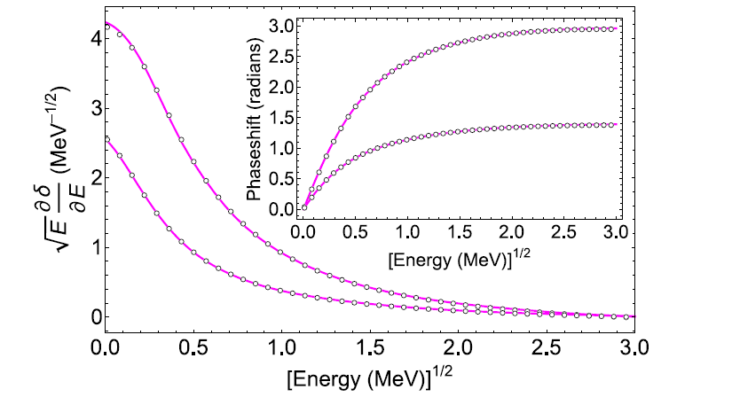
M. D. Higgins, C.H. Greene, A. Kievsky, M. Vivianni,
Phys. Rev. Lett. 125, 052501(2020)
Phys. Rev. C 103, 024004 (2021)
Hypersherical harmonics Method
AV8 potential which is the same one used by me.
No resonant state
They used AV18 potential and they had no resonant state.

Slide 21
Summary of the 4n calculation
Author
Method
How to obtain resonant state V_{NN} resonance
A.M. Shirokov et al. Non-core shell model + phase shift analysis JISP16 Er=0.8 MeV
Γ=1.4 MeV
S. Gandolfi et al. Quantum Monte Calro extrapolation chiral(NNLO) Er=1.84 MeV
Γ=0.282 MeV
K. Fossez et al., no-core Gamow shell model N3LO, JISP16, Er～7MeV
Γ～3.5MeV
E. Hiyama, R. Lazauskas et al., Gaussian Expansion + CSM AV8 No resonance
Faddeev Yakubovsky
Deltuva, Faddeev Yakbobsky + AGS SRG(AV18),NLO, No resonance
M. D. Higgins et al., Hypersherical harmonics phase shift analysis AV8, AV18, no resonance

Slide 22
Just recently, experimentally, one peak near 4n breakup threshold in the cross section
has been reported.
Question: How do we interpret this experimental data theoretically?

Slide 23
We calculated the reaction using several
kinds of NN interaction.
We see to have a peak near 4n threshold
without 3NF force.
We include 3NF force. But effect of 3NF
is small.
We interpret that a peak is emerged as
a consequence of the final interaction among
4n system and 4 neutrons in ⁸He projectile.

Slide 24
In this paper, wavefunction of ⁸He is treated as 4n into harmonics-oscillater.
In order to study the reaction in detail, we need to have ⁸He wavefunction
within the framework of ⁴He+4n at least.
The construction of wavefuction is on going.
The detail reaction calculation is future work.

Slide 25
To understand 4n system in more detail….
p
n
n
n
n
⁵H
n
n
n
p
n
Let’s add one triton to 4n.
⁷H
t
n
Neutron:6
Proton: 1
n
t
Super heavy hydrogen
n
n
n
n
Can we understand ⁵H and ⁷H with
NN interaction so far proposed?
n
n
⁷H is bound, resonance, nothing?

Slide 27
n
n
⁵H
n
p
n
transfer reaction p(⁶He, ²He)⁵H
A. Korcheninnikov, et al. Phys. Rev. Lett.
87 (2001) 092501.
Γ=1.9±0.4 MeV
Superheavy hydrogen
1/2⁺
1.7±0.3 MeV
t+n+n

Slide 28
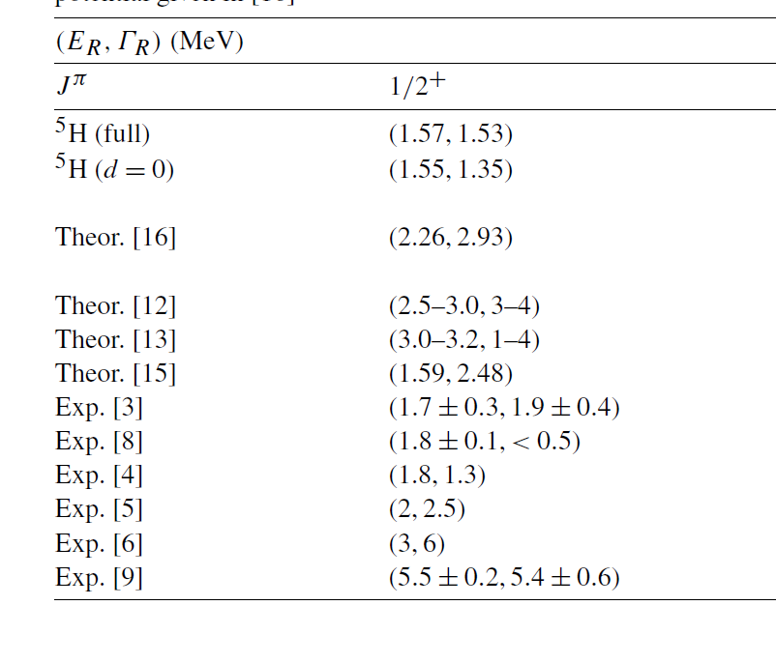
[3] A.A. Korosheninnikov et al., PRL87 (2001) 092501
[8] S.I. Sidorchuk et al., NPA719 (2003) 13
[4] M.S. Golovkov et al. PRC 72 (2005) 064612
[5] G. M. Ter-Akopian et al., Eur. Phys. J A25 (2005) 315.
Energy of 5H is similar. But decay width is dependent on experiment.

Slide 29
In 2017, we have a new data on ⁵H.
A. H. Wuosmaa, Phys. Rev. C95, 014310 (2017)
⁶He (d,³He) ⁵H
E_{r}=2.4±0.3 MeV Γ=5.3 ±0.4 MeV
⁷H
A. Korsheninnikov et al., PRL 90,
082501 (2003)
M. Caamano et al., PRL99, 062502(2007)
PRC 78, 044001 (2008)
n
n
n
n
n
p
n
E_{r}=0.57
+0.42
MeV
from t+4n threshold
-0.21
If we have narrow
decay at lower energy,
we could have
heavier H-hydrogen isotope
such as ⁹H.
Γ=0.09
+0.94
MeV
-0.06
¹²C(⁸He,⁷H)¹³N reaction
What is limit for H-isotope? Probably ⁷H?

Slide 30
Experiment situation:
Recently, ⁸He (p,2p) ⁷H reaction has been done at RIBF.
RIBF Experimental Proposal NP1512-SAMURAI34.
The analysis is on going.
Then, it is timely to calculate ⁷H to obtain the energy and width
theoretically.
Motivated by this situation, we study ⁷H structure within the
framework of t+4n 5-body problem. We also discuss on the
energy and decay width of ⁵H within t+n+n three-body problem.

Slide 31
Framework
NN: Minnesota potential (central potential)
n
n
n
⁷H=t+4n model
n
t
t-n potential => there is a large degree of ambiguity.
Only several data for phase shift of t-n
⁵H
n
n
t

Slide 32
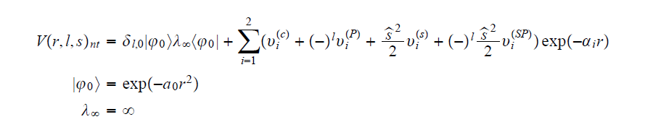
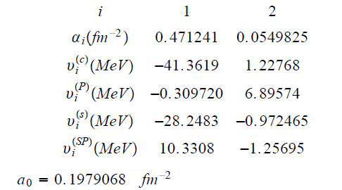
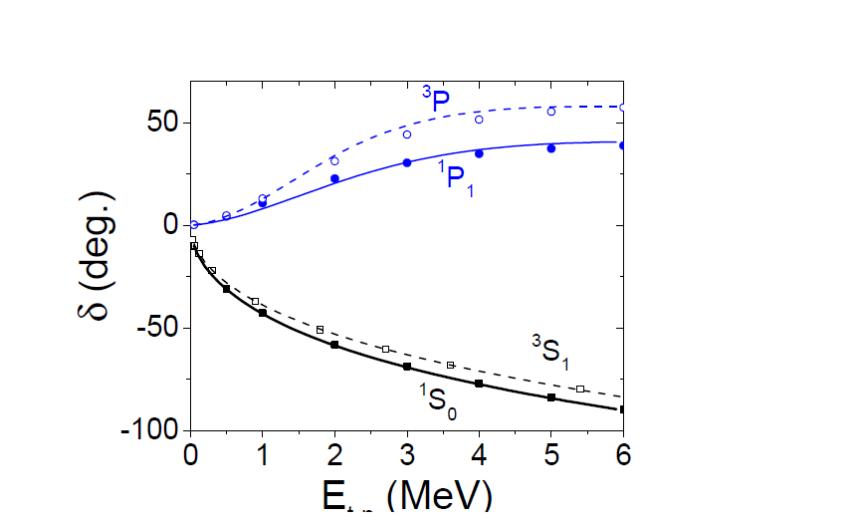
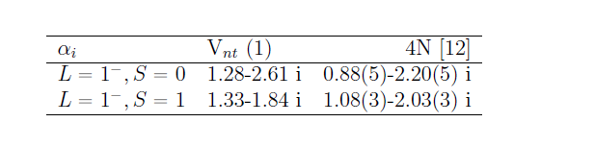
2
Based on four-body calculation with MT I-III
Two-body calculation of t-n is almost consistent
with that of 4-body calculation.

Slide 33


This is origin of breaking effect of ³H core.
+ I introduce a phenomenological
three-body t-n-n force to obtain energy trajectory.
V₀,b₃ : parameters.
Fit so as to reproduce the
data of ⁵H
apply
⁵H
n
n
t
Question: Which experimental data
of ⁵H should we fit?

Slide 34
[3] A.A. Korosheninnikov et al., PRL87 (2001) 092501
[8] S.I. Sidorchuk et al., NPA719 (2003) 13
[4] M.S. Golovkov et al. PRC 72 (2005) 064612
[5] G. M. Ter-Akopian et al., Eur. Phys. J A25 (2005) 315.
Energy of ⁵H is similar. But decay width is dependent on experiment.

Slide 35
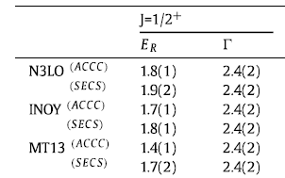
R. Lazauskas, E. Hiyama, J. Carbonell, PRB 791 335 (2019)
Fadeev-Yakubovsky method calculation of ⁵H
Γ=1.9±0.4 MeV
We take this result as ‘exp.’ data.
1/2⁺
Close to the below exp.data
1.7±0.3 MeV
A. Korcheninnikov, et al. Phys. Rev. Lett.
87 (2001) 092501.
t+n+n

Slide 36
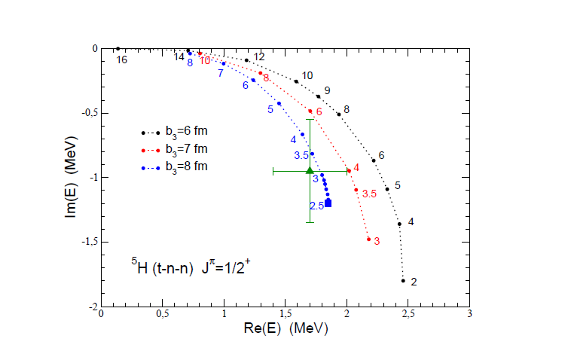
When b₃=8 fm and V₀=3 to 2.5 MeV, the energy pole of
⁵H is close to exp. data. If we have this potential parameter,
what is energy pole of ⁷H?

Slide 37
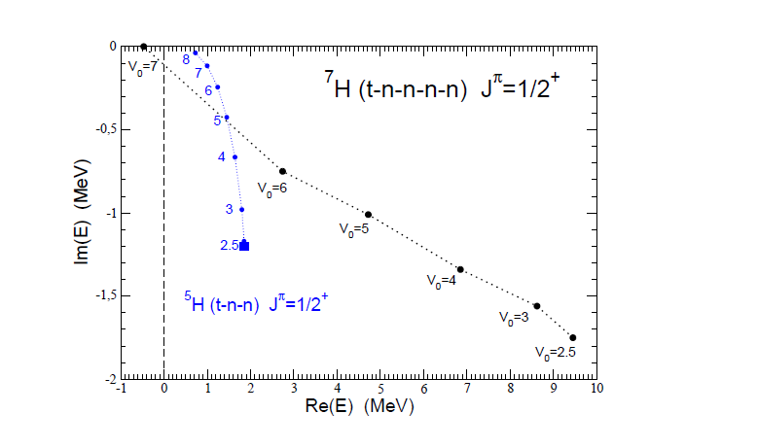
Im (E)=Γ/2
For V₀=2.5, we reproduce the data of ⁵H accurately.
In this case, the energy pole of ⁷H, E=9.5 MeV, Γ～3.5 MeV.
Our energy of ⁷H is much higher and broad decay width.

Slide 38
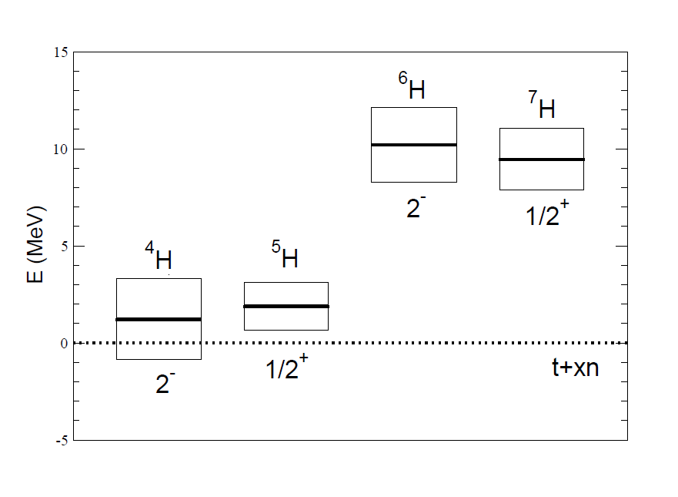
Summary of H-isotope (according to our calculation)
End of H-isotope
prediction

Slide 39
Summary
4n system:
Theoretically, it is difficult to have resonant state with NN realistic force.
To interpret recent data on a peak near 4n breakup threshold,
we calculate ⁸He(p,p ⁴He) 4n reaction and interpret that a peak is
a consequence of final state interaction.
⁷H system:
Motivated by ⁸He (p,2p) ⁷H reaction, we calculate ⁷H=t+4n 5-body model.
Assuming Er～1.9 MeV and Γ～2.4 MeV for ⁵H,
Our calculated energy and decay width of ⁷H are about Er～ 8 to 9 MeV,
and Γ～ 3 MeV.
However, the energy and decay width of ⁷H is strongly dependent on
⁵H. Thus, it would be very helpful to confirm energy pole of ^{５}H.
If our calculation on ⁷H is in good agreement with future data,
it would be difficult to have resonant state of 4n.

Slide 40
Thank you!

Slide 41
The lightest nucleus to have a bound state is
deuteron.
Exp.
n
n
⁴H
n
p
n
p
n
n
p
²H J=1⁺ -2.22 MeV
³H J=1/2⁺ -8.48 MeV

Slide 42
Theoretical calculation for ⁵H and ⁷H
N. K. Timofeyuk, PRC65, 064306(2002), PRC69 , 034336(2004)
Volkov NN potential, Hyperspherical harmonics method: 5-body and 7-body
calculations
⁵H: about 1 MeV above t+n+n threshold.
⁷H: about 3MeV above t+4n threshold
She calculated the energies with bound state approximation.
Then, she did not give decay width for these nuclei.
S. Aoyama and N. Itagaki, PRC80,021304 (R)
Volkov NN potential, AMD calculation
⁷H: 4.2 MeV above t+4n threshold, no calculation for decay width
No report for the energy of ⁵H
H. H. Li et al., PRC 104, L061306 (2021)
Gamow shell model calculation using Minnesota NN potential.
Energy and decay width of ⁵H is 1.4 MeV and 0.5 MeV, respectively.
Energy and decay width of ⁷H is about 2-3MeV and about 0.1 MeV,
respectively.
They predicted to have very narrow decay width for ⁵H and ⁷H.

Slide 43
Experiment situation:
Recently, ⁸He (p,2p) ⁷H reaction has been done at RIBF.
RIBF Experimental Proposal NP1512-SAMURAI34.
The analysis is on going.
Then, it is timely to calculate ⁷H to obtain the energy and width
theoretically.
Motivated by this situation, we study ⁷H structure within the
framework of t+4n 5-body problem. We also discuss on the
energy and decay width of ⁵H within t+n+n three-body problem.

Slide 44
Framework
NN: Minnesota potential (central potential)
n
n
n
⁷H=t+4n model
n
t
t-n potential => there is a large degree of ambiguity.
Only several data for phase shift of t-n
⁵H
n
n
t

Slide 45
2
Based on four-body calculation with MT I-III
Two-body calculation of t-n is almost consistent
with that of 4-body calculation.

Slide 46
This is origin of breaking effect of ³H core.
+ I introduce a phenomenological
three-body t-n-n force to obtain energy trajectory.
V₀,b₃ : parameters.
Fit so as to reproduce the
data of ⁵H
apply
⁵H
n
n
t
Question: Which experimental data
of ⁵H should we fit?

Slide 47
[3] A.A. Korosheninnikov et al., PRL87 (2001) 092501
[8] S.I. Sidorchuk et al., NPA719 (2003) 13
[4] M.S. Golovkov et al. PRC 72 (2005) 064612
[5] G. M. Ter-Akopian et al., Eur. Phys. J A25 (2005) 315.
Energy of ⁵H is similar. But decay width is dependent on experiment.

Slide 48
R. Lazauskas, E. Hiyama, J. Carbonell, PRB 791 335 (2019)
Fadeev-Yakubovsky method calculation of ⁵H
Γ=1.9±0.4 MeV
We take this result as ‘exp.’ data.
1/2⁺
Close to the below exp.data
1.7±0.3 MeV
A. Korcheninnikov, et al. Phys. Rev. Lett.
87 (2001) 092501.
t+n+n

Slide 49
When b₃=8 fm and V₀=3 to 2.5 MeV, the energy pole of
⁵H is close to exp. data. If we have this potential parameter,
what is energy pole of ⁷H?

Slide 50
Im (E)=Γ/2
For V₀=2.5, we reproduce the data of ⁵H accurately.
In this case, the energy pole of ⁷H, E=9.5 MeV, Γ～3.5 MeV.
Our energy of ⁷H is much higher and broad decay width.

Slide 51
Summary of H-isotope (according to our calculation)
End of H-isotope
prediction

Slide 52
Summary
4n system:
Theoretically, it is difficult to have resonant state with NN realistic force.
To interpret recent data on a peak near 4n breakup threshold,
we calculate ⁸He(p,p ⁴He) 4n reaction and interpret that a peak is
a consequence of final state interaction.
⁷H system:
Motivated by ⁸He (p,2p) ⁷H reaction, we calculate ⁷H=t+4n 5-body model.
Assuming Er～1.9 MeV and Γ～2.4 MeV for ⁵H,
Our calculated energy and decay width of ⁷H are about Er～ 8 to 9 MeV,
and Γ～ 3 MeV.
However, the energy and decay width of ⁷H is strongly dependent on
⁵H. Thus, it would be very helpful to confirm energy pole of ^{５}H.
If our calculation on ⁷H is in good agreement with future data,
it would be difficult to have resonant state of 4n.

Slide 53
Thank you!

