Slide 1
25, 2024

Slide 11
k⁻³

Slide 12
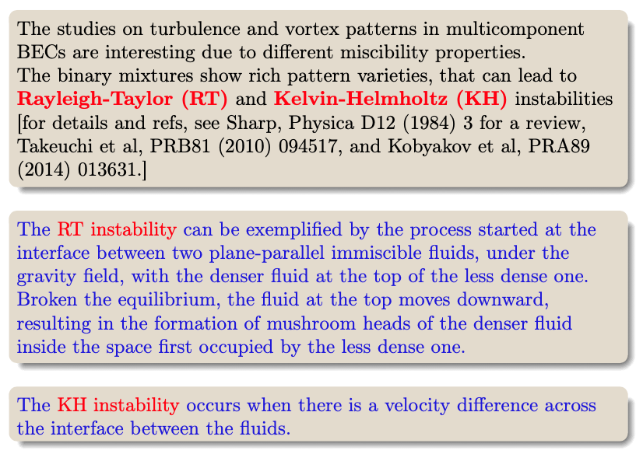

Slide 14
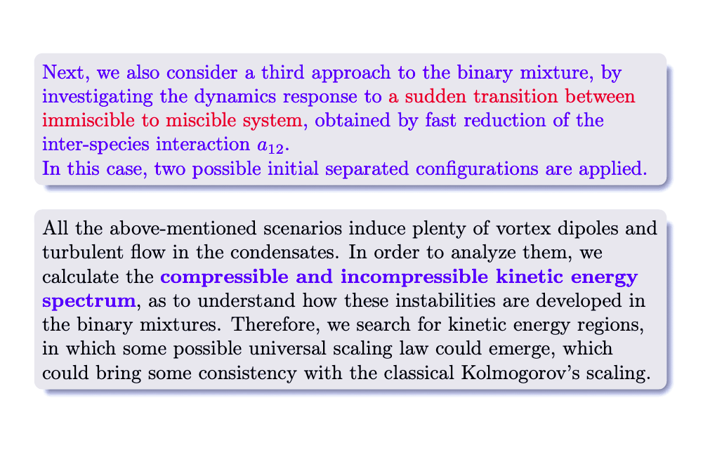

Slide 23
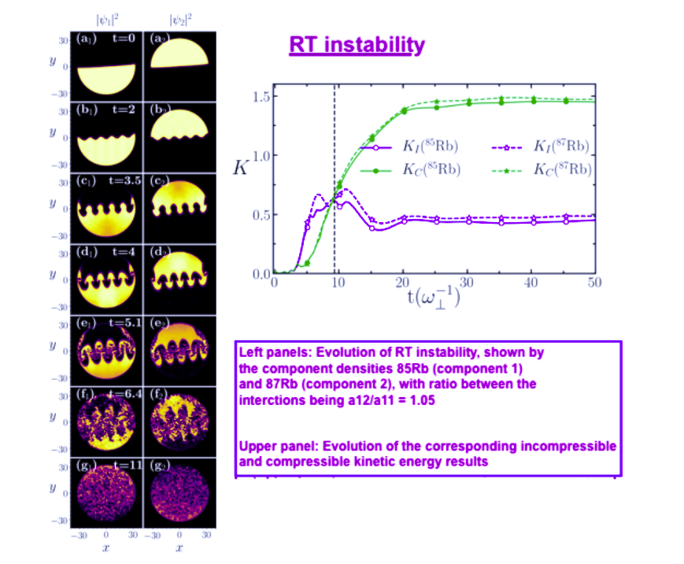
Upper: Time evolution of the incompressible and compressible kinetic energies for both components.
Left: Densities evolution of RT instability, shown by snap-shots, for the ⁸⁵Rb (left panels) and ⁸⁷Rb (right panels). The interaction ratio is kept in a₁₂/a₁₁=1.05 along the simulation.

Slide 24
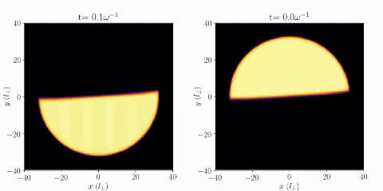
⁸⁵Rb
⁸⁷Rb
Rayleigh-Taylor Instability in binary BEC mixture

Slide 25
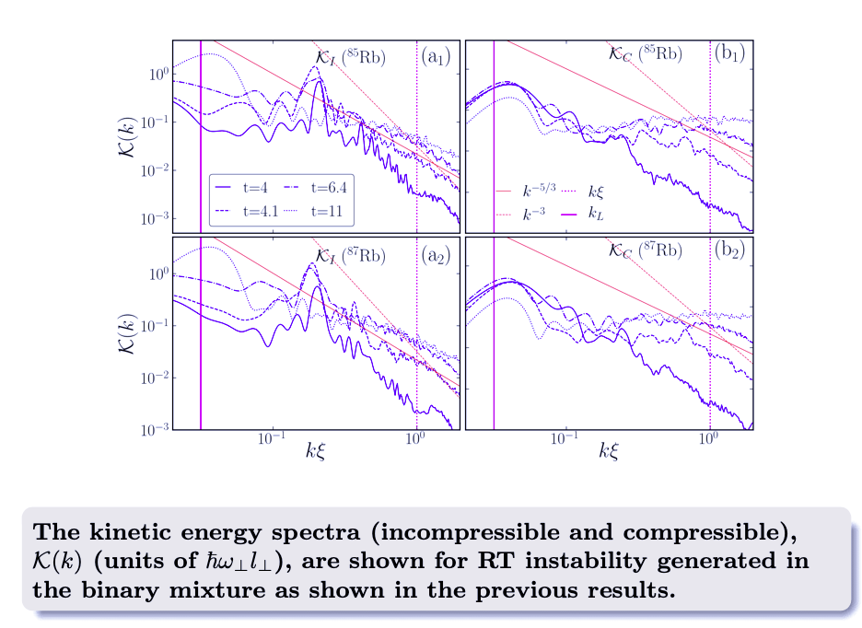

Slide 27
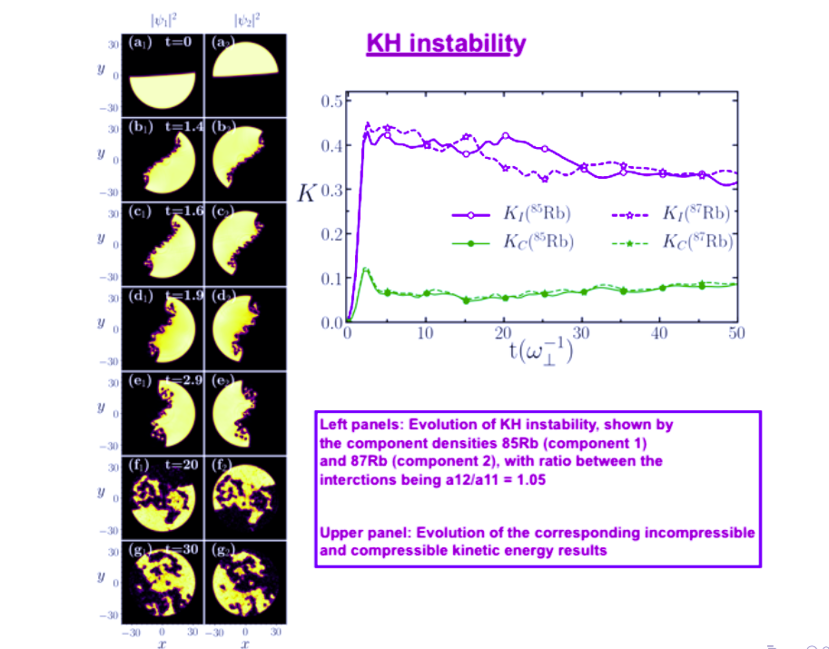
Upper: Time evolution of the incompressible and compressible kinetic energies for both components.
Left: Densities evolution of KH instability, shown by snap-shots, for the ⁸⁵Rb (left panels) and ⁸⁷Rb (right panels). The interaction ratio is kept in a₁₂/a₁₁=1.05 along the simulation.

Slide 28
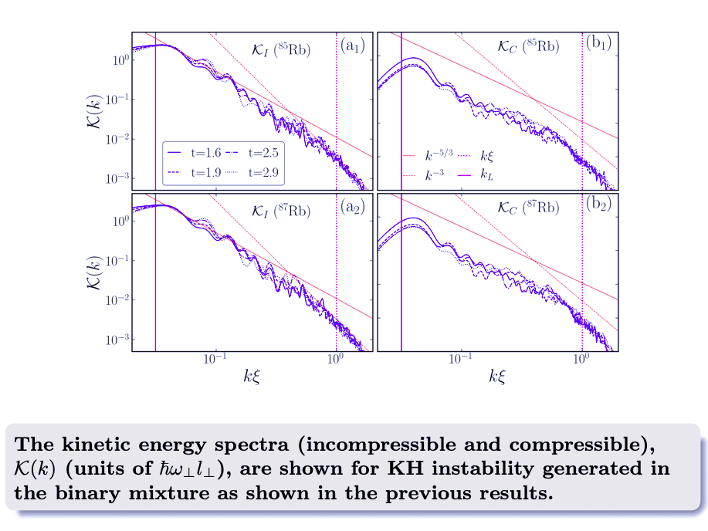

Slide 29
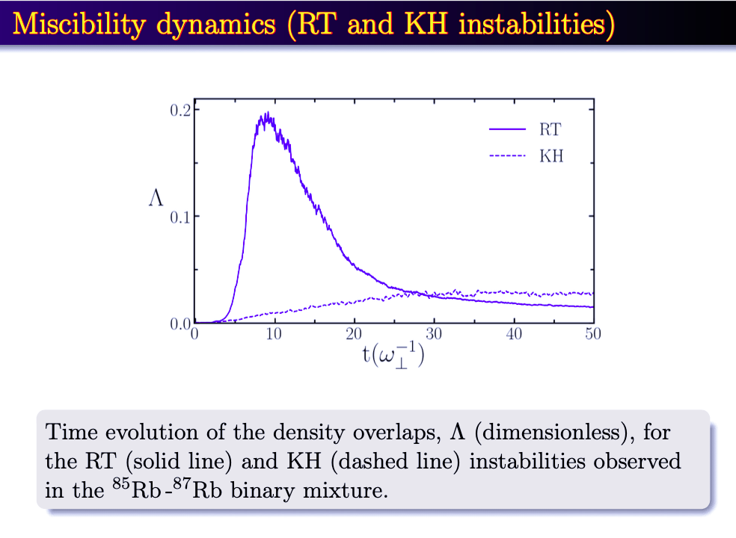

Slide 31
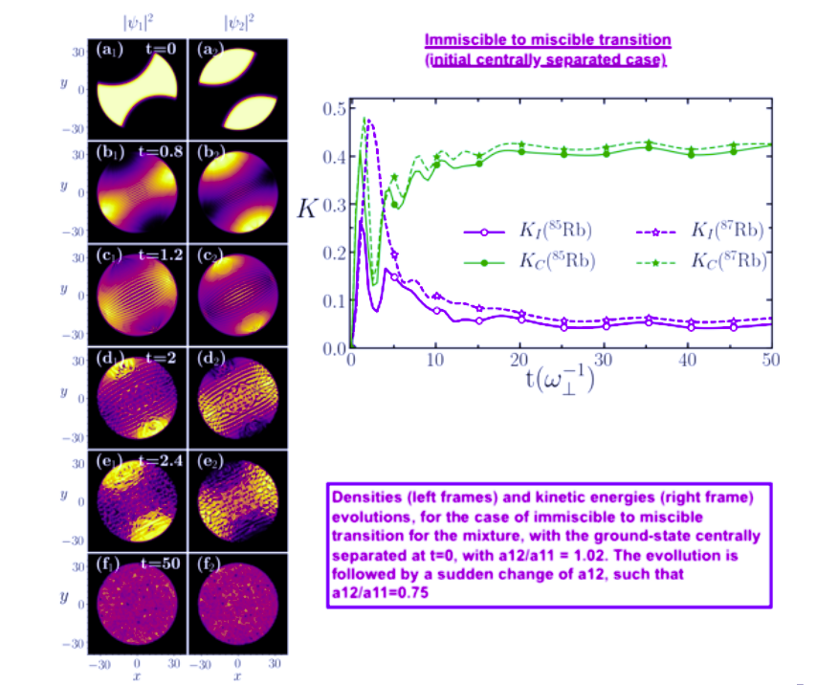
Upper: Time evolution of the incompressible and compressible kinetic energies for both components.
Left: Densities evolution in the immiscible to miscible transition for the ⁸⁵Rb (left panels) and ⁸⁷Rb (right panels) mixture, with ground-state centrally separated at t=0. The initial a₁₂/a₁₁=1.05 is changed to 0.75 in the simulation.

Slide 32
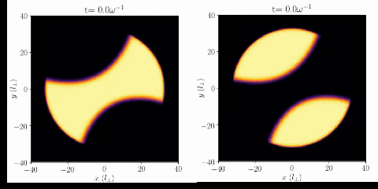
⁸⁵Rb
⁸⁷Rb
Instability in BEC mixture due to immiscible to miscible sudden transition
(centrally separated initial configuration)

Slide 33
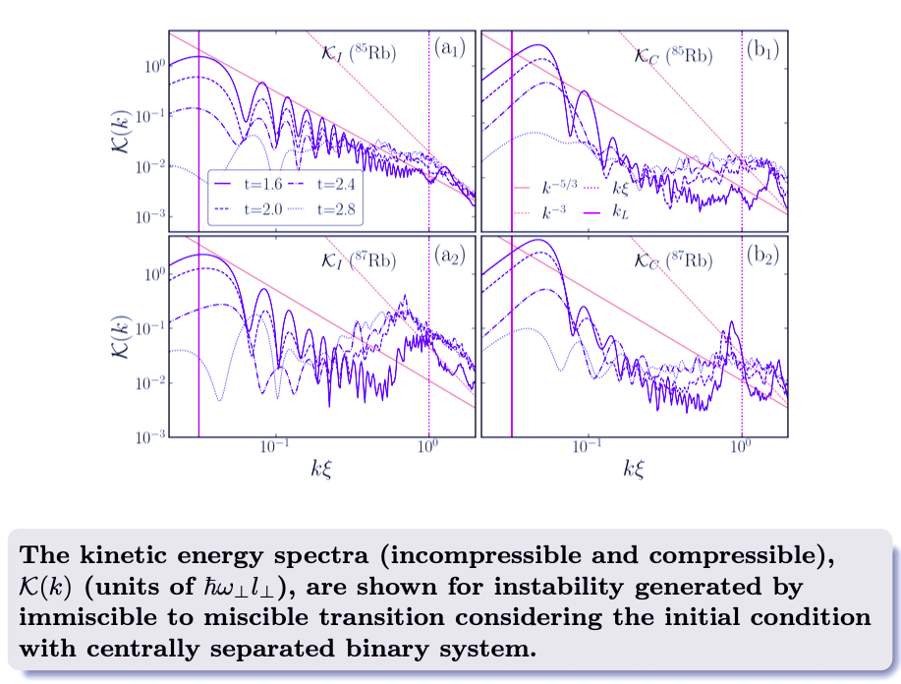

Slide 35
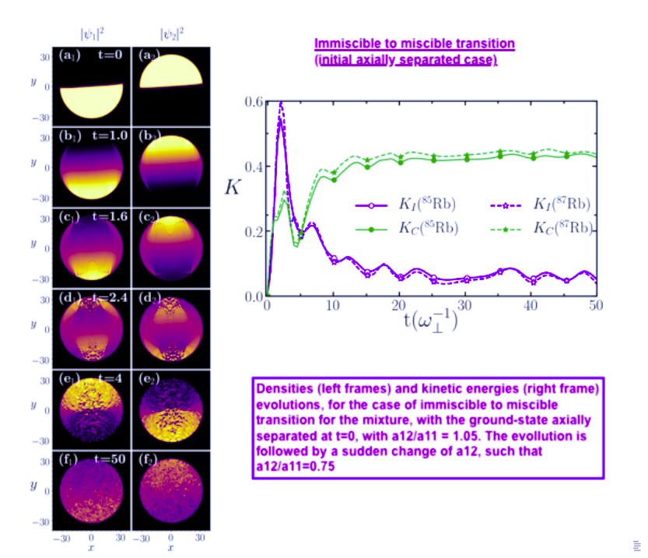
Upper: Time evolution of the incompressible and compressible kinetic energies for both components.
Left: Densities evolution in the immiscible to miscible transition for the ⁸⁵Rb (left panels) and ⁸⁷Rb (right panels) mixture, with ground-state axially separated at t=0. The initial a₁₂/a₁₁=1.05 is changed to 0.75 in the simulation.

Slide 36
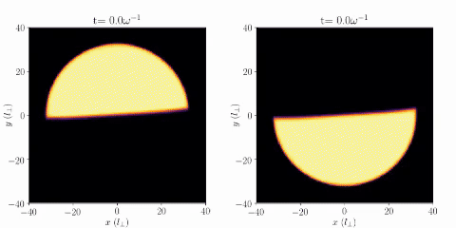
⁸⁷Rb
⁸⁵Rb
Instability in BEC mixture due to immiscible to miscible sudden transition
(axially separated initial configuration)
[In this animation the lighter species is at the right]

Slide 37
