Slide 1
The Peculiar Thermal Relaxation of Neutron Stars
tuzhonghao@xmu.edu.cn
Speaker: Zhong-Hao Tu (涂中豪)
Collaborator: Ang Li and Rodrigo Negreiros
IHEP, Beijing, China; Sept 26, 2024

Slide 2
Contents
Background
Thermal relaxation of neutron star
Peculiar thermal relaxation from superfluidity
Peculiar thermal relaxation of hyperon star
Summary and Perspective

Slide 3
Contents
Background
Thermal relaxation of neutron star
Peculiar thermal relaxation from superfluidity
Peculiar thermal relaxation of hyperon star
Summary and Perspective

Slide 4
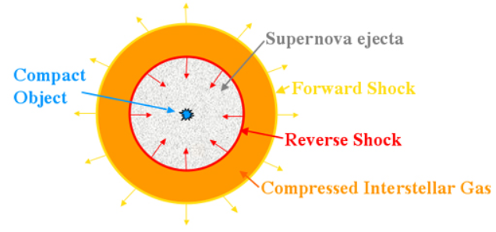
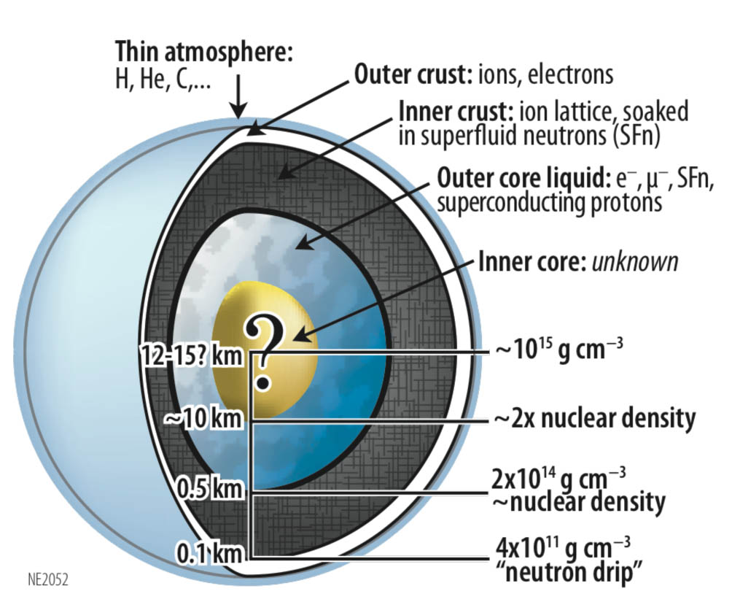
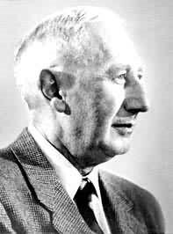
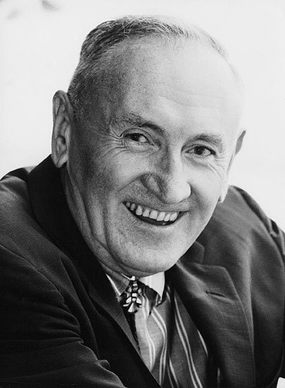
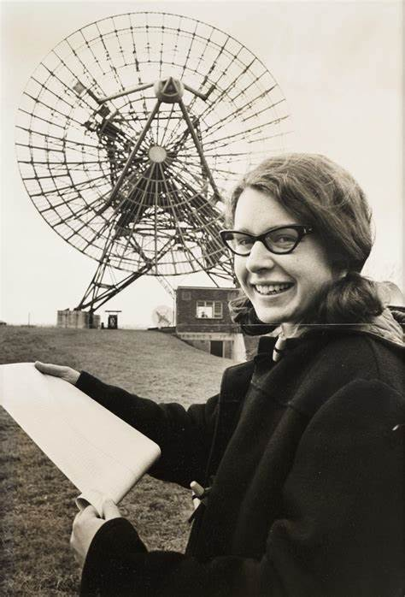
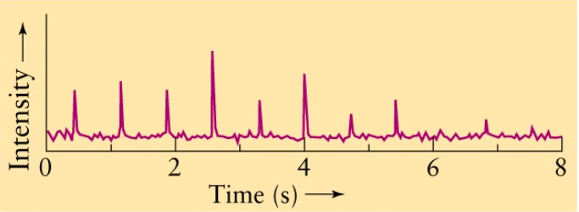
Neutron Stars
Walter Baade
Fritz Zwicky
1930’s，the possible existence of neutron stars
Jocelyn Bell
Lecture 19: Neutron Stars (ualberta.ca)
Index of /Images/nicer (nasa.gov)
1967，the first observation of pulsar

Slide 5
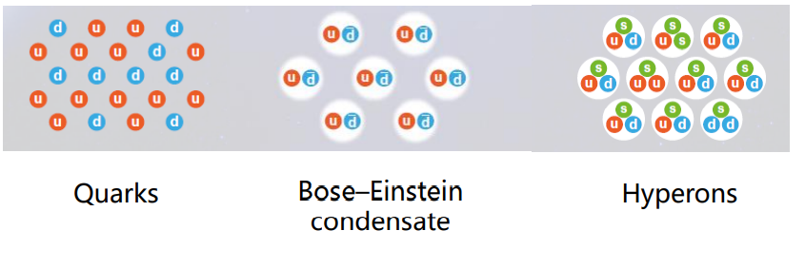
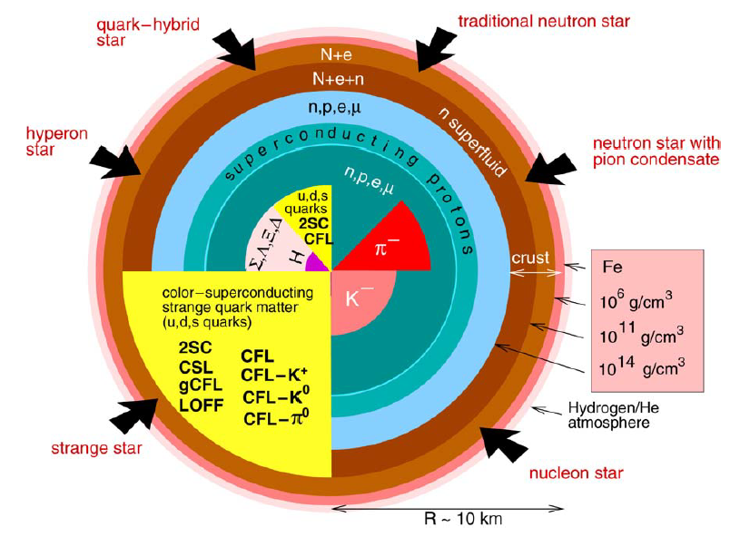
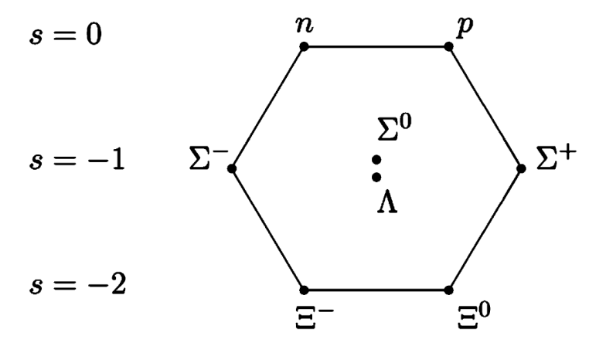
Neutron Star Inner Core
other possible compositions:
excited nucleon $Δ$
dark matter
……
Weber2005_PPNP54-193
Alexandrou2009_PRD80-114503

Slide 6
Neutron Star Inner Core
other possible compositions:
excited nucleon $Δ$
dark matter
……
classification of neutron stars:
nucleon star
hyperon star
quark star
hybrid star
dark matter mixed star
……
Weber2005_PPNP54-193
Alexandrou2009_PRD80-114503

Slide 7
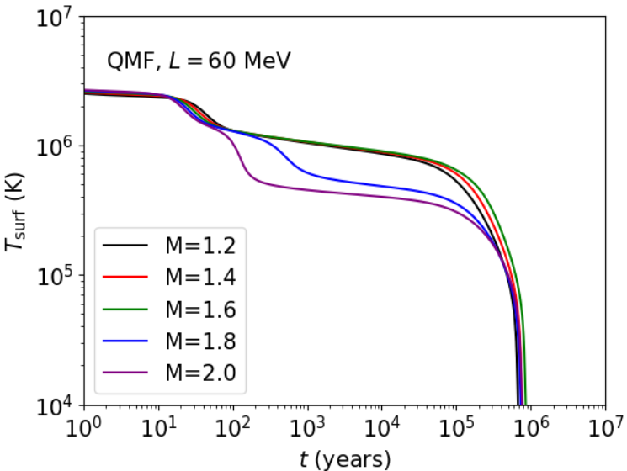
Neutron Star Long-term Cooling
状态方程

Slide 8
Neutron Star Long-term Cooling
状态方程
neutrino emissivity $ε$
specific heat $c_{v}$
thermal conductivity $κ$
MICRO

Slide 9
Neutron Star Long-term Cooling
状态方程
neutrino emissivity $ε$
specific heat $c_{v}$
thermal conductivity $κ$
MICRO
mass and radius profile $m(r)$
curvature profile $ϕ(r)$
MACRO

Slide 10
Neutron Star Long-term Cooling
状态方程
neutrino emissivity $ε$
specific heat $c_{v}$
thermal conductivity $κ$
MICRO
mass and radius profile $m(r)$
curvature profile $ϕ(r)$
Equation of State (EoS)
Superfluidity (SF）
Composition: hyperon? quark? $Δ$? ...
Mass
Magnetic field, envelopes …
MACRO

Slide 11
Neutrino Emissivity
dUrca vs. mUrca
Alford2024_arXiv2406.13717
 | threshold
np dUrca | $$Y_{p}>1/9$$
mUrca | $$×$$
hyperon dUrca | nearly the onset density of hyperon
spectator nucleon
Cooper pair breaking and formation (PBF)
Raduta2017_MNRAS475-4347
PBF process is triggered when internal temperature decreases to the critical temperature

Slide 12
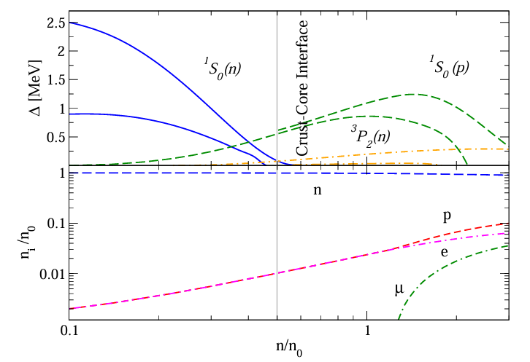
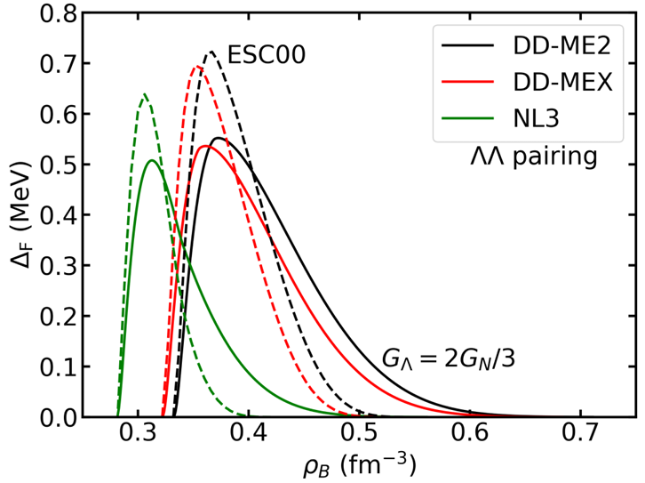
Superfluidity and Neutron Star Cooling
Baryon superfluidity is widely present within neutron stars.
Sedrakian2024_arXiv2407.13686
Tu2022_PRC106-025806

Slide 13
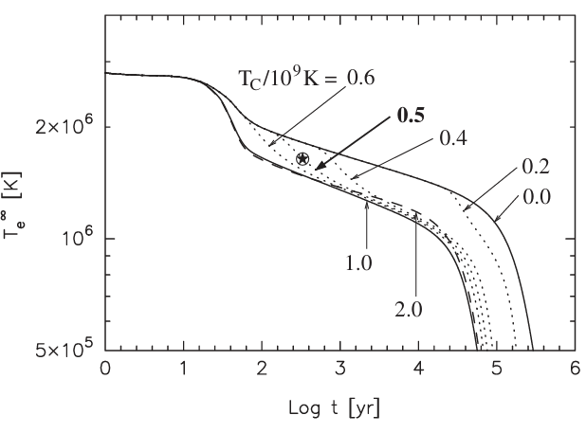
Superfluidity and Neutron Star Cooling
Baryon superfluidity is widely present within neutron stars.
PBF, accelerate cooling
Sedrakian2024_arXiv2407.13686
Tu2022_PRC106-025806
Page2011_PRL106-081101

Slide 14
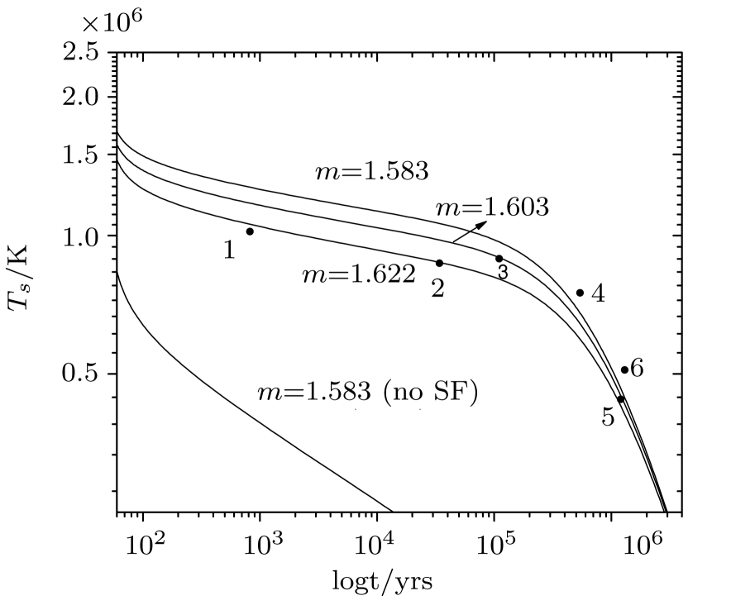
Superfluidity and Neutron Star Cooling
Baryon superfluidity is widely present within neutron stars.
PBF, accelerate cooling
suppress Urca, slow down cooling
with $Λ$ superfluidity
without $Λ$ superfluidity
Sedrakian2024_arXiv2407.13686
Tu2022_PRC106-025806
Page2011_PRL106-081101
Xu2011_CTP56-521
Superfluidity is essential to the neutron star cooling

Slide 15
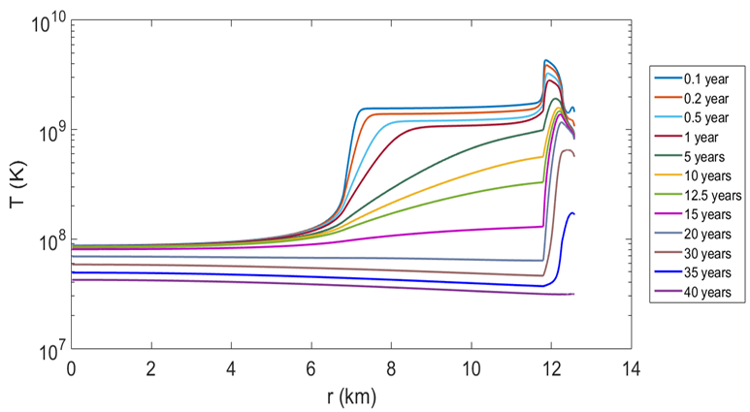
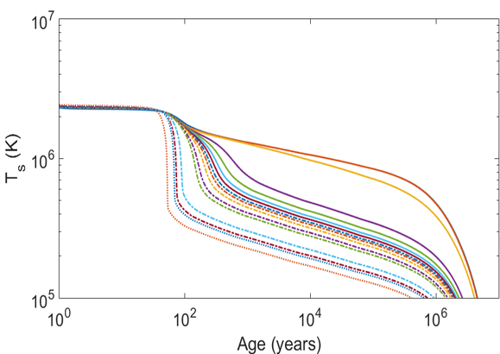
Thermal Relaxation of Neutron Star
core
crust
Sales2020_A&A642-A42
Gnedin2001_MNRAS324-725
Lattimer1994_ApJ425-802
cold front

Slide 16
Thermal Relaxation of Neutron Star
core
crust
Sales2020_A&A642-A42
Gnedin2001_MNRAS324-725
Lattimer1994_ApJ425-802
cold front
Thermal relaxation: the thermal coupling between the core and crust

Slide 17
Thermal Relaxation of Neutron Star
core
crust
Sales2020_A&A642-A42
Gnedin2001_MNRAS324-725
Lattimer1994_ApJ425-802
cold front
Thermal relaxation: the thermal coupling between the core and crust
Fitting:
Linear!

Slide 18
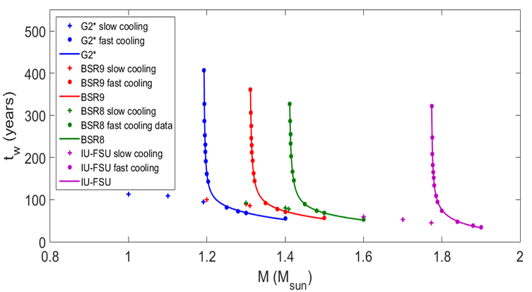
Thermal Relaxation of Neutron Star
Nucleon Star without Superfluidity.
Sales2020_A&A642-A42
Abnormally long relaxation time above the dUrca allowed mass!
?
How does the superfluidity affect the thermal relaxation?
Can we observe the peculiar thermal relaxation in other type neutron star, e.g., hyperon star?

Slide 19
Contents
Background
Thermal relaxation of neutron star
Peculiar thermal relaxation from superfluidity
Peculiar thermal relaxation of hyperon star
Summary and Perspective

Slide 20
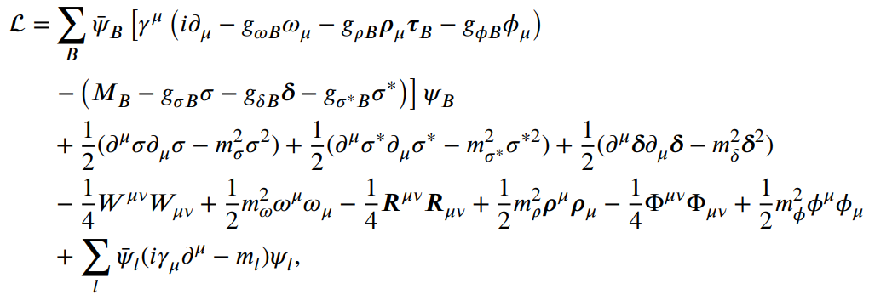
Thermal Relaxation of Neutron Star
Lalazissis2005_PRC71-024312
A. Bouyssy et al., PLB 64 (1976) 276
Page2004_ApJSupp155-623
EoS: $n+p+Λ\text{+}\text{(}σωρσ^{∗}φ\text{)}$
RMF model

Slide 21
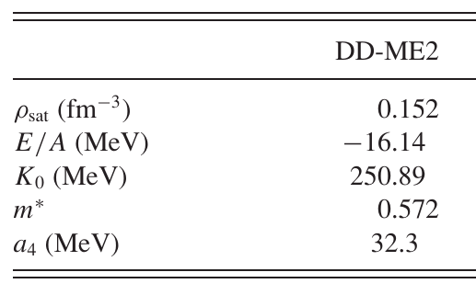
Thermal Relaxation of Neutron Star
Lalazissis2005_PRC71-024312
A. Bouyssy et al., PLB 64 (1976) 276
Page2004_ApJSupp155-623
EoS: $n+p+Λ\text{+}\text{(}σωρσ^{∗}φ\text{)}$
RMF model
NN interaction

Slide 22
Thermal Relaxation of Neutron Star
Lalazissis2005_PRC71-024312
A. Bouyssy et al., PLB 64 (1976) 276
Page2004_ApJSupp155-623
EoS: $n+p+Λ\text{+}\text{(}σωρσ^{∗}φ\text{)}$
RMF model
NN interaction
NY and YY interactions
$$U_{Λ}^{(N)}≃−30 MeV$$
No np dUrca， $Λp$ dUrca ${M_{c}^{DU}=1.3184M}_{⨀}$

Slide 23
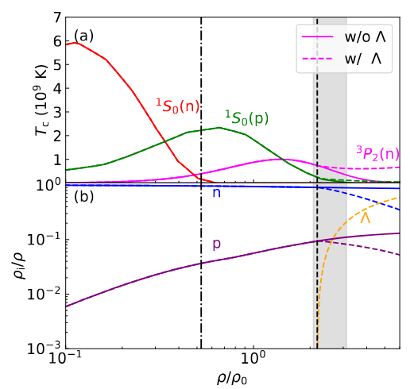
Thermal Relaxation of Neutron Star
Lalazissis2005_PRC71-024312
A. Bouyssy et al., PLB 64 (1976) 276
Page2004_ApJSupp155-623
EoS: $n+p+Λ\text{+}\text{(}σωρσ^{∗}φ\text{)}$
Superfluidity:
RMF model
NN interaction
NY and YY interactions
NY and YY interactions
$$U_{Λ}^{(N)}≃−30 MeV$$
No np dUrca， $Λp$ dUrca ${M_{c}^{DU}=1.3184M}_{⨀}$

Slide 24
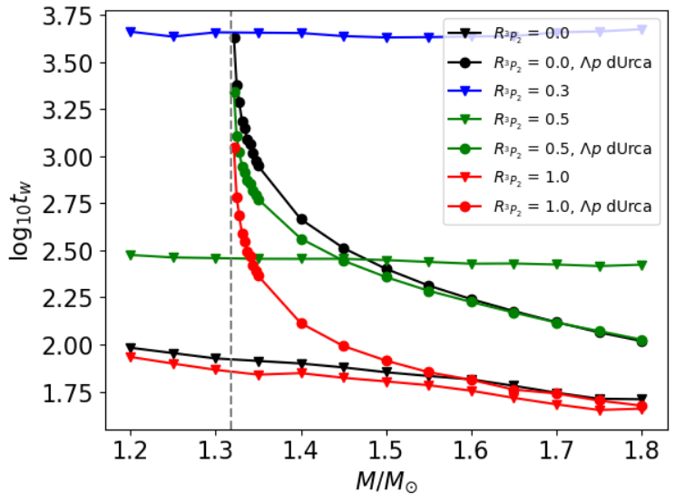
Thermal Relaxation of Neutron Star
Closing the dUrca, the dependence of $t_{w}$ on mass is linear, while its dependence on the critical temperature is nonlinear;
Above the mass that dUrca sets in, the dependences of $t_{w}$ on both mass and critical temperature are nonlinear.

Slide 25
Contents
Background
Thermal relaxation of neutron star
Peculiar thermal relaxation from superfluidity
Peculiar thermal relaxation of hyperon star
Summary and Perspective

Slide 26
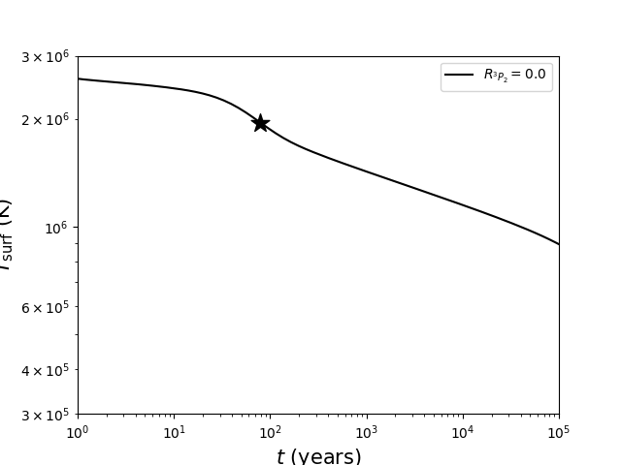
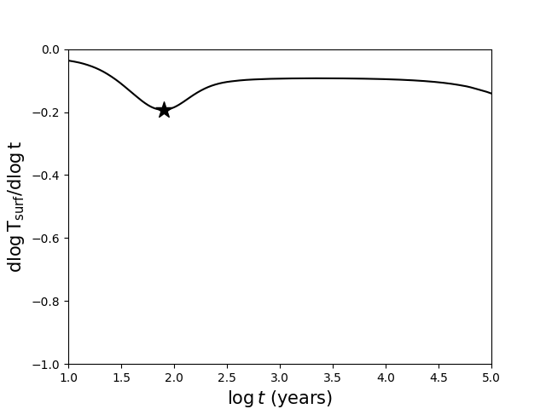
Peculiar Thermal Relaxation from Superfluidity
$${M=1.4 M}_{⨀}$$

Slide 27
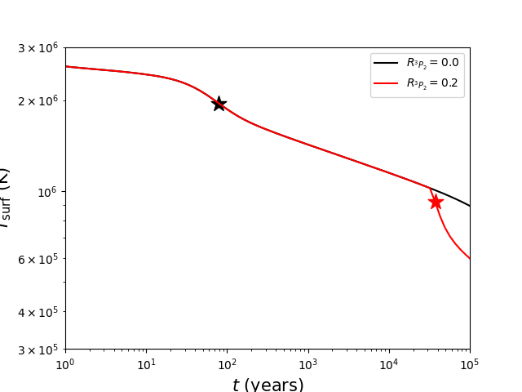
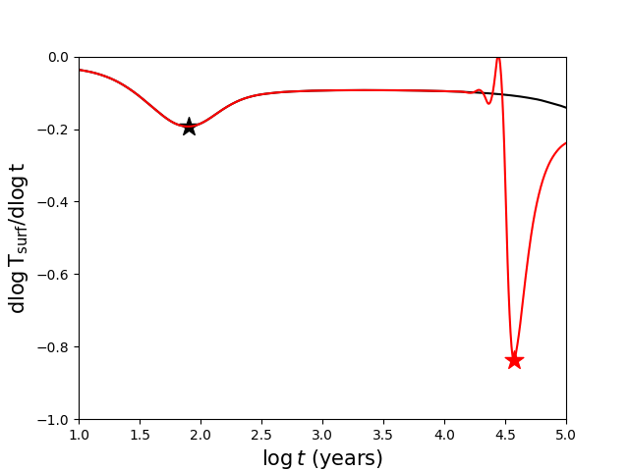
Peculiar Thermal Relaxation from Superfluidity
$${M=1.4 M}_{⨀}$$

Slide 28
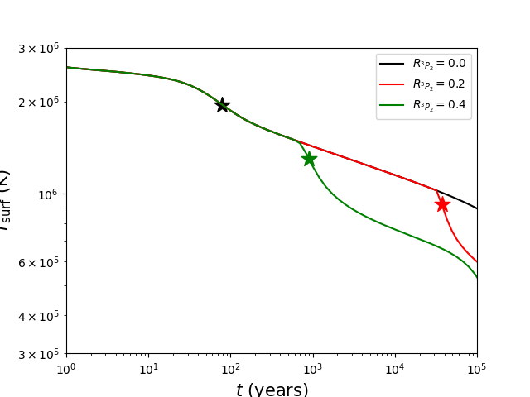
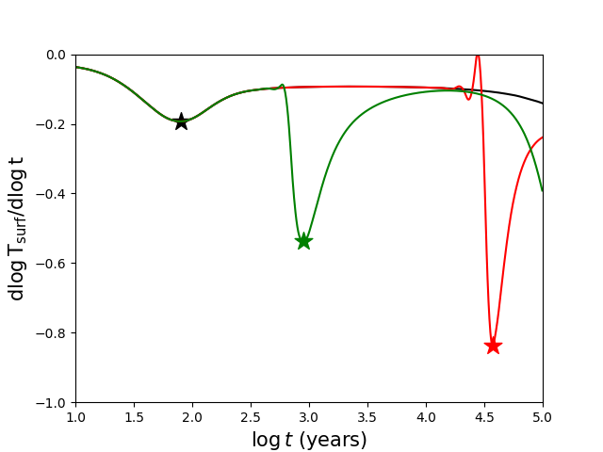
Peculiar Thermal Relaxation from Superfluidity
$${M=1.4 M}_{⨀}$$

Slide 29
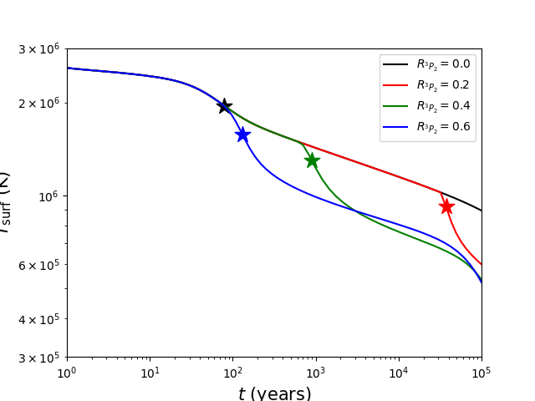
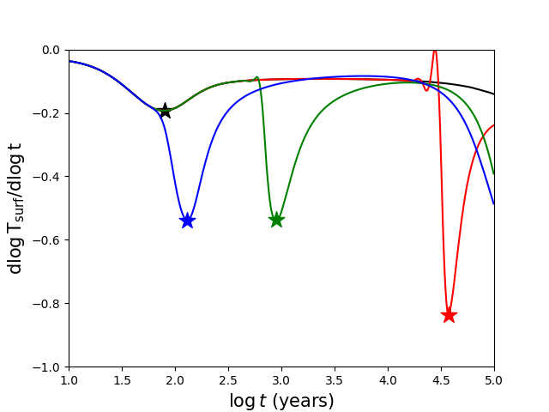
Peculiar Thermal Relaxation from Superfluidity
$${M=1.4 M}_{⨀}$$

Slide 30
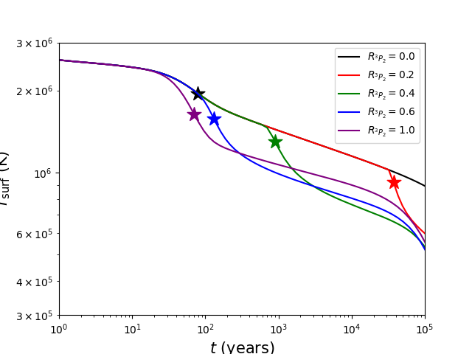
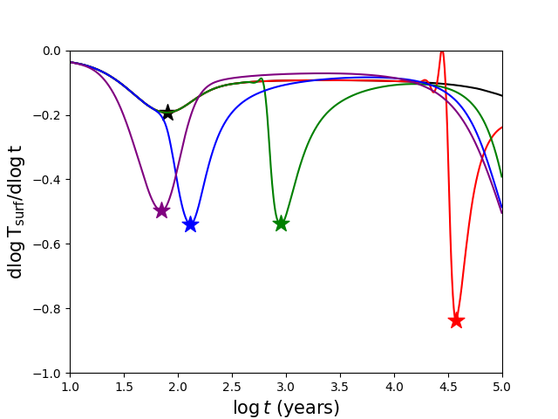
Peculiar Thermal Relaxation from Superfluidity
$${M=1.4 M}_{⨀}$$

Slide 31
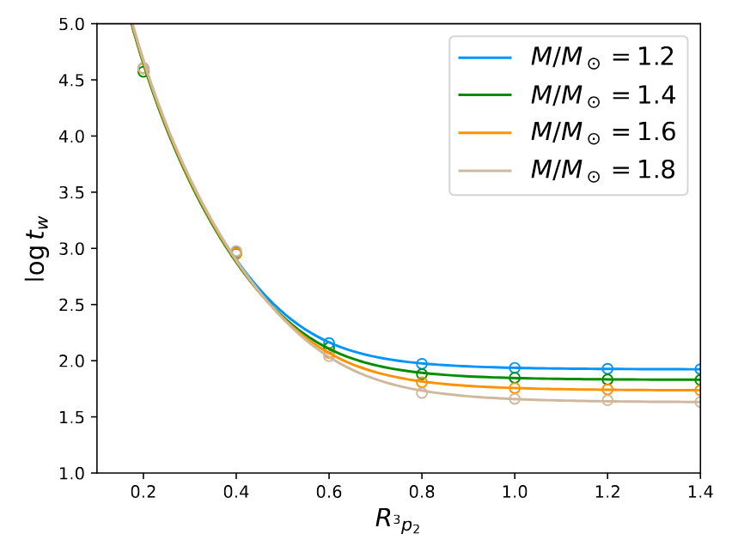
Peculiar Thermal Relaxation from Superfluidity
The late trigger of PBF process: waiting time
global energy balance:
Page2011_PRL106-081101
The smaller critical temperature $T_{cn}$, the longer relaxation time

Slide 32
Peculiar Thermal Relaxation from Superfluidity
The late trigger of PBF process: waiting time
global energy balance:
Page2011_PRL106-081101
The smaller critical temperature $T_{cn}$, the longer relaxation time
$τ_{mu}$: time-scale of mUrca dominated cooling
$R_{eff}$: SF effective suppression factor

Slide 33
Peculiar Thermal Relaxation from Superfluidity
The late trigger of PBF process: waiting time
re-coupling of core and crust
waiting for the trigger of PBF; nonlinear
Fitting:
The smaller critical temperature $T_{cn}$, the longer relaxation time
Other interactions (NL3 and PKDD) give the similar results: Model-independent.

Slide 34
Contents
Background
Thermal relaxation of neutron star
Peculiar thermal relaxation from superfluidity
Peculiar thermal relaxation of hyperon star
Summary and Perspective

Slide 35
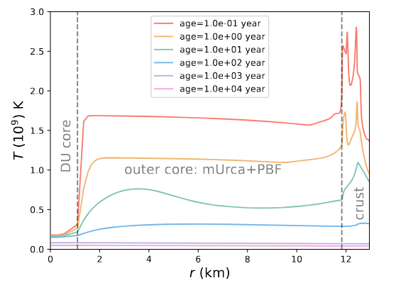
Peculiar Thermal Relaxation of Hyperon Star
DU core:
dUrca process, Low temperature;
outer core:
mUrca + PBF process;
Neutron star with ${M=1.3310M}_{⨀}$ and a very small DU core

Slide 36
Peculiar Thermal Relaxation of Hyperon Star
DU core:
dUrca process, Low temperature;
outer core:
mUrca + PBF process;
Thermal compensation to the DU core.
Neutron star with ${M=1.3310M}_{⨀}$ and a very small DU core

Slide 37
Peculiar Thermal Relaxation of Hyperon Star
DU core:
dUrca process, Low temperature;
the temperature is nearly constant if the DU core is very small.
outer core:
mUrca + PBF process;
Thermal compensation to the DU core.
thermal coupling between DU core and outer core
Neutron star with ${M=1.3310M}_{⨀}$ and a very small DU core

Slide 38
Peculiar Thermal Relaxation of Hyperon Star
The thermal coupling between DU core and outer core:
Outer core energy balance
mUrca
mUrca+PBF
DU core energy loss
$T_{DU}$: DU core temperature before reaching relaxation
$f_{DU}$: ratio of neutrino emissivity of dUrca to mUrca
$f_{V}$: ratio of the outer core volume to DU core
R: ratio of neutrino emissivity of $Λp$ to np dUrca, $∼0.04$
Neutron star with ${M=1.3310M}_{⨀}$ and a very small DU core

Slide 39
Peculiar Thermal Relaxation of Hyperon Star
The thermal coupling between DU core and outer core:
DU core energy balance

Slide 40
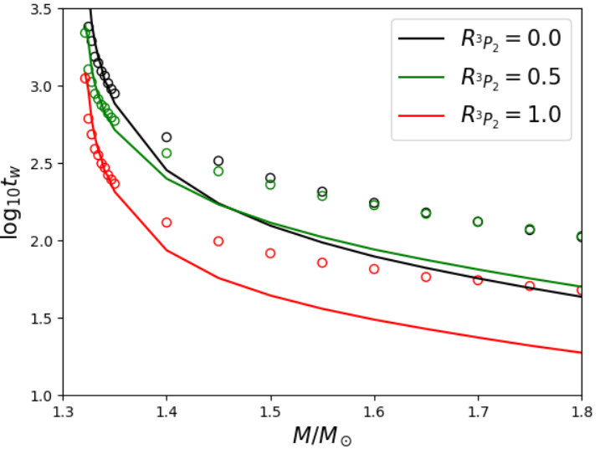
Peculiar Thermal Relaxation of Hyperon Star
The thermal coupling between DU core and outer core:
coupling of DU core and outer core
coupling of entire core and crust
$T_{t}$: the outer core temperature that reaching relaxation
for a neutron star with a very small DU core

Slide 41
Peculiar Thermal Relaxation of Hyperon Star
The thermal coupling between DU core and outer core:
coupling of DU core and outer core
coupling of entire core and crust
$T_{t}$: the outer core temperature that reaching relaxation
for a neutron star with a very small DU core

Slide 42
Peculiar Thermal Relaxation of Hyperon Star
The thermal coupling between DU core and outer core:
coupling of DU core and outer core
coupling of entire core and crust
Suitable for a neutron star with a small DU core
$T_{t}$: the outer core temperature that reaching relaxation
for a neutron star with a very small DU core

Slide 43
Contents
Background
Thermal relaxation of neutron star
Peculiar thermal relaxation from superfluidity
Peculiar thermal relaxation of hyperon star
Summary and Perspective

Slide 44
Summary and Perspective
Summary:
PBF and dUrca processes change the thermodynamic structure of neutron stars, leading to the re-coupling of the crust and core and peculiar relaxation times.
A possible way to probe the superfluidity and internal thermal properties of neutron stars.
Perspective:
More precise microscopic physical inputs for neutron stars are needed.
Suitable observation targets are required.
Thanks for your attention!

