Slide 1
Multi-neutron detection based on machine learning
DU Zeyu^{1, 2}, HUANG Siwei^{1, 2}, YANG Zaihong^{1, 2}†, LI Qite^{1, 2}, BIAN Jiawei^{1, 2}
1. School of Physics, Peking University, Beijing 100871, China
2. State Key Laboratory of Nuclear Physics and Technology, Peking University
2024.09.26

Slide 2
Outline
Background
Method – exclusion of crosstalk using DNN
Result – comparing traditional and machine learning algorithms
Summary

Slide 3
Background
Notes:
two neutron correlation not double
neutron correlation information
2n 成果较多，但是滴线外更丰中子的体系 比如4n 需要对衰变中子直接探测 实验较难
structure of unstable nuclei
study neutron-rich nuclear materials
double neutron correlation research

Slide 4
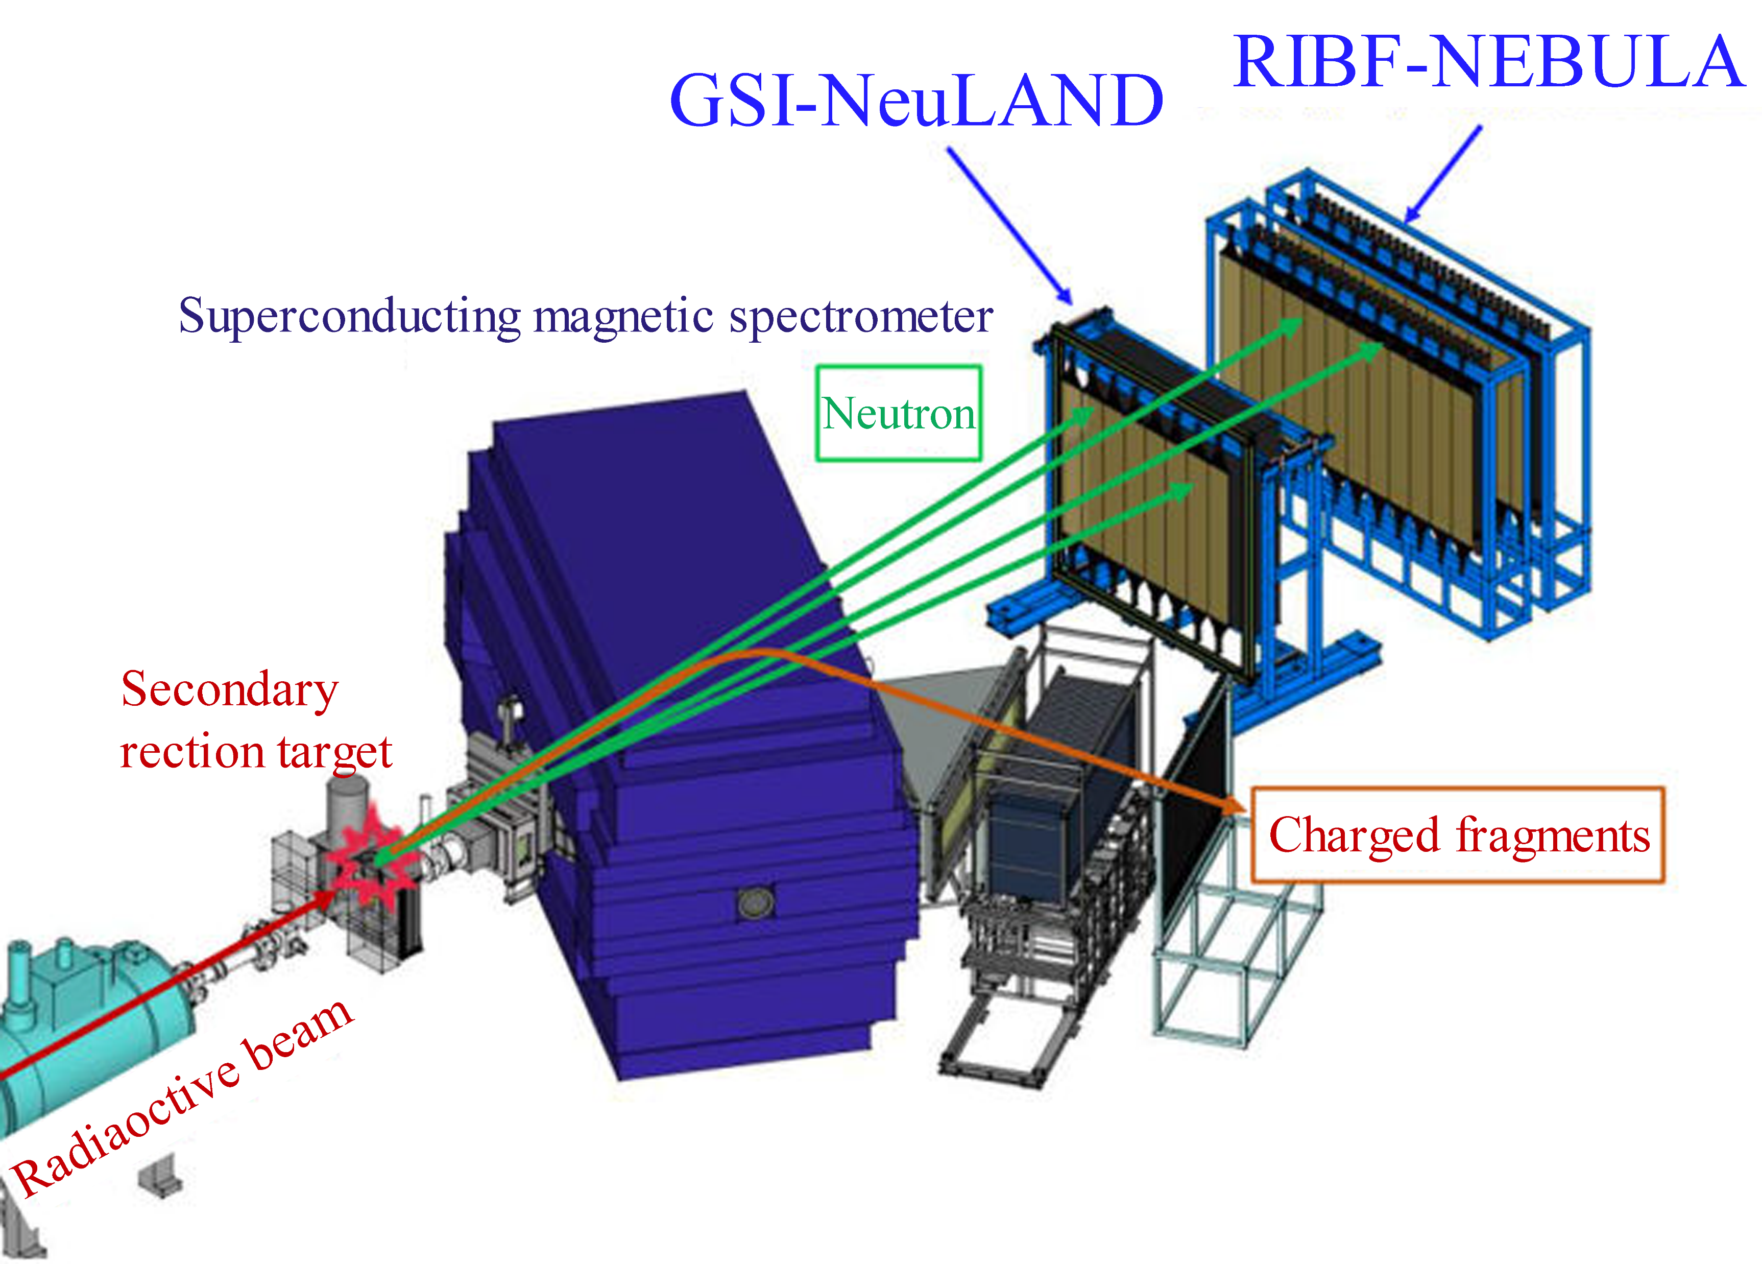
Multi-neutron detection experiment
invariant mass method
$$M^{∗}=\sqrt{{\left(E_{i}\right)}^{2}−{\left(ΣP_{i}\right)}^{2}}$$
$$E_{rel}=M^{∗}−Σm_{i}$$
($x,y,z,TOF,Q$)
momentum of neutrons
Relative energy
$E_{rel}$ spectrum
reconstruction
momentum of fragments
Typical layout of experiment at RIBF, RIKEN.
HUANG S, YANG Z, MARQUÉS F, et al. Few-Body Systems, 2021, 62(4): 102
Notes:
neutron-rich unstable nuclear reactions Taking the four-neutron detection experiment carried out at RIBF facility in Riken, Japan as an example
deflected and detected by the magnetic spectrometer
several plastic scintillator arranged in multiple layers.

Slide 5
crosstalk
crosstalk
The secondary charged particles
gamma rays
scattered neutrons
real neutron signal
crosstalk
The challenges of multi-neutron detection:
low detection efficiency of neutrons
large number of crosstalk signals, real neutron signal will inevitably be excluded
Notes:
special experimental techniques need to be developed to eliminate
in addition to real signals

Slide 6
Crosstalk
Data from Geant4 simulation
1n
a single neutron can also generate
a large number of crosstalk
directly select the first signal?
not applicable to the case of multiple neutron events,
timing of signals is very complicated
Notes:
the response of neutrons in detector arrays
a simulation study of single neutron incidence was first carried out

Slide 7
Traditional algorithm
high crosstalk rejection
1n
Crosstalk signals can be divided into two types
The first type
caused by the secondary particles near
the initial signal of the neutron detectors
time and space correlation
The second type
generated by reaction of scattered neutrons
velocity should decrease compared to incident neutrons.
kinematic condition
Kondo et al., Nuclear Instruments and Methods in Physics Research Section B 463: 173-178 (2020) S. W. Huang et al., Few-Body Systems 62(4): 1-7 (2021)
Notes:
the final remaining signal is considered to be the true signal generated by the incident neutron from the reaction target.
真实信号被排除 ，为什么需要ML？
精简：
通过串扰信号的时空关联和运动学关系对其进行排除
传统算法可以达到很高的排除率

Slide 8
Outline
Background
Method – exclusion of crosstalk using DNN
Result – comparing traditional and machine learning algorithms
Summary

Slide 9
Machine learning
predicting fission fragment yield distribution. WANG Z A, PEI J, LIU Y, QIANG Y., PRL 123: 122501 (2019)
predicting nuclear mass. Niu Z M, Liang H Z., PRC 06(2): L021303 (2022)
predicting ground state energy. Knöll et al., PLB 839: 137781 (2023)
particle identification in plastic scintillators.
Doucet et al., Nucl. Instrum. Methods Phys. Res., Sect. A 954, 161201 (2020)
particle identification in AT-TPC tracks.
Kuchera et al., Nucl. Instrum. Methods Phys. Res., Sect. A 940: 156-167 (2019)
C.A. Douma et al, Nucl. Instrum. Methods Phys. Res., Sect. A 990, 164951 (2020)
Notes:
In the study of nuclear physics for example
this study adopts a fully connected deep neural network,

Slide 10
Deep Neural Network
selected signals
reconstruct energy spectrum
(x,y,z,TOF,Q)
4n event or not
select 4 clusters
(contained real signals)
step1
step 2
Two-step deep neural network (DNN).
(1) Neutron multiplicity determination
(2) Neutron selection
Training/validation set (1million events) + test set
from Geant4 simulation
Notes:
The information extracted by the detector as the input features of the input layer.

Slide 11
Machine learning algorithm – step 1
Fully-Connected DNN
3 hidden layers (1024, 256, 128neurons)
threshold= 0.5
The principle of first step DNN
Input: Information recorded by the neutron detector (X,Y,Z,TOF,Q...)
Output: value between 0 (not 4n) and 1 (4n)
Notes:
超参数经过模拟优化确定

Slide 12
Machine learning algorithm – step 2
14 input layer features
12 hidden layers(200 neurons per layer)
Training Set: Number of reacted neutron equals object neutron
Feature: information of a single cluster (X,Y, Z,TOF,Q...)
Label: 0 or 1 (i.e. whether the cluster contains real signal)
To pick out the cluster where the real neutron is, each cluster is fed into the model and the predicted value p is obtained.
Sort all the output value to select them.
The principle of second step DNN

Slide 13
Outline
Background
Method – exclusion of crosstalk using DNN
Result – comparing traditional and machine learning algorithms
Summary

Slide 14
Result: 2n channel
Define:
crosstalk exclusion rate $r_{1}$
$$r_{1} =\frac{eliminated crosstalk events}{initial crosstalk events}$$
multi n misclassification rate $r_{2}$
$$r_{2} =\frac{ misclassified as 2n events}{total 2n events}$$
$$M^{∗}=\sqrt{{\left(E_{i}\right)}^{2}−{\left(ΣP_{i}\right)}^{2}}$$
$$E_{rel}=M^{∗}−Σm_{i}$$
/% | $r_{1}$ | $$r_{2}$$
traditional | 98.43 | 3.83
ML | 99.40 | 1.33
$E_{rel}$ peak position
Detection efficiency
Energy resolution
Notes:
use the trained neural network to predict the test set
verifies the reliability of the machine learning model
r1 r2的含义
in addition to efficiency, define two parameters to judge the effect of two
ML comparable slightly better

Slide 15
Result： 4n efficiency
/% | $r_{1}$ | $$r_{2}$$
traditional | 99.53 | 18.34
ML | 99.69 | 13.75
Preliminary result
Preliminary result
Machine learning algorithm improves the efficiency significantly

Slide 16
Result：4n resolution
Preliminary result
Preliminary result
Preliminary result
Energy resolution of ML algorithm will be slightly worse
Notes:
与r1 r2矛盾？
第二部挑选信号没有准确挑选

Slide 17
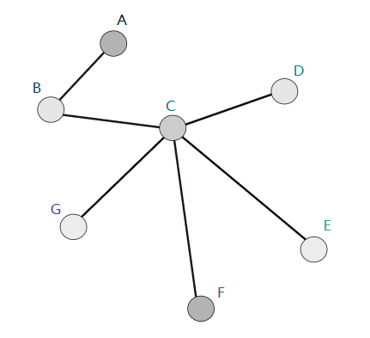
GNN (in progress)
correlation between different clusters of signals（missing in DNN）
vertex: represent the information of each detector
edge: information about correlation of two signals (such as $β$)
adapted from Particle-net in high energy physics
Build vertexes according to signals
define edge
using info of vertexes
update vertexes with edge info
define output to select real signals
Huilin Qu et al., Phys. Rev. D 101: 056019 (2020)

Slide 18
Summary
A neural network-based multi-neutron identification algorithm is developed, which significantly improves the four-neutron efficiency (>10 times) compared with the traditional algorithm.
We are now trying to use graph neural network (GNN) and other methods to develop multi-neutron identification algorithm, hoping to further improve the results by introducing correlations between clusters.
We will continue to explore and optimize algorithms for the high-efficiency and high-resolution multi-neutron spectrometer under construction, and apply them to multi-neutron detection.

