Slide 1
Construction and Test of Prototype of Advanced Multi-neutron Detection Array
Presenter: Jiawei BIAN
Supervisor: Zaihong YANG
State Key Laboratory of Nuclear Physics and Technology, Peking University
1

Slide 2
Outline
Background
Construction and Cosmic Ray Test
Setup
Data Analysis
Collimated Proton Beam Test
Summary
2

Slide 3
Background
stable nuclei
neutron star
shell model
unstable nuclei
neutron halo
cluster
exotic structure
neutron correlation and neutron cluster
3

Slide 4
Background
Preliminary design of AMDA
(Advanced Multi-neutron Detection Array)
50 units each plane, 30 planes
Adjacent planes arranged vertically
4
Notes:
Granularity
To verify some technique index
Describe the signal readout
Multi-neutron efficiency and capability

Slide 5
Outline
Background
Construction and Cosmic Ray Test
Setup
Data Analysis
Collimated Proton Beam Test
Summary
5
Notes:
PMT->SiPM a more complete construction and test

Slide 6
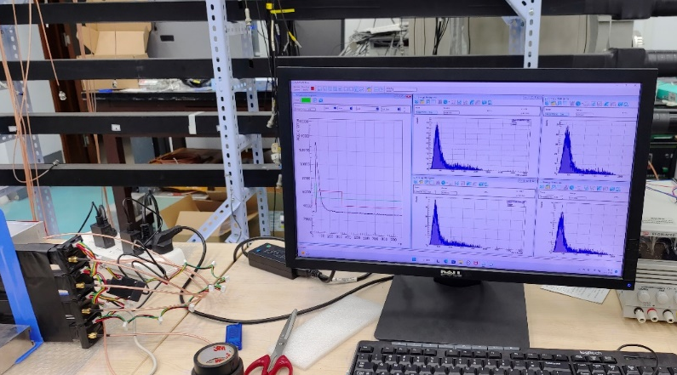
Setup
Prototype array
DAQ (CAEN)
DT5730
PC(CoMPASS)
6

Slide 7
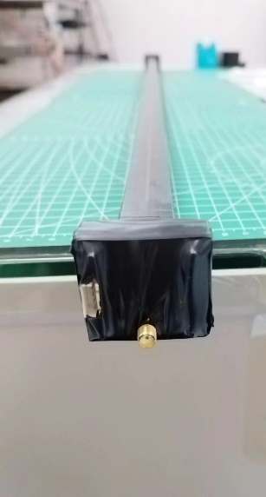
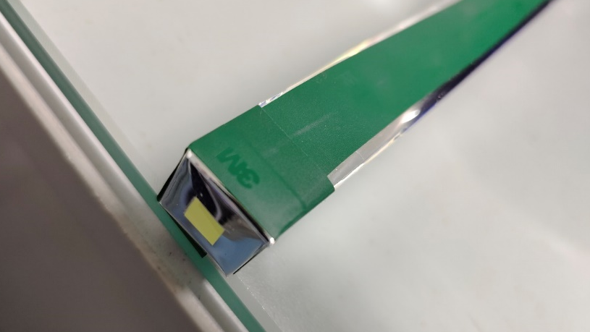
Setup: Detection Unit
Saint-Gobain BC408 plastic scintillator
(with ESR)
SiPM: SensL-C60035
Senser size | Microcell size | Parameter | Overvoltage | Typ. | Unit
6mm | 35μ | Breakdown Voltage |  | 24.2-24.7 | V
- | - | Over voltage |  | 1.0-5.0 | V
- | - | Rise Time |  | 1.0 | ns
- | - | Gain |  | $$3×{10}^{6}$$
SensL-C60035
7
Notes:
After attach…
Wrapped them entirely with shading tape

Slide 8
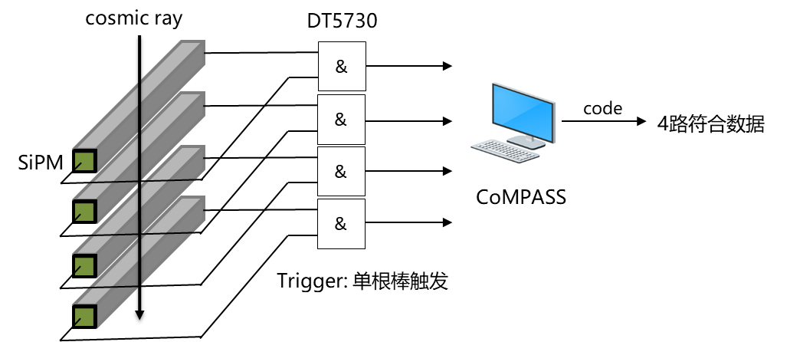
Setup: Logic Settings
offline
4-units
coincidence
Self-trigger for each unit
8
Notes:
make coincidence of A and B

Slide 9
Outline
Background
Construction and Cosmic Ray Test
Setup
Data Analysis
Collimated Proton Beam Test
Summary
9

Slide 10
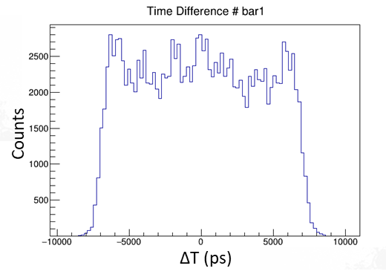
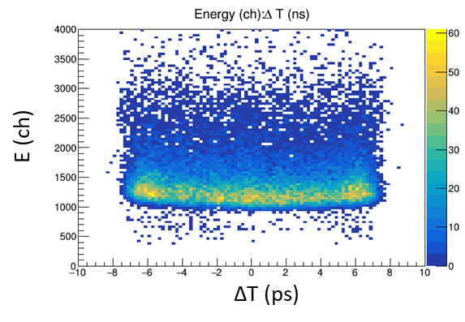
Raw Data Check
Time difference and Energy spectrum for 1 unit:
10
Notes:
Independent with x
Decay with x

Slide 11
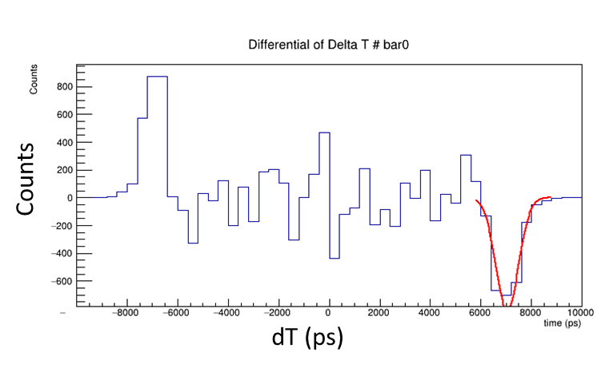
Calibration: Signal velocity
Differential Time difference gives out width $ΔT$.
Signal velocity given by $ΔT$ and Length $L$:
$$v=\frac{L}{2ΔT}$$
cosmic ray
$$v_{1}=\left(14.20±0.19\right) cm/ns$$
$$v_{2}=\left(14.26±0.17\right) cm/ns$$
$$v_{3}=\left(14.26±0.18\right) cm/ns$$
$$v_{4}=\left(14.03±0.18\right) cm/ns$$
11
Notes:
Edge->fastest position ->peak in differential spectrum
Correspond to

Slide 12
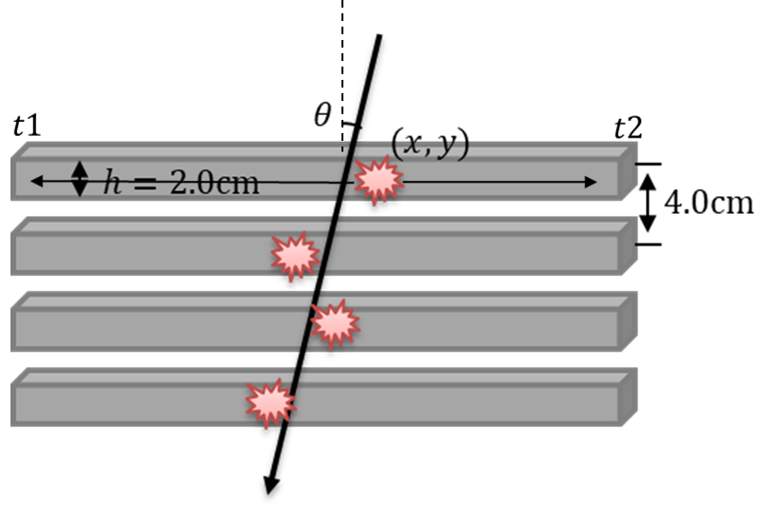
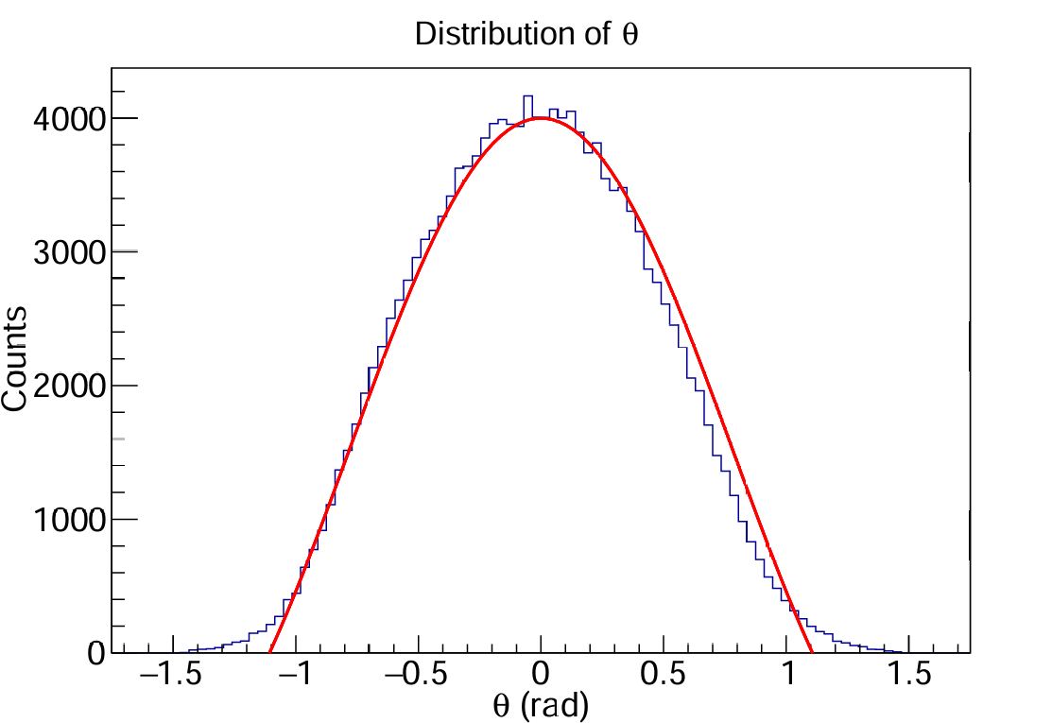
Calibration: Tracking
$$c_{0}⋅\cos^{2}θ+c_{1}$$
0: mid-point of bar; others: caused by module offset and so on
12
Notes:
Consistent with the

Slide 13
Position & Time Resolution
$$x_{0}$$
$$x_{1}$$
With the incident angle by tracking,
we can also select events with nearly vertical incidence:
$$σ_{x}=\frac{σ_{r}}{\sqrt{6}}=1.665 cm$$
$$σ_{t}=165.1 ps$$
$$x_{2}$$
$$x_{0}+x_{2}−2x_{1}=0$$
$Δ$x(cm)
13

Slide 14
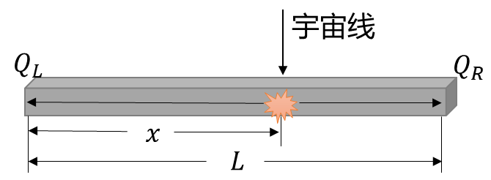
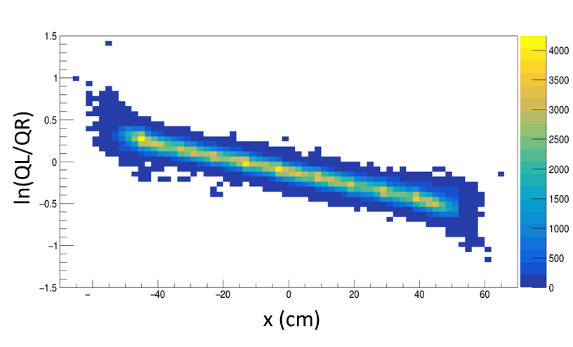
Attenuation Length
Cosmic rays
Energy of light signal decays with distance in plastic scintillator,
$Q_{l} \sim exp\left(−\frac{x}{λ}\right), Q_{r} \sim \exp\left(−\frac{L−x}{λ}\right).$
Attenuation length was derived by:
$$\ln\left(\frac{Q_{l}}{Q_{r}}\right)=\frac{L−2x}{λ}.$$
14

Slide 15
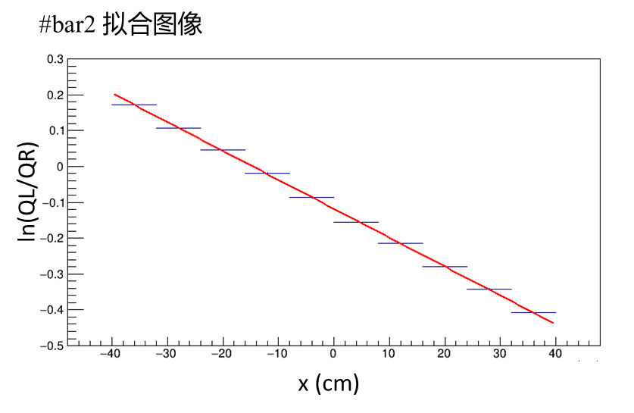
Attenuation Length
fit result of #bar2
$$λ_{1}=(161.02±0.08)cm$$
$$λ_{2}=(248.10±0.16)cm$$
$$λ_{3}=(233.75±0.15)cm$$
$$λ_{4}=(222.97±0.14)cm$$
$λ_{i}>200 cm\left(i=2,3,4\right)$ has satisfied the need for experiment.
15
Notes:
Technique is still not mature

Slide 16
Outline
Background
Construction and Cosmic Ray Test
Setup
Data Analysis
Collimated Proton Beam Test
Summary
16
Notes:
In addition to …

Slide 17
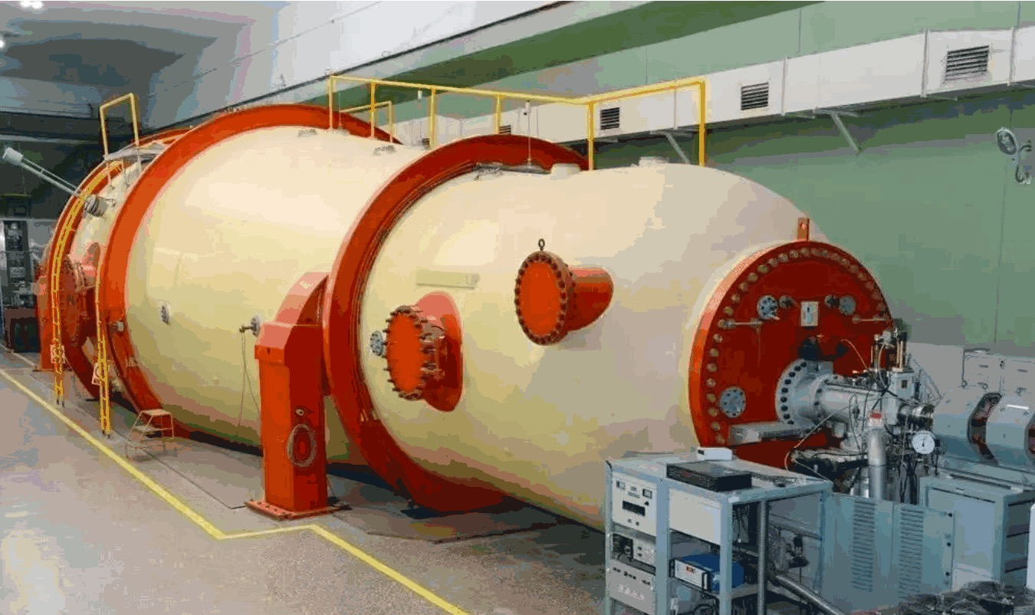
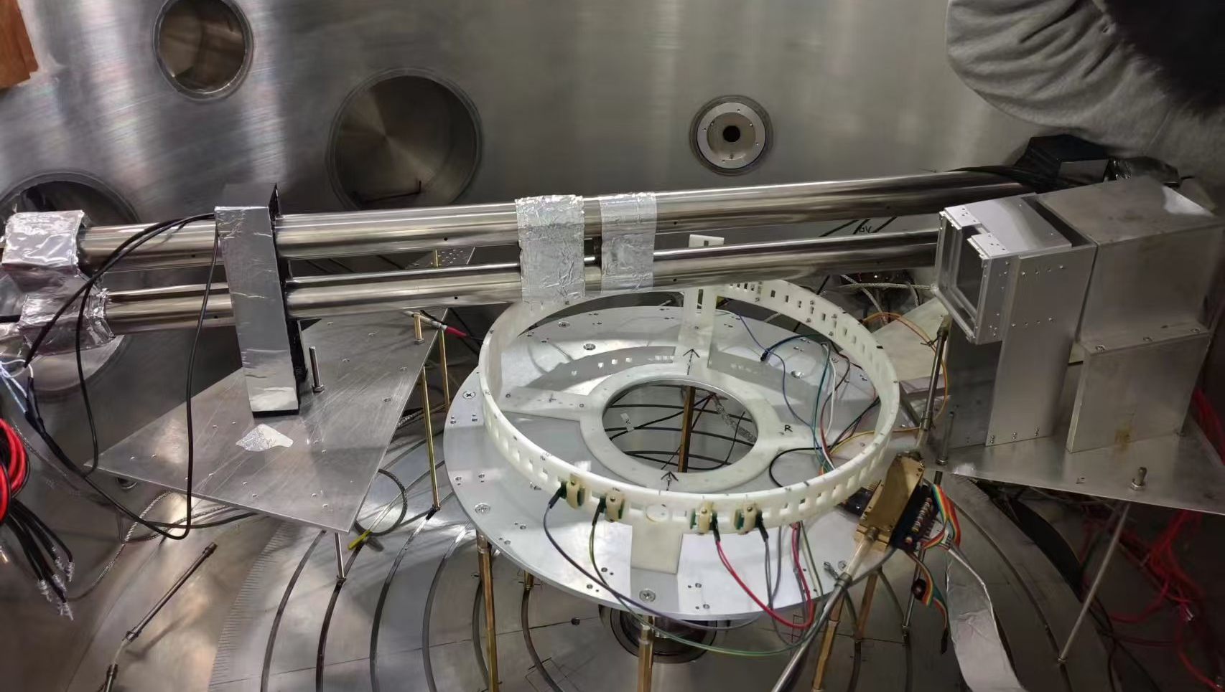
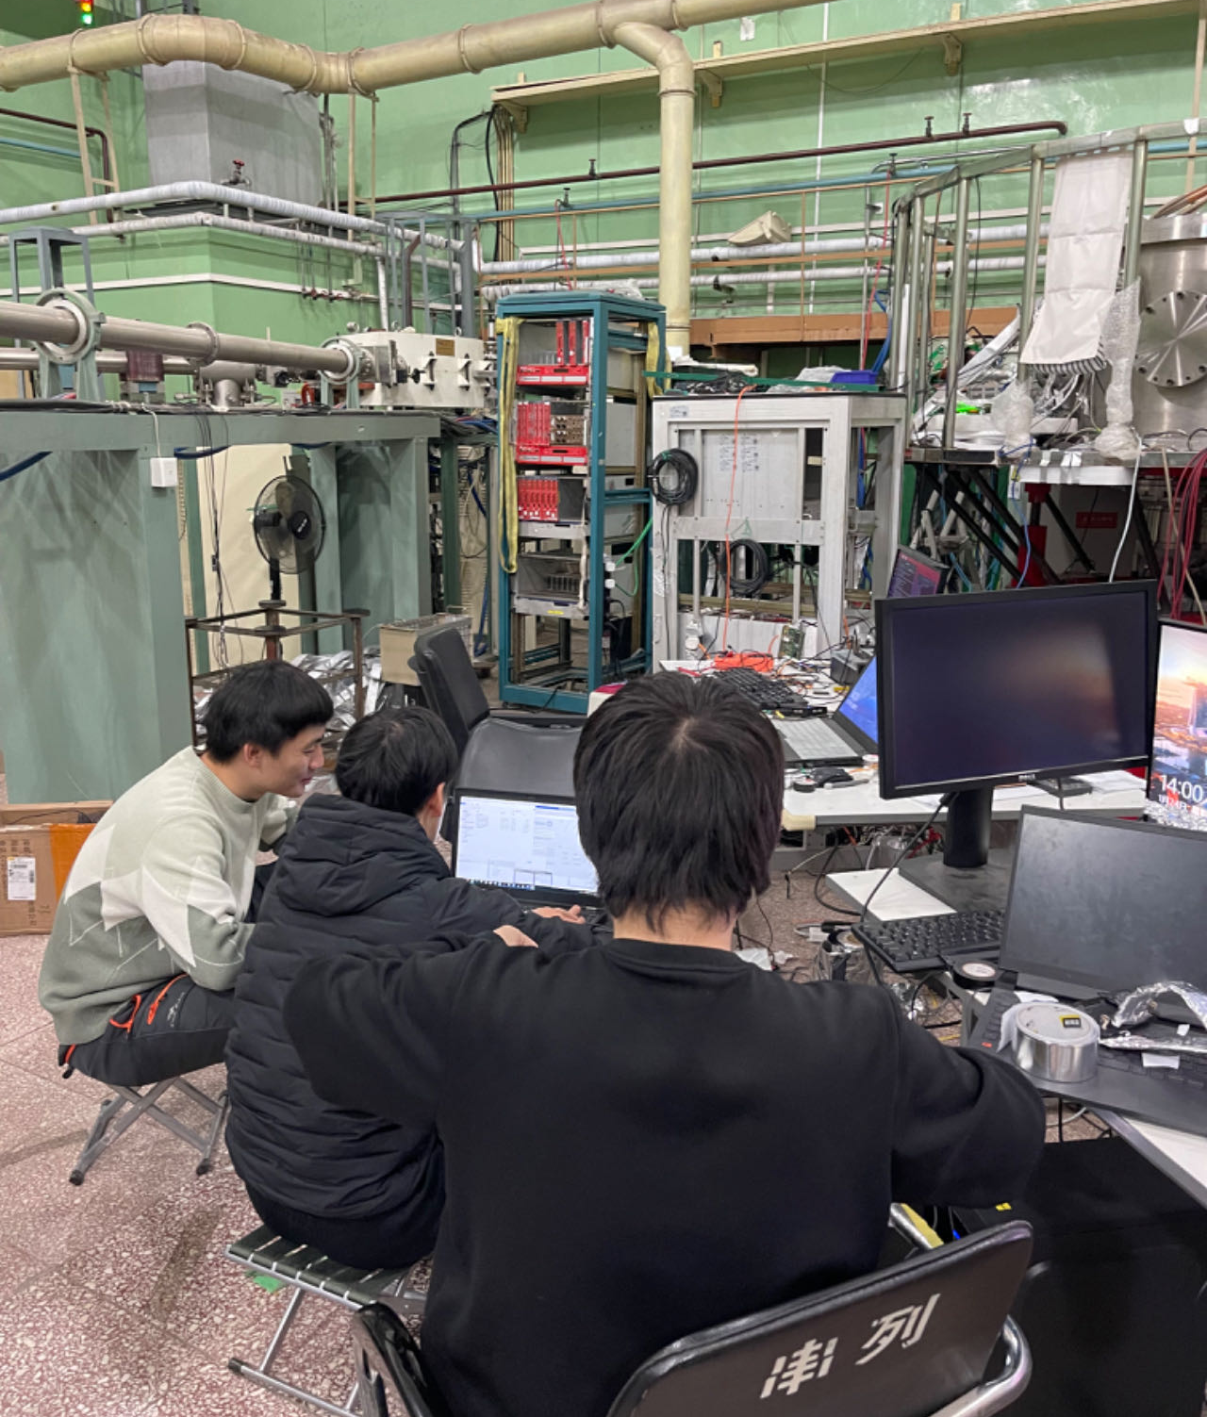
Collimated Proton Beam Test: Setup
plastic scintillator
steel tube
Beam energy: 17 MeV, 4 MeV
@CIAE, Beijing
¹²C target
proton beam
17
Notes:
Get collimated proton
2 different energy
In scattering chamber

Slide 18
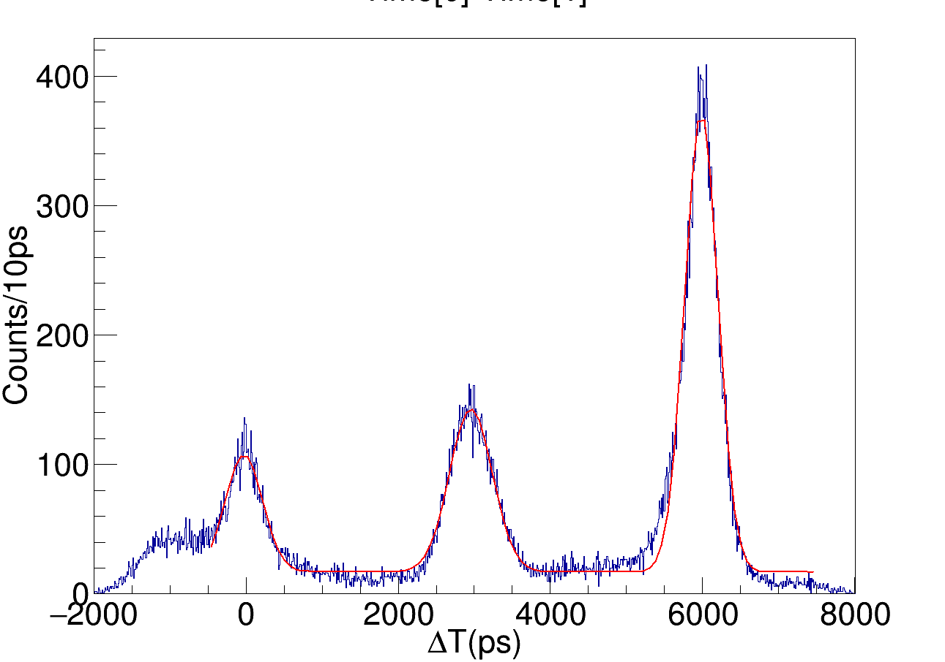
Collimated Proton Beam Test: Result
20 cm
Signal velocity could be given with time difference between adjacent peaks and $ΔL=20.0 cm.$
18
Notes:
加标题下划线

Slide 19
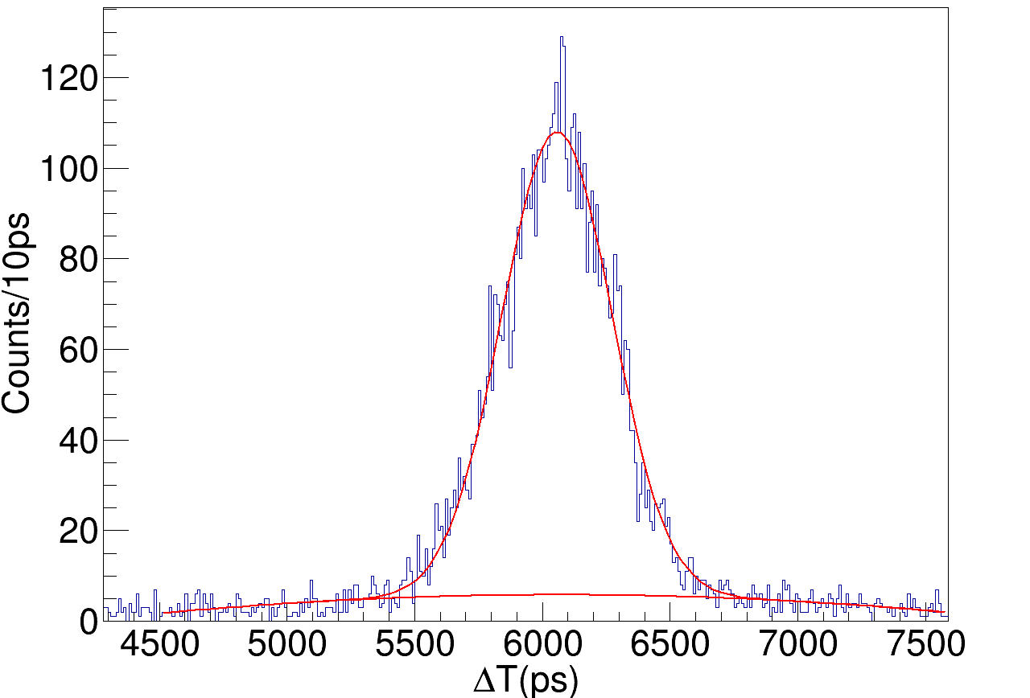
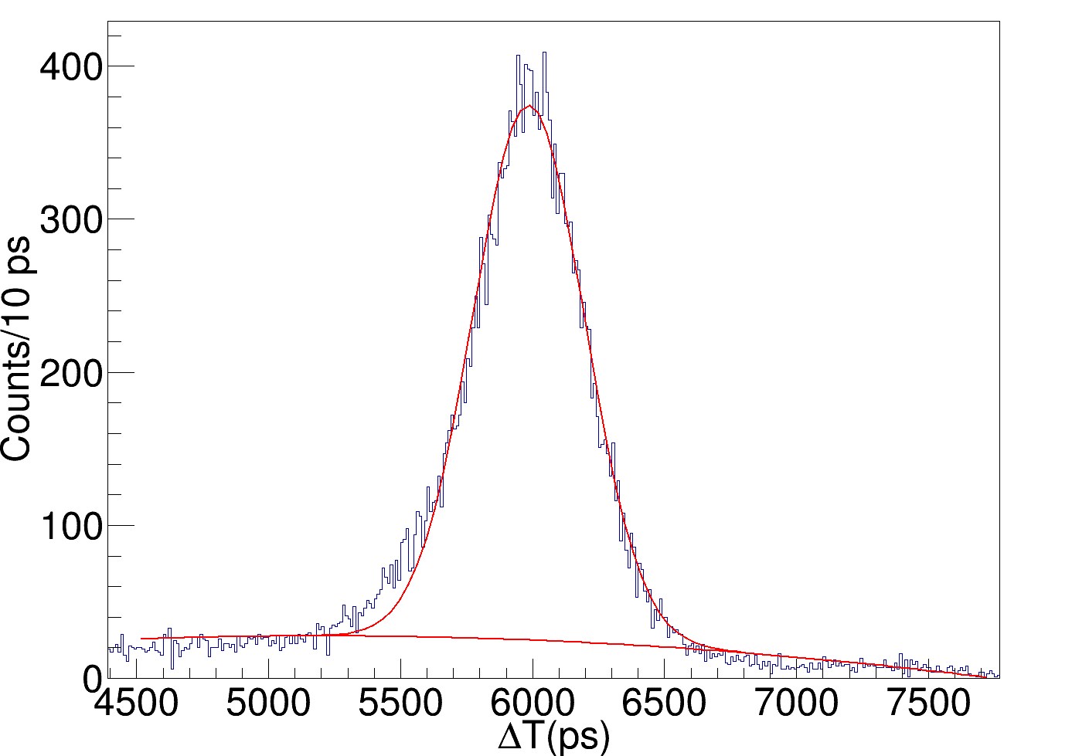
Collimated Proton Beam Test: Result
$$E=17 MeV$$
$$σ_{t}=152.55 ps$$
$$E=4 MeV$$
$$σ_{t}=149.38 ps$$
Beam energy(MeV) | Signal velocity(cm/ns) | Time resolution(ps) | Position resolution(cm)
17 | 13.31 | 152.55 | 1.438
4 |  | 149.38 | 1.406
19
Notes:
>1k comment

Slide 20
Summary
Prototype array constructed and tested
Time and position resolution, attenuation length have reached relatively high level.
Future plan：
Changing from CAEN DAQ to TOFPET-based electronics
Optimizing work conditions of SiPM
Developing machine learning algorithm for multi-neutron identification
Thank you!
(Zeyu DU et al. multi-neutron detection based on machine learning)
20

Slide 21
backup

Slide 22
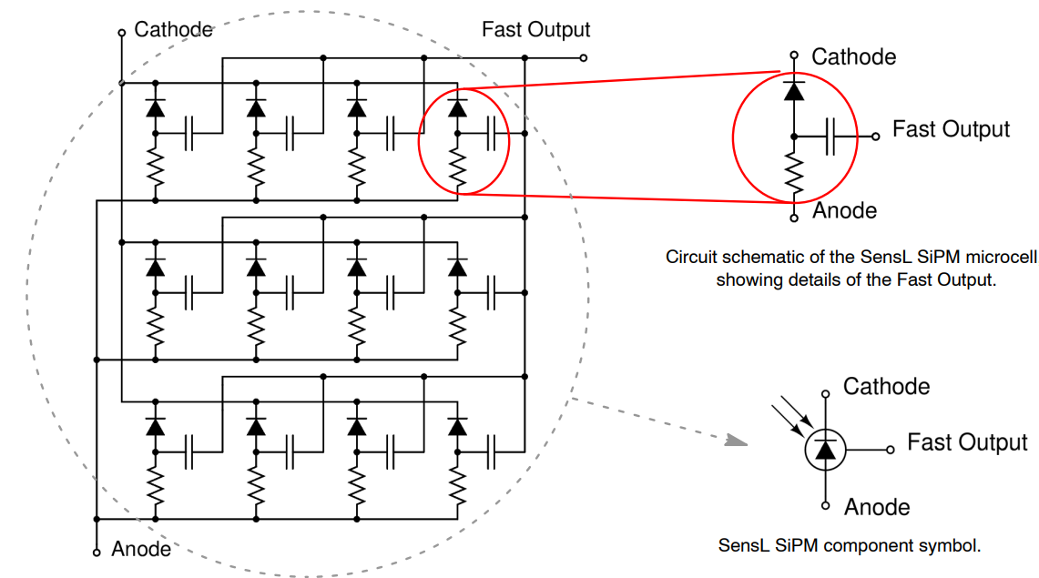
backup
SiPM (Silicon Photon Multiplier)：

