Slide 1
Light quark mass dependence of nucleon mass to two-loop order
Siwei Hu
Institute of High Energy Physics (IHEP)
In collaboration with Longbin Chen, Yu Jia, Zhewen Mo
Based on arXiv:2406.04124 [hep-ph]
September 26, 2024

Slide 2
Contents
Nucleon mass
Chiral perturbative theory – PCB problem
Nucleon self-energy (EOMS)
Phenomenology
Summary

Slide 3
Nucleon mass

Slide 4
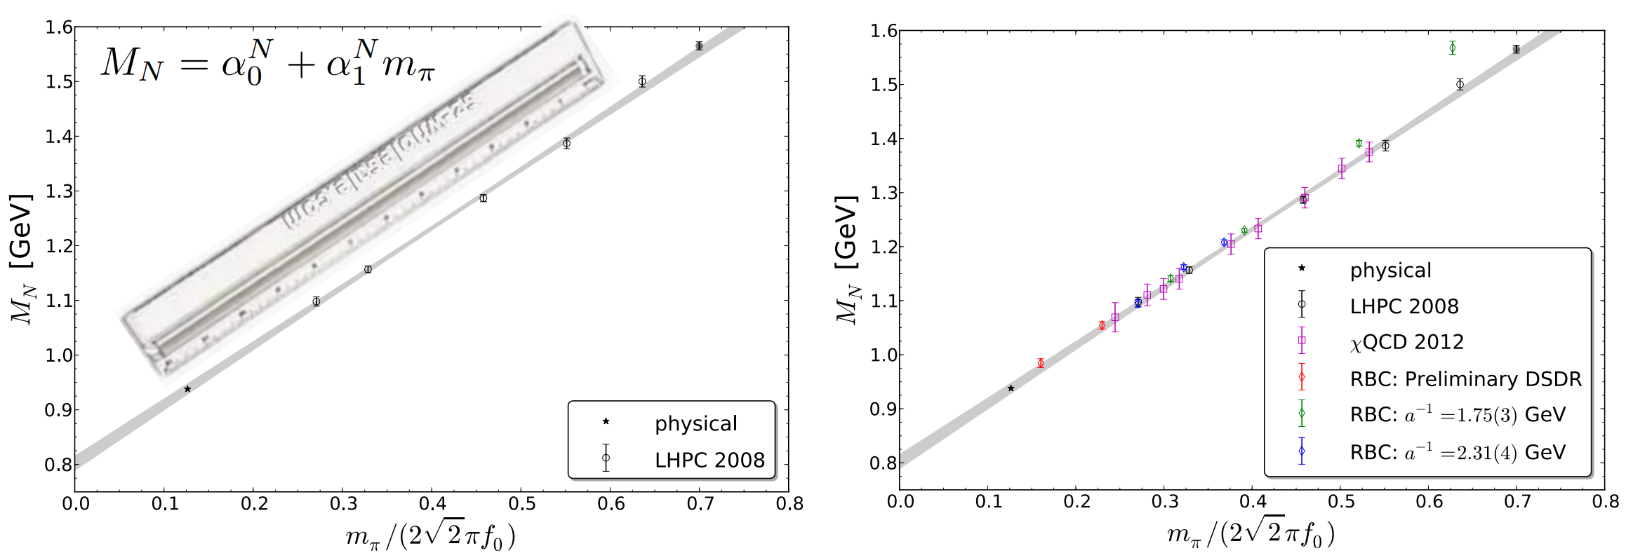
Nucleon mass
Nucleon mass
Proton and neutron $m_{p,n}=938 MeV$
Ruler approximation: $m_{N}= 800 MeV+ m_{π}$
$$m_{π}\sim \sqrt{m_{q}}$$
A. Walker-Load PoS LATTICE2013 (2014), 013
Works well over a large range
Wrong pion mass dependence
Lattice cannot approach chiral limit
Wrong leading term, free of $\log{M}$

Slide 5
Chiral perturbative theory

Slide 6
Chiral perturbative theory (ChPT)
ChPT —— low energy EFT
Degree of freedom —— meson and baryon (pion and nucleon)
Mesonic sector
Power counting
Steven Weinberg Physica A 96 (1979)
J. Gasser and H. Leutwyler Annals Phys. 158 (1984)
$ℒ_{ππ}^{(2)}= \frac{F^{2}}{4}Tr\left(∂_{μ}U∂^{μ}U\right)+\frac{F^{2}}{4}Tr\left(χU^{†}+U^{†}χ\right), U=exp(i\frac{\vec{π}∙\vec{σ}}{F})$
$${SU(2)}_{R}×{SU(2)}_{L}$$
Well defined expansion
$M_{π}=136 MeV ≪ Λ_{χ}=Ο\left(1GeV\right)$, $q \sim M_{π}/Λ_{χ}$
$∂_{μ} \sim Ο\left(q\right)$, $M_{π} \sim Ο\left(q\right)$, $χ=M_{π}^{2} \sim Ο(q^{2})$

Slide 7
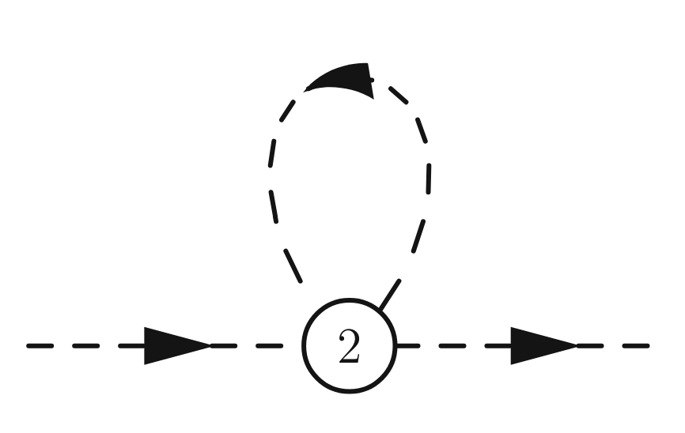
Power counting -- Mesonic sector
Power counting -- consist with dimension
$M_{π}=136 MeV ≪Λ_{χ}=4πF$, $q \sim M_{π}/Λ_{χ}$
$∂_{μ} \sim Ο\left(q\right)$, $M_{π} \sim Ο\left(q\right)$
$D=dim×N_{Loop} −2×N_{I}+ ∑{i N}_{V_{i}}$
$$dim×1−2×1+2 → Ο(q^{4})$$

Slide 8
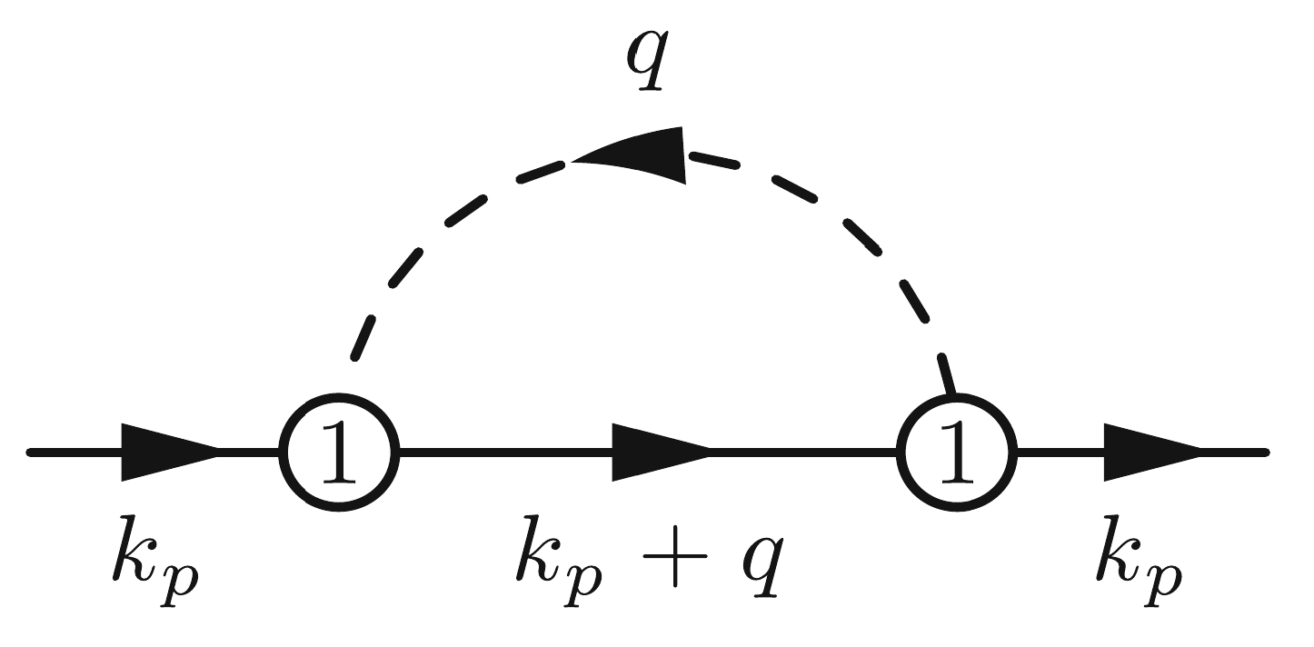
Baryon Chiral perturbative theory (BChPT)
baryon sector
Power counting breaking (PCB)
$M_{π}≪Λ_{χ}$, $m_{N}\sim Λ_{χ}$
$∂_{μ}π \sim Ο\left(q\right)$, $M_{π} \sim Ο\left(q\right)$, $m_{N} \sim Ο\left(q^{0}\right)$, $∂_{μ}Ψ \sim Ο\left(q^{0}\right)$
J. Gasser et al. Nucl.Phys.B 307 (1988)
$$D=dim×N_{L} −2×N_{I,π}−1×N_{I,N}+ ∑{i N}_{V_{i}}$$
$$dim×1−2×1−1×1+2 → Ο(q^{3})$$
PCB terms
Power counting breaking
A new scale get involved in the Feynman Integral

Slide 9
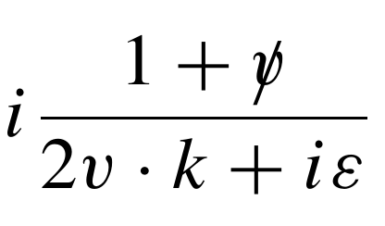
Renormalization
PCB – ill-defined cutoff of Feynman diagram
Heavy Baryon ChPT (HBChPT)
$p=mv+k$, $v=(1,0,0,0)$, $m → ∞$
Non-relativistic
Infrared Regularization (IR)
Discard the contribution near the pole $p^{2}=m^{2}$ (regular part).
Introduce un-physical cut, poor convergence
Extended-on-mass-shell scheme (EOMS)
counterterms absorb only the divergence and PCB terms
Keeps the relativity and analyticity
Phenomenological success
V. Bernard et al. Nucl.Phys.B 388 (1982)
E.E. Jenkins and A.V. Manohar Phys.Lett.B 255 (1991)
T. Becher and H. Leutwyler Eur.Phys.J. 9 (1999)
J. Gegelia and G. Japaridze Phys.Rev.D 60 (1999)
T. Fuchs et al. Phys.Rev.D 68 (2003)
L. Durand and P. Ha Phys.Rev.D 58 (1998)
L.S Geng et al. Phys.Rev.Lett. 101 (2008)
L.S Geng Front.Phys.(Beijing) 8 (2013)

Slide 10
Self-energy with EOMS scheme

Slide 11
Renormalization
Nucleon self-energy
Nucleon mass:
HBChPT:
Up to $Ο(q^{5})$, the correction can be absorbed by $g_{A}$.
IR:
Up to $Ο(q^{6})$
EOMS:
One Loop
Two loop
Tree and one loop
Two loop
J.A. McGovern and M.C. Birse Phys.Lett.B 446 (1999)
M.R. Schindler et al. Phys.Lett.B 649 (2007)
T. Fuches et al. Phys.Rev.D 68 (2003)
N.D. Conard et al. PoS CD2021 (2024)

Slide 12
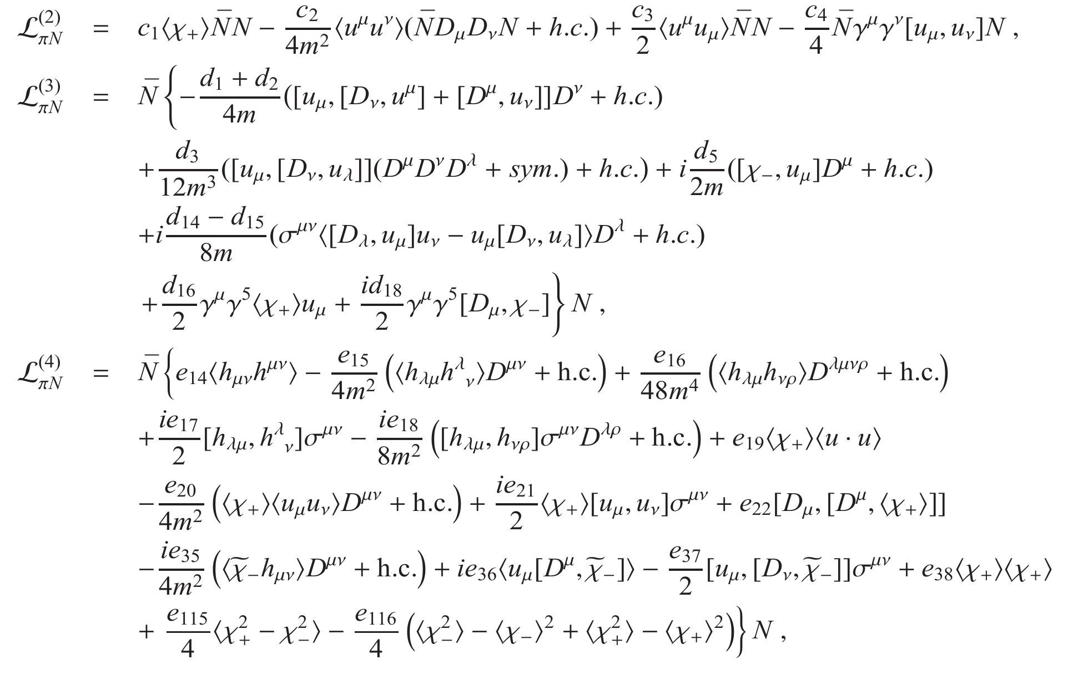
The expansion of nucleon mass
Lagrangian
Baryon sector
up to $Ο(q^{4})$
up to $Ο(q^{5})$
High order lagrangian contribute a tree level term ${\hat{g}}_{1}M^{6}$
$$ℒ_{BchPT}= ℒ_{ππ}^{(2)}+ℒ_{ππ}^{(4)}+\sum_{i=1}^{6}{ℒ_{πN}^{(i)}}$$
N. Fettes et al. Annals Phys. 283 (2000)
C.Q. Song et al. [2404.15047 [hep-ph]]
$M^{5}=m_{q}^{\frac{5}{2}}$, not analytic in quark mass $×$

Slide 13
The expansion of nucleon mass
$m_{N}$
1PI self-energy
Contact term
$$Σ_{c}=−4c_{1}M^{2}+{\hat{e}}_{1}M^{4}+{\hat{g}}_{1}M^{6}$$
Absorb the contact terms into propagator mass

Slide 14
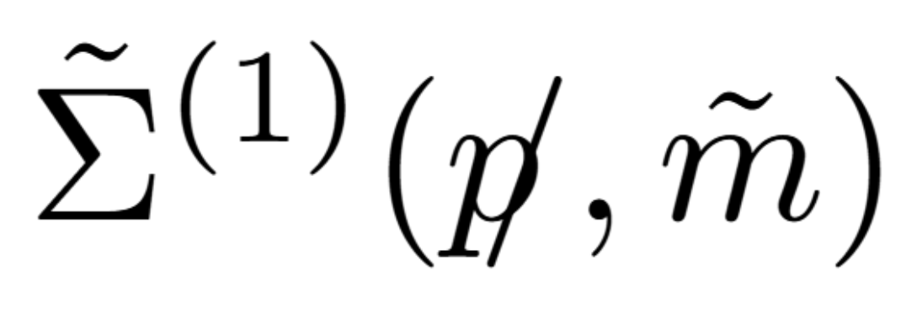
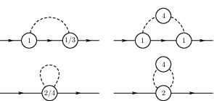
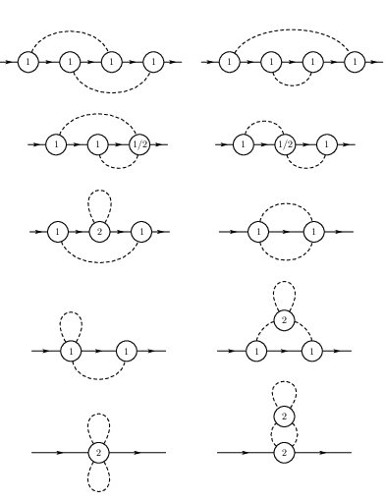
The expansion of nucleon mass
$Σ^{(2)}$
Three scales ($m_{N}, \tilde{m}, M$) Two scales
Method of region (MOR)
two regions for each integration
$l ∼ M_{π}$ soft $∼$IR singular part
$l ∼ m_{N}$ hard $∼$ IR regular part
Contain PCB

Slide 15
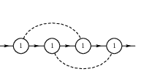
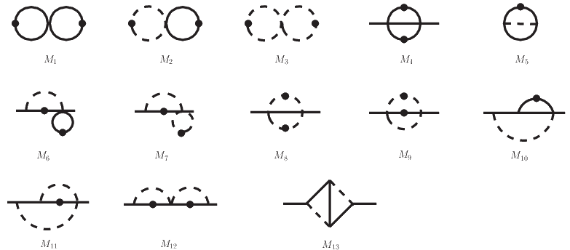
Analytic feynman integrals
Modern technology
Using IBP reduce to MIs
DEs for MIs
AMFlow for numeric check
Differential equation method
A.V. Kotikov Phys.Lett.B 254 (1991)
A.V. Kotikov Phys.Lett.B 267 (1991)
Numeric check: AMFlow
J.M. Henn Phys.Rev.Lett. 110 (2013)
L. Xiao and Y.Q. Ma
Comput.Phys.Commun. 283 (2023)

Slide 16
Renormalization (EOMS)
Bare perturbative theory
Substitute the bare quantity
mesonic sector
baryon sector
Use $δ_{div}$ to cancel the divergence
Find out PCB terms for each diagram, and use $δ_{eoms}$ to cancel
$πN$ scattering v.s. Nucleon self-energy
D.L. Yao et al. Phys.Rev.D 87 (2013)

Slide 17
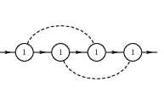
EOMS counterterms
Bare perturbative theory
tree diagram
one loop diagram
$$δ_{div}=(…)\frac{ℏ}{ε}+(…)\frac{ℏ^{2}}{ε^{2}}+(…)\frac{ℏ^{2}}{ε}$$
$$δ_{div}=(…)\frac{ℏ}{ε}$$
$$δ_{eoms}=\left(…\right)ℏ+(…)ℏ^{2}$$
$$δ_{eoms}=\left(…\right)ℏ+\left(…\right)ℏε$$
$$g_{A,B}= g_{A,R}+ δ_{div}g_{A}+ δ_{eoms}g_{A}$$
$πN$Coupling and $πN →πN$ need to be calculated to $Ο(ε)$
$\frac{ℏ}{ε}×\left(…\right)ℏε$
Finite PCB term $\left(…\right)ℏ^{2}$
loop
$$×$$
counterterms
All PCB terms can be removed by counterterms which free of $\log{M}$
A non-trivial check

Slide 18
Result
Tree level and one loop
$${\hat{e}}_{1}M^{4}$$
T. Fuches et al. Phys.Rev.D 68 (2003)

Slide 19
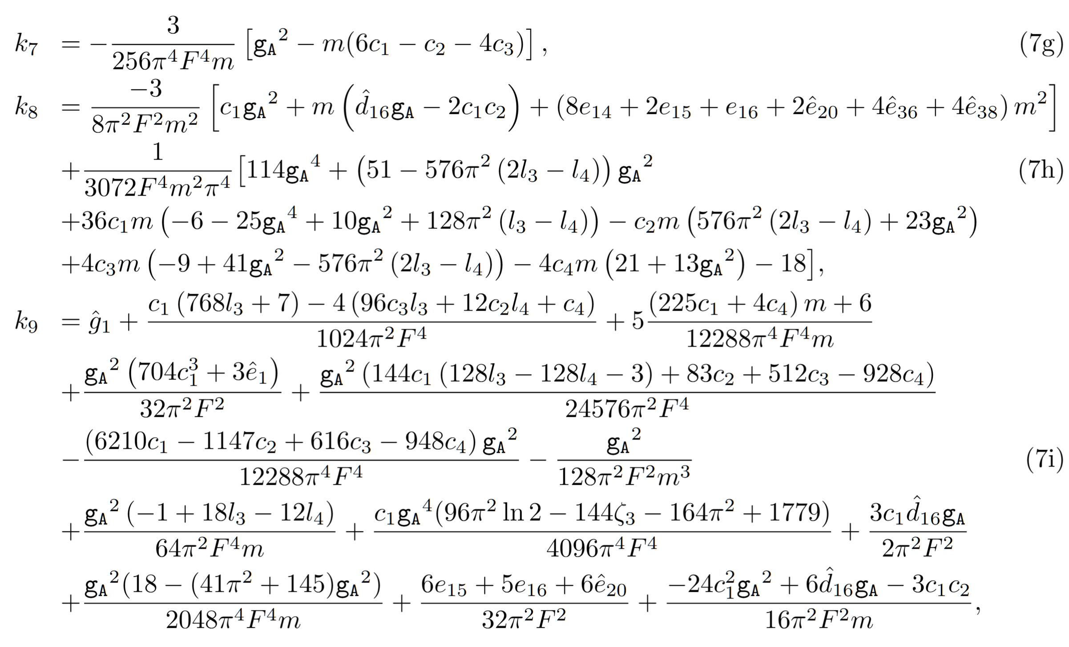
Result
Two loop
$${\hat{e}}_{1}M^{4}$$
$${\hat{g}}_{1}M^{6}$$
$Ο(q^{5})$:
$Ο\left(q^{4}\right)$?
$$\tilde{m}M^{4}ζ_{3}$$
$m$, ${\hat{e}}_{1}$ and ${\hat{g}}_{1}$ are undetermined
$$=mM^{4}ζ_{3}−4c_{1}M^{6}ζ_{3}+…$$
$$\tilde{m}=m−4c_{1}M^{2}+…$$
Leading logarithms consist with IR and BChPT
PCB
PC preserved
Expansion of $\tilde{m}$

Slide 20
Phenomenology

Slide 21
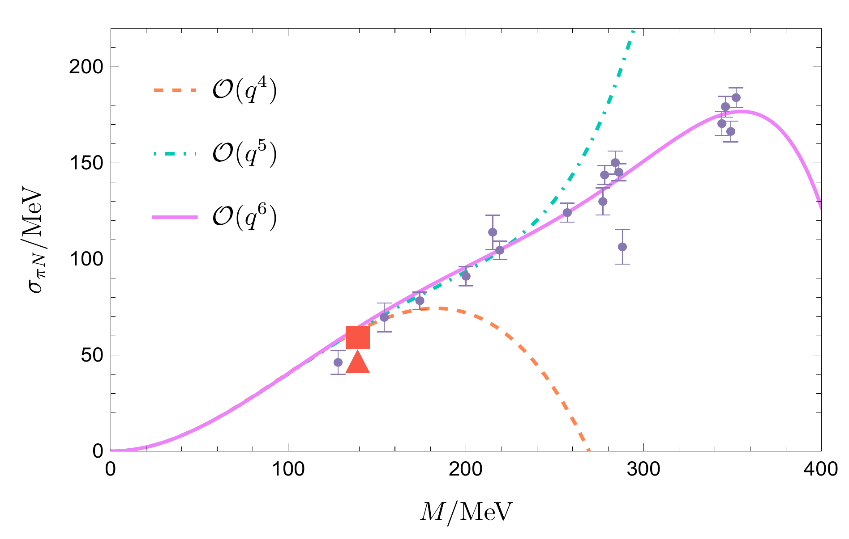
Sigma term
$σ_{πN}=\left\langle N | H_{s.b.} | N\right\rangle$
Directly related to the chiral symmetry breaking
$σ_{πN}=\left\langle N | m_{q}(\overline{u}u+\overline{d}d) | N\right\rangle =M^{2}\frac{∂m_{N}}{∂M^{2}}$
(Hellmann-Feynman theorem)
$$m_{N}=m−4c_{1}M^{2}+…$$
$m$, ${\hat{e}}_{1}$ and ${\hat{g}}_{1}$ are undetermined
Use $σ_{πN}$ to fit ${\hat{e}}_{1}$ and ${\hat{g}}_{1}$
$c_{1\sim 4}$, $d_{18}$, $e_{14\sim 16}$, ${\hat{e}}_{20, 36, 38}$
from one loop $πN$ scattering fitting
physical point: 45MeV~68MeV
D.L. Yao et al. Phys.Rev.D 87 (2013)
Lattice data points and :
A. Agadjanov et al. Phys.Rev.Lett. 131 (2023)
Roy-Steiner equation:
M. Hoferichter et al. Phys.Rev.Lett. 115 (2015)

Slide 22
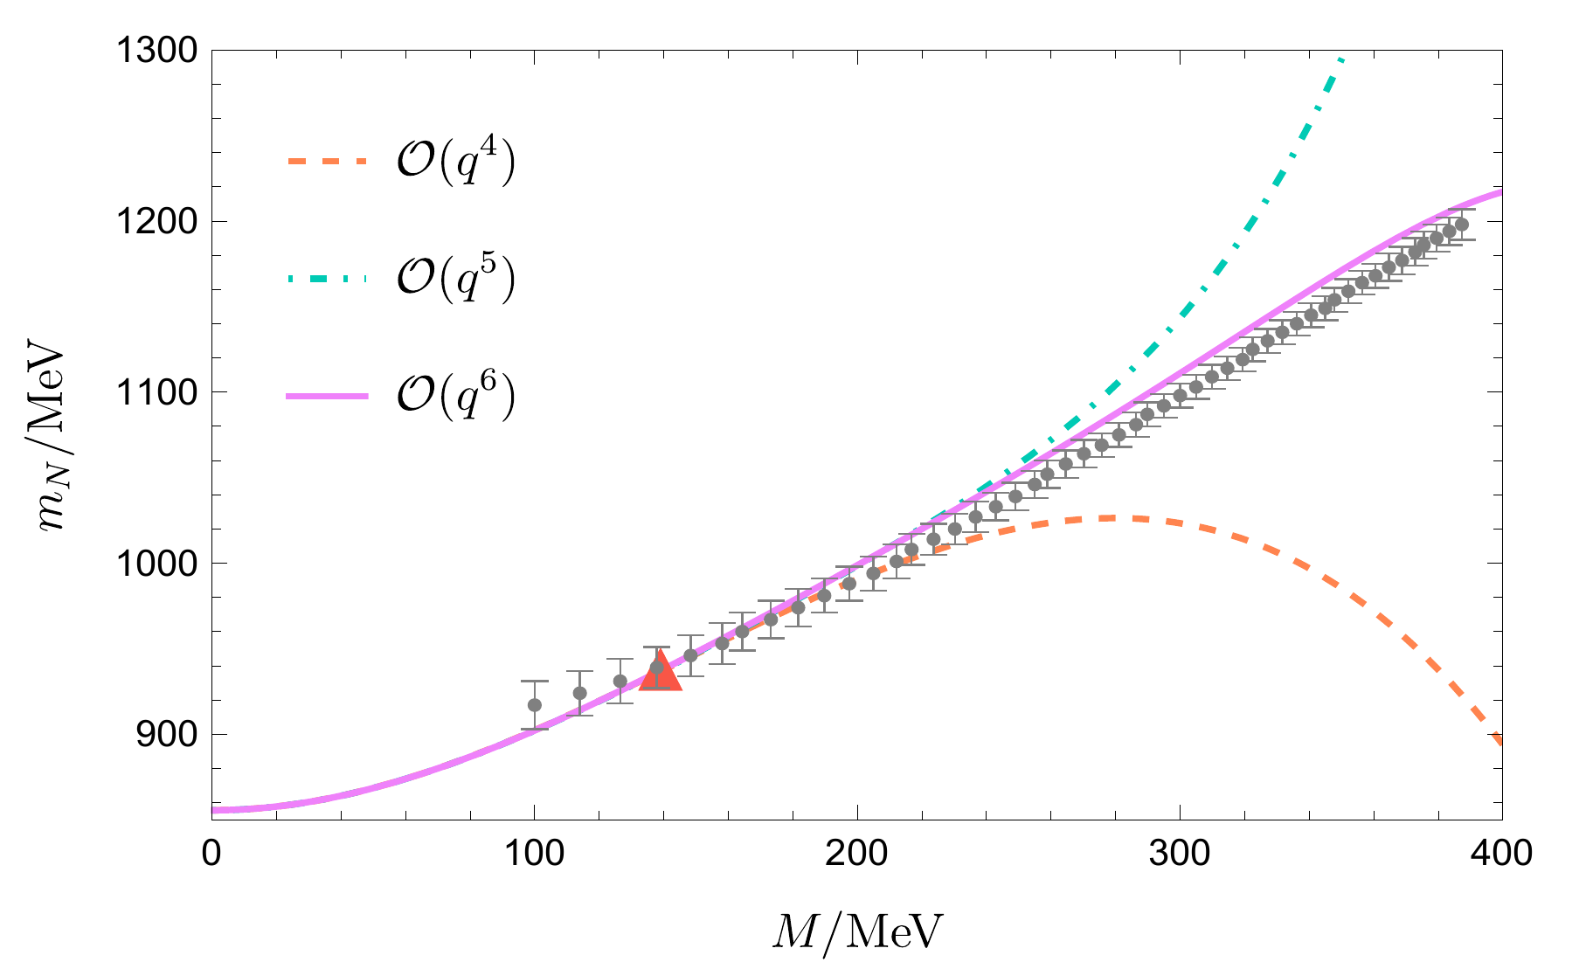
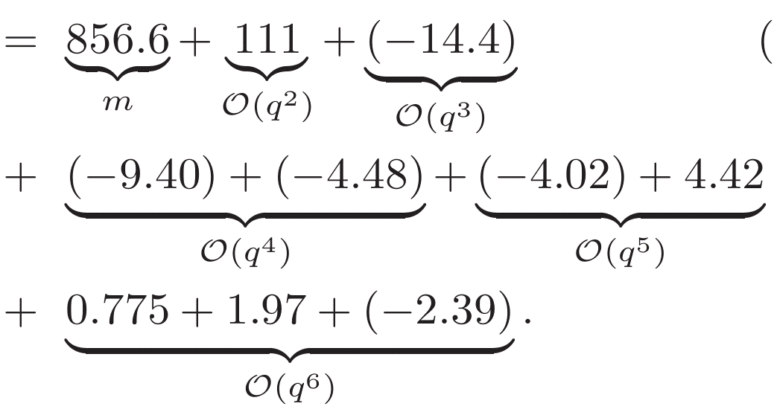
Nucleon mass
BChPT vs lattice
$m=856.6±1.7 MeV$
$Ο(q^{6})$ consistent with lattice result
Good convergence
Lattice data points:
Y.B. Yang et al. Phys.Rev.Lett. 121 (2018)

Slide 23
Summary

Slide 24
Summary
Analytic two-loop calculation of $m_{N}$
Verify the validity of EOMS scheme
The most precise prediction of nucleon mass in chiral limit
Pion mass dependence consistent with lattice prediction

Slide 25
Thank you for your attention

Slide 26
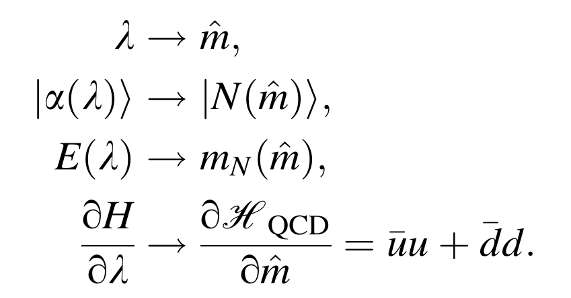
Back up
$$A+Bm_{π}^{2}+Cm_{π}^{3}+Dm_{π}^{3}+Em_{π}^{4}\log{m_{π}}$$

