Slide 1

Spin-orbit effect in multiphoton ionization
Jilin University, Dongdong Zhang
2024.09.25, Beijing

Slide 2
outline
Motivations
Multiphoton ionization of K atom: spin-orbit effect
Spin-orbit dynamics
Rabi-oscillations
Conclusions and outlooks

Slide 3
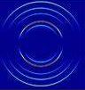
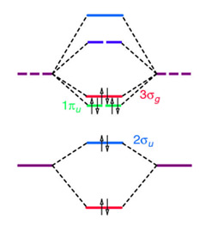
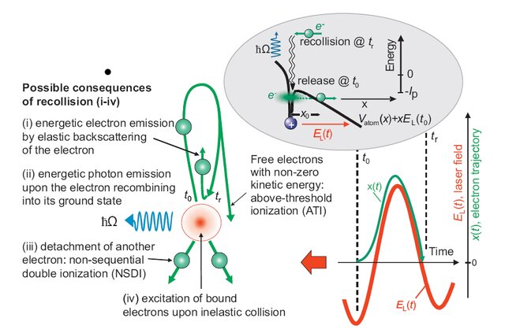
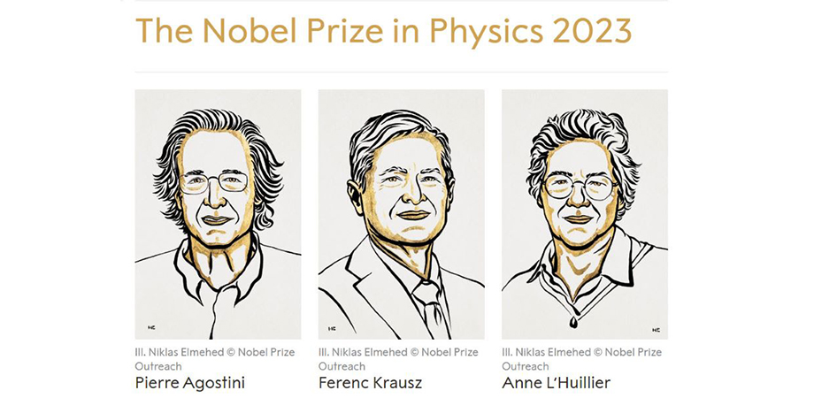
Motivation-photoionization
Fundamental research on structures
Non-linear phenomena
Applications

Slide 4
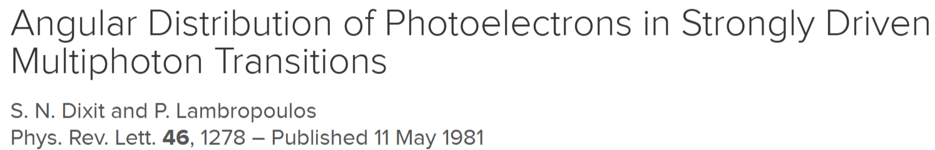
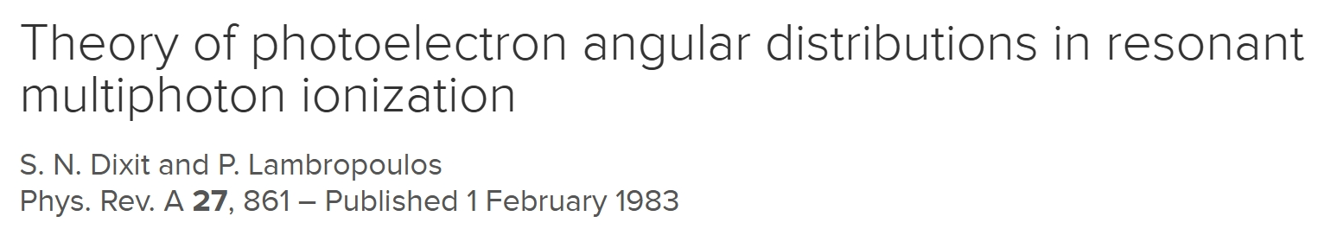
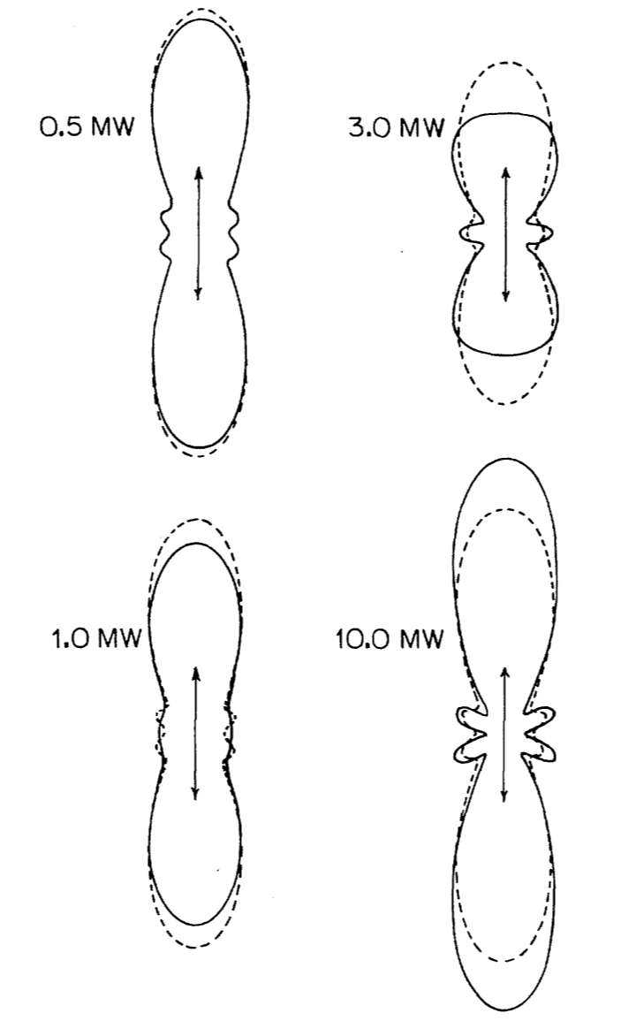
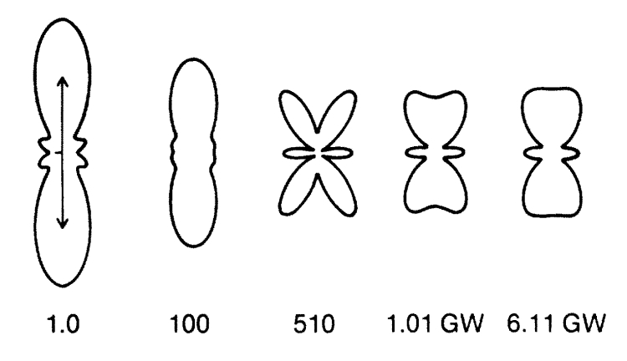
Backgrounds

Slide 5
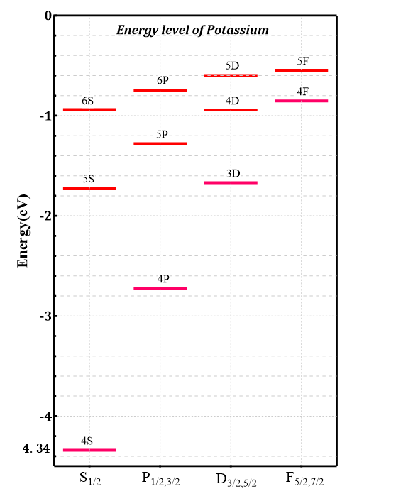
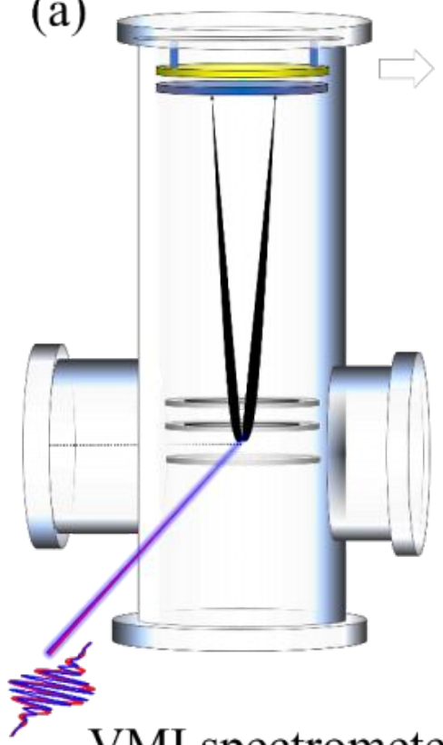
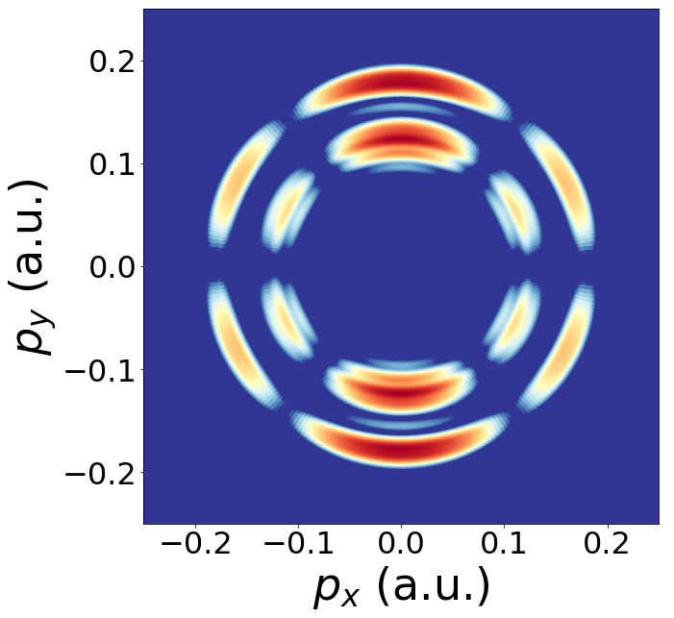



Potassium atoms
linear polarized, 800 nm, 50 fs, 10¹¹ W/cm²
momentum distribution of
photoelectrons
$$hv=1.55 eV$$
$$Y3,0$$
$$Ip=4.32 eV$$
VMIs

Slide 6
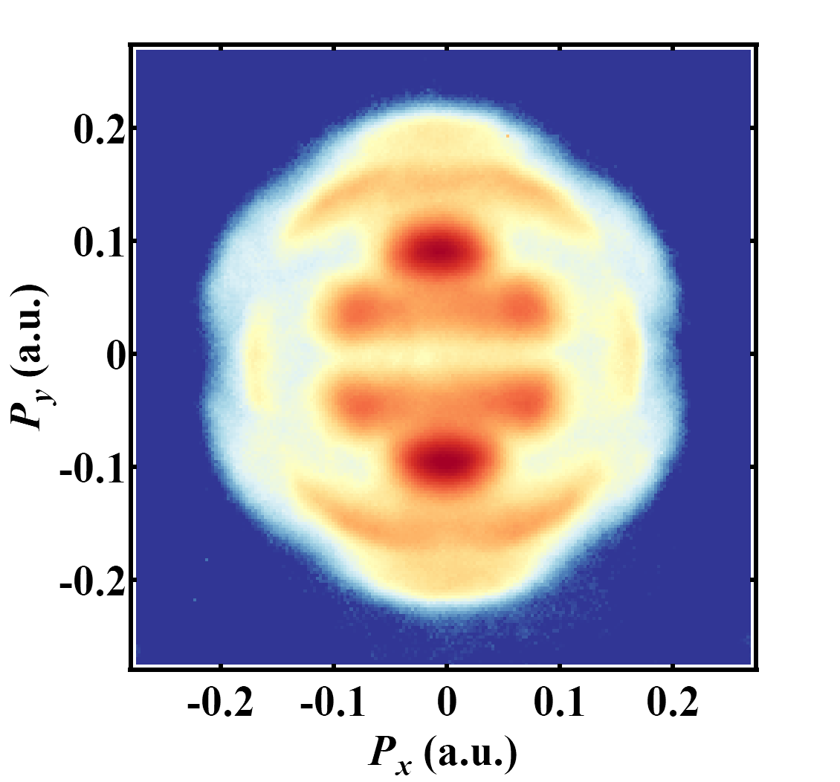
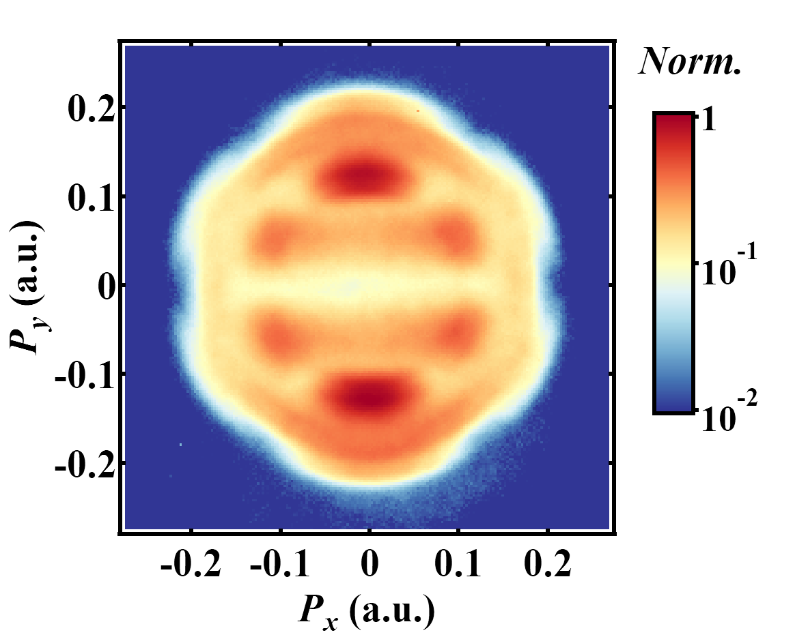
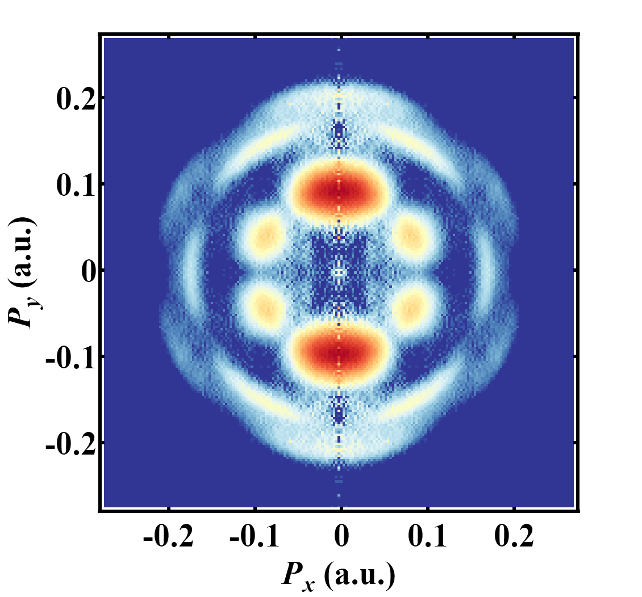
Ionization of K atom
Original image
Basex reconstruction
IP_{K} = 4.34 eV

Slide 7
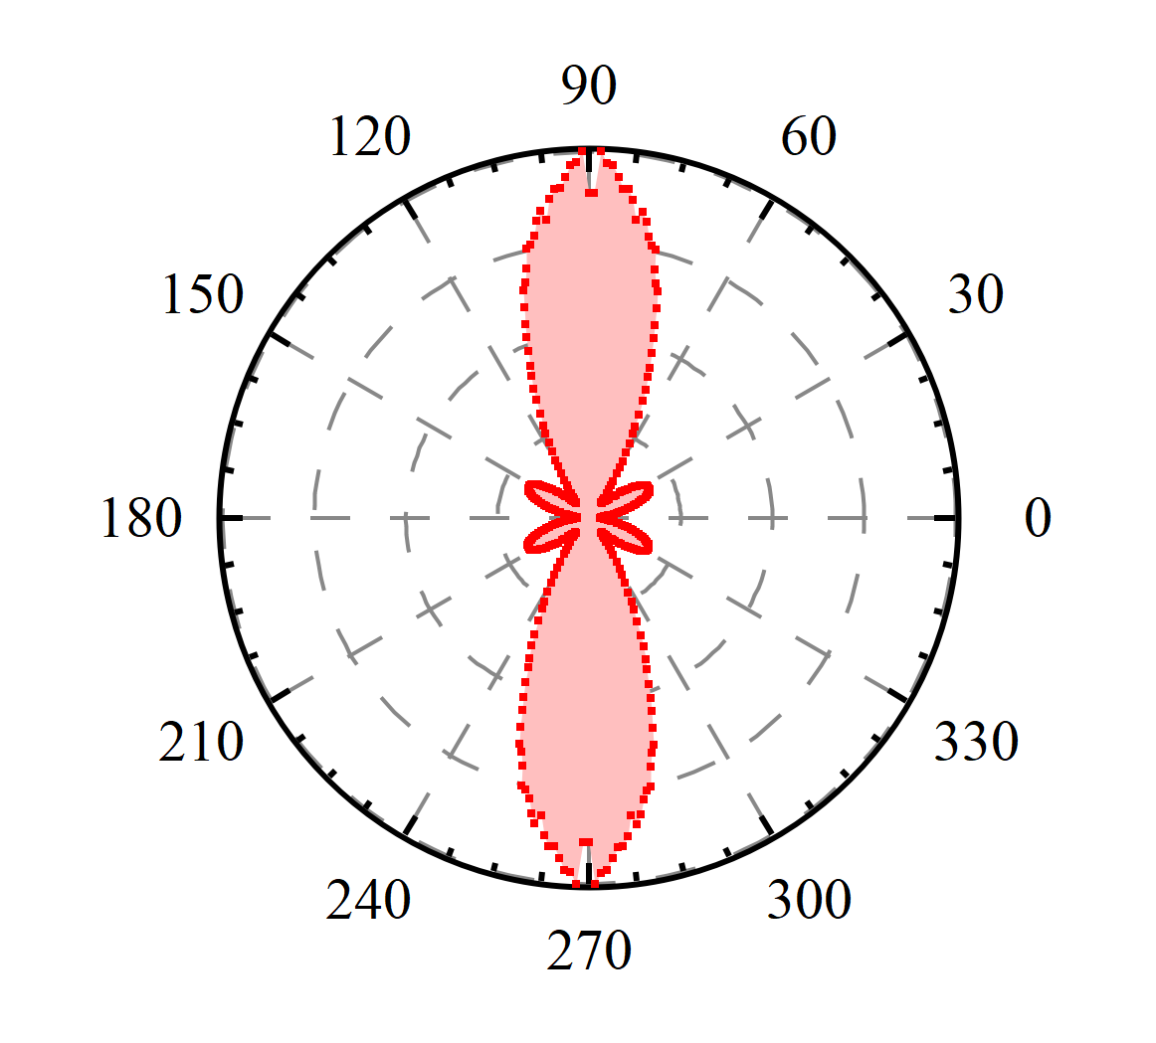
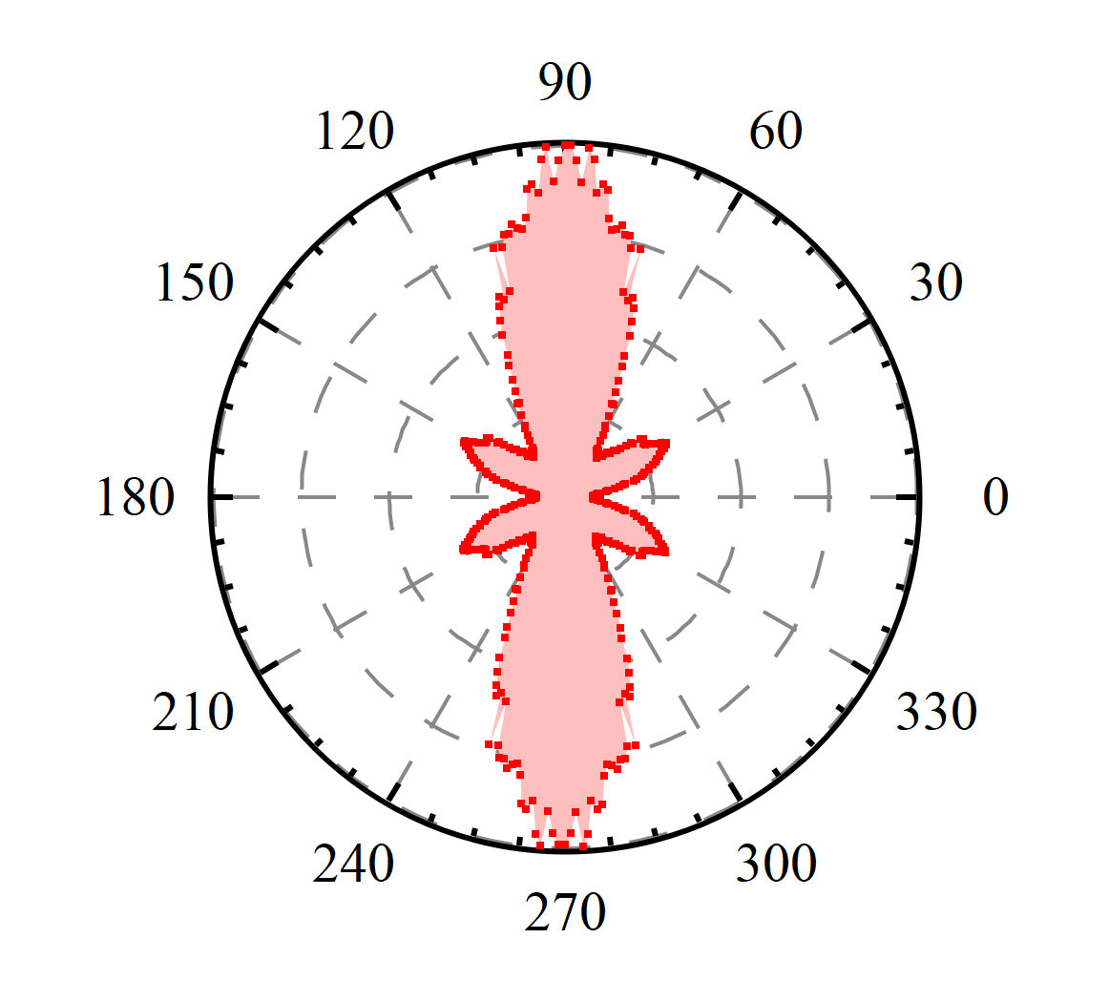
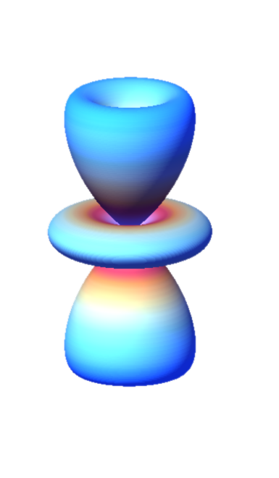
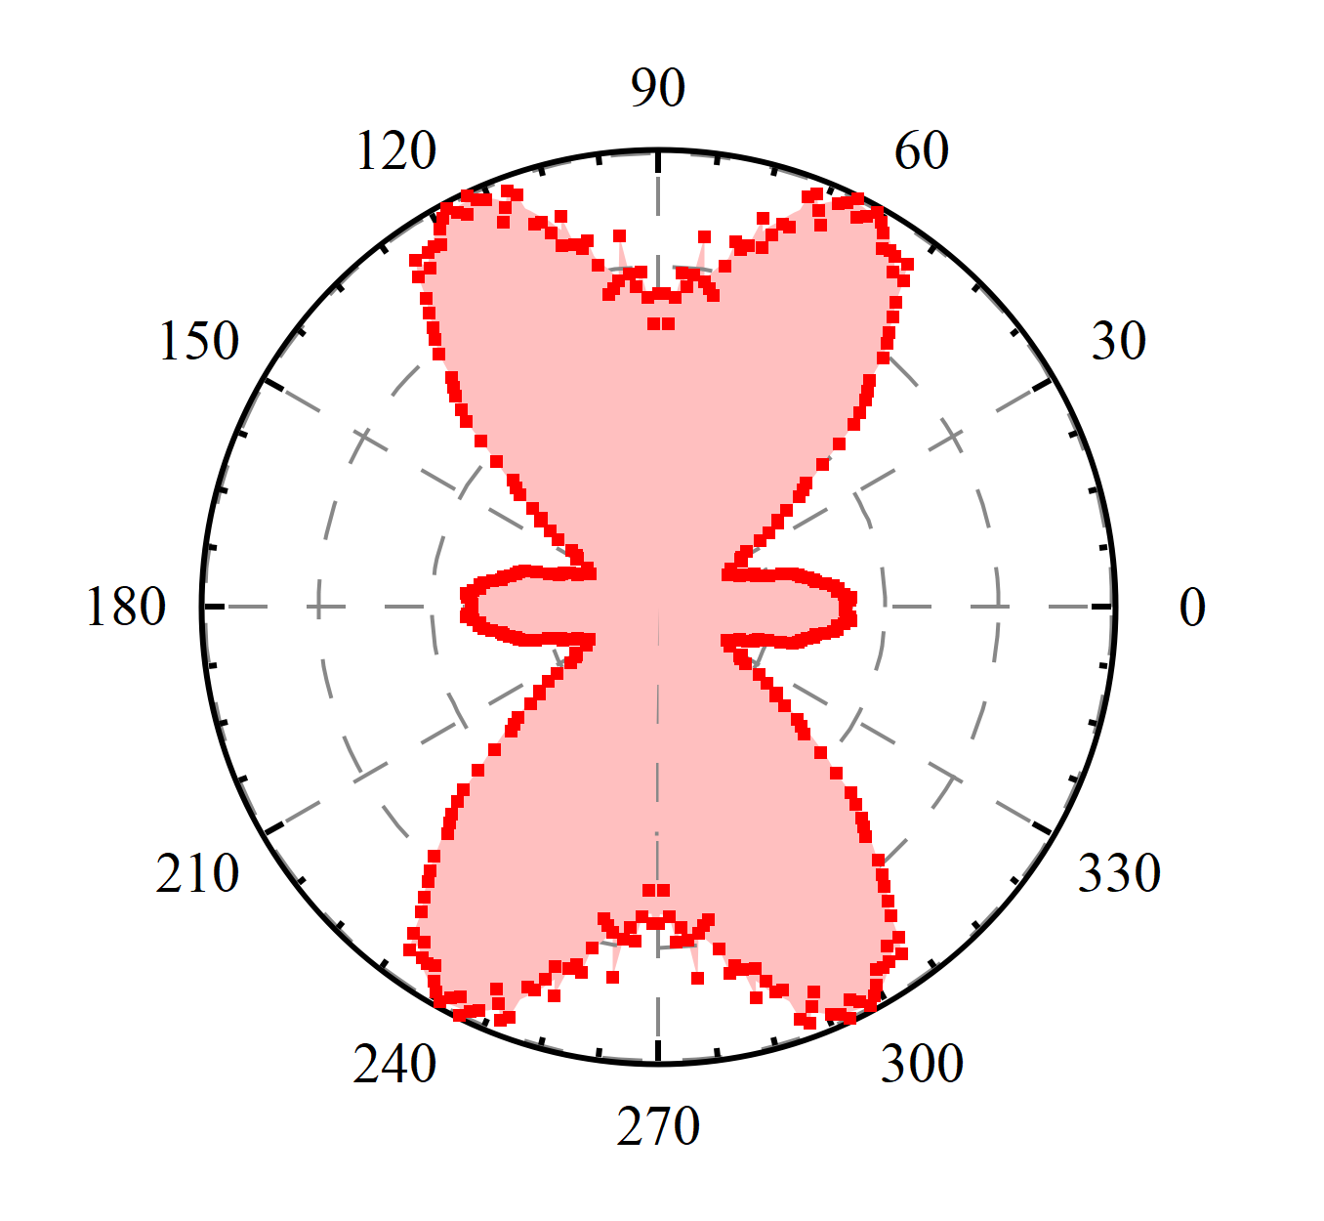
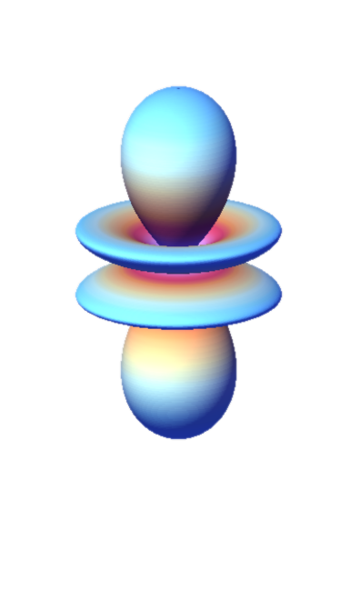
Angular distributions

Slide 8
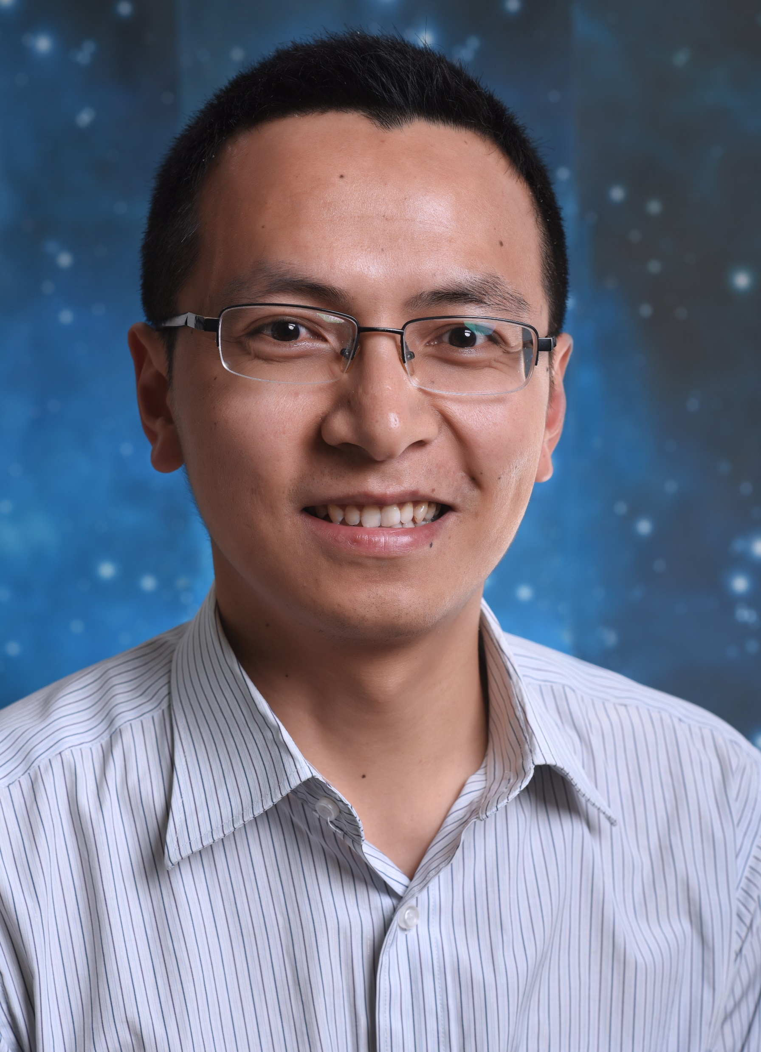
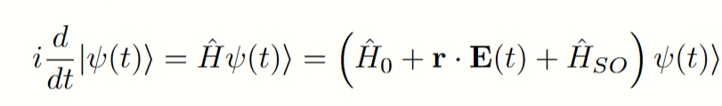

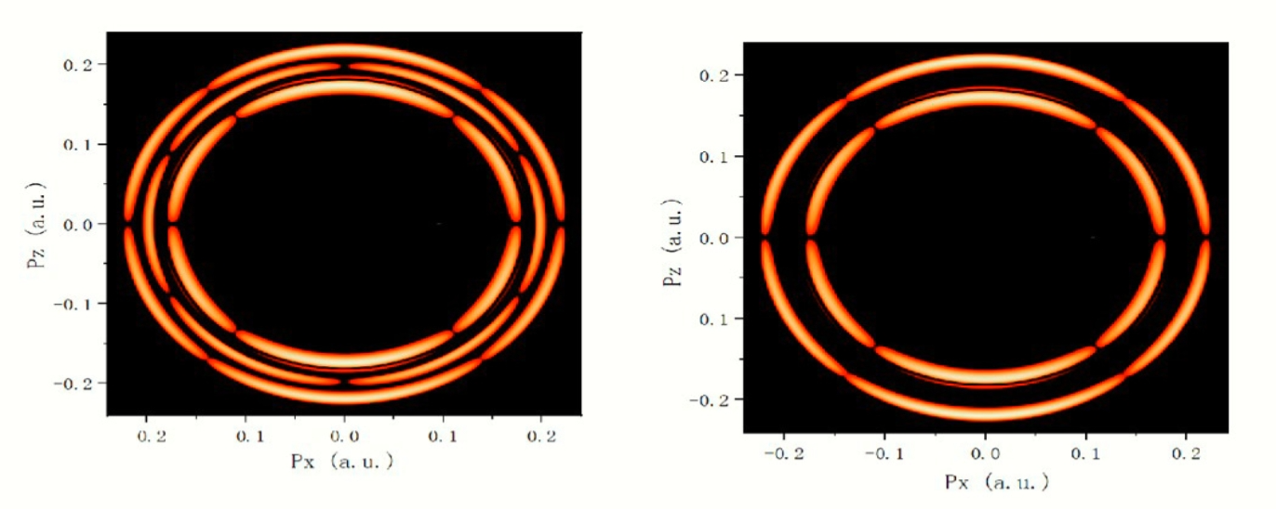
Spin-orbit effect
Xuanyang Lai
experiments
calculation with SO
calculation without SO

Slide 9
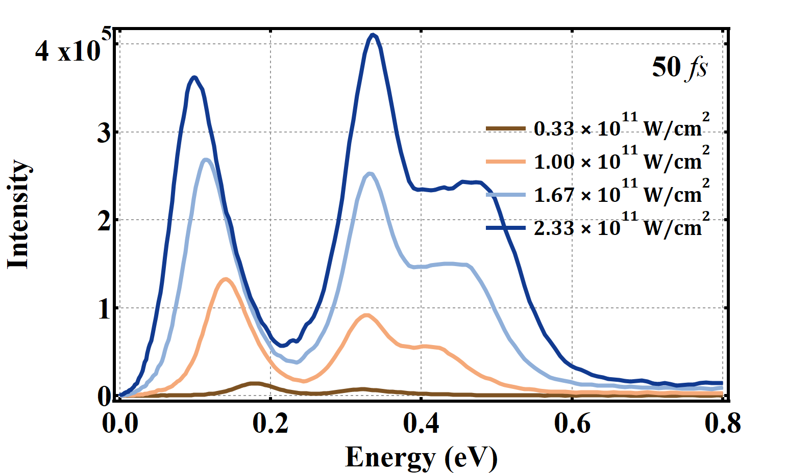
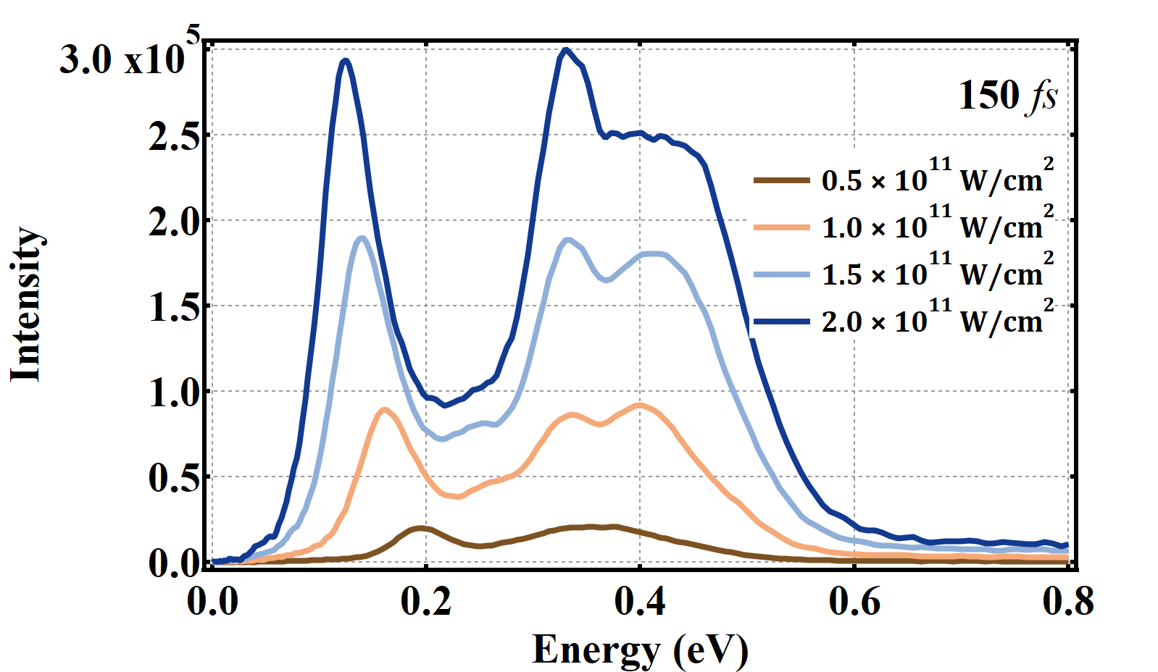
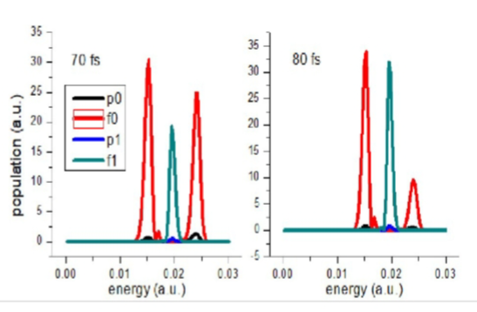
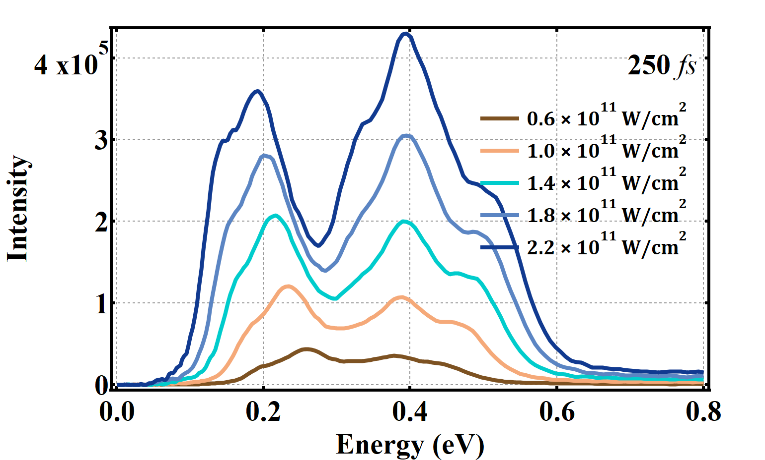
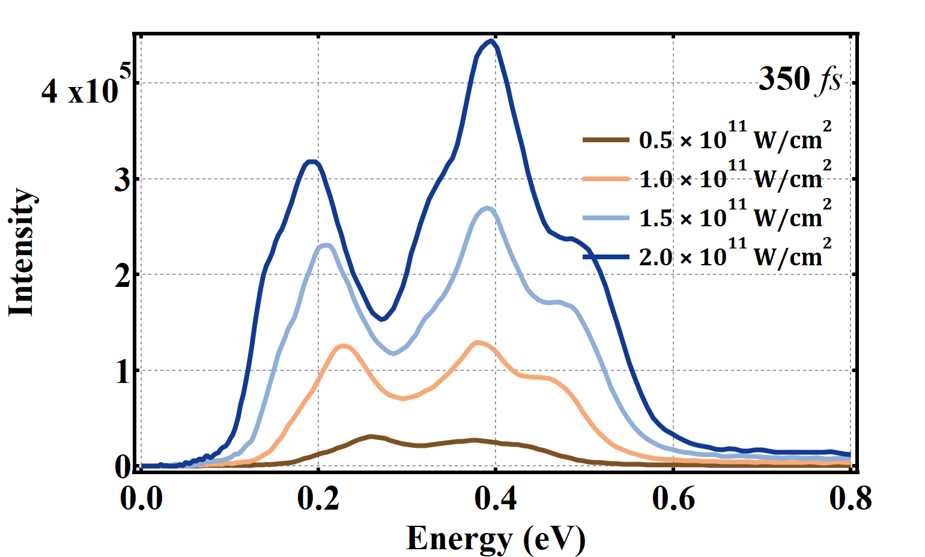
Pulse width and intensities
Experimental results
Theoretical results

Slide 10
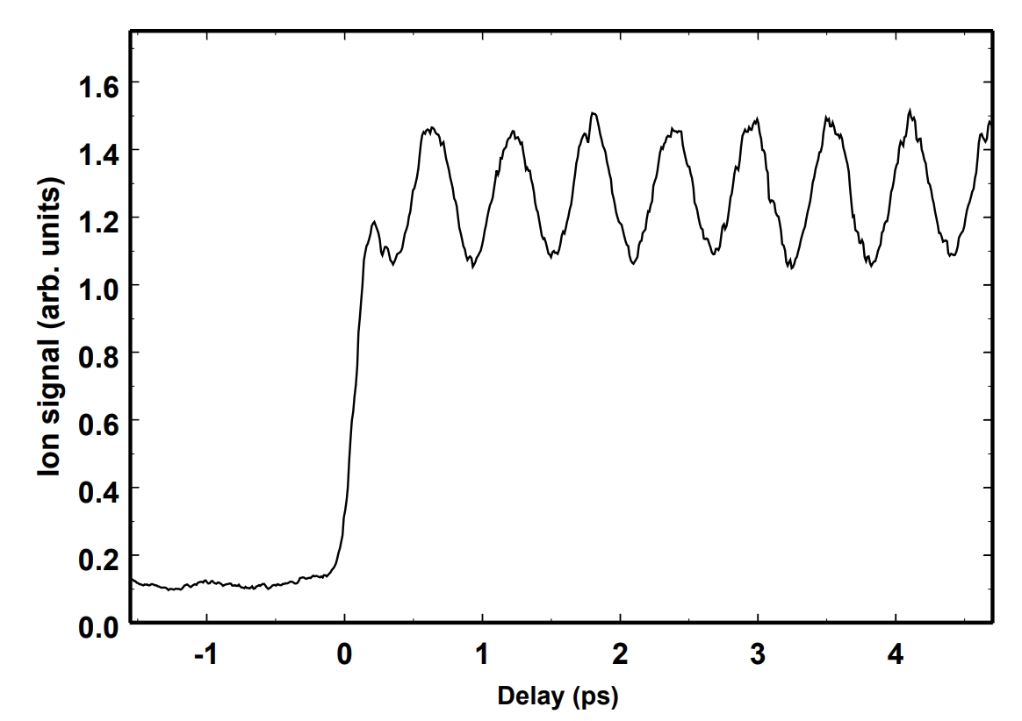
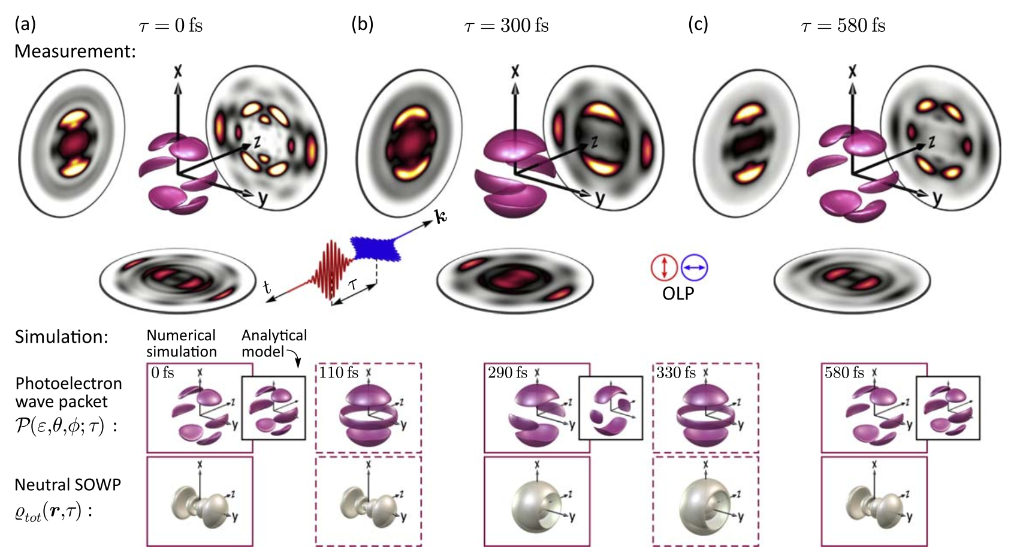
Spin-orbit dynamics
Eur. Phys. J. D 12, 255 (2000)
New J. Phys. 21 033001 (2019)

Slide 11
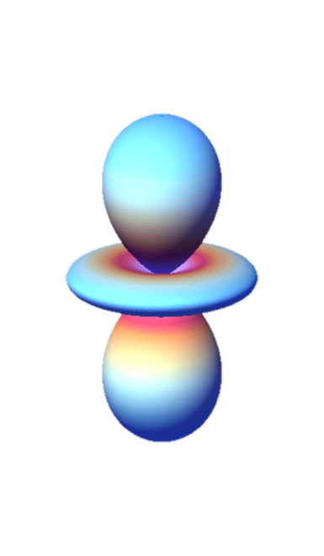
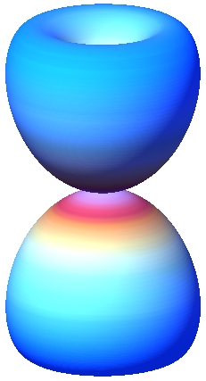
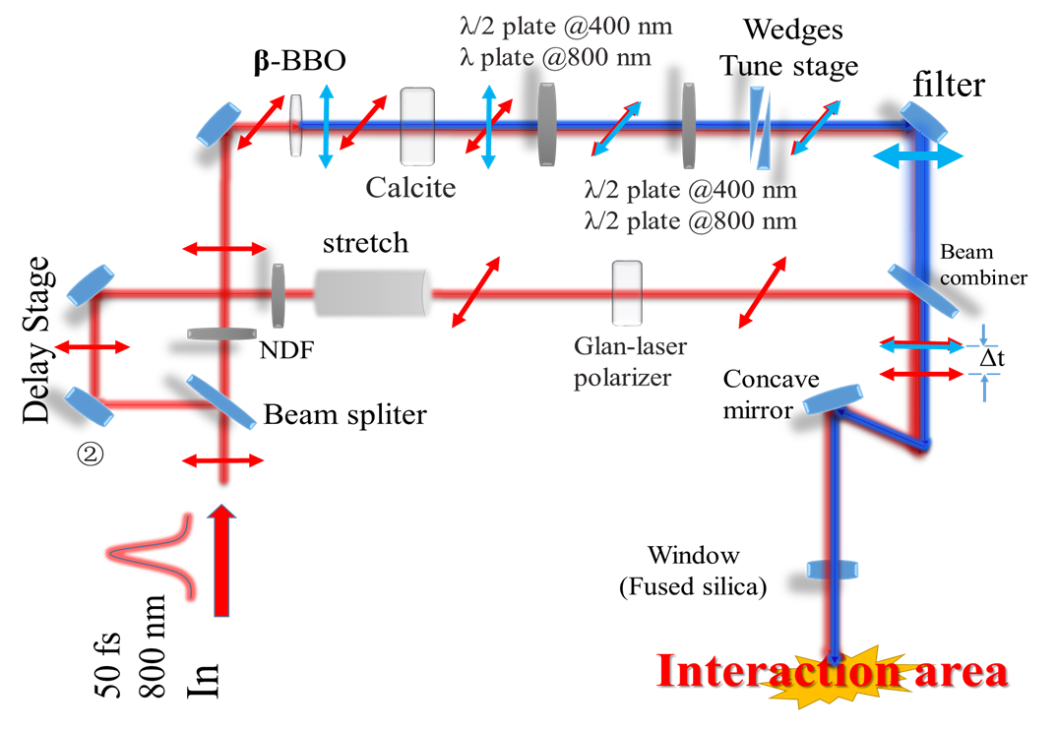

Dynamics of spin-orbit
d₀
d₁
experimental scheme
H_{SO}
s
²P_{1/2}
m_{l} = 0, m_{s} = 1/2
²P_{1/2}
m_{l} = 1, m_{s} = -1/2
800 nm
²S_{1/2}
m_{l} = 0, m_{s} = 1/2

Slide 12
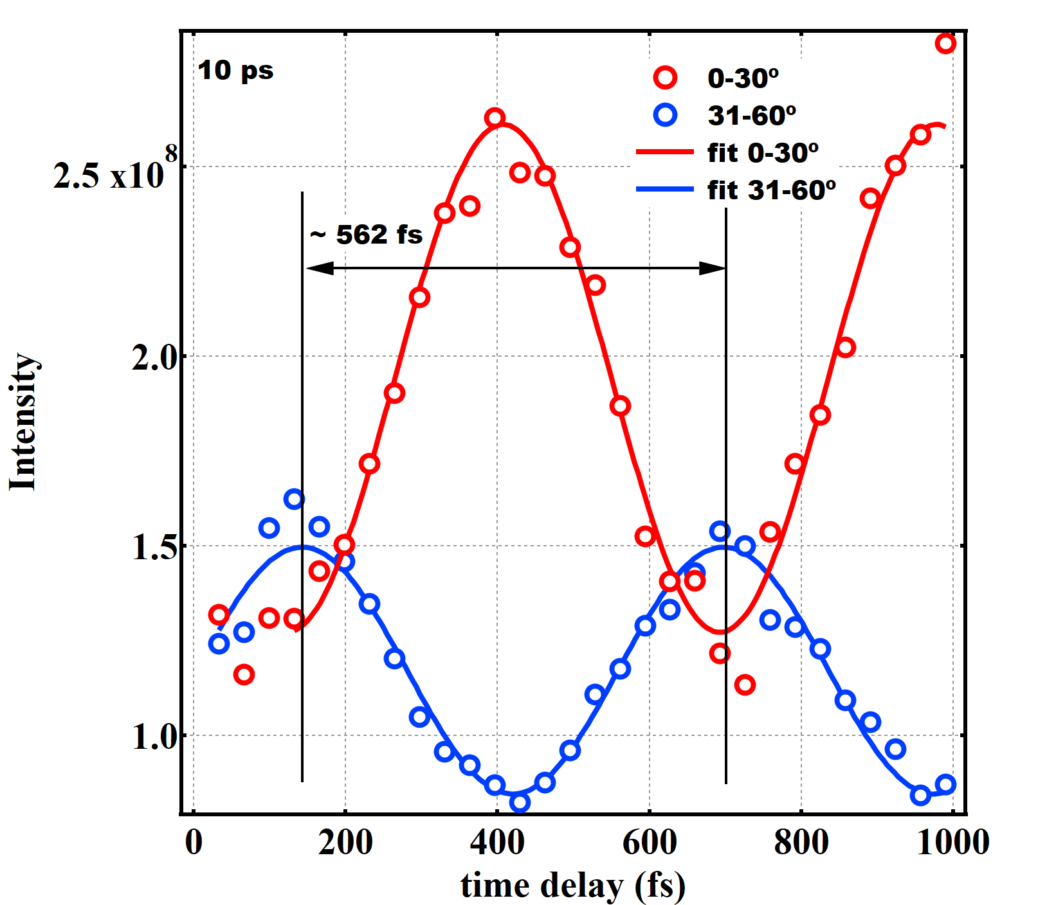
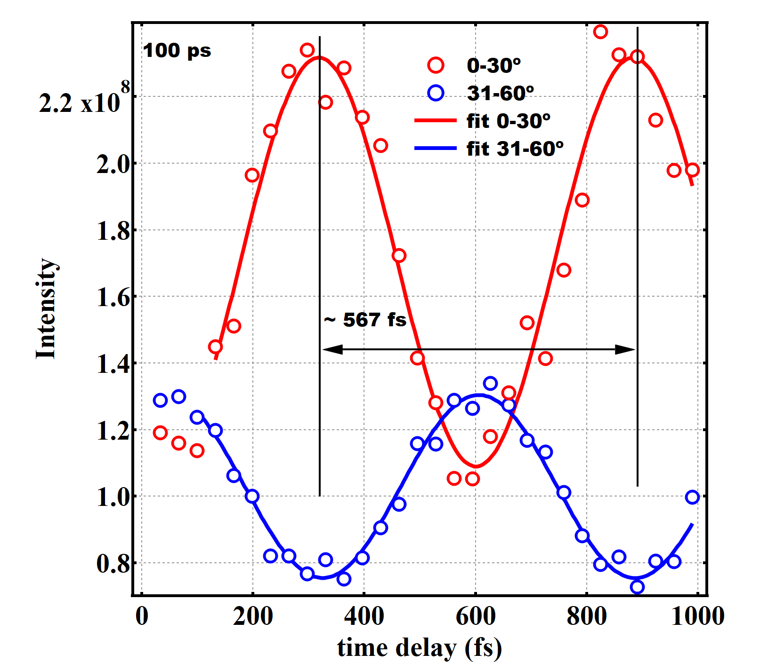
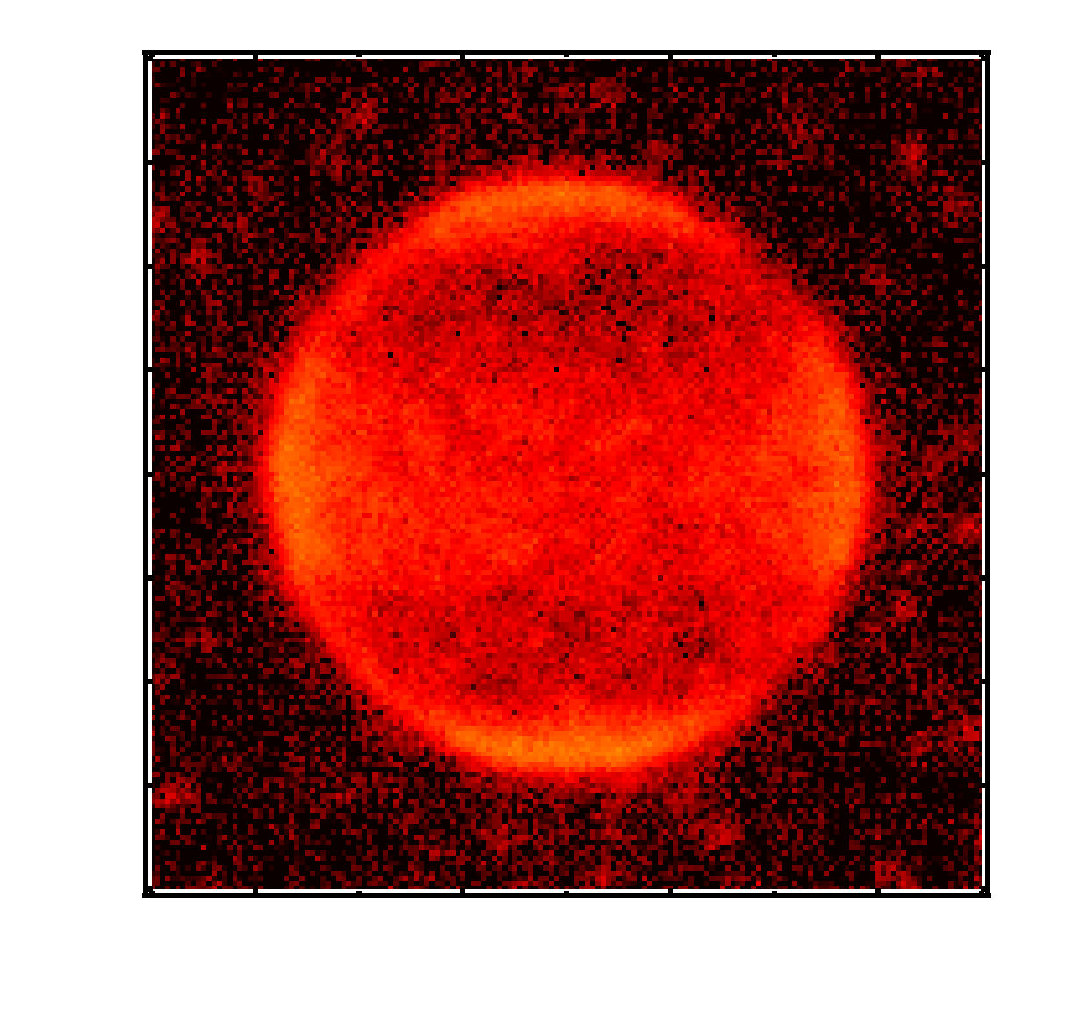
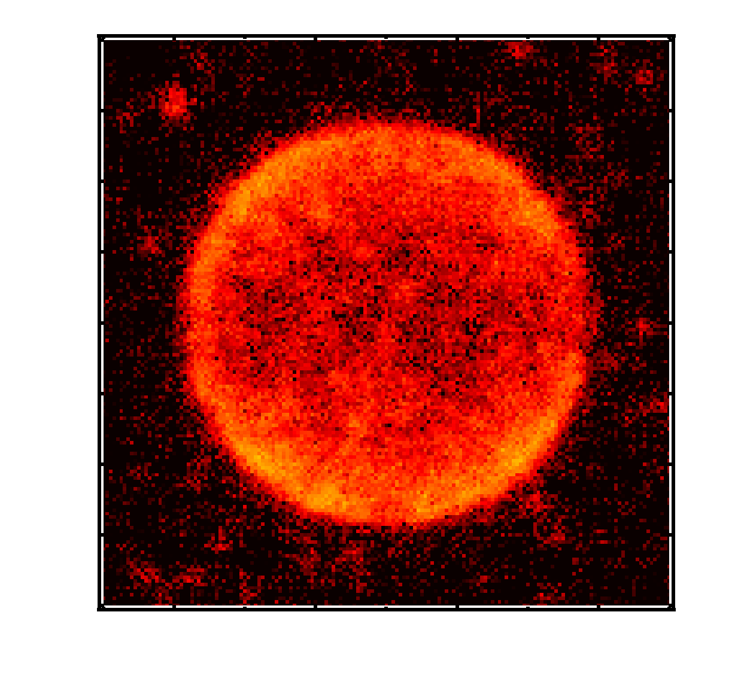
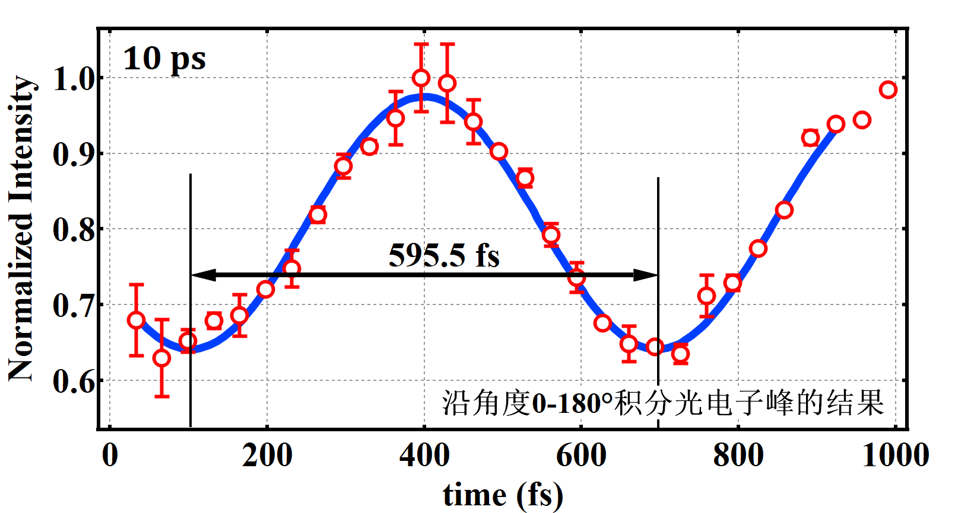
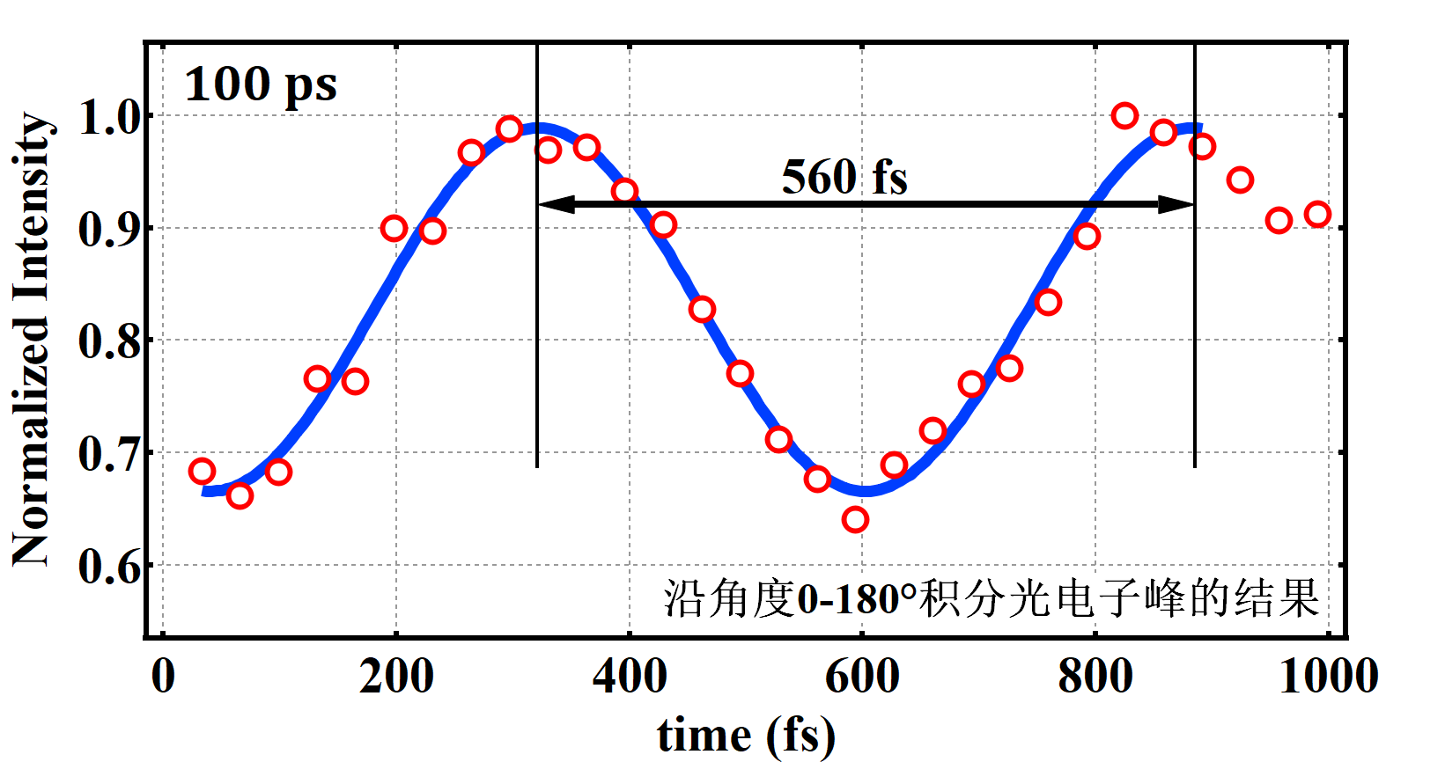
Yield as a function of delay
0-30⁰
30-60⁰

Slide 13
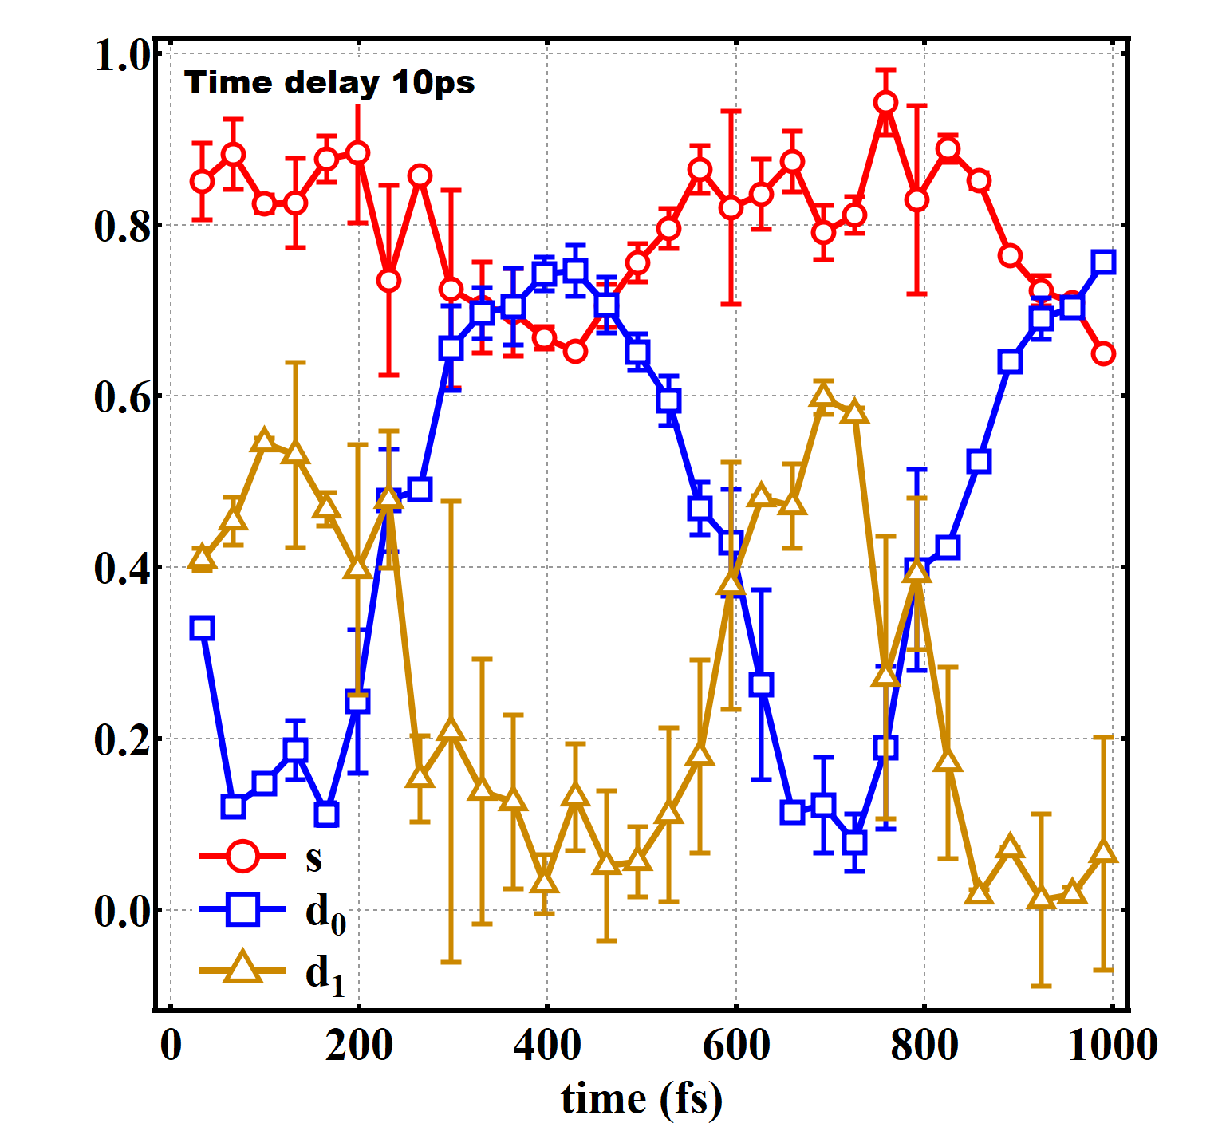
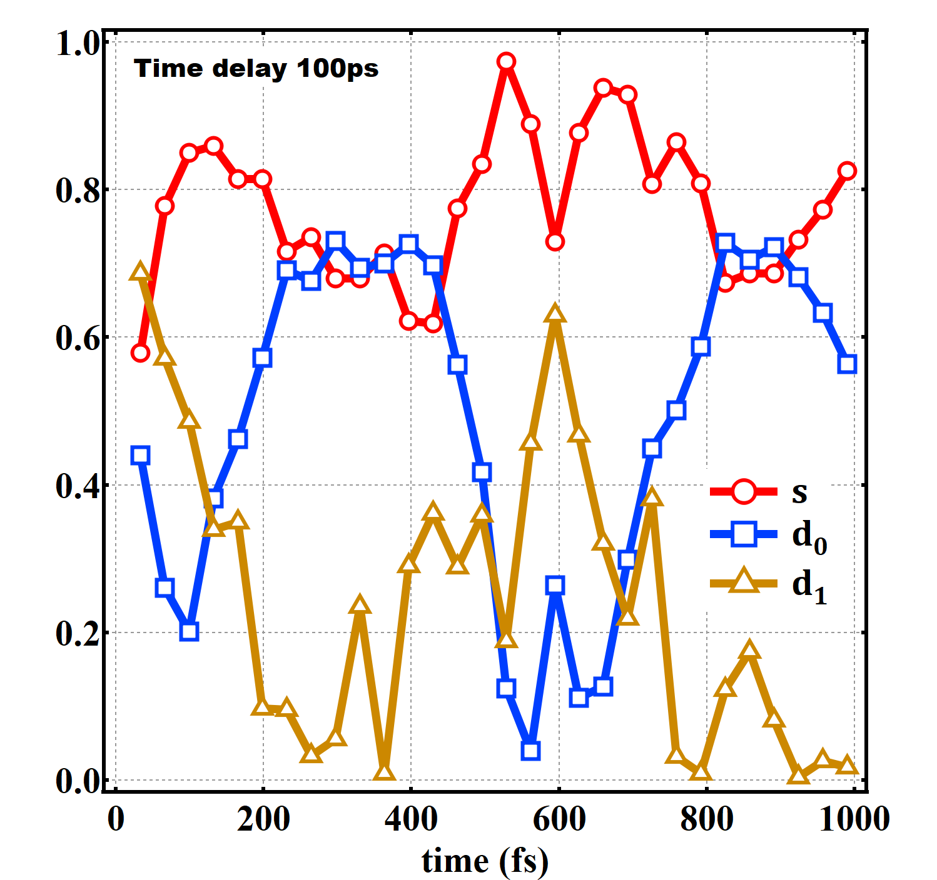
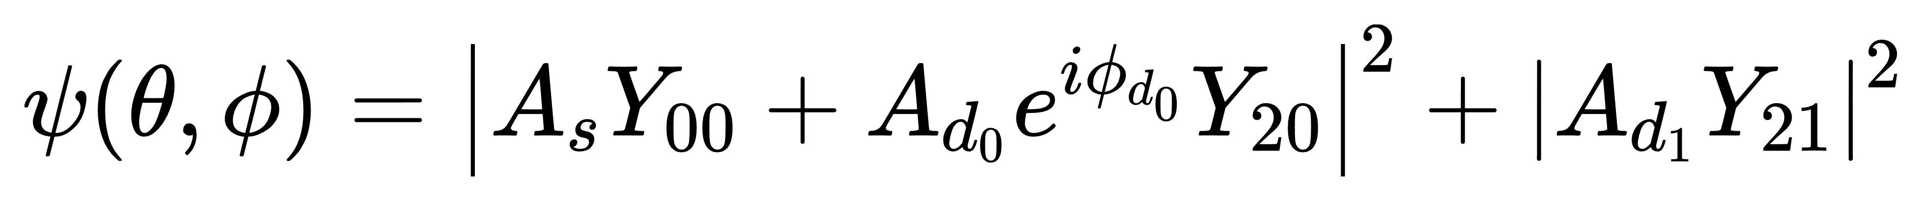

Partial wave analysis
$$= \frac{π}{2}$$

Slide 14
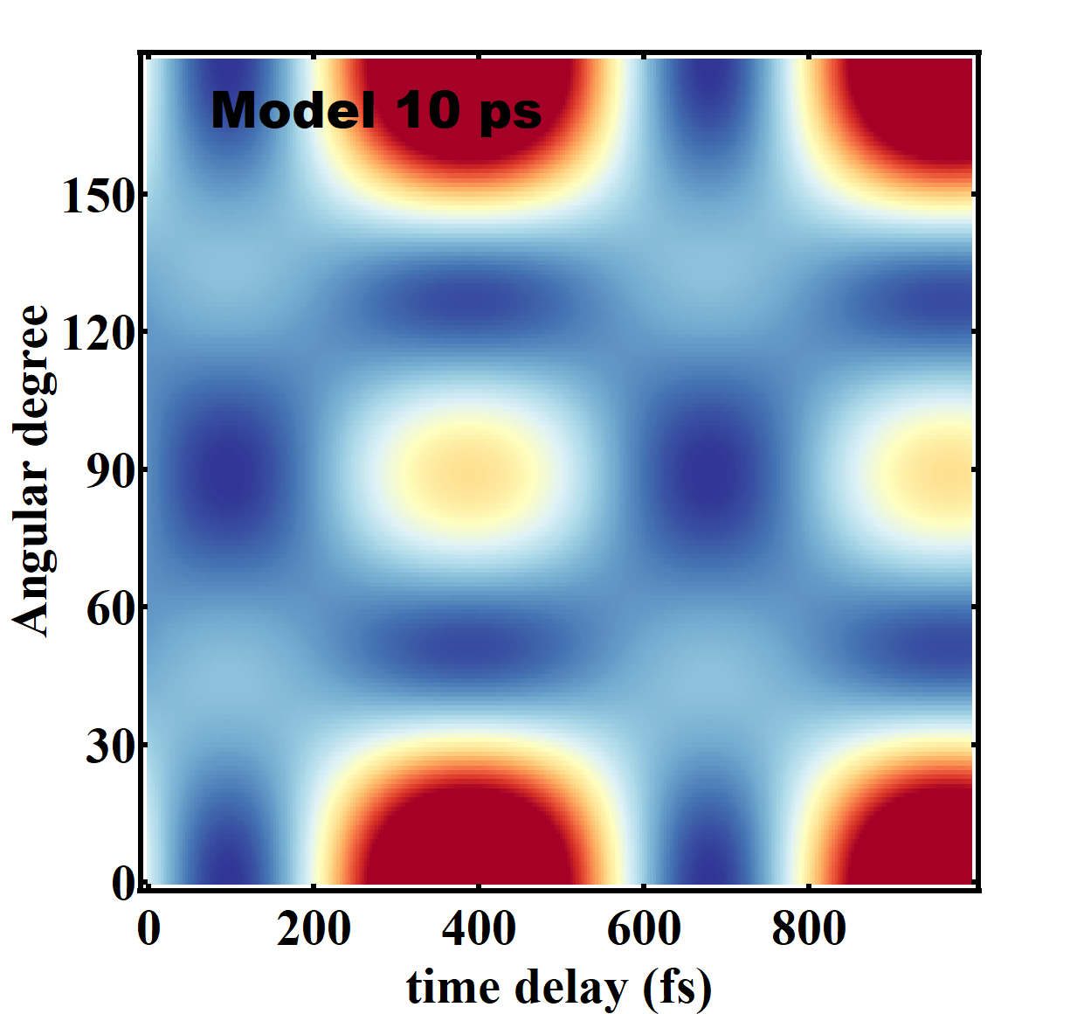
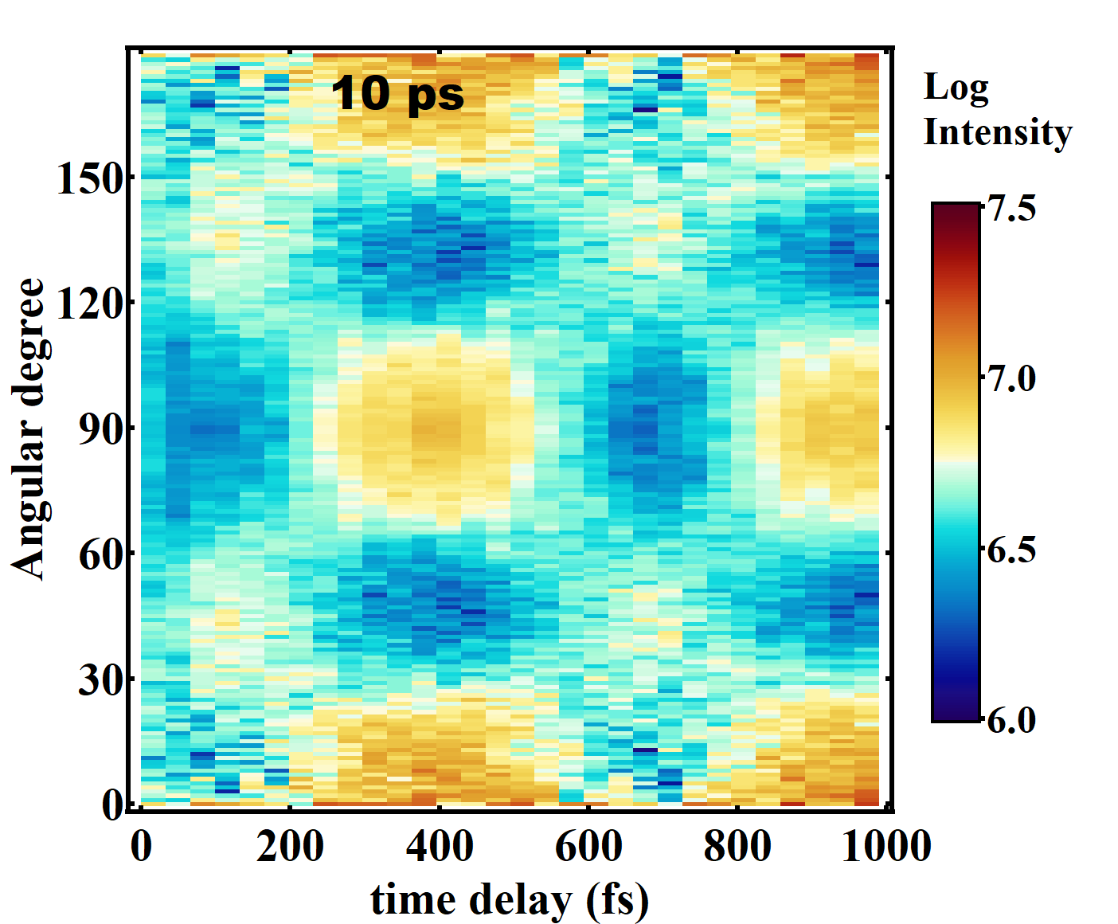
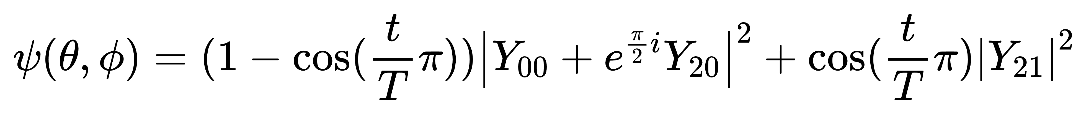
summary
fitting
Fitting：
Model:

Slide 15
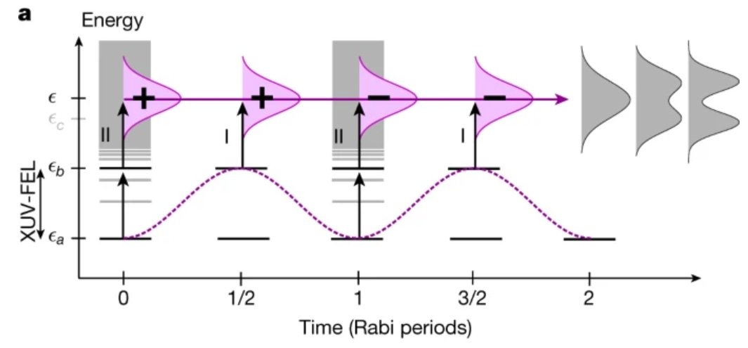
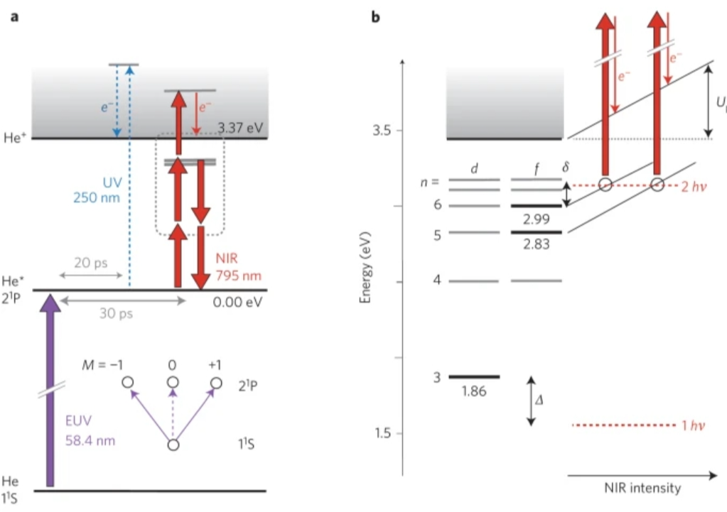
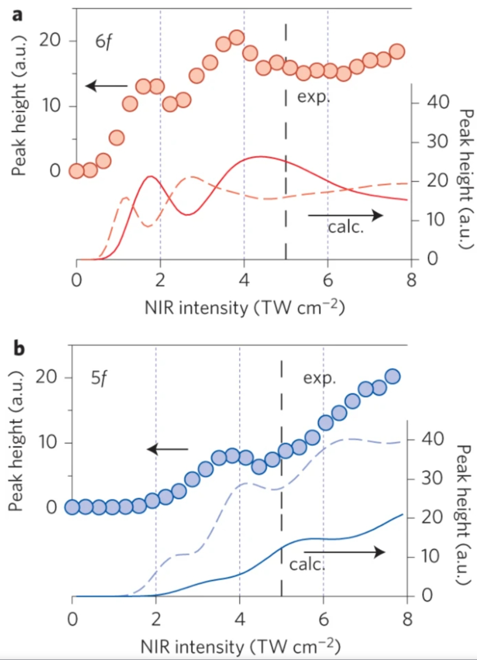
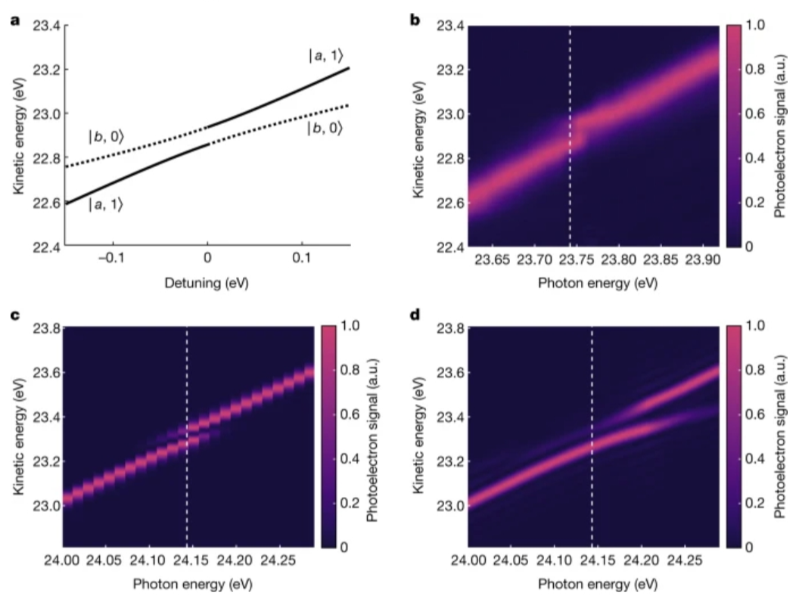
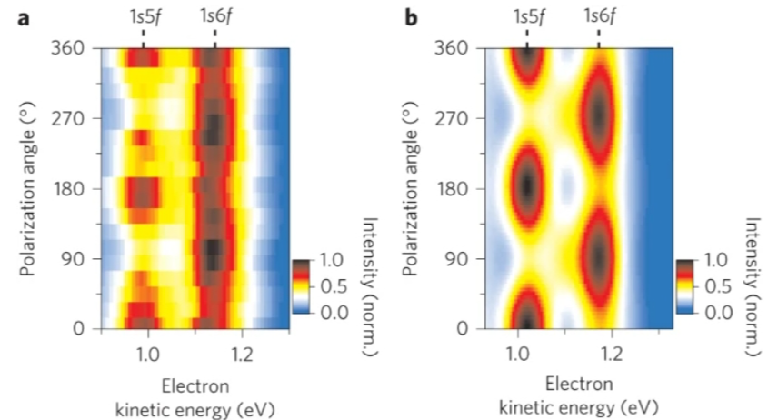
Rabi oscillation
Nature Photonics 10, 102 (2016)
Nature 608, 488 (2022)

Slide 16
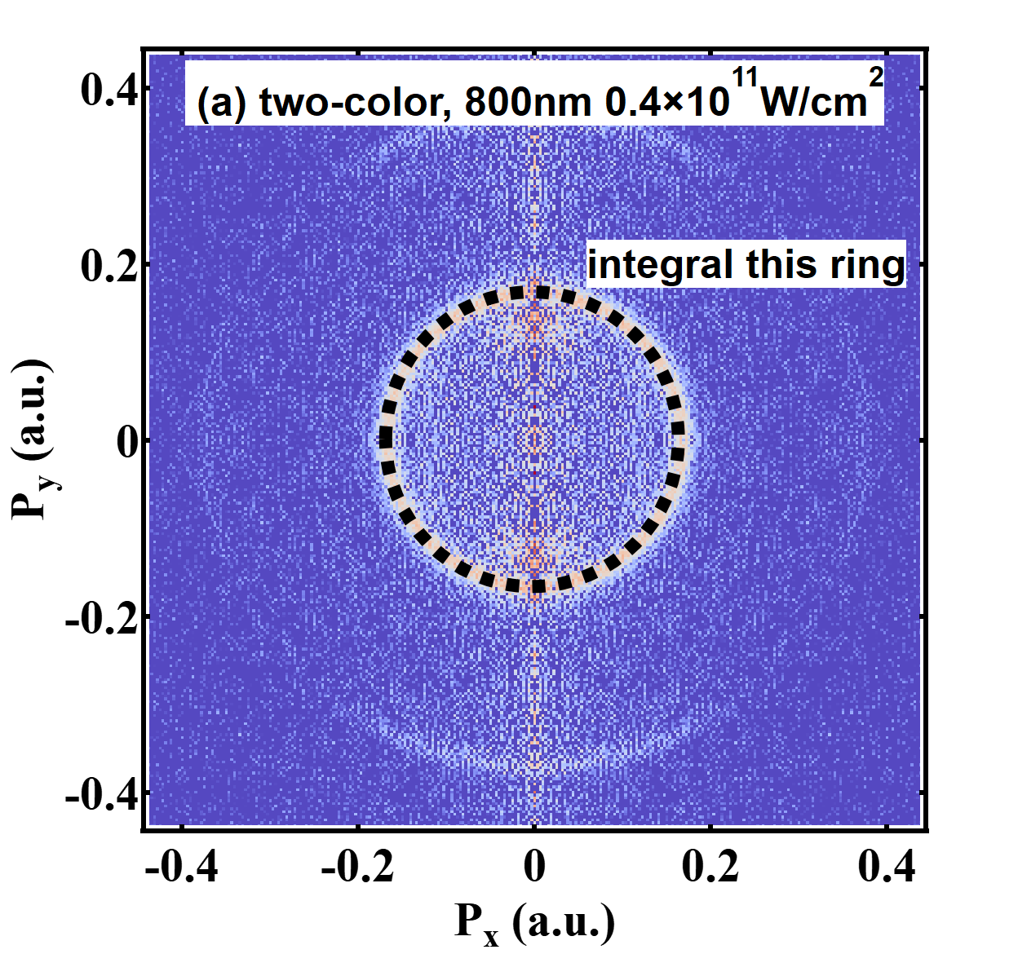





Rabi oscillation
400nm 3.5mW change power of 800nm 0.75 to 10mW step size 0.25mW

Slide 17


Rabi oscillation
sin²($\frac{Ω}{2}t0$)

Slide 18


Angular distribution

Slide 19



Angular distribution

Slide 20





Very weak field
The 800nm laser intensity in this group of experiment is quite weak thus single ionization process can not be obtained, and the imaging is fully originated from the 400nm + 800nm process.

Slide 21


No oscillation

Slide 22




Angular distribution
(a)
(b)
(c)
(d)

Slide 23



Angular distribution
(a)
(b)
(c)
(d)

Slide 24
Conclusions and Outlooks
spin-orbit effect can modify angular distribution of photoelectrons and leads additional peaks
observation of spin-orbit dynamics on hundreds femtoseconds time scale and exchange of partial waves
indication of Rabi oscillations and complicated partial wave evolutions
more theoretical calculations are needed!!!

Slide 25








Our team
Dajun Ding
Chuncheng Wang
Sizuo Luo
Xiaokai Li
Lanhai He
Helong Li
Pan Ma
Wankai Li
Thank you
for your attention!
Collaboration
Xuanyang Lai
APM
Financial supports:
National Key R&D Program of China.
National Natural Science Foundation of China, Key Program
Starting grant from Jilin University

