Slide 1
Nuclear hyperfine mixing and
laser-nuclear physics
Xu WANG （王旭）
Graduate School, China Academy of Engineering Physics,
Beijing

Slide 2
Nuclear hyperfine mixing (NHM) effect
Mixing of nuclear levels due to hyperfine (electromagnetic) interaction between the electron and the nucleus
Earliest paper (in Russian):
V. L. Lyuboshits, V. A. Onishchuk, and M. I. Podgoretskii,
Some interference effects due to the mixing of quantum levels by
external fields, Sov. J. Nucl. Phys. 3, 420 (1966)
Also called “nuclear spin mixing in hyperfine fields”
Most significant in highly charged ions: H-like, Li-like, B-like, …

Slide 3
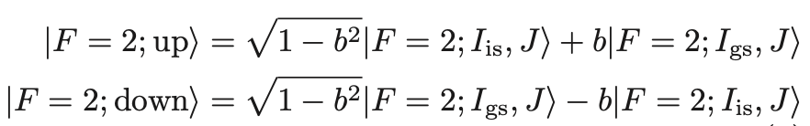
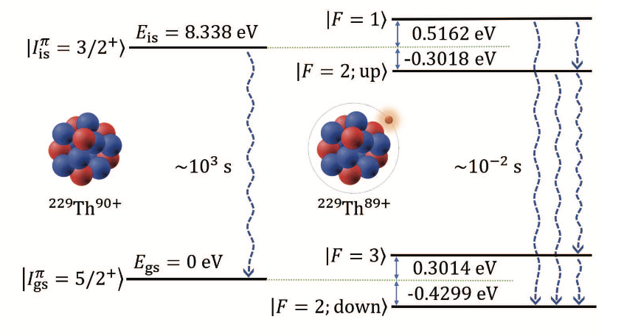




²²⁹Th⁸⁹⁺ : Nuclear hyperfine mixing (NHM) effect
$$b≈0.03$$
$$D→D+bμ_{e}$$
$D\sim$10⁻⁷ a.u.
$bμ_{e}\sim$10⁻⁴ a.u.
Th⁹⁰⁺ (bare nucleus)
Th⁸⁹⁺
V. M. Shabaev et al., Phys. Rev. Lett. 128, 043001 (2022)

Slide 4
²²⁹Th⁸⁹⁺
²⁰⁵Pb⁷⁷⁺
Nuclear
states
Electronic
states
Nuclear
states
Electronic
states
1/2⁻
2p_{3/2}
2.329
keV
2.356
keV
3/2⁺
5/2⁺
1s_{1/2}
5/2⁻
2p_{1/2}
With suitable electronic states, NHM effects can also be significant in nuclei with much higher energies.
W. Wang and XW, Phys. Rev. Lett. 133, 032501 (2024)

Slide 5
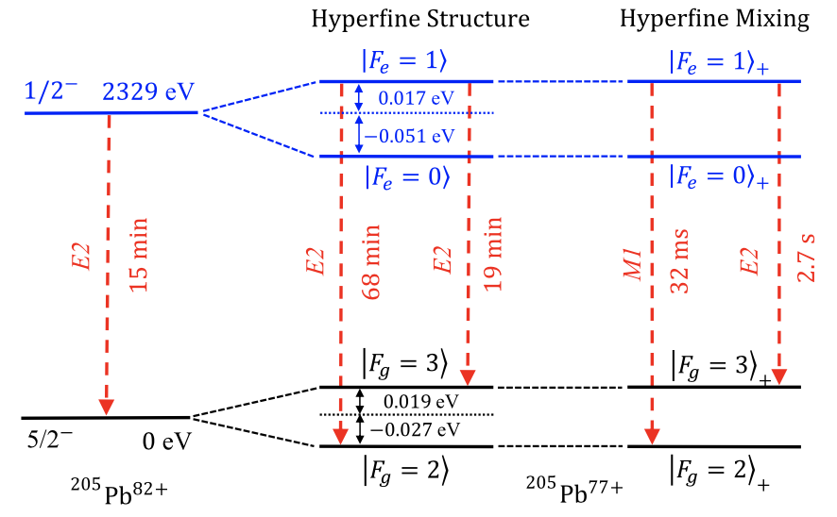
²⁰⁵Pb⁷⁷⁺
15 min → 32 ms
Opening of a new M1 channel
W. Wang and XW, Phys. Rev. Lett. 133, 032501 (2024)

Slide 6
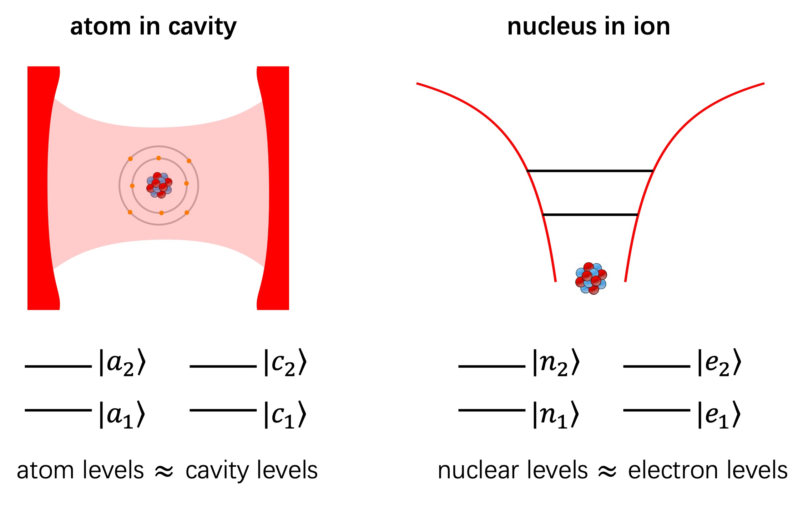
Ion is like a “resonator” for the nucleus!

Slide 7



NHM effect greatly enhances light-nucleus interaction:
$$D→D+bμ_{e}$$
$D\sim$10⁻⁷ a.u.
for ²²⁹Th⁸⁹⁺
$bμ_{e}\sim$10⁻⁴ a.u.
Lifetime shortening of nuclear excited state:
enhanced vacuum field-nucleus interaction
External laser field:
enhanced laser-nucleus interaction
NHM effect is important for laser-nuclear physics!

Slide 8
Laser nuclear physics = laser + nuclear physics
～ 1 eV
～ 1 MeV
laser
nucleus

Slide 9
Laser nuclear physics = laser + nuclear physics
～ 1 eV
～ 1 eV
～ 1 MeV
atom
molecule
laser
nucleus
Quantum optics
Nonlinear optics
Ultracold atoms
Atomic clocks
Strong-field atomic physics
……

Slide 10

Laser nuclear physics = laser + nuclear physics
1 eV$→…→$1 MeV
～ 1 MeV
laser
nucleus
Petawatt intense lasers
X-ray free electron lasers
Synchrotron radiation
Laser Compton scattering sources
Nuclear quantum optics
Nuclear clocks
Nuclear energy storage
Nuclear lasers
……

Slide 11

Quantum optics $→→$ Nuclear quantum optics
1st excited state
⁵⁷Fe
14.4 keV
Ground state
14.4 keV: synchrotron radiation
Nuclear version of quantum optical phenomena
Quantum optics on the 10-keV order of magnitude

Slide 12
Quantum optics $→→$ Nuclear quantum optics
Superradiance and collective Lamb shift:
R. Röhlsberger et al., Science 328, 1248 (2010)
Electromagnetically induced transparency:
R. Röhlsberger et al., Nature 482, 199 (2012)
Coherent control of X-ray waveforms:
F. Vagizov et al., Nature 508, 80 (2014)
Slow light:
K. P. Heeg et al., Phys. Rev. Lett. 114, 203601 (2015)
Rabi oscillations:
J. Haber et al., Nat. Photon. 11, 720 (2017)

Slide 13

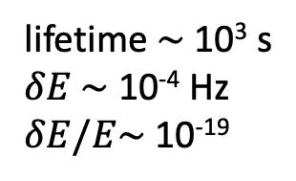
Atomic clocks $→→$ Nuclear clocks
1st excited state
²²⁹Th
Lowest known nuclear exited state
lifetime $\sim$ 10³ s
$δE \sim$ 10⁻⁴ Hz
$δE/E\sim$10⁻¹⁹
8.3 eV
Ground state
Proposal for nuclear clocks:
E. Peik and C. Tamm, Europhys. Lett. 61, 181 (2003)

Slide 14
Atomic clocks $→→$ Nuclear clocks
Direct measurement through internal conversion:
L. von der Wense et al., Nature 533, 47 (2016)
Hyperfine laser spectroscopy:
J. Thielking et al., Nature 556, 321 (2018)
Indirect optical excitation:
T. Masuda et al., Nature 573, 238 (2019)
Observation of radiative decay:
S. Kraemer et al., Nature 617, 706 (2023)
Direct optical excitation:
J. Tiedau et al., Phys. Rev. Lett. 132, 182501 (2024)
E. Elwell et al., Phys. Rev. Lett. 133, 013201 (2024)
C. Zhang et al., Nature 633, 63 (2024)

Slide 15

Strong-field atomic physics $→→$ Strong-field nuclear physics
Nobel 2018
10²³ W/cm²
CPA：chirped pulse amplification
D. Strickland and G. Mourou, Opt. Commun. 56, 219 (1985)

Slide 16
10²³ W/cm²
Strong-field atomic physics：
laser intensity ～ 1 atomic unit
3.5x10¹⁶ W/cm²
Highly nonlinear responses of atoms to the laser field

Slide 17
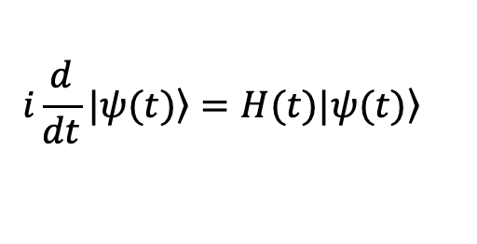





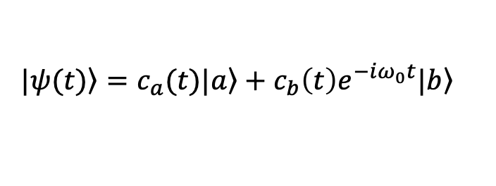

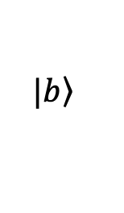


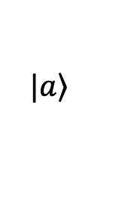


$$|\left.b\right\rangle$$
$$H_{I}\left(t\right)=−\vec{D}∙\vec{E}\left(t\right)=−\vec{D}∙{\vec{E}}_{0}f\left(t\right)\cos{ωt}$$
$∆E=ω_{0}=1$ a.u.
$$\left.|ψ(t)\right\rangle =c_{a}(t)|\left.a\right\rangle +c_{b}\left(t\right)e^{−iω_{0}t}|\left.b\right\rangle$$
$ℏω=0.2$ a.u.
$$|\left.a\right\rangle$$
$$i\frac{d}{dt}\left.|ψ(t)\right\rangle =H(t)\left.|ψ(t)\right\rangle$$
TDSE：
$$D_{ab}=D_{ba}=D$$
$$\dot{c_{a}}=−iDE_{0}f\left(t\right)\cos{ωt}e^{−iω_{0}t}{ c}_{b}$$
$D=1$ a.u.
$$⟹$$
$$\dot{c_{b}}=−iDE_{0}f\left(t\right)\cos{ωt}e^{+iω_{0}t}{ c}_{a}$$
Excitation probability:
$$P_{b}\left(t\right)={|c_{b}^{}(t)|}^{2}$$
Induced dipole moment:
$$D_{ind}\left(t\right)=D[c_{a}\left(t\right)c_{b}^{∗}\left(t\right)e^{iω_{0}t}+c.c.]$$

Slide 18



End-of-pulse excitation probability $P_{b}(t_{end})$
Highly nonlinear surges in excitation prob.
TDSE
$$P_{b}(t_{end})$$
perturbation theory
Laser intensity
(W/cm²)
$$η=DE_{0}/∆E$$
0.01
0.1
1.0

Slide 19

Induced dipole moment:
Source of radiation
$$D_{ind}\left(t\right)=D[c_{a}\left(t\right)c_{b}^{∗}\left(t\right)e^{iω_{0}t}+c.c.]$$
10¹¹ W/cm²
10¹³ W/cm²
10¹⁵ W/cm²
10¹⁶ W/cm²
Fourier transform
High harmonic generation

Slide 20
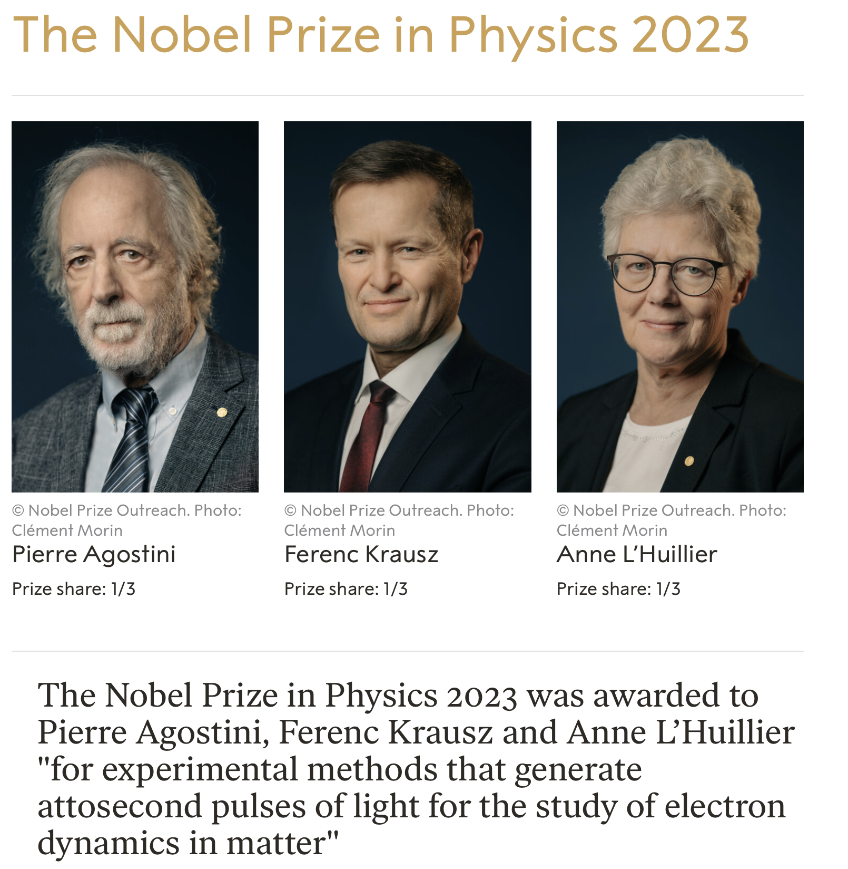
Attosecond
pulses

Slide 21
10²³ W/cm²
Strong-field nuclear physics?
Strong-field atomic physics：
laser intensity ～ 1 atomic unit
3.5x10¹⁶ W/cm²
Highly nonlinear responses of nuclei to the laser field?

Slide 22


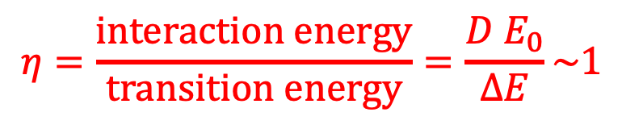
$$η=\frac{interaction energy}{transition energy}=\frac{D{ E}_{0}}{∆E}\sim 1$$
$$∆E$$
Usually for nuclei: $η≪1$ Nonlinear responses not anticipated
For intense laser + ²²⁹Th⁸⁹⁺ : $η\sim 1$ with contemporary intense lasers
$∆E$ minimized & $D$ maximized via nuclear hyperfine mixing
For ²²⁹Th: $∆E$ = 8.3 eV

Slide 23
²²⁹Th⁸⁹⁺ : NHM effect
$$b≈0.03$$
$$D→D+bμ_{e}$$
$D\sim$10⁻⁷ a.u.
$bμ_{e}\sim$10⁻⁴ a.u.
Th⁹⁰⁺ (bare nucleus)
Th⁸⁹⁺
V. M. Shabaev et al., Phys. Rev. Lett. 128, 043001 (2022)

Slide 24
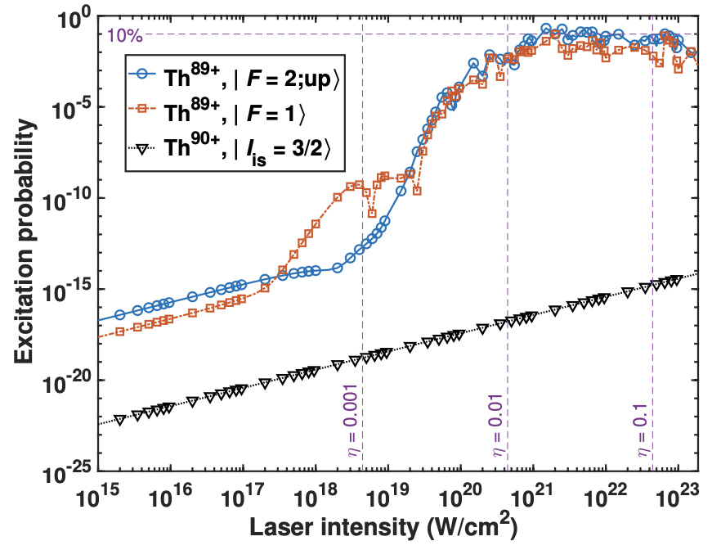
Highly efficient nuclear excitation: excitation prob. ～ 10%
Th⁸⁹⁺
Th⁹⁰⁺
H. Zhang, T. Li, and XW, Phys. Rev. Lett. in press

Slide 25
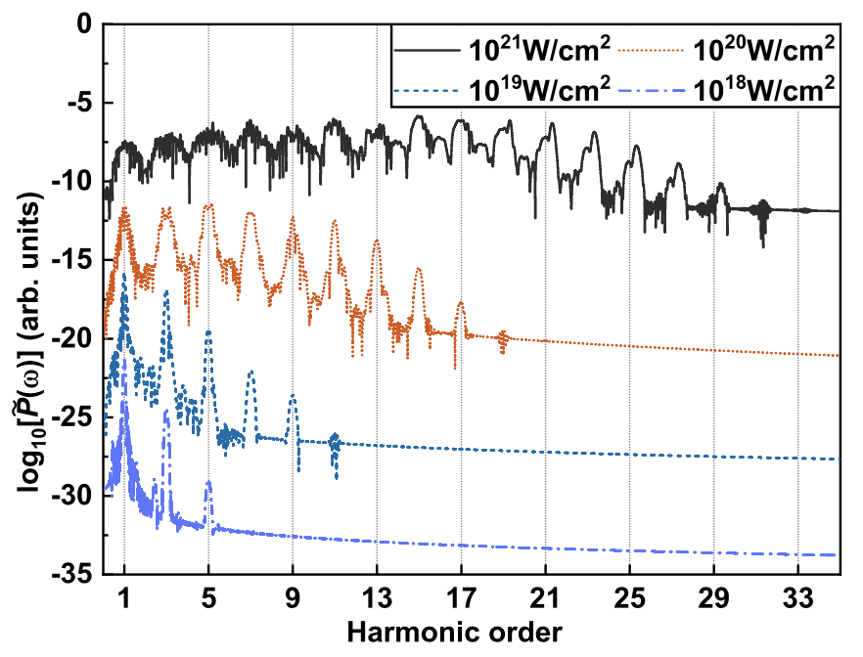
High harmonic generation
H. Zhang, T. Li, and XW, Phys. Rev. Lett. in press

Slide 26
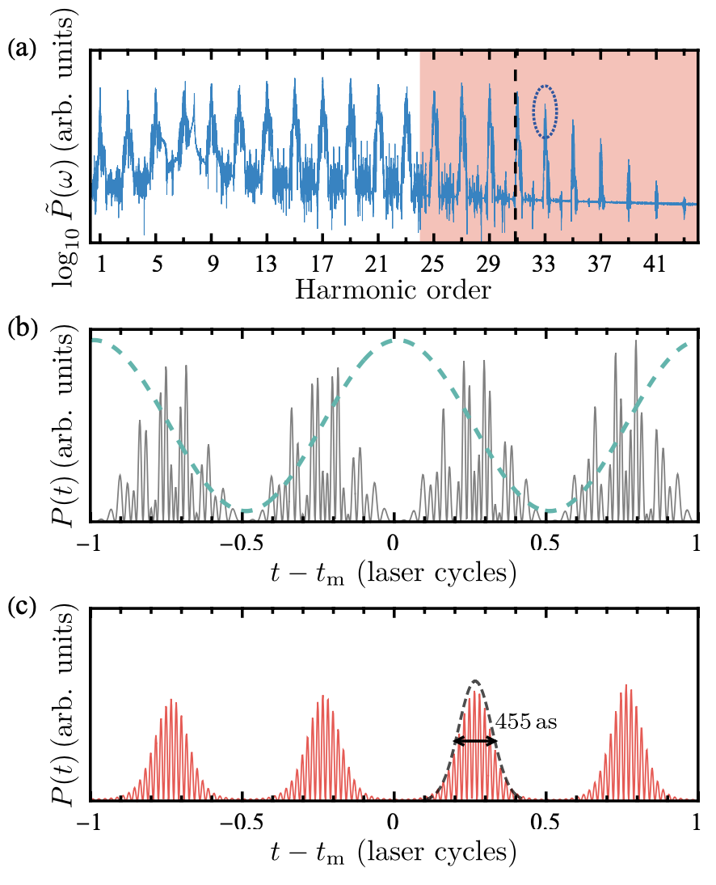
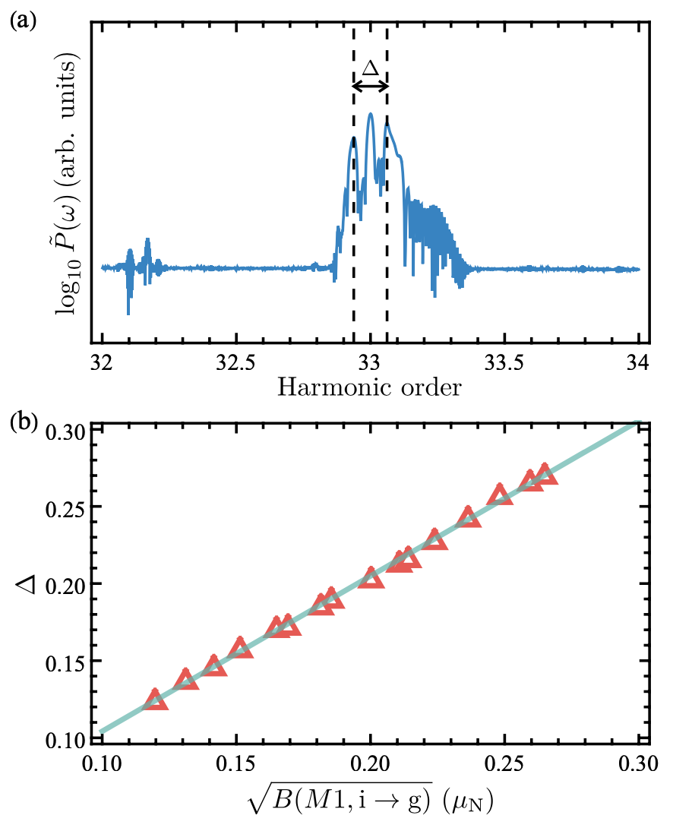
Attosecond pulses
Decoding nuclear information
Towards nuclear high harmonic spectroscopy
T. Li, H. Zhang, and XW, in preparation

Slide 27
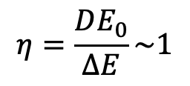

Summary:
Nuclear hyperfine mixing effect:
greatly enhancing light-nucleus interaction
The emerging field of laser-nuclear physics:
$$D→D+bμ_{e}$$
Quantum optics → Nuclear quantum optics
Atomic clocks → Nuclear clocks
Strong-field atomic physics → Strong-field nuclear physics
Highly nonlinear responses of nuclei to intense laser fields
$$η=\frac{DE_{0}}{∆E}\sim 1$$
Intense laser + ²²⁹Th⁸⁹⁺
Highly efficient nuclear excitation
High harmonic generation

Slide 28
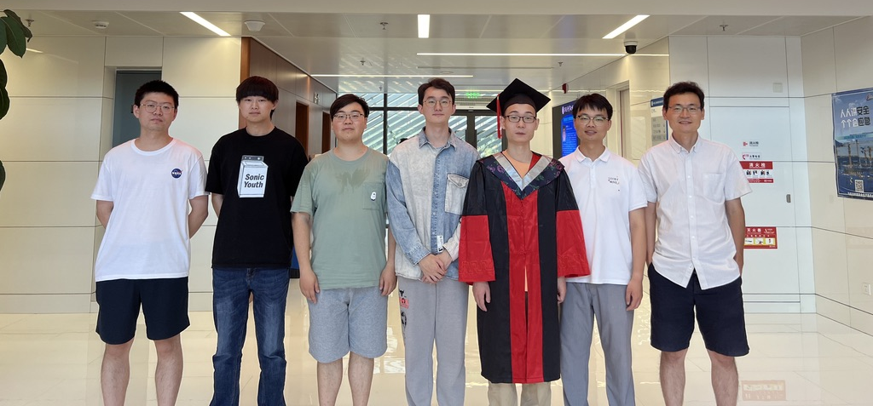
Hanxu ZHANG
Tao LI
Wu WANG

