Slide 1
Neutral-current Background Induced by Atmospheric Neutrinos in Large Liquid Scintillator Detectors
Jie Cheng (程捷)
North China Electric Power University (NCEPU)
2024/9/26
chengjie@ncepu.edu.cn

Slide 2
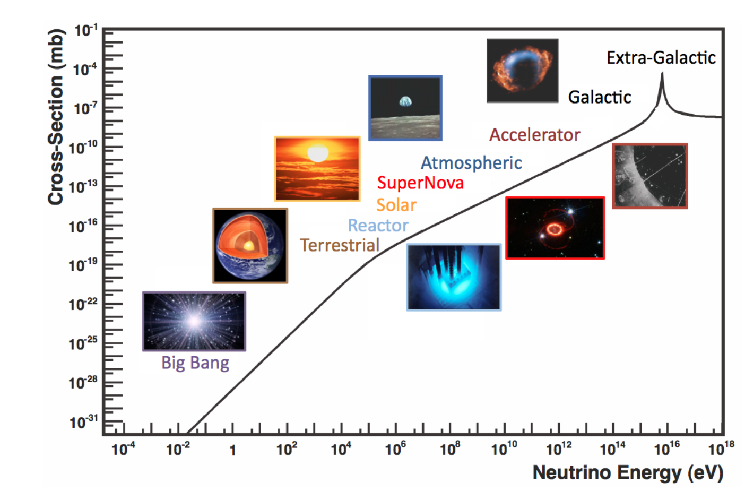
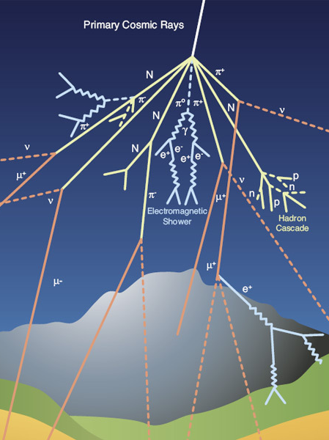
Atmospheric Neutrinos
Formaggio & Zeller, Rev. Mod. Phys. 84, 1307 (2012)
Atmospheric neutrinos: dominant in GeV region
Signals for neutrino oscillation: $θ_{23}$, $∆m_{31}^{2}$, Mass ordering, CP phase
Background to rare event searches: diffuse supernova neutrino background (DSNB), proton decay, dark matter, etc.
©cern

Slide 3
Atmospheric Neutrinos
Formaggio & Zeller, Rev. Mod. Phys. 84, 1307 (2012)
Neutrino can be observed via the detection of neutrino interaction in the detector
As the energy increases, the reaction channels are more complicated
The final state neutron multiplicity, pion production, and kinematics are very important distinctions
Neutrino energy range | Important Reaction channels
0 - 1 MeV | e elastic scattering (eES)
1 - 100 MeV | Inverse beta decay (IBD)
0.1 – 20 GeV | Neutral-current (NC), Charge-current (CC)
Atmospheric neutrinos: dominant in GeV region
Signals for neutrino oscillation: $θ_{23}$, $∆m_{31}^{2}$, Mass ordering, CP phase
Background to rare event searches: diffuse supernova neutrino background (DSNB), proton decay, dark matter, etc.

Slide 4
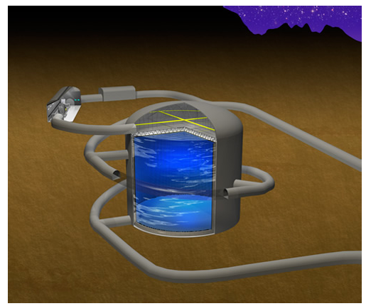
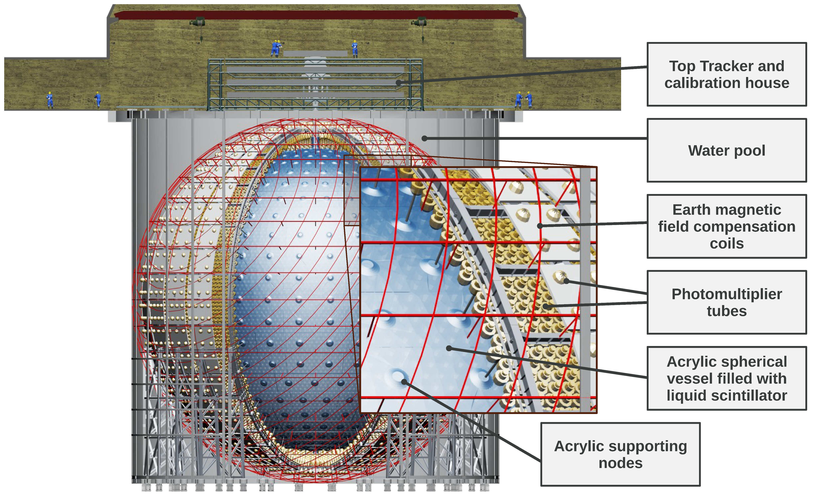
Next-generation Neutrino Detectors
Hyper-Kamiokande
Water detector
Target: ¹⁶O and H
DUNE
Liquid argon time-projection chamber detector
Main targets: Ar
JUNO
Liquid Scintillator (LS)
Main targets: ¹²C and H
Take the JUNO detector for example

Slide 5
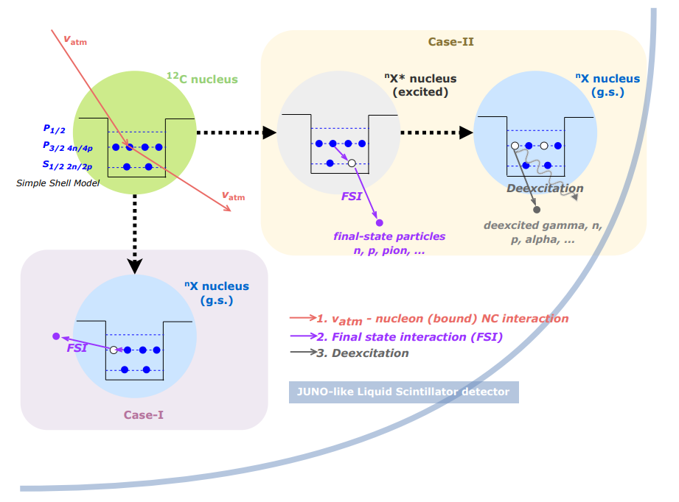
Methodology for Atm-$ν$ and ¹²C Interaction Prediction
Cheng et al, Phys. Rev. D 103. 05001 (2021)
Cheng et al, arXiv 2404.07429

Slide 6
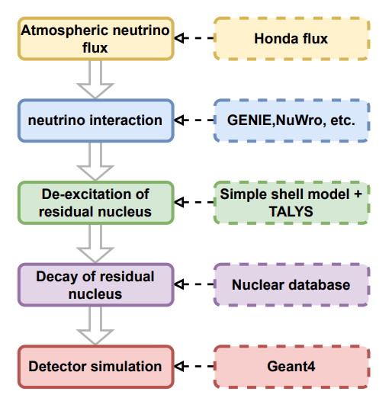
Methodology for Atm-$ν$ and ¹²C Interaction Prediction
Cheng et al, Phys. Rev. D 103. 05001 (2021)
Cheng et al, arXiv 2404.07429
$$N_{det}= φ ⨂{ }P ⨂{ σ} ⨂{ ε}$$
Atm-$ν$ measurement
Detector efficiency
Neutrino flux
Oscillation probability
Cross section
of $v_{x}+12C$

Slide 7
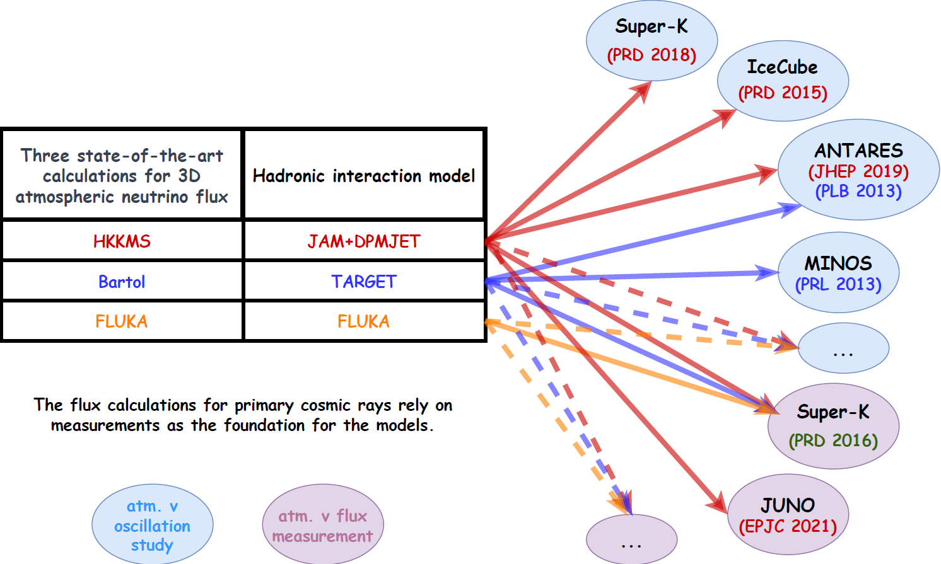
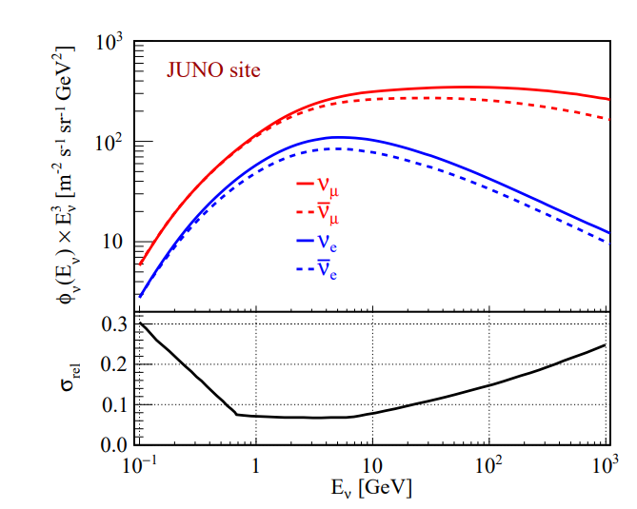
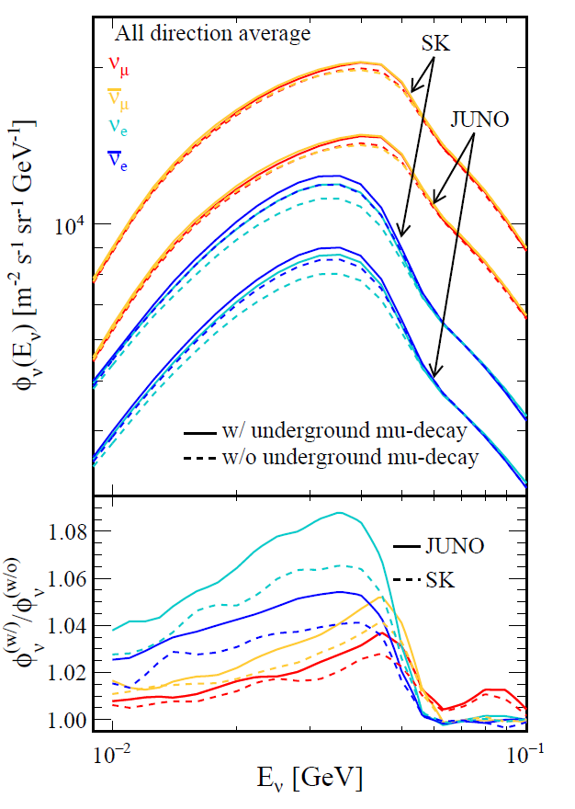
Atmospheric Neutrino: Flux
Phys. Rev. D 103 (2021) 5, 053001
JUNO site
Preliminary
Curtesy of the Honda Group
Jie Cheng@WANP2022
Sato Kazufumi@Neutrino2022
HKKMS atmospheric neutrino flux model for JUNO
Flux calculation developed from 10 MeV to 100GeV

Slide 8
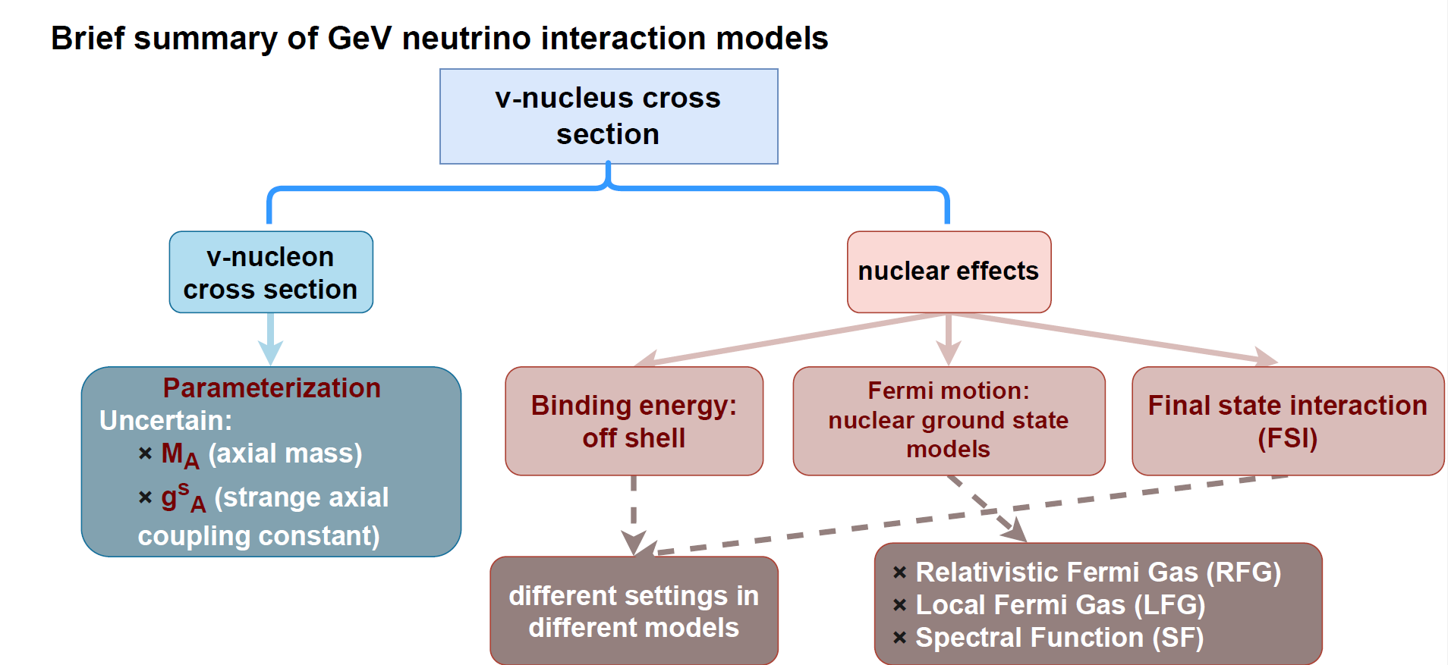
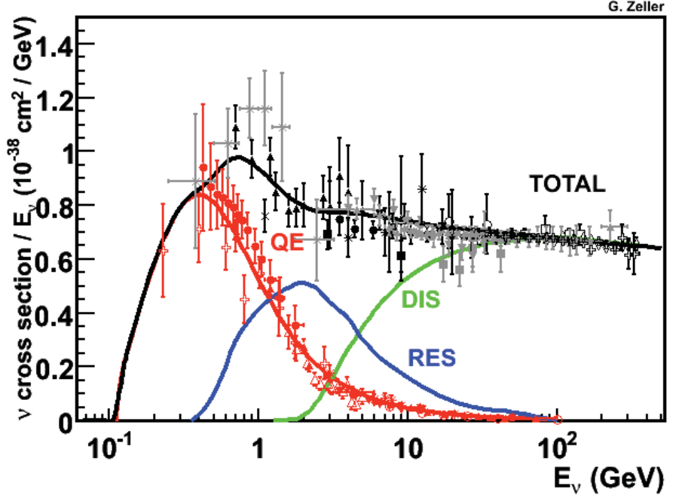
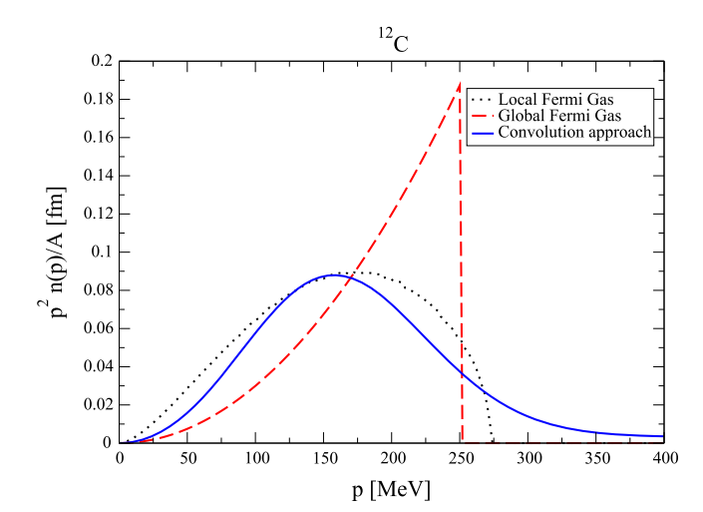
GeV Neutrino Interaction Models
[Rev. Mod. Phys. 84 (2012)]
Nucleon momentum distribution in the ground state of ¹²C in the RFG, LFG, and SF models.
GeV neutrino interaction is model dependent! Existing generators: GENIE, NuWro, GiBUU, NEUT, etc.
According to the above understanding of neutrino interaction, have preformed the systematic study of atmospheric neutrino interaction prediction

Slide 9
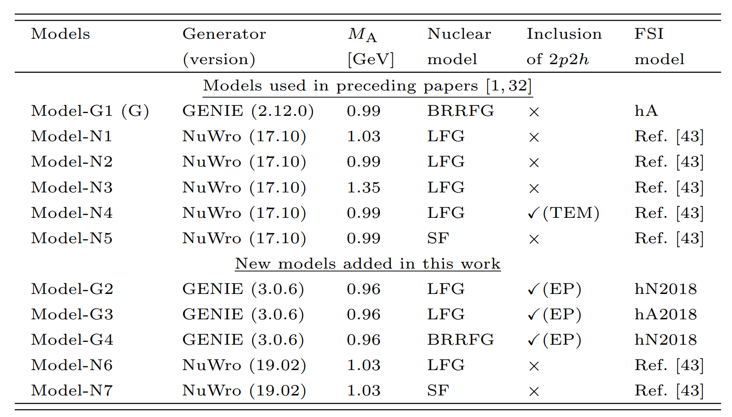
Neutrino Generator Models
Summary of the main features of models used in early and recent stages
BRRFG: relativistic Fermi gas model with “Bodek-Ritchie” modifications
LFG: local Fermi gas model
SF: spectral function
0.99 GeV: deuterium measurements
1.35 GeV: MiniBooNE neutrino QE data
TEM: Transverse Enhancement model for 2p2h
EP: Empirical model for 2p2h
Ref.[43]: Phys. Rev. D 79, 053003 (2009)
for QE

Slide 10
Neutrino Generator Models
Summary of the main features of models used in early and recent stages
for QE
Validated with MINERvA data
https://zenodo.org/records/6774990
Investigate the impact of different generators, nuclear model, FSI models on the NC bkg prediction
All processes are included, new models primarily focus on variations related to QE and do not fully explore variations related to RES, COH, and DIS
Plan to include GiBUU and NEUT in our calculation

Slide 11
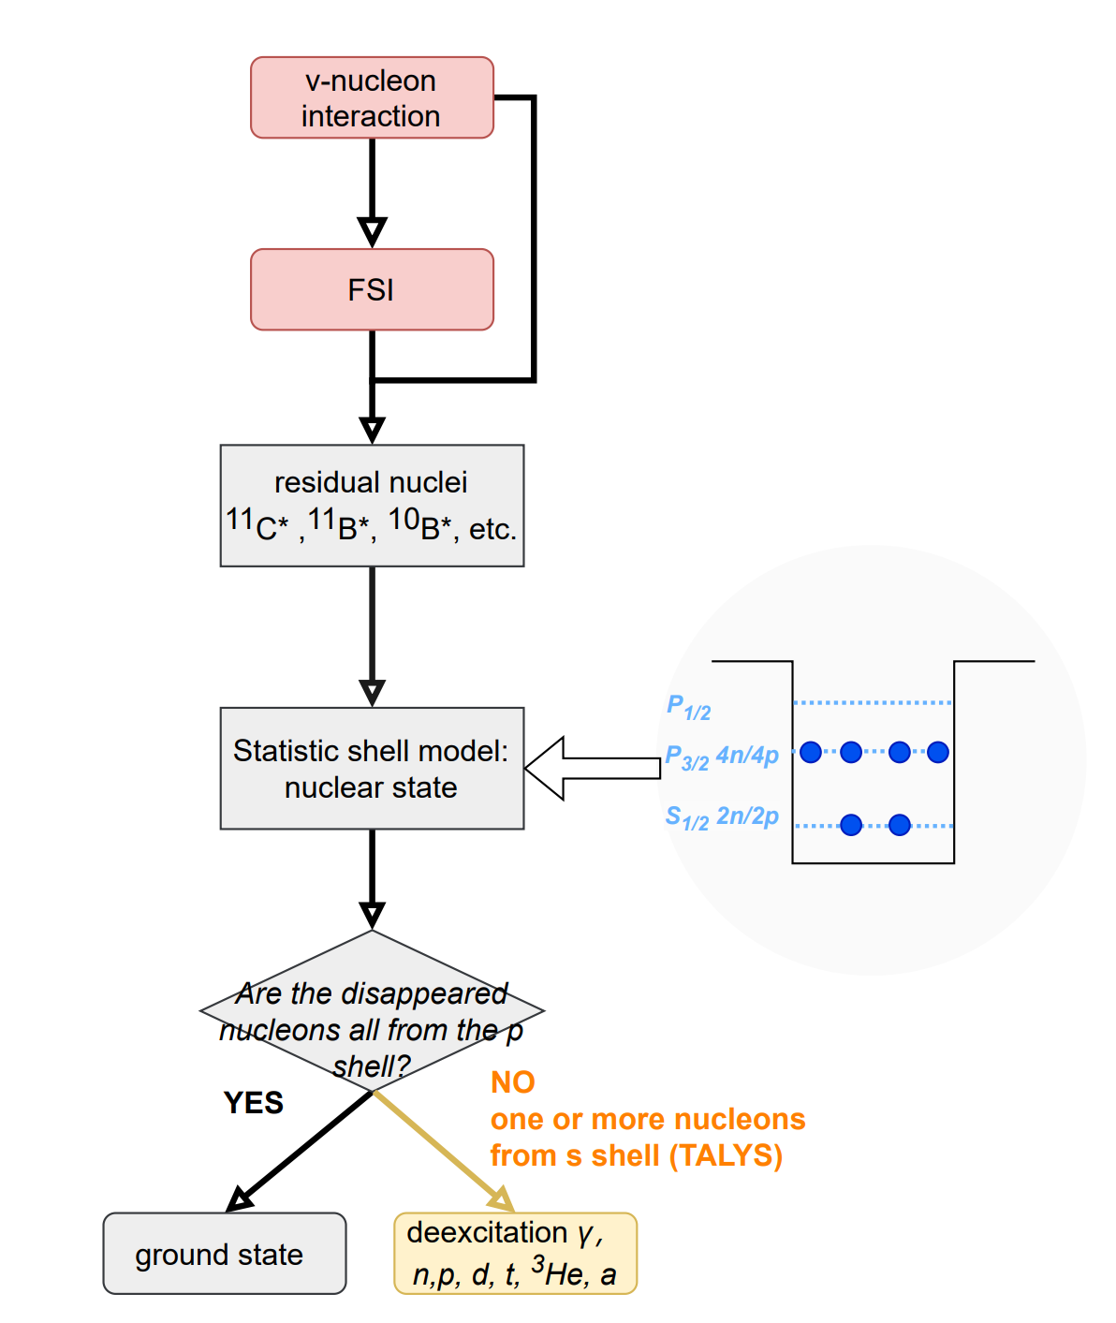
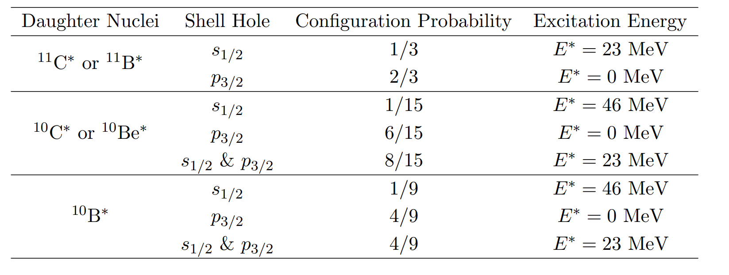
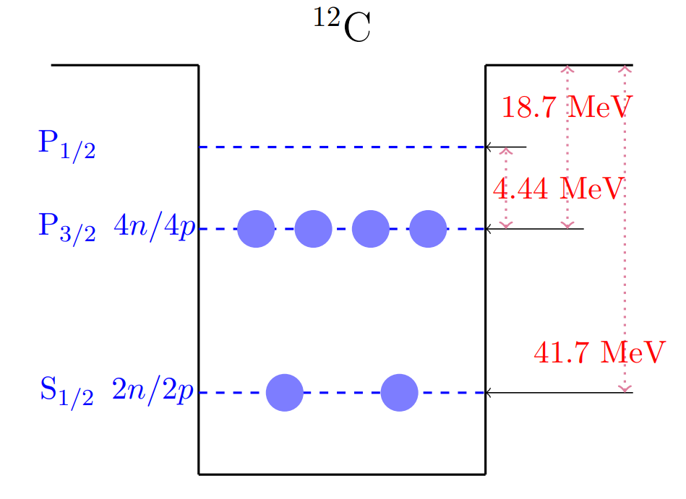
TALYS-based Deexcitation Model of Residual Nucleus
Simple shell model → Status of the residual nuclei
Phys. Rev. D 67 (2003) 076007
All residual nuclei with A>5 have been considered
Taking ¹¹C*, ¹¹B*, ¹⁰C*, ¹⁰Be* and ¹⁰B* for example
Assume each neutron or proton has same possibility(1/6) to leave the shell.

Slide 12
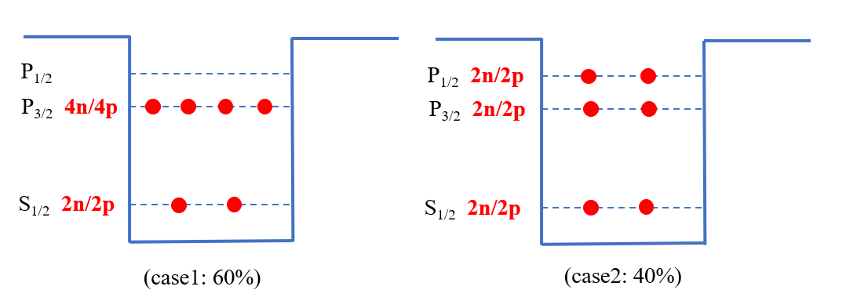
TALYS-based Deexcitation Model of Residual Nucleus
Simple shell model → Status of the residual nuclei
Phys. Rev. D 67 (2003) 076007
Go beyond simple shell model
considering the correlation between P shell (P_{1/2} and P_{3/2})
will be implemented
Assume each neutron or proton has same possibility(1/6) to leave the shell.
e.g, a neutron as well as a proton disappearance (nucleus: ¹¹C, ¹¹B):
Shell | State
S_{1/2} | $E^{∗}=23 MeV$
P_{3/2} | ground state
P_{1/2} | $E^{∗}=2 MeV$
33.3%
53.4%
13.3%

Slide 13
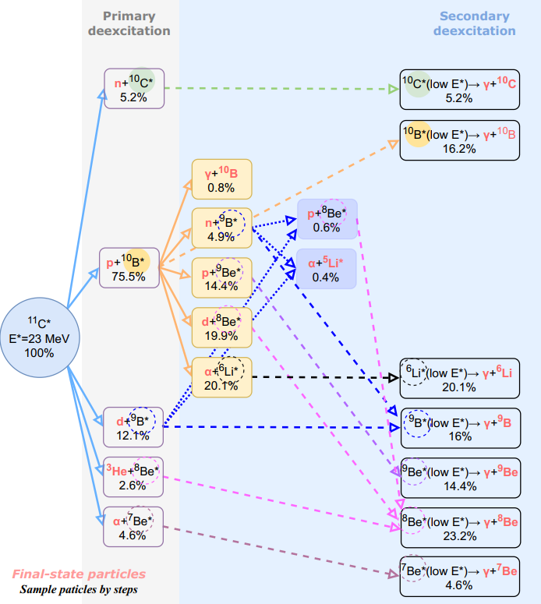
TALYS-based Deexcitation Model of Residual Nucleus
2. TALYS → Simulate residual nucleus at certain excited energy
http://www.talys.eu/home/
Taking the deexcitation chain of ¹¹C* with $E^{∗}$=23 MeV for example
TALYS also provides the energy spectra of the associated final-state particles

Slide 14
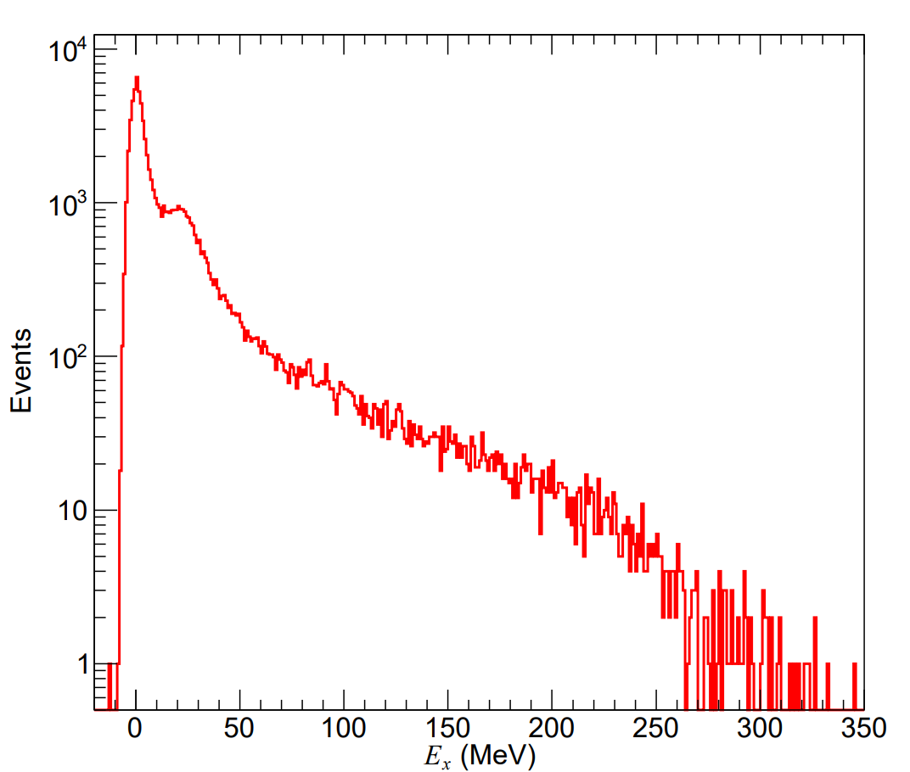
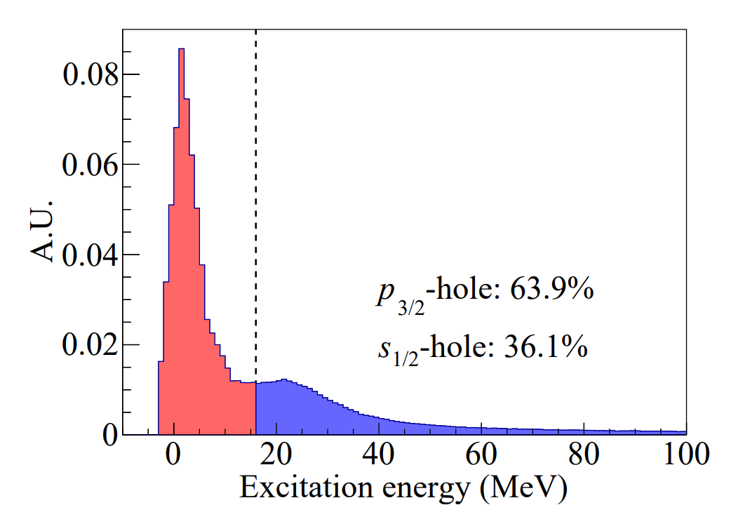
Other Publications for TALYS-based Deexcitation Model
Hu et al, Phys. Lett. B 831 (2022) 137183
Abe, Phys. Rev. D 109 (2024) 3, 036009
The differences from our method:
E* is estimated by (removal energy and separation energy) or (the invariant mass and ground-state mass of the residual nuclei) v.s. the statistic models (our work)
Input of TALYS is the continuous excitation energy spectrum v.s. e.g., 23 MeV for ¹¹B* (our work)
Hu et al
Abe
Challenge for this method:
difficult to get E* of the residual nuclei with using other nuclear models, such as RFG, LFG in neutrino generators
Input of TALYS: E*>16 MeV
33%
Excitation energy E* distribution of ¹¹B* based on SF model
For more details, refer to the reports by Abe and Guo this morning

Slide 15
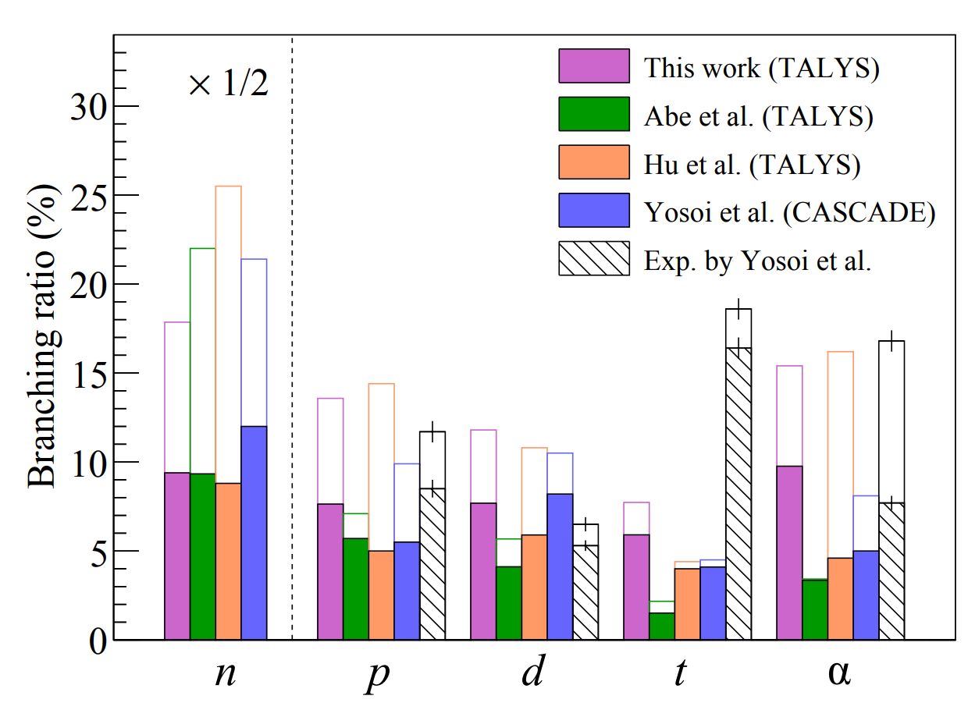
Comparison of Deexcitation Channels of ¹¹B*
Abe, Phys. Rev. D 109 (2024) 3, 036009
Hu et al, Phys. Lett. B 831 (2022) 137183
our work
Reaction ratio with neutron production: ~68% (our work)

Slide 16
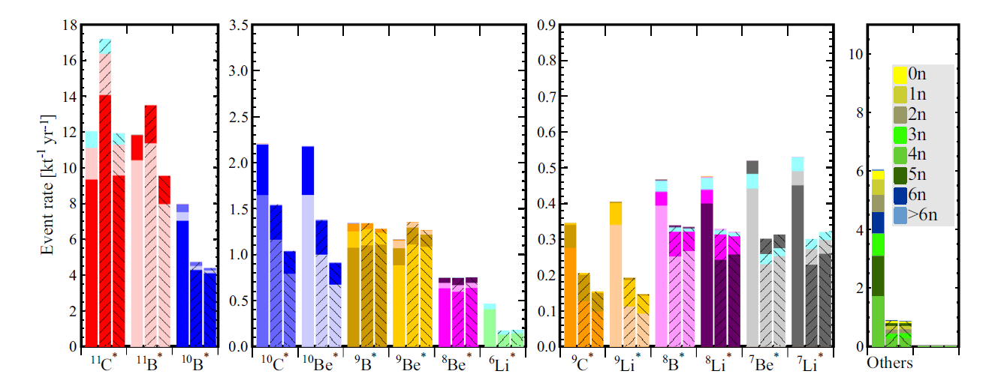
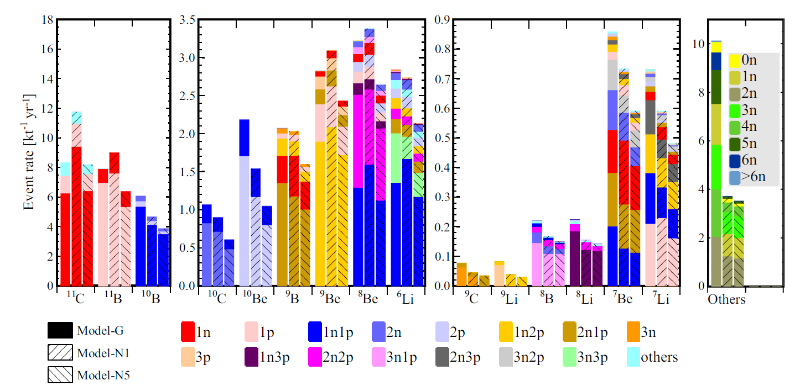
Impact of Deexcitation on Final-state Production of NC Events
Cheng et al, Phys. Rev. D 103. 05001 (2021)
Before deexcitation, ¹¹C, ¹¹B, ¹⁰B dominated
After deexcitation , ¹¹C, ¹¹B, ¹⁰B reduced, with more lighter nuclei
Exclusive final-state information, such as the neutron multiplicity, the charge pion multiplicity, the unstable nuclei, is important for tagging and reducing the background

Slide 17
Decay Modes of Residual Nuclei
Considering decay processes of unstable isotopes after de-excitation stage
 | Half time | Decay mode
$${}_{}^{8}{Li}$$ | 840.3 ms | $β^{−}$
$${}_{}^{9}{Li}$$ | 178.3 ms | ($β^{−}$,n)(50.8%) , $β^{−}$(49.2%)
$${}_{}^{7}{Be}$$ | 53.22 d | $ε$
$${}_{}^{8}{Be}$$ | 6.7X10⁻¹⁷ s | $α$
$${}_{}^{10}{Be}$$ | 1.39X10⁶ years | $β^{−}$
$${}_{}^{8}B$$ | 770 ms | $β^{−}$, $α$
$${}_{}^{9}B$$ | 800X10⁻²¹ s | p
 | Half time | Decay mode
$${}_{}^{9}C$$ | 126.5 ms | $β^{+}$(60%), $β^{+}$and p(23%) , $β^{+}$ and $α$ (17%)
$${}_{}^{10}C$$ | 19.29 s | $β^{+}$
$${}_{}^{11}C$$ | 20.334 min | $β^{+}$(99.79%), $ε$ (0.21%)
Liquid Scintillator
$$ν_{x}$$
$$ν_{x}$$
${}_{}^{6}{Li}$, ${}_{}^{7}{Li}$, ${}_{}^{9}{Be}$, ${}_{}^{10}B$, ${}_{}^{11}B$ and ${}_{}^{12}C$ : stable
neutron
$${}_{}^{12}C$$
Important for the background reduction and in situ measurement
${}_{}^{n}{X }$: residual nucleus with decay information

Slide 18
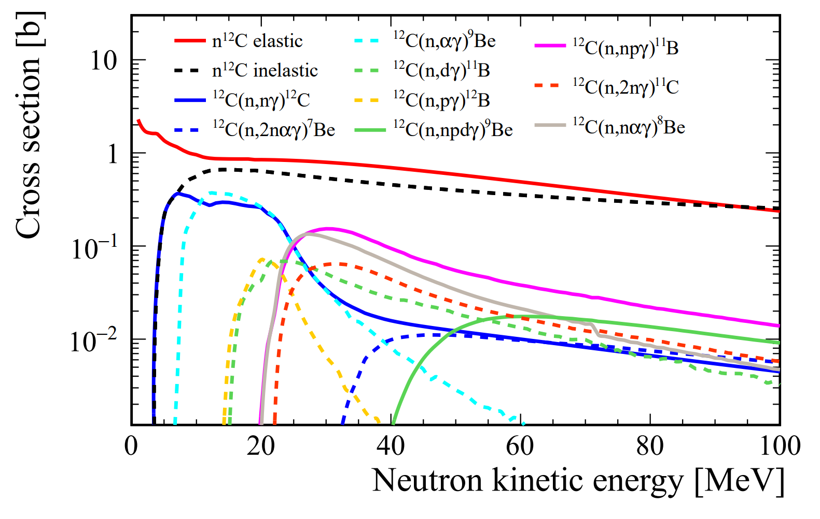
GEANT4-based Detector Simulation
Cheng et al., Eur. Phys. J. C (2024)
GEANT4 (4.10.p02)➔ simulate the propagation of final-state particles in LS
Hadronic models: QGSP_BERT_HP
JUNO detector as our reference
Include decay processes of unstable isotopes after deexciation stage
Secondary interactions (SI): final-state particles produced by a primary interaction, subsequently interact within the LS
Neutron tagging takes place after the SI
Tagged neutrons $≠$ final-state neutrons
Extracted from the results of TALYS

Slide 19
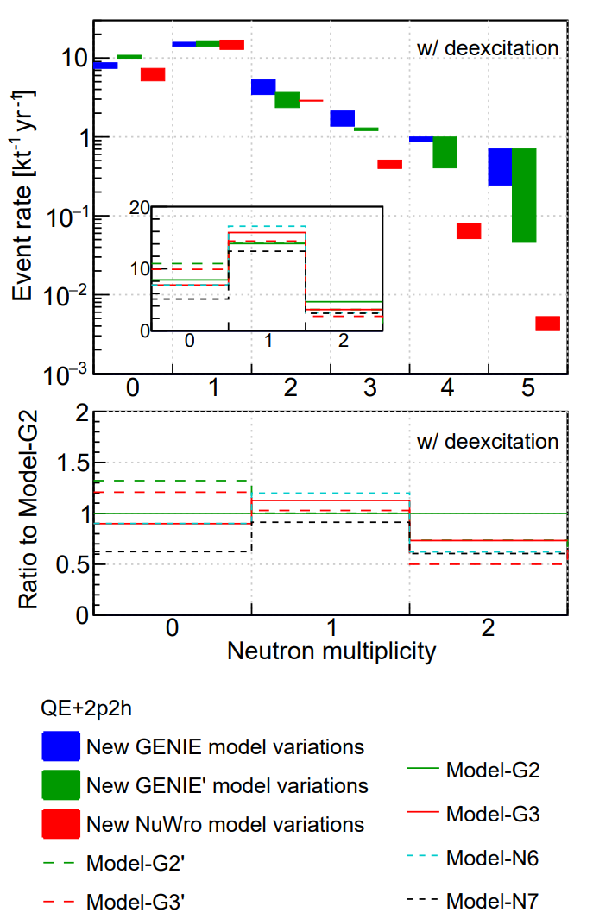
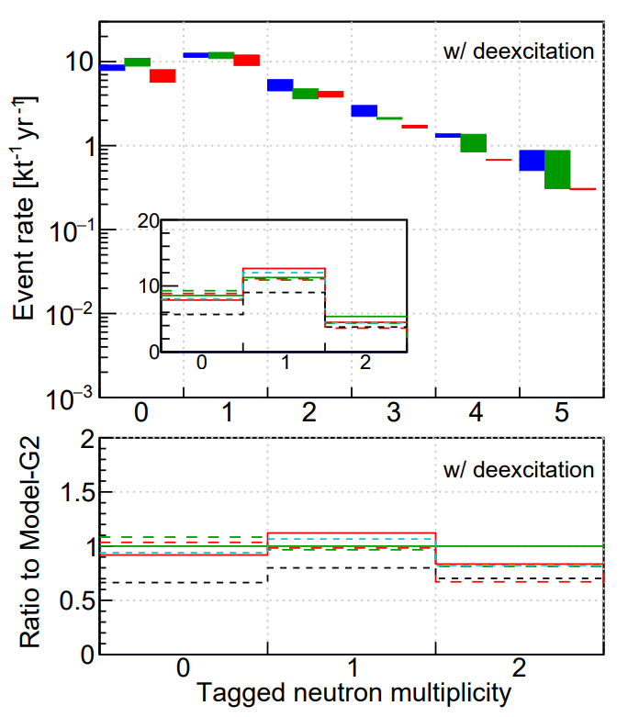
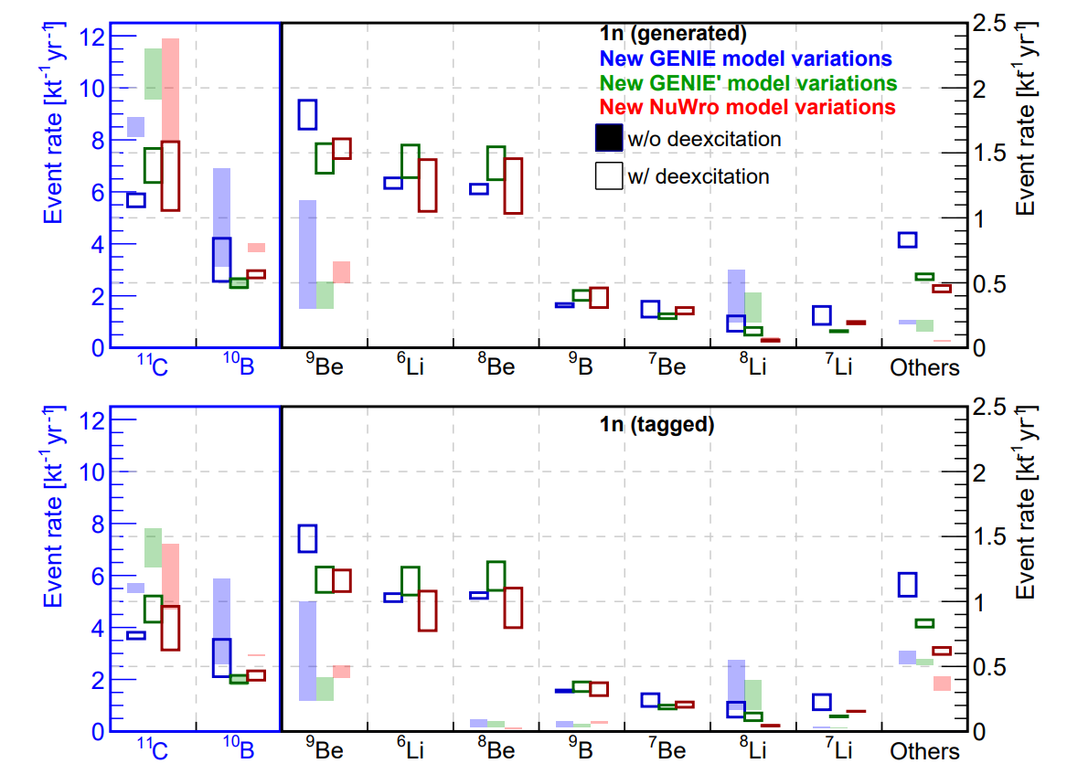
Comparisons
Cheng et al, arXiv 2404.07429
Final-state
Observed
Neutron multiplicity=1 decrease significantly from the final-state to observation due to the secondary interactions
After deexcitation process, ¹¹C, ¹⁰B reduced, with more lighter nuclei
¹¹C (one tagged neutron) significantly decreased due to the higher kinetic energies of fast neutron from NC with ¹¹C, making them more prone to inelastic scattering in LS

Slide 20
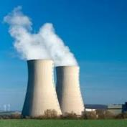
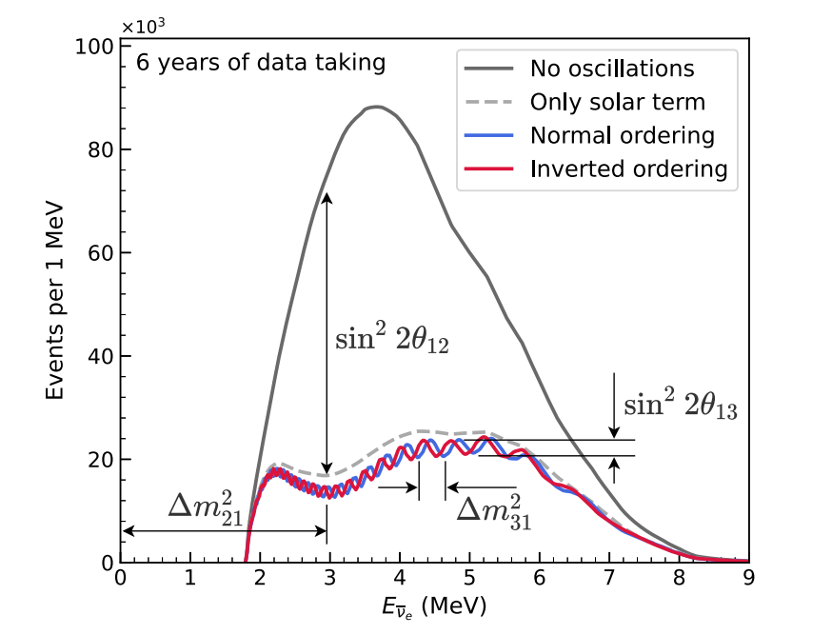
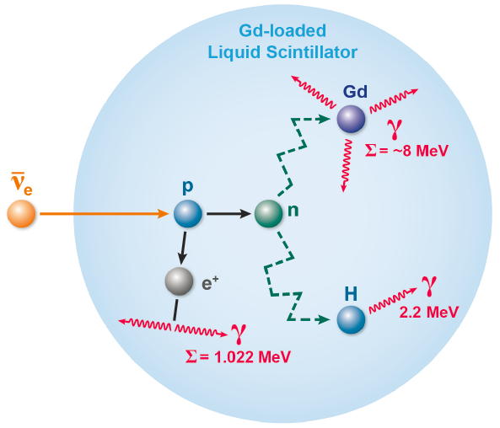
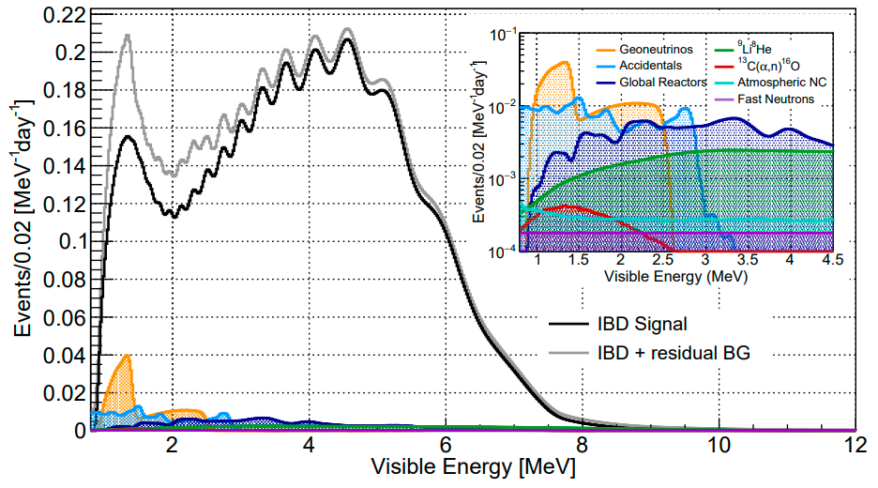
Reactor ${\overline{ν}}_{e}$
Neutrino oscillation & properties
Detection via inverse beta decay (IBD):
JUNO
JUNO, Chin. Phys. C 46 (2022) 12, 123001
Chin. Phys. C 46 (2022) 12, 123001
Expected signal and background:
200 μs
The double coincidence➔ suppression of background
Atmospheric NC➔ non-negligible background for precise measurement

Slide 21
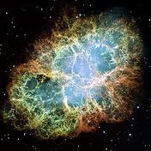
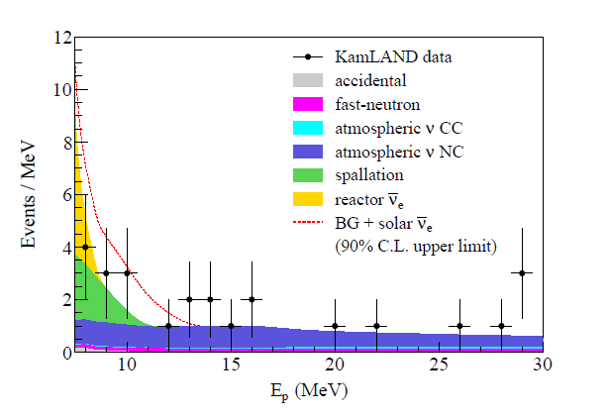
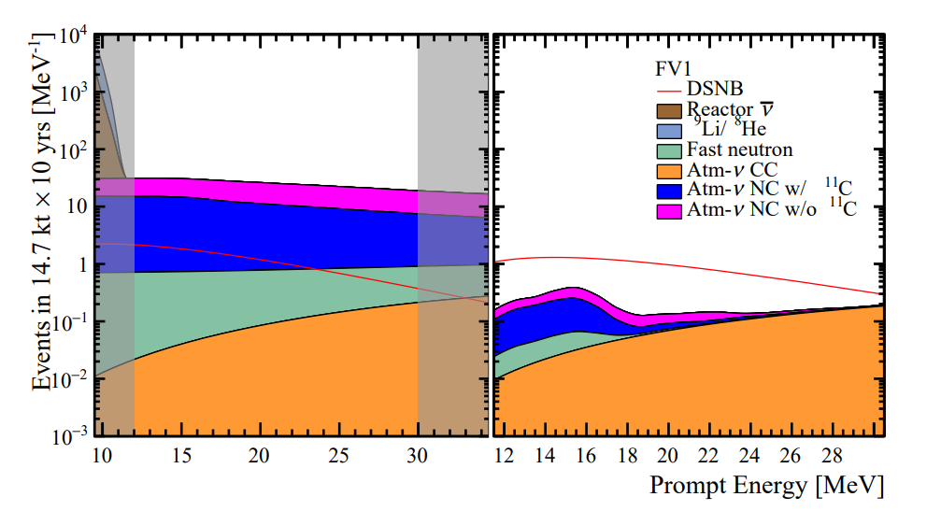
DSNB Research: Signal v.s. Background
Integrated flux of all past SNe:
cosmic star-information, average core-collapse neutrino spectrum, failed SNe rate, etc
DSNB primary detection via IBD
Astrophys.J.745:193,2012
JUNO, JCAP 10 (2022) 033
KamLAND, Astrophys.J.745:193,2012
Before background suppression
After background suppression
KamLAND: NC interactions of atm. neutrino with ¹²C in LS is the most significant source of the background in DSNB study.
JUNO: dominant background for DSNB is atm-$ν$ NC interactions
The key to detect DSNB in LS detector is the precise estimation of atm-$ν$ NC background

Slide 22
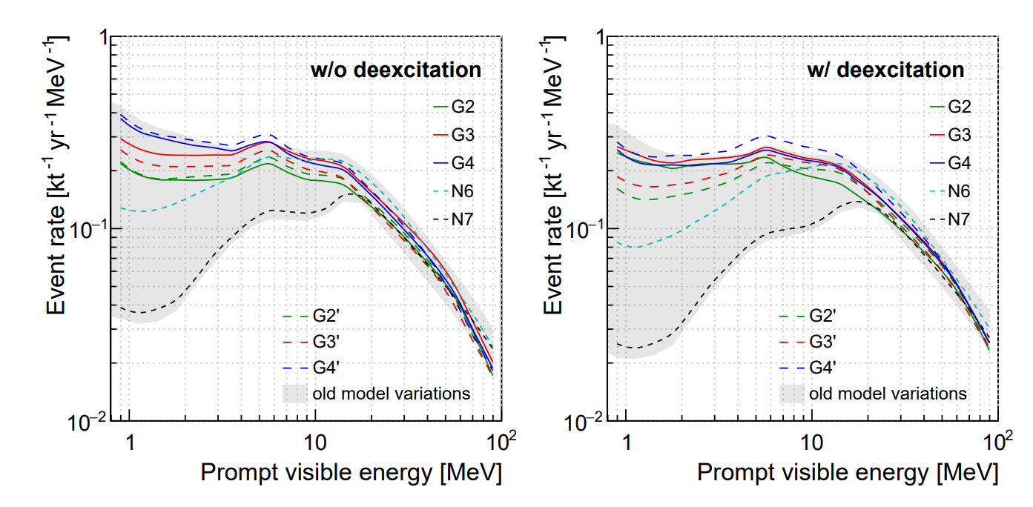
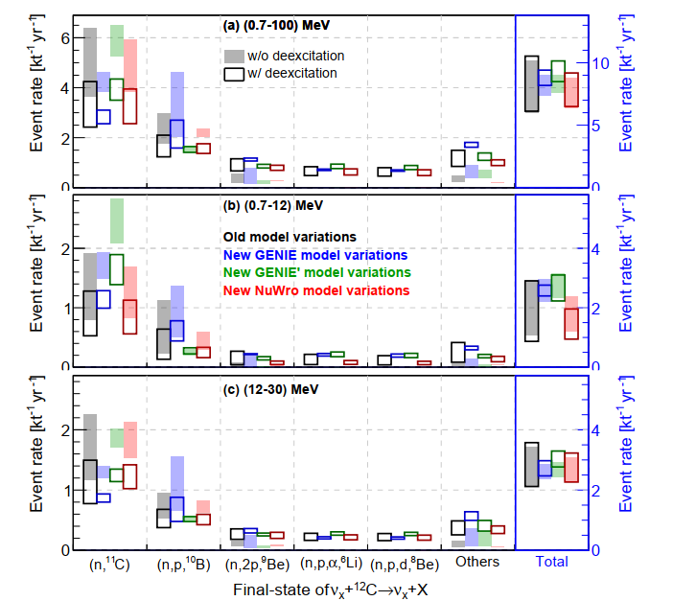
IBD-like NC Background
Cheng et al, arXiv 2404.07429
Reactor neutrino energy range
DSNB energy range
Focus on the prompt visible energy below 100 MeV
Large model variation in energy < 20 MeV, the model prediction lack sufficient experimental constraints.
With deexcitation,
energy spectra shift to higher energies and enlarge the model variations
dominant channels with ¹¹C and ¹⁰B reduce, and channels with lighter nuclei increase
The NC background rate with deexcitation as the nominal result
First detailed calculation of atm-v NC background in reactor neutrino energy range

Slide 23
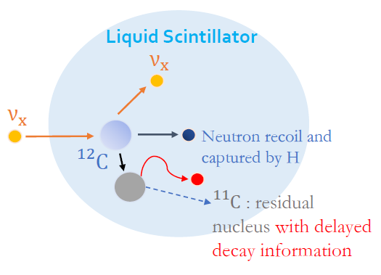
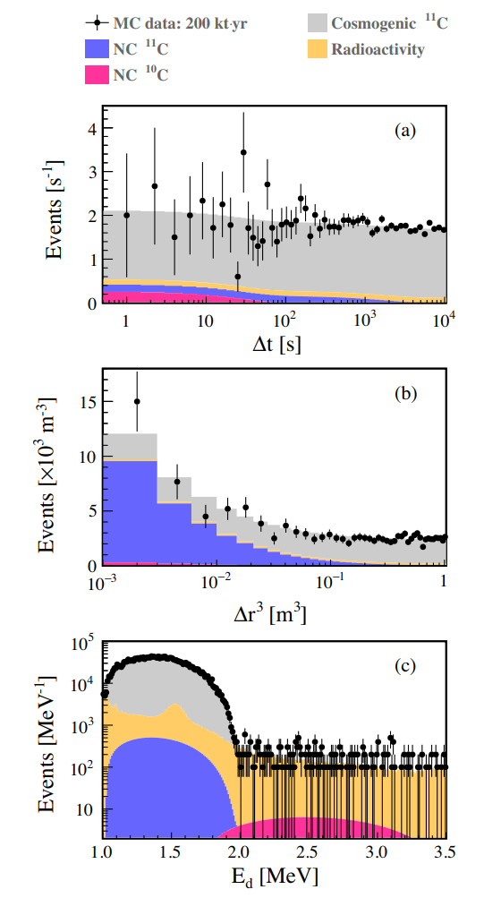
In situ Measurement
Cheng et al Phys. Rev. D 103 (2021) 5, 053002
Third event
Model variations in the DSNB energy range
➔ ~20%
Dominant channel:
$ν_{x}+12C→ν_{x}+n+11C$ (triple-coincident signature)
A maximum-likelihood method ➔ a combine fit to the time interval between the prompt and third events (a), cubic distance between the prompt and third events (b), and energy of the third event (c)
A systematic study on the measurement of the NC background and evaluation of the associated uncertainties

Slide 24
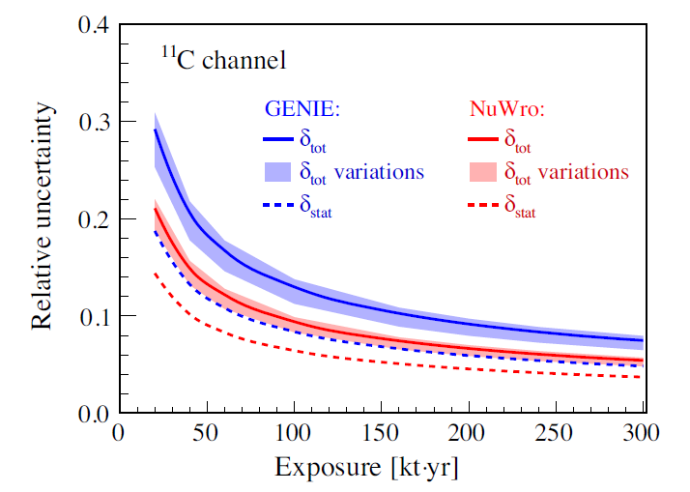
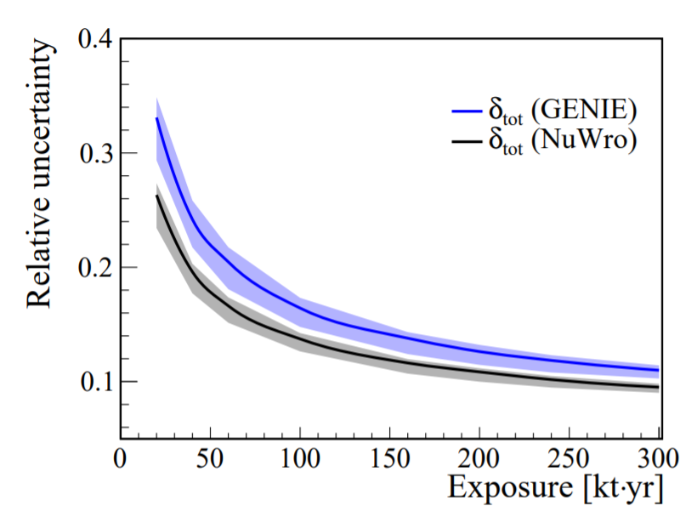
Uncertainty Estimation via In situ Measurement
Cheng et al Phys. Rev. D 103 (2021) 5, 053002
The uncertainty for the NC background for DSNB is evaluated
Future JUNO will be able to make a unique contribution to the worldwide dataset to improve the prediction of NC interaction on ¹²C
Reproduce NC background uncertainty from the summary in Phys.Rev.D 103 (2021) 5, 053002
JUNO, JCAP 10 (2022) 033
The bands are obtained by assuming different levels of natural radioactivity and cosmogenic ¹¹C in the accidental background
15%
Within 10 years JUNO data, NC background rate can be constrained on 15% level

Slide 25
Summary
Atmospheric neutrinos are one of most crucial backgrounds for many rare searches, such as DSNB, proton decay, dark matter, as well as reactor neutrinos
Neutrino interactions including deexcitation (combination of neutrino generators and TALYS) as well as detector response are developed.
Our work will help estimate single, double-coincident and triple-coincident backgrounds
The method of the NC background prediction has been adopted in JUNO related studies, e.g.,
DSNB (JCAP 10 (2022) 033)
Reactor neutrino (Chin. Phys. C 46 (2022) 12, 123001)
Indirectly dark matter research (JCAP 09 (2023) 001)
Also suitable for various experimental settings, such as HyperK, THEIA, DUNE
Not only rely on the model predictions, but also seek measurements to tune the model and constrain the associated uncertainty
JUNO
…

Slide 26
Thank you for your attention!

Slide 27
backup

Slide 28
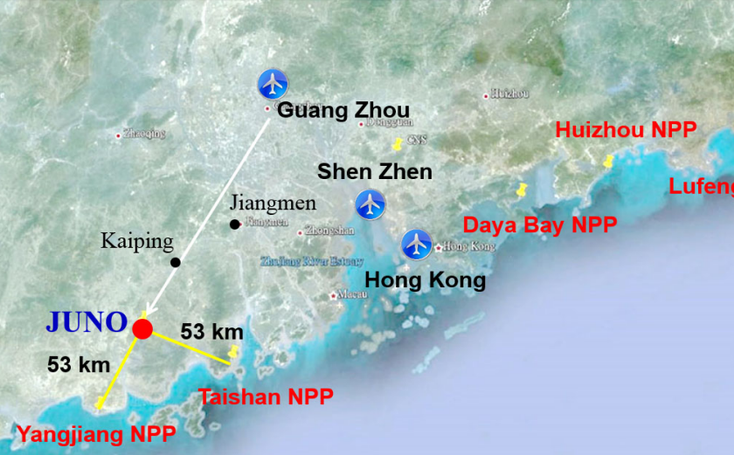
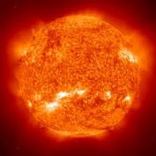
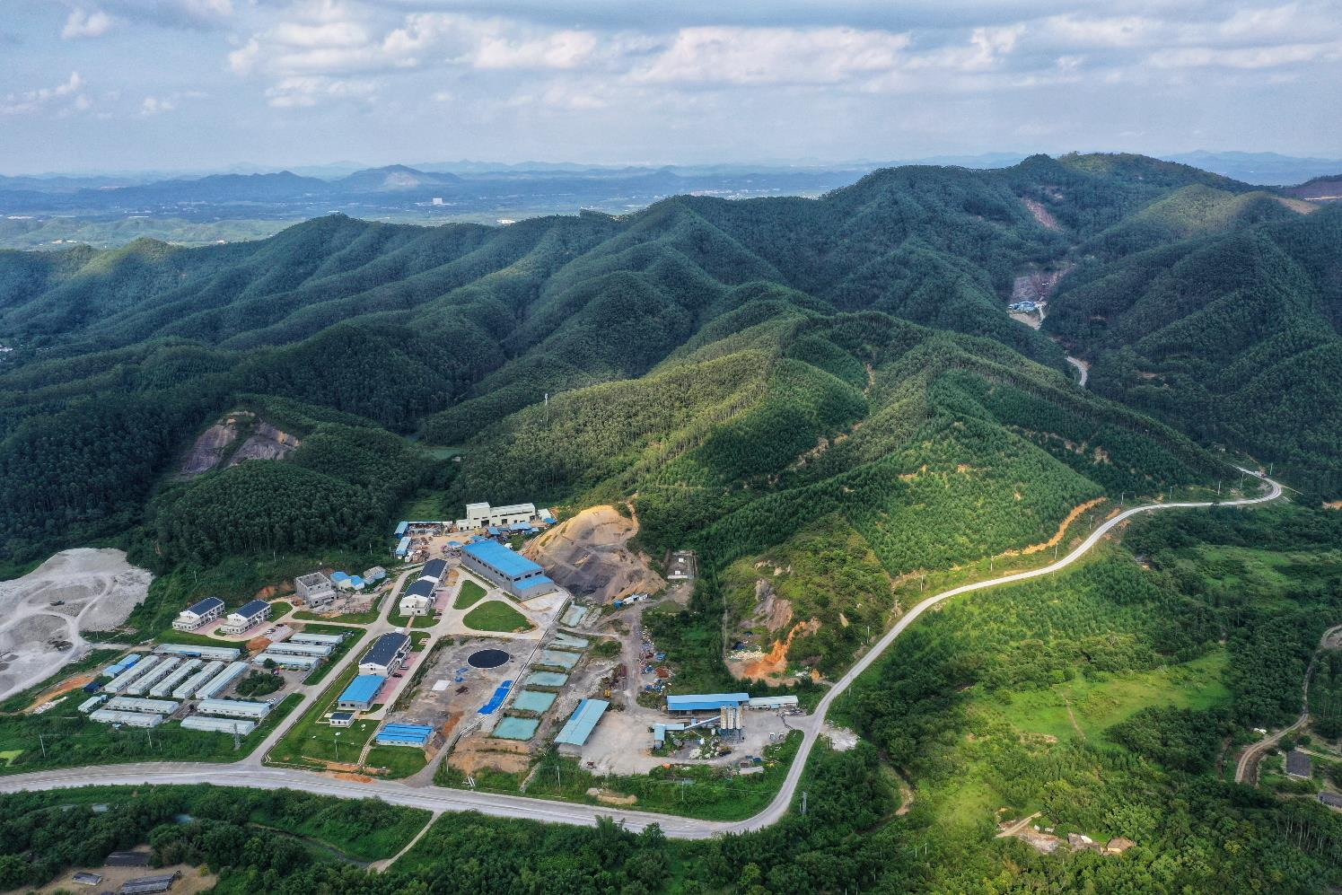
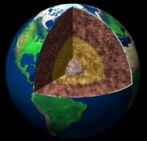
Jiangmen Underground Neutrino Observatory (JUNO)
PPNP 123 (2022) 103927
Multi-purpose neutrino experiment
Reactor
Atmosphere
~60 ${\overline{ν}}_{e}$ / day
Hundreds / year
Solar
Supernova
JUNO site
Civil construction finished in 2021/12
Supernova burst:
~7300 at 10 kpc
DSNB: 2-4 ${\overline{ν}}_{e} /$year
Hundreds / year for ⁸B
Earth
New physics
e.g., proton decay
Overburden
~650 m (1800 m.w.e.)
~400 / year

Slide 29
Jiangmen Underground Neutrino Observatory (JUNO)
PPNP 123 (2022) 103927
JUNO detector
44 m
JUNO site
Civil construction finished in 2021/12
Central Detector: 20 kton Liquid Scintillator (LS)
 | Target mass | PMT Coverage | Energy resolution @ 1 MeV | Light yield [PE/MeV]
Daya Bay | 20 ton (x8) | 12% | 8% | 160
Borexino | 300 ton | 34% | 5% | 500
KamLAND | 1 kton | 34% | 6% | 250
JUNO | 20 kton | 78% | 3% | >1300
Overburden
~650 m (1800 m.w.e.)

Slide 30
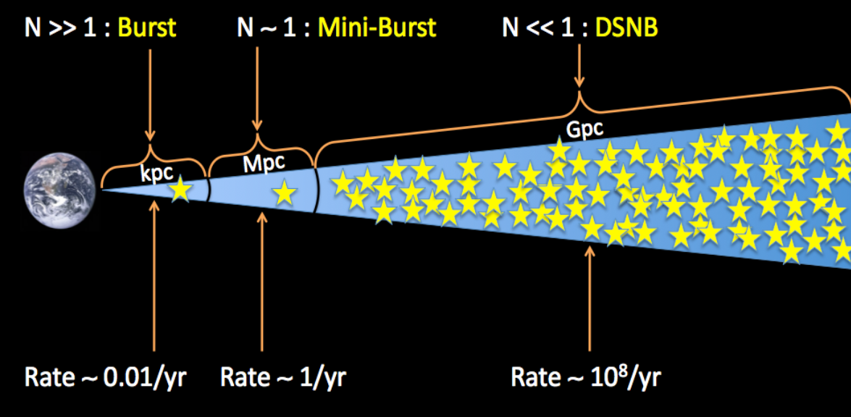
Diffuse Supernova Neutrino Background
Number of observed SN neutrinos
DSNB primary detection via IBD:
©J. Beacom
Prompt
Delayed
Very rare event rate :
2-4 events in JUNO per year
Not detected yet
Rate of SNe
Galactic:
High statistics,
All flavors
Extra-galactic:
Small statistics
Integrated flux of all past SNe:
cosmic star-information, average core-collapse neutrino spectrum, failed SNe rate, etc

Slide 31
Atmospheric Neutrino Challenges in Large LS Detectors
Challenges in LS detectors:
Neutrino interactions in LS rely on nuclear models
Precise model prediction (this talk)
CHENG, LI, WEN, ZHOU, Phys. Rev. D 103. 05001 (2021)
CHENG, LI, LI, LI, LU, WEN, paper in preparation
Few data measurement of atm-v NC interactions
In-situ measurement
CHENG, LI, LU, WEN, Phys. Rev. D 103. 05002 (2021)
The requirement of background suppression is quite high
Developed pulse shape discrimination (PSD) tools
CHENG, LUO, LI, LI, LI, et al., arXiv2311.16550

Slide 32
TALYS-based Deexcitation Model of Residual Nucleus
2. TALYS → Simulate residual nucleus at certain excited energy
http://www.talys.eu/home/
Taken from TALYS’s calculation
Final production of neutrons and unstable residual nuclei is crucial for tagging and reducing NC background in LS detectors

Slide 33
Atm-$ν$ NC interaction: in-situ measurement
Phys. Rev. D 103 (2021) 5, 053002
We perform a systematic study on the measurement of the NC background and evaluate the associated uncertainties
According to the possible association with unstable residual nuclei, a maximum-likelihood method is proposed to measure the triple-coincident signature of the NC background
The uncertainty of the NC background for DSNB is evaluated
Future JUNO will be able to make a unique contribution to the worldwide dataset to improve the prediction of NC interaction on ¹²C
Reproduce NC background uncertainty from the summary in Phys.Rev.D 103 (2021) 5, 053002
JCAP 10 (2022) 033
15%
Within 10 years JUNO data, NC background rate can be constrained on 15% level

Slide 34
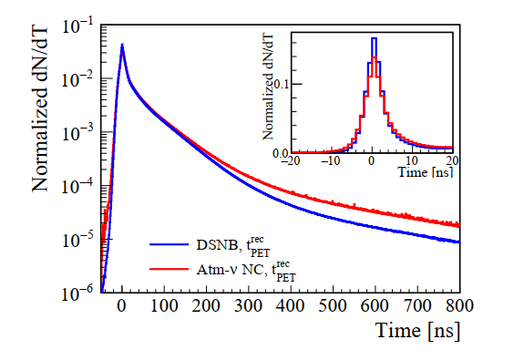
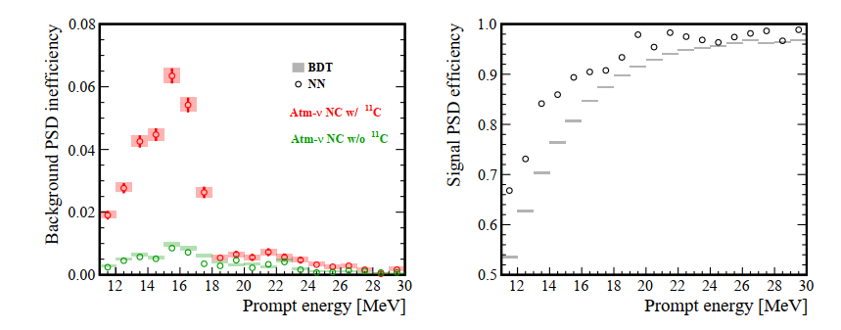
Developed PSD discriminator
arXiv 2311.16550
The S/B ratio in DSNB study before the PSD cut is about 0.05
Pulse shape discrimination (PSD): a powerful tool to significantly suppress atmospheric NC and fast neutron backgrounds
Methods based on Boosted Decision Trees and Neural Networks are developed, instead of simple tail-to-total method
The PSD efficiency for DSNB is about 80%, compared to 50% DSNB PSD efficiency in JUNO physics book (2016)
The energy dependent PSD efficiency is applied in the DSNB study for the first time

Slide 35
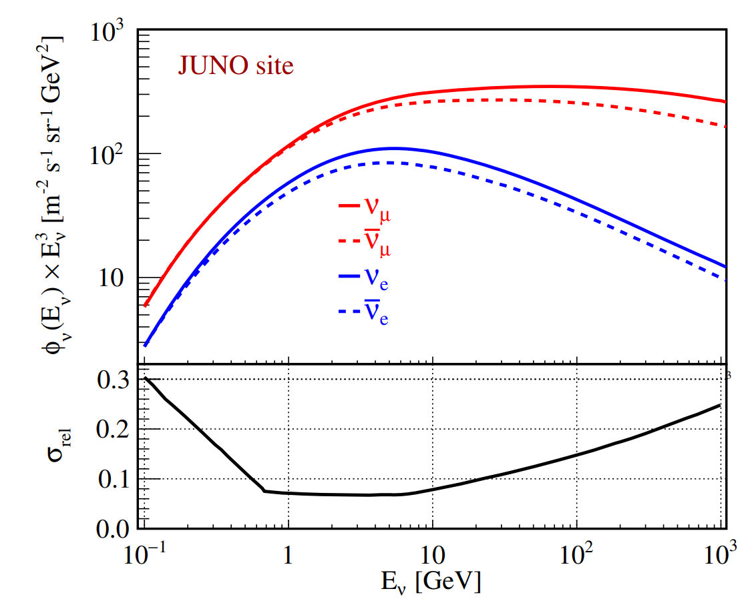
Atmospheric Neutrino Flux
Atmospheric neutrino sources: interactions of cosmic rays with nuclei in Earth’s atmosphere, in the presence of geomagnetic field effect
Initial fluxes of atmospheric neutrino calculated by Honda-san based on Phys. Rev. D 92, 023004 (2015)
Used in our work
$$N_{det}= φ ⨂{ }P ⨂{ σ} ⨂{ ε}$$
Atm-$ν$ measurement
Detector efficiency
Neutrino flux
Oscillation probability
Cross section
of $v_{x}+12C$

Slide 36
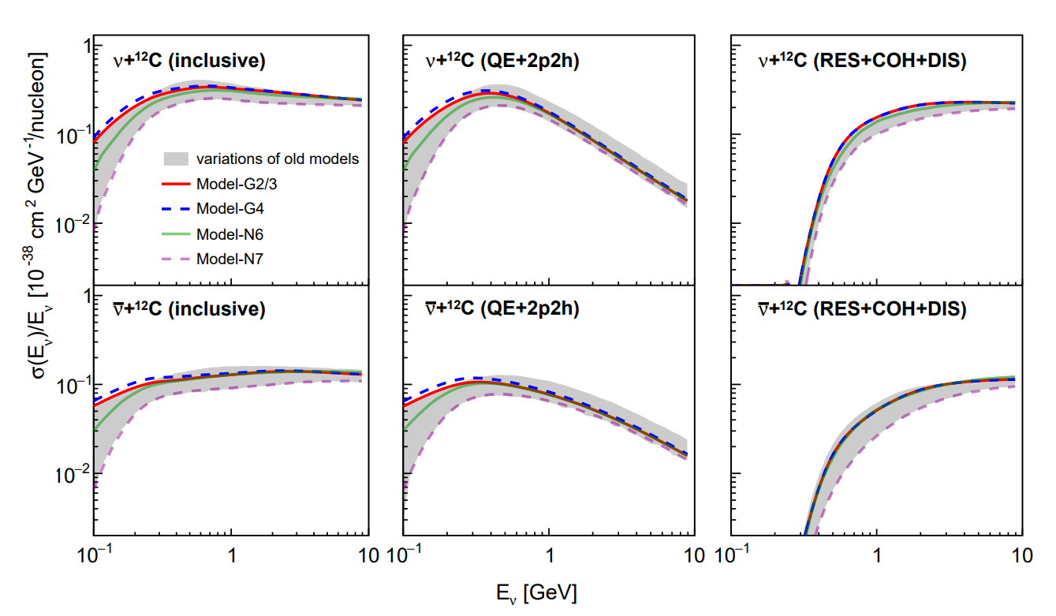
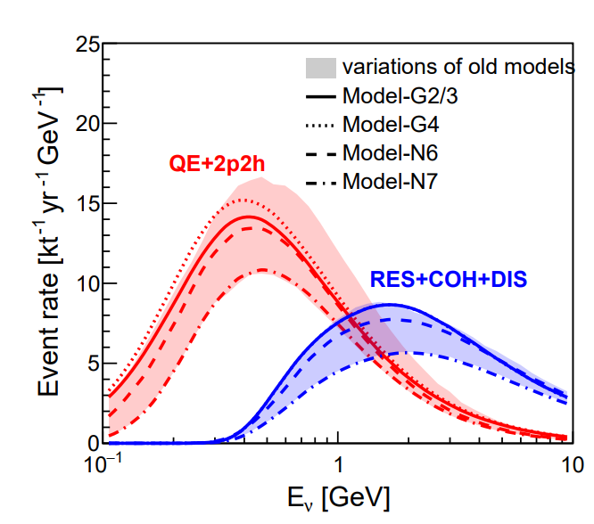
Cross-section and Event Rate
Cheng et al, arXiv 2404.07429
LFG
BRRFG
SF
Model variations regarding the initial interactions: a systematic uncertainty
QE and 2p2h events: ~99% of the NC background in the searches for IBD signals below 100 MeV visible energy
The following final-state investigations of the NC interactions focus on QE and 2p2h
Energy transfer

Slide 37
Production of Final-state Neutrons
Cheng et al, arXiv 2404.07429
QE+2p2h
QE+2p2h
hN2018 FSI
hA2018 FSI
Have found final-state nucleons with zero kinetic energy in GENIE models
https://github.com/GENIE-MC/Generator/issues/369
GENIE authors suggest to mark a nucleon as intermediate if its kinetic energy = 0
modify G(2-4) to G’(2-4) that no zero kinetic energy in the final-state and the corresponding residual nuclei are modified.
New GENIE model: Model-G2, G3, G4
New GENIE’ model: Model-G2’, G3’, G4’
New NuWro model: Model-N6, N7
$ξ_{deex}$ : the ratio of the event rate with deexcitation to that without deexcitation

