Slide 1

Electron-ion collider in China (EicC)
Peng Sun (Institute of Modern Physics, Chinese Academy of Sciences)

Slide 2
Outline
Introduction
Physics highlights
Summary

Slide 3
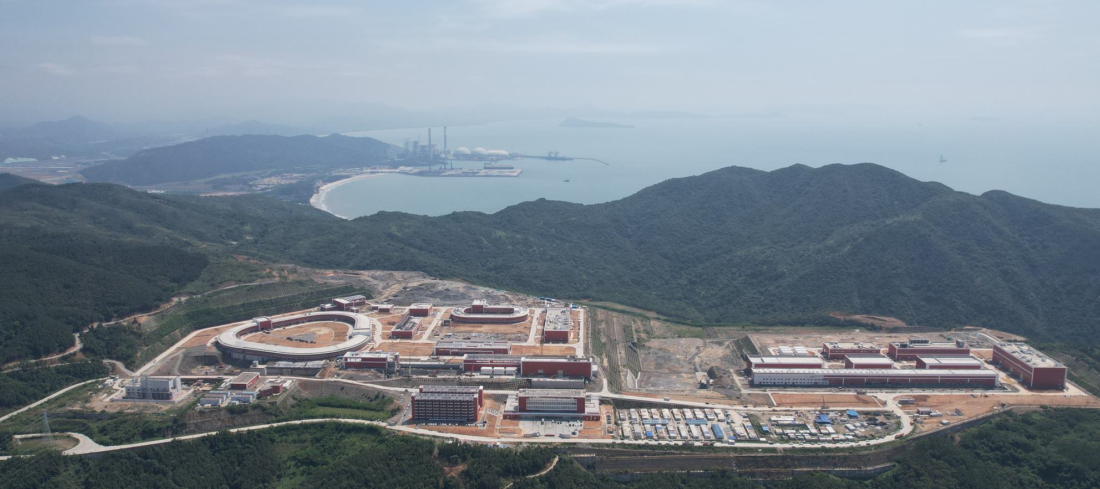

Electron Ion Collider in China…Huizhou(惠州) in Guangdong province
Picture in May 2024
→ Deliver the first heavy ion beam in 2025
HIAF under construction
Electron Ion Collider in China, EicC
EIC in China

Slide 4
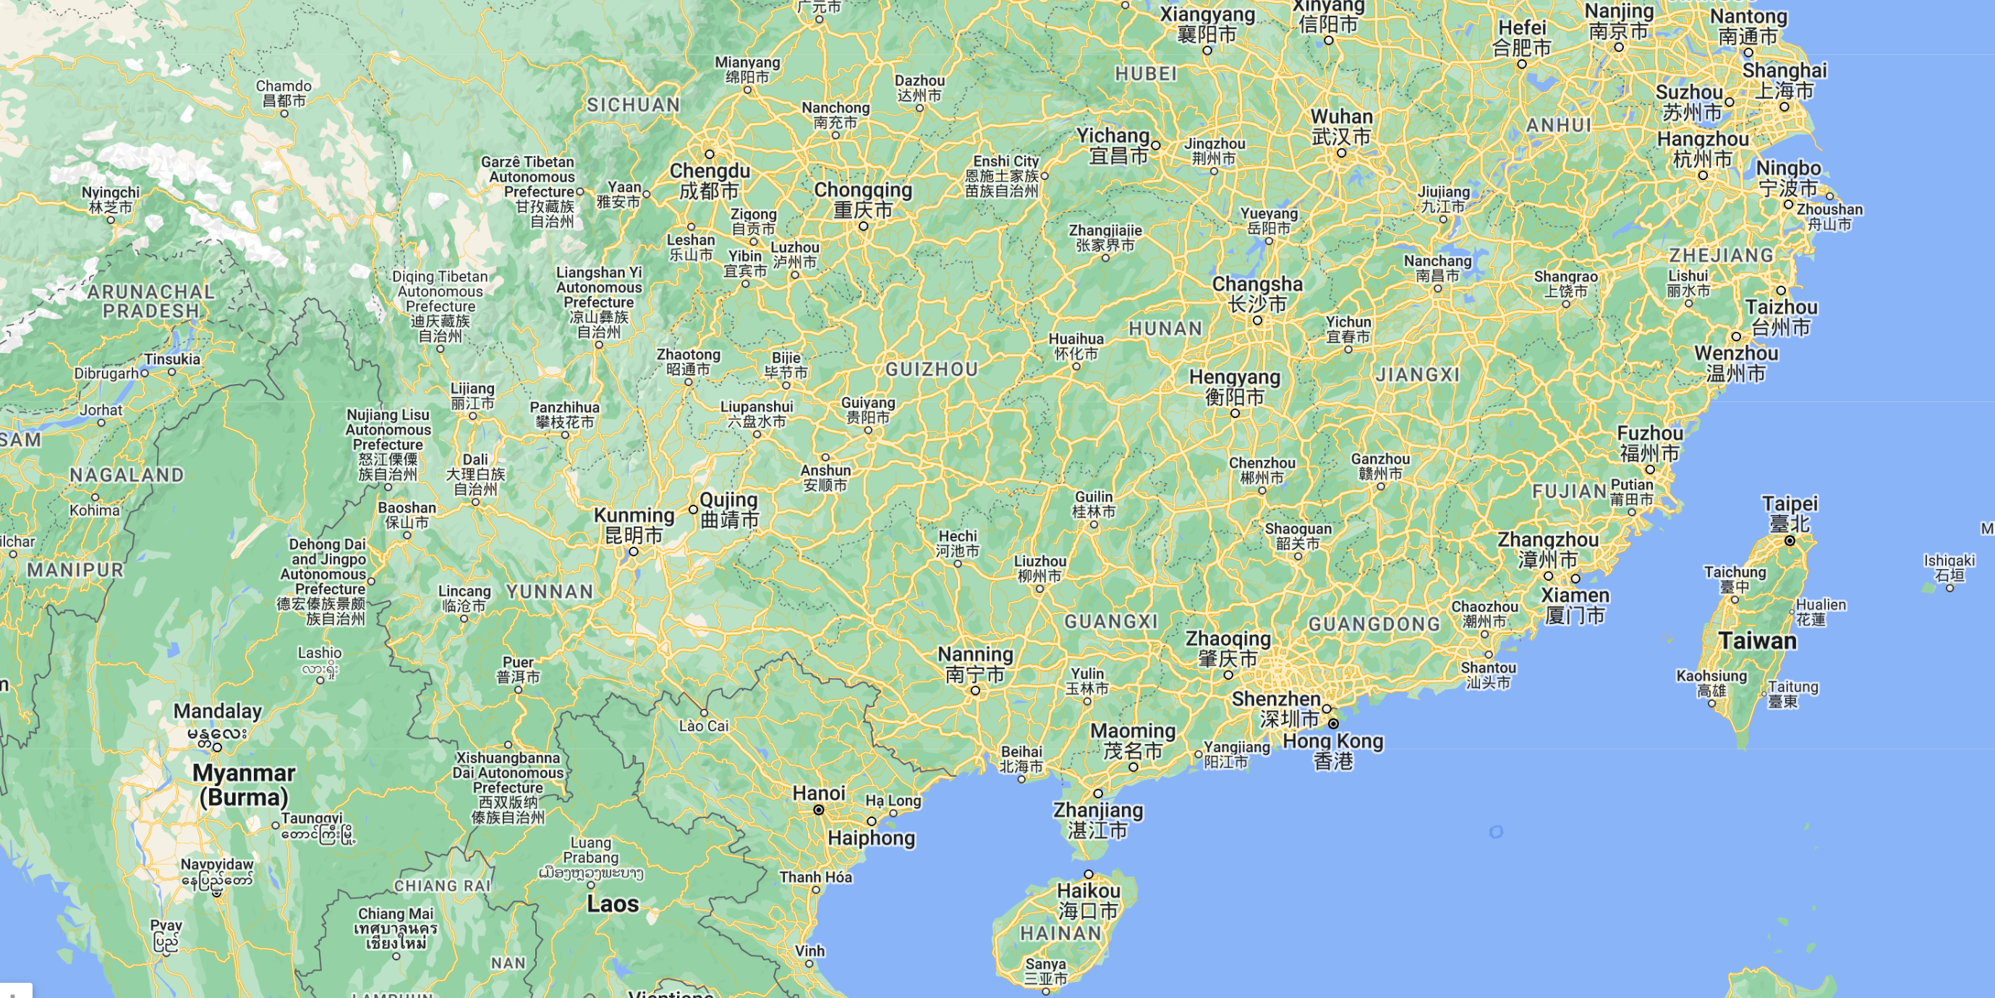
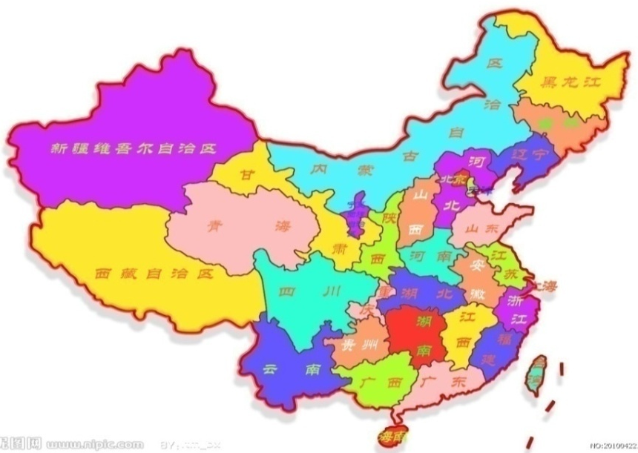
Location: Huizhou, Guangdong
HIAF construction: 2018 - 2025
HIAF

Slide 5
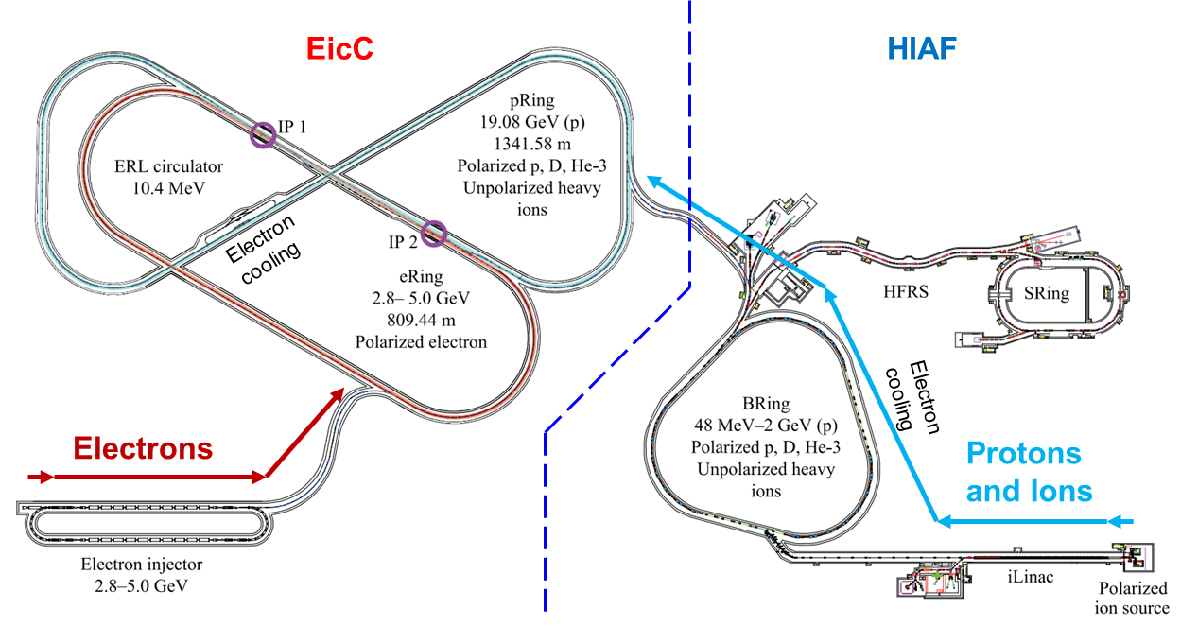

EicC Accelerator complex layout
20 GeV p + 3.5 GeV e
$\sqrt{S}:$16.7GeV
High Lumi.：
2-4 x10³³ cm⁻²s⁻¹
Polarized beams

Slide 6

EicC white paper (arXiv: 2102.09222)
Published in the Frontiers of Physics (2021)
https://link.springer.com/article/10.1007/s11467-021-1062-0
Spin structure of the nucleon: 1D, 3D
  polarized electron + polarized proton/light nuclei
Partonic structure of nuclei and the Parton interaction with the cold nuclear environment
  unpolarized electron + unpolarized various nuclei
Quarkonium with c/cbar, b/bbar
Origin of the proton mass study via J/Psi and Upsilon near-threshold production
Detector + Accelerator preliminary design
46 institutes and >100 physicists

Slide 7
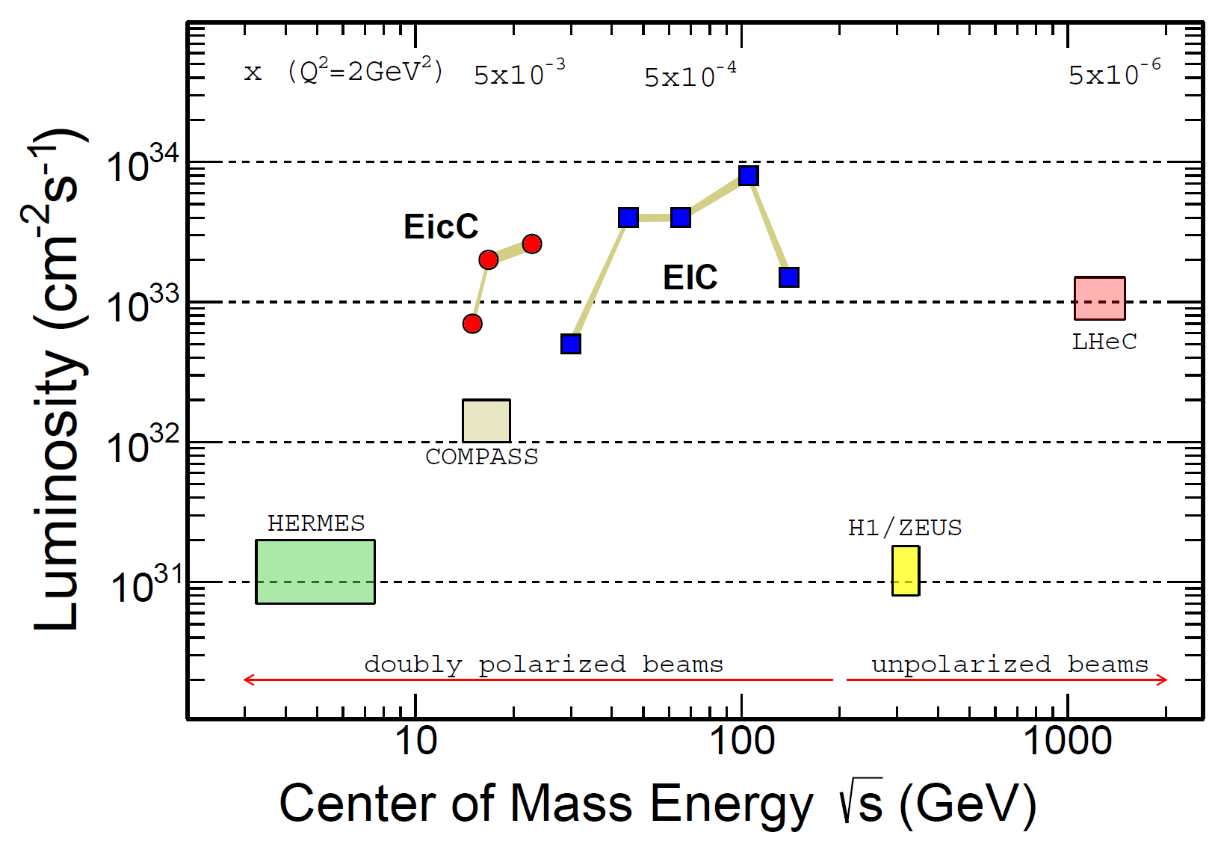
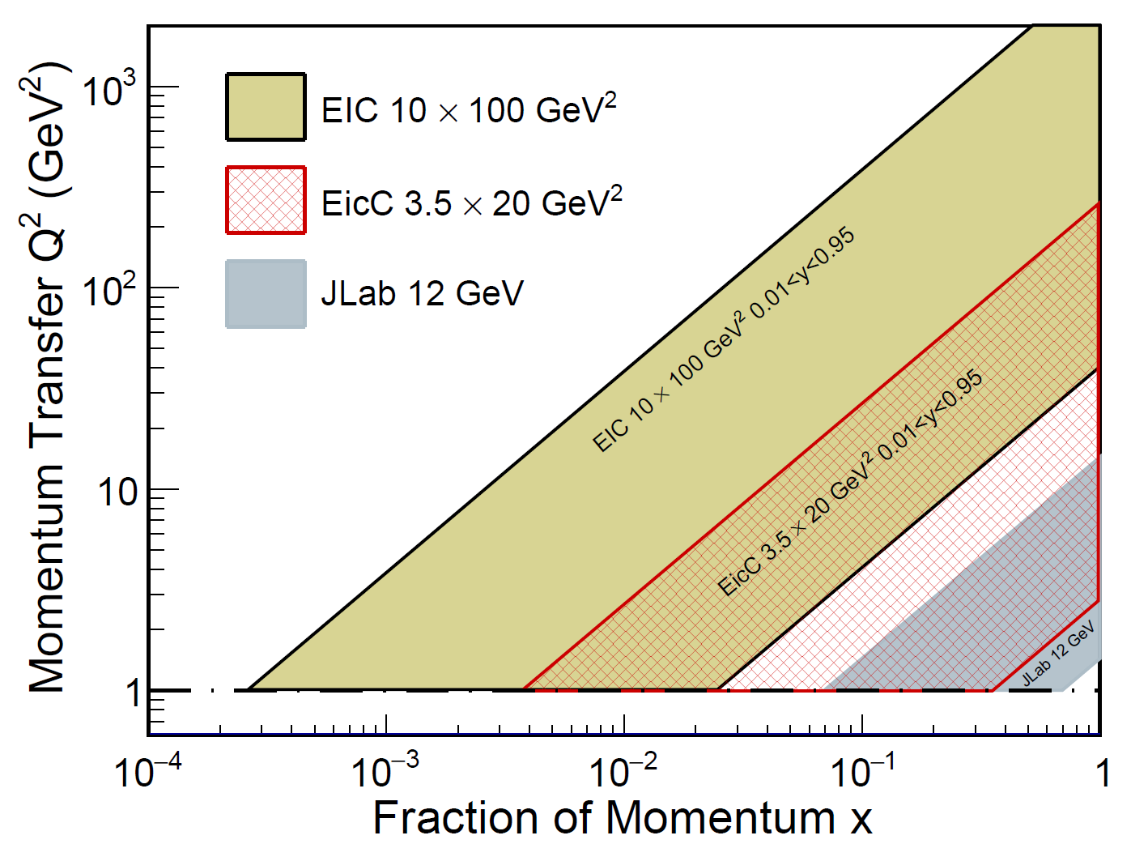
EicC parameters
EicC covers the kinematic region between JLab experiments and EIC@BNL
EicC complements the ongoing scientific programs at JLab and future EIC project
EicC focuses on moderate x and sea-quark region

Slide 8
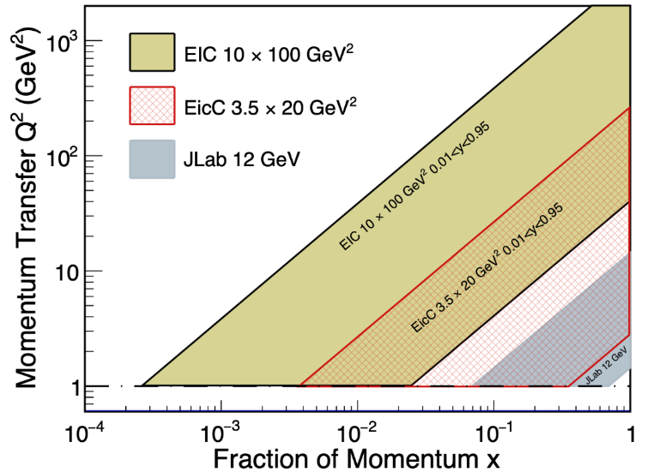
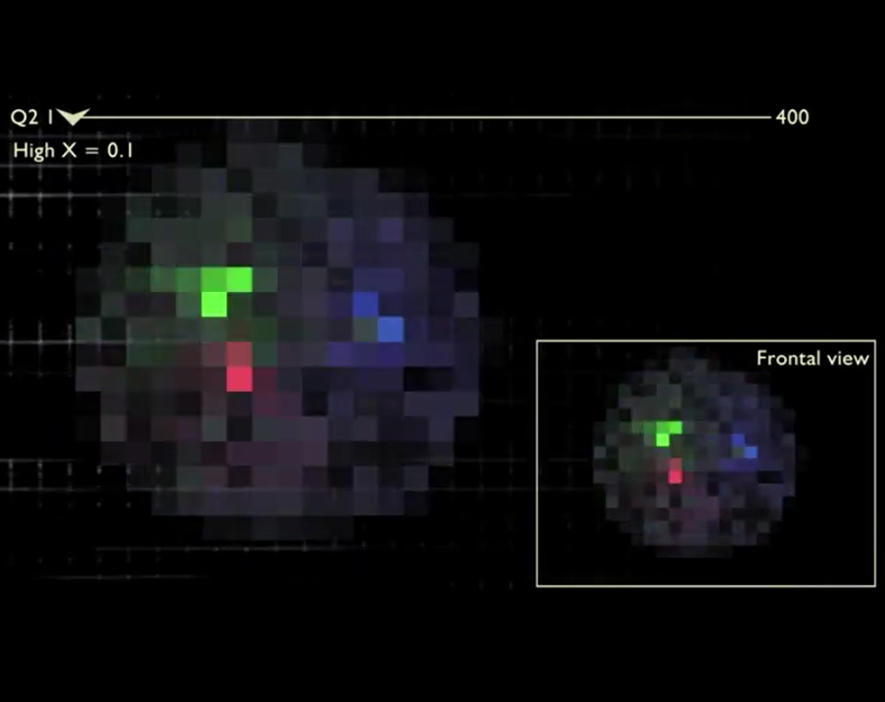
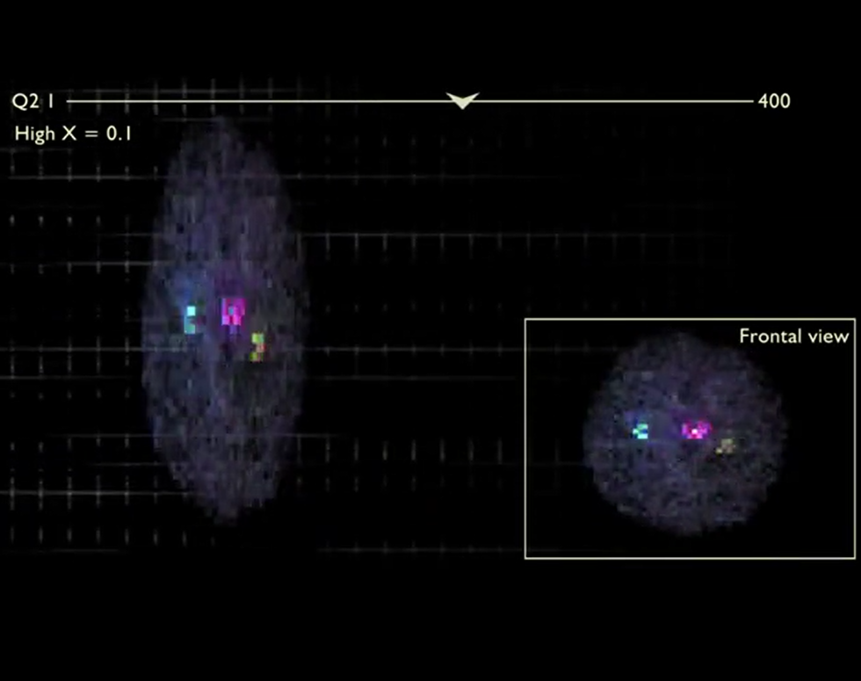
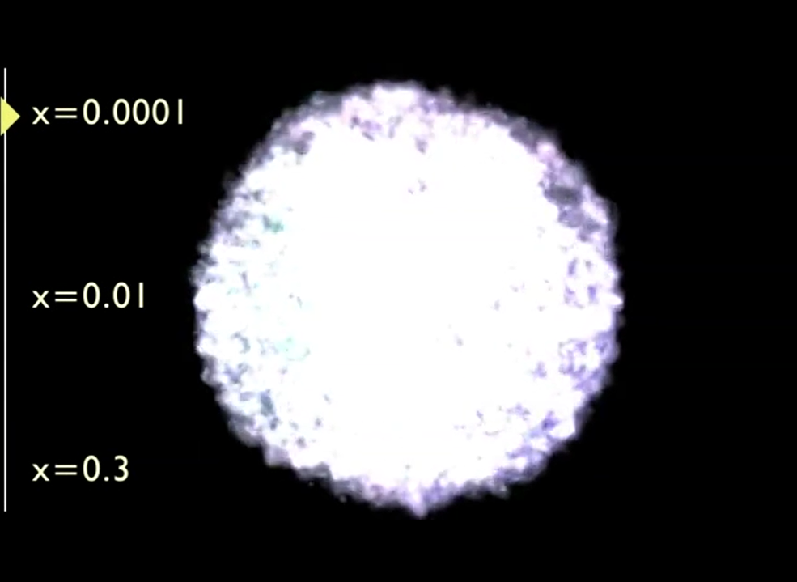
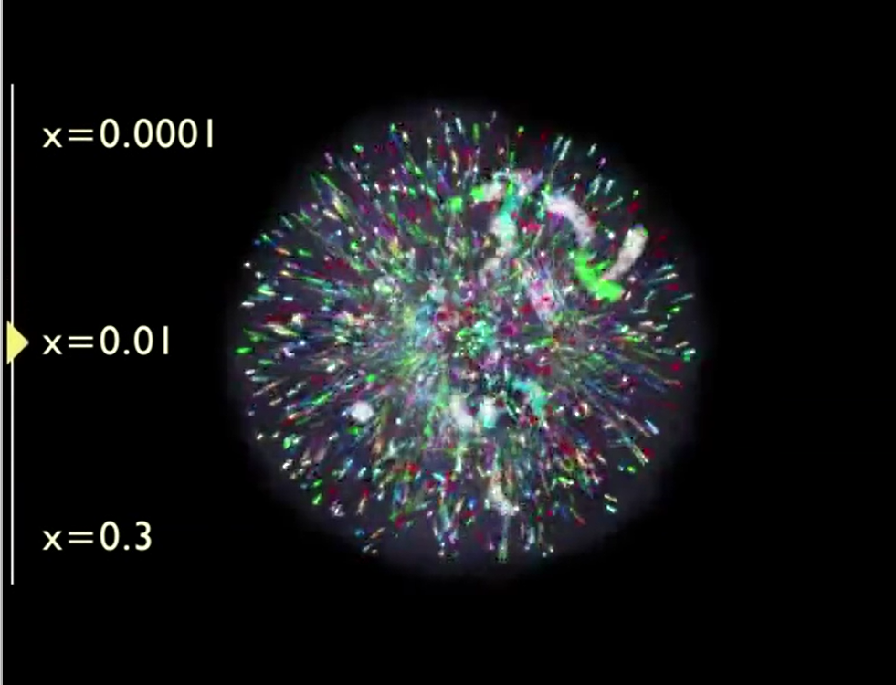

Kinematic region VS physics
See a video at:
http://eicug.org/
Different x → different picture
Broad Q² coverage：
  QCD evolution
  Non-perturbative → perturbative
Gluon dominates
Gluon + sea quarks
Valence quarks

Slide 9



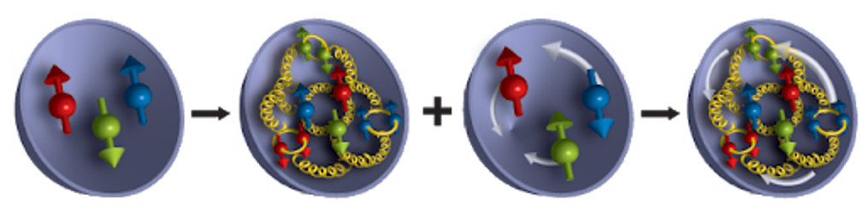
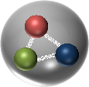
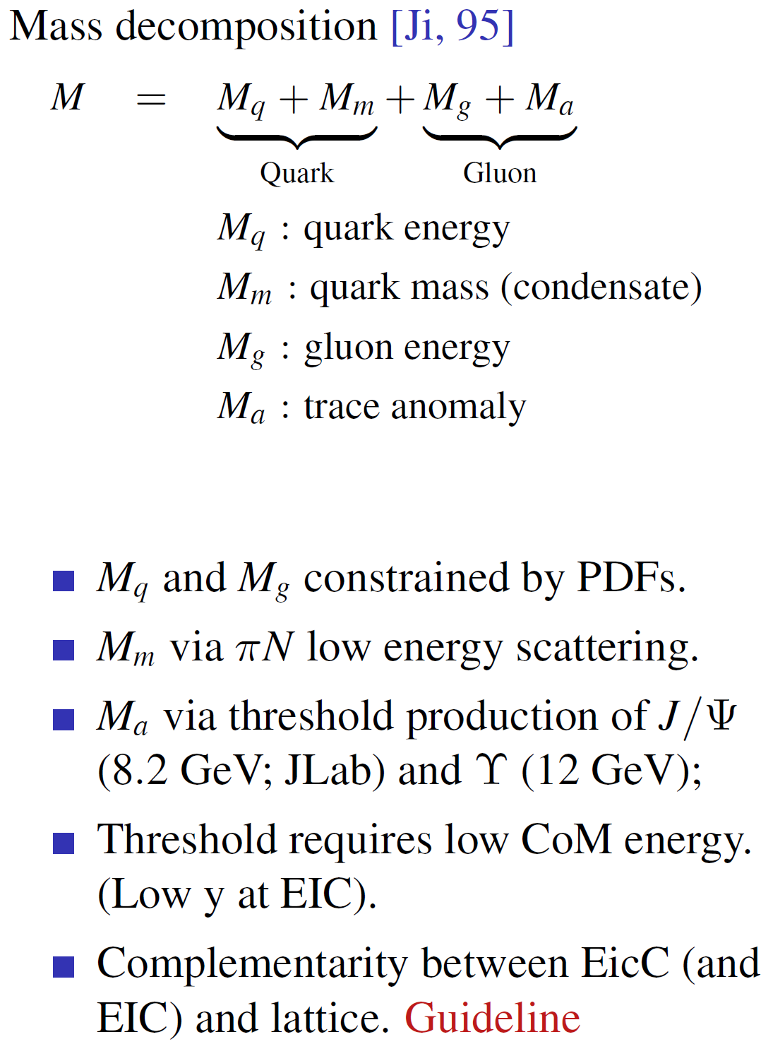

spin
mass
Higgs
mechanism
Gell-Mann
quark model
Proton
mass
1970s
1980s/2000s
Now
Spin decomposition:
Mass decomposition:
$S_{tot}=\frac{1}{2}= \frac{1}{2}∆Σ+∆G+$ $𝓛_{q}+𝓛_{g}$
Quark spin
Gluon Spin
Quark OAM
Gluon OAM
Quark energy
Quark mass
Gluon energy
Trace anomaly
Experimentally… we need to determine each of the above contributions

Slide 10
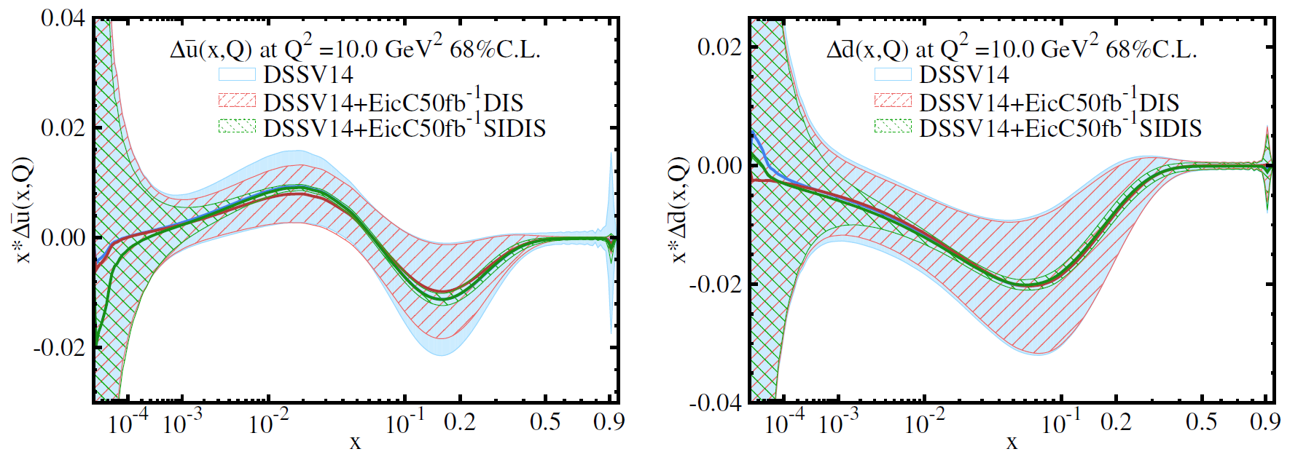
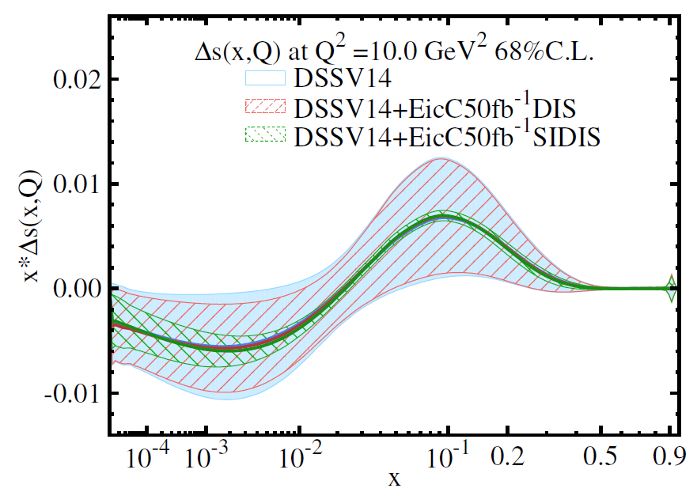
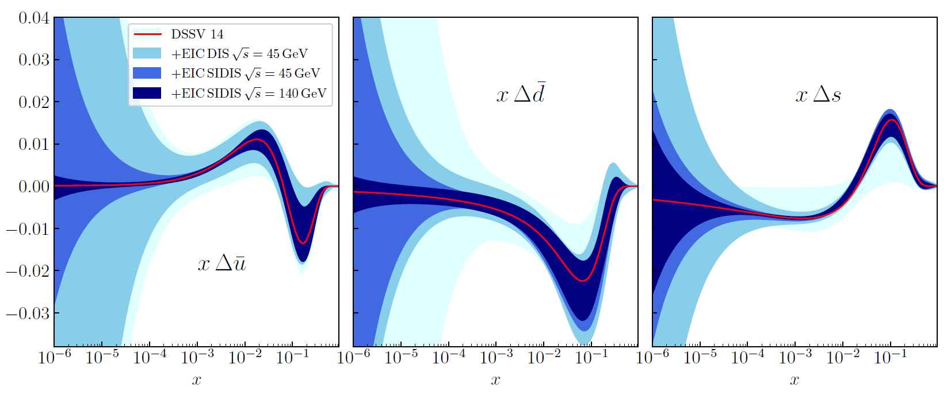
EicC and EIC-helicity distribution via SIDIS (1D spin)
D. Anderle, T. Hou, H. Xing, M. Yan, C. -P. Yuan, Y. X. Zhao, JHEP08, 034 (2021)
An NLO study
EicC white paper
EicC coverage
complementary
EIC Yellow Report

Slide 11
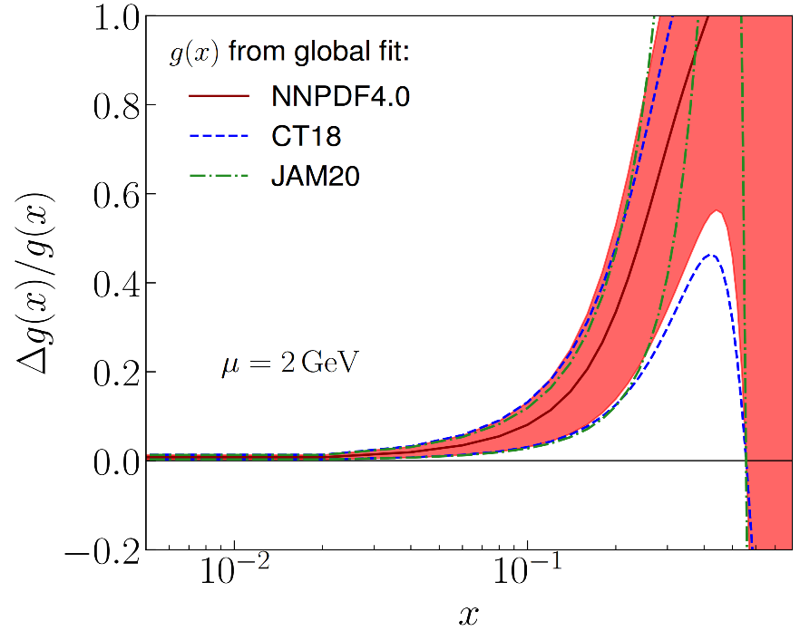
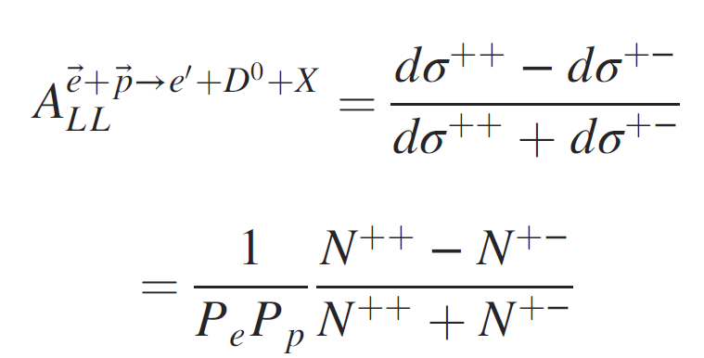
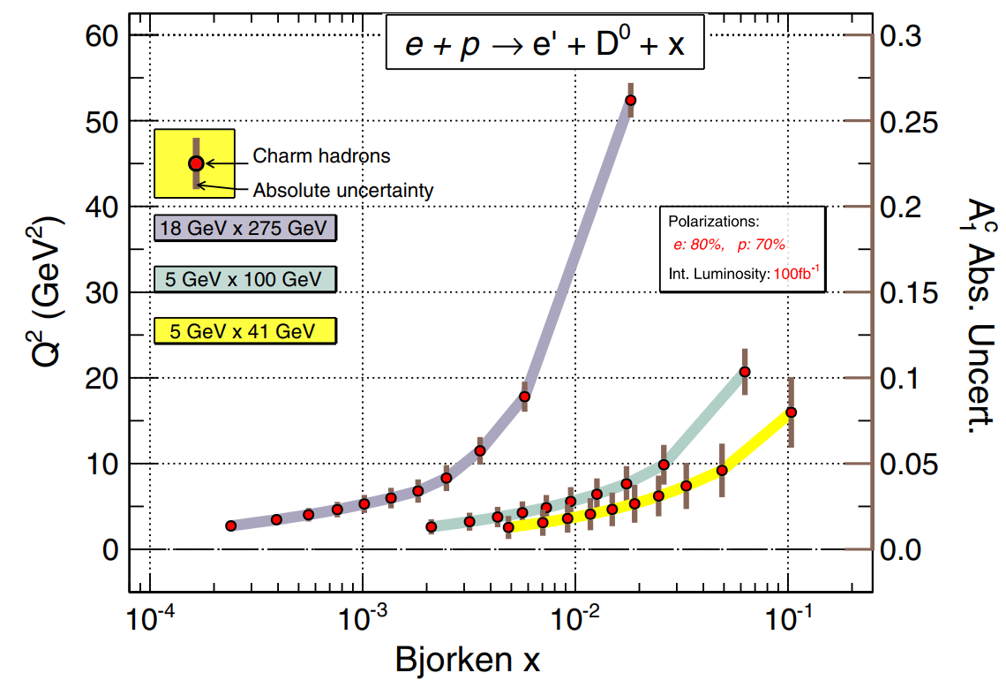
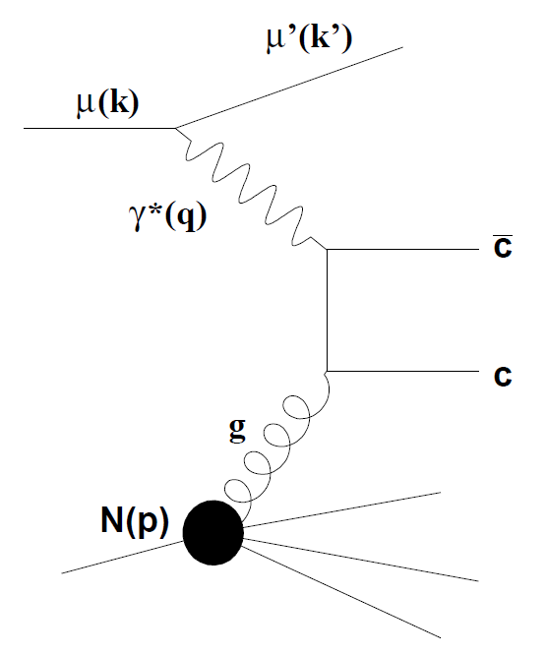
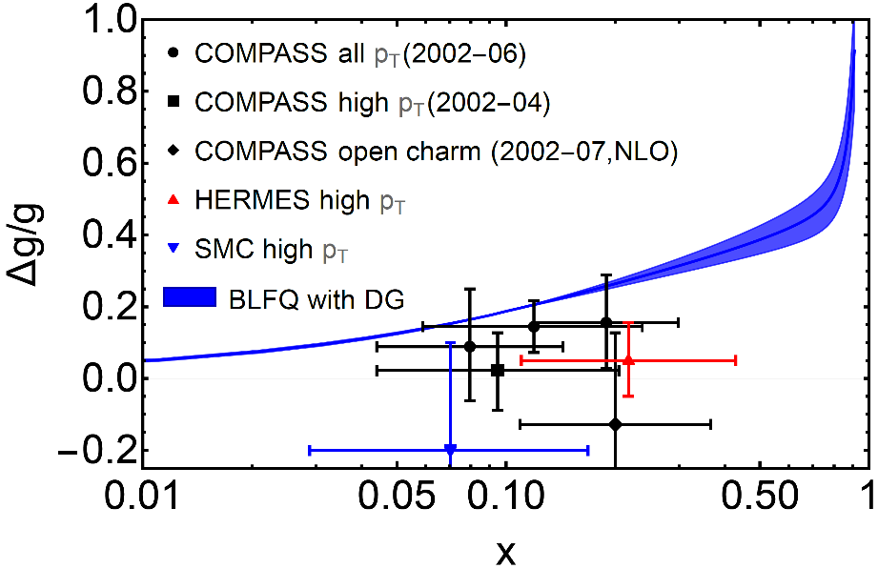
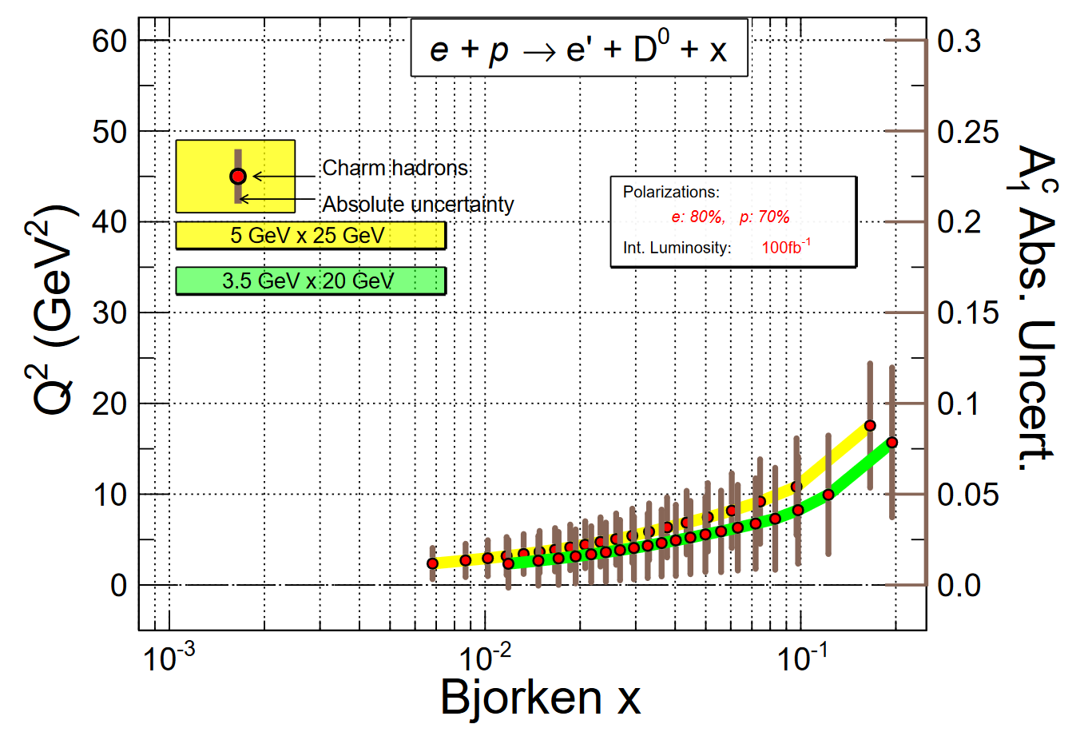
EicC and EIC-gluon polarization (at large x)
ArXiv:2211.15587
D. Anderle , X. Dong, …, E. Sichtermann, …, F. Yuan, Y. X. Zhao , Phys. Rev. D104, 114039 (2021)
EIC
e'
e
complementary
ArXiv:2209.08584
EicC

Slide 12
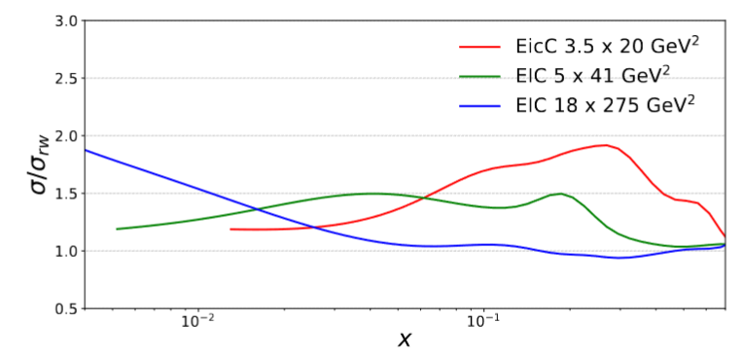
EicC and EIC-gluon polarization (at large x)
ArXiv:2211.15587
D. Anderle , X. Dong, …, E. Sichtermann, …, F. Yuan, Y. X. Zhao, Phys. Rev. D104, 114039 (2021)
EIC
e'
e
complementary
ArXiv:2209.08584
EicC

Slide 13
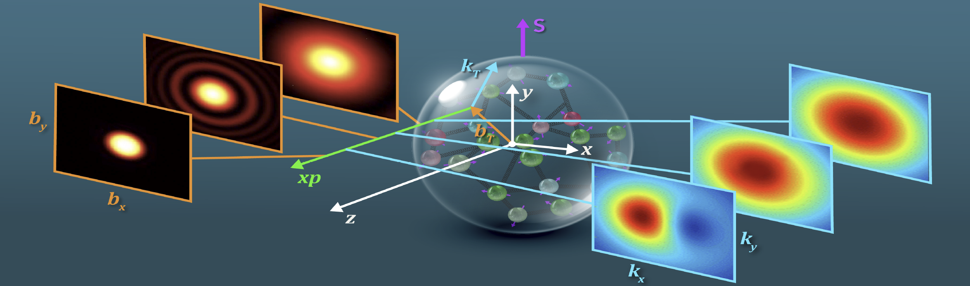
GPDs
TMDs
GPDs: deformation of Parton’s spatial distribution when hadron is polarized
TMDs: deformation of Parton’s confined motion when hadron is polarized

Slide 14




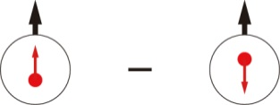
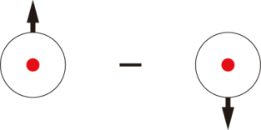
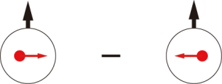
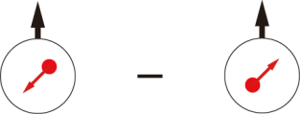
Leading-Twist TMDs
 |  | Quark polarization
 |  | Unpolarized (U) | Longitudinally Polarized (L) | Transversely Polarized (T)
Nucleon Polarization | U
 | L
 | T
f₁ =
h₁⊥ =
Boer-Mulders
g₁ =
h_{1L}⊥ =
Helicity
Worm Gear
h₁ =
f _{1T}⊥ =
Transversity
g_{1T} =
Sivers
Worm Gear
h_{1T}⊥ =
Pretzelosity
Nucleon Spin
Quark Spin
Survive the k_{T} integration, yield 1D pdfs

Slide 15
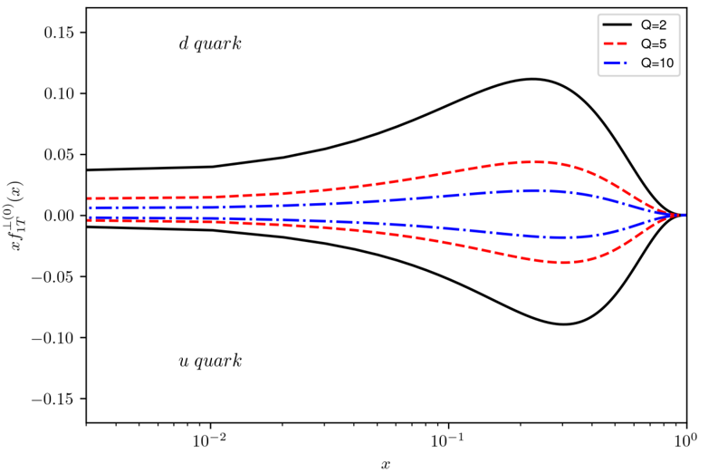
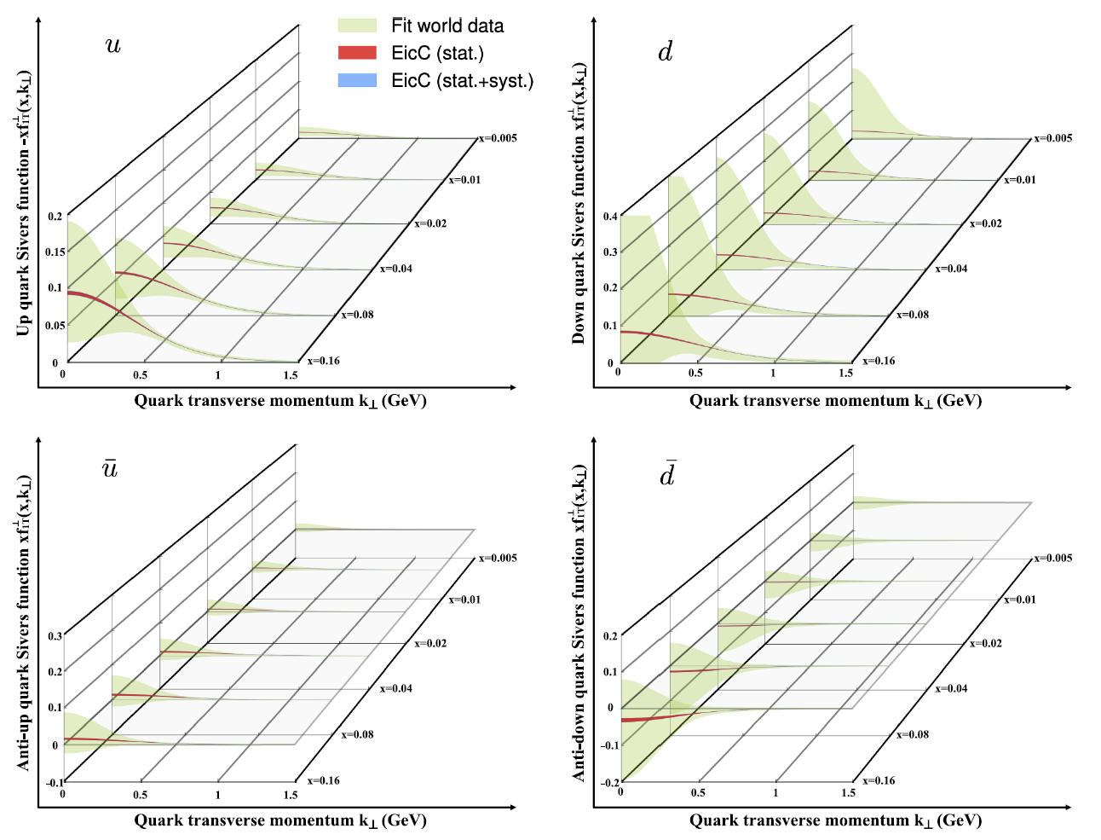
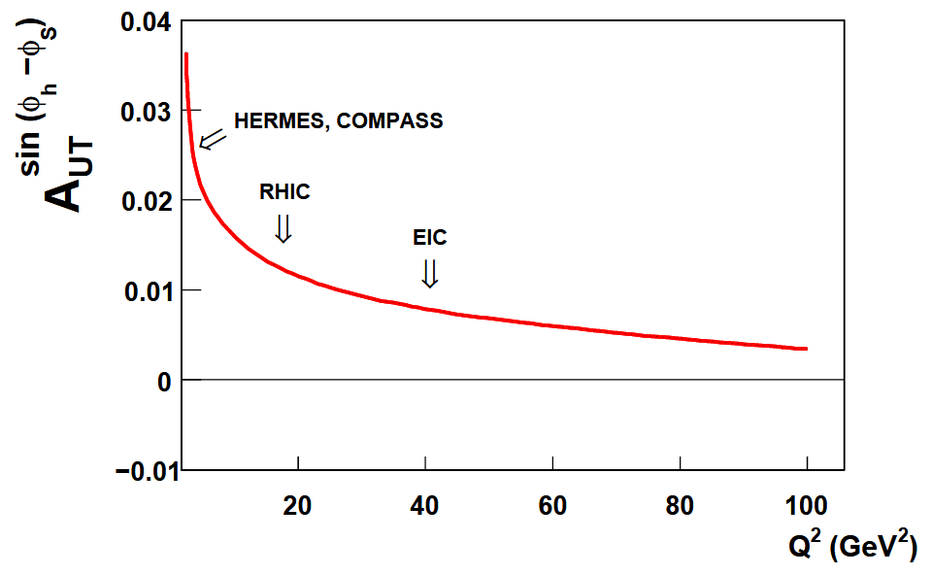
EicC and EIC-Sivers TMDs
C. H. Zeng, T. B. Liu, P. Sun, Y. X. Zhao, PRD106.094039 (2022)
Higher Q²
S. Aybat et. al. Phys. Rev. Lett 108, 242003 (2012)
EicC
15
Higher Q², smaller effect
Smaller x, smaller effect
complementary

Slide 16
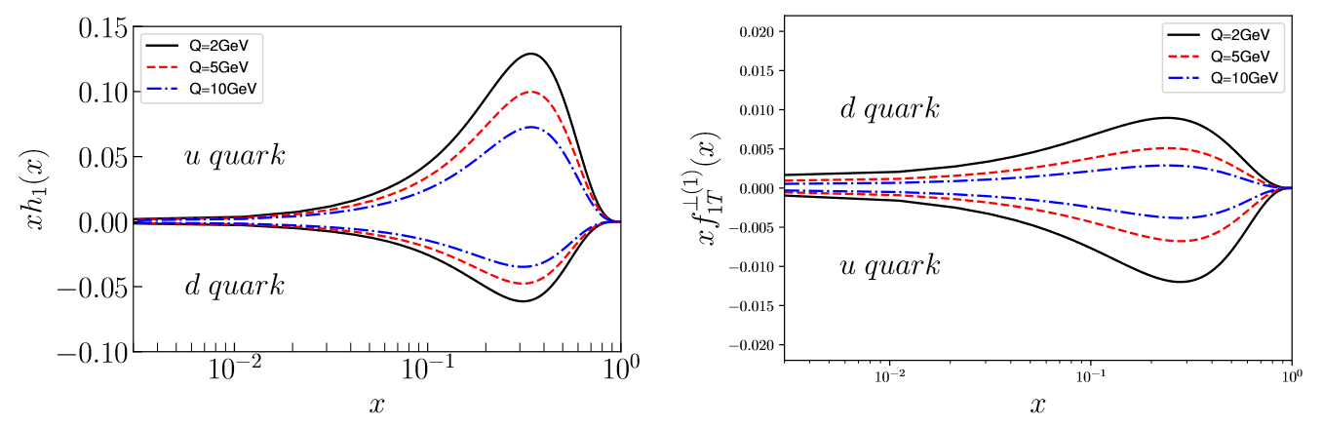
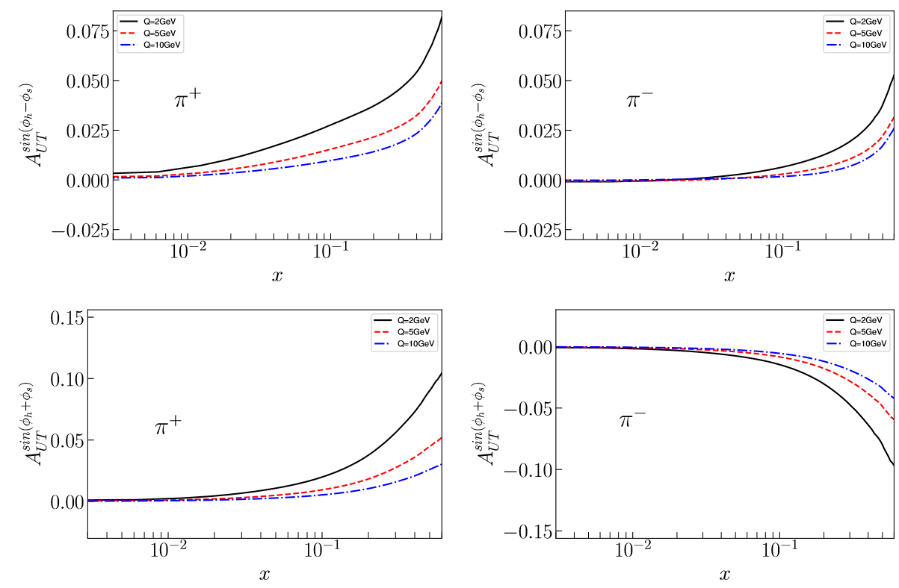
More words on TMDs study
Transversity
Observables
Sivers
For TMDs study: We need a moderate-energy EIC but with high luminosity

Slide 17
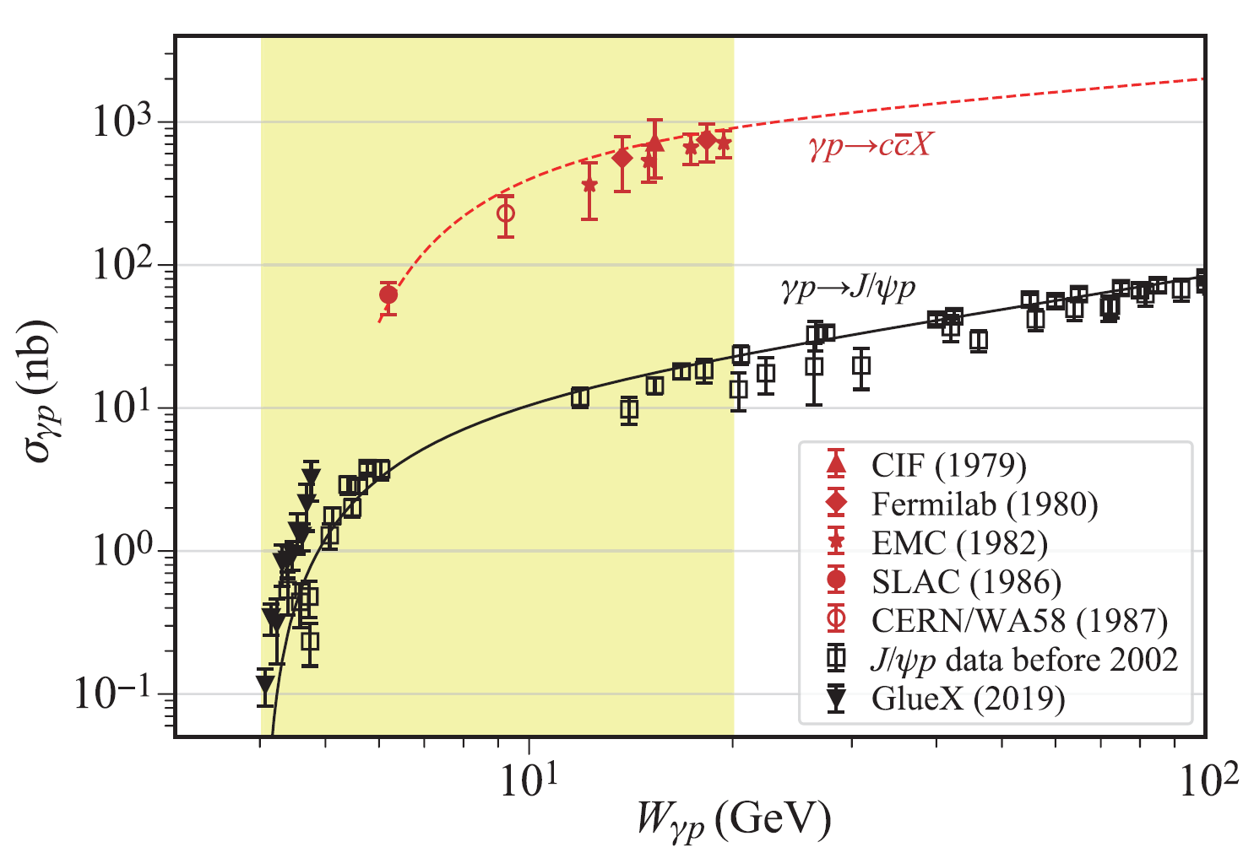
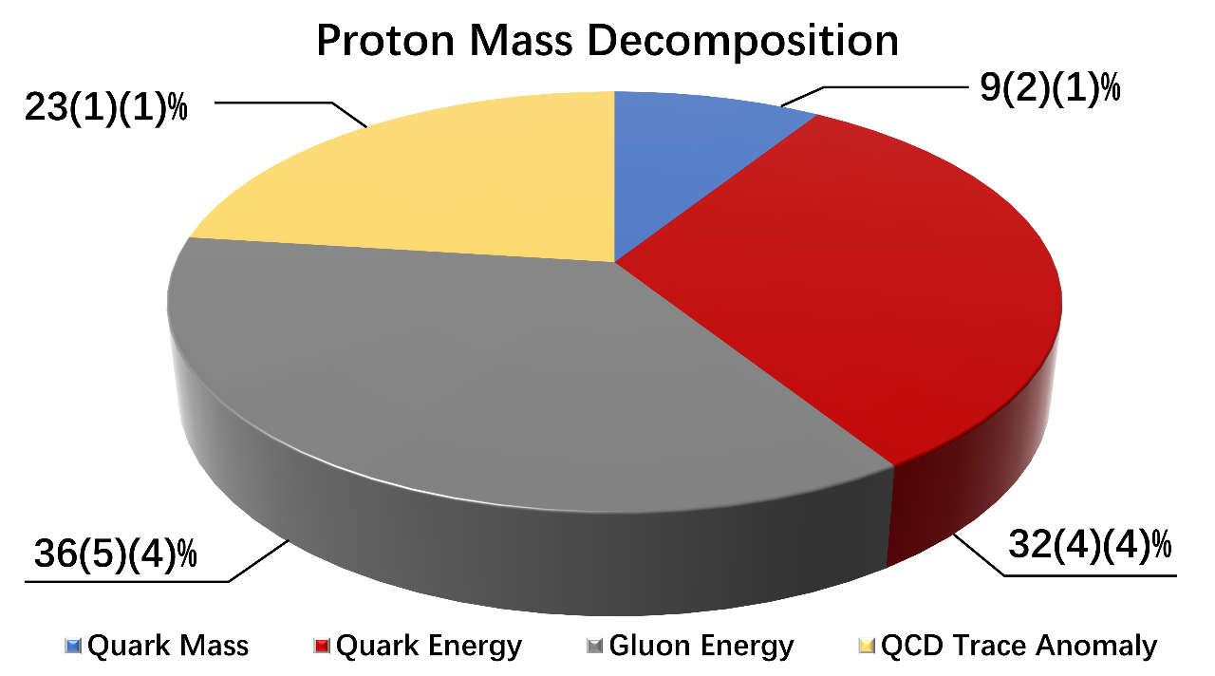
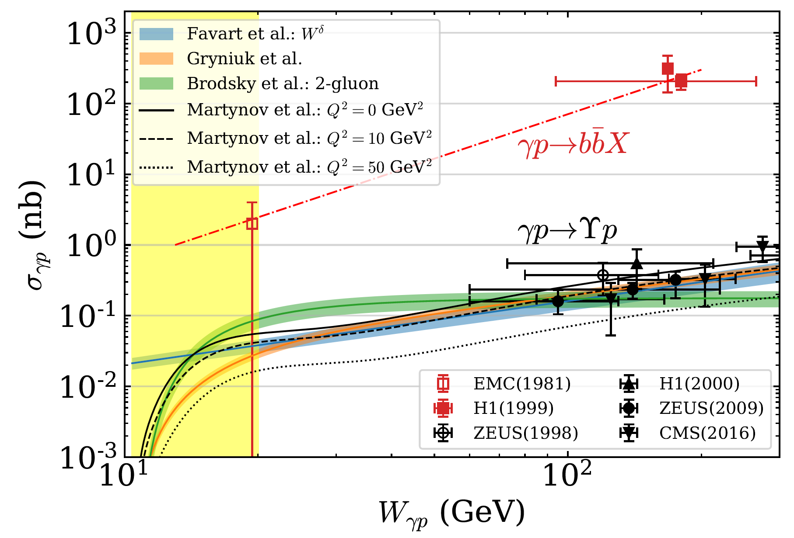
Proton mass study
Near threshold J/Psi production
Lattice QCD calculation
Phys. Rev. Lett. 121 (2018) 21, 212001
JLab
&
EicC
&
EIC
Near threshold Upsilon production
Quark energy and gluon energy constrained by PDFs
Quark mass via πN low energy scattering
Trace anomaly via threshold production of J/Psi and Upsilon ?
EicC
&
EIC
One of the hot topics under discussions

Slide 18
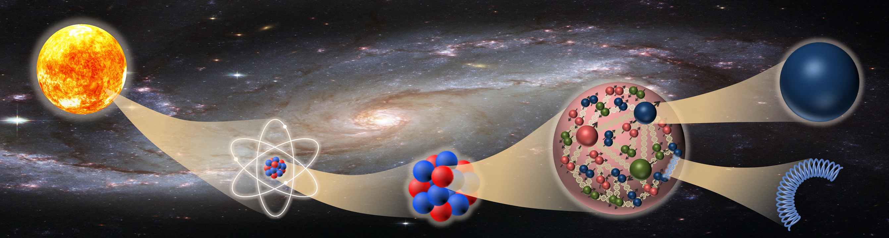
EIC
EicC: Multi-dimensional imaging of the structure of the nucleon
quarks
atom
nucleus
nucleon
gluons
EicC: QCD dynamics that can affect the identity of nucleons in a nucleus

Slide 19
EIC
Physics: Understand the inner structure of the visible world
Detector: Push for the development and application of cutting-edge technology
quarks
atom
nucleus
nucleon
gluons

Slide 20
Backups

Slide 21
Timeline
18 | 19 | 20 | 21 | 22 | 23 | 24 | 25 | 26 | 27 | 28 | 29 | 30 | 31 | 32 | 33 | 34 | 35 | 36 | 37 | 38 | 39 | 40
十三五 |  |  | 十四五 |  |  |  |  | 十五五 |  |  |  |  | 十六五 |  |  |  |  | 十七五
HIAF
Accelerator
HIAF-U
EicC
CEE
CEE⁺
Detector
CHNS
EicC

Slide 22
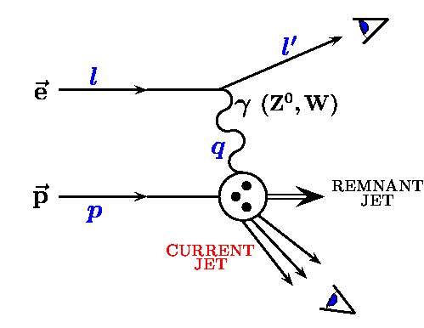
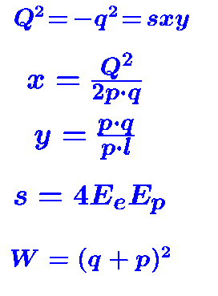
Lepton-Nucleon Scatterings
QED tool to study QCD nature of the nucleon
[1]
QED probe is clean
α_{EM} ~1/137 with broad Q coverage
One-photon exchange approximation:
~1% accuracy
Detection scale is determined by Q²:
200 MeV ~ 1fm
[3]
[2]
Observe scattered electron/muon [1]
Observe current jet/hadron [1]+[2]
Observe remnant jet/hadron as well [1]+[2]+[3]
→ inclusive
→ semi-inclusive
→ exclusive

Slide 23
Do we understand the building blocks of our visible world?
quarks
atom
nucleus
nucleon
gluons
Open questions:
→How do quarks + gluons as well as their interactions make up a nucleon?
→How can the nucleon’s emergent property be explained at quarks and gluons’ degree of freedom?

Slide 24
High Intensity heavy-ion Accelerator Facility (HIAF)
HIAF total investment: 2.5 billion RMB (Funded)
Booster Ring:
Circumference: 569 m
Rigidity: 34 Tm
Accumulation
Cooling & acceleration
HIAF for atomic physics, nuclear physics, applied research in biology and material science etc.
HFRS
SRing
iLinac
Superconducting Ion Linac:
Length: 180 m
Energy: 17 MeV/u (U³⁴⁺)
  CW and pulse modes
BRing
Two-plane painting injection scheme
Fast ramping rate operation

Slide 25
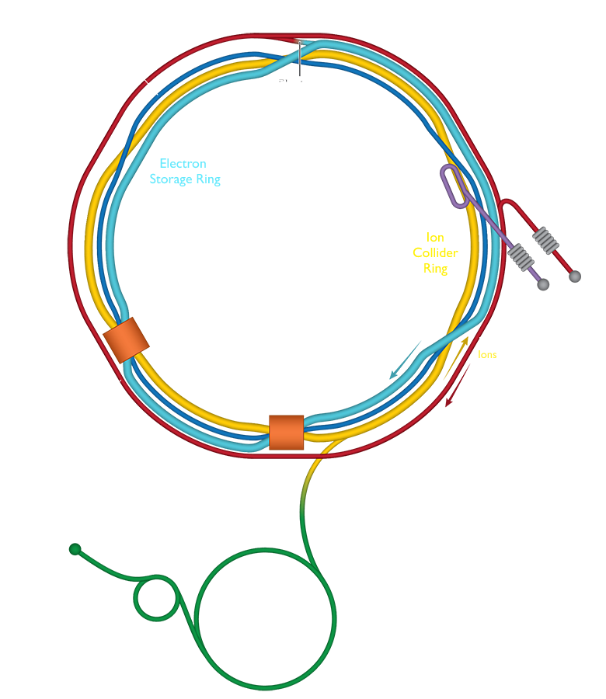
US EIC at Brookhaven National Laboratory
EIC website:
https://www.bnl.gov/eic/
ePIC collaboration (1st interaction point):
https://wiki.bnl.gov/EPIC/index.php?title=Collaboration
EIC User group:
https://www.eicug.org/
EIC whitepaper:
https://arxiv.org/abs/1212.1701
EIC yellow report:
https://arxiv.org/abs/2103.05419
EIC Conceptual Design Report:
https://www.osti.gov/biblio/1765663/

Slide 26
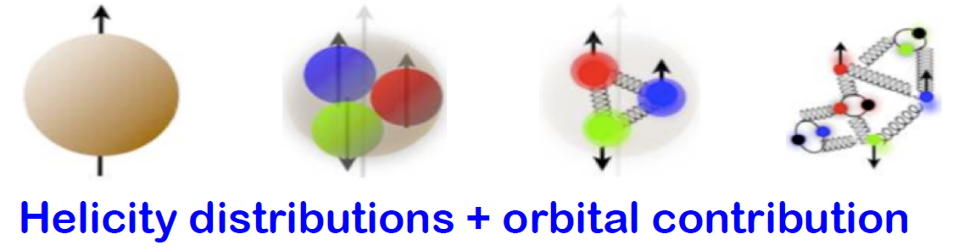
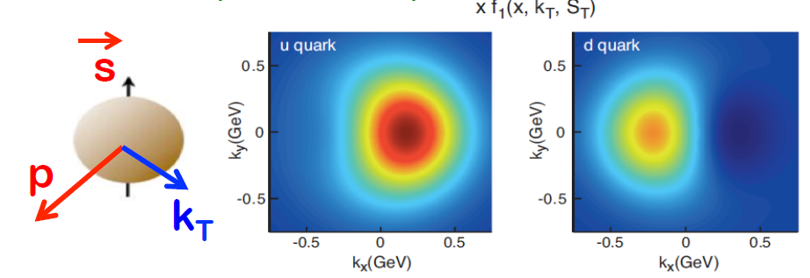
Open Questions driving the spin physics
How do quarks/gluons + their dynamics make up the proton spin?
How is proton’s spin correlated with the motion of the quarks/gluons?
How does proton’s spin influence the spatial distribution of partons?
Deformation of parton’s
confined motion
When hadron is polarized?
TMDs!
Deformation of parton’s
spatial distribution
When hadron is polarized?
GPDs!

Slide 27
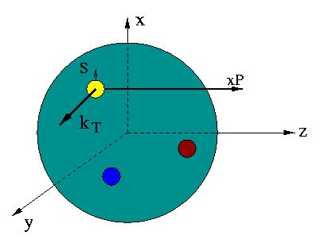
Unified view of nucleon structure
5D Dist.
W_{p}^{u}(x,k_{T},r ) Wigner distributions (X. Ji)
6D Dist.
d³r
d²k_{T} dr_{z}
TMD PDFs f₁^{u}(x,k_{T}), .. h₁^{u}(x,k_{T})‏
GPDs/IPDs
3D imaging
dx &
Fourier Transformation
d²k_{T}
d²r_{T}
Form Factors
G_{E}(Q²),
G_{M}(Q²)‏
PDFs
f₁^{u}(x), .. h₁^{u}(x)‏
1D

Slide 28
Unified view of nucleon structure
5D Dist.
W_{p}^{u}(x,k_{T},r ) Wigner distributions (X. Ji)
6D Dist.
d³r
d²k_{T} dr_{z}
TMD PDFs f₁^{u}(x,k_{T}), .. h₁^{u}(x,k_{T})‏
GPDs/IPDs
3D imaging
dx &
Fourier Transformation
d²k_{T}
d²r_{T}
Form Factors
G_{E}(Q²),
G_{M}(Q²)‏
PDFs
f₁^{u}(x), .. h₁^{u}(x)‏
1D
Experimentally

Slide 29

Structure functions and PDFs : Polarized case
beam/target helicity flips
Only scattered leptons are detected
Experimental observables
PDFs
A_{LL} , A_{LT}
Quark-Parton Model
QPM
Polarized pdfs
(A₁, A₂)
Q² << M_{Z}²
Helicity distribution ∆q=q↑(x) - q↓(x)
Polarized structure functions
g₁ , g₂

Slide 30
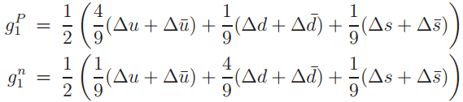

Flavor decompositions
With pure ү exchange in inclusive DIS:
Hmm … No third kind
of nucleon … No...
Assumption: SU(3) flavor symmetry
  Additional inputs from β-decay of neutron and hyperons
Δu + Δd -2 Δs
Δu + Δd
A way out:
SIDIS measurements: with the initial quark flavor tagged
    Fragmentation Functions needed

Slide 31
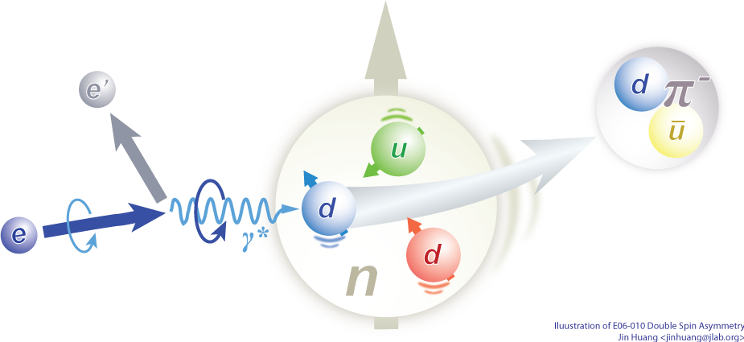

SIDIS processes for flavor decompositions
Electron-proton scattering
Pion/Kaon
Fragmentation Functions
Experimental observable: polarized structure functions g1
input
input
Leading Order picture
Extracted nucleon structure information: polarized PDFs (helicity distribution)

Slide 32

Spin of the nucleon-helicity distribution
A NLO impact study
See arXiv:2103.10276
JHEP08(2021)034
EicC white paper
EicC coverage
EIC Yellow Report

Slide 33

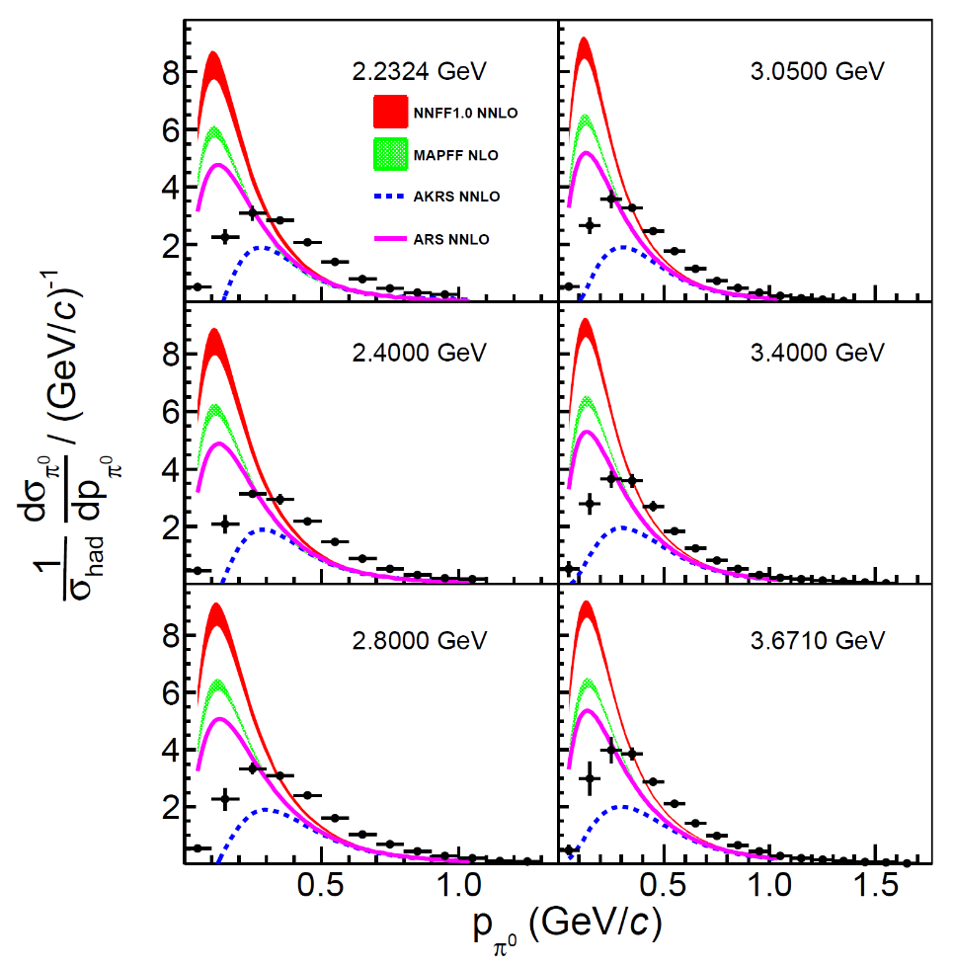
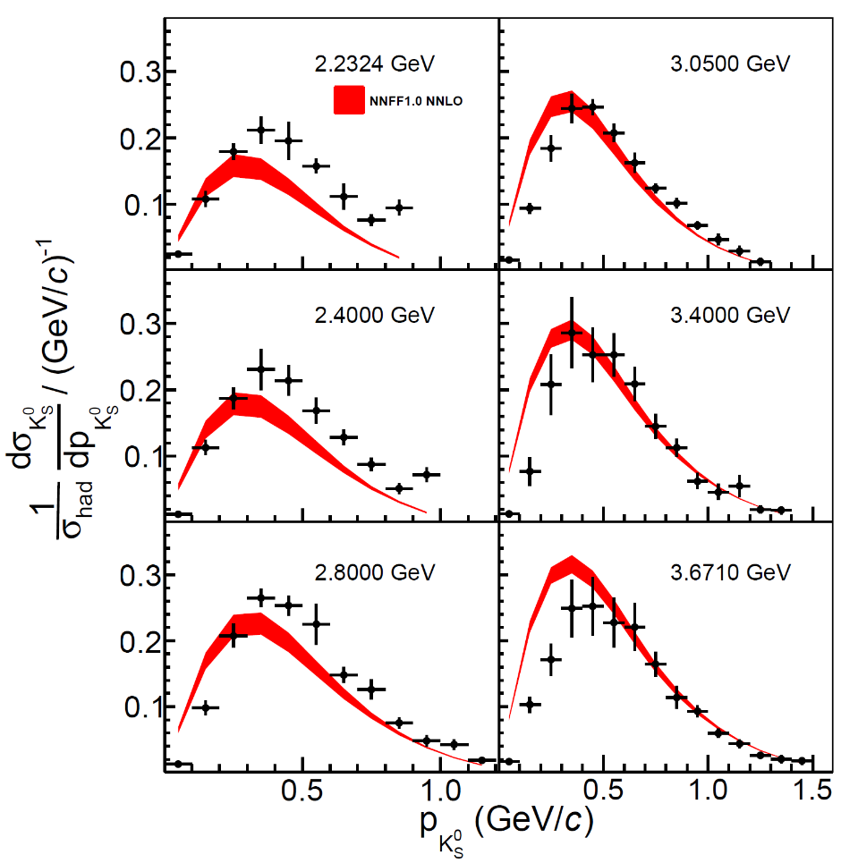
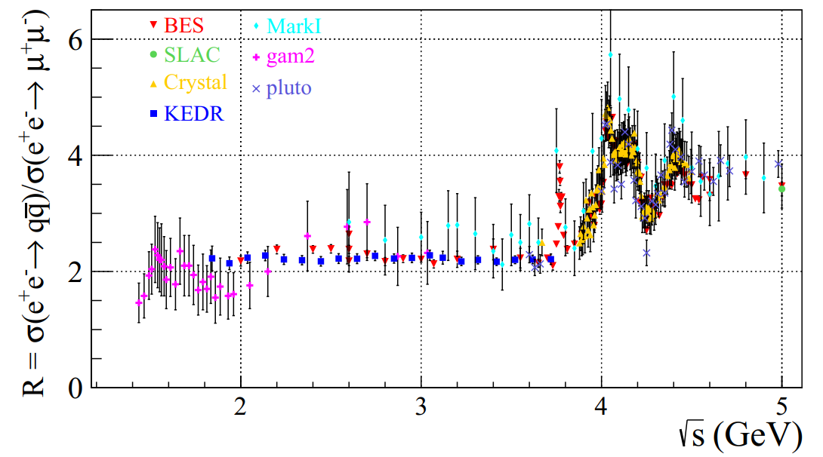
Multiplicity measurements at BESIII
Multiplicity:
~
at LO
h is a particular type of hadron such as π⁰, π^{+/-}, K^{+/-} …
First precision measurements at BESIII: Phys. Rev. Lett. 130, 231901 (2023)
Analyses of many other final states are ongoing → provide inputs for future EIC
BESIII energy coverage

Slide 34
EicC and EIC-gluon polarization (at large x)
arXiv:2211.15587
D. Anderle , X. Dong, …, E. Sichtermann, …, F. Yuan, Y. X. Zhao Phys. Rev. D104, 114039 (2021)
EIC
e'
e
complementary
arXiv:2209.08584
EicC

Slide 35
Unified view of nucleon structure
5D Dist.
W_{p}^{u}(x,k_{T},r ) Wigner distributions (X. Ji)
6D Dist.
d³r
d²k_{T} dr_{z}
TMD PDFs f₁^{u}(x,k_{T}), .. h₁^{u}(x,k_{T})‏
GPDs/IPDs
3D imaging
dx &
Fourier Transformation
d²k_{T}
d²r_{T}
Form Factors
G_{E}(Q²),
G_{M}(Q²)‏
PDFs
f₁^{u}(x), .. h₁^{u}(x)‏
1D
Experimentally

Slide 36


TMDs in SIDIS Cross Section
Target SSA, beam-target DSA measurements

Slide 37

Separation of Collins, Sivers and Pretzelosity through azimuthal angular dependence
UT: Unpolarized beam + Transversely polarized target
→TMD: Transversity
→TMD: Sivers
→TMD: Pretzelosity

Slide 38
EicC and EIC-Sivers TMDs
C. H. Zeng, T. B. Liu, P. Sun, Y. X. Zhao, PRD106.094039 (2022)
Higher Q²
S. Aybat et. al. Phys. Rev. Lett 108, 242003 (2012)
EicC
38
Higher Q², smaller effect
Smaller x, smaller effect
complementary

Slide 39





Spin structure of the nucleon-GPDs
The extraction of CFF with neural network methods [Kumericki, 19]
Only with this azimuthal angular modulation

Slide 40
Highlighted physics topics
Spin of the nucleon: 1D, 3D
  polarized electron + polarized proton/light nuclei
Partonic structure of nuclei and the parton interaction with the nuclear environment
  unpolarized electron + unpolarized various nuclei
Exotic states with c/cbar, b/bbar (BESIII community in China)
Mass of the nucleon

Slide 41
“old” and long standing problems for cold nuclear matter effect
arXiv:2107.12401

Slide 42

Nuclear PDFs study with ion beam
EicC coverage
With only a few hours of running

Slide 43
Nuclear medium effect for parton propagation and hadronization

Slide 44
Highlighted physics topics
Spin of the nucleon: 1D, 3D
  polarized electron + polarized proton/light nuclei
Partonic structure of nuclei and the parton interaction with the nuclear environment
  unpolarized electron + unpolarized various nuclei
Exotic states with c/cbar, b/bbar (BESIII community in China)
Mass of the nucleon

Slide 45
Quarkonium as a probe
Gluon GPDs
Spectroscopy
Quarkonium
Gluon TMDs
Nucleon mass ?
Nuclear medium effect

Slide 46
J/Psi production at EicC

Slide 47
Upsilon production at EicC

Slide 48
Exotic states production at EicC

Slide 49
Highlighted physics topics
Spin of the nucleon: 1D, 3D
  polarized electron + polarized proton/light nuclei
Partonic structure of nuclei and the parton interaction with the nuclear environment
  unpolarized electron + unpolarized various nuclei
Exotic states with c/cbar, b/bbar (BESIII community in China)
Mass of the nucleon

Slide 50

Proton mass study
Lattice QCD calculation by Yang et al, 2018
?
EicC coverage

Slide 51

Proton mass study
GPDs 研究
Gravitational Form Factors
Defining Ma related observables…ongoing efforts

Slide 52
Outline
General introduction
Physics highlights
Project status
Summary

Slide 53

Towards Conceptual Design Report (CDR)
EicC white paper
CDR preparation
…

Slide 54


Why we need an Electron-Ion Collider
Electron-Ion Collider：
Polarized beams (first time)
High lumi.（100-1000 x HERA）
High polarization ~70%
Full detector coverage
Bjorken scaling (unpol.)
“Spin crisis” (pol.)
“HERA Legacy” (unpol.)
3-D structure
Quotation from “Why we need an EIC” by Raju Venugopalan, 2021
Only feasible with a polarized EIC
Nailing down the quark and gluon spin content of the proton
Three dimensional images of the internal structure of hadrons
Exploring the terra incognita of the nuclear quark-gluon landscape
Discovery and characterization of universal gluon matter?

Slide 55
Working groups
Accelerator | Physics | Detector
1) EicC Accelerators | 1) 1D spin | 1) Vertexing + tracking
2) Ion Sources | 2) 3D spin (TMDs + GPDs) | 2) PID
3) Ion Machine | 3) Exotic states | 3) Calorimetry
5) Electron Machine | 4) EHM and proton mass | 4) IR + Magnet
5) Polarization | 5) Nuclei | 5) Luminosity and polarimetry
6) Electron cooling | 6) LQCD | 6) Forward detector
7) IR | 7) DSE | 7) DAQ
8) Common System | 8) New ideas: (1) Jets (2) Heavy flavor observable (3) Fragmentation function | 8) Simulations
 |  | Software: EicCRoot
EicC CDR Volume I | EicC CDR Volume II

Slide 56

EicC detector considerations
Detailed full Geant4 simulation is ongoing

Slide 57





Subsystem simulations---an example
Tracking with all-silicon or Si+MPGD design
arXiv:2102.08337
Calorimetry system

Slide 58






Detector R&Ds
sTGC detector
25cm x 25 cm Micromegas mass production
R&D on 0.4m x 0.4m
Clean rooms of ISO6 and ISO7 (in total of 200 m²) for detector assembling
Shashlyk and W-powder+ScFi EMCal
ALICE style ITS2 MAPS pixel detector
1m x 0.5 m GEM (self-stretching)
DIRC prototype

Slide 59
Timeline
First version of EicC CDR
CY | 18 | 19 | 20 | 21 | 22 | 23 | 24 | 25 | 26 | 27 | 28 | 29 | 30 | 31 | 32 | 33 | 34 | 35
 | 5-year-plan |  |  | 5-year-plan |  |  |  |  | 5-year-plan |  |  |  |  | 5-year-plan
 | HIAF
EicC |  |  |  | R&D
 |  |  |  |  |  |  |  |  | √s ~ 17GeV, 2x10³³/s/cm²
 |  | R&D and construction
 |  | In operation

Slide 60
To follow our regular meetings/workshops
For subscription to the eicc_member mailing list, please do it in the following link:
http://lists.ustc.edu.cn/sympa/subscribe/eicc_member?previous_action=info
For subscription to the eicc_physics mailing list, please do it in the following link:
http://lists.ustc.edu.cn/sympa/subscribe/eicc_physics?previous_action=info
For subscription to the eicc_detector mailing list, please do it in the following link:
http://lists.ustc.edu.cn/sympa/subscribe/eicc_detector?previous_action=info
For subscription to the eicc_accelerator mailing list, please do it in the following link:
http://lists.ustc.edu.cn/sympa/subscribe/eicc_accelerator?previous_action=info

Slide 61
Thanks
and
you are more than welcome to join the effort!

Slide 62
Backups

Slide 63


EicC Detector Overview
Subsystems to realize the EicC physics goals:
  Vertex & tracking detectors
  PID detectors
  Calorimeters
  Far Forward detectors
  Luminosity monitor & Polarimetry
  DAQ
  Simulation & software
Questions need to be addressed:
  Targeted resolutions
  Technology candidates
  Simulation results
  R&D activities or plan
  Inputs to DAQ

Slide 64

1. Vertex and tracking detector
Yuming Ma, Aiqiang Guo, Yutie Liang, Yuxiang Zhao (IMP)
Physics requirements for EicC tracking:

Slide 65

-Yuming Ma
Further dedicated optimization of the scale and structure recently based on Det_v3

Slide 66




Performance with new tracking design
-Yuming Ma

Slide 67


2. PID detectors
- Xin Li (IMP)
实现EicC实验中高亮度、大动量范围的带电粒子鉴别
快速响应和超高分辨
结构紧凑，抗辐照
PID探测器方案：
桶部：内反射切仑科夫探测器（DIRC）
端盖：环形成像切仑科夫探测器（mRICH、dRICH）
低动量（<1GeV/c)：MPRC、LGAD
PID momentum coverage:
<4 GeV/c at e-Endcap;
<15 GeV/c at ion-Endcap ;
<6 GeV/c at Barrel
不同粒子鉴别探测器覆盖动量范围

Slide 68



端盖PID探测器
- Xin Li (IMP)
Modular RICH是一种基于气凝胶的切仑科夫探测器。它利用菲涅耳透镜产生聚焦作用以提高粒子分辨能力（菲涅耳透镜聚焦对透射光波长范围具有限制作用，可减小瑞利散射效应）。其结构紧凑灵活，可以在末端安装高精度PMT测量飞行时间信息，进而提高其PID能力。
Dual RICH则包含两种不同折射率的辐射体，因此能够覆盖更大动量范围。由于气凝硅胶辐射体可覆盖低动量区，在中等动量区与气体辐射体覆盖范围重叠，因此dRICH测量范围不存在中间“空白区”。
预期目标：
Modular RICH实现3σ π/K分辨范围 ~6 GeV/c（径迹角分辨~1mrad）
采用气凝胶+气体辐射体（C₂F₆）dRICH探测器，预期可达15GeV/c的3σ π/K分辨。
目前方案调研中

Slide 69




桶部PID探测器
- Xin Li (IMP)
内反射切仑科夫探测器（DIRC）：
不同带电粒子激发的切仑科夫辐射角不同，基于这一原理的DIRC探测器通过测量不同粒子激发切仑科夫光的传输时间和出射角度不同进行粒子鉴别。
预期目标：
采用熔融石英作为切仑科夫辐射体，MPC-PMT作为光电探测阵列，作为紧凑型桶部探测器实现高动量（1~6GeV/c）的粒子鉴别
为此需要~1mrad的角分辨，以及皮秒量级的时间分辨（<100ps)
多通道皮秒定时电子学的配套研发
研究进度：
参考PANDA和EIC的桶部DIRC探测器设计，模拟完成DIRC初步方案，小尺寸DIRC原型制作中
桶部DIRC方案
PANDA和EIC的DIRC粒子鉴别范围

Slide 70







桶部DIRC方案
- Xin Li (IMP)
NLAK33B/PbF
Heraeus suprasil-312
Fused silica
MCP-PMT array
R10754/H13700
ESR reflection film
聚焦前
Fused silica radiator
聚焦后
Focus Lens
石英辐射体: 13mm x 35mm x 2600mm
梯形光导: (30mm+220mm) x 320mm x 300mm
MCP-PMT: 滨松 R10754 (5.75mm, 4x4 Pixel) / H13700 (3mm, 16x16 Pixel)
聚焦透镜: 3-layer lens (fused silica + NLAK33B glass) curvature radius: 30◦, 30/7.5cm, 厚度1cm
微型光导：漏斗形光导(厚度2~3mm)连接梯形光导和单个PMT像素单元，消除PMT边框死区和减小串扰影响

Slide 71





单块DIRC角分辨和PID性能模拟
- Xin Li (IMP)
Different transit time cut & correlation for forward & backward photons
Entries/1000
Forward photons
ESR film
6GeV/c Pion
Backward photons
Transit time(ns)
σ_{θc} (mrad)
前后向出射光子分开进行传输时间甄别和切仑科夫辐射角重建
不同位置分辨PMT（R10754/ 13370）对应的DIRC角分辨(~1mrad)；角分辨~1mrad时，不同时间分辨对应的6GeV/c π/k分辨能力随粒子入射角的变化(>3σ)。
Separation power [s. d.]
Black: σ_{t} = 120ps
Red: σ_{t} = 70ps
Green: 5.75mm PMT pixel
Blue: 3mm PMT pixel
Polar Angle (◦)
Polar Angle (◦)

Slide 72

MRPC/TOF PID at low momentum
- Yi Wang (Tsinghua)
Standard parameters:
Resistivity of glass: ~10¹² Ω.cm
Working gas: 90%Freon+5%iso-butane+5% SF6
Time resolution <100ps
Efficiency >95%
Charge: a few PC
Dark current: a few nA
Noise ~1Hz/cm²
Rate <100 Hz/cm²
Large area, low cost
Read out
Insulator
Carbon
Resistive
plate
Insulator
Read out
MRPC structure
TOF PID:
π /k ~1.6 GeV/c,
(π,k)/p ~ 3.0 GeV/c

Slide 73


Toward 20ps resolution: narrow gap MRPC
- Yi Wang (Tsinghua)
Simulation indicates proper ways to design the gap thickness and arrange the stacks
Narrower gap thickness required
σ_{TOF} <20 ps，the intrinsic resolution of narrow gaps MRPC is around 15ps，so the time jitter of readout electronics <13~15 ps。
σ_{MRPC} <20 ps，the gas gap: <0.18mm
gap number: >16

Slide 74



LGAD Reference
低增益雪崩探测器(LGAD)：一种超快响应硅探测器。通过半导体中局部雪崩放大产生具有快速上升沿的信号脉冲，进行高时间分辨的粒子鉴别。相比MRPC，它的结构更紧凑，测量飞行时间之外还可提供高分辨粒子径迹位置信息。
预期目标：
实现低动量（0.1~2GeV/c)的带电粒子鉴别
皮秒量级的高时间分辨（~30ps）。
LGAD的像素探测单元尺寸可达几十um，提供高精度粒子径迹重建信息。
EicC Barrel
Radius ~80cm (try to achieve 50cm)
Time resolution ~20ps

Slide 75






Cosmic Ray Platform
不同批次闪烁体的发光效率
宇宙线测试平台：闪烁体 + SiPM, 8 layer (4 layer for x, y each), 探测面积 50cm x 50cm
One layer：3 module + 1 electronics
One module：16块EJ-200 + 32根光纤 + 8 SiPM
位置分辨~1mm, 时间分辨<100ps
*Cooperation with the EicC USTC group

Slide 76

3. Calorimeter system for EicC
Ye Tian, Dexu Lin/ (IMP)
Basical ECal special requirement:
E-endcap: good low energy resolution
Barrel: short radius, good angle resolution
Ion-endcap: angle resolution, π⁰ reconstruction, PID.
e-Endcap
ion-Endcap
Barrel
Detector | Pseudorapidity | Angle(degree)
Ion-Endcap | 3 | 5.7
 | 1.5 | 25.2
Barrel
 | -1 | 139.6
e-Endcap
 | -3 | 174.3

Slide 77



Ecal Design in Simulation
Ye Tian (IMP)
Shashlik module
General design of whole Ecal Detector.
CsI is applied in e-endcap, Shashlik style is applied in both barrel and ion-endcap
The actual distances of the two endcaps to IP depend on the available space of the EicC design
Z=2.4 m
Z=-1.5m +
R=0.9m
CsI module
 | EMC | type | z/r[m] | Length[cm],X₀ | Coverage[cm] | pseudorapidity | Tower size
EicC | e-endcap | CsI | Z=-1.5 | 30, 16X₀ | 15.0<r<128 | (-3.0, -1.0) | 4.0*4.0(front)
 | barrel | Shashlik | R=0.9 | 45, 16X₀ | -105.8<z<187.5 | (-1.0, 1.5) | 4.0*4.0 (front)
 | Ion-endcap | Shashlik | Z=2.4 | 45, 16X₀ | 24.0<r<113 | (1.5, 3.0)

Slide 78
Module (7x7) array simulation result
Ye Tian (IMP)
Shashlik simulation result
CsI simulation result
Energy resolution
Energy resolution
Position resolution
Position resolution
Energy resolution

Slide 79


Shashlik ECal cosmic ray test result
Ye Tian (IMP)
Assembled Shashlik module
Horizontal cosmic ray NPE spectrum (PMT)
Landau peak: 62.8 (NPE)
Horizontal test setup
Module
Trigger scintillator

Slide 80


CsI(Tl) attenuation cosmic ray test
Ye Tian (IMP)
The attenuation length is a main parameter of CsI(Tl), influence the uniformity of energy deposit
Simulation shows muon deposit 22.3 MeV in CsI, created 1.1M photons.
Fitted by $y=A∙e^{− \frac{x}{λ}}$
λ=21.6 ± 4 cm
λ=24.8 ± 4.4 cm
Cosmic ray signal sample
Short attenuation length confirmed, even though the appearance of crystal is transparent!

Slide 81

4. Far Forward Detectors
Weizhi Xiong(SDU), Yutie Liang (IMP)

Slide 82
New Design of FF Beamline
Dipole 1: z = 5 m B = 2.52 T L = 0.8 m
R1 = p*10/3./B1 = 20GeV*10/3./2.52 = 26.455 m
Bending angle = asin(L/R) = 0.03 rad = 30 mrad
Dipole 3: z = 15.4 m B = -3.4 T L = 0.8 m
R2 = p*10/3./B2 = 20GeV*10/3./2.69 = 19.61 m
Bending angle = asin(L/R) ~ 0.04 rad = 40 mrad
Dipole 2: z = 10 m B = 2.69 T L = 2.0 m
R2 = 24.783 m
Bending angle = 80 mrad
Dipole 4: z > 16 m B = ? L = ? m
R2 = ? m
Bending angle = 120 mrad
O
L=0.8m
50 mrad
A
R3
= 19.61m
B
50 mrad
30 mrad
R1
= 26.455m
50 mrad
30 mrad
80 mrad
R2
= 24.783m
C
D
L=0.8m
40 mrad
120 mrad
Slides from Yutie

Slide 83


Material Effect for Neutron
Weizhi Xiong(SDU)
ZDC
Current ZDC acceptance +/- 15 mrad, 13.5m from IP
New beamline design effectively reduce all material effect due to beam pipe and air
Plan to work on ZDC digitization and full detector response studies
+/- 15 mrad cone
Result shown in EicC 3rd CDR
Current result

Slide 84


5. Beam polarimetry & luminosity monitor
Boxing Gou (IMP), Jinlong Zhang(SDU), Yutie Liang (IMP)
Electron end
Luminosity & e polarimetry
Ion end

Slide 85


Slide 86




Recent studies on proton polarimetry
Boxing Gou (IMP)

Slide 87

6. DAQ design
Kai Chen (CCNU)
- Streaming Readout

Slide 88

Kai Chen (CCNU)

Slide 89

Yutie Liang (IMP)
7. Simulation framework & software
Structure of EiccRoot
Top level: ROOT, Virtual MC, etc.
Middle level: FairRoot framework manages the general infrastructure with simulation and tasks
EiccRoot: implementation of the EicC detector sim. and rec. inside FairRoot framework
Notes:
FairRoot is a software framework mainly for high energy and nuclear physics experiments.
FairRoot is developed based on ROOT. In this plot, the top level shows the common used softwares, such as ROOT and Geant4. FairRoot depends on these softwares.
The middle level shows the structure of FairRoot. It manages the general infractructure with simulation and tasks.
The bottom level shows the specific experiment implementation using FairRoot. Currently, there are many experiments using FairRoot, such as PANDA, CBM, and EicC.

Slide 90

Yutie Liang (IMP)

Slide 91


Yutie Liang (IMP)
EicC software update & status
Tracking, ECal, Forward detector packages in good shape
EiccRoot_2.0.0 released with main updates of:
  Full magnetic fields (16 field maps) in the IR region
  GenFit package adapted using field map service in EiccRoot
  EiccBoxGenerator and EiccEvtGenHybrid updates
  Complete beam pipe design from -40 to 20 meters
IR + Magnet
Beam Pipe
Central: solenoid
Ion Forward region: 3 dipoles + 3 quadrupoles
Electron Forward region: 4 dipoles + 5 quadrupoles

Slide 92
EicC detector design

Slide 93



EicC detector design
Tracking: Silicon + MPGD
1.5 T magnet

Slide 94

EicC detector design
PID: ToF + (DIRC + RICH)

Slide 95







EicC detector design
PID: ToF + (DIRC + RICH)
DC-LGAD
AC-LGAD

Slide 96

EicC detector design
PID: ToF + (DIRC + RICH)
Focusing mirror
Photon sensor

Slide 97



EicC detector design
Ecal: Shashlik + CsI crystal
Shashlik
CsI crystal

Slide 98

EicC detector design
Far-Forward detector
IP
Electron beam
ZDC
EDT
Ion beam
FDT

