Slide 1

Gamow shell model description of neutron-rich
He hyper-isotopes
Xin Li
East China Normal University, Shanghai
Cooperators: Prof. Nicolas Michel (IMP), Associate Prof. Jianguo Li (IMP)
The 23rd International Conference on Few-Body Problems in Physics (FB23), Beijing, China, 2024/9/23
Notes:
Good afternoon! It is an honor to be here at the 23 rd international conference on few body problems in Beijing.
My name is xin Li, form east China normal university in shanghai, and I am excited to present my reasearch today.
I have worked under the supervisor of prof. Xian-Rong Zhou, with valuable cooperation of prof. Nicolas Michel and Associate prof. jian guo Li.
Today I will be discussing our recent work on the Gamow shell model description of neutron-rich He hyper-isotopes.

Slide 2
Outline
Introduction
Gamow Shell Model framework
Neutron-rich hyper-isotopes
Energy spectra
Particle occupation probabilities
Neutron densities
Summary
2024/9/23 Beijing
Notes:
My presentation is mainly divided into the following four parts. First, I’ll provide a brief overview of the hypernuclei and current experimental progress.
Next, I’ll introduce the framework of Gamow shell model and how to extend to hypernuclei.
Then the results of the neutron-rich hyper-isotopes are presented for prove the validly of our model.
Finally, a summary will be given.

Slide 3
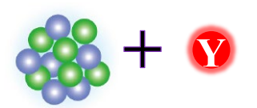
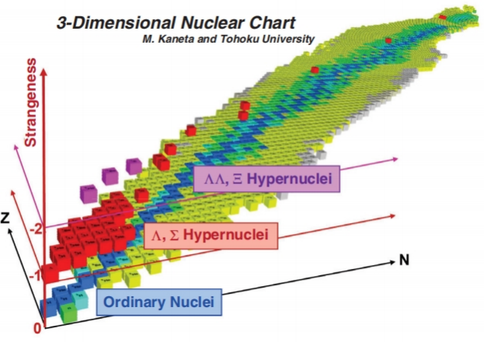

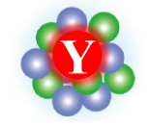
Introduction
nucleon
hyperon/meson
The most abundant experimental data.
Λ、 Λ Λ 、 Ξ 、Σ
Hypernuclei
K⁻ pp
H. Tamura, Prog. Theor. Exp. Phys. 1, 02B012 (2012).
Notes:
Let’s start by introducing hypernuclei. We’re all quite familiar with ordinary nuclei, which are finite quantum systems made up of protons and neutrons.
When one or more of these nucleons are replaced by strange particles, a hypernucleus is formed.
The addition of strange particles transforms the nuclear chart, which originally only had two dimensions—proton number and neutron number—into a three-dimensional one.
Hypernuclei are classified based on the type of hyperons they contain, such as Λ hypernuclei, double-Λ hypernuclei, Ξ hypernuclei, and Σ hypernuclei.
There are also mesonic (mi zao nic )nuclei, which consist of a kaon(ki on) and two protons.
Among these, the single-Λ hypernucleus was the first one to be discovered experimentally and remains the most extensively studied type.

Slide 4
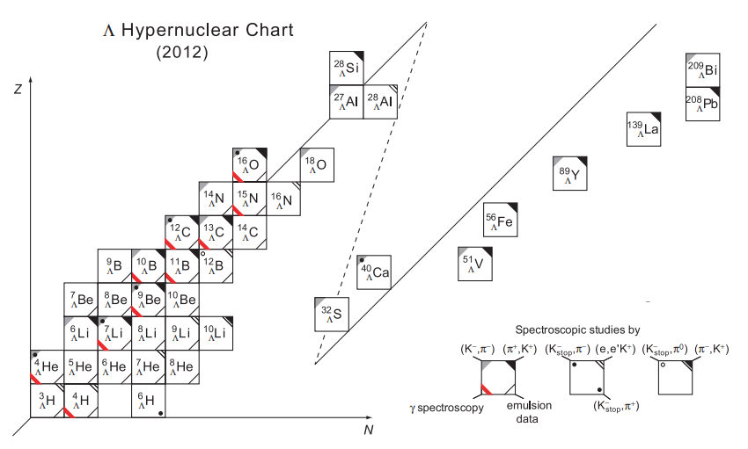
Experimental progress
Production of hypernuclei ：
Pion-induced reactions
Heavy-ion collisions
Electron-nucleus reactions
…
Buyukcizmeci, N et al., The Eur. Phys. Jour. A 56 (2020)
Buyukcizmeci, N et al., Phys. Rev. C 108, 05490 (2023).
M. Kozhevnikova et al., Phys. Rev. C 109, 034901(2024)
A. Kittiratpattana et al., Phys. Rev. C 109, 044913 (2024)
… …
Bombarding nuclear emulsions with beams generated either by cosmic rays or particle accelerators.
H. Tamura, Prog. Theor. Exp. Phys. 2012, 02B012.
Notes:
In the first two decades(dai k z) of research, hypernuclei were mainly produced by bombarding nuclear emulsions(yi mao shen s) with beams generated either by cosmic rays or particle accelerators.
At that time, most of the experimental data focused on hypernuclei in the light-mass region, where the mass number A is less than 16.
For helium hyper-isotopes, experimental observations have confirmed the existence of Λ4He throughΛ8​He.
Currently, the main methods for producing hypernuclei include pion-induced reactions, heavy-ion collisions, and electron-nucleus reactions, among others.

Slide 5
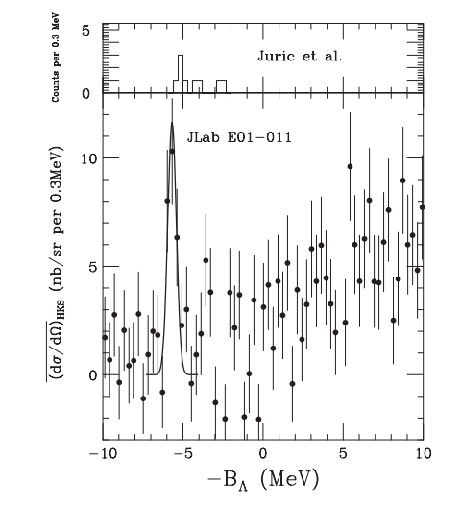
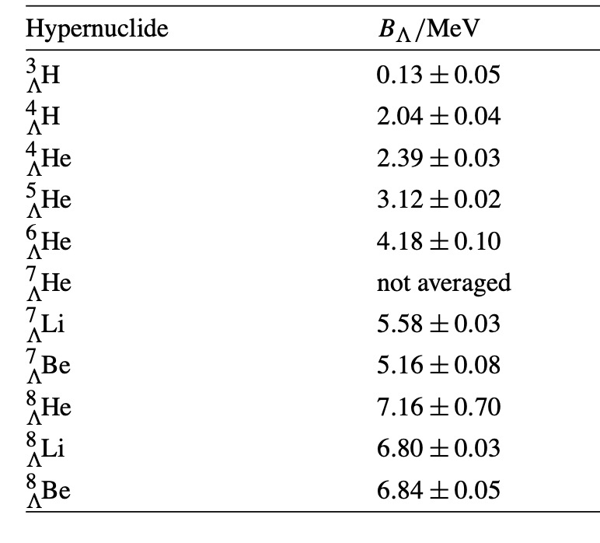
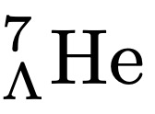
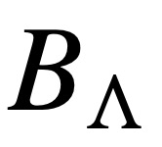
Experimental progress
Binding energies of light hypernuclei measured in emulsion.
5.55 ± 0.10(stat.)
± 0.11(sys.)
= 5.68 ± (stat.) ± 0.25(sys.) MeV
D.H. Davis , Nucl. Phys. A 754 (2005)
S. N. Nakamura et al., Phys. Rev. Lett 110, 012502 (2013)
Notes:
In particular, He7Lambda was observed in 2013 at Jefferson Laboratory (JLAB)
Following this discovery, the experiment was repeated (ri pi tei d) with five times, and the binding energy was reported to be 5.55 ± 0.10(stat.) ± 0.11(sys.).
For He8Lambda, there have been six events by emulsion data, which has large error bar 0.7 Mev.

Slide 6
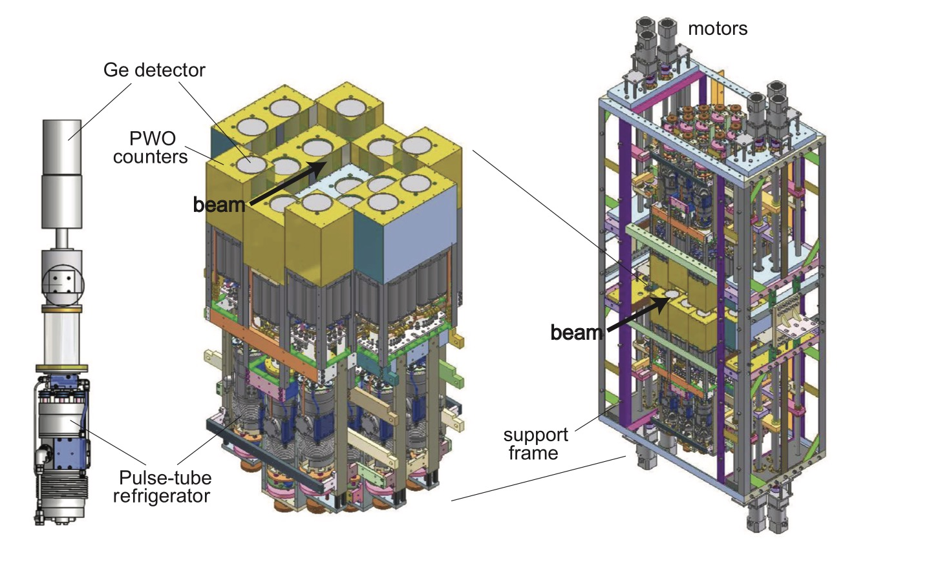
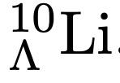
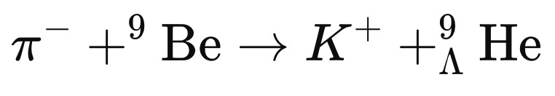
Experimental progress
Japan proton accelerator
research complex (J-PARC)
Double-charge-exchange reaction
(π⁻,K⁺) on ¹⁰B to produce
Next Plan
H. Tamura, Prog. Theor. Exp. Phys. 2012, 02B012.
Notes:
Neutron-rich or proton-rich nuclei can exhibit exotic structures and novel phenomena, such as shell evolution, shape coexistence, and halo structures.
It is crucial for studying nucleon-hyperon interactions.
Experimentally, a pioneering (pair nier ring) study used a double-charge exchange reaction on a Boron10(bao run) target to produce the neutron-rich hypernucleus Lithium10Lambda.
Building on this experience, it should now be feasible to produce Helium9Lambda at J-PARC.
This hypernucleus would be an extremely exotic system. Therefore, it is timely to study Helium hyper-isotopes.

Slide 7
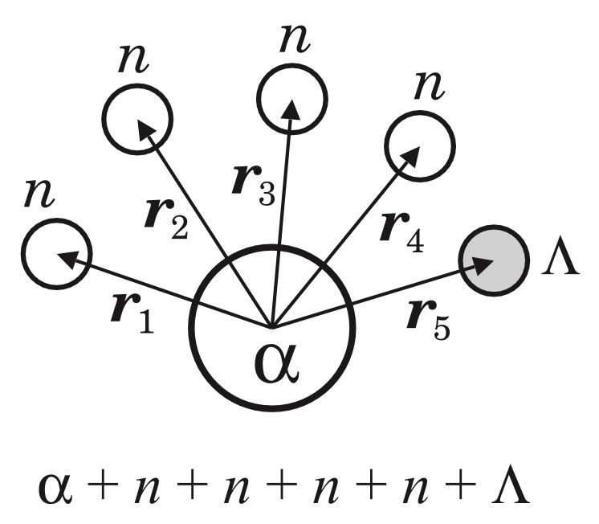



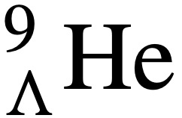

Theoretical progress
Theoretically, have studied
by using two-body, three-body, and four-body cluster models, respectively.
E. Hiyama et al., Phys. Rev. C 53, 2075 (1996).
E. Hiyama et al., Phys. Rev. C 80, 054321 (2009).
E. Hiyama et al., Phys. Rev. C 91, 054316 (2015).
Recently, Myo et al. predicted the energy spectra of
within the framework of an six- body cluster model using the cluster orbital shell model (COSM).
Without ΛN − ΣN coupling.
The relative coordinates of the five valence particles around the α cluster
T. Myo and E. Hiyama, Phys. Rev. C 107 054302 (2023)
Notes:
There have been several theoretical studies on neutron-rich hypernuclei, including Λ5He, Λ6He, and Λ7​He, which were studied by using cluster models.
Recently, Myo et al. predicted the energy spectra of Λ9He within the framework of a six-body cluster model using the Cluster Orbital Shell Model (COSM).
They describe the neutron-rich He isotopes assuming an alpha cluster represents the strongly bound He4 core.
The relative coordinates of the five valence particles around the alpha cluster are shown in this picture.
However, their study used an effective single-channel ΛN interaction, without including ΛN-ΣN coupling.

Slide 8
Motivation
The Gamow Shell Model (GSM) is a powerful tool for the description of the exotic properties of drip line nuclei. The main purpose of the present work is to investigate the structure of neutron-rich He hyper-isotopes with the complex-energy GSM extended to hypernuclei, including ΛN−ΣN coupling.

Slide 9
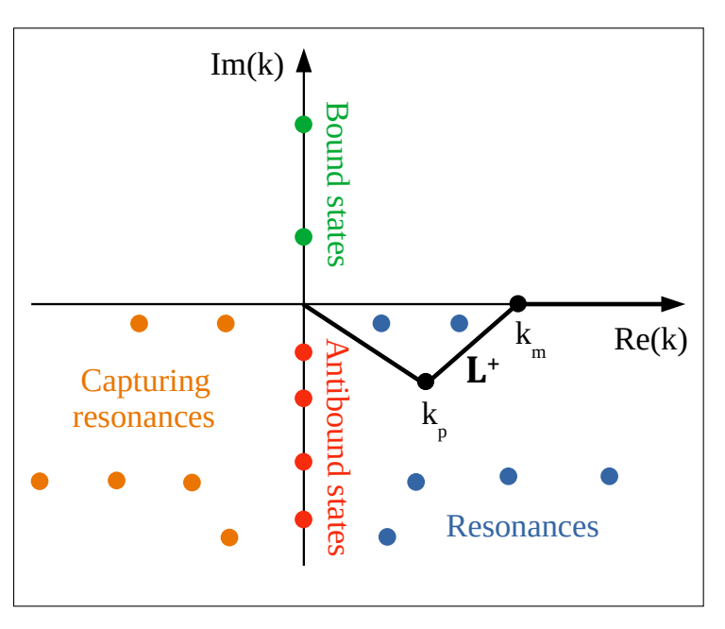
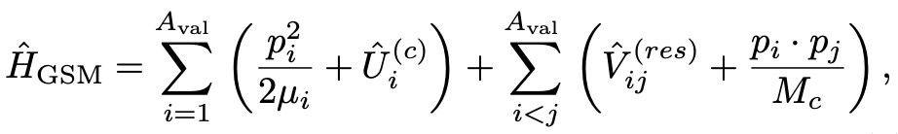
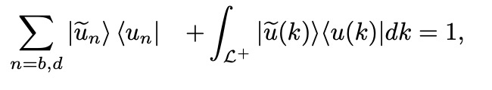
Gamow shell model framework
GSM Hamiltonian reads with COSM coordinates
Satisfies the following completeness relation
Recoil term of the ⁴He core
Berggren basis : bound, resonance and scattering states
N. Michel, M. Płoszajczak,
The Gamow Shell Model:
the unified theory of nuclear structure and reactions,
Lecture Notes in Physics, Springer (2021)
Notes:
In this work, we also assume that the neutron-rich He hyper-isotopes can be described by a system of valence baryons(bai rui angs) evolving around an inert (yi ner t) 4He core.
The GSM Hamiltonian in COSM coordinates (kao ao de ne s) can be expressed this form
The single-particle basis is the Berggren basis, generated by a finite-depth potential (typically (ti pi kao lei) of Woods- Saxon type).
The Berggren basis contains bound, resonance, and scattering states, and satisfies (sai tei s fai s) the following completeness relation for a given partial wave of quantum numbers.

Slide 10



Gamow effective Hamiltonian of hypernuclei
Core-valence interaction (One-body interaction)
Interaction between valence baryons (Two-body interaction)
NN interaction：
Central term
Spin-orbit term
Coulomb term
N.Michel et al., 2009 J. Phys. G: Nucl. Part. Phys. 36 013101
Notes:
The GSM interaction consist of the one-body core-valence potential and two-body interaction between the valence baryons(bai rui angs) .
The core-valence potential is taken as a Woods-Saxon field, with a central term, a spin-orbit term, and a Coulomb term for protons and charged hyperons.
The interaction between valence baryons can be divided into two parts.
For nucleon-nucleon (NN) interaction, we adopt a two-body effective nuclear potential which include central, spin-orbit, tensor, and Coulomb terms.

Slide 11
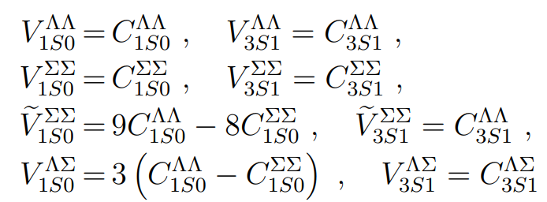
Gamow effective Hamiltonian of hypernuclei
ΛN interaction
5 contact terms : fit from experimental data.
3 other contact terms : SU(3)f –symmetry.
Henk Polinder et al., Nucl. Phys. A 779 (2006) 244–266
Notes:
For hyperon-nucleon interaction,
These 5 contact terms need to be fit from the experimental data.
The other three contact terms are then determined by SU(3)f -symmetry.

Slide 12
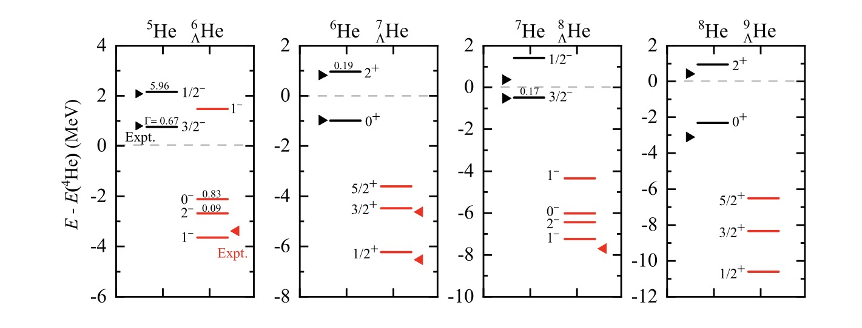
Results——Energy spectra
Deeply bound state 1/2⁺
Weakly bound state 3/2⁺
Narrow resonant state 5/2⁺
Xin Li, N. Michel, J. G. Li and Xian-Rong Zhou, arXiv:2408.16223vl
Notes:
We show the energies of low-lying states of Helium hyper-isotopes and associated nuclei.
Resonance wave functions are given by Gamow states.
For Helium5 to Helium8, one can see that the calculation (black lines) are in good agreement with the experimental data (black triangles(chuan gao s)).
GSM accurately (ai) reproduces the neutron-emission (ei mei shen) width of (wei sao fu)the resonance states.
For hypernuclei, the observed Λ binding energy in Helium6 Λ is well reproduced (re pro diu s d ). Three resonant states and one bound state are given in our calculations.
It should note that the core nucleus Helium5 is unbound and the addition of Λ hyperon result the ground state of Helium6 Λ is bound only by 0.17 MeV with respect to the Helium5 Λ + n threshold (si rai shi hold).
Thus Helium6 Λ is a typical neutron halo nucleus.
We also predict the energy spectra of the hypernucleus Helium9Λ. The addition of the Λ hyperon significantly increases the baryonic (bai rui ang nei k) binding, resulting in a deeply bound state, a weakly state and a narrow resonant state.

Slide 13
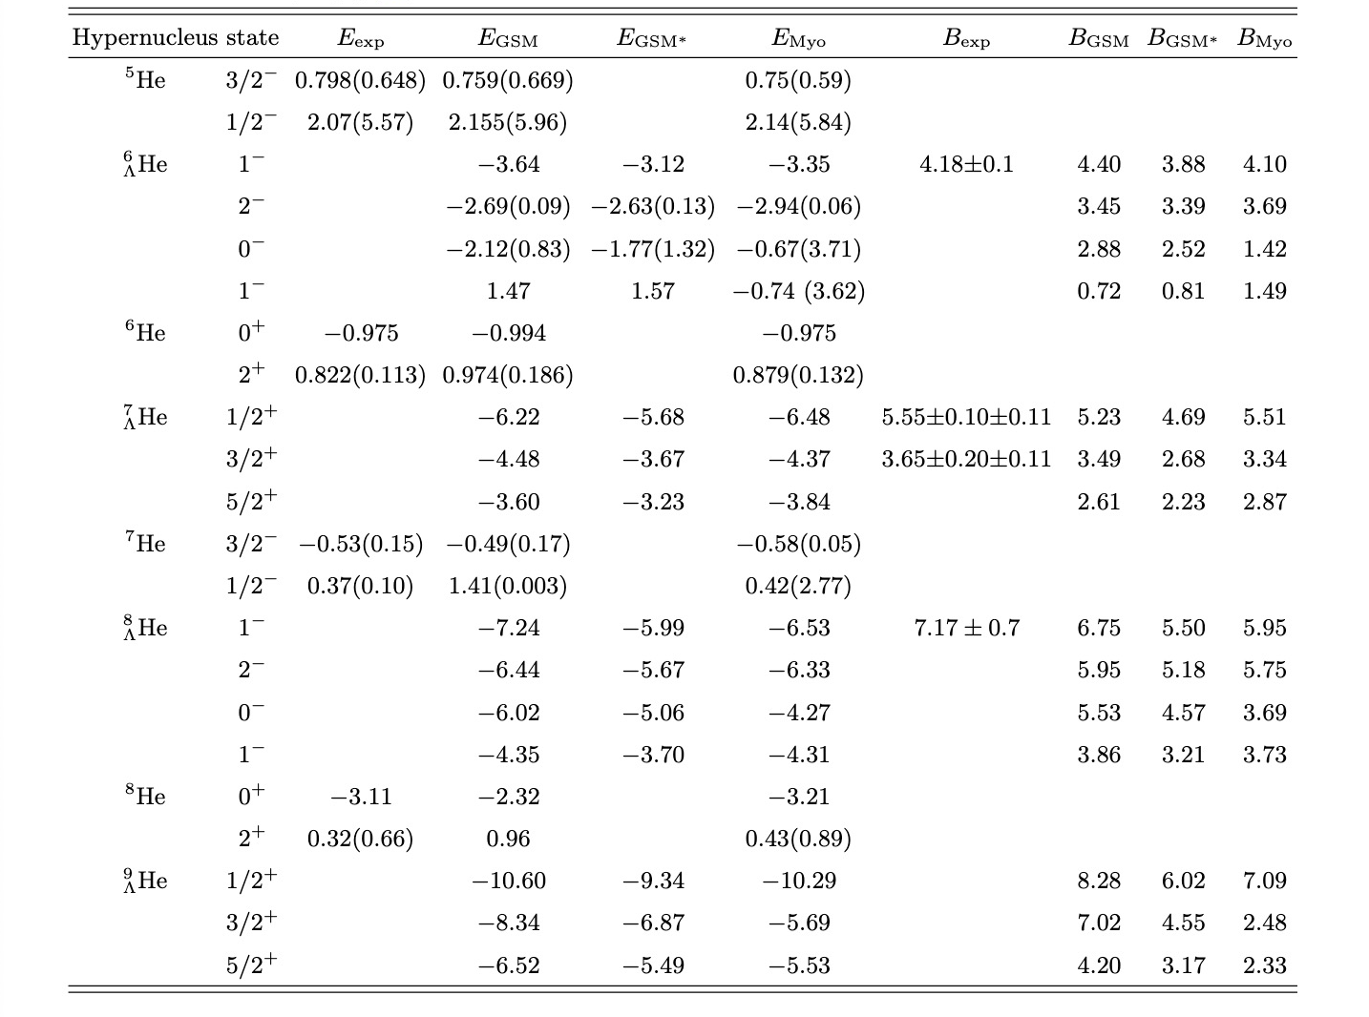
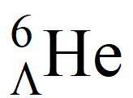
Results—— Energy spectra
The Λ binding energies for − are reduced by 0.52, 0.54, 1.25 and 2.26 MeV, respectively.
As the neutron number in the hypernucleus increases, the ΛN − ΣN coupling on hyperon binding energies becomes more pronounced.
Different theoretical predictions
between Myo’s and GSM.
Xin Li, N. Michel, J. G. Li and Xian-Rong Zhou, arXiv:2408.16223vl
T. Myo and E. Hiyama, Phys. Rev. C 107 054302 (2023)
Notes:
The detailed energy spectra of the studied hypernuclei, along with associated core nuclei, are depicted (dei peik tei d) in this table.
To validate (wai lei date) our results, we compare them with experimental and other theoretical data.
Our calculations demonstrate close agreement between the ground-state hypernuclear binding energies computed by GSM and experimental values, as well as with results obtained by Myo using the cluster model.
However, discrepancies (dis kre pen seis) arise in the prediction of low-lying excited states compared to Myo’s results.
GSM show that He9Lambda has a deeply bound state, a weakly bound state, and a resonant state, but Myo results in a deeply bound state and two narrow resonances.
The variability in predictions among different models for low-lying excited states is comprehensible.
Therefore, to enhance predictive accuracy, it is essential to increase the available (e wei le bao) experimental data to effectively constrain the model parameters.
To explore the influence of ΛN-ΣN coupling on the Λ hyperon binding energies in neutron-rich hypernuclei,
we additionally provide energy results excluding the ΛN-ΣN coupling channel in Table, denoted (dei no teid) as EGSM star.
The Λ binding energies for He6 Λ−He9 Λ are reduced about .
As the neutron number in the hypernucleus increases, the ΛN − ΣN coupling on hyperon binding energies becomes more pronounced.

Slide 14
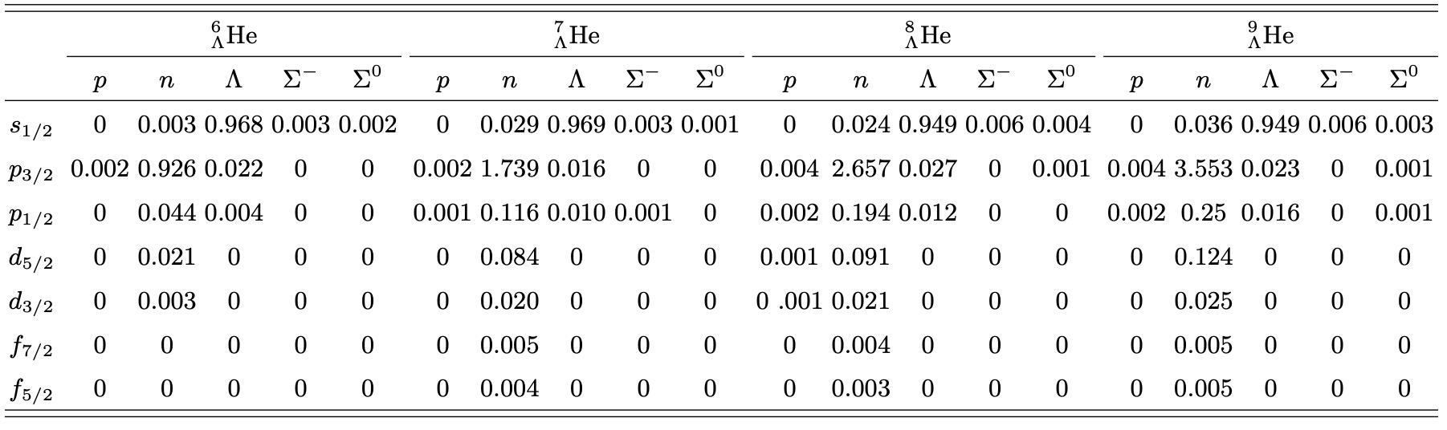
Results—— Particle occupation probabilities
Σ occupation probabilities are small, of the order of 0.1%,
Sufficient to generate about 1 MeV in binding energies.
Xin Li, N. Michel, J. G. Li and Xian-Rong Zhou, arXiv:2408.16223vl
Notes:
The probabilities(probo beileteis) of particle occupation in different partial waves are shown in this Table.
Even the sigma occupation probabilities are small, of the order of 0.1% , they are still sufficient(se fei shen t) to generate about 1 MeV in binding energies.
This indicates that ΛN − ΣN channel coupling is crucial for the calculation of hypernuclear spectra and can not be neglected(nei ge laik teid).

Slide 15
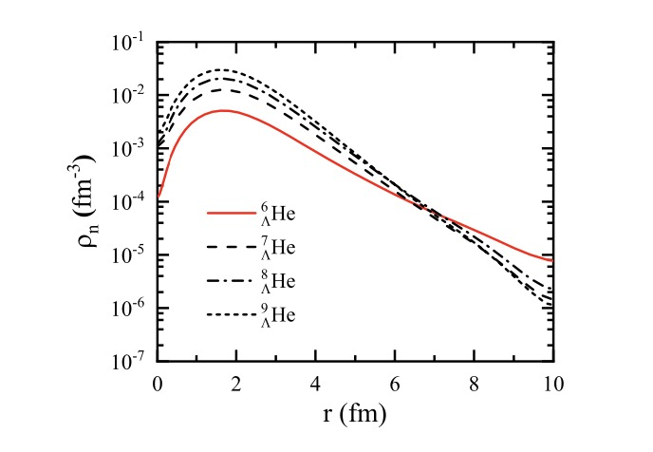
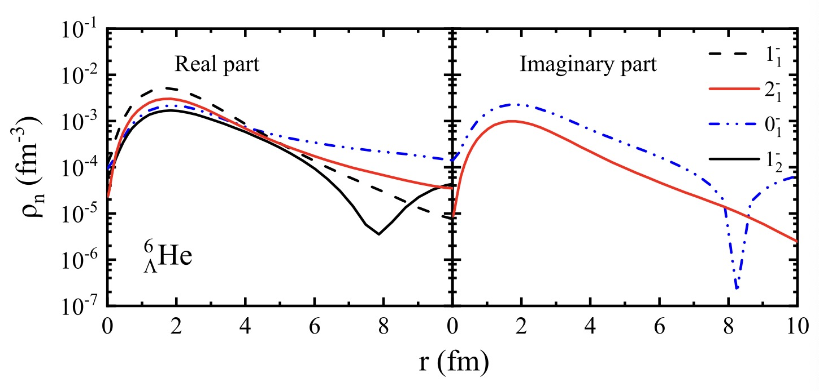
Results—— Neutron densities
Neutron halo
Real part : resonance structure visible
Imaginary part : depend on width
Xin Li, N. Michel, J. G. Li and Xian-Rong Zhou, arXiv:2408.16223vl
Notes:
The first figure(fei ger) shows the neutron density of hypernuclei in their ground states.
Due to the strong dependence of density with respect to neutron binding energy, it directly points out the effect of continuum (kang tei nium) coupling on wave functions asymptotes(ai seim touzi).
The ground state of 6ΛHe is a halo state, characterized (kai ruikter raizd) by a large extension of the nuclear density compared to well bound systems of similar baryon number.
The second figure shows the real and imaginary parts of the density distributions for both ground and excited states of heliu6lambda.
Oscillations(ao sei leishen s) at large distance also occur in the density of the first 0- and the second 1- hypernuclear states, with its imaginary part in the former and real part in the latter.
This reflects the resonance character of these states. The first 0- state bears a large width, resulting in large values for both its real and imaginary parts.

Slide 16
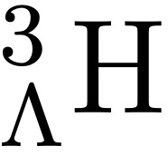
Summary
The Gamow Shell Model (GSM) framework has been extended to hypernuclei, and it provides a good description for both weakly bound and resonant hypernuclei. A very narrow 5/2⁺ resonance (Γ < 1 keV) is found in .
Our calculation shows that the Σ occupation in different partial waves is small (～0.001), but Λ binding energies are reduced by about 1 MeV due to ΛN − ΣN coupling. Therefore, Σ particle coupling cannot be neglected.
Neutron halo is obtained in .
The NCGSM calculations of hypernuclei are in progress (Λ halo in ) .

Slide 17
Thanks for your attention！

