Slide 1
Shape coexistence in Ne isotopes and hyperon impurity effect on low-lying states
Huai-Tong Xue
Nanyang Normal University
Cooperator: Xian-Rong Zhou, Q. B. Chen(ECNU),
Ji-Wei Cui (Xidian), Hiroyuki Sagawa( Aizu Aizu-Wakamatsu,)
The 23rd International Conference on Few-Body Problems in Physics (FB23), Beijing, China, 2024/9/23
Notes:
Dear all, good day. My name is Xue Huaitong, and I am from Nanyang Normal University. It is a great honor to have the opportunity to participate in this conference and to present our recent work to you.
The topic of my presentation is "Shape Coexistence in Ne Isotopes and the Impurity Effect of Hyperons in Their Excited States." This work is related to hypernuclear physics and the exotic phenomenon. My collaborators include Professor Zhou from East China Normal University, who is also my PhD supervisor, Researcher Chen Qibo, Dr. Cui from Xidian University, and Professor Sagawa from Aizu University.

Slide 2
Outline
Introduction
Formalism
Results and discussions
Summary

Slide 3
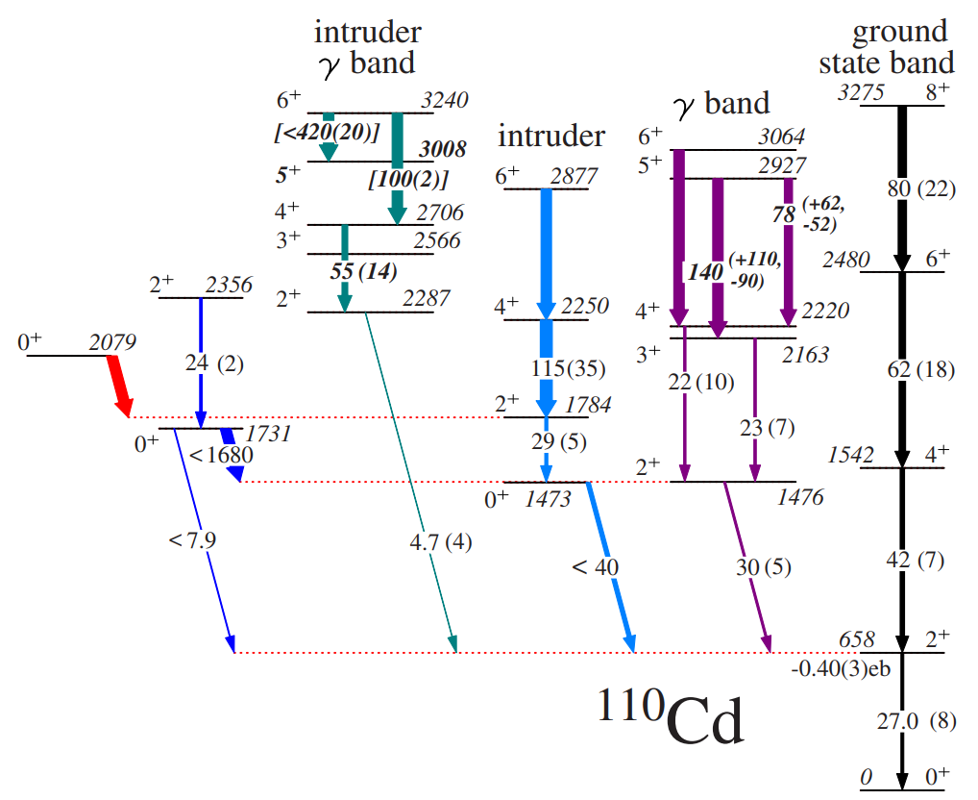
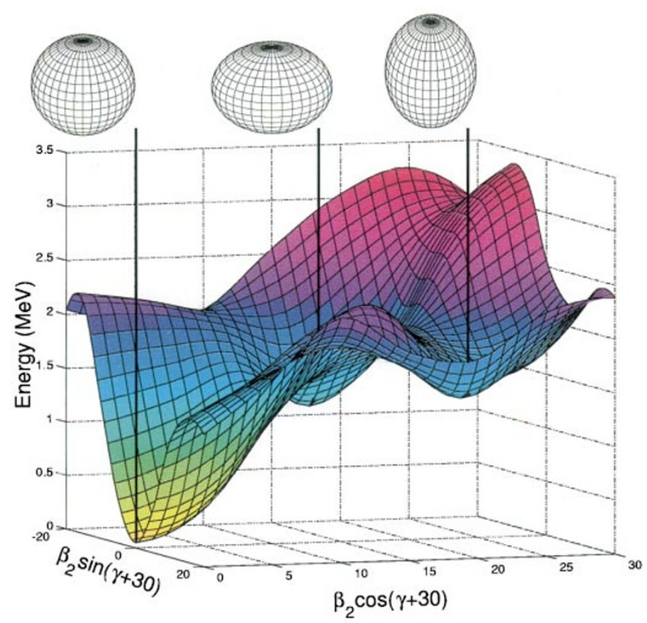
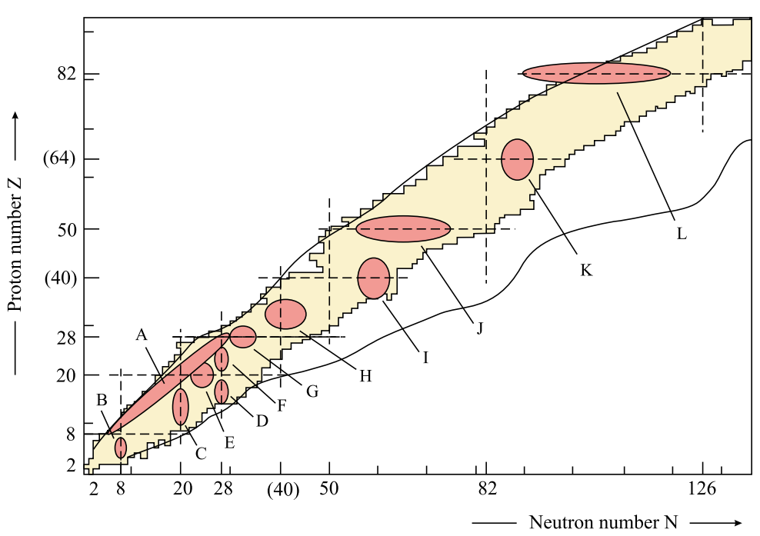
Shape coexistence in nuclei
Shape coexistence manifests as multiple energy minima with different shapes
“shape coexistence”
Heyde, Wood, Rev. Mod.Phys.83, 1467(2011)
P. E. Garrett, et al., Phys. Rev. Lett. 123, 142502 (2019)
Calculated potential energy surface of ¹⁸⁶ Pb.
Shape coexistence widely distributed throughout the entire nuclear chart
In ¹¹⁰Cd, a γ band built on the shape-coexisting intruder configuration is suggested.
Andreyev, Huyse , Duppen, et al., nature 405, 6785 (2000)
Notes:
as we all konw, the shape of a nucleus is one of its most fundamental properties, and its exploration across the nuclear landscape provides insight into the mechanisms underlying how protons
and neutrons are organized.
Generally speaking, nuclear shape coexistence is the phenomenon in which distinct shapes occur within the same nucleus and at a similar energy. Minima in the total potential energy can be found for shapes that include spherical, prolate or oblate and even triaxial.
After it was first proposed in 1956, shape coexistence has been observed in heavy and medium-heavy nuclei, as well as light nuclei ,and an up-to-date view of the experimental and theoretical thinks that it occurs in all nuclei.
In recent years, the concept of shape coexistence has not only been studied at the mean field level, but also discussed in the low-lying spectra.
for example, In 110 Cd /ˈkædmiəm/ , a gamma band built on the shape-coexisting intruder configuration is suggested.

Slide 4
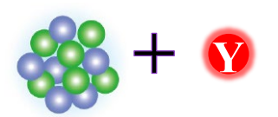
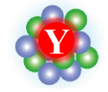
Hypernucleus
nucleon
hyperon/meson
The experimental data of single Λ hypernucleus is the most abundant
H. Tamura, Prog. Theor. Exp. Phys. 1, 02B012 (2012).
hypernuclei： Λ、 Λ Λ 、
Ξ 、Σ
nuclei with strangeness
Meson nuclei：K⁻pp
Notes:
Meanwhile, the investigation of hypernuclei is also another hot topic in nuclear physics nowadays.
As mentioned by the previous speakers, the explorations of hypernuclear systems comprising nucleons and hyperons can exert far-reaching implications on nuclear physics.
C====================================================================
To begin, let me briefly introduce hypernuclei. The atomic nucleus, as many of you are familiar with, is a self-bound finite quantum system composed of protons and neutrons. When one or more nucleons in the nucleus are replaced by particles with strange quantum number (S), a hypernucleus is formed. Hypernuclei are categorized based on the type of strange particles they contain. For example, a single-Lambda hypernucleus contains one Lambda hyperon, a double-Lambda hypernucleus contains two, a Xi hypernucleus contains a Xi hyperon, and a Sigma hypernucleus contains a Sigma hyperon. Additionally, there are mesonic nuclei formed by K- mesons and two protons. Among all hypernuclei, the single-Lambda hypernucleus has the most experimental data available, and it has been a focal point for many theoretical studies.

Slide 5
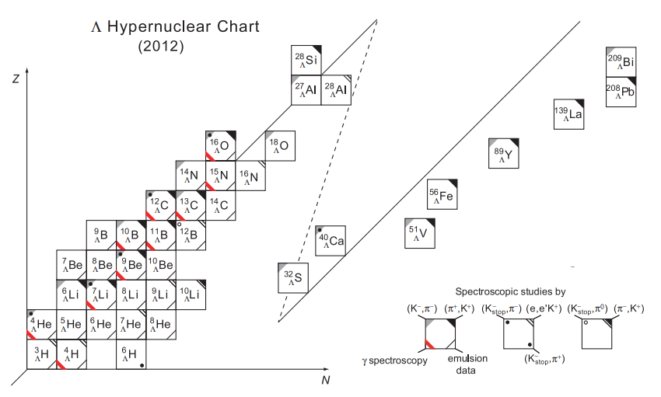
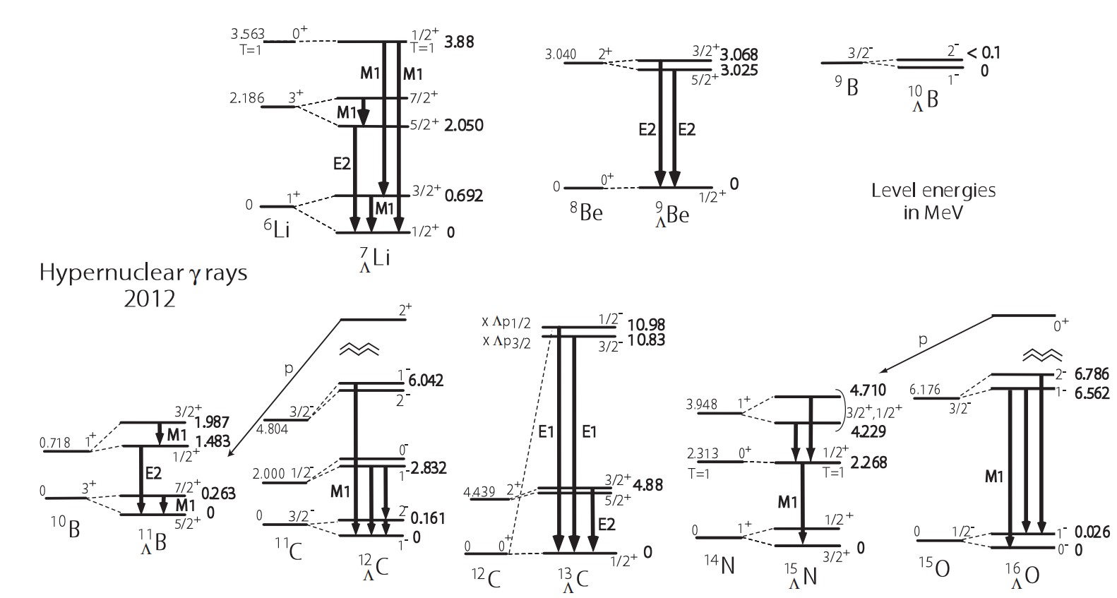
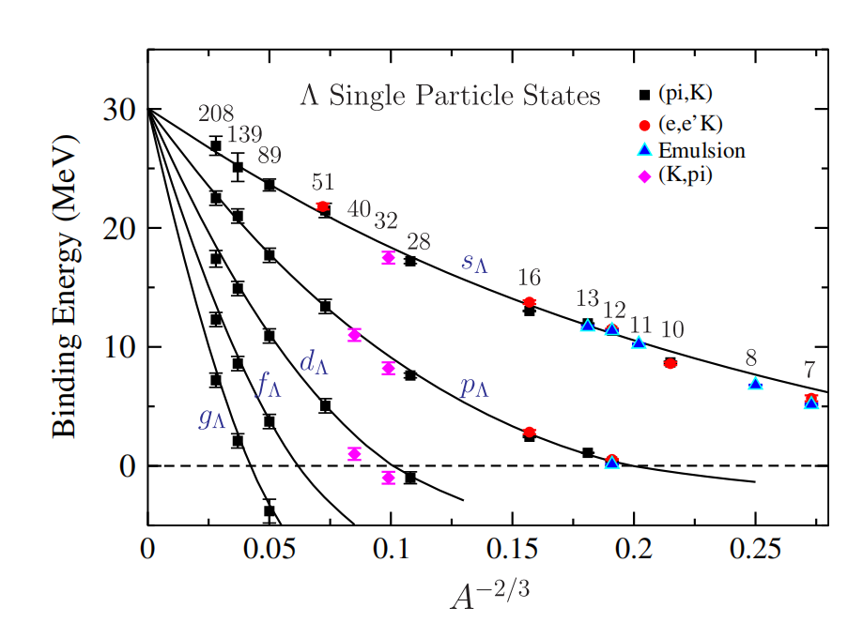
Experimental progress
H. Tamura, Prog. Theor. Exp. Phys. 2012, 02B012.
A. Gal, et. al., Rev. Mod. Phys., Vol. 88, No.3(2016)
Notes:
Single L hypernucleus is the earliest discovered hypernucleus in experiments and is also currently the most data rich hypernucleus.
Subsequently, with the introduction of more experimental methods and the development of detection instruments,
the measurement of hypernuclei extended to heavier regions, and the properties of excited states of hypernuclei were measured.

Slide 6
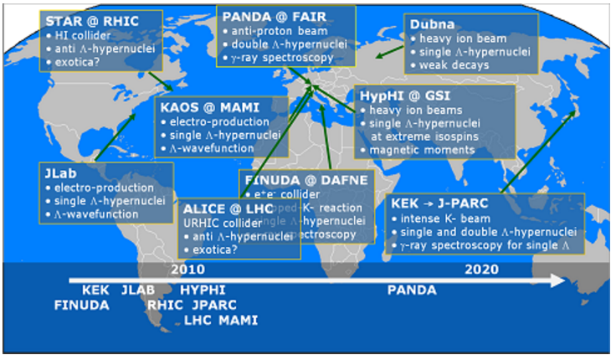
Experimental facilities in the world
HIAF (High Intensity heavy ion Accelerator Facility , started construction in 2018)
To Understand the interactions within nucleus.
To Study the properties of high energy density matter.
Expected to produce exotic hypernuclei in the future
Hui Zhou, China
Notes:
At present, several large experimental facilities worldwide are conducting or planning hypernuclear experiments. As shown in the picture, facilities interested in hypernuclear physics span the globe, from the United States to Europe to Asia. For instance, the High Intensity Heavy Ion Accelerator Facility (HIAF), which began construction in 2018 under the Chinese Academy of Sciences, is expected to produce exotic hypernuclei in the future.

Slide 7
Theory for hypernucleus
Relativistic Mean Field (RMF)
N. K. Glendenning et al, Phys. Rev. C 48, 889 (1993).
T.-T. Sun et al, Phys. Rev. C 96, 044312 (2017).
B. Bhowmick et al, Eur. Phys. J. A 50, 125 (2014).
Y.-T. Rong, Phys. Rev. C 104, 054321 (2021)......
Brueckner-Hartree-Fock (BHF)
J. Cugnon et al, Phys. Rev. C 62, 064308 (2000).
E. Khan et al, Phys. Rev. C 92, 044313 (2015).
H.-J. Schulze et al, Phys. Rev. C 88, 024322 (2013)……
Beyond-mean-field approach
H. Mei et al, Phys. Rev. C 91, 064305 (2015).
J.-W. Cui et al, Phys. Rev. C 95, 024323 (2017).
X. Y. Wu et al, Phys. Rev. C 95,034309 (2017)......
Few-body calculation
Hiyama & Kamimura et al, PRC 66, 024007 (2002).
Hiyama & Kamimura et al, PRL 104, 212502 (2010)…...
Cluster model
E. Hiyama et al, Phys. Rev. C 66, 024007 (2002).
E. Hiyama et al, Prog. Part. Nucl. Phys. 63, 339 (2009)……
Ab initio approach
H. Nemura et al, Phys. Rev. Lett. 89, 142504 (2002).
Roland Wirth et al, Phys. Rev. Lett. 113, 192502 (2014)……
Skyrme-Hartree-Fock (SHF)
X-R.Zhou et al, PRC 76 034312(2007)
H-J. Schulze et al, PRC 90 047301(2014)……
Notes:
Many theoretical approaches have been developed to study the properties of hypernuclei,
such as the shell model, cluster model, antisymmetrized molecular dynamics model, nonrelativistic and relativistic mean-field model, and the beyond mean-field approach and so on.

Slide 8
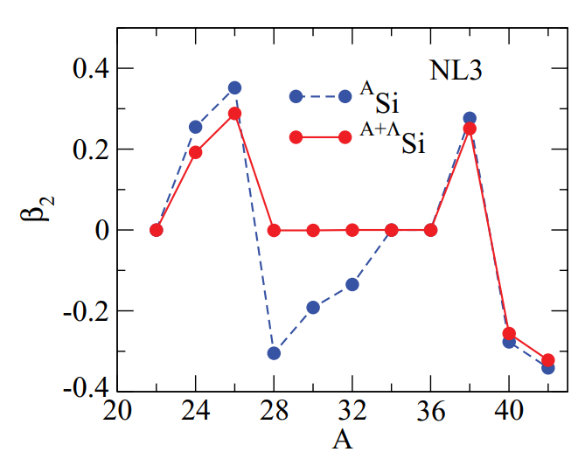
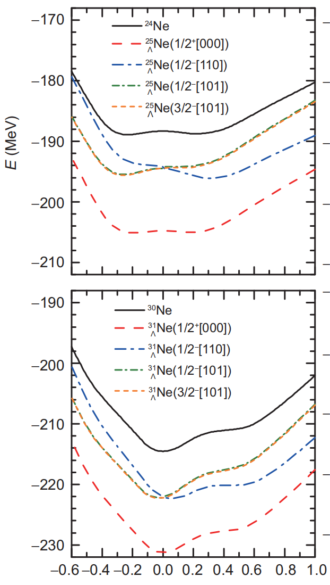
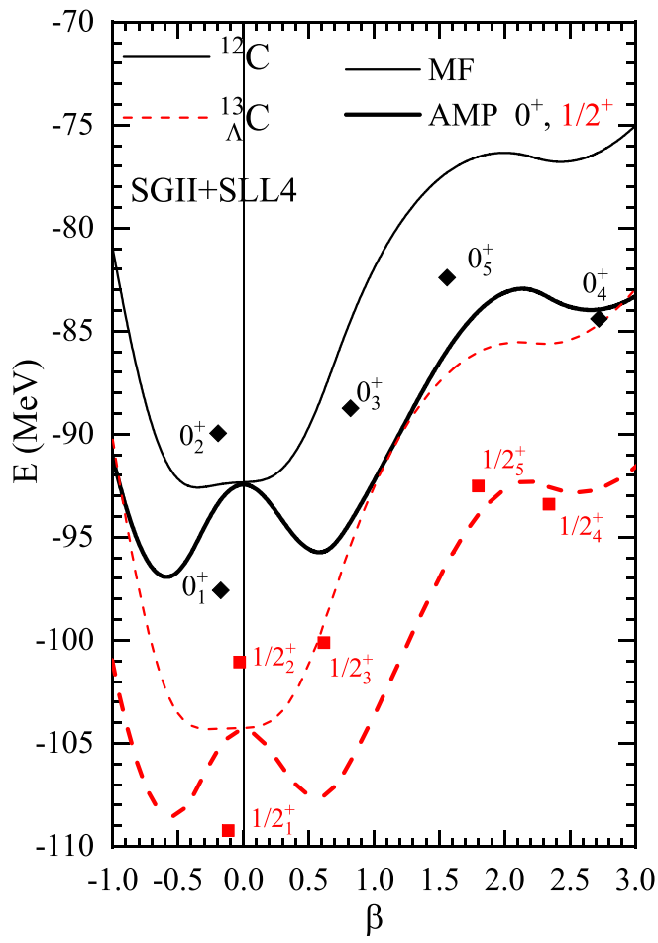
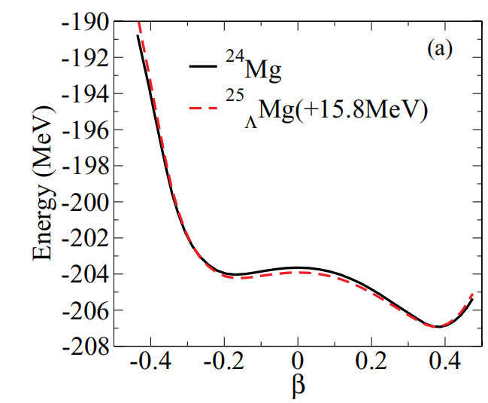
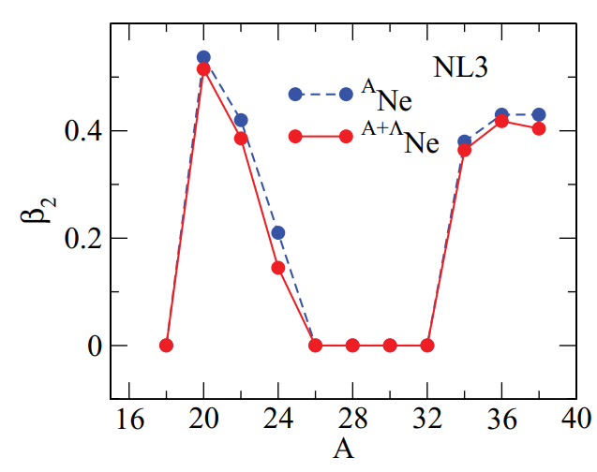
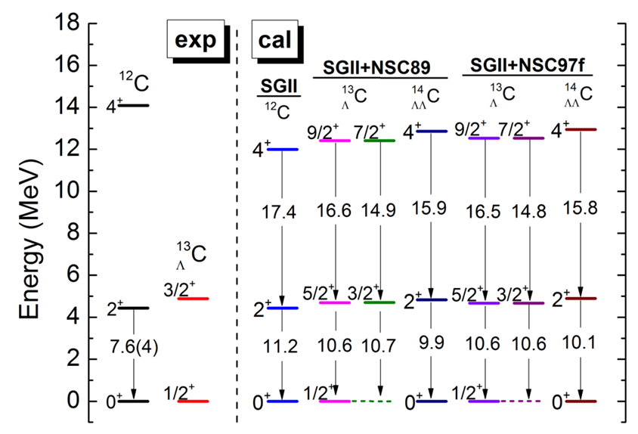
The impurity effects of the Λ hyperon
Myaing Thi Win et al., Phys. Rev. C 83, 014301 (2011)
Huai-Tong Xue, et al., Phys. Rev. C 109, 024324 (2024)
C. Chen, Q. K. Sun, Y. X. Li, and T.T. Sun, Sci. China-Phys. Mech. Astron. 64, 2820
Myaing Thi Win et al., Phys. Rev. C 78, 054311 (2008)
PESs as a function of the deformation parameter β2 in the Ne isotopes, as well as the corresponding single-Λ hypernuclei.
Ji-Wei Cui, et al., Phys. Rev. C 95, 024323 (2024)
Notes:
In the studies of hypernuclei, the impurity effect of hyperons on the shape of nuclei is often discussed.
The impurity effects of the Λ hyperon may drastically change the nuclear shape. Generally, the lowest sΛ hyperon can reduce nuclear deformation and render the core nucleus more spherical.
For example, in ref. [42], the deformation properties of Λ hypernuclei 29ΛSi and 13ΛC were investigated by the axial-deformed relativistic-mean-field (RMF) model and they were observed to be spherical owing to the additional sΛ hyperon while the core nuclei 28Si and 12C were oblate.
In addition, the the impurity effect of hyperons on shape coexistence has been studied at the mean field aspect. However,
The change of energy spectra due to the interplay between the shape coexistence and the Λ hyperon has not been carefully discussed.
Such works need the restoration of rotational symmetry and the Generator coordinate method, which has been successfully realized in some works.
The purpose of this paper is to use the beyond SHF model with AMP and GCM calculations to study the neon hyperisotopes from A = 20 up to A = 34 and to investigate the impurity effect of Λ hyperon on shape coexistence.
Therefore, we are particularly interested in hypernuclei with exotic phenomenon, specifically the effects of hyperons on the exotic properties of nuclei. In this study, we investigate the shape coexistence in Ne isotopes and the impurity effect of hyperons on their low-lying states.

Slide 9
Outline
Introduction
Formalism
Results and discussions
Summary

Slide 10
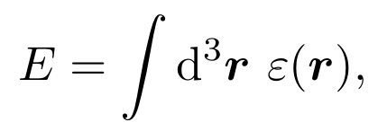
Skyrme-Hartree-Fock for hypernuclei
Total energy of a hypernucleus in Skyrme Hartree-Fork(SHF)
The SHF local energy-density functional of hypernuclear
They depend on the one-body densities, kinetic densities, and spin-orbit currents
X.-R. Zhou, H.-J. Schulze et al, Phys. Rev. C 76, 034312 (2007).
Notes:
In the DSHF approach, the total energy of a hypernucleus is given by the equation 1, where the energy-density functional is eq2, with εN and εL as contributions from NN and L N interactions, respectively.
The one-body density ρq, kinetic density τq, and s.o. current Jq can be calculated by the single particle wavefunction.

Slide 11
Skyrme-Hartree-Fock for hypernuclei
Skyrme Λ N interaction (Determine the parameters by phenomenologically fitting the experimental data. )
Two alternative parametrizations of nonlinear effects are indicated: the first one (~a3) motivated from G-matrix calculations, and the second one (~a3) derived from a NN contact force.
The functional for the hyperon(s) part
Mean field of Λ
Contribution to the mean field of nucleon
H.-J. Schulze, E. Hiyama, Phys. Rev. C 90, 047301 (2014).
Notes:
For the Skyrme-type interactions, εL is given as Eq1, where the last term is the s.o. part, which is adjusted to reproduce the observed s.o. splitting of 13LC in our approach.
Two alternative parametrizations of nonlinear effects are indicated, i.e., the first one a3 derived from a G matrix and the second one a3 from a NN contact force, The SLL4 L N force used in this work employs the
first choice.
Then we can get the nucleonic mean field and hyperonic mean field by the density functonal.

Slide 12
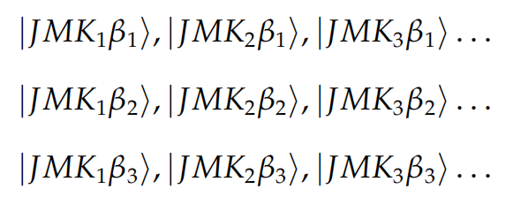
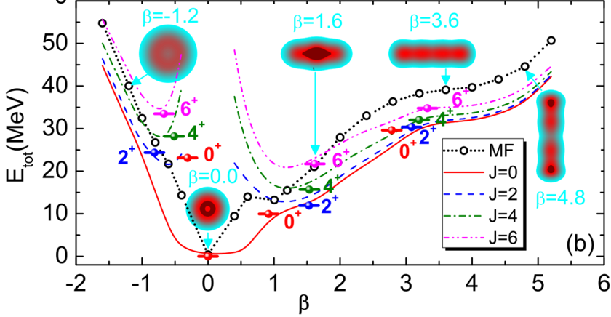
Angular momentum projection+coordinate generation method
The projected wave function of hypernuclus
Construct the wave function space:
Expand the wave function of hypernucleus in the space:
β is the collective coordinate, here are the deformation parameter.
Consider shape fluctuations by summing up β
J. M. Yao et al., Phys. Rev. C 90, 054307 (2014)
By summing K to mix components with different K. For axisymmetric even-even nuclei, K is generally taken as 0.
Notes:
The hypernuclear states are given by a superposition of projected MF wave functions onto exact angular momentum J:

Slide 13
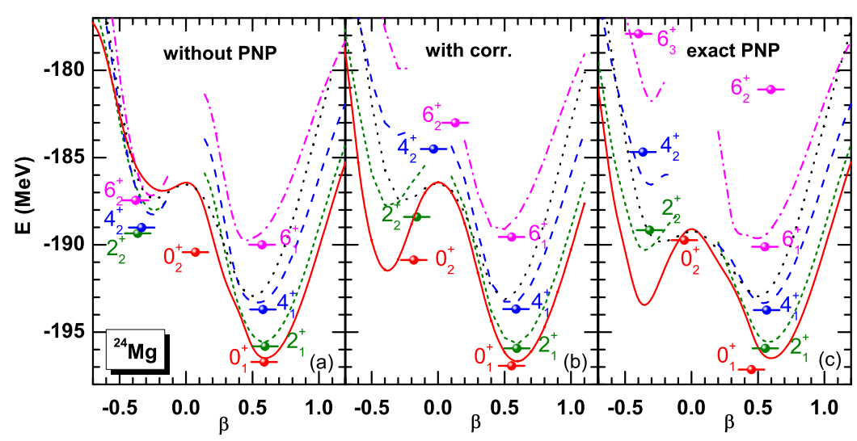
Angular momentum projection+coordinate generation method
Solve the Hill-Wheeler equation to obtain the energy eigenvalues:
Matrix elements
Particle number correction:
J. M. Yao, arXiv:2204.12126v1
Particle number correction can achieve an effect similar to particle number projection, and the calculation speed is faster.
Notes:
To obtain the eigenstate |αJM> , each weight Fα J (β) in Eq. (1) is determined by the Hill-Wheeler-Griffin equation, in which the corrected Hamiltonian and norm elements are
given by, The corrected Hamiltonian Hˆ is defined as

Slide 14
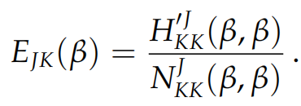
Angular momentum projection+coordinate generation method
collective wave functions
Projected potential energy surface
Average deformation：
r.m.s. radius:
electric quadrupole transition
Notes:
Since the projected states do not form an orthogonal basis, Fα J (β) are nonorthogonal functions [37], and orthogonal
collective wave functions are constructed as,
Given the weight function Fα J (β), the Projected potential energy surface, root-mean-square (rms) radius, Average deformation, electric quadrupole transitionis defined as,

Slide 15
Outline
Introduction
Formalism
Results and discussions
Summary

Slide 16
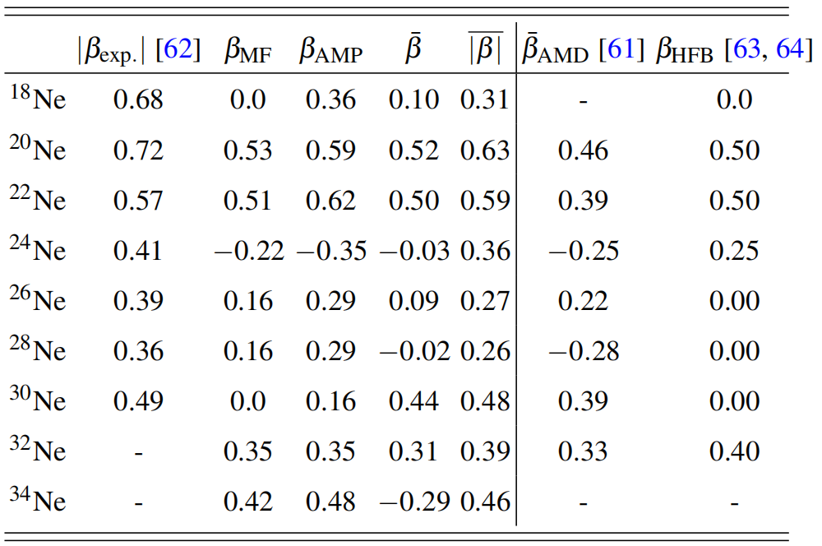
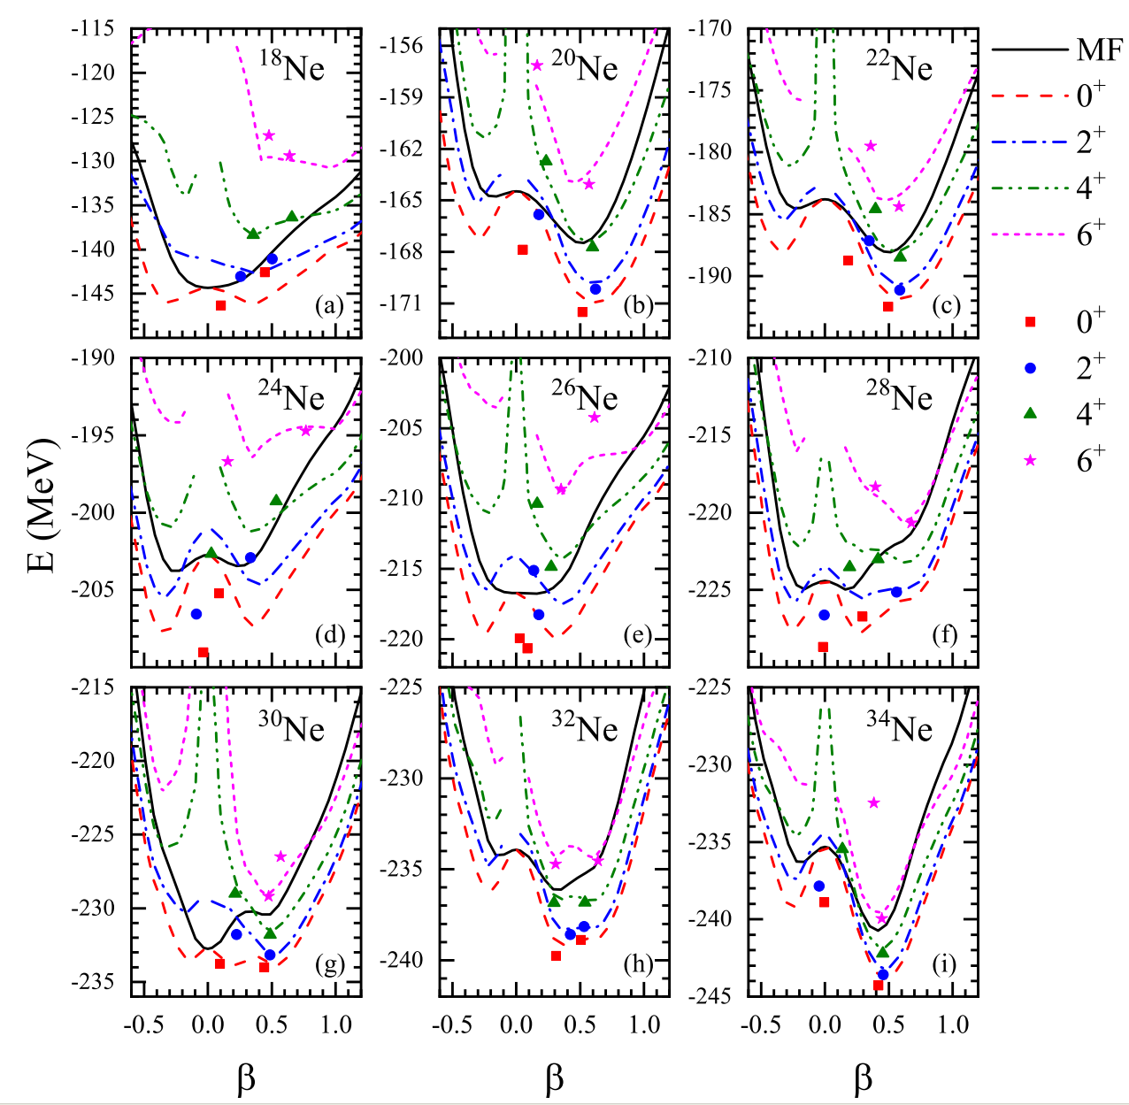
deformation and PES of Ne
The deformation calculated in this work is in good agreement with the experimental values, and the results are reliable.
Huai-Tong Xue, et al., Shape coexistence in Ne isotopes and hyperon impurity effect in hypernuclei, accepted by Phys. Rev. C.
Angular momentum projection not only enhance energy, but also changes the shape of the energy curves.
Notes:
Table I shows quadrupole deformations of the Ne-isotopes in this current work, compared to the ones from experiments
and the ones given by other models(AMD and HFB). It can be seen that, except for 24Ne, 26Ne, and 28Ne, the deformation obtained in this work, especially the average deformation
β¯ of the ground state, is reasonably consistent with the experimental one, which is closer to the experimental value than thatcalculated by AMD.
The mean field PESs (black solid line) and projected energy curves are shown in Fig. 1.
The most remarkable fact about this Fig is how strongly the restoration of the rotational symmetry modifies the mean-field PES. For most isotopes, the energy barrier between the two minima is enhanced due to the restoration of rotational symmetry.
The results of the mean field indicate that there is shape coexistence in the two isotopes 24Ne and 28Ne, due to the presence of two minima on the
potential energy surface with similar energy but completely different shapes. The angular momentum projection provides additional shape coexistence nuclei: 26Ne and 30Ne.
Therefore, the AMPPESs show the phenomenon of shape coexistence for some nuclei and/or some spin values, and thus configuration mixing has to be considered in order to gain a better
understanding of the structure of these states.

Slide 17
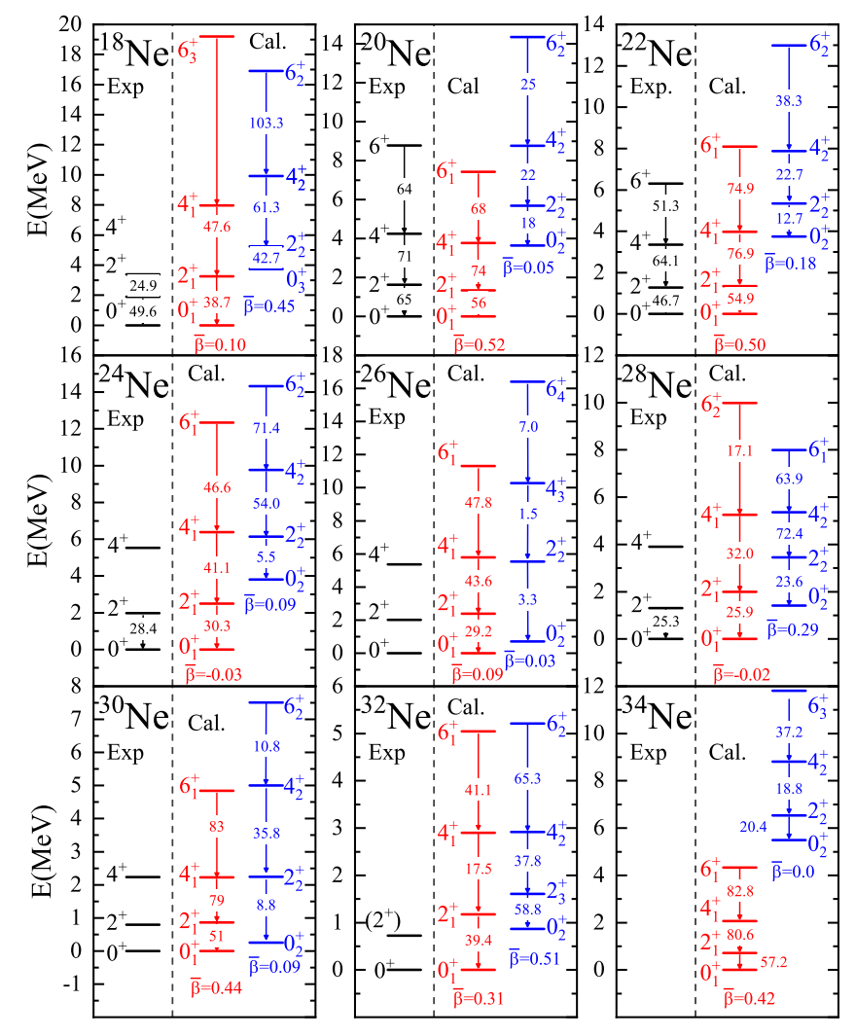
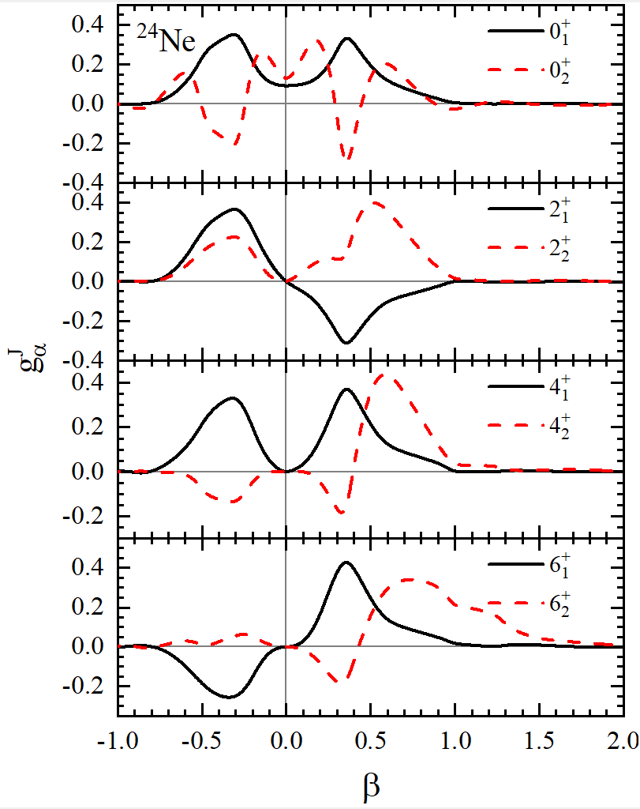
Low-lying states of Ne
The energy level spacing in the second excitation band of ${}^{20\sim 26,34}$Ne is comparable to that of the rotational band, and the phase exhibits oscillatory characteristics, which may be the β vibration band.
For the second band of ${}^{28\sim 30}$Ne, the spacing of energy levels within the band are roughly equal, exhibiting characteristics of vibrational bands (harmonic like spectrum ).
Huai-Tong Xue, et al., Shape coexistence in Ne isotopes and hyperon impurity effect in hypernuclei, accepted by Phys. Rev. C.
Notes:
Based on the comparison of the energy of each excited state and B(E2) values between them in the ground state band shown in Fig. with the experimental values,
it can be said that our calculation reasonably provides a rotational band that is consistent with the experimental values for every Ne isotope except for 18Ne.
In addition, the excitation energy levels and predicted B(E2) values in the second band of these nuclei are also given in Fig. 2.
What`s more, the results of GCM indicate that the ground states of 24Ne, 26Ne, and 28Ne are not truly spherical, but are a mixture of prolate
and oblate configurations. However, there is a phenomenon of strong mixing of different shapes within one physical state
instead of coexistence of several physical states based on differently shaped configurations.

Slide 18
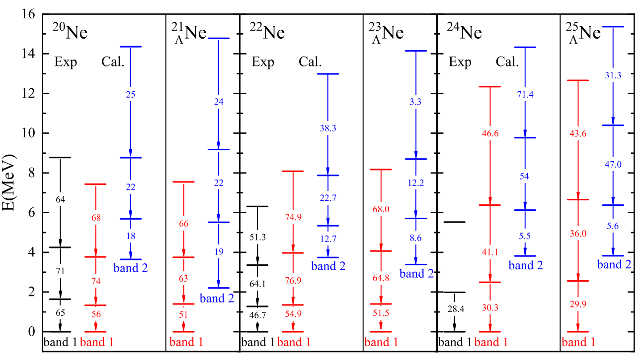
Impurity effects of $\text{Λ}$ on the hypernuclei
The influence of Λ hyperons on the rotating band is limited because the excited states within the band are all located at the lowest energy of the projected potential energy surface.
The impact of Λ hyperons on the second excitation band is significant, with most band structures being disrupted.
The Λ hyperon affects the original excitation mode, and the second excitation of${}_{\text{Λ}}^{21\sim 25}$Ne shows a trend of developing from β vibration to vibration.
Huai-Tong Xue, et al., Shape coexistence in Ne isotopes and hyperon impurity effect in hypernuclei, accepted by Phys. Rev. C.
Notes:
To investigate the impurity effect of Λ1s on low-lying states, the comparion of low-lying spectra of hypernuclei and nuclei are shown. In Fig. 5, the level structures of the second bands of 20Ne and 21ΛNe, 22Ne and 23ΛNe, and 24Ne and25ΛNe are given, and it is found that the addition of Λs appears to affect the excitation modes of these bands. As shown in
Fig. 5, this phenomenon is particularly evident in 20Ne and21ΛNe, and is also reflected in 22Ne and 23
ΛNe, 24Ne and 25ΛNe, where structures resembling β vibration transition to vibration modes with equal energy gaps.

Slide 19
Outline
Introduction
Formalism
Results and discussions
Summary

Slide 20
Summary
The results of the mean field indicate that there is shape coexistence in the two isotopes ²⁴Ne and ²⁸Ne, due to the presence of two minima on the potential energy surface with similar energy but completely different shapes.
The angular momentum projection provides additional shape coexistence nuclei: 26Ne and 30Ne.
The results of GCM indicate that the ground states of ²⁴Ne, ²⁶Ne, and ²⁸Ne are not truly spherical, but are a mixture of prolate and oblate configurations. However, there is a phenomenon of strong mixing of different shapes within one physical state instead of coexistence of several physical states based on differently shaped configurations. The results of GCM indicate that shape coexistence is difficult to form in Ne isotopes.
In addition, well established rotational bands based on deformed ground states and β vibrational bands, whose collective wave functions exhibit positive and negative phase oscillations with similar structures to rotational bands, were found in the isotopes ^{20−24,34}Ne.
We found that the s-state Λ has a shrinkage effect on the states in the ground band, similar to its effect on the ground state in the mean-field. However, more dramatic is the influence of the Λs on the second band, which is quite unusual, as it seems to change the excitation mode of this band. The addition of the Λs results in an equidistant orientation within the band, shifting it from a β vibration band to a vibration band limit.

Slide 21
Thanks for your attention
Collaborator :
Xian-Rong Zhou
Q. B. Chen
Ji-Wei Cui
H. Sagawa
If you are interested in the details of this job, please refer to arXiv: 2407.15048
Huai-Tong Xue, et al., Shape coexistence in Ne isotopes and hyperon impurity effect in hypernuclei, accepted by Phys. Rev. C.

