Slide 1



Overview of Hadronic Molecules
Feng-Kun Guo
Institute of Theoretical Physics, Chinese Academy of Sciences
05-09 Sept. 2022

Slide 2

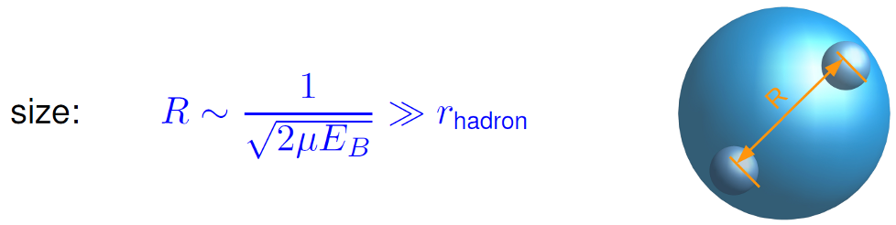
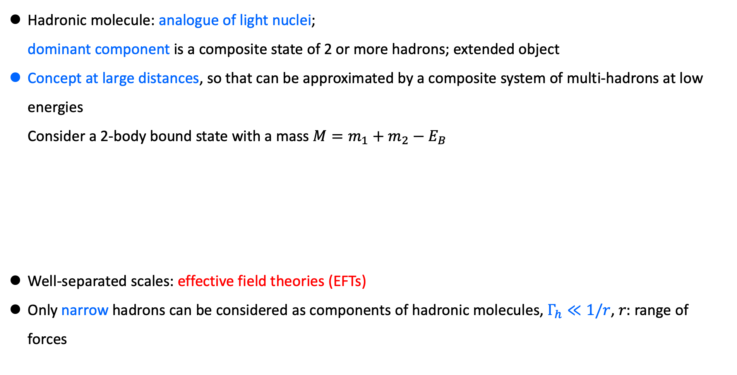
Hadronic molecules
Hadronic molecule: analogue of light nuclei;
dominant component is a composite state of 2 or more hadrons; extended object
Concept at large distances, so that can be approximated by a composite system of multi-hadrons at low energies
Consider a 2-body bound state with a mass $M=m_{1}+m_{2}−E_{B}$
Well-separated scales: effective field theories (EFTs)
Only narrow hadrons can be considered as components of hadronic molecules, $Γ_{h}≪1/r$, $r:$ range of forces
FKG, Meißner, PRD 84 (2011) 014013; see also Filin et al., PRL 105 (2010) 019101

Slide 3
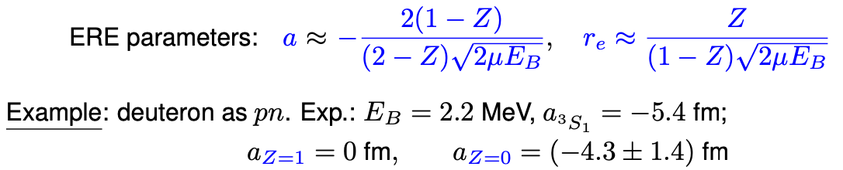





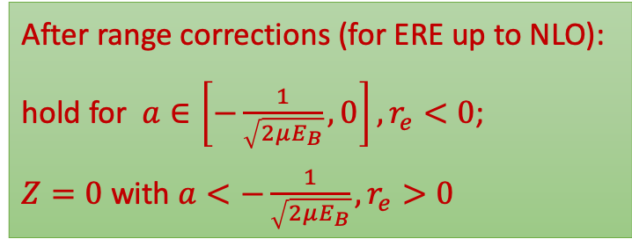
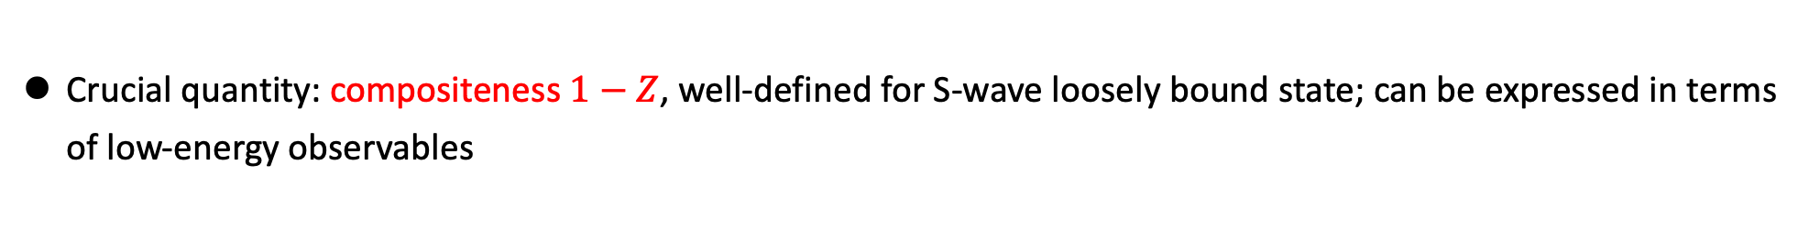




Hadronic molecules
How is energy excited inside a hadron:
  Radial excitations?
  Excitation of light quark-antiquark pairs $⇒$ compact multiquarks?
  Hadron-hadron pairs? In the form of hadronic molecules
    Implication of confinement (large-size systems in favor of color-singlet clusters)?
    More and more molecular candidates have been observed (see below)
Different confinement pictures
$$q$$
$$\overline{q}$$
$$\overline{q}$$
$$q$$
$$\overline{q}$$
$$\overline{q}$$
$$q$$
$$q$$
hadronic molecule
compact tetraquark
    If compact multiquarks exist too, why are the extended molecules so easily produced?
Crucial quantity: compositeness $1−Z$, well-defined for S-wave loosely bound state; can be expressed in terms of low-energy observables
S. Weinberg (1965); V. Baru et al. (2004); T. Hyodo et al. (2012); F. Aceti, E. Oset (2012); Z.-H. Guo, J. Oller (2016); I. Matuschek et al. (2021); J. Song et al. (2022); M. Albaladejo, J. Nieves (2022) ; Y. Li, FKG, J.-Y. Pang, J.-J. Wu, PRD 105 (2022) L071502 …
After range corrections (for ERE up to NLO):
hold for $a∈\left[−\frac{1}{\sqrt{2μE_{B}}},0\right], r_{e}<0$;
$Z=0$ with ${a<−\frac{1}{\sqrt{2μE_{B}}},r}_{e}>0$

Slide 4
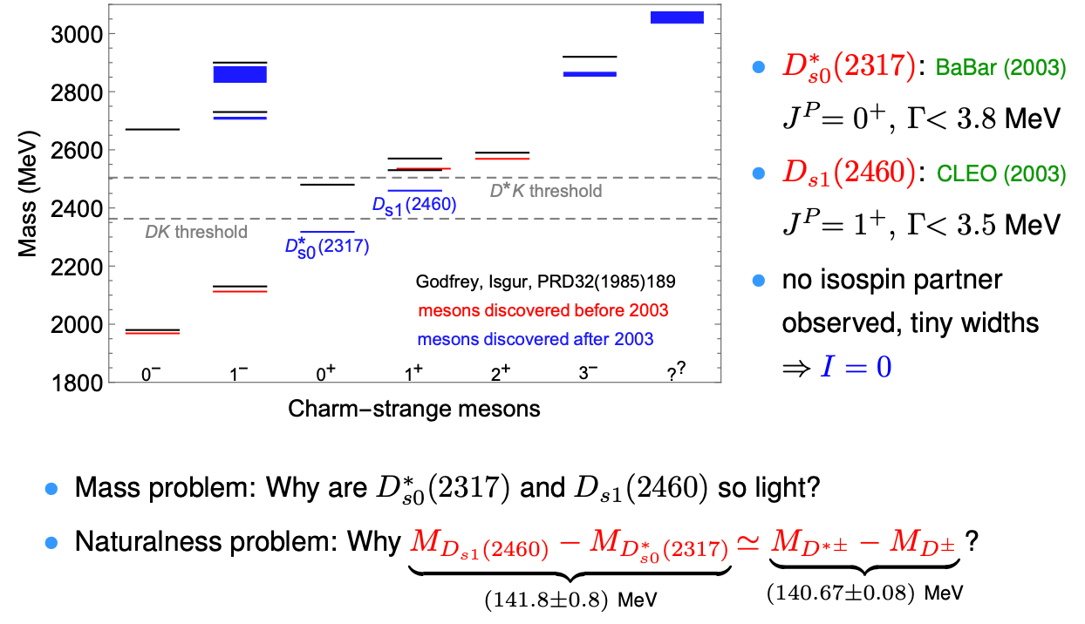
Charm-strange mesons
BaBar (2003)
CLEO (2003)

Slide 5
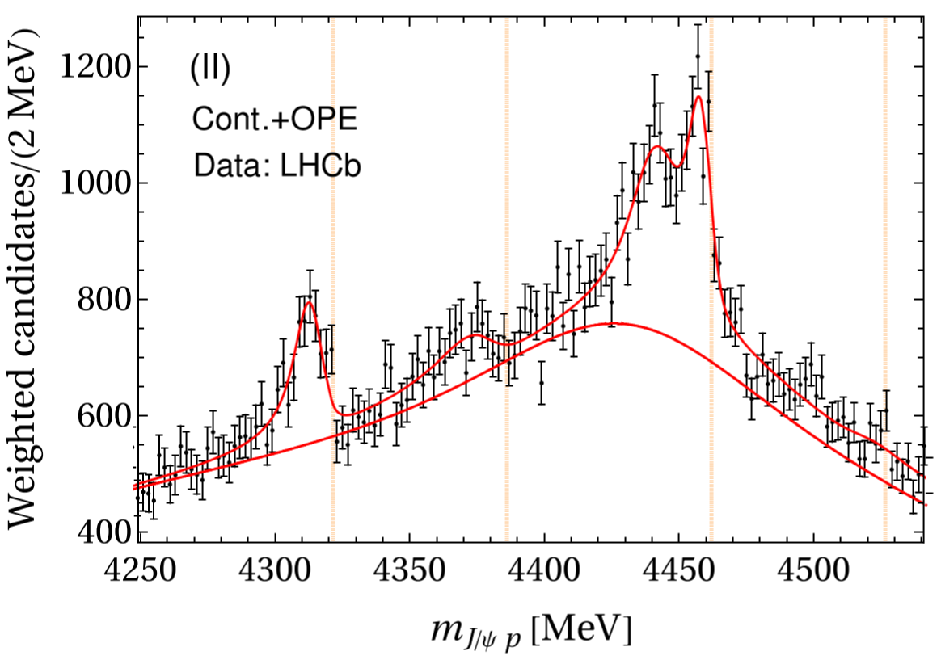
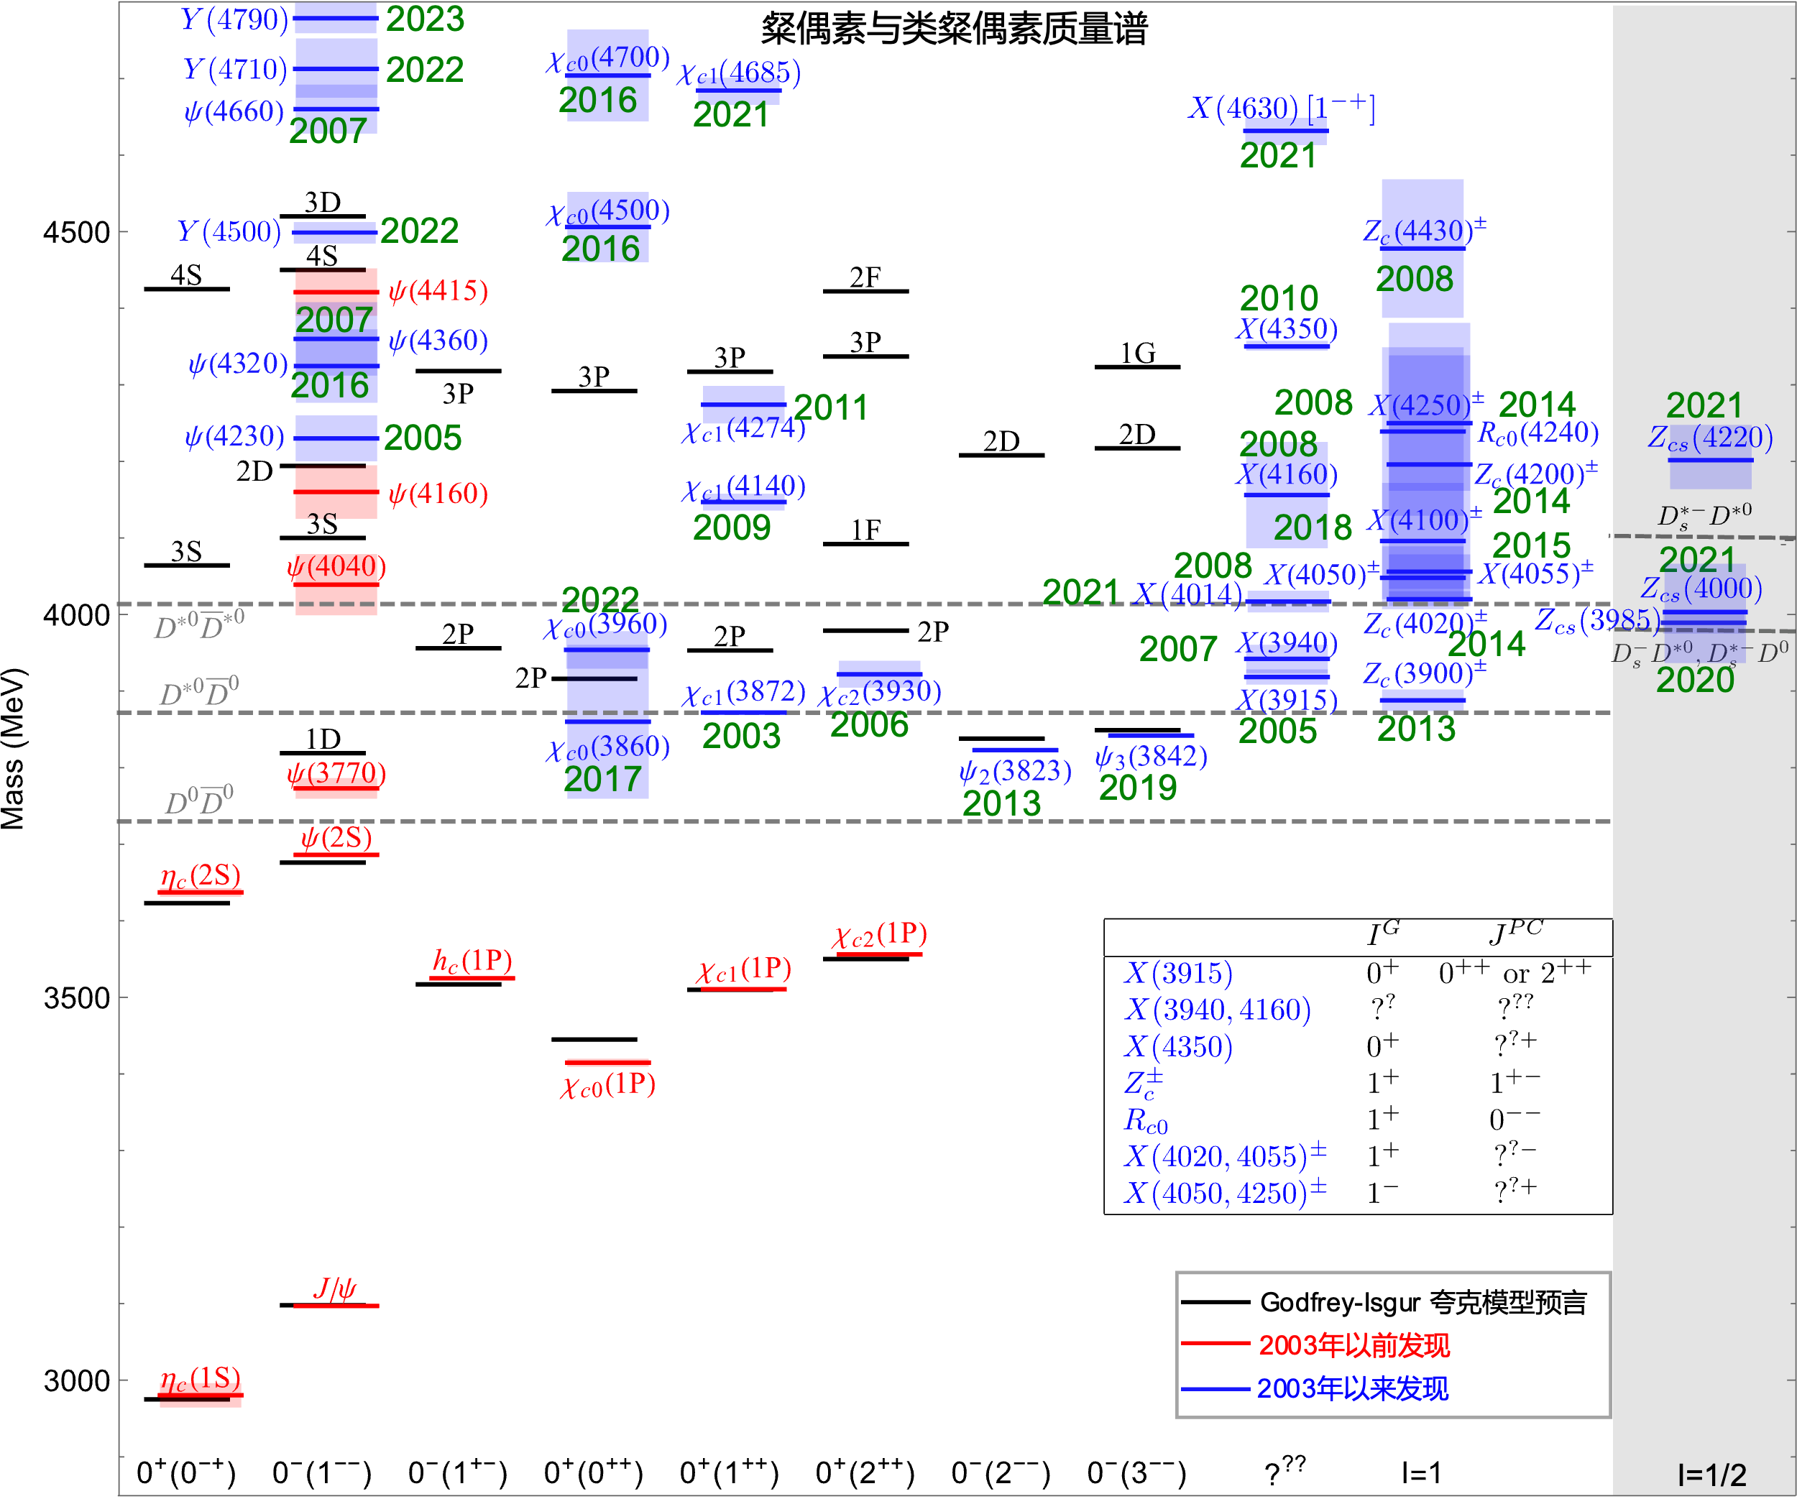
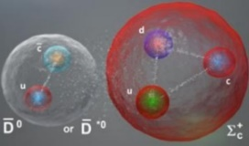
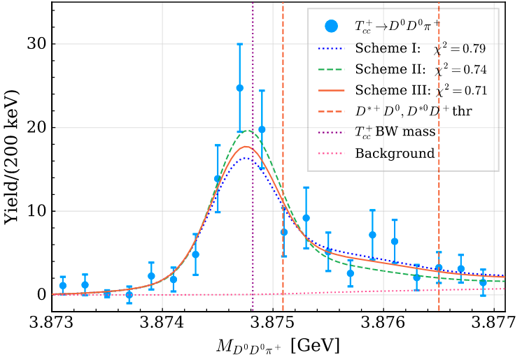








Hidden-charm and double-charm exotic hadrons
Charmonium-like states
Hidden-charm pentaquarks
$$Σ_{c}\overline{D}$$
$$Σ_{c}^{∗}\overline{D}$$
$$Σ_{c}{\overline{D}}^{∗}$$
$$Σ_{c}^{∗}{\overline{D}}^{∗}$$
Data: LHCb, PRL122 (2019) 222001;
Fit: M.-L. Du, et al., PRL 124 (2020) 072001
Double-charm tetraquarks
$$\overline{q}$$
$$\overline{q}$$
$$c$$
$$c$$
Data: LHCb, Nature Phys. 18 (2022) 751;
Fit: M.-L. Du et al., PRD 105 (2022) 014024

Slide 6
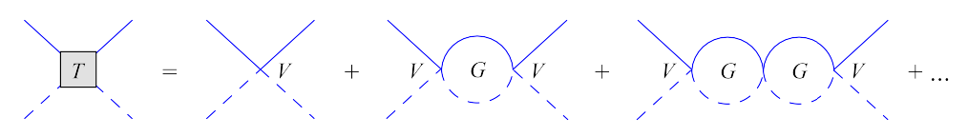
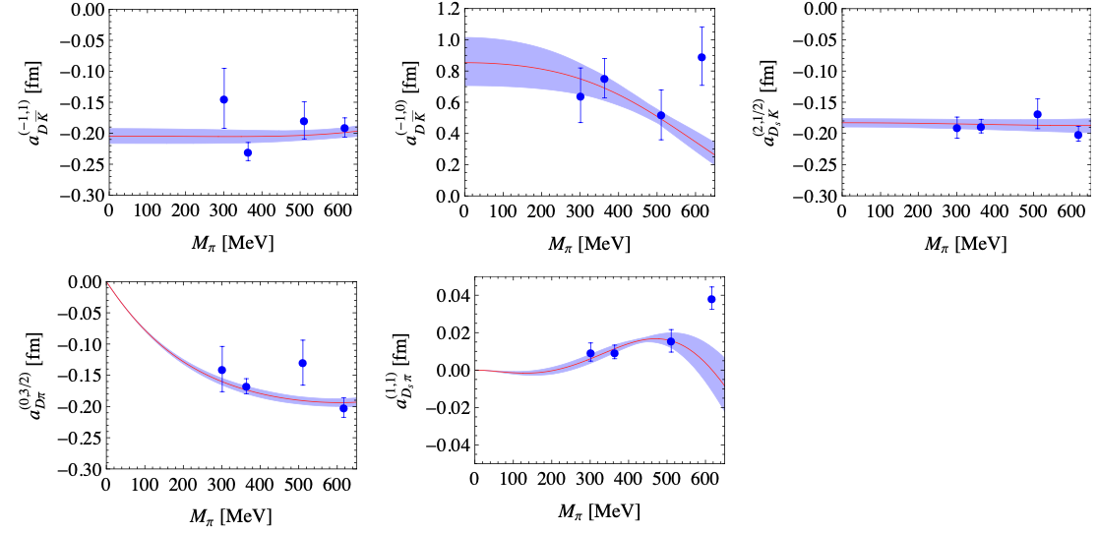
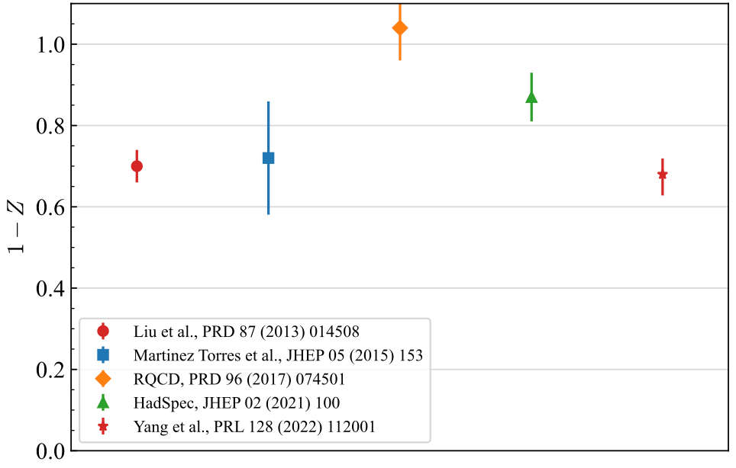
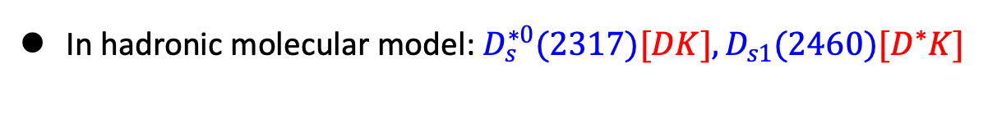
Charm-strange mesons from chiral EFT and lattice QCD
In hadronic molecular model: $D_{s}^{∗0}(2317)[DK], D_{s1}(2460)[D^{∗}K]$
Barnes, Close, Lipkin (2003); van Beveren, Rupp (2003); Y.-Q. Chen, X.-Q. Li (2004); Kolomeitsev, Lutz (2004); FKG et al. (2006); Gamermann et al. (2007); …
Chiral EFT for the sncattering between charmed mesons and light pseudoscalar mesons
Parameters fixed from fitting to lattice QCD results
$DK$ compositeness of $D_{s}^{∗0}(2317)$ from lattice QCD
L. Liu, Orginos, FKG, Hanhart, Meißner, PRD86(2013)014508

Slide 7
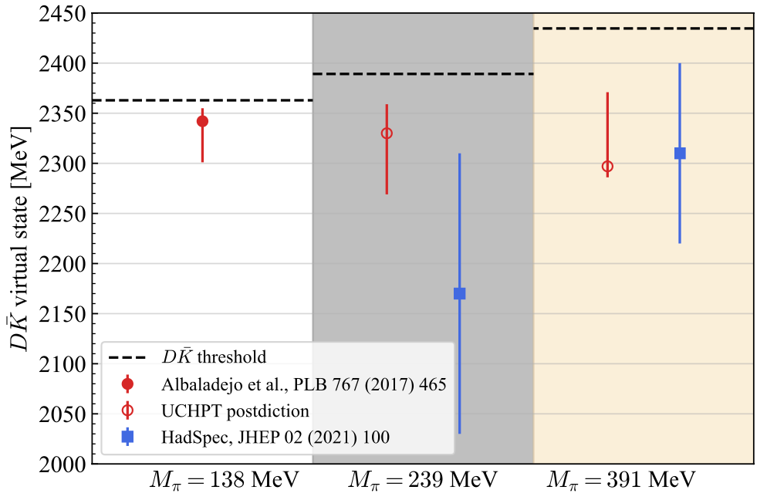
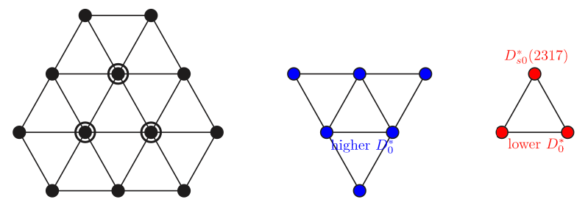
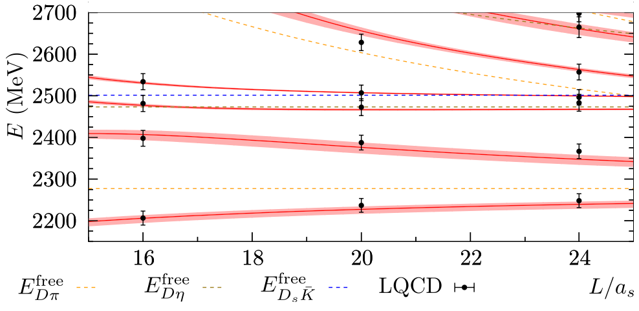
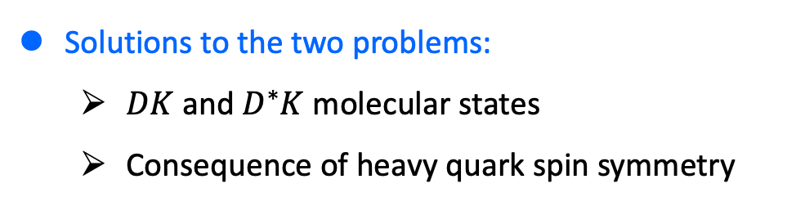

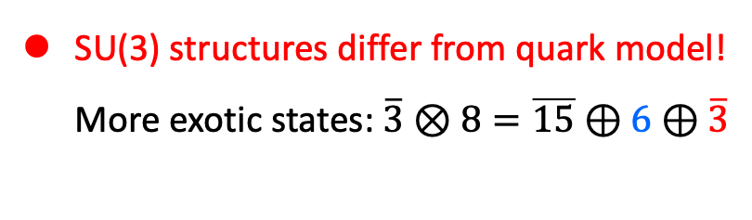
Charm-strange mesons from chiral EFT and lattice QCD
SU(3) structures differ from quark model!
More exotic states: $\overline{3}⊗8=\overline{15}⊕6⊕\overline{3}$
Prediction of $I=0, D\overline{K}$ virtual state confirmed by lattice QCD
M. Albaladejo, P. Fernandez-Soler, FKG, J. Nieves, PLB 767 (2017) 465
repulsive
attractive
most
attractive
Comparison with lattice
Parameter free!
More supports from lattice & exp. not shown
M.-L. Du, FKG, Hanhart, Kubis, Meißner, PRL 126 (2021) 192001; …
Solutions to the two problems:
  $DK$ and $D^{∗}K$ molecular states
  Consequence of heavy quark spin symmetry

Slide 8
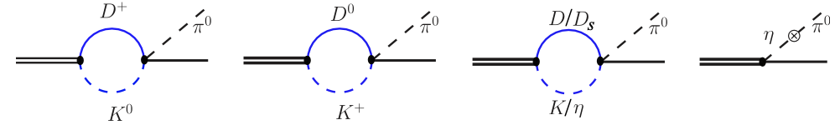
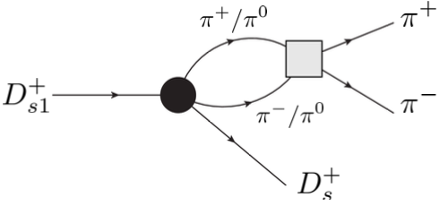
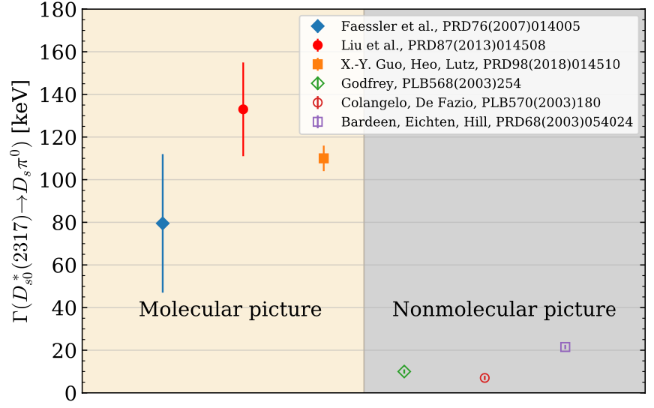
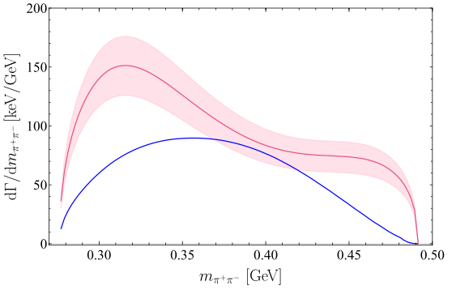
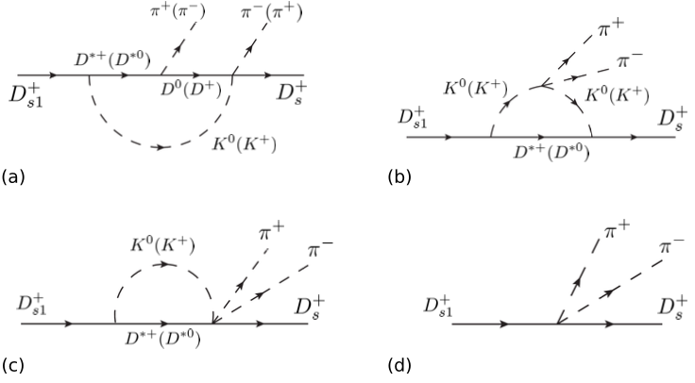


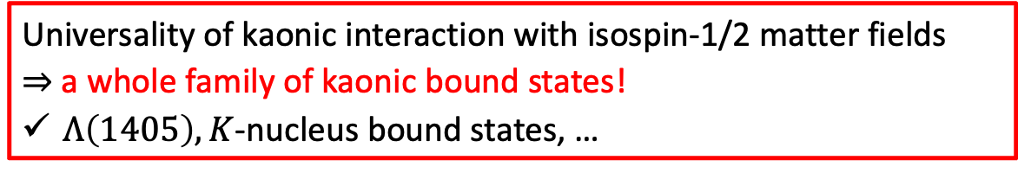
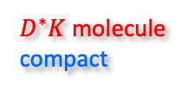
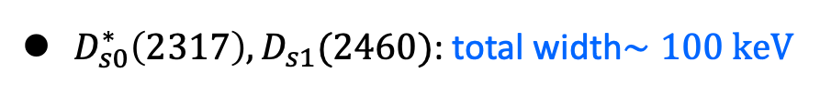
Charm-strange mesons: smoking guns of molecular structure
$D_{s0}^{∗}\left(2317\right), D_{s1}(2460)$: total width$∼100 keV$
$D_{s1}\left(2460\right)→D_{s}π^{+}π^{−}$: double-bump
M.-N. Tang, Y.-H. Lin, FKG, U.-G. Meißner, CTP 75 (2023) 055203
Prediction to be tested: Belle II & LHCb
$D^{∗}K$ molecule
compact
BESIII measured $Br\left(D_{s0}^{∗}→D_{s}π^{0}\right)≈100\%$
width still not measured!
BESIII, PRL 97 (2018) 051103
At PANDA? M.C. Mertens (2012)
Universality of kaonic interaction with isospin-1/2 matter fields
$⇒$ a whole family of kaonic bound states!
$Λ\left(1405\right), K$-nucleus bound states, …
Dalitz, Tuan, Oller, Meißner, Jido, Oset, Ramos, Hyodo, Weise, Mai, …

Slide 9
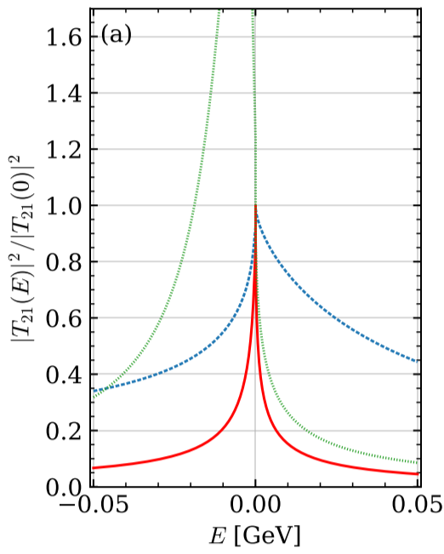
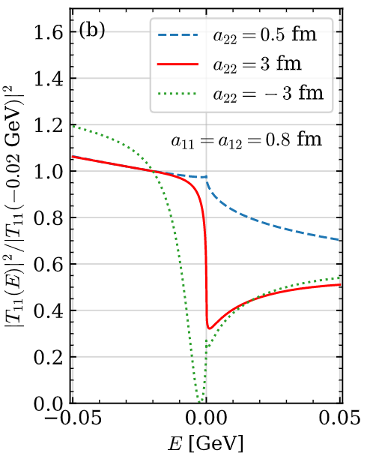
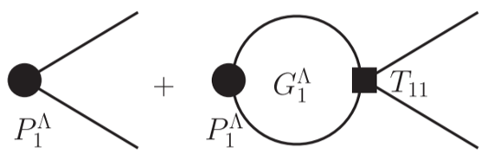
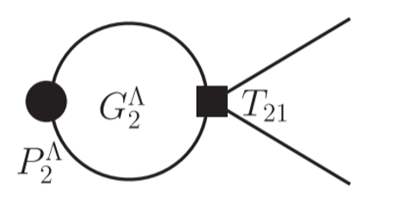
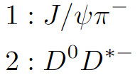
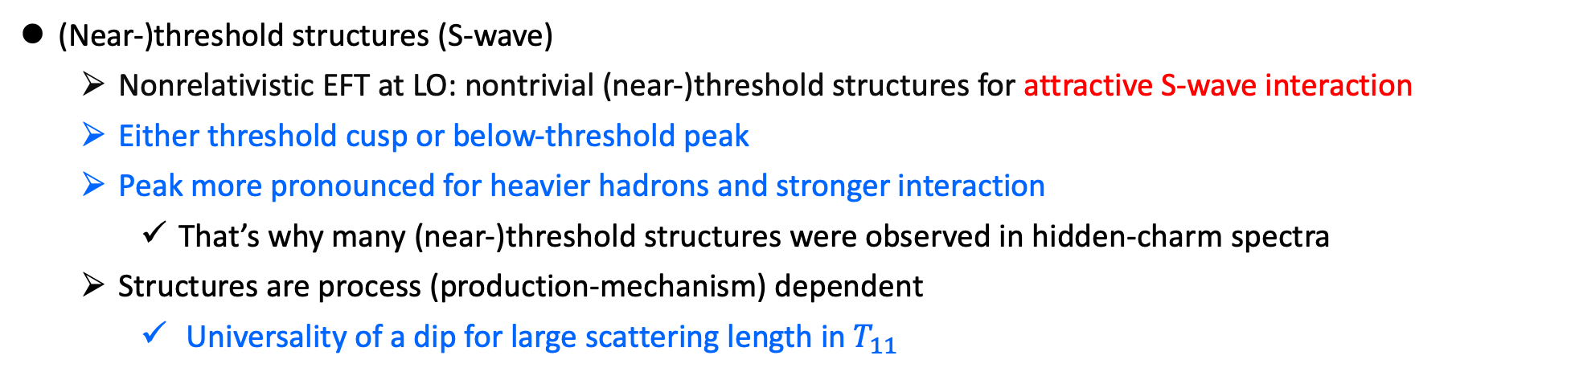
(Near-)threshold structures
X.-K. Dong, FKG, B.-S. Zou, PRL 126 (2021) 152001
Extension: classification of 2-channel near-threshold structures, Z.-H. Zhang, FKG, arXiv:2407.10620
(Near-)threshold structures (S-wave)
  Nonrelativistic EFT at LO: nontrivial (near-)threshold structures for attractive S-wave interaction
  Either threshold cusp or below-threshold peak
  Peak more pronounced for heavier hadrons and stronger interaction
    That’s why many (near-)threshold structures were observed in hidden-charm spectra
  Structures are process (production-mechanism) dependent
    Universality of a dip for large scattering length in $T_{11}$
Correction due to 3-body threshold, talk by Alexey Nefediev
Distinct line shapes of amplitudes in the same coupled channels with the same poles

Slide 10
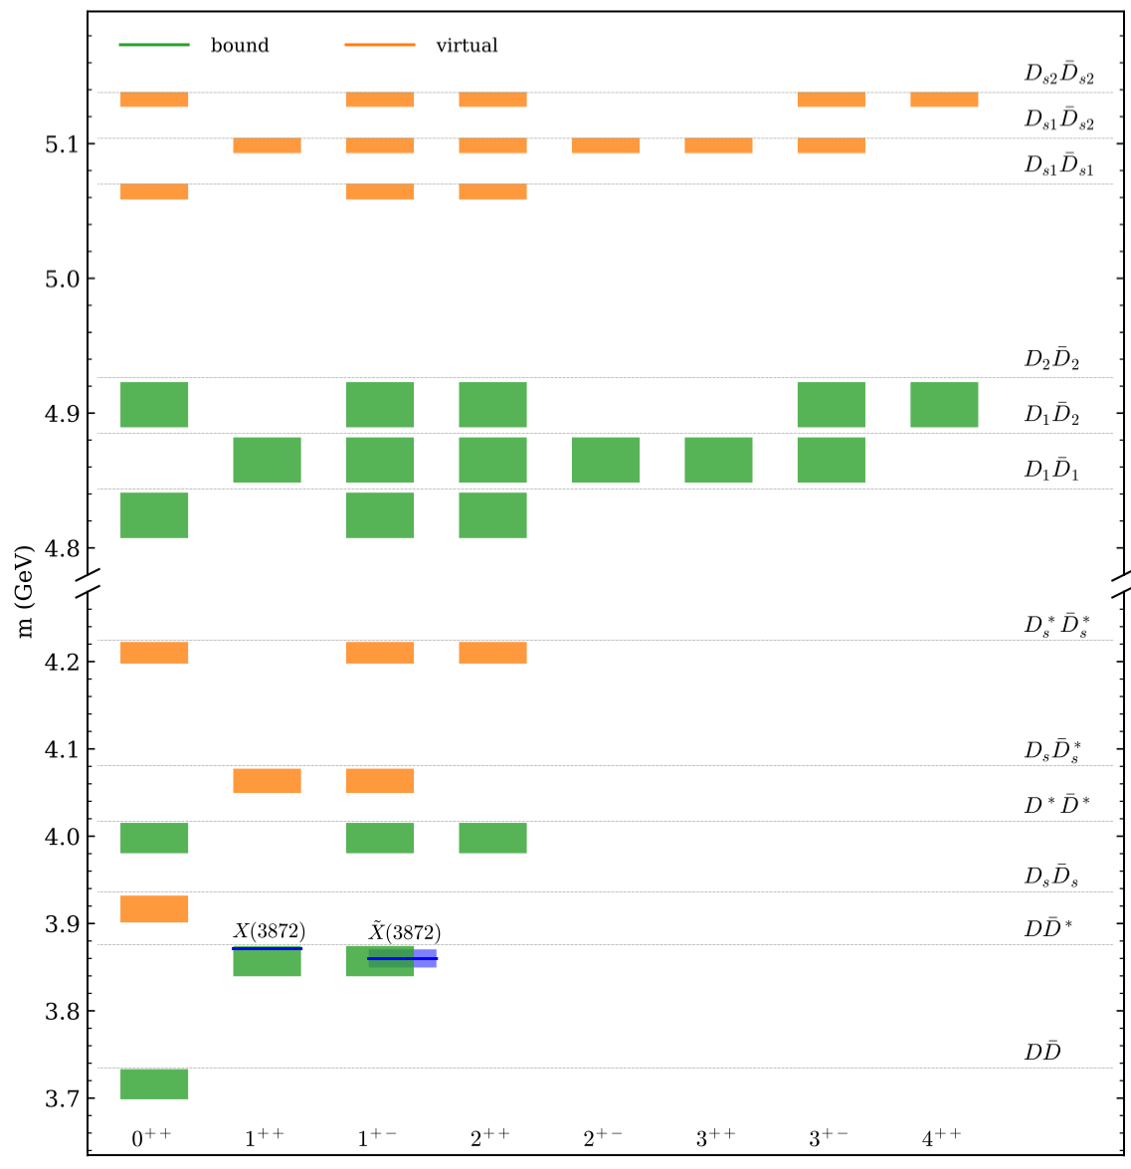

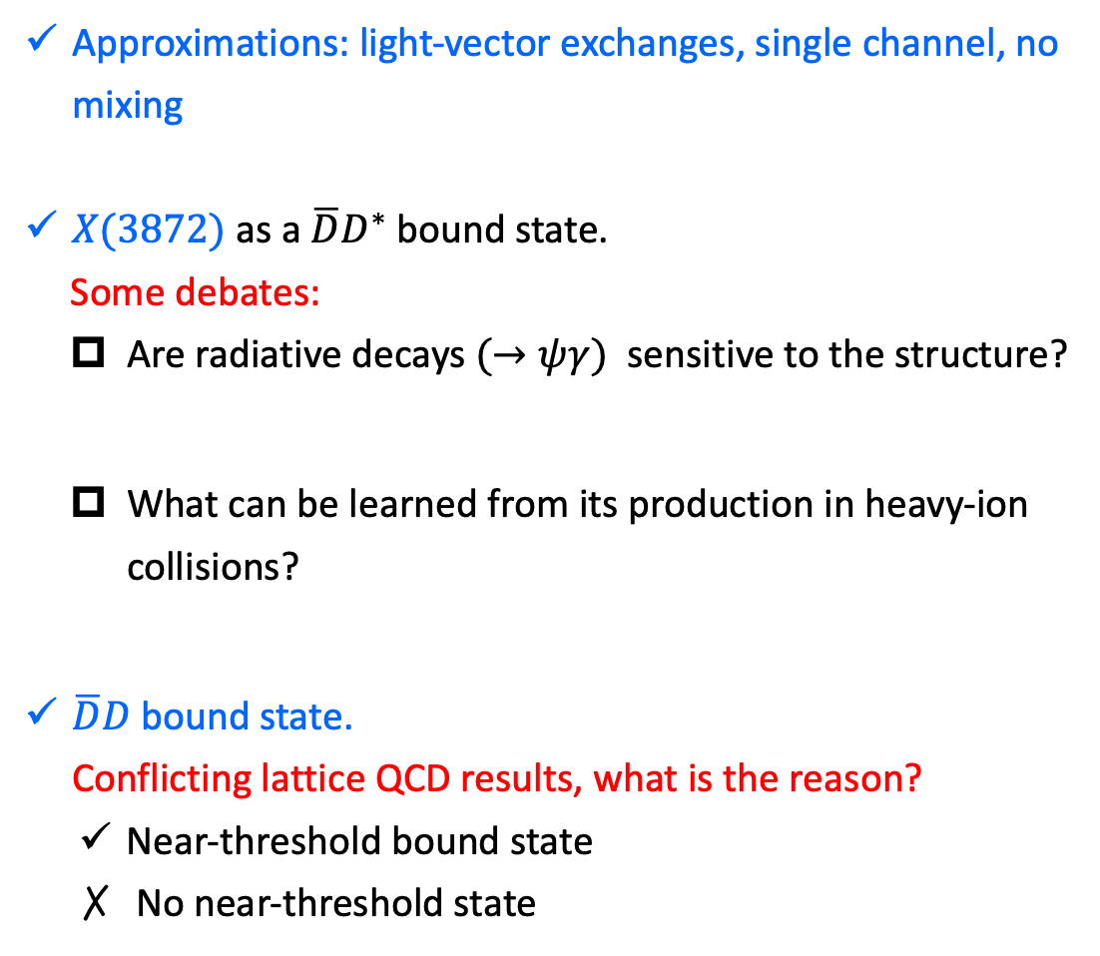

Hidden-charm mesons: $P=+$
X.-K. Dong, FKG, B.-S. Zou, Progr.Phys. 41 (2021) 65
Approximations: light-vector exchanges, single channel, no mixing
$X(3872)$ as a $\overline{D}D^{∗}$ bound state.
  Some debates:
  Are radiative decays $(→ψγ)$ sensitive to the structure?
  What can be learned from its production in heavy-ion collisions?
$\overline{D}D$ bound state.
Conflicting lattice QCD results, what is the reason?
  Near-threshold bound state
  No near-threshold state
$$\left(I,S\right)=(0,0)$$
$$\left(I,S\right)=(0,0)$$
First predicted in Törnqvist (1993)
E. Swanson, PLB 598 (2004) 297;
FKG et al., PLB 742 (2015) 394
The answer is no!
S. Cho et al., PRL 106 (2011) 212001;
H. Zhang et al., PRL 126 (2021) 012301;
B. Chen et al., PRC 105 (2022) 054901;
E. Braaten et al., arXiv:2408.03935; …
$$X(3960)$$
S.Prelovsek et al., JHEP 06 (2021) 035
D.Wilson et al., PRL 132 (2024) 241901

Slide 11
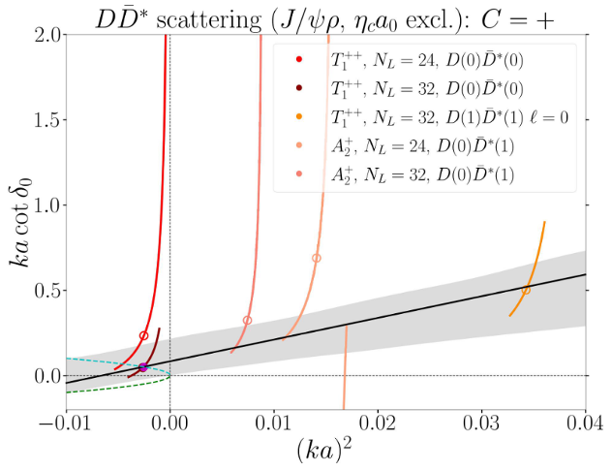
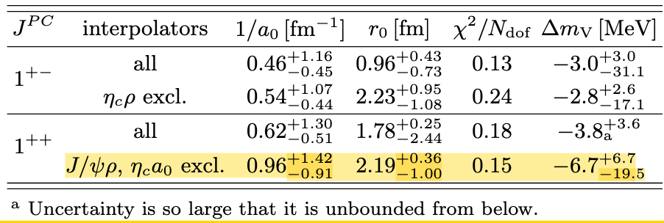


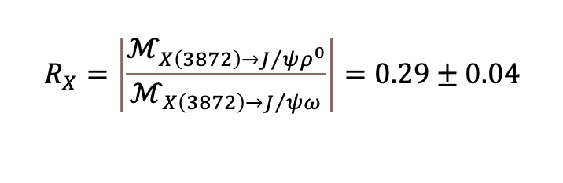

Closer look into $X(3872)$
Z.-H. Zhang, T. Ji, X.-K. Dong, FKG et al., JHEP 08 (2024) 130
Chiral EFT for the $J^{PC}=1^{++}$ $D{\overline{D}}^{∗}$ interaction with three-body effects. Two low-energy constants at LO
Two inputs from $X(3872)$ properties :
    Mass
    $M_{X}={3871.69}_{−0.04−0.13}^{+0.00+0.05}MeV$
    Isospin breaking in decays
  Prediction: there must exist an isovector $J^{PC}=1^{++}$ state ($W_{c1}^{0,±}$)
Support from lattice QCD
M. Sadl et al., arXiv:2406.09842 [hep-lat]
LHCb, PRD 102 (2020) 092005
$$M_{D^{0}}+M_{D^{∗0}}=3871.69(7) MeV$$
PDG 2024
LHCb, PRD 108 (2023) L011103
$$R_{X}=\left|\frac{ℳ_{X\left(3872\right)→J/ψρ^{0}}}{ℳ_{X\left(3872\right)→J/ψω}}\right|=0.29±0.04$$
Virtual state
(like the ${{}_{}^{1}S}_{0}$ $NN$)
Threshold cusps
$W_{c1}^{±}$:
${−8}_{−5}^{+8}$ MeV from $D^{0}D^{∗−}$ threshold

Slide 12
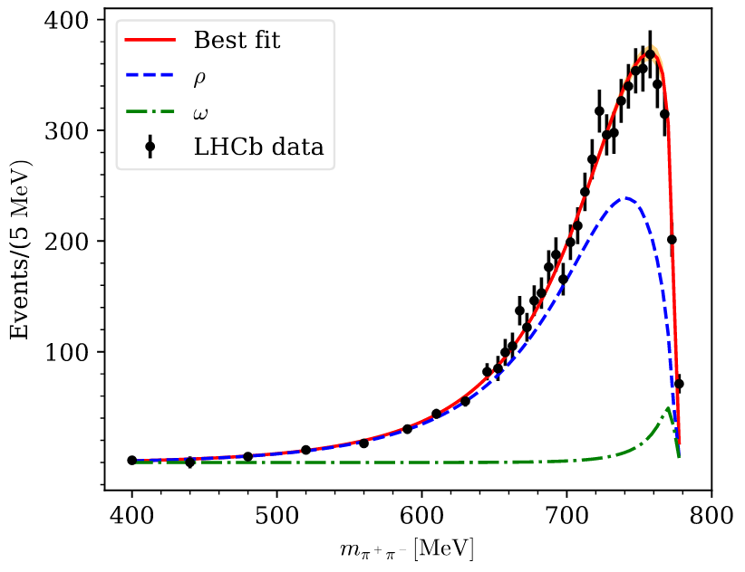





Closer look into $X(3872)$
J. M. Dias, T. Ji, X.-K. Dong et al., arXiv:2409.13245
Update with model-independent analysis of the isospin breaking in $X→J/ψπ^{+}π^{−}$ decay
  Omnes description of the $ππ$ final state interaction
  $ρ−ω$ mixing from $ω→π^{+}π^{−}$ with vac. pol. correction
  Updated pole position for the $J^{PC}=1^{++}$ state ($W_{c1}^{0,±}$)
$$R_{X}=\left|\frac{ℳ_{X\left(3872\right)→J/ψρ^{0}}}{ℳ_{X\left(3872\right)→J/ψω}}\right|=0.19±0.02$$
${4.3}_{−1.1}^{+1.4}$ above the $D^{+}D^{∗−}$ threshold
${31}_{−13}^{+20}$ below the $D^{0}D^{∗−}$ threshold
Threshold cusps
Experimental confirmation (cusp in $J/ψπ^{±}π^{0}$)?

Slide 13
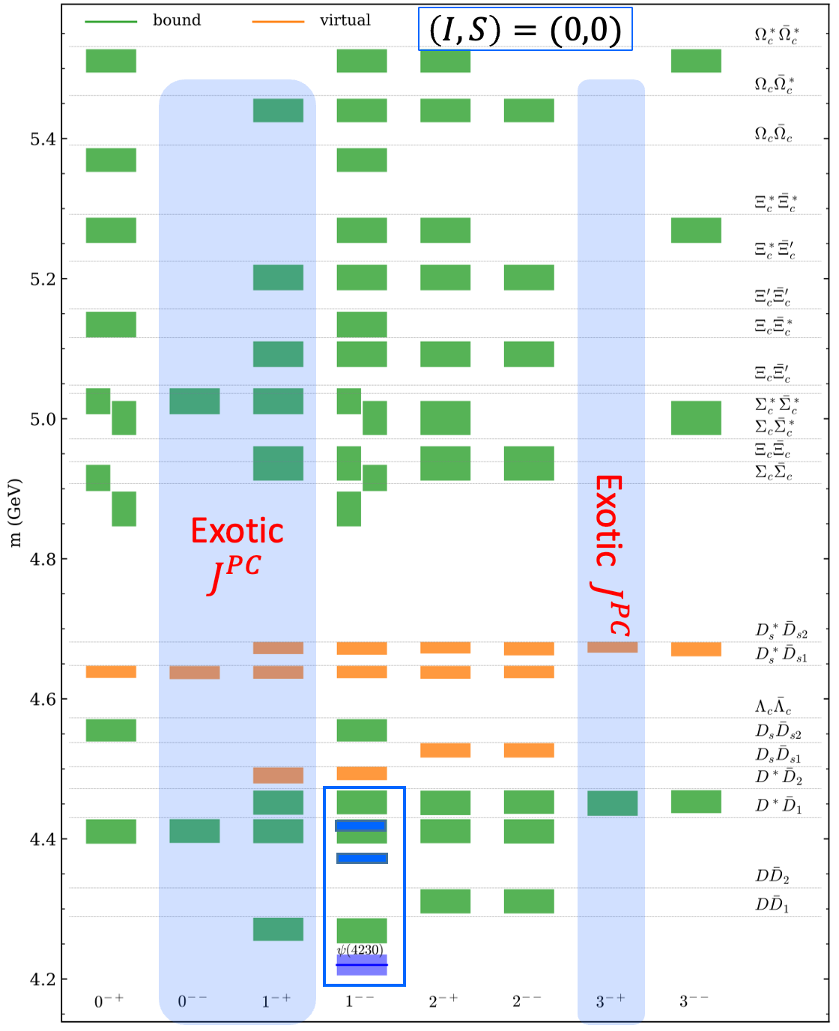
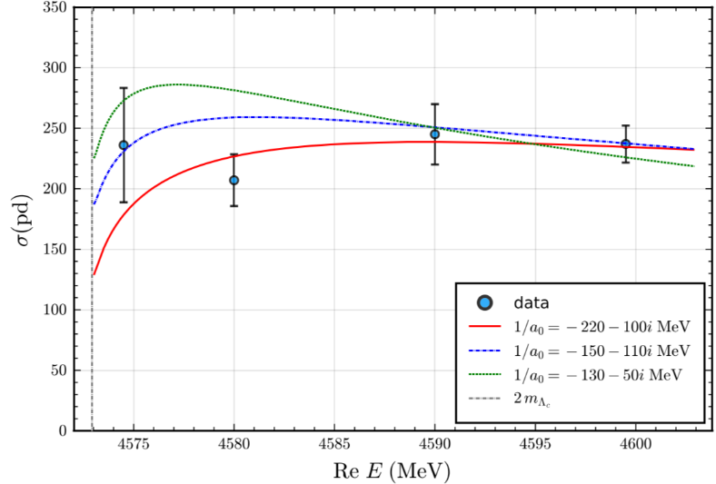
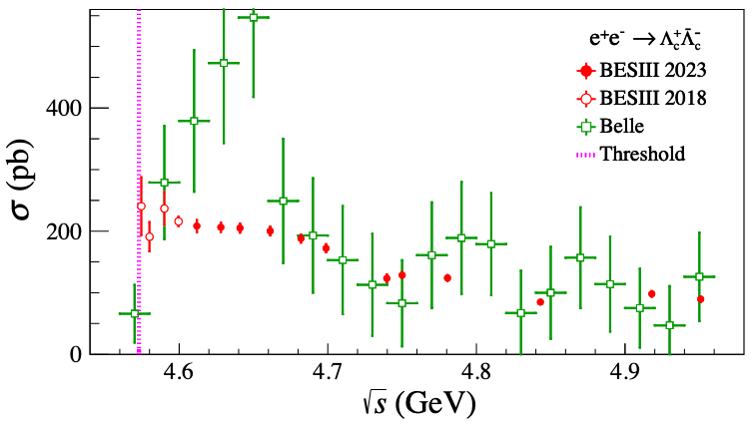
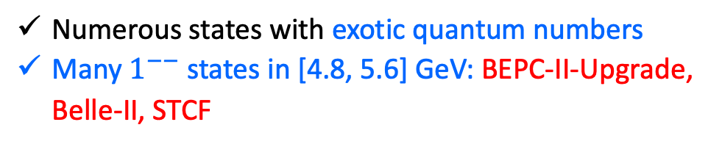
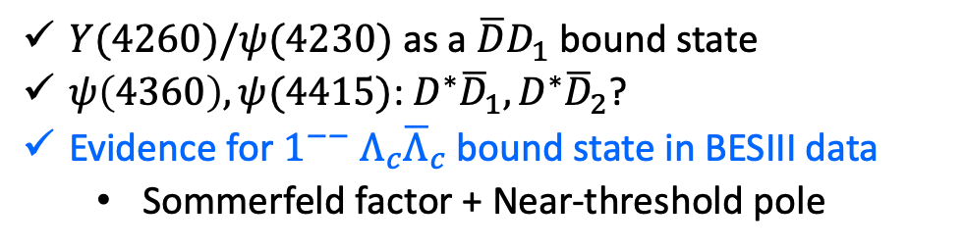
Hidden-charm mesons: $P=−$
$Y(4260)/ψ(4230)$ as a $\overline{D}D_{1}$ bound state
$ψ\left(4360\right), ψ(4415)$: $D^{∗}{\overline{D}}_{1}, D^{∗}{\overline{D}}_{2}$?
Evidence for ${1^{−−} Λ}_{c}{\overline{Λ}}_{c}$ bound state in BESIII data
  Sommerfeld factor + Near-threshold pole
Updated measurement: BESIII, PRL 131 (2023) 191901
Data taken from BESIII, PRL 120 (2018) 132001;
See also Q.-F. Cao et al., PRD 100 (2019) 054040
Numerous states with exotic quantum numbers
Many $1^{−−}$ states in [4.8, 5.6] GeV: BEPC-II-Upgrade, Belle-II, STCF

Slide 14
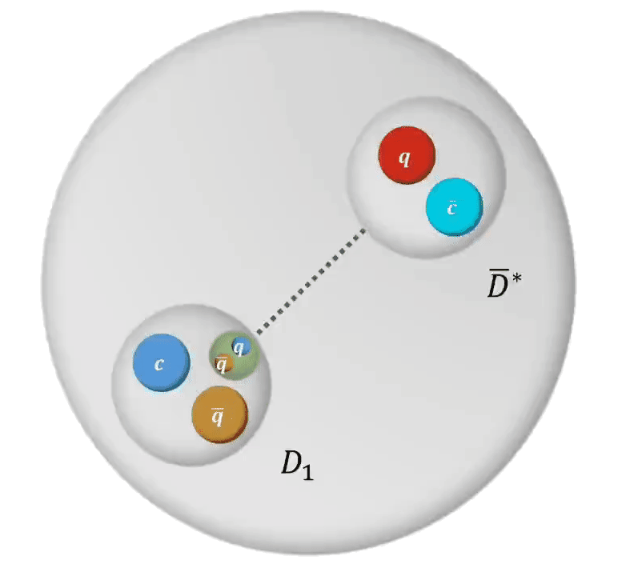
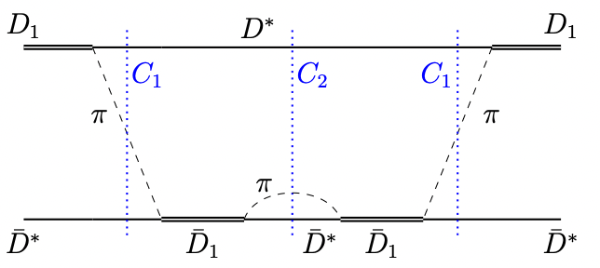




Closer look into the $0^{−−}$ state
T. Ji, X.-K. Dong, FKG, B.-S. Zou, PRL 129 (2022) 102002
Prediction of an exotic $0^{−−}$ spin partner $ψ_{0}(4360)$ [$D^{∗}{\overline{D}}_{1}$] of $ψ\left(4230\right), ψ\left(4360\right),$ $ψ(4415)$ as $D{\overline{D}}_{1}, D^{∗}{\overline{D}}_{1}, D^{∗}{\overline{D}}_{2}$ hadronic molecules
Robust against the inclusion of coupled channels and three-body effects
May be searched for using $e^{+}e^{−}→ψ_{0}η, ψ_{0}→J/ψη, D{\overline{D}}^{∗},D^{∗}{\overline{D}}^{∗}π, …$
Molecule | Components | $$J^{PC}$$ | Threshold | $$E_{B}$$
$$ψ(4230)$$ | $$\frac{1}{\sqrt{2}}\left(D{\overset{‾}{D}}_{1}−\overset{‾}{D}D_{1}\right)$$ | $$1^{−−}$$ | 4287 | $$67±15$$
$$ψ(4360)$$ | $$\frac{1}{\sqrt{2}}\left(D^{∗}{\overset{‾}{D}}_{1}−{\overset{‾}{D}}^{∗}D_{1}\right)$$ | $$1^{−−}$$ | 4429 | $$62±14$$
$$ψ(4415)$$ | $$\frac{1}{\sqrt{2}}\left(D^{∗}{\overset{‾}{D}}_{2}−{\overset{‾}{D}}^{∗}D_{2}\right)$$ | $$1^{−−}$$ | 4472 | $$49±4$$
$$ψ_{0}$$ | $$\frac{1}{\sqrt{2}}\left(D^{∗}{\overset{‾}{D}}_{1}+{\overset{‾}{D}}^{∗}D_{1}\right)$$ | $$0^{−−}$$ | 4429 | $$63±18$$
$$M=\left(4366±18\right) MeV,$$
$Γ<10 MeV$
Can be searched for at BEPC-II-Upgrade, Belle-II, STCF

Slide 15





Hidden-charm pentaquarks
LHCb: 3 narrow $P_{c}$ states below $Σ_{c}{\overline{D}}^{(∗)}$ thresholds
${\overline{D}}^{(∗)}Σ_{c}$ hadronic molecules above 4 GeV were predicted well before
J.-J. Wu, R. Molina, E. Oset, B.-S. Zou, PRL 105 (2010) 232001;
J.-J. Wu, T.-S. H. Lee, B.-S. Zou, PRC85(2012)044002
Other predictions: W.L.Wang et al. (2011); Z.C. Yang et al. (2012); Xiao, Nieves, Oset (2013); Karliner, Rosner (2015); …
Heavy quark spin symmetry: 7 ${\overline{D}}^{(∗)}Σ_{c}^{(∗)}$ hadronic molecules
Xiao, Nieves, Oset (2013); Liu et al. (2018, 2019); Sakai et al. (2019); . . .
LHCb, PRL 122 (2019) 222001
State | $$M[MeV]$$ | $$Γ[MeV]$$
$$P_{c}(4312)^{+}$$ | $$4311.9±{0.7}_{−0.6}^{+6.8}$$ | $$9.8±{2.7}_{−4.5}^{+3.7}$$
$$P_{c}(4440)^{+}$$ | $$4440.3±{1.3}_{−4.7}^{+4.1}$$ | $$20.6±{4.9}_{−10.1}^{+8.7}$$
$$P_{c}(4457)^{+}$$ | $$4457.3±{0.6}_{−1.7}^{+4.1}$$ | $$6.4±{2.0}_{−1.9}^{+5.7}$$
M.-Z. Liu et al., PRL 122 (2019) 242001

Slide 16










Hidden-charm pentaquarks
X.-K. Dong, FKG, B.-S. Zou, Progr.Phys. 41 (2021) 65
$$\left(I,S\right)=(1/2,0)$$
$$\left(I,S\right)=(1/2,0)$$
M.-L. Du et al., PRL 124 (2020) 072001; JHEP 08 (2021) 157
$P_{c}$ states as ${\overline{D}}^{(∗)}Σ_{c}^{(∗)}$molecules
The LHCb data can be well described with a chiral EFT
$$\left(I,S\right)=(0,1)$$
$$\left(I,S\right)=(0,1)$$
$P_{cs}(4459)$: 2 ${\overline{D}}^{∗}Ξ_{c}$ molecular states
$P_{cs}\left(4338\right):$ $\overline{D}Ξ_{c}$ molecular state
STCF can contribute here: $e^{+}e^{−}→J/ψp\overline{p}, Λ_{c}{\overline{D}}^{(∗)}p$, $J/ψΛ\overline{Λ}, Σ_{c}^{(∗)}{\overline{D}}^{(∗)}p$, …

Slide 17





Double-charm tetraquarks and dibaryons
X.-K. Dong, FKG, B.-S. Zou, CTP 73 (2021) 125201
$$\left(I,S,B\right)=(0,0,0)$$
$$\left(I,B\right)=(0,2)$$
$T_{cc}(3875)$ as $D^{∗}D$ molecule
The LHCb data can be well described in a chiral EFT w/ 3-body effects
M.-L. Du et al., PRD 105 (2022) 014024;
For discussions on related left-hand cut effects,
M.-L. Du et al., PRL 131 (2023) 131903;
J.-Z. Wang et al., PRD 109 (2024) L071505;
L. Meng et al., PRD 109 (2024) L071506;
M.T. Hansen et al., JHEP 06 (2024) 051; …
Talks by A. Rusetsky, M.-L. Du, X. Zhang, M. Mai
There is an isoscalar $DD^{∗}$ molecular state
It has a spin partner $1^{+}$ $D^{∗}D^{∗}$ state
Many ($>100$) double-charm molecular states in other sectors
3- and 4-body effects for most of them remain to be explored

Slide 18
Reviews ($≫10$) in the last few years
  H.-X. Chen et al., The hidden-charm pentaquark and tetraquark states, Phys. Rept. 639 (2016) 1
  A. Hosaka et al., Exotic hadrons with heavy flavors: X, Y, Z, and related states, PTEP 2016 (2016) 062C01
  J.-M. Richard, Exotic hadrons: review and perspectives, Few Body Syst. 57 (2016) 1185
  R. F. Lebed, R. E. Mitchell, E. Swanson, Heavy-quark QCD exotica, PPNP 93 (2017)143
  A. Esposito, A. Pilloni, A. D. Polosa, Multiquark resonances, Phys. Rept. 668 (2017) 1
  FKG, C. Hanhart, U.-G. Meißner, Q. Wang, Q. Zhao, B.-S. Zou, Hadronic molecules, RMP 90 (2018) 015004
  A. Ali, J. S. Lange, S. Stone, Exotics: Heavy pentaquarks and tetraquarks, PPNP 97 (2017) 123
  S. L. Olsen, T. Skwarnicki, Nonstandard heavy mesons and baryons: Experimental evidence, RMP 90 (2018) 015003
  Y.-R. Liu et al., Pentaquark and tetraquark states, PPNP107 (2019) 237
  N. Brambilla et al., The XYZ states: experimental and theoretical status and perspectives, Phys. Rept. 873 (2020) 154
  Y. Yamaguchi et al., Heavy hadronic molecules with pion exchange and quark core couplings: a guide for practitioners, JPG 47 (2020) 053001
  FKG, X.-H. Liu, S. Sakai, Threshold cusps and triangle singularities in hadronic reactions, PPNP 112 (2020) 103757
  G. Yang, J. Ping, J. Segovia, Tetra- and penta-quark structures in the constituent quark model, Symmetry 12 (2020) 1869
  C.-Z. Yuan, Charmonium and charmoniumlike states at the BESIII experiment, Natl. Sci. Rev. 8 (2021) nwab182
  H.-X. Chen, W. Chen, X. Liu, Y.-R. Liu, S.-L. Zhu, An updated review of the new hadron states, RPP 86 (2023) 026201
  M. Mai, U.-G. Meißner, C. Urbach, Towards a theory of resonances, Phys. Rept. 1001 (2023) 2248;
  L. Meng, B. Wang, G.-J. Wang, S.-L. Zhu, Chiral perturbation theory for heavy hadrons and chiral effective field theory for heavy hadronic molecules, Phys. Rept. 1019 (2023) 2266;
  M.-Z. Liu et al., Three ways to decipher the nature of exotic hadrons: multiplets, three-body hadronic molecules, and correlation functions, arXiv: 2404.06399
  ……
+ a book:
  A. Ali, L. Maiani, A. D. Polosa, Multiquark Hadrons, Cambridge University Press (2019)

Slide 19


Thank you for your attention!
Open questions
Open questions for almost every exotic hadron candidate …
How can the many resonant structures beyond naïve quark model be classified?
  Which ones are reliable, i.e., lay the foundation for deeper insights?
  What can be learned about confinement mechanism?
Lessons from Zweig (1980):

Slide 20





Poles and line shapes
V1: $a_{11}δ≫1, \left|a_{12}\right|δ≫1$
V2: $a_{11}δ∈(0,1), \left|a_{12}\right|δ≫1$
The $X\left(3872\right)−W_{c1}$ system corresponds to case V4 in the classification of coupled-channel near-threshold structures in
V2
V3
V4
V1
Zhen-Hua Zhang, FKG, arXiv:2407.10620
V4: $a_{11}δ≫1, \left|a_{12}\right|δ∈(0,1)$
V3: $a_{11}δ∈\left(0,1\right), \left|a_{12}\right|δ∈(0,1)$

Slide 21




Poles and line shapes
B1: $a_{11}δ≪−1, \left|a_{12}\right|δ≫1$
B2: $a_{11}δ∈(−1,0), \left|a_{12}\right|δ≫1$
Other cases with two poles
Zhen-Hua Zhang, FKG, arXiv:2407.10620
B2
B3
B4
B1
B4: $a_{11}δ≪−1, \left|a_{12}\right|δ∈(0,1)$
B3: $a_{11}δ∈\left(−1,0\right), \left|a_{12}\right|δ∈(0,1)$

