Slide 1
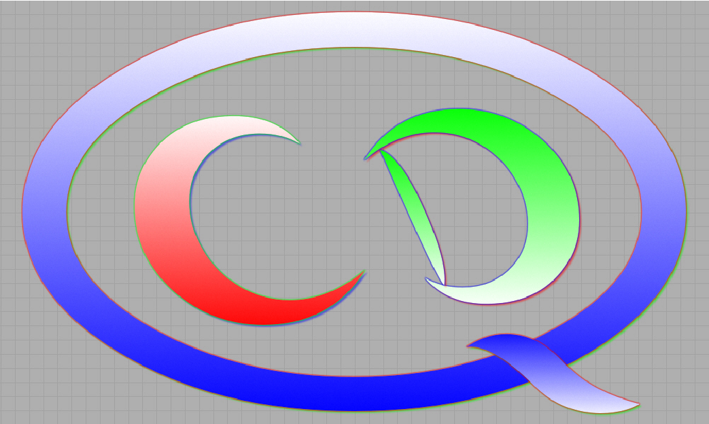
Structure of Low-Lying States in Carbon-12 Using Nuclear Lattice Effective Field Theory
Shihang Shen
Beihang University
Collaborators: Serdar Elhatisari, Timo A. Lähde, Dean Lee, Bing-Nan Lu, and Ulf-G. Meißner

Slide 2
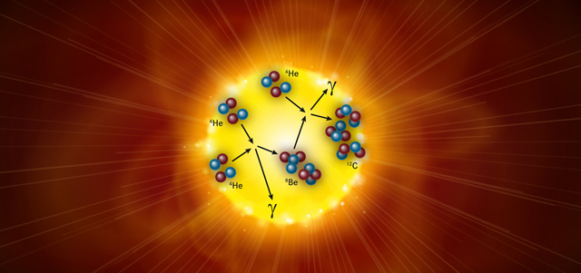
Carbon-12
Life element: ¹²C
F. Hoyle, Astrophys. J. Suppl. Ser. 1, 121 (1954)
Hoyle state
0₂⁺
α
2₁⁺
α
α
0₁⁺
https://www.quantamagazine.org/the-physics-behind-the-elements-of-life-20121204/

Slide 3
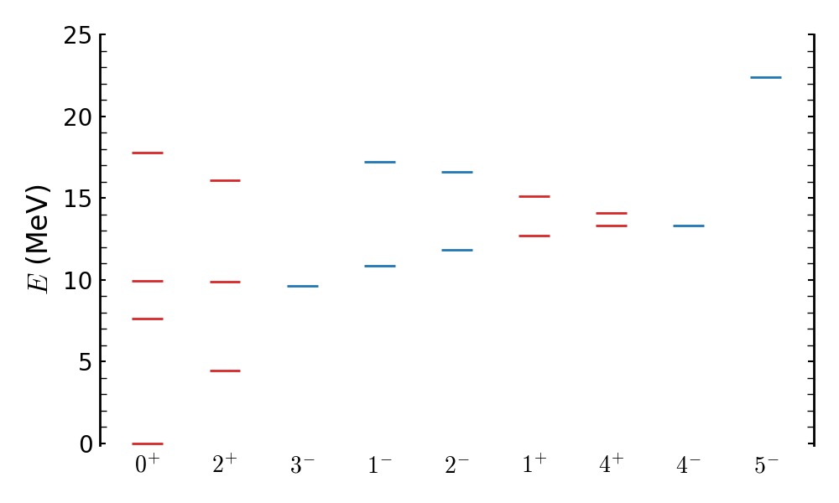
Low-Lying Levels in Carbon-12
Selected low-lying experimental spectrum of ¹²C
J. H. Kelley, J. E. Purcell, and C. G. Sheu, Nucl. Phys. A, 968, 71–253 (2017)
Rotation of equilateral triangle: 0⁺, 2⁺, 3⁻, 4±, and 5⁻ states (ground state band)
Shape of Hoyle state and Hoyle band
Breathing modes of Hoyle state and its rotational excitations
… …
R. Bijker and F. Iachello, Phys. Rev. C, 61, 067305 (2000)
M. Freer and H. O. U. Fynbo, Prog. Part. Nucl. Phys., 78, 1–23 (2014)
K. C. W. Li et al., Phys. Lett. B, 827, 136928 (2022); Z. Cheng et al. arXiv: 2406.15060

Slide 4
Theoretical Investigations
Algebraic Cluster Model
Antisymmetrized/Fermionic molecular dynamics
Antisymmetrized quasicluster model
Cluster model
Density functional theory
Monte-Carlo shell model (MCSM)
No-core shell model (NCSM)
Nuclear lattice effective field theory (NLEFT)
Replica exchange Monte Carlo
Tohsaki-Horiuchi-Schuck-Röpke wave functions
… …
R. Bijker and F. Iachello, Annals Phys., 298, 334–360 (2002)
R. Bijker and F. Iachello, Phys. Rev. C, 61, 067305 (2000)
Y. Kanada-En’yo, Prog. Theor. Phys. 117, 655 (2007)
M. Chernykh, et al., Phys. Rev. Lett., 98, 032501 (2007)
W. Horiuchi and N. Itagaki, Phys. Rev. C, 107, L021304 (2023)
N. Itagaki, et al., Phys. Rev. C 75, 054309 (2005)
H. Takemoto, et al., Phys. Rev. C 107, 044304 (2023)
H. Moriya, et al., Eur. Phys. J. A 59, 37 (2023)
H.-T. Xue, et al., Phys. Rev. C, 109, 024324 (2024)
P. W. Zhao, N. Itagaki, and J. Meng, Phys. Rev. Lett. 115, 022501 (2015)
T. Otsuka et al., Nature Commun., 13, 2234 (2022)
T. Abe et al., Phys. Rev. C, 104, 054315 (2021)
P. Choudhary et al., Phys. Rev. C, 107, 014309 (2023)
P. Navratil, J. P. Vary, and B. R. Barrett, Phys. Rev. Lett., 84, 5728–5731 (2000)
S. Shen, et al., Nature Commun., 14, 2777 (2023)
E. Epelbaum, et al., Phys. Rev. Lett., 106, 192501 (2011)
T. Ichikawa and N. Itagaki., Phys. Rev. C, 105, 024314 (2022)
S. Li, et al., Phys. Rev. C, 109, 054329 (2024)
Tohsaki, A., et al., Phys. Rev. Lett. 87, 192501 (2001)

Slide 5
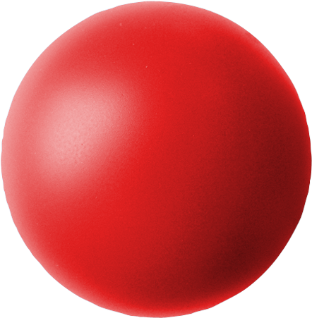
Structure and Shape
Shell model
?
Cluster model
1p_{1/2}
1p_{3/2}
1s_{1/2}
Hoyle State, debate
Linear arrangement of 3α-particles
Vibrational excitation, triangular symmetry
Bose Einstein Condensate of α-particles
Cluster-gas close to an equilateral triangle
Superposition of 3α arrangements
… …
M. Freer and H.O.U. Fynbo., Prog. Part. Nucl. Phys. 78, 1 (2014)
H. Morinaga, Phys. Rev. 101, 254 (1956)
R. Bijker and F. Iachello, PRC, 61, 067305 (2000)
A. Tohsaki, et al., Phys. Rev. Lett. 87, 192501 (2001)
Y. Kanada-En’yo, Prog. Theor. Phys. 117, 655 (2007)
M. Chernykh, et al., Phys. Rev. Lett., 98, 032501 (2007)

Slide 6
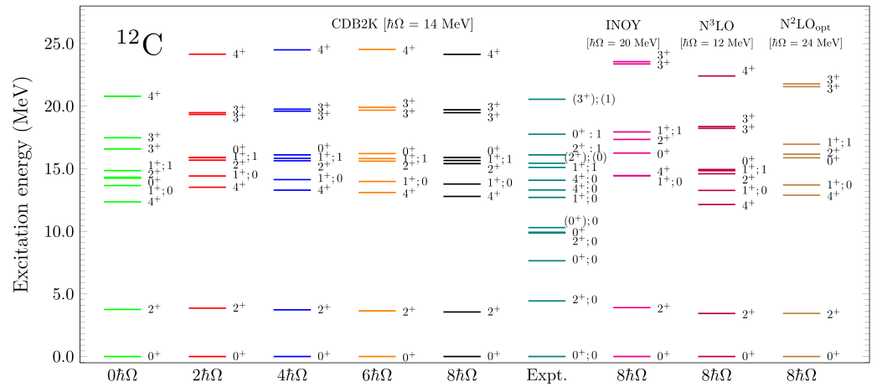
Ab initio Study
Hoyle state is a challenge for ab initio method
No-core shell model
P. Choudhary et al., Phys. Rev. C, 107, 014309 (2023)

Slide 7
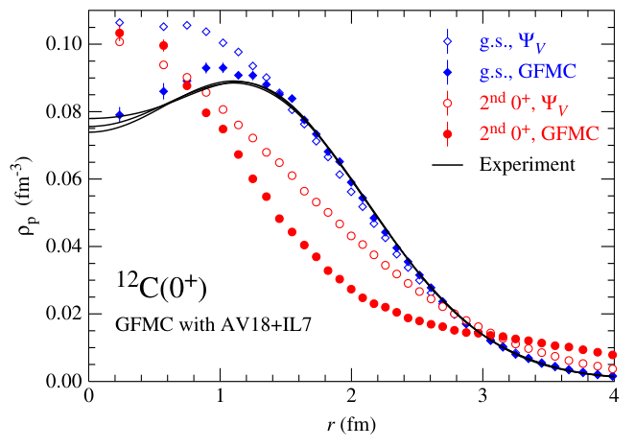
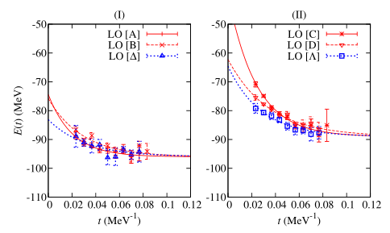
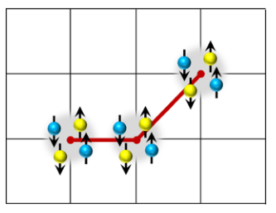
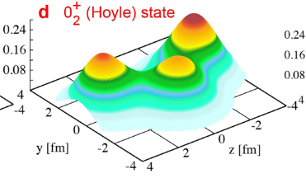
Ab initio Study
First successful ab initio description: nuclear lattice effective field theory (NLEFT)
Green’s function Monte Carlo
Monte Carlo Shell Model
J. Carlson, et al., Rev. Mod. Phys., 87, 1067 (2015)
T. Otsuka et al., Nature Commun., 13, 2234 (2022)
In this work
Study low-lying structure of ¹²C in NLEFT
Make use of SU(4) symmetry to alleviate sign problem
To give a full description of all the low-lying states, both cluster and shell-model type
To propose new method to study the geometric structure (using pinhole algorithm)
To propose geometric description to quantify different excitation mode

Slide 8
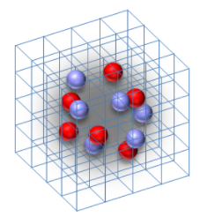
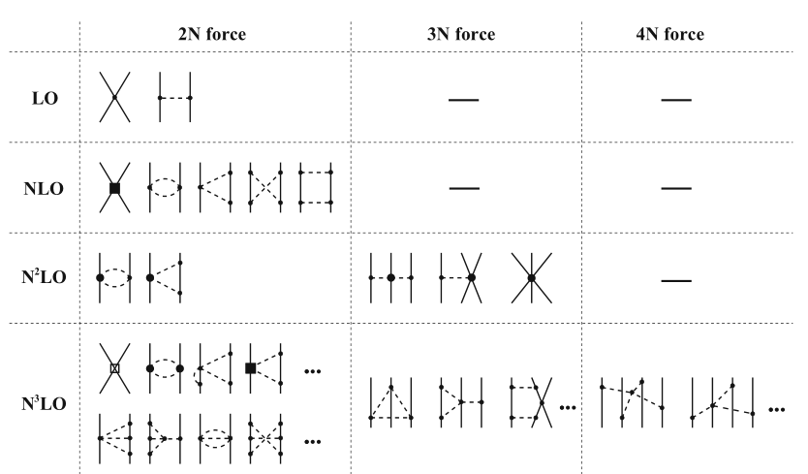
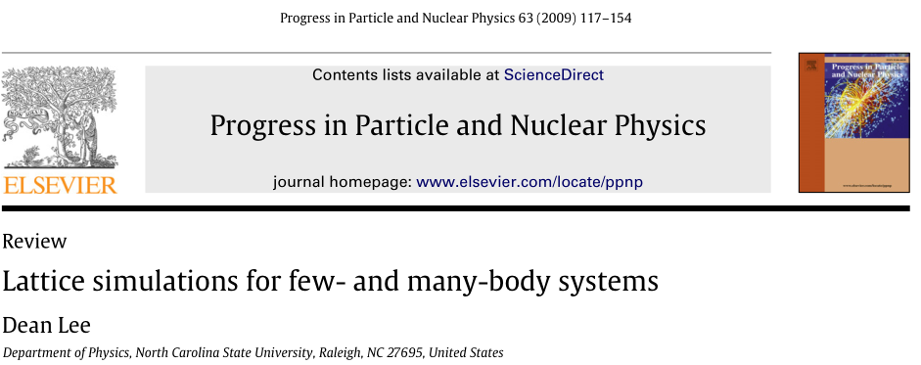
Theoretical Framework
Nuclear lattice effective field theory (NLEFT)
16O, E. Epelbaum et al., PRL 112, 102501 (2014)
α-α scattering, S. Elhatisari et al., Nature 528, 111 (2015)
thermodynamics, B.-N. Lu et al., PRL 125, 192502 (2020)
... ...
Upper left figure is in courtesy of E. Epelbaum
lattice figure from https://www.physics.ncsu.edu/ntg/leegroup/research.html

Slide 9
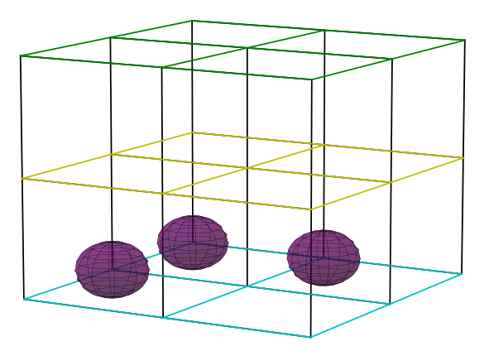
Theoretical Framework
Starting from an initial many-body wave function:
Euclidean time projection with transfer matrix:
with H the many-body Hamiltonian, a_{t} and a the temporal and spatial lattice spacing.
1d_{3/2}
20
2s_{1/2}
t = L_{t}
t = L_{t}/2
t = 0
1d_{5/2}
8
1p_{1/2}
1p_{3/2}
2
1s_{1/2}

Slide 10
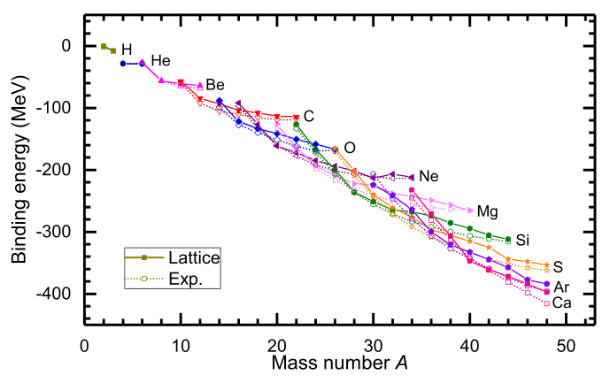
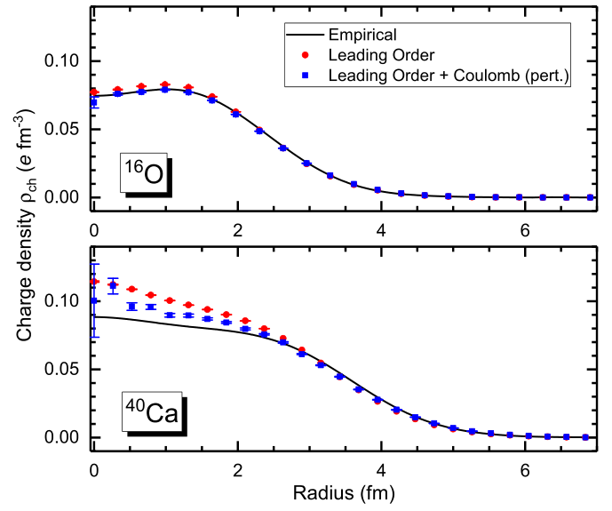
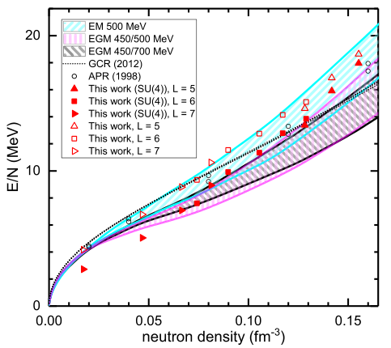
Theoretical Framework
Wigner SU(4) symmetric interaction (spin and isospin independent):
S. Elhatisari et al., PRL 119, 222505 (2017)
Sign problem is largely suppressed
Ground state properties of light and medium mass nuclei, and neutron matter can be well reproduced
Higher order (e.g. N3LO) can be built on with perturbation
J.W. Chen, D. Lee, T. Schäfer, PRL, 93, 242302 (2004)
B.-N. Luu et al., PLB 797 (2019) 134863
Elhatisari et al., Nature 630, 59 (2024)

Slide 11
Theoretical Framework
Auxilary field with Monte-Carlo sampling
Final states are a superposition of millions of configurations (Slater determinants)
ρ
ρ
∫ ds
ρ

Slide 12
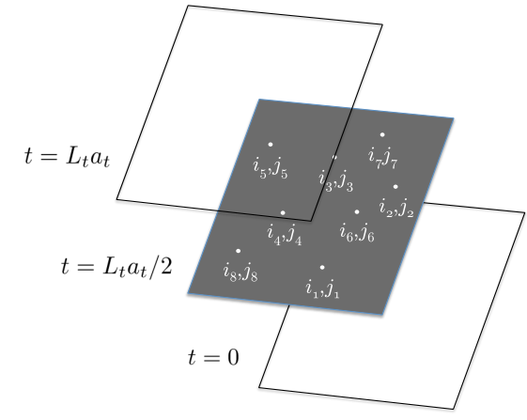
Theoretical Framework
Pinhole algorithm
A time slice is inserted to sample
the positions and spin-isospin
indices in the middle time step.
Those millions of A-body positions contains all correlation information and provides a powerful tool to study the structure and geometry of nuclei
S. Elhatisari et al., PRL 119, 222505 (2017)
r_{c.m.}
r₁ , r₂ , ..., r_{A}

Slide 13
Numerical Details
Lattice length L = 14.8 fm with spacing a = 1.64 fm (π/a ~ 378 MeV)
Temporal lattice spacing a_{t} = 0.55 fm/c.
Fitted results for SU(4) interaction
C₂ [MeV⁻²] | C₃ [MeV⁻⁵] | s_{L} | s_{NL}
−2.15×10⁻⁵ | 6.17×10⁻¹² | 0.08 | 0.05
 | NLEFT | Exp.
E(⁴He) [MeV] | -28.1 (1) | -28.3
E(¹²C) [MeV] | -91.6 (1) | -92.2
r_{c}(¹²C) [fm] | 2.52 (1) | 2.47 (2)
And to some extent transition properties.
S. Shen et al., Nature Commun. (2023) 14:2777
S. Shen et al., EPJA, 57, 276 (2021)

Slide 14
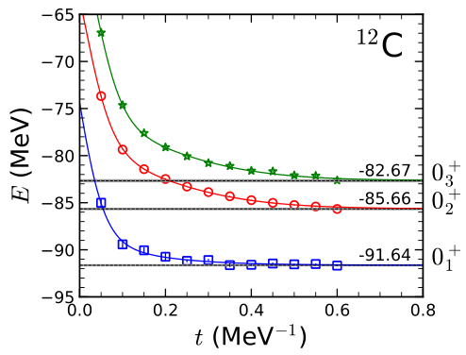
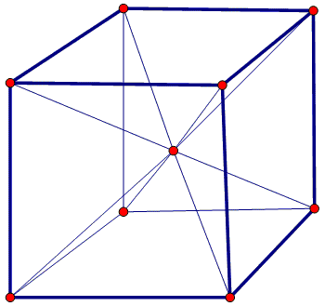
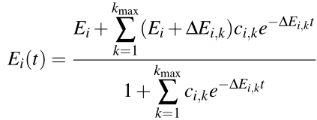
Calculation of the Hoyle State
Hoyle state
Angular momentum projection: SO(3) group reducted to cubic group O
J | irrepresentation
0 | A₁
1 | T₁
2 | E + T₂
3 | A₂ + T₁ + T₂
4 | A₁ + E + T₁ + T₂
T. A. Lähde et al., JPG 42 (2015) 034012
Web figures from: https://en.wikipedia.org/wiki/Sphere
https://math.ucr.edu/home/baez/icosidodecahedron/7.html

Slide 15
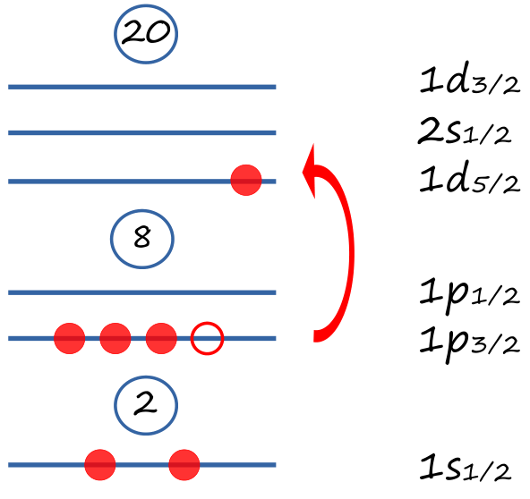
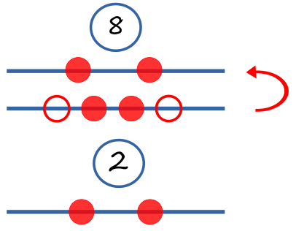
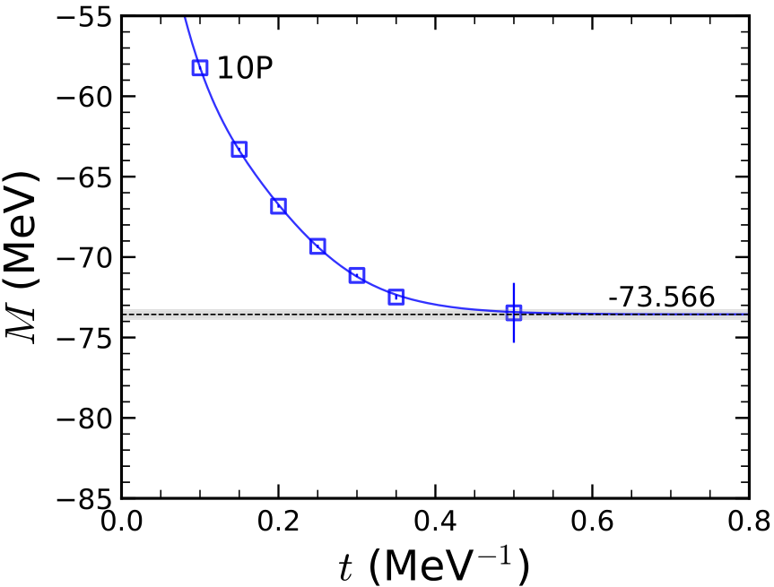
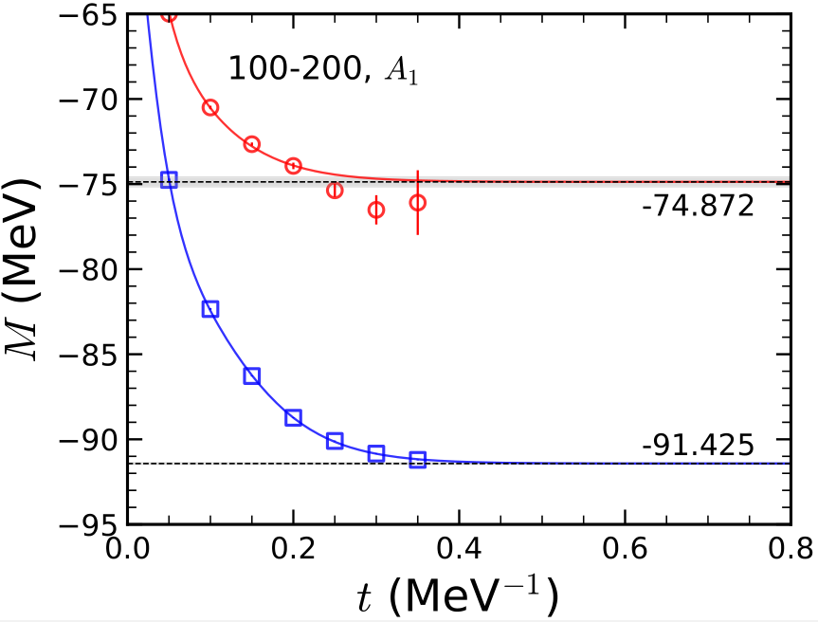
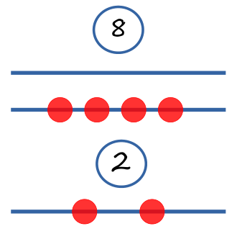
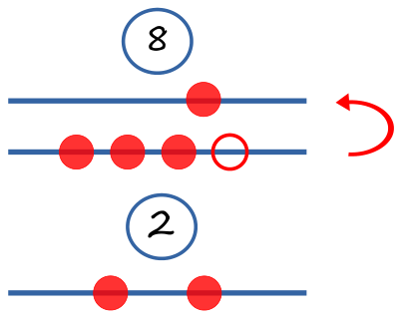
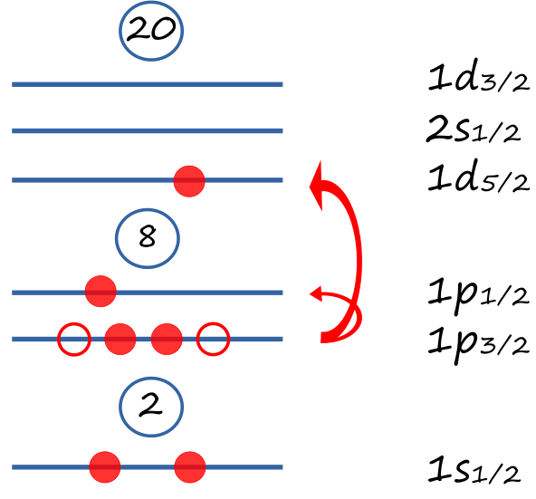
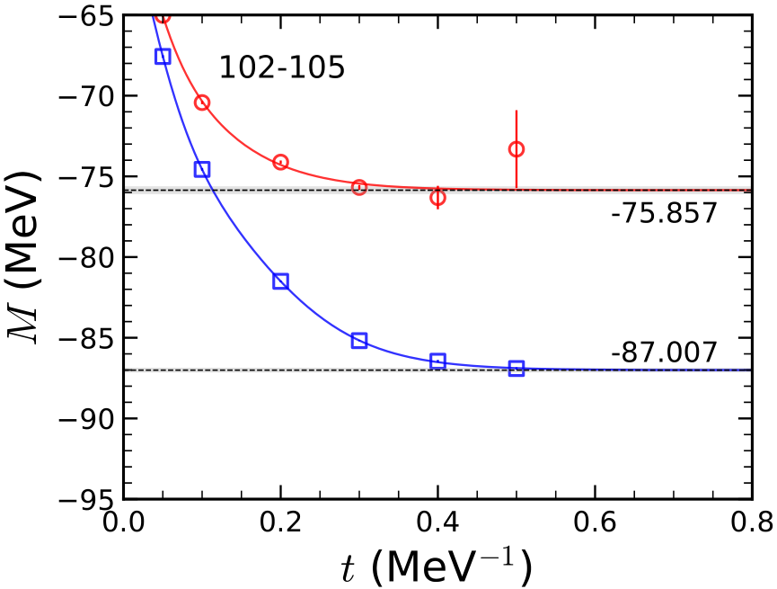
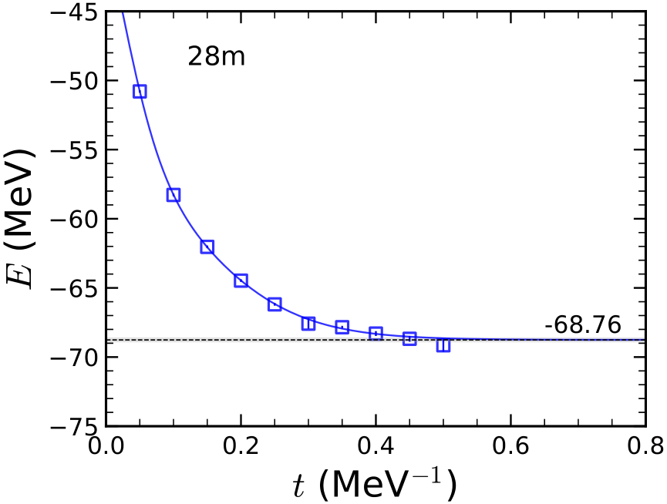
Shell-Model States Used as Initial Wave
0₁+, 0₄+
4-
2+, 1+
5-

Slide 16
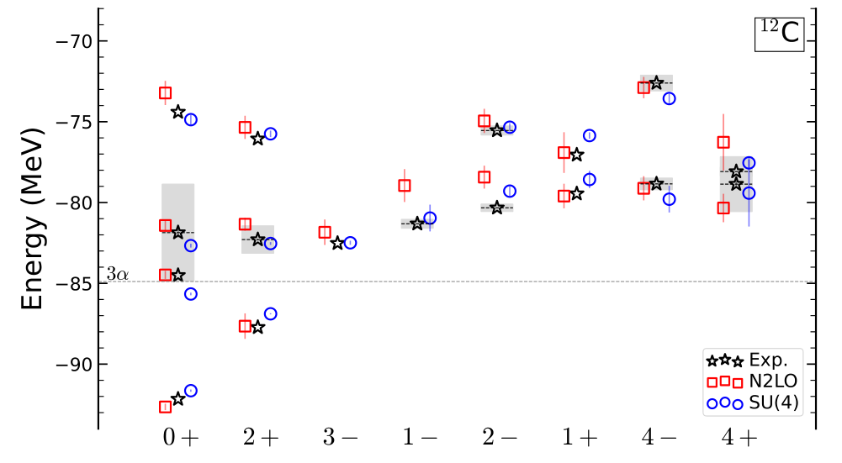
Low-lying Spectrum
Spectrum of ¹²C calculated by NLEFT using N2LO and SU(4) interaction in comparison with experimental data.
S. Shen et al., Nature Commun. (2023) 14:2777

Slide 17
Electromagnetic Properties
Quadrupole moment and transition rates of ¹²C calculated by NLEFT, comparing with other theoretical calculations and Experiments. Units for Q and M(E0) are e fm² and for B(E2) e² fm⁴.
Future Experiments can be used as a test.
fermion molecular dynamics (FMD) M. Chernykh et al., PRL 98, 032501 (2007)
α cluster M. Chernykh et al., PRL 98, 032501 (2007)
BEC Y. Funaki et al., PRC 67, 051306 (2003); EPJA 24, 321 (2005)
in-medium no-core shell model (NCSM) A. D’Alessio et al., PRC 102, 011302 (2020)
generator coordinate method (GCM) B. Zhou, PRC 94, 044319 (2016)
Exp. F. Ajzenberg-Selove, NPA 506, 1 (1990); J. Saiz Lomas, PhD thesis, University of York, UK (2021)

Slide 18
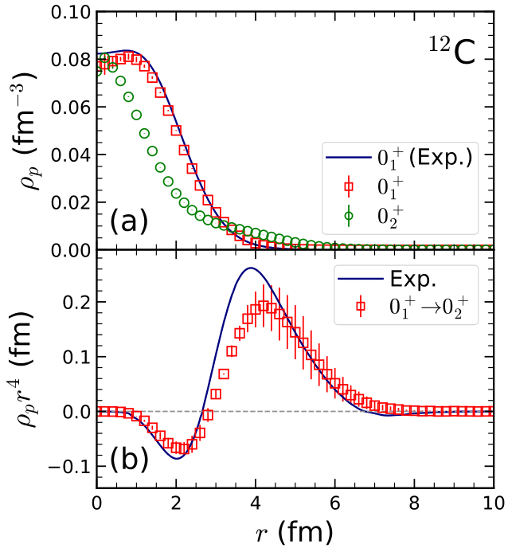
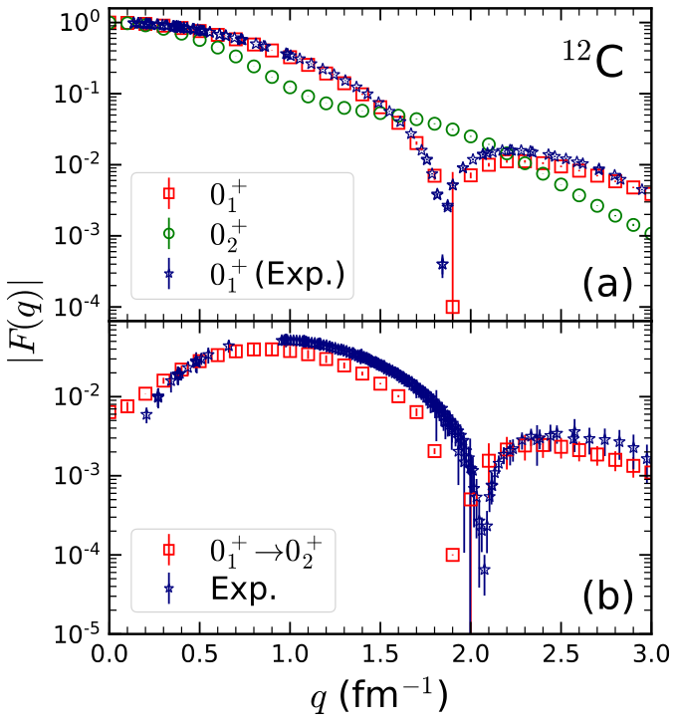
Density Profiles
Charge density distributions (left) and form factors (right) of ground state, Hoyle state, and transitions between them.
Exp. M. Chernykh et al., PRL 105, 022501 (2010)
I. Sick and J. S. Mccarthy, NPA 150, 631 (1970)
P. Strehl, Z. Phys. 234 (1970) 416; H. Crannell et al., NPA 758, 399 (2005)

Slide 19
Investigation of the Geometry
Define (α) clusters
Identify 3 spin-up protons;
Find the closest possible of the other 3 types of particles (spin-down proton, spin-up neutron, spin-down neutron);
Calculate the rms radius of α cluster defined this way and compare with 4He calculation.
 | 12C, 0_1+ | 12C, 0_2+ | 4He
rms α cluster [fm] | 1.65 | 1.71 | 1.63

Slide 20
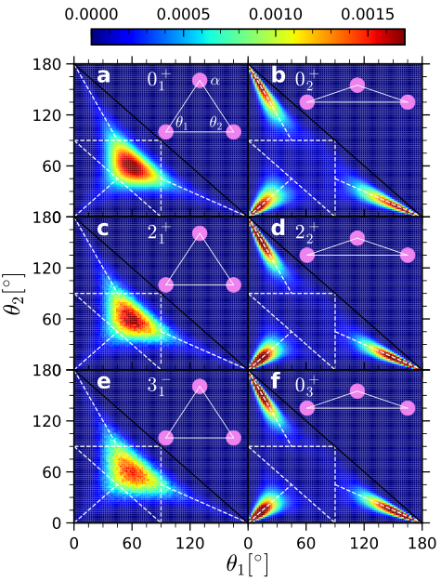
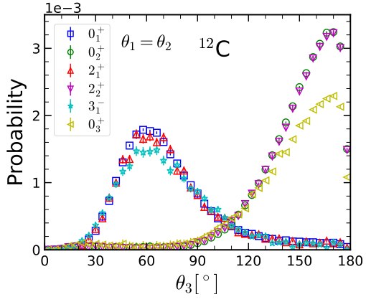
Distribution of Angles
Probability distribution for the two inner angles of the triangle formed by the three α clusters.
θ₃
θ₁
θ₂

Slide 21
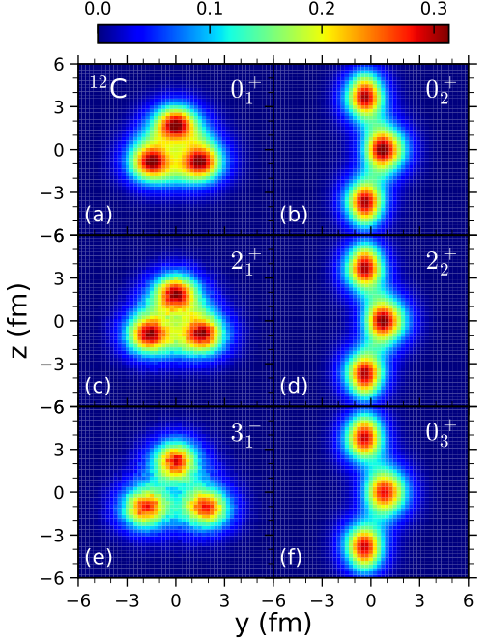
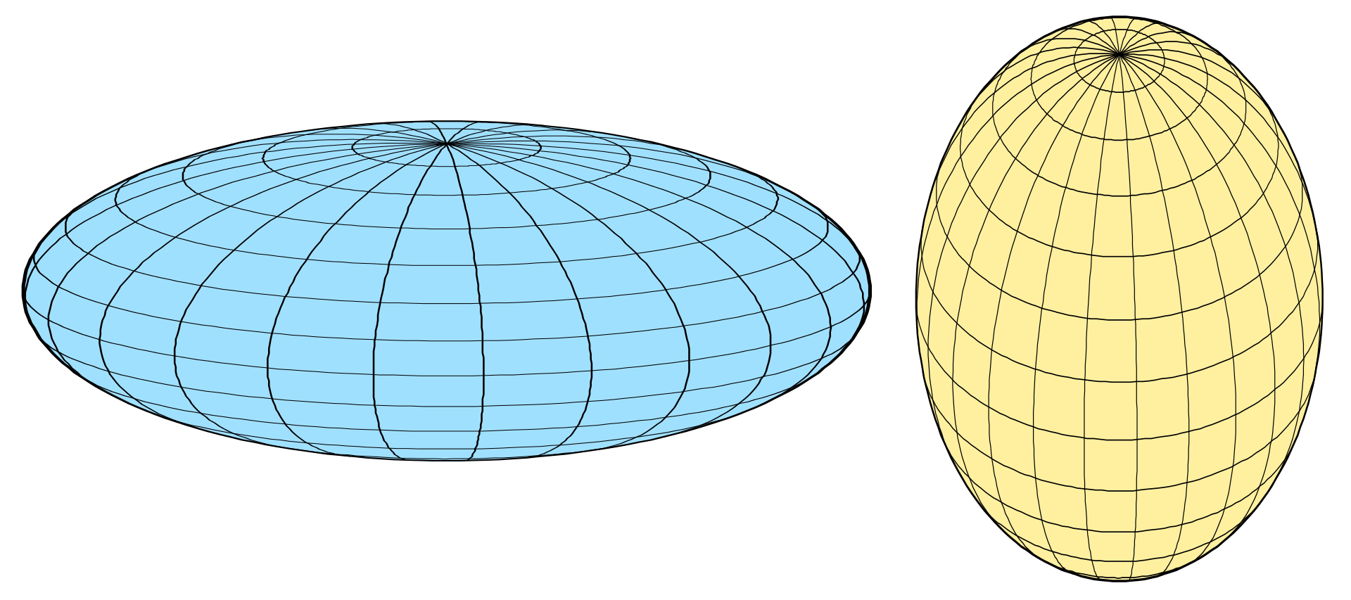
Intrinsic Density Distribution
Alignment of configurations:
For equilateral triangle type:
Align shortest principal axis to x;
Rotate 1 α to y = 0 (positive z), and (randomly) +/- 120°.
For obtuse triangle type:
Align longest principal axis to z;
Rotate central α to x = 0 (positive y).
[fm⁻³]
~ 2 fm ~4 fm
x z
Web figure from: https://en.wikipedia.org/wiki/Spheroid

Slide 22
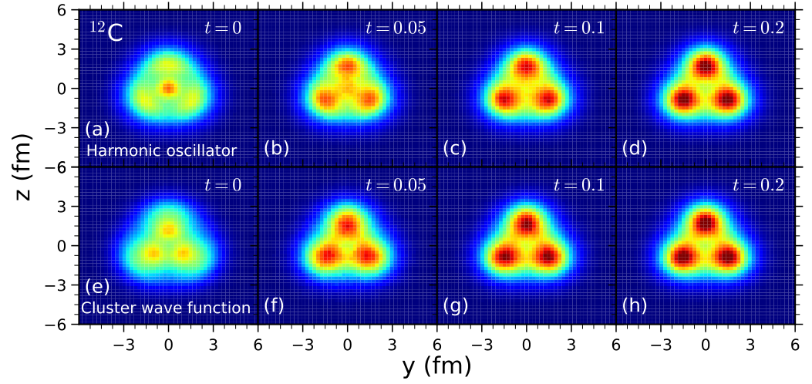
Cluster Formation
Density distribution of ¹²C ground state using (a-d) harmonic oscillator or (e-h) cluster wave function as initial states, with Euclidean projection time ranging from t = 0 to 0.2 MeV⁻¹.
confirms the finding in Ref. E. Epelbaum et al., PRL 109, 252501 (2012)

Slide 23
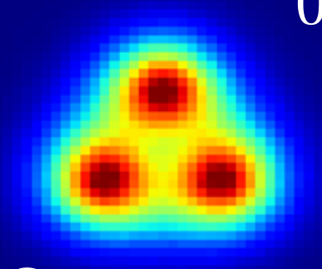
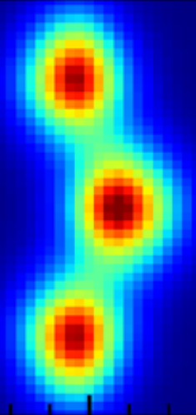
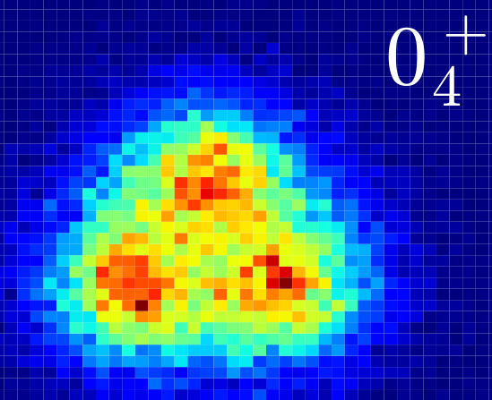
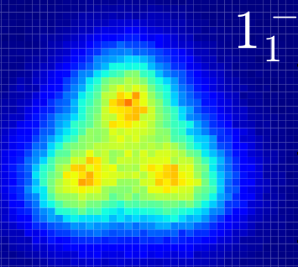
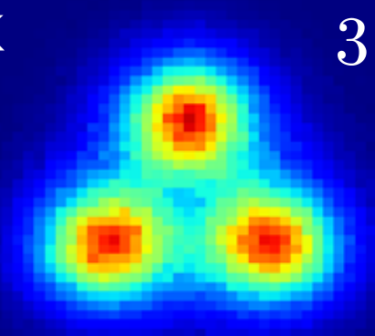
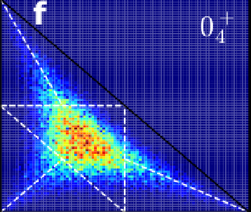
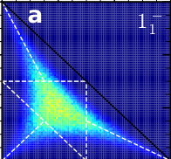
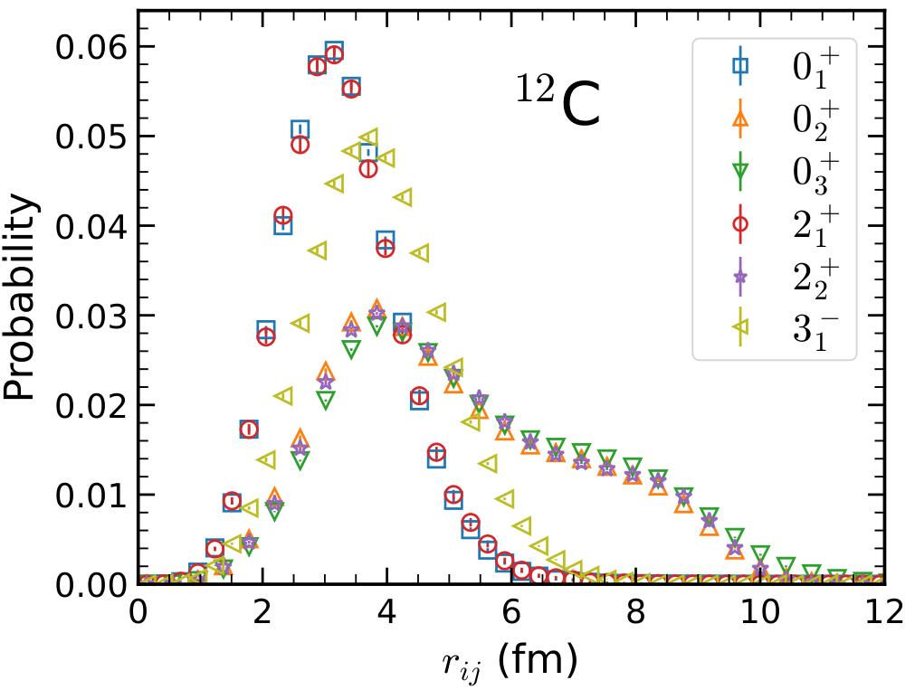
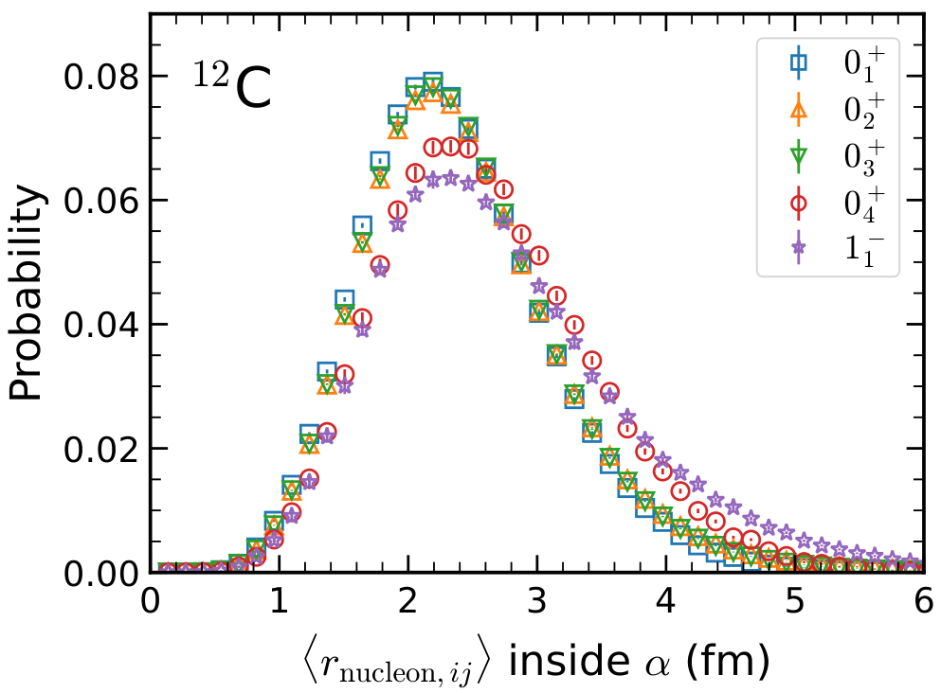
Cluster Excitation? Single-Particle Excitation?
1d_{5/2}
1p_{1/2}
1p_{3/2}
1s_{1/2}

Slide 24
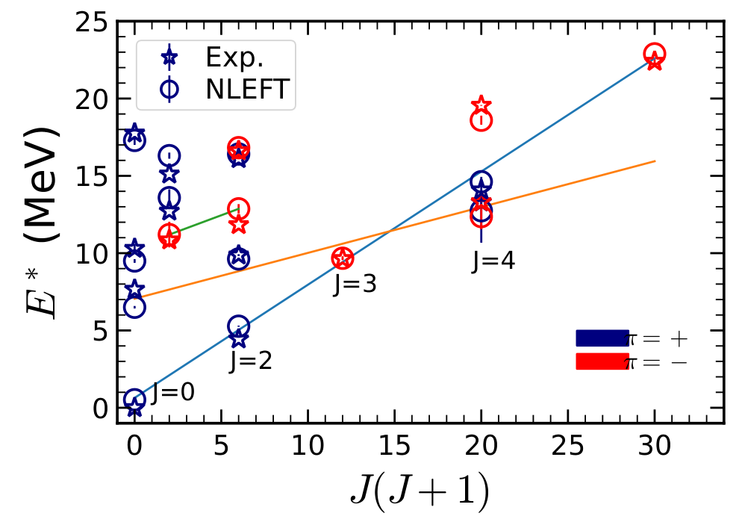
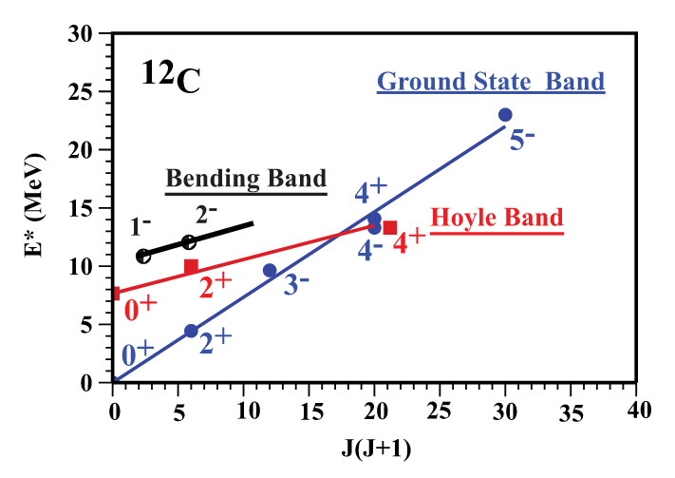
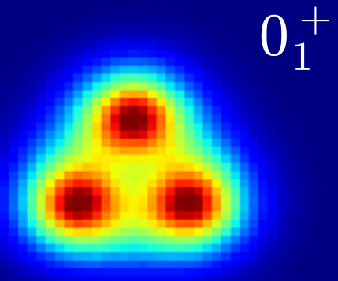
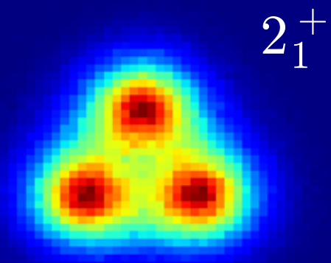
Band Structure
Marín-Lámbarri, D. J. et al., Phys. Rev. Lett. 113, 012502 (2014)
R. Bijker and F. Iachello, Phys. Rev. C, 61, 067305 (2000)
Exp.

Slide 25
Breathing Mode of Hoyle State
3D density at y = 0 plane
Distance distribution
Hoyle state Rotation Breathing
Angle distribution
θ₃
θ₁
θ₂

Slide 26
Geometry Information in the Low-Lying Spectrum
To summarize the geometry properties of each states in the low-lying spectrum of ¹²C calculated by NLEFT:
2 types of shape: equilateral or large angle obtuse triangle.
α cluster is well maintained (solid triangles) or diminished (dashed ones).

Slide 27
Summary
Summary
Low-lying spectrum of ¹²C have been studied by NLEFT using SU(4) and N2LO interaction, the agreement with experiment is impressive, not only energies, but also electromagnetic transitions and density profiles.
A tomographic scan of the three-dimensional geometry of the nuclear states has been introduced. The Hoyle state and its rotational excitations, as already stated in E. Epelbaum et al., PRL 109, 252501 (2012), are found to be an obtuse triangle with large angle.
Geometric structure (angle/distance) has been discussed, characteristics of cluster structure and single-particle structure are shown.
Perspectives
¹⁶O, ²⁰Ne, ... ⁴⁰Ca
Full N3LO interaction
Elhatisari et al., Nature 630, 59 (2024)

Slide 28
APPENDIX

Slide 32
a = 1.97 fm π/a ~ 314 MeV

Slide 33
a = 1.64 fm π/a ~ 378 MeV

Slide 34
a = 1.32 fm π/a ~ 469 MeV

Slide 35
a = 0.99 fm π/a ~ 626 MeV

Slide 36
Shell-Model States as Initial Wave
α cluster structure is less clear due to single-particle excitation, especially when excited to the next shell.

Slide 37
Shell-Model States as Initial Wave

Slide 40
S. Shen, T. A. Lähde, D. Lee, U.-G. Meißner, EPJA 57, 276 (2021)

