Slide 1

$Ξ_{c}−Ξ_{c}^{′}$ mixing from Lattice QCD
王 伟
上海交通大学
2023年11月25日

Slide 2
Outline
Flavor SU(3) Symmetry
Weak Decay Effective Hamiltonian
SU(3) in semi-leptonic charmed baryon decays
    Symmetry confronted with data
Symmetry breaking and Lattice QCD
Notes:
2

Slide 3
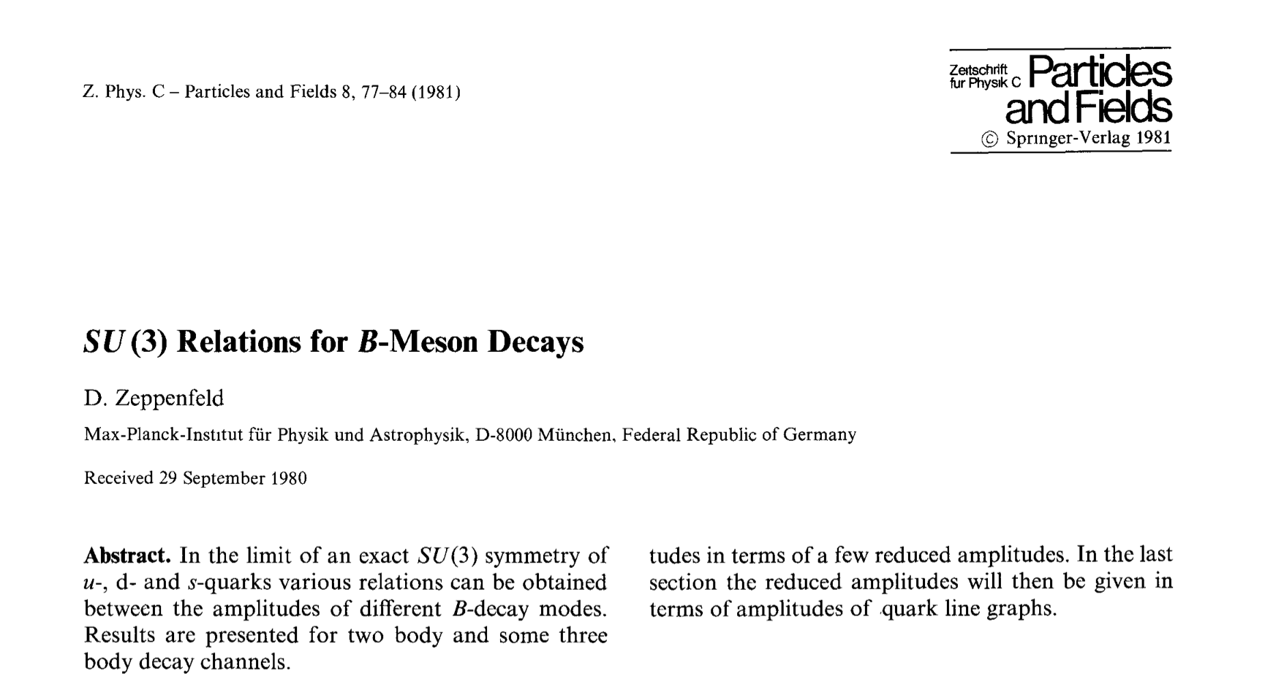
A long history
Zeppendfeld, 1981
Chau,1986
Chau,Cheng,1987, 1989
Savage and Wise, 1989
Deshpande, He, 1995
Chiang, Gronau, Rosner, Suprun 2004
Cheng, Chiang,2010
Li, Lu, Yu, 2012
Geng…
Hsiao…
Notes:
3

Slide 4
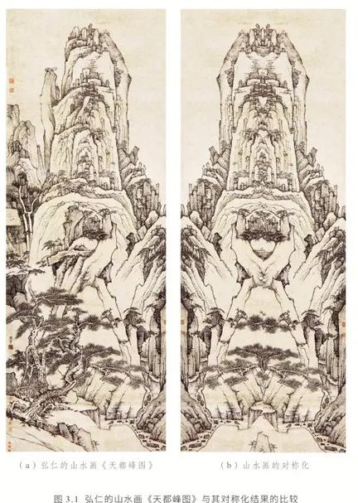

SU(3) in group theory
$$ℒ_{q}=\overline{q}\left(iD_{μ}γ^{μ}−m_{q}\right)q$$
$q$=$\left(\begin{matrix}u \\ d \\ s\end{matrix}\right)$ åå
对称展示宇宙之美，不对称生成宇宙之实
Notes:
4

Slide 5
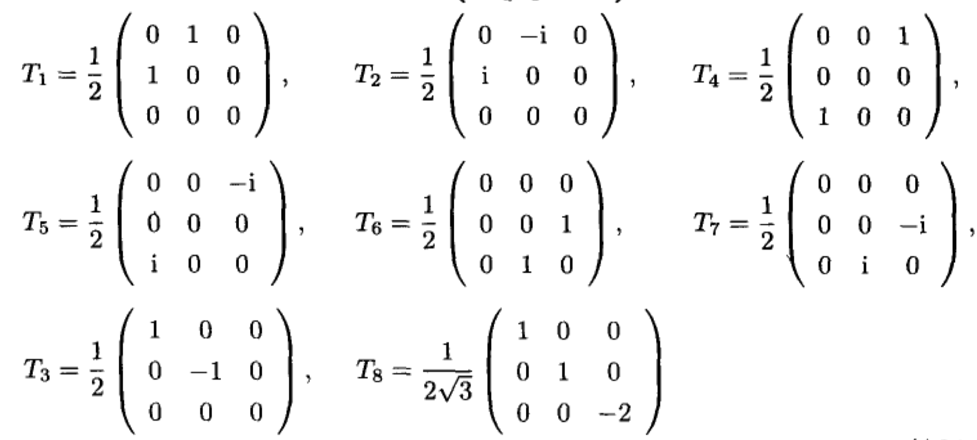

SU(3) in group theory
SU(3) 变换：
$$u^{†}u=1,\det\left(u\right)=1$$
8个生成元：
Notes:
5

Slide 6
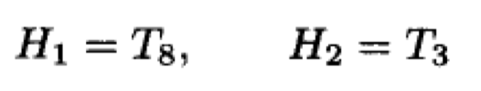
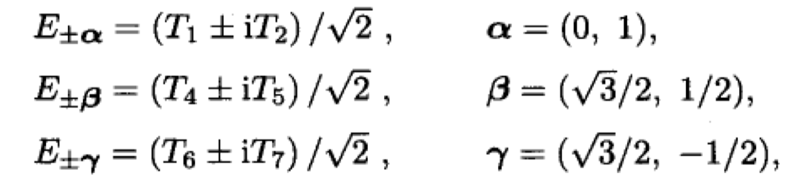
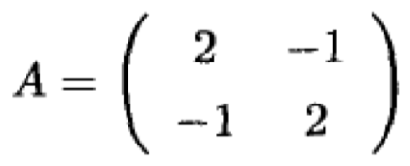


SU(3) in group theory
嘉当-外尔基(Cartan-Weyl basis)：根矢量与素根
$A_{2}$李代数的邓金图与嘉当矩阵
邓金图
嘉当矩阵
Notes:
6

Slide 7

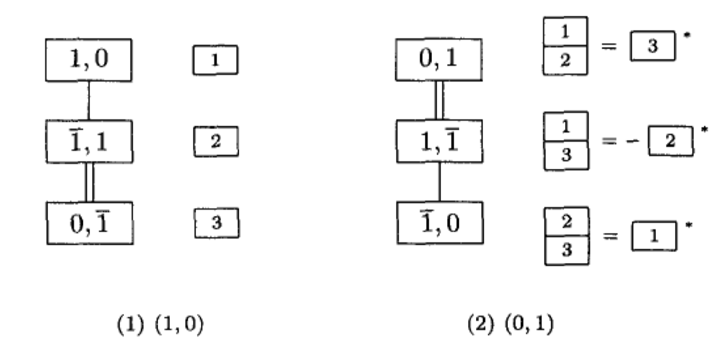
SU(3) in group theory
权矢量与基本主权
方块权图与张量基
Notes:
7

Slide 8
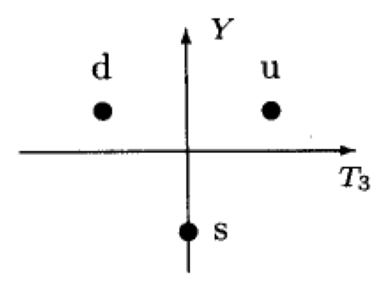
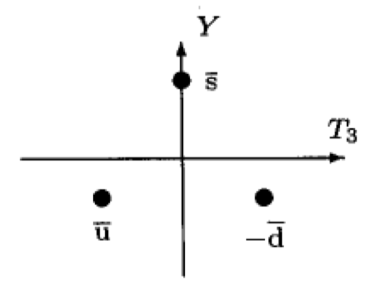
SU(3) in group theory
平面权图
(10)
(01)
Notes:
8

Slide 9
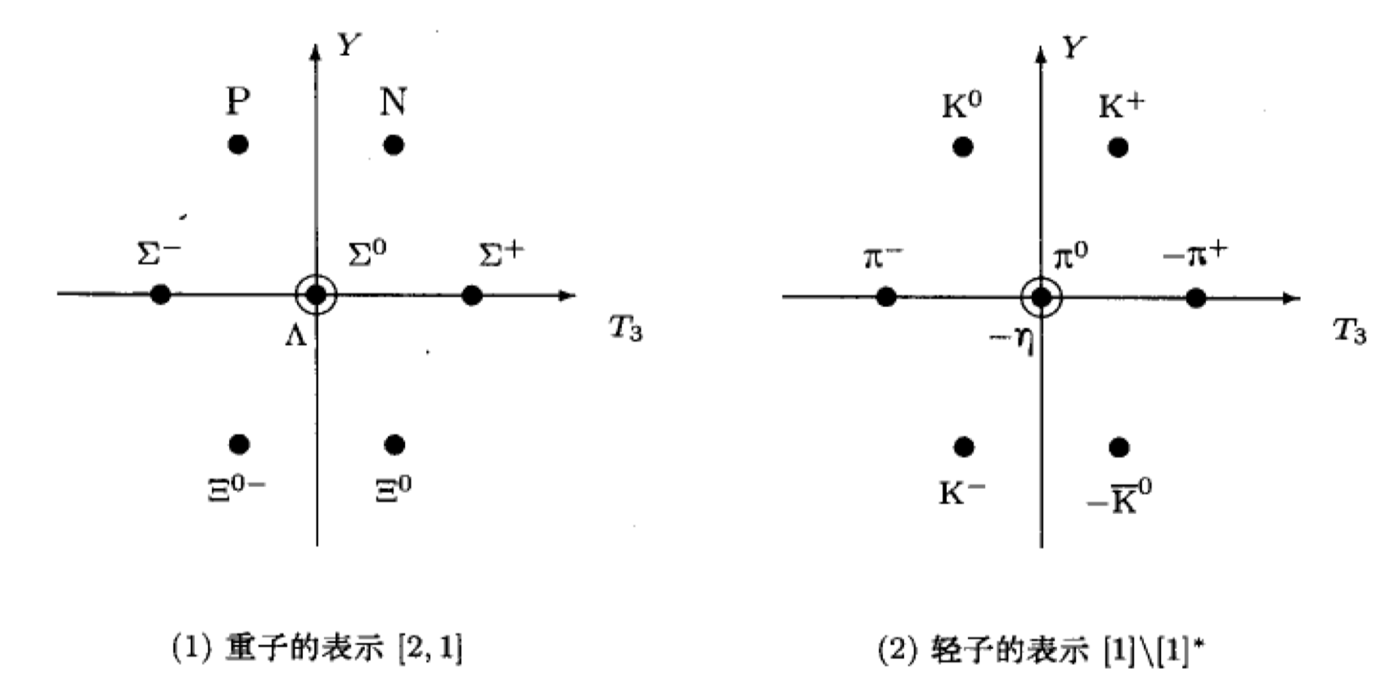
SU(3) in group theory
平面权图
Notes:
9

Slide 10
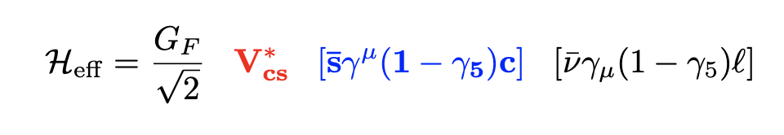
Weak Decay Effective Hamiltonian
SU(3) triplet
Notes:
10

Slide 11
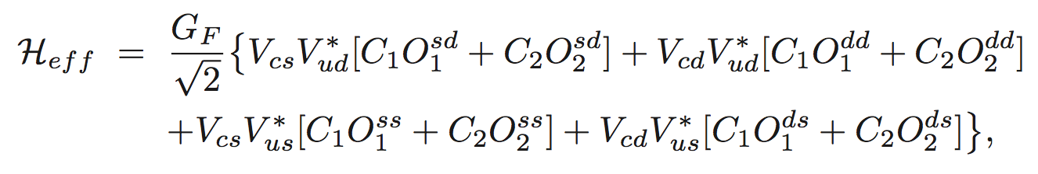
Weak Decay Effective Hamiltonian
Nonleptonic:
Color flow
Different flavors
SU(3) decomposition
Notes:
11

Slide 12
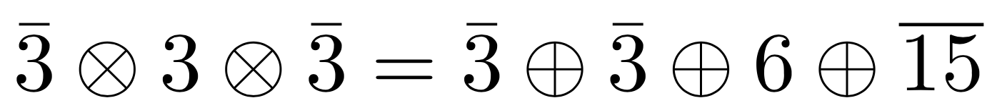
Weak Decay Effective Hamiltonian
Notes:
12

Slide 13
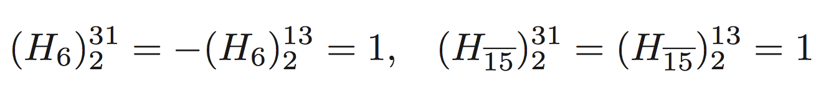
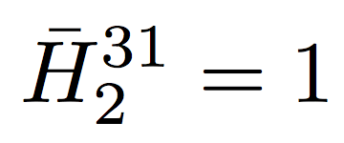
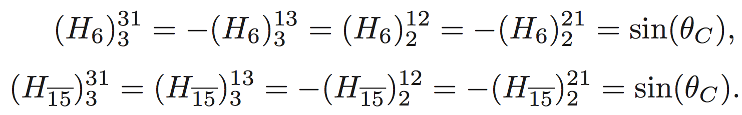
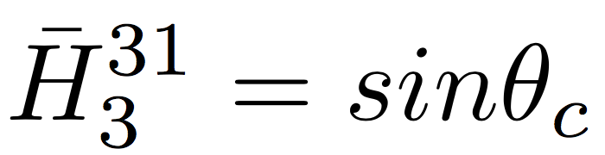
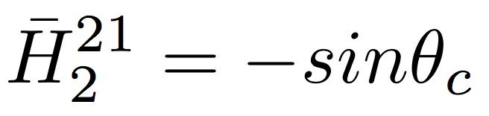
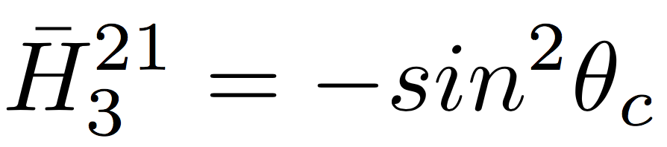

Weak Decay Effective Hamiltonian
Cabibbo-Allowed:
Cabibbo-Suppressed:
Doubly Cabibbo-Suppressed:
In charm operator vanishes since:
Notes:
13

Slide 14
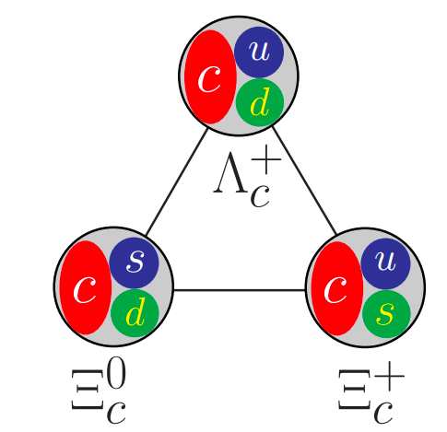
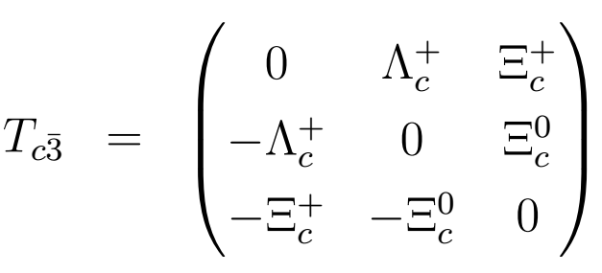
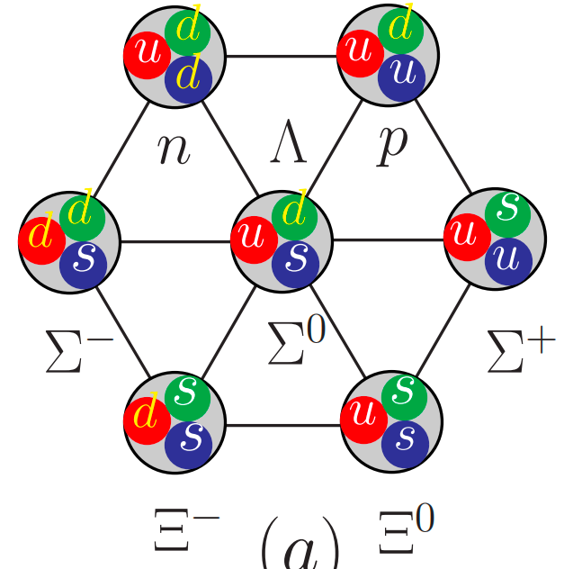
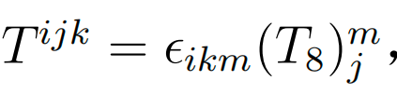
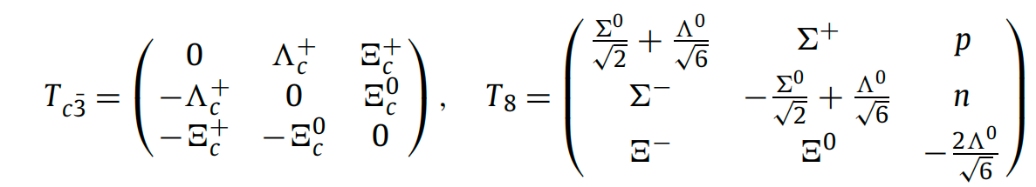



SU(3) in semileptonic charmed baryon decays
SU(3) symmetry analysis
u d s
u
d
s
Anti-triplet:
Octet:
Hamiltonian:
Notes:
14

Slide 15

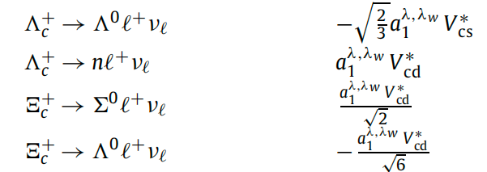
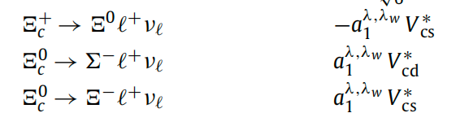
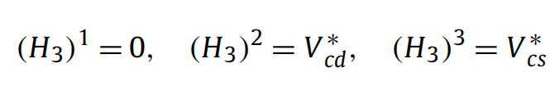
SU(3) in semileptonic charmed baryon decays
SU(3) relations
Hamiltonian, initial state and final state in SU(3) matrix
Amplitude:
expand
Notes:
15

Slide 16
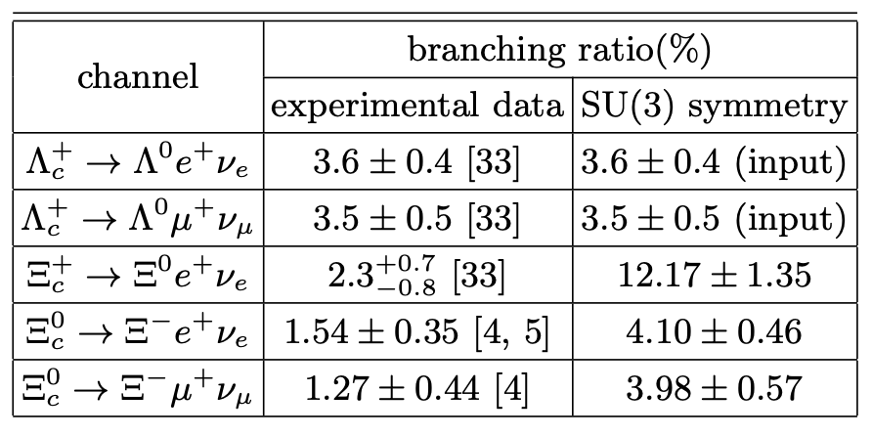
SU(3) in semileptonic charmed baryon decays
SU(3) relations
input data
6σ standard deviation
6σ standard deviation
5σ standard deviation
33. PDG/PTEP 083C01 2020
4. Belle, 2103.06496/PRL 2021
5. ALICE, 2105.05187/PRL 2021
Very large SU(3) symmetry breaking effect!
Notes:
16

Slide 17




SU(3) symmetry breaking
强子化：$\frac{m_{s}−m_{u}}{Λ_{QCD}}$
$$ℒ_{q}=\overline{q}\left(iD_{μ}γ^{μ}−m_{q}\right)q$$
$q$=$\left(\begin{matrix}u \\ d \\ s\end{matrix}\right)$
硬散射：$\frac{m_{s}−m_{u}}{Q}$
QED:$α_{em}$
Notes:
17

Slide 18
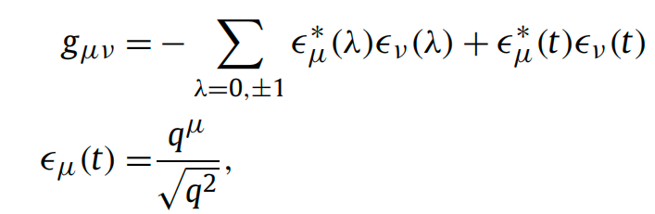
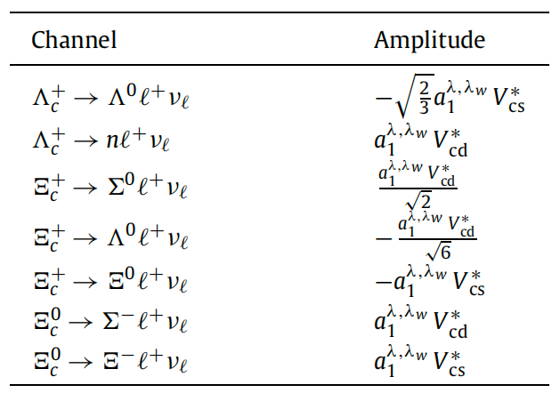
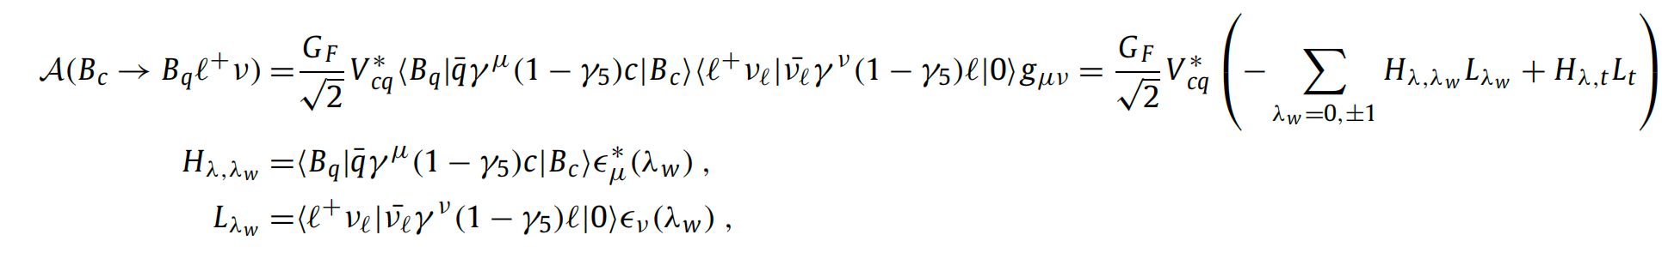

SU(3) in semileptonic charmed baryon decays
Attempts:
The SU(3) amplitude in semi-leptonic decays
SU(3) matrix
Notes:
18

Slide 19
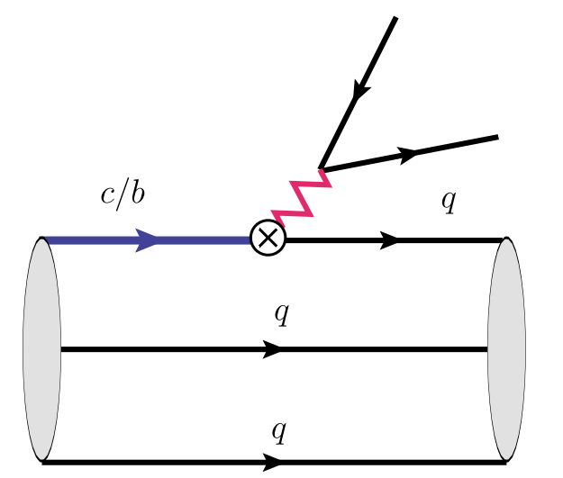
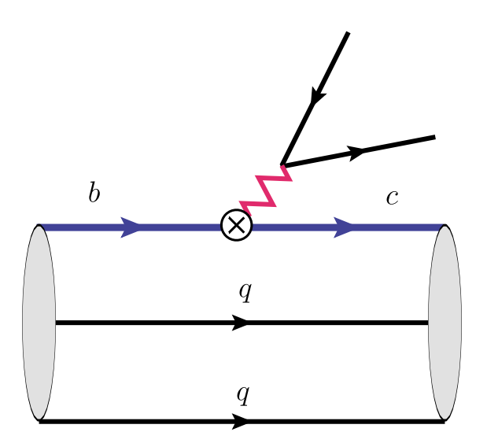
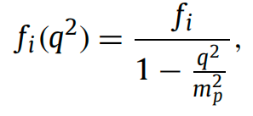
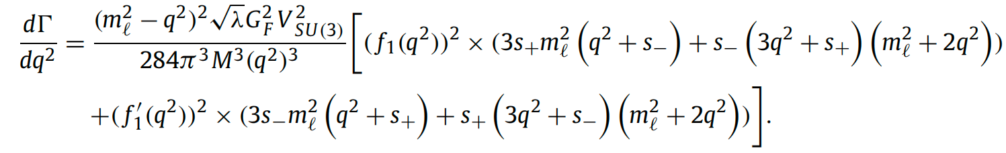

SU(3) in semileptonic charmed baryon decays
Attempts:
dominant
suppressed by 1/m_{b}
Notes:
19

Slide 20
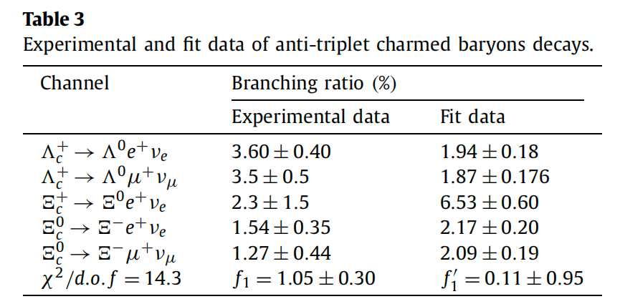
SU(3) in semileptonic charmed baryon decays
Attempts:
incompatible with SU(3) symmetry
Notes:
20

Slide 21
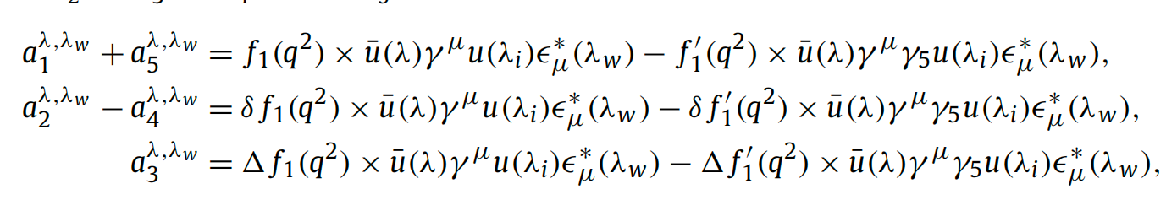
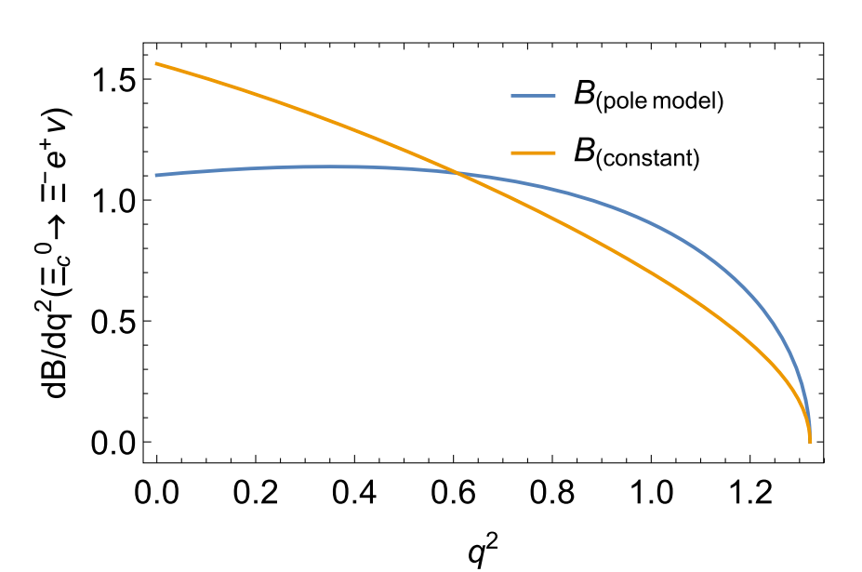
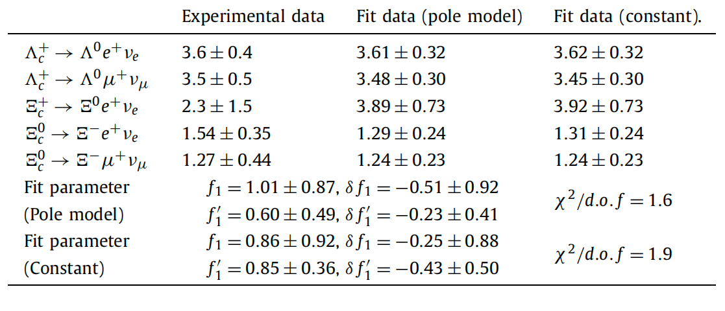
SU(3) in semileptonic charmed baryon decays
Attempts: SU3V
Helicity amplitude:
The differential branching ratio with two different treatments of form factors
Pole model
Constant
Notes:
21

Slide 22

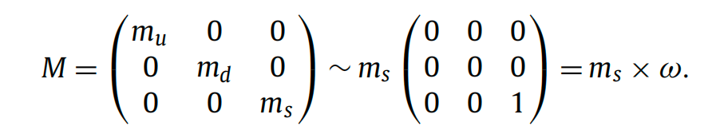
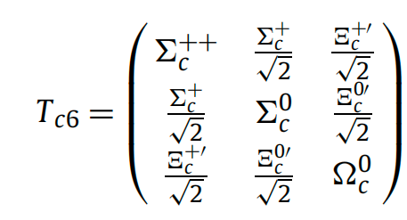

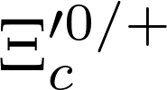
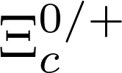


SU(3) in semileptonic charmed baryon decays
Attempts:
Symmetry breaking matrix:
Amplitude:
The anti-triplet and sextet mixing: the SU(3) symmetry breaking effect ω.
ω
Notes:
22

Slide 23
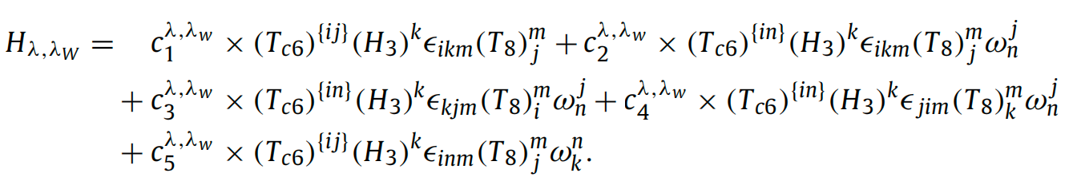
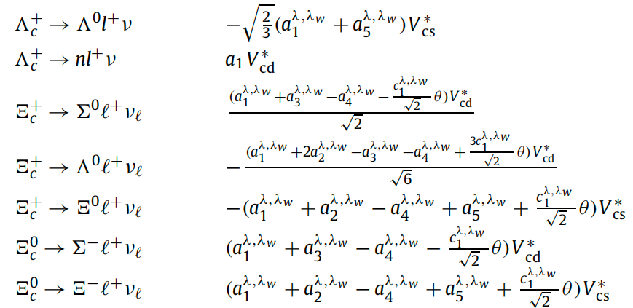

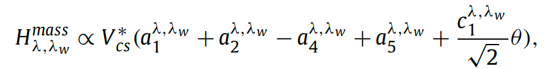
SU(3) in semileptonic charmed baryon decays
Attempts:
SU(3) amplitude
Amplitude of sextet semi-leptonic decays:
Amplitude after sextex and anti-triplet mixing:
Notes:
23

Slide 24


SU(3) in semileptonic charmed baryon decays
Attempts:
SU(3) amplitude
Redefine the helicity amplitude:
Absorb the θ and $c_{1}$ into $a_{2}$ and $a_{4}$
Notes:
24

Slide 25


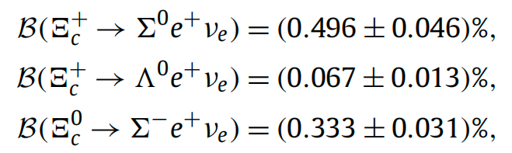
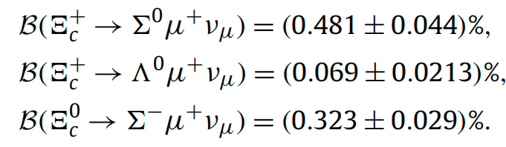
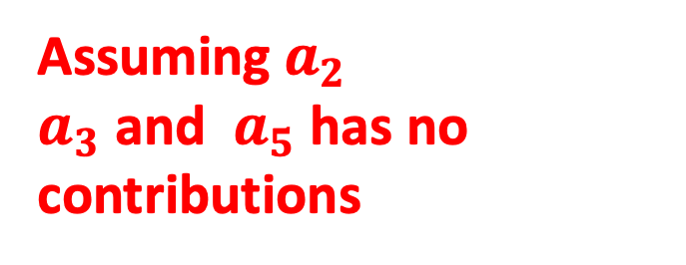
SU(3) in semileptonic charmed baryon decays
Prediction
Scenarios
Assuming $a_{5}$ has no contributions
Assuming $a_{2}$
$a_{3}$ and $a_{5}$ has no contributions
Notes:
25

Slide 26
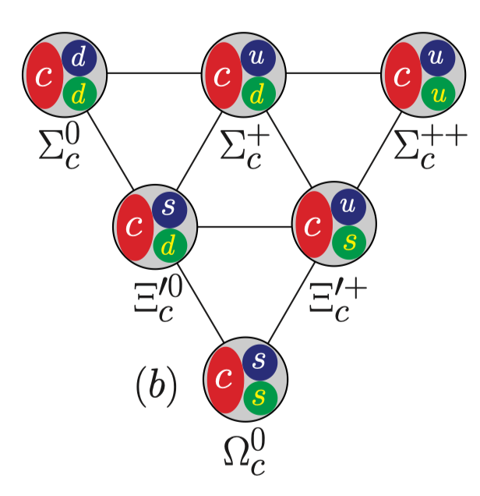




$Ξ_{c}−Ξ_{c}^{′}$ mixing
26
$Ξ_{c}$ and SU(3) breaking
Triplet
Sextet
2203.10352, Ke, Li
2210.07211, Geng, Jin , Liu
θ = 16.27◦ ± 2.30◦ or 85.54◦ ± 2.30◦
|θ| = 0.137(5)π

Slide 27




$Ξ_{c}−Ξ_{c}^{′}$ mixing

Slide 28



$Ξ_{c}−Ξ_{c}^{′}$ mixing
28
$Ξ_{c}$ and SU(3) breaking
Preliminary
Preliminary
Hang Liu,et.al. Phys.Lett.B 841 (2023) 137941

Slide 29

$Ξ_{c}−Ξ_{c}^{′}$ mixing
29
$Ξ_{c}$ and SU(3) breaking
Preliminary
Preliminary
Hang Liu,et.al. Phys.Lett.B 841 (2023) 137941

Slide 30


$Ξ_{c}−Ξ_{c}^{′}$ mixing
30
Mixing angle
直接拟合
求解本征问题
Hang Liu,et.al. Phys.Lett.B 841 (2023) 137941

Slide 31

$Ξ_{c}−Ξ_{c}^{′}$ mixing
31
Small mixing angle:
SU(3) breaking
Heavy quark symmetry breaking

Slide 32



$Ξ_{c}−Ξ_{c}^{′}$ mixing
The Lagrangian can be decomposed into SU(3) conserving and breaking terms:
The same mass and charge for u, d, s,SU(3) conserving
The mass and charge differences are attributed to the SU(3) breaking terms

Slide 33





$Ξ_{c}−Ξ_{c}^{′}$ mixing
Hamiltonian:
The SU(3) conserving Hamiltonian is diagonalized by $Ξ_{c}^{\overline{3}}$ and $Ξ_{c}^{6}$ :
The full Hamiltonian is diagonalized by $Ξ_{c}$ and $Ξ_{c}′$:
Transformation between doublets: ${\left|S\right\rangle =\left(\left|Ξ_{c}^{\overline{3}}\right\rangle , |Ξ_{c}^{6}⟩\right)}^{T}$, ${\left|P\right\rangle =\left(\left|Ξ_{c}^{}\right\rangle , |Ξ_{c}^{′}⟩\right)}^{T}$
Hang Liu,, Wei Wang,Qi-An Zhang, 2309.05432

Slide 34





$Ξ_{c}−Ξ_{c}^{′}$ mixing
In the basis of ${\left|S\right\rangle =\left(\left|Ξ_{c}^{\overline{3}}\right\rangle , |Ξ_{c}^{6}⟩\right)}^{T}$ :
H =
$$\left|S\right\rangle =U^{T}|P⟩$$
Hang Liu,, Wei Wang,Qi-An Zhang, 2309.05432

Slide 35





$Ξ_{c}−Ξ_{c}^{′}$ mixing
On the another hand:
$$\left\langle Ξ_{c}^{6}\left|H_{0}\right|Ξ_{c}^{\overline{3}}\right\rangle =0$$
$H_{0}$ conserves SU(3) symmetry
An unkown matrix element
Mixing angle
Extracting $θ$
Hang Liu, Wei Wang,Qi-An Zhang, 2309.05432

Slide 36



$Ξ_{c}−Ξ_{c}^{′}$ mixing
Calculate a three-point correlation function on lattice:
Hang Liu, Wei Wang,Qi-An Zhang, 2309.05432

Slide 37

Summary
37
Flavor SU(3) is a useful tools to analyze heavy quark weak decays.
To match the measured semi-leptonic decay BF, the required $Ξ_{c}−Ξ_{c}′$ mixing angle is around $10°−20°$
QCD contribution: $\sim 1°$ , QED contribution: $0.04°$
  Thank you very much!

