Slide 1

CPV of heavy baryons at LHCb
俞洁晟
湖南大学
重味物理前沿论坛研讨会
华中师范大学
24 - 27 Nov 2023, Wuhan, China

Slide 2
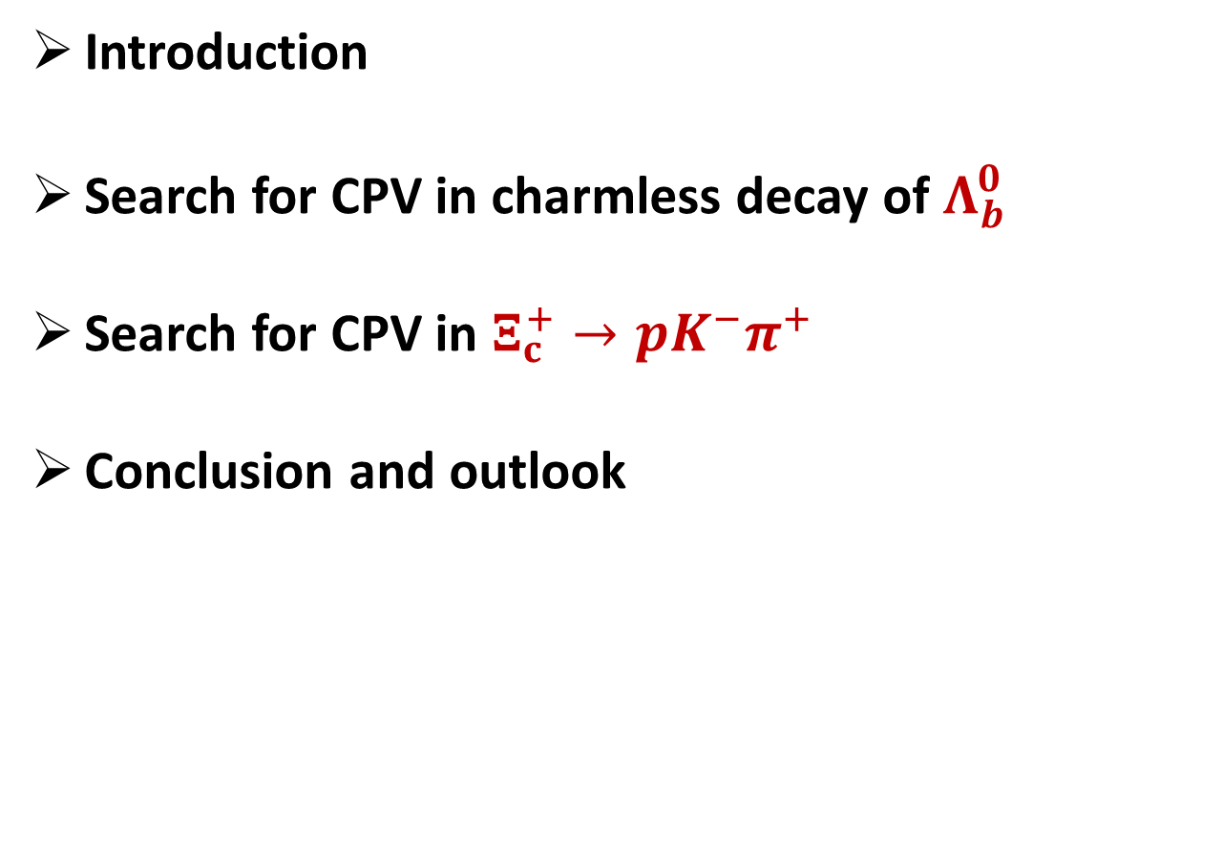
Outline
Introduction
Search for CPV in charmless decay of $Λ_{b}^{0}$
Search for CPV in $Ξ_{c}^{+}→pK^{−}π^{+}$
Conclusion and outlook

Slide 3
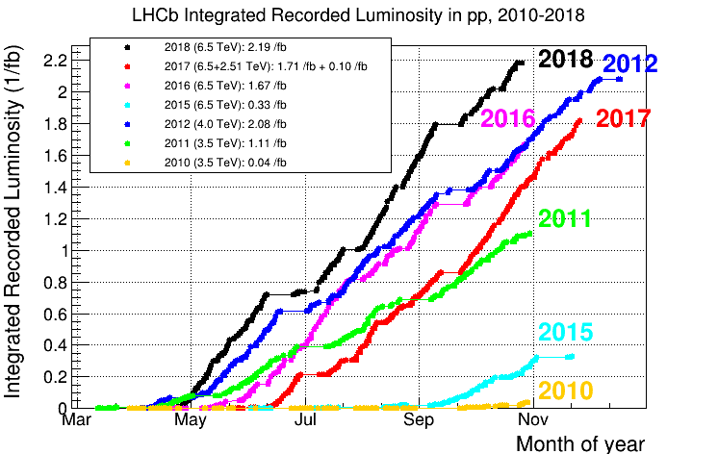
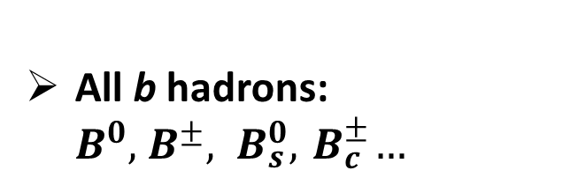


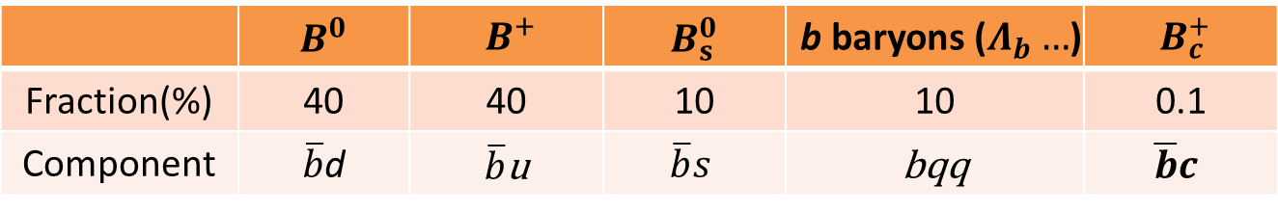
LHCb data
RUN-I
1 fb⁻¹ of pp collisions at 7 TeV
2 fb⁻¹ of pp collisions at 8 TeV
RUN-II (2015~2018 13 TeV)
$σ$(RUN-II)$≈$ 2$σ$(RUN-I)
All b hadrons: ${B^{0},{ B}^{±}, B}_{s}^{0}, { B}_{c}^{±}…$
$$σ\left(pp→c\overline{c}X\right)≈20×σ(pp→b\overline{b}X)$$
 | $$B^{0}$$ | $${ B}^{+}$$ | $$B_{s}^{0}$$ | b baryons ($Λ_{b}…$) | $${ B}_{c}^{+}$$
Fraction(%) | 40 | 40 | 10 | 10 | 0.1
Component | $\overline{b}$d | $\overline{b}$u | $$\overline{b}s$$ | bqq | $$\overline{b}c$$
PRD 85.032008

Slide 4
Introduction
Baryons is the main component of matter
CPV never observed in baryon decays to now
LHCb has the unique possibility to search for CPV in heavy baryon decays where sizeable CPV effects are expected in the Standard Model
Perform measurements in regions of phase space for increased sensitivity to localised CP violation effects. Different strong phases at play

Slide 5

Search for CPV in charmless decay of $Λ_{b}^{0}$

Slide 6
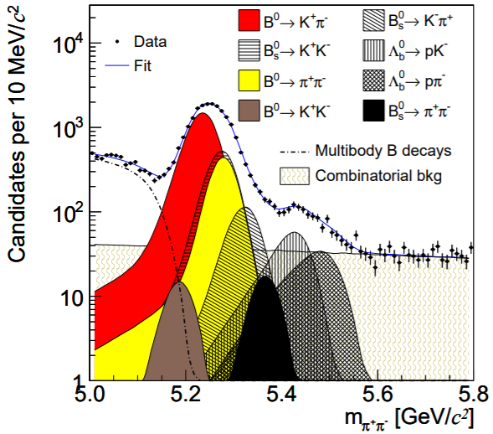
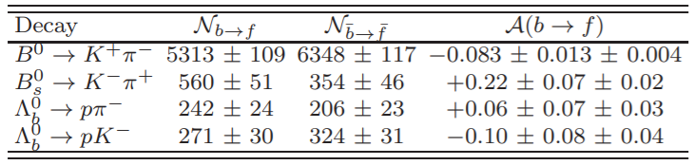
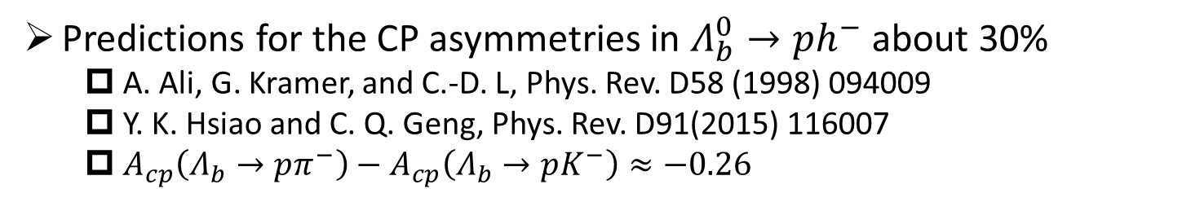
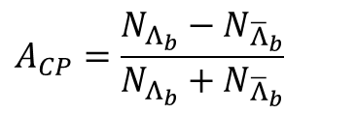
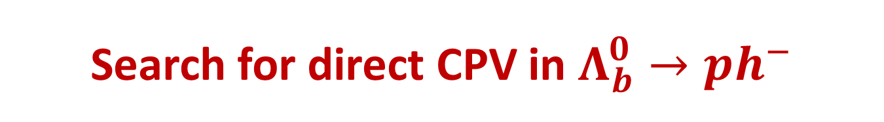
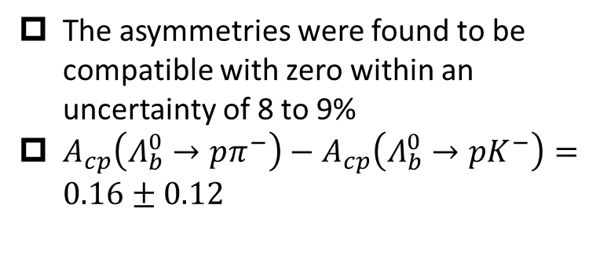
Search for direct CPV in $Λ_{b}^{0}→ph^{−}$
Predictions for the CP asymmetries in $Λ_{b}^{0}→ph^{−}$ about 30%
  A. Ali, G. Kramer, and C.-D. L, Phys. Rev. D58 (1998) 094009
  Y. K. Hsiao and C. Q. Geng, Phys. Rev. D91(2015) 116007
  $A_{cp}\left(Λ_{b}→pπ^{−}\right)−A_{cp}\left(Λ_{b}→pK^{−}\right)≈−0.26$
$$A_{CP}=\frac{N_{Λ_{b}}−N_{{\overline{Λ}}_{b}}}{N_{Λ_{b}}+N_{{\overline{Λ}}_{b}}}$$
The first measurements of these by CDF
The asymmetries were found to be compatible with zero within an uncertainty of 8 to 9%
$A_{cp}\left(Λ_{b}^{0}→pπ^{−}\right)−A_{cp}\left(Λ_{b}^{0}→pK^{−}\right)=0.16±0.12$
Phys. Rev. Lett. 113 (2014)242001

Slide 7
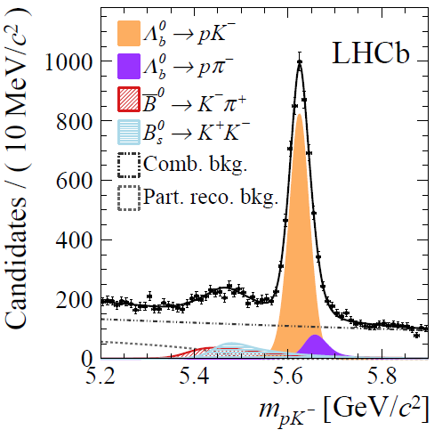
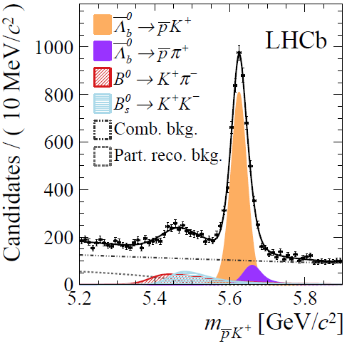
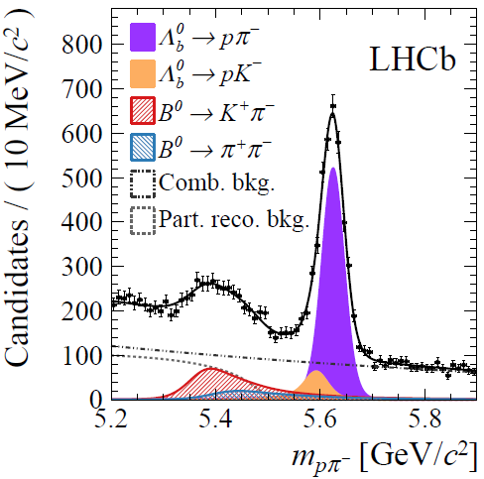
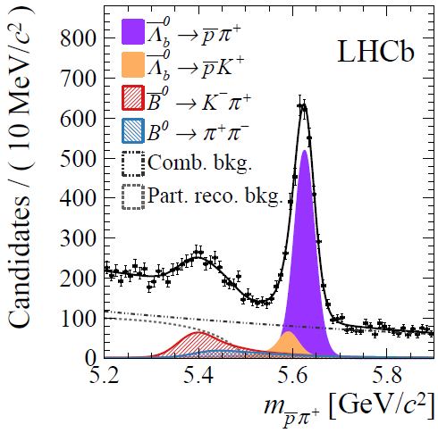



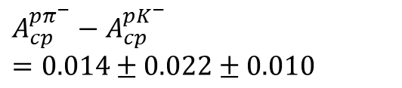
Search for direct CPV in $Λ_{b}^{0}→ph^{−}$ with RUN-I data
$$A_{cp}^{pK^{−}}=−0.020±0.013±0.019$$
$$A_{cp}^{pπ^{−}}=−0.035±0.017±0.020$$
$$A_{cp}^{pπ^{−}}−A_{cp}^{pK^{−}}=0.014±0.022±0.010$$
No CP-violation
Much improved precision with CDF
Phys. Lett. B 787 (2018) 124-133

Slide 8
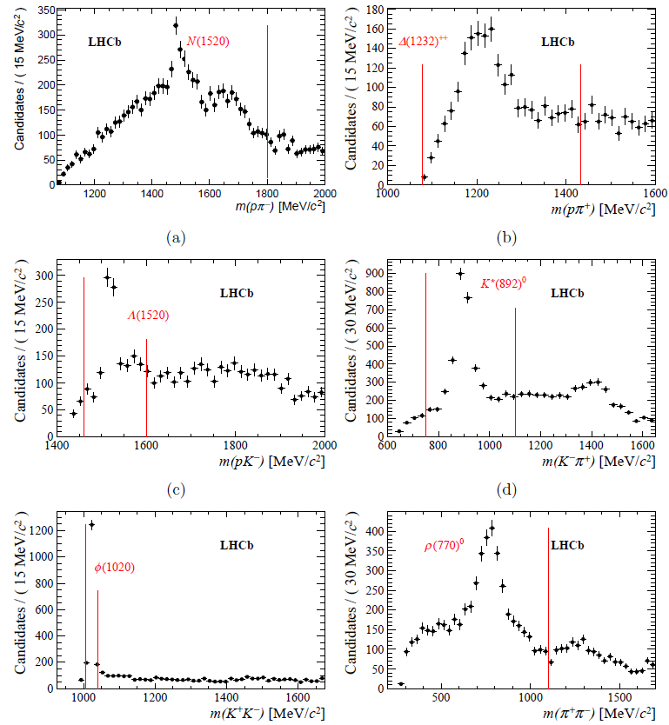

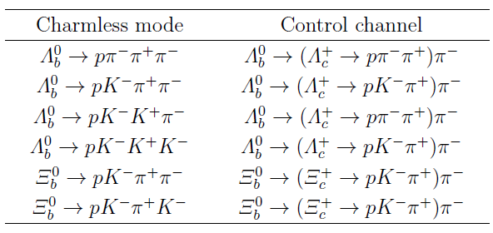


CPV in charmless four-body $Λ_{b}$ and $Ξ_{b}^{0}$decays
Run-I, $3 fb^{−1}$
Eur. Phys. J. C79 (2019) 745

Slide 9
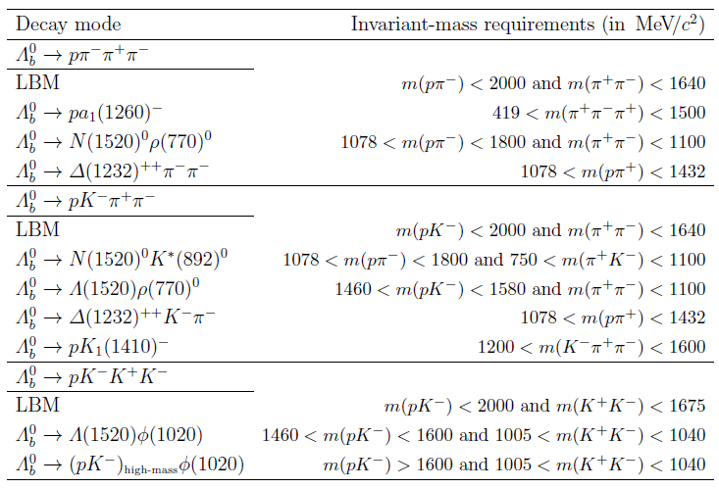
CPV in charmless four-body $Λ_{b}$ and $Ξ_{b}^{0}$decays
Eur. Phys. J. C79 (2019) 745

Slide 10
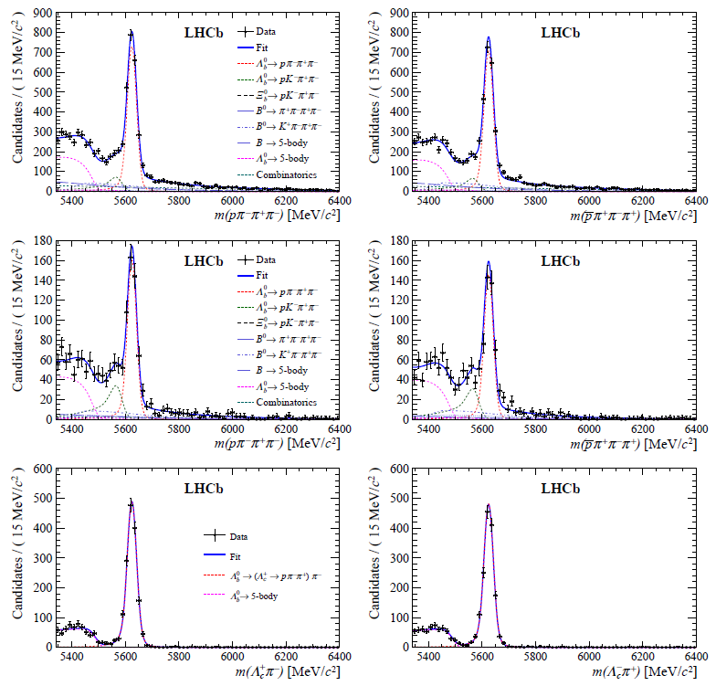
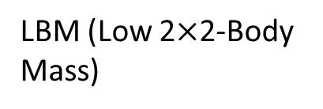
CPV in charmless four-body $Λ_{b}$ and $Ξ_{b}^{0}$decays
Full phase space
LBM (Low 2$×$2-Body Mass)
Control channel.
Eur. Phys. J. C79 (2019) 745

Slide 11
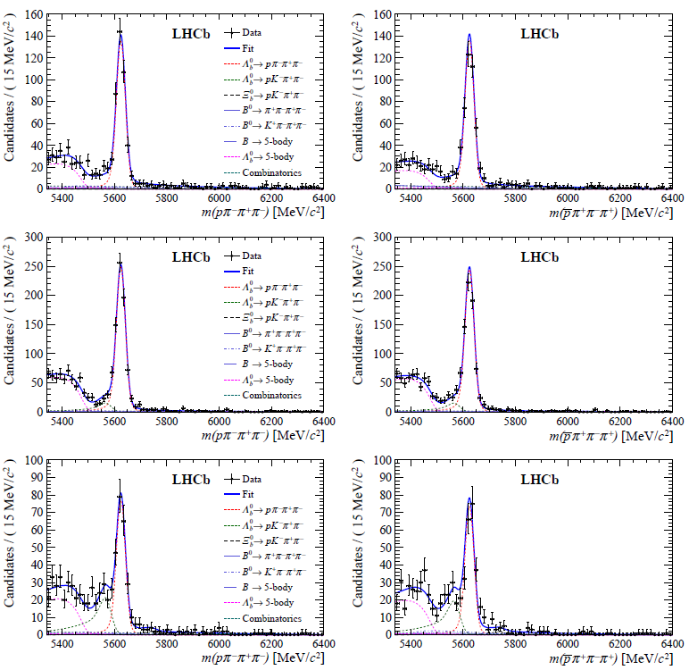




CPV in charmless four-body $Λ_{b}$ and $Ξ_{b}^{0}$decays
$$Λ_{b}→pa_{1}{\left(1620\right)}^{−}$$
$$Λ_{b}→∆{\left(1232\right)}^{++}π^{−}π^{−}$$
$$Λ_{b}→N{\left(1520\right)}^{0}ρ{\left(770\right)}^{0}$$
Eur. Phys. J. C79 (2019) 745

Slide 12
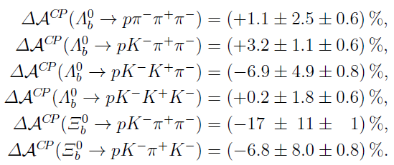
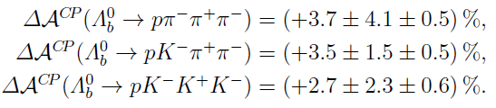
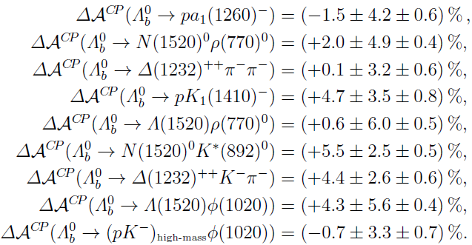
CPV in charmless four-body $Λ_{b}$ and $Ξ_{b}^{0}$decays
No CP-violation
Eur. Phys. J. C79 (2019) 745

Slide 13

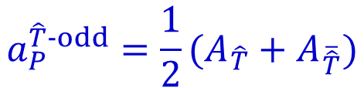


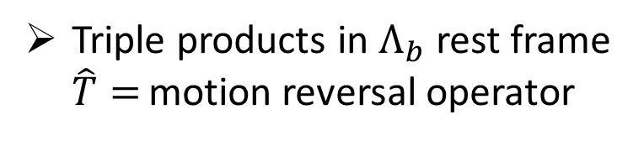
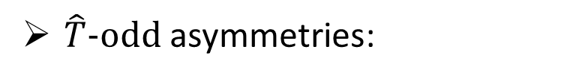
Search for CPV using TPA
Triple products in $Λ_{b}$ rest frame
$\hat{T}=$ motion reversal operator
$$∝sinΦ$$
$$∝sin\overline{Φ}$$
$\hat{T}−odd$ asymmetries:
$$a_{CP}^{\hat{T}−odd}=\frac{1}{2}(A_{\hat{T}}−A_{\overline{\hat{T}}})$$
CP-violating observable:
P-violating observable:
$$a_{P}^{\hat{T}−odd}=\frac{1}{2}(A_{\hat{T}}+A_{\overline{\hat{T}}})$$

Slide 14
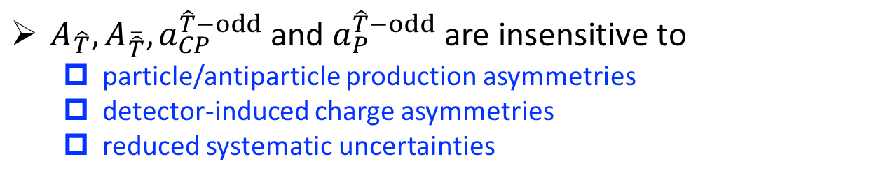
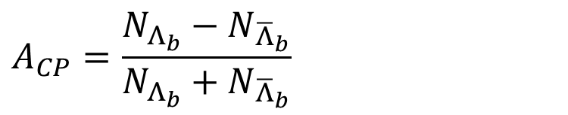

Sensitivity to CPV
$A_{\hat{T}},A_{\overline{\hat{T}}},a_{CP}^{\hat{T}−odd}$ and $a_{P}^{\hat{T}−odd}$ are insensitive to
  particle/antiparticle production asymmetries
  detector-induced charge asymmetries
  reduced systematic uncertainties
Complementary approach to $A_{CP}$ analysis
$$A_{CP}=\frac{N_{Λ_{b}}−N_{{\overline{Λ}}_{b}}}{N_{Λ_{b}}+N_{{\overline{Λ}}_{b}}}$$
Sensitive to potential new physics effects:
  W. Bensalem, A. Datta, and D. London, New physics effects on triple product correlations in Λb decays, Phys. Rev. D66 (2002) 094004, arXiv:hep-ph/0208054

Slide 15
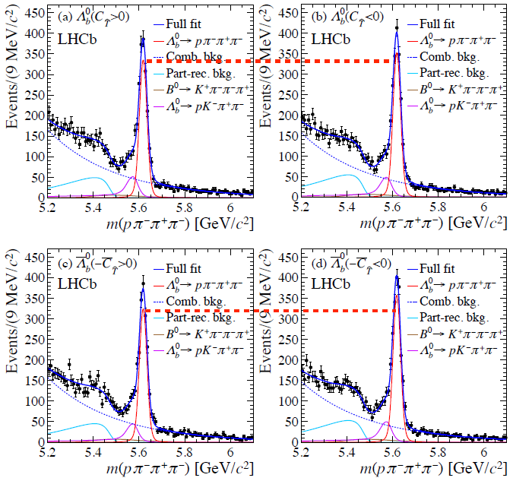



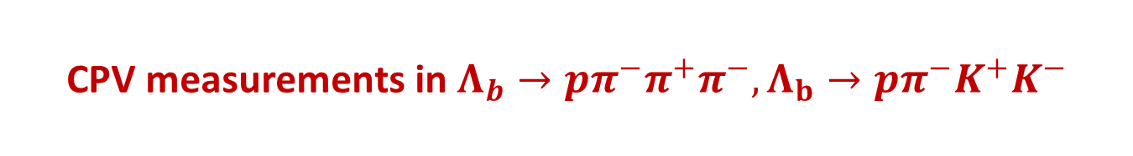




CPV measurements in $Λ_{b}→pπ^{−}π^{+}π^{−},Λ_{b}→pπ^{−}K^{+}K^{−}$
Run-I, $3 fb^{−1}$
For $Λ_{b}→pπ^{−}π^{+}π^{−}$
$$a_{CP}^{\hat{T}−odd}=(1.15±1.45±0.32)\%$$
$$a_{P}^{\hat{T}−odd}=(−3.71±1.45±0.32)\%$$
For $Λ_{b}→pπ^{−}K^{+}K^{−}$
$$a_{CP}^{\hat{T}−odd}=(−0.93±4.54±0.42)\%$$
$$a_{P}^{\hat{T}−odd}=(3.62±4.54±0.42)\%$$
Nature Phys. 13 (2017) 391-396

Slide 16
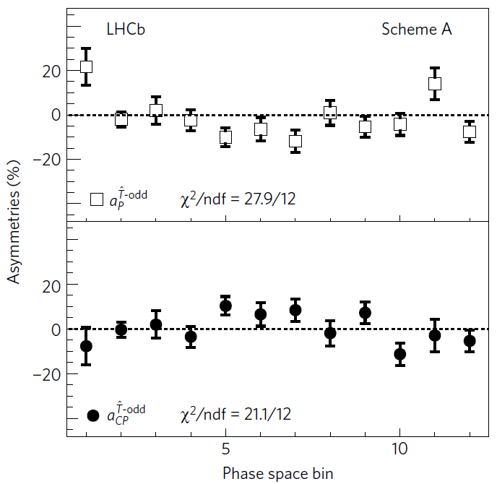
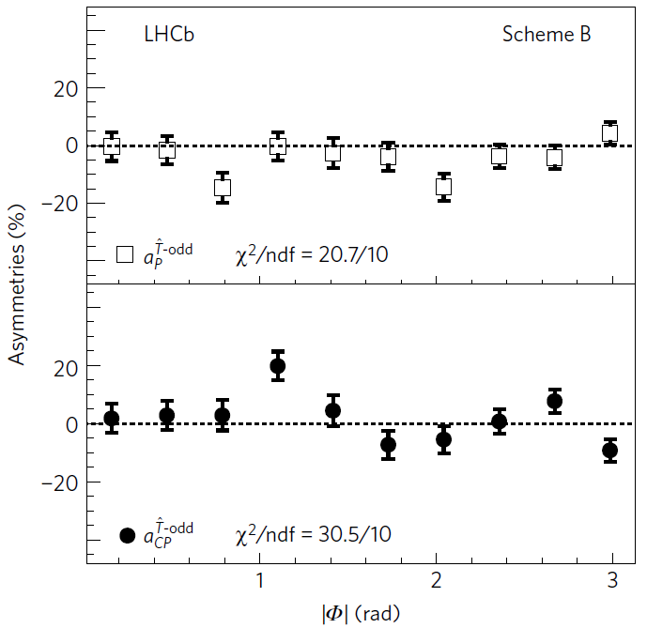
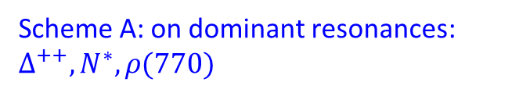

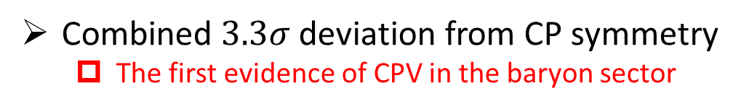
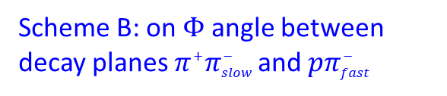
$$\text{Measurement} \text{asymmetries} \text{in} \text{phase} \text{space} \text{regions}$$
Scheme A: on dominant resonances: $∆^{++}, N^{∗}, ρ(770)$
Scheme B: on $Φ$ angle between
decay planes $π^{+}π_{slow}^{−}$and $pπ_{fast}^{−}$
Nature Phys. 13 (2017) 391-396
Combined $3.3σ$ deviation from CP symmetry
  The first evidence of CPV in the baryon sector

Slide 17
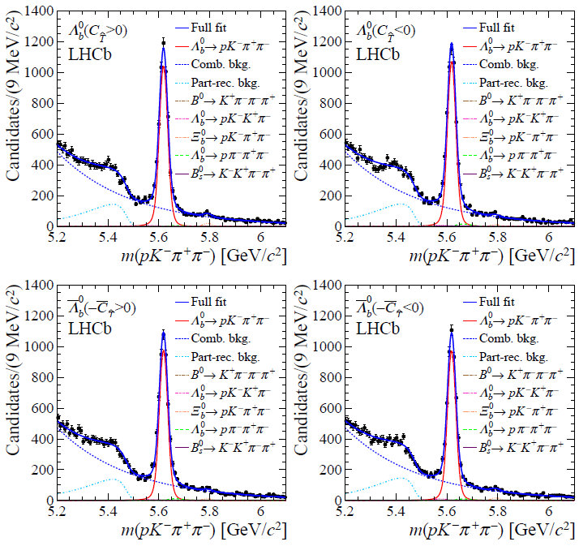

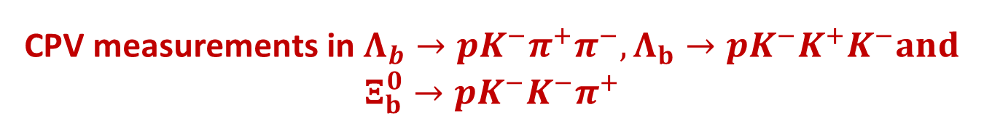
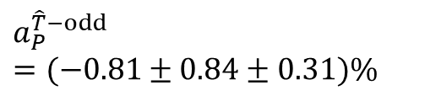
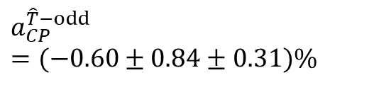
CPV measurements in $Λ_{b}→pK^{−}π^{+}π^{−},Λ_{b}→pK^{−}K^{+}K^{−}and$ $Ξ_{b}^{0}→pK^{−}K^{−}π^{+}$
Run-I, $3 fb^{−1}$
For $Λ_{b}→pK^{−}π^{+}π^{−}$
$$a_{CP}^{\hat{T}−odd}=(−0.60±0.84±0.31)\%$$
$$a_{P}^{\hat{T}−odd}=(−0.81±0.84±0.31)\%$$
JHEP 08 (2018) 039

Slide 18
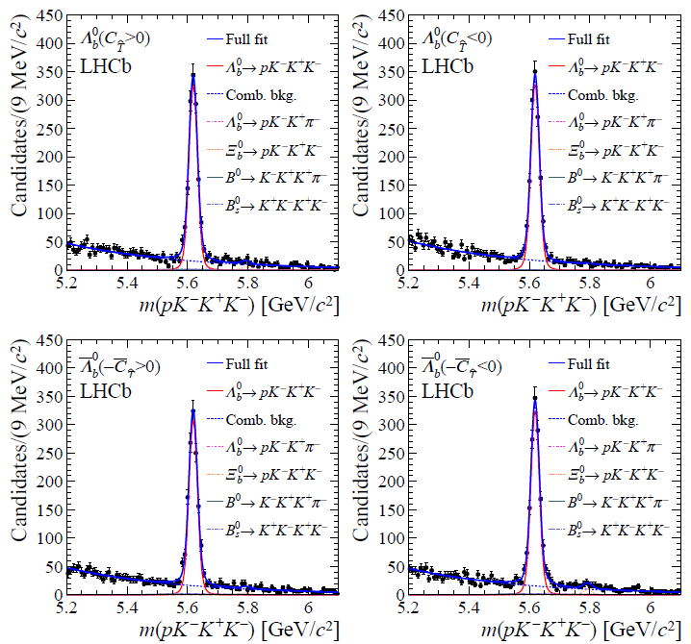

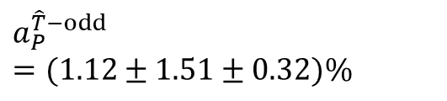
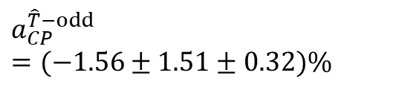
CPV measurements in $Λ_{b}→pK^{−}π^{+}π^{−},Λ_{b}→pK^{−}K^{+}K^{−}and$ $Ξ_{b}^{0}→pK^{−}K^{−}π^{+}$
Run-I, $3 fb^{−1}$
For $Λ_{b}→pK^{−}K^{+}K^{−}$
$$a_{CP}^{\hat{T}−odd}=(−1.56±1.51±0.32)\%$$
$$a_{P}^{\hat{T}−odd}=(1.12±1.51±0.32)\%$$
JHEP 08 (2018) 039

Slide 19
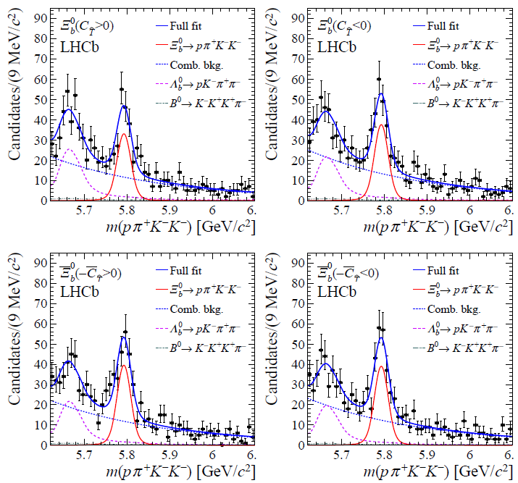

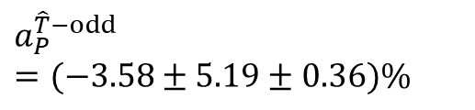
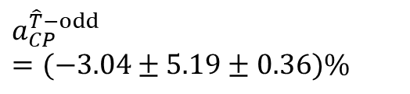
CPV measurements in $Λ_{b}→pK^{−}π^{+}π^{−},Λ_{b}→pK^{−}K^{+}K^{−}and$ $Ξ_{b}^{0}→pK^{−}K^{−}π^{+}$
Run-I, $3 fb^{−1}$
For $Ξ_{b}^{0}→pK^{−}K^{−}π^{+}$
$$a_{CP}^{\hat{T}−odd}=(−3.04±5.19±0.36)\%$$
$$a_{P}^{\hat{T}−odd}=(−3.58±5.19±0.36)\%$$
JHEP 08 (2018) 039

Slide 20
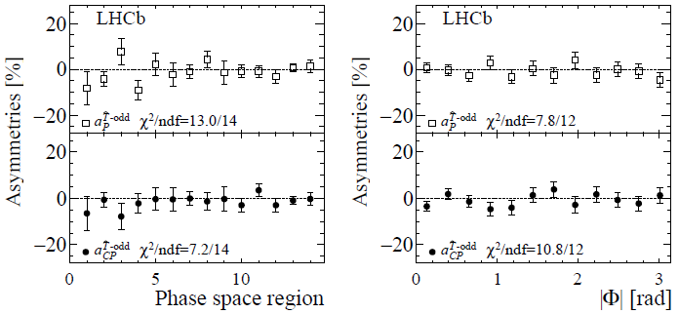
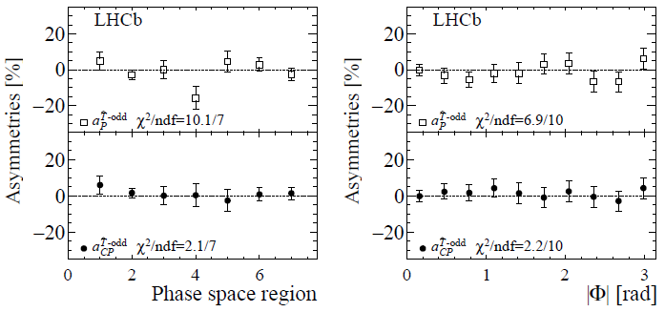



$$\text{Measurement} \text{asymmetries} \text{in} \text{phase} \text{space} \text{regions}$$
$$Λ_{b}→pK^{−}π^{+}π^{−}$$
$$Λ_{b}→pK^{−}K^{+}K^{−}$$
No CP-violation and Violation of P symmetry

Slide 21
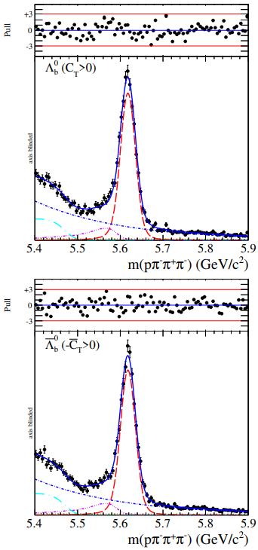
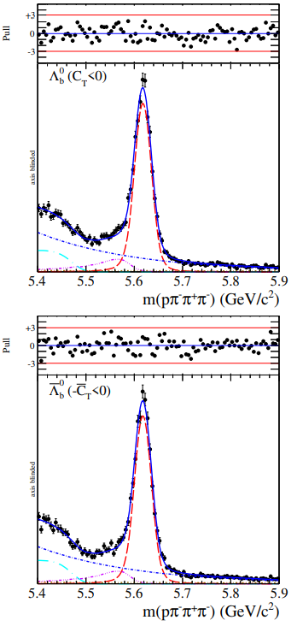




CPV measurements in $Λ_{b}→pπ^{−}π^{+}π^{−}$
(2011,2012,2015,2016,2017) $6.6 fb^{−1}$
Signal Yield: 27687
RUN-I signal yield: 6636
$$a_{CP}^{\hat{T}−odd}=(−0.7±0.7±0.2)\%$$
$$a_{P}^{\hat{T}−odd}=(−4.0 ± 0.7 ± 0.2")\%$$
Phys. Rev. D 102 (2020) 051101

Slide 22


$$\text{Measurement} \text{asymmetries} \text{in} \text{phase} \text{space} \text{regions}$$
Scheme A: on dominant resonances: $∆^{++}, N^{∗}, ρ(770)$
Scheme B: on $Φ$ angle between
decay planes $π^{+}π_{slow}^{−}$and $pπ_{fast}^{−}$
Phys. Rev. D 102 (2020) 051101
No CP-violation
Violation of P symmetry is observed

Slide 23

Search for CPV in $Ξ_{c}^{+}→pK^{−}π^{+}$

Slide 24




Search for CPV in $Ξ_{c}^{+}→pK^{−}π^{+}$ with Run-I data
In SM, CPV in the charm sector are expected at ${10}^{−3}$ or less for singly Cabibbo-suppressed (SCS) decays
NP can enhance CPV effects up to ${10}^{−2}$
Binned $S_{CP}$ method
  In case of CPV , a deviation from the normal distribution is expected, generating a p-value close to zero.
Unbinned kNN method
  Test whether baryons and antibaryons share the same parent distribution function
Eur. Phys. J. C80 (2020) 986

Slide 25


Search for CPV in $Ξ_{c}^{+}→pK^{−}π^{+}$ with Run-I data
Eur. Phys. J. C80 (2020) 986

Slide 26



Search for CPV in $Ξ_{c}^{+}→pK^{−}π^{+}$ with Run-I data
Binned $S_{CP}$ method
2011 29bins
2012 111bins
p-values using a $χ^{2}$ test are larger than 32%, consistent with no evidence for CPV
Eur. Phys. J. C80 (2020) 986

Slide 27

Search for CPV in $Ξ_{c}^{+}→pK^{−}π^{+}$ with Run-I data
Unbinned kNN method
2011
2012
No significant deviation from the hypothesis of CP symmetry
Eur. Phys. J. C80 (2020) 986

Slide 28

Conclusions and Outlook
Many results on CPV of heavy baryons at LHCb
  No direct CPV in $Λ_{b}^{0}→ph^{−}$
  No direct CPV in charmless four-body $Λ_{b}$ and $Ξ_{b}^{0}$decays
  No CPV in $Λ_{b}→pπ^{−}π^{+}π^{−}$
  No CPV in $Λ_{b}→pK^{−}π^{+}π^{−},Λ_{b}→pK^{−}K^{+}K^{−}and$ $Ξ_{b}^{0}→pK^{−}K^{−}π^{+}$
  No CPV in $Ξ_{c}^{+}→pK^{−}π^{+}$
Opportunities with Run 3&4 (50 $fb^{−1}$)
  Higher precision these measurements
  Wider scope for exploitation

Slide 29
Thank you!

Slide 30
Back up

