Slide 1





守信 求实 好学 力行
Theoretical overview of three-body B decays
邹芝田
2023年11月，武汉

Slide 2

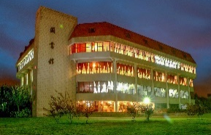

outline
Motivation
The framework of the B meson decays to three final states
Theoretical framework in Factorization Approach and PQCD Approach
Some results and developments
A short summary
START

Slide 3

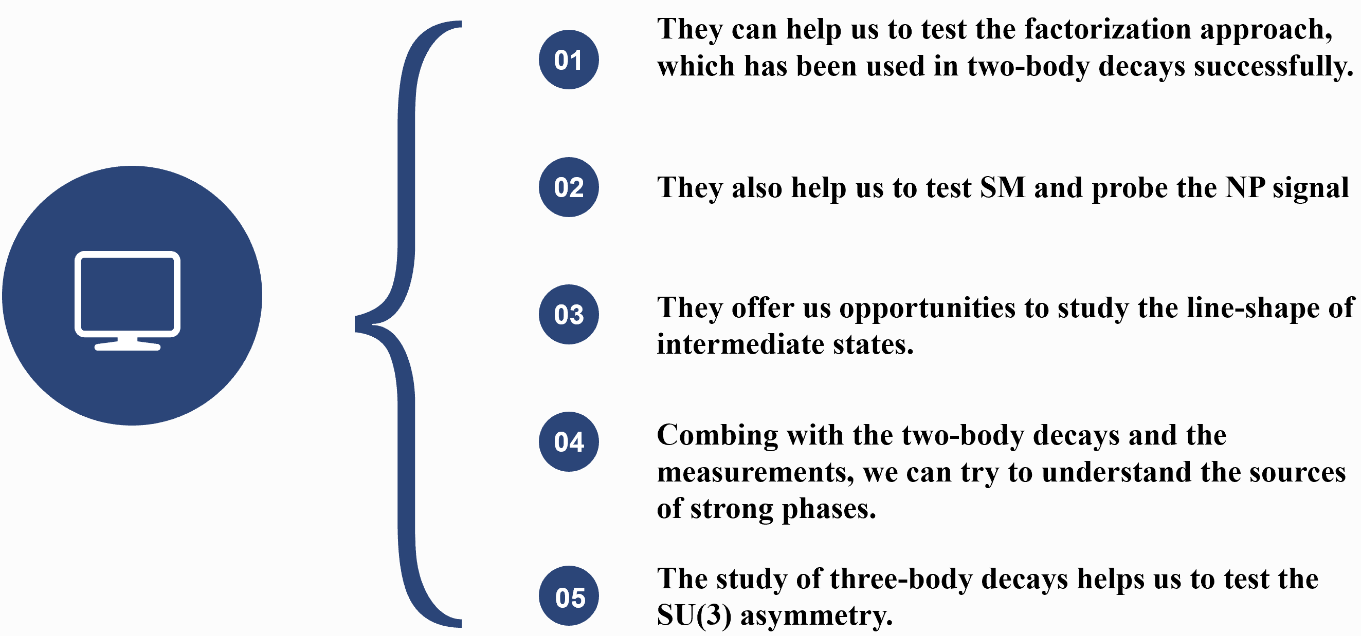
Why 3-body decays ?

Slide 4


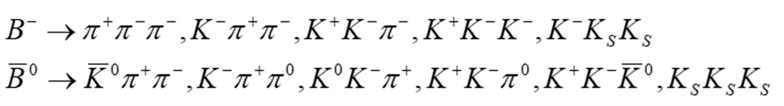



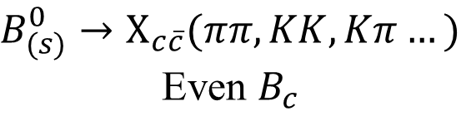


the research situation at present
Experiment
Theory
Large amounts of data from CDF, D0, Belle, BABAR, LHCb etc. Collaborations. (Most with BFs ~ 10-5)
H.Y. Cheng, C.K. Chua, Y. Li,…
A. Furman, B.El Bennich, R. Kaminski, T. Mannel, X.H. Guo, Y.D. Yang, Z.H. Zhang,…
H.N. Li, C.D. Lu , Z.J. Xiao…….
$$B_{(s)}→DPP$$
$$B→DDP$$
X.G. Xiao, G.N. Li, D. Xu, J.L. Rosner, M. Gronau,…
$$B_{(s)}^{0}→X_{c\overline{c}}(ππ,KK,Kπ…)$$
Even $B_{c}$
Ulf-G. Meißner (Light-cone),
A. Khodjamirian (QCD)
Notes:
Data are results of entangled nonresonant and resonant contributions, and of different partial waves.
Developing a reliable theoretical approach to 3-body hadronic B decays is important.
Understand data and predict direct CP asymmetries of 3-body decay modes in localized regions of phase space
Very challenging!

Slide 5
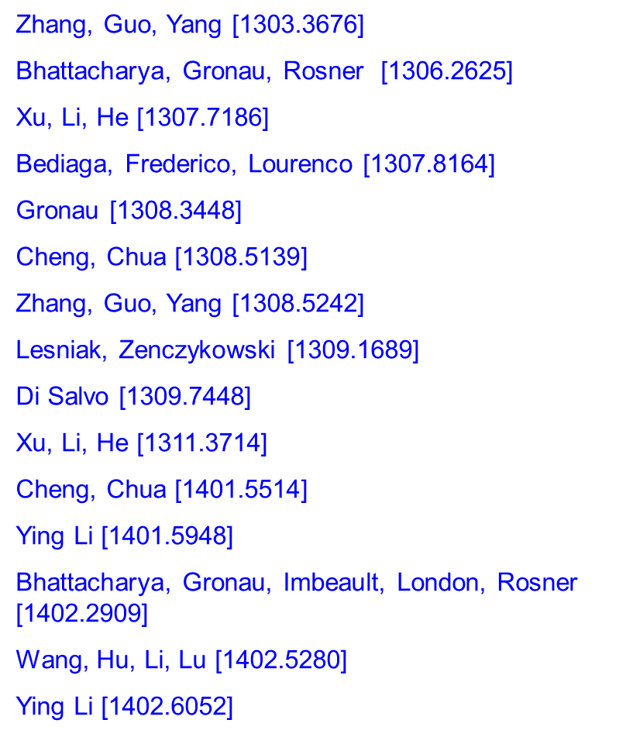
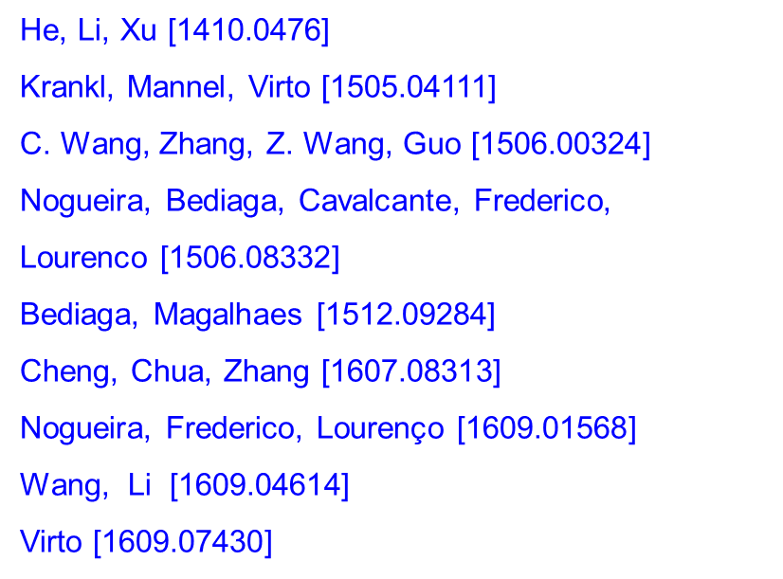
Notes:
Unlike charmless B→ M₁M₂ decays which can be described by QCD-inspired theories such as QCDF, pQCD, SCET, the reliable theoretical tool for 3-body B decays is still in the stage of modeling

Slide 6
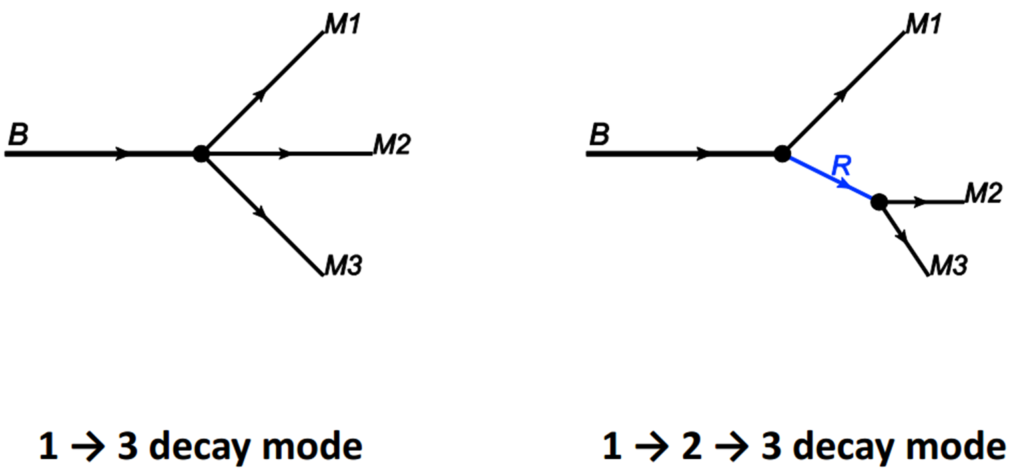

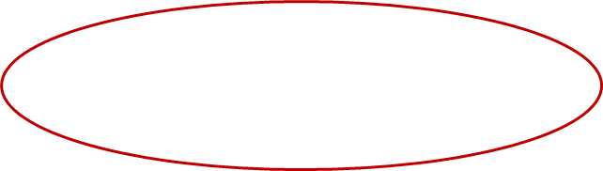
二、Framework:
How the B meson decay to three light mesons?
关键
词语
关键
词语
关键
词语
关键
词
关键
词语
关键
词语
关键
词语

Slide 7


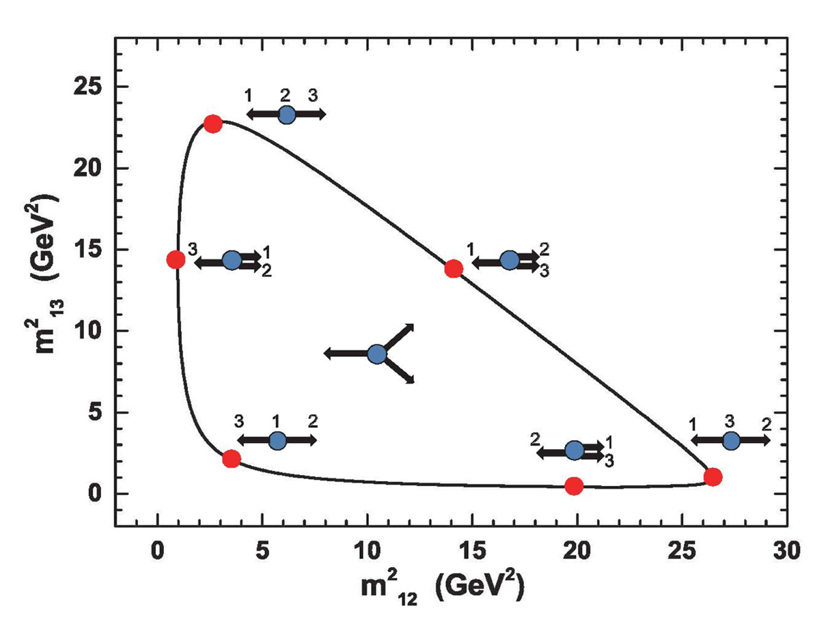

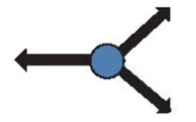



Dalitz plot analysis
The central region corresponds to the case where all three final particles fly apart with large energy(E≈mB/3).
The corners correspond to the case in which one of final particles is approximately at rest (i.e. soft), and the other two fly back-to-back with large energy (E ≈mB/2).
The central part of the edge corresponds to the case in which two particles move collinearly with large energy and the other energetic particle recoils back.

Slide 8
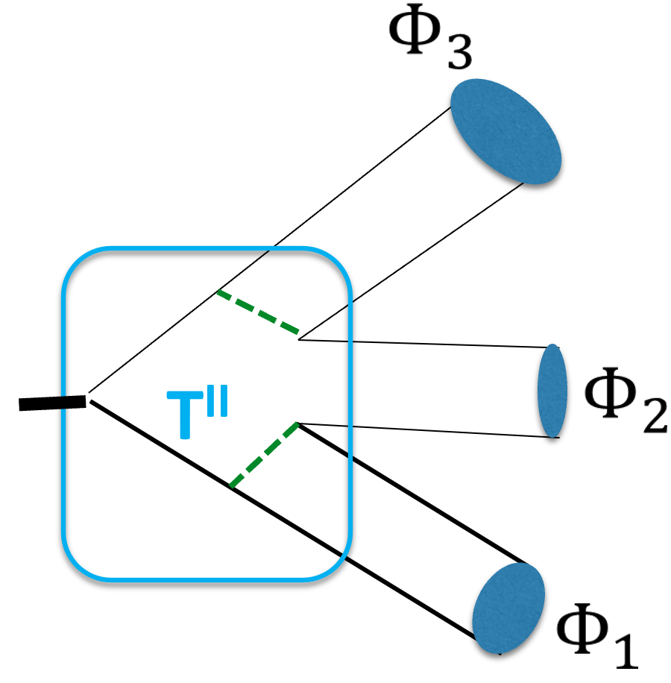
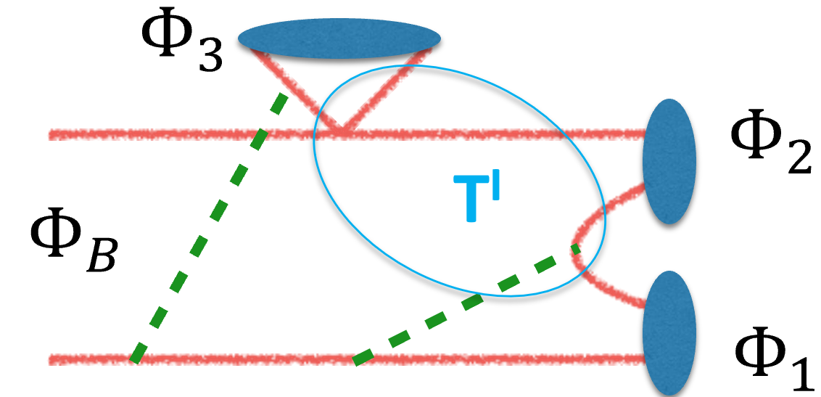
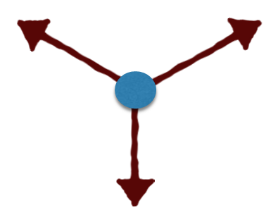


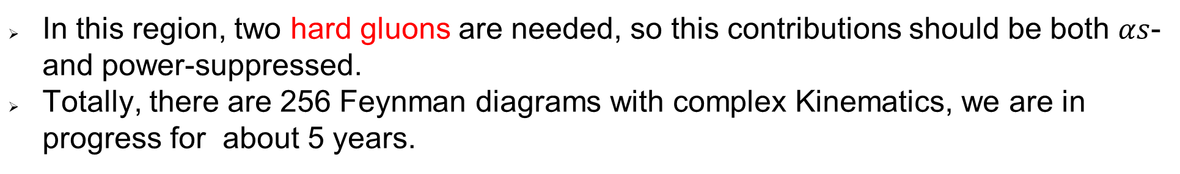
Center region
Hard kernels
In this region, two hard gluons are needed, so this contributions should be both $αs$- and power-suppressed.
Totally, there are 256 Feynman diagrams with complex Kinematics, we are in progress for about 5 years.

Slide 9

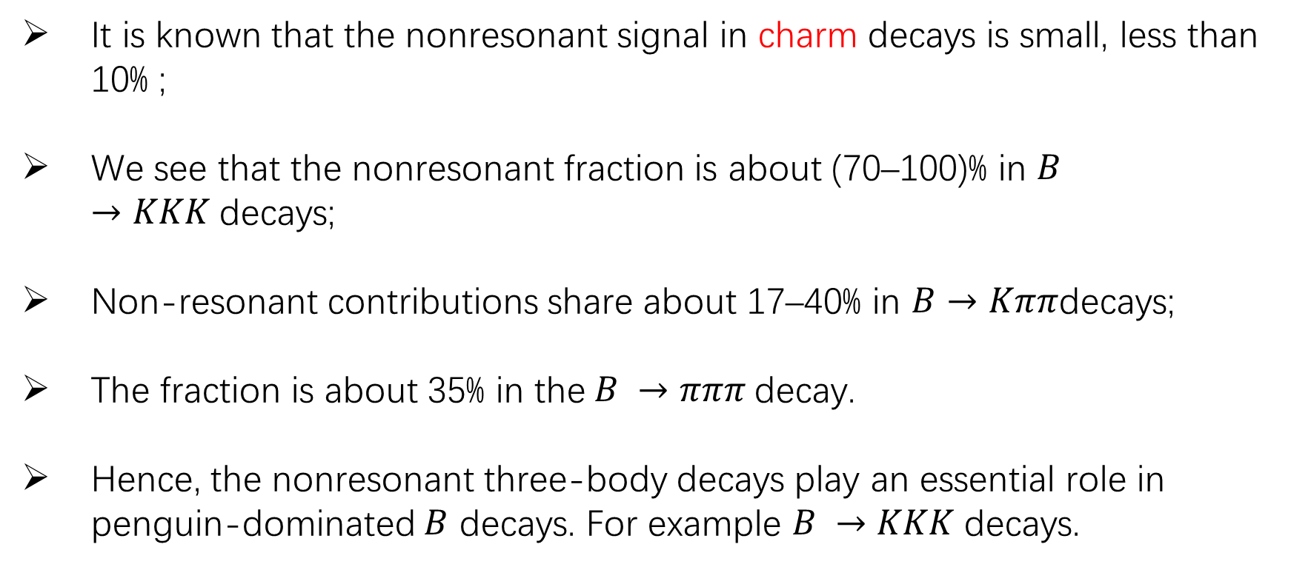
It is known that the nonresonant signal in charm decays is small, less than 10% ;
We see that the nonresonant fraction is about (70–100)% in $B →KKK$decays;
Non-resonant contributions share about 17–40% in $B→Kππ$decays;
The fraction is about 35% in the$B →πππ$decay.
Hence, the nonresonant three-body decays play an essential role in penguin-dominated $B$ decays. For example $B →KKK$decays.

Slide 10

So large, Why?
The energy release scale in weak B decays is of order 5 GeV, whereas the major resonances lie in the energy region of 0.77 to 1.6 GeV, or less than 2.0GeV. Consequently, it is likely that three-body B decays may receive sizable non-resonant contributions.
How to evaluate?
Hai-Yang Cheng ,etc
Heavy-Meson Chiral Perturbative theory, the large contributions are involved in the $B→P_{1}P_{2}$ transition.
PQCD group (zhi-tian zou, Ying Li, etc)
Dominated by the two-hard-gluon exchange process. The pure annihilation type contributions can be perturbatively calculated.

Slide 11
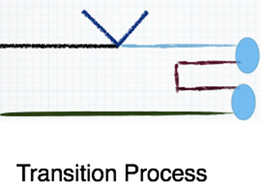

NR in Factorization Approach
NR contribution of
b→u
Early attempt: Apply heavy meson chiral perturbation theory (HMChPT) to evaluate form factors r and ω±
Bajc, Fajfer, Oakes, Pham; Deandrea et al. (’99)
NR rates for tree-dominated B→KKπ, πππ will become too large
For example, BF(B⁻→K⁺K⁻π⁻)_{NR} = 33×10⁻⁶ larger than total BF, 5×10⁻⁶
BF(B⁻→π⁺π⁻ π⁻)_{NR} = 75×10⁻⁶ larger than total BF, 5.3×10⁻⁶
⇒ HMChPT is applicable only to soft mesons !

Slide 12
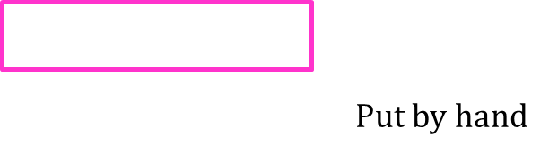
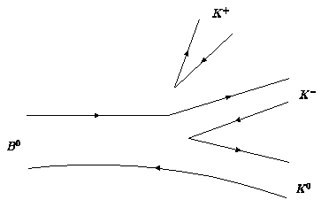

We write tree-induced NR amplitude as
p₁
-- HMChPT is recovered in soft meson limit, p₁, p₂→0
-- The parameter α_{NR} ∼ 1/(2m_{B}Λ_{χ}) is constrained from B⁻→π⁺π⁻π⁻

Slide 13
For penguin-dominated modes, B⁻→ K⁺K⁻K⁻, K⁻π⁺π⁻, NR rates induced by b→ u tree transition are too small compared to b→ s penguin transition due to
|V_{ub}V_{us}*| << |V_{cb}V_{cs}*| ∼ |V_{tb}V_{ts}*|.
BF(B⁻→ K⁺K⁻K⁻)^{NR} ∼ 1.1×10⁻⁶ from b→ u transition, while BF^{NR}_{expt}∼ 23×10⁻⁶
⇒ NR contributions to penguin-dominated modes arise from
b→ s penguin transition
NR rates: mostly from b→s (via <KK|ss|0>) and a few percentages from b→u tree transitions

Slide 14
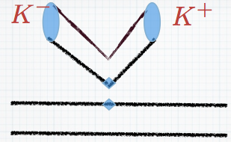
NR in current induced process
Current Induced Process
<K⁺K⁻|qγ_{μ}q|0> can be related to the kaon’s e.m. form factors
c_{h}, x₁, x₂ fitted from kaon e.m. data
Chua,Hou,Shiau,Tsai (’03)
motivated by asymptotic constraint from QCD counting rules
Brodsky, Farrar (’75)

Slide 15
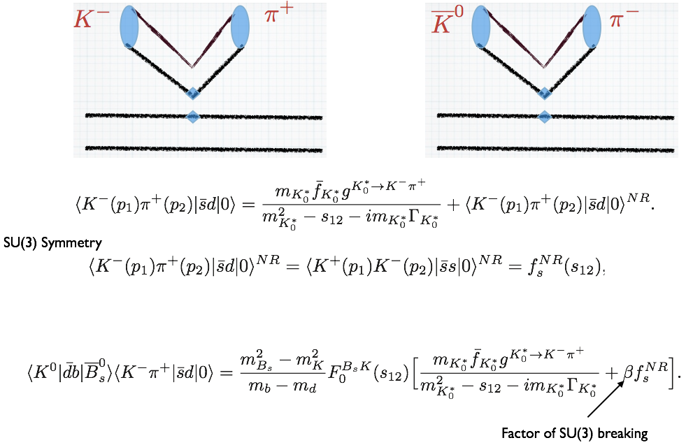

Slide 16
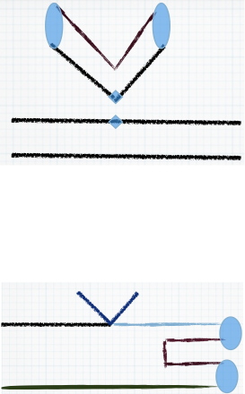

Slide 17
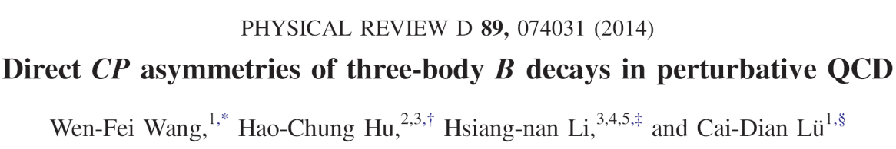
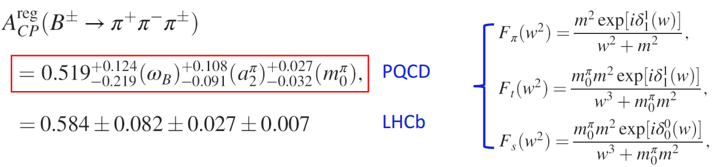

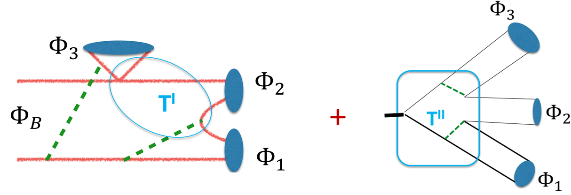
NR in PQCD approach
PQCD (with help of two-meson distribution amplitudes)

Slide 18
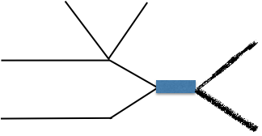
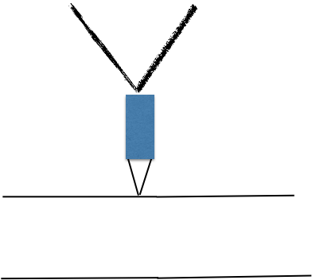
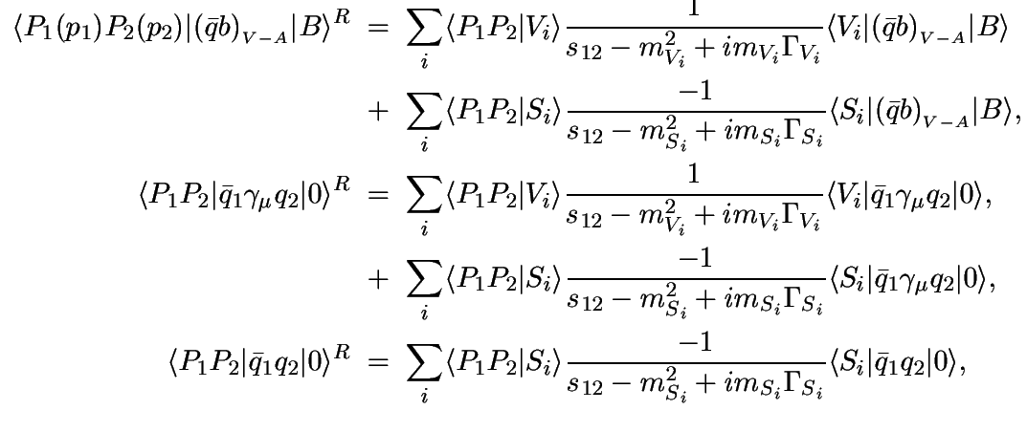
R-contribution in Factorization Approach
V_{i} = φ,ρ,ω,… , S_{i} =f₀(980), f₀(1370), f₀(1500),… for P₁P₂=π⁺π⁻,
V_{i} = K*(892),K*(1410),… , S_{i} = K₀*(1430),… for P₁P₂= K±π

Slide 19
The decay amplitude of B⁰ → K⁺K⁻K⁰ consists of two pieces:
Nonresonant: <B⁰→ K⁺K⁻><0→ K⁰>
<B⁰→ K⁰><0→ K⁺K⁻>
(<B⁰→ K⁰><0→ K⁺K⁻>)_{penguin}
Resonant: B⁰→ f₀K⁰→ K⁺K⁻K⁰ , f₀ = f₀(980), f₀(1500), f₀(1710),…
B⁰→ VK⁰→ K⁺K⁻K⁰, V = ρ, ω, φ,…
Weak phase:
CKM matrix elements
Strong phases:
effective Wilson coefficients
propagator (s - m² + imΓ)⁻¹
matrix element <M₁M₂|qq|0> for NR contribution in the penguin sector

Slide 20
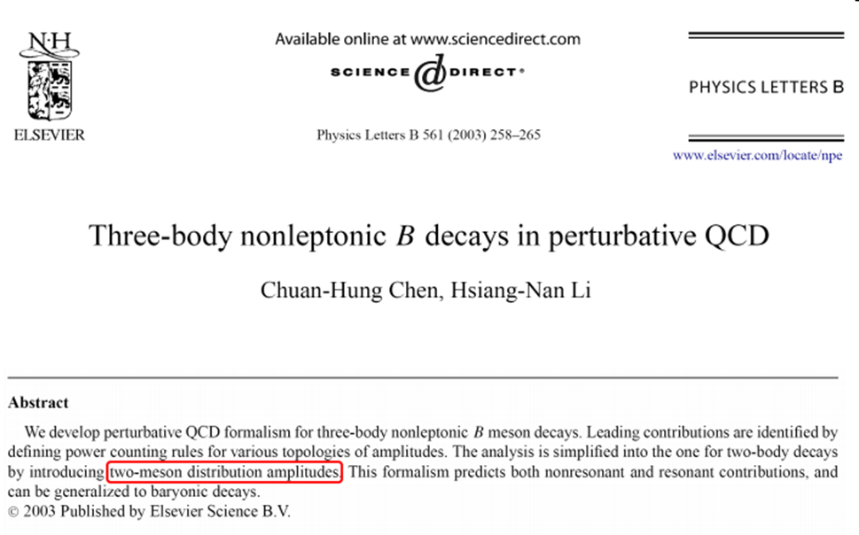
R-contribution in PQCD approach

Slide 21
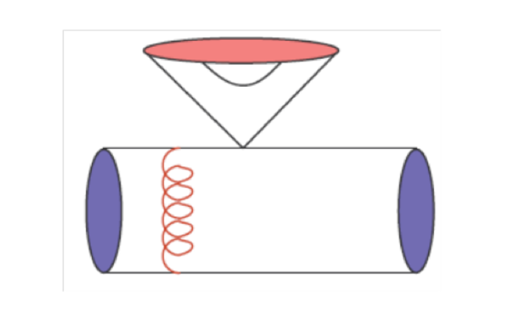
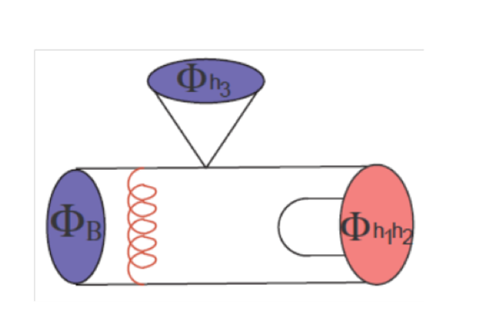
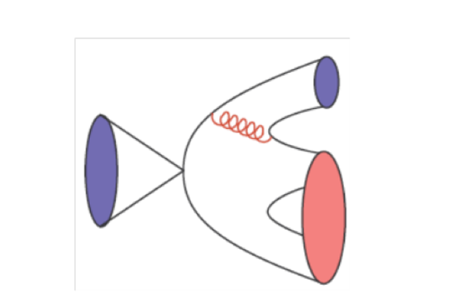
Edge-Regions=Resonance contribution
添加标题
$$⟨P_{1}P_{2}P_{3}|𝒪_{i}|B⟩_{c}=T_{i}^{I}⊗F^{B→P_{1}}⊗Φ_{P_{2}P_{3}}+T_{i}^{II}⊗F^{B→P_{1}P_{2}}⊗Φ_{P_{3}}+T_{i}^{III}⊗Φ_{B}⊗Φ_{P_{1}}⊗Φ_{P_{2}P_{3}}$$
Hard kernels
Transition form factor
Two-meson wave function

Slide 22
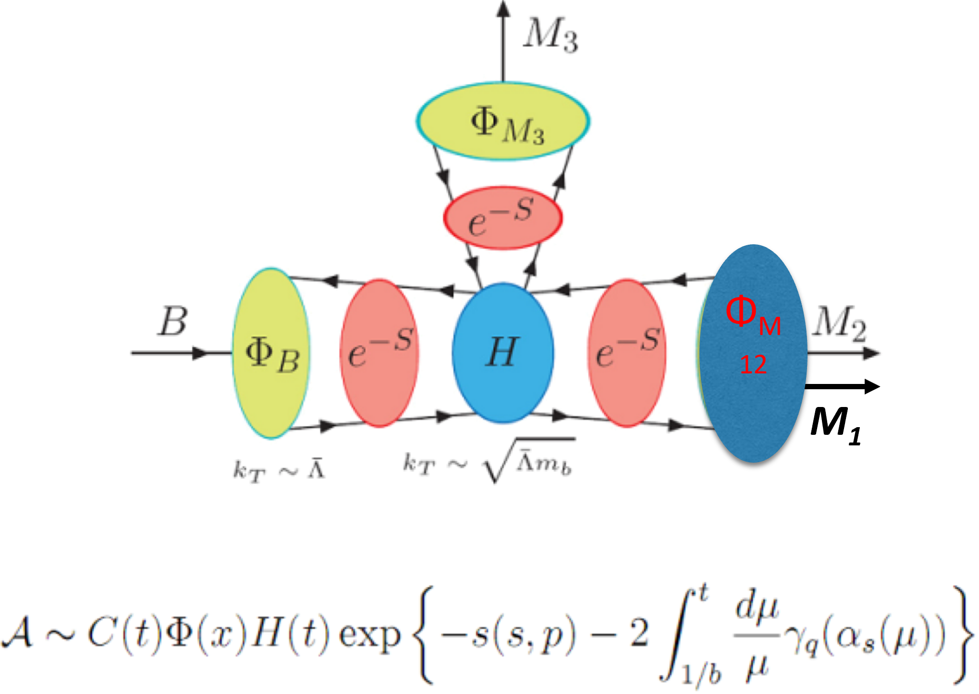

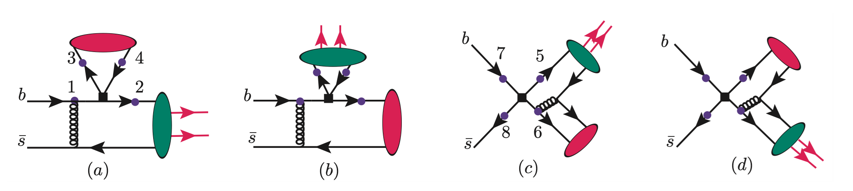
PQCD framework for resonant 3-body B decays
Nonperturbative parts are factorized into universal wave functions
The hard part can be calculated perturbatively.
Parton kT smears end‐point singularity
添加标题

Slide 23
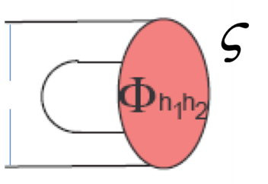
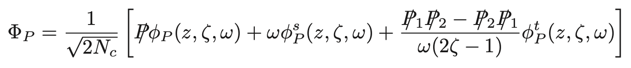
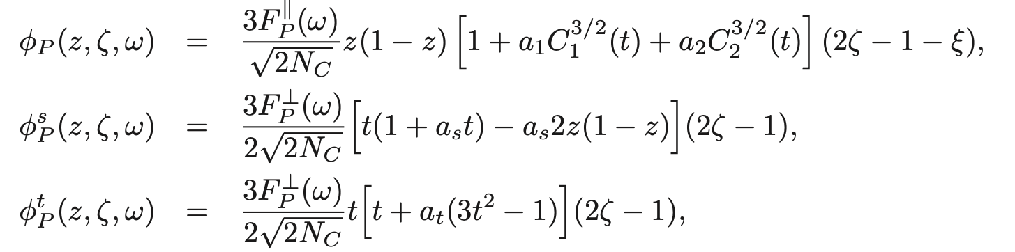
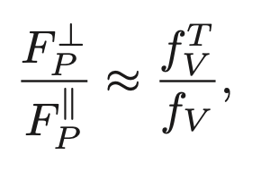
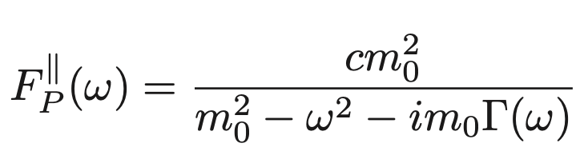

LCDA of the two-meson pair in PQCD approach
Take$B→K_{s}(Kπ)$for example
For the P-wave $Kπ$pair
1911.09348
For the P -wave form factor $F_{P}^{∥}$, we adopt the RBW model
$K^{∗}(980),K^{∗}(1410),K^{∗}(1680)$ should be considered.

Slide 24
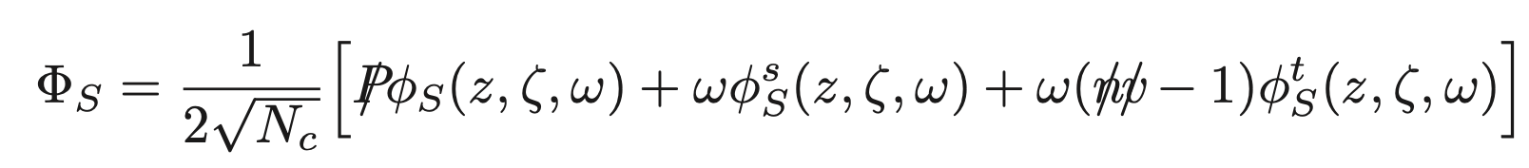

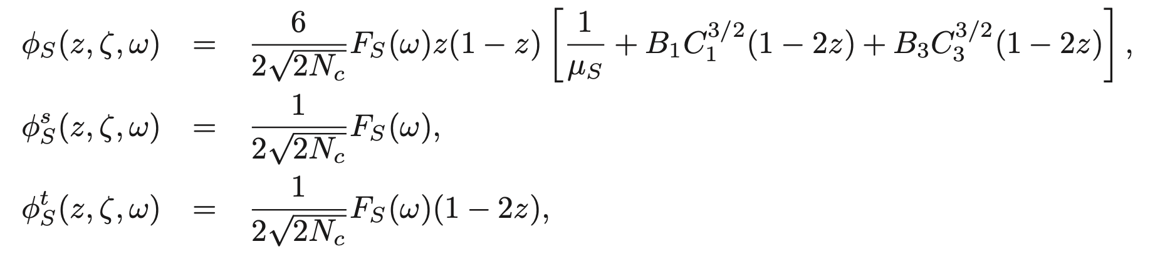
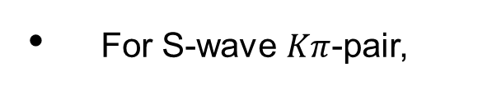
For S-wave $Kπ$-pair,
Scalar form factor
SU(3) breaking, tiny,
suppressed by the difference of quark masses

Slide 25
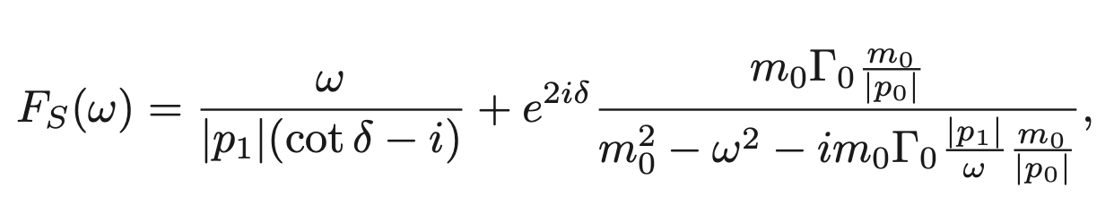

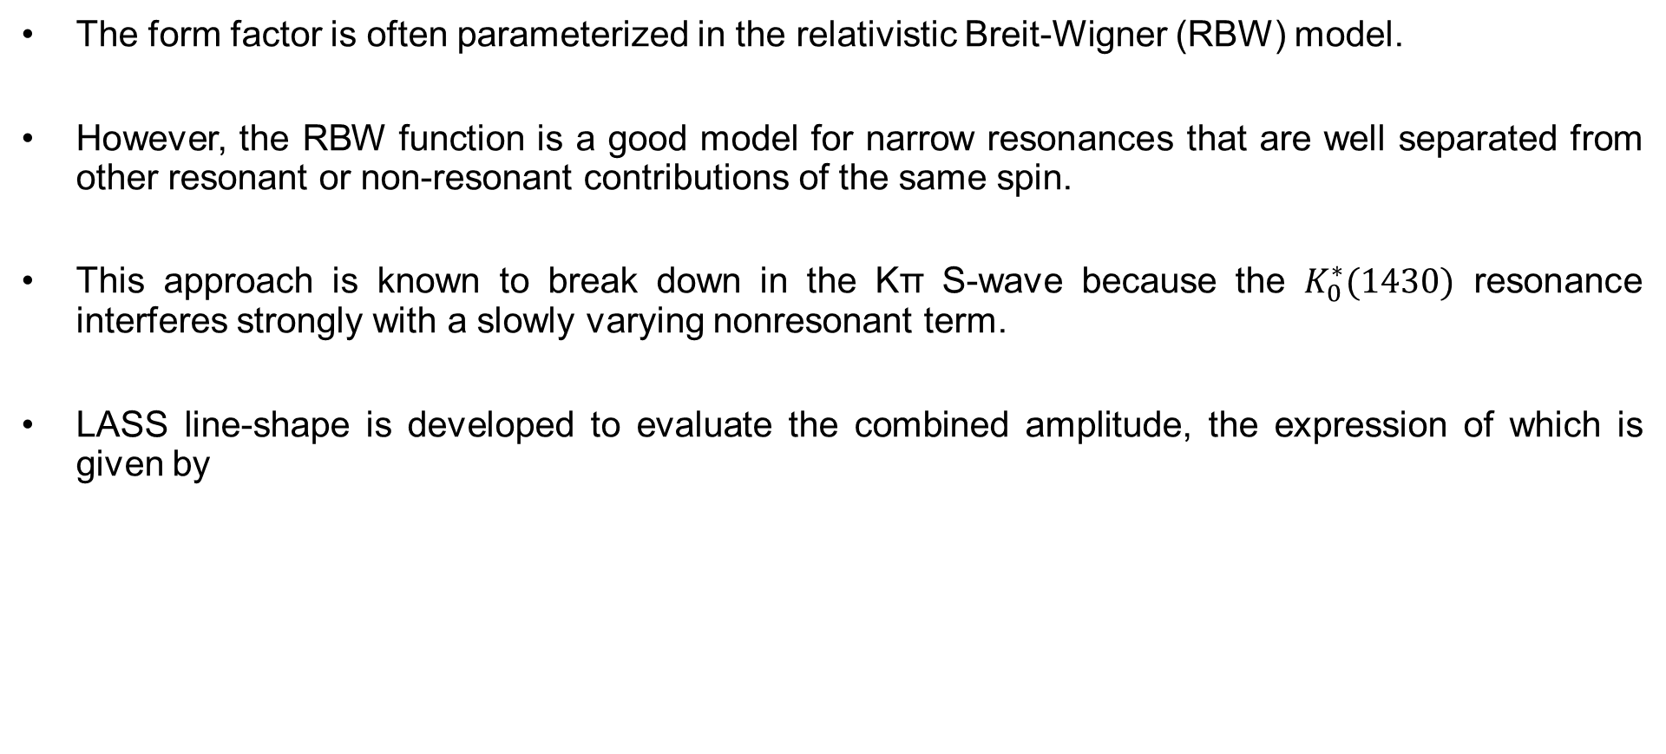
S-wave form factor
The form factor is often parameterized in the relativistic Breit-Wigner (RBW) model.
However, the RBW function is a good model for narrow resonances that are well separated from other resonant or non-resonant contributions of the same spin.
This approach is known to break down in the Kπ S-wave because the $K_{0}^{∗}(1430)$ resonance interferes strongly with a slowly varying nonresonant term.
LASS line-shape is developed to evaluate the combined amplitude, the expression of which is given by
0712.1605
1711.09854
Nonresonance
resonance

Slide 26
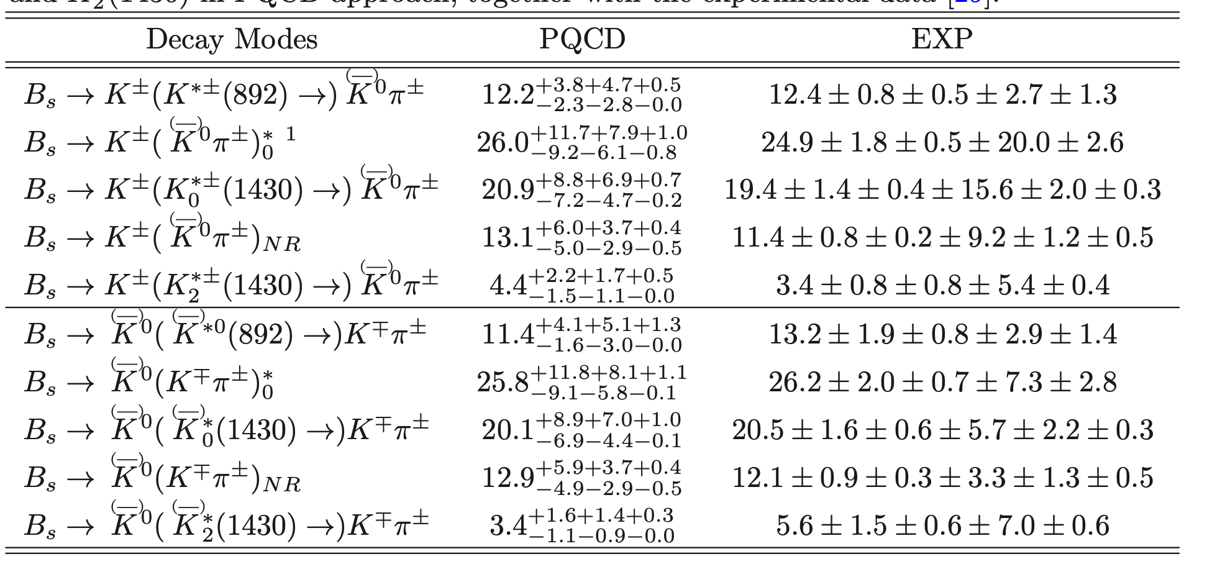
BR of $Bs→KKπ$ decays in PQCD approach
Eur.Phys.J.C 80 (2020) 6, 517
JHEP 06 (2019) 114
Unit:10⁻⁶

Slide 27
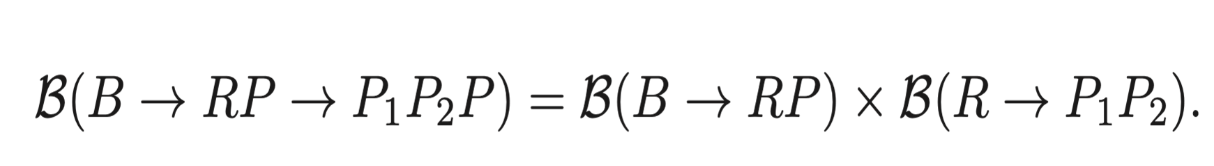
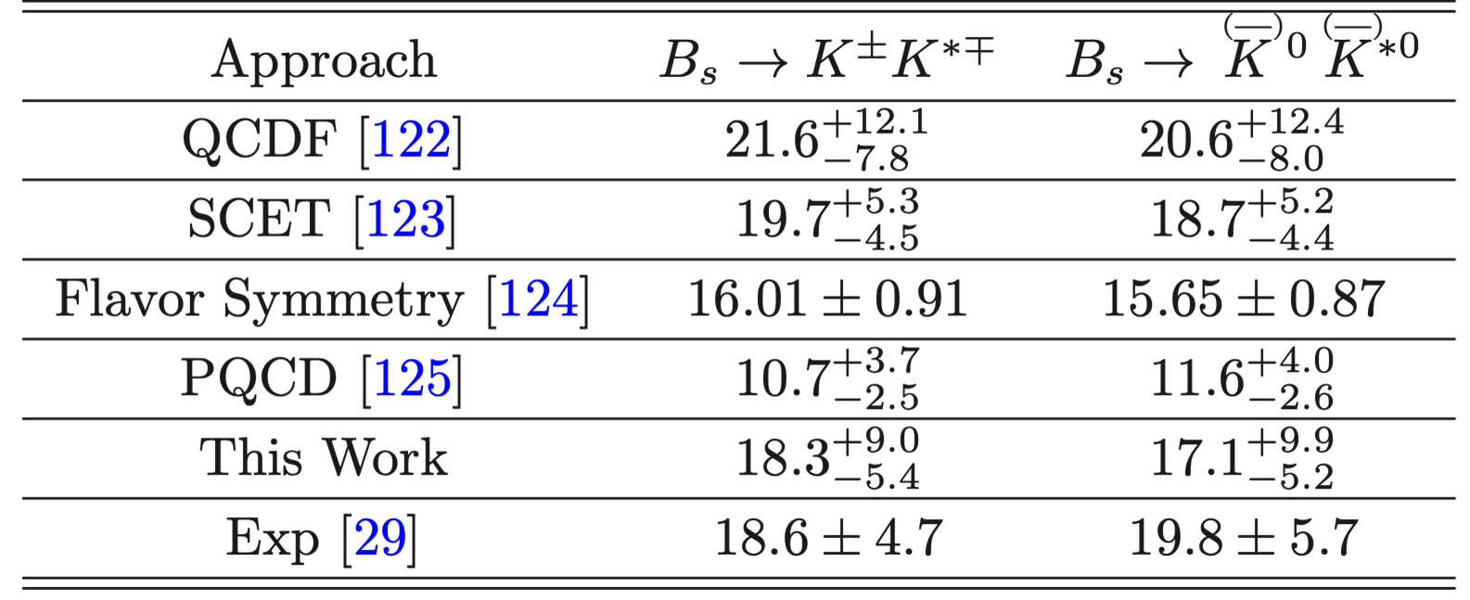
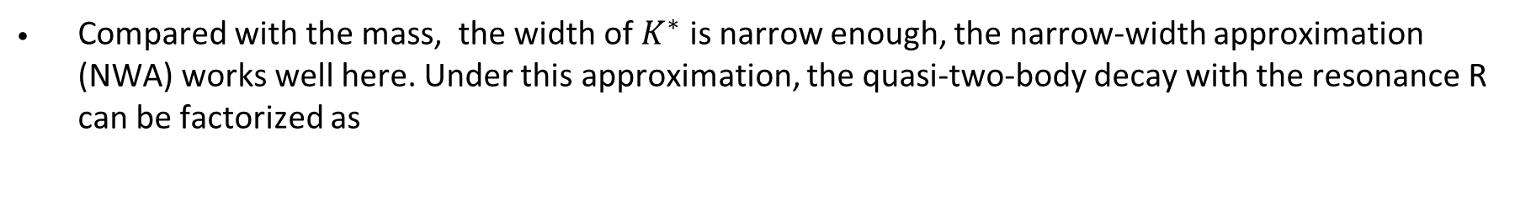
Compared with the mass, the width of $K^{∗}$ is narrow enough, the narrow-width approximation (NWA) works well here. Under this approximation, the quasi-two-body decay with the resonance R can be factorized as
Using the averaged $B(K^{∗}(892)→Kπ)≈100\%$, we then estimate the branching fractions of the corresponding two-body decays as

Slide 28
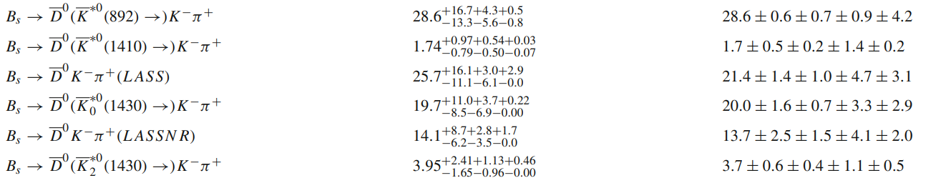
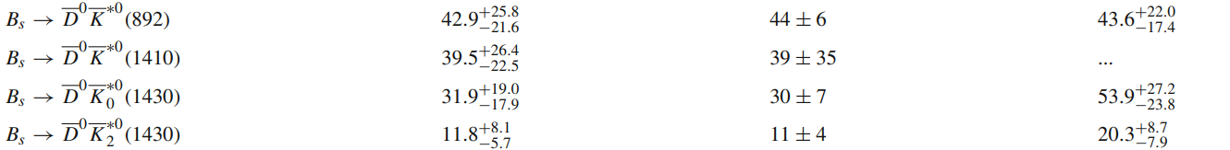

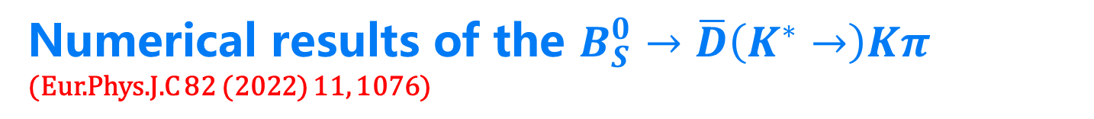
Numerical results of the $B_{S}^{0}→\overline{D}\left(K^{∗}→\right)Kπ$ (Eur.Phys.J.C 82 (2022) 11, 1076)
LHCb
Unit:${10}^{−5}$
PRD 92,012012(2015)
$$ℬ\left[B→M_{1}\left(R→\right)M_{2}M_{3}\right]=ℬ\left[B→M_{1}R\right]×ℬ[R→M_{2}M_{3}]$$

Slide 29







NWA is invalid in $B→M_{1}\left(f_{0}\left(980\right)→\right)KK$ decays
Using the NWA the averaged experimental measurements(PDG) of quasi-two-body decays$B^{+}→K^{+}f_{0}\left(980\right)→K^{+}K^{+}K^{−}$and $B^{+}→K^{+}f_{0}\left(980\right)→K^{+}π^{+}π^{−}$, the ratio between the $f_{0}\left(980\right)→K^{+}K^{−}$ and $f_{0}\left(980\right) →π^{+}π^{−}$
But:
$ℛ=0.69±0.32$ between $B→KK^{+}K^{−}$and $B→Kπ^{+}π^{−}$ decays by BABAR. Phys. Rev. D 74, 032003 (2006)
While $ℛ=0.92±0.07$ if the parameters of $f_{0}(980)$ are adopted from BES
Meanwile $ℛ\sim 0.625±0.21$by BES using $J/ψ→φf_{0}\left(980\right)→φπ^{+}π^{−}$and $J/ψ→φf_{0}\left(980\right)→K^{+}K^{−}$ decays
(Phys. Lett. B 607, 243–253 (2005)
BES also obtained $ℛ={0.25}_{−0.20}^{+0.22}$ by $J/ψ→γχ_{c0}→γf_{0}\left(980\right)f_{0}\left(980\right)→γπ^{+}π^{−}K^{+}K^{−}$ and $J/ψ→γχ_{c0}→γf_{0}\left(980\right)f_{0}\left(980\right)→γπ^{+}π^{−}π^{+}π^{−}$
Phys. Rev. D 70, 092002 (2004)
Phys. Rev. D 72, 092002 (2005)
$ℛ={0.37}_{−0.13}^{+0.23}$ in $B_{s}→J/ψf_{0}\left(980\right)→J/ψπ^{+}π^{−}$ and $B_{s}→J/ψf_{0}\left(980\right)→J/ψπ^{+}π^{−}$
Eur. Phys. J. C 79(9), 792 (2019)

Slide 30




It seems that we hardly can reach a reliable and universal $ℛ$, and even the PDG have not performed the averaged value using the current experimental data
Why?
The above-mentioned discrepancy can be resolved by noting that the factorization relation (NWA) for the resonant three-body decay is applicable only when the two-body decays $B→RM$ and $R→M_{1}M_{2}$are kinematically allowed and the resonance is narrow, the so-called narrow width approximation. However, as the decay $f_{0}\left(980\right)→KK$ is kinematically barely or even not allowed, the off resonance peak effect of the intermediate resonant state will become important.
Phys.Rev.D 76 (2007) 094006
Eur. Phys. J. C (2020) 80:394

Slide 31



The controversial $f_{X}(1500)$ resonance
Measurements of $B^{0}→K^{+}K^{−}K_{s}$and $B^{±}→K^{+}K^{−}K^{±}$from BABAR and Belle have shown evidence of a wide structure in the $m_{KK}$spectrum around 1.5 GeV.
Phys. Rev. D 74, 032003(2006 ); Phys. Rev. Lett. 99, 161802(2007); arXiv:0808.0700
Phys. Rev. D 71, 092003(2005); Phys. Rev. D 82, 073011(2010).
It is assumed as a single scalar resonance; however a vector hypothesis could not ruled out.
The BABAR measurement of $B^{+}→K^{+}K^{−}π^{+}$ appears to show an enhancement around 1.5 GeV
Phys. Rev. Lett. 99, 221801(2007).
the structure is either a vector meson or something exotic.
Phys. Rev. D 79, 051101(R) (2009).
The BABAR analysis of $B^{±}→K_{s}K_{s}π^{±}$finds no evidence of a possible $f_{X}(1500)$

Slide 32





Phys. Rev. D 85 , 112010 (2012)
Dalitz-plot analyses of $B^{0}→K^{+}K^{−}K_{S}$, $B^{+}→K^{+}K^{−}K^{+}$ and $B^{+}→K_{S}K_{S}K^{+}$ by BABAR
Conclusion : The $f_{X}(1500)$ is not a single scalar resonance, but instead can be described by the sum of the well-established resonances $f_{0}(1500)$, $f_{2}\left(1525\right)$, and $f_{0}(1710)$.
But in the amplitude analysis of $B_{s}→K_{S}K_{S}K_{S}$ by BABAR
Phys. Rev. D 85, 054023 (2012)
“We do not observe any significant contribution from the so-called $f_{X}(1500)$ resonance seen in, for example, $B^{+}→K^{+}K^{−}K^{+}$. The peak in the invariant mass between 1.5 and 1.6 GeV can be described by the interference between the $f_{0}(1710)$ resonance and the nonresonant component.”

Slide 33




Is the $f_{X}\left(1500\right)$a vector meson?
Until 2019, LHCb reported the amplitude analysis of $B^{±}→π^{±}K^{+}K^{−}$ decay.
a resonance $ρ^{0}\left(1450\right)$ with wide width dominates the $K^{+}K^{−}$ system.
$Γ\left(ρ\left(1450\right)\right)=400±60$ MeV
$f_{X}\left(1500\right)$= $ρ^{0}\left(1450\right)$ ???
NR?

Slide 34





PHYSICAL REVIEW D 103, 013005 (2021)
If $f_{X}\left(1500\right)$= $ρ^{0}\left(1450\right)$
NR
R

Slide 35



the nonresonant contribution is negligible
Suggestion : $f_{X}\left(1500\right)$= $ρ^{0}\left(1450\right)$
LHCB
PHYSICAL REVIEW D 103, 013005 (2021)

Slide 36
Summary
1
2
三体衰变的因子化
Puzzle
Dalitz图中间区域的理论计算
4
3
如何精确分割共振和非共振贡献
如何精确地拟合两粒子分布振幅中的参数

Slide 37


守信 求实 好学 力行
Thanks for your attention
汇报人：邹芝田烟台大学
2023年11月，武汉

Slide 38






Numerical Results
Using $B(K_{0}^{∗}(1430)→Kπ)=93±10\%$, we then estimate the branching fractions as
Results from LHCb
Using $B(K_{2}^{∗}(1430)→Kπ)=49.9±1.2\%$, we then estimate the branching fractions as
Results from LHCb
Notes:
Using the same method, we can also get the branching ratios of the S-wave and D-wave two-body decays. They are also in agreement with the LHCb measurements within the errors.

Slide 39

S-wave form factor
The form factor is often parameterized in the relativistic Breit-Wigner (RBW) model.
However, the RBW function is a good model for narrow resonances that are well separated from other resonant or non-resonant contributions of the same spin.
This approach is known to break down in the Kπ S-wave because the $K_{0}^{∗}(1430)$ resonance interferes strongly with a slowly varying nonresonant term.
LASS line-shape is developed to evaluate the combined amplitude, the expression of which is given by
0712.1605
1711.09854
Nonresonance
resonance
Notes:
Now we detailed introduce the S-wave form factor. As usual, the form factor is ……………………
But the RBW function is a good ------------------
This approach is------------------------. The details can be checked in this article.
LASS lineshape is developed to -----------------------------------. The first term is the non-resonant contribution. The second is the resonant one.
M0 and Gamma0 are the pole mass and width of K*(1430).
P1 is the momentum of K-pi pair. P0 is the value of p1 when the invariant mass equals to the m0.
Exponential term is the relative phase. It is a strong phase.
R Acan be determined by experiments. （the scattering length and the effective range）

