Slide 1
第二届桂子山粒子物理前沿研究论坛
The application of tensor forms of topological amplitudes in the heavy hadron decays
报告人： 王 迪
单 位：湖南师范大学

Slide 2
第二届桂子山粒子物理前沿研究论坛
Contents
1
Topology in tensor form
2
Linear correlation of topologies
3
Generating flavor sum rule
4
From topology to rescattering

Slide 3
第二届桂子山粒子物理前沿研究论坛
Contents
1
Topology in tensor form
2
Linear correlation of topologies
3
Generating flavor sum rule
4
From topology to rescattering

Slide 4
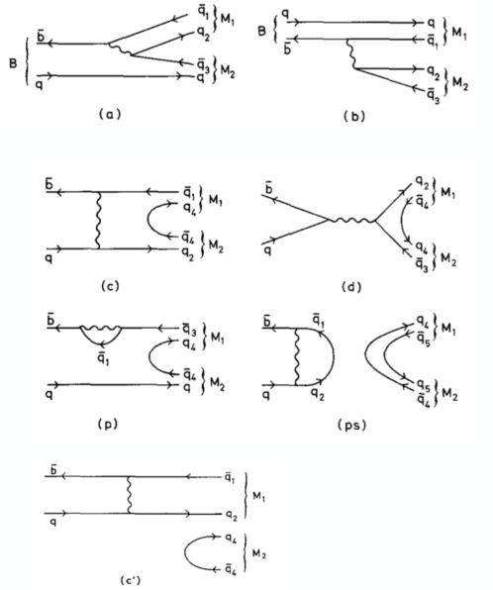
第二届桂子山粒子物理前沿研究论坛
Topological diagram
Defined according to the topologies of quark flow in weak decay
Include all strong interaction effects, perturbative and non-perturbative
Model-independent, could be extracted from data
D. Zeppenfeld, Z. Phys. C, 77 (1981), L. L. Chau, Phys. Rept. 95, 1 (1983)
4

Slide 5
第二届桂子山粒子物理前沿研究论坛
Topologies in tensor form
X. G. He and W. Wang, Chin. Phys. C 42, 103108 (2018).
Topological amplitude in tensor form
Bridge between topological diagrams and invariant tensors
Operator
CKM
…
5

Slide 6
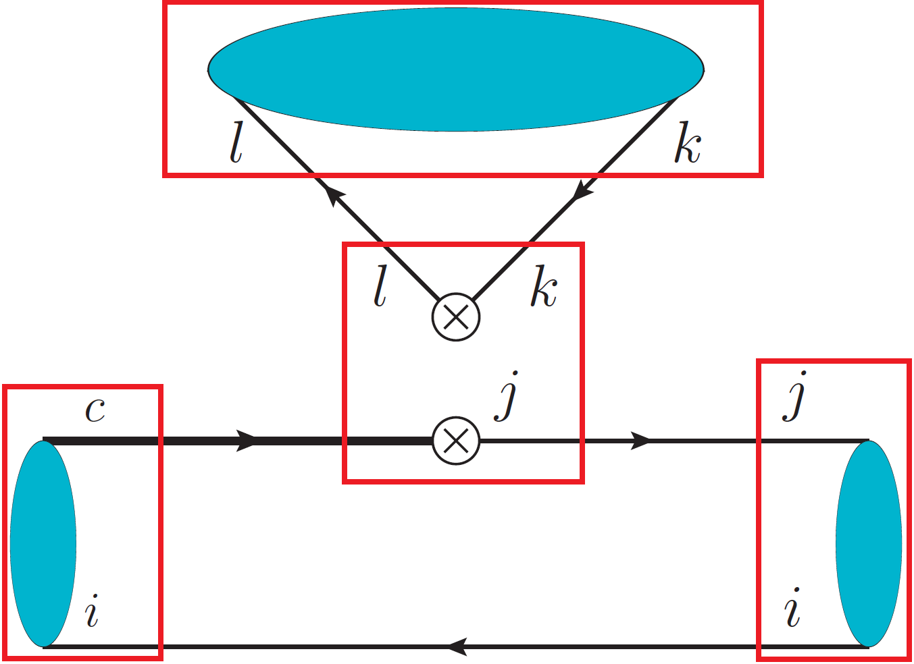
第二届桂子山粒子物理前沿研究论坛
Topology Invariant Tensor
SU(N) invariant
Clebsch-Gordan coefficient, mode-dependent
Reduced matrix element, mode-independent
Wigner-Eckart theorem
Index-contraction Quark flowing
6

Slide 7
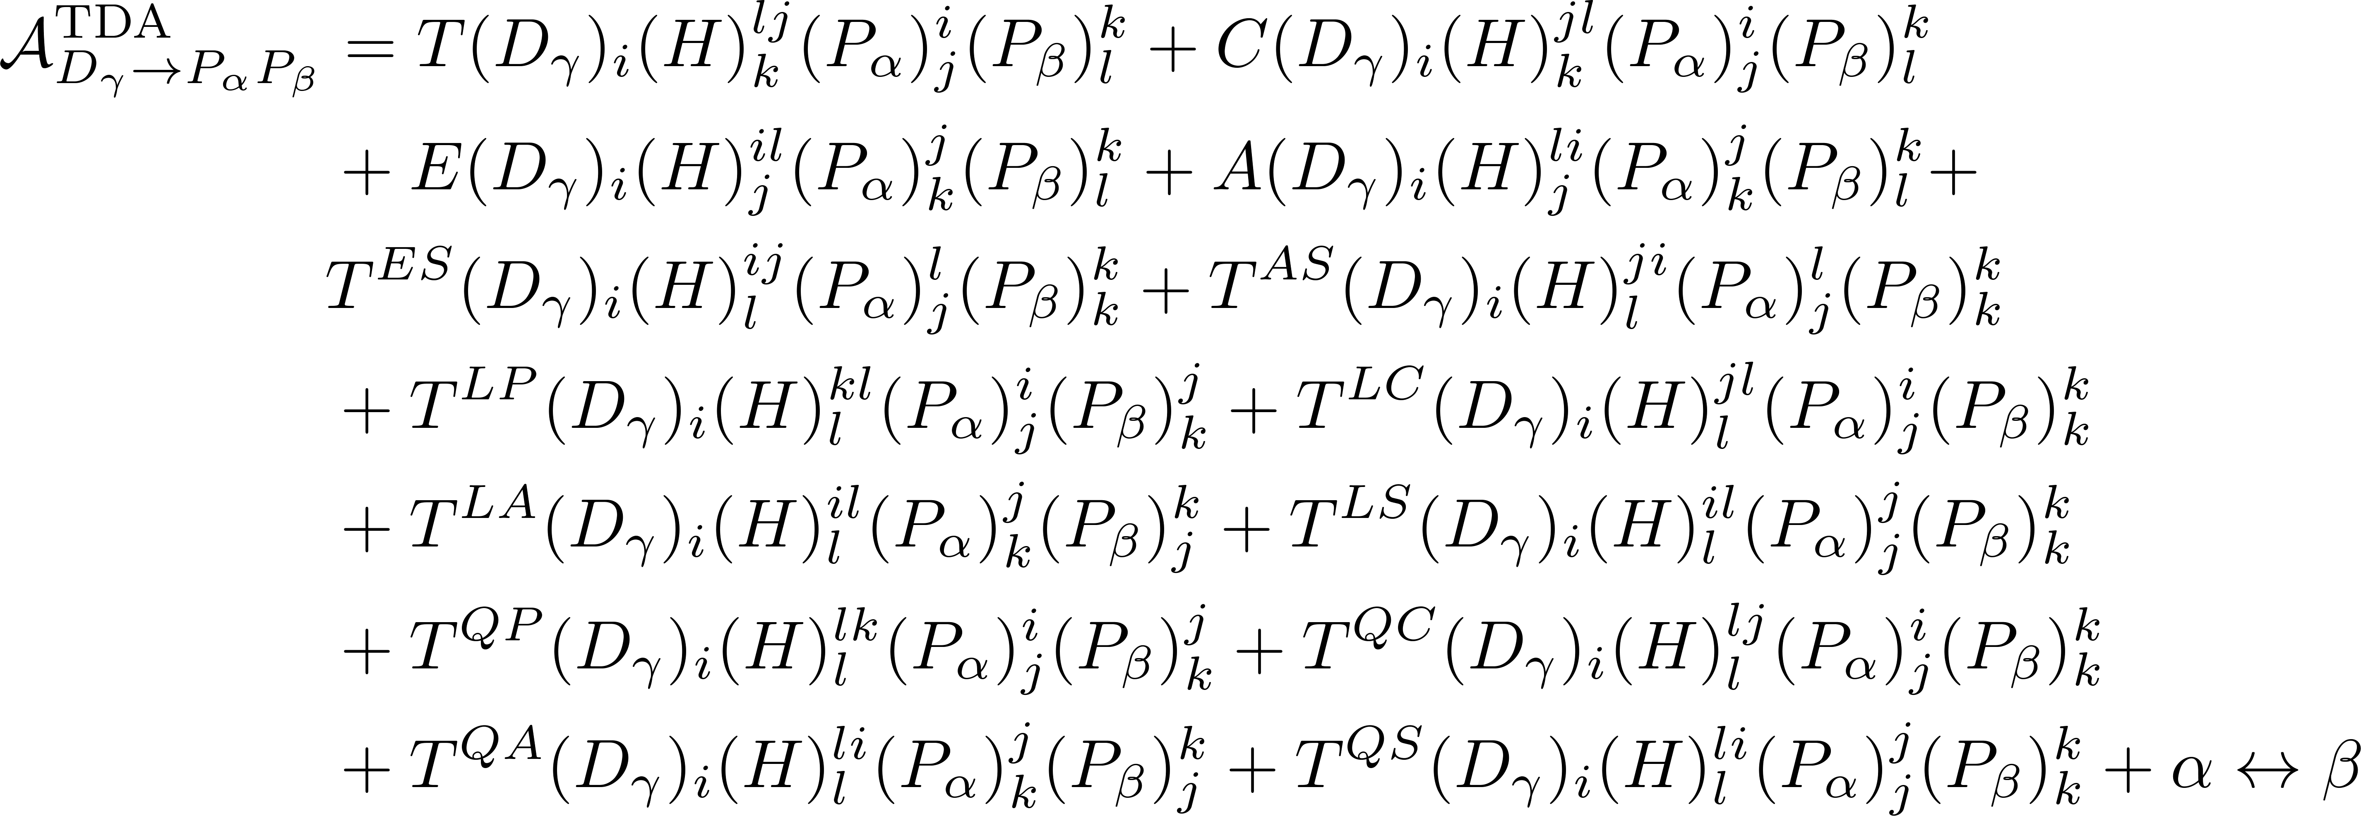
第二届桂子山粒子物理前沿研究论坛
Topologies in D PP
completeness
7

Slide 8
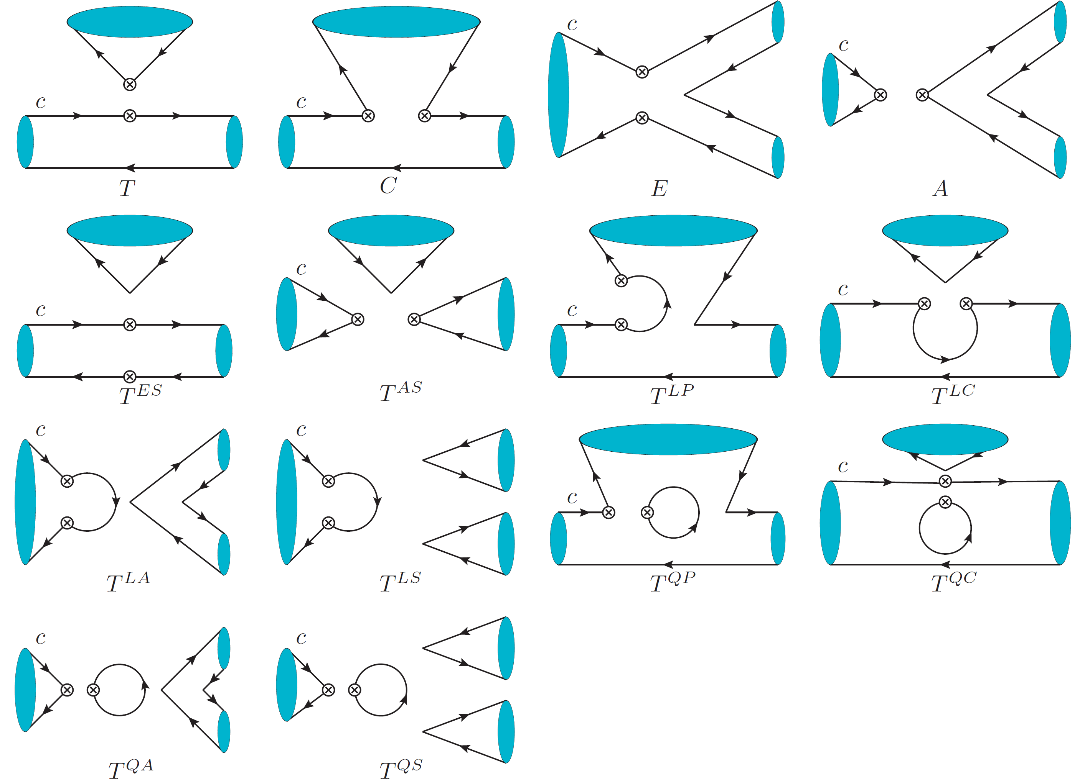
第二届桂子山粒子物理前沿研究论坛
Topologies in D PP
D. Wang, C. P. Jia and F. S. Yu, JHEP 09, 126 (2021).
8

Slide 9
第二届桂子山粒子物理前沿研究论坛
Contents
1
Topology in tensor form
2
Linear correlation of topologies
3
Generating flavor sum rule
4
From topology to rescattering

Slide 10
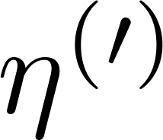
第二届桂子山粒子物理前沿研究论坛
Linear correlation of topologies
It has been noticed that one of the topologies in the D and B meson decays is not independent in the SU(3) limit
T. G. Rizzo and L. L. C. Wang, BNL-27950. D. Zeppenfeld, Z. Phys. C 8, 77 (1981).
X. G. He and W. Wang, Chin. Phys. C 42, 103108 (2018).
If is not analyzed in the D decays into PP, only three of the T, C, E and A diagrams are independent. It is no longer correct when is included.
B. Bhattacharya and J. L. Rosner, Phys. Rev. D 81, 014026 (2010).
G. Hiller, M. Jung and S. Schacht, Phys. Rev. D 87, no. 1, 014024 (2013).
Why?
10

Slide 11
第二届桂子山粒子物理前沿研究论坛
SU(3) irreducible amplitude
TDA = IRA
11

Slide 12
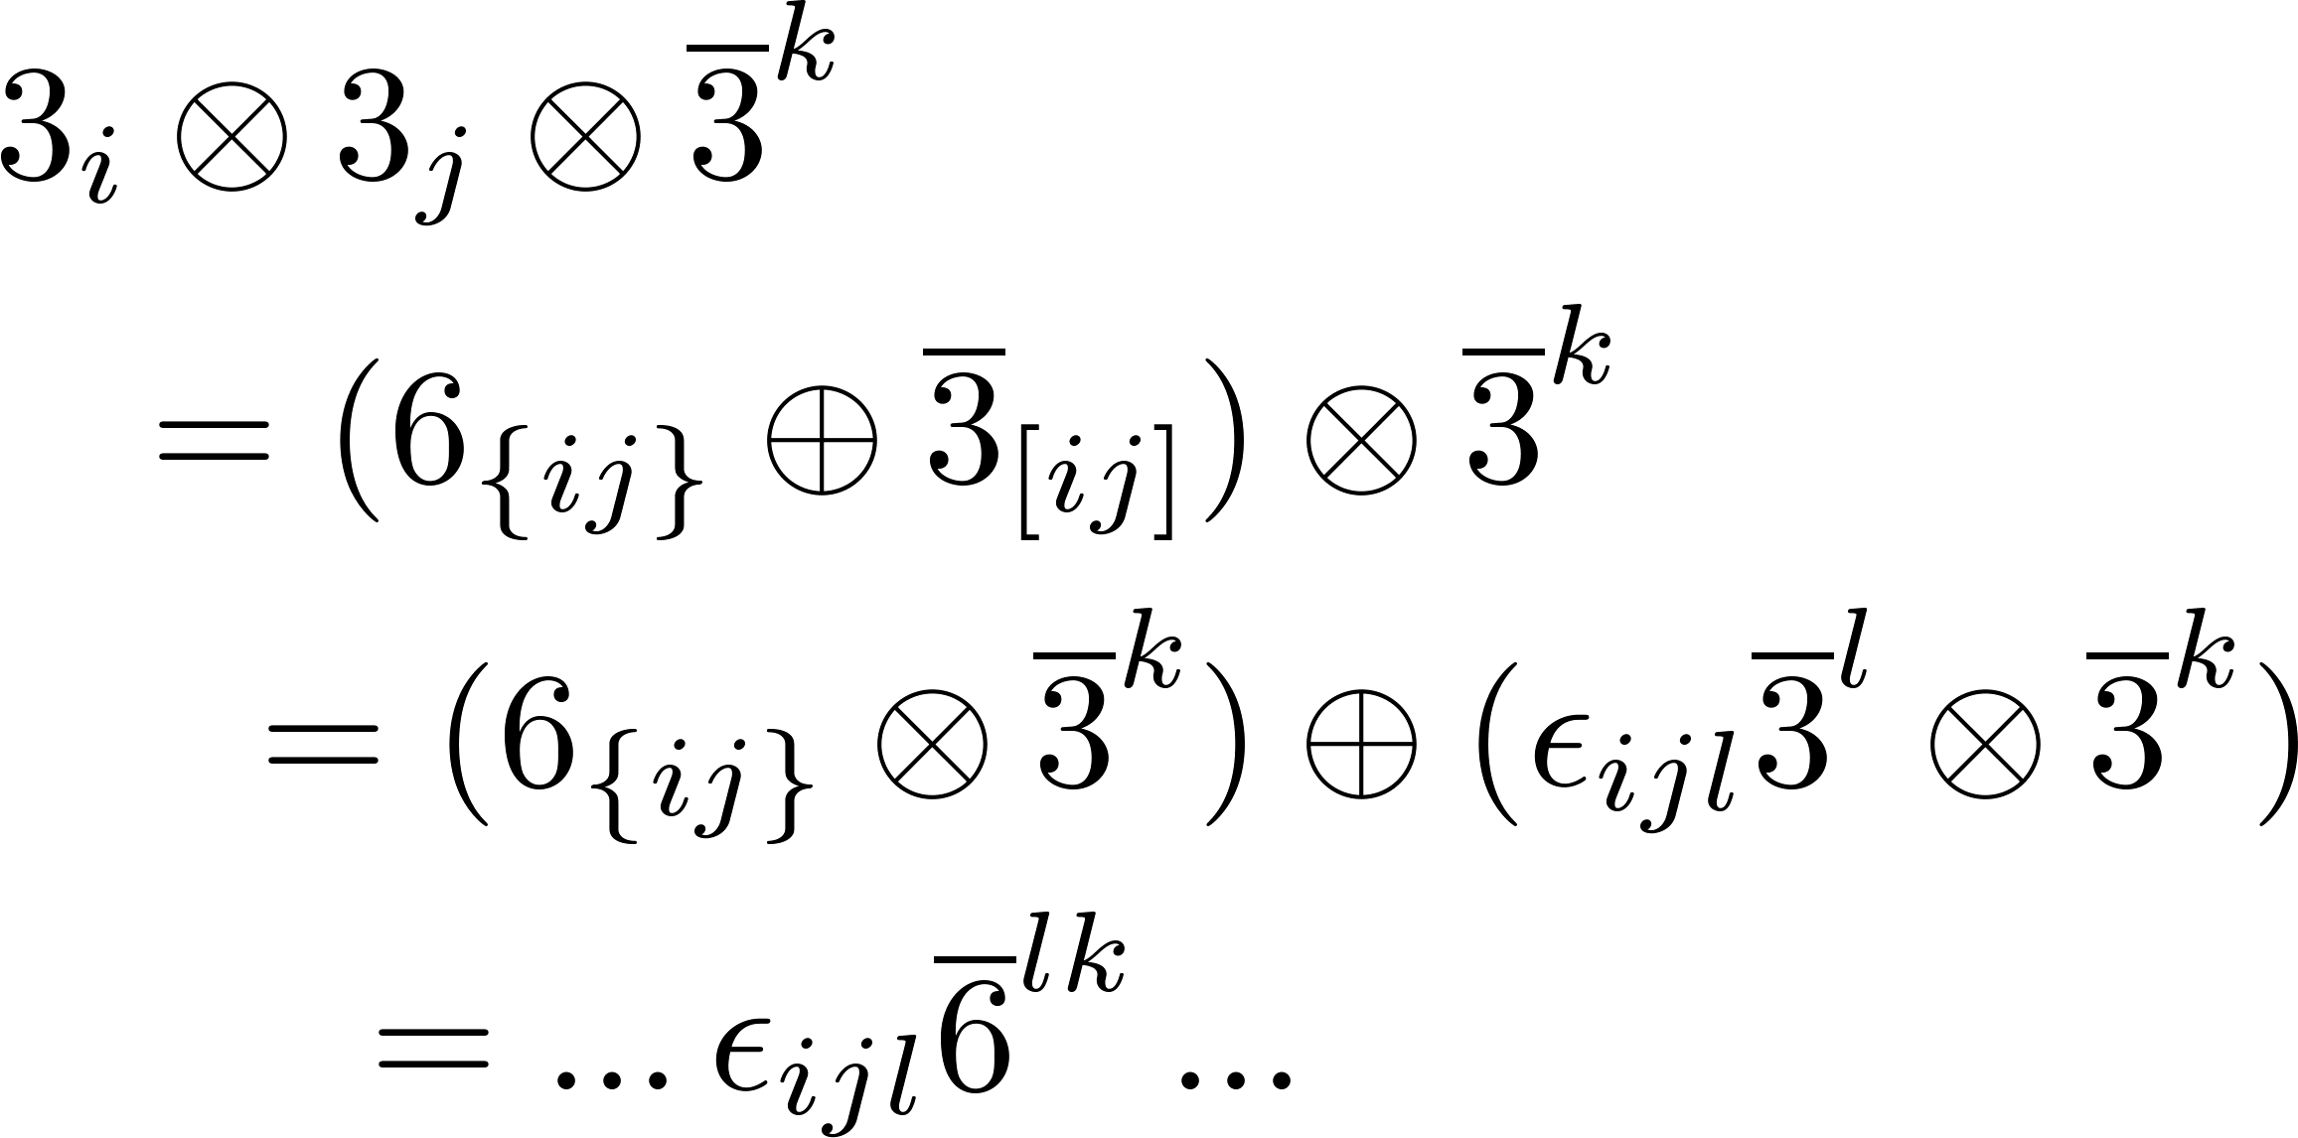
第二届桂子山粒子物理前沿研究论坛
Linear correlation
i,j: anti-symmetric
l,k: symmetric
12

Slide 13
第二届桂子山粒子物理前沿研究论坛
Linear correlation
13

Slide 14
第二届桂子山粒子物理前沿研究论坛
SU(N) group
, all the topological amplitudes are independent.
14

Slide 15
第二届桂子山粒子物理前沿研究论坛
Contents
1
Topology in tensor form
2
Linear correlation of topologies
3
Generating flavor sum rule
4
From topology to rescattering

Slide 16
第二届桂子山粒子物理前沿研究论坛
SU(3) sum rule
Example
Amplitude decomposition
C. P. Jia, D. Wang and F. S. Yu, Nucl. Phys. B 956, 115048 (2020)
Other Way ? Isospin, U-spin, V-spin sum rules ?
16

Slide 17
第二届桂子山粒子物理前沿研究论坛
Abstract SU(3) sum rule
If there exists an operator T, under which the Hamiltonian is invariant, TH = 0. The invariance of Hamiltonian under T is related to the generation of sum rules.
To obtain SU(3) sum rules, we apply operator T to the initial/final states and compute coefficients expanded by the initial/final states
Y. Grossman and D. J. Robinson, JHEP 04, 067 (2013)
17

Slide 18
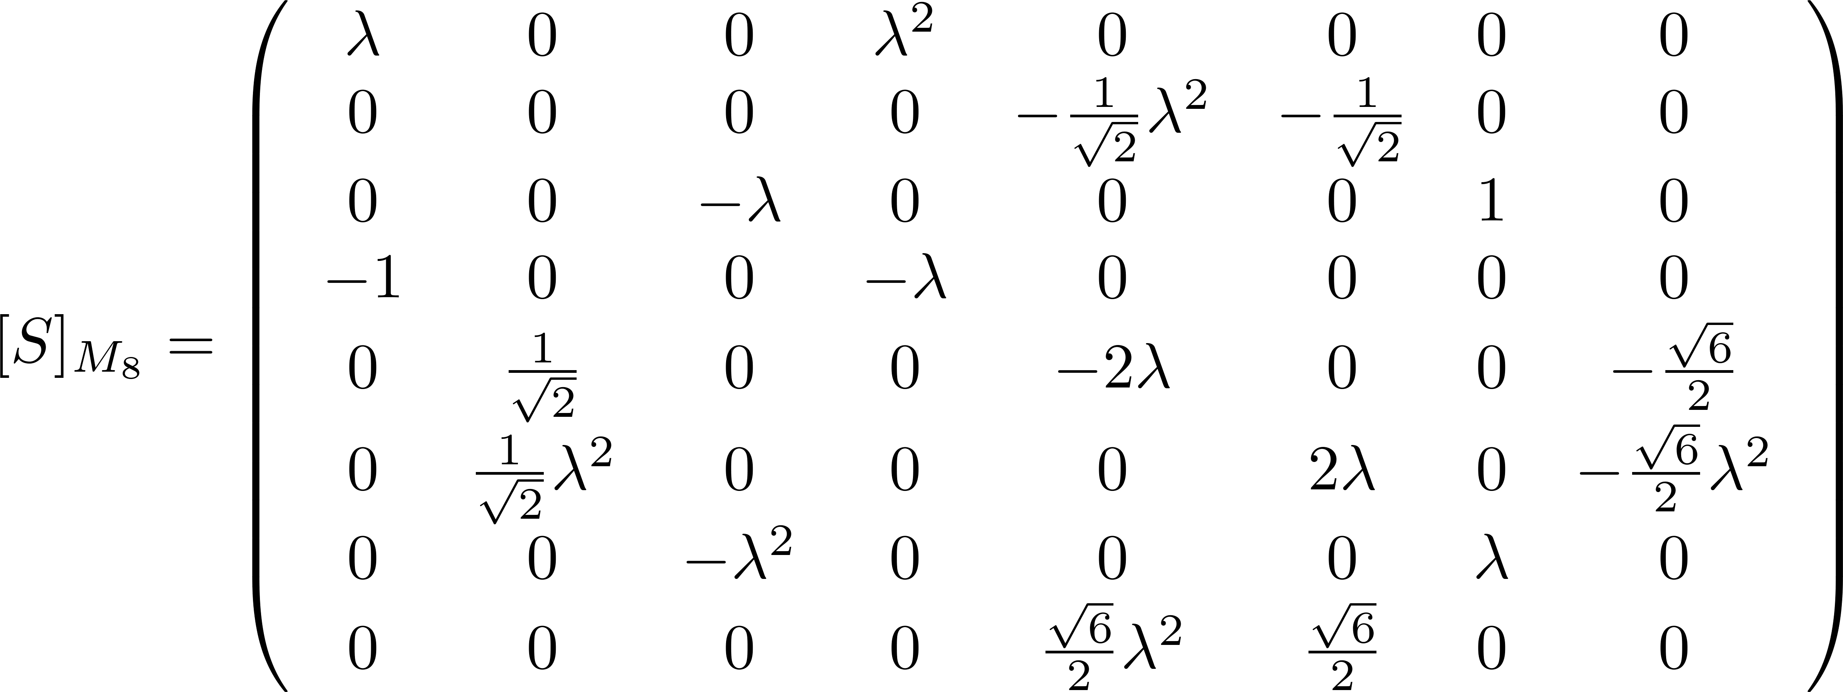
第二届桂子山粒子物理前沿研究论坛
SU(3) sum rules
Basis:
18

Slide 19
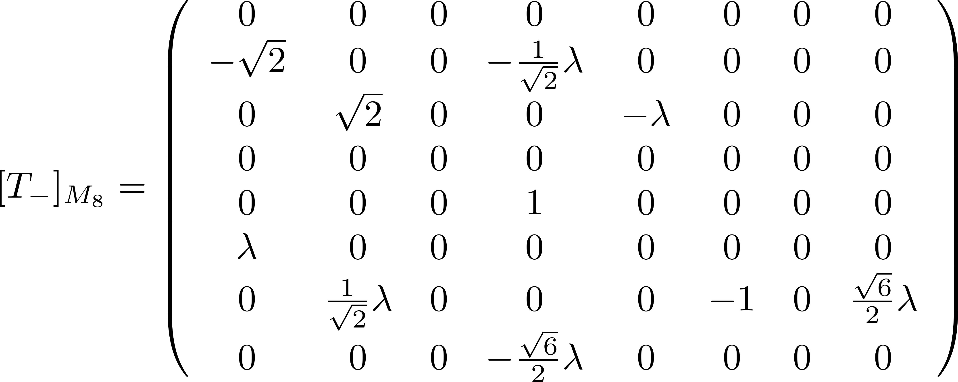
第二届桂子山粒子物理前沿研究论坛
SU(3) sum rules
Master formula:
arXiv:2204.05915 [hep-ph]
19

Slide 20
第二届桂子山粒子物理前沿研究论坛
SU(3) sum rules
A SU(3) sum rule is generated if appropriate are selected.
 | Charge |  | Subgroup
arXiv:2204.05915 [hep-ph]
20

Slide 21
第二届桂子山粒子物理前沿研究论坛
Abstract isospin sum rule
No operator T constructed by I₃, I₋, I₊ which T H_{c}=0.
Isospin sum rule ?
21

Slide 22
第二届桂子山粒子物理前沿研究论坛
Isospin sum rule
Apply I₋ to the initial/final states
A isospin sum rule is generated if appropriate and are selected
22

Slide 23
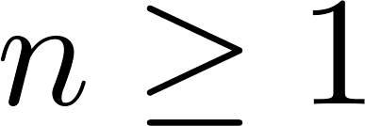
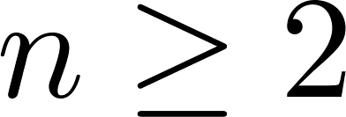
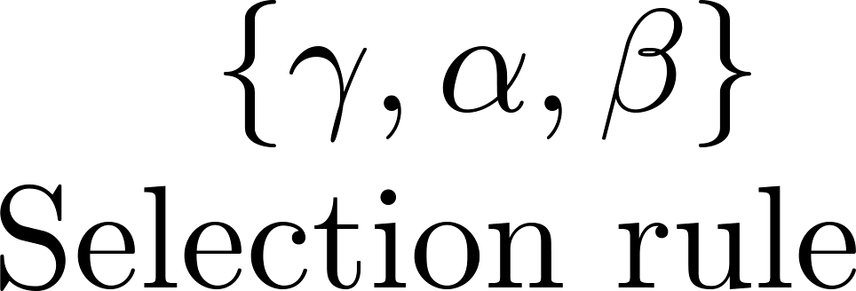
第二届桂子山粒子物理前沿研究论坛
Isospin sum rule
Mode | CF | SCS | DCS
The isospin sum rules are generated by I- acting on initial/final states once and twice for the CF decays and the SCS/DCS decays respectively.
arXiv:2301.06104 [hep-ph]
23

Slide 24
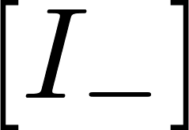
第二届桂子山粒子物理前沿研究论坛
Isospin sum rules
CF mode
SCS/DCS mode
Other decay modes:
V-spin and U-spin sum rules:
24

Slide 25
第二届桂子山粒子物理前沿研究论坛
Contents
1
Topology in tensor form
2
Linear correlation of topologies
3
Generating flavor sum rule
4
From topology to rescattering

Slide 26
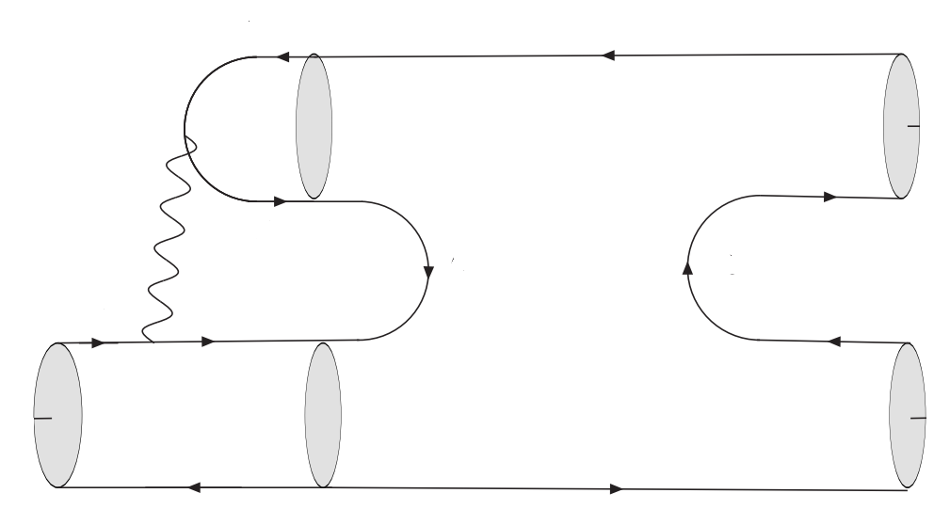
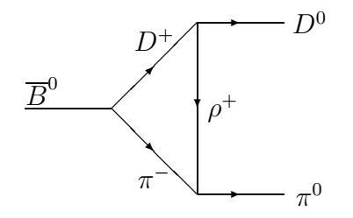
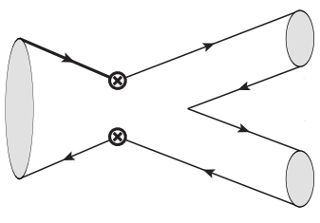
第二届桂子山粒子物理前沿研究论坛
From topology to rescattering
The non-perturbative QCD effects are modeled as an exchange of one particle between the two particles generated from short-distance tree emitted process. It forms a triangle diagram at hadron level.
Two approaches to get triangle diagram
Calculating the hadron-level Feynman diagram (A)
Extracting from topological diagram via quark diagram (B)
(A) = (B) ?
26
?

Slide 27
第二届桂子山粒子物理前沿研究论坛
From topology to rescattering
27
?

Slide 28
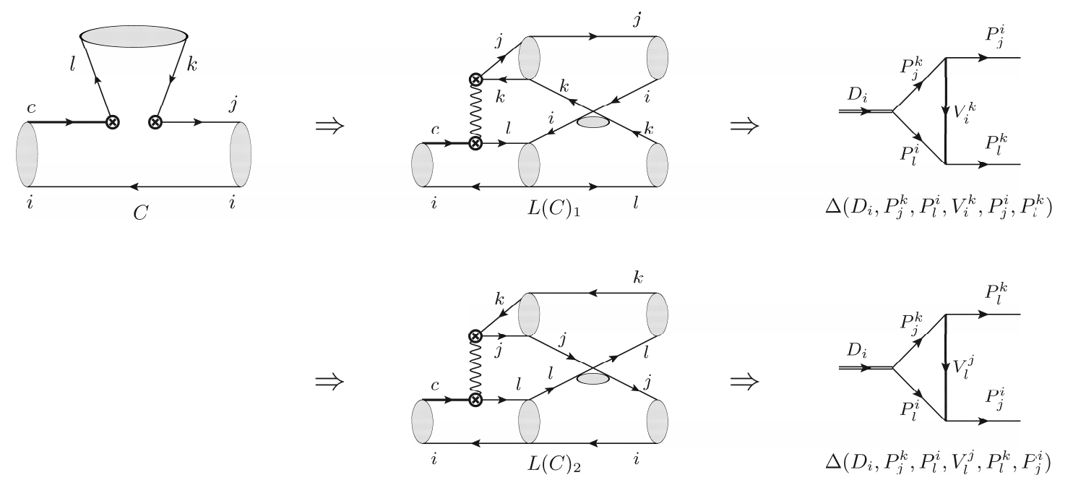
第二届桂子山粒子物理前沿研究论坛
C diagram
28
?

Slide 29
第二届桂子山粒子物理前沿研究论坛
C diagram
29
?

Slide 30
第二届桂子山粒子物理前沿研究论坛
Penguin diagram
(A) (B)
M. Ablikim, D. S. Du and M. Z. Yang, Phys. Lett. B 536, 34-42 (2002).
H. Y. Cheng, C. K. Chua and A. Soni, Phys. Rev. D 71, 014030 (2005).
Is it over ?
Isospin relation
30
?

Slide 31
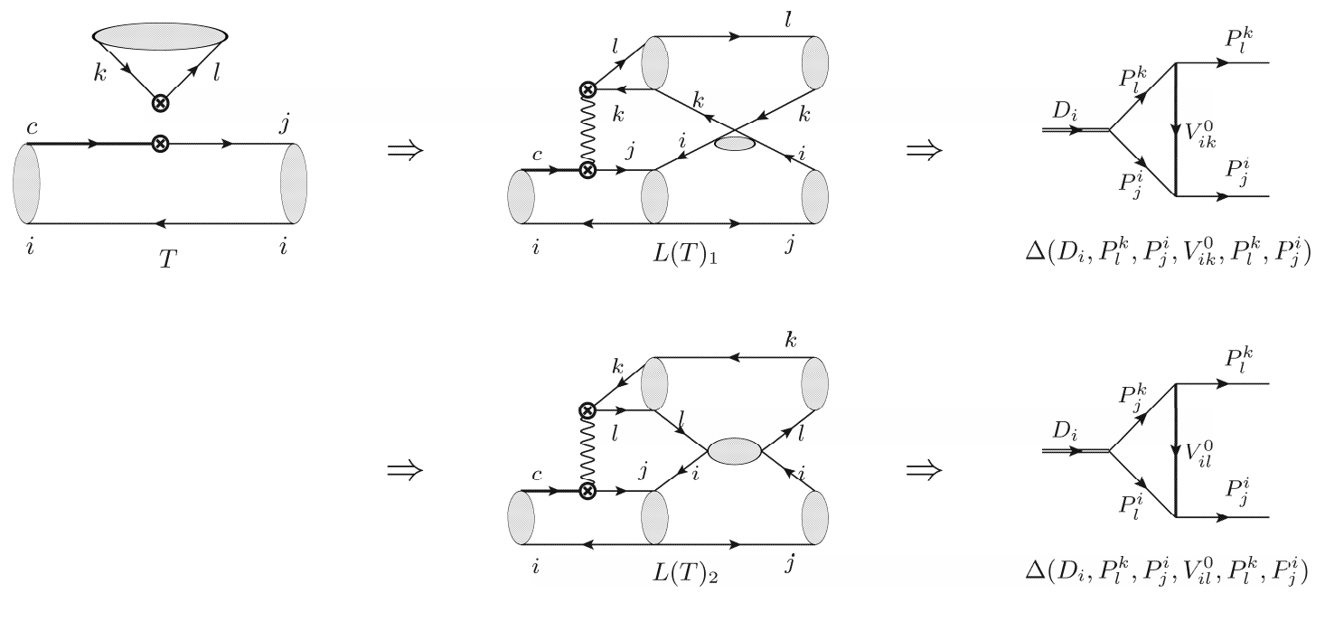
第二届桂子山粒子物理前沿研究论坛
T diagram
31
?

Slide 32
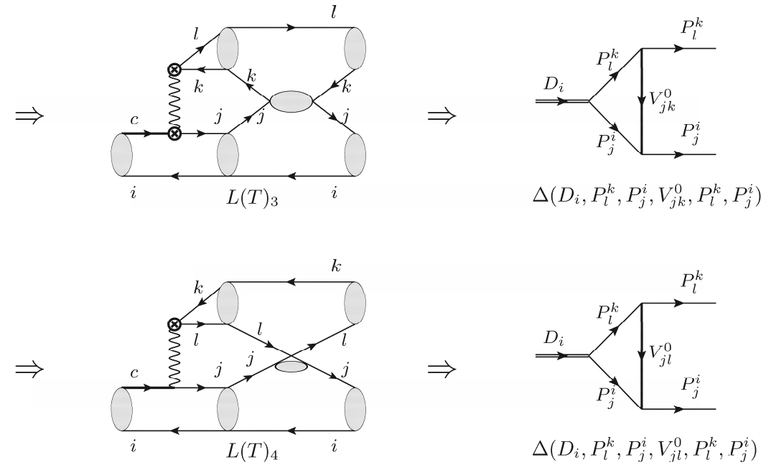
第二届桂子山粒子物理前沿研究论坛
T diagram
32
?

Slide 33
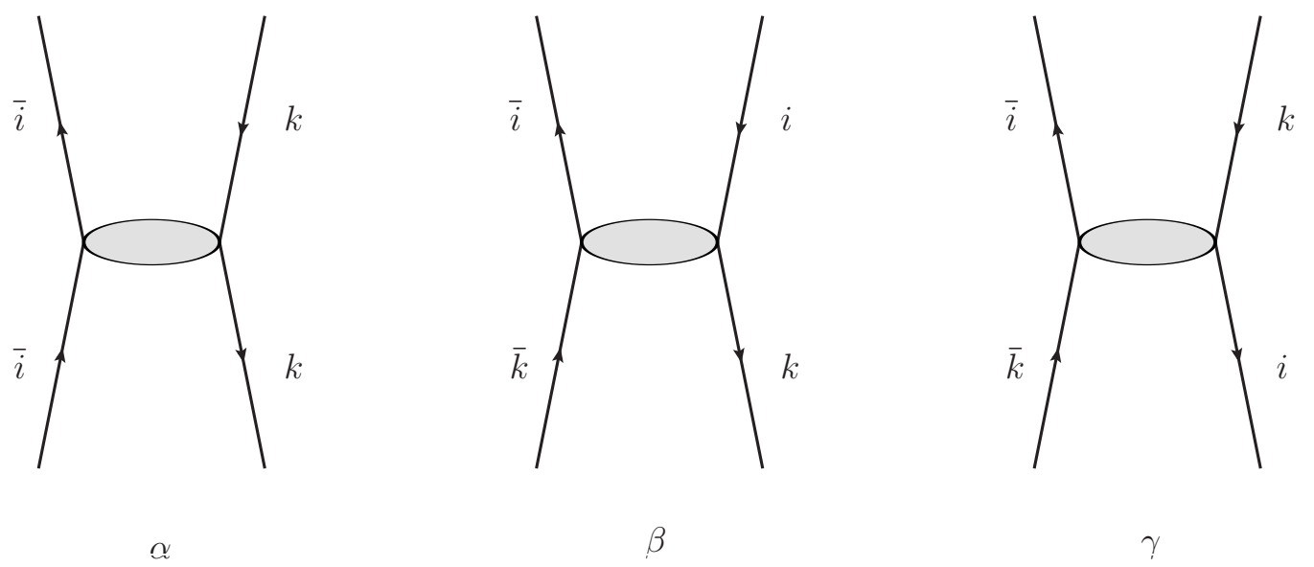
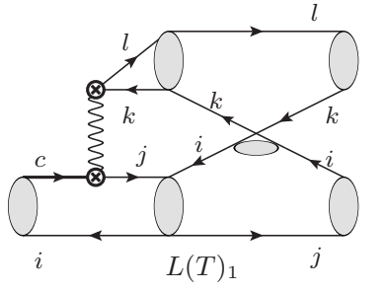
第二届桂子山粒子物理前沿研究论坛
T diagram
If i=k, interchanging two fermions produces a minus sign according to the Pauli exclusion principle, and hence
Triangle diagrams in T amplitude vanish under the SU(3) flavor symmetry.
33
?

Slide 34
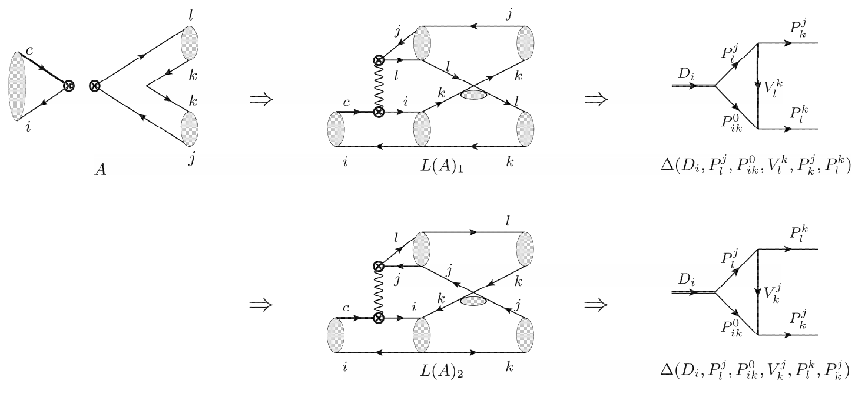
第二届桂子山粒子物理前沿研究论坛
A diagram
34
?

Slide 35
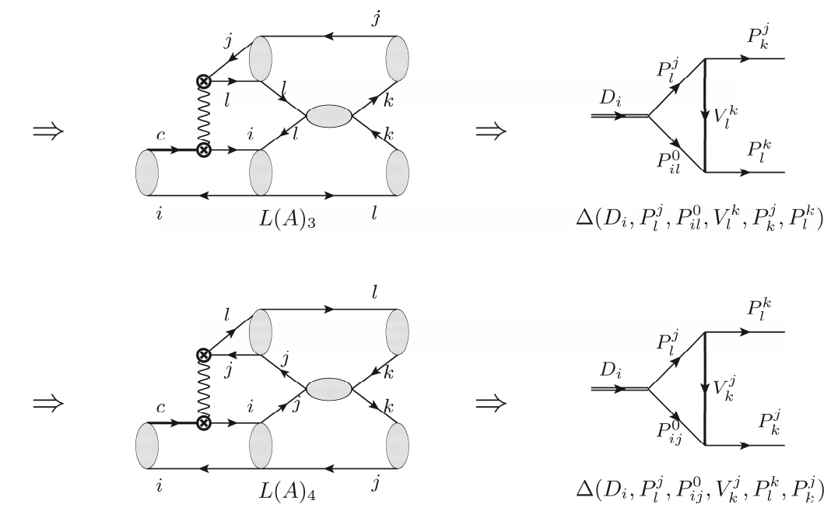
第二届桂子山粒子物理前沿研究论坛
A diagram
Triangle diagrams vanish in the SU(3) flavor symmetry
35
?

Slide 36
第二届桂子山粒子物理前沿研究论坛
Examples
vertexes cancel
Consistent with the diagrams derived directly from the chiral Lagrangian.
36

Slide 37
第二届桂子山粒子物理前沿研究论坛
From topology to rescattering
R. Aaij et al. [LHCb Collaboration], Phys. Rev. Lett. 122, no. 21, 211803 (2019).
Large CPV in charm !
37
?

Slide 38
第二届桂子山粒子物理前沿研究论坛
Wigner-Eckart Theorem
Mathematical Form
InvariantTensor
Universality
TDA
Physical Explanation
Permutation/Combination
Completeness
Insert propagaters and strong vertexes
SU(N) decomposition
Insert operators
Equivalence
IRA
SRF
TRI
Linear correlation of topologies
Test flavor symmetry
Estimation of rescattering contribution
Thanks for your attention !

